Slide 1
Evaluation of Immunogenicity in Biotherapeutics
Surendra J. Chavan, Ph.D.
CTO & Founder
Quantimmune Solutions PVT
Subsidiary of Accutest Research Laboratories (I) PVT. LTD.
Biowaivers and Biosimilars – 2014
October 27-29, 2014
Hyderabad, India

Slide 2
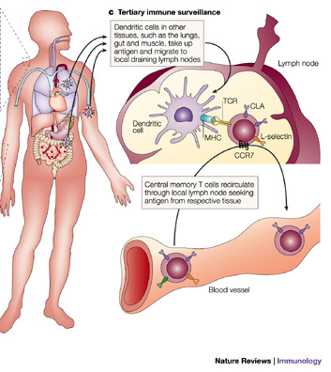

Agenda
What? Why? & How
Introduction
Regulatory Guidance
Immunogenicity Test

Slide 3



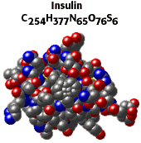



Therapies
Monoclonal Antibodies
(Biomolecules)
C₃₂₆₄H₅₀₀₂N₈₄₀O₉₉₈S₂₀
~150,000 Da
Nanotechnology
&
Cell based therapies
Aspirin
(Small Molecules)
Mw: 181 Da
Insulin or EPO or IFN
(Biomolecules)
~ 5800 Da
Non-biologics complex molecules

Slide 4
Generics Vs Biologics/Biosimilars
Small Therapeutic Molecules (Generics) | Biologics / Biosimilars
Low molecular weight | High molecular weight
Species-independent | Species-Specific
Specific mechanisms | Pleiotropic mechanisms
Production – Chemical Synthesis | Production - living cells (prokaryote/Eukaryote)
Easy to analyze generic product by atomic structure | Difficult to impossible to analyze generic product by atomic structure
Pharmacokinetic studies are usually performed by one bioanalytical method (mostly LC/MS) | Several bioanalytical assays are necessary
Non-immunogenic | Usually immunogenic

Slide 5
Immunogenicity
Immunogenicity is the ability of a particular substance, such as an antigen or epitope, to provoke an
        Humoral &/or Cell mediated
immune response in the body of a human or animal
Wanted Immunogenicity:
Vaccine provokes an immune response against the pathogen (virus, bacteria...) aiming at protecting the organism
Unwanted immunogenicity:
The organism mounts an immune response against a therapeutic antigen (ex. recombinant protein, or monoclonal antibody) which can induce adverse effects
US FDA: It is propensity of the therapeutic protein product to generate immune response to itself and to related proteins or to induce immunologically related adverse clinical events.

Slide 6


Immune system – Immunogenicity
Innate Immunity
B Cell activation
Anti-Drug Antibodies (ADA)
Adaptive Immunity
T Cell activation
Unwanted Immune response against Biologics/Biosimilars
Antibody Dependent Cell-mediated Cytotoxicity (ADCC)
Complement Dependent Cytotoxicity (CDC)
Cell mediated Cytotoxicity
Hypersensitivity
Platelet and Neutrophil activation
Cytokine Strom

Slide 7
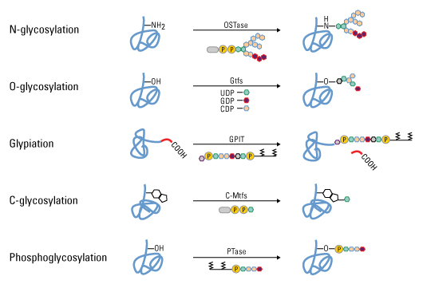
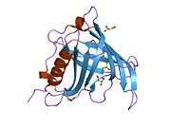
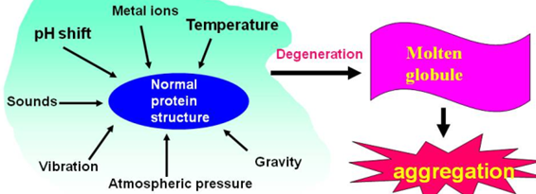
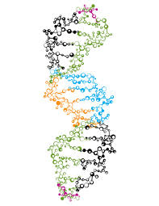
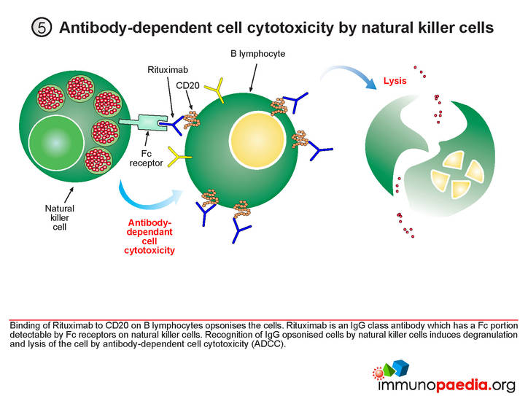


Product and Process Specific Factors Influencing Immunogenicity
Product origin
Sequence variants,
Structural format – Fusion Protein, bi-specific, multi-specific
PTM – Oxidation, Deamidation, Aldehyde Modification, Deamination, Glycosylation, Pegylation etc
Aggregates – Size, Reversibility/Dissociation, Confirmation, Chemical Modification, Morphology
Impurities – HCP, LPS, Protein A/G, Media proteins, CpG, etc
Properties of the protein – Immuno-modulatory
Formulation components
Container Closure

Slide 8
Patient Specific Factors Influencing Immunogenicity
Patient features
  Age
  Gender
  Genetic makeup
  Immune Status
  Nature of Disease
  Pre-existing Antibodies
  Prior sensitization / History of Allergy
  Tolerance to endogenous proteins
Target expression
Dose
Route (intradermal > inhalation > subcutaneous > intraperitoneal > intramuscular > intravenous)
Frequency
Duration
Contaminant medication

Slide 9
Factors influencing Immunogenicity
UNKNOWN

Slide 10
Clinical Effects of Immunogenicity
Benign, non-significant to serious, life-threatening depending on the therapeutic
Efficacy—Alter PK/PD
          Reduction of the clinical response and alter bio-distribution
Safety
          Safety issues can occur even when there is no loss of efficacy
          Neutralize biologic effects and compromise further therapy (factor VIII, IFNα2a, GM-CSF)
          Cross-react with native protein and induce adverse symptoms (Epo, Megakaryocyte growth and development factor (MGDF))
Acute consequences
      Infusion site reactions (ISR), anaphylactic reactions
Non-acute consequences
      Delayed-type hypersensitivity/immune complexes
      Cross-reactivity with an endogenous counterpart
Notes:
Clinical Impact Clinical Outcome
Safety ➢ Hypersensitivity or anaphylactic reactions
➢ Neutralize activity of endogenous counterpart with unique
function causing deficiency syndrome
➢ Immune complex formation
Efficacy ➢ Neutralize activity of therapeutic protein
➢ Increase or decrease efficacy by extending or curtailing half
life
➢ Increase or decrease efficacy by changing bio-distribution
Pharmacokinetics ➢ Extend, or curtail half life
➢ Alter biodistribution
➢ PK changes may dictate changes in dosing
None ➢ No discernible impact

Slide 11
Immunogenicity: Regulatory Guidance
Testing for unwanted immunogenicity is integral to product development (clinical & post-marketing phase) for ensuring:
  Clinical safety and/or efficacy of a bio-therapeutic
  Chronic use of bio-therapeutics
  Product comparability
US-FDA Guidance:
Guidance for Industry Immunogenicity Assessment for Therapeutic Protein Product Draft Guidance Aug 2014
EMA Guideline
Guideline on Immunogenicity Assessment of Biotechnology-Derived Therapeutic Proteins EMA/CHMP/BMWP/14327/2006
Guideline on Immunogenicity Assessment of monoclonal antibodies (in consultation) EMA/CHMP/BMWP/86289/2010
Notes:
Immunogenicity of biological products is a high profile
concern for industry and for regulatory authorities
– Immunogenicity may impact safety and/or efficacy
– FDA & EMA require that immunogenicity of biotherapeutics be
evaluated
– Development of biotherapeutics for chronic use is increasing the
need to understand potential implications of immunogenicity
– Immunogenicity strategies and data are essential components of
Target Product Profiles, INDs, BLAs, & USPIs

Slide 12
Immunogenicity testing Guidelines
Recommendations for routine monitoring of changes in clinical response and linking immunologic findings to clinical events
  Immunogenicity as part of all clinical trials
  Evaluate all patients and not in a symptom-driven manner
  Standardize sampling schedule as much as possible
Specifically analyze adverse events for linkage to an unwanted immune response
Provide guidance on how prescriber should handle patient in case unwanted immune response occurs (increase dose/discontinue, etc.)

Slide 13
Challenges of Immunogenicity
Prediction of immunogenicity
  In silico and T cell methods are promising but need further developments
  Impossible to predict
    incidence
    characteristics of immune response
    clinical consequence and significance of immunogenicity
Determination of immunogenicity
  Human clinical data needed—cannot be replaced by use of animal or in vitro or in silico tools
  Requirement of well design studies
  Need for highly sensitive and specific assays

Slide 14
Immunogenicity Testing
Analysis of Immunogenic response
Antibody response to Biologics (ADA)
    Binding antibodies to Biologics
    Neutralizing antibodies to Biologics
Immunological response
    Immune cell subset analysis
    Functional analysis of T cells, B cells, NK cells, Monocytes/Macrophages, Neutrophils
    T cell receptor repertoire analysis (TCR Vβ analysis)
    B cell receptor repertoire analysis
Host Genetic Factors
  HLA
  Rheumatoid factor
Mouse
Chimeric
30% mouse
Immunogenicity
Humanized
3-5% mouse
Human

Slide 15
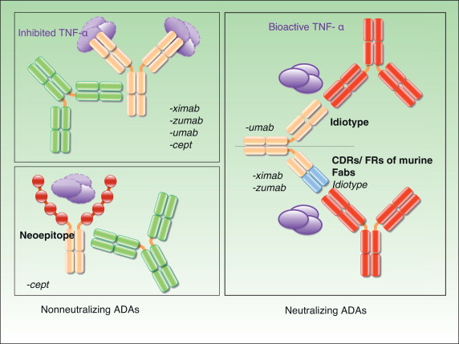
Immunogenicity Testing:
Multi-tiered approach
Anti-Drug Antibody (ADA) Testing
Binding Antibody Testing (Screening – confirmation and subtyping)
Enzyme-Linked Immunosorbent Assay (ELISA)
    Standard sandwich ELISA
    Bridging ELISA
    Electrochemiluminescence (ECL)
Optical Sensor-based
    Surface Plasmon Resonance (SPR; Bicore, ProteOn XPR36)
Neutralizing Antibody (NAb) Testing with Blocking Assays
Related to mechanism of action of biologics
  Receptor Binding
  Cell based functional assays
Notes:
-Cell based: reagents are genetically engineered and then stored as cell lines.
-Have to be concerned about consistency across cell passages.
Immunogenicity testing will be performed by multi-tiered approach: screening assay for detection, specificity assay for confirmation, titer assay for concentration, isotyping assay for characterization, and a cell based bioassay for neutralizing anti-drug antibodies
Anti-drug antibodies assay
Screening assay for identification of antibody positive samples/patients,
Confirmation assay for validate the presence of antibodies and determining antibody specificity,
Neutralisation assay (in general functional bioassays,
Characterization assay which assess and characterize the clinical impact of antibodies (and possibly other components of immune responses) if these are detected/induced

Slide 16
ADA Assay Development
Positive control antibody
Sensitivity
Cut point
Specificity
Precision
Drug tolerance
Acid-base neutralization/dissociation steps
Dilution
Robustness
Positional variation
Confirmatory assays
Gupta et al 2007; Journal of Immunological Methods 321 p1-18
Gupta et al 2011; Journal of Pharmaceutical and Biomedical Analysis, 55 p878-888

Slide 17
Key parameters - Optimization of Nab Bioassay
  Temperature (growth, media for seeding & stimulation)
  Time of cell growth prior to stimulation
  Time of stimulation
  Confluency of cells
  Therapeutic drug/serum incubation time/concentration etc
  Assay read out method
  Incubation time with assay read out reagents
  Type & Brand of 96-well plates
  Plate sealers/evaporation controls
  Media composition (FBS, Defined Media, antibiotics, etc; e.g. Cells may require FBS for survival, but FBS may interfere with the assay outcome)
  Plate Layout

Slide 18
Strategy to assess Immunogenicity
Well Designed Clinical Study – Collection of sample at appropriate Time-points
Neutralization Assay
Bioassay /LBA
Neutralizing Ab against drug
Screening Assay
POS
Confirmation
Assay
POS
POS
NEG
NEG
Negative for ADA
Binding Ab against drug
Characterization
Biomarker

Slide 19
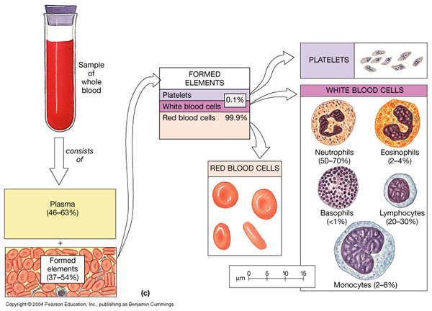
Roadways to evaluate Immunogenicity for novel biologics @ QIS
Ex vivo studies in samples from healthy donors and patients
Database of ~30,000 healthy donors
  Interaction between therapeutic proteins and serum proteins
  Platelet activation studies
  Whole blood activation studies
  Macrophages and DC activation through Pattern recognition receptors such as TLRs
  HLA-binding studies
  Gene array studies
  3D-Culture systems
Notes:
-Cell based: reagents are genetically engineered and then stored as cell lines.
-Have to be concerned about consistency across cell passages.
Immunogenicity testing will be performed by multi-tiered approach: screening assay for detection, specificity assay for confirmation, titer assay for concentration, isotyping assay for characterization, and a cell based bioassay for neutralizing anti-drug antibodies
Anti-drug antibodies assay
Screening assay for identification of antibody positive samples/patients,
Confirmation assay for validate the presence of antibodies and determining antibody specificity,
Neutralisation assay (in general functional bioassays,
Characterization assay which assess and characterize the clinical impact of antibodies (and possibly other components of immune responses) if these are detected/induced

Slide 20
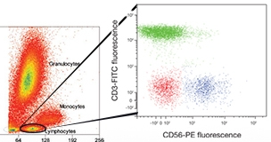
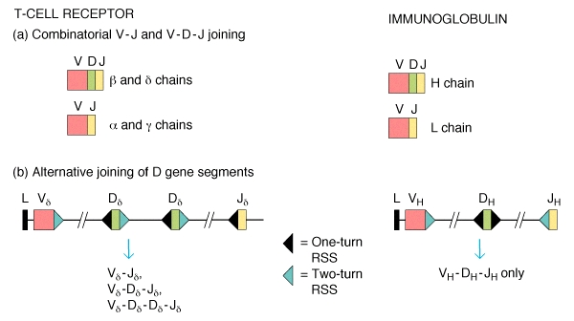
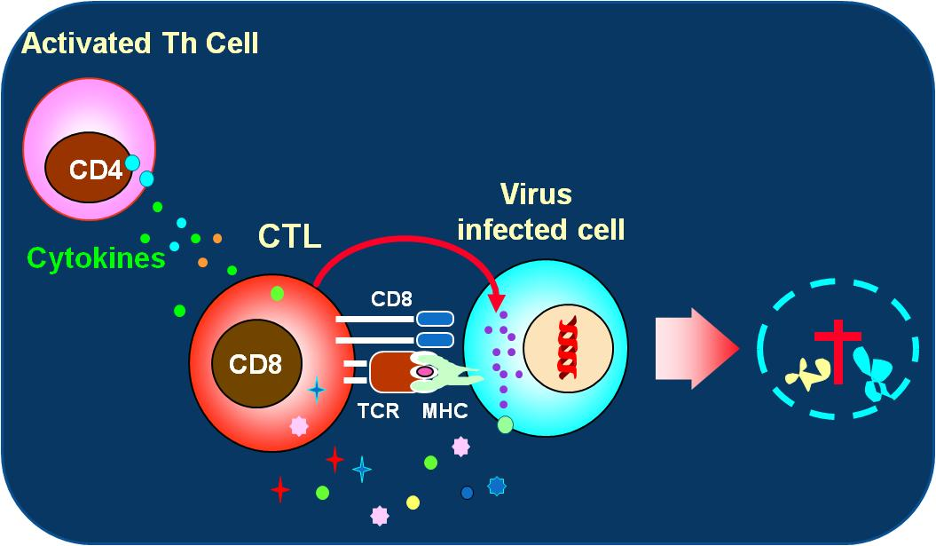
Immunogenicity / Immunotoxicity Studies
Static Studies
  Immunoglobulin, Complement, Acute Phase Protein Levels
  Cytokine Evaluations
  Histamines
  Immunophenotyping: Peripheral Blood
Functional studies
  T cell - Dependent Antibody Response
  Natural Killer Cell Assays
  Mitogen/Antigen Proliferation
  Hemolytic Complement assays
  Immune cell subset activation studies
  Phagocytosis or Oxidative Burst potential
  Functional analysis of T cells, B cells, NK cells, Monocytes/Macrophages, Neutrophils
  T cell receptor repertoire analysis (TCR Vβ analysis)
  B cell receptor repertoire analysis
  Evaluation of thymic function (TREC assay)

Slide 21
Pre-Clinical & Clinical Immunogenicity Assessment – Novel Biologics
R&D
Lead Identification & Optimization
Preclinical
Clinical Phase I to III
MKT
In silico Assessment
Immunogenicity Assessment
Risk Based Assessment
Sensitive ADA Assay Development & Validation
ADA characterization (Incidence, Titer, Ig Isotype, Nab/Titer, Other)
Study Design & Statistical Analysis Plan Design
Sample Analysis & Data Acquisition
Study Data Analysis and Interpretation
Impact assessment (PK/PD/Safety/Efficacy)
Program Data Meta-Analysis

Slide 22
Immunogenicity in Biosimilar Development
Clinical Trial
Pre-clinical Studies
Physiochemical Characterization
Biological Characterization
Validation
Immunogenicity
Process Development
Design Specification
Analytical

Slide 23
Concluding thoughts Immunogenicity
Immunogenicity is a key matric of Product Safety and Quality
Complex and Challenging
Time need to develop and validate – start early
Think about control antibodies and cut point samples early in advance
Evaluate Product/Process/Patient specific factors
Being wrong may have serious consequences – always cautious, don’t be shy to turn the stones
There is always room for improvement – use modern but correct techniques
Use – why, when, where & How
Innovators has lot of information use it smartly and wisely
Remember – a one size fits all approach is not applicable in Immunogenicity assay development
Sharing improves the knowledge
Keep it Simple and Sweet (KISS)

Slide 24

Quantimmune Solutions
Thank You!
Scientist and Regulatory Agencies Across the World

