Slide 1
Past and Future Extreme Climate Events in Canadian Prairies: Integrating Economics and Climate
Suren Kulshreshtha and Elaine Wheaton
University of Saskatchewan
Saskatoon, Canada
Presentation made at the Earth Sciences and Climate Change Conference, San Francisco, July 28 2014

Slide 2
Synopsis
Background
Extreme Events in the Canadian Prairie Provinces
Future Climate Change and Extreme Events
Impacts of Extreme Events on Agriculture
Impacts of Extreme Events on Other Sectors
Economic Cost of Extreme Events – Methodological Issues
Challenges for the Future

Slide 3
Background
Predictions of climate change for the Canadian prairie region suggest a higher growing season temperature and longer growing season associated with more variable precipitation
In addition, frequency of some extreme events would also increase
Canadian Prairie Region is predominantly an agricultural region of Canada
Increased frequency of extreme events would have a serious impact on the region’s economy, and through that on the national economy

Slide 4
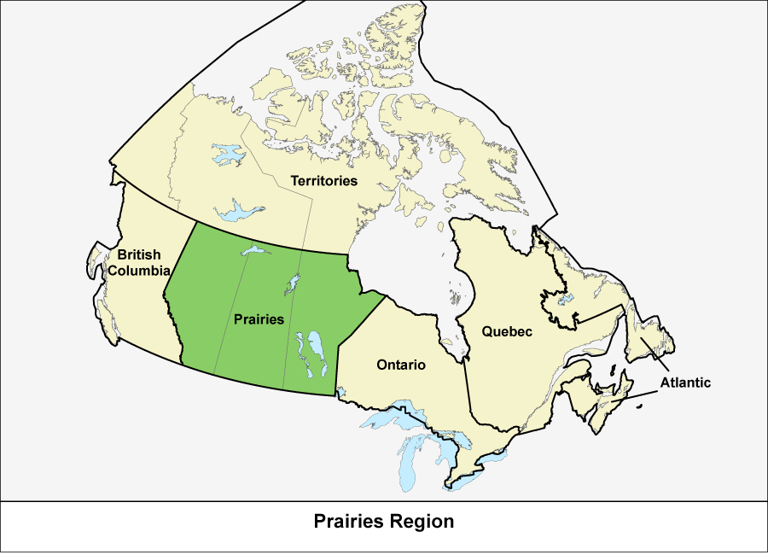
Location of Canadian Prairie Provinces

Slide 5
Canadian Prairie Region
Consist of three provinces: Alberta, Saskatchewan, and Manitoba
Region is the breadbasket of Canada with 81% of all area under crops
Changes in crop productivity of the region would not only affect field crop producers but also livestock producers and through these impacts, the entire socio-economic fabric of the region
Though linkages (trade and others), these impacts would permeate to other parts of Canada as well.

Slide 6
Why bother finding out about climate and its extremes?
Signs of a changing climate are clear and having effects
Temperature extremes are changing, especially in the winter and spring
Precipitation is highly variable
Climate has strong effects, especially on year to year changes of agricultural production and water resources
In the region, droughts are frequent and create large negative impacts

Slide 7
Most Expensive Canadian Natural Disasters (Total Estimated Economic Impact >=$1 billion 2000$)
[Courtsy: Grace Koshida, Environment Canada]
]
Date of occurrence | Event | Location | Estimated Total Cost (billion 2000$)
2001-2002 | Drought | Prairies,Ontario, Nova Scotia, PEI | $5.8
1980 | Drought |  | $5.8
 | Freezing rain | Ontario to New Brunswick | $5.4
1988 | Drought | Prairies | $4.1
1979 | Drought | Prairies | $3.4
1984 | Drought | Prairies | $1.9
 | Flood | Québec | $1.6
May, 1950 | Flood | Manitoba | $1.1
 | Hurricane Hazel | Toronto & Southern ON | $1.1
1931-1938 | Drought | Prairies | $1.0
1989 | Drought | Prairies | $1.0

Slide 8
Climate Resources for Agriculture-
New Normal (Beaulieu and Wittrock 2013)
Evidences of climate change are already here.
Frost free season has lengthened at a rate of about 5d/10y or at least 25d in central agricultural SK since the 1960s
Crop heat units have increased
Number of hot days (>35C) has increased from about 1-3d in the 1960s to 2-5d in the 2000s
Number of cold days (<-40C) has decreased from 1-6d in the 1960s to near zero in the 2000s

Slide 10
Extreme Events on the Canadian Prairies
Most extreme events on the Canadian Prairies are of two types:
  Occurrence of dry spells
  Heavy rainfall / precipitation
Typically dry spells, alternatively called droughts, also come in different forms
  In terms of scope, they can be local, regional, or national in nature
  In terms of periodicity, they can be single period or multi-period droughts
In the past multi-period droughts have occurred in 1890s, 1910s, 1930s, late 1950s to early 1960s, 1980s, 1999-2005, and 2009-10.

Slide 11
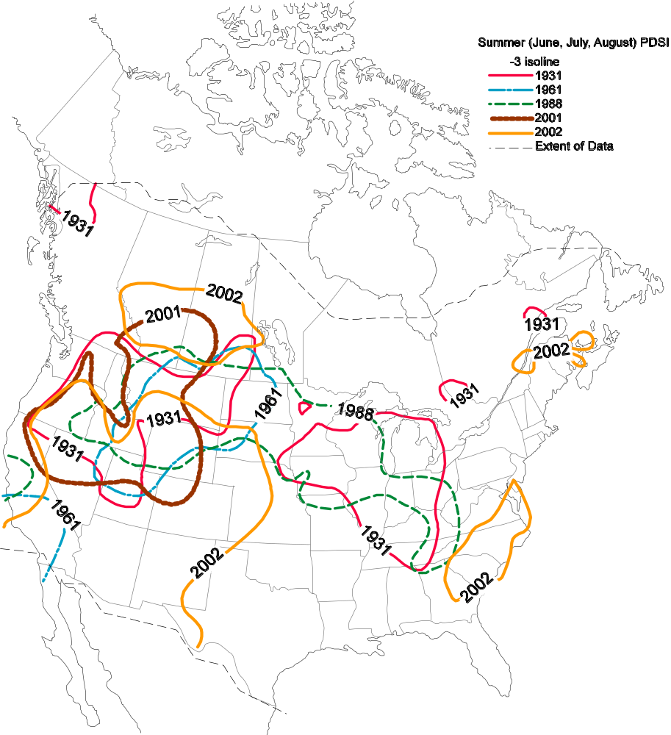
Many droughts but Drought of 2001-2002 was different
2001 and 2002 drought years appear to be the most extensive of this set of major droughts
Preferred area for droughts in Canada is the southern prairie provinces
Northward extension of these recent droughts appears unusual
2001-2002 was a major multi-year drought, unlike many others
Notes:
In the 20th century, we have had a few droughts -- 1931, 1961, 1988, 2001, and 2002

Slide 12
Excessive Moisture Extremes
Saskatchewan has among the most extreme rainfall events in Canada. For example, the largest eight hour precipitation event in Canada occurred in the Vanguard area of southwestern Saskatchewan on 3 July 2000. Damage included flooded buildings, washed-out roads and rail lines, compromised drinking water supplies, and decreased agricultural production (Hunter et al.2002)
In 2014, flooding in southeast Saskatchewan and southwest Manitoba has left 1.5 million ha of crop unseeded or drowned

Slide 13
Maximized Storm Rainfall in SE SK (For perspective, mean annual precipitation is about 350 to 450 mm)(Wheaton et al 2013)
Amount (mm) | Duration (h) | Area
556 | 24 | Point estimate
395 | 24 | Basin estimate
449 | 72 | Basin estimate
508 | 6 | 10 sq mi
660 | 24 | 10 sq mi
736 | 72 | 10 sq mi
488 | NA | Basin average+snow
Notes:
Source: Wheaton et al 2013 p. 25
Buffalo Gap amount is 250mm in 1h
Vanguard amount is 375mm in 8h

Slide 14
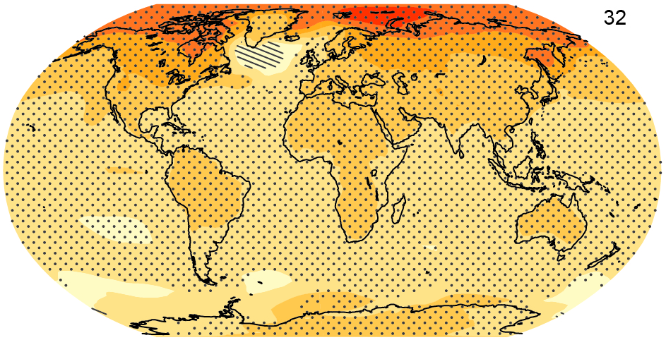
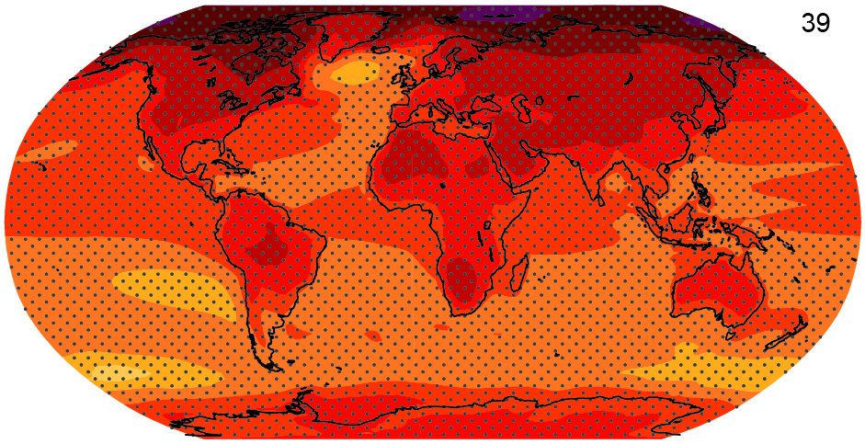
Projected warming
Difference between 1986-2005 and 2081-2100
RCP2.6
RCP8.5
Figure SPM.8, IPCC WG1 AR5

Slide 15
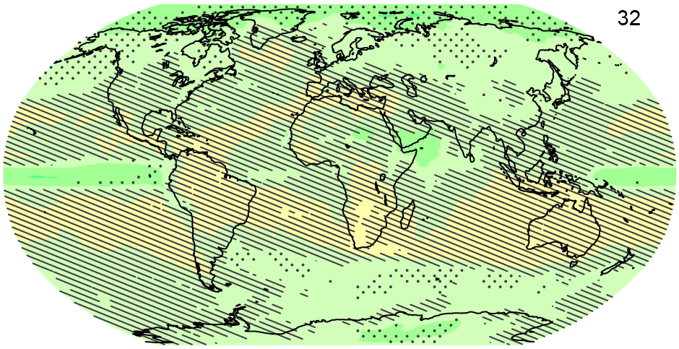
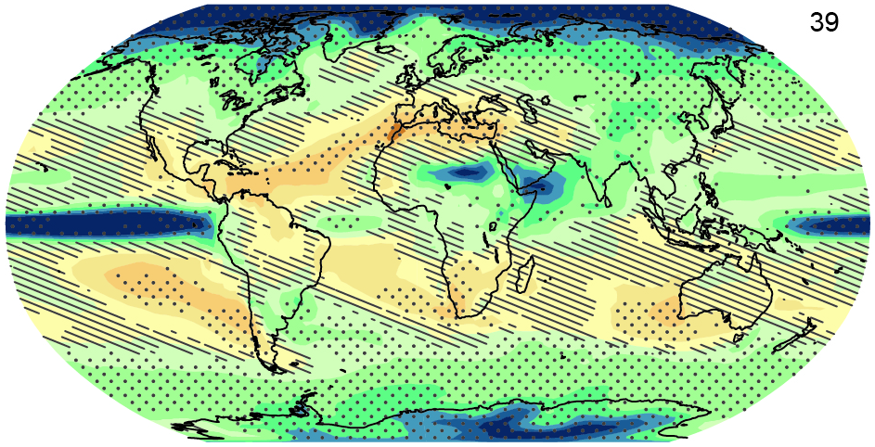
Projected precipitation change
Difference between 1986-2005 and 2081-2100
RCP2.6
RCP8.5
Figure SPM.8, IPCC WG1 AR5

Slide 16
Dry Times become Drier &
Wet Times become Wetter (Wheaton et al 2013)
More extreme dry and wet times & areas
Higher temperatures lead to more evaporation and less snowcover
Longer warm seasons & warmer winter
Changing atmosphere-ocean circulation patterns

Slide 17
Probable Future Droughts (Wheaton et al 2013)
Increased intensity of dryness, driven by increased evaporation potential with higher temperatures and longer warm seasons. Drying likely overwhelms projected increases in precipitation
Droughts of 6-10 months and longer increase frequency by about 4 events (2050s)
Frequency of long duration droughts of five years and longer more than doubles towards 2100 AD, and
Frequency of decade-long droughts and longer triples towards 2100.

Slide 18
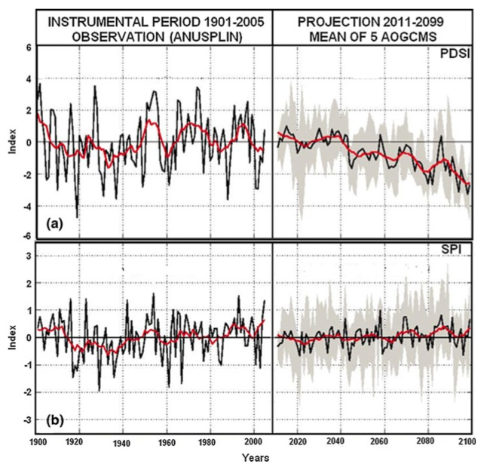
Past and Future Area- Averaged Summer Drought Indices (Bonsal et al 2012)

Slide 19
Future Probable Extreme Precipitation Scenarios (Wheaton et al 2013)
Number of 1:20y potential maximum precipitation event doubles towards 2100
Rainfall amount of extreme maximum events increases by 5% to 20% (2050s)
Many wet periods similar to those of the 1970s occur towards 2050s, and
Expect surprises as new combinations of climate characteristics emerge
This is a research gap that requires much more understanding.

Slide 20
Impacts of Extreme Events on Agriculture
Both dry and wet events would have devastating impacts on agriculture
Droughts result in reduced soil moisture, crop losses, soil compaction, herd reduction, cost of feed, forage losses, among others
Excessive rainfall and flooding result in large damages for agriculture and communities, including: delayed spring planting, crop losses (both quality and quantity), soil compaction (with use of equipment on land), runoff and soil erosion, reduced access to land, and harvest constraints.
Social impacts of droughts and floods include changes in quality of life, damage to infrastructure, tourism and recreation and uncertainty of public policies

Slide 21
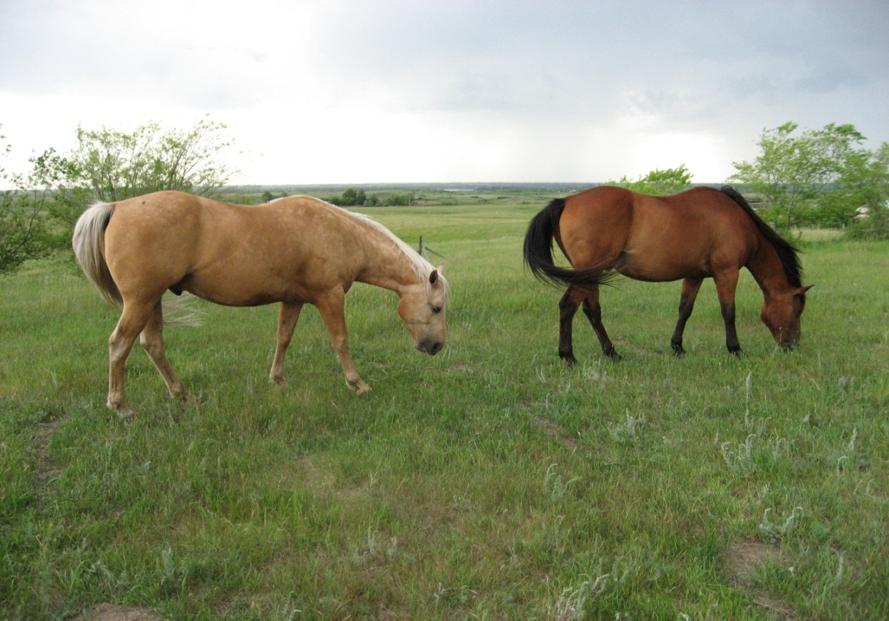
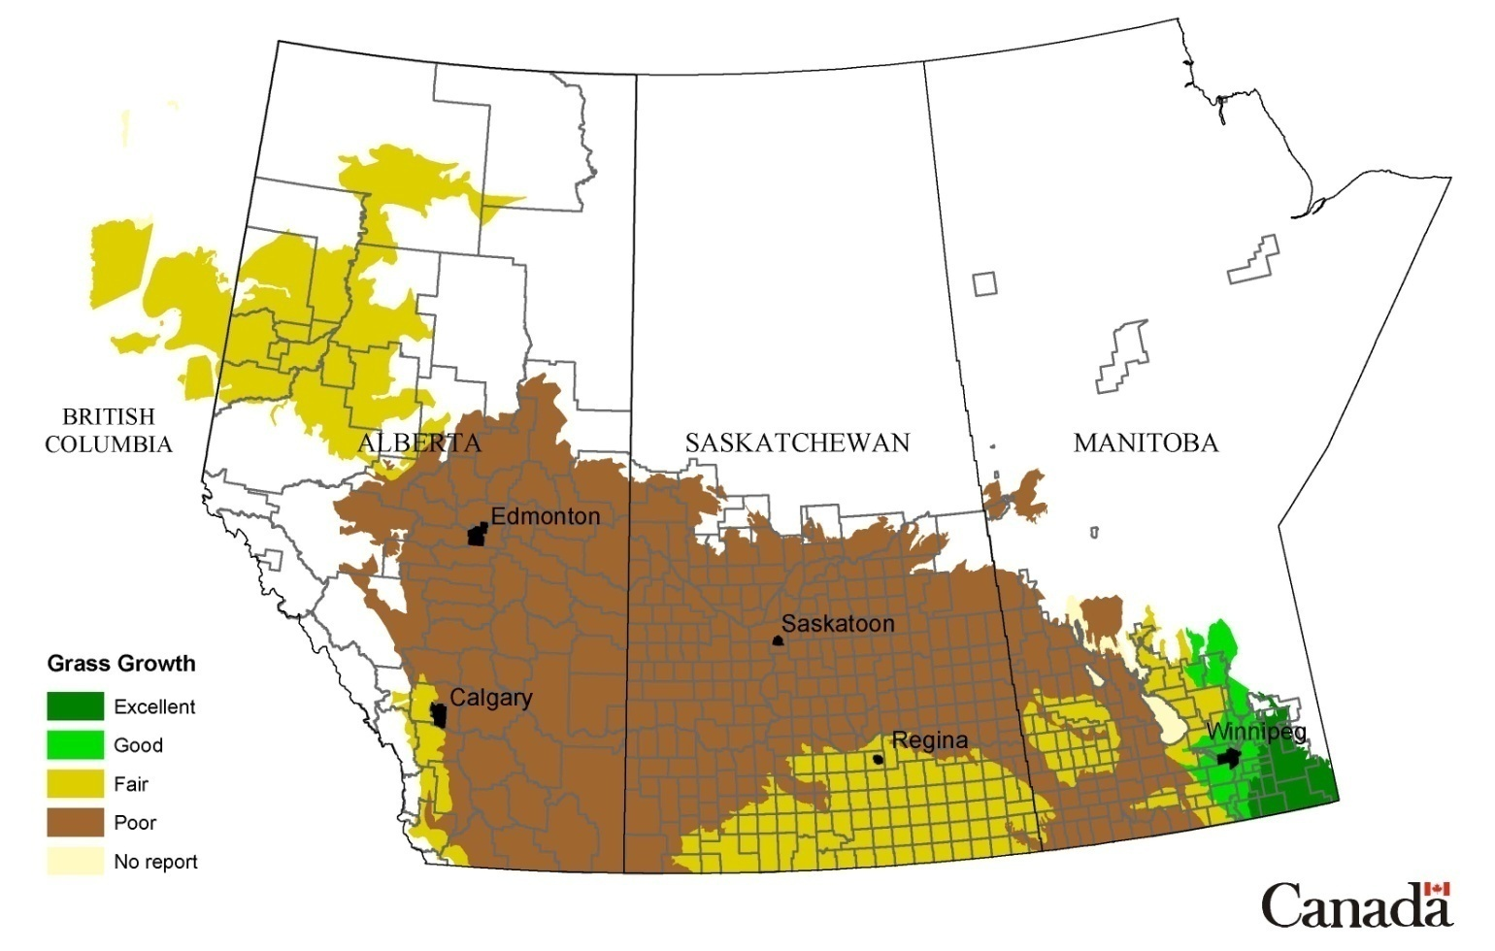
Grasslands Suffer during Droughts
Grass Growth on Pastures
for 6 June 2002
Notes:
Photo by E. Wheaton summer 2007
Map source: PFRA-AAFC

Slide 22
Adapting to these changes and Adaptation Capacity
Adaptation is key to reducing the negative impacts of climate change including extreme events
Prairie farmers are highly adaptable folks. Undertaking off-farm jobs in periods of lower farm income and rising input cost, is an excellent example
In response to 2001-2002 droughts, Wheaton et al (2007) mentioned most used types of adaptation were those for crops and livestock, followed by water and economics, then community support and technologies
Institutions assist producers to make adaptations to droughts
However, adaptive capacity is unevenly distributed

Slide 23
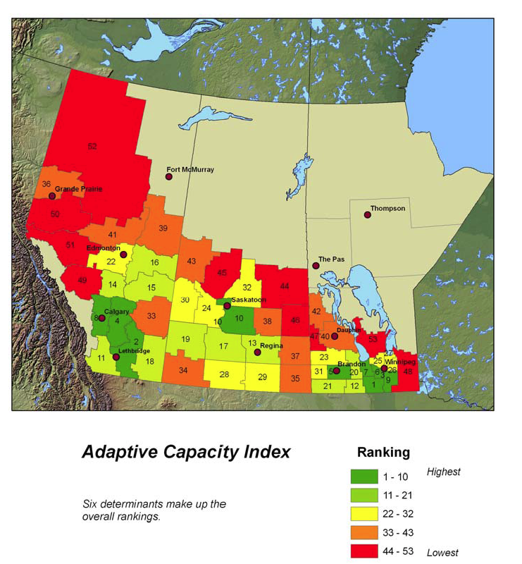
Adaptive Capacity Index for the Prairie Provinces (Source: Swanson et al. (2007)

Slide 24
Impacts of Extreme Events on Non-agricultural sectors
Drought stressed forests -- Forests are vulnerable to droughts
Agricultural based manufacturing – high cost of importing inputs
Transportation infrastructure in the northern regions of the Prairie Provinces would be affected
Health of individuals – emergence of new diseases, increased stress, also heat stress, for e.g.

Slide 25
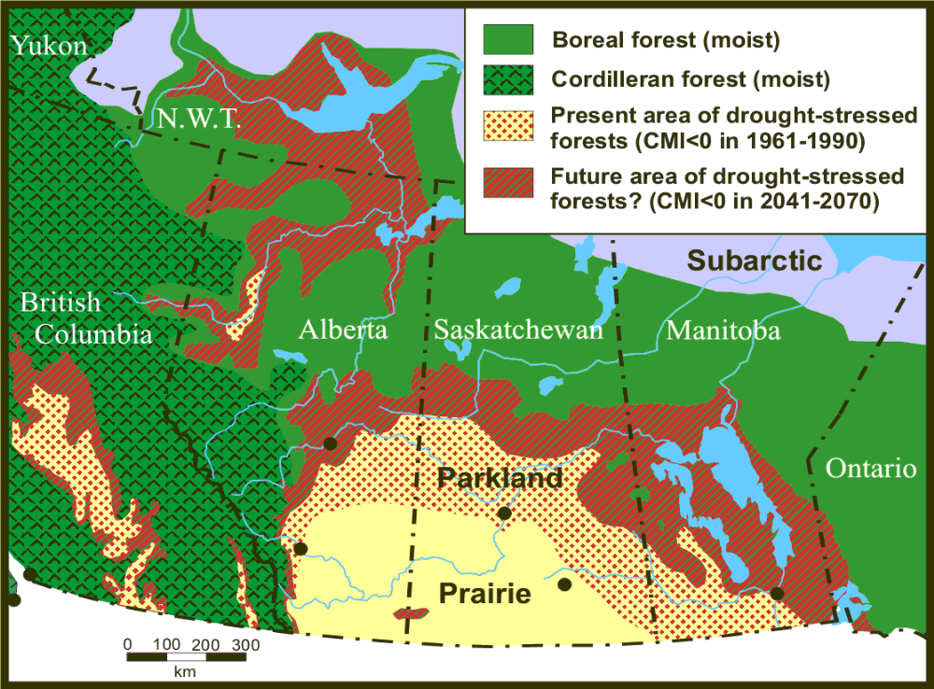
Drought-stressed forests (Hogg et al)

Slide 26
Impacts on Transportation Sector
Increased frequency of intense rains would affect erosion of roads, bridges, culverts, and railways
Higher frequency of heat waves would result in degradation of railways and asphalt-based roads
Northern winter roads could only be used for a shorter period
Reduced snow clearing expenditures in more years
Post of Churchill ice-free season will increase, but to expand capacity requires large investments

Slide 27
Future Possible Droughts and Floods?
Chances of multi-year droughts increase
Increases in severity and area
Droughts overwhelm the increases in average precipitation
Expect surprises, such as switches to extreme rainfalls
Extreme rainfall events will increase

Slide 28
True Economic Cost of Extreme Events
Typical practice is to take drought / floods one year at a time
This lead to serious underestimation
Reasons include:
  Even a single year drought can have impacts on the future productivity of the economy
  True cost of the drought combines current as well future impacts

Slide 29
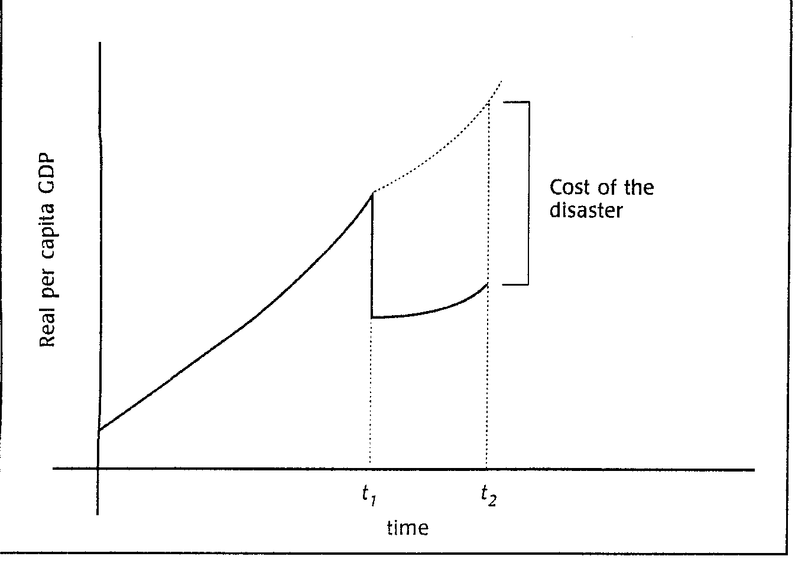
Cost of a Disaster – Total vs. Single Period
(Dore and Etkins, 2000)

Slide 30
A Comprehensive Assessment of Economic Cost of Extreme Events
All assessments should be done from both local and national accounting stances
From economic theory point of view, the ideal manner in which we could estimate the economic costs to the society of an extreme event (or for that matter, any disaster) is to equate it to:
  DISTORTIONS CREATED BY THE EXTREME EVENT TO THE NORMAL DEVELOPMENT AND EXPANSION OF THE ECONOMY

Slide 31
Sources of Distortion should include
Direct loss of value added due to the extreme event in various sectors of the economy
Loss of human capital (Loss of human lives and associated human capital)
Indirect economic losses / costs
Loss of capital destroyed by the event (To include man-made private capital, such as buildings, machinery; and man-made social capital, such roads, bridges)
Fiscal costs of the government, including effects of changes in fiscal measures (Additional taxes needed)
Distributional issues of impacts
Value of lost ecological goods and services – Non-Market Goods
Economic losses resulting from social impacts of the event
Cost of adaptation measures (including possible migration)

Slide 32
Sources of Distortion should include (2)
According to the Millennium Ecosystem Assessment of the United Nations, “Humans are totally dependent on the nature”
Nature provides us with four types of services: Provisioning Services, Cultural Services, Supporting Services, and others.
Since these services enhance individual’s well-being, they place a value on them, called Ecological Goods and Services
Any reduction in these services reduces social welfare and therefore, need to be accounted for.
Loss of human capital – Loss of lives plus effect of stress
Long-term cost of adaptation (including migration)

Slide 33
Future Research Needs
Need for an integrated assessment of climate change impacts
Need to estimate the true social cost of extreme events to include not just the direct costs and benefits but all social and fiscal costs

Slide 35
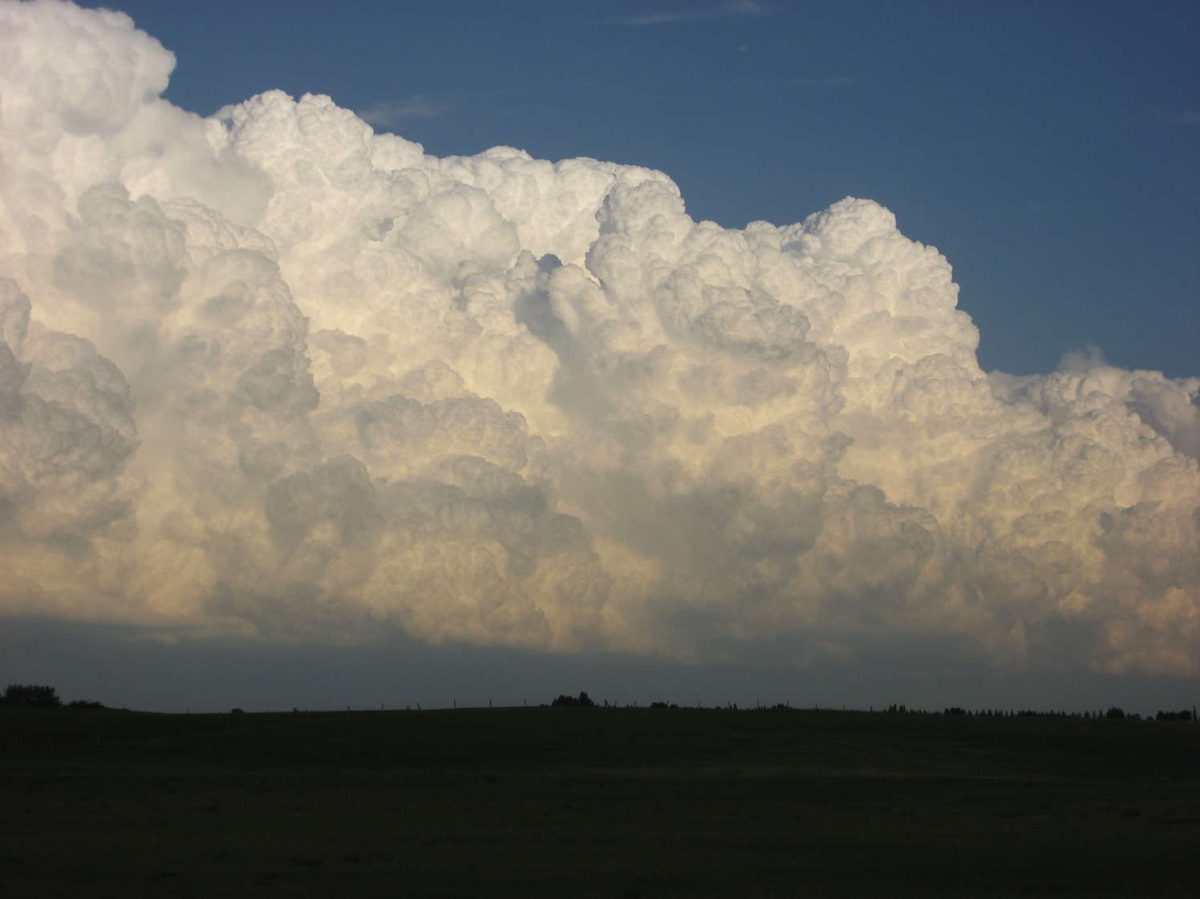
Concluding Remarks -- Future Expected Agroclimates
Accelerated changes in above conditions, e.g. longer growing seasons, milder winters, decreased snow cover, increased heat waves
Past droughts may seem mild compared with future droughts
Increased potential for major rainstorms and floods
More switches of dry/wet and hot/cold
Expect the unexpected with unstable climates
Notes:
Photo E. Wheaton 2009

