Slide 1

Surajit Chattopadhyay
Pailan College of Management and Technology, Kolkata, India
Email: surajitchatto@outlook.com
Investigating an association between sunspot numbers and summer-monsoon rainfall in India
3rd International Conference on
Hydrology & Meteorology
September 15-16, 2014, HICC, Hyderabad, India

Slide 2
ISMR-an overview
The summer monsoon during the months of June to September (JJAS) is the major rainfall season for India. Hence, the prediction of Indian summer monsoon rainfall (ISMR) is always in high demand as its high variability has significant impact on economy of the country.
During ISM the Western Ghats and the northeast region receives precipitation due to orographic interplay and eastern India i.e. Orissa, Chhattisgarh and West Bengal receives precipitation due to monsoon trough.
Most of the statistical forecasting techniques available till dates have concentrated only in generating a deterministic prediction without any measure of its inherent uncertainty.
As probabilistic predictions have the ability to quantify the uncertainty, it has more potential to decision makers than deterministic forecasts
Recently some studies have raised the issues of making probabilistic forecast using GCMs.

Slide 3
Significant recent works on ISMR
Acharya, N., Kar, S.C., Mohanty, U.C., Kulkarni, M.A., Dash, S.K., 2011. Performance of GCMs for seasonal prediction over India - a case study for 2009 monsoon. Theor. Appl. Climatol. 105, 505–520.
Acharya, N., Chattopadhyay, S., Kulkarni, M.A., Mohanty, U.C., 2012. A neurocomputing approach to predict Monsoon Rainfall in Monthly scale using SST anomaly as a predictor. Acta Geophys. 60, 260–279.
Acharya, N., Mohanty, U. C., Sahoo, L., 2013. Probabilistic multi-model ensemble prediction of Indian summer monsoon rainfall using general circulation models: A non-parametric approach. Comptes Rendus Geoscience. 345, 126-135.
Abhilash, S., Sahai, A. K., Pattnaik , S., De, S., 2013. Predictability during active break phases of Indian summer monsoon in an ensemble prediction system using climate forecast system. J. Atmos. Solar-Terres. Phys. 100–101, 13–23.
Singh, A., Acharya, N., Mohanty, U.C., Robertson, A. W., Mishra. G., 2012. On the predictability of Indian summer monsoon rainfall in general circulation model at different lead time. Dynamics of Atmospheres and Oceans. 58, 108-127.

Slide 4
The following pioneering work states……
“The extent to which changes in solar activity affect climate has been the subject of considerable investigation over many years and has often been the cause of speculation and controversy.
As observational and modelling techniques improve, and our understanding of the natural internal variability of the climate system advances, it is becoming more feasible both to detect solar signals in climate records and to investigate the mechanisms whereby the solar influence acts.
This subject is an interesting and complex scientific area to study, but it is now also of considerable practical importance in terms of differentiating natural and anthropogenic causes of climate change so that more reliable estimates can be made of the potential future impacts of human activities on climate.”
The Effects of Solar Variability on the Earth's Climate
Author(s): Joanna D. Haigh
Source: Philosophical Transactions: Mathematical, Physical and Engineering Sciences,
Vol. 361, No. 1802, (Jan. 15, 2003), pp. 95-111

Slide 5
A brief overview of Sunspot

Slide 6
Although the details of sunspot generation are still a matter of research, it appears that sunspots are the visible counterparts of magnetic flux tubes in the Sun's convective zone that get "wound up" by differential rotation.
If the stress on the tubes reaches a certain limit, they curl up like a rubber band and puncture the Sun's surface. Convection is inhibited at the puncture points; the energy flux from the Sun's interior decreases; and with it surface temperature.
Due to its link to other kinds of solar activity, sunspot occurrence can be used to help predict space weather, the state of the ionosphere, and hence the conditions of short-wave radio propagation or satellite communications. Solar activity (and the sunspot cycle) are frequently discussed in the context of global warming.

Slide 7
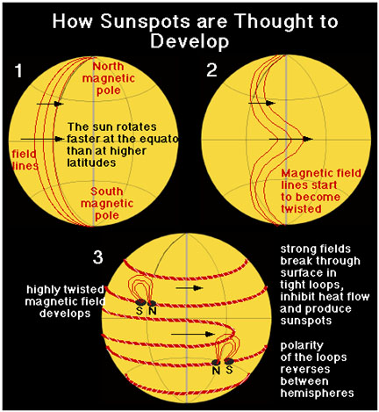

Slide 8
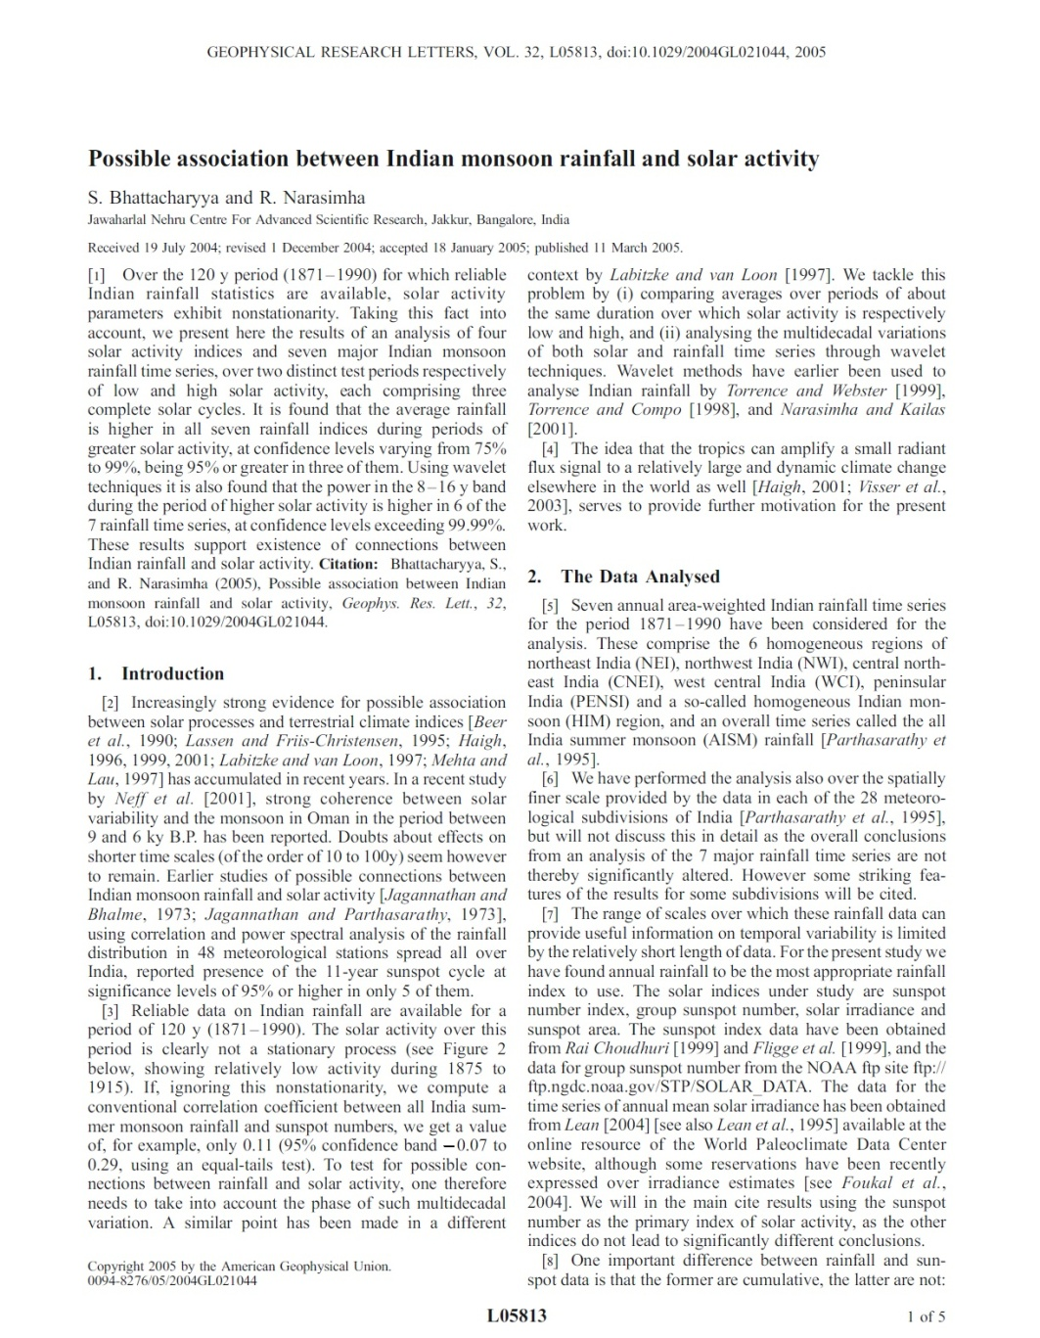
Motivation behind the study
It is found that the average rainfall is higher in all seven rainfall indices during periods of greater solar activity, at confidence levels varying from 75% to 99%, being 95% or greater in three of them. Using wavelet techniques it is also found that the power in the 8–16 y band during the period of higher solar activity is higher in 6 of the 7 rainfall time series, at confidence levels exceeding 99.99%.
These results support existence of connections between Indian rainfall and solar activity
Bhattacharyya, S., and R. Narasimha (2005), “Possible association between Indian monsoon rainfall and solar activity”, Geophys. Res. Lett., 32, L05813, doi:10.1029/2004GL021044.

Slide 9
Other works in this direction
Thomas, Robert G. "Rome rainfall and sunspot numbers." Journal of atmospheric and solar terrestrial physics 55.2 (1993): 155-164.
Seleshi, Yilma, G. R. Demarée, and J. W. Delleur. "Sunspot numbers as a possible indicator of annual rainfall at Addis Ababa, Ethiopia." International journal of Climatology 14.8 (1994): 911-923.
Bell, Gordon John. "Changes in sign of the relationship between sunspots and pressure, rainfall and the monsoons." Weather 32.1 (1977): 26-32.

Slide 10
Purpose of the present paper
In the present work we shall investigate whether there is any association between the SN time series and the summer monsoon (June–September; abbreviated as JJAS) rainfall time series over India.
We shall analyze the autocorrelation structure of the time series under consideration and subsequently execute a spectral analysis after Box–Cox transformation of both of the time series.
We shall also examine the possibility of using SN as a predictor for the summer monsoon rainfall over India.

Slide 11
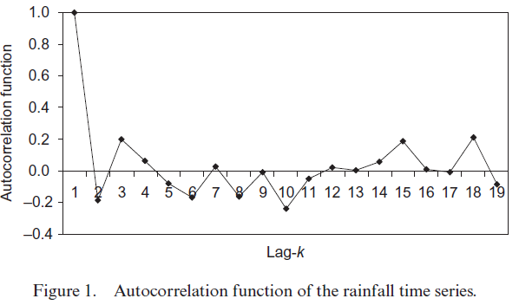
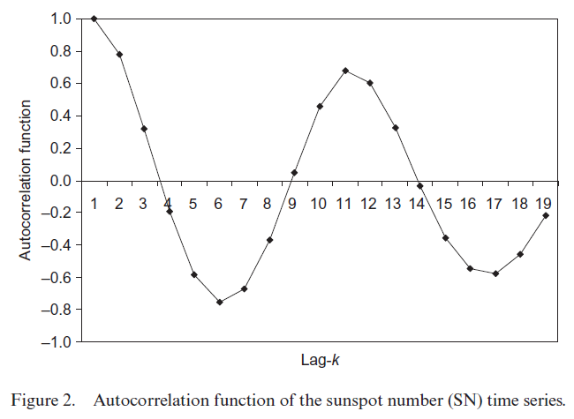
Autocorrelation function
We consider the summer monsoon (JJAS) rainfall time series over India
collected from the website of the Indian Institute of Tropical Meteorology, Pune, and the mean annual SN time series
collected by the National Oceanic and Atmospheric Administration (NOAA), Boulder, Colorado during the period from 1935 to 1998.
No persistence
Apparent periodic behavior
we find a clear 11-year cycle in the ACF

Slide 12
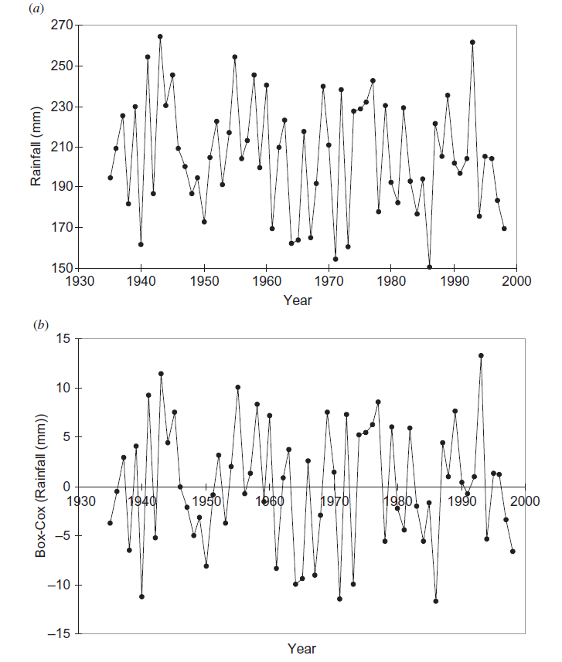
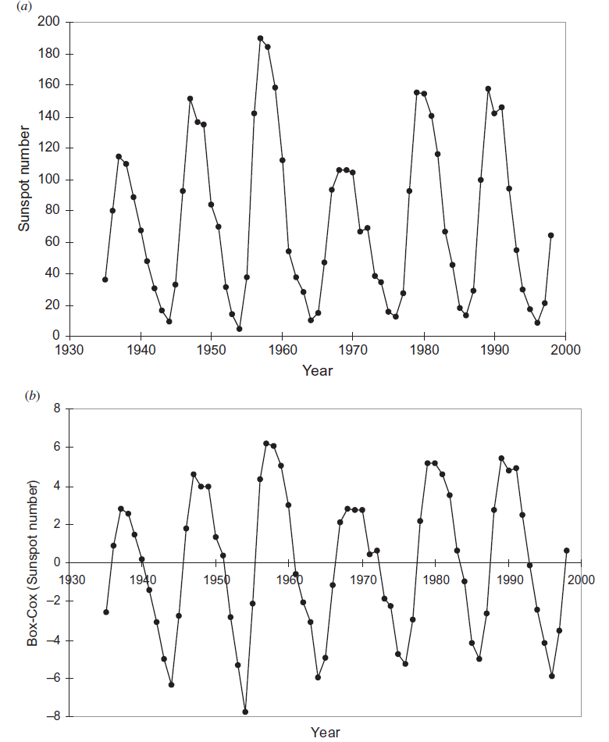
Box–Cox transformation to convert the time series to Normal i.e. skewness (μ₃/σ³ )=0 (the transformation parameter is computed using Newton Raphson method)
Skewness (Pearson) for ISMR=0.049 , for SN=0.477
For the rainfall time series, λ = 0.716 and G =203.811, and for the SN time series λ = 0.366, and G =52.839.
It is found that both of the time series under consideration are positively skewed.
Thus, we apply a Box–Cox transformation to the time series to stabilize the variance as follows
where X_{t} is the original series, G is the sample geometric mean, λ is the transformation parameter, and Z_{t} is the transformed series.

Slide 13

Spectral Analysis
After transforming the time series by Box–Cox, we carry out a spectral analysis of the time series. Detailed theory of the spectral analysis is available in Wilks (2006, pp. 83–86).
Any data series consisting of n points can be represented by adding together a series of n/2 harmonic functions as:
A_{k} and B_{k} are Fourier coefficients, y_{t} is the entry to the time series at time t. Spectral density is
The advantage of this new perspective is that it allows us to see separately the contributions to a time series that are made by processes varying at different speeds, that is by processes operating at a spectrum of different frequencies
The horizontal axis of a spectrum can also be scaled according to the reciprocal of the frequency, or the period of the kth harmonic as:
τ_{k}=n/k, where k=1, 2, ..., n/2=32.

Slide 14
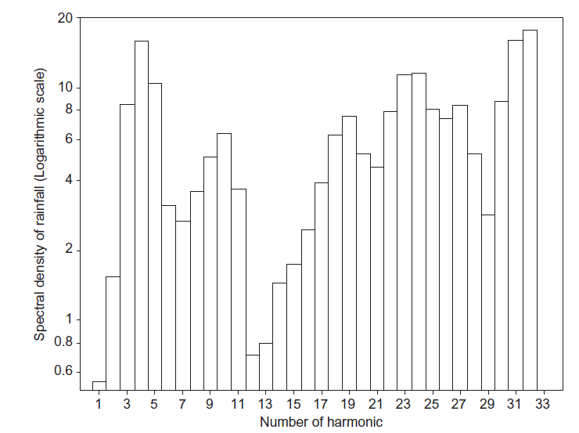
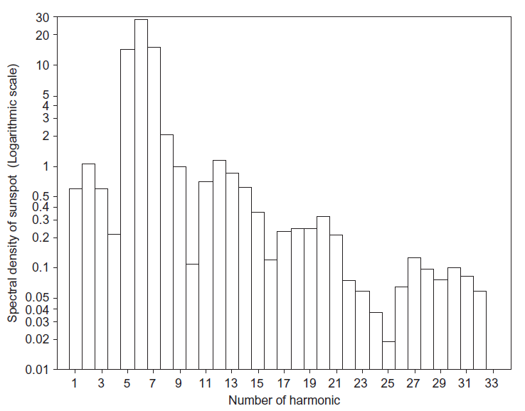
Thus, we understand that the most important harmonic in the two time series differ by
(16–10.67)=5.33 years.
If we look at the spectral densities for the rainfall time series we find that there is a prominent spectral density at the harmonic τ₅. Thus, τ₅ is a prominent harmonic in both of the time series.
Most important variations in the data series are represented by the harmonics τ₄ =64/4=16 and τ ₃₁ =64/31=2.06, τ ₃₂ =2.
Most important variations in the data series are represented by the harmonics τ₆ = 64/6 = 10.67. Other important harmonics are τ ₅ and τ ₇.
Rainfall
Sunspot

Slide 15
Development of a predictive model for the monsoon rainfall using the SN as the single predictor
We revealed that τ₅ is a prominent harmonic in both of the time series. Thus, we can consider τ₅ as a common harmonic.
From this, we attempt to establish a predictor–predictand relationship between SN and monsoon rainfall.
As the common harmonic contributes very little to the entire spectra, it is not logical to go for a linear regression.
Furthermore, the correlation between the two time series is 0.037, which indicates the absence of any linear association between the two time series.

Slide 16
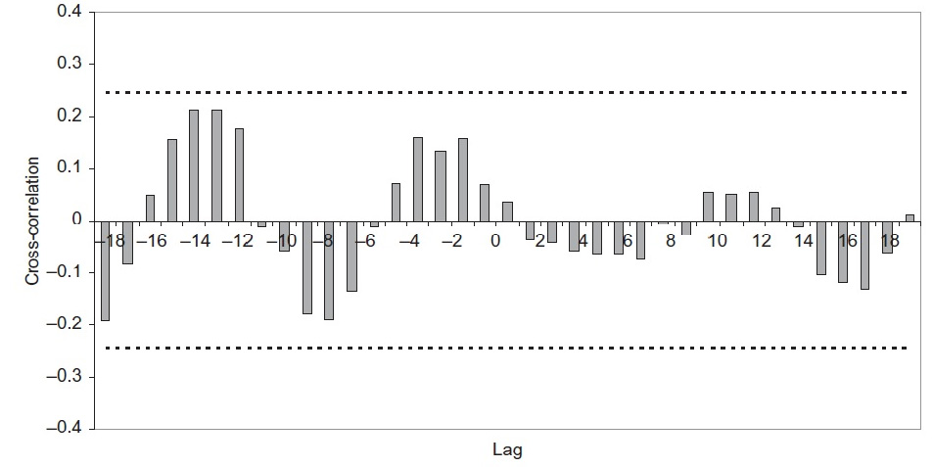
Cross Correlation
Cross-correlation is a measure of similarity of two waveforms as a function of a time-lag applied to one of them.
We present the cross-correlation between SNs and rainfall amounts.
It is observed that the cross-correlation amounts always lie in the range [−0.2,0.2].
This further indicates the absence of any linear association between the two time series under consideration.

Slide 17
As τ₅ has been revealed as common to both of the time series, we can try to determine some relationships within a period of 64/5=12.8 years.
In cross-correlation between SN and rainfall, we find that there are significant positive and negative spikes at lags separated by approximately 5.
This means that, in five time steps, the correlation is changing from extremely negative to extremely positive.
Taking all these into account, we decided to test a model based on 5-year averages of the observations.

Slide 18
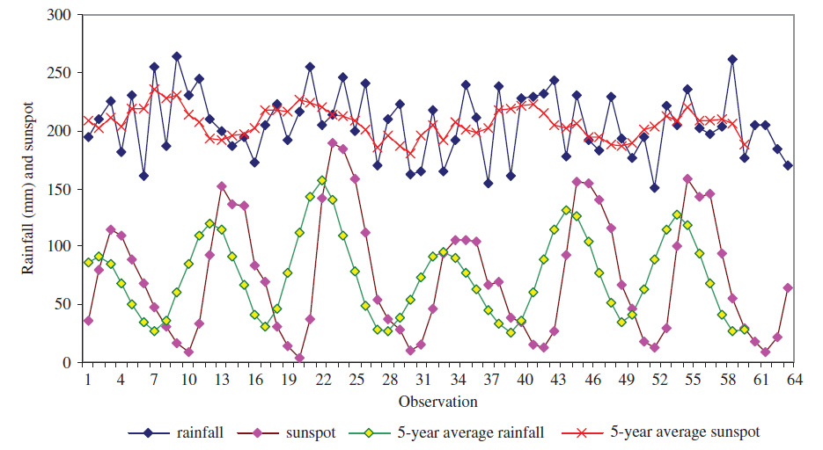
Moving Average
We find that moving the average to 5 years gives more smoothness to the time series. Thus, we try to estimate the 5-year average monsoon rainfall amount over India using the corresponding 5-year average SNs as predictor.
We present the actual time series and those after taking the 5-year average. It can be seen that the time series are becoming smoother after taking the 5-year averages.

Slide 19
ANN model generation
Advantages of ANN
(see: SILVERMAN, D. and DRACUP, J.A., 2000, Artificial neural networks and long-range precipitation prediction in California. Journal of Applied Meteorology, 39, pp. 57–66.)
We consider a time series pertaining to the study period 1935–1998. Thus, we have 64 data in each time series. We
denote this series by x₁, x₂, x₃, ..., x₆₃, x₆₄.
From the original time series, we derive a new time series whose entries are
1. A priori knowledge of the underlying process is not required.
2. Existing complex relationships among the various aspects of the process under investigation need not be recognized.
3. Solution conditions, such as those required by standard optimization or statistical models, are not preset.
4. Constraints and a priori solution structures are neither assumed nor enforced.

Slide 20
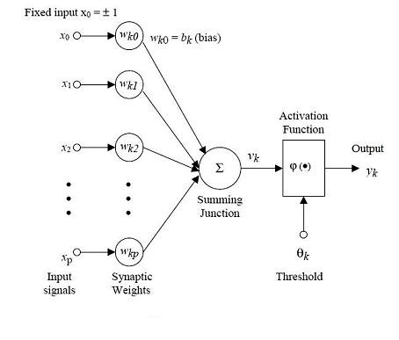
Outline of an ANN
Outline of a Multilayer Perceptron (MLP)
Details of the theory of ANNs are available in Bishop (1995), Rojas (1996) and in many other books.Geophysical systems are generally characterized by various degrees of chaos and non-linearity .
Numerous examples are available where the ANN has been implemented in forecasting atmospheric phenomena. Some significant examples include Gardner and Dorling (1998), Hsieh and Tang (1998).
Gardner MW, Dorling SR. 1998. Multilayer Perceptron- a review of applications in atmospheric sciences. Atmospheric Environment 32: 2627–2636.
Hsieh,W.W. and Tang, B., 1998, Applying neural network models to prediction and data analysis in meteorology and oceanography. Bulletin of the American Meteorological Society, 79, pp. 1855–1870.

Slide 21
MLP learning
Since the advent of the backpropagation algorithm a vast variety of improvements has been made to the technique for supervised learning of MLP. The backpropagation algorithm looks for minimum error function in weight space using the method of gradient descent.
Rojas R. 1996. Neural Networks: A Systematic Introduction. Springer-
Verlag New York, Inc.: New York.
Medsker LR, Jain LC. 2000. Recurrent Neural Networks: Design and
Applications. CRC Press: Boca Raton, FL.
This equation represents an iteration process that finds the optimal weight vector by adapting the initial weight vector w0. This adaptation is performed by presenting to the network sequentially a set of pairs of input and target vectors.
The positive constant η is called the learning rate. The direction vector d_{k} is the negative gradient of the output error function E.
the i-th correction for weight w_{k}
γ and α are the learning and momentum rate respectively, and E denotes the error.

Slide 22
The input matrix for the generation of the ANN-based prediction model is of the order of
(60 × 2), where the first column pertains to the predictor (i.e. the SN) and the second column pertains to the predictand (i.e. the monsoon rainfall).
From the data series, 70% of the data are chosen as the training set and the remaining 30% of the data are chosen as the test set.
An adaptive gradient learning in the cascade mode is used with a maximum allowable hidden layer size of 60.
The sigmoid function (f (x) = (1 + e^{−x})⁻¹) is taken as the activation function.
Minimization of the mean squared error is chosen as the stopping criterion.
After training and testing the network and validating over the entire set of 60 data, the optimum network architecture is available with seven hidden nodes.

Slide 23
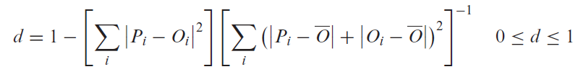
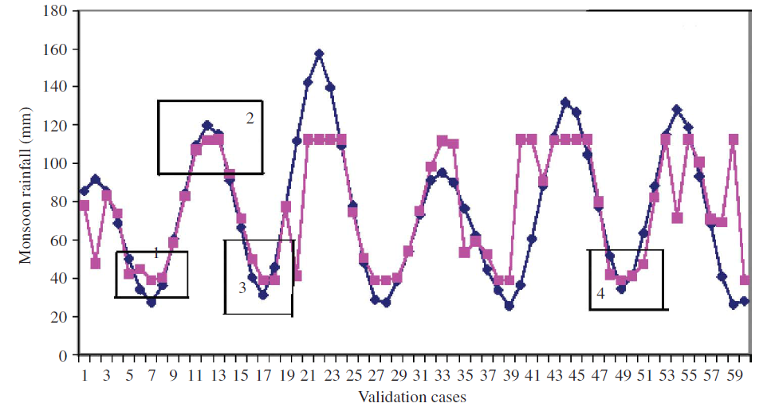
Willmott’s Index
We find that d =0.795 in the present model. This indicates, in general, a good model.
The model outputs are presented here, where all the validation cases are presented.
In this figure, it is found that in various validation cases, the actual and predicted values have almost coincided.
In many cases, although they are not coincident, a close association is visible.

Slide 24
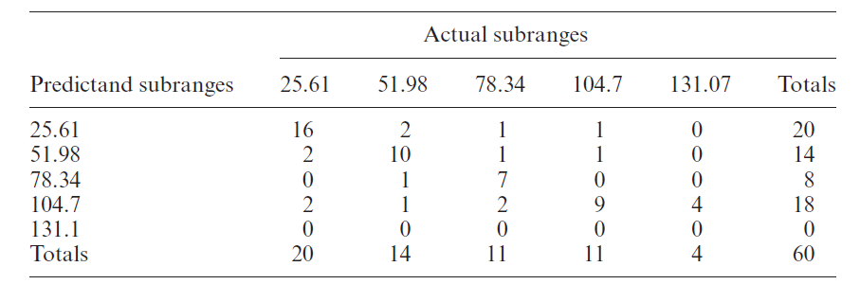
Confusion matrix
A confusion matrix was generated to view the prediction capacity of the ANN model.
A confusion matrix is a square matrix whose rows and columns represent the subranges for the real-world target and model outputs, respectively.
The value in the (i,j) position of the matrix is the number of records for which the real-world target output is in the ith subrange and whose real-world model output is within the jth subrange.
This table shows that for the subrange 25.61–51.98 mm there are 20 observations and 16 predictions. Thus, there is 80% accuracy for this subrange. For the subrange 51.975–78.34 mm, there are 14 observations and 10 predictions, which means that there is 71% accuracy for this subrange. Thus, it can be interpreted that for lower rainfall amounts there is more possibility of an accurate forecast by ANN than in the case of higher rainfall amounts.

Slide 25
Concluding remarks
We analysed the autocorrelation structures, which showed a wave pattern in the case of SN. However, in the case of the monsoon rainfall, no such pattern was discerned.
Considering previous studies on the association between solar activities and climate, we tried to find some association despite the apparent non-linearity implied by the very low cross-correlation.
Implementing spectral analysis we obtained a common prominent harmonic between the two time series under consideration. The common harmonic was the fifth harmonic, which implies a common cycle of 12.8 years.
We decided to implement an ANN in the form of multilayer perceptrons with sigmoid non-linearity.
We derived new time series by averaging the observations for 5 years. Finally, it was revealed that by the implementation of the ANN, an average of 5-year SNs can give some estimate for the 5-year averaged summer monsoon rainfall over India.

Slide 26
Thank You

