Slide 1



Nanostructured Composites of Graphene/Metal Oxides for Effective
Natural Gas Sweetening
-Dr. Sunil Lonkar
Department of Chemical Engineering
The Petroleum Institute
Abu Dhabi, UAE

Slide 2
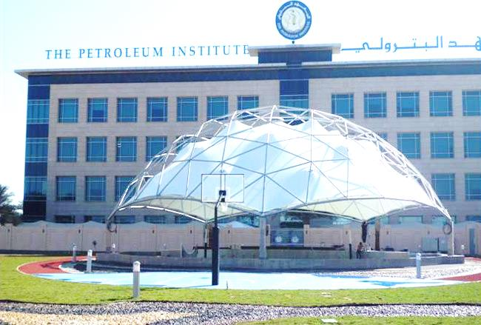

PI at Glance
PI was established in 2001 in Abu Dhabi, UAE
A premier engineering education institute in Middle East, 2000 undergraduate and graduate students, over 200 faculty
The PI’s sponsors and affiliates include the Abu Dhabi National Oil Company (ADNOC) and four major international oil companies that include BP, Japan Oil Development Company, Shell and Total.
Nanotek 2014

Slide 3
Outline
  Introduction
  Synthesis and Characterization
  - Graphene Oxide
  -Graphene/Metal Oxide nanohybrids
  Adsorption Mechanism
  Sorption studies
  Remarks
Nanotek 2014
2
Notes:
2
2

Slide 4
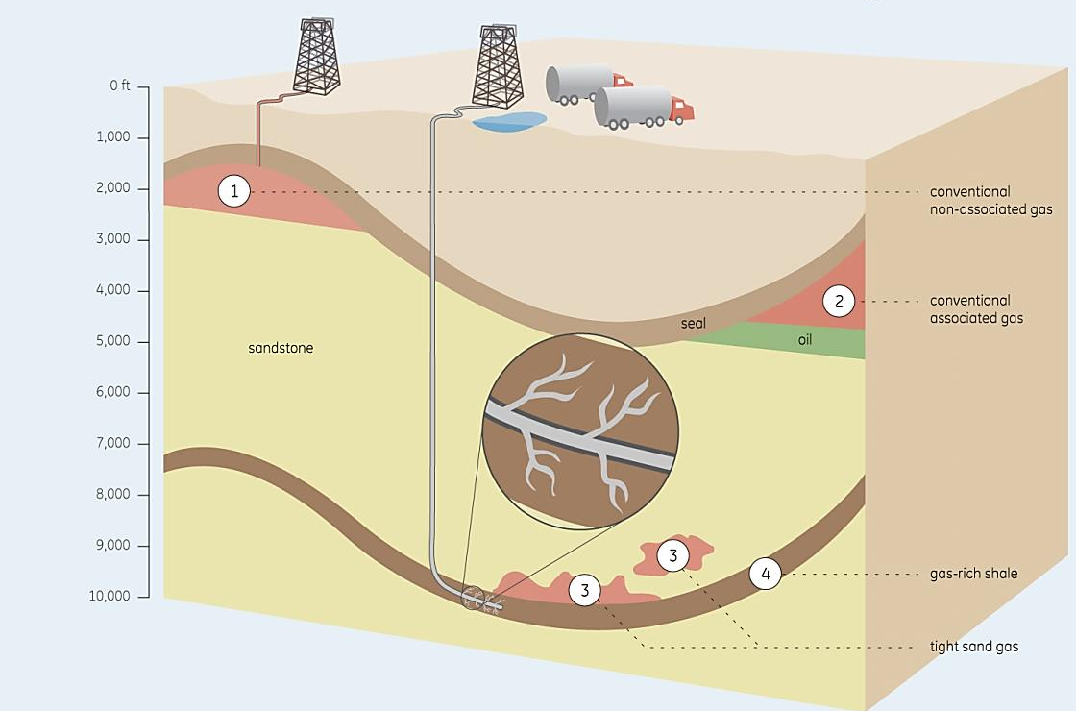
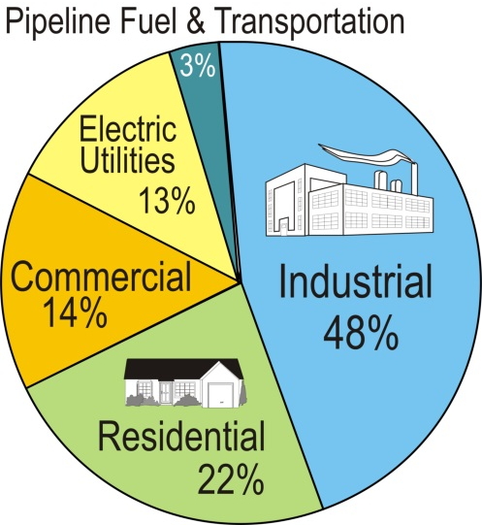
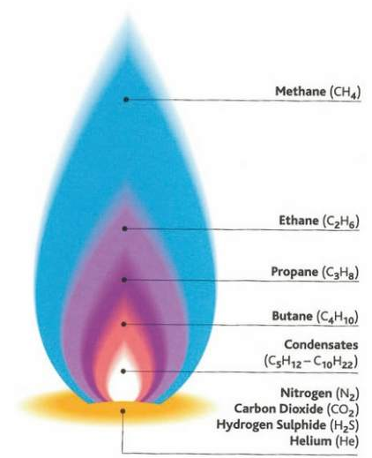

Introduction
The geology of NG recourses
Natural Gas (NG)
Cleanest fossil fuel
Source: US geological survey
I
Purification
II
Purified gas
Raw gas
Nanotek 2014
3
Notes:
Most natural gas extracted from the Earth contains, to varying degrees, low molecular weight hydrocarbon compounds; examples include methane (CH₄), ethane (C₂H₆), propane (C₃H₈) and butane (C₄H₁₀).

Slide 5
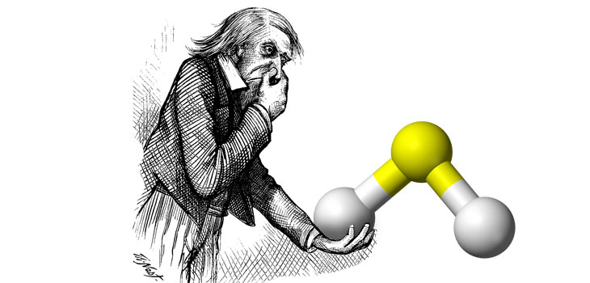
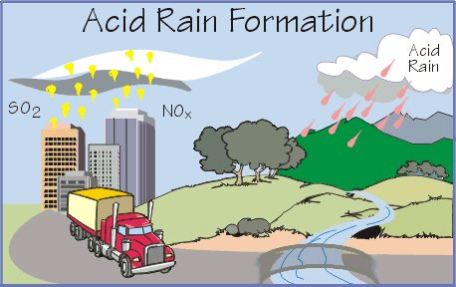
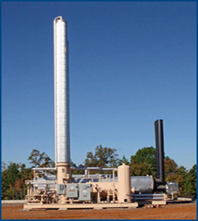
Natural Gas Sweetening
Sour Gas
- The gas containing more than 4 ppm of hydrogen sulfide (H₂S) under STP
Offensive odor
High toxicity
Serious corrosion problems
Reduce efficiency of gas treatments
S
H
H
Natural Gas sweetening processes
Chemical absorption using aqueous amines (Amine Sweetening process)
  Challenges
  -Intensive energy requirement for regeneration
  -Amine foaming in the absorber
  -Corrosion
  -Oxidative and thermal degradation of amine in the regenerator
Amine column
Nanotek 2014
4
Notes:
100 ppm for longer time is enough to cause death
H2S is also known to be a major contributor to acid rain when oxidized in the atmosphere to SO2.
Amine treatment/scrubbing: Alkylamines, Monoethanolamine (MEA), Methyldiethanolamine (MDEA)

Slide 6
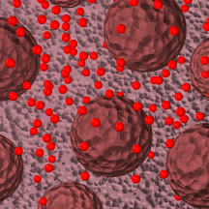
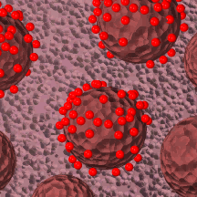
Solid Adsorbents
Physical process: van der Waals and electrostatic forces
High surface area, thermal stability, defined pore size and reactivity (polarity)
Zeolites (natural and synthetic), Metal oxides, and Carbonaceous adsorbents for gas separations
H₂S
Adsorption
Metal Oxide
Nanotek 2014
5

Slide 7
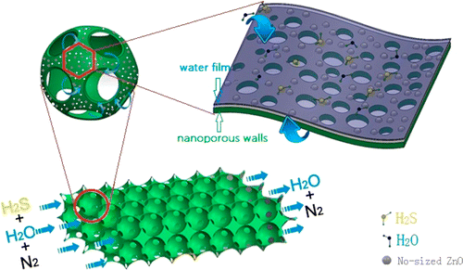
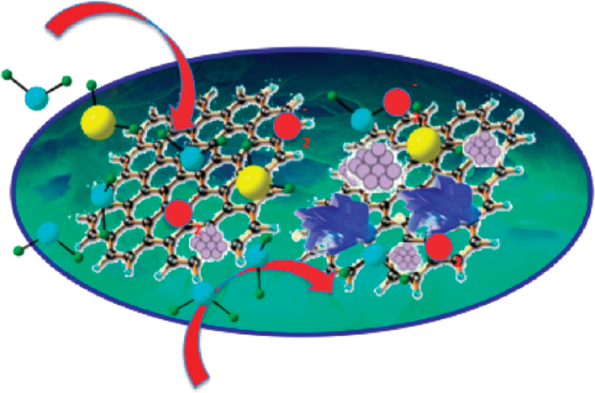
Hybrid Adsorbent Materials
“Multidimensional hierarchical composites can take full advantages of each kind of components, which is an effective way for the preparation of multifunctional materials with exceptional properties”
Metal Oxides:
-Zinc, Iron and Copper Oxides posses high thermal stability and proven reactivity towards H₂S
Carbon materials
- Activated carbon, Graphene, CNTs etc. posses very high surface area, ability tailor surface properties
ZnO–silica composites with 3D macropores structures as sorbents for H₂S removal at RT, Wang et al. ACS Appl. Mater. Interfaces, Article ASAP
Graphite Oxide with Copper (Hydr) oxychlorides
Bandosz et al., ACS Appl. Mater. Interfaces 2012, 4, 3316−3324
Chemosphere 58 (2005) 467–474., Chem. Engg. J. 166 (2011) 1032–1038.,.
Nanotek 2014
6
Notes:
If we combine the porosity and high surface area of carbon materials and reactivity of metal oxide a new adsorbent system with high efficiency can be developed.
The combination of multidimensional nanomaterials can take full advantages of each kind of components

Slide 8
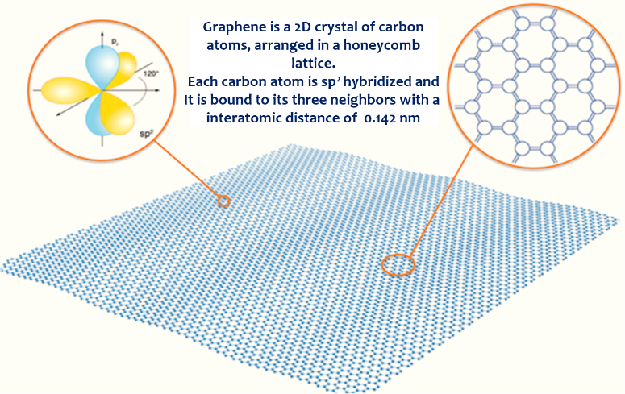
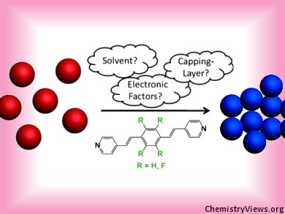
Graphene/Metal Oxide Nanohybrids
Single layer of carbon atoms arranged in a honeycomb lattice
Surface area = 2630 m²/g ,
Mechanical Properties (1200 GPa),
Electrical Conductivity (3000 S/cm),
Thermal conductivity (5000 W/(m.K)
Nanoparticle aggregation is major issue in gas-solid adsorption
Loss in active surface area and subsequently lower efficiency as adsorbent.
Aggregation
Hybridization of selected nanosized metal oxides (NMOs) supported on carbonaceous graphene. This combination allows for efficient adsorption due to the very high surface area of graphene and high reactivity of NMOs.
Nanotek 2014
7
Notes:
Graphene (2 dimensional, mono-atomic thick sp2-carbon structure) has recently received increasing attention as a material of interest due to its high electronic conductivity, large surface area and high mechanical strength
For gas-solid adsorption, one of the major issues is to avoid aggregation of nano-sized particles Which eventually losses in active surface area, with consequences of lower utilization efficiency of the adsorbent.

Slide 9
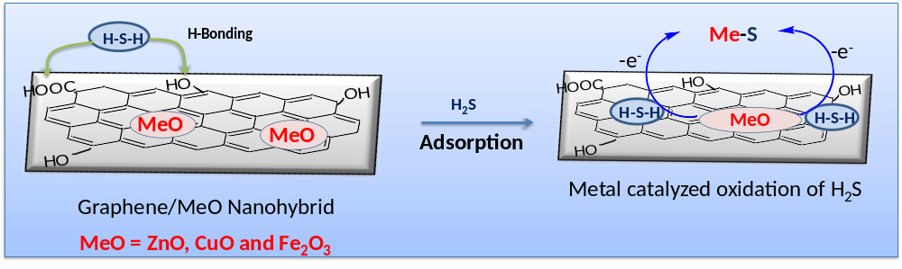
Adsorption mechanism
Hot air /O₂
I.
ZnO (s) + H₂S (g)
ZnS (s) + H₂O (g)
II.
CuO (s) + H₂S (g)
CuS (s) + H₂O (g)
III.
F₂O₃ (s) + 3H₂S (g)
Fe₂S₃ (s) + 4H₂O (g)
Nanotek 2014
8
Notes:
Higher conductivity of the graphene phase than that of graphite oxide helps in electron transfer in redox reactions

Slide 10
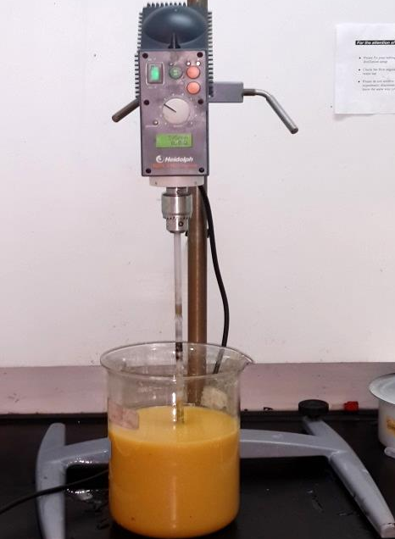
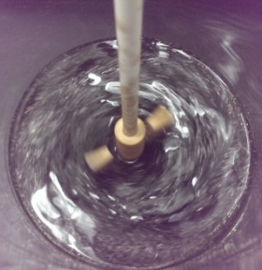
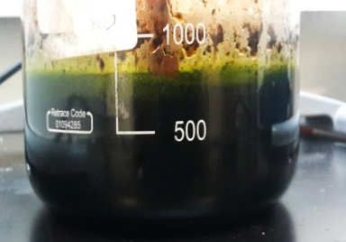
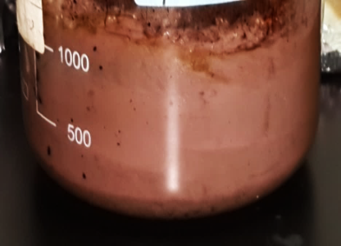
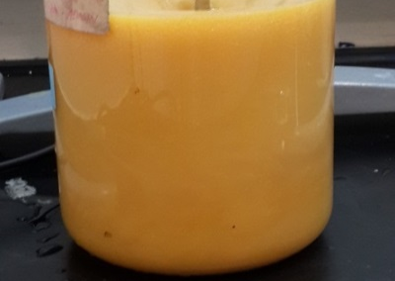
Experimental
GO synthesis (Improvised Tours Method)
  High surface area GO can be obtained
  May have high pore volume
  Greater amount of hydrophilic oxidized graphene
  More regular carbon framework and large GO sheets
Graphite
+
H₂SO₄
H₃PO₄
+
KMNO₄
H₂O₂
+
H₂O
30 min
90 min
72 hr
96 hr
Graphite Oxidation
Nanotek 2014
9
Notes:
9
9

Slide 11
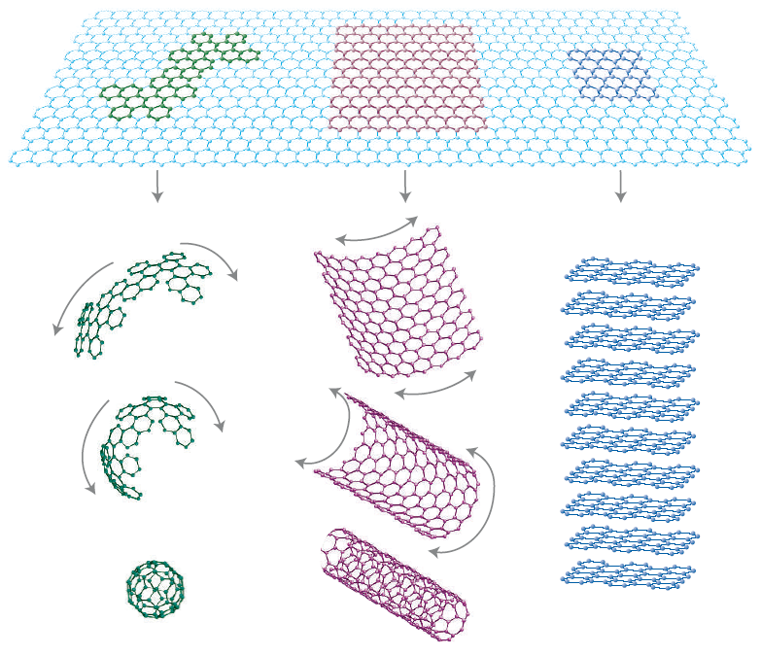
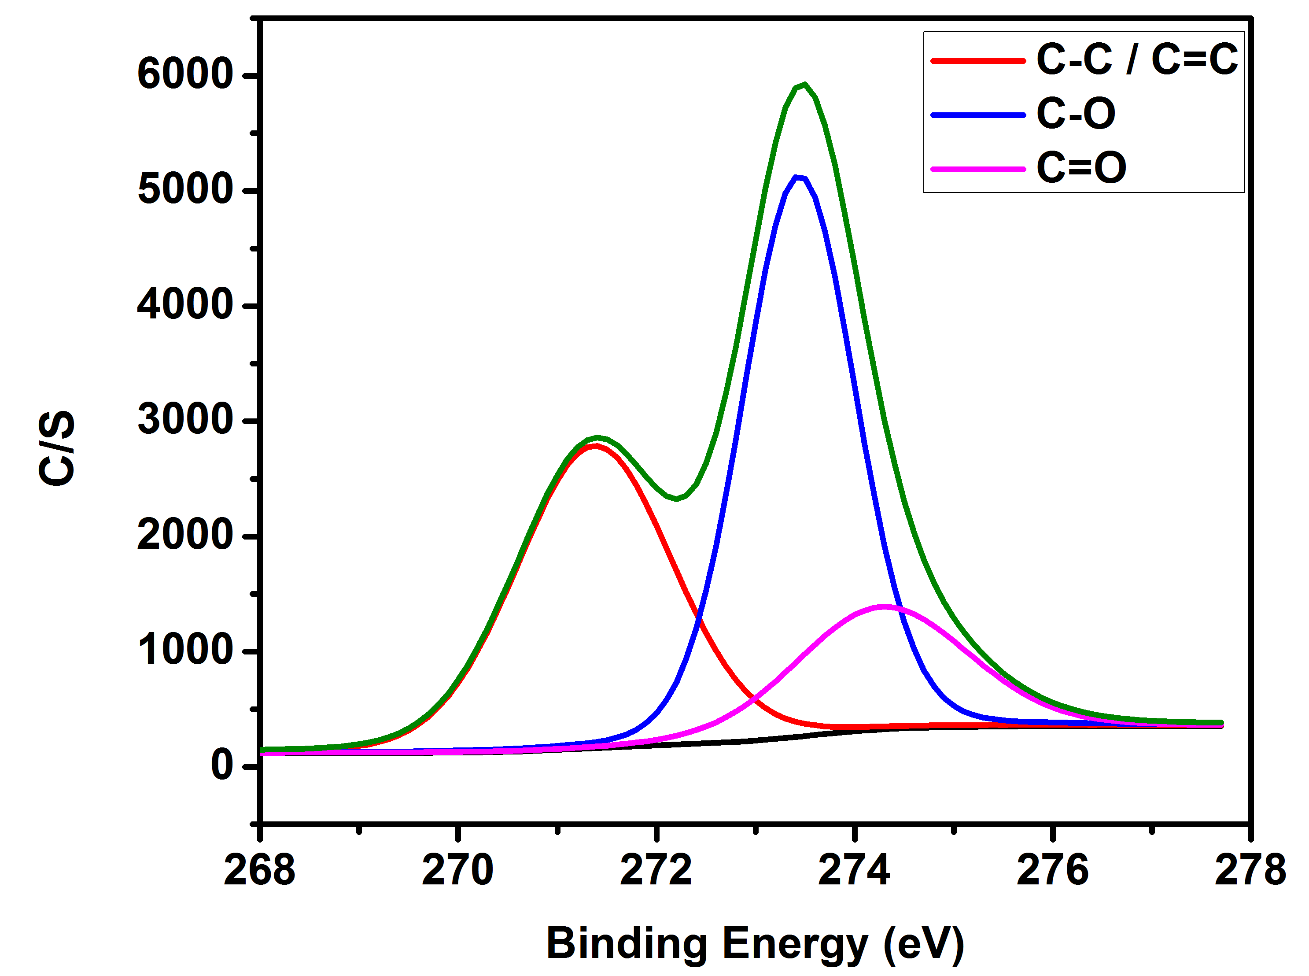
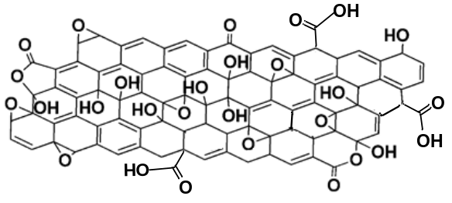
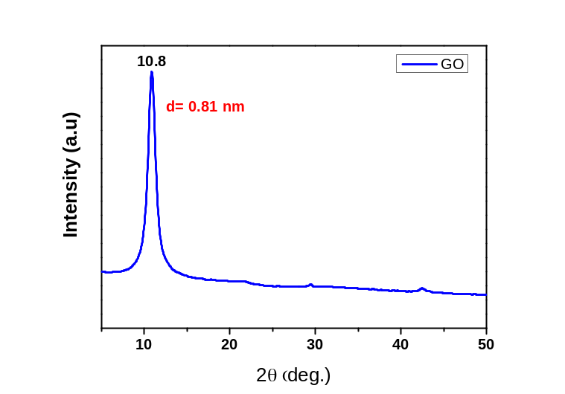
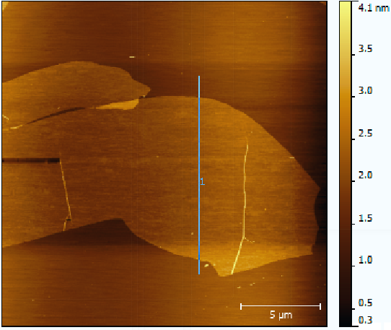
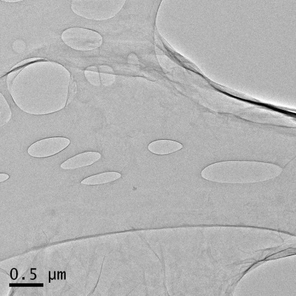
GO Characterization
Graphite Oxide
XPS
Graphite
0..81
GO
0.34
Oxidation
XRD
AFM
TEM
Nanotek 2014
10

Slide 12
Synthesis of Graphene/Metal Oxide Hybrids
In-situ thermo-annealed synthesis
Similar protocol was used to synthesize Graphene/CuO and Graphene/Fe2O3 composites
Nanotek 2014
11
Notes:
Electonegatice sites such as epoxy, carboxyl and hydoxyl easily interacts with metal hydroxides which is the seeds for metal oxide nanopaticles

Slide 13
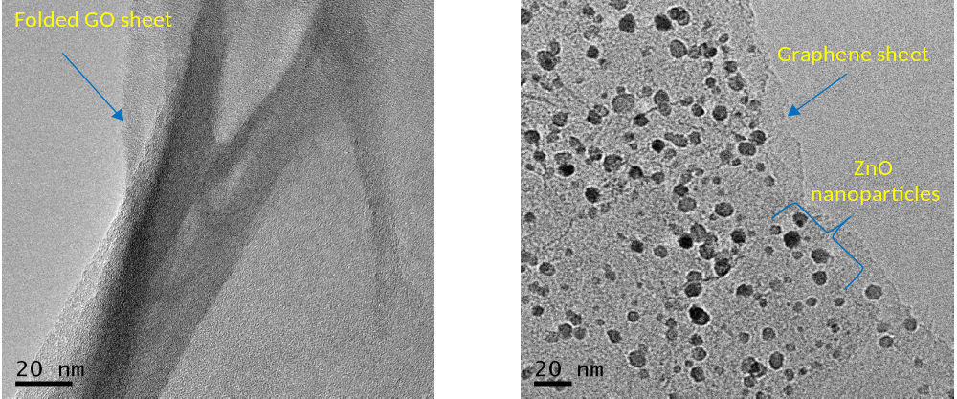
Characterization of Nanohybrids
Graphene/ZnO
XRD
TEM
XRD reveals formation of highly crystalline ZnO nanoparticles in conjunction with reduction GO to TRG
TEM confirms the uniform dispersion of ZnO NPs into resulting hybrids.
Particle size appear to be below 10 nm (ZnO QDs)
Nanotek 2014
12

Slide 14
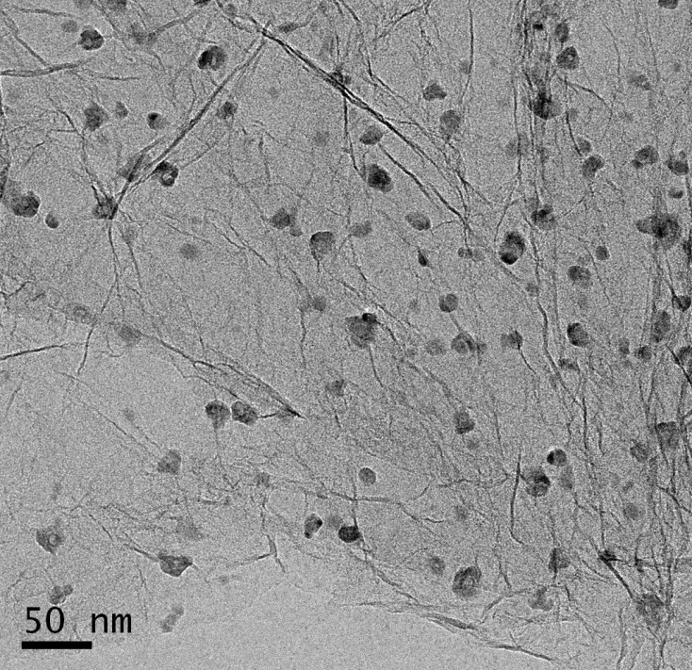
Graphene/CuO
XRD
TEM
TRG
CuO
XRD reveals formation of highly crystalline CuO nanoparticles in conjunction with reduction GO to TRG
TEM confirms the uniform dispersion of CuO NPs into resulting hybrids having particle size below 20 nm
Nanotek 2014
13

Slide 15
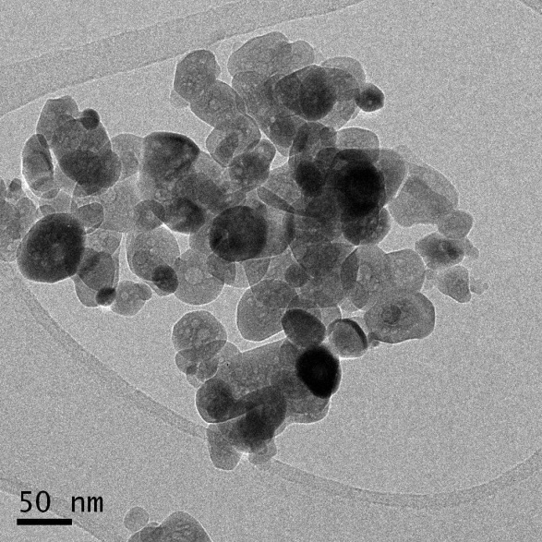
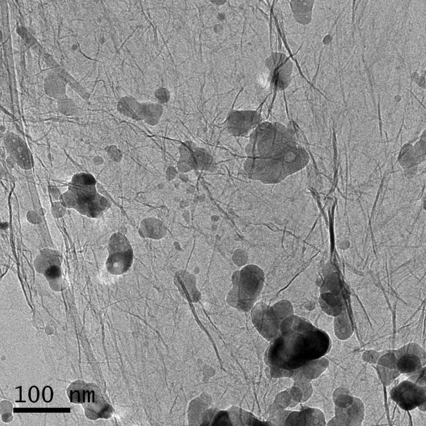
Graphene/Fe₂O₃
XRD
TEM
Fe₂O₃
TRG/ Fe₂O₃
XRD reveals formation of highly crystalline Fe₂O₃ nanoparticles in conjunction with reduction GO to TRG
Phase change from alpha to gamma for Fe₂O₃ was observed in presence of graphene.
Uniform dispersion of Fe₂O₃ NPs into resulting hybrids having particle size below 50 nm
Nanotek 2014
14

Slide 16
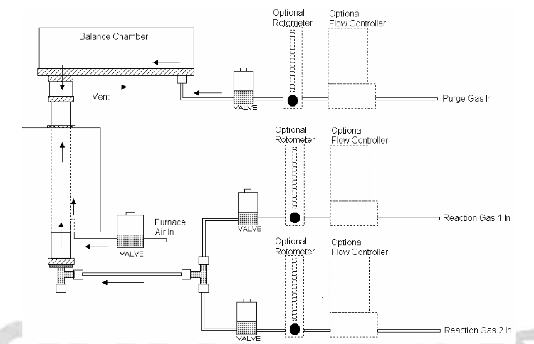
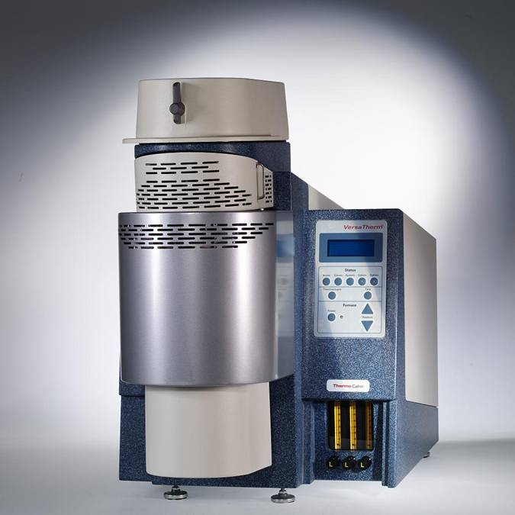
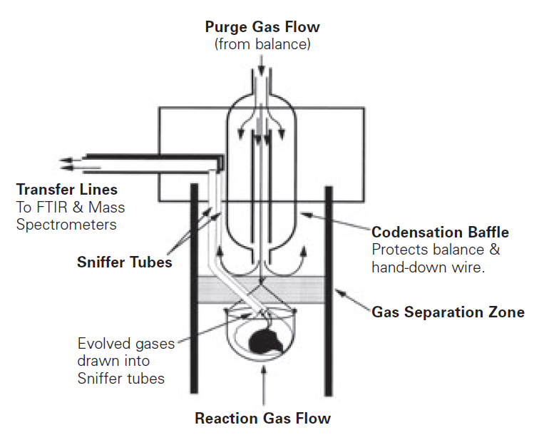
H₂S sorption capacity
Adsorption Parameters:
Pressure = Ambient Pressure
Temperature = 23-25°C
H₂S Flow Rate = 48 mL/min
N₂ (Purge) Flow Rate = 50 mL/min
N₂ (Balance) Flow Rate = 20 mL/min
(N₂)
(N₂)
(2,000 ppm H₂S/N₂)
(N₂)
Nanotek 2014
15

Slide 17
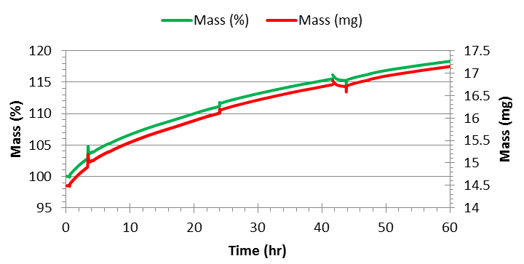
Graphene/ZnO H₂S Sorption capacity @ 25 ºC
Sorbent = TRG/ZnO ( 5 wt%)
Mass Increase = 18% (Maximum sorption capacity was NOT reached)
Mass of H₂S Adsorbed (per 1.00 g sorbent) = 0.18 g H₂S
Moles of H₂S Adsorbed (per 1.00 g sorbent) = 5.28 mmol H₂S
Sorption Capacity of Sorbent = 5.28 mmol H₂S/g TRG-ZnO
(Sorption capacity of Methyldiethanolamine [MDEA] is about 4.2 mmol H₂S/g amine)
Nanotek 2014
16

Slide 18
Remarks
Successfully synthesized nanohybrids of graphene with selected metal oxide (ZnO, CuO and Fe₂O₃).
In-situ thermo annealing process is effective for NPs synthesis with simultaneous GO reduction.
Characterization confirms that hybridization result in uniform dispersion of NPs on graphene surface.
Initial H2S adsorption studies confirms that these hybrid posses great potential to be used in natural gas sweetening process
Further studies are required to understand the regeneration process and efficiency of other metal oxides.
Nanotek 2014
17

Slide 19
Acknowledgements
Chair, Chemical Engineering Department
Dr.Ahmed Abdala & Dr.Vikas Mittal
Mr.Vishnu Pillai
Nanotek 2014
18

Slide 20







Thank you!!
Nanotek 2014
19

