Slide 1

May 2017
Electromagnetic-based Ethanol Chemical Sensor using Metamaterial Absorber
Sungjoon Lim (Ph.D.)
Microwave Wireless Communication Lab (MWCL)
School of Electrical and Electronics Engineering,
Chung-Ang University
sungjoon@cau.ac.kr

Slide 2

Agenda of Today’s Talk
Research Background
Design and Structure
Results and Discussion
Conclusion

Slide 3
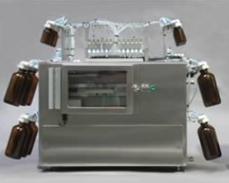
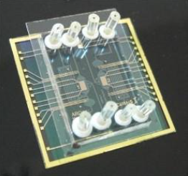
Research Background
[ Conventional Equipment]
[ Microfluidic channel ]
[ Most of liquid are wasted ]
[ Minimize wasted liquid]
· Conventional process for bioassays and sensing chemical liquid
Tubes or valves are used. Most of liquids are wasted
· Microfluidic channel Minimize wasted liquid
Using A little amount Sensitivity

Slide 4
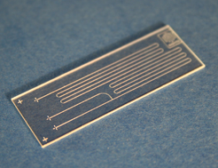
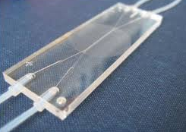
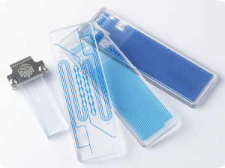
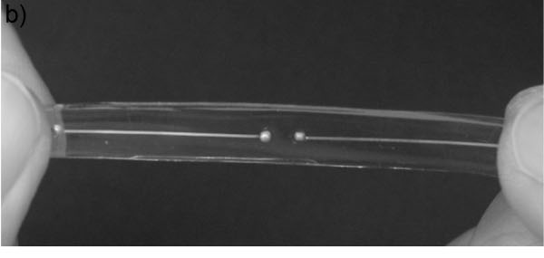
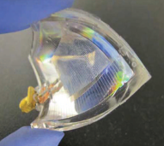
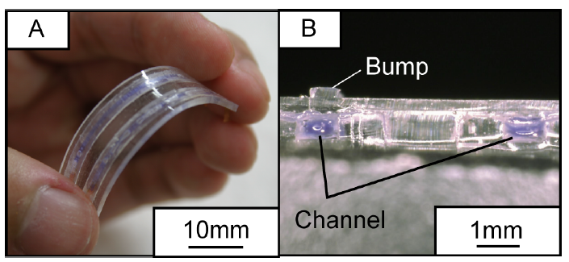
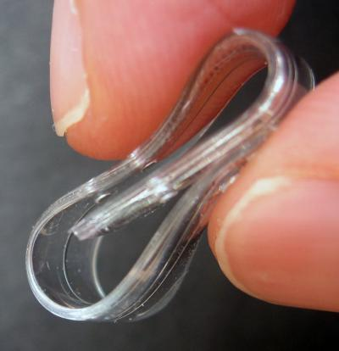
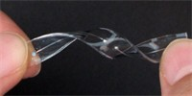
Research Background
Microfluidic Channels for Different Applications
Making use of appropriate fabrication processes and ingredients, microstructure PDMS elastomers may exhibit favorable electrical performance, and withstand severe folding, twisting, and straining without any mechanical failures.
reference: Google

Slide 5
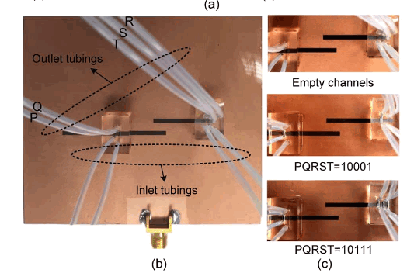
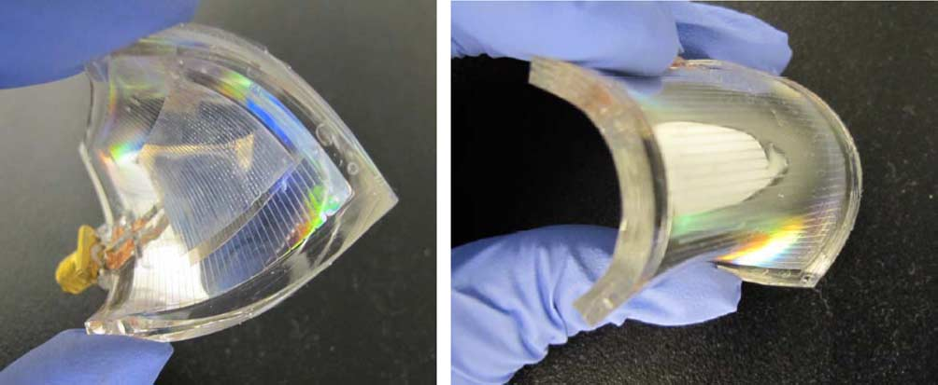
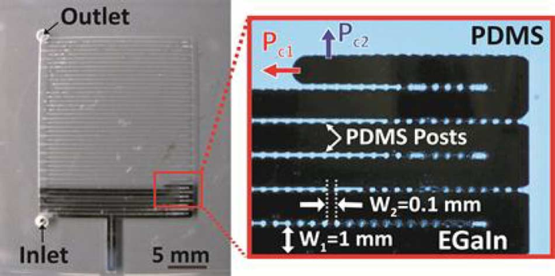
Research Background
Microfluidically Tunable RF Structures
Switchable dual band slot antenna [1]
Flexible liquid metal microstrip patch antenna [2]
[1] Pourghorban Saghati, J. Singh Batra, J. Kameoka and K. Entesari, "A Microfluidically Reconfigurable Dual-Band Slot Antenna With a Frequency Coverage Ratio of 3:1,“
in IEEE Antennas and Wireless Propagation Letters, vol. 15, no. , pp. 122-125, 2016.
[2] G. J. Hayes, J. H. So, A. Qusba, M. D. Dickey and G. Lazzi, "Flexible Liquid Metal Alloy (EGaIn) Microstrip Patch Antenna," in IEEE Transactions on Antennas and
Propagation, vol. 60, no. 5, pp. 2151-2156, May 2012.

Slide 6
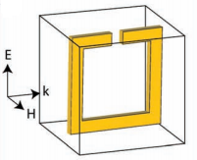
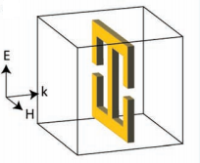
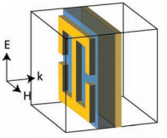
Research Background
Metamaterials
Split Ring Resonator (SRR)
It responds to EM waves with a magnetic response.
Resonant permeability (μ) is produced.
Electric Ring Resonator (ERR)
It responds to EM wave with electric response.
Resonant permittivity (ε) is produced.
ERR with Conducting Ground Plane
It generates both electric and magnetic responses.
Electric response can be controlled by the geometry of the ERR.
Magnetic response can be controlled by the spacing between the ERR and ground plane.
Watts, Claire M., Xianliang Liu, and Willie J. Padilla. "Metamaterial electromagnetic wave absorbers." Advanced materials 24.23 (2012): OP98-OP120.

Slide 7
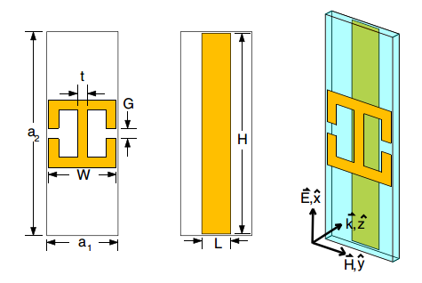
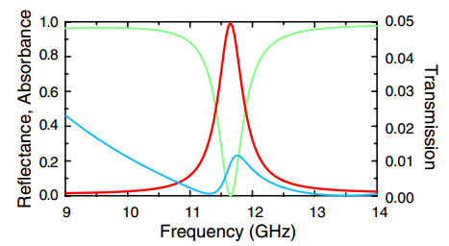
Research Background
Metamaterial absorber
Electric ring resonator (ERR) is placed on the top of the substrate.
Thin cut wire is placed on the bottom of the substrate.
Electric response can be controlled by the geometry of the ERR.
Magnetic response can be controlled by the spacing between the ERR and bottom wire.
Currents in the ERR and wire are anti-parallel. ➔ Magnetic couples to them providing a resonant μ.
From these phenomena, metamaterial absorber can match the impedance to free space.
It use losses in the homogeneous layer to absorb the incident radiation.
N. I. Landy, S. Sajuyigbe, J. J. Mock, D. R. Smith, and W. J. Padilla, “Perfect metamaterial absorber,” Phys. Rev. Lett., vol. 100, no. 20, 2008.

Slide 8
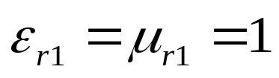
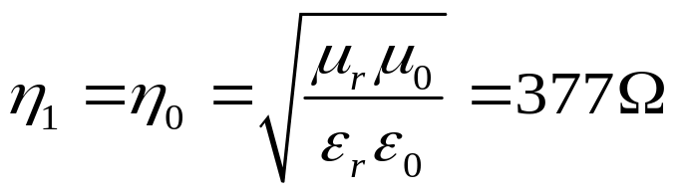



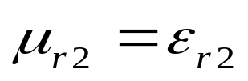
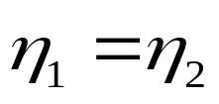
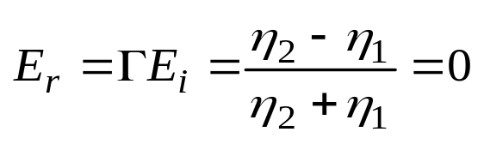
Research Background
Principle of the metamaterial absorber
Air
MTM
η₁
η₂
< Metamaterial absorber design >
Tailor the effective permittivity and permeability of the metamaterial.
Metamaterial’s impedance and air’s impedance can be matched.
Minimize reflection and maximize losses, so we can realize a perfect absorber.

Slide 9
Agenda of Today’s Talk
Research Background
Design and Structure
Results and Discussion
Conclusion

Slide 10

Design and Structure
Structure of the proposed metamaterial sensor
< Layout of the proposed sensor >
The split-ring cross resonator (SRCR) is adopted because of its symmetric and simple structure.
The bottom layer is fully covered with conductor to prevent transmission.
The LC resonance of the SRCR can be generated from the inductance of the crossed wire as well as the capacitance of the gap at the circular ring.
The capacitive components of the SRCR are dependent of the effective dielectric constant around the gap, as shown in the following equation :
$$C=\frac{ε_{eff}{10}^{−3}}{18π}\frac{K(k)}{K′(k)}d$$
W. Withayachumnankul, C. Fumeaux, and D. Abbott, “Compact electric-LC resonators for metamaterials,” Optics Express, vol. 18, no. 25, pp. 25912-25921, 2010.

Slide 11
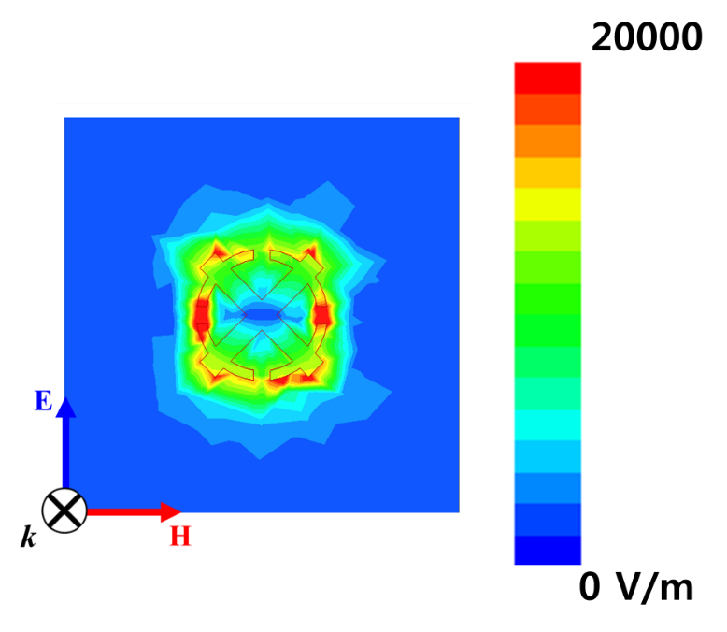
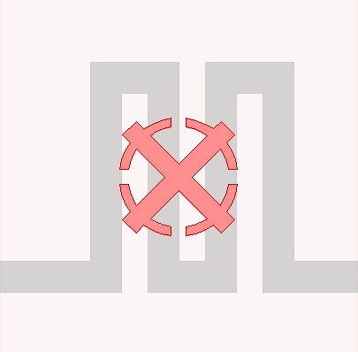
Design and Structure
Simulated E-field distribution and channel layout of the proposed sensor
< Simulated E-field distribution >
< Layout with a meandering channel >
For designing the microfluidic channels, the electric field distribution of the metamaterial absorber is simulated.
The E-field of the incident wave is strongly coupled around the SRCR, especially at the left and right side capacitive gaps.
Therefore, the microfluidic channel should be designed considering all capacitive gaps of the SRCR.

Slide 12
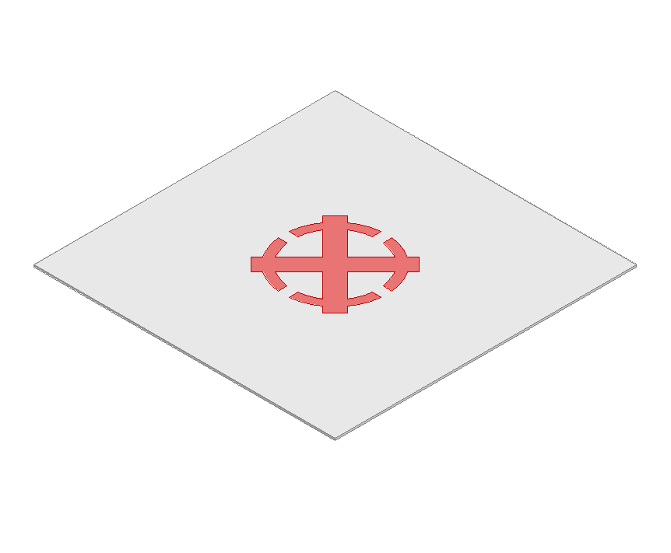

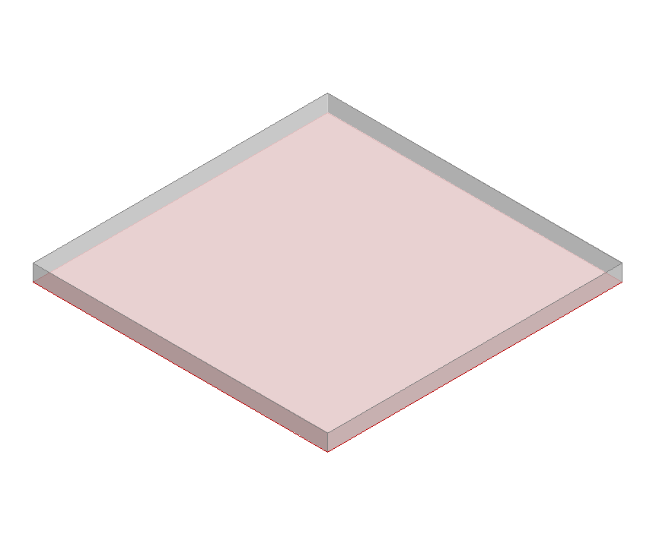
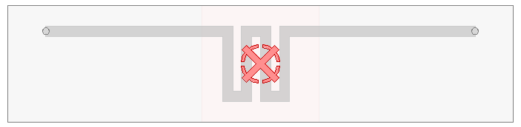
Design and Structure
Final design of the proposed sensor
Conductive Pattern
Layer (SRCR)
Fluidic Channel Layer
Bottom Layer
< Three-dimensional structure >
< Top view of the final chemical sensor >
The proposed chemical sensor consists of three layer.
The microfluidic structure is engraved in the dielectric substrate.
➔Extra devices for the microfluidic channels are not required.
Considering practical measurement environments, the final chemical sensor, including the liquid inlet and outlet, is shown in the figure above.

Slide 13
Agenda of Today’s Talk
Research Background
Design and Structure
Results and Discussion
Conclusion

Slide 14
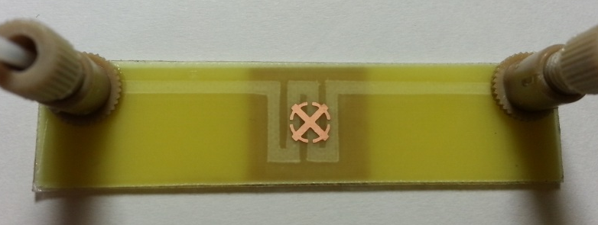
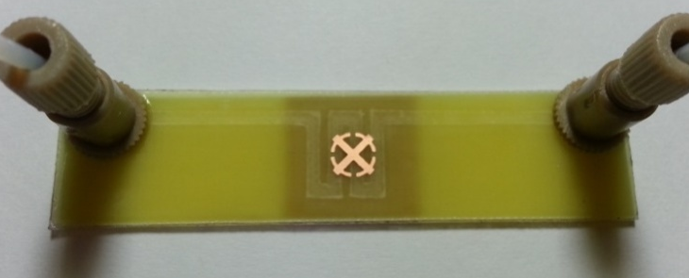
Results and Discussion
Fabricated prototype sample of the proposed sensor
Empty state
Liquid-filled state
< Photograph of the fabricated sample >
The prototype sample was fabricated by combining three layers of FR4 substrate with a permittivity of 3.7 and dielectric loss of 0.02.
The first layer consists of a conductive SRCR pattern etched on 0.1-mm-thick FR4 substrate at the top of the entire structure.
The second layer, placed in the middle, is the microfluidic channel with a 0.1-mm thickness carved by using craft-cutting technology.
The bottom layer of 0.8-mm-thick FR4 substrate is fully covered with copper on only one side.
Each layer is attached by adhesive laminating film.

Slide 15
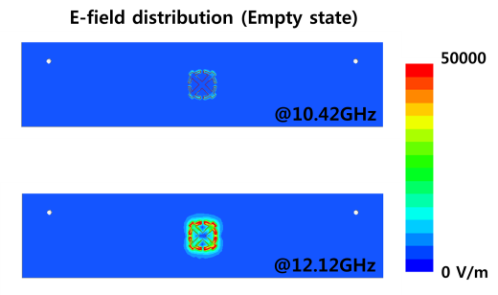
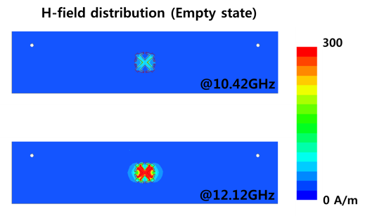
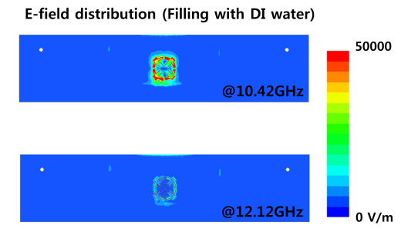
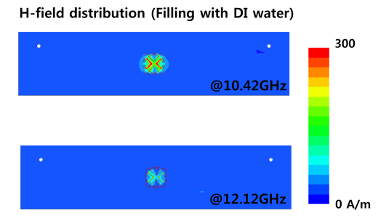
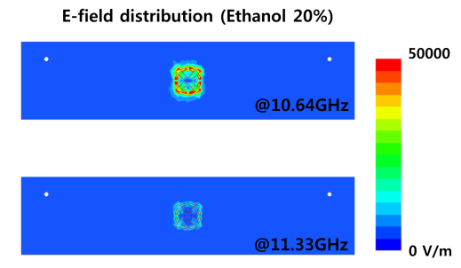
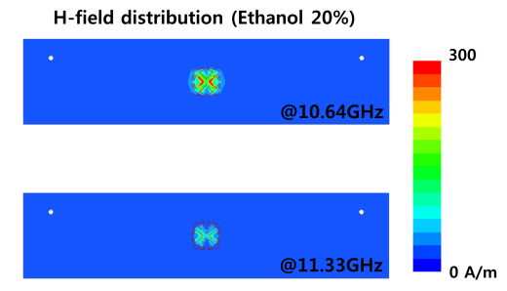
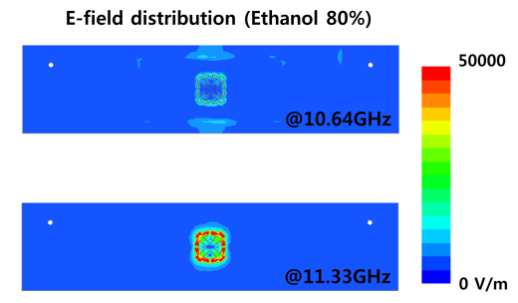
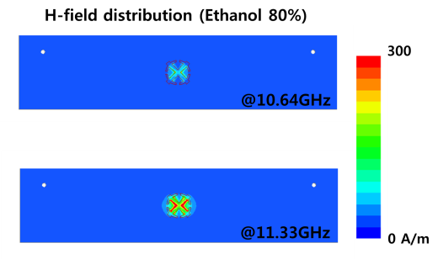
Results and Discussion
Electric and magnetic responses of the proposed sensor
< Empty state >
< Filling with DI water >
< Ethanol 20% >
< Ethanol 80% >
The electric and magnetic responses of the proposed chemical sensor can be understood by investigating the electric and magnetic field distributions.
When the microfluidic channel is in the empty state, the electric and magnetic fields are strongly distributed around the SRCR at 12.12GHz.
The strong electric and magnetic responses are only generated at 10.64GHz for a 20% concentration, and only at 11.33GHz for an 80% concentration of the ethanol.
The proposed chemical sensor has its electric and magnetic resonance at different frequencies in accordance with the types and concentrations of the substances that fill the microfluidic channels.
Using this principle, the proposed sensor can detect the concentrations of the ethanol injected into the microfluidic channels.

Slide 16
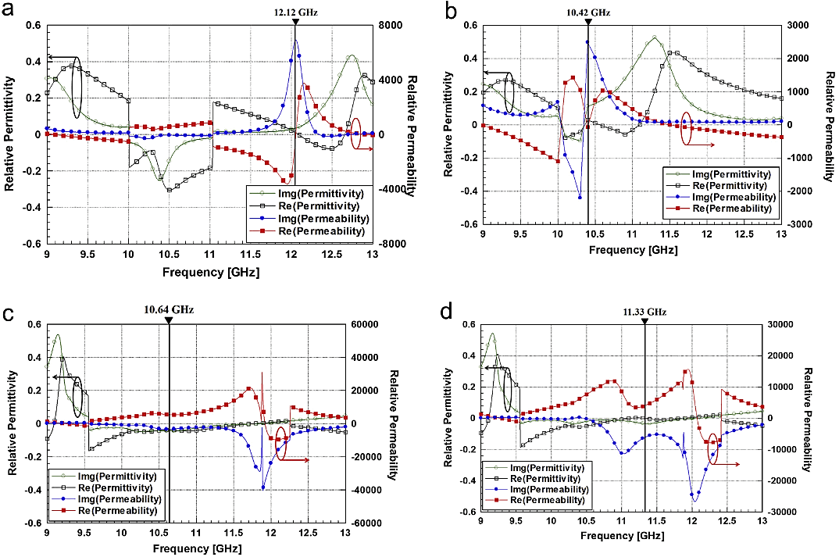
Results and Discussion
Relative permittivity and permeability of proposed metamaterial
Real and imaginary values of simulated relative permittivity and permeability for (a) empty state, (b) filled with DI-Water, and (c) 20% and (d) 80% concentrations of the ethanol (vertical lines indicate the resonant frequencies).

Slide 17
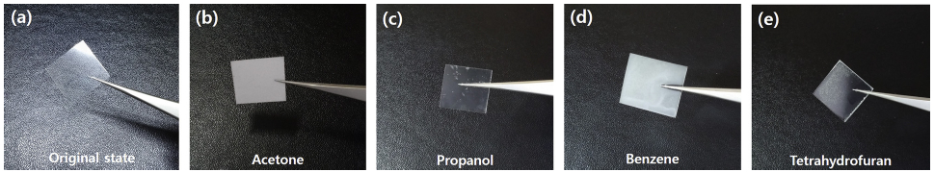
Results and Discussion
Reaction of laminating film with different chemicals
The absorptivity of the proposed chemical sensor is measured for different liquids.
However, the type of liquid is limited because the adhesive laminating film is reacted with Acetone, Propanol, Benzene and Tetrahydrofuran as shown in the figure below.
When the laminating film with 0.06 mm thickness reacts to Acetone, Propanol, Benzene and Tetrahydrofuran, the film gets thicket to 0.296, 0.29, 0.31 and 0.42 mm, respectively.
Therefore the proposed sensor cannot be used for these mentioned chemicals because the microfluidic channel gets stuck.

Slide 18
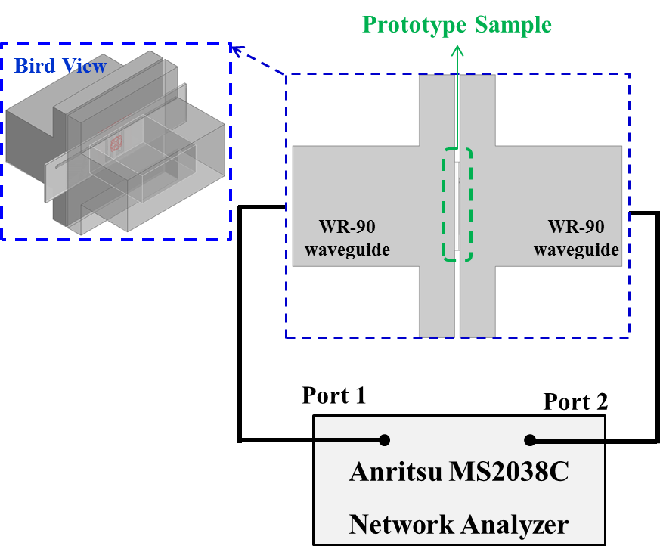

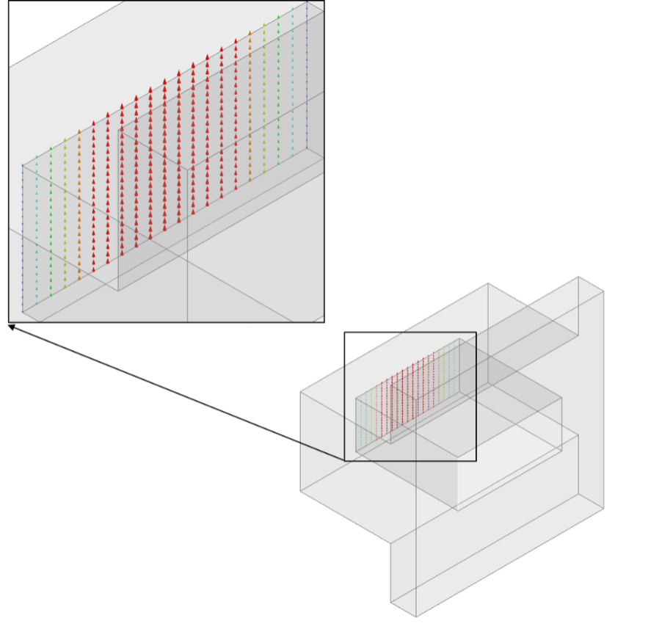
Results and Discussion
Waveguide measurement setup
The absorptivity can be calculated by,
But, transmission is zero because of
the metallic bottom layer.
Two WR-90 waveguide adapters and Anritsu MS2038C network analyzer are used for measurement.
The waveguides are placed on the top and bottom of the prototype sample, and the reflection coefficients were measured.
We used the dominant TE₁₀ mode of WR-90, the incident wave from WR-90 into the prototype sample is longitudinal.
Therefore, we placed the prototype sample horizontally.

Slide 19
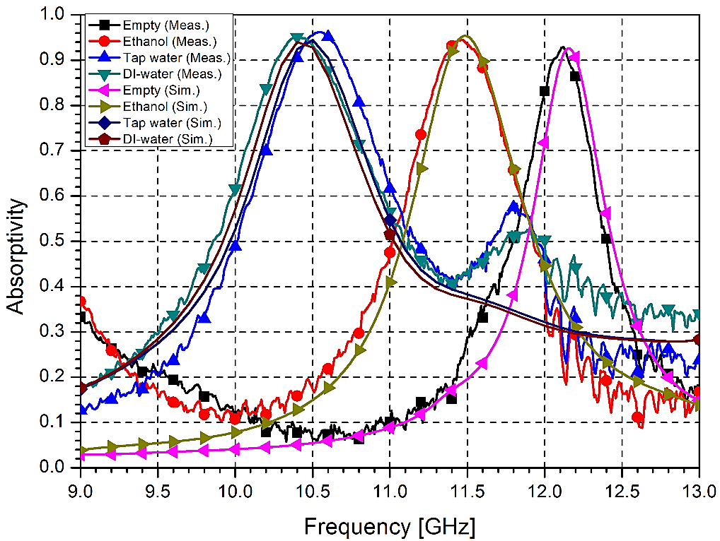
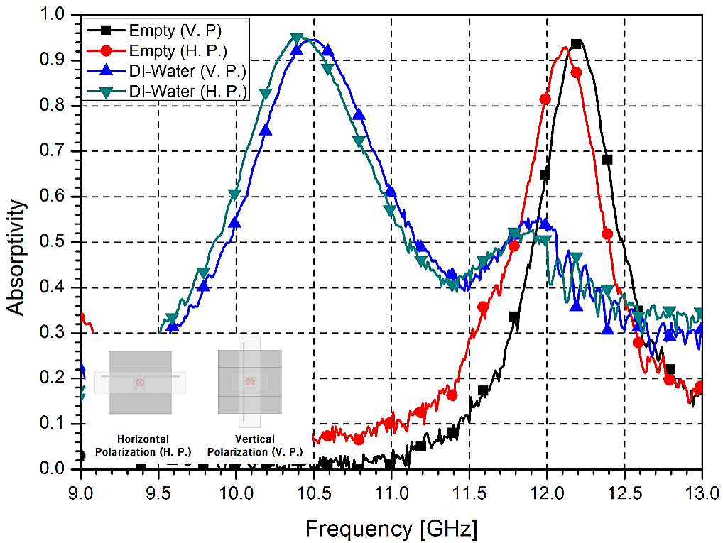
Results and Discussion
Simulation and measurement results for different liquids
< Different liquids >
< Polarizations >
The proposed sensor has 92.9% absorptivity at 12.12 GHz in the empty state of the channel.
When the liquids are injected into the channel, the resonant frequency shifts to 11.46 GHz (ethanol), 10.54 GHz (tap water), and 10.42 GHz (DI water).
When the polarization is changed, the proposed chemical sensor produces almost the same results.

Slide 20
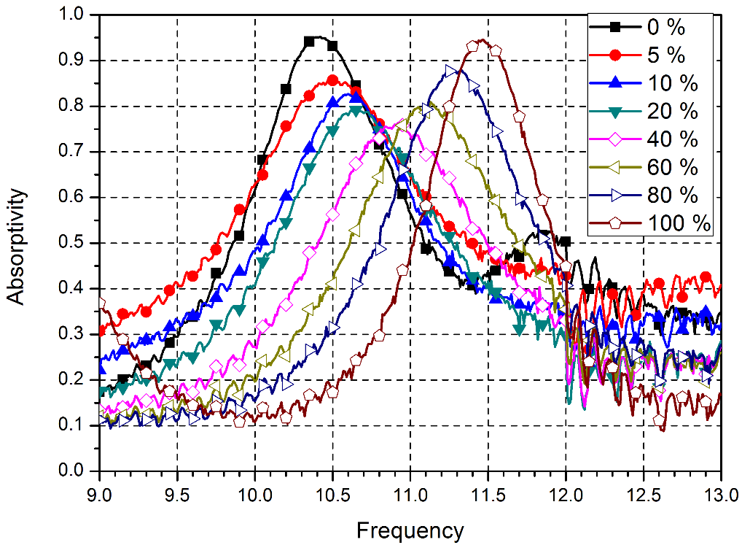
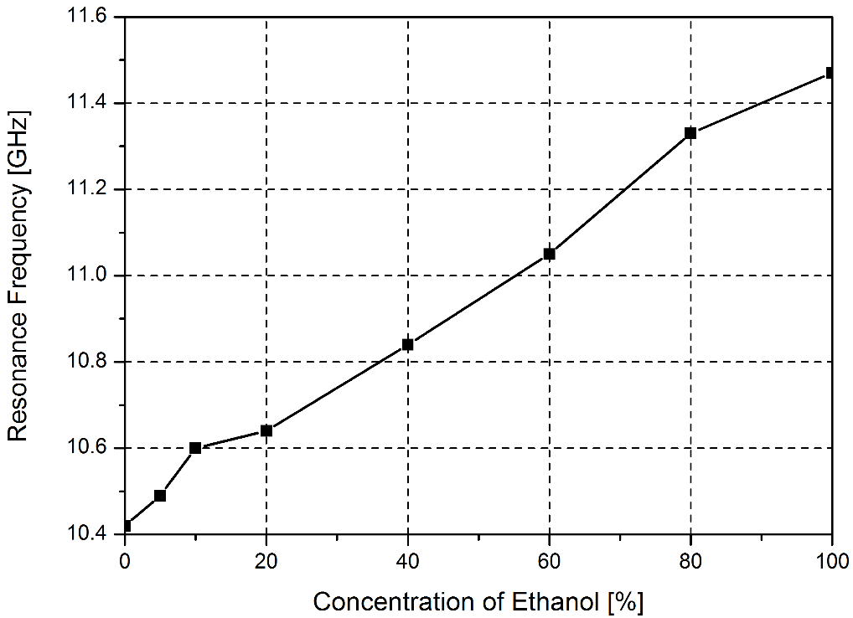
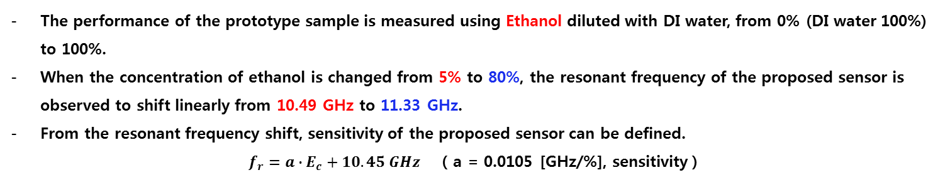
Results and Discussion
Measurement results for different concentration of Ethanol
< Measured absorptivity >
< Resonant frequency shift >
The performance of the prototype sample is measured using Ethanol diluted with DI water, from 0% (DI water 100%) to 100%.
When the concentration of ethanol is changed from 5% to 80%, the resonant frequency of the proposed sensor is observed to shift linearly from 10.49 GHz to 11.33 GHz.
From the resonant frequency shift, sensitivity of the proposed sensor can be defined.
$f_{r}=a∙E_{c}+10.45 GHz$ ( a = 0.0105 [GHz/%], sensitivity )

Slide 21
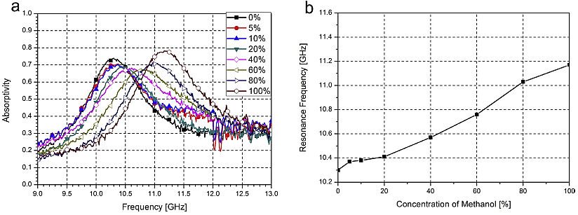
Results and Discussion
Measurement results for different concentration of Methanol
< Measured absorptivity >
< Resonant frequency shift >
The performance of the prototype sample is measured using Methanol diluted with DI water, from 0% (DI water 100%) to 100%.
When the concentration of Methanol is changed from 0% to 100%, the resonant frequency of the proposed sensor is observed to shift from 10.25 GHz to 11.2 GHz.

Slide 22
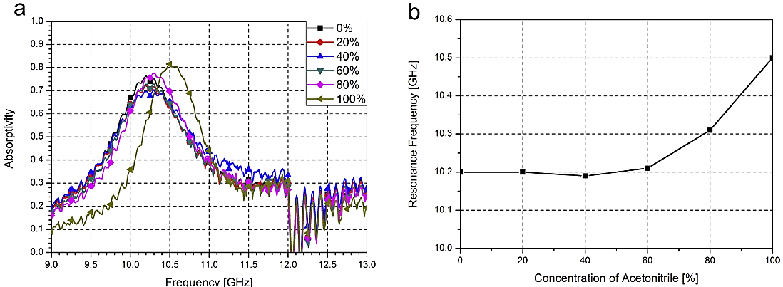
Results and Discussion
Measurement results for different concentration of Acetonitrile
< Measured absorptivity >
< Resonant frequency shift >
The performance of the prototype sample is measured using Acetonitrile diluted with DI water, from 0% (DI water 100%) to 100%.
When the concentration of Acetonitrile is changed from 0% to 100%, the resonant frequency of the proposed sensor is observed to shift from 10.2 GHz to 11.6 GHz.

Slide 23
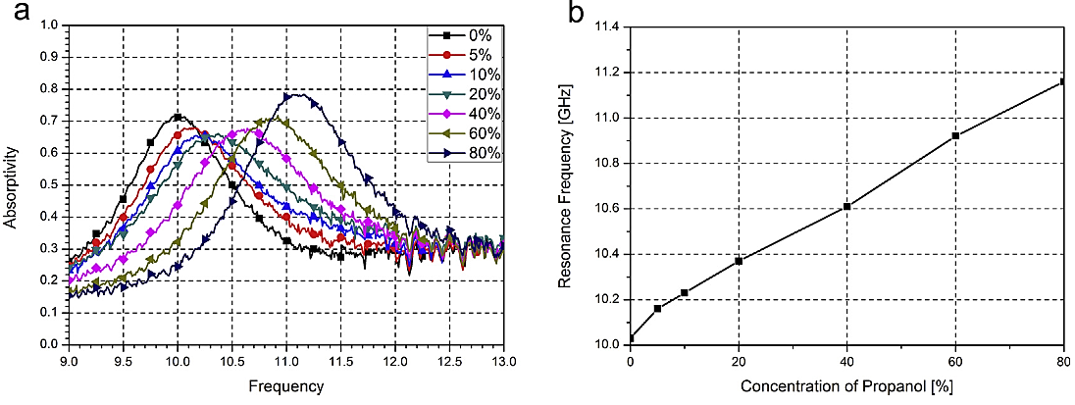
Results and Discussion
Measurement results for different concentration of Propanol
< Measured absorptivity >
< Resonant frequency shift >
The performance of the prototype sample is measured using Propanol diluted with DI water, from 20% (DI water 100%) to 100%.
When the concentration of Acetonitrile is changed from 0% to 80%, the resonant frequency of the proposed sensor is observed to shift from 10 GHz to 11.15 GHz.

Slide 24

Results and Discussion
Measurement results for different concentration of Acetone
< Measured absorptivity >
< Resonant frequency shift >
The performance of the prototype sample is measured using Acetone diluted with DI water, from 20% (DI water 100%) to 100%.
When the concentration of Acetonitrile is changed from 0% to 80%, the resonant frequency of the proposed sensor is observed to shift from 10.1 GHz to 10.35 GHz.

Slide 25
Agenda of Today’s Talk
Research Background
Design and Structure
Results and Discussion
Conclusion

Slide 26
Conclusion
A novel electromagnetic-based ethanol sensor using a microfluidic metamaterial absorber is proposed.
The proposed chemical sensor can detect ethanol concentrations by measuring the changes in a resonant frequency.
The resonant frequency of the proposed chemical sensor changes from 10.49 GHz to 11.46 GHz when the concentration of ethanol is varied from 5% to 100%.
It is experimentally demonstrated that the proposed sensor is insensitive to incident polarization.
It is experimentally verified that the proposed chemical sensor is working up to 100% ethanol, 100% methanol, 100% acetonitrile, 80% propanol, 80% acetone and 5% benzene.
When the proposed metamaterial resonator is extended to a large periodic array, the chemical sensor can be effectively used for wireless chemical sensors.

Slide 27



Slide 28

Appendix
Varying loss factors of metamaterial absorber
Figure shows the reflection peaks while the loss factor in the material is varied.
When the dielectric loss tangent is changed to zero (from 0.02), the reflections are increased from -19 dB to -4.5 dB at 9.7 GHz.
In addition, when copper is replaced by a PEC with infinite conductance, the reflection is increased to 0 dB.

