Slide 1

RASER (Rate Amplification based on the Substrate-Enhanced Reaction) Model of Single-Molecule Enzyme Catalysis
Sungchul Ji, Ph.D.
Department of Pharmacology and Toxicology
Ernest Mario School of Pharmacy
Rutgers University
Piscataway, N.J. 08854
sji@rci.rutgers.edu

Slide 2
Outline
The definition of terms and principle
1) Fourier theorem, standing waves, and resonance, and Chladni plate
2) Blackbody radiation spectra and the Planckian radiation equation (PRE)
3) Resonance
4) laser (Light Amplification based on Stimulated Emission of Radiation)
5) Dissipative vs. equilibrium structures
(2) Single-Molecule Enzymology and the Planckian Distribution Equation (PDE)
1) Single-molecule cytochrome oxidase catalytic activity
2) Turnover-time histogram fits PDE
3) RASER model of enzyme catalysis
(3) Other experimental data that fit the PDE
1) Protein folding free energy
2) mRNA metabolisms in yeast and human breast tissues
3) human decision-time histogram (Drift-Diffusion Model)
(4) The SID-TEM-TOF mechanism as the Common Mechanisms PDE.
1) The Planckian processes = the physicochemical processes that generate long-tailed
histograms fitting PDE)
2) The Petoukhov postulate = Organisms are musical instruments
(5) Conclusions
Notes:
I want tot thank Hans-Ferdinand for inviting me to this wonderful, highly stimulating interdisciplinary meeting, from which I have learned so much during the past several days. I also what to thank him and his staffs for making our stay in this historical city of Graz a comfortable and enjoyable experience.

Slide 3
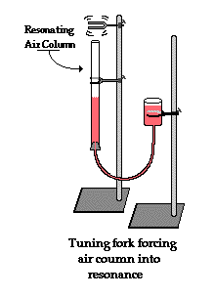
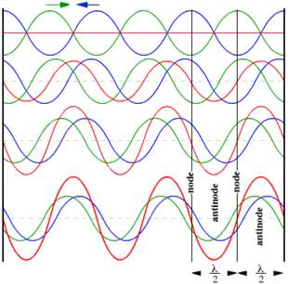
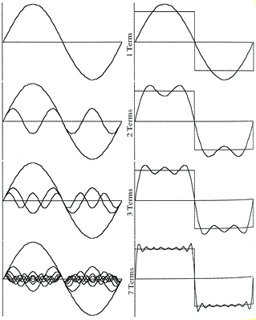
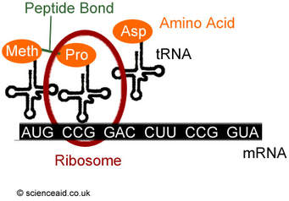
Physics of Waves
Fourier Theorem Any periodic wave having frequency f can be constructed as a sum of a series of sine waves with frequencies f, 2f, 3f, 4f, etc., called the Harmonic series. | Standing waves https://commons.wikimedia.org/wiki/File:Superpositionprinciple.gif | Resonance

Slide 4
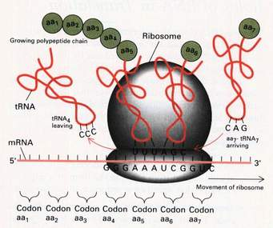
Ribosome as a Multidimensional Degree of Freedom Oscillator

Slide 5

Resonance
Resonance is a phenomenon in which a vibrating system or external force drives another system to oscillate with greater amplitude at specific frequencies.
Frequencies at which the response amplitude is a relative maximum are known as the system's resonant frequencies or resonance frequencies.
https://en.wikipedia.org/wiki/Resonance

Slide 6
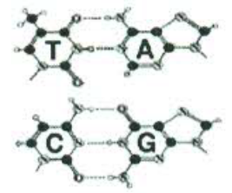
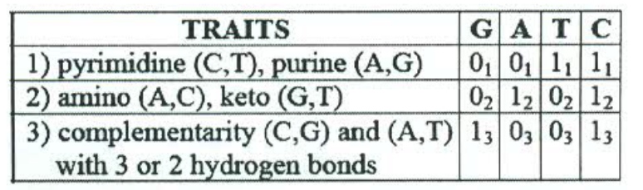
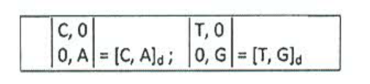
The Petoukhov Coincidence & the Resonating Oscillator Hypothesis
Watson-Crick pair | Yin-yang pairs
 | Tensor products of the (2*2)-nucleotide matrices: [C,A]_{d}⊗[C,A]_{d}⊗[C,A]_{d} = [CCC, CCA, CAC, CAA, ACC, ACA, AAC, AAA]_{d} Pro Pro His Gln Thr Thr Asn Lys [C,A]_{d}⊗[C,A]_{d}⊗[T,G]_{d} = [CCT, CCG, CAT, CAG, ACT, ACG, AAT, AAG]_{d} Pro Pro His Gln Thr Thr Asn Lys [C,A]_{d}⊗[T,G]_{d}⊗[C,A]_{d} = [CTC, CTA, CGC, CGA, ATC, ATA, AGC, AGA]_{d} Leu Leu Arg Arg Ile Met Ser Stop [C,A]_{d}⊗[T,G]_{d}⊗ [T,G]_{d} = [CTT, CTG, CGT, CGG, ATT, ATG, AGT, AGG]_{d} Leu Leu Arg Arg Ile Met Ser Stop [T,G]_{d}⊗[C,A]_{d}⊗[C,A]_{d} = [TCC, TCA, TAC, TAA, GCC, GCA, GAC, GAA]_{d} Ser Ser Tyr Stop Ala Ala Asp Glu [T,G]_{d}⊗[C,A]_{d}⊗[T,G]_{d} = [TCT, TCG, TAT, TAG, GCT, GCG, GAT, GAG]_{d} Ser Ser Tyr Stop Ala Ala Asp Glu [T,G]_{d}⊗[T,G]_{d}⊗[C,A]_{d} = [TTC, TTA, TGC, TGA, GTC, GTA, GGC, GGA]_{d} Phe Leu Cys Trp Val Val _{Gly} _{Gly} [T,G]_{d}⊗[T,G]_{d}⊗[T,G]_{d} = [TTT, TTG, TGT, TGG, GTT, GTG, GGT, GGG]_{d} Phe Leu Cys Trp Val Val _{Gly Gly}

Slide 7
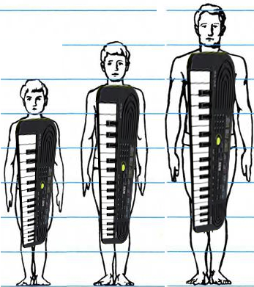
Organisms as Musical Instruments
(S. Petoukhov)
s.g

Slide 8
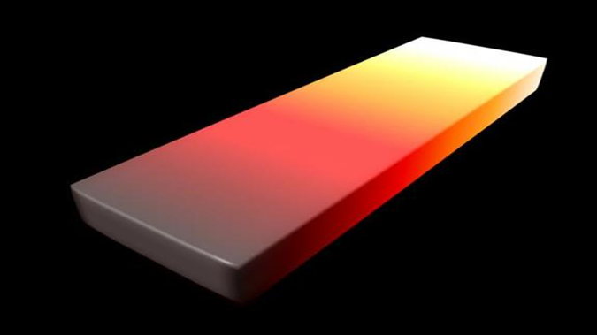
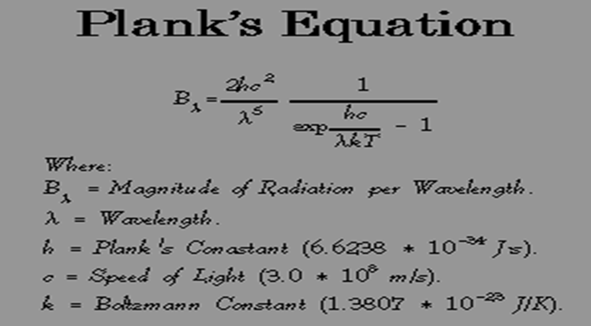
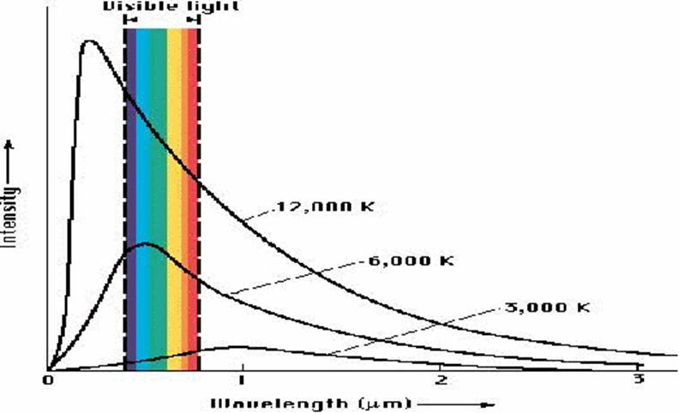
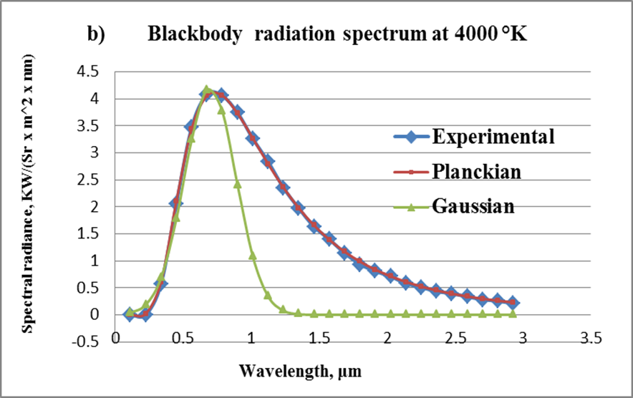
Generalizing the Planck Radiation equation to the Planck Distribution (PD)
Blackbody radiation equation: u(λ, T) = (2hc²/λ⁵)/(e^{hc/λkT} – 1) (1) Blackbody radiation-like equation (BRE) y = (a/x⁵)/(e^{b/x} - 1) (2) Planckian Distribution Equation (PDE) y =(a(Ax + B)⁻⁵)/(e^{b/(Ax + B)} – 1) (3)
Notes:
Figure 1. (a) Blackbody radiation: All matter emits light with different wavelengths and intensities when heated producing the so-called blackbody radiation spectra shown in (b). (c) The blackbody radiation equation discovered by M. Planck (1858-1947) in 1900. (d) Reproduction of the blackbody radiation spectrum with the Planckian distribution equation, Eq. (3).

Slide 9

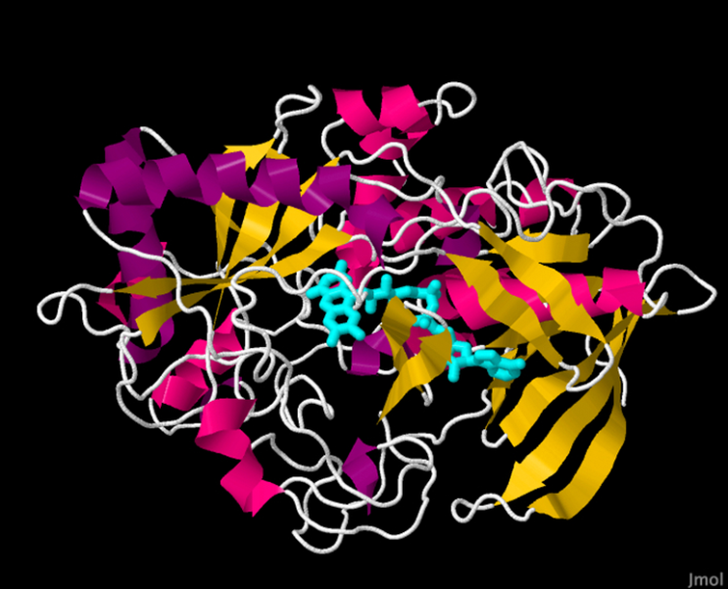
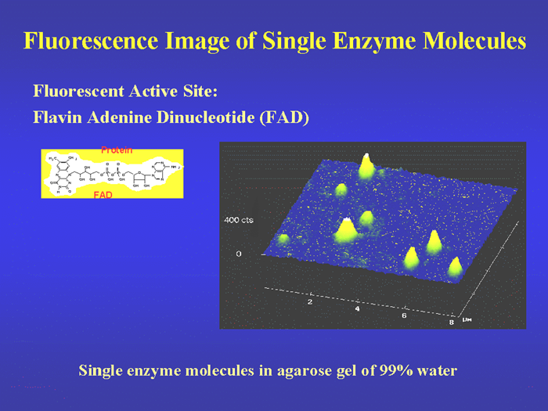
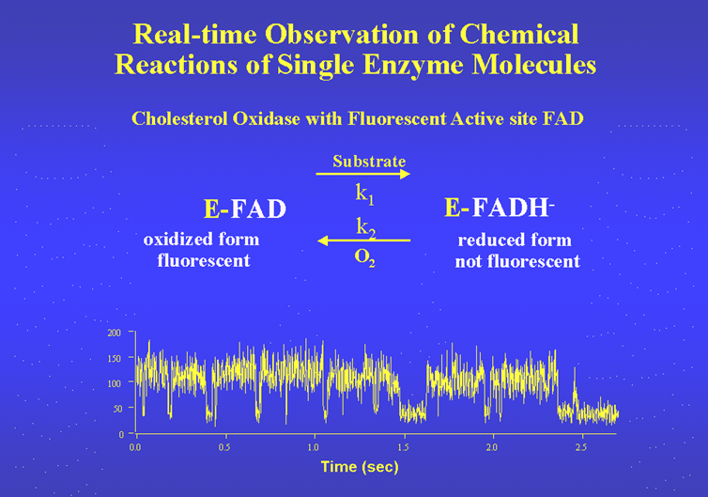
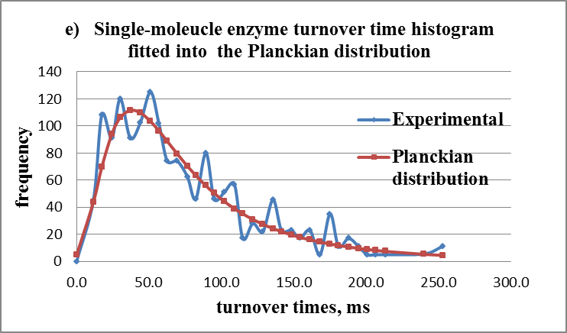
Single-Molecule Enzyme Kinetic Data of Cholesterol Oxidase fit the Planckian Distribution, y = (a/x⁵)/(e^{b/x} – 1) (2008)
Notes:
Figure 2. The fluorescence image of single molecules of cholesterol oxidase (COx) immobilized in agarose gel. When FAD is illuminated at 442 nm, the prosthetic group, FAD, emits fluorescence at 530. Reproduced from http://www.nigms.nih.gov/News/Reports/single_molecules.htm
Figure 3 The measurement of the turnover of a cholesterol oxidase (COx) molecule in the presence of cholesterol (0.20 mM) and oxygen (0.25 mM). FAD, is fluorescent when in its oxidized state with an average relative intensity of about 130 units (which is referred to as the “on“ state) and non-fluorescent when in its reduced state with an average intensity of about 40 units (which is referred to as the “off” state). Reproduced from http://www.nigms.nih.gov/News/Reports/single_molecules.htm.
Figure 4. The distribution of the kinetic parameters (on-times) measured from COx molecules. (Left) The distribution of the on-times (i.e., the duration of the times that the FAD molecule remains in its oxidized state and fluorescent). (Right) The distribution of the rate constants, k2, for the reduction of FAD to FADH2 measured from 33 COx molecules. At any given time, the k2 values measured from different molecules of COx vary by a factor of up to 5. Reproduced from http://www.nigms.nih.gov/News/Reports/single_molecules.htm
Figure 5. Single-molecule enzymic activity of cholesterol oxidase activity measured in [7] (see blue squares) is partially simulated by BRE (see purple squares).

Slide 10
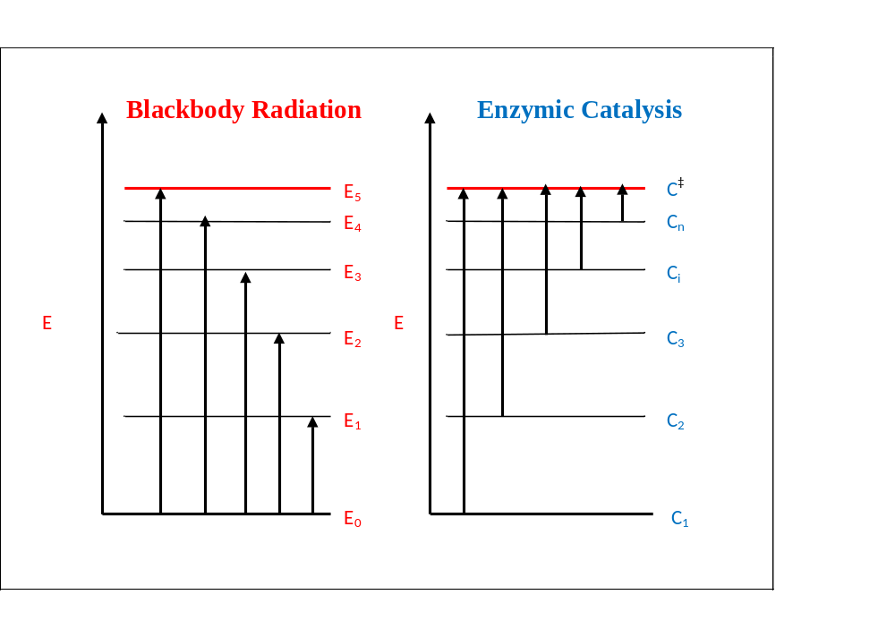
Quantization of Energy Levels in Atoms and Enzymes
Notes:
Figure 6. A comparison between blackbody radiation and enzymic catalysis. (Left) Blackbody radiation involves promoting the energy levels (vibrational, electronic, or vibronic) of oscillators from their ground state E0 to higher energy levels, E1 through E5. The wavelength of the radiation (or quantum) absorbed or emitted is given by ΔE = Ei – E0 = hf, where Ei is the ith excited-state energy level, h is the Planck constant, f is the frequency, and ΔE is the energy absorbed when an oscillator is excited from its ground state to the ith energy level. Alternatively, blackbody radiation can be thought of as resulting from the transitions of electrons from one energy level to another within matter, e.g., from E1 to E0, from E2 to E0, etc. (Right) A single molecule of cholesterol oxidase (COx) is postulated to exist in n different conformational states (i.e., conformational substates of Frauenfelder et al. [8]) denoted here as Ci with i = 1 to n. Each conformational state (or conformer) is thought to carry a set of sequence-specific conformational strains, or conformons, and can be excited to a common transition state (denoted as C‡) by thermal fluctuations, leading to catalysis [1, Section 12.12].

Slide 11
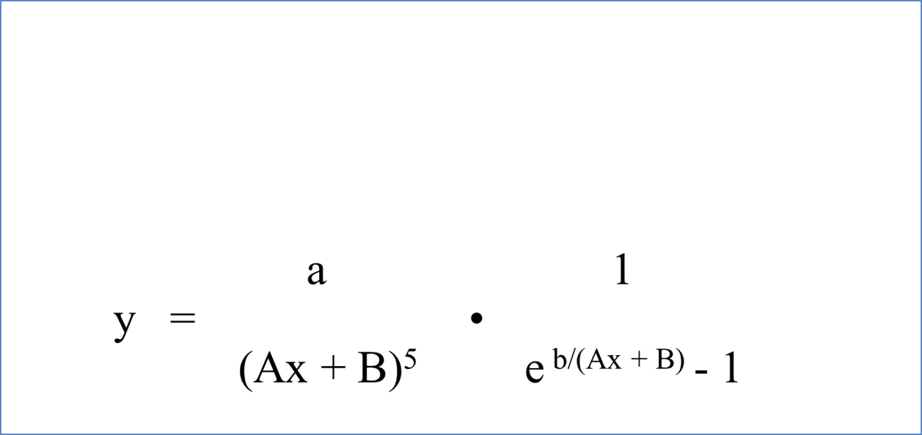

The Wave-Particle Duality in the Planckian Distribution
Number of standing waves per unit frequency per unit volume
Average energy per standing waves

Slide 12
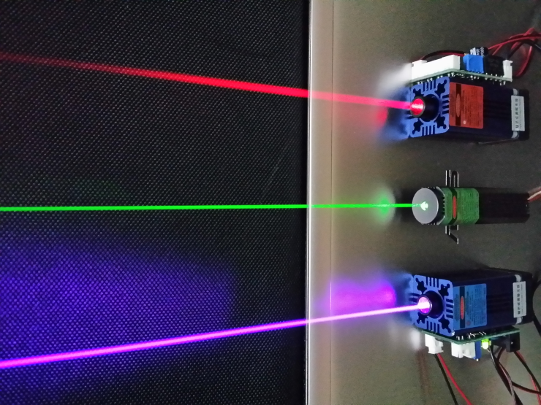
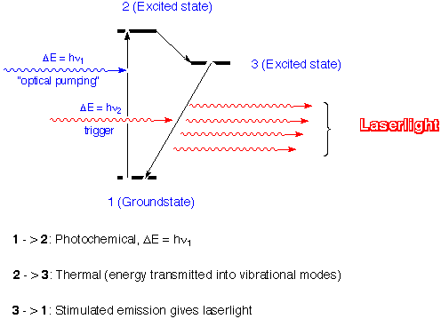
LASER: Light Amplification by Stimulated Emission of Radiation
Laser
Cholesterol oxidase
Notes:
The input of “pumping” photons, hν₁, cause the electrons of the atoms constituting the laser medium (e.g., ruby crystal) to undergo a transition from the ground state energy level to the excited state energy level (see the 1 to 2 arrow).
The excited state is short-lived, lasting fpr only 10⁻¹² seconds or less, and lose some of its energy as heat, thereby undergoing a transition to a lower energy level called “metastable” state (see the 2 to 3 arrow). Sate 3 is more stable than State 2 but still much more unstable than the ground state (see 1).
When there are enough number of electrons in the excited state (thus creating the so-called ”population inversion”), the arrival of triggering photons, hν_{2,} induces the de-excitation of electrons from the metastable excited state to the ground state (see the 3 to 1 arrow), accompanied by the emission of photons identical to the triggering photons, hν₂, but larger in number than the original triggering photons (as symbolized by the amplification of one photon to 4 shown in the figure). The emitted photons are “coherent” in in that they are identical with respect to (i) amplitude, (ii) frequency, and (ii) phase.

Slide 13
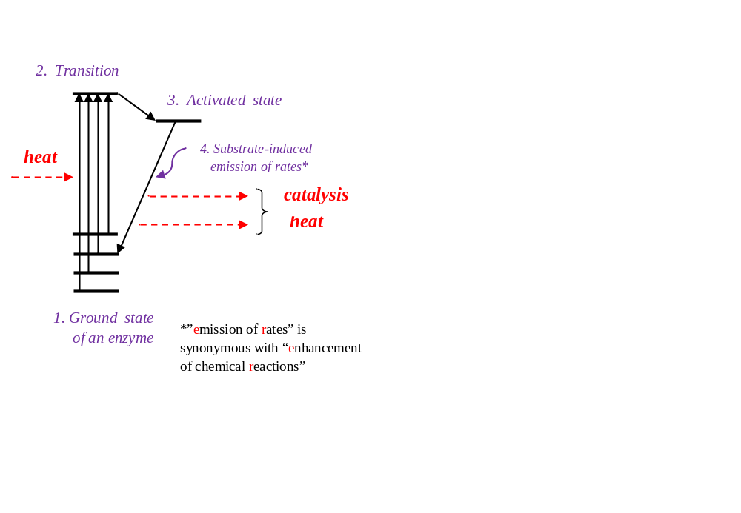

RASER: Rate Amplification by Substrate-induced Enhancement of Chemical Reactions
Cholesterol oxidase
Notes:
Unlike electrons in atoms that are all in the lowest-energy ground state before absorbing photons (Slide 7), enzymes exist in different ground states before thermal excitation (i.e., before absorbing thermal energy) as indicated by the four solid bars.
It is postulated that when an enzyme absorbs enough thermal energies through Brownian motions, it is excited to the transition state which can last only for a short period of time, typically 10⁻¹⁴ to 10⁻¹² seconds, the periods of chemical bond vibrations.
The thermally excited enzyme is thought to undergo a transition to a more stable state called the “activated state” lasting probably up to 10⁻⁹ seconds.
It appears that the activate state can be deactivated in two ways – (i) spontaneously (as in “spontaneous emission” in laser, see Slide 6), and (ii) induced by substrate binding (as in “induced emission” in Slides 6 & 7).
It is possible that during spontaneous deactivation of the active state of an enzyme, the excess energy is released as uncoordinated and random infrared photons, whereas during the substrate-induced deactivation, the excess energy of the enzyme-substrate complex is released in a coordinated manner resulting in catalysis, just as the triggering photon-induced de-activation of electrons in atoms results in the amplification of emitted photons in laser (Slide 6).
(6) The enzyme catalytic cycle consists of 3 steps, 1->2, 2->3, and 3->1. If we assume that steps 2->3 and 3->1 are fast relative to Step 1->2, we can derive an equation for the rate constant of this step using the Arrhenius equation. Rate constant, k, is defined by Eq. (1):
Rate = k [enzyme-substrate complex] = k [enzyme][substrate] . . . . . . . . . . . . . (1)
where the square brackets indicate concentrations. Please note that “rate” and
“rate constant” are different. According to Eq. (1), “rate constant” is same as the “rate measured under the
conditions where [enzyme] = [substrate] = 1”.
Rate constant, k, of a chemical reaction, whether catalyzed or not, is given by the Arrhenius equation:
k = Ae^{-ΔG‡ /RT} . . . . . . . . . . . . . . . . . . . . . . . . . . . . . . . . . . . . . . . . . . . . (2)
where A is the “pre-exponential factor”, ΔG‡ is the activation Gibbs free energy, R is the gas constant, and T is temperature. Gibbs free energy, ΔG, is the difference between the Gibbs free energy level of the final sate minus that of the initial state:
ΔG = G_{final} -. G_{initial} . . . . . . . . . . . . . . . . . . . . . . . . . . . . . . (3)
And Gibbs free energy change, ΔG, is defined as follows:
ΔG = ΔH - TΔS
= ΔE + PΔV – TΔS . . . . . . . . . . . . . . . . . . . . . . . . . . . . . . . . . (4)
where H is enthalpy defined as the sum of energy E and the product of volume, V, and pressure, P, and S in entropy, a measure of disorder. Under
usual experimental conditions, the volume change, ΔV, is negligible, reducing Eq. (4) to Eq. (5):
ΔG = ΔE – TΔS . . . . . . . . . . . . . . . . . . . . . . . . . . . . . . . . . (5)
Applying Eq. (3) to Step 1 -> 2, we can obtain
ΔG‡ = G‡ - G_{i} . . . . . . . . . . . . . . . . . . . . . . . . . . . . . . . . . . . . . . . . . . . (6)
where G‡ is the Gibbs free energy level of the enzyme at the transition state and G_{i} is the Gibbs free energy level of the i^{th} ground state.
Inserting Eq. (6) into Eq. (2) leads to
k = Ae^{-ΔG‡ /RT}
= Ae^{- (G‡ - Gi )/RT}
= A(e^{- G‡/RT})(e^{Gi/RT} )
= A’e^{Gi/RT} . . . . . . . . . . . . . . . . . . . . . . . . . . . . . . . . . . . (7)
where A’ is a constant given by the product of A and e^{-G‡/RT}. The key point of the long derivation of Eq. (7) is this:
“The rate constant of an enzyme-catalyzed reaction is determined . . . . . . . . . . . . . . . . . (8)
by the Gibbs free energy level of the ground state of the enzyme.”
One quantitative evidence supporting Step 1-> 2 being the rate-limiting step is the recent observation [25, pp. 343-368, see Figure 11.28] that the single-molecule measurements of the enzyme activity of cholesterol oxidase obeys the same mathematical equation, BRE (see Slide 2), that is obeyed by the electronic energy level transitions that occur during blackbody radiation (see Slide 4).
It is important to point out that the mechanism of enzyme catalysis proposed in this slide assumes that the enzyme is excited to its transition state before the substrate binds to it (hence called the “pref-fit” mechanism) rather than before as proposed by Koshland in 1958 (and hence called the “induced fit” mechanism widely taught in biochemistry textbooks). I proposed the pre-fit mechanism of enzyme catalysis in 1974 based the application of the Franck-Condon principle imported from physics to biology [(see Glossary generalized Franck-Condon principle, also called the principle of slow and fast processes, explained in Glossary).

Slide 14
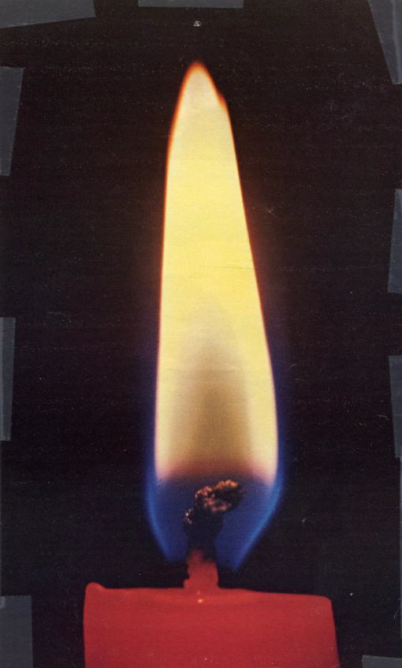
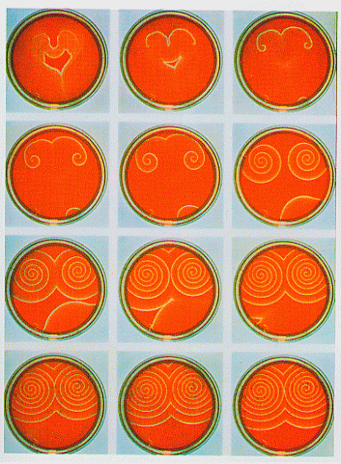
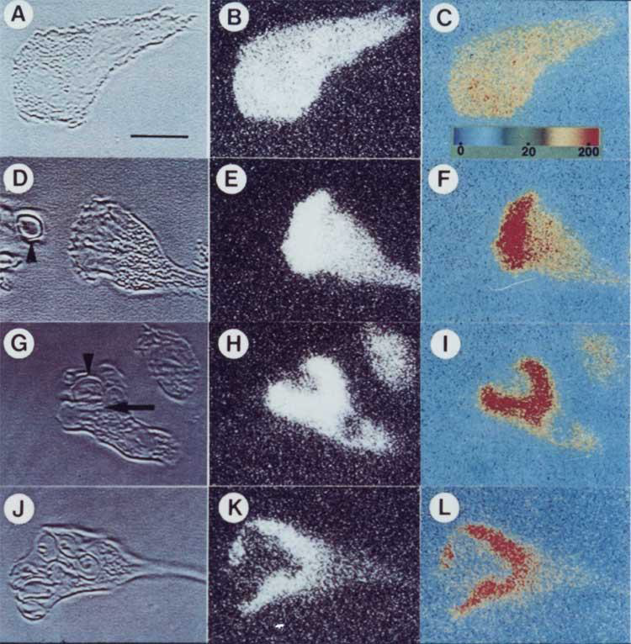
Dissipative Structures (or Dissipatons) in Physics, Chemistry, and Biology
Physics Chemistry Cell Biology
(Electronic excitations) (Belusov-Zhabotinsky reaction) (Neutrophils chemotaxing toward an opsonized
particle; images are Ca⁺⁺ gradients )
Notes:
Here are some examples of dissipative structures or dissipatons, for short.
The flame of a candle where in the electrons in atoms are continuously cycling between their excited and ground sates energized by the heat produced from the chemical reactions that covert hydrocarbons to carbon dioxide, water, and light.
These are the pictures of Petri dishes taken from above where in the so-called Belousov-Zhsabotinsky reaction is proceeding. In each Petri dish chemical reactions are occurring that produce visible products such as carbon dioxide bubbles.
The calcium ion concentrations inside the cell can be visualized using calcium ion-sensitive fluorescent dyes.

Slide 15
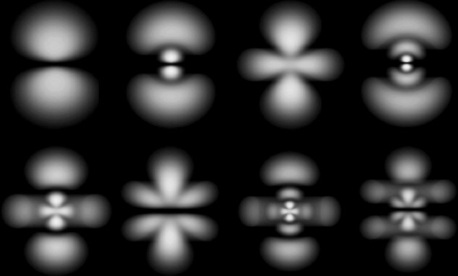
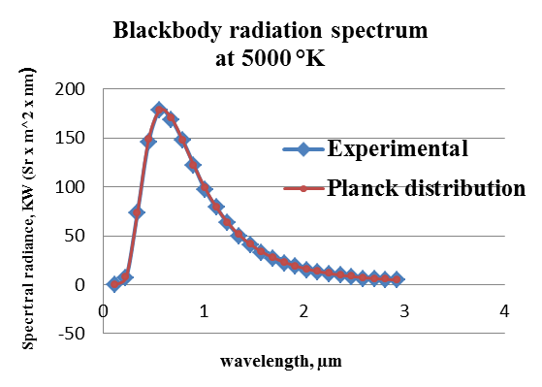
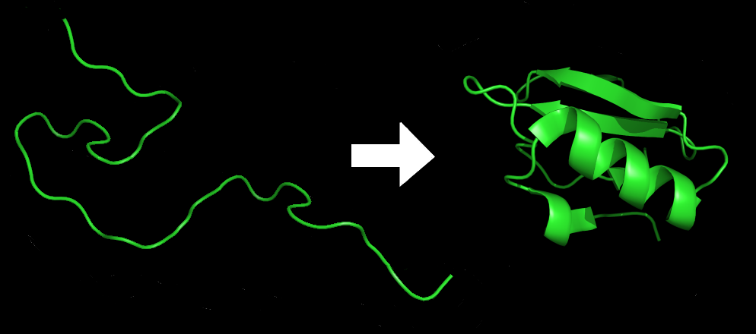
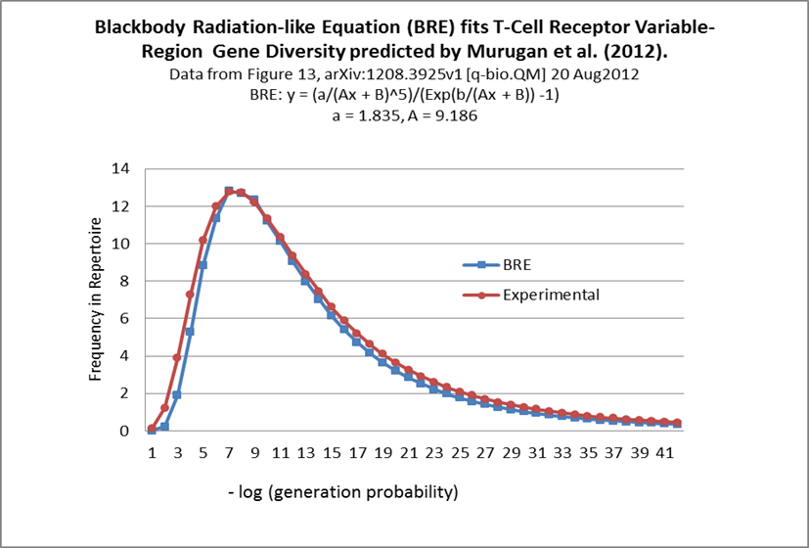
The Planckian Distribution Quantizes Organizations in terms of b/A, a/A & B/A

Slide 16
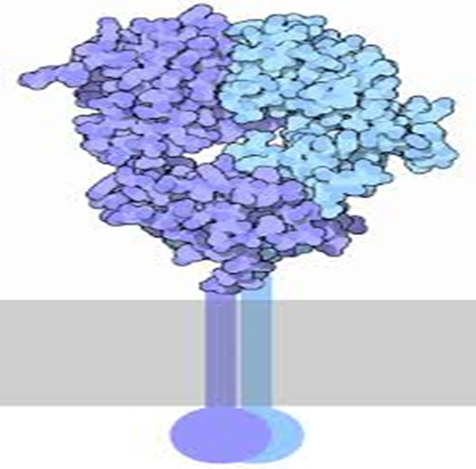
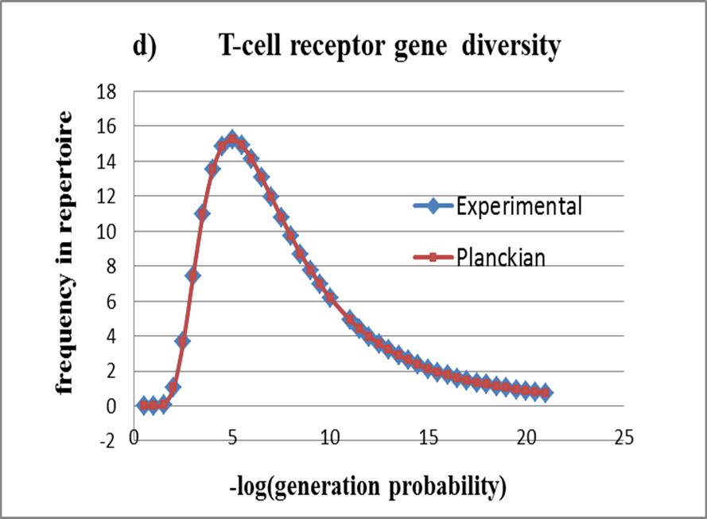

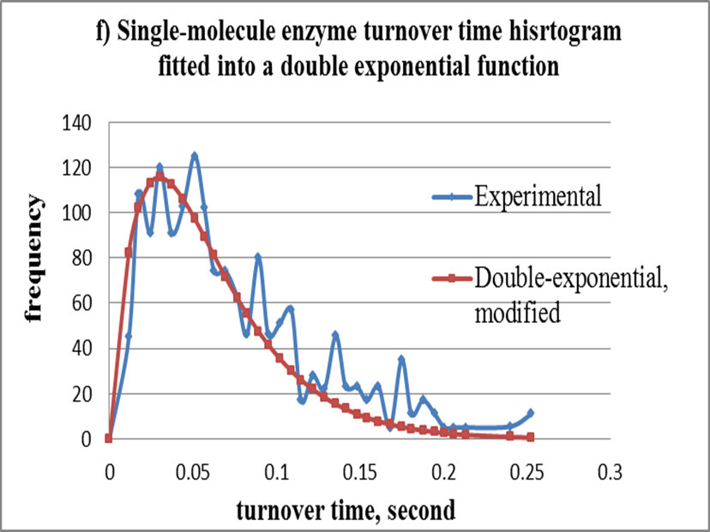

Slide 17
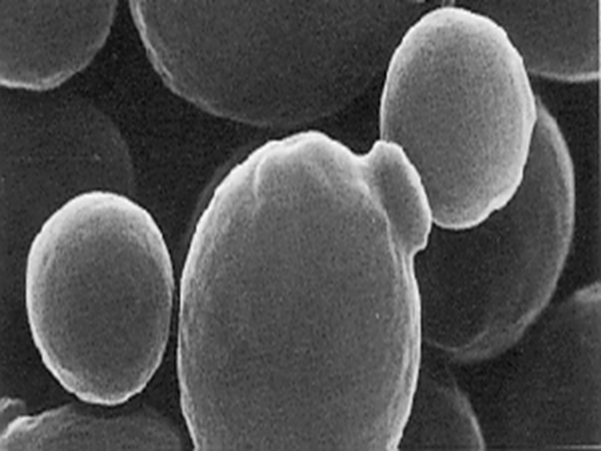
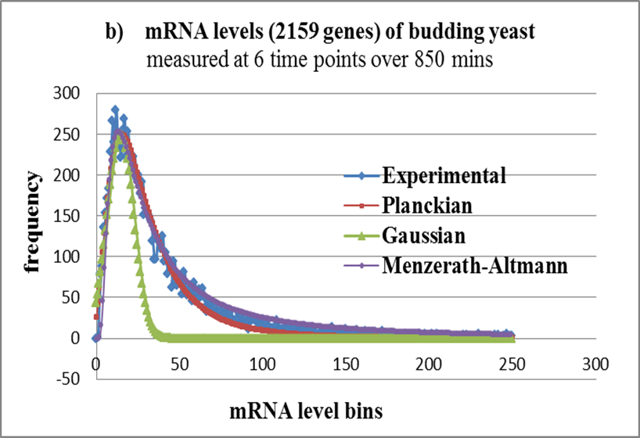
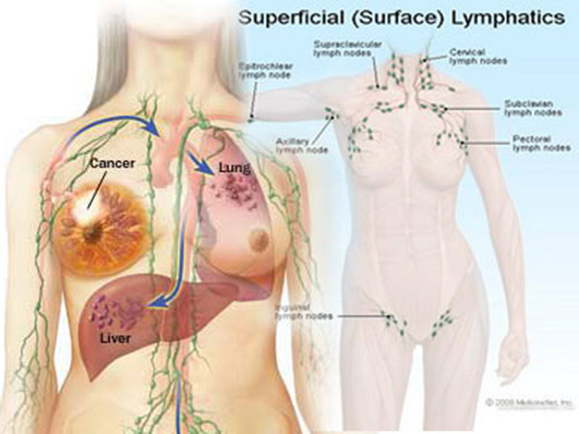
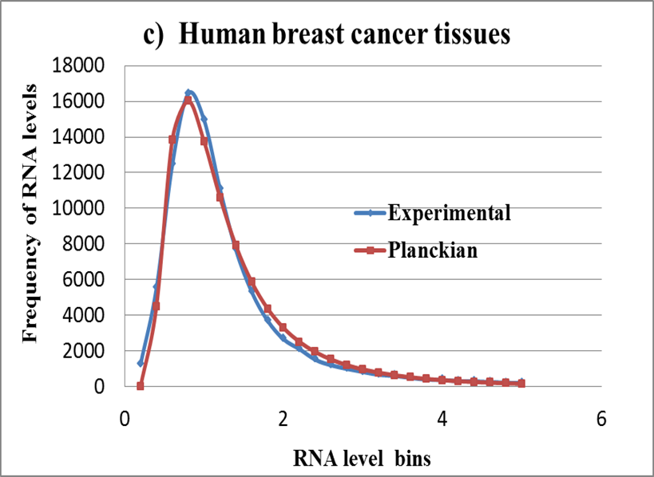

Slide 18
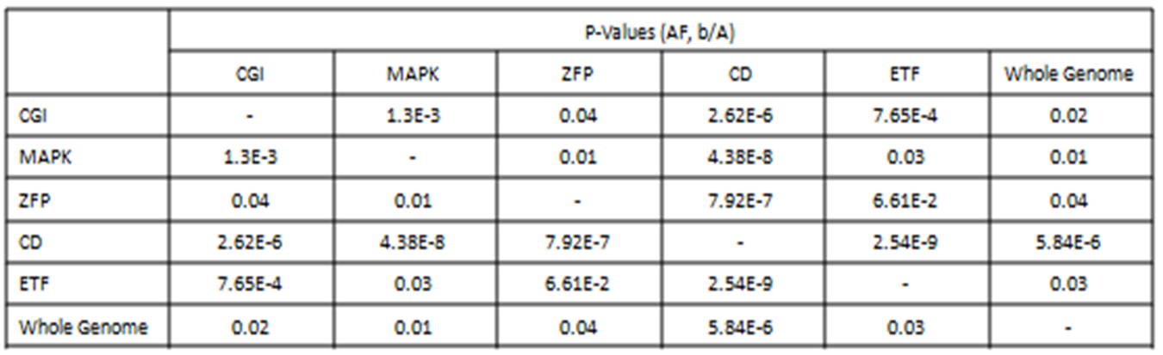
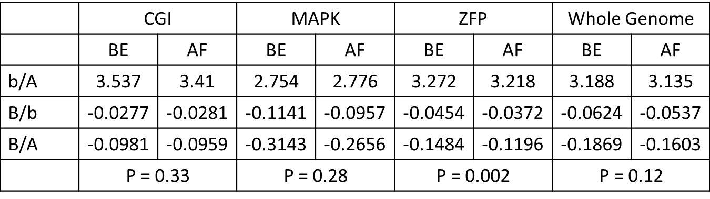
The Planckian Distribution Parameters can detect differences in metabolic pathways and their responses to drug treatment y = (a/(Ax + B)⁵)/(e^{b/(Ax + B)} – 1)

Slide 19
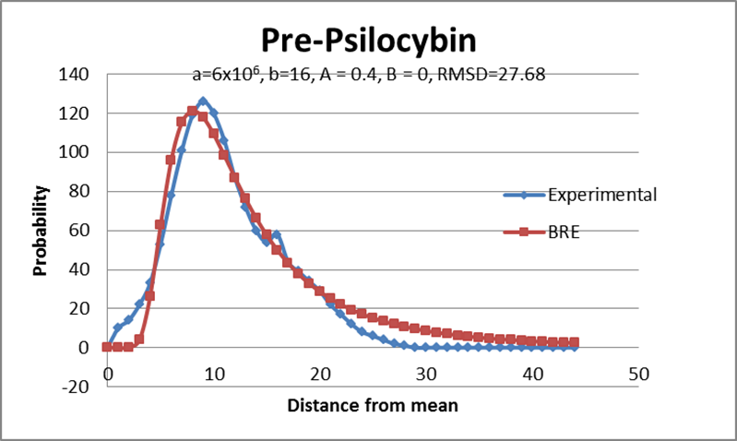
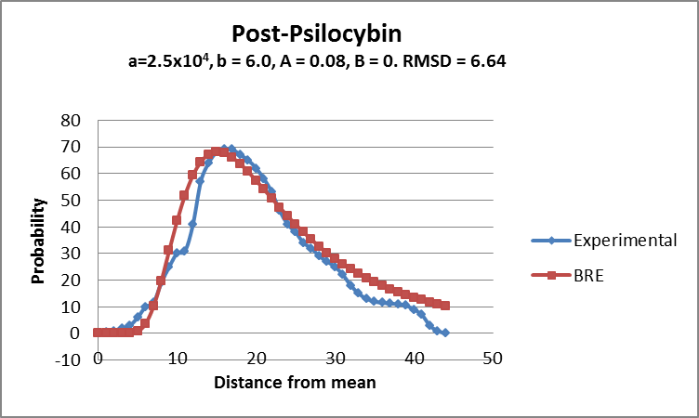
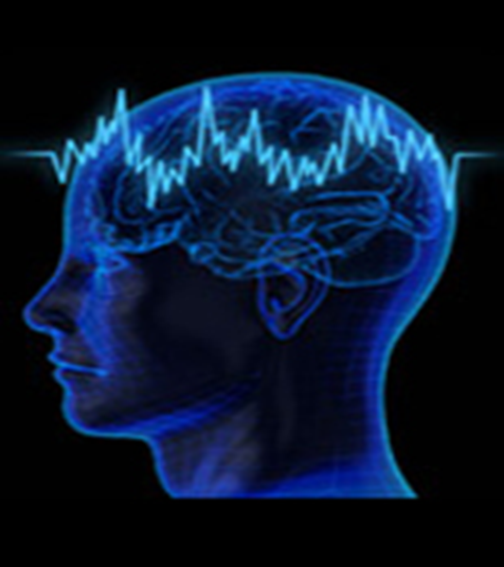
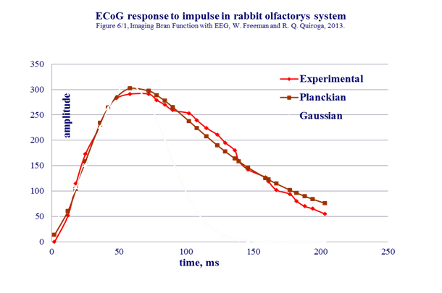

Slide 20

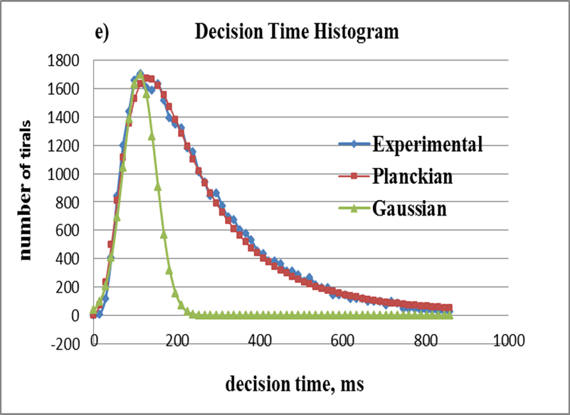

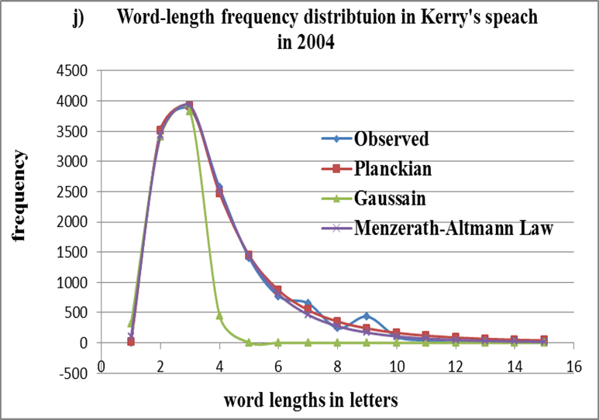

Slide 21
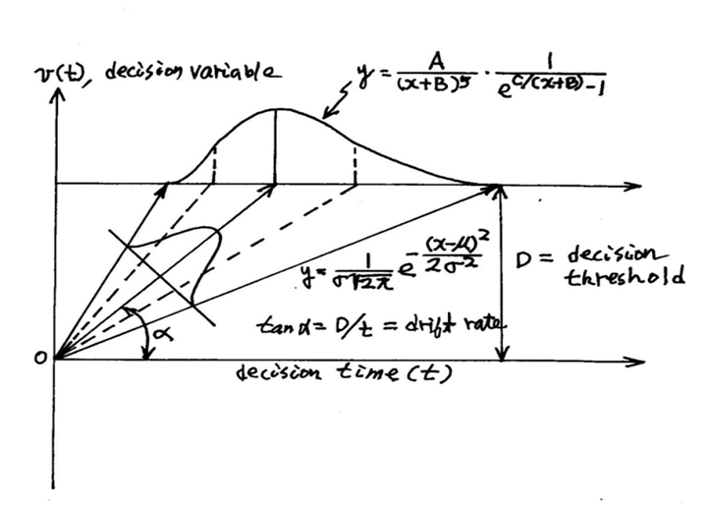
Planckian Distribution as the Energy-Driven Transform of Gaussian Distribution: Drift-Diffusion Model (DDM)

Slide 22
SID-TEM-TOF: Signal-Induced Deactivation of the Themally Excited Metastable State To Function
RASER: Rate Amplification by Substrate-induced Enhancement of Chemical Reactions
Cholesterol oxidase
Notes:
Unlike electrons in atoms that are all in the lowest-energy ground state before absorbing photons (Slide 7), enzymes exist in different ground states before thermal excitation (i.e., before absorbing thermal energy) as indicated by the four solid bars.
It is postulated that when an enzyme absorbs enough thermal energies through Brownian motions, it is excited to the transition state which can last only for a short period of time, typically 10⁻¹⁴ to 10⁻¹² seconds, the periods of chemical bond vibrations.
The thermally excited enzyme is thought to undergo a transition to a more stable state called the “activated state” lasting probably up to 10⁻⁹ seconds.
It appears that the activate state can be deactivated in two ways – (i) spontaneously (as in “spontaneous emission” in laser, see Slide 6), and (ii) induced by substrate binding (as in “induced emission” in Slides 6 & 7).
It is possible that during spontaneous deactivation of the active state of an enzyme, the excess energy is released as uncoordinated and random infrared photons, whereas during the substrate-induced deactivation, the excess energy of the enzyme-substrate complex is released in a coordinated manner resulting in catalysis, just as the triggering photon-induced de-activation of electrons in atoms results in the amplification of emitted photons in laser (Slide 6).
(6) The enzyme catalytic cycle consists of 3 steps, 1->2, 2->3, and 3->1. If we assume that steps 2->3 and 3->1 are fast relative to Step 1->2, we can derive an equation for the rate constant of this step using the Arrhenius equation. Rate constant, k, is defined by Eq. (1):
Rate = k [enzyme-substrate complex] = k [enzyme][substrate] . . . . . . . . . . . . . (1)
where the square brackets indicate concentrations. Please note that “rate” and
“rate constant” are different. According to Eq. (1), “rate constant” is same as the “rate measured under the
conditions where [enzyme] = [substrate] = 1”.
Rate constant, k, of a chemical reaction, whether catalyzed or not, is given by the Arrhenius equation:
k = Ae^{-ΔG‡ /RT} . . . . . . . . . . . . . . . . . . . . . . . . . . . . . . . . . . . . . . . . . . . . (2)
where A is the “pre-exponential factor”, ΔG‡ is the activation Gibbs free energy, R is the gas constant, and T is temperature. Gibbs free energy, ΔG, is the difference between the Gibbs free energy level of the final sate minus that of the initial state:
ΔG = G_{final} -. G_{initial} . . . . . . . . . . . . . . . . . . . . . . . . . . . . . . (3)
And Gibbs free energy change, ΔG, is defined as follows:
ΔG = ΔH - TΔS
= ΔE + PΔV – TΔS . . . . . . . . . . . . . . . . . . . . . . . . . . . . . . . . . (4)
where H is enthalpy defined as the sum of energy E and the product of volume, V, and pressure, P, and S in entropy, a measure of disorder. Under
usual experimental conditions, the volume change, ΔV, is negligible, reducing Eq. (4) to Eq. (5):
ΔG = ΔE – TΔS . . . . . . . . . . . . . . . . . . . . . . . . . . . . . . . . . (5)
Applying Eq. (3) to Step 1 -> 2, we can obtain
ΔG‡ = G‡ - G_{i} . . . . . . . . . . . . . . . . . . . . . . . . . . . . . . . . . . . . . . . . . . . (6)
where G‡ is the Gibbs free energy level of the enzyme at the transition state and G_{i} is the Gibbs free energy level of the i^{th} ground state.
Inserting Eq. (6) into Eq. (2) leads to
k = Ae^{-ΔG‡ /RT}
= Ae^{- (G‡ - Gi )/RT}
= A(e^{- G‡/RT})(e^{Gi/RT} )
= A’e^{Gi/RT} . . . . . . . . . . . . . . . . . . . . . . . . . . . . . . . . . . . (7)
where A’ is a constant given by the product of A and e^{-G‡/RT}. The key point of the long derivation of Eq. (7) is this:
“The rate constant of an enzyme-catalyzed reaction is determined . . . . . . . . . . . . . . . . . (8)
by the Gibbs free energy level of the ground state of the enzyme.”
One quantitative evidence supporting Step 1-> 2 being the rate-limiting step is the recent observation [25, pp. 343-368, see Figure 11.28] that the single-molecule measurements of the enzyme activity of cholesterol oxidase obeys the same mathematical equation, BRE (see Slide 2), that is obeyed by the electronic energy level transitions that occur during blackbody radiation (see Slide 4).
It is important to point out that the mechanism of enzyme catalysis proposed in this slide assumes that the enzyme is excited to its transition state before the substrate binds to it (hence called the “pref-fit” mechanism) rather than before as proposed by Koshland in 1958 (and hence called the “induced fit” mechanism widely taught in biochemistry textbooks). I proposed the pre-fit mechanism of enzyme catalysis in 1974 based the application of the Franck-Condon principle imported from physics to biology [(see Glossary generalized Franck-Condon principle, also called the principle of slow and fast processes, explained in Glossary).

Slide 23
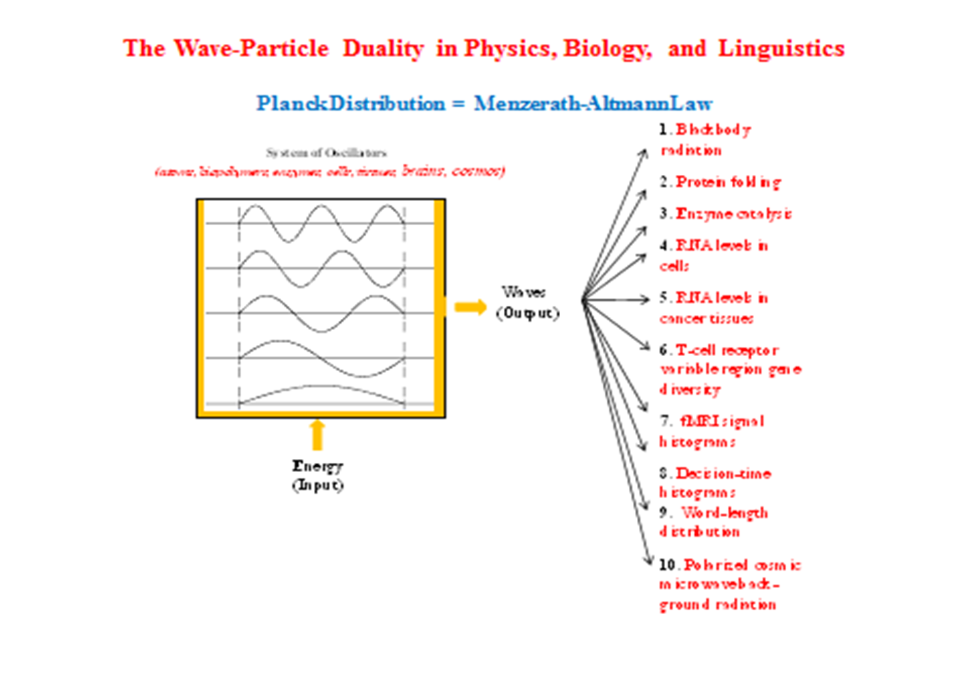


Slide 24
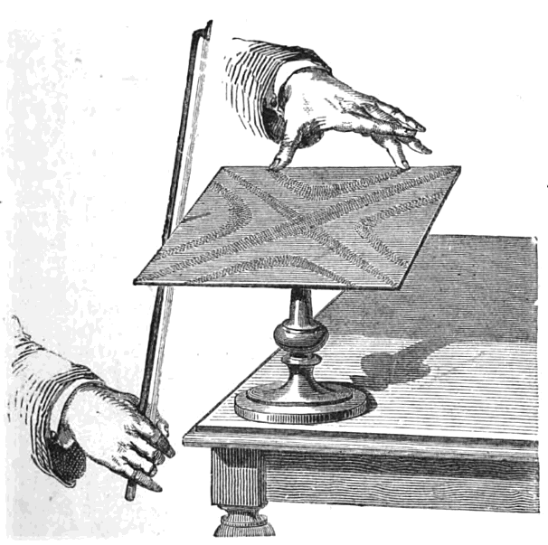
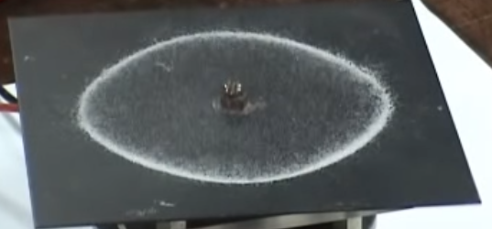
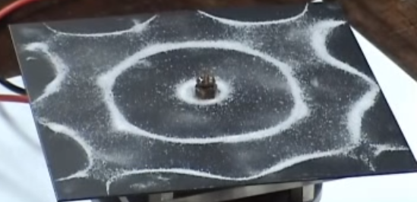
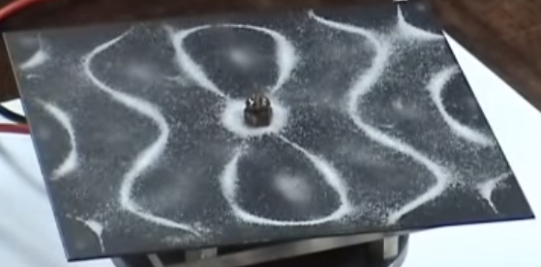


The Chladni Figures as a Metaphor for Intracellular RNA Concentration Waves
https://www.youtube.com/watch?v=wMIvAsZvBiw

Slide 25
A comparison between the Chladni plate and the living cell.
 | Chladni plate | Cell
Particles | Sand | mRNA molecules
System containing particle | Plate | Volume confined by the cell membrane
Energy source | Oscillation generator external to the plate with two knobs, one adjusting the frequency and the other adjusting volume of vibrations. | Energy production in the cell via two mechanisms – (i) substrate-level phosphorylation producing from one molecular of glucose 2 ATP from glycolysis in the cytosol and 2 more from the Krebs cycle in the matrix space in mitochondria, and (ii) oxidative phosphorylation catalyzed by the inner membrane of mitochondria producing 36 ATP molecules per glucose.
Frequency affects | The number of nodes in the Chladni figures (i.e., the number of the white bands on the Chladini plate) | The number of the nodes of the mRNA concentration standing waves in such a manner that increasing frequency increases the complexity of mRNA levels in the cytosol.

Slide 26


Slide 27
CONCLUSIONS
1) Emergence of New Biology based on the
Wave-Particle Duality Principle
2) Towards the Enzyme-centered Cell Biology
(vis-à-vis the DNA-centered Cell Biology)
3) Towards the Cell-centered Genetics
(vis-à-vis the DNA-centered Genetics)

Slide 28
Thank you for your attention.

