Slide 1
Variation in Price Effects of Affiliation across Health System Types
Sung W. Choi, Ph.D.
Department of Health Administration
School of Public Affairs
Penn State Harrisburg

Slide 2
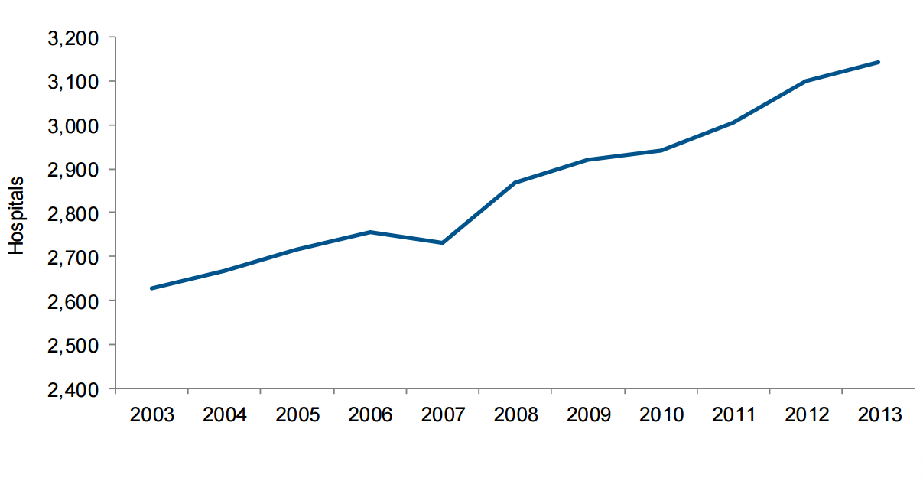
Health Systems in the United States
Inter-organizational consolidation among providers
Since the 1980s, various health systems have been proliferated in the US.
System hospitals
Source: American Hospital Association, & American Hospital Association. (2015). Trend Watch Chart book 2015: trends affecting hospitals and health systems. AHA, Chicago.
Notes:
1. A health system is an inter-organizational consolidation of health organizations— notably, hospitals—that provides a diverse range of health services.
2. In 2013, total 3,100 US-based community hospitals, accounting for 62% of all US-based community hospitals, are affiliated members of a health system.
3. Community hospital is defined as all hospitals accessible by the general public, which excludes hospitals operated by the Department of Defense, the Department of Health and Human Services, and the Veterans Health Administration.

Slide 3
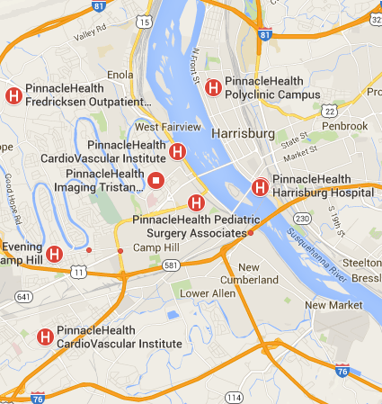
HS Proposal: Penn State Hershey Medical Center & Pinnaclehealth
History
  1987 Capital Health System
    Harrisburg Hospital
    Seidle Hospital
  1996 PinnacleHealth
    Capital Health System
    Polyclinic Hospital
  2015 Hershey-Pinnacle
    Challenged by the FTC
    Federal Appeals Court
    blocked the merger proposal.

Slide 4
Price Effects of Health System Affiliation
Two rationales behind the proliferation of health systems in the US are:
  Efficiency (Procompetitive effects)
    Affiliated providers can enhance the efficiency of care by pooling medical devices or consolidating functions to attain economies of scale or scope.
  Market Power (Anticompetitive effects)
    Health systems can strengthen market power by collective bargaining process to raise the price of care.
The net effect is an empirical question!
Notes:
- The American Hospital Association (1992) has officially urged hospitals to collaborate with each other to improve the efficiency of care.
- Karen Ignagni, the president of America’s Health Insurance Plans (AHIP), said “the rhetoric is all about efficiency, but the reality is all about higher prices”
Administrative functions (e.g., accounting, billing, purchasing, human resources departments)
Support functions (e.g., laundry, housekeeping, pharmacy)

Slide 5
Procedure-level Pricing Studies
Procedure-level pricing studies find mixed results on the effects of health system affiliation.
    - Brooks et al., 1997; Capps & Dranove, 2004; Dor, Grossman & Koroukian, 2004; Dor, Koroukian & Grossman, 2004; Moriya, Vogt & Gaynor, 2010; Dor et al., 2012.
    Limitation: These studies assumed the price effects of system affiliation are same among all health systems.
        - Brooks et al., 1997; Capps & Dranove, 2004; Dor et al., 2012
Notes:
The same questions has been asked by many scholars, and they find mixed results.
For some higher prices for others lower prices. We cannot get meaningful implications.

Slide 6
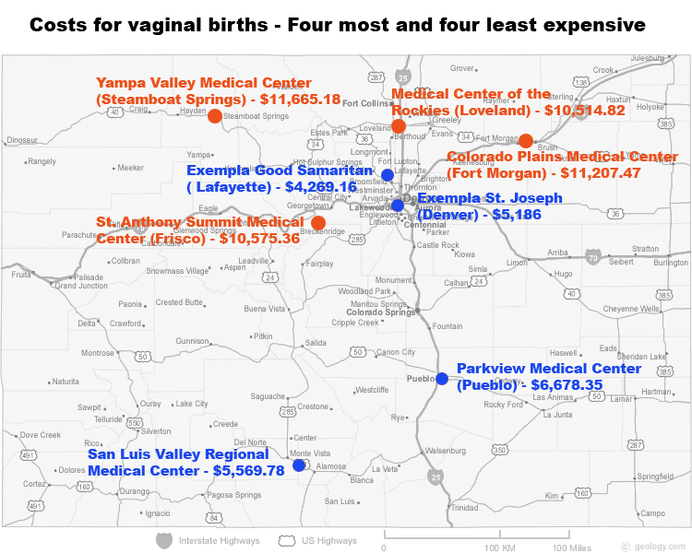
Variation in Hospital Birth Price
Notes:
We cannot assume all hospital systems are same. That is a too strong assumption.
Then how can we incorporate the diversity among different hospital systems.

Slide 7
Taxonomy of health systems
Taxonomy by Bazzoli et al. (1999):
  Unique empirical taxonomy for health systems (AHA Annual Survey)
Three criteria for evaluation
  Centralization: degree of health care services provided at system level compared to provided at individual hospital level
  Differentiation: allocation of health care services within the affiliated hospitals
  Integration: degree of services provided by system owned facilities compared to contracted out facilities
➔ Identified four health system types
Notes:
Centralization is defined as the “degree of health care services provided at the system/network level, compared to individual hospital level” Differentiation is defined as allocation of different health care services within affiliated hospitals.
Integration is defined as “degree of services provided by system owned facilities compared to contracted out facilities.”

Slide 8
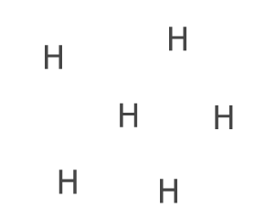
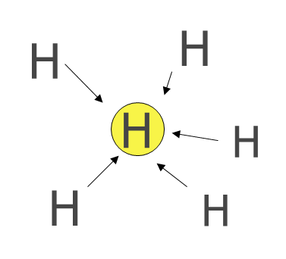
Independent Health System
  No allocation of services and referrals among affiliated facilities
Decentralized Health System
  Limited allocation of services and referrals among affiliated facilities
Note: represent a specific centralized service, H represents a hospital, represents referral.
Source: Bazzoli, G. J. (2008). Models and Performance of Multi-Hospital Networks in the US. presented at The World of Health Care: International Experiences of Excellence speaker series, Luiss School of Business, Rome Italy.
Notes:
DCHS/DCHN: Several large hospitals typically far from each other
IHS/IHN: Small hospitals typically in rural areas

Slide 9
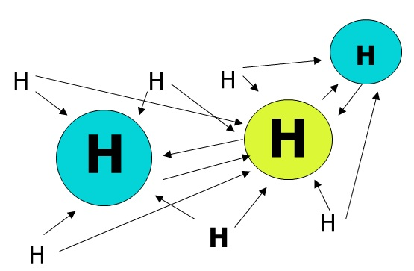
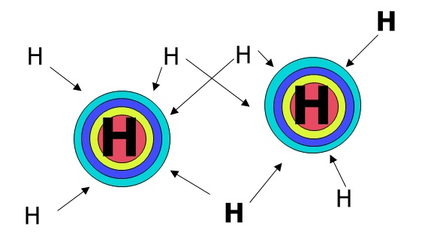
Moderately Centralized Health System
  Allocation of selected health services in multiple designated facilities
Centralized Health System
  Allocation of many services in a few designated facilities
H
Notes:
CHS/CHN: Large, central hospitals with several nearby small hospital affiliates
MCHS/MCHN: Hospitals of varying sizes, generally near to each other

Slide 10
Research Questions
Is the price of care lower (or higher) in system-affiliated hospitals than non-affiliated hospitals?
Any variation in prices effects of system affiliation across different system types?
Notes:
- Comparing risk-adjusted price of Cardiac and Cancer surgeries before and after the system formation.
Evaluate a major case of hospital system/network formation from 2002 to 2007

Slide 11
Contributions
This study analyzes the negotiated prices of cardiac and cancer surgeries rather than list price.
This study examines different types of health systems rather than an identification variable.
This study investigates the price effects of health system types and incorporates characteristics of merging parties in antitrust analysis of hospital systems.
➔ This study aims to demonstrate that antitrust analysis should consider not only market concentration abut also hospital characteristics.

Slide 12
Data & Study Sample
MarketScan Commercial Claims and Encounters Data®
  Collects health care claims for 23 million privately insured employees from approximately 100 large employers in the US
American Hospital Association Annual Survey Database™
  Nationally representative hospital database that includes structure, inpatient and outpatient utilization, expenses, and locations
Period: 2002 - 2007
MARKETSCAN 2002-2007
Hospital admissions
( n= 8,104,571)
CABG Cases
( n= 53,392)
PCI Cases
( n= 235,300)
Colectomy Cases
( n= 63,746)
Notes:
1. MarketScan Commercial Claims and Encounters Data® is One of the largest private health insurance database in the US.

Slide 13
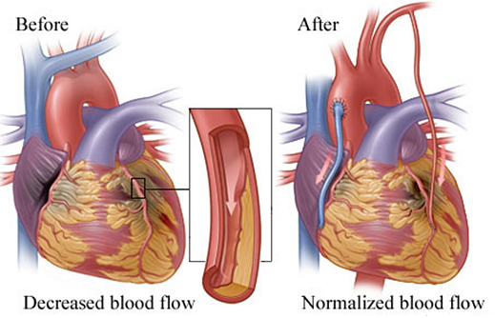
Coronary Artery Bypass Graft (CABG)
Surgical procedure that diverts the flow of
blood around
a section of
a blocked artery
Creating a new
pathway to the
heart improves
blood flow to
heart muscle
Source: © Healthwise Incorporated.

Slide 14
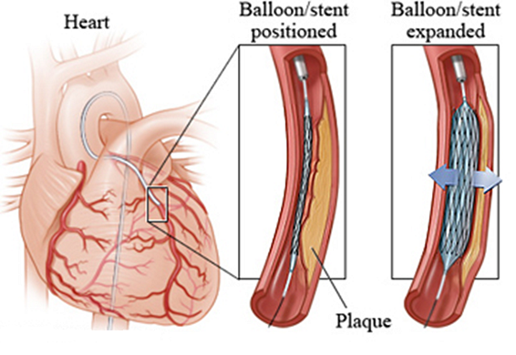
Percutaneous Coronary Intervention (PCI)
Procedure used to open clogged heart arteries.
PCI involves temporarily inserting and inflating a tiny balloon where your artery is clogged.
Source: © Healthwise Incorporated.

Slide 15
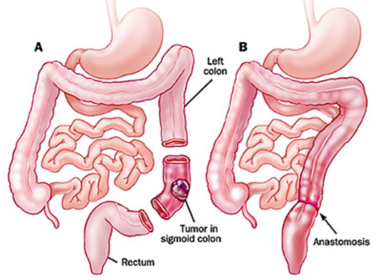
Colon Cancer Surgery (Colectomy)
Surgical procedure to remove part of colon.
Colectomy may be
necessary to treat
or prevent diseases
and conditions
- Colon cancer
- Crohn's disease
- Bowel obstruction
Source: © Healthwise Incorporated.

Slide 16
Why CABG, PCI and Colectomy?
Heart disease is the number one cause of death in the US
  2nd Cancer, 3rd Chronic lower respiratory disease
Colorectal cancer is the 2nd leading cause of cancer mortality
  1st Lung Cancer, 3rd Breast Cancer
Well-defined surgical procedures in patient-level databases
  Not substitutable for outpatient care
  Not discretionary procedures
Notes:
Heart disease accounts for around 25% of all death in the US 2013.
159,260 people died due to Lung cancer in 2014.
40,000 women died due to Breast cancer in 2014.

Slide 17
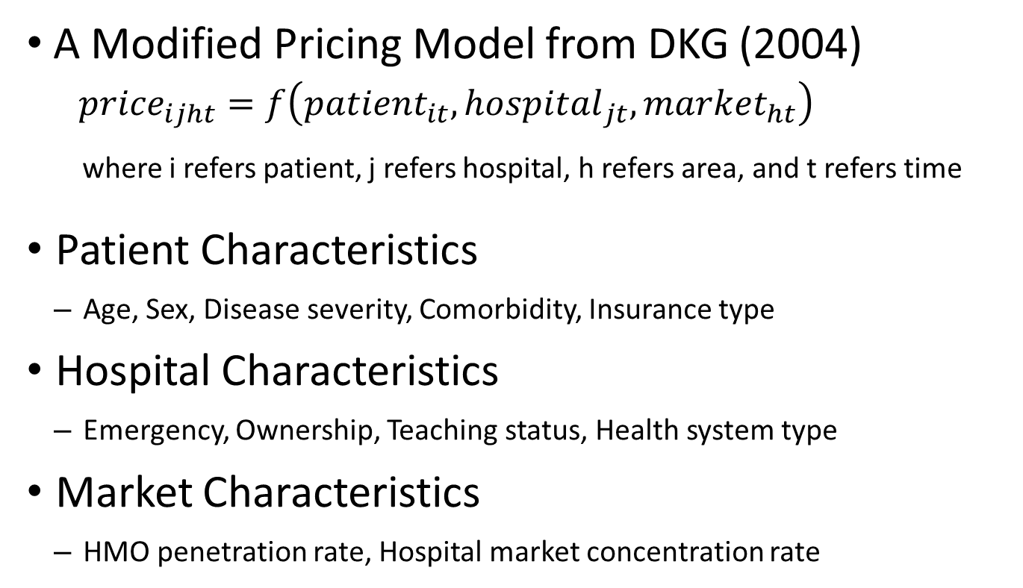
Health Care Pricing Model
A Modified Pricing Model from DKG (2004)
  $${price}_{ijht}=f\left({patient}_{it}, {hospital}_{jt}, {market}_{ht}\right)$$
  where i refers patient, j refers hospital, h refers area, and t refers time
Patient Characteristics
  Age, Sex, Disease severity, Comorbidity, Insurance type
Hospital Characteristics
  Emergency, Ownership, Teaching status, Health system type
Market Characteristics
  HMO penetration rate, Hospital market concentration rate
17
Notes:
17

Slide 18
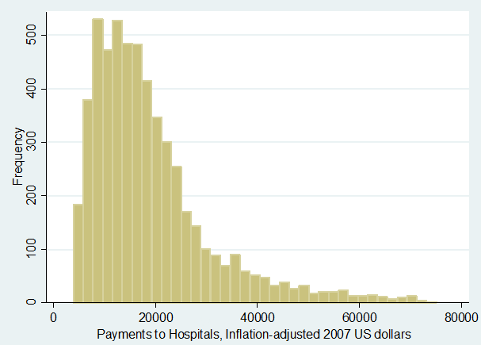
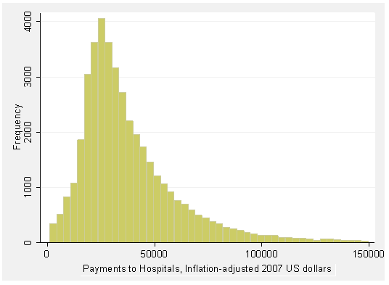
Empirical Methods
Generalized Linear Model
  Rightly skewed price distribution violates normality assumption of OLS.
  Retransformation by using link function
    Satisfying normality assumption with the original scale
Colectomy Price Distribution
CABG Price Distribution
Source: MarketScan 2002 - 2007, AHA Survey Database 2002 - 2007

Slide 19
Results-Generalized Linear Model
Table 13. Systematic Variations in Price Effects Across Different System Types
 | CABG |  | PCI |  | Colectomy
 | Model1 | Model2 | Model1 | Model2 | Model1 | Model2
System | -0.066*** |  | -0.006 |  | 0.035**
 | (0.000) |  | (0.209) |  | (0.030)
Centralized |  | 0.002 |  | 0.022*** |  | 0.021
 |  | (0.938) |  | (0.001) |  | (0.310)
Moderate |  | -0.078*** |  | 0.006 |  | 0.075***
 |  | (0.000) |  | (0.341) |  | (0.000)
Decentralized |  | -0.085*** |  | -0.029*** |  | 0.019
 |  | (0.000) |  | (0.000) |  | (0.313)
Independent |  | -0.156*** |  | -0.130*** |  | 0.001
 |  | (0.000) |  | (0.000) |  | (0.982)
Patient Demographics | Yes | Yes | Yes | Yes | Yes | Yes
Hospital Characteristics | Yes | Yes | Yes | Yes | Yes | Yes
Market Conditions | Yes | Yes | Yes | Yes | Yes | Yes
Time Dummies | Yes | Yes | Yes | Yes | Yes | Yes
Note: Centralized =centralized health system; Moderate = moderately centralized health system; Decentralized = decentralized health system; Independent = independent hospital system.
Notes:
- Severity: Having one more comorbidity on average was associated with 6.34 % increase in colectomy price

Slide 20
Discussion
The CABG and PCI prices in Independent HS were significantly lower than the prices in non-affiliated hospitals, by 15.6 percent and 13 percent respectively.
  ➔ Less centralized health systems are more likely to have lower prices than non-system hospitals.
The PCI price in Centralized HS was 2.2 percent higher than in non-affiliated hospitals.
  ➔ More centralized health systems are more likely to have higher prices than non-system hospitals.
Notes:
-Null hypothesis: Mergers in the antitrust safety zone are less likely to be anticompetitive.
-Type 2 error: failure to reject a false null hypothesis.
-Type 1 error: reject a true null hypothesis

Slide 21
Antitrust Guidelines by the FTC
Market Concentration: Herfindahl-Hirschman Index
  Sum of the squares of the market shares of the hospital within a market
  Perfect competition (HHI: 0), Monopoly (HHI: 10,000)
Unconcentrated markets (HHI < 1500)
  Mergers will not be challenged in this range.
Moderately concentrated markets (1500 ≤ HHI < 2500)
  Significant antitrust concerns for mergers with ∆HHI ≥ 100
Highly Concentrated Markets (2500 ≤ HHI )
  Significant antitrust concerns for mergers (100 ≤ ∆HHI < 200)
  Reinforcing market power for mergers (∆HHI ≤ 200)
Source: Department of Justice and Federal Trade Commission (2010)

Slide 22
Implications
Price effects are different!
  Health system affiliation is significantly associated with lower price for less centralized health systems.
Antitrust guidelines by US DOJ and FTC
  Emphasize market definition and share of the merging parties
  Pay less attention on the characteristics of merging parties.
Suggestion to improve antitrust analysis.
  The results of this study suggest that antitrust review can be more effective by considering different health system types.
Notes:
Antitrust guidelines should not discourage potentially procompetitive in other words price reducing health system formations.

Slide 23
Q & A

