Slide 1


Lowering Facility Operational Cost by HVAC system Optimisation.
Sundar Chellamani
Technical Director
SysComm Project Management Ltd.
Define ● Deliver ● Sustain

Slide 2
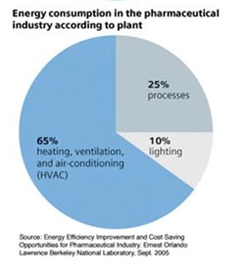

Operating Cost of HVAC system
HVAC system uses about 65% of overall plant energy usage
Focus of this presentation
  Reducing Energy costs
  Improving competitiveness
  More Environment friendly
  facility
There is huge scope in reducing HVAC operating costs without large investment

Slide 3
Definition of Cleanroom
ISO 14644-1 defines
A room in which the concentration of airborne particles is controlled, and which is constructed and used in a manner to minimise the introduction, generation and retention of particles inside the room and in which other relevant parameters, e.g.. Temperature, humidity and pressure are controlled as necessary.

Slide 4
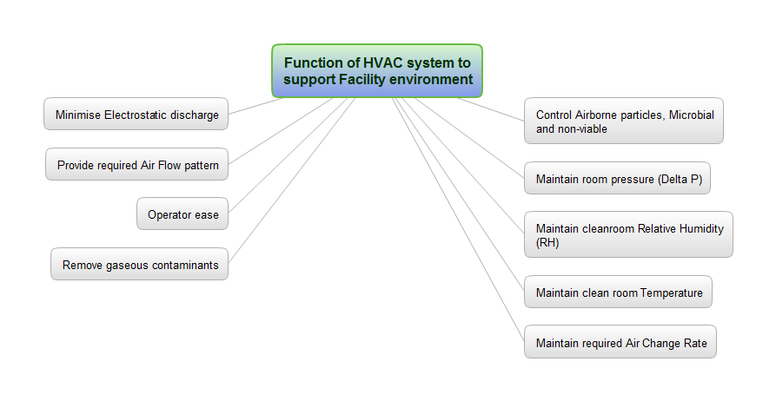
Function of HVAC system to support facility environment

Slide 5
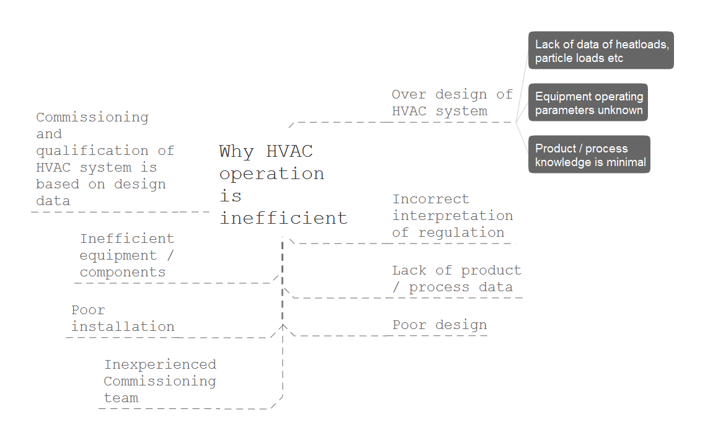
Why HVAC Operation is inefficient

Slide 6
Common observation of Air change rates example
Company | Grade A | Grade B | Grade C | Grade D | CNC
Facility 1 | 0.5 m/s | 30 acph | 20 acph | 15 acph | 15 - 20 acph
Facility 2 | 0.45 m/s | 45 acph | 25 acph | 15 acph | 15 acph
Facility 3 | 0.45 m/s | 60 acph | 40 acph | 25 acph | 15-20 acph
Acceptance criteria for cleanroom validation is different for different companies.
Most of the cleanrooms across the globe are over designed with respect to product / process requirements and regulatory expectation.

Slide 7
Common Observation on HVAC Operation with respect to higher energy utilisation
Higher air change rates.
Higher cleanroom classification
Higher pressure difference between rooms / zones
Too much fresh air usage
Tighter tolerance for temperature and humidity
Higher unidirectional flow velocity
Constant steady operation of the facility regardless of production schedules or office occupancy

Slide 8
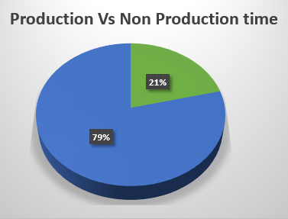
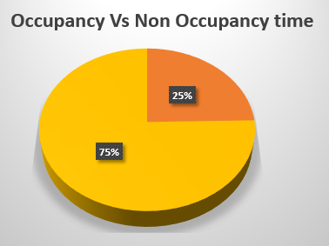
Typical Facility Usage and Occupancy
Non Occupancy
Non Production
Assuming one shift operating facility

Slide 9

How efficient is your HVAC system?
What is the HVAC operating cost per year?
What is the Plant energy cost per year?
Is there a scope for reduction in HVAC operating cost?
Can an assessment be made on the energy usage?

Slide 10
Challenges / Barriers of high HVAC system operating costs?
The following are some common challenges/barriers for why facilities avoid the optimisation of cleanrooms:
Lack of site resources within the organisation
QA / Validation – don’t want to make changes
Complex change control system
Difficulty finding the right expertise / consultant
Energy reduction is not a priority in the organisation
No available downtime for the cleanroom
Any change after qualification is perceived as regulatory risk.
Risk of getting back on track after any shutdown to keep up the production schedule

Slide 11
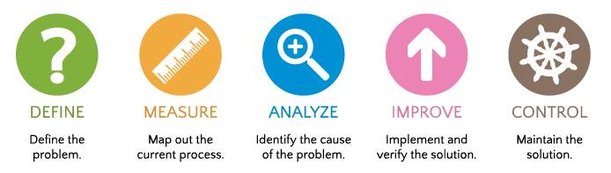
Create a Road map for Optimisation
The Six Sigma DMAIC (Define, Measure, Analyse, Improve, Control) methodology can be thought of as a roadmap for problem solving and HVAC improvement.
Stage | Tasks
Define | Calculate EUI, benchmark against industrial average.
Measure | Collect and organise energy consumption data, breakdown consumption into various areas and identify the major consumers of energy.
Analyse | Study the energy consumption pattern and find the root cause of high waste.
Improve | Develop and implement strategies to minimise waste and reduce energy consumption.
Control | Monitor the process after change and observe the level of improvement and sustain.
STEPS

Slide 12
Define and set achievable HVAC Energy goals
Calculate Energy Utilisation Index (EUI) of the facility
Benchmark the facility energy consumption against the industry average
After benchmarking, set achievable energy reduction goals and define ‘what is success’
  E.g. Percent energy reduction
Definition of EUI: Measure of total energy consumed in heating or cooling a building or facility over a period of time. Common unit is kWh/ m²/year.
Industry Average ~ 215 kWh/ m²/year
DEFINE

Slide 13
Create Energy Utilisation Index
Collect and organise energy consumption data, breakdown consumption into various areas as indicated on the chart below
Total Energy Consumption
MEASURE
Electricity
Steam Generation
Compressed Air
Chilled water
LPHW
Process
HVAC
Boiler Electric
Gas / Oil
Soft water

Slide 14
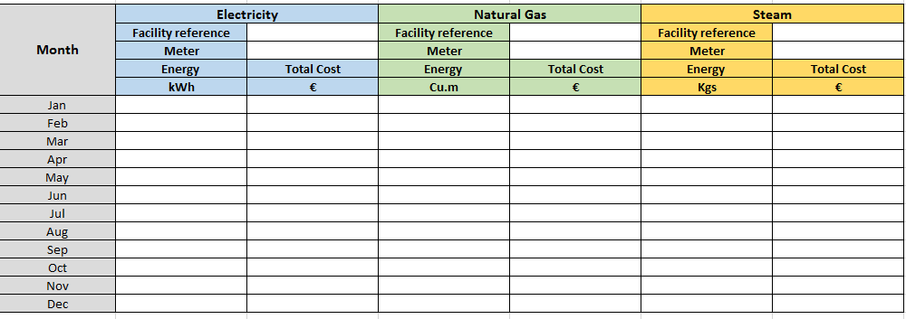
Collect all relevant data over a period
Make sure the required metering devices are available and calibrated for use.
MEASURE

Slide 15
Optimisation example – Scope of reduction
Optimisation example: Based on theory
Flow rate is proportional to the rotational speed of the fan motor, i.e. if flow is halved, power is reduced by factor of 8 and pressure is reduced by factor of 4.
ANALYSE
A small change in the rotational speed leads to significant change in power consumption. Nothing is too little.

Slide 16
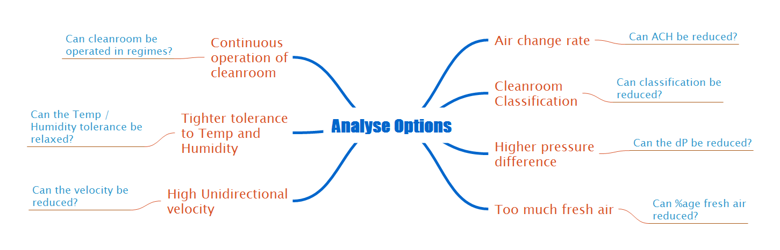
Analyse options based on collected data
ANALYSE

Slide 17
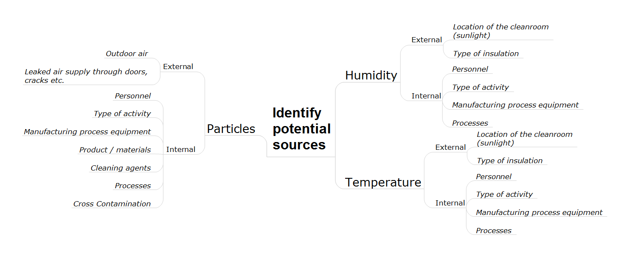
Identify potential sources that induce parameters variation
ANALYSE

Slide 18
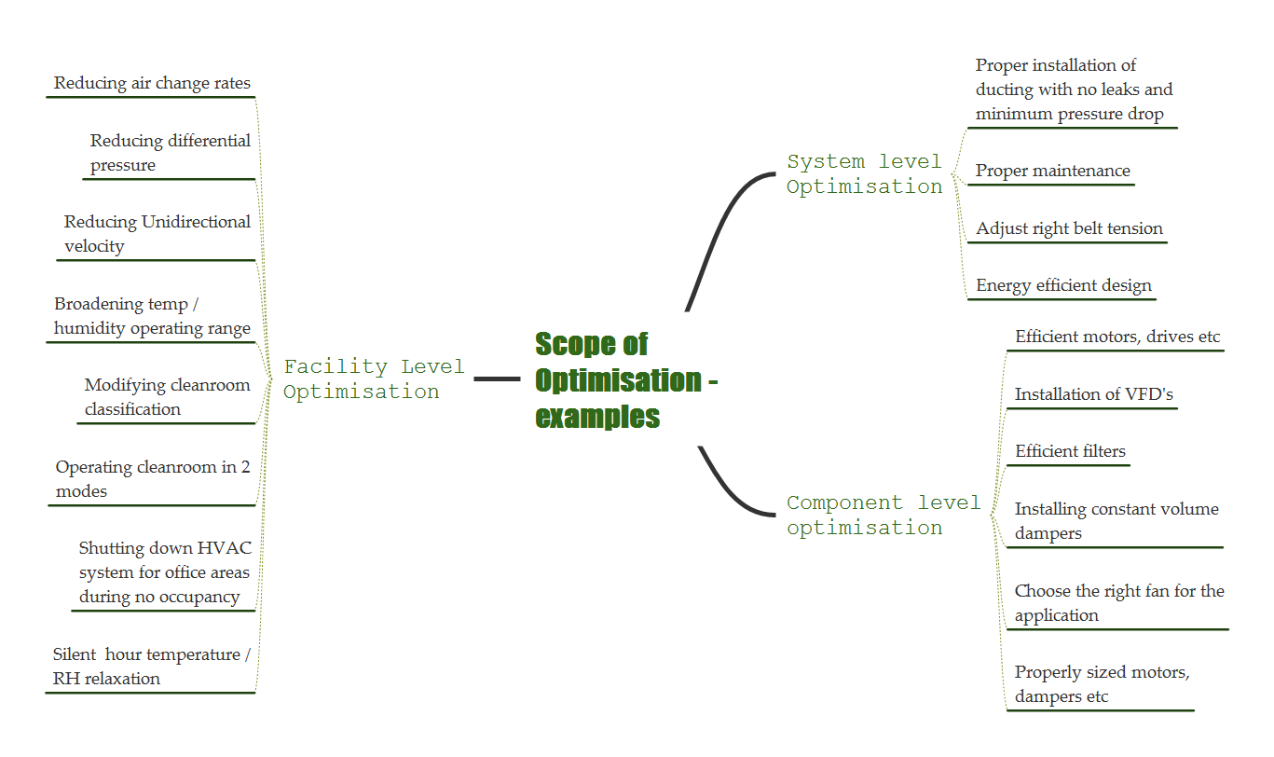
Scope of Optimisation - Examples
ANALYSE
Not all changes require QA approval

Slide 19
High level sequence
Any Energy reduction effort of a qualified cleanroom must be assessed and approved by relevant QA team prior to implementation.
The following steps are proposed:
Conduct energy studies to justify potential reduction in operating cost before implementation.
Conduct Quality Risk Assessments (QRA)
  To be conducted by a multidisciplinary team inclusive of QA / QC discipline.
Collect additional data based on observation from QRA through additional QC experiments.
ANALYSE

Slide 20
Identification of risks through QRA
Quality Risk Assessment – as per ICH Q9
Conduct QRA as a multidisciplinary team inclusive of QA, QC, Validation, Engineering and Operations.
Set a target reduction of operating parameters within compliance band
Identify all potential quality risks through conducting proper risk assessment as per ICHQ9.
QC to collect supporting data over a period to justify the proposed reduction ( must have no quality impact)
Complete a risk assessment table based on observed results
ANALYSE

Slide 21
Identification of risks through QRA
Example as below
HVAC RISK ASSESSMENT - EXAMPLE
HVAC Current configuration | HVAC proposed configuration | Potential Failure | Potential effect of failure | Initial |  |  |  | Proposed experimental studies | Proposed experimental studies | Revised |  |  |  | Proposed modifications
 |  |  |  | Severity | Probability | Detectability | RPN |  |  | Severity | Probability | Detectability | RPN
Air change rate at 25 acph | Reduction in air change rate up to 15 acph | Increased particles in the room | Product contamination | 9 | 9 | 6 | 81 | Reduce the air change rate in steps and monitor the collect room particulate data for both viables and non-viables | Reduce the air change rate in steps and monitor the collect room particulate data for both viables and non-viables | 9 | 3 | 6 | 27 | The air change rate can be reduced to 18 acph based on the experimental data.
 |  | Recovery times do not meet requirement | Product contamination | 9 | 9 | 6 | 81 |  |  | 9 | 3 | 6 | 27
ANALYSE

Slide 22
Implement Energy Optimisation – as example
Implement energy optimisation based on outcome of QRA
Air change rate reduction reducing air volumes
Reduction of UDF velocity (0.45m/s) from average to appropriate velocity.
Operating at 2 air change rate flow regimes
Silent hour temperature and RH relaxation
Shutting down HVAC systems on unused non-production areas.
Re-evaluation on HEPA filter replacement frequency
Setting the right RH based on product / process requirements
IMPROVE

Slide 23
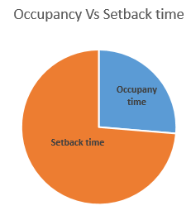
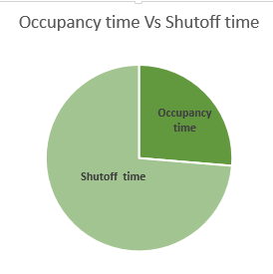
Monitor, Observe and Sustain
Implement all changes for sustained operation
Monitor the process after change and observe the level of improvement using statistical methods.
Confirm that the cleanroom operations are within the product / process requirements and operates as per regulatory compliance.
CONTROL

Slide 24
Conclusion
  HVAC system operations optimisation can provide significant savings in plant operational costs
  The following combined skills are essential to perform a HVAC systems optimisation
    Knowledge in Commissioning, Qualification and Operation of HVAC systems
    Possess understanding of Energy Management
    Possess understanding of regulatory aspects of cleanroom

Slide 25
Thank You
Sundar Chellamani
Technical Director
SysComm Project Management Limited
3015 Lake Drive
Citywest Business Park
Dublin 24
Ireland
sundar.chellamani@syscomm.ie

