Slide 1
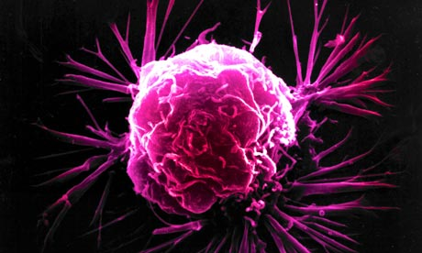


Induction of Apoptosis by 4-(3-(Tert-butylamino)imidazo [1,2-a]pyridine-2-yl)
benzoic Acid in Breast Cancer Cells via Upregulation of PTEN
Cancer Summit 2015
Sumit Siddharth
PhD Scholar (ICMR-SRF)
Cancer Biology Lab
School of Biotechnology
KIIT University
Odisha, INDIA

Slide 2


Cancer
Breast Cancer
Breast cancer is a major health issue and a key cause of mortality among women across the globe
A disease of uncontrolled cell growth and proliferation.
Breast is composed of fatty tissues containing a network of lobules which contain milk glands
Almost 90% of breast cancers originate in these lobules
Abnormal cells grow beyond their usual boundaries and invade the adjoining organs.
One third of women with breast cancer die because of breast cancer

Slide 3
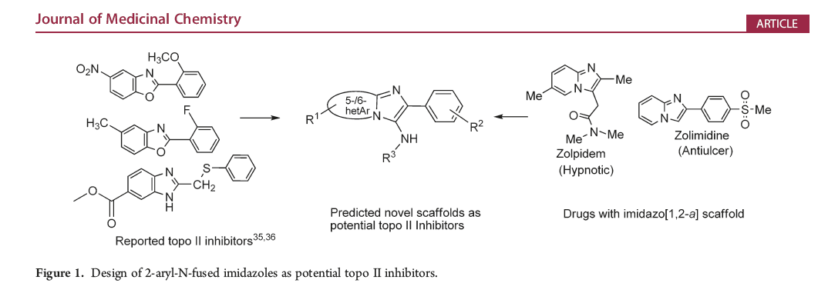
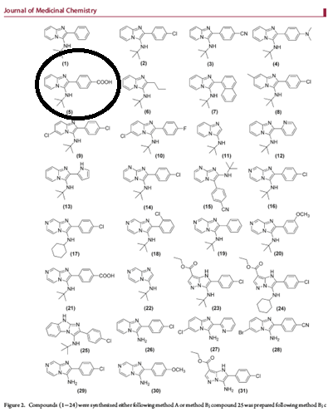
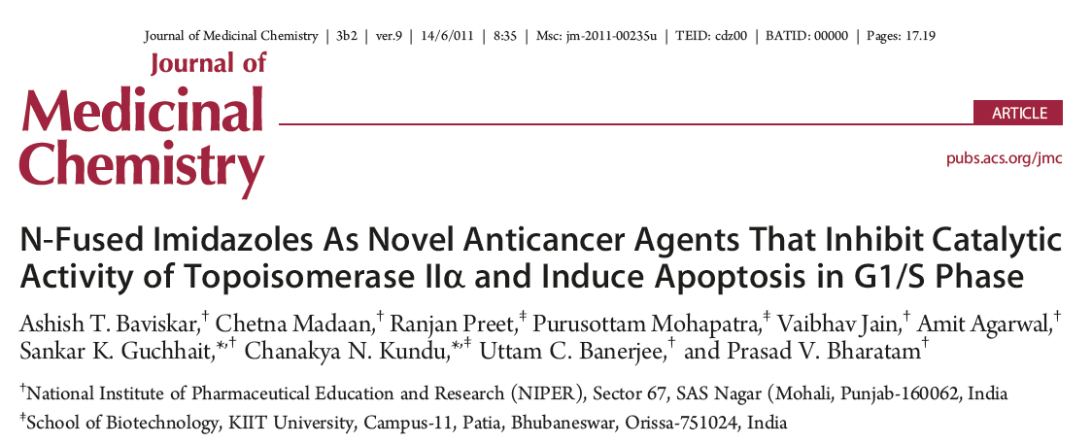
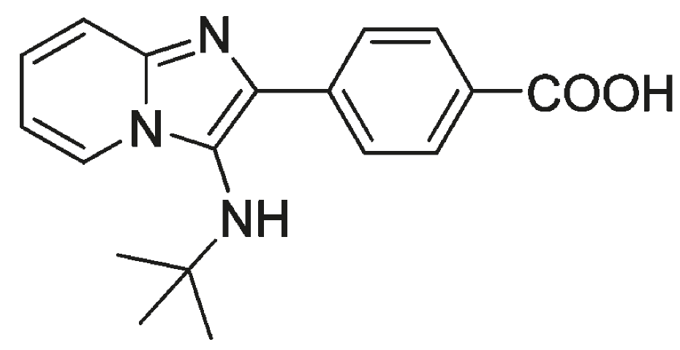
Among 31 derivatives {4-(3-(Tert-butylamino)imidazo[1,2-a]pyridine-2-yl) benzoic Acid } (Bicyclic N-fused aminoimidazole-derivative) (BNFA-D) was found to be:-
Potent anticancer agent against breast cancer cells
Antimigratory
Pro-Apoptotic
Arresting the cell cycle at G1-S transition phase
Inhibiting the catalytic ATPase domain of human topoisomerase IIα
Indian Patent, application no. 91/DEL/20112011

Slide 4
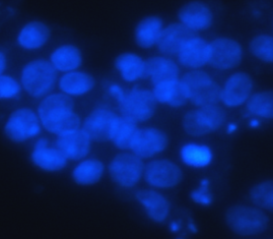
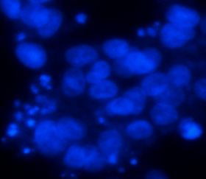
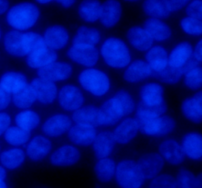
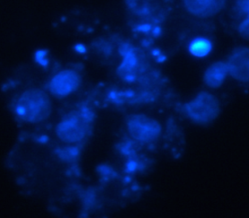
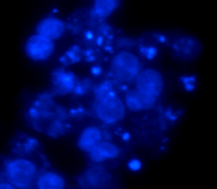
Figure 1
A
B
***
*
**
C
D
10 µm
*
10 µM
15 µM
*
10 µm
*
*
Control
25 µM
35 µM
BNFA-D inhibits Wnt Signaling cascade and caused apoptosis in breast cancer cells with an LC50 of 15 µM and exhibits minimal toxicity to the normal breast epithelial cells.

Slide 5
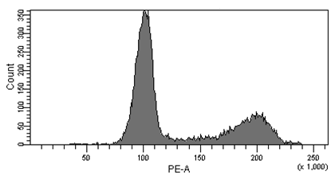
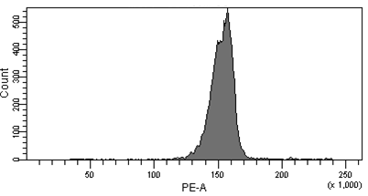
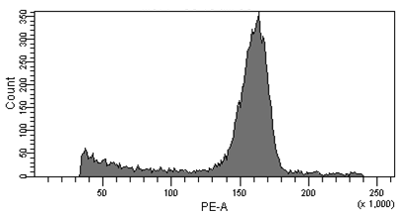
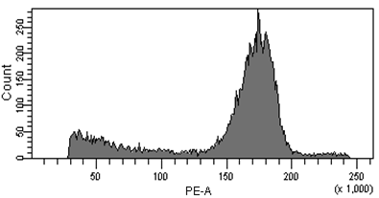
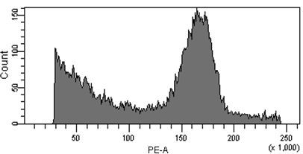
E
SubG1 = 0.5 ± 0.1
G1 = 63.6 ± 1.9
S = 8.3 ± 0.8
G2/M = 27.1 ±1.2
SubG1 = 0.4 ± 0.1
G1 = 0.5 ± 0.5 *
S = 96.9 ± 1.8 *
G2/M = 2.0 ± 0.2 *
SubG1 = 11.2 ± 0.3 *
G1 = 6.7 ± 0.4 *
S = 67.4 ± 0.7 *
G2/M = 14.0 ± 0.5
Untreated
10 µM
15 µM
SubG1 = 15.6 ± 0.2 *
G1 = 5.3 ± 0.2 *
S = 53.1 ± 1.7 *
G2/M = 25.0 ± 0.4
SubG1 = 29.6 ± 0.5 *
G1 = 9.4 ± 1.2
S = 48.5 ± 0.8
G2/M = 11.4 ± 0.8
25 µM
35 µM
BNFA-D causes apoptosis as well as a clear cut ‘S’ phase arrest in MCF-7 breast cancer cells.

Slide 6








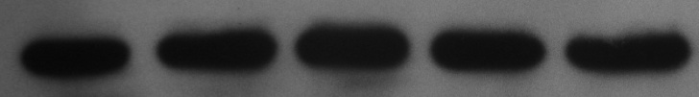
Figure 2
0 10 15 25 35
1.0 1.5 2.9 3.0 11.0
BNFA-D (µM)
1.0 1.5 1.3 1.4 2.0
PTEN
GSK3β
1.0 0.5 0.1 0.0 0.0
1.0 0.5 0.1 0.1 0.1
β-Catenin
P-GSK3β
(Ser 9)
1.0 0.8 0.4 0.1 0.1
1.0 1.4 1.5 1.4 1.9
C-MYC
CK1
1.0 0.8 0.6 0.1 0.0
Cyclin D1
1.0 0.9 1.2 1.2 10.0
1.0 0.9 0.9 0.8 0.9
p21
1.0 1.0 1.0 1.0 1.0
APC
GAPDH
1.0 0.9 0.7 0.7 0.8
AKT
Phosphatase and tensin homologue deleted on chromosome 10.
Dual phosphatase
Lipid phosphatase, PTEN metabolizes PIP3.
Protein phosphatase, PTEN autodephosphorylates itself at threonine 366 as well as acts as an antagonist to PI3K
1.0 0.9 1.0 0.8 0.1
Phospho-AKT (Ser 473)
1.0 0.6 0.2 0.2 0.1
PI3K
BNFA-D inhibits Wnt signaling cascade by activating PTEN.

Slide 7


Figure 3
A
B
Lysate +IgG
*
0
10
15
25
35
*
*
BNFA-D (µM)
1 1 0.1 0 0
β-Catenin
1 2.8 3.3 3.2 3.5
PTEN
Anti-GSK-3β
*
- + + + + +
1 2 3 4 5 6
Lane
BNFA-D regulates the physical interaction between GSK-3β with PTEN.
A dose dependent decrease in β-Catenin, a substrate of GSK-3β was observed.
BNFA-D upregulated PTEN activated GSK-3β leading to the downregulation of β-Catenin thereby inhibiting Wnt cascade.

Slide 8
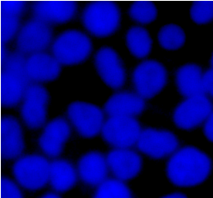
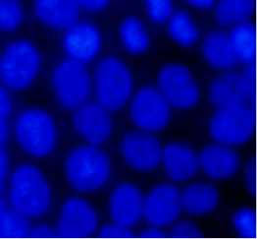
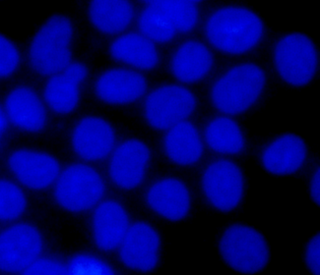
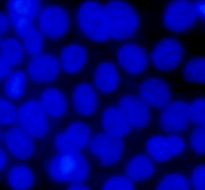
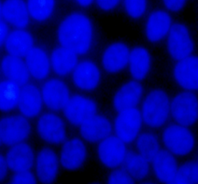
Figure 4
A
B
*
*
*
*
*
C
D
10 µm
10 µm
10 µM
15 µM
*
Control
25 µM
35 µM
BNFA-D mediated inhibition of Wnt/TCF signaling depends on PTEN.

Slide 9
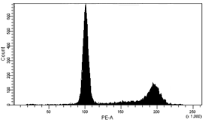
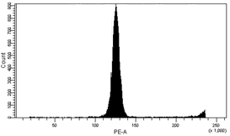
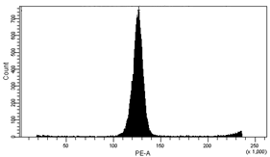
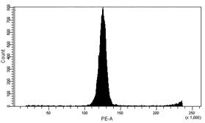
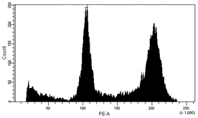
E
SubG1 = 1.1 ± 0.1
G1 = 60.8 ± 1.9
S = 10.2 ± 0.8
G2/M = 27.5 ± 1.2
SubG1 = 0.7 ± 0.1
G1 = 7.1± 0.5 *
S = 86.4 ± 1.8 *
G2/M = 1.9 ± 0.2 *
SubG1 = 1.9 ± 0.3
G1 = 10.8 ± 0.4 *
S = 82.6 ± 0.7 *
G2/M = 1.6 ± 0.5 *
Untreated
10 µM
15 µM
SubG1 = 1.8 ± 0.2
G1 = 10.6 ± 0.2 *
S = 82.9 ± 1.7 *
G2/M = 1.3 ± 0.4 *
SubG1 = 10.1 ± 0.5 *
G1 = 32.7 ± 1.2
S = 12.0 ± 0.8
G2/M = 42.8 ± 0.8
25 µM
35 µM
BNFA-D treated PTEN knockdown cells an ‘S’ phase arrest with a minor increase in apoptotic population

Slide 10

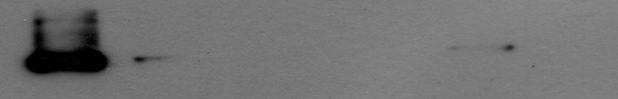

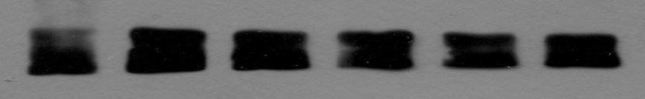
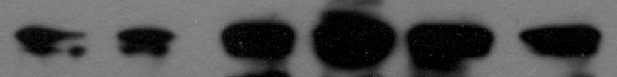
MCF-7 PTEN KNDN
Figure 5
MCF-7
10
15
25
35
BNFA-D (µM)
1 0.1 0 0 0 0
PTEN
1 0.9 0.8 0.8 1 0.7
PI3K
PTEN loss activates an upstream proproliferative signaling environment evoked by PI3K leading to activation of Wnt signaling cascade via inhibition of GSK3β.
1 1 0.9 0.9 1 1
AKT
1 1.8 2.2 2.1 2.1 3.0
P-AKT (Ser 473)
1 0.1 0 0 0.1 0
GSK3β
1 4 4.2 5.5 5.9 5.7
P-GSK3β (Ser 9)
1 1.3 1.1 1.1 0.9 1
β-Catenin
1 1 2 2.9 2.5 2
Cyclin D1
1 1.3 1 1.2 1.2 1.1
GAPDH

Slide 11

Conclusion
BNFA-D inhibited breast cancer cells and caused apoptosis along with an ‘S’ arrest.
BNFA-D inhibits Wnt signaling cascade in breast cancer cells.
BNFA-D activated PTEN physically interacts with GSK-3β emphasizing a cross talk between PI3K/AKT and Wnt signaling.
Loss of PTEN activates PI3K/AKT/p- GSK-3β (Ser 9) axis causing abberant Wnt activation.
BNFA-D
PTEN
PI3K
AKT
GSK-3β
Wnt Signaling

Slide 12
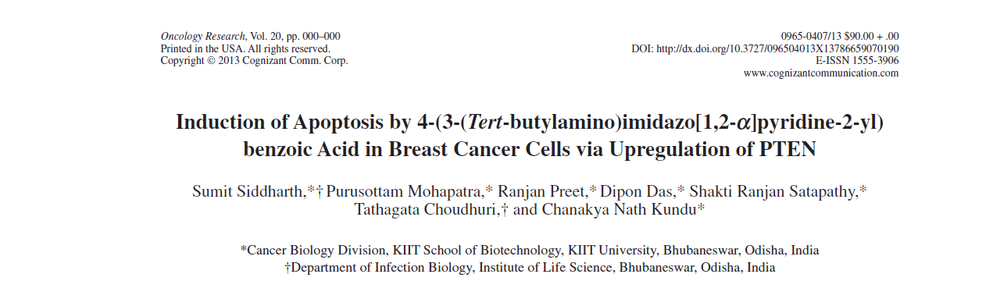
Oncology Research, 2013

Slide 13

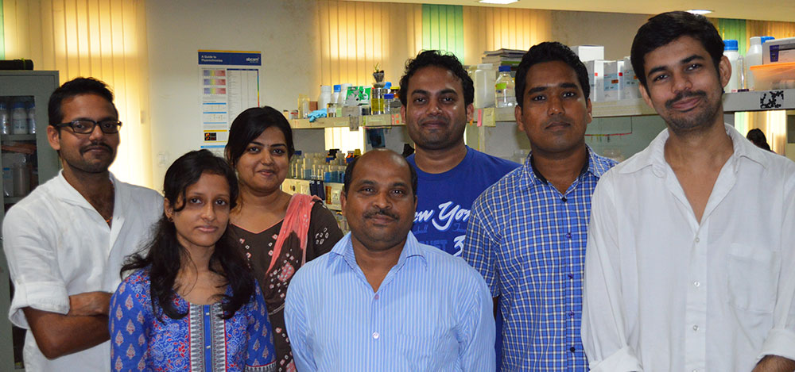
School of Biotechnology, KIIT University, Bhubaneswar, Odisha
Supervisor: Dr. Chanakya Nath Kundu
Our collaborators
Dr. Robert W Sobol
(University of Pittsburgh)
Dr. Michael D Wyatt
(South Carolina College of Pharmacy)
Dr. Tathagata Choudhuri
(Visva Bharati University)
Dr. C R Patil
(North Maharashtra University)
Dr. Chinmaya Choudhuri
(IICB, Kolkata)
Dr. Shankar K Guchhait
(NIPER, Mohali)
OMICS Group, Organizing committee of 5th Asia-Pacific Summit on Cancer Therapy
Department of Biotechnology, Govt. of India
Indian Council of Medical Research, Govt. of India

Slide 14


PRESENT
FUTURE
There is a CAN in the CANcer because we CAN beat it.

Slide 15


