Slide 1



SQL on Big Data
Technology, Architecture, Innovations
Sumit Pal
Independent Consultant Big Data Architecture & Solutions
palsumitpal@gmail.com
https://sumitpal.wordpress.com/

Slide 2

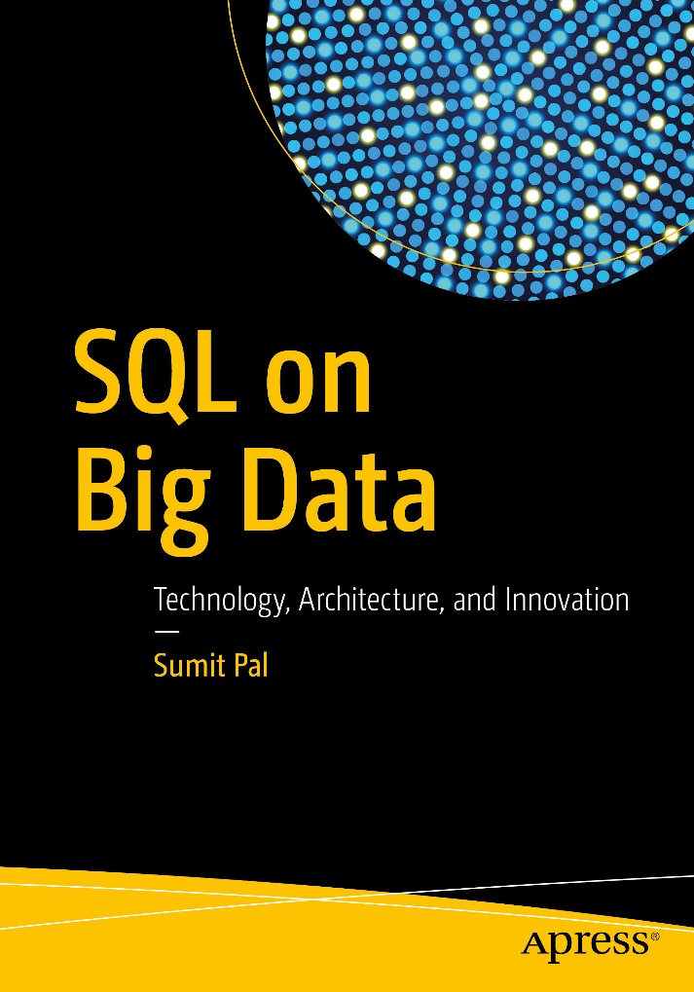
Introduction
Work History
Independent Consultant Big Data, Data Science – 2014-Current
Verizon – Associate Dir – Big Data Analytics – 2013-14
LeapFrogRX – Tech Director/Architect – 2006-13
Oracle OLAP Server Development Team–1997-04
Microsoft SQLServer Replication Development Team– 1996-97

Slide 3
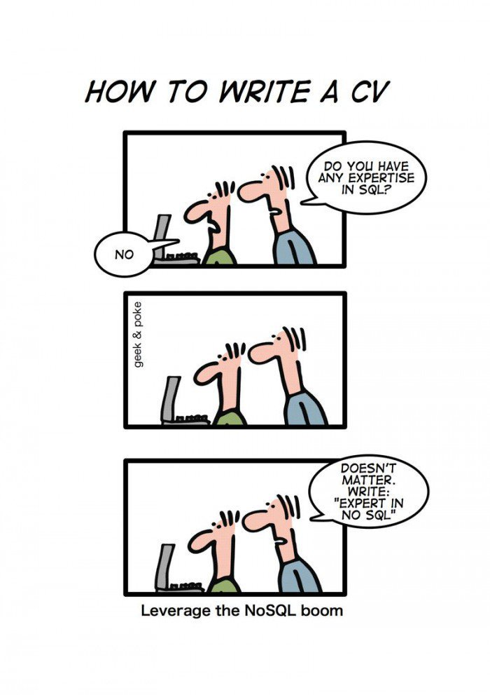

Slide 4
Topics
Why - SQL on Big Data
Architectural Limitations Challenges & Solutions
Architecture – Batch, Interactive, Stream, Operational
Innovations – OLAP, BlinkDB, MapD

Slide 5
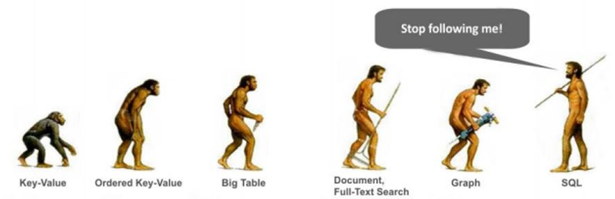
Why SQL on Big Data

Slide 6
Why SQL on Big Data
More data on HDFS/S3/NoSQL Databases
Most popular data querying language
Bridge between BA and Big Data
Integration with BI Tools
Scale that traditional DBMS cannot offer

Slide 7
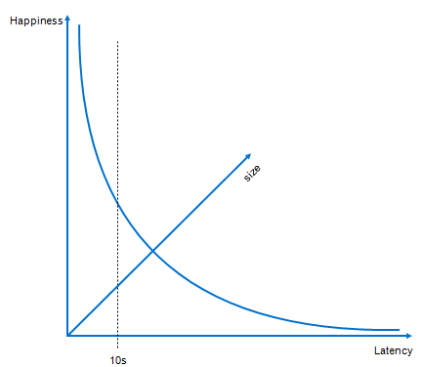
SQL on Big Data Goals
Distributed, Scale Out Architecture
Avoid Expensive Analytic DBs/Appliances
Avoid Data Movement : HDFS → Analytic DBs
High Concurrency
Low Latency

Slide 8
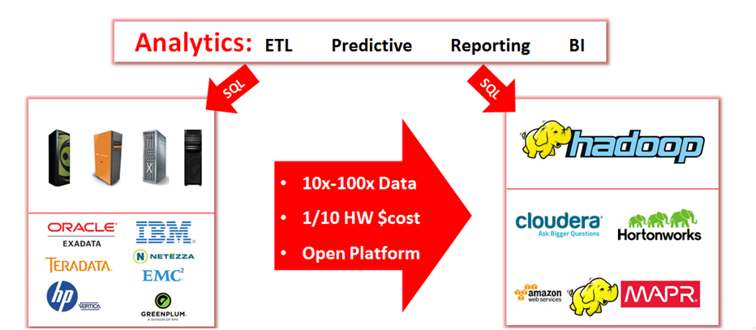
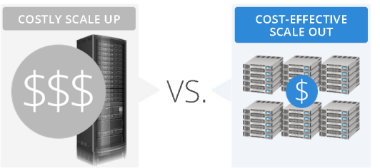
Why SQL on Big Data
Appliances

Slide 9



























SQL in Big Data Landscape

Slide 10
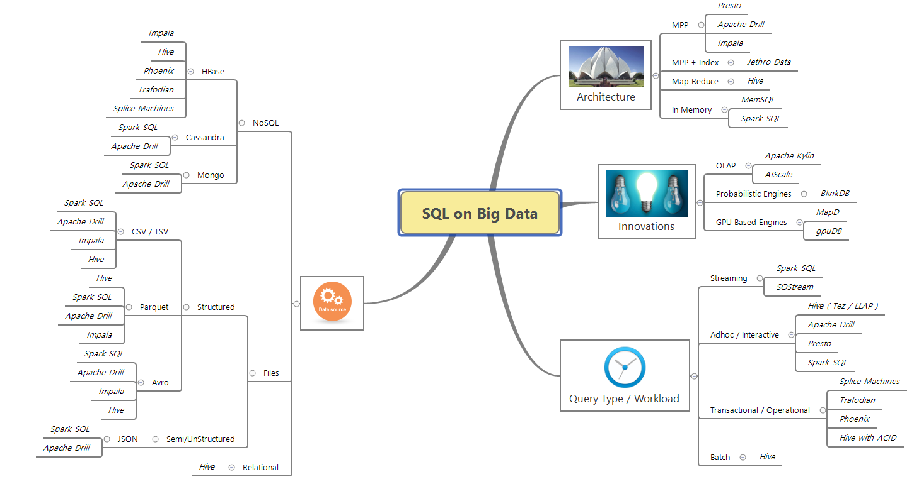
SQL on Big Data

Slide 11
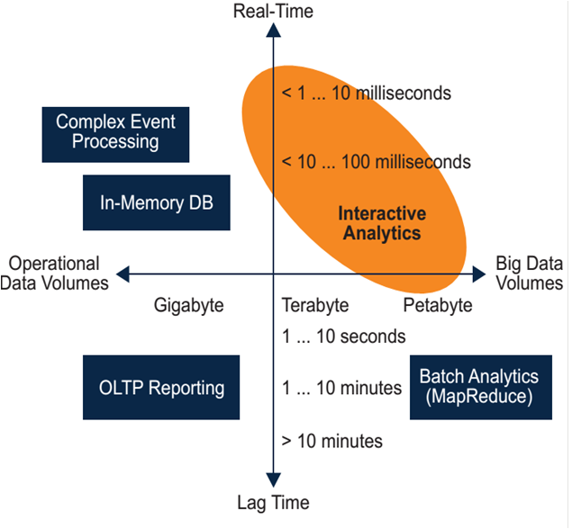
Workload Types

Slide 12
Problems of Initial SQL on Big Data Solutions
Map Reduce & HDFS – meant to solve Batch Oriented Data
Map Reduce is high-latency
Map Reduce Not designed for Optimized long Data Pipelines (Complex SQL is inefficiently expressed as many MR stages)
Disk IO between Map & Reduce do lot of Shuffling & Sort
HDFS is WORM – How to Support ACID (HDFS 2.0)

Slide 13

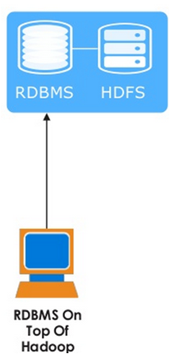
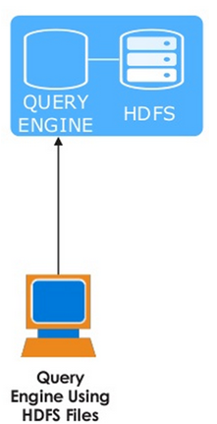
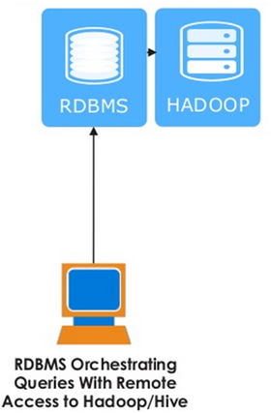
Approaches to solve the challenges

Slide 14
Solve Latency Challenges
Storage layer optimizations
Data retrieval - Ensure Data locality, Optimal Storage Layout / Formats
File Formats – Avro, ORC, Parquet, Sequence Files
Choosing the optimal file format in Hadoop is one of the most essential drivers of functionality and query performance
Data Compression ( Reduce IO) – GZIP, BZIP2, LZO, Snappy, LZ4
Workloads are IO Bound – Reduce IO – Compression Algorithms
Compression has a gotcha – Must be Splittable for HDFS
Tradeoff – Storage & Network Bandwidth / CPU

Slide 15

Batch SQL on HDFS
Uses Map Reduce in the background
Primarily for large ETL jobs for batch workloads
Extensibility (with UDF/UDAF/UDTF)
Loose-Coupling with its InputFormats and Ser/De
Limited support for Unstructured Data – JSON
Not designed for Streaming

Slide 16
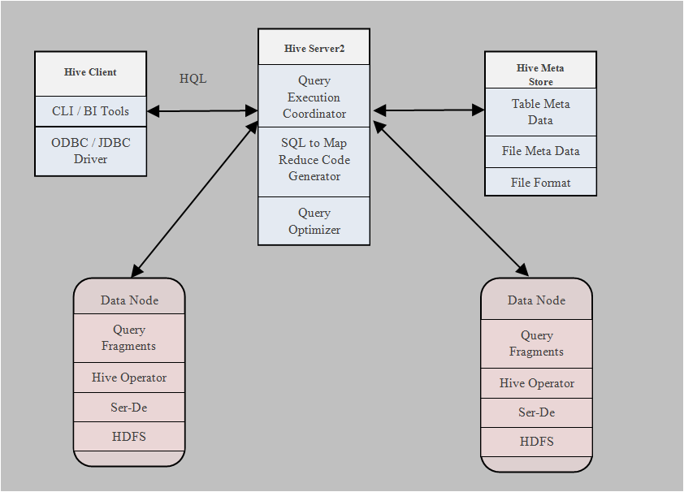
Hive Architecture

Slide 17





SQL Engines for Interactive Workload

Slide 18
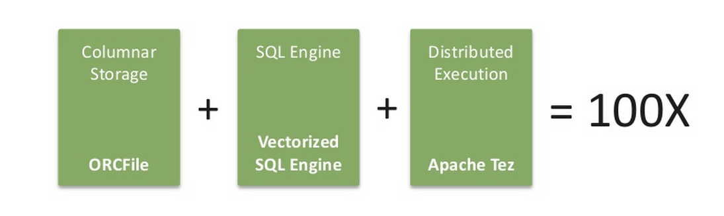
Optimizations – Hive
Partitioning & Bucketing - Bucketing takes care of Data Skew
Vectorization
Reduces the CPU usage, for query scans, filters, aggregates, and joins
Processing a block of 1024 rows at a time
Each column is stored as a Vector
Uses few instructions and fewer clock cycles - processor pipeline and caching
Pipelines data - Execution Stages instead of temporary intermediate ﬁles
Reduce Startup, Scheduling and other overheads of MapReduce

Slide 19
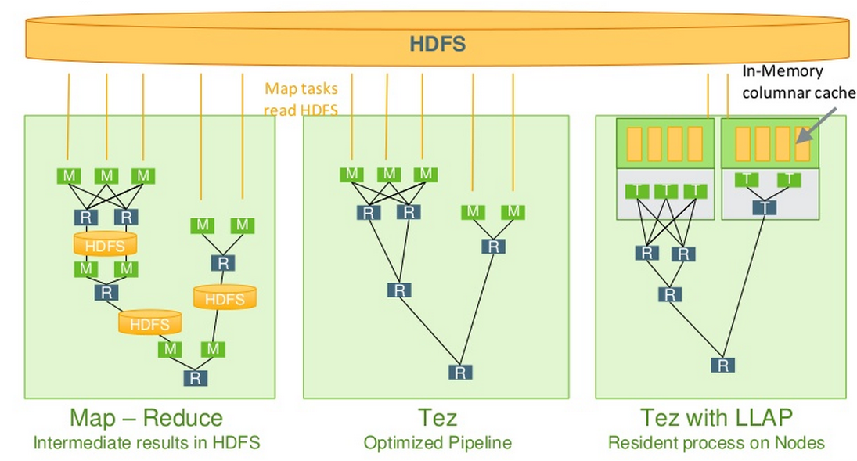
Optimizations – Hive
Hortonworks

Slide 20
MPP / Full Scan Architecture
Client: SELECT day, sum(sales) FROM t1 WHERE prod=‘abc’ GROUP BY day
Data Node
Data Node
Data Node
Data Node
Data Node
Query Planner/Mgr
Query Planner/Mgr
Query Planner/Mgr
Query Planner/Mgr
Query Planner/Mgr
Query Executor
Query Executor
Query Executor
Query Executor
Query Executor
Performance and resources based on the size of the dataset

Slide 21
Impala Architecture
MPP (Massively Parallel Processing) execution engine
LLVM (Low Level VM) Compile at Runtime - Low Latency
3 Daemons:
• impalad Handles client requests & internal requests
• statestored Name service & metadata
• catalogd Metadata changes to all impalad

Slide 22
Impala Architecture
Fast and Efficient IO manager - handle large data spread across array of hard drives (rotational, or SSD)
Designed to run on modern architecture, recommended chipsets (i.e. Sandy Bridge, Bulldozer), as the LLVM-IR compiler will use newer hardware instructions to help maximize IO throughput
Impala’s execution engine is decoupled from the storage engine, allowing it to plug other storage engines underneath
Impala - streams the results in between the nodes
- two types of join algorithms: partitioned and broadcast
Notes:
Efﬁcient I/O layer to read data stored in HDFS which spawns one I/O thread per disk on each node.
Impala I/O layer decouples the requests to read data (which is asynchronous), and the actual reading of the data (which is synchronous) keeping disks and CPUs highly utilized at all times.
Exploits Streaming SIMD Extension (SSE) instructions, available on the latest generation of Intel processors to parse and process textual data efﬁciently
Enable short-circuit reads and block location tracking as per the Impala instructions Short-circuit reads allow reading local data directly from the FS

Slide 23
Impala Architecture
Runtime code generation - to improve execution times
Perform just in-time (JIT) compilation to generate machine code
Virtual function calls incur a large performance penalty.
If object type is known, use code generation to replace the virtual function call with inline
HDFS feature short-circuit local reads to bypass the Data Node protocol when reading from local disk

Slide 24
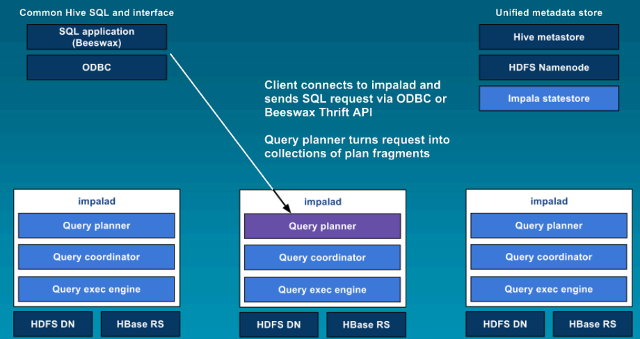
Impala Architecture
Cloudera

Slide 25
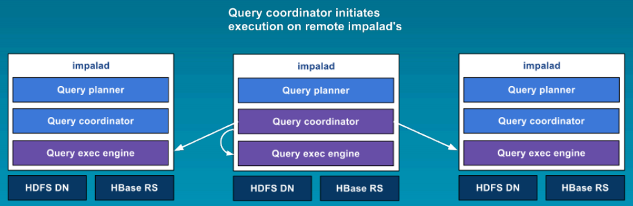
Impala Architecture
Cloudera

Slide 26
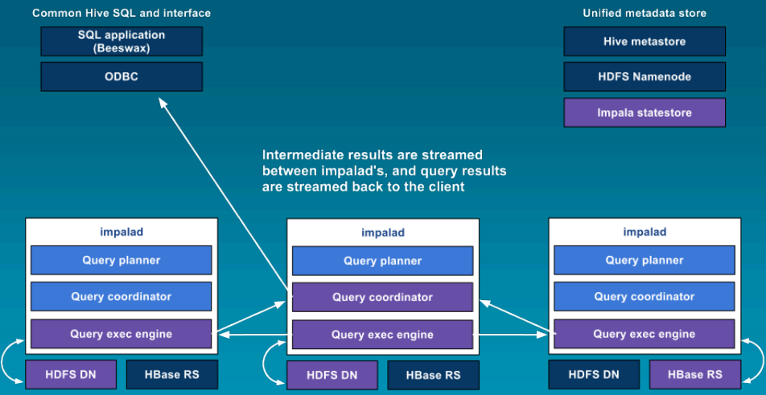
Impala Architecture
Cloudera

Slide 27
Impala Architecture
Advantage No Data Movement out of the clusters, No SPOF
DisAdvantage
Daemon on the each Data Node
Cannot recover from mid-query failures -- Restart again
Working set of a query to ﬁt in the physical memory of the cluster
Reasons for High Performance
  C++ Instead of Java
  Runtime Code Generation
  New Execution Engine ( Not Map Reduce )
  Optimized Data/File Format – Parquet (Columnar Compressed)

Slide 28
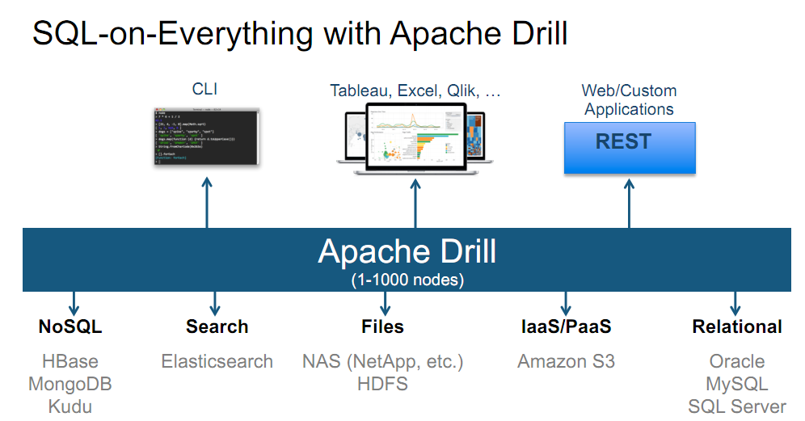
Apache Drill
MapR

Slide 29
Apache Drill - Architecture
Interactive Analysis : HDFS/Cassandra/Mongo
File Formats - XML, JSON, Avro, Protocol Buffers
Drillbits - DataNodes to provide Data Locality
Query Optimization Can Plug Custom optimizers
Correlated Sub Query, Analytics Function
Dynamic Data Schema Discovery

Slide 30
Apache Drill
Support for user-deﬁned functions (UDF)
Nested data as a ﬁrst-class citizen
Drill – Schema Discovery on the Fly
Relational Engines – Schema on Write
Hive, Impala – Schema on Read
Apache Drill – Schema on the Fly
(evolving schema or schema-less)

Slide 31
Apache Drill - Architecture
Query
1. Query comes to Drillbit (JDBC, ODBC, CLI, REST)
2. Drillbit generates execution plan - query optimization & locality
3. Fragments are farmed to individual nodes
Driver
4. Result is returned to driving node
Drillbit/
Foreman
Drillbit
Drillbit
DFS/HBase/Hive
DFS/HBase/Hive
DFS/HBase/Hive
Notes:
Distributed quey engine
Any Drill bit can accept the request
Driver drillbit

Slide 32
Spark SQL
Data sources - Text files, JSON, Hive, HDFS, Parquet, RDBMS
Static & Dynamic Schema
Higher level of programming abstraction – DataFrame & Dataset
Integration with Spark Streaming – DStreams Transformed to DataFrames - SQL can be executed

Slide 33
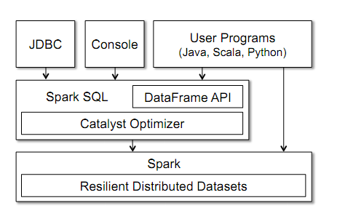
Spark SQL
Databricks

Slide 34
MPP Vs Batch
 | MPP | Batch
Design | Executor CPU Memory Disk Processing task is bounded to specific executor holding required data shard | Tasks Number of tasks has completely no relation to the number of executors. #Tasks = #InputSplits = #HDFS blocks Tasks assigned to executors in arbitrary order based on availability
Problem | Stragglers - MPP would always have a node with a degraded disk array, which would lead to degraded performance for this node Solved in Batch Speculative execution helps with the degraded nodes - because of shared storage, which is impossible in MPP | With MPP, you don’t need to put intermediate data on the Disk. Executor processes a task and STREAMS result to the next task Have no option but to store the intermediate results on the local drives results in High Latency
Concurrency | Low | High
Latency | Low | High

Slide 35
JethroData – Indexes in Hadoop
Client: SELECT day, sum(sales) FROM t1 WHERE prod=‘abc’ GROUP BY day
Jethro Query Node
Query Node
1. Index Access
2. Read data only for require rows
Data Node
Data Node
Data Node
Data Node
Data Node
Performance and resources based on the size of the result-set

Slide 36
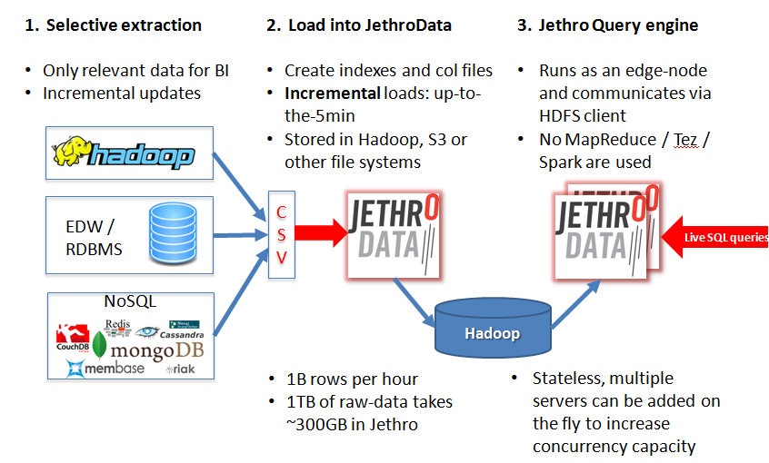

Slide 37
SQL on UnStructured Data
Apache Drill - Semi-Structured Data JSON/HBase/Files/Directories
using SQL Without Up Front Schema Definition
Schema is discovered on the fly based on the query
Hive Ser-De - create SQL like interface to files of any structure
Hive works with JSON files if - pre-processed to remove carriage returns and records are flattened

Slide 38
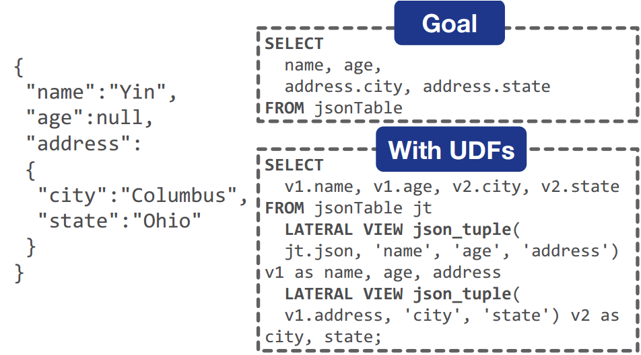
SQL on UnStructured Data

Slide 39
SparkSQL For UnStructured Data
SQL Query
Parser
Optimizer
JSON
Data
Jackson Lib
Spark Auto Schema Generator
Dataset with Schema
Spark Execution
ResultSet

Slide 40
Streaming SQL - Architecture
Store and Process-second DOES NOT WORK
Hadoop unable to offer Latency & Throughput for Real-Time
( Telecoms, IOT and Cyber security )
Streams - Infinite Tables sorted by Time & Processed as Window of Data
Standing query that executes Continuously over data
InMemory Processing / Lock-free Data Structures
Stream analytics - Statistical Models, Algorithms on data that arrives continuously, often as an unbounded sequence of instances.

Slide 41
Spark SQL for Streaming Architecture
Spark Streaming
Micro Batch RDD
Spark Core
ML
GraphFrames
SQL
Spark Streaming Receivers
Input
Data
Stream
Micro Batch RDD
Spark Core
ML
GraphFrames
SQL

Slide 42
Streaming SQL – Other Products
PipelineDB
SQLStream
Parstream
Druid

Slide 43
Transactional/Operational SQL on Hadoop
“Operational” is an emerging Hadoop market - least mature
ACID transactions Support in Hive (HIVE-5317)
SQL Merge now Supported in Hive (Slowly Changing Dimensions in Data Warehouses
Trafodian
Phoenix
Splice Machine
http://tephra.io/
(globally-consistent transactions on top of Hbase – Using MVCC)
Notes:
Hadoop being perceived as having a number of weaknesses (or gaps) in
terms of addressing the requirements for transactional SQL workloads.

Slide 44
Trafodian Architecture
Extends HBase - adds support for ACID
Distributed Transaction Management for distributed transaction across multiple HBase regions
ANSI SQL implementation accessible ODBC/JDBC connection
Relational Schema abstraction which makes feel like relational

Slide 45
Trafodian Architecture
Stores all columns in a 1 CF to improve efficiency/speed
Column Name Encoding to save disk & I/O
Columns are assigned data types when inserting / updating
Extends ACID - transactions span multiple tables & rows
Supports Primary Key & Composite Key /
Secondary Indexes

Slide 46
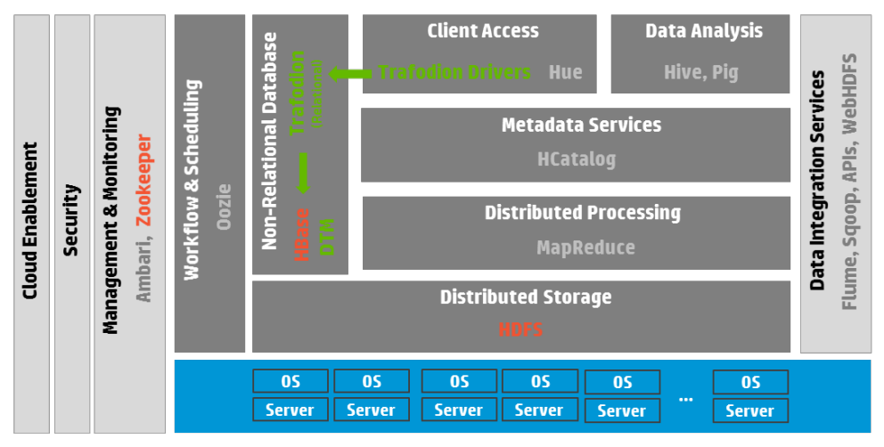
Trafodion Architecture

Slide 47
Phoenix - Architecture
Relational layer on top of HBase
Low Latency Query Model & SQL support over HBase API
SQL query compiled it into a series of HBase scans
Metadata is stored in an HBase table and versioned
Pushes Computation to the HBase Region Servers
Coprocessors (Server-Side) Minimize Data Transfer & Prune Data
Uses Native HBase APIs Not Map/Reduce framework of HBase

Slide 48
Phoenix - Architecture
Query optimizations
Secondary indexes
Statistics
Reverse scans
Small scans
Skip scans

Slide 49
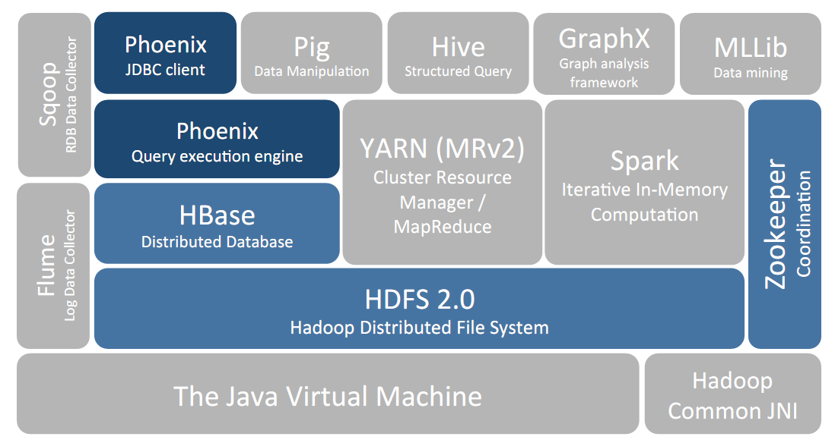
Phoenix - Architecture

Slide 50
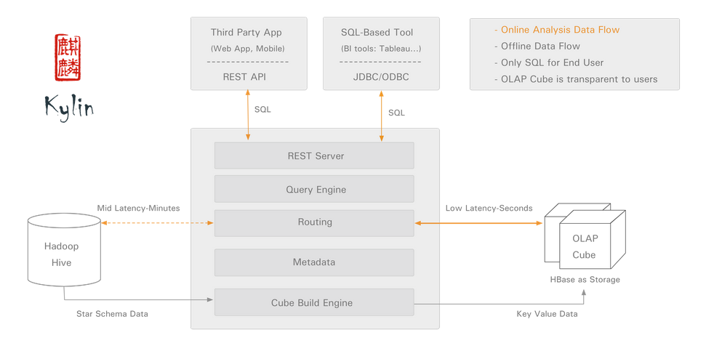
OLAP on Hadoop - Apache Kylin

Slide 51

Probabilistic SQL Engines
Fast
Massively Parallel, Approximate Query Engine
Meaningful approximate results (with error thresholds)
Creates Offline Samples based on Error Margins
Runs queries on these samples
Samples are placed as stripes across multiple machines – Disk / Memory
SQL Engines
Accurate
Big
Time Bound & Error Bound Queries
Select avg(sessiontime) from clickstream_table within 1 seconds
Select avg(sessiontime) from clickstream_table error .05 and confidence = .95

Slide 52
SQL Engine on GPUs – MapD
GPU - DB & Visual Analytics Platform
    - MapD Analytical Database
    - MapD Immerse Visualization
Queries Executed in Parallel - 40,000 cores / server ( Single Node)
Written in C++ & hooks into CUDA or OpenCL
Caches hot data in GPU
Compiles queries on the fly using LLVM / Vectorizes execution
Highly-optimized kernels for database operations
Executes queries on both CPU & GPU, if working dataset cannot fit in GPU memory
Notes:
Single Server Solution
GPU-powered database and visual analytics software platform
SQL queries to be executed in parallel across nearly 40,000 cores per server, yielding massive speedups over leading in-memory databases
innovative high-performance offering that combines GPU technology with the firm’s own columnar database and visualization frontend
Architecture of the database is tuned for massively parallel compute elements and the performance on GPUs is far better than on CPUs with multiple cores and threads per core.
Compile queries on the fly with LLVM, generating intermediate codes, and we can target Nvidia GPUs and Intel and AMD CPUs
MapD database is written in C++ and hooks into CUDA or OpenCL environments to talk to the GPUs and SQL queries are compiled down with LLVM
It is also a visualization system that runs on those same GPUs, and this is one of the secrets of the program. Because it is rendering data on the same devices that is doing the calculations on that data, there is no data movement at all. That means visualization also happens very fast. This visualization system in MapD is based on the D3.js JavaScript library, and OpenGL is used to visualize the data that D3.js displays in a Web browser.
currently runs on a single node, with multi-
node capability planned for the near future. A server with 8
Nvidia K80 cards, with a total of 192GB of GPU RAM, can
typically handle a dataset of 1 - 3TB in raw size within GPU
RAM. Larger datasets of 10 - 15TB can be handled in CPU
RAM at still-impressive speeds.
computational parallelism, their high-speed memory, and
their graphics pipeline to form an end-to-end system that
allows for high-speed querying, analytics, and visualization
on big datasets.

