Slide 1

Expression of the Gene of Predicted Zymogen Granule Protein (G3MZ19) homologue in the Bali cattle (Bos javanicus) Saliva
Sulaiman Ngongu Depamede
Faculty of Animal Science
and Consortium for Large Ruminant Research,
Mataram University
JalanMajapahit No 62 Mataram, NTB, Indonesia 83125

Slide 2
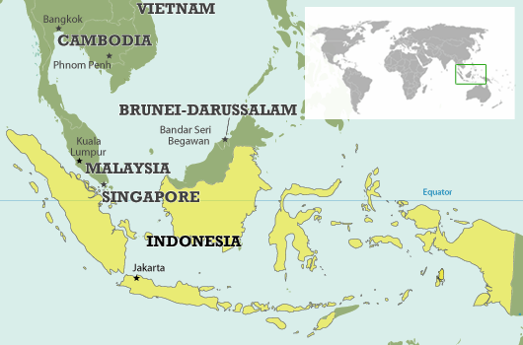

Mataram, Lombok

Slide 3
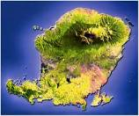

Slide 4

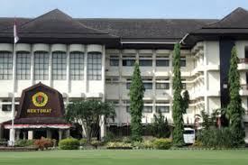
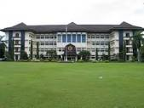
Main Research:
Crops/rice
Bali cattle (large ruminants)
Sea weed and pearls (marine biology)
Tropical diseases

Slide 5
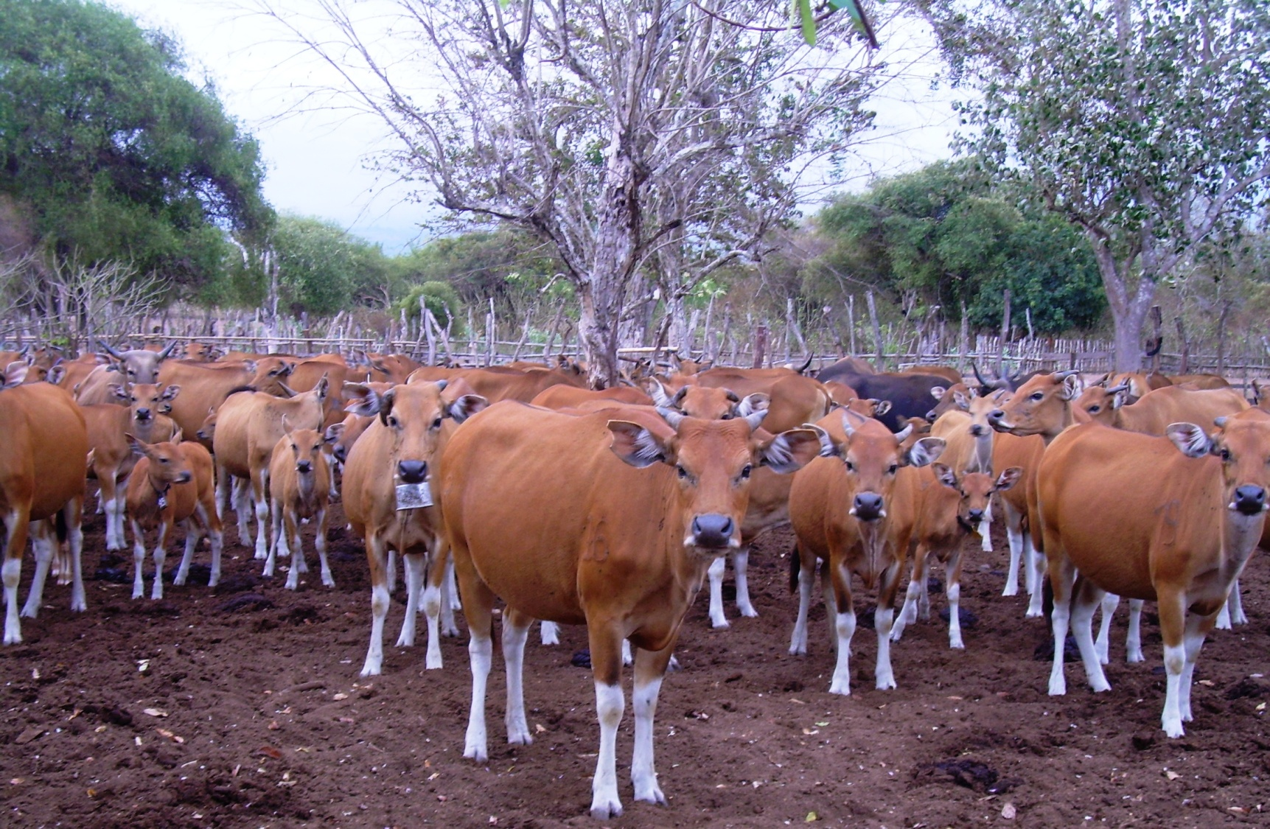
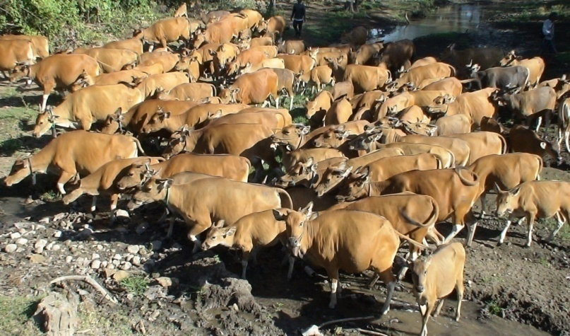
Photo by Prof. Soekardono

Slide 6
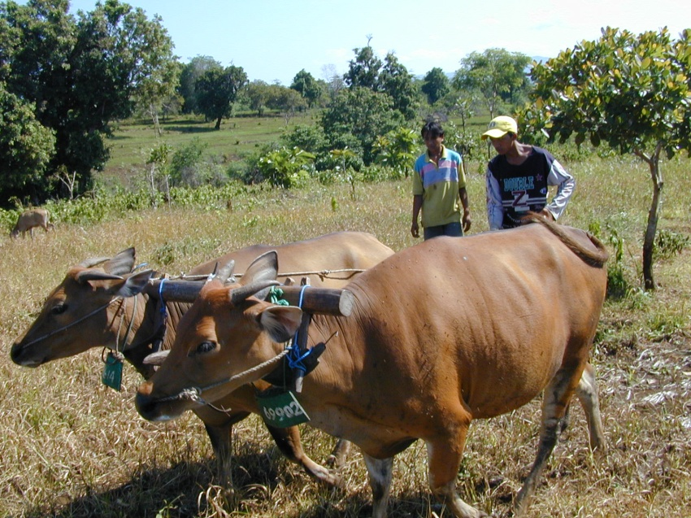
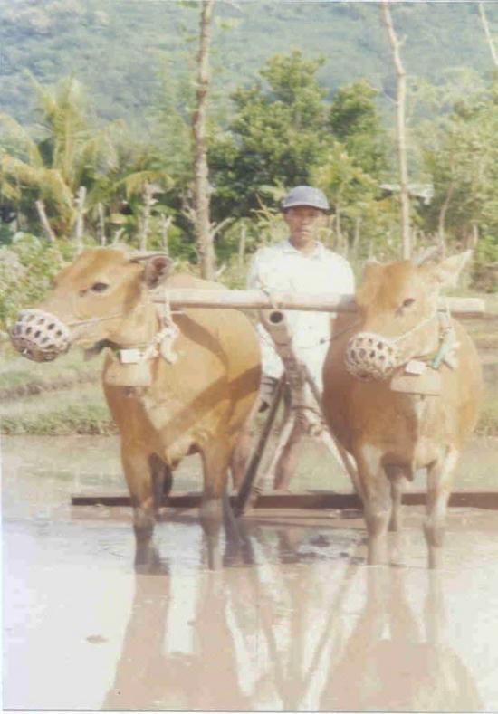
The main purposes of large ruminants:
Mainly for meat
as a source of labor to plow the land in rural areas

Slide 7
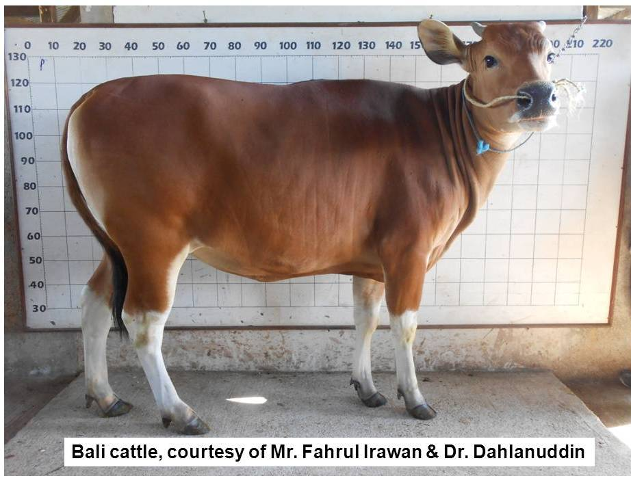
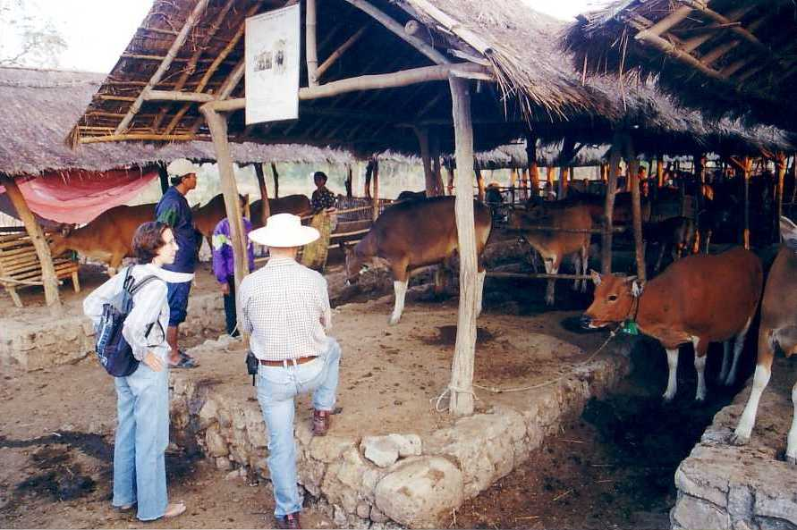

Slide 8
The “story” behind the studies on
Bali cattle saliva
Is it possible to develop noninvasive test methods for ruminants?
  - Effects of mimosine (toxin of Leucaena leucocephala)
Do Bali cattle have “specific bioactive” compounds?

Slide 9
Project 1. Isolation and characterization of saliva compounds
Compound Mr ~ 14 kDa: Able to inhibit the growth of Staphylococcus aureus
Predicted: Lysozyme
(Depamede et al., 2012)

Slide 10
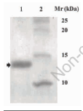
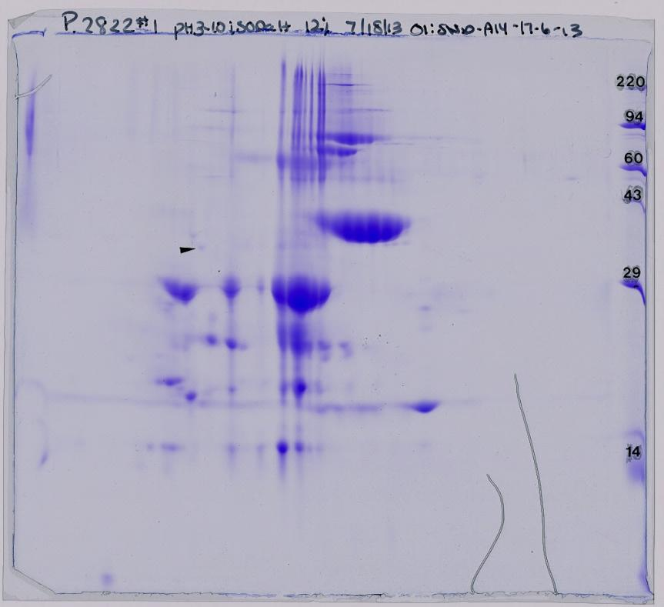
Project 2.
1D & 2D-SDS-PAGE + MALDITOF of 14 kDa compounds
Proved was not Lysozyme: MBL/Jacalin-like superfamily
G3MZ19 | Predicted zymogen granule protein 16 homologue
F1N1Z8 | Pancreatic adenocarcinoma up regulated factor-like
F1MCV8 | Prolactin-inducible protein homologue precursor
(Depamede, 2013)

Slide 11
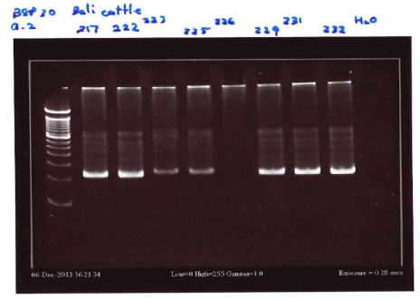
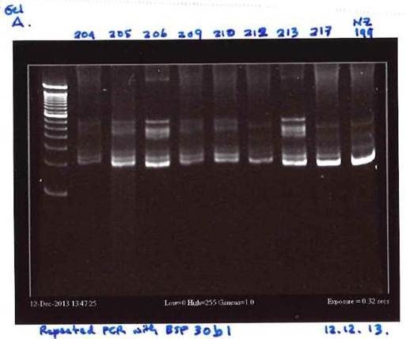
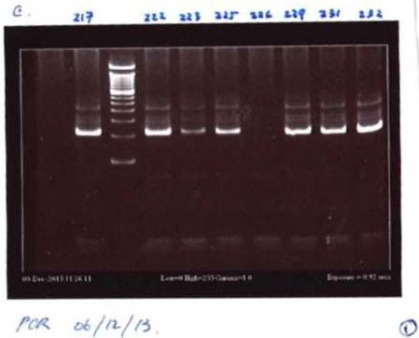
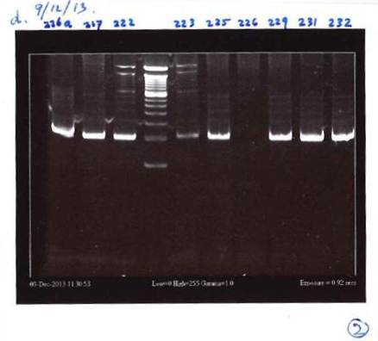
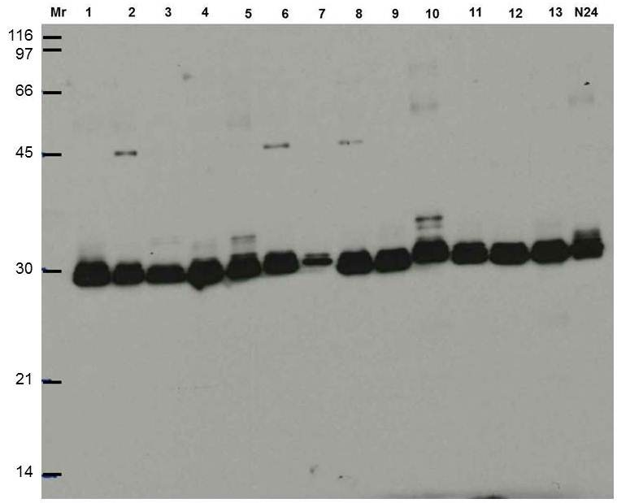
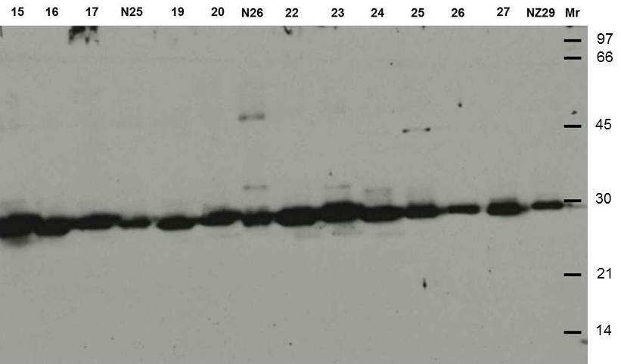
Project 3.(collaborative research with Ruakura RC, Hamilton AgRes, NZ)
Studies on Phenotypes and genotypes of BSP30 in Bali cattle

Slide 12
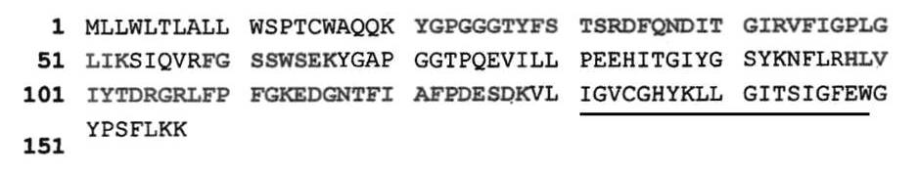
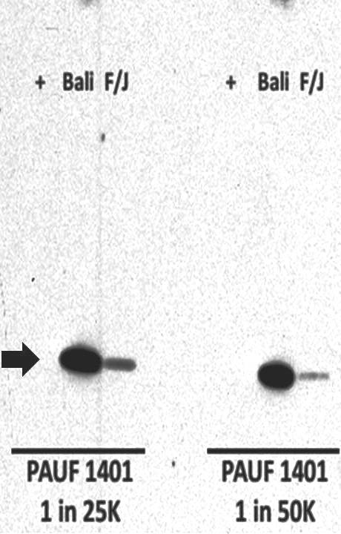
Project 4
(collaborative research with Hamilton AgRes, NZ)
Raising Ab against Pancreatic adenocarcinoma up-regulated factor (PAUF) in the saliva of Bali cattle.
MALDI-TOF/TOF results

Slide 13
Project 5
G3MZ19 gene expression based on MALDI-TOF/TOF.
G3MZ19 | Predicted zymogen granule protein 16 homologue
F1N1Z8 | Pancreatic adenocarcinoma up regulated factor-like
F1MCV8 | Prolactin-inducible protein homologue precursor

Slide 14
Project 5
G3MZ19 gene expression based on MALDI-TOF/TOF.
Materials and Methods
Animal samples
non-pregnant and non-lactating Bali cows (Bos javanicus), housed in a barn with individual pen, fed with King grass (Pennisetum purpureum) and water was given ad libitum.
Collections of saliva were carried out in the barn using disposable plastic pipettes

Slide 15
Project 5
G3MZ19 gene expression based on MALDI-TOF/TOF.
Materials and Methods
DNA extraction
Total genomic DNA was extracted from the whole blood samples of the Bali cattle collected aseptically through the jugular vein.
The extractions were carried out using a commercially available kit (NucleoSpin®, Macherey-Nagel, Germany) following the manufacturer’s instructions.
The isolated DNA then subjected a standard PCR analysis.

Slide 16
Project 5
G3MZ19 gene expression based on MALDI-TOF/TOF.
Materials and Methods
Detection of G3MZ19 in Bali cattle genomic DNA
Genomic DNA (20 ng) was subjected to be amplified using KAPA2G Fast Ready MIX PCR Kit (KAPA Biosystem, USA)
PCR program: predenaturation for 5 min at 94ºC, 40 cycles of 40s at94ºC, 40s at 56ºC, 15s at 72ºC, followed by a final extension of 5 min at 72ºC.

Slide 17
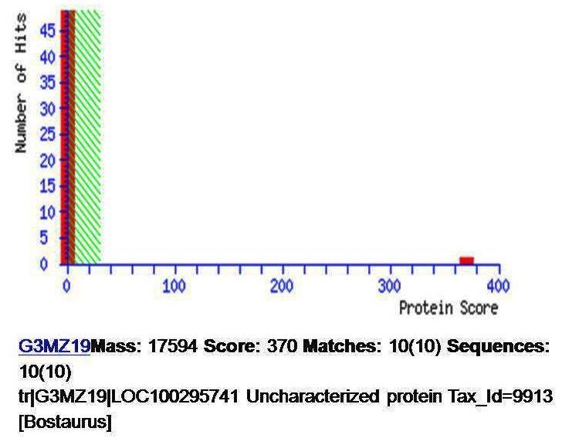
Project 5
G3MZ19 gene expression based on MALDI-TOF/TOF.
Representation of Mascot search result on G3MZ19 in Bali cattle saliva.

Slide 18
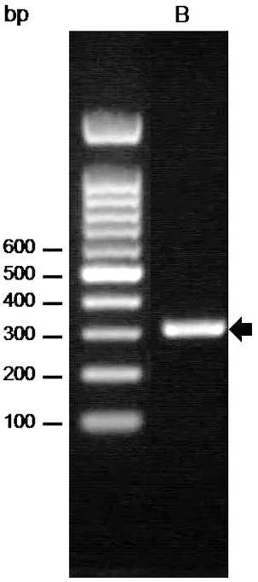
Project 5
G3MZ19 gene expression based on MALDI-TOF/TOF.
Representation of purified PCR products of Bali cattle G3MZ19 gene of 306 bp (B, arrow).
The primers used for the reactions were ACGTACTATTGGATAATCCCAG (Fwd) and AGTATCCAGGTGAGGTTTGG (Rev), derived from bovine (Bos Taurus, G3MZ19|LOC100295741, Tax_Id=9913, LudwigNR database and UniProt) and were designed using the Primer Quest program of Integrated DNA Technologies (IDT®, USA).

Slide 19
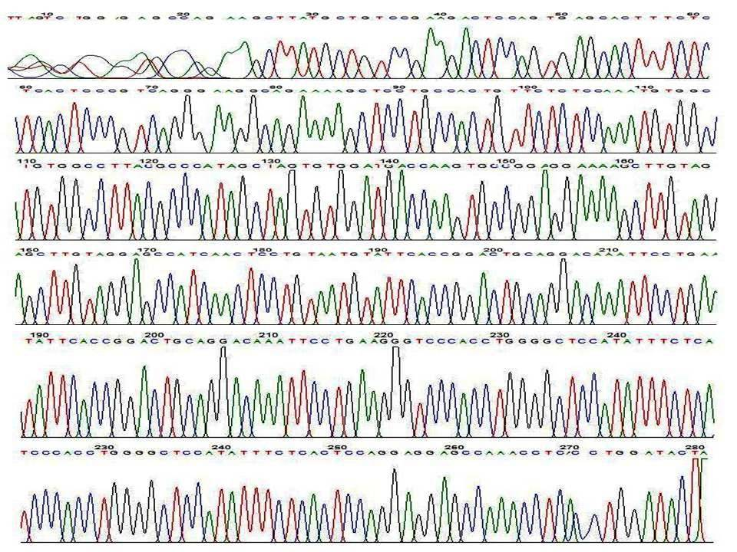
Project 5
G3MZ19 gene expression based on MALDI-TOF/TOF.
Representation of sequence profile of G3MZ19 gene from genomic DNA of Bali cattle.

Slide 20
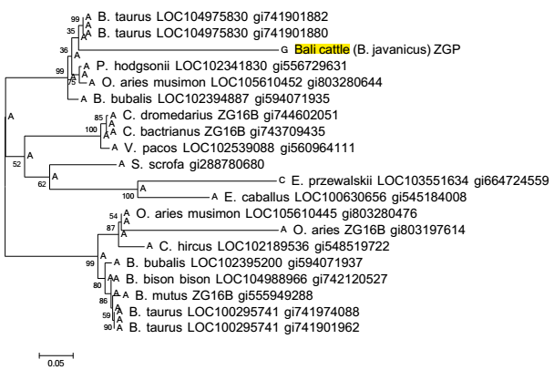
Project 5 G3MZ19 gene expression based on MALDI-TOF/TOF.
Phylogenetic tree constructed by maximum likelihood-ancestor method based on the nucleotide sequence of maximum score of zymogen granule protein genes explored in NCBI BLAST using Mega 6.
Bootstrap values are pointed to the major nodes as percentage of the data obtained from 1,000 resamplings. Zymogen granule protein fragment gene (ZPG) of Bali cattle is highlighted.

Slide 21
Conclusion
saliva is a potential candidate media not only for noninvasive disease diagnostics and monitoring but also for evolution study of ruminants
Various methods/techniques can be applied – proteomics-genomics

Slide 22
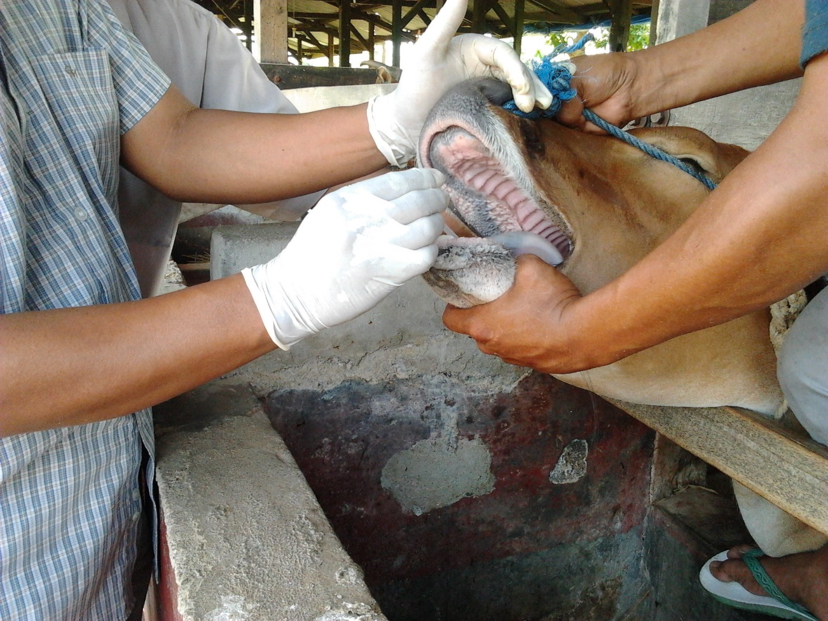
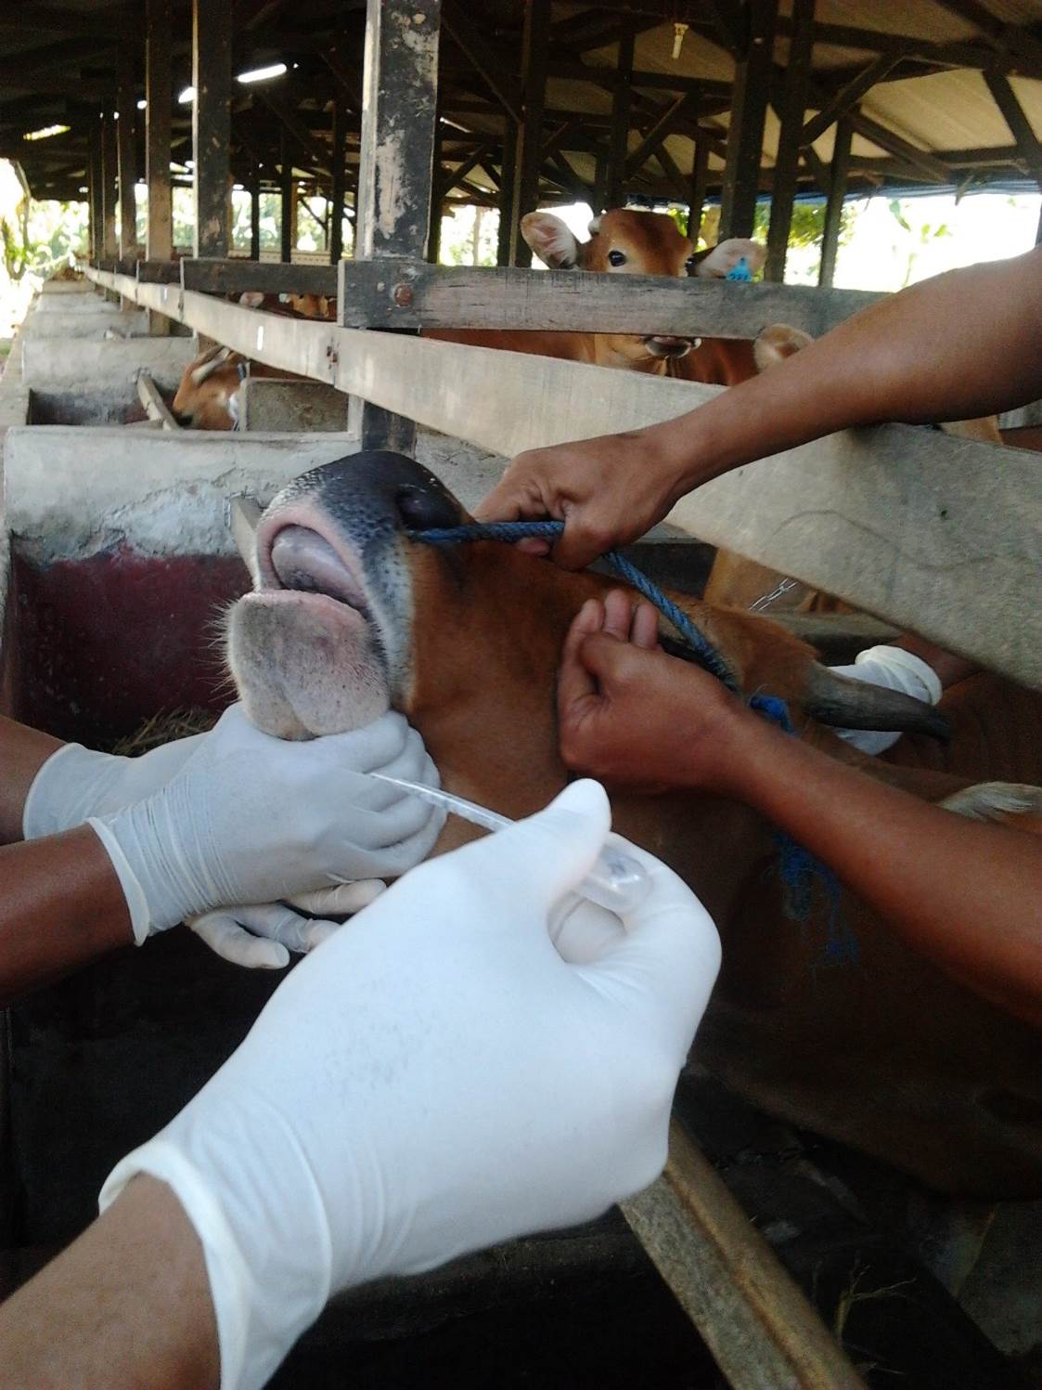
Future plans
Feed efficiency ?
Immune systems?
Bioactive/ cancer?
Diagnostics?

Slide 23
Acknowledgments:
Rector of Mataram UniversityUnram), Dean of Faculty of Animal Science-Unram,
Dr. Dahlanudin (Director of KRRB),
Prof. Mulyanto, Dr. Tom Wheeler, Dr. Brendan Haigh, Dr. G.A. Smolenski, Dr. Marita K Broadhurst, Dr. Rita Lee
This study was supported by the General Directorate of Higher Education, Ministry of Education and Culture, Republic of Indonesia through “HIKOM” Program, No. 375.D/SP-APHK/UN18.12/PL/2013.

Slide 24
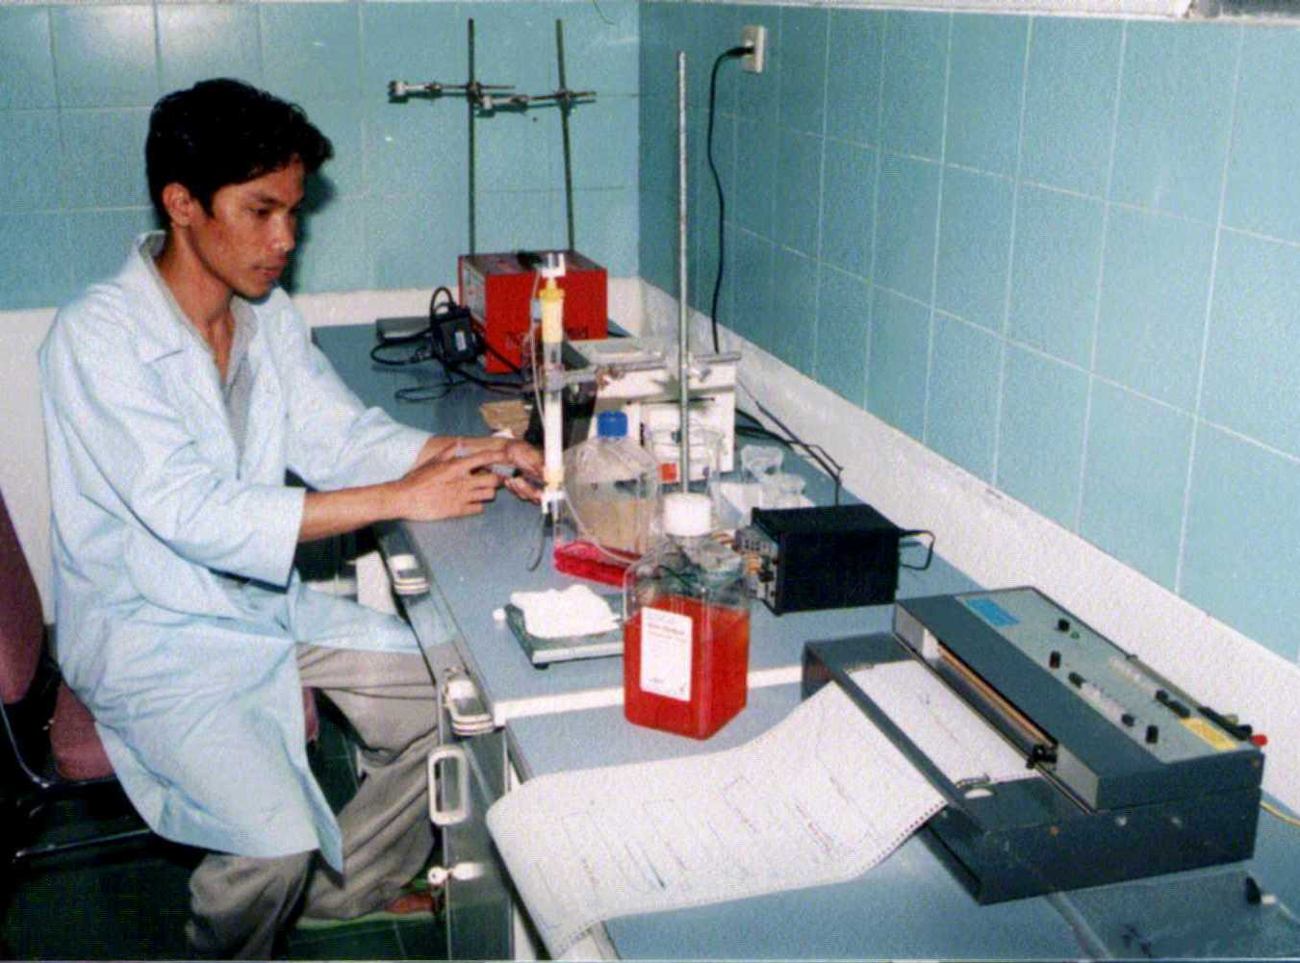
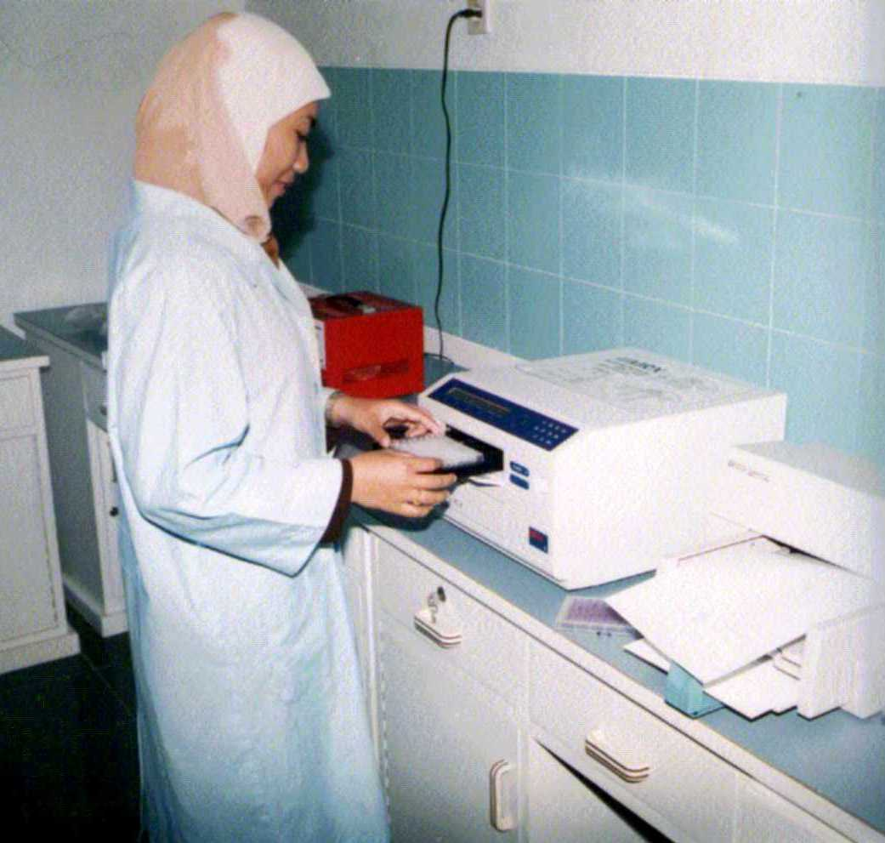
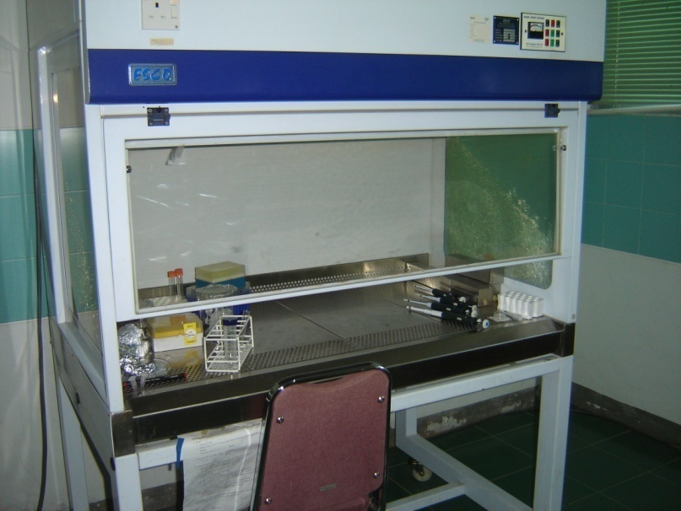
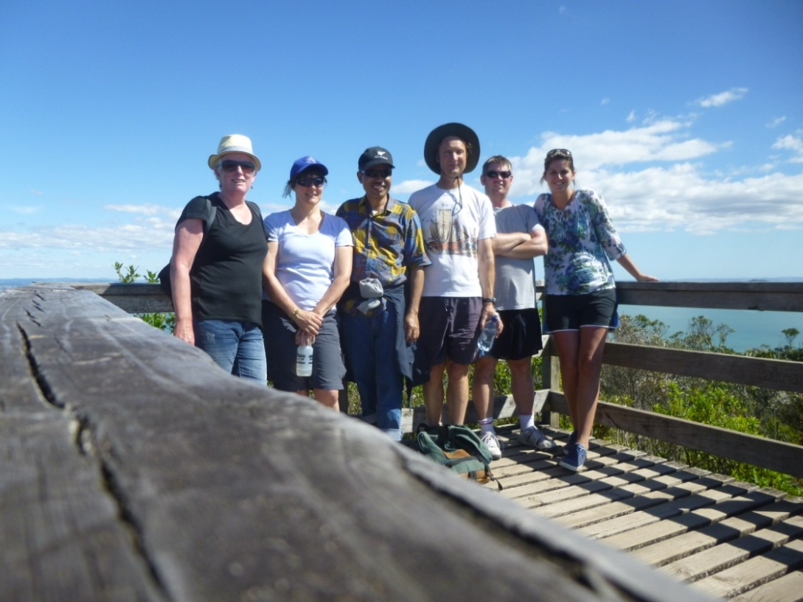
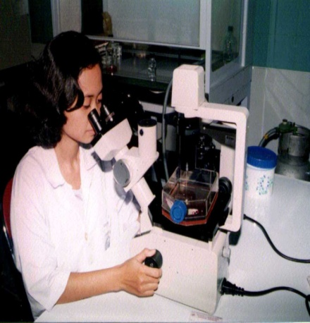
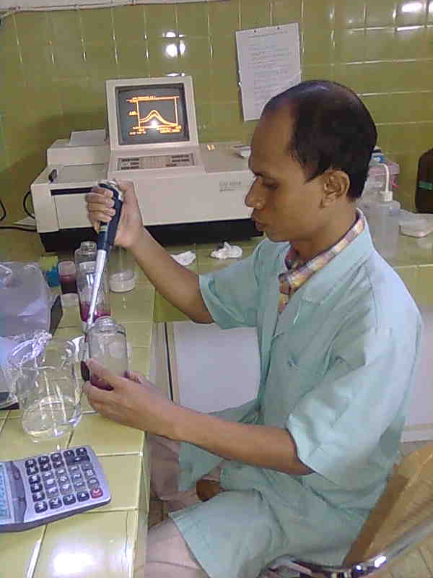
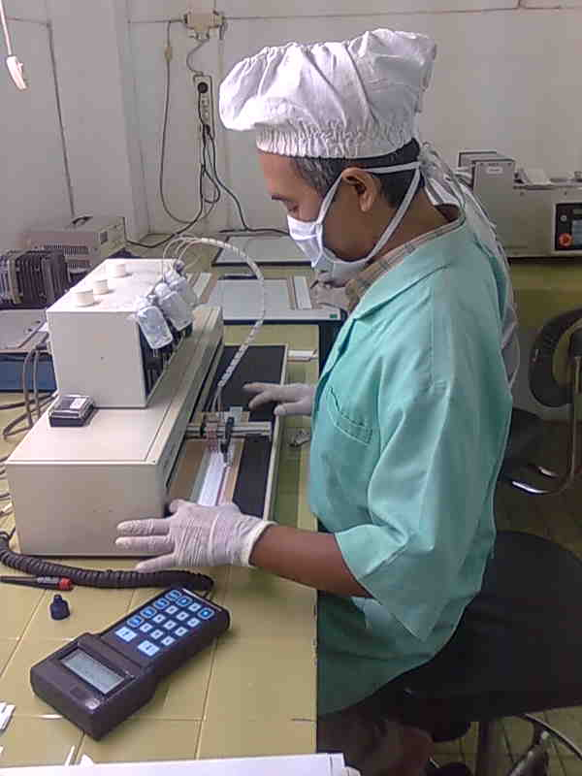

Slide 25

Thank you

