Slide 1
Calcination of the UAE Limestones: A Laboratory Experiment
2nd International Conference on Geology
April 21-22, 2016 Dubai, UAE
Sulaiman A. S. A. Alkaabi
Osman Abdelghany, Mohamed M. El Tokhi, Bahaa Eddin Mahmoud
Department of Geology, College of Science, UAE University, AlAin UAE
Abdel Monem M. Soltan
Department of Geology, Ain-Shams University, Cairo Egypt

Slide 2
Content
Identify Calcination
Calcination in Industry
Calcination Steps
Lime Types
Study Areas & Formations
Investigation Techniques
Results Discussion:
Petrography, Mineralogy, Chemistry, Physical Characteristics
Hydration Rate
Microstructures
Activation Energy, E
Conclusion

Slide 3
What is Calcination?
Heating of a solid to a high temperature, below its melting point, to create a condition of thermal decomposition or phase transition other than melting or fusing – Synthesis of Inorganic Materials
Burning of calcium carbonate (limestone) to calcium oxide (quicklime)
CaCO3 → CaO + CO2
ΔH(900°C)=3010 kJ mol-1

Slide 4
Calcination in Industry
Calcination is one of the vital industrial application for limestone.
Limestone calcination is industry achieved in
  Rotary kiln or vertical shaft
  limestone is fed as lumps of 6-25 mm in rotary kilns and 25-50mm in vertical shaft
  The calcination begins at ~780°C and requires about 3.2 GJ/ton
The shrinking core reaction model is the most famous model illustrating the limestone calcination.

Slide 5
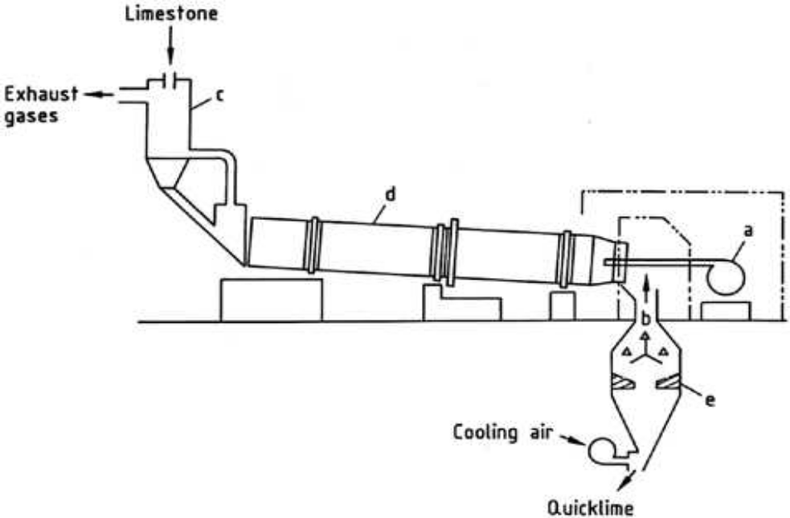
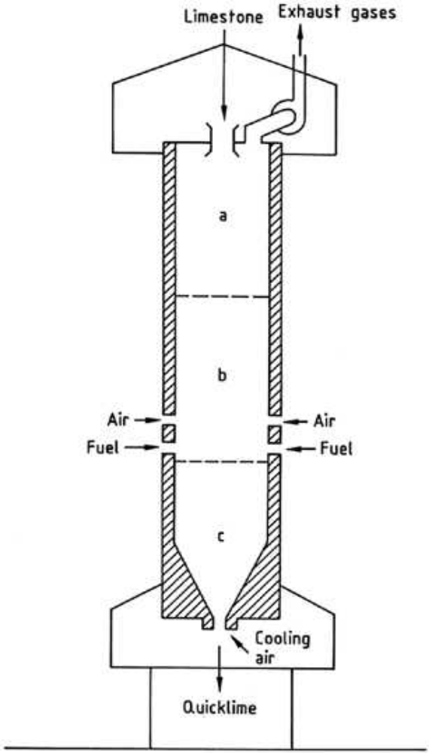
Calcination in Industry
Schematic of a rotary kiln
Burner
Combustion air
Pre-heater
Kiln
Cooler
Schematic of a vertical shaft kiln.
Preheating zone
Calcining zone
Cooling zone.

Slide 6
Limestone Calcination Steps
Limestone lumps calcination begins from outside to inside, leaving the limestone core intact:
  Transfer of the kiln hot gases to the limestone lump surface
  The surface begins to calcine
  The hot gases migrate to the lump interior through the micro-porous lime layer, so become a new reaction interface
  Continuous calcination produces CaO & CO2
  CO2 moves to the lime lump surface, then from the lump surface to the kiln.
Hot gases transfer within the limestone lump mainly depends on the original limestone petrographic facies,
Escape of CO2 during calcination is controlled by the developed lime microfabric.

Slide 7
Lime General Types
Based on the applied firing temperature during calcination, the resulted lime can be termed:
  Soft-burnt lime (Quicklime)
    At a temperature range 900-1150°C
    higher surface area, consequently more reactive
  Dead-burnt lime
    At a temperature >1150°C
The applied firing temperature in this study is fit for quicklime.

Slide 8
Investigation Techniques
Crushing and sieving of the crushed material through 5- & 10-mm sieves to select the particle size range similar to that used in the construction industry
Detailed petrographic examination using:
    1. Transmitted light microscopy (TLM),
    2. Cathodoluminescence microscopy (CLM)
    3. Scanning electron microscopy (SEM).
Mineral composition was determined by:
    X-ray diffraction analysis (XRD)
Chemical composition was determined
    X-ray fluorescence (XRF)
Bulk density and apparent porosity were determined using the liquid displacement (Archimedes) method, where the samples are soaked for 1h under vacuum in kerosene (specific gravity (γ)=0.8).
The samples were examined with X-ray micro-computed tomography (micro-CT)

Slide 9
Investigation Techniques
Calcination was conducted by loading the sample in porcelain crucibles and:
  firing for 0.25, 0.5, 1 and 2 h
  at 800, 900, 1,000 and 1,100 °C
  16 firing trials for each sample in a lab scale electrical muffle furnace.
After each calcination run, the lime grains were immediately examined for their microfabric characteristics (via SEM and CLM), free lime content and hydration rate.
CLM for distinguishing the different crystalline phases based on their cathodoluminescence behavior
For the CLM, the fired lime grains were directly mounted in Araldite resin, soaked under vacuum for 2 h, dried overnight in electric dryer at 100 °C, mounted on a glass slide and then polished using ethanol.

Slide 10
Investigation Techniques
The free lime content was quantitatively measured applying the sugar method:
  A definite weight of the lime is dissolved in sugary solution and then titrated against a standardized HCl solution.
Hydration rate was measured in terms of the rate of hydration temperature increase.
  Lime grains were crushed to a 1–2 mm size range and then mixed with water (1 lime : 4 distilled water) in a thermostatically isolated container.
  Rise of hydration temperature was measured each 15 s for a period of 20 min.
  The time of the maximum hydration temperature (ΔTmax sec) and its value (Tmax °C), the rate of temperature increase (RTI°C/s.), and the time for 60 °C temperature increase (T60s.) were all measured or calculated.

Slide 11
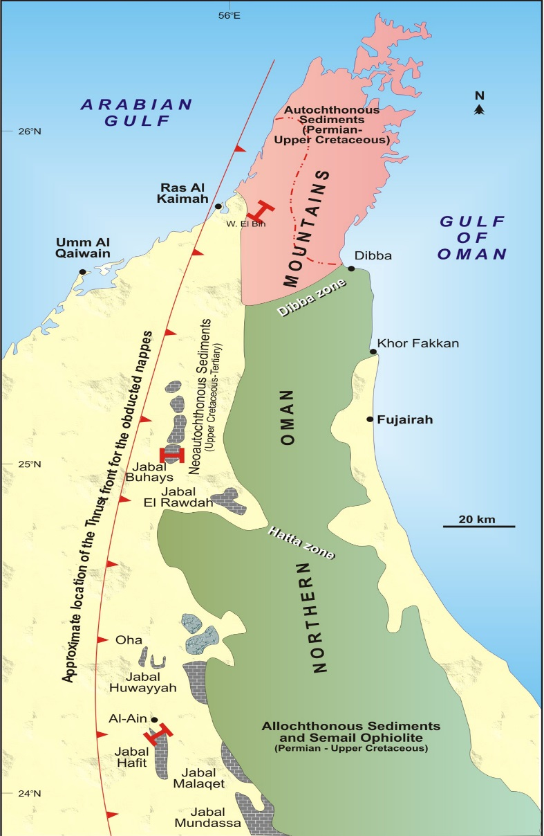
Study Areas & Formations
The investigated samples represent six different formations were collected from three main locations.
Wadi AlBih Area (RAK): Musandam (Jurrassic), Ghalilah (Late Triassic), Shauiba (Early Cretaceous)
“JabelBuhays” Al Fayah Area Muthaymimah (Paleocene – Early Eocene)
Jabel Hafit (AlAin): Dammam (Middle-Late Eocene) and Asmari (Early Oligocene)

Slide 12
Results Discussion
Petrography, mineralogy, chemistry and physico-mechanical properties of the limestone lumps significantly affect the quality of the calcined lime.
The main source of liberated lime is the calcite
Other carbonate minerals like dolomite may occur & results in periclase that has a low hydration rate.
CaCO3 content of the limestone should be > 98.6 % while the SiO2 should be ˂1 % in order to produce highly reactive lime after calcination.
Precalcination porosity of the limestone:
  Provides for uniform distribution of hot gases inside the limestone lump
  Accelerates CO2 escape
Lime that is rich in micro-fracture pores has a higher hydration rate than lime rich in intra-particle pores

Slide 13
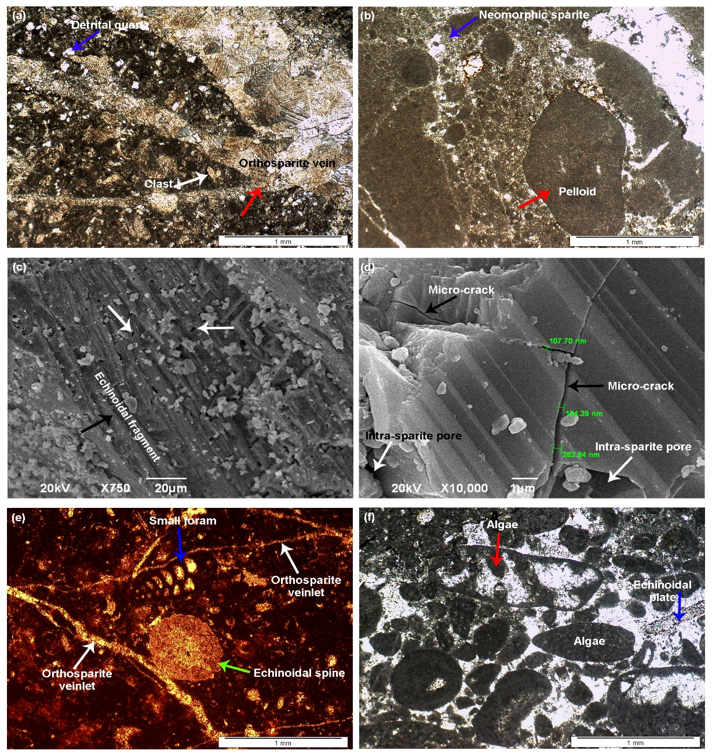
Results - Petrography
Sample | Allochems (%) | Orthochems (%) | Bulk density, g/cm³ | Apparent porosity, (%)
Ghalilah | 20.00 | 80.00 | 2.60 | 2.20
Musandam | 40.00 | 60.00 | 2.80 | 1.60
Shauiba | 55.00 | 45.00 | 2.84 | 2.20
Muthaymimah | 50.00 | 50.00 | 2.60 | 2.00
Dammam | 80.00 | 20.00 | 2.90 | 1.20
Asmari | 70.00 | 30.00 | 2.85 | 1.40
Ghalilah limestone (3a)
Dominated by micrite (80 %)
belongs to the siliceous micrite facies.
Musandam limestone
wackestone-packstone facies (pelbiosparite). 3b, c, d, e
Shauiba limestone
packstone-grainstone (biosparite)
Echinoids, bryozoans and algal (55 %)
3f

Slide 14
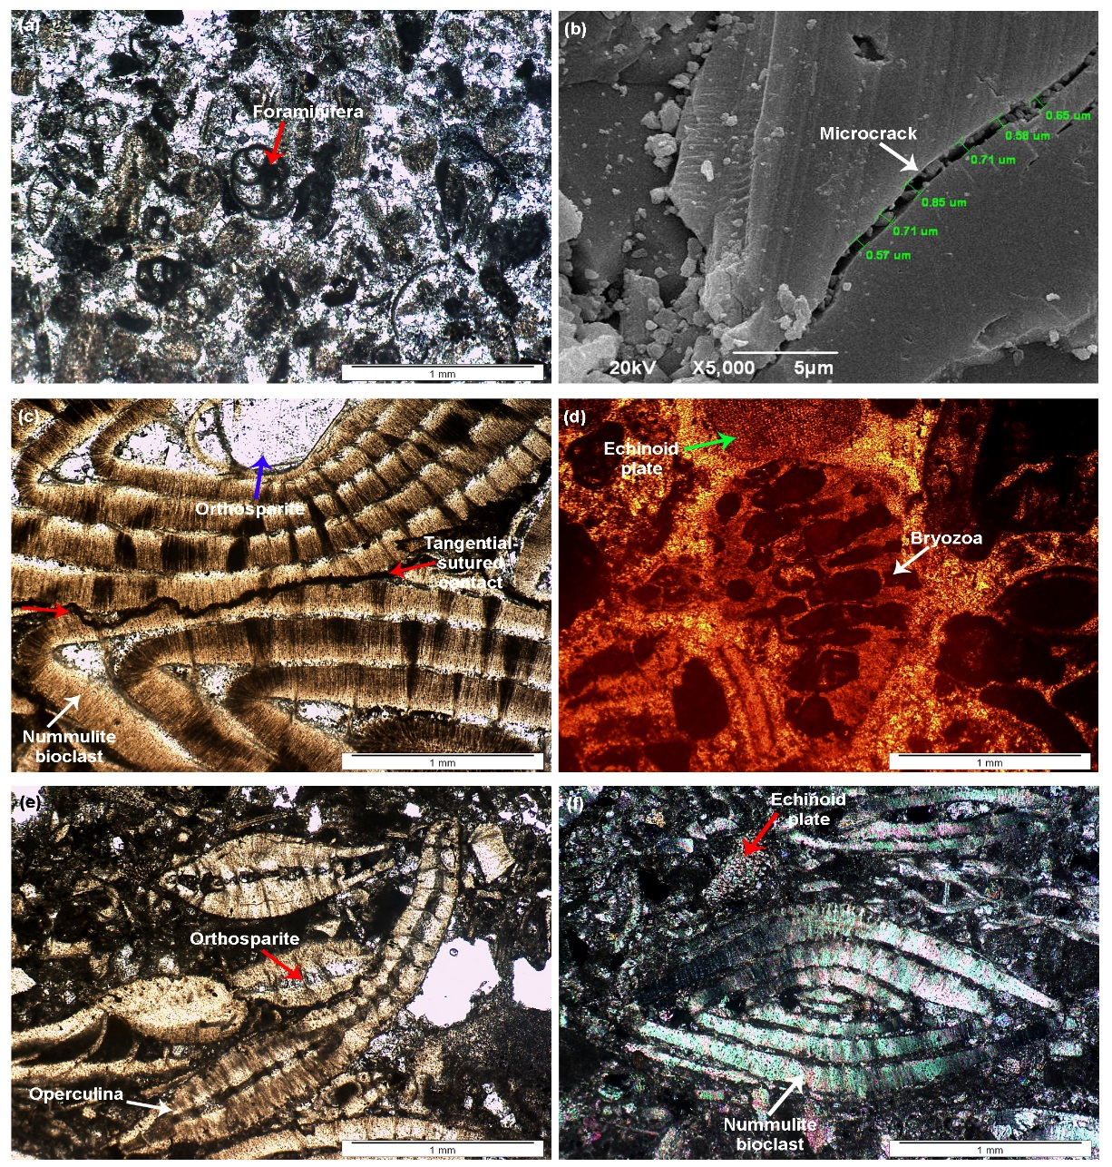
Results - Petrography
Sample | Allochems (%) | Orthochems (%) | Bulk density, g/cm³ | Apparent porosity, (%)
Ghalilah | 20.00 | 80.00 | 2.60 | 2.20
Musandam | 40.00 | 60.00 | 2.80 | 1.60
Shauiba | 55.00 | 45.00 | 2.84 | 2.20
Muthaymimah | 50.00 | 50.00 | 2.60 | 2.00
Dammam | 80.00 | 20.00 | 2.90 | 1.20
Asmari | 70.00 | 30.00 | 2.85 | 1.40
Muthaymimah limestone
Also Packstone-grainstone facies (biosparite). 4a & 4b
Dammam limestone
grainstone facies (biosparite).
Gravel-size rounded nummulite. 4c & d
Asmari limestone
Grainstone-biosparite facies. Similar to Damam. Differs only in its lower orthochem & higher allochem. 4e & f

Slide 15
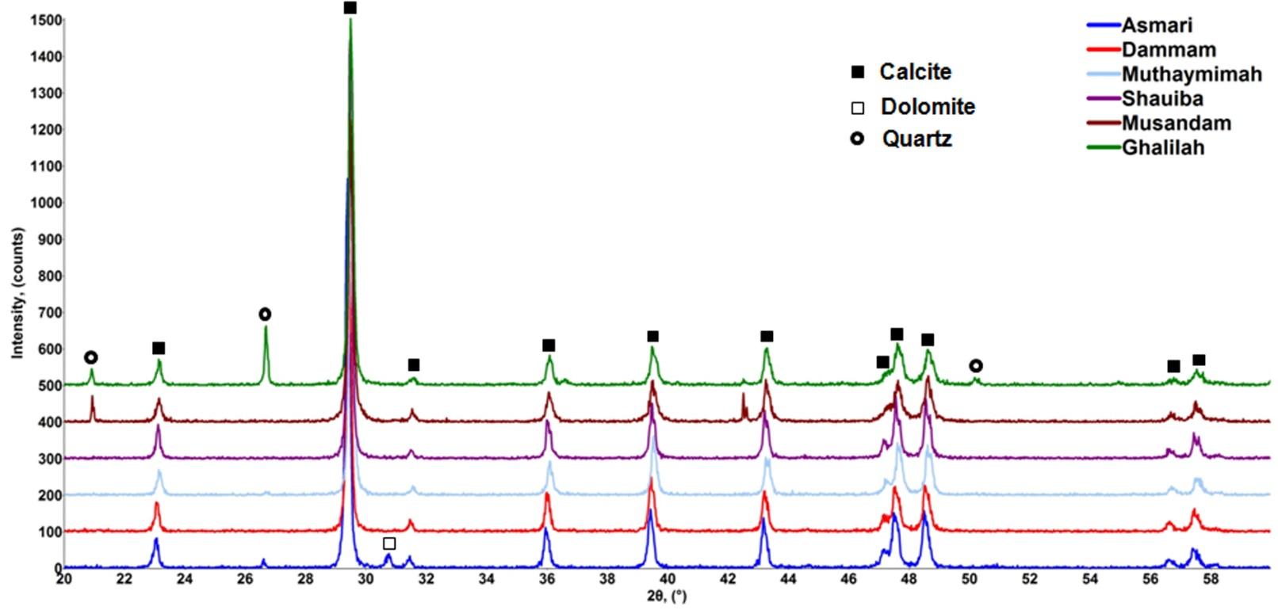
Results - Mineralogy
Calcite is the major mineral in all samples
Quartz is significant only in Ghalilah limestone.
Dolomite is minor or trace in Asmari limestone.

Slide 16
Results - Chemistry
All limestones, except Ghalilah, are a rather homogeneous
The chemical analyses are consistent with the petrography and mineralogy.
CaO (48.15–55.53 %) is the major oxide in all samples due to the predominance of calcite.
The lowest content of CaO (48.15 %) in the Ghalilah limestone is linked with the highest content of SiO2 (12.85 %) due to disseminated quartz grains in the micritic groundmass
Total Impurity Oxides (TIO): (SiO2, Al2O3, Fe2O3, TiO2 and MnO) is also high (~13%) Ghalilah
Sample | SiO₂ | TiO₂ | Al₂O₃ | Fe₂O₃ | MnO | MgO | CaO | Na₂O | K₂O | P₂O₅ | Cl | SO₃ | LOI | TIO
Ghalilah | 12.85 | 0.03 | 0.10 | 0.40 | 0.03 | 0.13 | 48.15 | 0.01 | 0.20 | 0.09 | 0.01 | 0.20 | 37.65 | 13.41
Musandam | 0.09 | 0.01 | 0.01 | 0.04 | 0.01 | 0.11 | 55.52 | 0.01 | 0.01 | 0.06 | 0.01 | 0.16 | 43.62 | 0.16
Shauiba | 0.07 | 0.01 | 0.01 | 0.05 | 0.01 | 0.12 | 55.53 | 0.01 | 0.01 | 0.05 | 0.01 | 0.13 | 43.66 | 0.15
Muthaymimah | 0.25 | 0.01 | 0.02 | 0.06 | 0.01 | 0.14 | 55.42 | 0.01 | 0.01 | 0.07 | 0.01 | 0.15 | 43.50 | 0.35
Dammam | 0.20 | 0.01 | 0.02 | 0.30 | 0.01 | 0.15 | 55.25 | 0.01 | 0.01 | 0.08 | 0.01 | 0.28 | 43.41 | 0.54
Asmari | 0.45 | 0.01 | 0.02 | 0.05 | 0.01 | 0.11 | 55.32 | 0.01 | 0.01 | 0.07 | 0.01 | 0.18 | 43.46 | 0.54

Slide 17
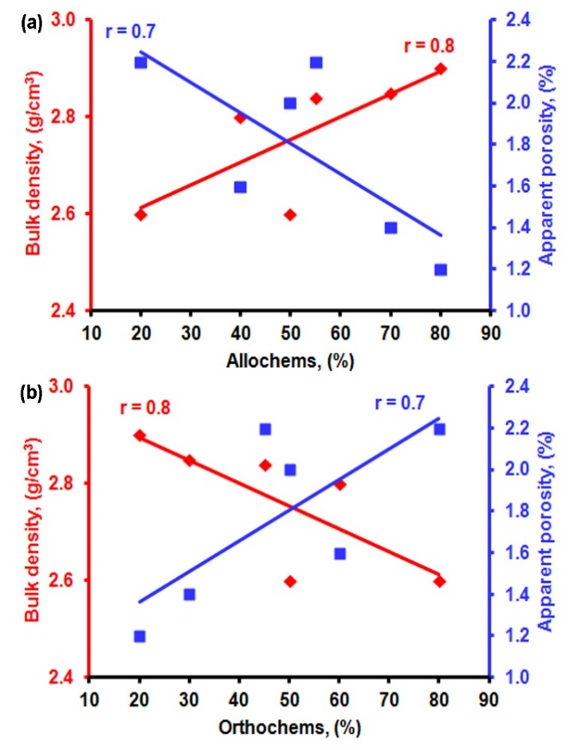
Results - Physical Characteristics
Bulk density : 2.60 - 2.90 g/cm3
Apparent porosity: 1.20 - 2.20 %.
Both characteristics show correlation with the contents of allochems and orthochems of the limestone samples
Increase allochem content → increase bulk density → decrease the apparent porosity.
Increase orthochems → increase apparent porosity.
Sample | Allochems (%) | Orthochems (%) | Bulk density, g/cm³ | Apparent porosity, (%)
Ghalilah | 20.00 | 80.00 | 2.60 | 2.20
Musandam | 40.00 | 60.00 | 2.80 | 1.60
Shauiba | 55.00 | 45.00 | 2.84 | 2.20
Muthaymimah | 50.00 | 50.00 | 2.60 | 2.00
Dammam | 80.00 | 20.00 | 2.90 | 1.20
Asmari | 70.00 | 30.00 | 2.85 | 1.40

Slide 18
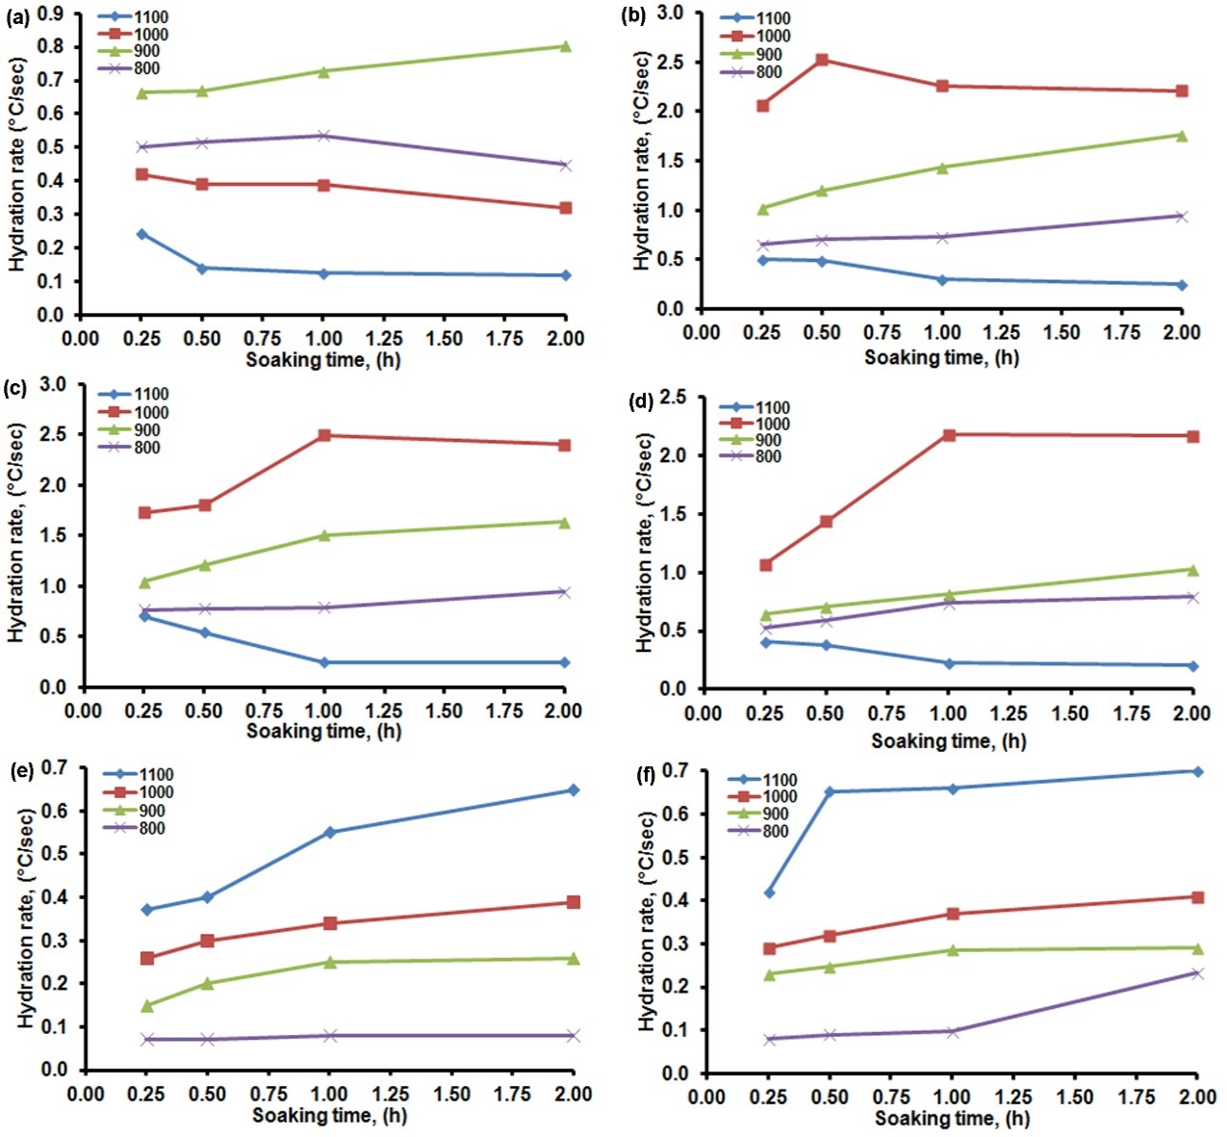
Lime Hydration Rate
Sample | TIO | E, (Kcal/mole) | Hydration rate, (°C/sec)
Ghalilah | 13.41 | 34.38 | 1.80
Musandam | 0.16 | 31.50 | 2.53
Shauiba | 0.15 | 28.00 | 2.49
Muthaymimah | 0.35 | 16.50 | 2.18
Dammam | 0.54 | 14.70 | 0.65
Asmari | 0.54 | 26.00 | 0.70

Slide 19
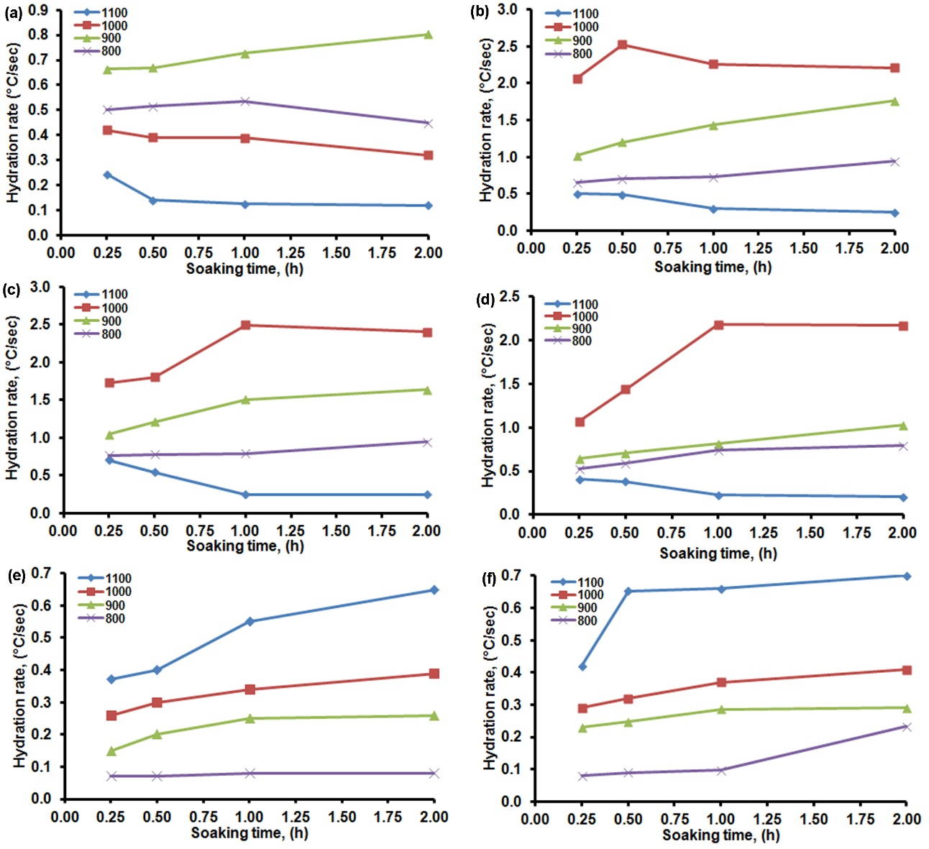
Lime Hydration Rate
The Ghalilah, Musandam, Shauiba & Muthaymimah samples have their lowest hydration rates at 1100 °C-2 h (a-d)
The maximum hydration rates for these four samples are 0.80, 2.53, 2.49 and 2.18 °C/s, respectively, occurring at different firing temperatures and soaking times.
The Dammam and Asmari show maximum hydration rates at 1100 °C-2 h (0.65 and 0.70 °C/s, respectively) (e & f)

Slide 20
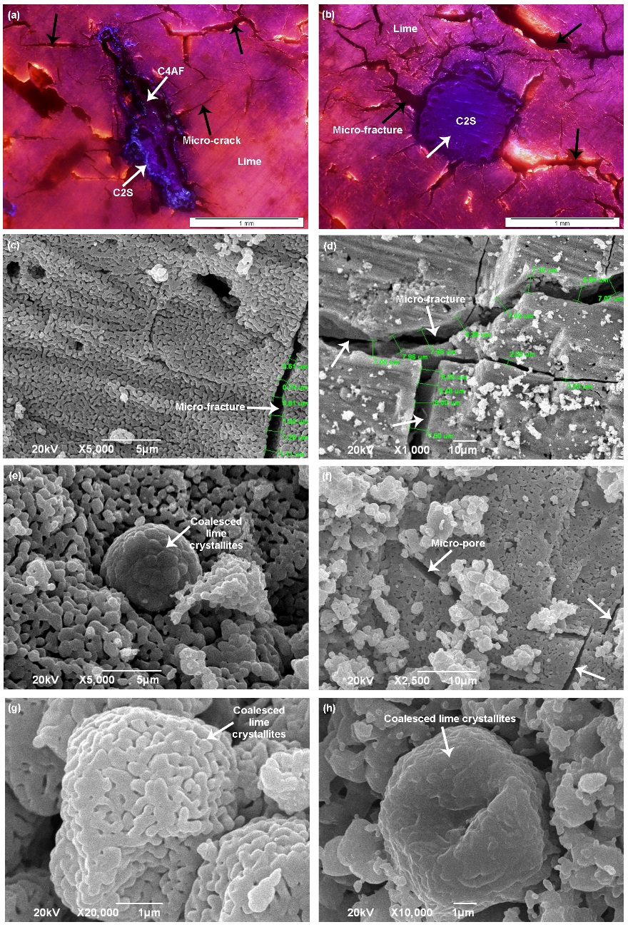
Lime Microstructure
Lime is the main phase in all samples
Di Ca-silicate (C2S) and Ca-aluminoferrite (C4AF) are found in the Ghalilah lime (8a & b).
The lime crystallites are minute (<1 μm) in all samples.
  They show a degree of coalescence in the Musandam (8e), Shauiba (8g) and Muthaymimah (8h) limes, indicating a grain growth “sintering”
Fig. 8

Slide 21
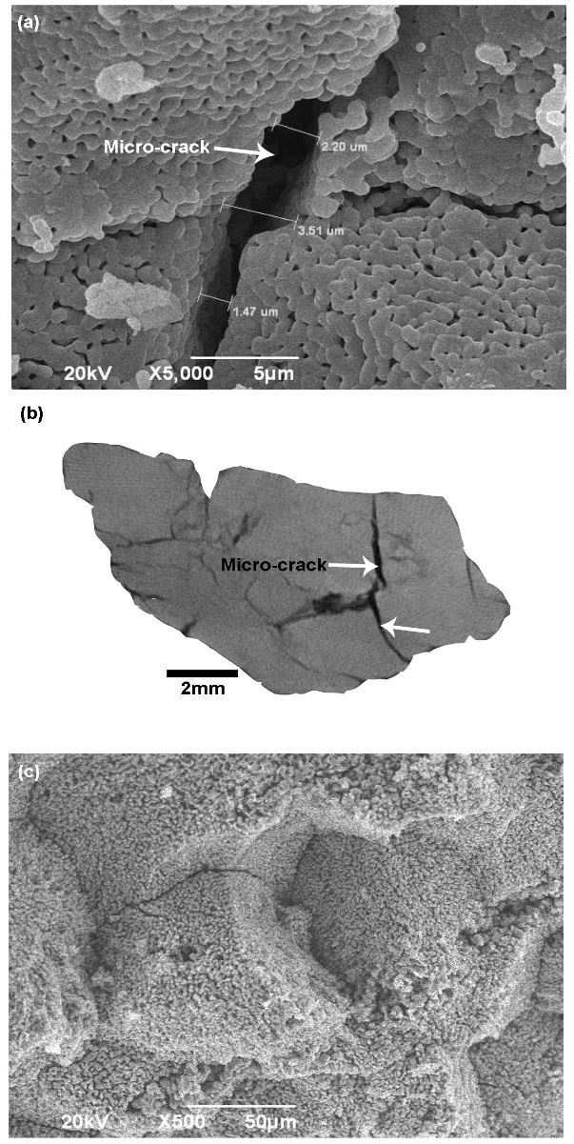
Lime Microstructure
Micro-fractures have developed after calcination in the Ghalilah (8a & b), Musandam (8c), Dammam (9a) and Asmari (9b) limes.
A “ghost” of the pre-calcination limestone microstructure is recorded in the Shauiba (8f) and Dammam (9c) limes.
Fig. 9
Fig. 8

Slide 22
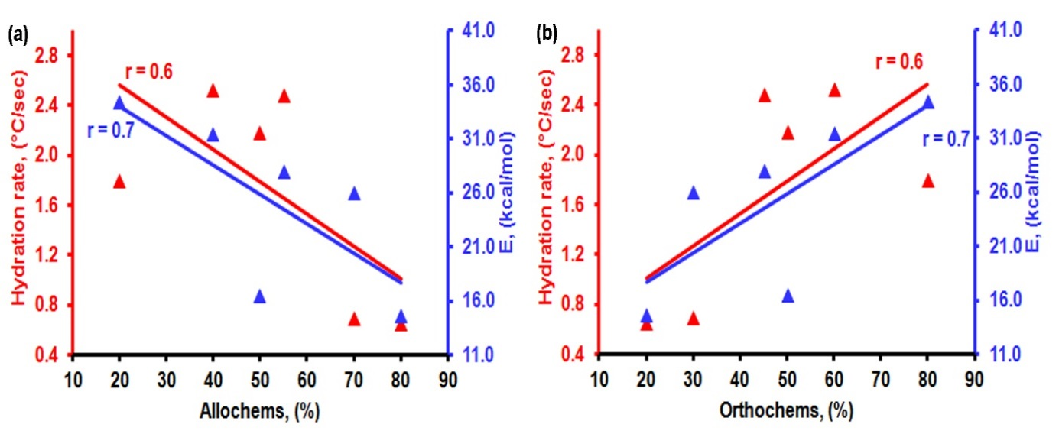
Calcination Activation Energy (E)
The activation energy (E) required for calcination to commence ranges between 14.70 and 34.38 kcal/mol
The impact of both the allochem and orthochem contents on E, hydration rate and the crystallinity of the lime hydration product “portlandite” is shown in this figure.
Sample | TIO | Activation E, (Kcal/mole) | Hydration rate, (°C/sec)
Ghalilah | 13.41 | 34.38 | 1.80
Musandam | 0.16 | 31.50 | 2.53
Shauiba | 0.15 | 28.00 | 2.49
Muthaymimah | 0.35 | 16.50 | 2.18
Dammam | 0.54 | 14.70 | 0.65
Asmari | 0.54 | 26.00 | 0.70

Slide 23
Rationality
Ghalilah
Lime hydration rate is very low rate: attributed to the impure nature of the Ghalilah limestone (~13 % TIO).
The TIO form C2S and C4AF phases that lower the amount of free lime & decrease its surface area.
Musandam
Lime hydration rate is the highest maximum of all, due to:
1. Higher concentration of the easily decomposed structureless
allochems represented by the peloids.
2. Formation of ~7 μm wide microfractures due to the calcination at 1000 °C-0.5 h
Lowest hydration rate at 1100 °C-2 h (0.25 °C/s) mainly due to growth of lime crystallites:
  The greater the crystallite size, the lower the surface area exposed to hydration, thus the lower hydration rate

Slide 24
Rationality
The hydration behavior of both the Shauiba and Muthaymimah limes is comparable.
  Both have their maximum hydration rate at 1,000 °C-1 h firing condition.
  The Shauiba has relatively higher hydration rate than the Muthaymimah due to its lower TIO content (0.16 %) .
  Both samples require longer soaking time, 1 h, for the achievement of their maximum hydration rates compared with the Musandam limestone.
    Due to higher medium-to coarsegrained allochem contents and their closely packed microstructure compared to the Musandam limestone
  The lime microfabric of both samples is very similar.
  At 1,000 °C-1 h they preserve the “ghost” microfabric of the allochems with the of micro-crack pores development:
    These pores facilitate the passage of both hot gases and water during calcination and hydration, respectively.
  At 1100 °C-2 h, the onset of grain growth results in lime crystallites of minimum surface area and lower hydration rates.

Slide 25
Rationality
The Dammam and Asmari limes show contrasting behavior:
  Their maximum hydration rates at 1,100 °C-2 h (0.65 and 0.70 °C/s,
  respectively).
  These very low rates are consistent with incomplete calcination.
    The main reason is the dominance of larger allochems in both.
  The calcination derived micro-and mega-fracture pores did not improve the hydration rate due mainly to the incomplete calcination of samples.
  The latter phenomenon is proved by the preservation of the “ghost” microfabric of the nummulite allochems.
The increase in allochems correlates with decrease in both the activation energy (E) and hydration rates.
The orthochem contents have positive relations with E and the hydration rate.

Slide 26

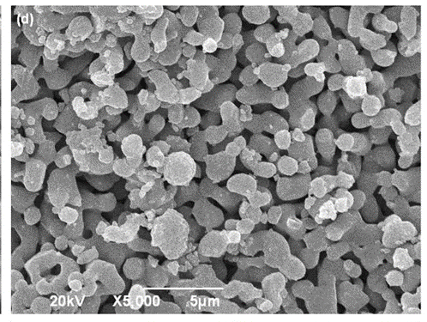
Rationality
The lower E values required for the allochem-rich-limestones imply that the calcination begins “earlier” in the allochems compared to the orthochems:
it requires higher E to initiate orthochem calcination
This could be related to the nature of the allochems in the which have mostly recrystallized walls.
Fig. 10c shows that the allochem-derived lime contains relatively larger lime crystallites compared to the orthochem derived lime (Fig. 10d) at 1,000 °C-1 h, supporting the “earlier” stage of allochem calcination.

Slide 27

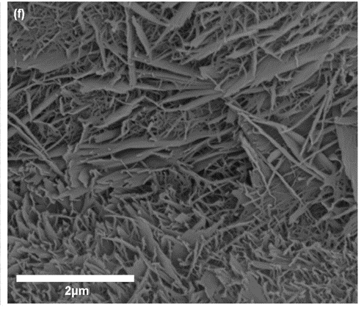
Rationality
Hydration rates directly increase with the increasing content of smaller lime crystallites, i.e., the orthochem-derived lime content.
Figure 10e illustrates the microstructure of the hydrated Musandam lime, which is orthochem-derived lime, at its maximum hydration temperature, after 2 days of hardening.
The hexagonal portlandite (Ca(OH)2) crystals are mostly subhedral.
The microstructure of the hydrated Dammam lime, which is an allochem-derived lime, reveals mainly anhedral and minor subhedral portlandite crystals (Fig. 10f).

Slide 28
Conclusion
Limestone calcination in a laboratory scale had done successfully with very important implications.
Calcite is the major mineral in all samples, with quartz as a major only in the Ghalilah, and dolomite is a minor component in the Asmari.
The chemical composition of all samples is rather homogeneous except Ghalilah.
The allochem contents have positive impact on the bulk density of the samples due to the rarity of pores in the allochems. Increase of orthochems may leads to a general positive trend in apparent porosity
The Ghalilah lime has the lowest maximum hydration rate due to its impure nature before calcination.
The Musandam limestone has the highest maximum hydration temperature due mainly to the smaller lime crystallites and the dominance of the post calcination micro-cracks.
Both Muthaymimah and Shauiba limestones require longer soaking time (1 h) to obtain their maximum hydration rates due mainly to their coarse-grained allochem contents.

Slide 29
Conclusion
Dammam and Asmari limestones need more advanced firing conditions than those applied in this study.
  This is mainly attributed to their high content of gravel-sized allochems.
Higher allochem content correlates with lower activation energy values required for calcination, implying earlier calcination of the allochems.
  This is due mainly to the nature of the allochems which mostly have recrystallized grain boundaries and walls.
Musandam, Shauiba and Muthaymimah limestones may be useful for the production of reactive soft-burnt lime under the applied firing conditions. Dammam and Asmari need advanced calcination conditions. Ghalilah limestone cannot be used for the production of lime.
Additional calcination experiment at higher firing conditions is suggested to verify the possibility of dead-burnt lime production.
The study has proved that petrography, mineralogy, chemistry and physico-mechanical properties of the calcined limestones significantly affect the quality of the resulted lime.

Slide 30
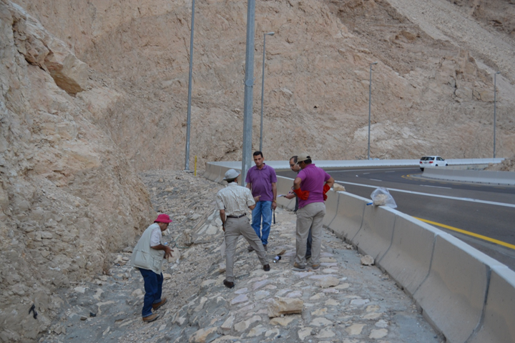
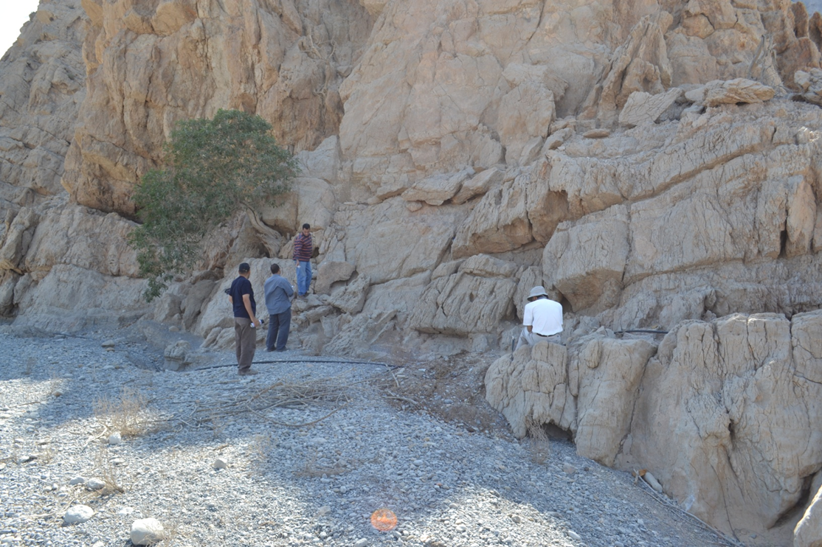
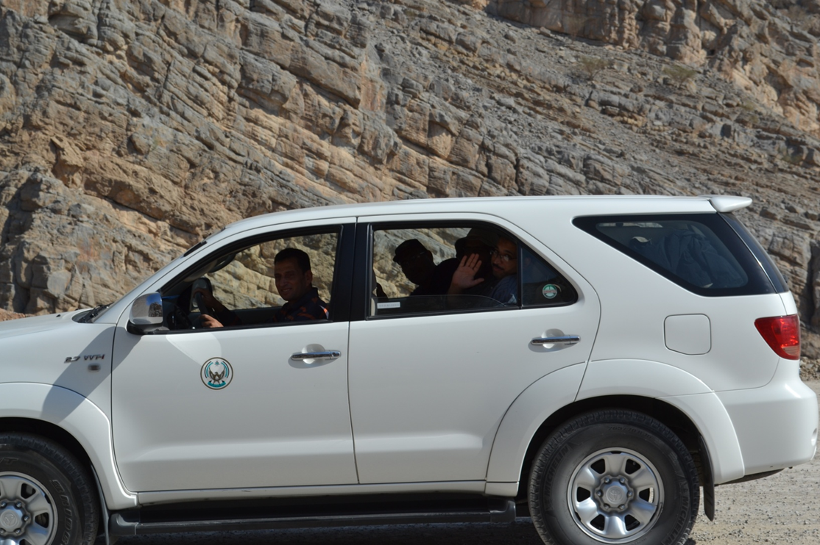
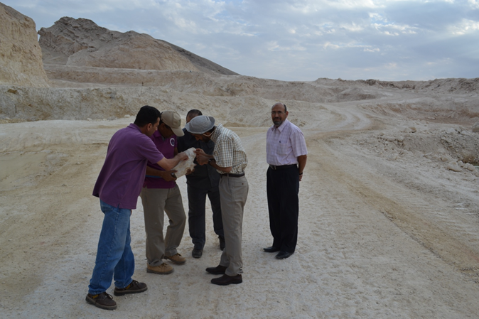
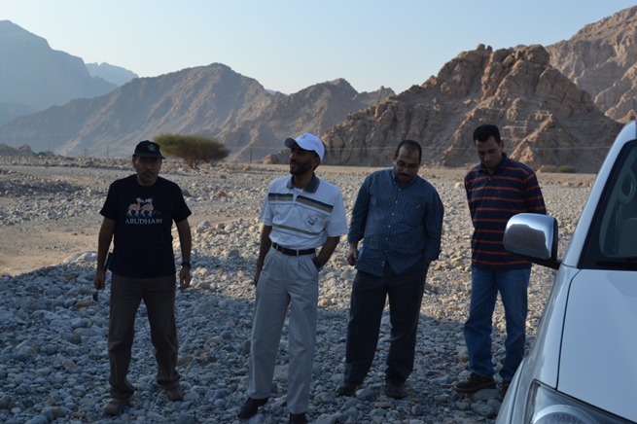
Thank You for the Attendance شكرا لحضوركم
شكرا
Thank You
شكرا
Thank You

