Slide 1


Mesenchymal Stem Cells to Repair Vascular Damage after Chemotherapy: Past, Present and Future
Cell Therapy 2014
Las Vegas, NV, USA
Sulaiman Al-Hashmi, PhD
Sultan Qaboos University
Oman

Slide 2
What are MSCs?
Stem cell capacity
Stromal property
Non-hematopoietic cells
Multipotent cells
0.001 - 0.01% of nucleated cells in BM
Adhere to culture plate
Express variable range of cell markers

Slide 3
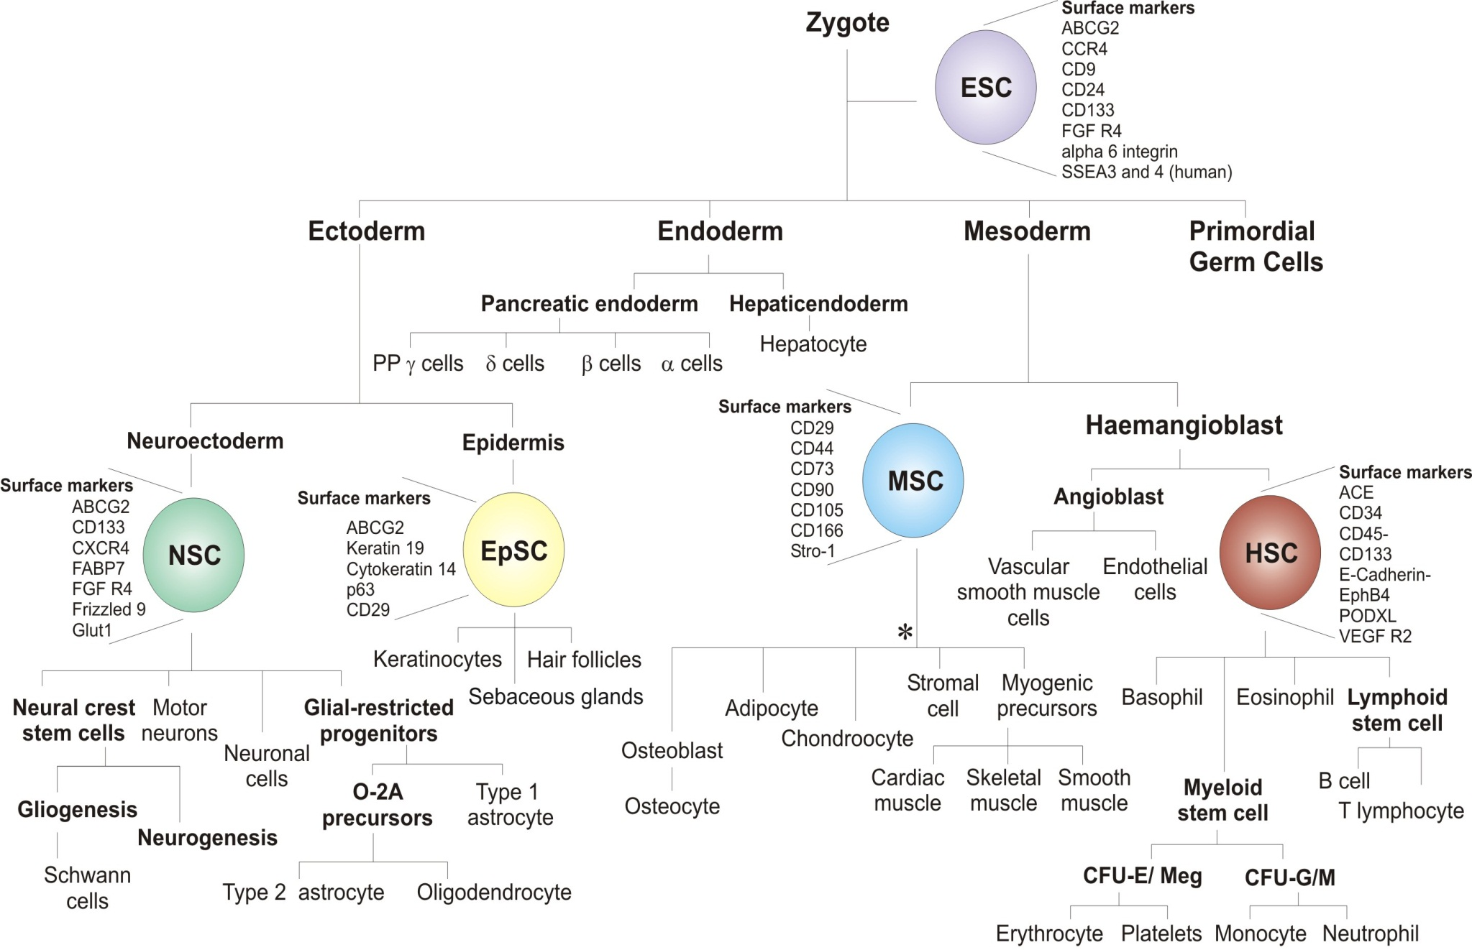

Totipotent
Pluripotent
Multipotent
http://www.york.ac.uk/res/bonefromblood/background/osteogenesis.html

Slide 4
MSCs
Muscle cells
Self renewal
Neurocytes
Adipocytes (Fat)
Chondrocytes (Cartilage)
Osteoblast (Bone)

Slide 5
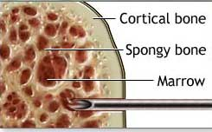
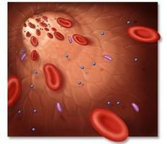
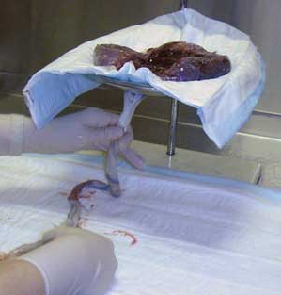
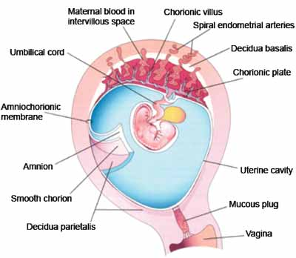
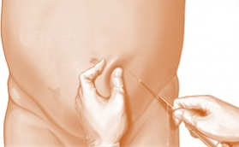
MSC Sources
Bone marrow
Peripheral blood
Cord blood
Placenta and fetal membrane
Adipose tissue
Hass et al 2011; Orbay et al 2012

Slide 6
Common MSC Markers
Negative Markers | Roles
CD34 | Primitive hematopoietic cells and endothelial cells
CD45 | Leukocytes
CD11b and CD14 | Monocytes and macrophages
CD79α & CD19α | B cells
HLA Class II | Antigen presenting cells and lymphocytes
Positive Markers
CD73/5’-Nucleotidase | Catalyzes production of extracellular adenosine from AMP
CD90/Thy1 | Wound repair, cell-cell and cell-matrix interactions
CD105/Endoglin | Vascular homeostasis; modulates TGF-β functions via interaction with TGF-β receptors (RI & RII)
Dominici et al 2006

Slide 7
MSC Clinical Applications
Hematopoietic Stem Cell Transplantation
    Enhance engraftment
    Reduce graft versus host disease
Solid Organ Transplantation
  Improved graft function
  Reduced rejection
Repair Vascular Damage
  Chemotherapy
  Radiotherapy
  Others

Slide 8
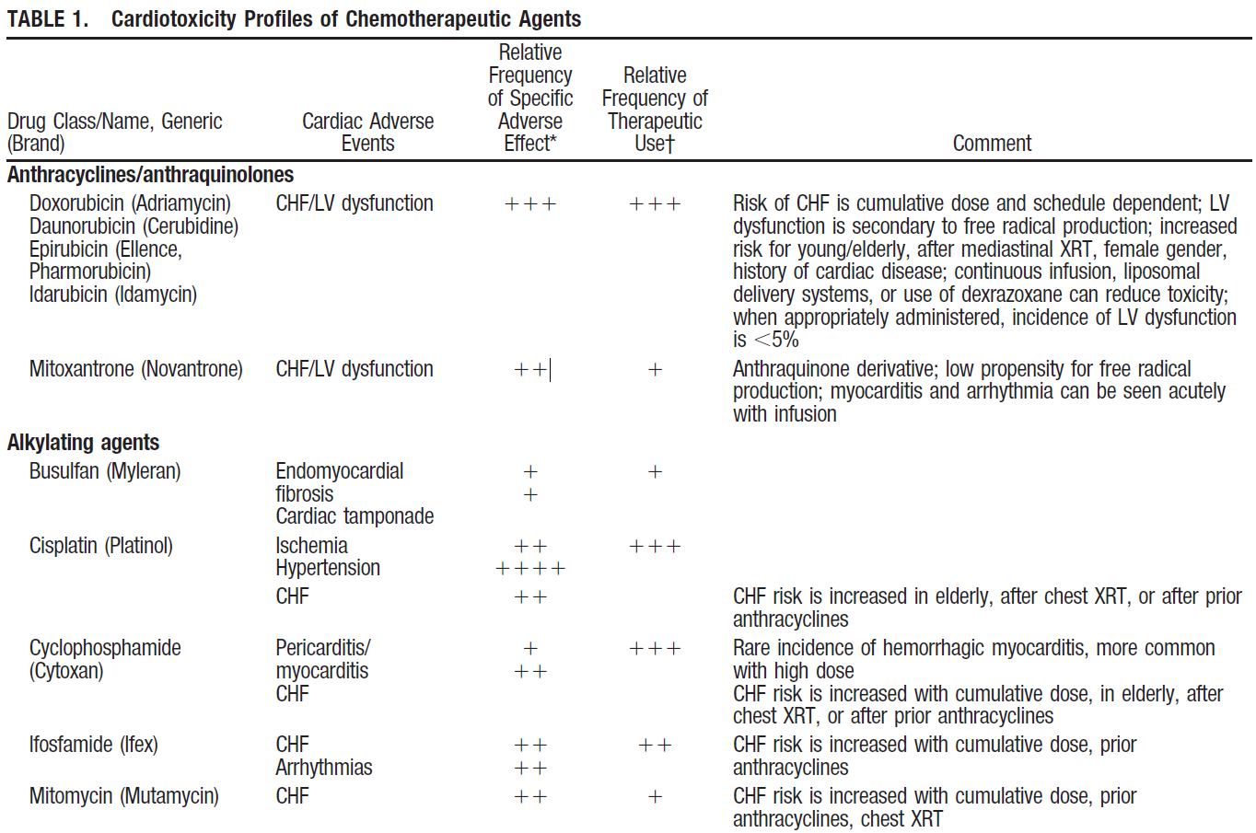
Chemotherapy and Vascular Toxicity
Edward et al 2004

Slide 9
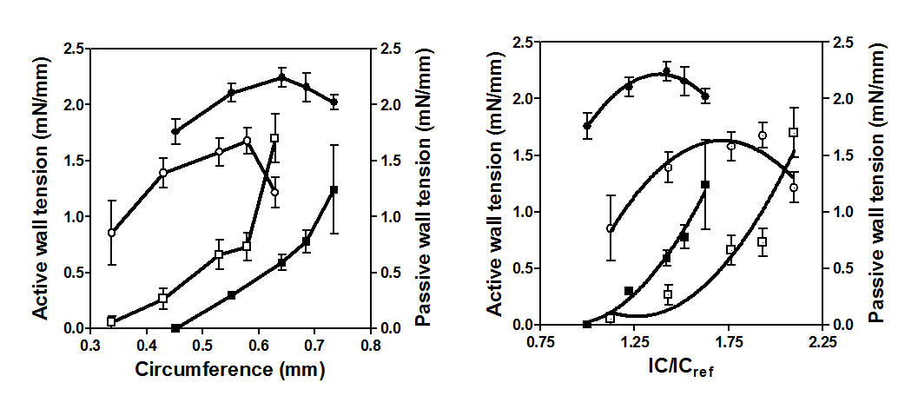
Bu-Cy and Vascular Toxicity
Al-Hashmi et al, 2012

Slide 10
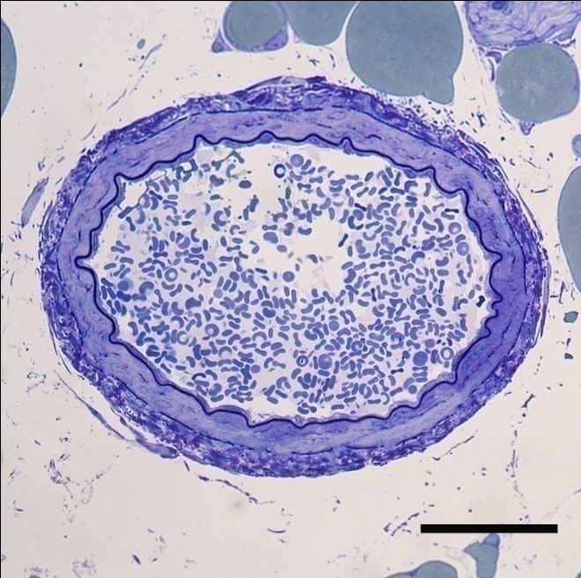
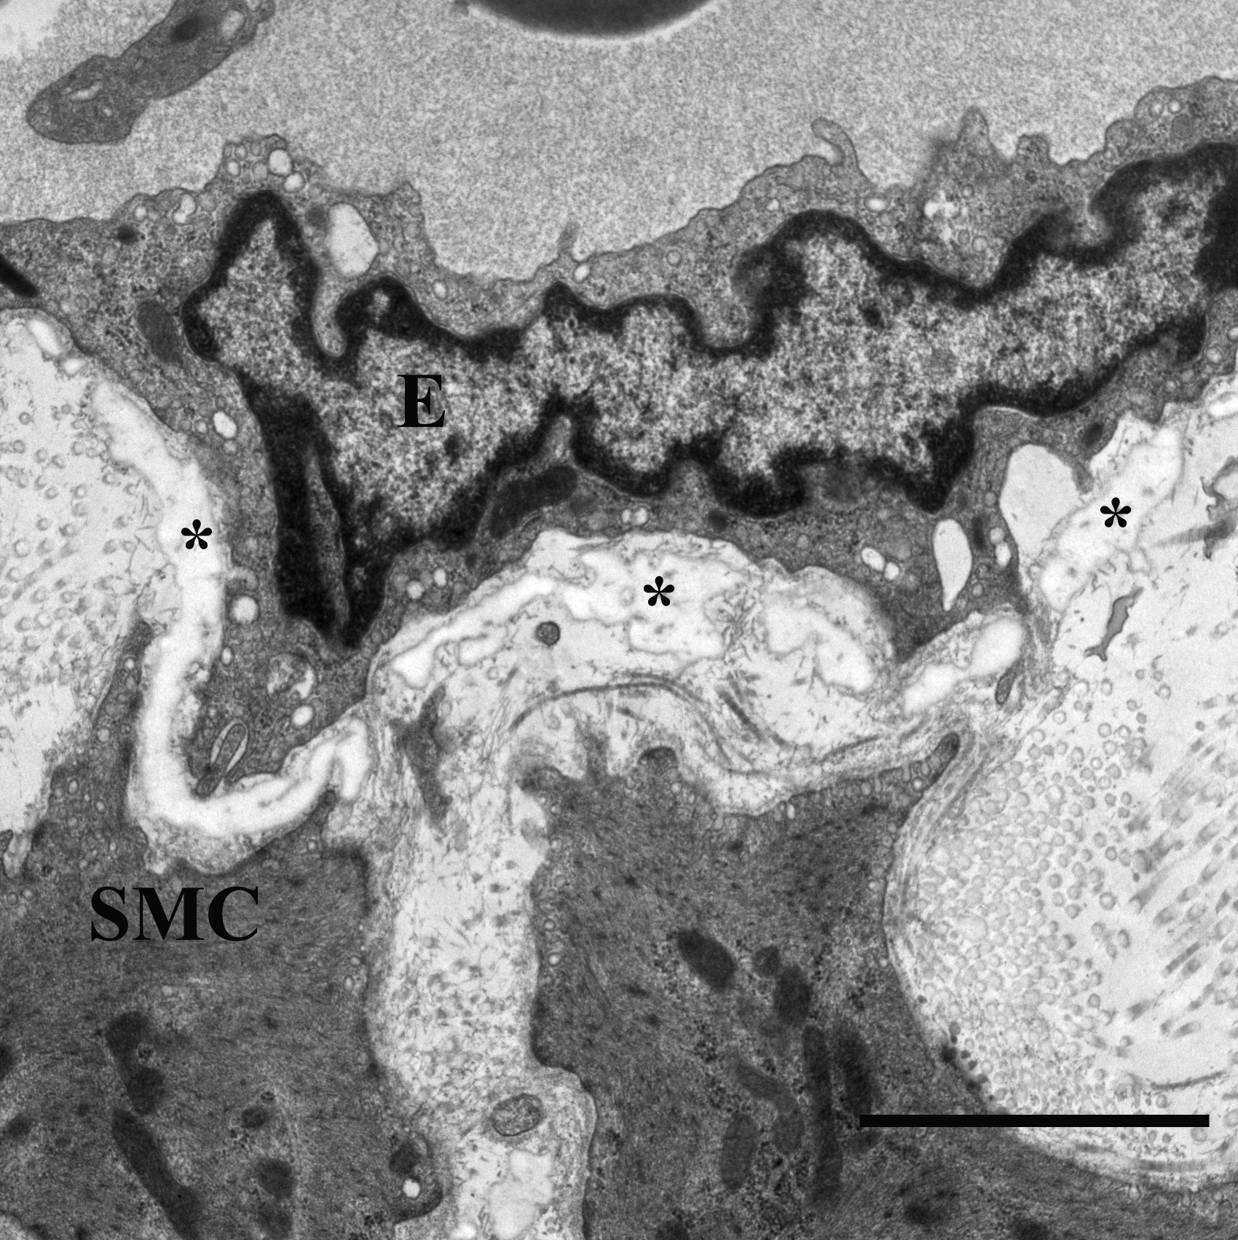
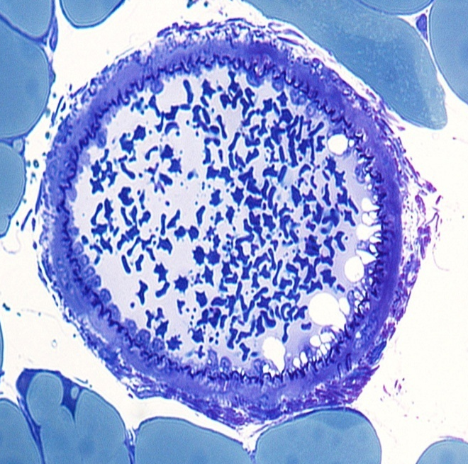
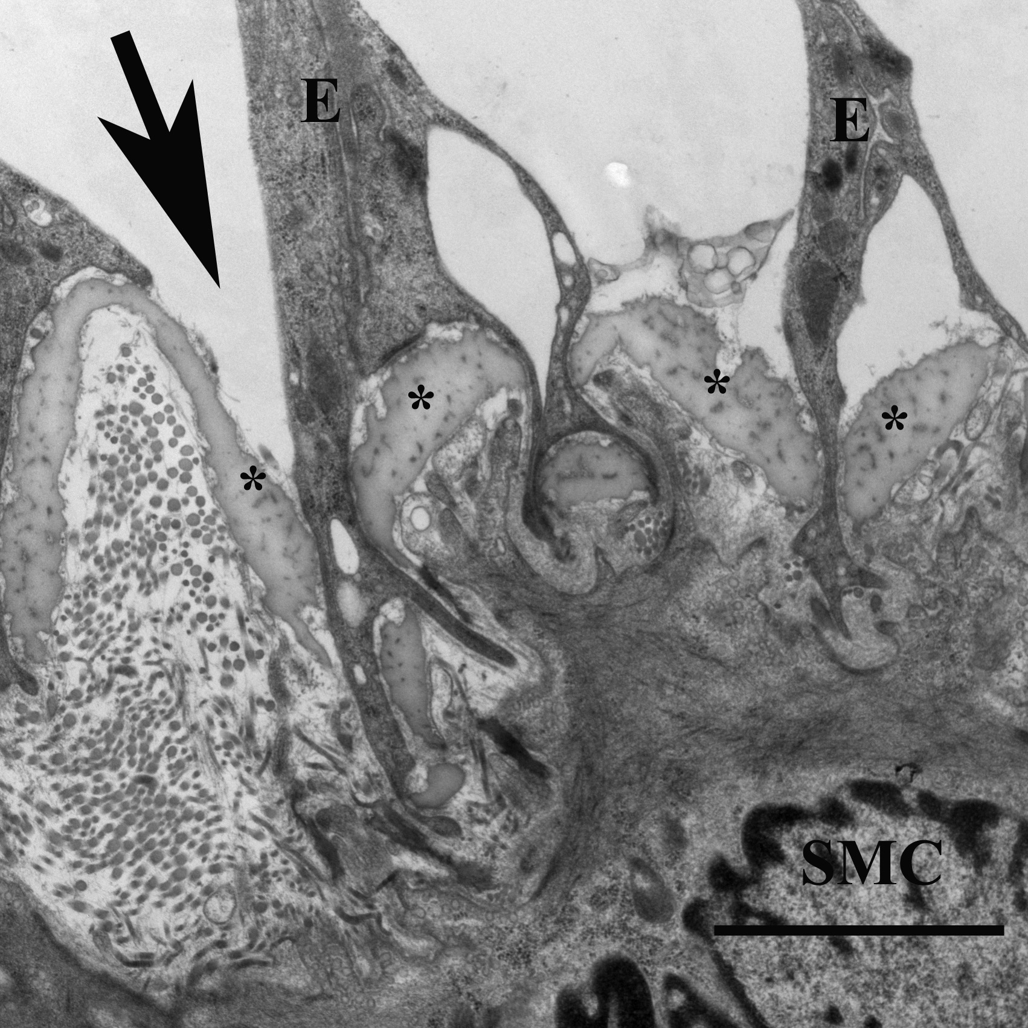
Bu-Cy and Vascular Toxicity
Control
Unbroken endothelial cell-cell contact
uniform endothelial surface
Bu-Cy
Detaching of endothelial cells
Cell-cell contacts were disrupted
rounded and frequently blebs
Al-Hashmi et al, 2012

Slide 11
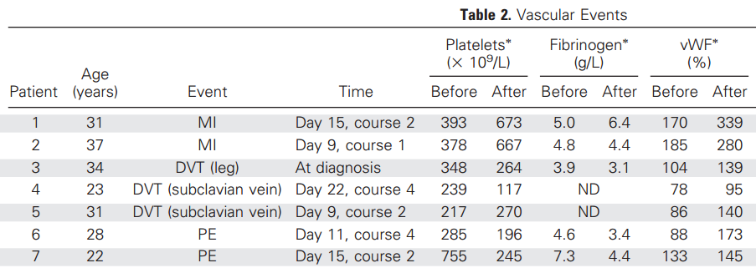
Chemotherapy & Vascular Toxicity
Cisplatin-based therapy
Testicular cancer patients
Before and after chemotherapy
MI, myocardial infarction; DVT, deep vein thrombosis; PE, pulmonary embolism; vWF, von Willebrand factor
Nuver et al, 2005

Slide 12
MSCs and Vascular Repair
MSC Source
  Rat BM
Injury induction
  Ligation of proximal left coronary artery
    MI
MSC infusion
  Infarct area (2 x 10⁶)
Outcomes
  Expressed muscle and endothelium markers
  Improved LV function
Dai et al 2005

Slide 13
MSCs and Vascular Repair
MSC Source
  Canine BM
Injury induction
  Ameroid constrictor placement
    Chronic myocardial ischemia
MSC infusion
  Intramyocardial injections (10 x 10⁷)
Outcomes
  Improved ejection fraction & vascular density
  Increased vascularity
  Improved cardiac function
MSC Differentiation
  SMCs & ECs
Silva et al 2005

Slide 14
MSCs and Vascular Repair
MSC Source
  Porcine BM
Injury induction
  Occlusion followed by reperfusion of the anterior coronary artery
    MI
MSC infusion
  Intramyocardial injections (20 x 10⁷)
Outcomes
  Improved myocardial blood flow
  Improved ventricular & late cardiac functions
  Enhanced blood vessels maturation
  Reduced endomyocardial apoptosis
  Reduced infarct scarring
Schuleri et al 2008

Slide 15
MSCs and Vascular Repair
MSC Source
  Porcine BM
Injury induction
  Carotid artery cannulation
    MI
MSC infusion
  Transendocardial injections (10 x 10⁷)
Outcomes
  Differentiated into cardiomyocytes and vascular structures
  Stimulated endogenous cardiac stem cells proliferation and differentiation
  Stimulated cardiomyocyte replication
  Reduced infarct size
Hatzistergos et al 2010

Slide 16
MSCs and Vascular Repair
MSC Source
  C57Bl/6 mice BM
    Express GSK-3 β
Injury induction
  Carotid artery ligation
    MI
MSC infusion
  Border zone of MI (1.5x 10⁵)
Outcomes
  GSK-3β increased MSCs survival
  GSK-3 β -MSCs induced cardiomyocyte differentiation and angiogenesis
  GSK-3 β–MSCs increased capillary density
  GSK-3 β–MSCs upregulated paracrine factors (VEGF-A)
Cho et al 2011

Slide 17
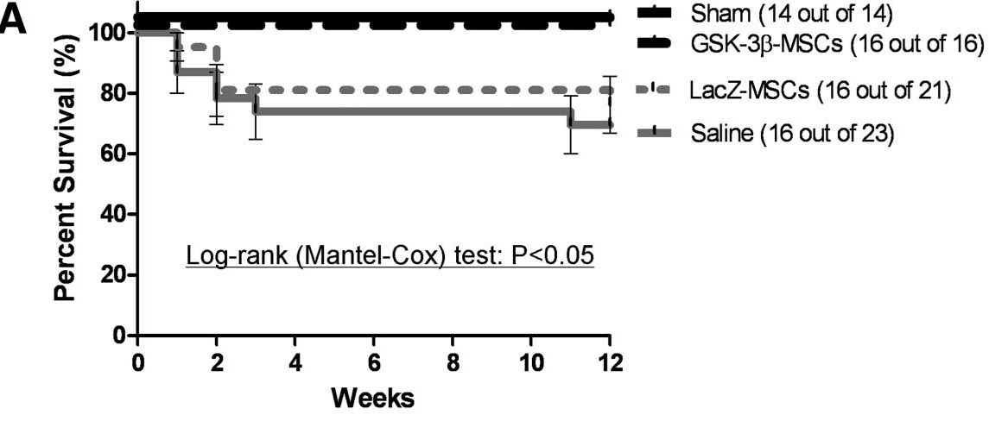
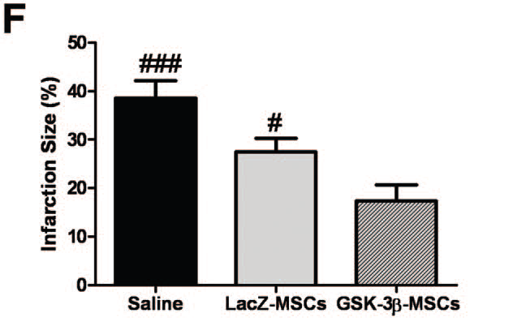
Cho et al 2011

Slide 18
MSCs and Vascular Repair
MSC Source
  C57Bl/6 mice BM
Injury induction
  Removal of endothelium with a flexible wire
    Carotid artery injury
MSC infusion
  IV injection (1 x 10⁵)
Outcomes
  Differentiated into neo-ECs in the injury
  Contributed to vascular remodeling
  Expressed different markers
  Formed the tube-like structure
Li et al 2013

Slide 19
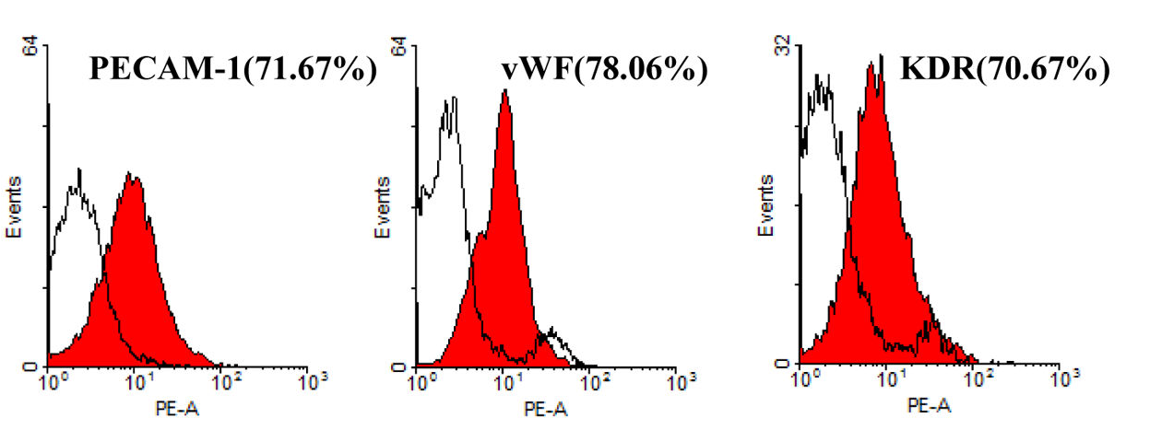
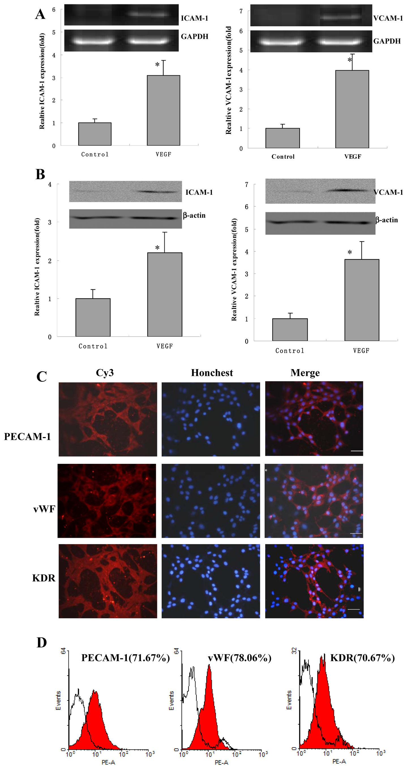
Li et al 2013

Slide 20
MSCs in clinical practice (Meta Analysis)
Searched databases
  PubMed, OVID, EMBASE, the Cochrane Library, and ClinicalTrials.gov
Outcome
  Improved LVEF in patients
Efficacy of Cells in transplantation influenced by
  Source of cells
  Route of infusion
  Type of injury
BMCs & MSCs infusion is a safe and effective therapy to improve vascular repair
Xiao et al 2014; Xu et al 2014; Tian et al 2014

Slide 21
Precautions
Intra-myocardial calcification
Vascular calcification
Increase aortic stiffness
Systolic hypertension
Transient improvement
Unregulated differentiation
Liao et al 2012; Dai et al 2005

Slide 22
Prospective
MSC therapy under intensive investigation
  Establish clinical relevant vascular injury models
  Sources & doses
  Timing
  Protocols
Collaboration
  Type of disease
  Data sharing

Slide 23

Thanks

Slide 25
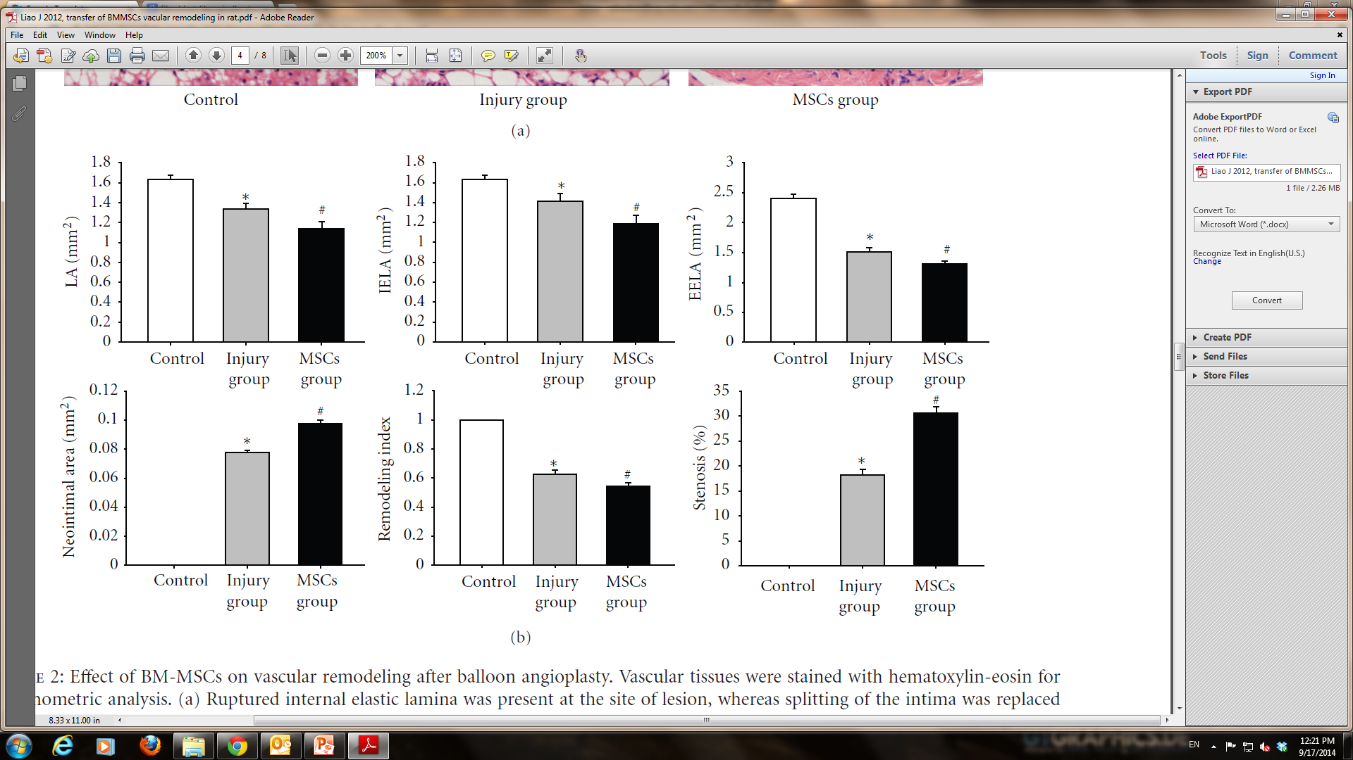
Liao et al 2012

Slide 26
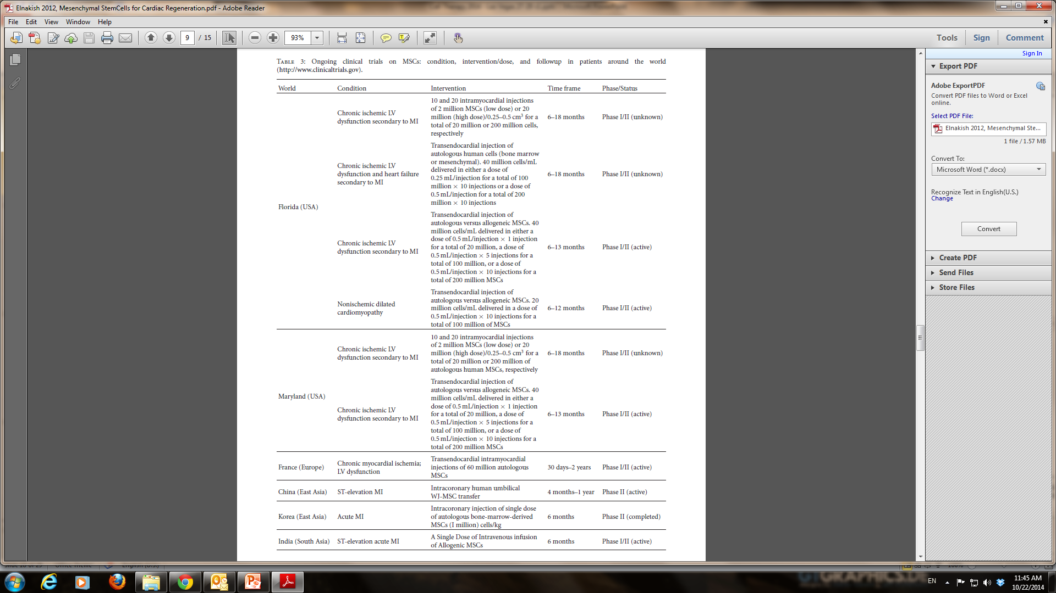
MSCs in clinical practice
Elnakish et al 2012

Slide 27
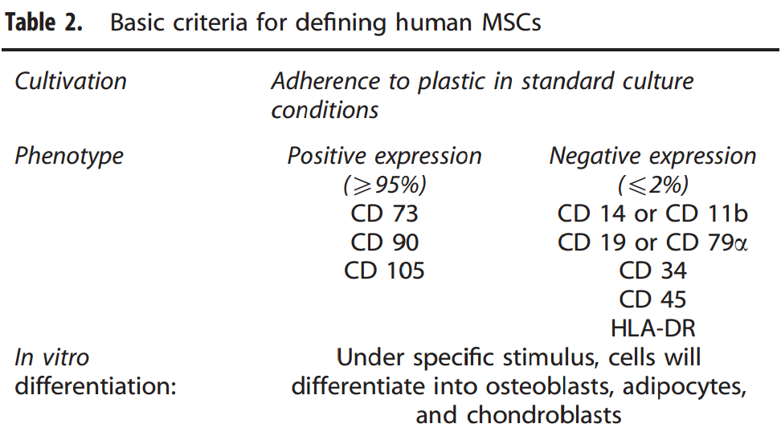
Cancer Gene Therapy (2014), 12 – 23

