Slide 1

Surgical Resection Of Residual
Breast Cancer: Stem Cells that Neoadjuvant
Chemotherapy Leave Behind
SuEllen Pommier, Ph.D., Cynthia Jackson, M.S., Jennifer Peckham, M.S.,
Patrick Muller, B.S., Mary Condron, M.D., Nora Jameson, M.S. and Rodney F. Pommier, M.D.

Slide 2
Breast Cancer Heterogeneity
Breast cancers with similar pathology do not all respond to treatment equally well.
There is a substantial recurrence rate observed in both ER- and ER+ breast cancers, irrespective of the use of chemotherapy or hormonal treatment.
Lancet 2005; 365: 1687-1717
Notes:
Lancet 2005; 365: 1687-1717

Slide 3
There are Two Ways to Treat Breast Cancer
Chemo Naive
NAC
Surgery
Neoadjuvant Chemotherapy
Surgery
Adjuvant Chemotherapy
Residual
Disease?
Assess response

Slide 4
Statistics on Residual Disease (RD)
  RD is still present in 70-90% of patients treated with chemotherapy.
  RD correlates with poorer survival.
Earl H. et al. BMC Med. 2015, 13:234
Notes:
Earl et al. BMC Med. 2015, 13:234

Slide 5
Breast Cancer Stem Cell Research
What cells survive chemotherapy?
Thought that cancer stem and progenitor cells may initiate and maintain the tumor proliferation.
They harbor oncogenic mutations.
May be responsible for high recurrence rate.
Hypothesis: BCSC will be present in RD and harbor oncogenic mutations.
Cancer Res 2006; 66:9339-44
Cancer Res 2008; 68: 3243-50
J Natl Cancer Inst 2008; 100:672-79
J Natl Cancer Inst 2006; 98:1777-85
Notes:
This is best accomplished through the investigation of fresh surgical specimens whenever possible. Cancer Res 2006; 66:9339-9344
1a. Specifically we are examining the role of Cancer Stem cells in these processes.
2. We hope that by our investigation of CSC we will also

Slide 6
Study Design
Objective: To determine correlations between:
BCSC frequencies
BCSC mutations
and residual disease
in tumors treated with neoadjuvant chemotherapy (NAC).
Notes:
-To determine correlations between the frequencies of breast cancer stem cells, their mutations, and their response to chemo,
3 cohorts were enrolled in our study:
38 cancer patients who had not been treated with chemotherapy
11 patients who had been treated w/ chemo
20 healthy breast reduction patients (validated by Pathology benign tissue)
the BCSCs were isolated as described previously and the DNA was sequenced using the Ion Torrent hot spot oncogene panel.

Slide 7
Tissue Samples: Fresh Surgical Specimens obtained from 2 sets of patients
Chemo Naive
NAC
Neoadjuvant Chemotherapy
Surgery
Surgery
Adjuvant Chemotherapy
Notes:
To test this hypothesis we compared tumors obtained from two sets of patients

Slide 8
Patient Demographics, Tumor Characteristics
 | NAIVE | NAC
Patients | n = 37 | n = 11 | SIG.
specimens | N=195 | N = 55
Age (yrs) | 57 | 50 | p = NS
range | 28-90 | 35-64
Tumors | n =39 | n= 11
Stage (%) |  |  | p =NS
I | 16 (41) | 2 (18)
II | 18 (46) | 7 (64)
III | 4 (10.5) | 1 (9)
IV | 1 (2.5) | 1 (9)
Hormone R |  |  | p =NS
ER+PR+/-H2+ | 3 (7.5) | 1 (9)
ER+PR+/-H2- | 30 (77) | 7 (64)
TNBR | 2 (5) | 2 (18)
ER-PR-H2+ | 4 (10.5) | 1 (9)

Slide 9
Treatment Regimens of NAC
No. of patients | Treatments
9 | doxorubicin/cyclophosphamide, followed by paclitaxel
1 | Same as above, plus trastuzumab
1 | Docetaxel; docetaxel/trastuzumab/pertuzumab, trastuzumab/pertuzumab only; denosumab
Notes:
Chemotherapy was uniform

Slide 10
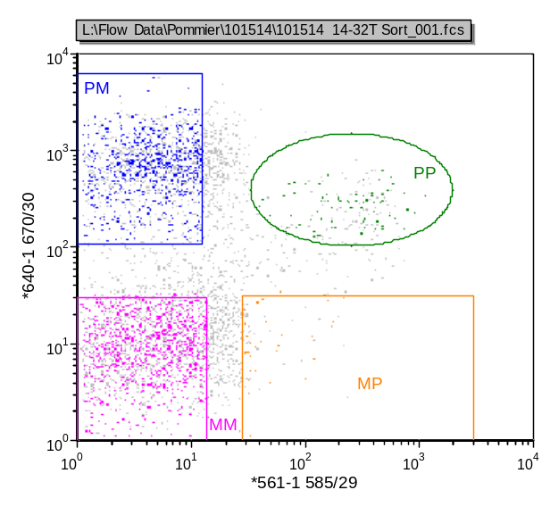
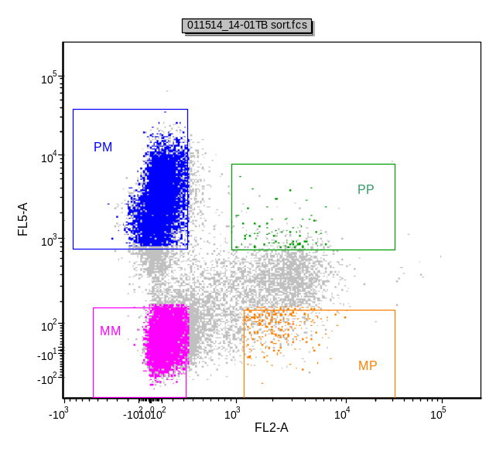
Fluorescence-Activated Cell Sorting (FACS)
Chemo Naive
Post Chemo (NAC)
CD49f
CD24
Notes:
13-35 M, 14-32 T, 14-01 TB

Slide 11
Selection and Quantification of Breast Cells
Remove CD45+ and CD31+ cells
Collect breast stem/progenitor cells
Stem/progenitor Cell Markers:
CD49f
CD24
Measure % breast stem/progenitor markers
CD44
EpCAM
Proc Natl Acad Sci 2003; 100:3983-88
Notes:
CSC can be distinguished from non-tumorigenic stem cells by a variance in the cell surface profile.
Pan Cytokeratin: 4,5,6,8,13, 18
Hemopoietic and endothial cells

Slide 12
GENETICS
BCSCs mutations identified
  Ion Torrent Hot Spot oncogene panels.
ABL1 | EZH2 | JAK2 | PTEN | AKT1
FBXW7 | IDH2 | PTPN11 | ALK | FGFR1
KDR | RB1 | APC | FGFR2 | KIT
RET | ATM | FGFR2 | KRAS | SMAD4
BRAF | FLT3 | MET | SMARCB1 | CDKN2A
GNAQ | NOTCH1 | STK11 | CTNNB1 | HNF1A
NPM1 | TP53 | EGFR | HRAS | NRAS
VHL | ERBB2 | IDH1 | PDGFRA | ERBB4
JAK2 | PIK3CA
Notes:
We used the HotSpot panel to detect mutations in our Breast Cancer and CSC samples. Hotspot regions, including ~2,800 COSMIC mutations of 50 oncogenes and tumor suppressor genes. 300,000- 500,000 reads/specimen; 1800 reads / amplicon; 95% 100x coverage; 50% 500x coverage

Slide 13
Results
Cellular Changes in Post Chemotherapy
Residual Disease
Notes:
We also examined post chem tumor samples to determine what sort of effect Chem has on

Slide 14
Post NAC Vascular Cell Changes: Whole tumor
p=0.04
Notes:
Stem Cells. 2014 Jan;32(1):145-56. doi: 10.1002/stem.1556.
CD44 expressed on cancer-associated fibroblasts is a functional molecule supporting the stemness and drug resistance of malignant cancer cells in the tumor microenvironment.
Kinugasa Y¹, Matsui T, Takakura N.

Slide 15
Pathologic Responses to NAC (N=11)
9/11 patients
2/11 patients
Mostly viable tumor
Densely cellular
Brisk mitotic rates
Patchy response
No treatment effect
Small foci of tumor
Minimal residual

Slide 16
Naïve vs NAC Stromal Cell Changes (%) lin-CD49f-CD24- increase
p=0.04

Slide 17
CD49f-CD24- Cell Populations
% Ave.
Staining

Slide 18
Naïve vs NAC Cell Changes (%)

Slide 19
Stem/progenitor Cell Changes (%)

Slide 20
Stem/progenitor Cell Changes in CD49f and CD24 Expression (%)
Differ in frequency and CD44

Slide 21
EpCam %: Naïve vs NAC Stem/progenitor Cells
CD49f+24+ CD49f+24- CD49f-24+ CD49f-24-

Slide 22
CD44 %: Naïve vs NAC Stem/progenitor Cells
p = 0.024
p = 0.05
Notes:
CD44 inc in 2 of 4 populations
Dependent of CD49f marker.
EpCam not significantly different

Slide 23
Chemo Naïve Vs NAC Stem/Prog Differences

Slide 24
Chemo Naïve Vs NAC Stem/Prog Differences

Slide 25
Clinical Significance?
Lin-CD49f-CD24+
2.43 fold increase
Relative increase of 59%
Genetic component

Slide 26
GENETICS
BCSCs predominant mutations
ABL1 | EZH2 | JAK2 | PTEN | AKT1
FBXW7 | IDH2 | PTPN11 | ALK | FGFR1
KDR | RB1 | APC | FGFR2 | KIT
RET | ATM | FGFR2 | KRAS | SMAD4
BRAF | FLT3 | MET | SMARCB1 | CDKN2A
GNAQ | NOTCH1 | STK11 | CTNNB1 | HNF1A
NPM1 | TP53 | EGFR | HRAS | NRAS
VHL | ERBB2 | IDH1 | PDGFRA | ERBB4
JAK2 | PIK3CA
Notes:
We used the HotSpot panel to detect mutations in our Breast Cancer and CSC samples. Hotspot regions, including ~2,800 COSMIC mutations of 50 oncogenes and tumor suppressor genes. 300,000- 500,000 reads/specimen; 1800 reads / amplicon; 95% 100x coverage; 50% 500x coverage

Slide 27
Prominent Mutations: Naïve Breast Cancer
Tumors, Stem/Progenitor Cells and CAFs
 | PIK3CA | TP53
Pre Chemo n= 38 | 12 (31.6%) | 2 (5.3%)
Total Tumor tissue | 9 (23.4) | 0
CD49f+24+ | 6 (15.8) | 1 (2.6)
CD49f+24- | 4 (10.5) | 0
CD49f-CD24+ | 5 (13.2) | 0
CD49f-CD24- CAF + | 0 | 1 (2.6)
Notes:
SMARCB1 homozygous in Epithelioid sarcoma; ours our heterozygous. In Rabdoid tumor deregulates G1-S transition.
Stk11- serine threonine Kinase in cervical cancer
PI3K (HRAS) pathway disruption seen in many cancers
PDGFRA:tyrosine kinase receptor These growth factors are mitogens for cells of mesenchymal origin. plays a role in organ development, wound healing, and tumor progression and stromal tumors
MET: proto-oncogene tyrosine-kinase activity papillary renal carcinoma.
Includes samples:
12-110 T 13-04 T 13-10 T Core 13-25 T 13-29 T 13-50 T 14-02 T 14-09 T 14-11 T Core 14-12 T 14-13 T 14-18 T 14-19 T 14-21 T 14-32 T 14-33 T 14-35 T 14-42 T 14-44 T

Slide 28
Prominent Mutations: Following NAC treatment
Tumors, Stem/Progenitor Cells and CAFs
 | PIK3CA | TP53
NAC n= 11 | 4 (36.4%) | 4 (36.4%)
Total Tumor tissue | 4 (36.4) | 2 (18.2)
CD4f+24+ | 1(9.1) | 1(9.1)
CD49f+24- | 1 (9.1) | 1(9.1)
CD49f-CD24+ | 3 (9.1) | 2(18.2)
CD49f-CD24- CAF + | 0 | 1(9.1)

Slide 29
Contribution of Genetic Mutations
Cell Population | Relative Increase Cells/tumor | Mutation Incidence %
CD49f+ CD24- | Constant; Inc.CD44
CD49f-CD24+ | 59% | 31.6 - 36.4
CD49f-CD24- CAF+ | 24.5% | 5.3 - 36.4
In NAC tumors:
BCSC populations remain constant or increase in cell number
Mutation incidence higher in post-chemo tumors
Mutations are distributed throughout the different BCSC populations and more prevalent
Notes:
13-35 M, 14-32 T, 14-01 TB

Slide 30
Summary
RD found in the majority of breast cancer patients treated with neoadjuvant chemotherapy.
Histopathology found little effect from NAC treatment.
NAC tumors contained viable cells.

Slide 31
Summary
Increase in the frequency of PIK3CA and TP53 mutations NAC tumors vs Naïve.
Increase in cancer stem/progenitors cells in NAC tumors that harbor these mutations.
There may be a cumulative effect.
J Natl Cancer Inst 2008; 100:672-79

Slide 32
Conclusion
Stem/progenitor cells are present in RD.
They are viable, increased in number, and harbor higher mutation frequencies.
These findings may explain the higher recurrence and poorer survival rates in patients with RD.

Slide 33

Acknowledgements
Surgical Oncology Fellow
Rodney Pommier, MD Mary d'Alelio
Arpana Naik, MD Statistics
John Vetto, MD Knight Cancer Inst. Core
Plastic and Reconstructive Surgery
Juliana Hansen, MD
Pathology
David Sauer, MD Funding Megan Troxell, MD Janet E. Bowen Foundation
Lab Personnel
Patrick Muller, BS
Jennifer Peckham, MS
Cynthia Jackson, MS
Nora Jameson, MS

Slide 35
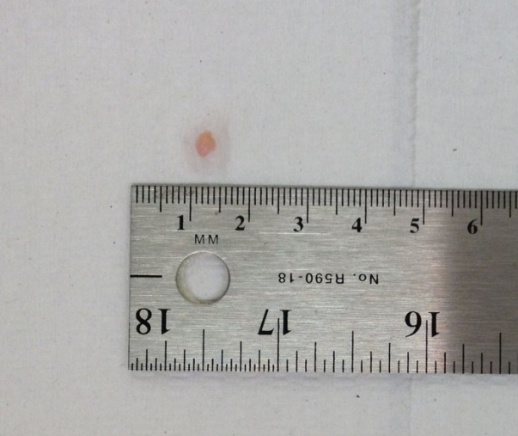
Surgical Specimen Sample Size
BrCa:
naïve: 0.05 -1.0 g
NAC: 0.01-1.0g
Reduction: 0.7- 3.0 g
Adequate: 0.2 g

Slide 36
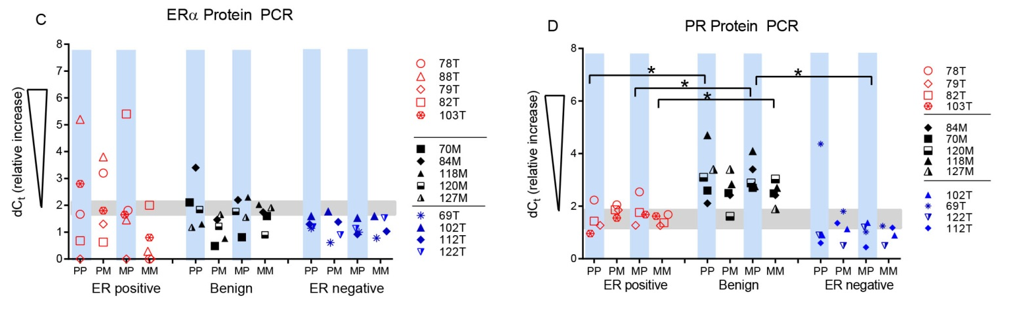
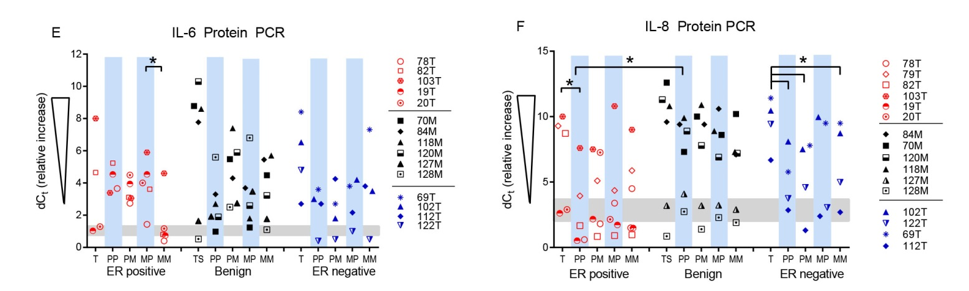
PROTEIN RESULTS
Patient variation
CSC are ER and PR
negative
Patient variation
Similar to benign
Notes:
These graphs represent our results .
If cells fall Below the gray bar CSC they are ER neg. CSC are ER neg even among ER+ tumors. Some patient variation but over, quite negative.
The same is true for the PR. IL-6 and Il_8 mediators of ER activity

