Slide 1


A study on the MSWI fly ash modifying for inorganic gel of cement admixtures
2nd World Congress and Expo on
Recycling
Berlin, Germany, July 25-27, 2016.
Sue-Huai Gauª, Chang-Jung Sun^{b}, Ming-Guo Liª and Yen-Hsun Leeª
Tamkang University
Taoyuan Innovation Institute of Technology
Taiwan, ROC.

Slide 2
Outline
1
Background
2
Methods
3
Results and Discussion
4
Conclusions

Slide 3

Background

Slide 4
Background
Municipal solid waste incinerator (MSWI) fly ashes contain high concentrations of heavy metals and dioxins, which are defined as hazardous wastes usually.
Solidification followed by designated landfilling has been popular used in the world, but the long term stability still be worried about.
Zero-Waste or Zero-Landfill policy has been ask in many countries, therefor, there were many studies discussed with the recycling of the MSWI fly ash, while seldom of then were commercialized.

Slide 5
Background
Eco-cement and melting technologies have been developed in Japan for three decades already, but still been questioned a lot today.
Dioxin could be destroyed in the high temperature of cement kiln, but most of the heavy metals will evaporated in the form of chloride compounds, increased the hazard of fly ash in the APCD.
MSWI fly ashes have the characteristics of pozzolanic property, but applied as the substitute of cement directly is not feasibly due to the impurities in it.

Slide 6
Background
Washing followed by wet ball milling had been proved to have the ability to elevate the pozzolanic property and destroy Dioxin effectively, due to the mechno-chemical reaction.
The pozzolanic material could be activated by alkali hydroxide accompanied with sodium silicate, which could produce an inorganic gel material to elevate the strength during cementing.

Slide 7
Background
In this study, the silicate component comes from metakaolin, calcium comes from washed MSWI fly ash, and the activation were executed by wet ball milling under the sodium hydroxide solution, after drying, the product was used as the cement admixture.

Slide 8
Methods

Slide 9
Methods
Fly ash was collected from the reaction product of a 1,350 ton/d MSW mechanical grate incinerator operated around 950 ºC, with semi-dry and bag-filter system.
Ash washing was carried out twice with distill water in a liquid to solid ratio 5 for 5 min.

Slide 10
Methods
Metakaolin was adopted the industrial grade of kaolin from Yun-nan China. After drying, calcining at 550 ºC for 1.5 hr, then 700 ºC 3hr.
Conventional ball-milling machine were used, the liquid to solid ratio was 9 during the milling of the mixed ash, the ball miller were operated below the critical speed.

Slide 11
Results and Discussion

Slide 12
Table 1 The properties of MSWI fly ash and metakaolin
 | pH | Moisture content (%) | Ignition loss (%) | D₅₀ (μm)
Raw fly ash | 11.28 | 1.03 | 3.38 | 7.38
Washed fly ash | 12.15 | 2.8 | - | 7.07
Metakaolin | 4.37 | 0.5 | - | 8.92

Slide 13
Table 2 Elements
Elements | Washed fly ash |  | metakaolin
Ca | 32.4 |  | 0.09
Si | 2.03 |  | 19.3
Al | 0.61 |  | 16.7
Mg | 1.06 |  | 0.07
Fe | 0.72 |  | 0.71
Na | 0.62 |  | 0.54
K | 0.46 |  | 1.22
 |  |  | Unit：wt.%
Table 3 Heavy metals content
Elements |  | Washed fly ash |  | metakaolin
Zn |  | 18,400 |  | 124
Pb |  | 3,170 |  | 352
Cd |  | 207 |  | N.D. ª
Cr |  | 281 |  | 90
Cu |  | 3,450 |  | 438
ªN.D.：Not detectable |  |  |  | Unit：mg/kg

Slide 14
Table 4 TCLP leaching concentration
Elements |  | Washed fly ash |  | metakaolin |  | Hazardous waste standard
Zn |  | 1.84 |  | 0.14 |  | -
Pb |  | 7.69 |  | 0.3 |  | 5
Cd |  | N.D.ª |  | N.D. |  | 1
Cr |  | 0.06 |  | N.D. |  | 5
Cu |  | 0.11 |  | N.D. |  | 15
ªN.D.： No detectable (Pb=5 ppb, Zn=0.3 ppb, Cu=0.6 ppb, Cd=0.35 ppb, Cr=0.5 ppb) |  |  |  |  |  | Unit：mg/L

Slide 15
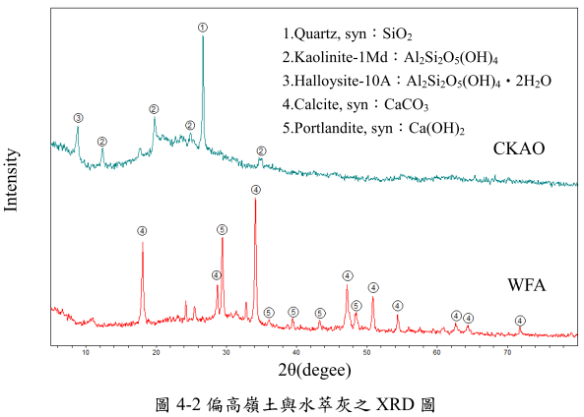
Fig. 1 XRD pattern

Slide 16
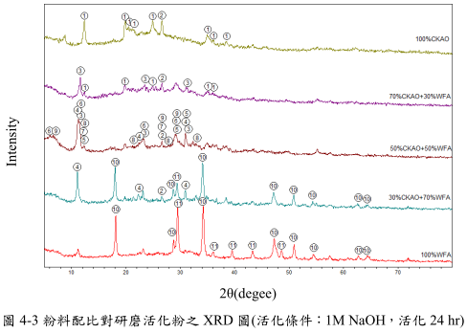
Fig. 2 XRD pattern of active powder ( 1M NaOH, 24h)

Slide 17
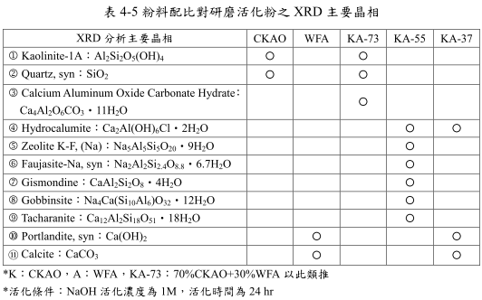

Fig. 5 XRD crystalline of milling activation
XRD crystalline phase
and so on
* Activation： 1M NaOH 24h

Slide 18
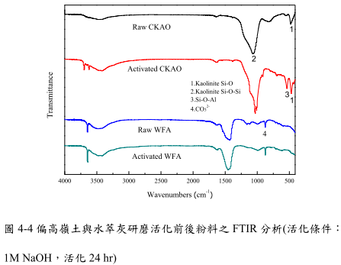
Fig. 3 FTIR pattern (1M NaOH, 24h)

Slide 19
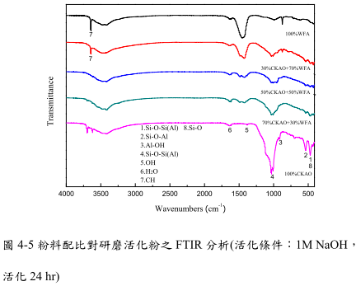

Slide 20
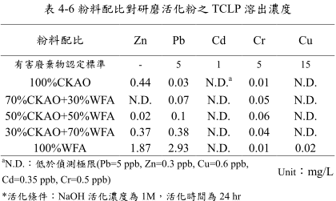
Table 6 TCLP leaching the activation powder ( 1M NaOH 24h)
Powder ratios
Regulation
Not detectible

Slide 21
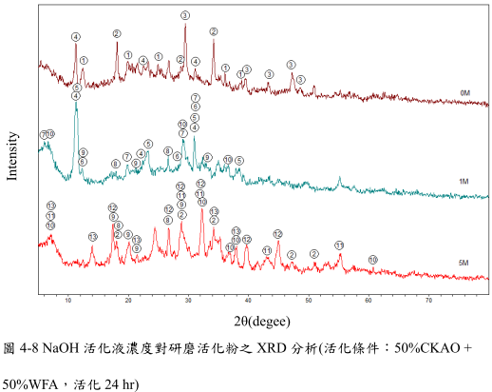
Fig. 4-8 The XRD pattern of milled active powder treated by NaOH active solution (50% CKAO + 50%WFA, 24h)

Slide 22
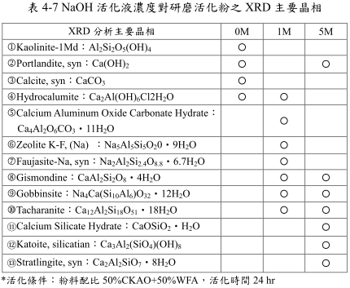
Table 7 XRD crystalline of milling activation powder in NaOH solution
XRD crystalline phase
Activation: 50% CKAO + 50%WFA, 24h of milling

Slide 23
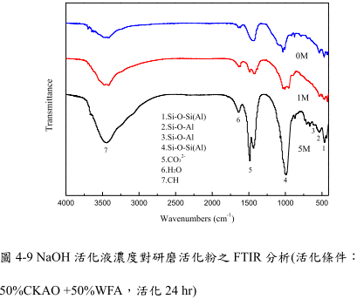
Fig. 4-9 FTIR pattern of the milling activation (50% CKAO + 50%WFA, 24h)

Slide 24
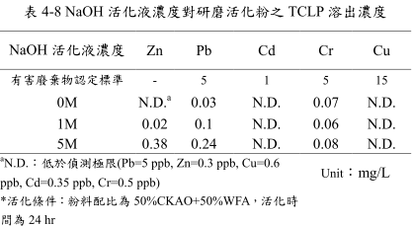
Table 8 The TCLP leaching of the milling activation powder
NaOH active solutions
Limitation
Not detectible
Active parameter： 50% CKAO + 50%WFA, 24h of active time

Slide 25
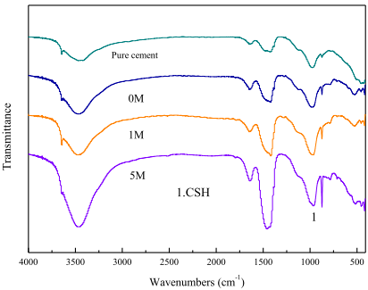
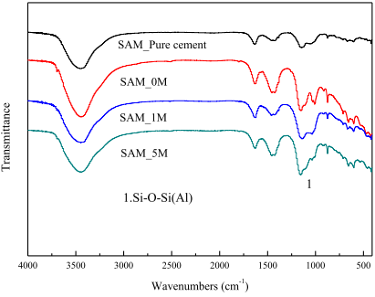
活化液濃度對活化粉取代水泥之影響(1/1)
NaOH活化液濃度對研磨活化粉取代水泥10%之28天水泥漿體與28天水泥漿體經SAM前處理之FTIR分析
活化粉條件：
1.50%CKAO+50%WFA
2.活化24 hr
Pure cement ：養護28天純水泥漿體
SAM：水楊酸-甲醇萃取前處理

Slide 26
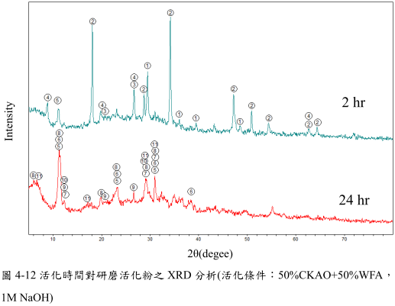
Fig. 4-12 XRD pattern of milled active powder in different active time (50% CKAO + 50%WFA, 24h)

Slide 27
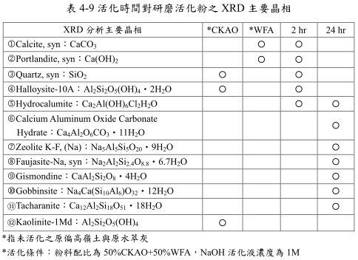
Table 9 XRD crystalline of milling activation powder
XRD crystalline phase
metakaolin and extracted fly ash before active process
Milling activation： 50% CKAO + 50%WFA, 1M of NaOH

Slide 28
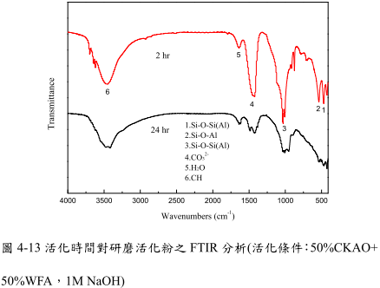
Fig. 4-12 FTIR pattern of milling activation powder (Active parameter： 50% CKAO + 50%WFA, 1M of NaOH)

Slide 29
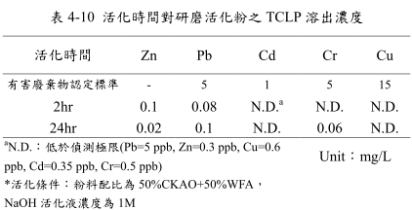
Table 10 The TCLP of the milling activation powder at different activation time
active time
Regulation
Not detectible
Activation： 50% CKAO + 50%WFA, 1M of NaOH

Slide 30
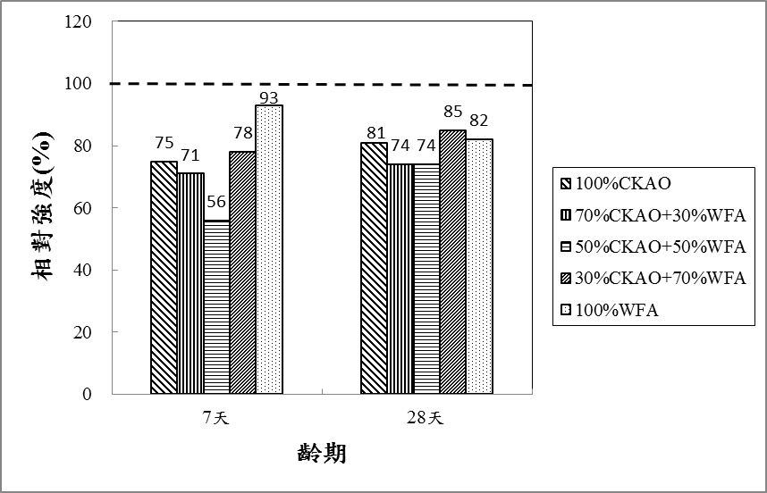
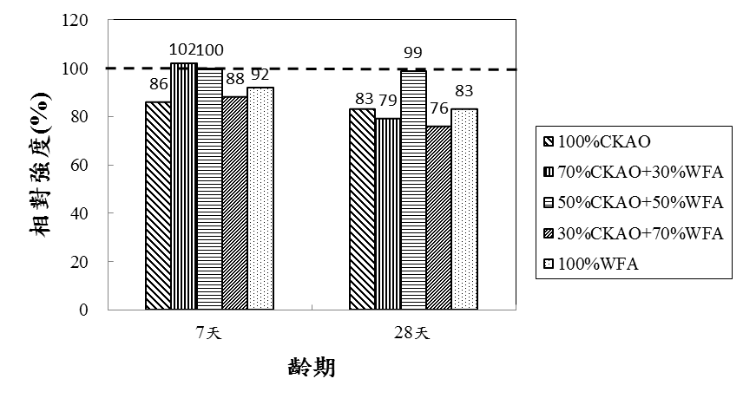
Relative compressive strength
Relative compress strength (%)
Activation:
1 M NaOH, milling 24 hr
10%
Curing time (day)
Relative compress strength (%)
5%
Curing time (day)

Slide 31
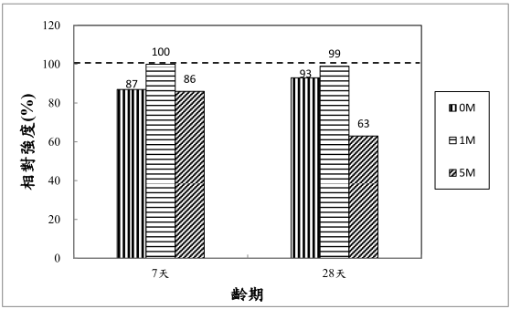
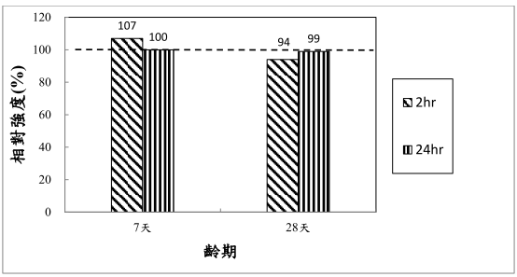
Relative compressive strength
Relative compress strength (%)
Cement additive 5%
Activation 24 hr
50%CKAO+50%WFA
7 28
Curing time (day)
Relative compress strength (%)
Cement additive 5%
Activation:1M NaOH
50%CKAO+50%WFA
7 28
Curing time (day)

Slide 32
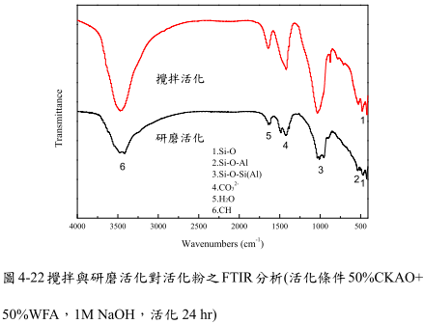
stirring active
milling active
Fig. 4-22 FTIR pattern of active powder with stirring and milling activation(50% CKAO + 50%WFA, 1M of NaOH 24h)

Slide 33
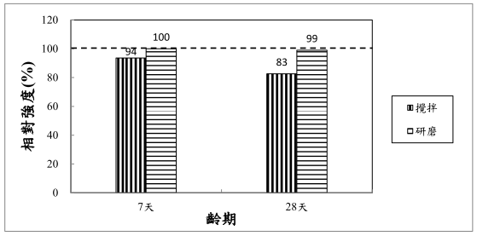
Relative compressive strength (%)
stirring activation
milling activation
7 28
Curing time (day)
Cement additive 5%

Slide 34
Conclusions

Slide 35
Conclusions(1/3)
The reaction of 50% metakaolin, 50% washed fly ash (5C5W) with 1M NaOH solution after 24 hr milling produces multiple crystal species of inorganic gel.
TCLP test showed that, the activated powder were far below the hazard waste limitations of heavy metals.

Slide 36
Conclusions(2/3)
The milling activation powder were replaces 10% of cement, low workability caused lower relative compressive strength.
Replacing 5% cement grouting to cure 7 days and 28 days, could form inorganic gels in the cured cement evidently, which raised the relative compressive strength up to 100% compared to the pure cement sample.

Slide 37
Conclusions(3/3)
For the activated powder process, milling activation has more contribution than stirring activation in the formation of inorganic gel and helps the growth of inorganic gel in cement curing.

Slide 38
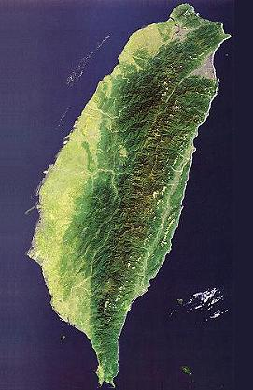

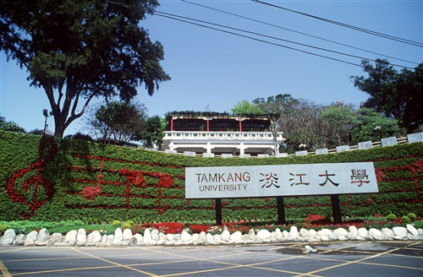
Taiwan, ROC
Sunset of Tamsui River

Slide 39

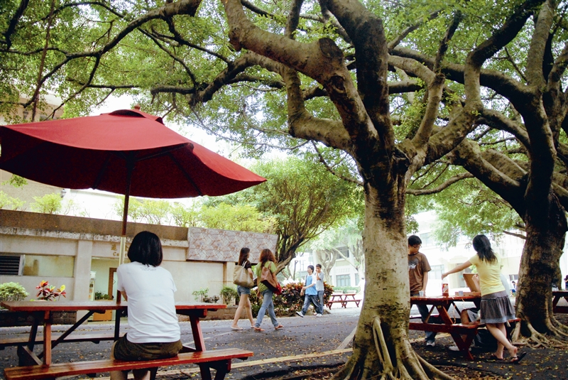
Thank you for your Attention
E-mail: shgau@mail.tku.edu.tw

