Slide 1
Synthesis and characterization of green nanoparticles and their effect on seed germination.
Sudipta Panja, Kalyani Khanra, Indranil Choudhuri, and Nandan Bhattacharyya
Department of Biotechnology, Panskura Banamali College; Panskura RS; PIN 721152; Purba Medinipur; West Bengal; INDIA

Slide 2
Introduction
What is nanoparticle?
Nanoparticle is defined as a cluster of atom between 1 to 100 nanometer in size that behaves like a whole unit with respect to its all properties. Nanoparticle is one of the most important gifts of science in modern era.
Nanoparticle have superior properties than the bulk substances
  Mechanical strength
  Thermal stability
  Catalytic activity
  Electrical conductivity
  Magnetic properties
  High driving force for diffusion due to its high surface area to volume ratio
  surface plasmon resonance
  Application of nanoparticles
10⁻² m
1 cm
10 mm
10⁻³ m
1 millimeter (mm)
10⁻⁴ m
0.1 mm
100 m
Microworld
10⁻⁵ m
0.01 mm
10 m
10⁻⁶ m
1 micrometer (m)
10⁻⁷ m
0.1 m
100 nm
Nanoworld
10⁻⁸ m
0.01 m
10 nm
10⁻⁹ m
1 nanometer (nm)
10⁻¹⁰ m
0.1 nm

Slide 3
Why did we use plant as a starting materials for synthesis of nanoparticles?
Involves the use of less toxic chemicals.
The biologically synthesized nanoparticles may be less toxic.
Eco-friendliness
There are no maintenance as microbial culture.
Cost effective
The plants is a good source of various phytochemicals which have good medicinal value.

Slide 4
Aim of the study
Synthesis of plant mediated silver nanoparticle which is cost effective.
Characterization of the silver nanoparticle by UV/VIS, TEM, XRD and FTIR.
Study of the antibacterial, antifungal, larvicidal activity of the nanoparticle
Study of cytotoxicity of the silver nanoparticle in cancer cell by MTT assay.
Study the effects of the nanoparticles on the seed germination.

Slide 5
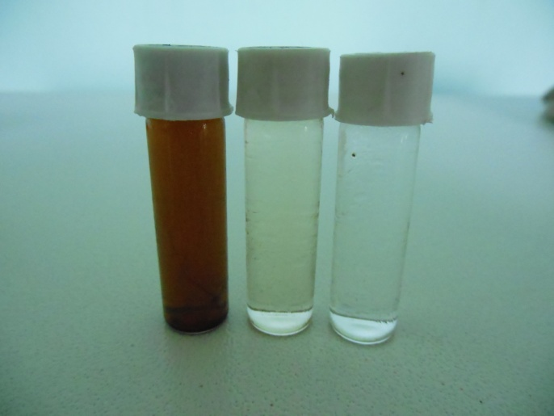
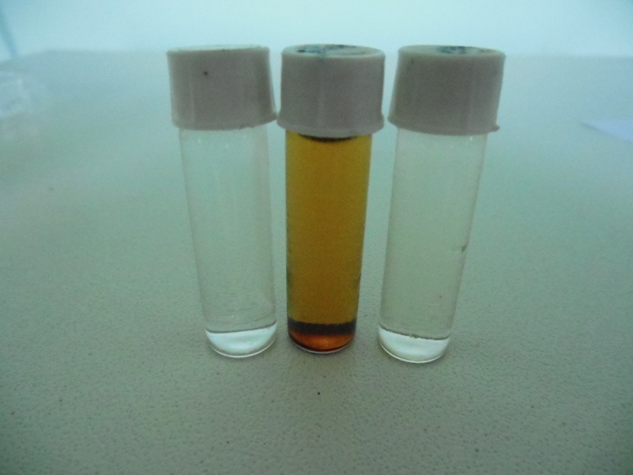
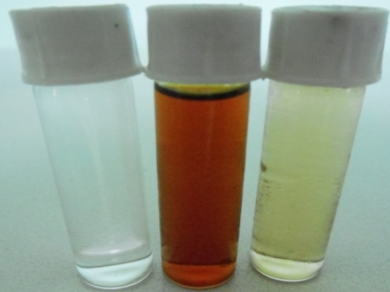
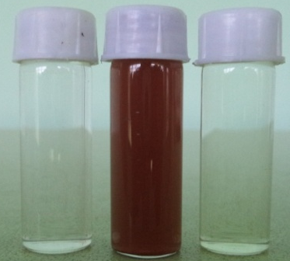
Synthesis of plant mediated silver nanoparticles
synthesis of silver nanoparticles from plant extract by using 1mM silver nitrate solution
Hydrothermal process.
The plant biomass acts as both reducing agent and stabilizing agent and the solvent is aqueous solution.
Washing of nanoparticle.
Color change of the solution is the indication of synthesis of silver nanoparticles
A
B
C
C
A
B
C
A
B
C
A
B
Leaves of
Cryptolepis buchanani
Stem of
Cryptolepis buchanani
Leaves of
Ehretia laevis Roxb
Leaves of
Rauvolfia serpentina

Slide 6
Antibacterial and antifungal activity were studied by well diffusion method.
The larvicidal activity of the synthesized silver nanoparticle was tested against mosquito larvae of Aedes aegypti.
Study of cytotoxicity by MTT assay against MCF7 and HeLa cell line.
Study the effect on seed germination by using Lens culinaris.

Slide 7
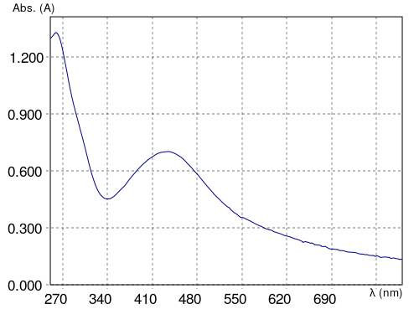
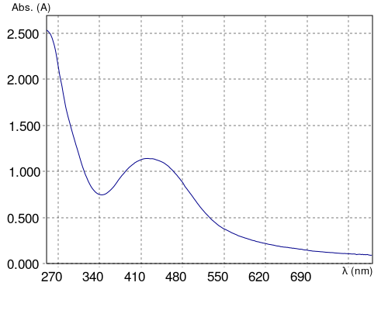
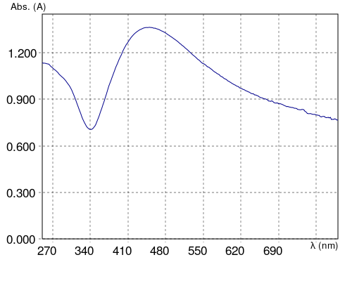
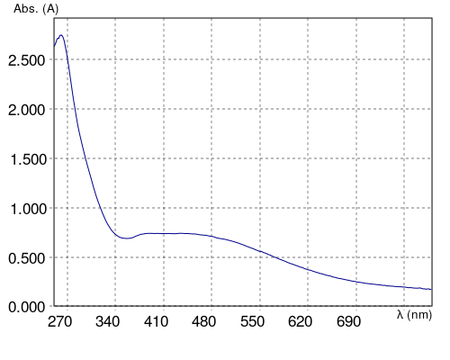
Characterization of the synthesized nanoparticles by UV -VIS
Fig A. Nanoparticle from
leaf extract of
Cryptolepis buchanani
Fig B. Nanoparticle from
stem extract of
Cryptolepis buchanani
Fig C. Nanoparticle from
leaf extract of
Ehretia laevis Roxb
Fig D. Nanoparticle from
leaf extract of
Rauvolfia serpentina
A
B
C
D

Slide 8
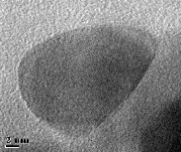
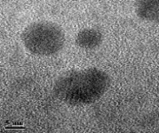
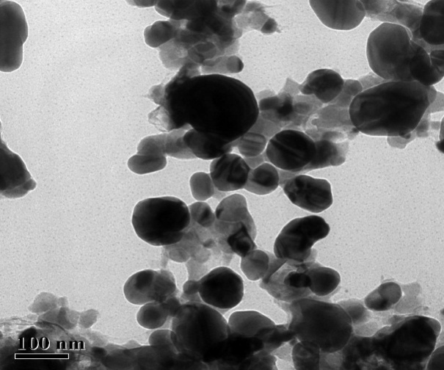
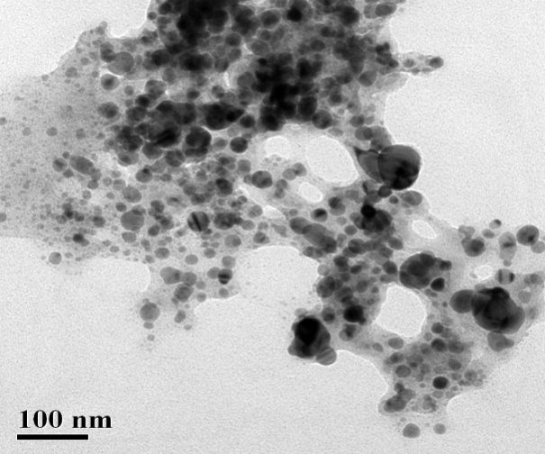
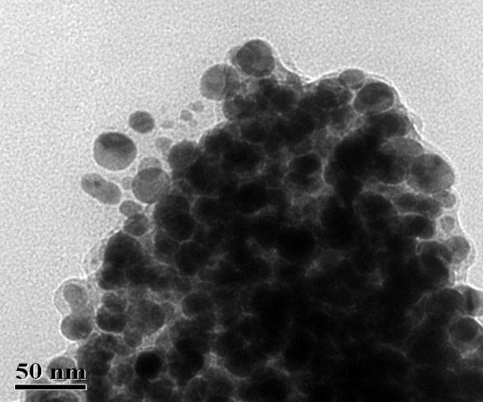
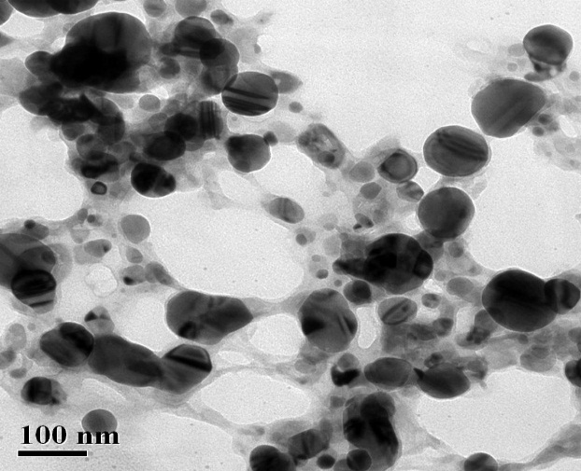
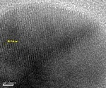
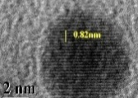
Characterization of the synthesized nanoparticles by TEM
Fig A. Nanoparticle from leaf extract of
Cryptolepis buchanani
Fig B. Nanoparticle from stem extract of
Cryptolepis buchanani
Fig C. Nanoparticle from leaf extract of
Ehretia laevis Roxb
Fig D. Nanoparticle from leaf extract of
Rauvolfia serpentina
A
B
C
D

Slide 9
Characterization of the synthesized nanoparticles by FTIR
Fig A. Nanoparticle from leaf extract of
Cryptolepis buchanani
Fig B. Nanoparticle from stem extract of
Cryptolepis buchanani
Fig C. Nanoparticle from leaf extract of
Ehretia laevis Roxb
Fig D. Nanoparticle from leaf extract of
Rauvolfia serpentina
A
B
D
C

Slide 10
Antibacterial activity of the AgNP against gram positive bacteria
Bacillus subtilis
Enterococcus faecalis

Slide 11
Antibacterial activity of the AgNP against gram negative bacteria
Pseudomonas aeruginosa
E.coli

Slide 12
Antifungal activity of the AgNP
Aspergillus niger
Candida albicans

Slide 13
Larvicidal activity of the AgNP against Aedes aegypti
% Mortality = [(% test mortality- % control mortality)/100-% control mortality]x 100

Slide 14
Cytotoxicity study of the AgNP against HeLa and MCF7 cell line
HeLa cell line
MCF 7 cell line

Slide 15
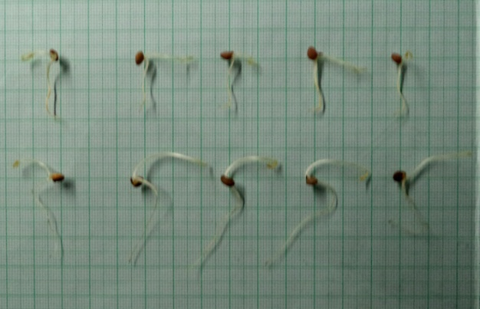
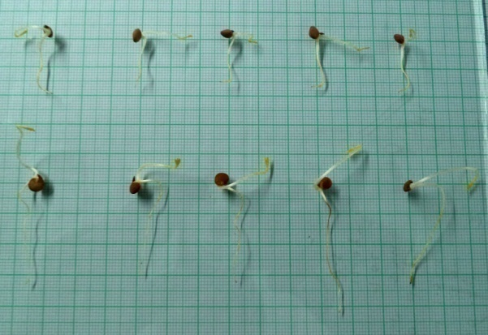
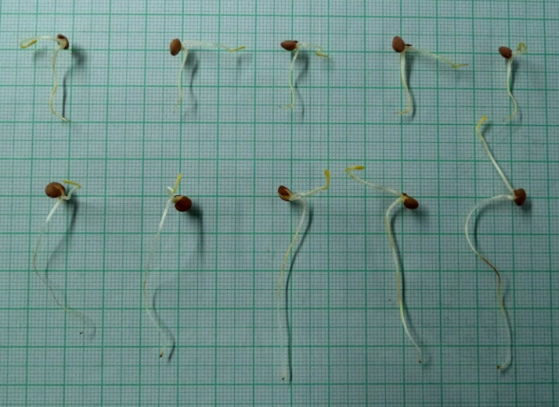
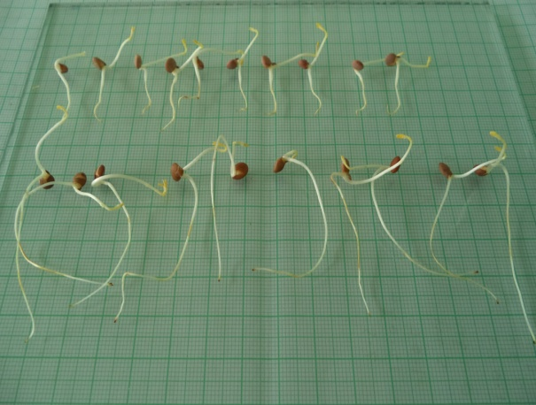
Effects of AgNP on seed germination
Fig A. Nanoparticle from
leaf extract of
Cryptolepis buchanani
Fig B. Nanoparticle from
stem extract of
Cryptolepis buchanani
Fig C. Nanoparticle from
leaf extract of
Ehretia laevis Roxb
Fig D. Nanoparticle from
leaf extract of
Rauvolfia serpentina
A
B
C
D

Slide 16
Effects of AgNP on the germination of Lens culinaris Seed

Slide 17
Effects of AgNP on the Vigour Index (VI) of germinated
Lens culinaris Seed

Slide 18
Effects of AgNP on the root length of Germinated
Lens culinaris Seed

Slide 19
Effects of AgNP on the shoot length of Germinated Lens culinaris Seed

Slide 20
Conclusion
The synthesized Ag NPs were characterized by different techniques for calculation of crystalline size, particles size, morphology,antimicrobial , larvicidal activity etc.
The different concentrations of AgNPs effect on Lens culinaris seed germination . All the AgNP shows positive effects on seed germination. AgNP from Ehretia laevis shows positive activity on seed germination and AgNP prepared from Ehretia laevis also breaks seed dormancy.

Slide 21
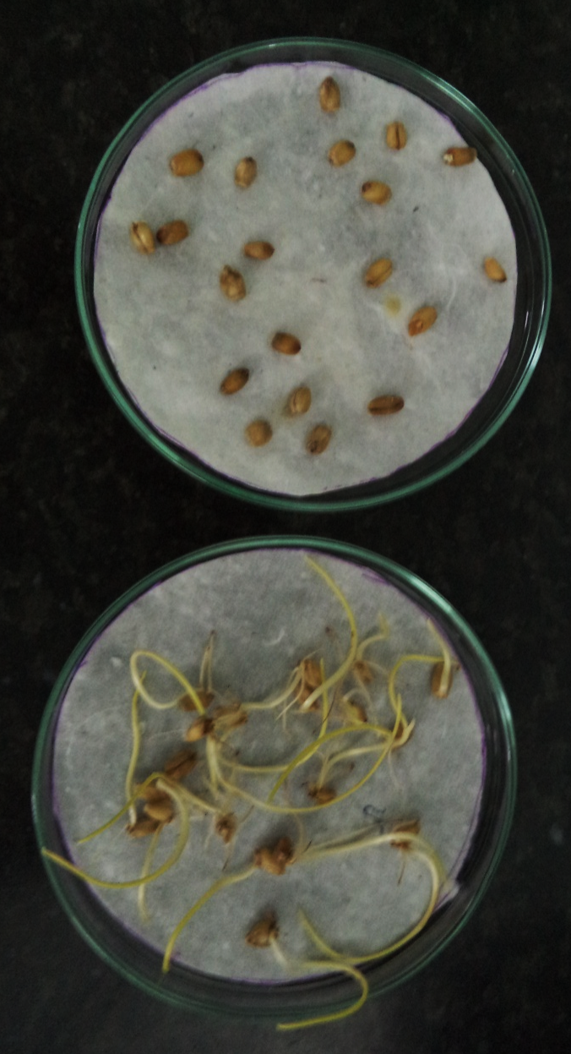
Future study
The cytotoxicity study on selective cancer cells may lead to therapeutic use as anticancer agent.
It may also effect on breaking of seed dormancy. Further studies are needed to confirm and to determine the mechanisms of breaking seed dormancy.

Slide 22
Thank You for Your Attention

