Slide 1
The Affordable Care Act of 2010, Health Workforce, and the Emerging Models of Healthcare Delivery in the US: The Role of Health Economists in Policy Evaluation
Sudip Chattopadhyay
Fellow, National Center for Health Workforce Analysis
Health Resources and Services Administration (HRSA)
Professor of Economics
San Francisco State University

Slide 2
Challenging Issues of Health Workforce in Primary Care
Shortage of clinicians in Health Professional Shortage Areas (HPSA)
Shortage of clinicians trained in primary care
Geographic mal-distribution of providers

Slide 3
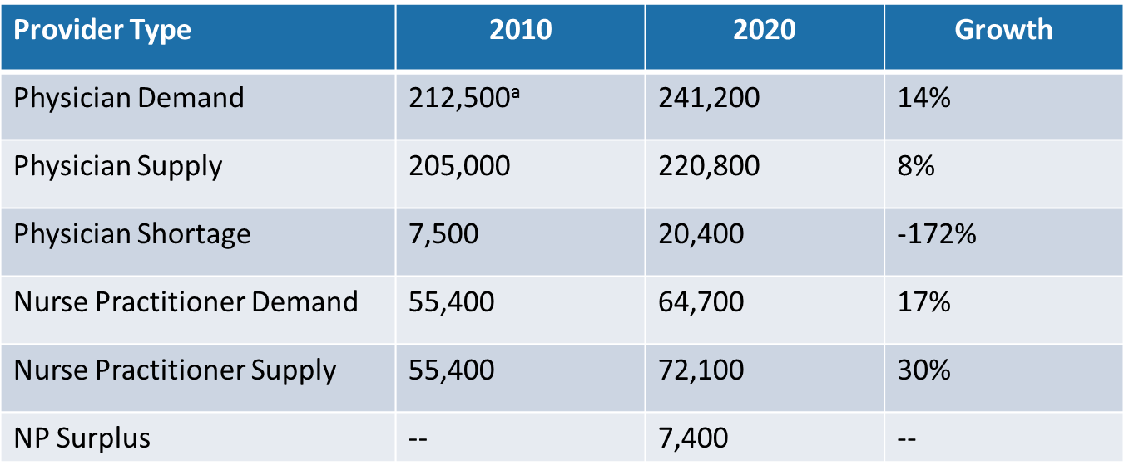
Current and Projected Supply and Demand of Primary Care Providers
Source: U.S. Department of Health and Human Services, Health Resources and Services Administration, National Center for Health Workforce Analysis. Projecting the Supply and Demand for Primary Care Practitioners Through 2020. Rockville, Maryland: U.S. Department of Health and Human Services, 2013.
ª National demand projections presented in this report assume that in 2010 the national supply of primary care physicians was adequate except for the approximately 7,500 FTEs needed to de-designate the primary care HPSAs.

Slide 4
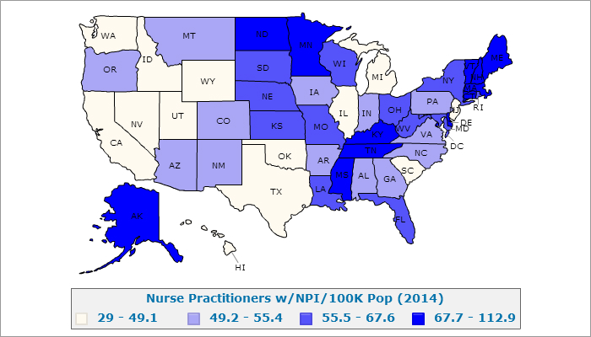
Geography of Nurse Practitioners’ Supply
Source: AHRF available at http://ahrf.hrsa.gov/arfdashboard/ArfGeo.aspx accessed 2/2/2016

Slide 5
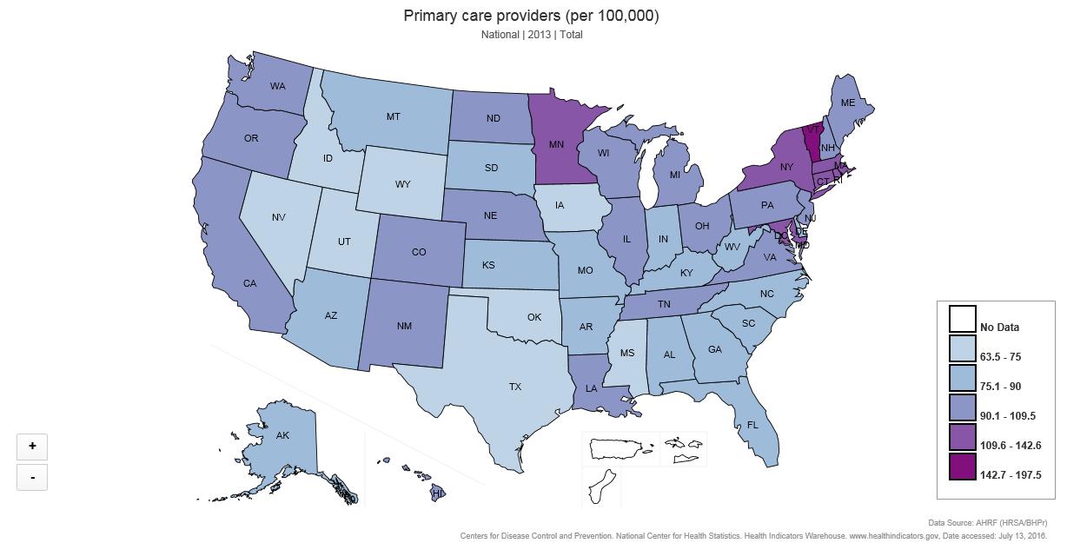
Geographic Mal-distribution of Providers

Slide 6

2015 Nurse Practitioners’ State Practice Environment

Slide 7
Labor Market in the Presence of Externality
Wage rate ($)
Net Benefit (Surplus)
Supply: Marginal Cost
Total Cost
Quantity of Labor
A
B
Demand: Marginal Private Benefit
Demand: Marginal Social Benefit

Slide 8
Public policies and research programs at HRSA to address workforce issues
  NHSC program (Student debt relief program to attract and retain clinicians in HPSA)
  Rural training track programs (Funding medical school programs and rural residency track programs to train graduates to serve in rural areas)
  States’ lifting of the restrictive SOP laws
  Investing in new delivery models of care: Team-based approach, PCMH model, Accountable Care Organizations
  Investing in Health IT and Electronic Health Records
  Payment reforms (volume-based to value-based payment model)

Slide 9
Ongoing Economic Research in Health Workforce at HRSA
Investing in National Health Services Corps to Promote Health in Health Professional Shortage Areas: Does It Pass the Economic Cost-Benefit Test?
Promoting Rural Practice in Medical School Education: An Economic Rationale
Cost of Nurse Practitioners’ Restrictive Scope of Practice Laws
The Cost Impact of Health IT and the New Models of Primary Care in Federally Qualified Health Centers
Cost-Efficiency in the Patient Centered Medical Home Model: New Evidence from Federally Qualified Health Centers (FQHC)

