Slide 1

EVOLUTION AND FEATURES OF METAL OXIDE NANOSTRUCTURE ELECTRODE MATERIALS IN SUPERCAPACITOR
(ENERGY STORAGE MATERIAL)
Dr.S.SELLADURAI,
PROFESSOR
DEPARTMENT OF PHYSICS,
ANNA UNIVERSITY,
CHENNAI-25

Slide 2
INTRODUCTION
Due to the necessity of energy storage all over the world. Its irresistible demand to make energy storage devices with superior performance and increased energy/power capabilities as compared to current technologies are one of the major challenges among the researchers.
Battery, fuel cells and electrochemical supercapacitors paves a way to remove energy shortage.
The energy storage and conversion mechanism are different and electrochemical similarities exists in all the three energy storage systems.
Our work mainly aimed to achieve novel structured nanomaterials for supercapacitors.

Slide 3
Tremendous efforts has been put towards nano-structured material supercapacitors for energy storage. Nano structured materials has highly advantageous due to its unique dimension, high surface area, good electrical conductivity and high electrochemical activity.
Recently published reports strongly imply that the progress on nanostructure morphologies can overcome the issues arises such as stability, efficiency and energy/power output.

Slide 4
SUPERCAPACITORS
Supercapacitors boast a high energy storage capacity compared to regular capacitors, but they still lag behind batteries in that area. Supercapacitors have much larger power densities than batteries, fuel cells and larger energy densities than conventional capacitors.
Supercapacitors deliver in a rapid burst of energy during peak power demands and then immediately store energy and capture excess power that's otherwise lost.
Supercapacitors utilize high surface area electrode materials and thin electrolytic dielectrics to achieve capacitances several orders of magnitude larger than conventional capacitors.
In the example of an electric car, a supercapacitor can provide needed power for acceleration, while a battery provides range and recharges the supercapacitor between surges.

Slide 5
SUPERCAPACITOR CONSTRUCTION
Supercapacitors consists of three major parts porous electrode, electrolyte and separator.
ELECTRODE
Selection of electrode materials plays a crucible role in determining the electrical properties of a super capacitor.
Carbon, conducting polymers, metal oxides are the electrode materials used.
ELECTROLYTE
The possible energy density will be limited by the electrolyte.
There are currently two types of electrolyte in use in EDLC’s organic and aqueous.

Slide 6
SEPARATOR
The separator prevents the occurrence of electrical contact between the two electrodes, but it is ion-permeable.
Polymer or paper separators can used with organic electrolytes
Ceramic or glass fiber separators are often used with aqueous electrolytes
High electrical resistance , a high ionic conductance and a low thickness.

Slide 7
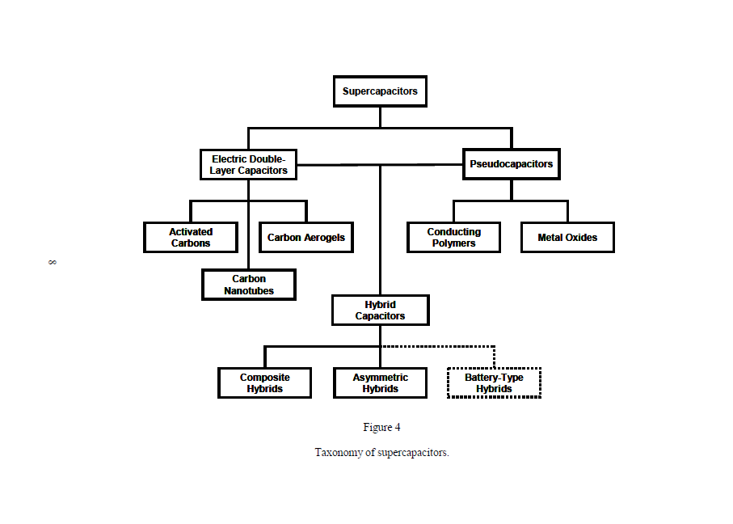
CLASSIFICATION OF SUPERCAPACITORS

Slide 8
Electrochemical Double Layer Capacitor
EDLC’s are constructed from two carbon based electrodes, an electrolyte and a separator.
EDLC’s store charge electro statistically or non- faradaically and there is no transfer of charge between electrode and electrolyte .
EDLC’s utilize an electrochemical double layer of charge to store energy. As voltage is applied, charge accumulates on the electrode surfaces.
These double layers coupled with an increase in surface area and decrease in the distance between electrodes. This allows EDLC’s to achieve higher energy densities than conventional capacitors.
The charge storage in EDLC’s is high reversible, which allows them to achieve very high cycling stabilities.

Slide 9
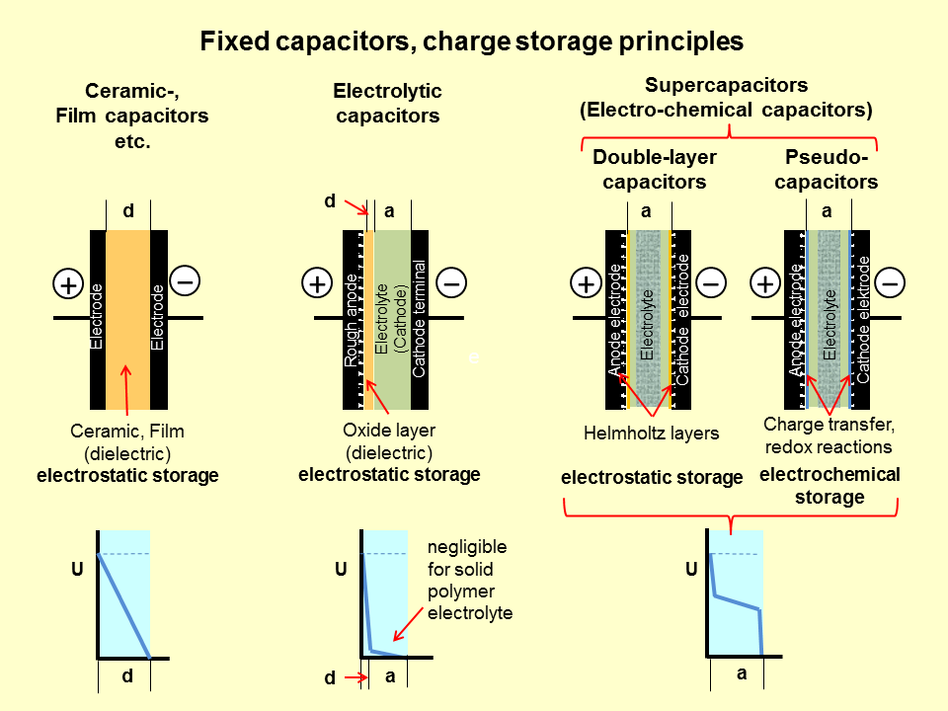

Slide 10
PSEUDOCAPACITOR
Pseudocapacitor store charge Faradaically through the transfer of charge between electrode and electrolyte.
The Faradic process may allow pseudocapacitors to achieve greater capacitances and energy densities than EDLC’s.
There are two electrode materials that are used to store charge in pseudocapacitors, conducting polymers and metal oxides.
HYBRID CAPACITOR
Hybrid capacitors utilizes both Faradaic and Non-Faradaic processes to store charge.
Hybrid capacitors have achieved energy and power densities greater than EDLC’s without sacrifices in cycling stability and affordability.
Hybrid capacitors distinguished based on the electrode material type.
Composites, asymmetric and battery type respectively.

Slide 11
Nanotechnology involved Nanomaterials and Graphene application developments though have led to new possibilities for energy storage, with high charge and discharge rates, which can be made very cheaply. But before we go into specific details, it would be sensible to first outline the basics of energy storage and the potential goals of developing new kind of nanomaterials such low cost metal oxides, conducting polymer, carbon hydrogel, graphene etc., as a hybrid supercapacitor or supercapattery.
6th International Conference on Materials Science and Engineering September 12-14,2014, Atlanta, USA

Slide 12
OUTLINE
Mainly focused towards the recent advancements in supercapacitors via transition metal oxides and composite electrode.
RuO₂ was the first impressive and remarkable material in supercapacitors for energy storage. RuO₂ is a conductive metal oxide, with three oxidation states accessible within1.4 V, exhibiting an impressive reported specific capacitance up to 2000 F g⁻¹ .
Manganese oxide is one of the most studied, due to its low cost, environment friendliness, and relatively high theoretical capacitance of 1100–1300 F g⁻¹ .
Cobalt-based compounds and composites have been extensively studied as pseudo-capacitors, exhibiting high specific capacitances up to 3000 F g⁻¹.
Nickel based and Ni(OH)₂ materials are more attractive because of its high theoretical values 2573 and 2082 F g⁻¹ .

Slide 13
NiO ELECTRODE
Kundu et al. reported NiO-nanofibers/Ni through the electro-spinning technique porous NiO nanofibers grown on a nickel foam current collector which exhibited high specific capacitances of 737 F/g at 2 A/g.
Cheng et al. made hybrid nanonet/nanoflower NiO deposited on carbon fiber paper, exhibited the highest areal capacitance of 0.93F cm⁻² .
In this way our group have reported that the extremely porous NiO hierarchical nano flake/nano-flower hybrid architecture on porous carbon cloth via a simple hydrothermal method.

Slide 14
Features of Metal Oxide Electrode for Supercapacitors
In view on metal oxide electrode materials, initial focus is on noble metal oxides (MOs) such as RuO₂ and IrO₂. RuO₂ is a conductive metal oxide, with three oxidation states accessible within 1.4 V, exhibiting an impressive reported specific capacitance up to 2000 F g⁻¹. RuO₂ is known to be the most effective electrode material, but the extremely high cost and toxicity limit its applications. Hence, cheaper transition metal oxides, such as nickel oxides, cobalt oxides, manganese oxides and iron oxides, are actively studied.
6th International Conference on Materials science and Engineering, Sep 12-14, 2016 Atlanta USA

Slide 15
Among them, manganese oxide is one of the most studied, due to its low cost, environment friendliness, and relatively high theoretical capacitance of 1100–1300 F g⁻¹.But its low density, low conductivity, and poor cycling stability associated with its unsatisfactorily high rate capability remain to be improved. Cobalt-based compounds and composites have been extensively studied as pseudo-capacitors, exhibiting high specific capacitances (up to 3000 F g⁻¹), high areal capacitance(25 F cm⁻²), large specific surface area and long cycle life. However, the working potential window of most of the cobalt electrode materials is small, which seriously affects the application of cobalt electrode materials.

Slide 16
Being widely used in supercapacitors, nickel based compounds and composites have also been generally studied. Nickel based materials, in particular, nickel oxide (NiO) and nickel hydroxide (Ni(OH)₂), have attracted extra interest due to their high theoretical capacitance values (the theoretical capacitance values of NiO and Ni(OH)₂ in a potential window of 0.5 V are 2573 and 2082 F g⁻¹, respectively), thermal stability and high chemical stability, environmentally benign nature, lower cost and ready availability. Kundu et al. prepared NiO-nanofibers/Ni through the electro-spinning technique followed by appropriate heat treatment, the fabrication of binder-free electrodes consisting of porous NiO nanofibers directly grown on a nickel foam (NF) current collector.[39]The as-fabricated binder-free electrodes exhibited high specific capacitances of737, 731, 679, 626, 591 and 570 F g⁻¹ at current densities of 2, 5, 10, 20, 30 and 40 A g⁻¹, respectively, showing wonderful capacitance retention at high current rates. The NiO-nano fibers/Ni electrodes also revealed superior cycling stability up to 8000 cycles without discernable capacitance fading at various current densities

Slide 17
Cheng et al. made hybrid nanonet/nanoflower NiO deposited on carbon fiber paper (CFP), and two types of electrodes with different morphologies were grown on the CFP by hydrothermal and electrodeposition processes. The hybrid NiO electrodes with a mass loading of 1.1mg cm⁻² exhibited the highest areal capacitance of 0.93F cm⁻² (∼840 F g⁻¹ of the active material and 84 F g⁻¹ of the total weight, including the CFP current collector and substrate),which was better than most of the similar materials reported for supercapacitors. In this way our group have reported that the extremely porous NiO hierarchical nano flake/nano-flower hybrid architecture from interconnected ultra-thin nano-crystals on highly conductive porous carbon cloth via a simple hydrothermal approach without any structure directing agent.
(Padmanathan, N, Selladurai, S, Mani Rahulan, K, ColmO’Dwyer and Razeeb, K. M, (2015), Ionics, 21, 2623–2631)
6th International Conference on Materials science and Engineering, Sep 12-14, 2016 Atlanta USA

Slide 18
Results
The maximum specific capacitance of 170 Fg⁻¹ for a current density of 5 Ag⁻¹ was achieved.
As a two electrode symmetric configuration, the device showed a highest capacitance of 34.9 Fg⁻¹ at 1 Ag⁻¹ current density.
A maximum specific energy density of 19.4 Wh kg⁻¹ at a high power density of 1002.8W kg⁻¹ at a constant current density of 1 Ag⁻¹ .
An efficiency of 58% after 25,000 cycles with a potential window of 0 to ±2 V.

Slide 19
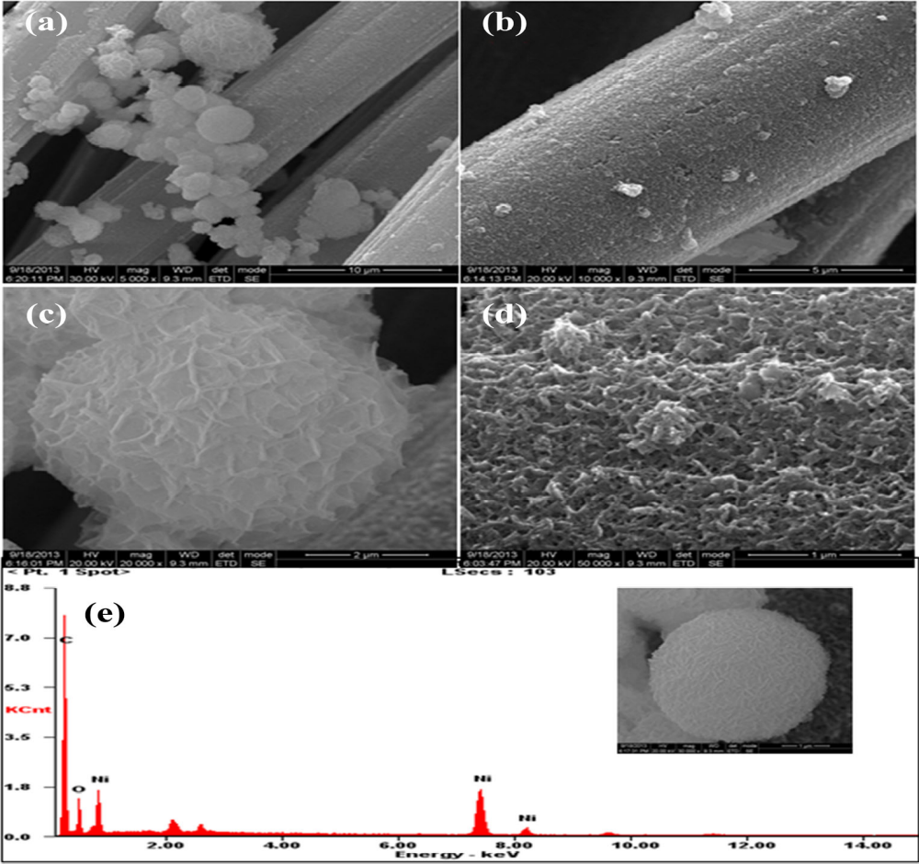
SEM images and EDS spectrum of NiO hybrid microstructure
Padmanathan, N, Selladurai, S, Mani Rahulan, K, ColmO’Dwyer and Razeeb, K. M, (2015), Ionics, 21, 2623–2631.

Slide 20
Co₃O₄ ELECTRODE
Deori et al has reported the cubic spinel Co₃O₄ nanoparticles results high specific capacitance of 476 F g⁻¹, energy density 42.3 Wh kg⁻¹ and power density 1.56kW kg⁻¹ at current density of 0.5 Ag⁻¹ .
Kazemi et al has reported electrodeposited Co₃O₄-ECF nano-flakes on electro-etched carbon fiber cloth. It resulted specific capacitance of 598.9 F g⁻¹ at a currents density of 6.25 A g⁻¹ , energy density 40.75 Wh kg⁻¹ and power densities 27.69 kW kg⁻¹ .
Our group has developed hybrid nanowire/nanoflower microstructure of Co₃O₄ on carbon cloth substrate.
A supercapacitor made from this hybrid architecture in organic electrolyte resulted a maximum specific capacitance of 4.8 mF cm⁻² at a constant density of 3 mA cm⁻², energy density of 4.2 mW h cm⁻³ with a power density of 1260 mW cm⁻³.
The estimated Rct value is approximately 3.19 and 5.4 Ω for aqueous electrolyte and 1.7 and 11.45 Ω for non-aqueous electrolyte before and after the cycle test.

Slide 21
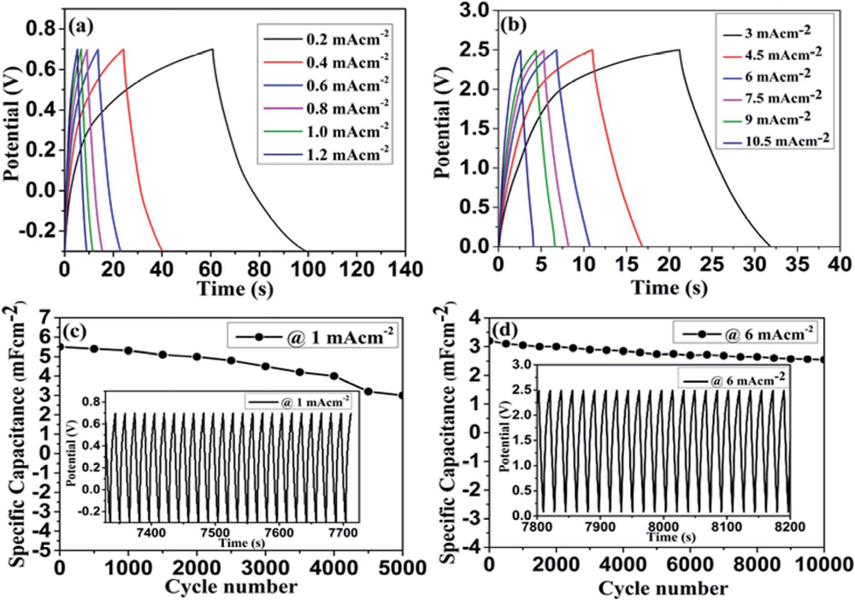
Electrochemical performance of Co₃O₄ nanowire/nanoflower hybrid microstructure
Padmanathan, N, Selladurai, S and Razeeb, K.M, RSC Adv., 2015, 5, 12700–12709

Slide 22
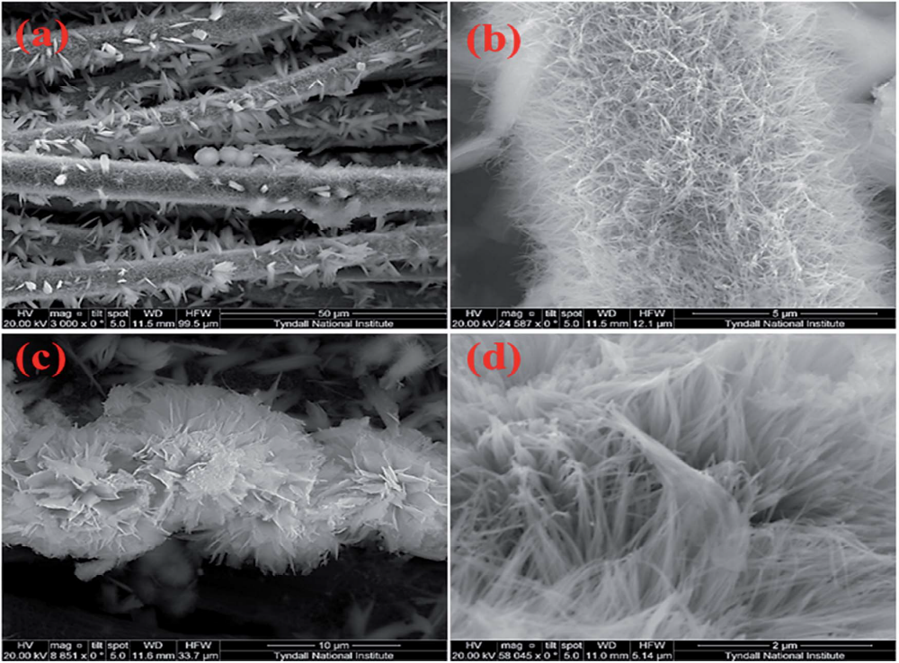
HRSEM images of Co₃O₄ nanowire/nanoflower hybrid microstructure
Padmanathan, N, Selladurai, S and Razeeb, K.M, RSC Adv., 2015, 5, 12700–12709

Slide 23
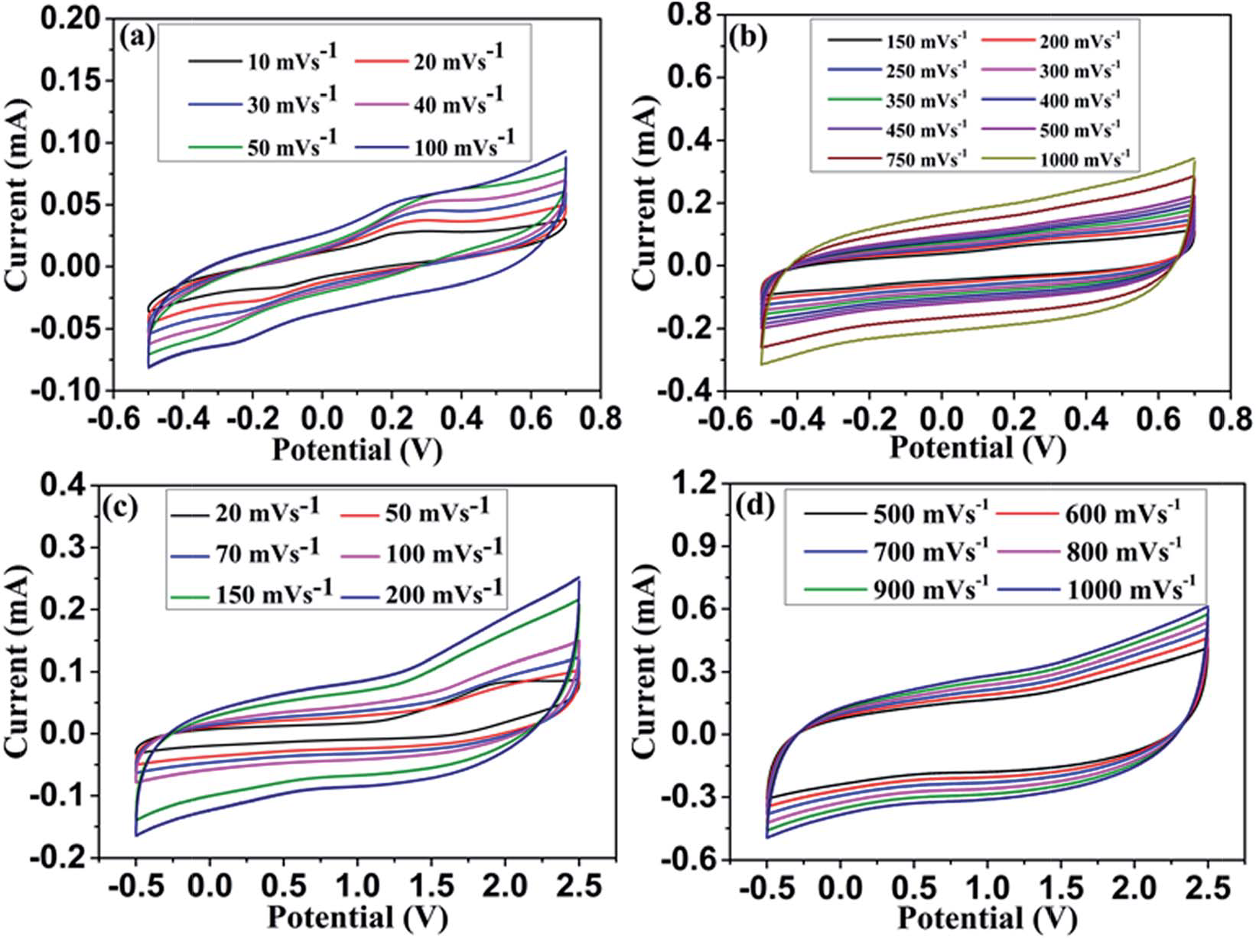
Cyclic voltammograms of Co₃O₄ based symmetric supercapacitor in 3 M KOH (a & b) and 1 M TEABF4 in PC (c & d) measured at different scan rates.

Slide 24
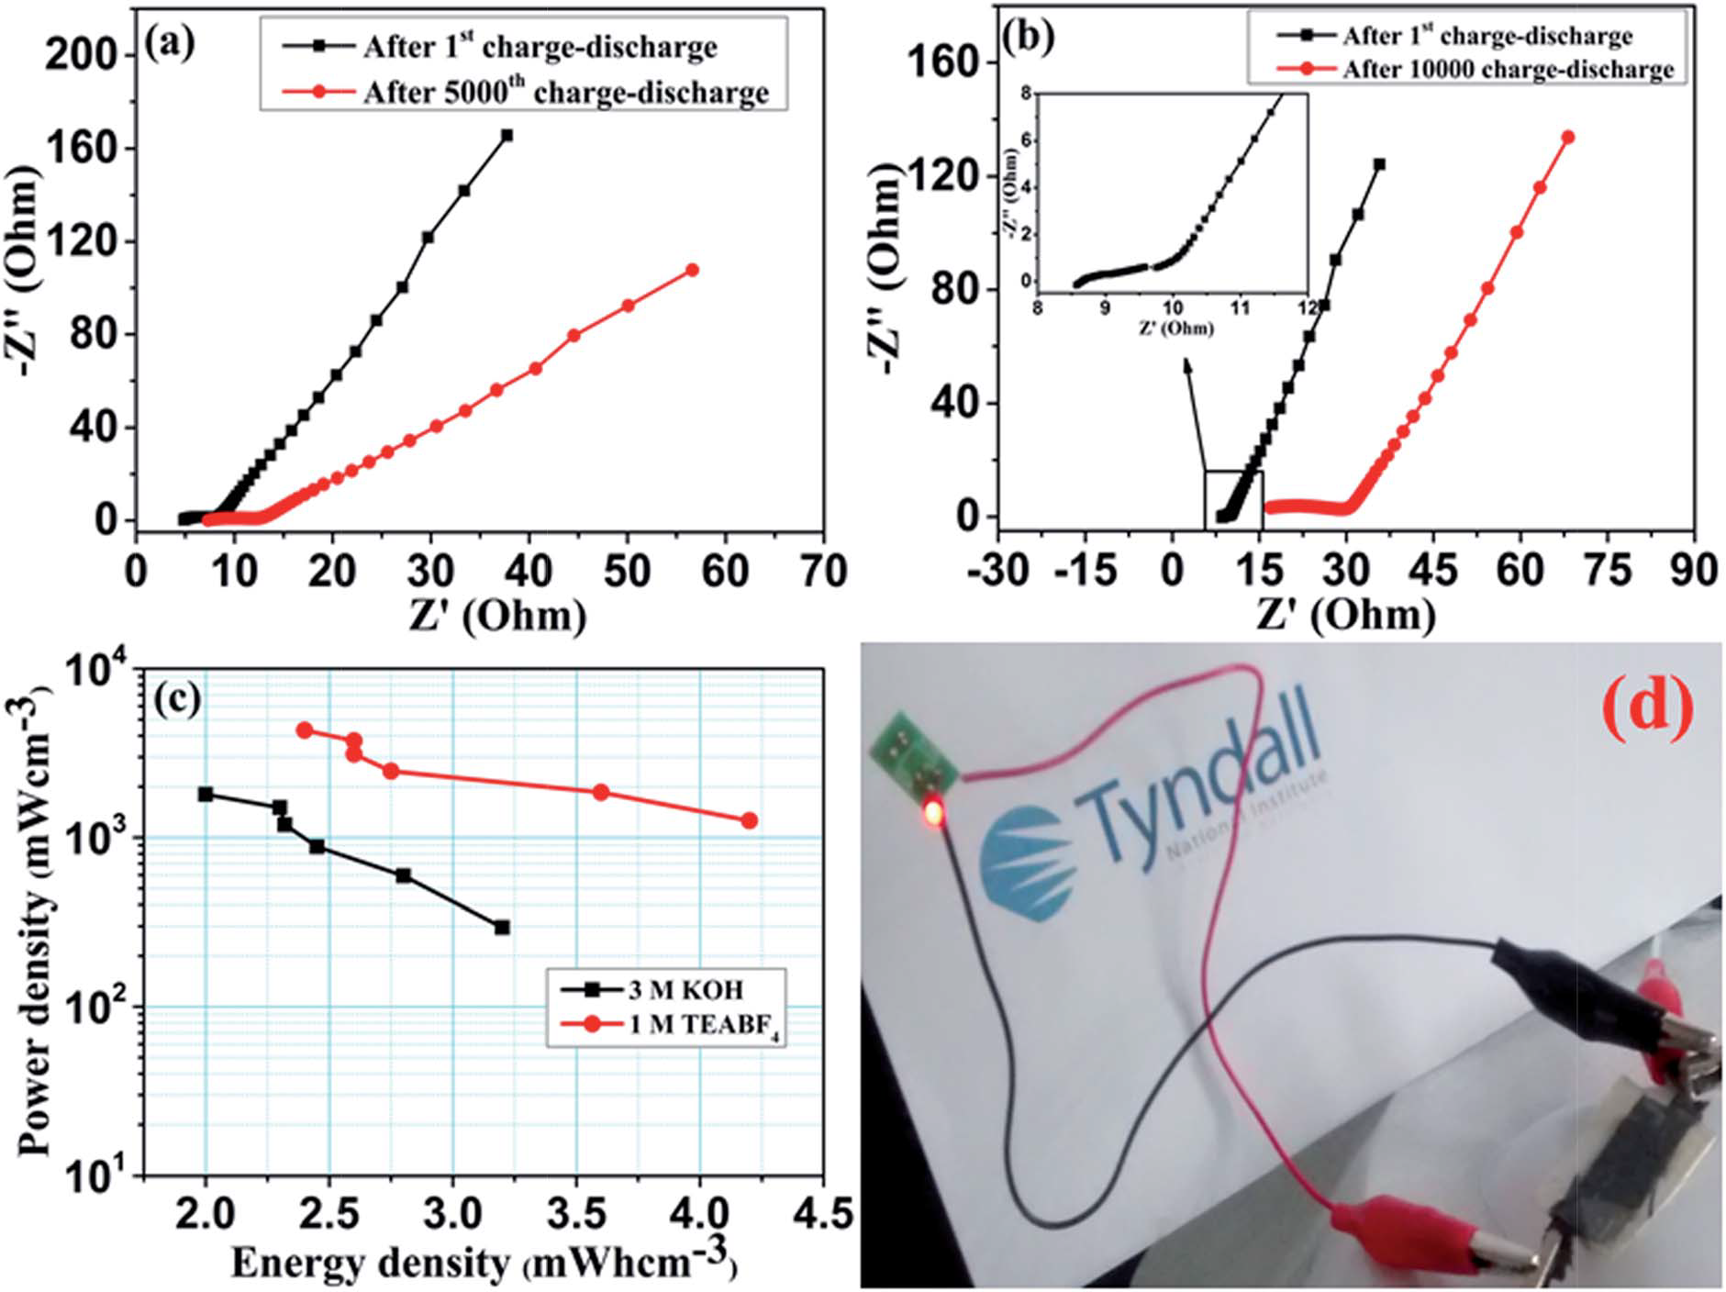
Fig Nyquist plot of fabricated symmetric supercapacitor in (a) 3 M KOH, (b) 1 M TEABF4, (c) Ragone plots (energy vs. power) for the device in 3 M KOH (black) and 1 M TEABF4 (red). (d) Optical photograph of a commercialized LED lighted by charged supercapacitor in 1 M TEABF4.

Slide 25
SPINEL NICKEL COBALTITE ELECTRODE
Nickel cobaltite possesses high electronic conductivity due to rich redox reactions with contributions from both nickel and cobalt ions.
Yuan et al have studied the facile template free synthesis of ultra-layered mesoporus NiCo₂O₄ nanowires towards high-performance electrochemical capacitors. The electrode exhibited high specific capacitance 401 F g⁻¹ at 1 A g⁻¹ .
Our group have studied the NiCo₂O₄ nanostructure synthesized via solvothermal , direct growth on carbon cloth and auto combustion technique.
The maximum specific capacitance obtained for NiCo₂O₄ synthesised via solvothermal method is 524 F g⁻¹ at 0.5 A g⁻¹ at 300°C.
Recently, we have reported that the direct growth of NiCo₂O₄ nanoflakes and nanowall super structure on carbon fiber cloth and investigated for supercapacitor applications.

Slide 26
NiCo₂O₄ nanowall – network structure delivers a maximum capacitance of 1225 F g⁻¹ at 5 Ag^{-1.}
NiCo₂O₄ nanoflakes exhibited specific capacitance of 844 F g⁻¹ at 1 A g⁻¹ .
We had also reported three dimensional porous NiCo₂O₄ was synthesised via combustion method using citric acid as fuel was applied for supercapacitors as first time.
The material’s electrochemical properties was well studied by means of varying calcination temperatures at 350˚C, 400 ˚C and 500 ˚C.
The maximum capacitance of 512 F/g , 908 F/g and 827 F/g at 5 mV/s was obtained at 350˚C , 400 ˚C and 500 ˚C calcined materials.

Slide 27
NiCo₂O₄NANOSTRUCTURES | SPECIFIC CAPACITANCE
NiCo₂O₄ nanoparticle | 524 F g⁻¹ at 0.5 A g⁻¹
NiCo₂O₄ nanoflakes | 844 F g⁻¹ at 1 A g⁻¹
NiCo₂O₄ nanowall | 1225 F g⁻¹ at 5 Ag⁻¹
3D porous NiCo₂O₄ at different calcinations | 350˚C | 512 F g⁻¹ at 5 mV/s
 | 400˚C | 908 F g⁻¹ at 5 mV/s
 | 500˚C | 827 F g⁻¹ at 5 mV/s

Slide 28
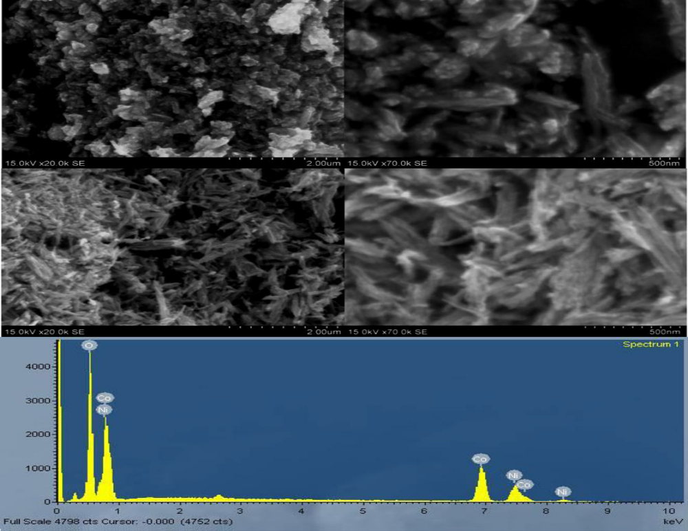
(a-e) SEM images of NiCo₂O₄ nanoparticle and the corresponding EDS spectrum

Slide 29
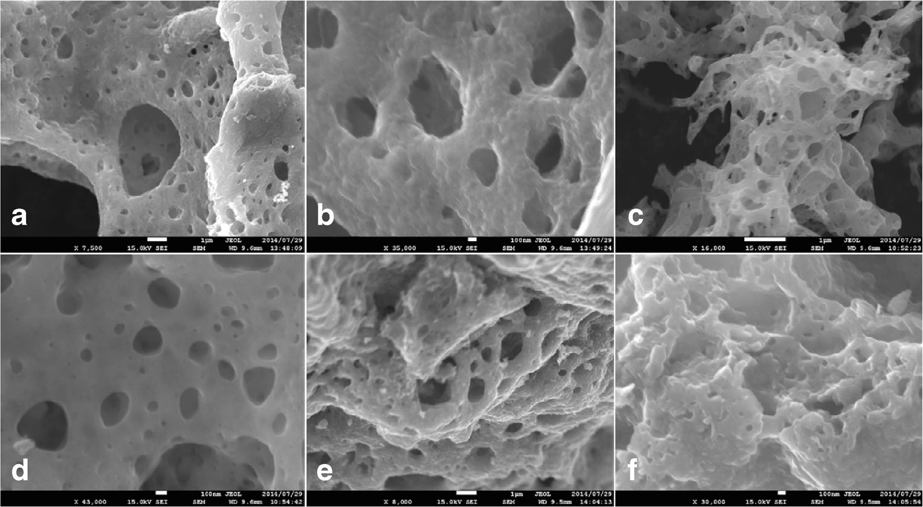
3D porous NiCo₂O₄ at low and high magnification a–b NiCo-350, c–d
NiCo-400, and e–f NiCo-500

Slide 30
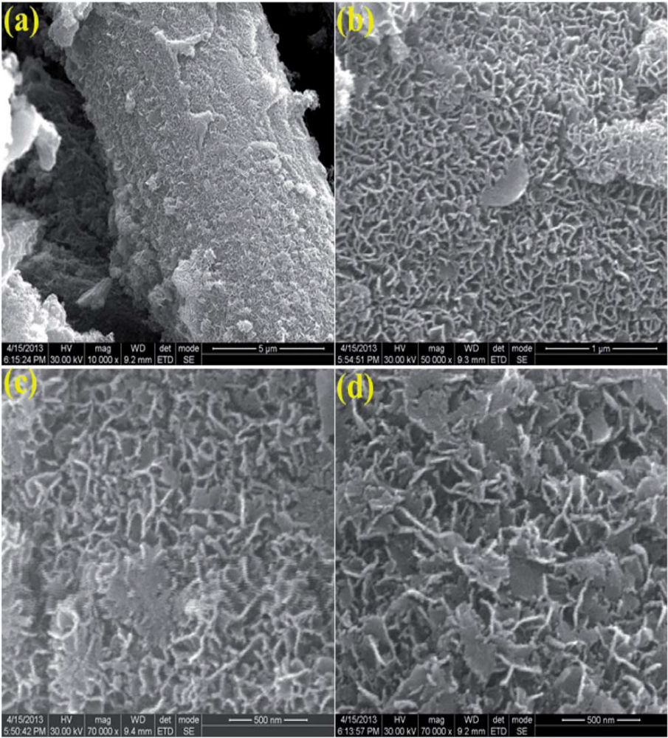
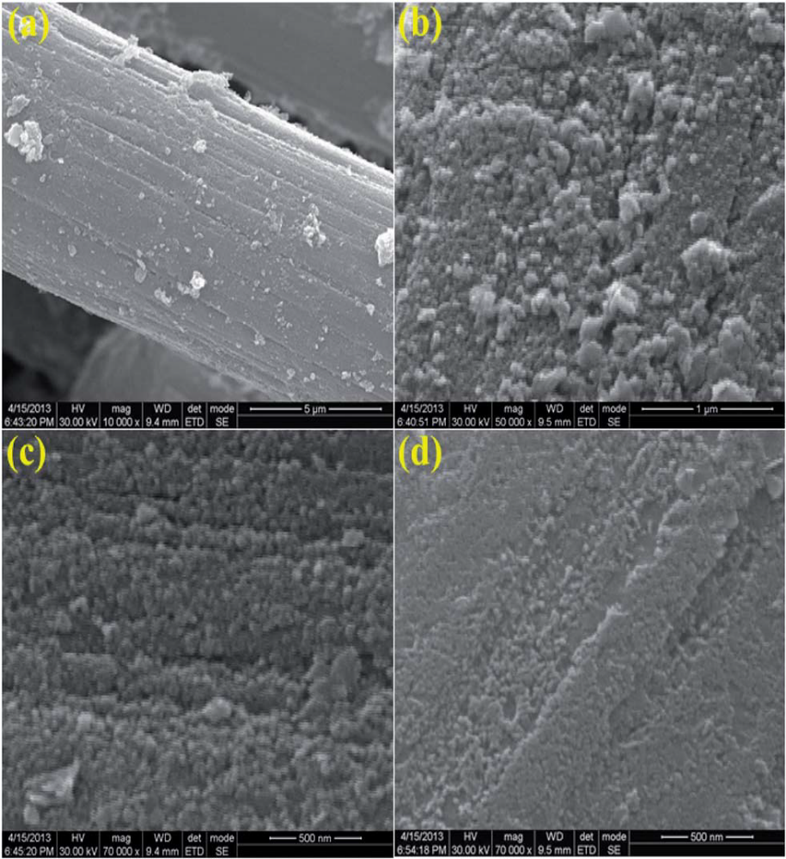
Fig (a-d) SEM images of NiCo₂O₄ nanowall structure
Fig (a-d) SEM images of NiCo₂O₄ nanoflakes structure

Slide 31
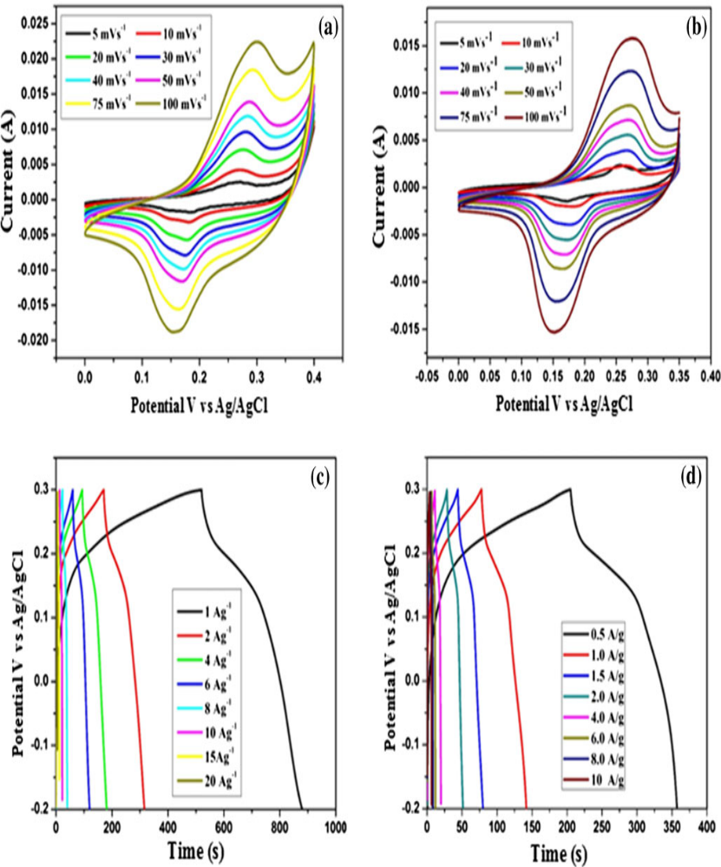
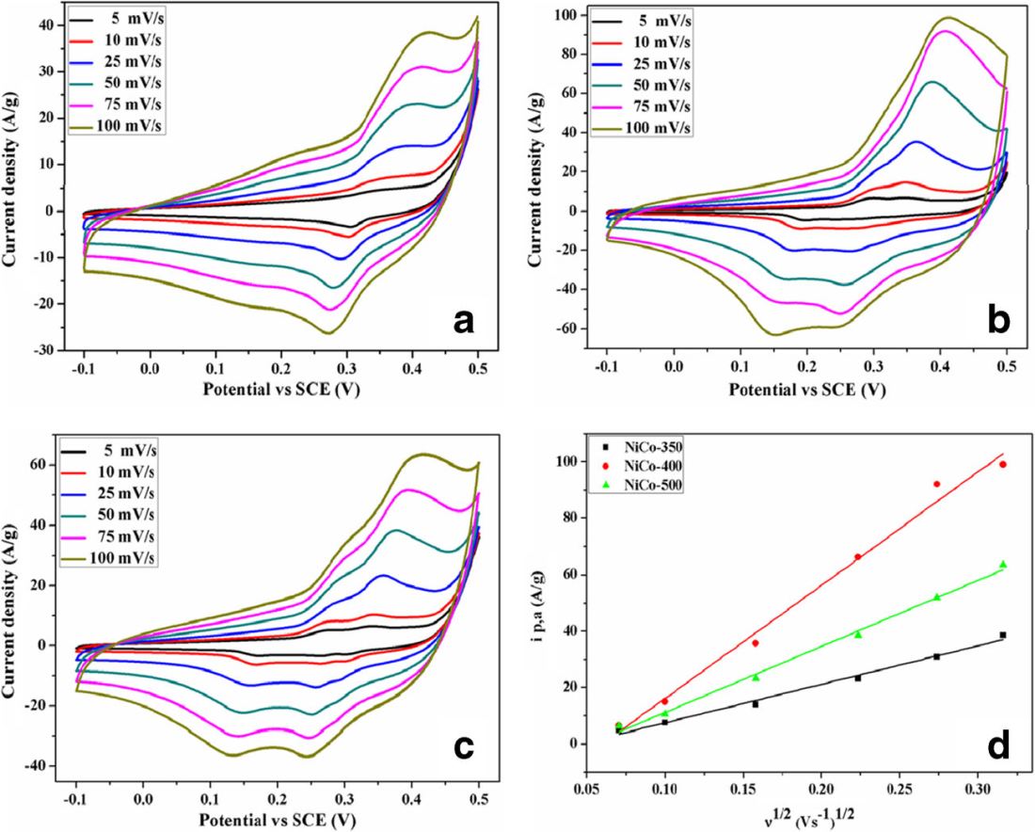
Fig 3D porous NiCo₂O₄ (a-c) CV curves recorded at different scan rates (5–100 mV) for the samples calcined at 350, 400 and 500 °C and (d) shows the Randles – Sevcik plot of the electrode materials
Fig (a-d) Electrochemical performance of NiCo₂O₄ nanoparticle calcined at 400˚C and 300 ˚C .

Slide 32
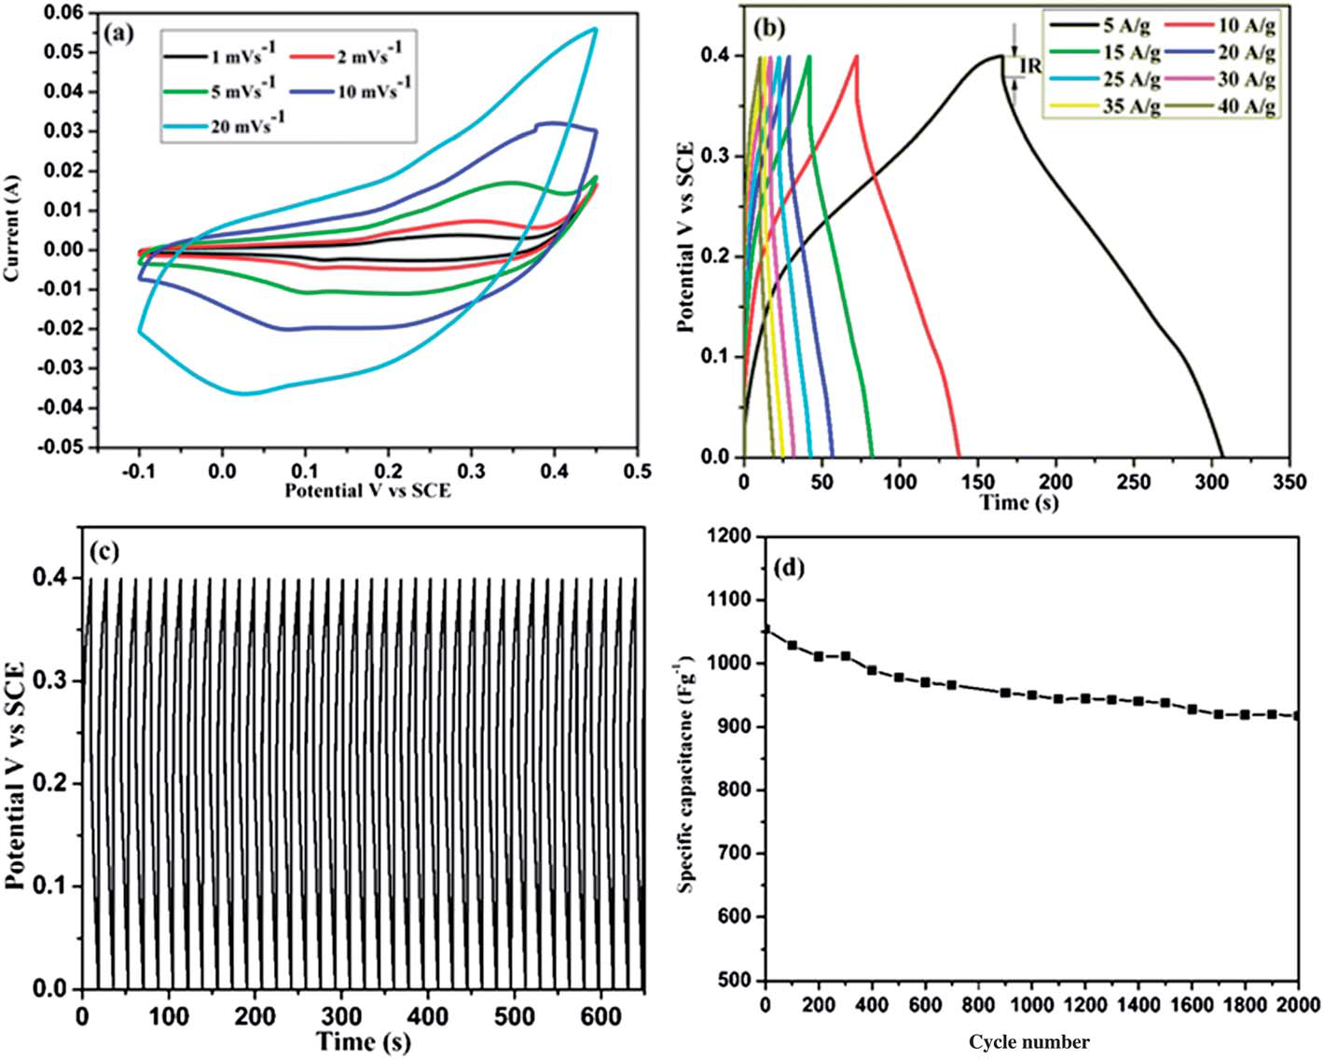
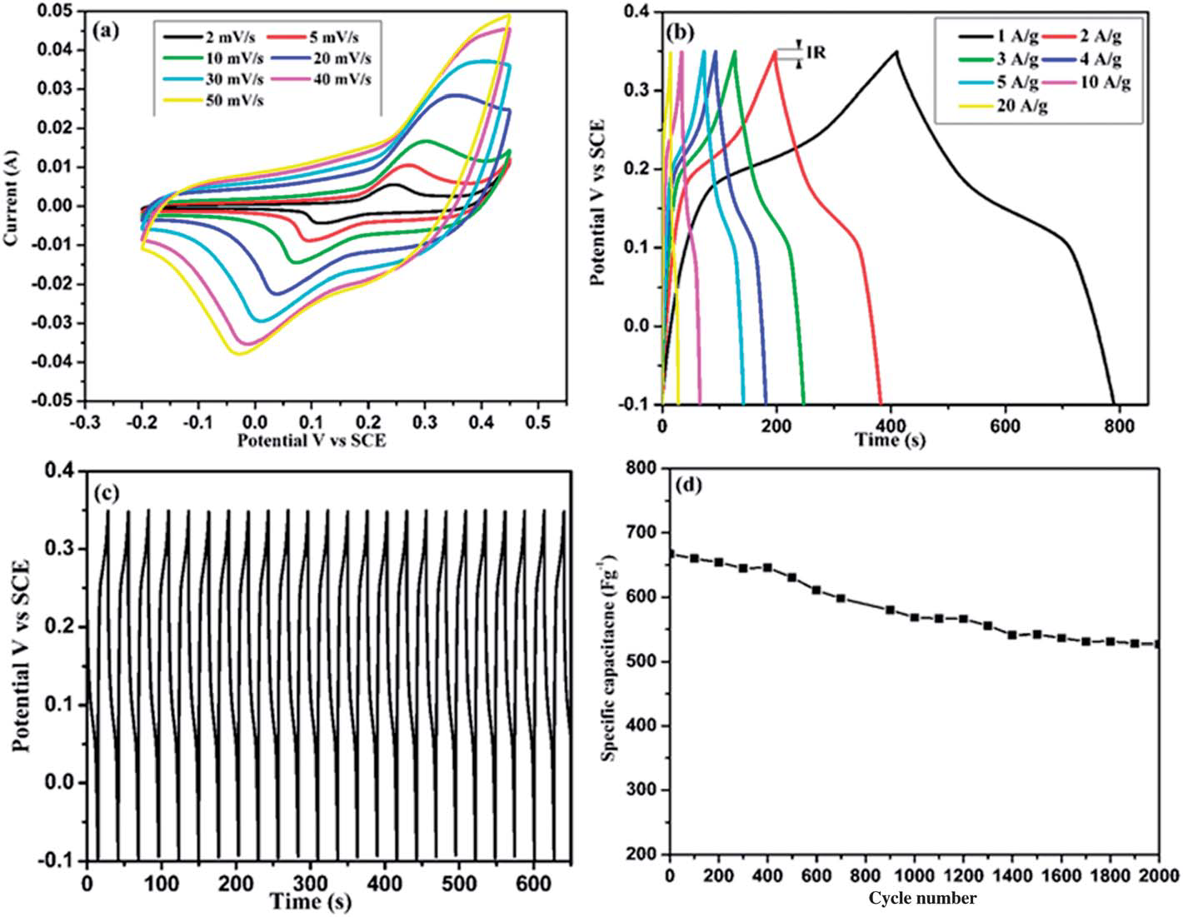
NiCo₂O₄ nanowall (a) CV curves at various scan rates (b) charge/discharge at various current densities (c) continuous charge/discharge cycles at the constant current density of 20 A g⁻¹ and (d) the capacitance cycling performance at a constant current density of 20 A g⁻¹.
NiCo₂O₄ nanoflakes (a) CV curves at various scan rates (b) charge/ discharge voltage profiles at various current densities (c) continuous charge/discharge cycles at the constant current density of 20 A g⁻¹ and(d) the capacitance cycling performance at a constant current density of 20Ag⁻¹.

Slide 33
MnCo₂O₄ ELECTRODE
Our group has investigated the electrochemical performance of spinel MnCo₂O₄ nanostructure.
Similar to NiCo₂O₄ nanostructure , MnCo₂O₄ was expected to show higher specific capacitance.
An attempt was taken by our group to prepare MnCo₂O₄ via solvothermal method and calcined at two different temperatures at 300 ˚C and 400˚C.
MnCo₂O₄ nanostructure resulted a maximum specific capacitance of 189 F g⁻¹ and 346 F g⁻¹ at constant current density of1 A g⁻¹ for 300 ˚C and 400˚C calcined samples.

Slide 34
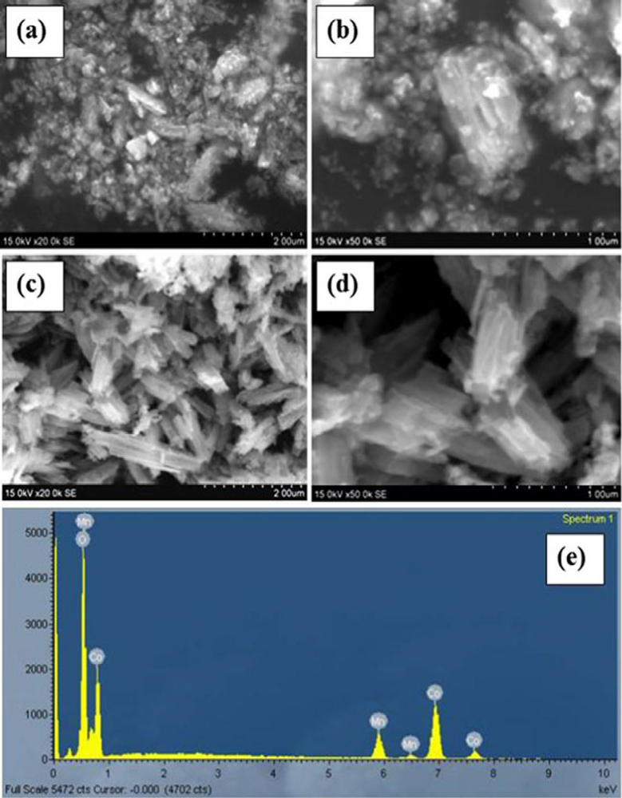
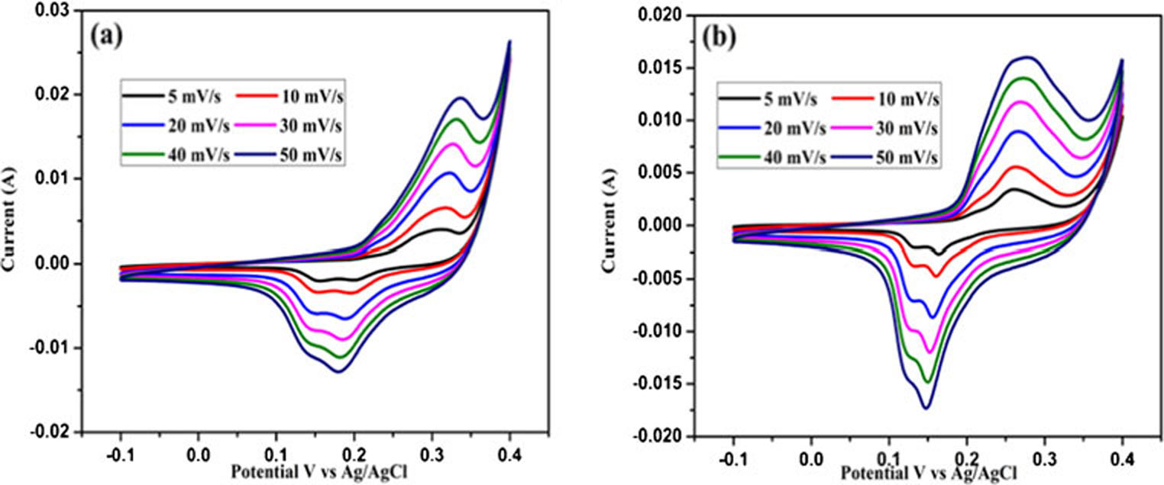
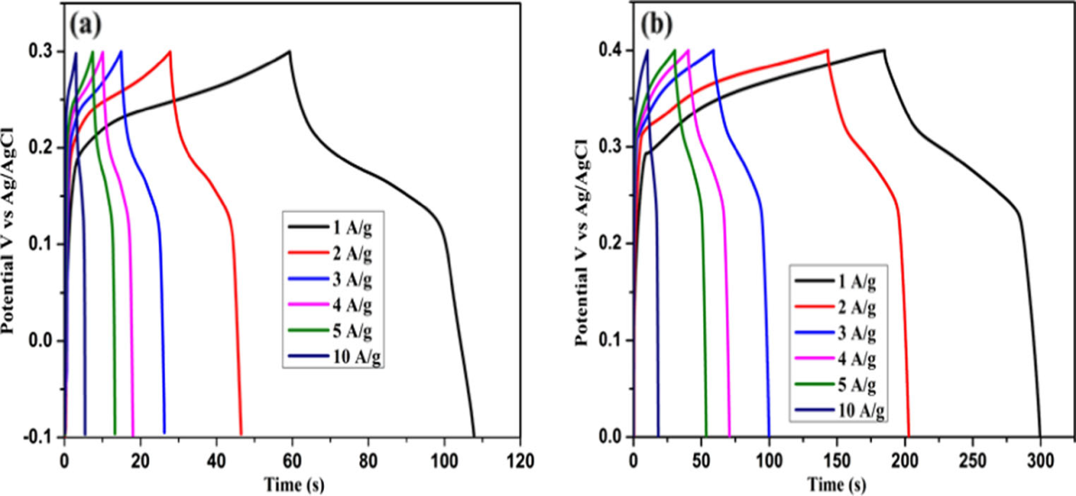
Fig (15) CV curves of MnCo2O4 calcined at 300 °C (a) and at 400 °C (b)
Fig 14 (a-e) SEM images of MnCo₂O₄ nanostructures and the corresponding EDS spectrum
Fig (16) Charge/discharge curves of MnCo2O4 calcined at 300 °C (a) and at 400 °C (b)

Slide 35
CoMoO₄ ELECTRODE
Electrochemical performance of molybdate nanostructure provoked to study CoMoO₄ supercapacitive nature.
Mai et al. reported CoMoO₄ nanowires with a specific capacitance 62.8 F g⁻¹
Xia et al. reported CoMoO₄ nanoparticles with a specific capacitance of 72 F g⁻¹.
Veerasubramani et al reported CoMoO₄ nanostructures with a maximum specific capacitance of 133 F g⁻¹.
Our group has been developed the direct growth of CoMoO₄nanoflakes on carbon fiber cloth. A symmetric supercapacitor was fabricated using this electrode as both positive and negative electrode.
Our device delivered the maximum specific capacitance of 8.3 F g⁻¹ at a constant current density of 1 A g⁻¹ , energy density 2.6 Wh kg⁻¹ and power density 748.8 W kg⁻¹ .

Slide 36
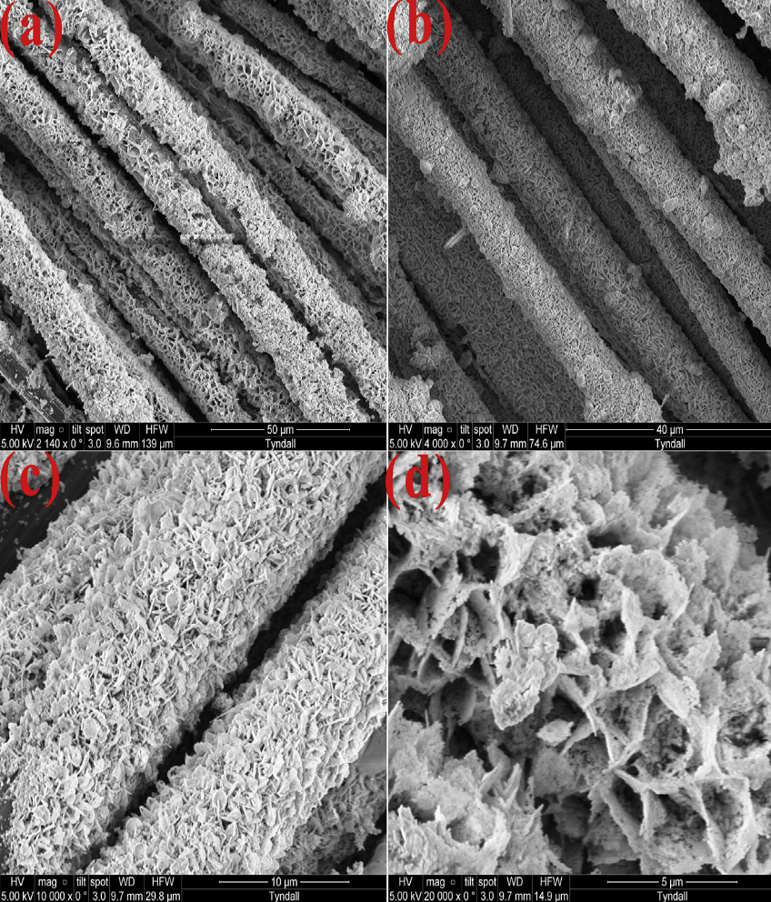
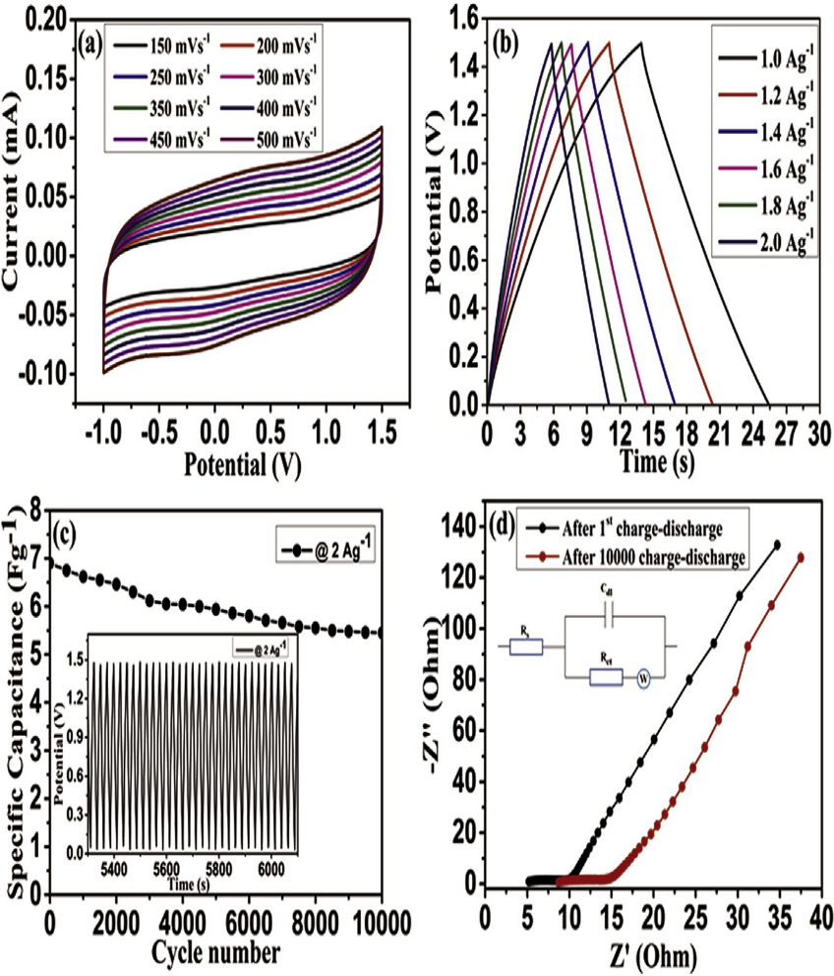
Fig 17(a-d) SEM images of the CoMoO₄nanoflake electrode
Fig 18 (a-d) Electrochemical performance of the CoMoO₄nanoflake electrode

Slide 37
Mn substituted spinel cobalt oxide electrode
It is well known that Manganese-Cobalt oxide system in which both involves several oxidation states. It increases high redox activity.
Prasad and Miura reported that electrodeposited manganese-cobalt oxide shows improved capacitive performance than manganese-nickel oxide.
Zhao et al. reported that manganese oxide specific capacitance can be increased by doping cobalt ions.
Chang et al. reported that Co addition can hinder the Mn ion dissolution into electrolyte, which enhances the reversibility and stability of cobalt-manganese oxide composite.
Li et al. reported change in electrochemical characteristics of cobalt-manganese oxide with respect to calcination temperature.
To best of our knowledge no one reported evalutation of Mn doped spinel cobalt oxide system for supercapacitor.

Slide 38
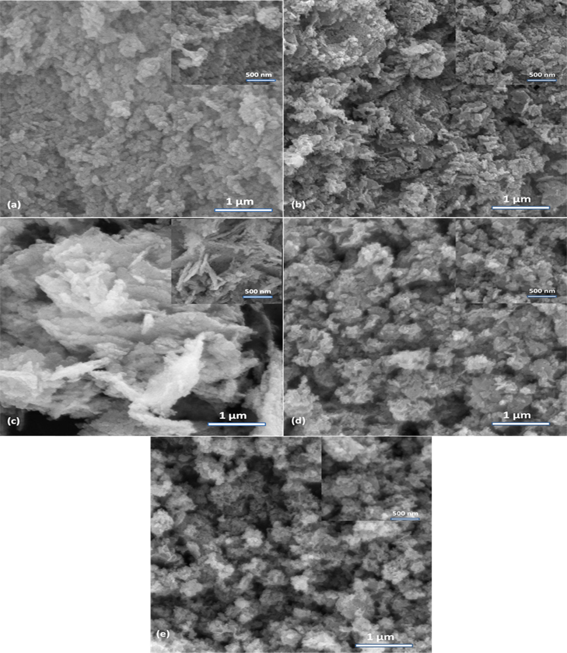
Fig 19. Typical HRSEM images of (a) PCO, (b) CM-05, (c) CM-10, (d) CM-15 and (e) CM-20

Slide 39
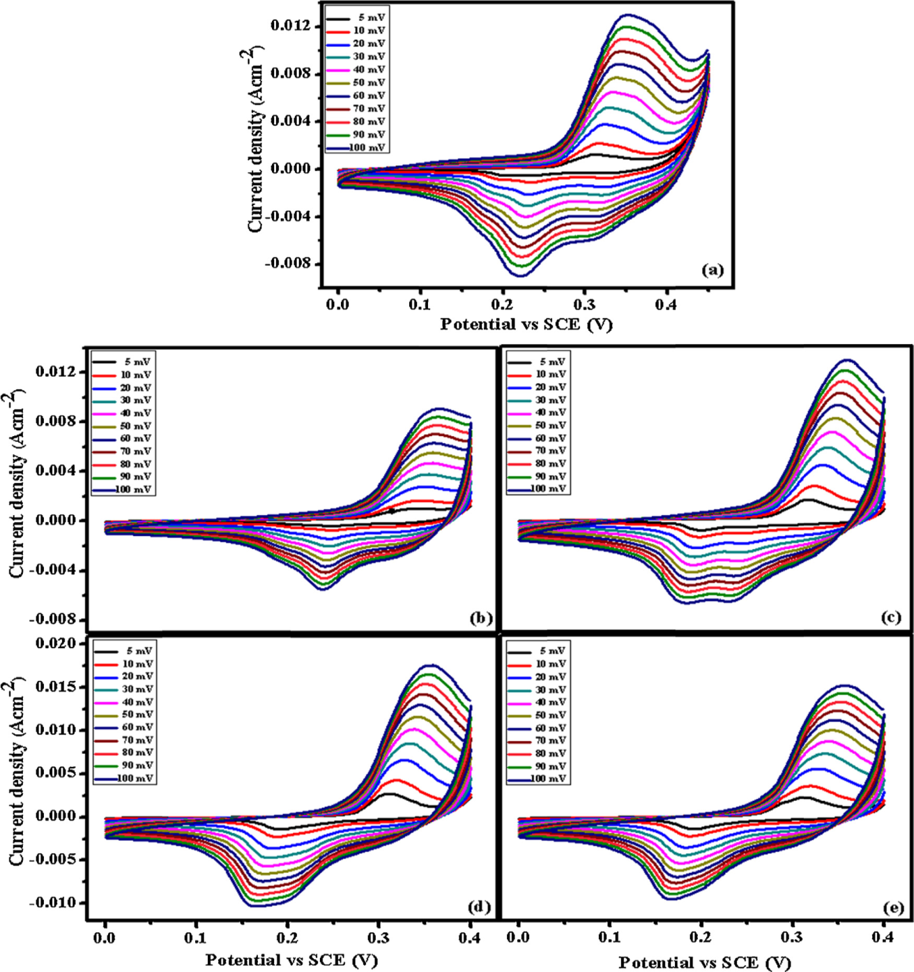
RESULTS
The specific capacitance of pure and Mn doped Cobalt oxide from CV,
Pure CO – 345 F/g
CM-05 – 274 F/g
CM-10 – 394 F/g
CM-15 – 436 F/g
CM-20 – 440 F/g
From GCD C_{s},
Pure CO – 311 F/g
CM-05 – 217 F/g
CM-10 – 359 F/g
CM-15 – 400 F/g
CM-20 – 404 F/g
Fig. Shows the CV recorded for the samples between the scan rate 5-100 mV (a) PCO, (b) CM-05, (c) CM-10, (d) CM-15 and (e) CM-20 in 3 M KOH aqueous electrolyte

Slide 40
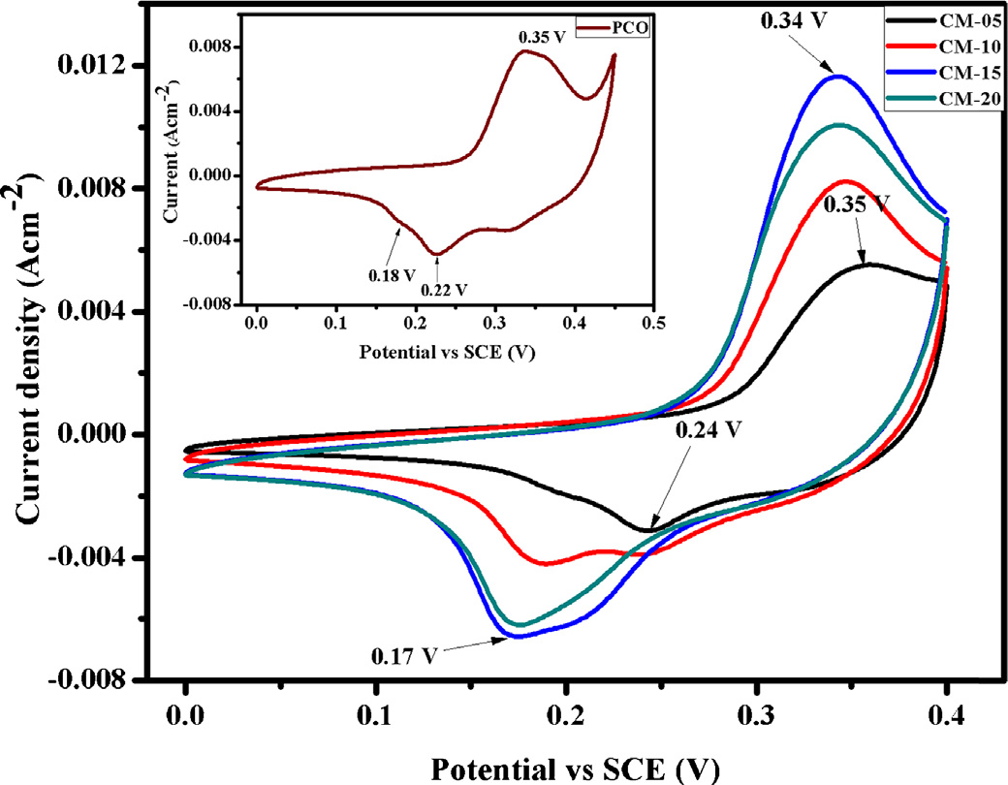
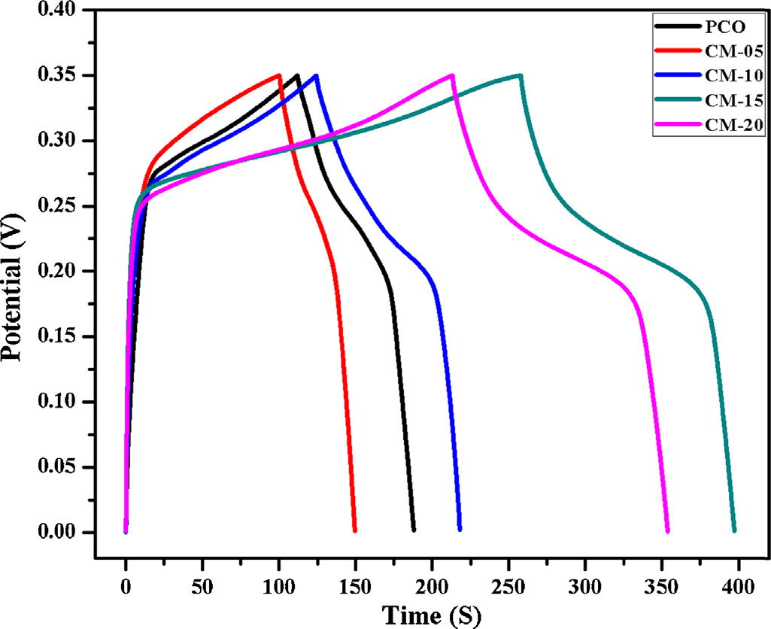
Fig. CV of Mn doped electrodes recorded at 50 mVs⁻¹ and inset showing the CV of undoped cobalt oxide in 3 M KOH aqueous electrolyte
Fig. Charge-discharge curves of the prepared electrode materials compared at a current density of 1 Ag⁻¹ in 3 M KOH aqueous electrolyte

Slide 41
CeO₂ ELECTRODE
We report a simple hydrothermal synthesis of CeO₂ hexagonal nanoplates and carbon coated CeO₂ nanorods with urea and D-glucose.
CV of CeO₂ nanostructures were measured at different scan rates over the potential range of 0–0.45 V. The well resolved pair of redox peaks within the observed sweep potential for all of the sweep rates can be directly attributed to the faradaic redox reaction of Ce³⁺ /Ce⁴⁺.
The maximum Cs is 602 F/g for the CeO₂ nanoplates and carbon coated CeO₂ exhibits capacitance of 644 F/g at 0.5 A/g.

Slide 42
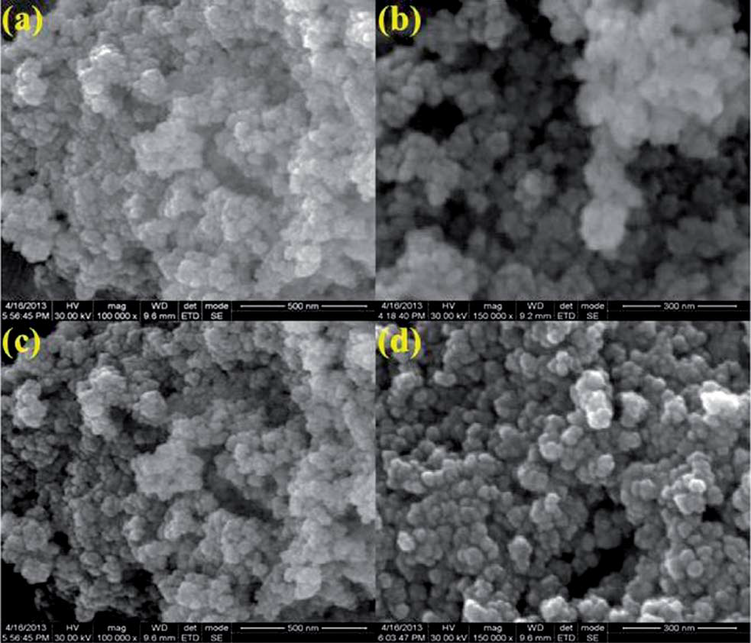
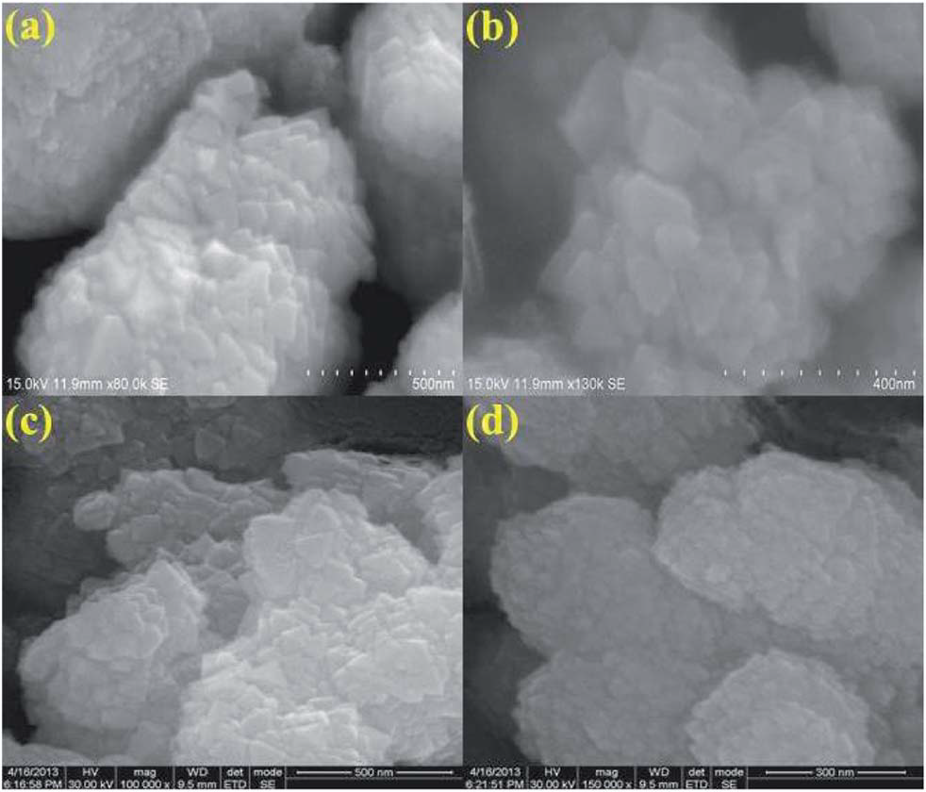
Fig HRSEM images of the as-prepared (a and b) and 300 C heat treated (c and d) CeO2 hexagonal nanoplates
Fig HRSEM images of the as-prepared (a and b) and 450 C heat treated (c and d) CeO₂/C nanorods

Slide 43
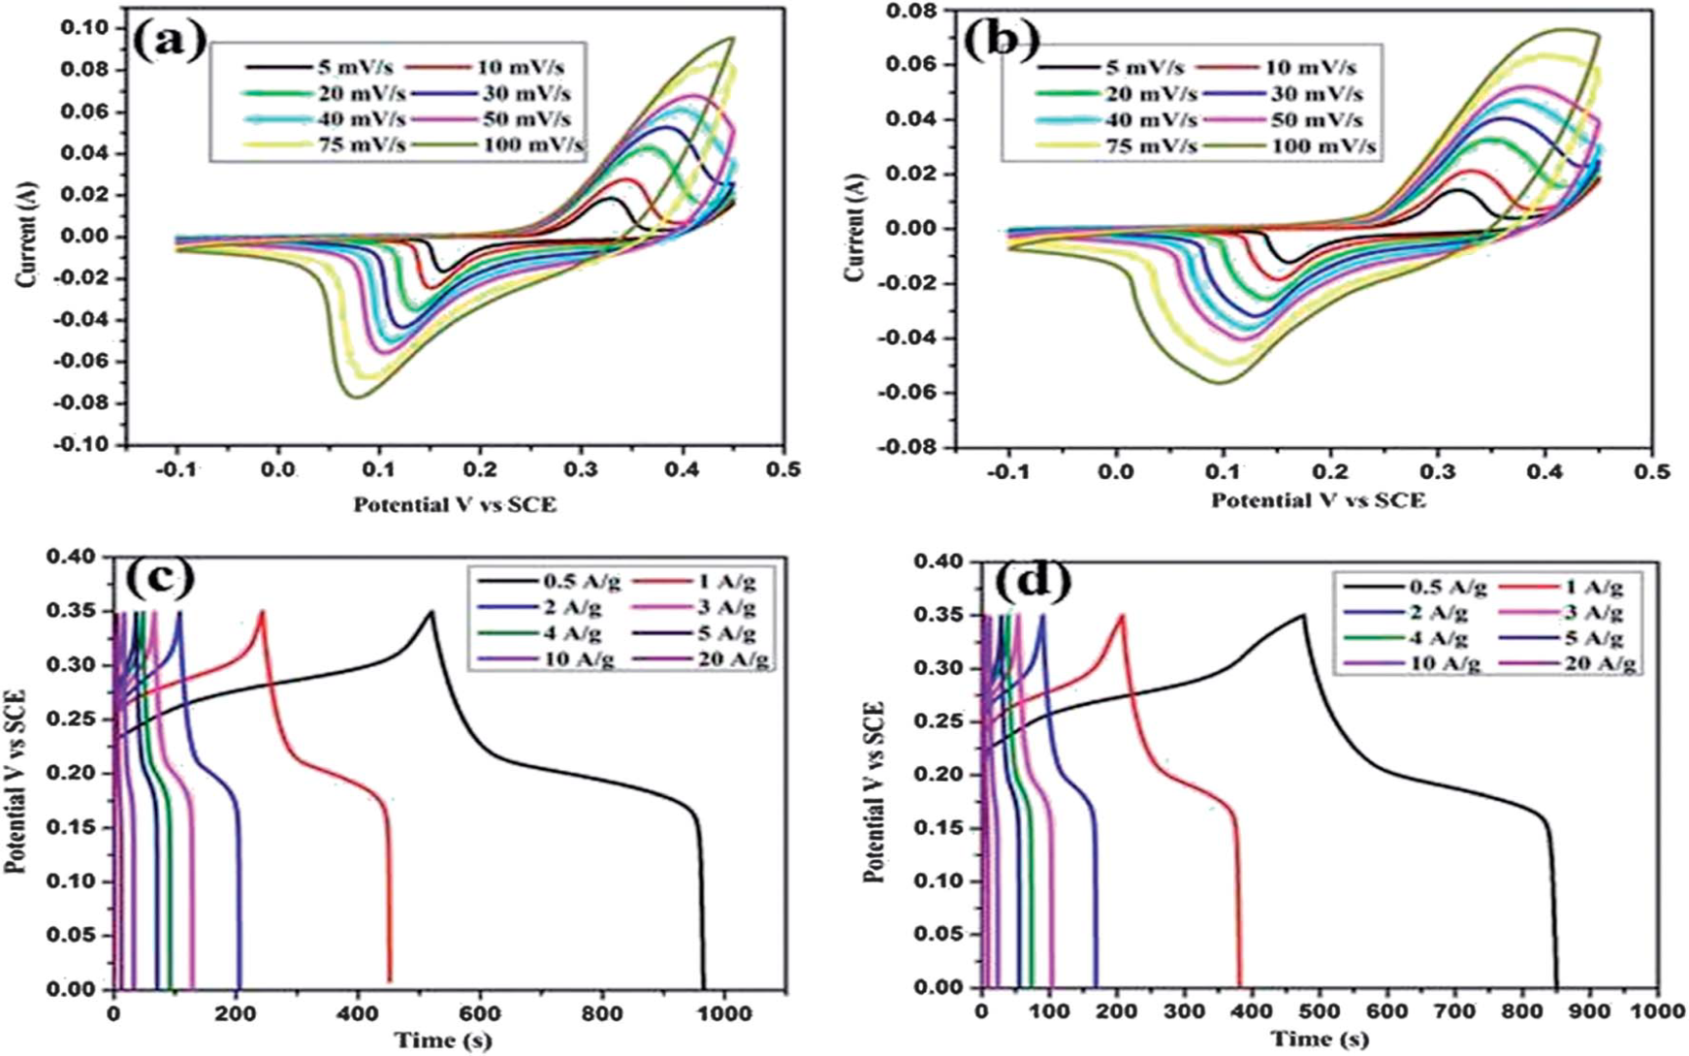
Fig Cyclic voltammograms and charge–discharge curves of the CeO₂ hexagonal nanoplates (a and c) and the carbon coated CeO₂ nanorods (b and d).

Slide 44
NiO – CeO₂ binary oxide electrode
The redox and catalytic features of CeO₂ are more pronounced when it is mixed with other transition or rare earth metal oxides.
Obviously, the combination of NiO–CeO₂ also expected to be a better electrode for supercapacitor.
Our group reported the NiO-CeO₂ binary oxide for supercapacitor for the first time.
Porous NiO–CeO2 mixed oxide was synthesized through glycol assisted citrate sol–gel method.
Binary oxide calcined at 500 °C shows specific capacitance of 305 Fg⁻¹ at the constant current density of 1 Ag⁻¹.
Binary oxide calcined at 700 °C exhibits a specific capacitance of 167 Fg⁻¹ at the constant current density of 1 Ag⁻¹ .

Slide 45
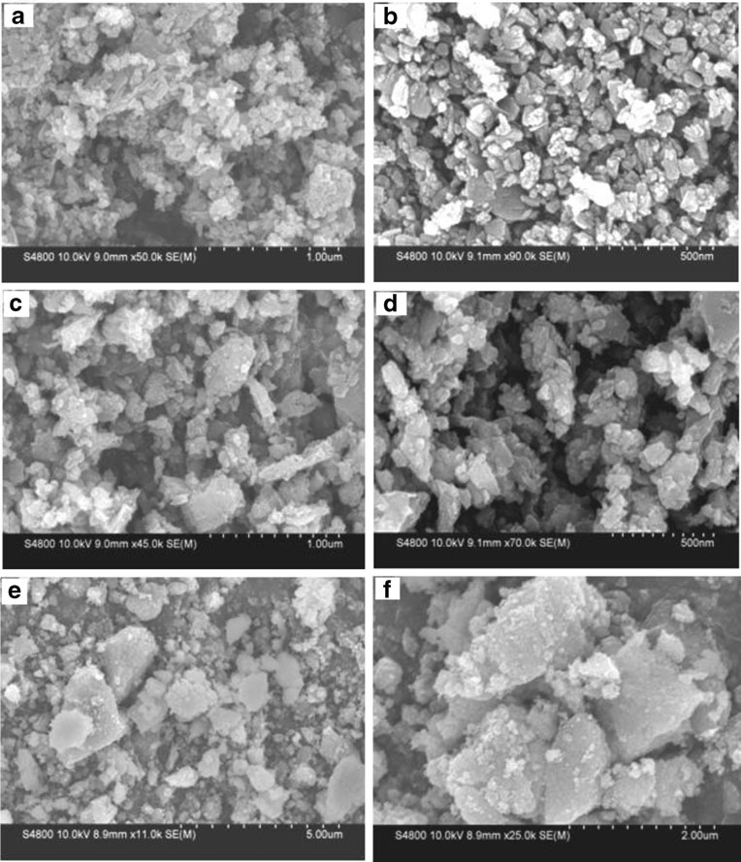
Fig SEM micrographs of the NiO–CeO2mixed oxides calcined at 500 °C (a and b), 600 °C (c and d) and 700 °C (e and f)

Slide 46
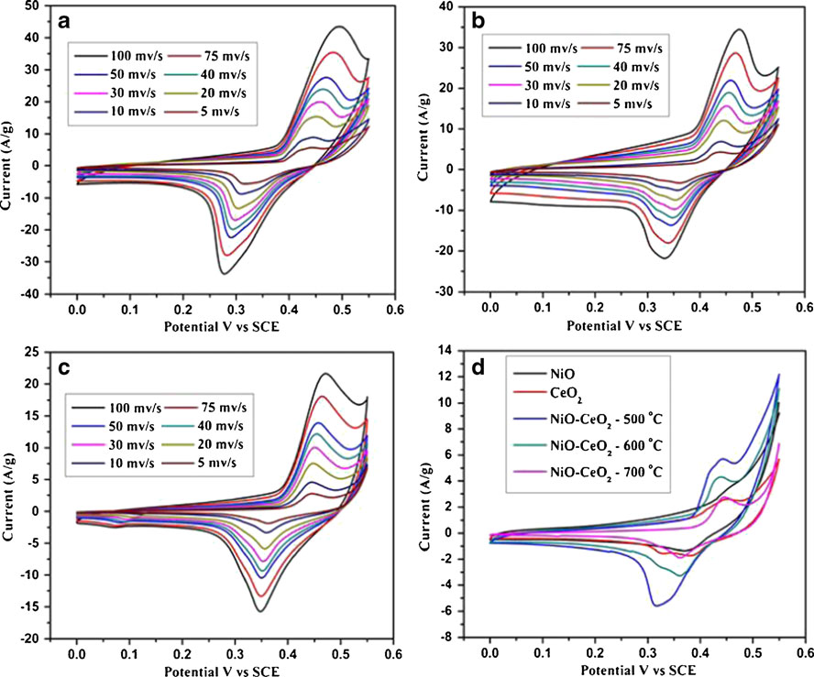
Fig CV of NiO–CeO2 mixed oxide electrode material heated at a 500, b 600, and c 700 °C. d Comparison of CVs of individual and the mixed oxide at the scan rate of 5 mV/s

Slide 47
CONCLUSION
In summary, various transition metal oxides as binary composites and spinel structured materials were well studied for supercapacitor electrode applications.
Transition metal oxides such as NiO , cubic spinel Co₃O₄ , NiCo₂O₄, MnCo₂O₄, CoMoO₄, CeO₂, NiO - CeO₂ binary composite, Mn doped cobalt oxide were studied.
Outstanding supercapacitive performance delivered by NiCo₂O₄ nanostructured material makes remarkable place in the fabrication of supercapacitor.

Slide 48
METAL OXIDES | SPECIFIC CAPACITANCE
NiO | 170 Fg⁻¹ at 5 A/g
Co₃O₄ | 4.8 mF cm⁻² at a currents density of 6.25 A g⁻¹
NiCo₂ O₄
NiCo₂O₄ nanoparticle | 524 F g⁻¹ at 0.5 A g⁻¹
NiCo₂O₄ nanoflakes | 844 F g⁻¹ at 1 A g⁻¹
NiCo₂O₄ nanowall | 1225 F g⁻¹ at 5 Ag⁻¹
3D porous NiCo₂O₄ at different calcinations | 350˚C | 512 F g⁻¹ at 5 mV/s
 | 400˚C | 908 F g⁻¹ at 5 mV/s
 | 500˚C | 827 F g⁻¹ at 5 mV/s

Slide 49
METAL OXIDES | SPECIFIC CAPACITANCE
MnCo₂ O₄ | 346 F g⁻¹ at a current density of 1 A/g
CoMoO₄ | 8.3 F g⁻¹ at a current of 1 A g⁻¹
Mn doped Cobalt oxide
Pure Co | 345 F/g
CM-05 | 274 F/g
CM-10 | 394 F/g
CM-15 | 436 F/g
CM-15 | 440 F/g
CeO₂ | 602 F/g at 5 mV/s
NiO - CeO₂ | 305 Fg⁻¹ at 1 A/g

Slide 50
Thank you for
Your Kind Patience

