Slide 1
Best practices for high concentration Ultrafiltration Applications
Subhasis Banerjee, Ph.D.
Group Manager, BSN, Merck Millipore
Biowavers, Biologics & Biosimilar Conference; Hyderabad, Oct 2014
Notes:
Intro…

Slide 2
Overview
  Driver for high protein concentration (HPC) in Biologics.
  Challenges in processing HPC using UF.
  New UF cassette development for HPC applications.

Slide 3
High Concentration Drivers for Biologics
  High patient doses required for biological products (mAbs):
    ~1-3mg/kG (→ upto 10 mg/kg)
  Intravenous (IV) infusion – traditional delivery method
    Issues: Infusion side effects, cost, quality of life, patient compliance
Notes:
High doses reqd. for mAb therapy → due to the relatively lower potency of the drug
The majority of marketed mAb products are administered by intravenous infusion – historical method uses larger volume, lower protein concentration and a clinical setting.
Although in certain treatments this route of administration may be necessary, there is the potential for severe adverse effects that can accompany rapid infusion. For ex.: Herceptin carries a black box warning partly related to its mode of administration, which can result in infusion reactions including anaphylaxis (serious allergic reaction), angioedema, and acute respiratory distress syndrome.
It may also present significant patient compliance, acceptability, and cost of treatment issues that render it undesirable.

Slide 4
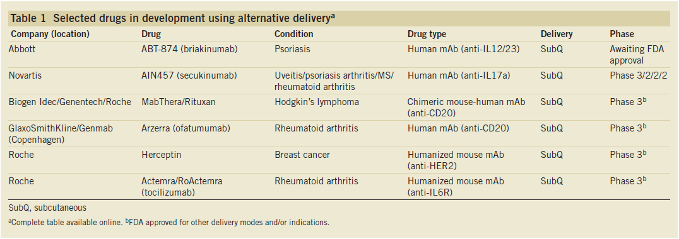
High Concentration Drivers for Biologics
  High patient doses required for biological products (mAbs):
    ~1-3mg/kG (→ upto 10 mg/kg)
  Intravenous (IV) infusion – traditional delivery method
    Issues: Infusion side effects, cost, quality of life, patient compliance
  Subcutaneous administration (Sub-Q) preferred by patients
    Ease of Use, savings in time & cost, convenience, mitigate severe after-effects of infusion
M.Eisenstein, v29 , # 2, Feb. 2011 Nature Biotech
Notes:
Ease of Use – ease of administration and also permits self-administration by patients. For ex. Sub-Q Herceptin takes 5 min to administer compared to the traditional 30-90 min.
Instead of visiting the doctor every four weeks for several hours of intravenous infusion, patients could take treatment in their own hands. The vast majority of oncology products that are mabs are given by IV administration, because the patient will be in the oncologist‘s office anyway; but, if you are talking about rheumatid arthritis, its quite nice for those to be self-administrered at home with a device that is capable of being used by a patient. Nevertheless, even leading cancer therapeutics, such as Herceptin and Rituxan, distributed by Roche, are undergoing similar reformulation, due in part to the potential for mitigating severe adverse effects that can accompany rapid infusion. For ex., studies have indicated that subcustneous injection of the anti-CD52 humanized rat mAb drug Campath at lower doses may match the effectiveness of IV delivery for the treatment of chronic lymphocytic leukemia while diminishing costs and minimizing infusion associated toxicity.
Different methods of subcutaneous delivery exists: basic prefilled syring to simple to use pen style atuinjectors.
After effects of infusion: Herceptin carries a black box warning partly related to its mode of administration, which can result in infusion reactions including anaphylaxis, angioedema, and acute respiratory distress syndrome.

Slide 5

  High Concentration Drivers for Biologics
  Subcutaneous injection Issues/Requirements
    Needle phobia and pain of injection

Slide 6
  High Concentration Drivers for Biologics
  Subcutaneous injection Issues/Requirements
    Needle phobia and pain of injection
      Studies show that increasing injection vol from 0.5 ml to 1 ml increases pain significantly
      Target injection vol < 1 ml
        For a 2-3 mg/kg dose, for a 70 kg person → 140-210 mg dose; if injectiion vol. needs to be less than 1 ml, we are talking about a protein concentration of > 140-210 g/L
  Sub-Q injections require high conc. protein formulations

Slide 7
  Challenges with High Concentration of Proteins
  Potentially significant changes in solution properties
    Viscosity → mechanical processing, drug delivery
    Osmotic Pressure → max conc in a TFF process
    Thermodynamic properties (excluded volume, donnan) → impurity clearance in diafiltration

Slide 8
  Challenges with High Concentration of Proteins
  Viscosity and Osmotic effects may combine to limit the ‘Max’ achievable concentration in a TFF process
  Let’s see how?

Slide 9
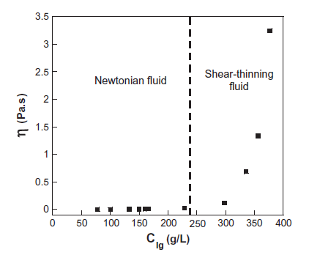
  Viscosity Effects
  Viscosity increases non-linearly with concentration
Burckbuchler, V., European Journal of Pharmaceutics 2010

Slide 10
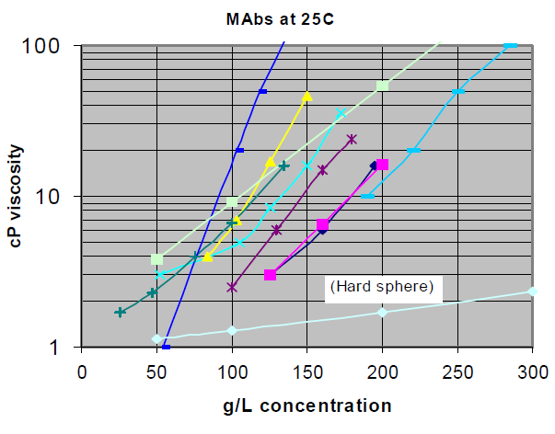
  Viscosity Effects
  Viscosity increases non-linearly with concentration
    Varies widely with mAb type for a given concentration

Slide 11
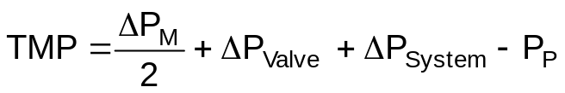
  Viscosity Effects – TFF Processing
  Pressure drop in a TFF system ↑ as viscosity ↑
Diafiltration
buffer
ΔP_{System}
Q_{R}
ΔP_{Valve}
Retentate
valve
Retentate
P_{R}
Feed
Tank
P_{F}
Q_{F}
ΔP_{M}
TMP
Feed
Permeate
P_{P}
Q_{P}

Slide 12
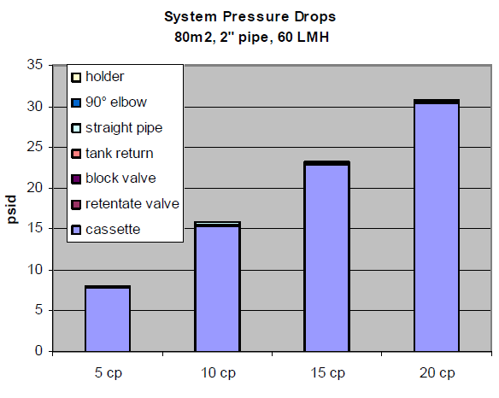
  Viscosity Effects – TFF Processing
  Pressure drop in a TFF system ↑ as viscosity ↑
    Cassette resistance dominates for a given flow geometry
ΔP_{System}

Slide 13


  Viscosity Effects – TFF Processing
  For a given flow, viscosity, cassette resistance determined by geometry:
    Channel size, screen type
V
C
A
    A screen “fine” - High pressure drop
    C screen “coarse” - Medium pressure drop
    V screen “suspended” - Very Low pressure drop
  Screen variables
    Weave pattern, wire diameter, mesh count, mesh opening, overmolding, orientation, etc.
DaCosta, A., JMS 1994
Notes:
Feed channel screens are inserted to improve back transport from membrane surface and increase flux
Local Dean vortices

Slide 14
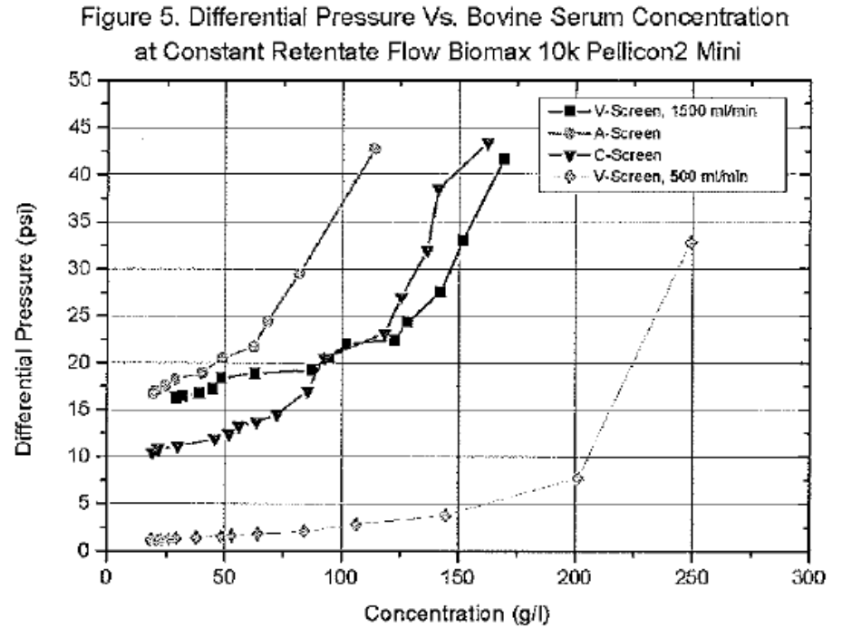
  Viscosity Effects – TFF Processing
  For a given flow, viscosity, cassette resistance determined by geometry:
    Channel size, screen type
V
C
A
A-Screen
C-Screen
V-Screen @ 15L/min/m²
V-Screen
Notes:
Higher pressure drop through tighter or fine cassette compare to suspended or coarse. Accentuated by flow, viscosity

Slide 15

  Osmotic Pressure Effects – TFF Processing
  Osmotic pressure resulting from concentration difference between membrane wall (Cw) and permeate (Cf≈0)
Feed
C_{b}
k
Retentate
C_{w}
membrane
C_{f}
TMP
Permeate
ΔΠ
  Applied TMP must be > osmotic pressure to force permeate flow
    Modules and equipment limit maximum TMP
Notes:
Higher pressure drop through tighter or fine cassette compare to suspended or coarse. Accentuated by flow, viscosity

Slide 16

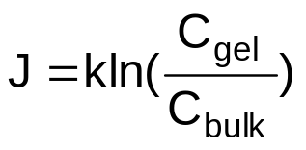
  How do high viscosity & osmotic pressure affect TFF processing?
  Permeate flux through a TFF membrane:
    Is determined by excess TMP over osmotic pressure
    Depends on mass transfer coeff (flow, geom) and solute conc.

Slide 17
  Example – Permeate flux vs Concentration for Tight and Open screens
  We notice that V-screen C_{gel} > C-Screen C_{gel}.
Open
Tight
398 g/L
242 g/L

Slide 18
  Inference
  High final concentrations achievable at lower feed flows and more open feed channel!
    Develop a more optimum feed channel for high conc (high viscosity) apps
      Existing C-Screen too tight, V-Screen possibly too open → optimum probably in-between
  Trade-off: lower permeate flux, larger membrane area

Slide 19
  High Viscosity Screen/Cassette Development
  Product need:
    What is the right screen size? What viscosity do we target?

Slide 20
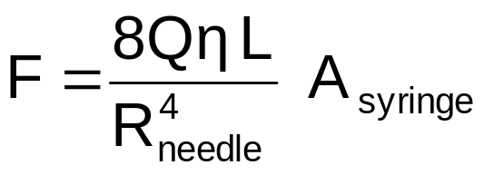
  Viscosity Target – Estimation
  High viscosity impacts the ability to load and deliver drug from the syringe
    At a given force, flow (Q) is proportional to
      fourth power of needle radius
      Inversely to viscosity
    If needle is too narrow
      Require High force or Slow flow
      Unreasonable time for patient to hold PFS during injection
        >20 sec

Slide 21
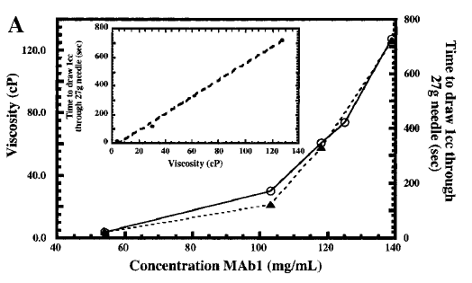
  Viscosity Target – Estimation
  High viscosity impacts the ability to load and deliver drug from the syringe
Shire et al, J. of Pharm Sci,
V93, NO. 6, JUNE 2004
Fig A: Viscosity (solid line, open circles) and syringe (27 gauge) loading time (dashed line, solid triangles) of a monoclonal antibody as a function of concentration.

Slide 22
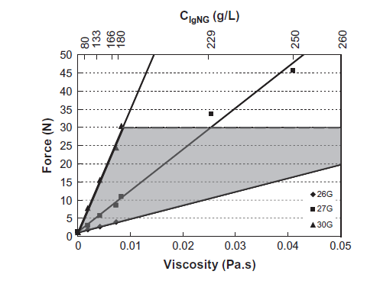
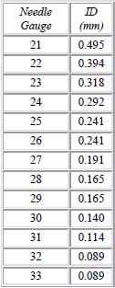
  Viscosity Target – Estimation
  High viscosity impacts the ability to load and deliver drug from the syringe
    Manual injection force limited to 10-30 N
    Typical sub-Q needle size range between 25-27 gauge*
30 Gauge
27 Gauge
SC delivery limited by
- Viscosity ~30cp
- Needle Size
- Injection Flowrate
26 Gauge
Burckbuchler, V., European Journal
of Pharmaceutics 2010
"http://en.wikipedia.org/wiki/Needle_gauge_comparison_chart"
*http://www.bccdc.ca/NR/rdonlyres/24C36473-261A-4FBD-8A41-444B3520DB64/0/
SectionIV_AdministrationofBiologicalProducts_June2012_.pdf
Notes:
As viscosity increases for a given needle size, or if the needle size narrows for a given viscosity, the injection force required is significantly increased.
For the 26, 27 Gauge needles, viscosity maxes out in the nbd of 30 cP. C-Screen is too tight , V-Screen probably too open in this range. So, an optimal viscosity target for the new cassette could be in the nbd of 30 cP. I think we targeted 25 cP for the D or High Viscosity screen.

Slide 23
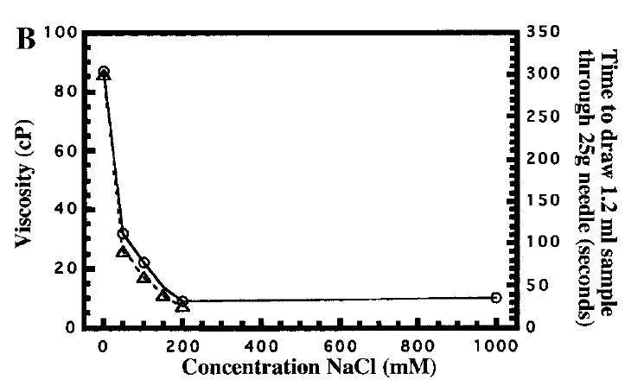
  Other Viscosity Reduction Techniques
  Viscosity may be reduced by appropriate excipients
    Ex. Addition of salt may reduce viscosity
Shire et al, J. of Pharm Sci,
V93, NO. 6, JUNE 2004
Fig: Viscosity (solid line, open circles) and syringe (25 gauge) loading time
of a monoclonal antibody at 125 mg/mL as a function of NaCl concentration.

Slide 24
  High Viscosity (Protein Conc) TFF Cassette
V
C
A
Too Open for HC Apps
Develop the
‘Just Right’ Size
Too tight for HC Apps

Slide 25
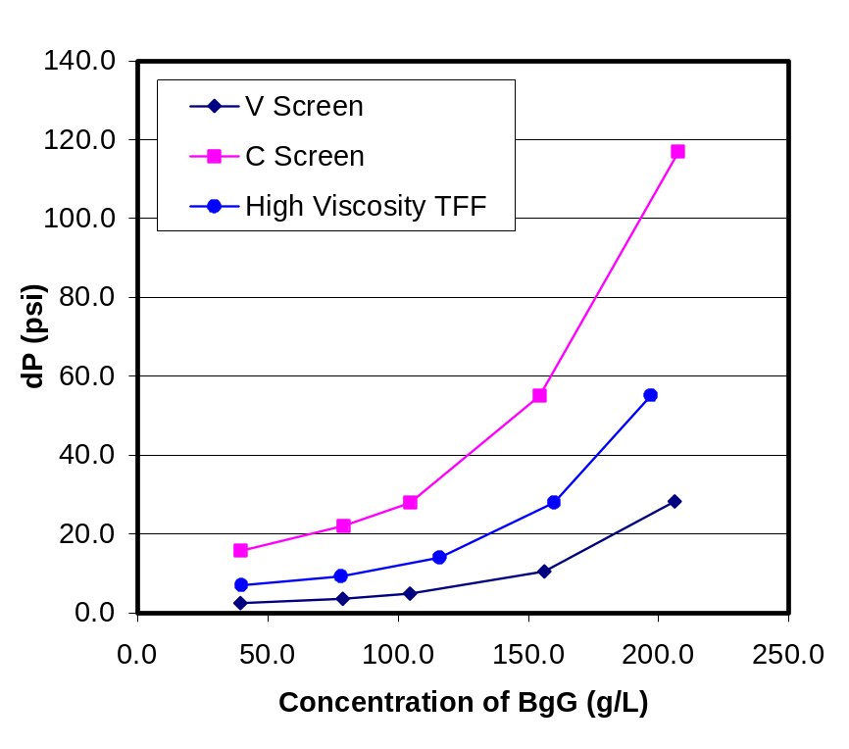
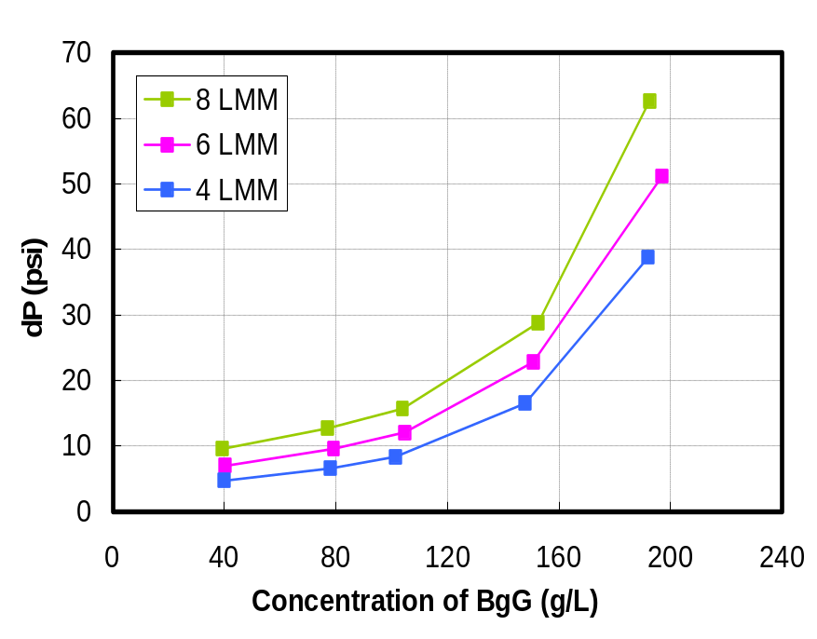
  The HV TFF Cassette – “Preview”
Pressure drop vs Concentration & Xflow:
At 8 L/min/m² cross flow rate
HV TFF Cassette –Cross Flow Effects
HV Cassette screen (‘D’ Screen) ΔP ~ 50% of C screen ΔP
ΔP=KμJ_{F}

Slide 26
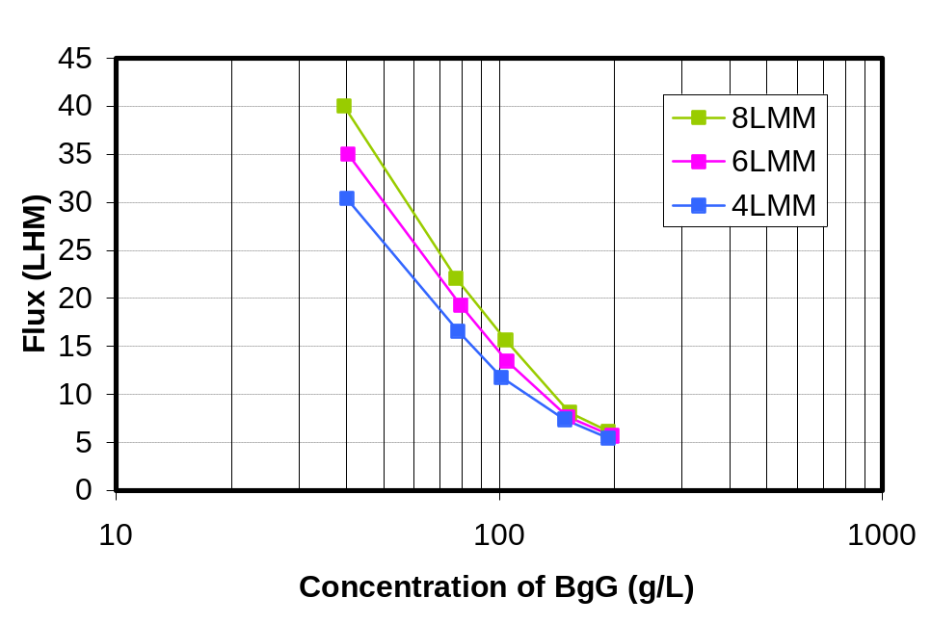
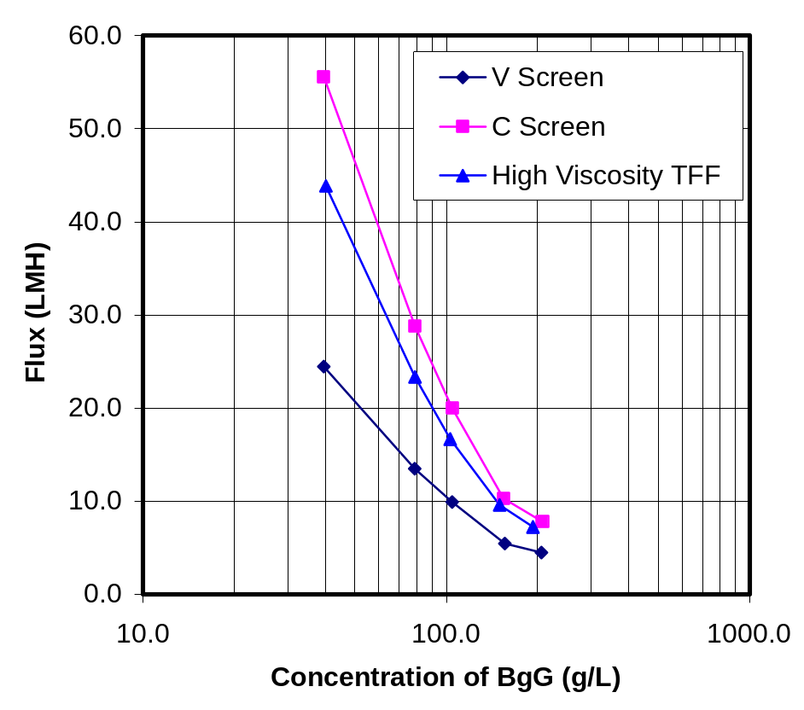
  The HV TFF Cassette – “Preview”
Flux vs. Concentration & Xflow:
At 8 L/min/m² cross flow rate
HV TFF Cassette –Cross Flow Effects
HV Cassette (D) screen J~ 80% of C screen J

Slide 27
  HV Cassette – Performance Summary
Product Attribute | Performance Outcome
Final viscosity | > 25 cP
Feed channel ΔP-water | 2-6 psi
Feed channel ΔP-mAb | 50% of C screen at ≥ 25 cP
Mass transfer k* | ≥ 150% of V-screen ≥ 80% of C-screen
Membrane Area | ≈ 0.5 X of V-Screen⊥ ≈ 1.2 X of C-Screen⊥
Mass transfer coefficient is compared at the same cross flow rate.
⊥At 8 L/min/m² cross flow rate
Enables the TFF process to optimally get to high protein concentrations
required for Subcutaneous drug delivery

Slide 28
Thank You!
Acknowledgements
Herb Lutz
Joseph Parrella
Bala Raghunath

