Slide 1


Biomarkers & Pharmacogenomics
in CNS disorders
Subbu Apparsundaram, PhD
CSO, V ClinBio
subbu@vclinbio.com
+1 862 485 7489
www.vclinbio.com
Sri Ramachandra University
Porur, Chennai, India

Slide 2

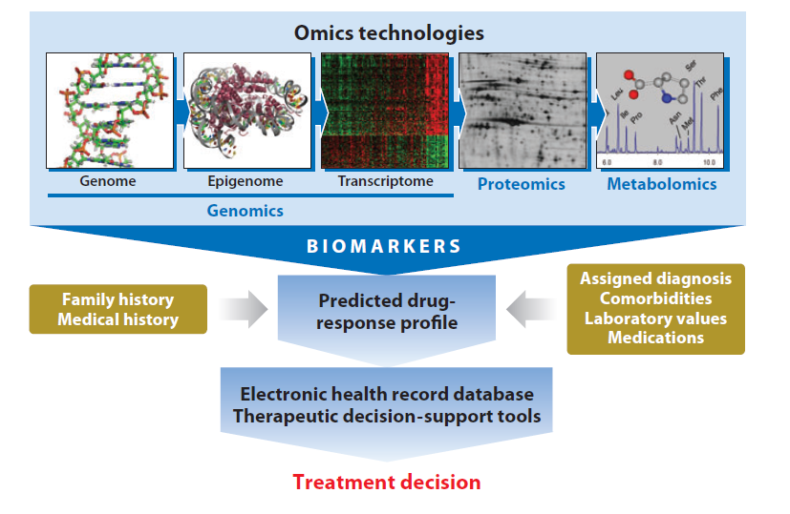
omics based prediction of drug response profiling
Meyer et al., Annu. Rev. Pharmacol. Toxicol
53:475-502, 2013

Slide 3
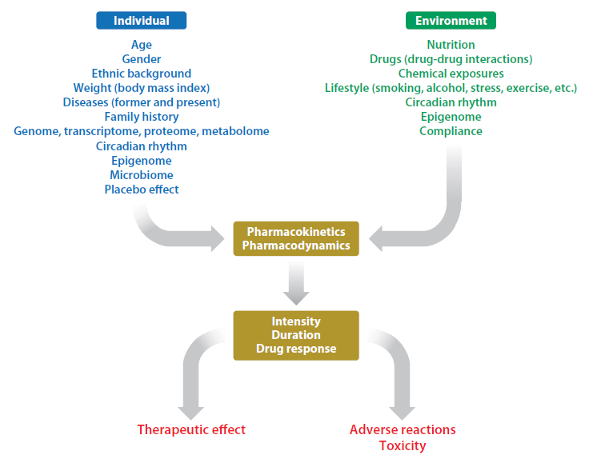
multiple factors influence drug response
Meyer et al., Annu. Rev. Pharmacol. Toxicol
53:475-502, 2013

Slide 4
challenges in drug therapy
Clinicians frustrations
  Lack of response
  Side effects
  Non-adherence
Patient frustrations
trial-and-error “roller coaster”
months/years of ‘trying’
too many side effects
multiple medications
doctor visits etc
missed work

Slide 5
FDA-pharmacogenomic biomarkers in labeling
Oncology drugs
Ado-Trastuzumab
Emtansine ERBB2
Afatinib EGFR
Anastrozole ESR1, PGR
Arsenic Trioxide PML/RARA
Bosutinib BCR/ABL1
Brentuximab
Vedotin TNFRSF8
Busulfan Ph Chromosome
Capecitabine DPYD
Cetuximab EGFR
Cetuximab KRAS
Cisplatin TPMT
Crizotinib ALK
Dabrafenib (1) BRAF
Dabrafenib (2) G6PD
Dasatinib BCR/ABL1
Denileukin Diftitox IL2RA
Erlotinib (1) EGFR
Erlotinib (2) EGFR
Erlotinib (1) EGFR
Erlotinib (2) EGFR
Everolimus (1) ERBB2
Everolimus (2) ESR1
Exemestane ESR1
Fluorouracil (2) DPYD
Fulvestrant ESR1
Ibritumomab Tiuxetan MS4A1
Imatinib (1) KIT
Imatinib (2) BCR/ABL1
Imatinib (3) PDGFRB
Imatinib (4) FIP1L1/PDGFRA
Irinotecan UGT1A1
Lapatinib ERBB2
Letrozole ESR1, PGR
Mercaptopurine TPMT
Nilotinib (1) BCR/ABL1
Nilotinib (2) UGT1A1
Obinutuzumab MS4A1
Ofatumumab MS4A1
Omacetaxine BCR/ABL1
Panitumumab (1) EGFR
Panitumumab (2) KRAS
Pazopanib UGT1A1
Pertuzumab ERBB2
Ponatinib BCR –ABL T315I
Rituximab MS4A1
Tamoxifen (1) ESR1, PGR
Tamoxifen (2) F5
Tamoxifen (3) F2
Thioguanine TPMT
Ticagrelor CYP2C19
Tositumomab MS4A1
Trametinib BRAF
Trastuzumab ERBB2
Tretinoin PML/RARA

Slide 6
FDA-pharmacogenomic biomarkers in labeling
other drugs
Drug Therapeutic Area HUGO Symbol
Abacavir Infectious Diseases HLA-B
Atorvastatin Endocrinology LDLR
Azathioprine Rheumatology TPMT
Boceprevir Infectious Diseases IFNL3
Carglumic Acid Metabolic Disorders NAGS
Carisoprodol Rheumatology CYP2C19
Carvedilol Cardiology CYP2D6
Celecoxib Rheumatology CYP2C9
Cevimeline Dental CYP2D6
Chloroquine Infectious Diseases G6PD
Chlorpropamide Endocrinology G6PD
Clopidogrel Cardiology CYP2C19
Dapsone Dermatology G6PD
Dapsone Infectious Diseases G6PD
Dexlansoprazole Gastroenterology CYP2C19
Dexlansoprazole Gastroenterology CYP1A2
Eltrombopag Hematology F5
Eltrombopag Hematology SERPINC1
Esomeprazole Gastroenterology CYP2C19
Fluorouracil Dermatology DPYD
Flurbiprofen Rheumatology CYP2C9
Glimepiride Endocrinology G6PD
Glipizide Endocrinology G6PD
Glyburide Endocrinology G6PD
Ivacaftor Pulmonary CFTR
Lansoprazole Gastroenterology CYP2C19
Lenalidomide Hematology del ( 5q)
Lomitapide Endocrinology LDLR
Mafenide Infectious Diseases G6PD
Maraviroc Infectious Diseases CCR5
Methylene Blue Hematology G6PD
Metoclopramide Gastroentrology CYB5R1-4
Metoprolol Cardiology CYP2D6
Mipomersen Endocrinology LDLR
Mycophenolic Acid Transplantation HPRT1
Nalidixic Acid Infectious Diseases G6PD
Nitrofurantoin Infectious Diseases G6PD
Omeprazole Gastroenterology CYP2C19
Pantoprazole Gastroenterology CYP2C19
Peginterferon alfa-2b Infectious Diseases IFNL3
Pegloticase Rheumatology G6PD
Perphenazine Psychiatry CYP2D6
Phenytoin Neurology HLA-B
Prasugrel Cardiology CYP2C19
Pravastatin Endocrinology LDLR
Primaquine Infectious Diseases G6PD
Propafenone Cardiology CYP2D6
Propranolol Cardiology CYP2D6
Quinidine Cardiology CYP2D6

Slide 7
FDA-pharmacogenomic biomarkers in labeling
other drugs
Drug Therapeutic Area HUGO Symbol
Quinidine Cardiology CYP2D6
Quinine Sulfate Infectious Diseases G6PD
Rabeprazole Gastroenterology CYP2C19
Rifampin, Infectious Diseases NAT1-2
Rosuvastatin Endocrinology LDLR
Simeprevir Infectious Diseases IFNL3
Sodium Nitrite Antidotal Therapy G6PD
Sofosbuvir Infectious Diseases IFNL3
Succimer Hematology G6PD
Sulfamethoxazole
and Trimethoprim Infectious Diseases G6PD
Telaprevir Infectious Diseases IFNL3
Terbinafine Infectious Diseases CYP2D6
Ticagrelor Cardiology CYP2C19
Tolterodine Genitourinary CYP2D6
Voriconazole Infectious Diseases CYP2C19
Warfarin (1) Cardiology or Hematology CYP2C9
Warfarin (2) Cardiology or Hematology VKORC1
Warfarin (3) Cardiology or Hematology PROC
PharmGKB: http://www.pharmgkb.org

Slide 8
FDA – CNS Drugs:
pharmacogenomic biomarkers in labeling
CYP2D6
CYP2C19
Amitriptyline
Aripiprazole
Atomoxetine
Citalopram
Clomipramine
Clozapine
Codeine
Desipramine
Dextromethorphan & Quinidine
Diazepam
Doxepin
Fluoxetine
Fluvoxamine
Iloperidone
Imipramine
Modafinil
Nortriptyline
Paroxetine
Perphenazine
Pimozide
Protriptyline
Risperidone
Tetrabenazine
Thioridazine
Citalopram
Clobazam
Drospirenone
Ethinyl Estradiol
HLA-B
Phenytoin
HLA-A
HLA-B
Carbamazepine

Slide 9
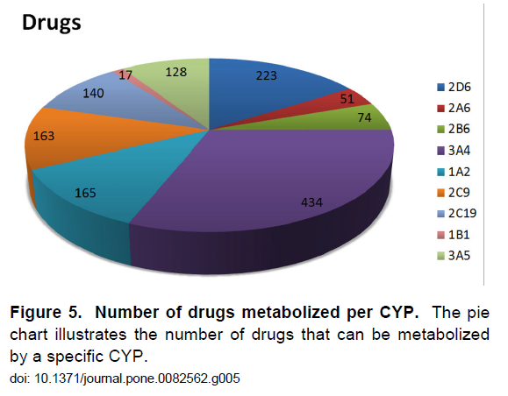
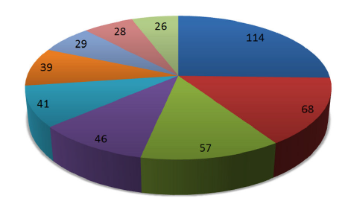
cytochrome P450 enzymes (CYPs)
# of SNPs per CYP
# drugs metabolized per CYP
CYP2C19
CYP2D6
Preissner et al. 2013
PLOS one : e 8562

Slide 10
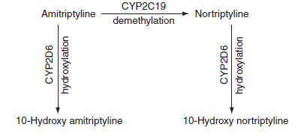
Tricyclic antidepressant metabolism by CYP2D6 and CYP2C19
Clinical Pharmacology & Therapeutics 93: 402-408, 2013
Parent drug | CYP2C19 metabolite | CYP2D6 metabolite | Therapeutic drug monitoring
Amitriptyline | Nortriptyline | hydroxy-amitriptyline | amitriptyline + nortriptyline
Clomipramine | desmethyl-clomipramine | hydroxy-clomipramine | clomipramine + desmethyl-clomipramine
Desipramine | -------- | hydroxy-desipramine | desipramine
Doxepin | desmethyl-doxepin | hydroxy-doxepin | doxepin + desmethyl-doxepin
Imipramine | Desipramine | hydroxy-imipramine | imipramine + desmethyl-imipramine
Nortriptyline | -------- | hydroxy-nortriptyline | nortriptyline
Trimipramine | desmethyl-trimipramine | hydroxy-trimipramine | trimipramine + desmethyl-trimipramine

Slide 11
association between allelic variants & enzyme activity
CYP2D6
Functional Status | Activity Value | Alleles
Functional / normal activity / wild-type | 1 | *1, *2, *27, *33, *35, *45, *46, *39, *48, *53
Reduced function / decreased activity | 0.5 | *9, *10, *17, *29, *41, *49, *50, *54, *55, *59, *69, *72
Non-functional / no activity | 0 | *3, *4, *5, *6, *7, *8, *11, *12, *13, *14, *15, *16, *18, *19, *20, *21, *31, *36, *38, *40, *42, *44, *47, *51, *56, *57, *62
CYP2C19
Functional Status | Alleles
Functional / normal activity / wild-type | *1
Loss-of-function / no or decreased activity | *2, *3, *4, *5, *6, *7, *8
Gain-of-function / increased activity | *17
Clinical Pharmacology & Therapeutics 93: 402-408, 2013

Slide 12
CYP2D6 genotypes with resulting activity scores and phenotype classification
Allele 1 | Allele 2 | CYP2D6 Diplotype | CYP2D6 Activity Score | Phenotype
*1 | *1xN | *1/*1xN | ≥3.0 | UM
*2x2 | *41 | *2x2/*41 | 2.5 | UM
*1 | *2 | *1/*2 | 2.0 | EM
*1 | *17 | *1/*17 | 1.5 | EM
*2 | *3 | *2/*3 | 1.0 | EM
*1 | *4x2 | *1/*4x2 | 1.0 | EM
*10 | *10 | *10/*10 | 1.0 | EM
*4 | *10 | *4/*10 | 0.5 | IM
*5 | *6 | *5/*6 | 0 | PM
EM = extensive metabolizer; PM = poor metabolizer
IM = intermediate metabolizer; UM = ultrarapid metabolizer
Clinical Pharmacology & Therapeutics 93: 402-408, 2013

Slide 13
predicted metabolizer phenotypes based on CYP2D6 diplotypes
Predicted Metabolizer Phenotype (Range Multi-Ethnic Frequencyª)
Allele | *1 | *2 | *1xN or *2xN | *3 | *4 or *4xN | *5 | *6 | *9 | *10 | *17 | *41
*1 | EM | EM | UM | EM | EM | EM | EM | EM | EM | EM | EM
*2 |  | EM | UM | EM | EM | EM | EM | EM | EM | EM | EM
*1xN or *2xN |  |  | UM | EM or UM | EM or UM | EM or UM | EM or UM | UM | UM | UM | UM
*3 |  |  |  | PM | PM | PM | PM | IM | IM | IM | IM
*4 |  |  |  |  | PM | PM | PM | IM | IM | IM | IM
*5 |  |  |  |  |  | PM | PM | IM | IM | IM | IM
*6 |  |  |  |  |  |  | PM | IM | IM | IM | IM
*9 |  |  |  |  |  |  |  | EM | EM | EM | EM
*10 |  |  |  |  |  |  |  |  | EM | EM | EM
*17 |  |  |  |  |  |  |  |  |  | EM | EM
*41 |  |  |  |  |  |  |  |  |  |  | EM
Clinical Pharmacology & Therapeutics 93: 402-408, 2013

Slide 14
predicted metabolizer phenotypes based on CYP2C19 diplotypes
Predicted Metabolizer Phenotype (Range Multi-Ethnic Frequencyª)
Allele | *1 | *2 | *3 | *4 | *5 | *6 | *7 | *8 | *17
*1 | EM | IM | IM | IM | IM | IM | IM | IM | UM
*2 |  | PM | PM | PM | PM | PM | PM | PM | IM
*3 |  |  | PM | PM | PM | PM | PM | PM | IM
*4 |  |  |  | PM | PM | PM | PM | PM | IM
*5 |  |  |  |  | PM | PM | PM | PM | IM
*6 |  |  |  |  |  | PM | PM | PM | IM
*7 |  |  |  |  |  |  | PM | PM | IM
*8 |  |  |  |  |  |  |  | PM | IM
*17 |  |  |  |  |  |  |  |  | UM
Clinical Pharmacology & Therapeutics 93: 402-408, 2013

Slide 15
frequencies of CYP2C19 alleles in
major race/ethnic groups
C | African | American | East Asian | European | Middle Eastern | Oceanian | South/Central Asian
*1^{c} | 0.68 | 0.69 | 0.60 | 0.63 | 0.87 | 0.24 | 0.62
*2 | 0.15 | 0.12 | 0.29 | 0.15 | 0.12 | 0.61 | 0.35
*3 | 0.0052 | 0.00028 | 0.089 | 0.0042 | 0.011 | 0.15 | 0.024
*4 | 0.00093 | 0.0024 | 0.00049 | 0.0025 | ND | ND | 0.00
*5 | ND | 0.00 | 0.00062 | 0.000073 | ND | ND | 0.00
*6 | 0.00 | 0.00 | 0.00 | 0.00017 | ND | ND | 0.00
*8 | 0.00 | 0.0012 | 0.00 | 0.0035 | ND | ND | ND
*17 | 0.16 | 0.18 | 0.027 | 0.21 | ND | ND | ND
Clinical Pharmacology & Therapeutics 93: 402-408, 2013

Slide 16
other pathways modulating antidepressant action
5-HT
  SLC6A4
  HTR1A
  HTR1B
  HTR2A
  HTR3A
  HTR3B
  HTR6
  TPH1
  TPH2
Norepinephrine
  COMT
  MAO-A
  SLCA2
HPA axis
  FKBP5
  NR3C1
Signal transduction &
growth factors
  BDNF
  GNB3
  OPRM1
dopamine
  SL6A3
  DRD4
enzymes
  ACE
  GSK3B
  IDO2
glutamatergic
  GR1K4

Slide 17
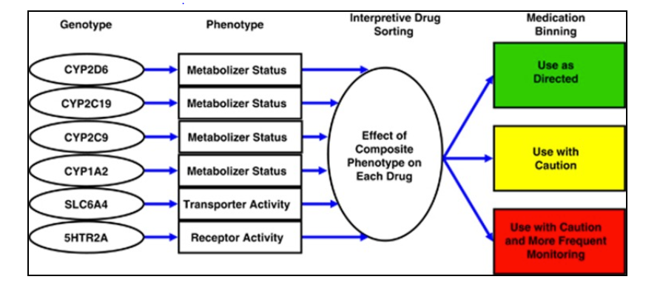
antidepressant treatment algorithms
Assurex GeneSight

Slide 18
clinical implications
Patient stratification procedures in clinical practice will be useful to achieve greater efficacy and safety
Genotyping (stratification) prior to treatment may provide tailored therapies
Regional differences in genotypes (stratification) should be investigated to facilitate dosing and regimen

Slide 19
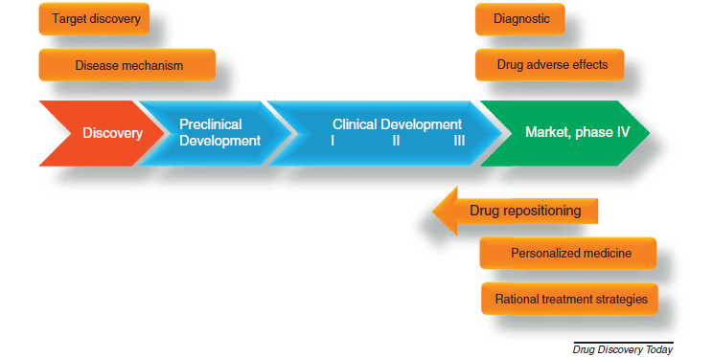
Omic technologies can be applied in different phases of drug discovery and development
Patient stratification
Efficacy & Safety readouts
Sri Ramachandra University
Chennai, India

Slide 22
frequencies of CYP2D6 alleles in
major race/ethnic groups
Allele | African | African American | Caucasian (European + North American) | Middle Eastern | East Asian | South/ Central Asian | Americas | Oceanian
*1^{c} | 0.39 | 0.41 | 0.52 | 0.59 | 0.34 | 0.53 | 0.62 | 0.70
*2^{d} | 0.20 | 0.12 | 0.27 | 0.24 | 0.12 | 0.31 | 0.24 | 0.012
*3 | 0.0003 | 0.0034 | 0.013 | 0.0013 | 0.00 | 0.00 | 0.0052 | 0.00
*4 | 0.033 | 0.06 | 0.18 | 0.076 | 0.0045 | 0.065 | 0.11 | 0.011
*5 | 0.06 | 0.058 | 0.028 | 0.023 | 0.058 | 0.025 | 0.016 | 0.049
*6 | 0.00 | 0.0027 | 0.0091 | 0.0096 | 0.0002 | 0.00 | 0.005 | 0.00
*7 | 0.00 | 0.00 | 0.0012 | 0.00 | 0.00 | ND | 0.00 | 0.00
*8 | 0.00 | 0.00 | 0.0003 | 0.00 | 0.00 | ND | 0.0015 | 0.00
*9 | 0.0010 | 0.0054 | 0.02 | 0.00 | 0.0008 | 0.014 | 0.013 | 0.00
*10e | 0.067 | 0.043 | 0.028 | 0.035 | 0.42 | 0.19 | 0.034 | 0.016
*14 | 0.0013 | 0.00 | 0.00 | 0.00 | 0.0092 | 0.00 | 0.0047 | 0.00
*17^{f} | 0.19 | 0.18 | 0.0027 | 0.014 | 0.0002 | 0.0038 | 0.023 | 0.0005
*36 | 0.00 | 0.0056 | 0.00 | 0.00 | 0.017 | ND | ND | 0.00
*41^{g} | 0.10 | 0.10 | 0.092 | 0.22 | 0.022 | 0.10 | 0.057 | 0.00
xN^{h} | 0.075 | 0.043 | 0.028 | 0.067 | 0.015 | 0.013 | 0.033 | 0.088
*1xN^{i} | 0.014 | 0.0044 | 0.0077 | 0.038 | 0.0031 | 0.0050 | 0.0078 | 0.11
*2xN^{i} | 0.015 | 0.016 | 0.013 | 0.036 | 0.0042 | 0.0050 | 0.023 | 0.00
*4xN^{i} | 0.014 | 0.020 | 0.0028 | 0.00 | 0.00 | 0.00 | 0.0036 | 0.00
Clinical Pharmacology & Therapeutics 93: 402-408, 2013

Slide 23
omics based prediction of drug response profiling

Slide 24
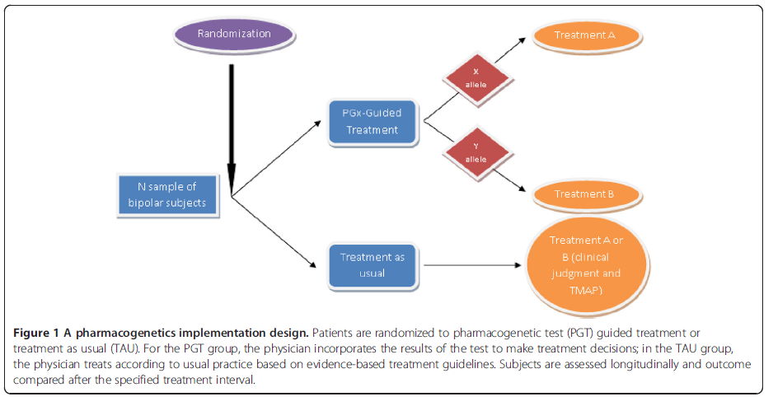

Slide 25
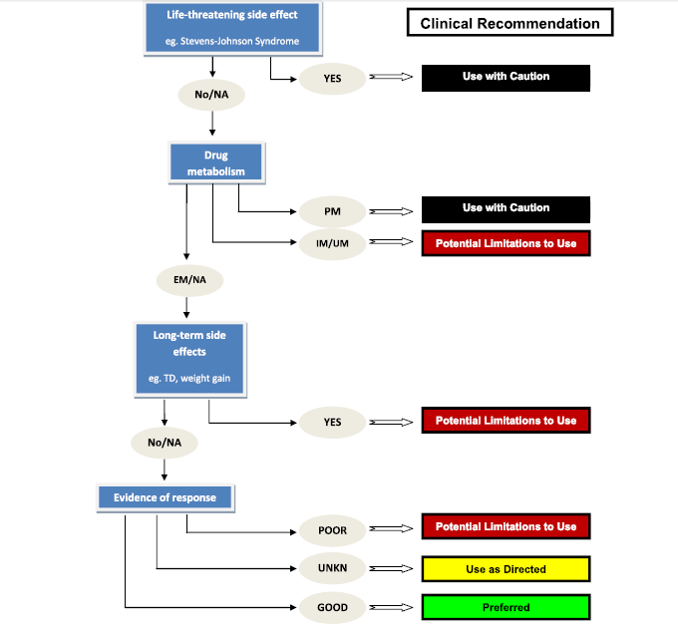

Slide 27
challenges in antidepressant therapy
Lack of response: ~ 50% of patients with depression do not respond to their first treatment
Side effects: In the clinical studies, up to 30% of patients discontinues treatment due to intolerable side effects
Nonadherance: Up to 7% of patients receiving prescription for antidepressant drugs are non-adherent, with side effects most common reason
Patient frustrations
trial-and-error “roller coaster”
months/years of ‘trying’
too many side effects
multiple medications
doctor visits etc
one size fits all

Slide 28
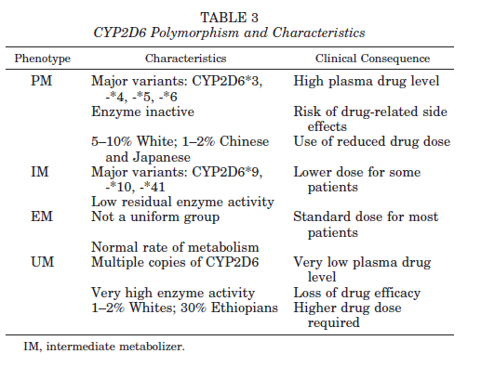

Slide 29
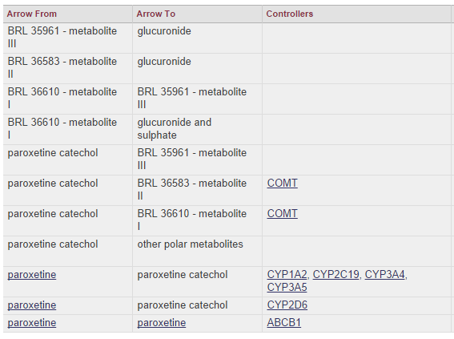

Slide 30
Supplemental Table S4. Association between allelic variantsª and CYP2D6 enzyme activity
Functional Status | Alleles | References
Functional / normal activity / wild-typeª | *1 | ⁵⁷
Loss-of-function / no or decreased activity | *2, *3, *4, *5, *6, *7, *8 | ⁵⁸⁻⁶⁴
Gain-of-function / increased activity | *17 | ⁶⁵⁻⁶⁷

Slide 31
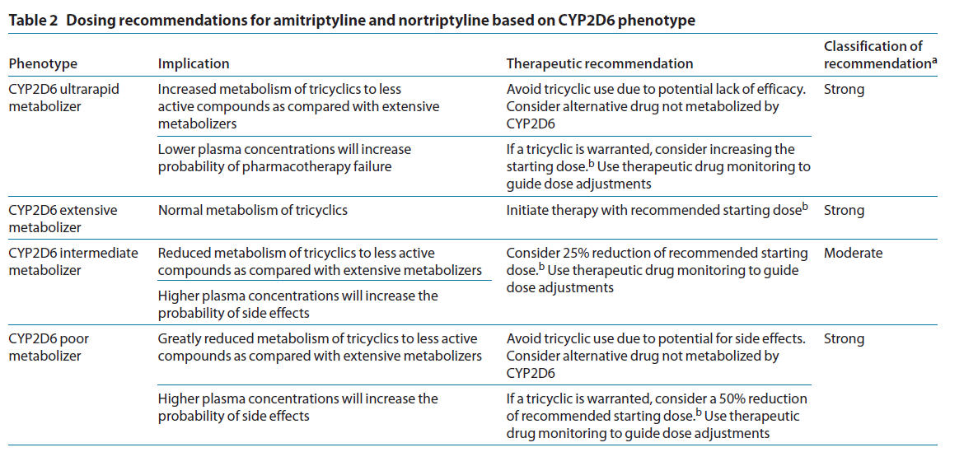
Tricyclic antidepressant metabolism by CYP2D6 and CYP2C19
Clinical Pharmacology & Therapeutics 93: 402-408, 2013

Slide 32
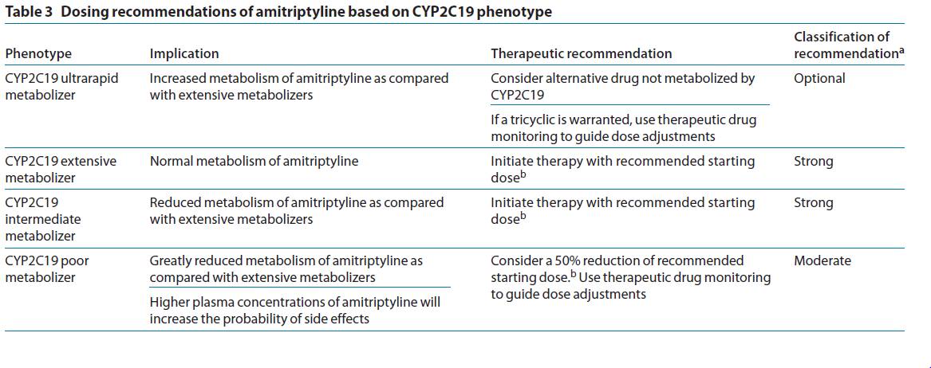
Tricyclic antidepressant metabolism by CYP2D6 and CYP2C19
Clinical Pharmacology & Therapeutics 93: 402-408, 2013

Slide 33
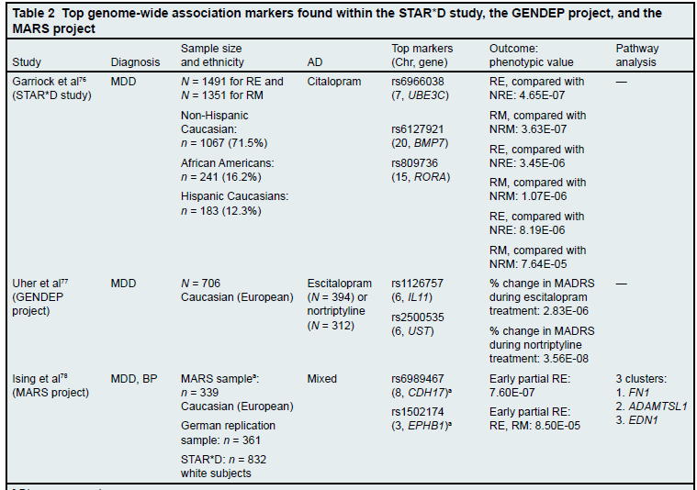
GWAS studies

Slide 34
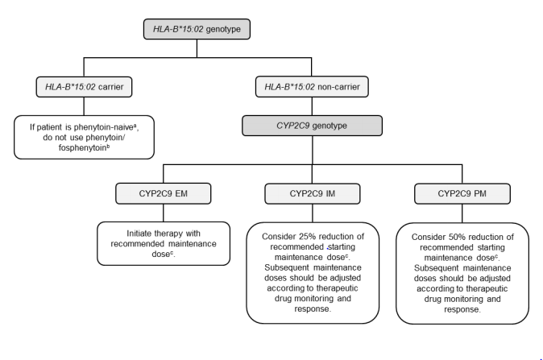
pharmacogenomics: phenytoin
Clinical Pharmacology & Therapeutics 93: 402-408, 2013

