Slide 1



PHA Bioplastics
Synthesis and Material Properties
University of Queensland (Australia) and AnoxKaldness (Sweden)
UQ: S. Pratt, B. Laycock, L. P. Halley, P. Lant, Luigi Vandi
Current PhD students: Montaño-Herrera, Syarifah Nuraqmar Syed Mahamud, C. Chen.
Industry Partners: M. Arcos-Hernández, P. Magnusson, P. Johansson, A. Werker.
Notes:
August 10 – 4-5pm (1h).

Slide 2
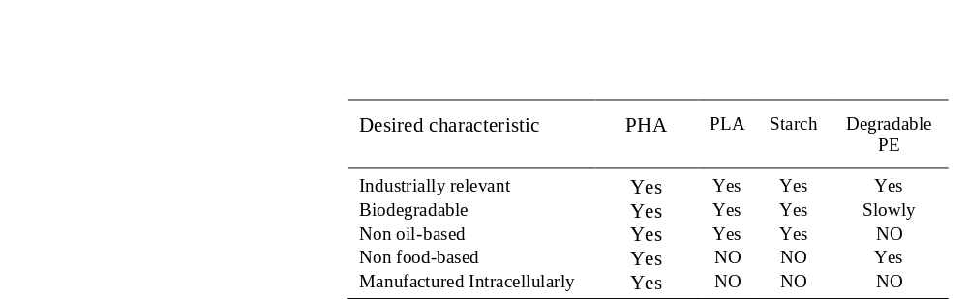
Some context…
But…
PHB, and to a lesser extent PHBV, is stiff and brittle
PHBV suffers from ‘aging’
PHBV is challenging to process / narrow processing window
PHBV is expensive to make
Notes:
Message – PHA is interesting, but acknowledge limitations and pre/miss-conceptions.

Slide 3
Overview
Bioprocesses
Downstream processing
Product
2. Pure Culture
3. Options?
Bioreactors
Biomass Harvesting and Treatment
Extraction and Recovery
Feedstock
Dry PHA
1. Properties?
2. Mixed
Culture
What are the properties? How are they set?
Does it matter if pure or mixed cultures are used for PHA production?
Material Balance: Mixed culture production opens the door to using waste streams as feedstocks but how much feedstock is needed?
Notes:
Message 1: Be clear on the full technology train – and how bioprocessing (synthesis) is linked to extraction and recovery and properties
Message 2: What’s the workshop about – start with some coverage of PHA chemo-thermo-mechanical properties, then coverage on the option for synthesizing in mixed cultures, then exercise on what that means for securing suitable feedstocks.
Most of the coverage of on the fundamentals of PHA will be considered through a ‘mixed culture lens’ because that where we come from.
Two parts – look backwards from Properties (see how they are set) and look forwards from synthesis (see what that effects).

Slide 4
Overview – our background in PHBV
PHA-Wood
Composites
Bioprocesses
Downstream processing
2. Pure Culture
Crystallisation
3. Options?
Bioreactors
Biomass Harvesting and Treatment
Extraction and Recovery
Block Polymers
Degradation
Feedstock
Dry PHA
Distribution / Blends
1. Properties?
Wastewater
2. Mixed
Culture
Thermal Degradation
Methane
Solvent Extraction
Mechanical Properties
Accumulation in AS
Biosolids
Notes:
Summary of activities at UQ – with AnoxKaldnes – it’s all been mixed culture.

Slide 5
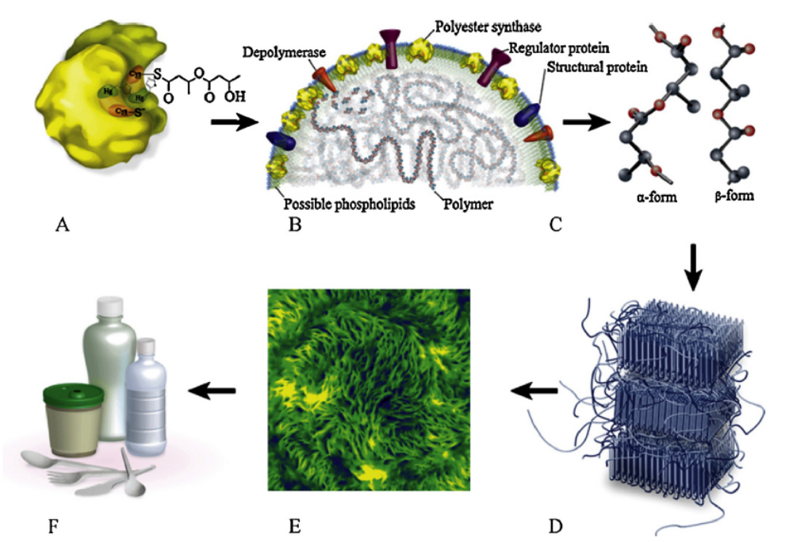
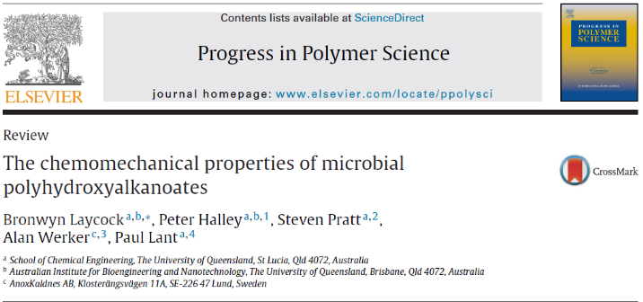
1. PHA properties – and how are they set?
A: Polymerisation
B: PHA granule (Rehm (2013))
C: PHA polymer chain
D: Semi crystalline polymer
E: AFM of a PHBV film
F: Plastic product
Notes:
Message: PHA is synthesised intracellularly – regardless of the technology train, there are a number of key steps to get to the product, namely polymerisation to PHA polymer chains, and packing of chains into PHA granules – how those chains pack is key to product properties.

Slide 6
Processing and mechanical properties
Synthesis
Core mechanical properties for commodity applications:
Elongation at break
Young’s modulus
Tensile strength
PHA-PHA
Blends
Micro-structure
Properties
Crystallinity
HB-HV
MW
PHB, and to a lesser extent PHBV, is stiff and brittle – because of high crystallinity
Notes:
Limiting the scope to commodity applications (conscious that this neglects all the opportunities in high value high performance PHAs) – a few key properties to look at … and they are mainly controlled by: composition, microstructure, crystallinity, blends, MW – and these are generally not independent of each other.
Parallel – be mindful that these ‘balls’ are all controlled by synthesis. We will see how the way we synthesised the PHA is related to the ‘balls’.

Slide 7
Processing and mechanical properties
 | P(3HB) Biomer 240 | P(3HB) Mirel P1001 | P(3HBV) ENMAT | P(3HBV) BioC 1000 | PolyProp
Melt Flow (g/10min) | 5-7 |  |  | 10-12
Density (g/cm³) | 1.17 | 1.39 | 1.25 | 1.22 | < 1
Crystallinity (%) | 60-70 |  |  | 50-60
Tensile Strength (MPa) | 18-20 | 28 | 36 | 30-40 | 40
Elongation (%) | 10-17 | 6 | 5-10 | 2.5-6 | 100
Tensile Modulus (GPa) |  |  | 1.4 | 2.5-3 | 2
Flexural Strength | 17 | 46 | 61
Flexural Modulus |  | 3.2 | 1.4
Melt Temp |  |  | 147 | 170-175 | 140-170
Our PHBV
3-60
0.8-3
80/170
From Shen et al in Laycock et al.
Notes:
Check numbers!
Where does that get us? To a commercial material that compares favourably with other thermoplastics – like polypropylene. * While these contain HV – they are low HV materials.
But again, some of the challenges – both real and perceived: processing, aging, stiffness/brittleness … and relatively expensive (at least double PE).
A number of research groups (eg Portuguese, Dutch) have looked to make PHBV in mixed cultures – to reduce costs… as have we. And the properties stack up. What’s interesting is that there seems to be opportunity to make high HV materials with IMPROVED properties. We’ll come back to that a bit later.

Slide 8
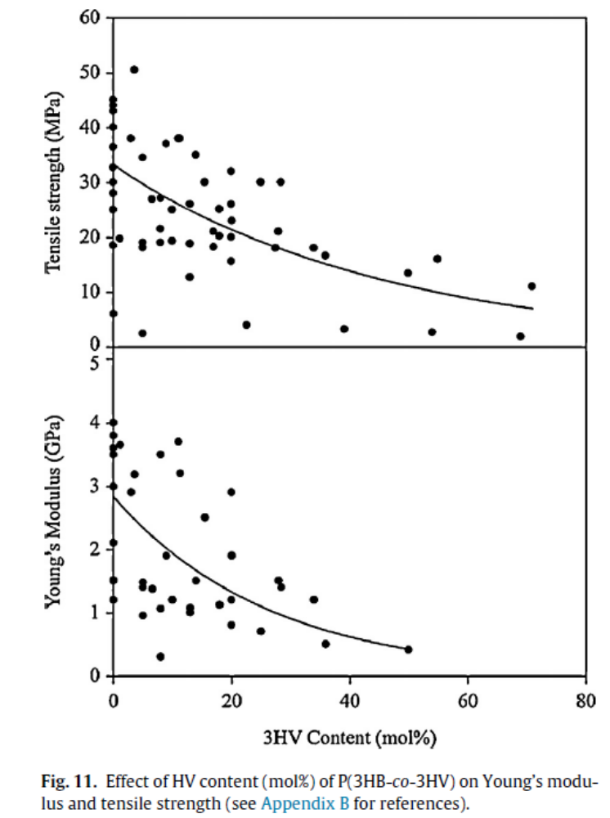
Composition
PHA-PHA
Blends
Micro-structure
Properties
Crystallinity
HB-HV
MW
Incorporation of HV units can drop stiffness and brittleness and increases elongation to break.
Why?
Inclusion of HV units effects / disrupts crystallinity.
Notes:
First thing – composition matters. HV units can reduce stiffness and brittleness. In short, because it disrupts crystallinity.
Not long ago it was assumed that it was all that mattered – but we’ll see that there are other factors that, combined with composition, that set the properties.

Slide 9
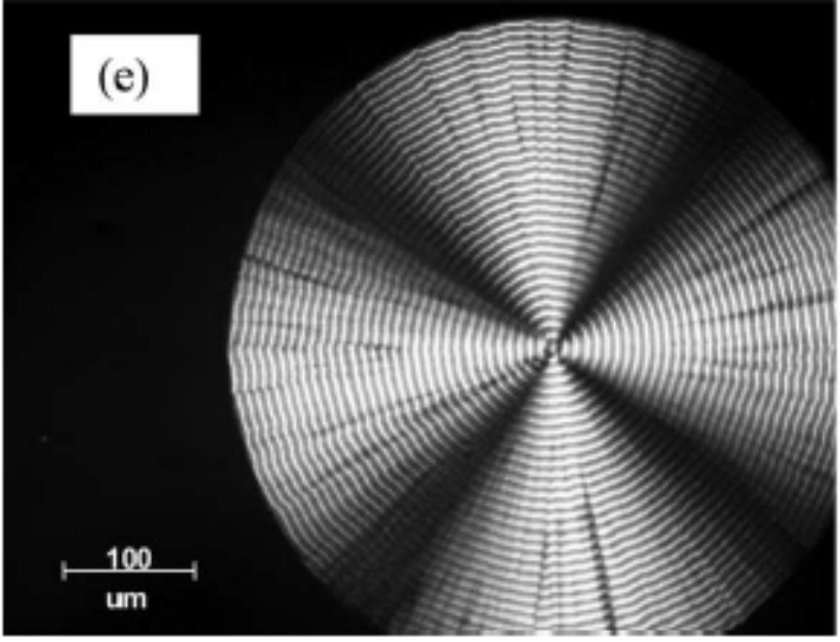
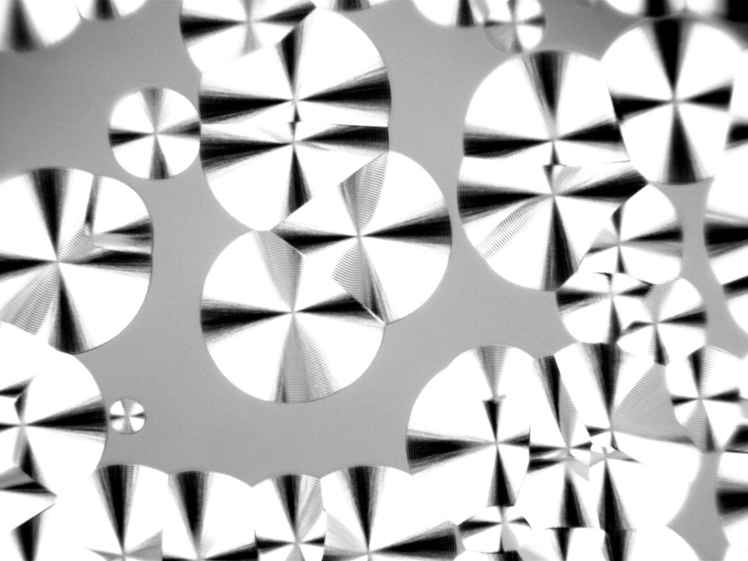
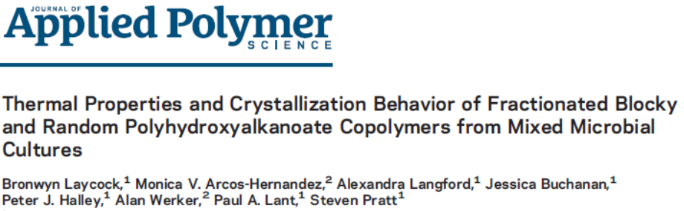
PHB
PHBV

Slide 10
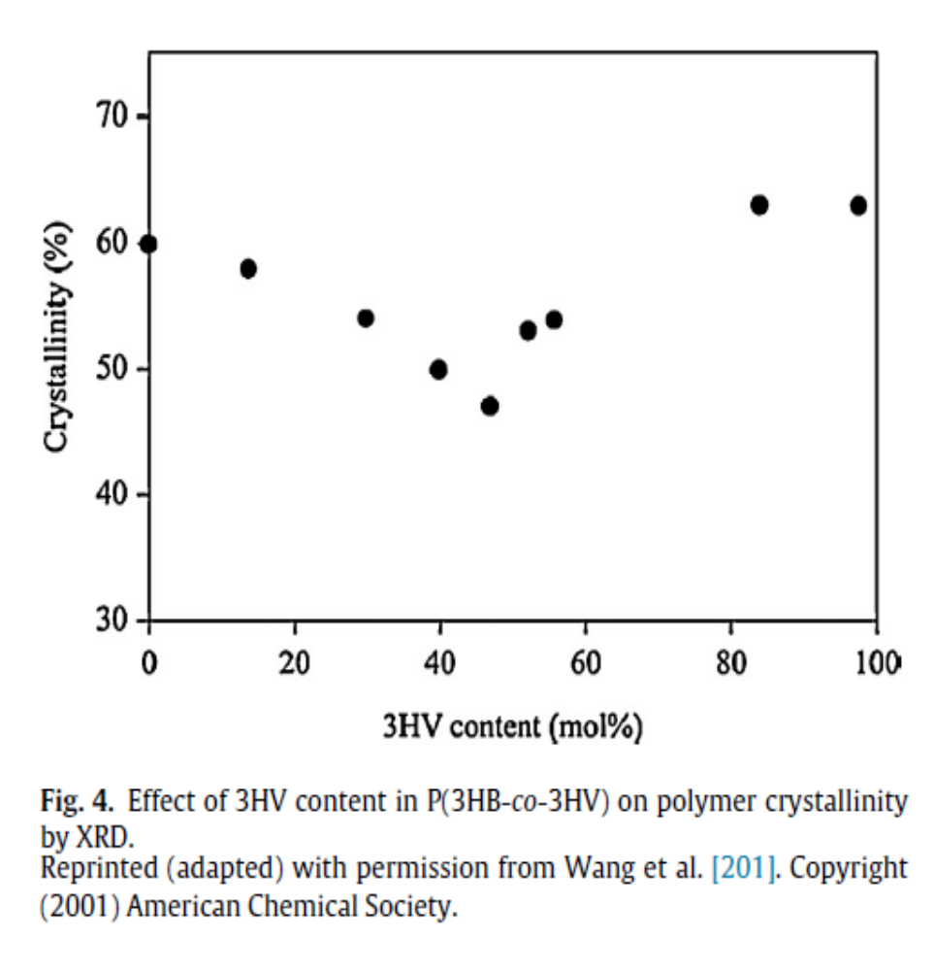
Crystallinity
PHA-PHA
Blends
Micro-structure
Properties
Crystallinity
HB-HV
MW
But…
Isodimorphic:
Copolymers exist together in the crystal structure – high degree of crystallinity across the range
Pseudoeutectic

Slide 11
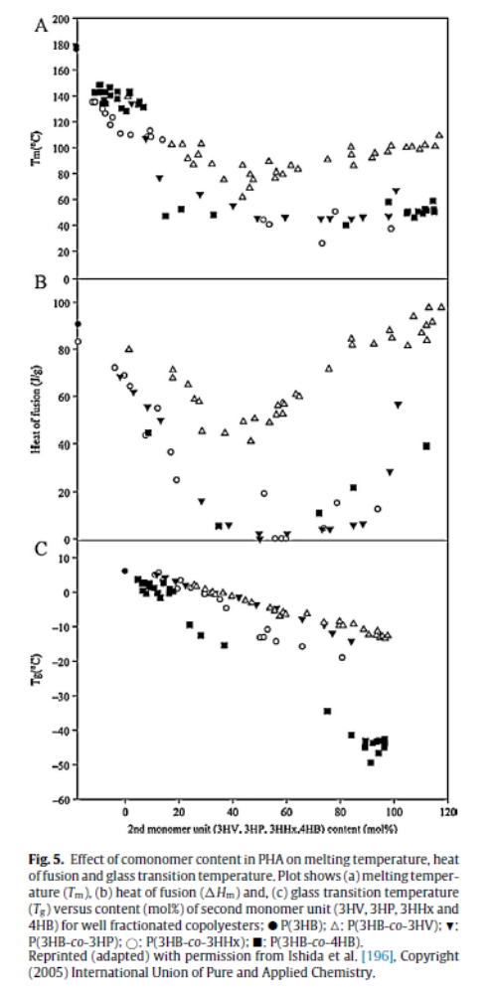
Pseudoeutectic

Slide 12
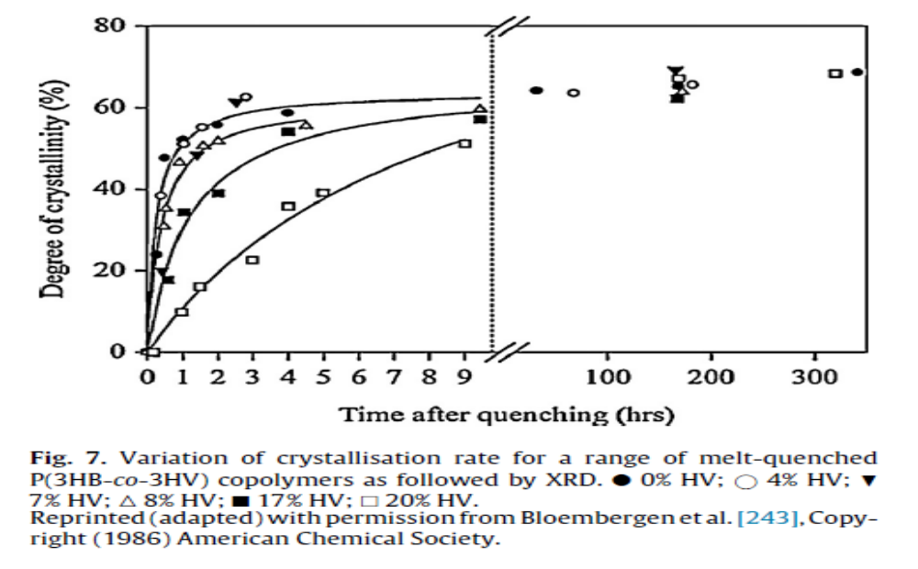
Crystallinity - Aging

Slide 13
Microstructure
PHA-PHA
Blends
Micro-structure
Properties
Crystallinity
HB-HV
MW
  Block copolymers
  Extend material property range, rapid crystallisation, limited embrittlement with aging (secondary crystallisation)
Long chain block copolymer
BBBBBBBBBBBBB
VBVBB
VVVVVVV
Short chain block copolymer
BBBBBB
VVVVV
BVVBBB
VVVVV
Random copolymer
BVBBVBVVVVBBVBBBBBVVBVVVBVBVVVVVBBBBVVBVBBV
Notes:
It’s not just composition, but how the monomer units are laid out.
Introduce block copolymers.

Slide 14
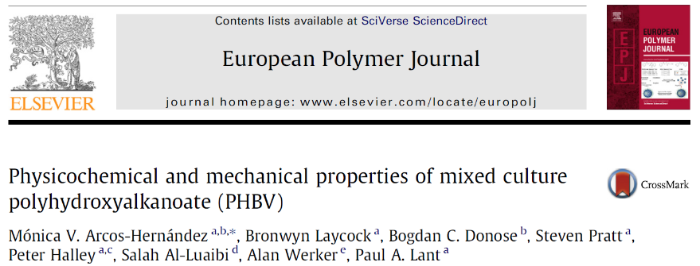
Manipulating microstructure
 | Feeding | Microstructure
A | HAc:HPr 50:50 HAc:HPr 70:30 | Random copolymers
B | HAc (4h) then HPr (4h) | A-B diblocks and/or A-B-A triblock, blended with random copolymer
C | HAc (1.0h) alternating HPr (0.5h) | A-B diblocks and/or A-B-A triblock and/or or possible (A-B)_{n} repeating multiblocks
D | R
2.3-3.0 | 0.8-1.0
5.6 | 0.6
20.0 | 0.44

Slide 15
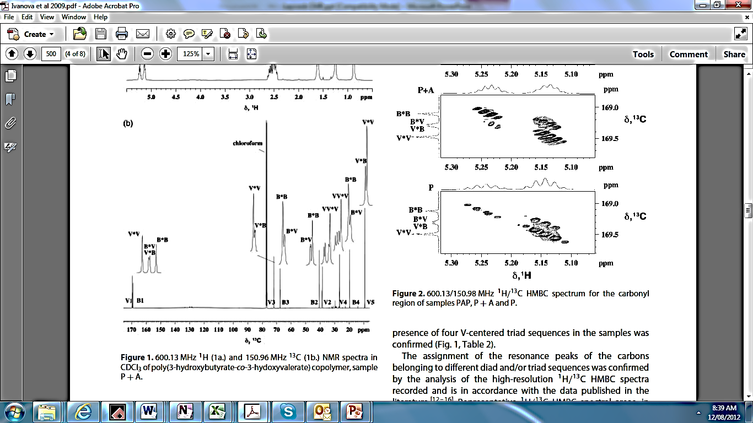
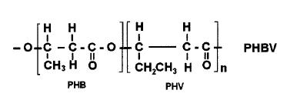
Characterising microstructure
Quantitative ¹³C NMR
Analyse diad and V-centred triad peak intensities
Compare distributions with statistically random copolymerisation and blends
D value >1.5, R value <1 = blocky copolymer or bimodal (or more) blend of random copolymers
B3
B2
V3
V2
V1
B1
V4
B4
V5

Slide 16
Manipulating microstructure
 | Feeding | Microstructure
A | HAc:HPr 50:50 HAc:HPr 70:30 | Random copolymers
B | HAc (4h) then HPr (4h) | A-B diblocks and/or A-B-A triblock, blended with random copolymer
C | HAc (1.0h) alternating HPr (0.5h) | A-B diblocks and/or A-B-A triblock and/or or possible (A-B)_{n} repeating multiblocks
Elongation (%) | Young’s Mod. MPa
5-6.5 | ˜850-950
3 | ˜2000
58 | ˜800

Slide 17
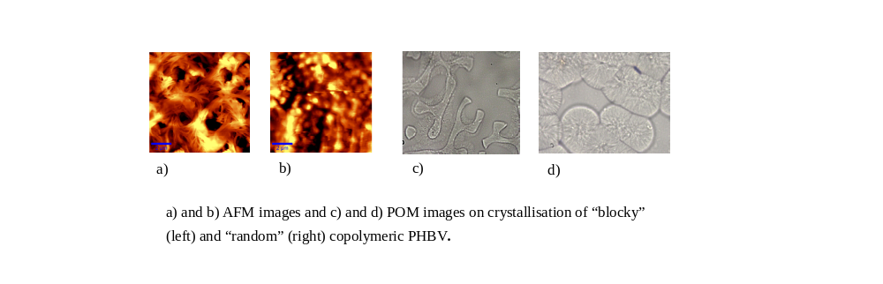
Microstructure and macroscale architecture
Blocky
Random
Blocky (C1 Fr2)
Random
10 µ
10 µm
10 µm
Notes:
Clear difference in morphology and crystallisation behaviour between the blocky and random materials – phase separation in the melt

Slide 18
Manipulating microstructure
Increased elongation for blocky copolymer retained over > 4 months
Result has been reproduced
However, most materials produced have properties similar to low HV content PHAs (low elongation to break) – it’s not straightforward to make ‘high’ performance PHBV materials.

Slide 19
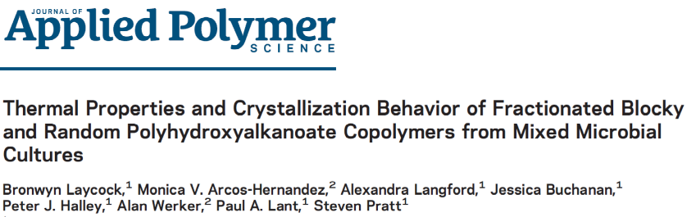
PHA-PHA blends
PHA-PHA
Blends
Micro-structure
Properties
Crystallinity
HB-HV
MW
We make PHBV copolymers…
but how homogeneous is the product?
As produced P(3HB)-based copolymers have been fractionated to give a series of fractions with narrow compositional distribution.
50% HV
50% HV
B
B
B
B
V
B
V
V
B
V
V
V
B
V
V
B
B
V
V
V
B
V
V
B
V
V
B
B
B
V
V
B
B
V
V
V
B
V
V
B
B
B
B
V
B
B
Same substrate and the same organism in the same conditions… two different groups of PHA copolymers (Yoshi and Inoue).

Slide 20
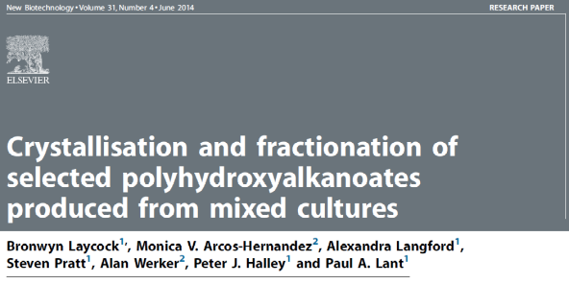
PHA-PHA blends
Sample | Fraction | %Mass fraction | HV %Cmol |  | M_{n} | M_{w} | PDI | D | R
 |  |  | by NMR | by GC/MS | g mol⁻¹ | g mol⁻¹
 |  |  |  |  | x 10⁻⁵ | x10⁻⁵
A4 | As-produced | 100 |  | 52% | 2 | 5.9 | 2.9 | 2.6 | 0.9
 | 1 | 42 | 38% | 40% | 1.7 | 5.3 | 3.1 | 8.7 | 0.7
 | 2 | 42 | 55% | 63% | 1.5 | 4.7 | 3.1 | 0.4 | 1
 | 3 | 16 | 71% | 77% | 1.3 | 4.6 | 3.6 | 1.6 | 1.1
 | R | 95
B1 | As-produced | 100 |  | 65% | 2.5 | 5.5 | 2.2 | 2.9 | 0.8
 | 1 | 18 | 33% | 45% | 1.9 | 5.5 | 3 | 6.7 | 0.56
 | 2 | 21 | 49% | 51% | 2.1 | 5.4 | 2.6 | 2.6 | 0.85
 | 3 | 61 | 89% | 91% | 1.6 | 5.4 | 3.3 | 2 | 0.9
 | R | 94
Material A4 and B1 fractionated into >3 distinct copolymers (based on composition)

Slide 21
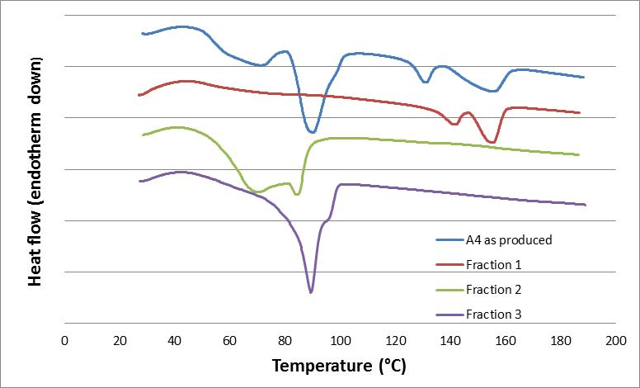
PHA-PHA blends (DSC)
Properties controlled by more rapidly crystallising components

Slide 22
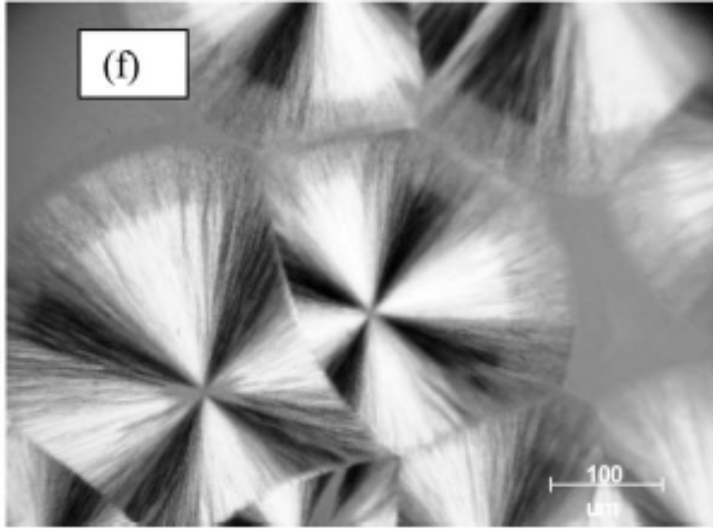
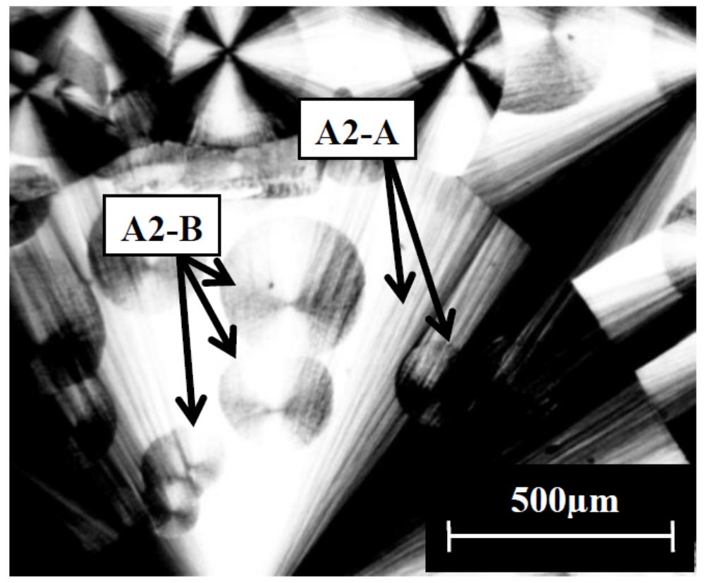
Blends

Slide 23
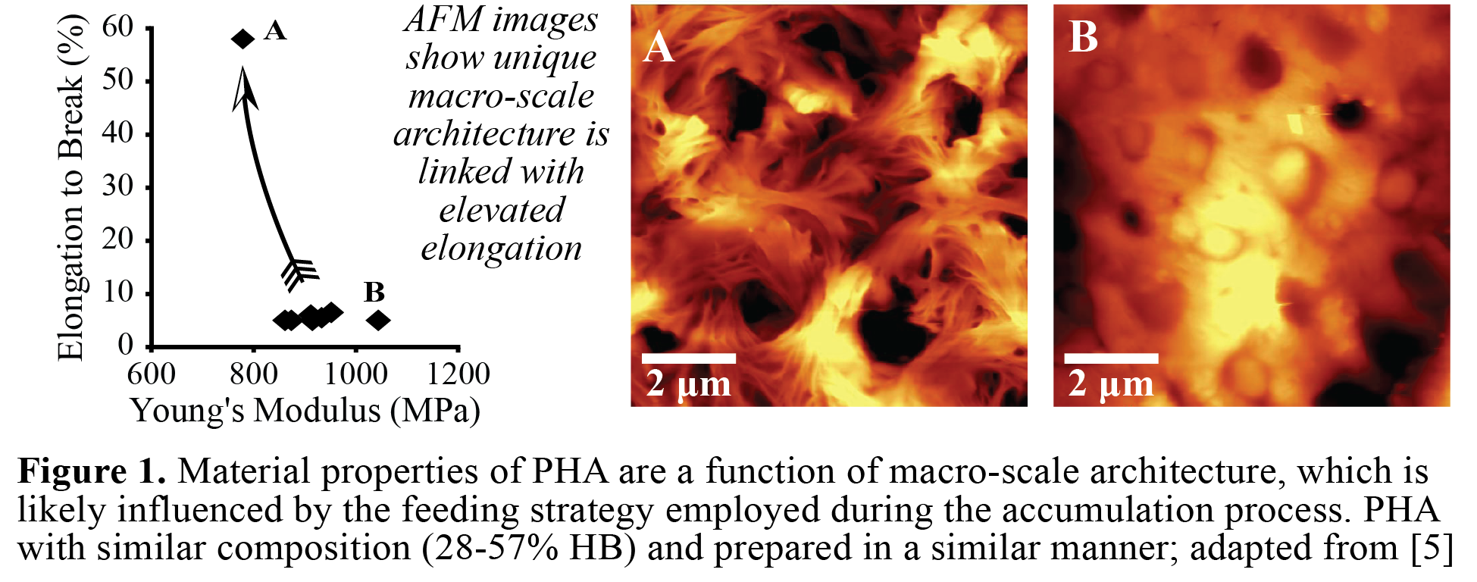

Macroscale architecture
Properties are a function of macro-scale architecture
Synthesis
PHA-PHA
Blends
Micro-structure
Properties
Crystallinity
HB-HV
macroscale architecture
MW
Notes:
Middle of presentation – and this is basically where we are at.
A number of factors effect ‘macroscale architecture’ and that in turn effects properties.
Let’s look closer at synthesis

Slide 24
2. PHA synthesis
PHA biotechnology is relatively expensive:
Requirement for refined substrates
Requirement for sterilisation
Opportunity for mixed culture production:
Waste organics as a feedstock
No requirement for sterilisation

Slide 25
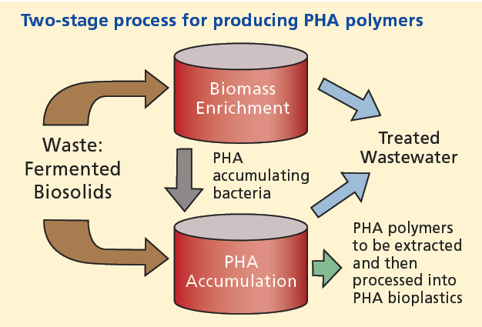
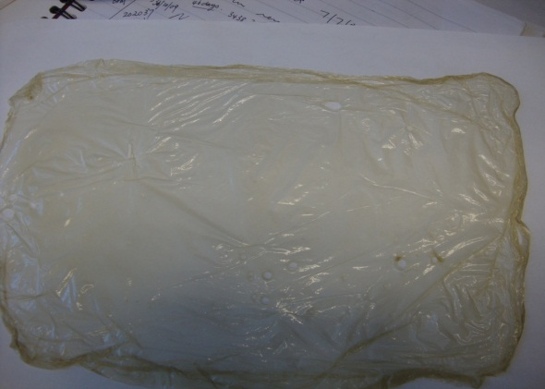
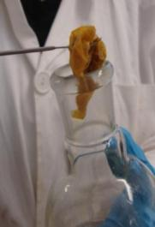
Process into bioplastic

Slide 26
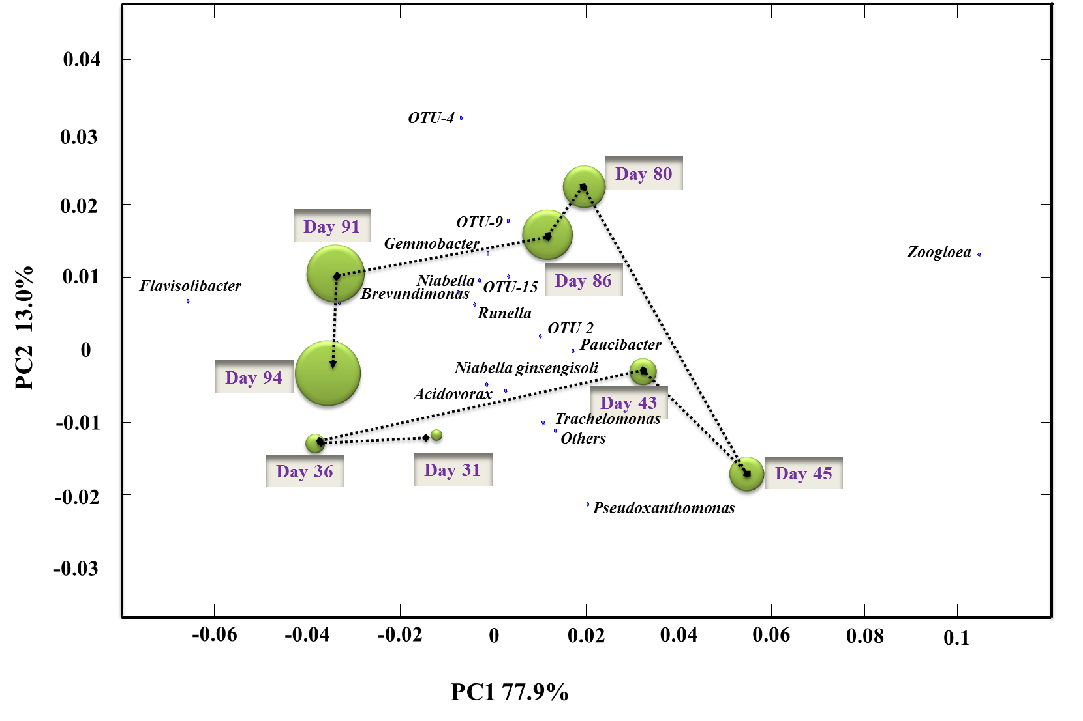
What does mixed culture synthesis mean for polymer properties?
Broad and dynamic distribution of populations of PHA accumulating organisms
So how does the community variability influence biopolymer synthesis?

Slide 27
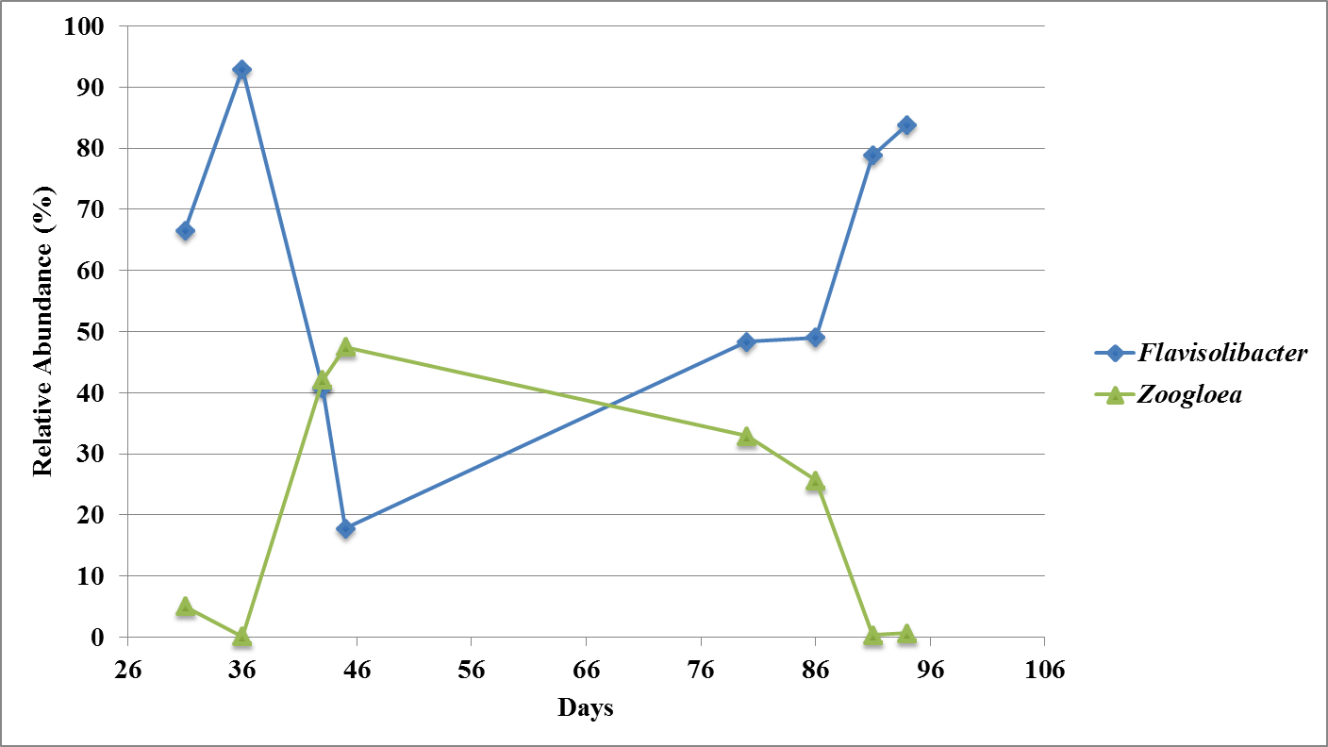
Shift in principal populations of species in SBR
PE2

Slide 28
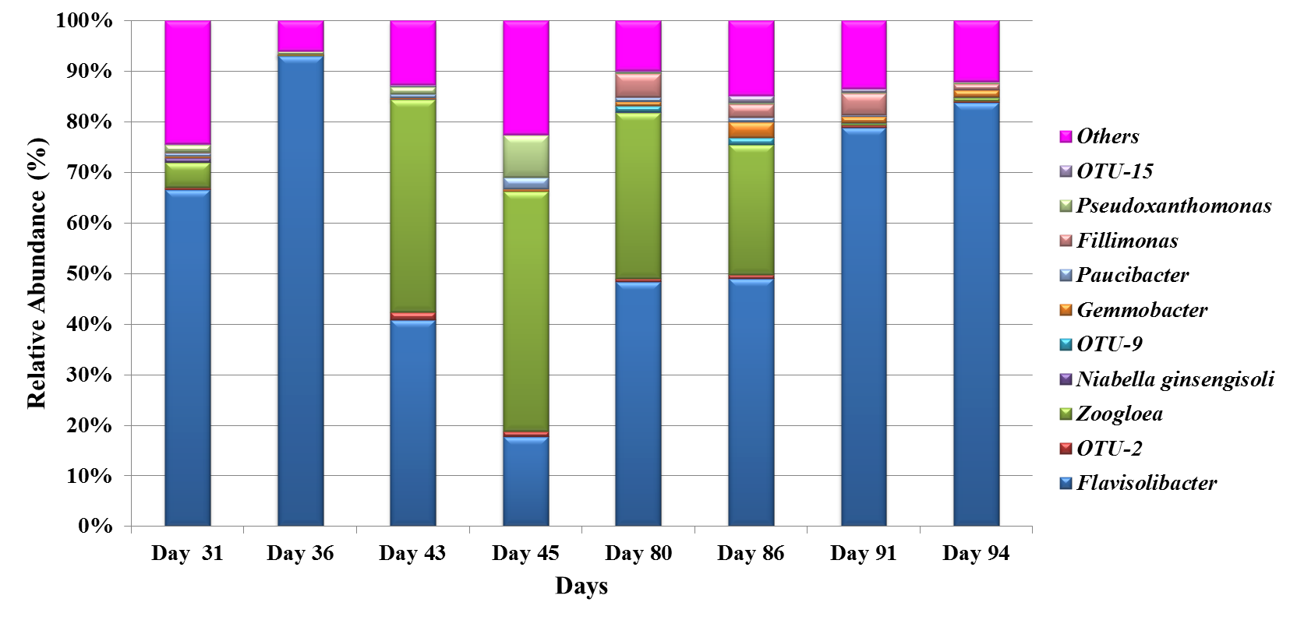
Community shift in enrichment SBR over time
PE2

Slide 29
What does mixed culture synthesis mean for polymer properties?
Multiple populations metabolising substrates at different rates.
      (Lemos et al, and Albuquerque et al, and UQ-Anox)
Individual populations shift metabolic ‘state’.
      (UQ-Anox)
Potential for:
      Complex substrate-monomer relationships.
      PHA-PHA blends – broad compositional distribution.

Slide 30

Flux in community
Description | PAP (gPHA/gVSS) | Y(PHA/S) 20 hr (gCOD PHA/ gCOD VFA)
100% HAc | 0.56 ± 0.04 | 0.48 ± 0.02
100% HAc | 0.48 ± 0.06 | 0.38 ± 0.04
100% HPr | 0.40 ± 0.04 | 0.31 ± 0.03
100% HPr | 0.48 ± 0.03 | 0.40 ± 0.07
50/50 HAc/HPr | 0.48 ± 0.06 | 0.39 ± 0.03
50/50 HAc/HPr | 0.52 ± 0.03 | 0.45 ± 0.03
Alt HAc/HPr | 0.59 ± 0.03 | 0.52 ± 0.03
Alt HAc/HPr | 0.52 ± 0.06 | 0.49 ± 0.03
Alt HAc/HPr | 0.53 ± 0.04 | 0.59 ± 0.02
Little effect on accumulation performance.
HV profile reproducible with feed strategy
PHA Accumulation Potential relatively stable
Overall PHA yields were similar

Slide 31
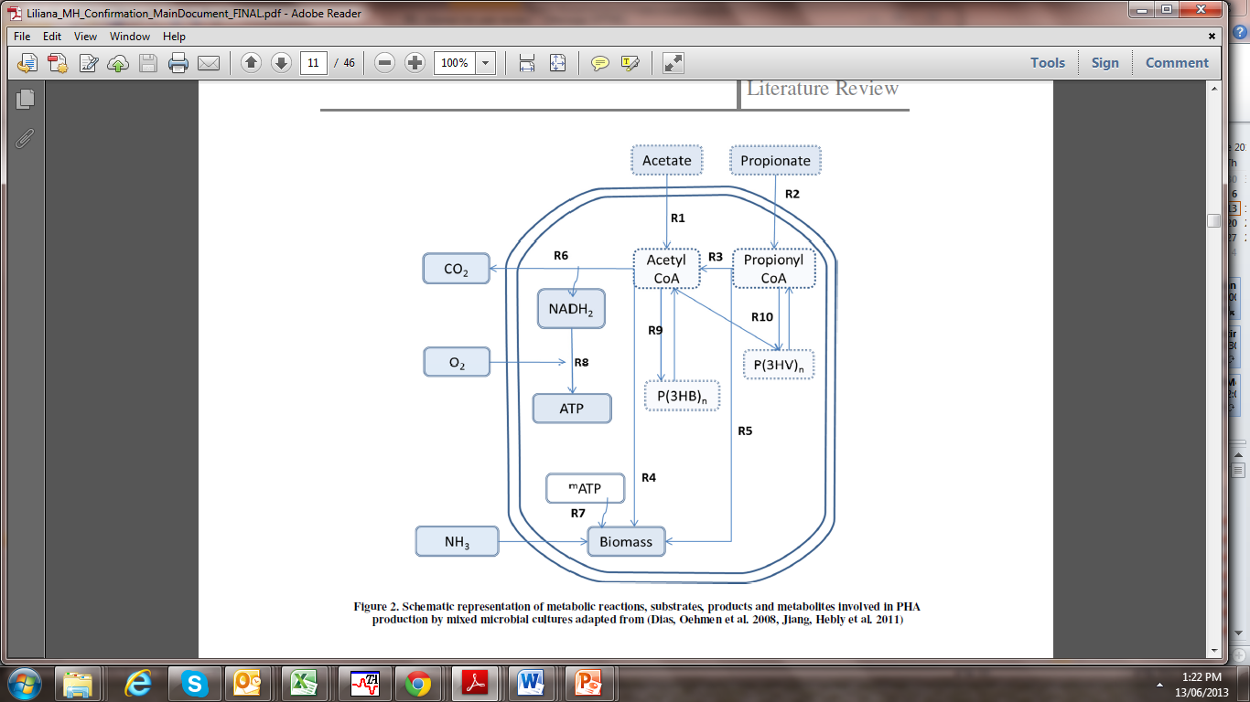
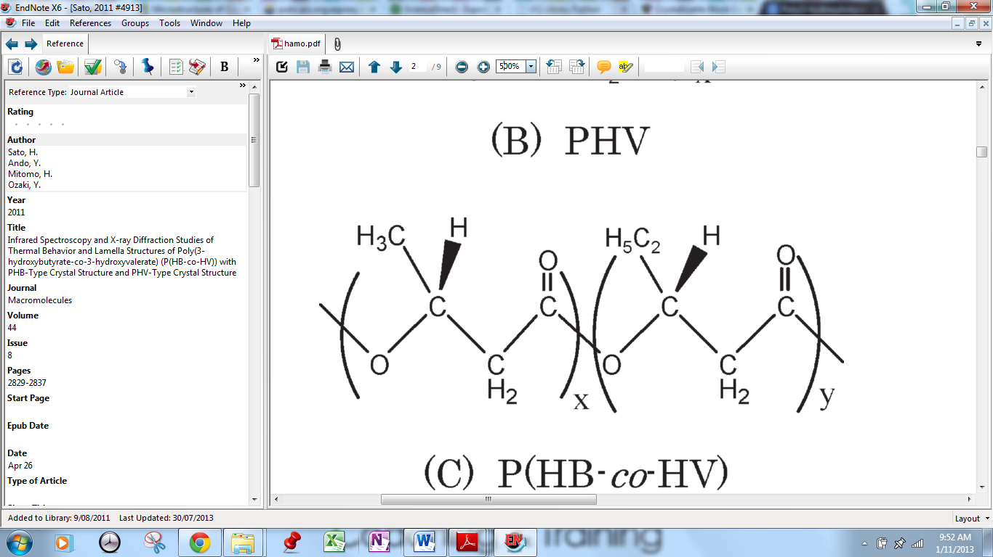
Substrate-monomer relationships
HB Unit HV Unit
Acetate HB
Propionate HV (mainly) and HB
Notes:
Look closer…

Slide 32
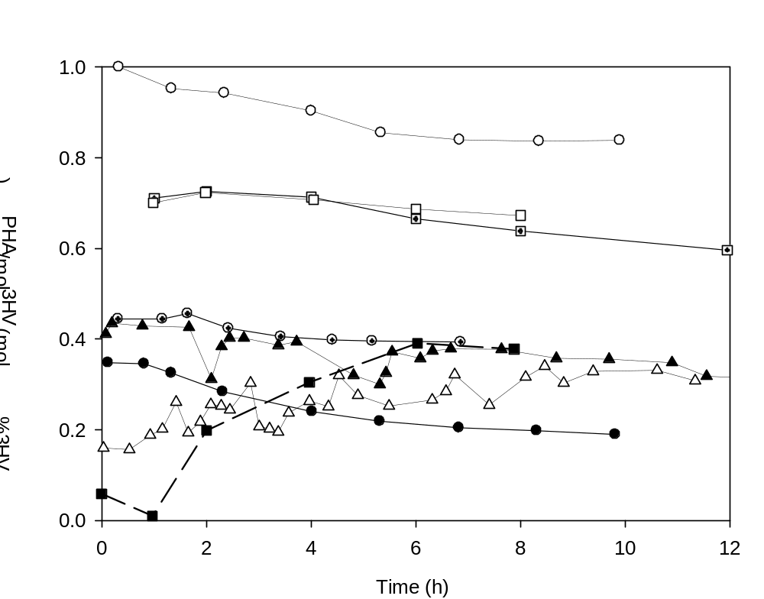
Substrate to monomer
Evolution of instantaneous molar 3HV fraction with respect to total PHA in mixed cultures under conditions of negligible or low cell growth rate.
(Jiang, Hebly et al. 2011; Pardelha, Albuquerque et al. 2014; Arcos-Hernandez, Laycock et al. 2013).
Generally HV synthesis is consistent – but not always...

Slide 33
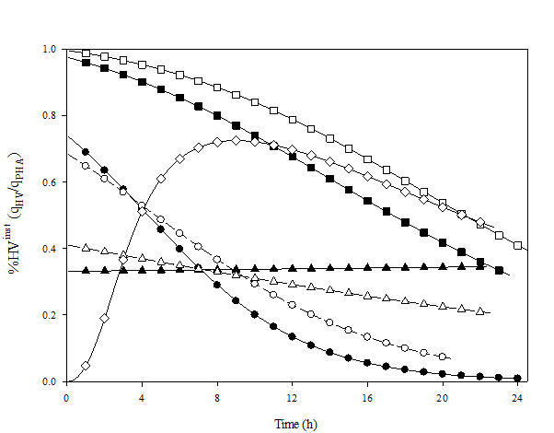
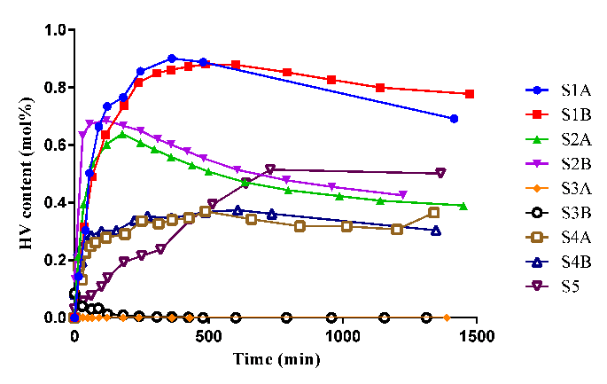
Polymer composition
Ac = acetate, Pr = propionate
Pr
Pr
Ac/Pr
Ac/Pr
Ac
Ac
Alt Ac/Pr
Alt Ac/Pr
Alt Ac/Pr’
HV:HB is not simply a function of Ac:Pr consumption…
Carbon flux through to the relevant precursors to the respective monomers is controlled by ‘metabolic state’.

Slide 34
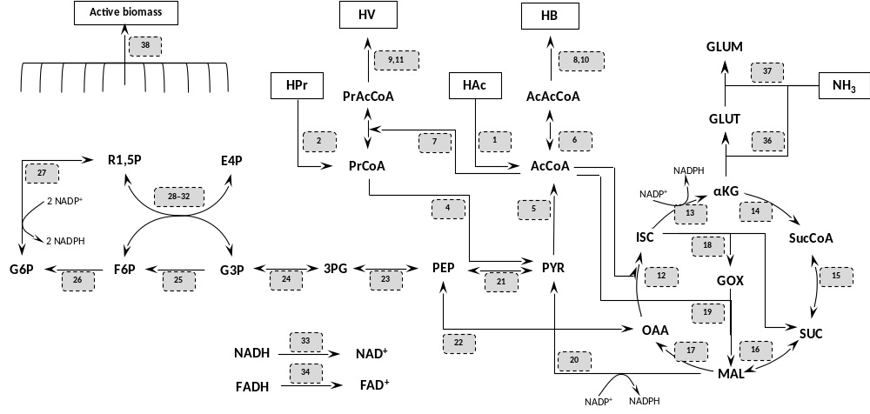
Metabolic states
Polymer composition

Slide 35

What does (mixed culture) synthesis mean for polymer properties?
Multiple populations metabolising substrates at different rates.
Individual populations shift metabolic ‘state’.
      Complex substrate-monomer relationships.
      PHA-PHA blends – broad compositional distribution.
Synthesis
PHA-PHA
Blends
Micro-structure
Properties
Crystallinity
HB-HV
MW
macroscale architecture
Notes:
Emphasis on synthesis – rather than mixed culture synthesis.

Slide 36
Material balance for PHA production
Company name | Carbon Substrate | Product name | Production (t/a)
DaniMer Scientific / Meredian | Canola oil | SelumaTM | 15,000
Metabolix/Antibióticos | Switchgrass, camelina, sugar | Mirel, MveraTM | 10,000
TianAn Biologic Material Co | Corn/cassava starch | ENMAT | 10,000
Tianjin GreenBio | Corn starch | SoGreenTM | 10,000
Bio-on | Beet or sugar cane | Bio-onTM | 10,000
PHB Industrial | Sugar cane | BiocycleTM | 2,000
Kaneka | Vegetable oil | AONILEX™ | 1000
Biomer | Sugar (sucrose) | Biomer PTM | 1,000
Newlight Technologies | Waste methane | AirCarbonTM | >500
Challenge:
Design for PHA production capacity of
> 10,000 t/a
How much feedstock is needed?

Slide 37
Material balance for PHA production
Accumulation Yield…
PHA Content…
Growth Yield…
Notes:
Accumulation Yield: 0.66 gPHA/gSubstrate… so need 15 000 t substrate per 10 000 t PHA
Content: 50%... So need 20k t biomass for 10 000 t PHA
Growth Yield 0.5…. So need 20k t substrate to grow enough biomass. Total now 35kt of substrate.

Slide 38
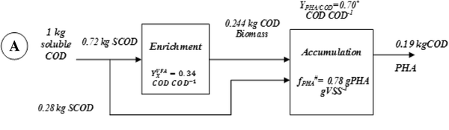
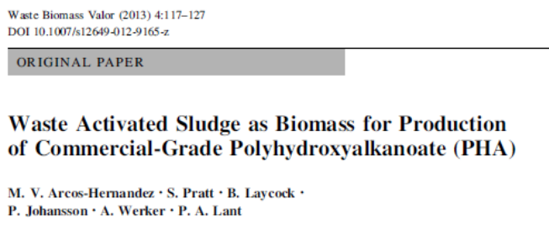
Material balance for PHA production
Challenge:
Design for PHA production capacity of > 10,000 t/a
How much feedstock is needed?
> 60% of C
as CO₂
> 20% of C
as CO₂

Slide 39
Material balance for PHA production
Challenge:
Design for PHA production capacity of > 10,000 t/a
How much feedstock is needed?
< 20% of C as PHA
So need > 50,000 t/a of organics
(less than the waste organics from a large paper mill)
Alternative carbon sources?
Biomass? Methane?
Techno-economics for PHA from CH₄…

Slide 40
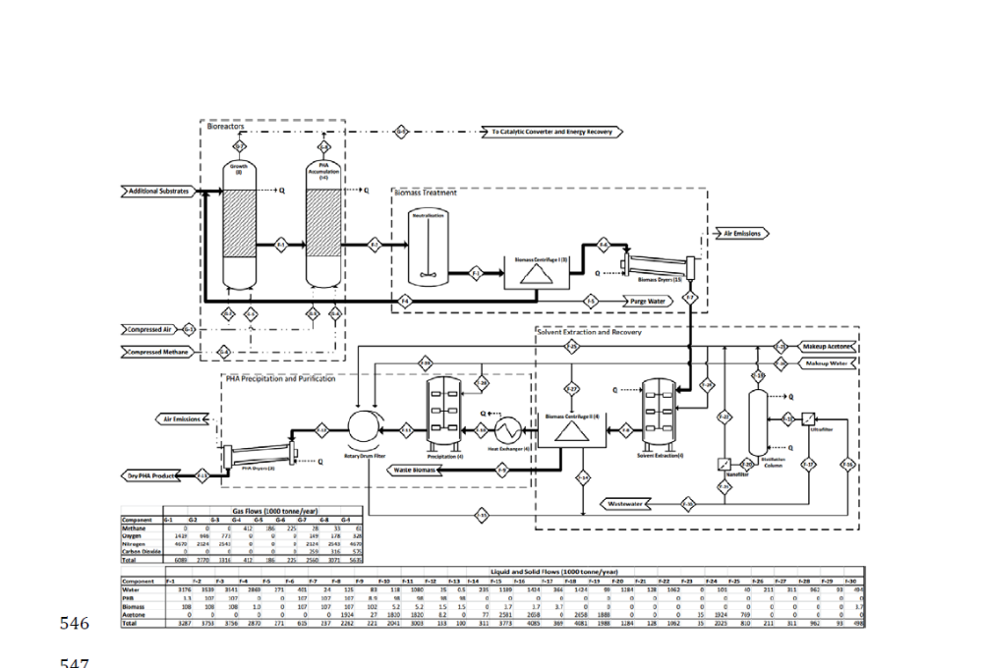
Material balance for PHA production

