Slide 1
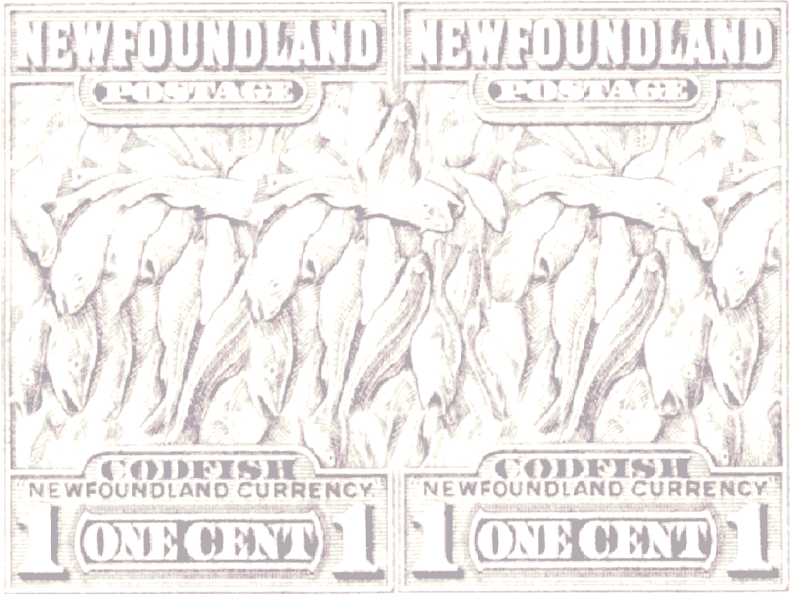

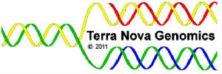
Genomic Biotech for Environmental Monitoring: Phylogeography & connectivity among marine populations as inferred from complete mtDNA genome sequences
Steven M Carr
Terra Nova Genomics, Inc. &
Dept of Biology, Memorial University of Newfoundland
St John's NL, Canada
2nd International Conference on Oceanography
Las Vegas NV, 21 July 2014

Slide 2
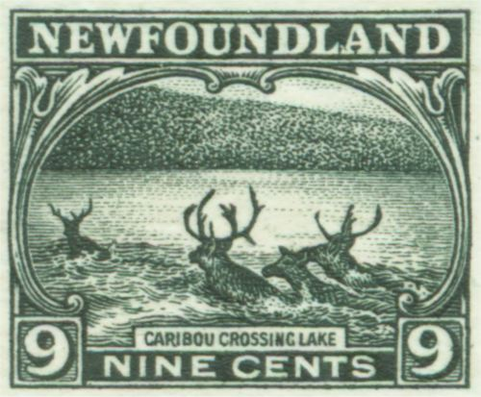
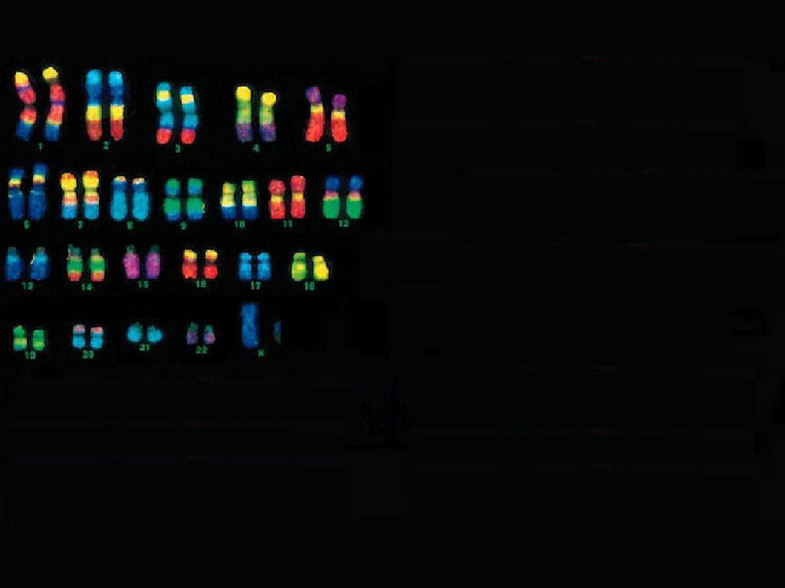
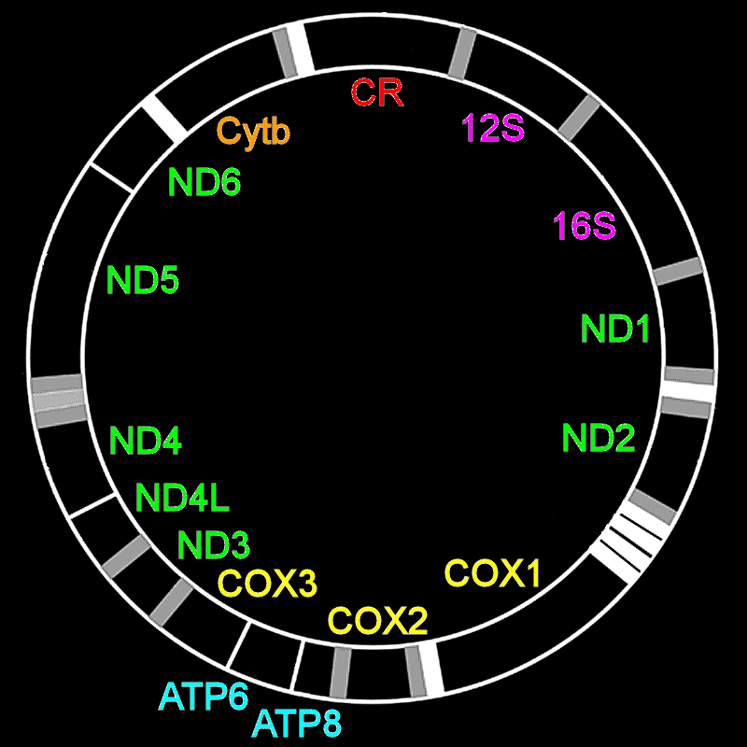
Two Genomes
nucDNA genome
2,850,000,000 bp
20,500 genes
mtDNA genome
~17,000 bp
38 genes
Notes:
Two genomes. Mitochondrial genome is extranuclear, maternally inherited, rapidly evolving

Slide 3
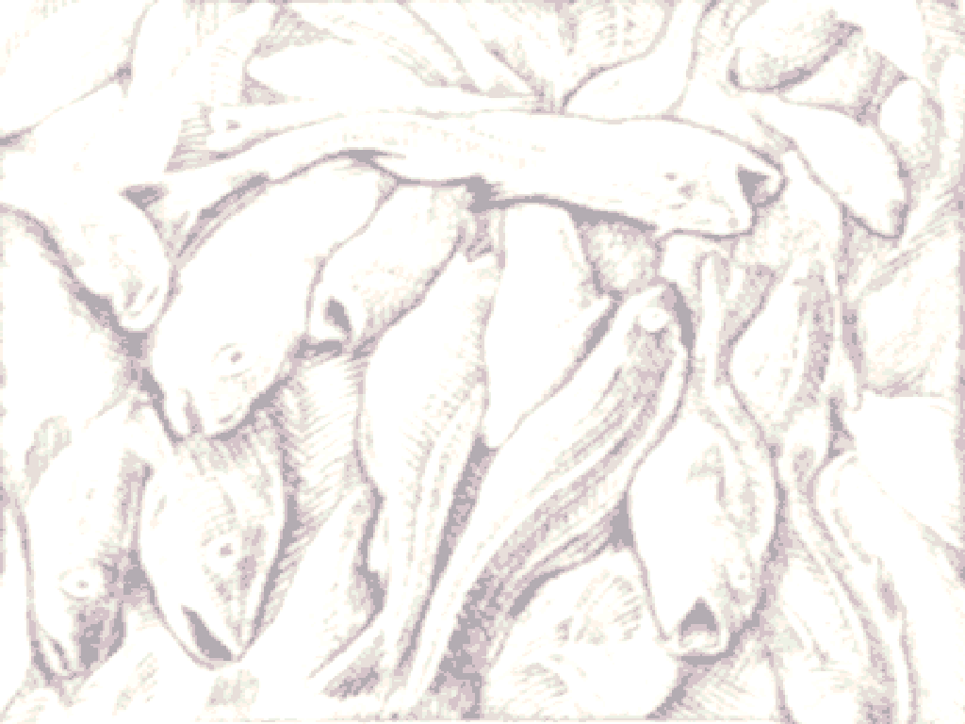
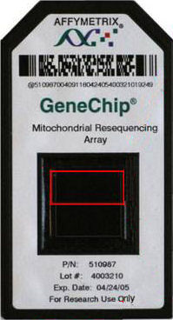
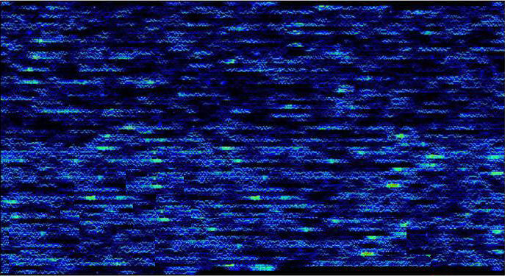
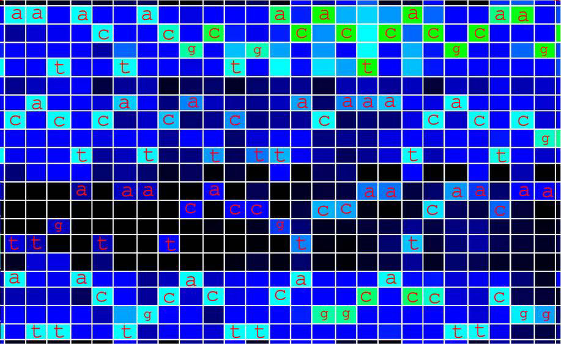
DNA Sequencing on a Microarray
Complete mtDNA genome in one experiment
[ SM Carr et al. 2008. Comp Biochem Physiol D 3:1-11 ]
Notes:
[8] microarray includes a reference DNA sequence, up to 30 thousand bases long, tiled as a series of overlapping 25-base oligonucleotide quartets. One
member of each quartet is specific for any of the four possible SNP variants of
the reference sequence at each position.
The DNA is PCRed, fragmented, tagged, labeled, and applied to the chip. Both
the forward and reverse strands are included.
The intensity of binding by the experimental DNA to the tiled reference oligos
is shown here as pseudocolours. The actual numerical data are analyzed in a
flexible spreadsheet algorithm. You can also simply read the sequence, left to
right, like an old-fashioned autorad, sideways, in colour.

Slide 4
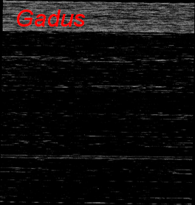
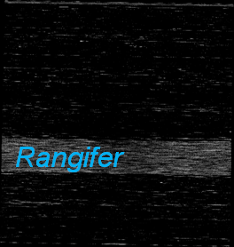
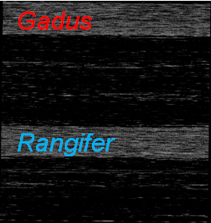
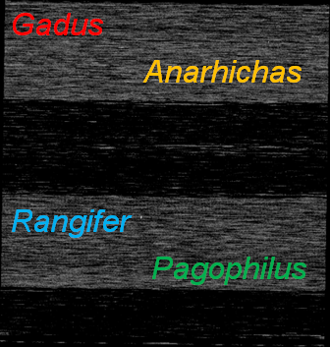
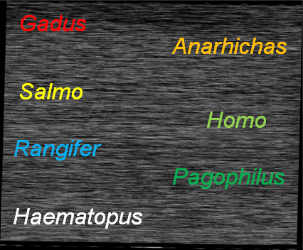
Molecular Velcro: Multi-species ArkChip
(Three fish, three mammals, one bird: 115,984 bp)
Notes:
ArkChip includes seven species, three mammals, three fish, one bird, total 115,984 including technical controls
Sequence quality checked by comparing single species results (effectively perfect wrt dideoxy data)
With two species combinations (intra- and interordinal combinations)
And four species combinations (two fish and two mammals)
And two duplicate seven-species experiments.

Slide 5
Information content of DNA microarrays:
7 species X 80 individuals / spp X 16.5 Kbp @ = 9.2 Mbp
Notes:
What this gives us is enormous amounts of genetic information and fully-resolved intraspecific trees, where every individual has a unique sequence.

Slide 6
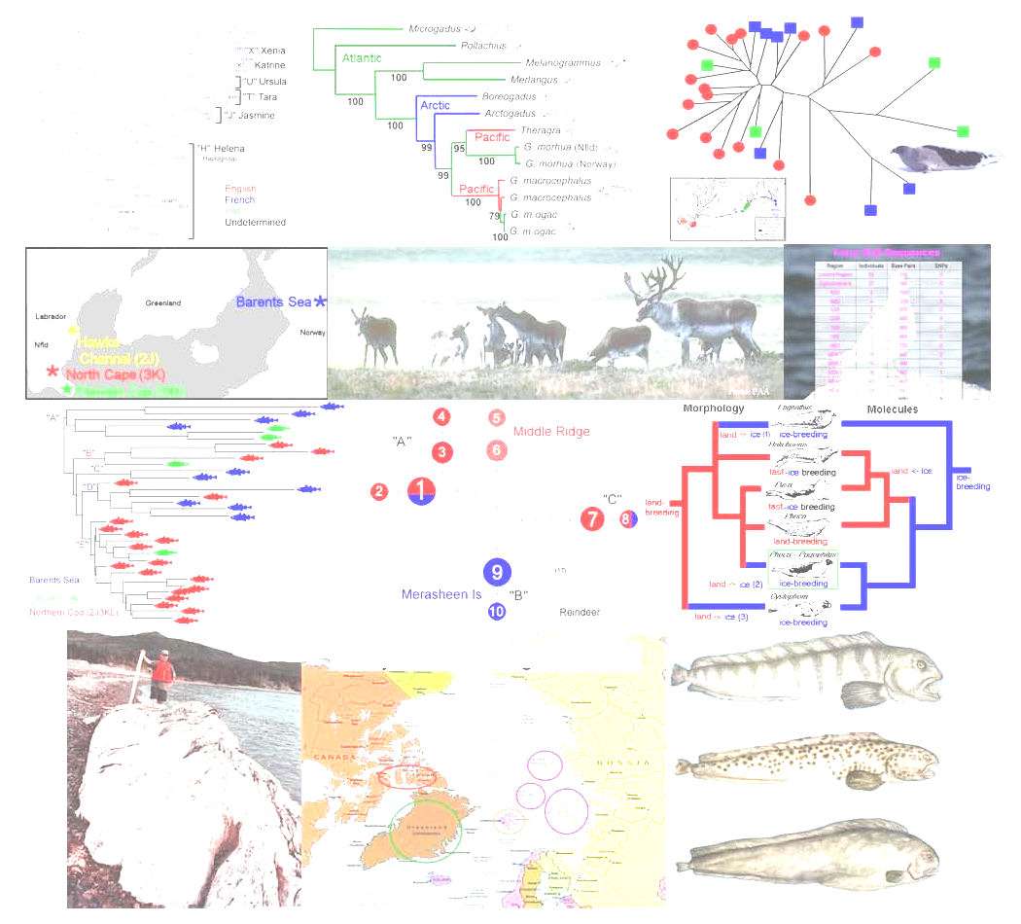
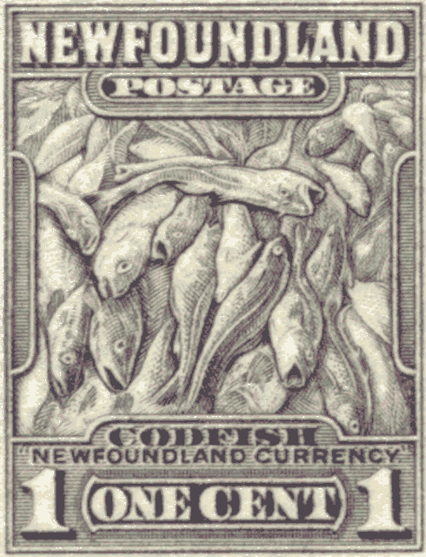
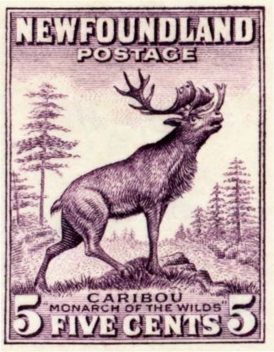
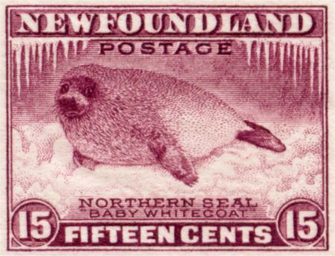
Atlantic Wolffish
(Anarhicas lupus)
Atlantic Cod
(Gadus morhua)
Newfoundland Caribou
(Rangifer tarandus)
Harp Seals
(Pagophilus groenlandicus)
Notes:
Three Newfoundland species, with biogeographic questions on species-wide and/or local scales.
Cod study in press in Genetics, all studies ongoing with new individuals and analyses.
Key qualitative results presented here, to illustrate power of intraspecific mitogenomic phylogeography
Gadus morhua, an important food fish of the North Atlantic.
Questions include species origins, Trans-Atlantic vicariance, stock structure, recovery from catastrophic collapse of Nfld fishery
Newfoundland Caribou
Ecological distinctive newfoundland population shows most of range of ecotypes of species throughout rest of range
Questions include origins of post-glacial recolonization after withdrawal of ice sheet
Southern origin from a Grand Banks refugium?
Northern origin across Strait of Belle Isle from Labrador
Herd structure, at a time of declining population numbers as part of 70-yr cycle
Harp Seals, part of traditional Newfoundland fishery
Various questions: interconnection of breeding patches
consequences of harvest or cull on newfoundland population
Gene flow between Newfoundland populations

Slide 7
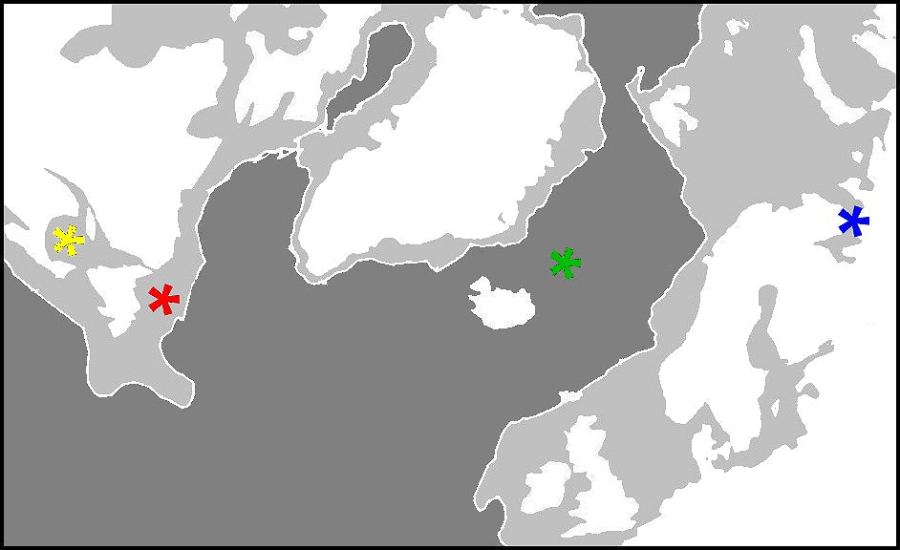

Harp Seal pupping & breeding grounds
White
Sea
Gulf
Greenland
Sea
Front

Slide 8
Genomic Phylogeography of Pagophilus
16.5 Kbp @ from 83 Harp seals
[ Carr, Duggan, Stenson, & Marshall 2014 PLoS ONE, in review ]

Slide 9
Is the observed tree geographically structured?
White Sea
Greenland Sea
Ice Front
Gulf
Front ‘99
Stronger geographic structures require fewer migration events;
Compare observed tree versus 10,000 random trees

Slide 10
Are populations geographically structured ?
Isolation-by-Distance
YES: Trans-Atlantic “Stepping-stone” model
requires significantly fewer migration events than random expectation

Slide 11
Population expansion wrt Climate Change over 300 Ky
Wisconsinan
glaciation

Slide 12
Testing structure of populations within species
Kolmogorov – Smirnov non-parametric test:
Are cumulative genetic distance curves significantly offset?
YES: Diversity among Greenland Sea Harp Seals is younger
than among White Sea seals [⬅ versus ➔]

Slide 13
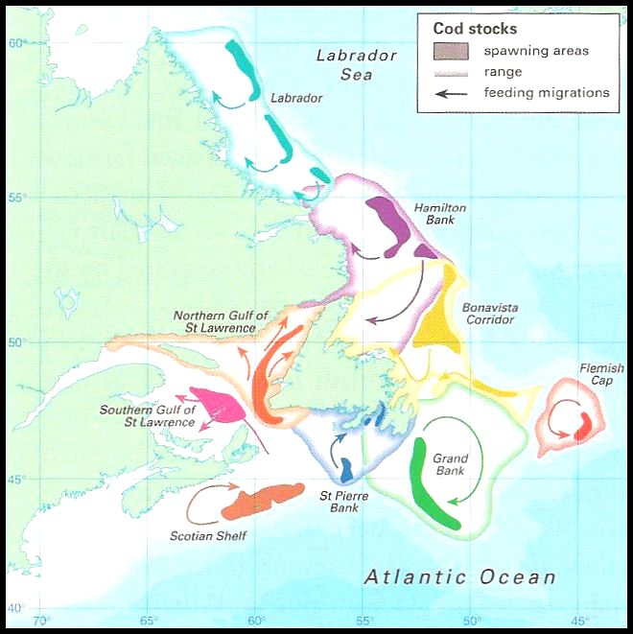
Spawning Stocks of Atlantic Cod
Are they genetically distinguishable populations ?
Notes:
This phylogenetic tree shows the relationships between the hominoid man-like primates.
The closest relative of humans is the chimpanzee (of which there are two species) at 4~5 MYBP and after that is the gorilla ca. 7 MYBP.
The orangutan and the the gibbon are the next two closest relatives.

Slide 14
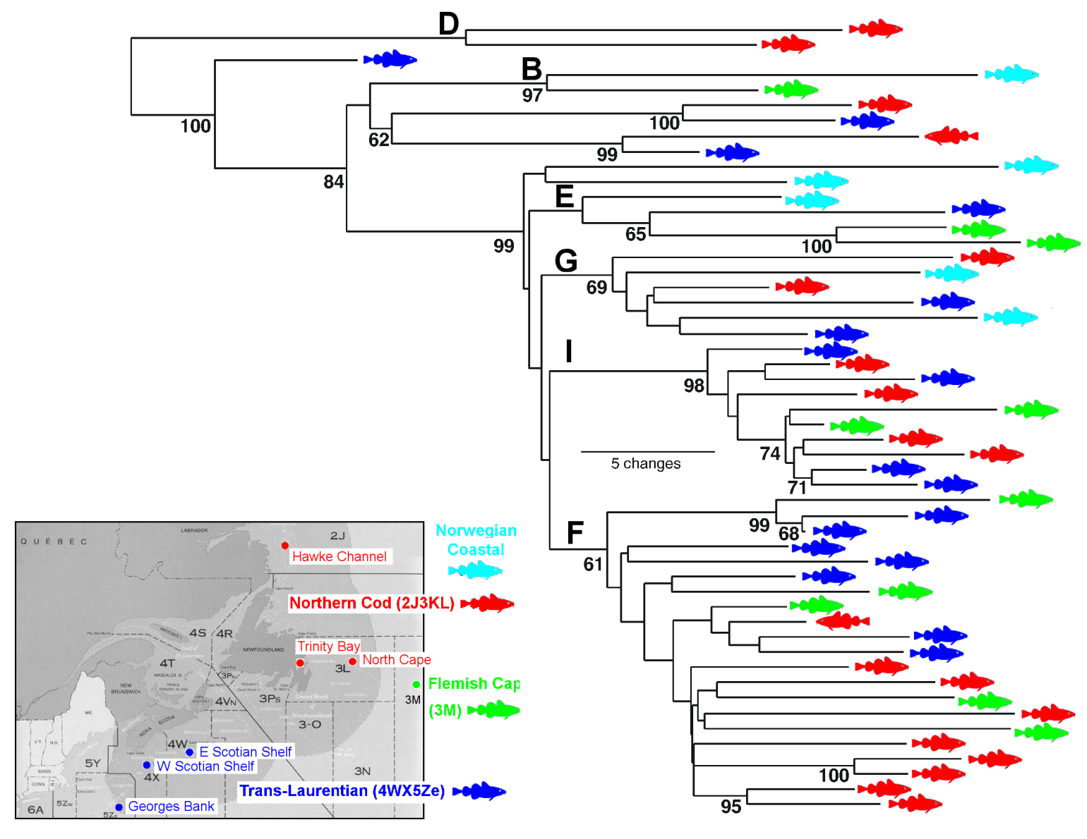

Family Tree of Atlantic Cod:
Northern Cod (2J3KL) vs Trans-Laurentian stocks (4WX5Ze) vs Flemish Cap (3M) vs Norwegian Coastal stocks
[ Carr & Marshall 2008 Genetics 180,381 & in progress ]
Bay Cod
Notes:
Update of results from last year in Halifax
Species coalescent at 162Kya, trans-atlantic inclusive clade at 128 Kya, most extensive superclade at 93 Kya. Expansion dates to 69 Kya
To Northern Cod (red fish), Flemish Cap cod (an offshore sea mount), and one Norwegian coastal population
Add Trans-Laurentian stocks (blue fish). Does Laurentian Channel separate stocks?
Lineages intermingled with Northern Cod throughout E F G I clades
Lineages include very old ones, note three blue fish at top
“B”-ish clade is now a larger component of the variation
“Bay Cod” may represent non-migratory stocks as part of traditional inshore fishery.
Note that one bay cod is part of the very old “B”-ish
Current experiments will include Baltic Sea cod in collaboration with Polish Oceanlogy Institute
Hope to expand coverage of mid-Atlantic, North Sea, & eastern stocks.

Slide 15
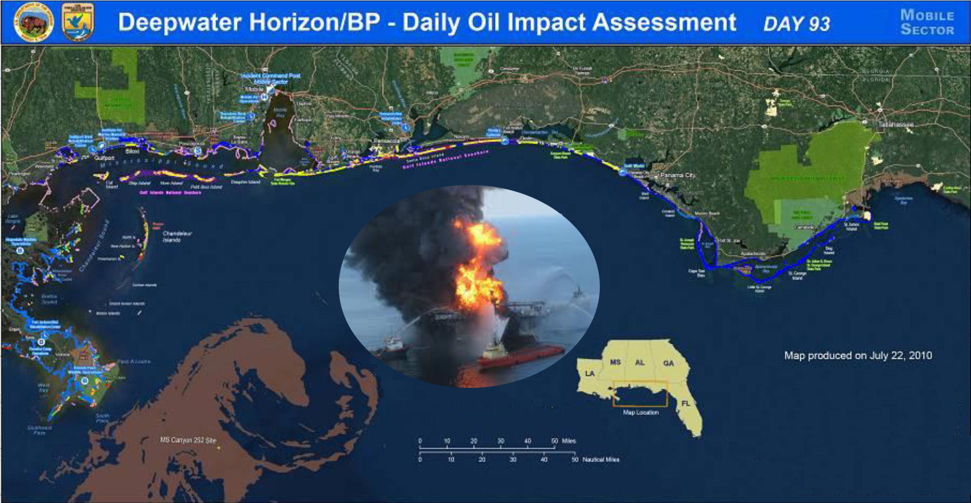
Worst-Case Scenario:
Oil Spill impacts Genome Ecosystem
Notes:
This phylogenetic tree shows the relationships between the hominoid man-like primates.
The closest relative of humans is the chimpanzee (of which there are two species) at 4~5 MYBP and after that is the gorilla ca. 7 MYBP.
The orangutan and the the gibbon are the next two closest relatives.

Slide 16
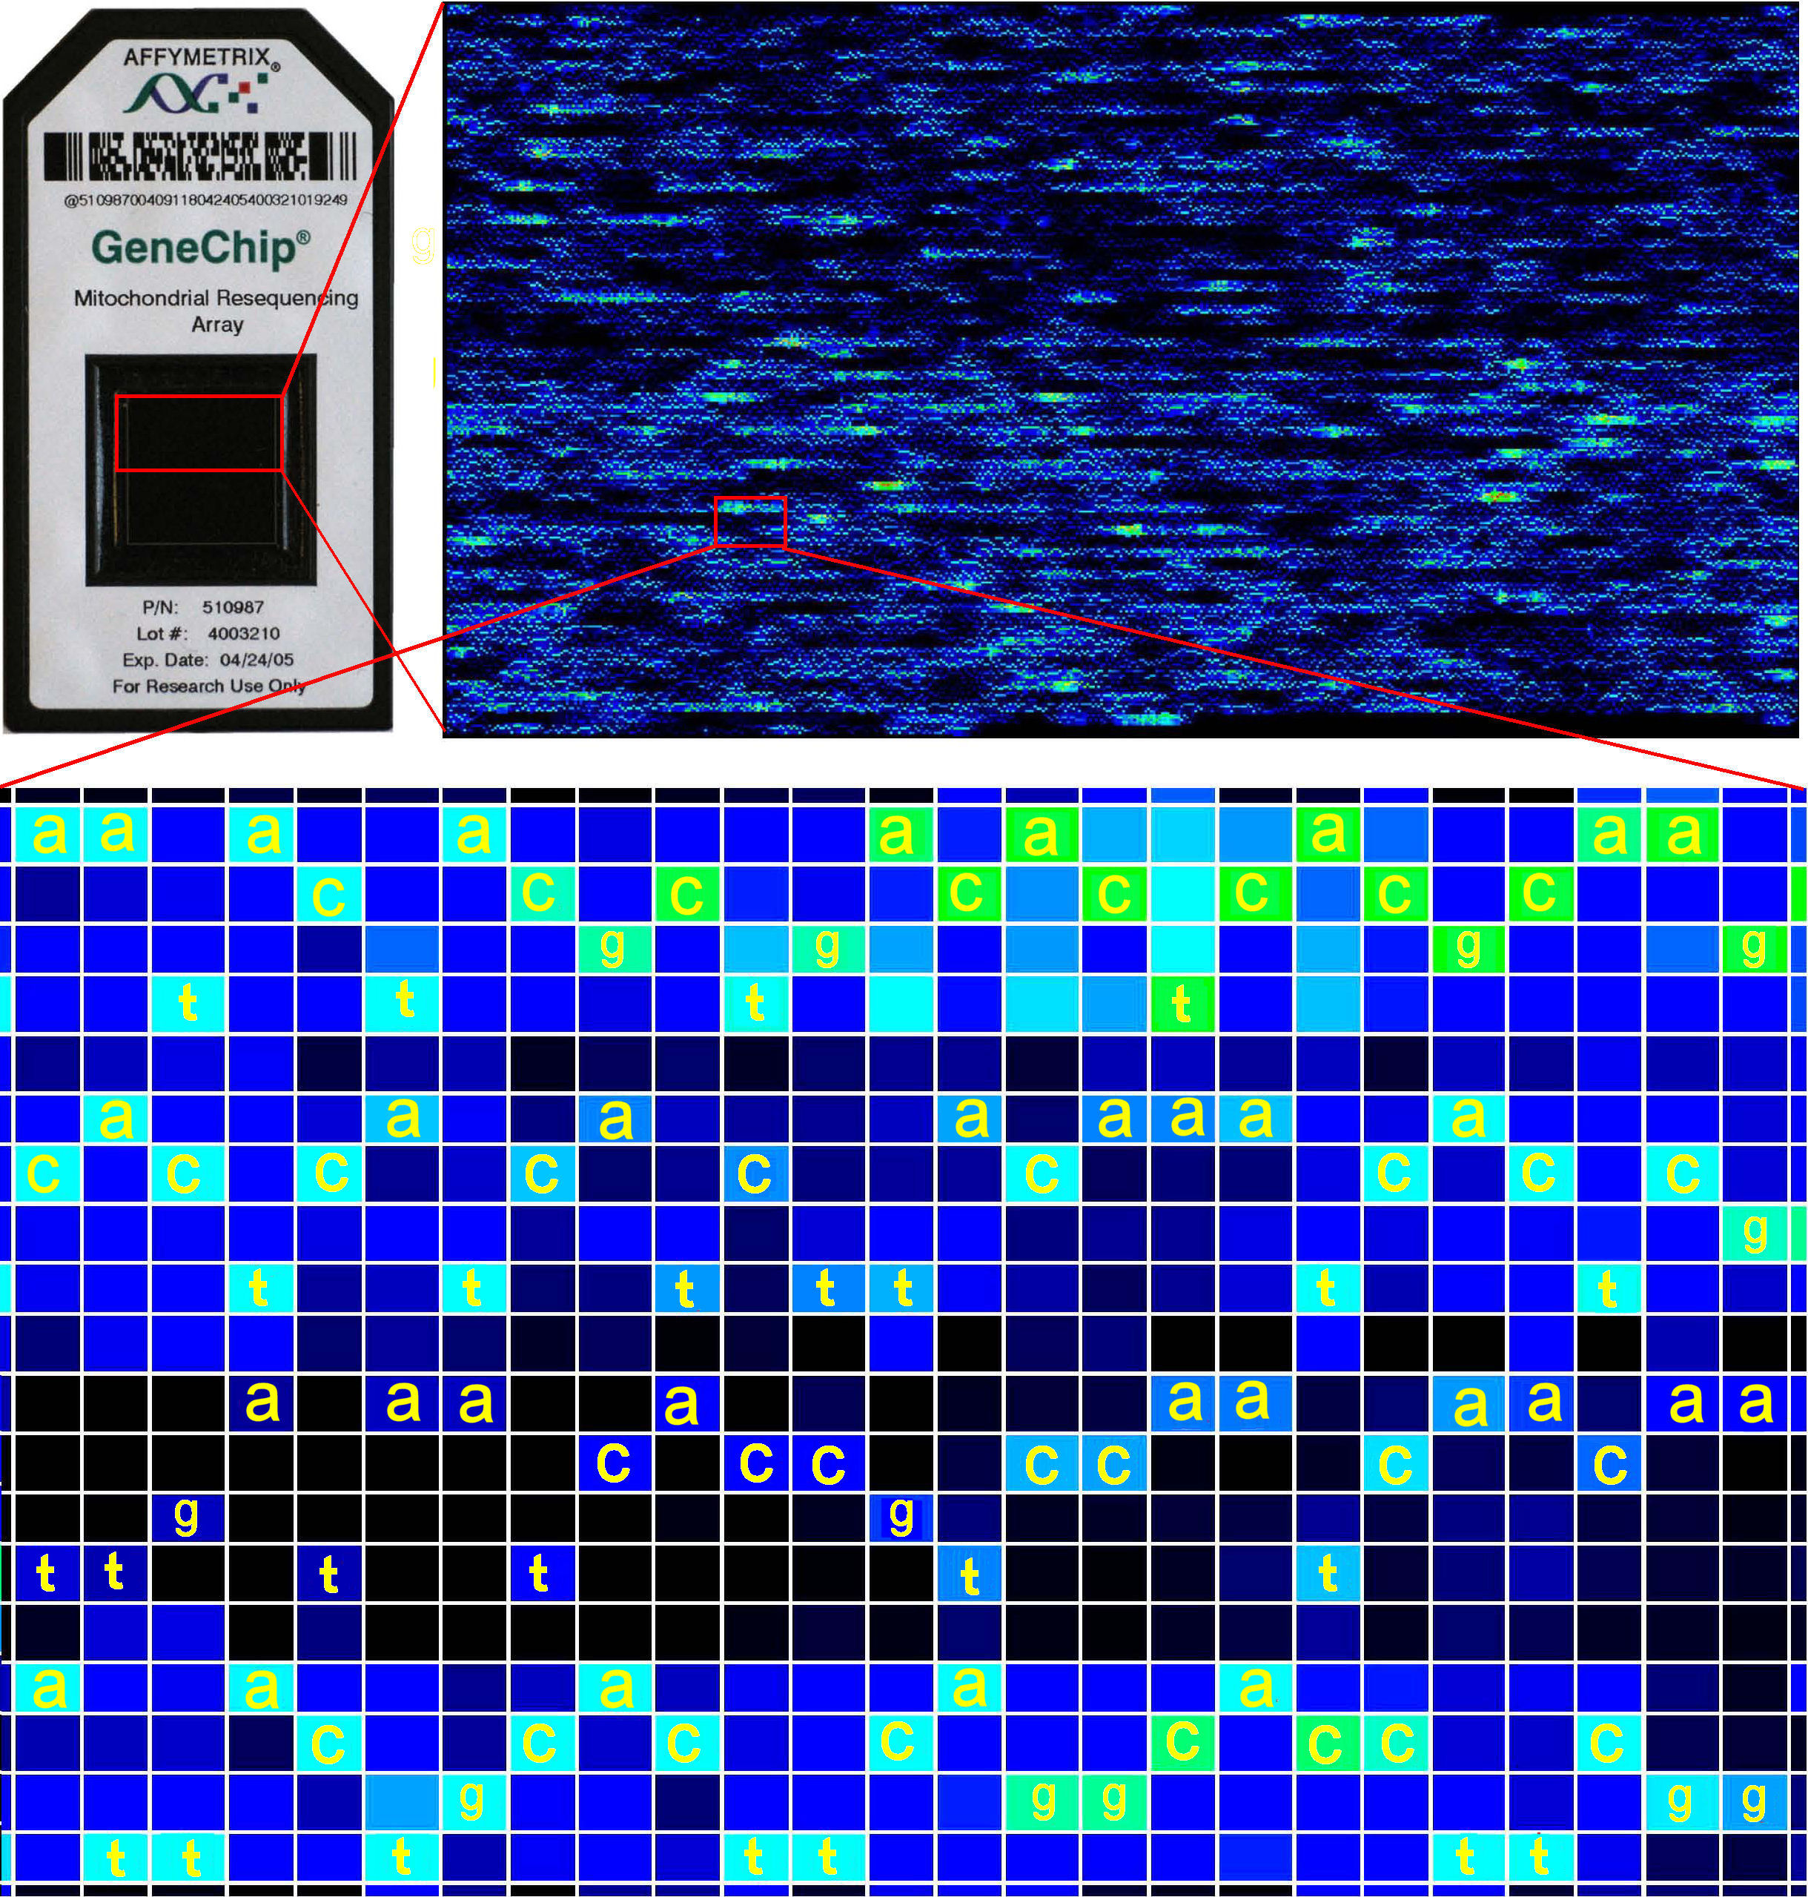

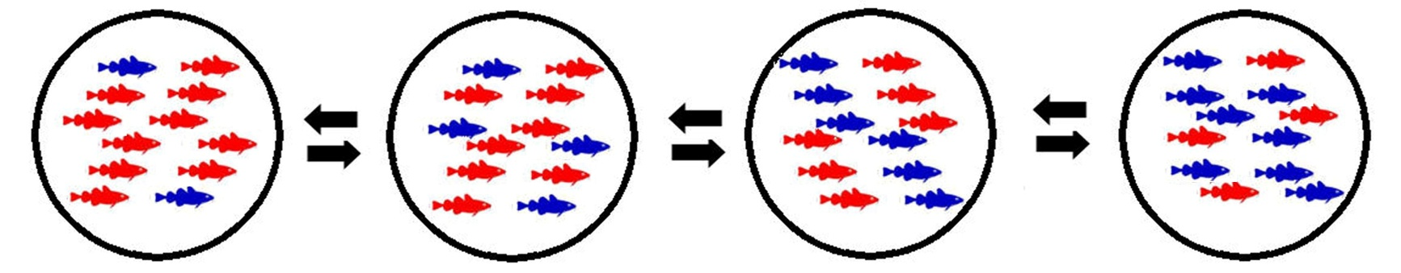
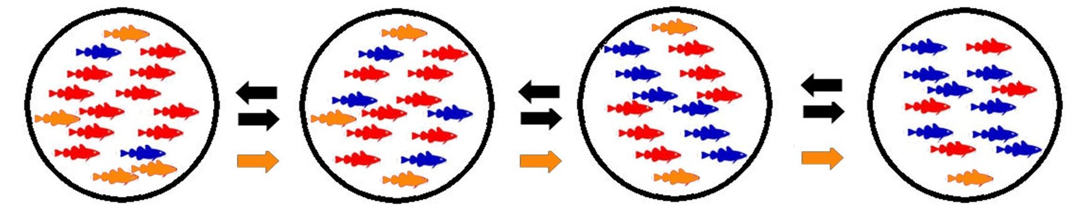
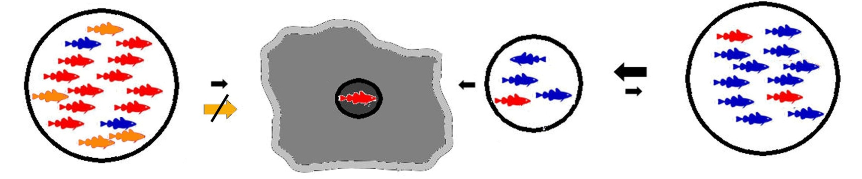
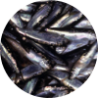
Genetic Consequences of Environmental Disruption
Gene Flow
Local success & dispersal
Loss of connectivity: disruption of gene flow & dispersal
Notes:
This phylogenetic tree shows the relationships between the hominoid man-like primates.
The closest relative of humans is the chimpanzee (of which there are two species) at 4~5 MYBP and after that is the gorilla ca. 7 MYBP.
The orangutan and the the gibbon are the next two closest relatives.

Slide 17
Notes:
[8] microarray includes a reference DNA sequence, up to 30 thousand bases long, tiled as a series of overlapping 25-base oligonucleotide quartets. One
member of each quartet is specific for any of the four possible SNP variants of
the reference sequence at each position.
The DNA is PCRed, fragmented, tagged, labeled, and applied to the chip. Both
the forward and reverse strands are included.
The intensity of binding by the experimental DNA to the tiled reference oligos
is shown here as pseudocolours. The actual numerical data are analyzed in a
flexible spreadsheet algorithm. You can also simply read the sequence, left to
right, like an old-fashioned autorad, sideways, in colour.

