Slide 1


June 27, 2017 | London, UK
Defining and exploiting the clinical mechanism of activity for alvocidib in acute myeloid leukemia patients
Steven L. Warner, PhD

Slide 2
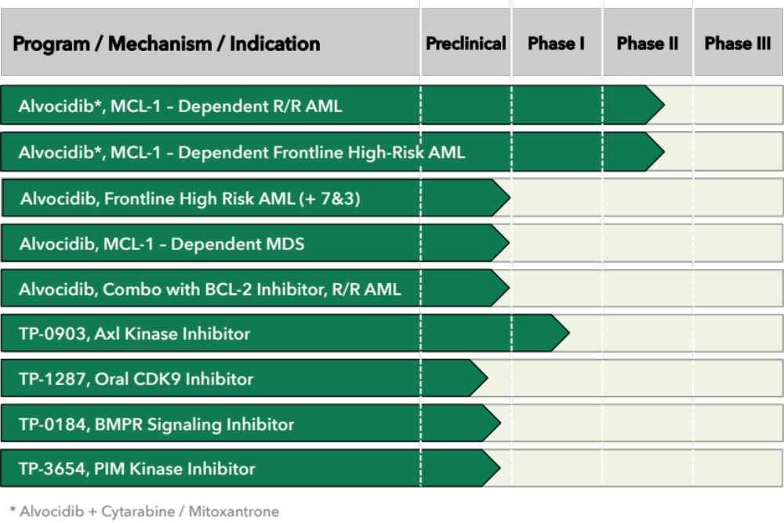
Tolero Pipeline

Slide 3
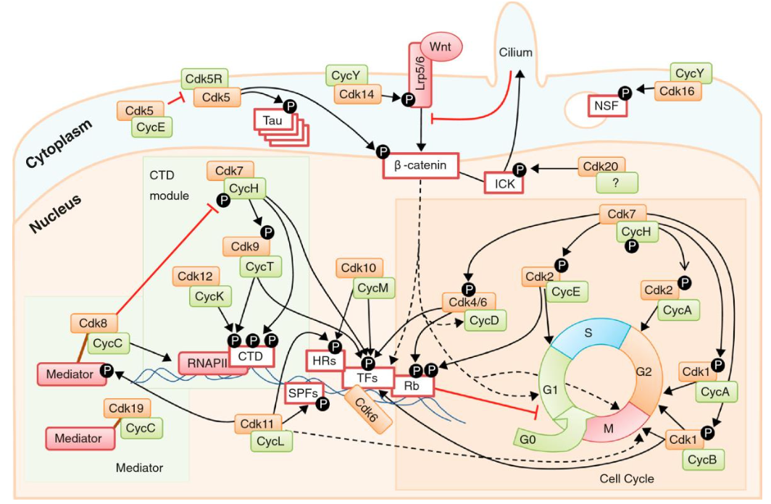
Alvocidib
Alvocidib (flavopiridol) was discovered in the 1990s and has historically been described as a pan-cyclin-dependent kinase inhibitor
In the past, most of the clinical development for alvocidib has focused on cell cycle inhibition and cytostatic activities
Clinical activity observed with alvocidib across dozens of clinical trials, but typically in undefined subset of patient populations
Malumbres. Genome Biology. 2014;15:122

Slide 4
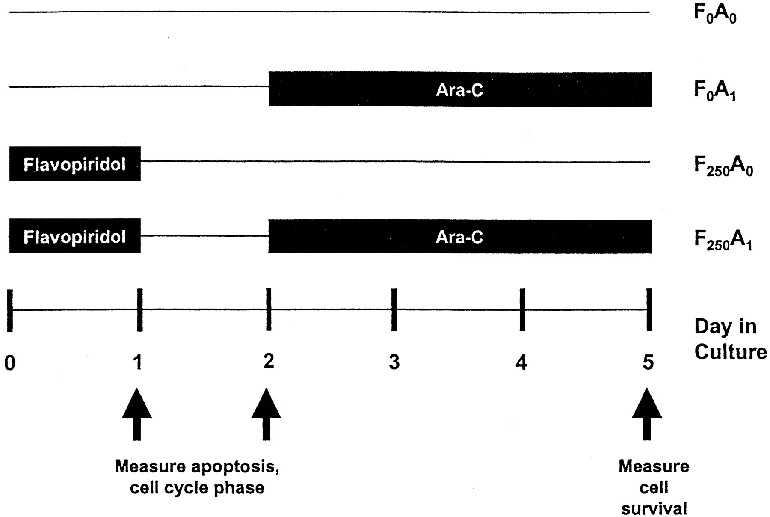
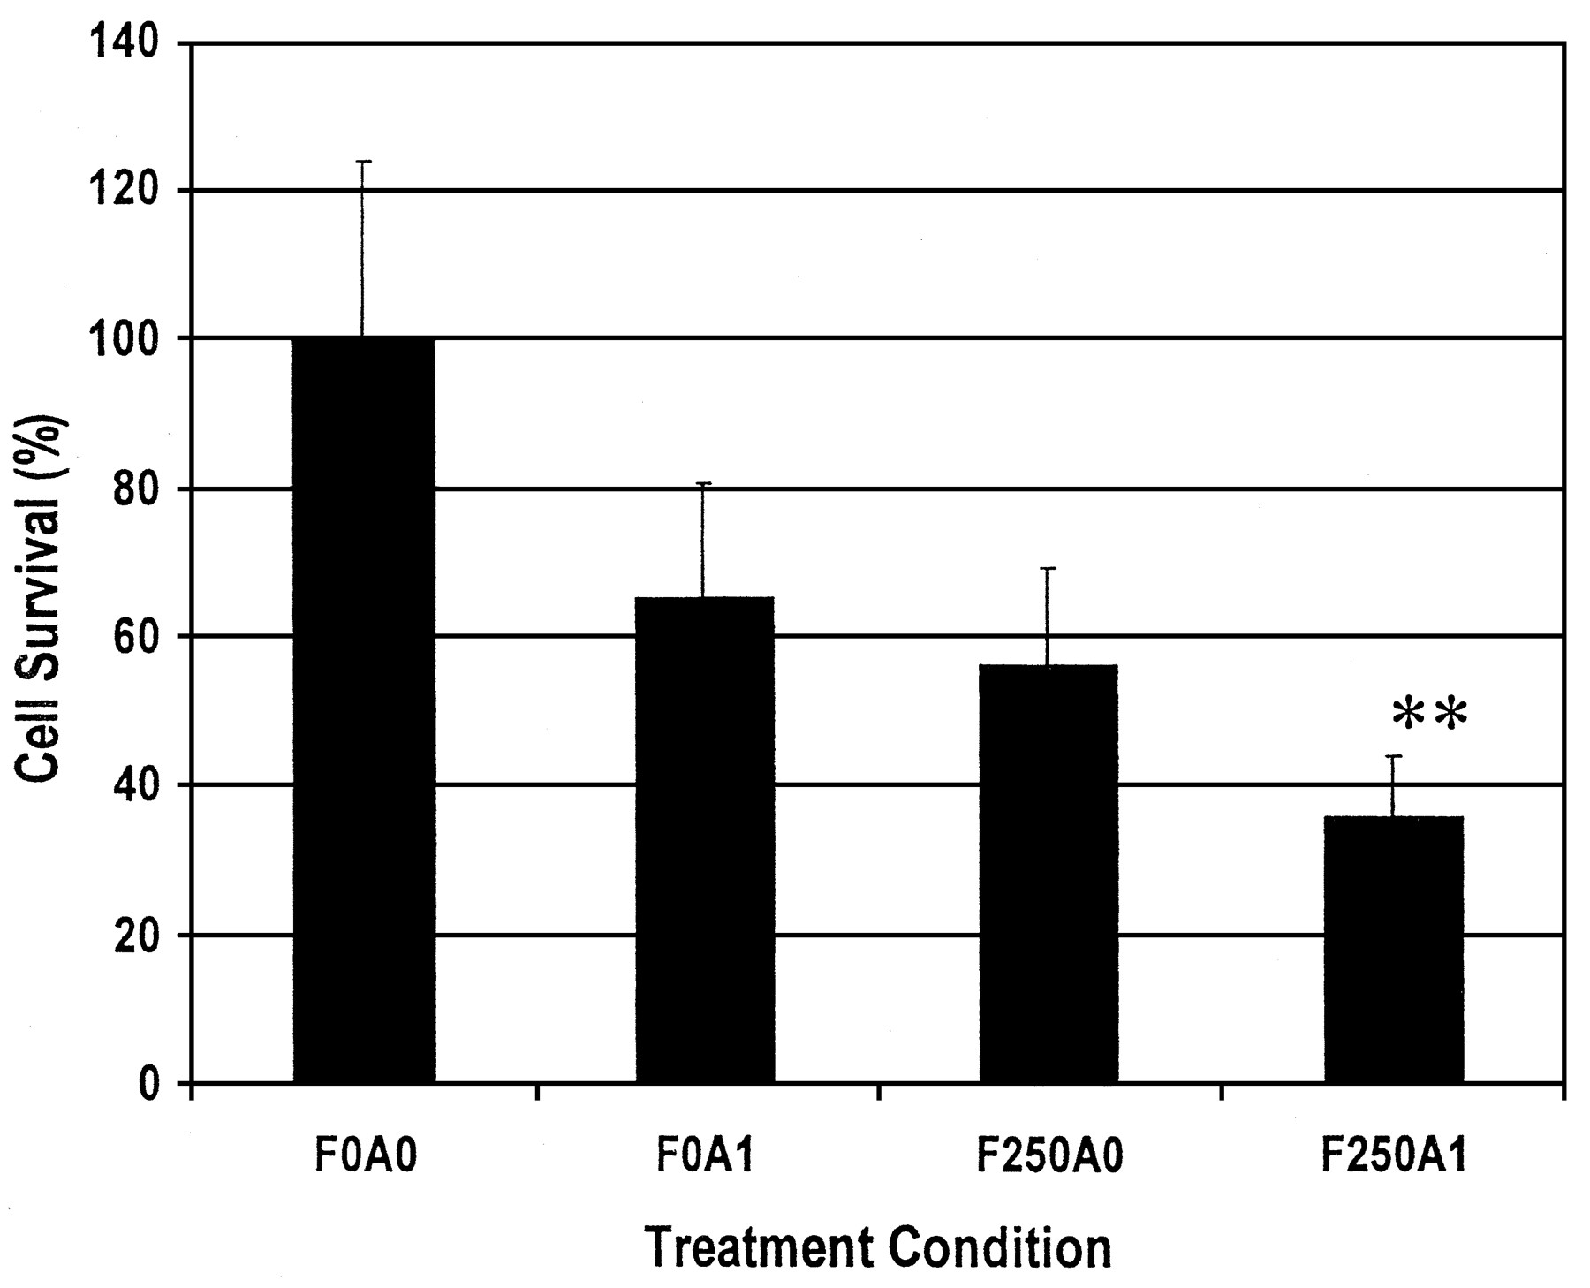
Timed Sequential Therapy with Alvocidib
Alvocidib
Alvocidib
Judith E. Karp et al. Clin Cancer Res 2003;9:307-315
In AML, Dr. Judy Karp pioneered a timed-sequential therapy regimen called ACM (alvocidib, cytarabine, and mitoxantrone)
The theory was that alvocidib would synchronize cells in the cell cycle followed by a release of cells into S-phase where agents such as cytarabine have maximal activity

Slide 5
ACM Dosing Schedule in AML
Alvocidib:
D1-3
[ See below ]
Ara-C:
D6-8; 2 g/m²
Given over 72 hrs
Mitoxantrone:
D9; 40 mg/m²
Alvocidib Dosing
SCHEDULE
Bolus loading dose (20-30 mg/m² 30-min IV) followed by continuous infusion dosing
(30-70 mg/m² given by 4-hr IV)
Karp JE, et al. Blood. 2011;117:3302-10.

Slide 6
Alvocidib Clinical History in AML
Relapsed / Refractory
OSU-O479/NCI-6947
Phase I
n=19
Monotherapy
alvocidib
JHU-O254/NCI-3170
Phase I
n=34 (26 AML)
JHU-O254/NCI-3170
Phase II extension
n=62
ECOG 1906
Phase II
n=36
JHU-06133/NCI-7889
Phase I
n=49
Frontline
JHU-0669/NCI-7845
Phase II
N=45
JHU-1101/NCI-8972
Phase II
ACM n=109; 7+3
n=56
JHU-O856/NCI-8237
Phase II
Arm A
N=39
JHU-O856/NCI-8237
Phase II
Arm B
N=39

Slide 7
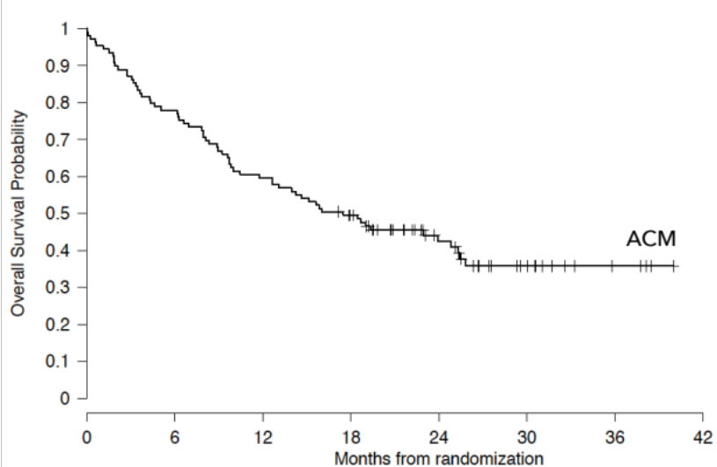
Positive Randomized Phase II in Frontline AML Patients
ACM Demonstrated a Statistically Significant Improvement In CR Rate Over 7+3
Most Patients Had Secondary AML or
Other Poor-Risk Features
Survival Plateaued in a High
Proportion of ACM-Treated Patients
Survival of ACM-Treated Patients
p = 0.003
ACM advantage was consistent across subgroups
including adverse cytogenetics, FLT3, secondary AML
Months from randomization
Source: Haematologica. 2015 Sep; 100(9): 1172–1179

Slide 8
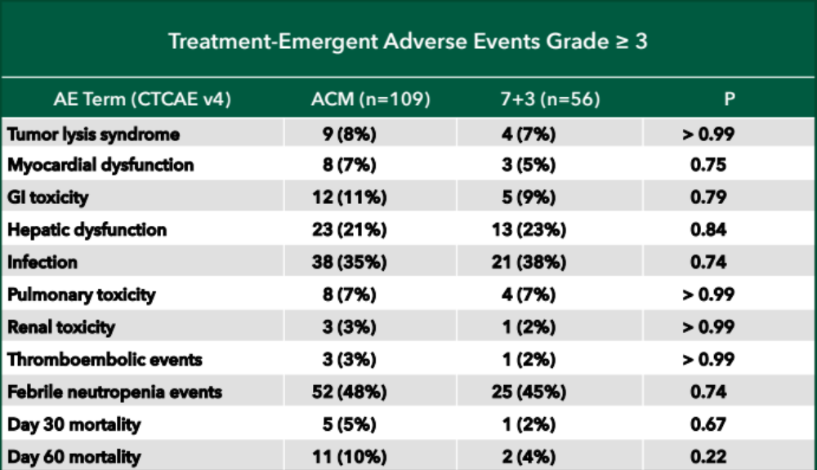
Safety Profile (ACM vs 7+3, n=165)
Haematologica. 2015 Sep; 100(9): 1172–1179

Slide 9
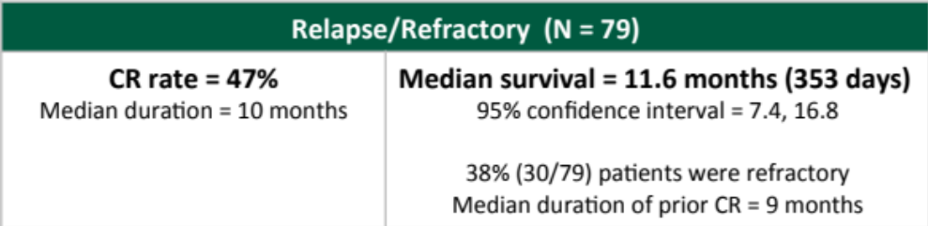
Phase I & II R/R AML Trials Overall Survival – Pooled Analysis
Survival Probability
ACM-treated patients
Time (Months)
Combination of R/R patients from J06133 and J0254. Tolero, data on file.

Slide 10
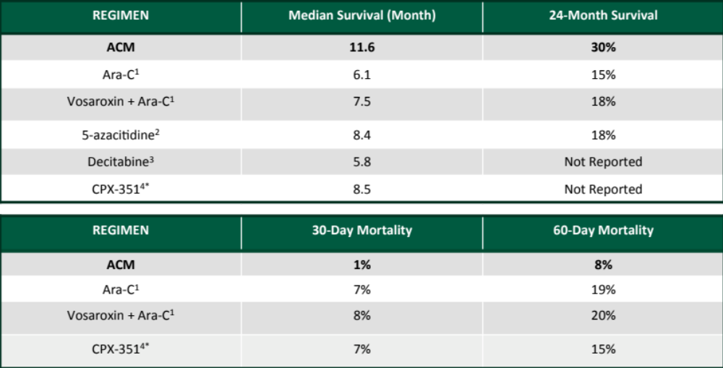
ACM Survival in R/R AML & Early Mortality
“Vosaroxin + Ara-C” data references from recently reported VALOR trial results.
R. Itzykson et al. Leukemia Research 39 (2015) 124-130.
Ritchie, Ellen K. et al. Leukemia & Lymphoma 54.9 (2013).
4. Cortes, Jorge E. et al. Cancer, 121 (2015): 234-242. (*Relapse Only)

Slide 11
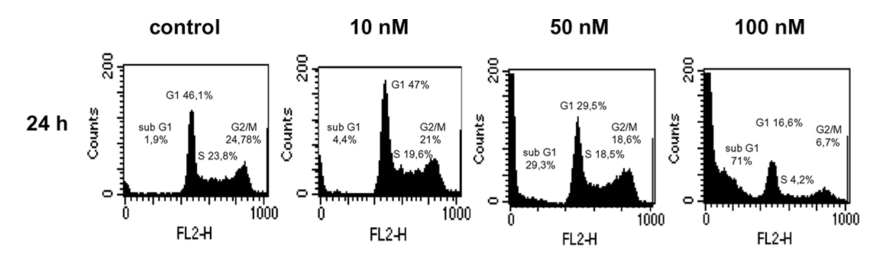
Alvocidib Activity in AML Is Not Cell Cycle Dependent
  Alvocidib causes rapid cell death; this cell death is not cell cycle dependent.
In the lab
    Apoptosis is rapid and not linked to cell cycle arrest.¹
In the clinic
    Three-day dosing of alvocidib resulted in an average of 87%, 76%, and 82% reduction of circulating blasts in patients with newly diagnosed, relapsed, and refractory disease, respectively.²
1. Mayer F. Invest New Drugs. 2005;23:205-11.
2. Blum W. Haematologica 2010;1098-1105.

Slide 12
Alvocidib is a Potent Inhibitor of CDK9
Understanding how to effectively develop CDK inhibitors has led to new advances in cancer treatment
Alvocidib has a differentiated profile targeting CDK 9 as well as CDK 4/6
Kinase Inhibition of CDK Family
Kinase | Alvocidib IC₅₀ (nM)
CDK9 | 6
CDK4/6 | 9
CDK7 | 23
CDK11 | 57
CDK5 | 110
CDK8 | 120
CDK3 | 410
CDK2 | 550
Malumbres. Genome Biology. 2014;15:122
Notes:
CDK inhibitors have come full circle. Early on they were studied intensely because they are important regulators of the cell cycle. But early results with this class of compounds were mixed.
Along the way we gained a better understanding of how to use these agents and now they are proving to be very effective
Originally CDK 4/6 were in focus because of the role in controlling the cell cycle
There is increasing interest in the role and function of CDK9 which effects functions in a critical step controlling transcription of genes known to be crucial in cancer biology.

Slide 13
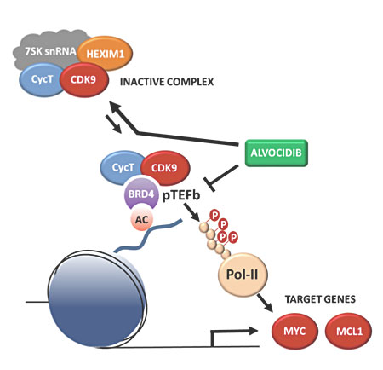
Alvocidib Disrupts Super Enhancer Activity via CDK9 Inhibition
Alvocidib is a potent inhibitor of CDK9
Alvocidib downregulates CDK9-driven transcription of super enhancer-regulated genes, such as c-Myc and MCL-1
Oncotarget. 2014: 6(5); 2667-2679

Slide 14
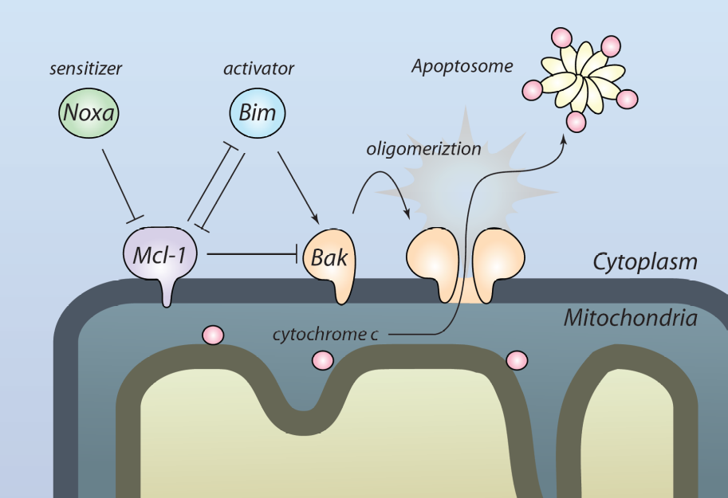
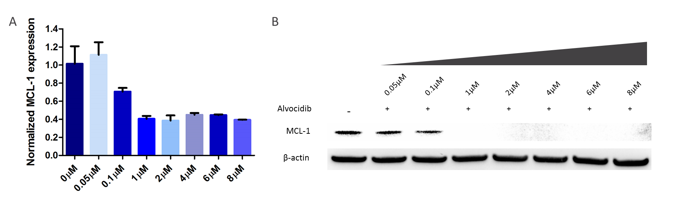
Alvocidib Inhibits Expression of MCL-1
Alvocidib inhibits the transcription of key anti-apoptotic genes, including MCL-1. Following Alvocidib treatment at various doses, protein levels are decreased in a dose-dependent fashion in MV4-11 cells.

Slide 15
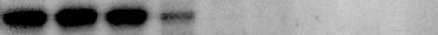
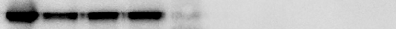
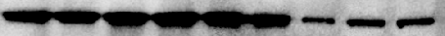
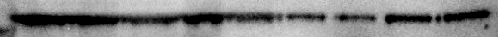
Inhibition of MCL-1 Protein Expression Persists in the Absence of Alvocidib
Duration of knockdown of MCL-1 following treatment with alvocidib (80nM).
Knockdown exceeds 96 hours in MV4-11 cells.
Washout
No Washout
Control
1 hr
3 hrs
16 hrs
24 hrs
48 hrs
72hrs
96 hrs
Control
3 hrs
16 hrs
24 hrs
48 hrs
72 hrs
96 hrs
6 hrs
1 hr
6 hrs
MCL-1
β-actin

Slide 16
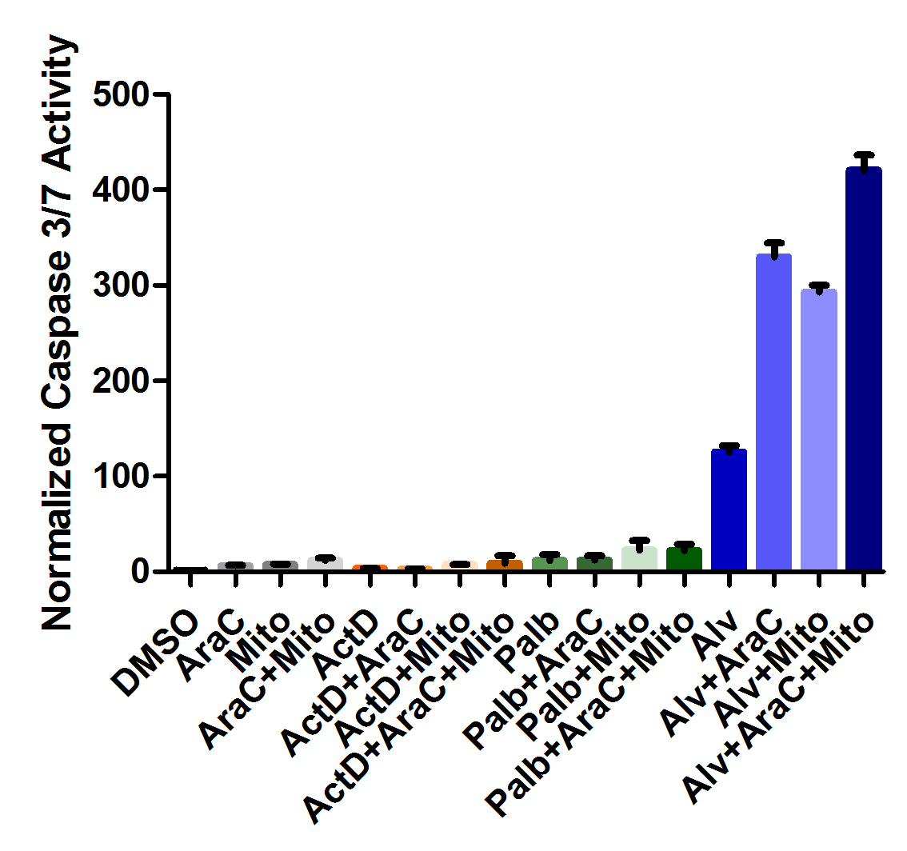
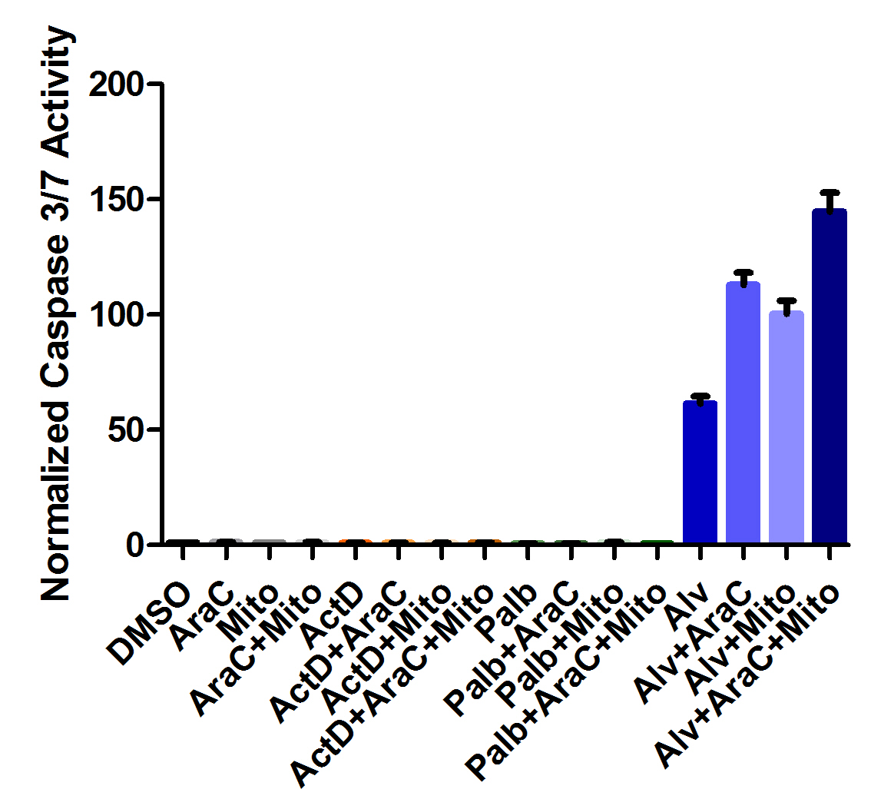
ACM is a Synergistic Regimen
A
B
Treatment schedule
1nM Mitoxantrone
80nM Alvocidib
100nM Ara-C
Total time elapsed
0 hrs
24 hrs
48 hrs
72 hrs
96 hrs
120 hrs

Slide 17
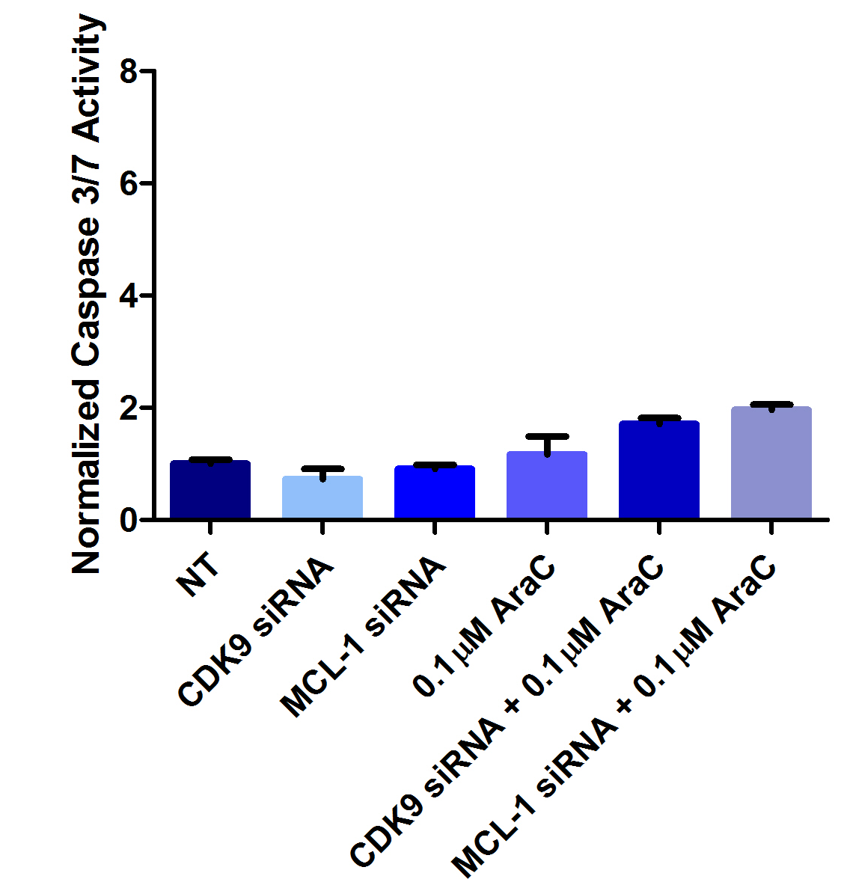
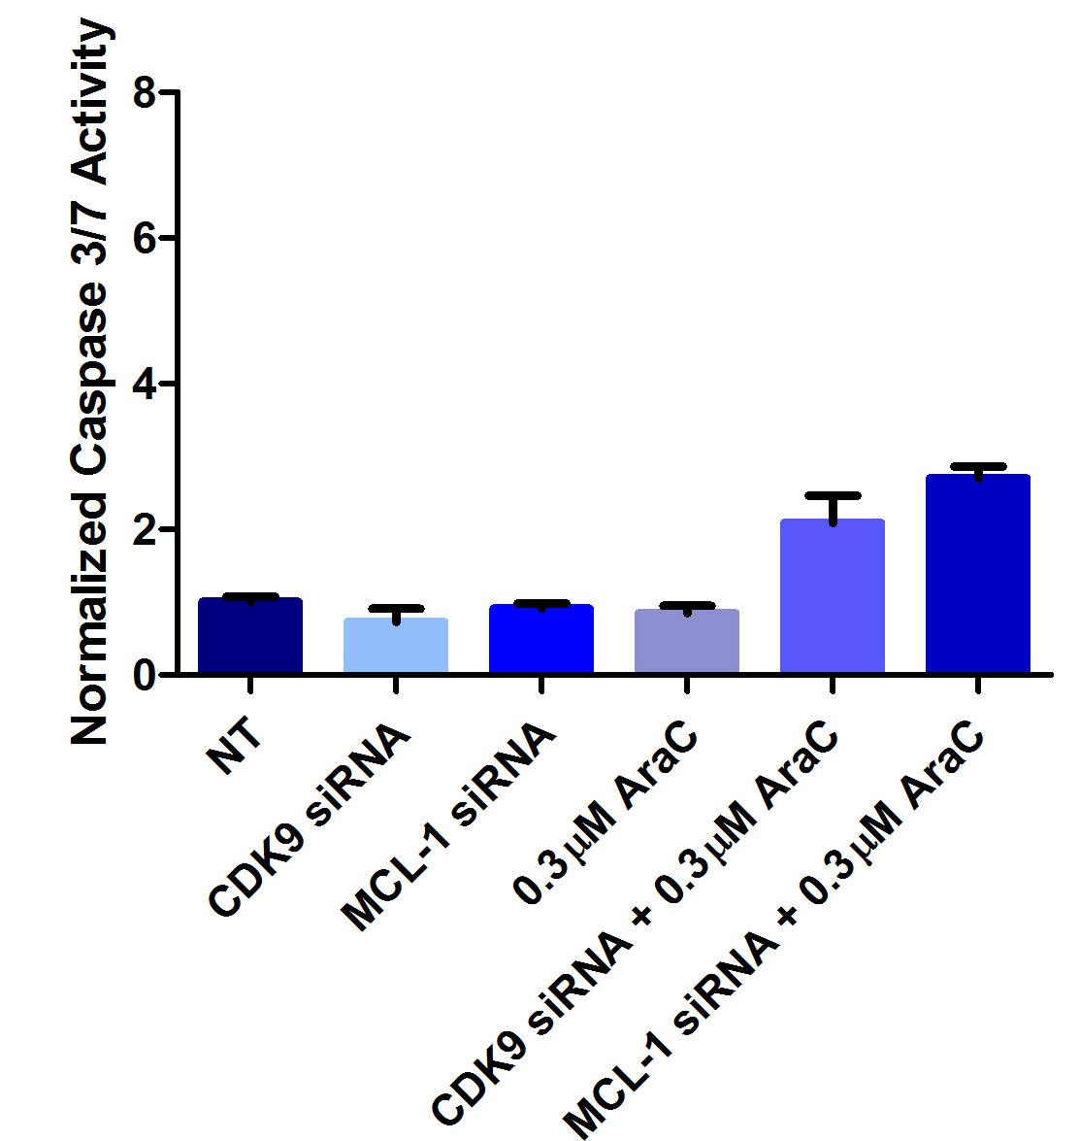
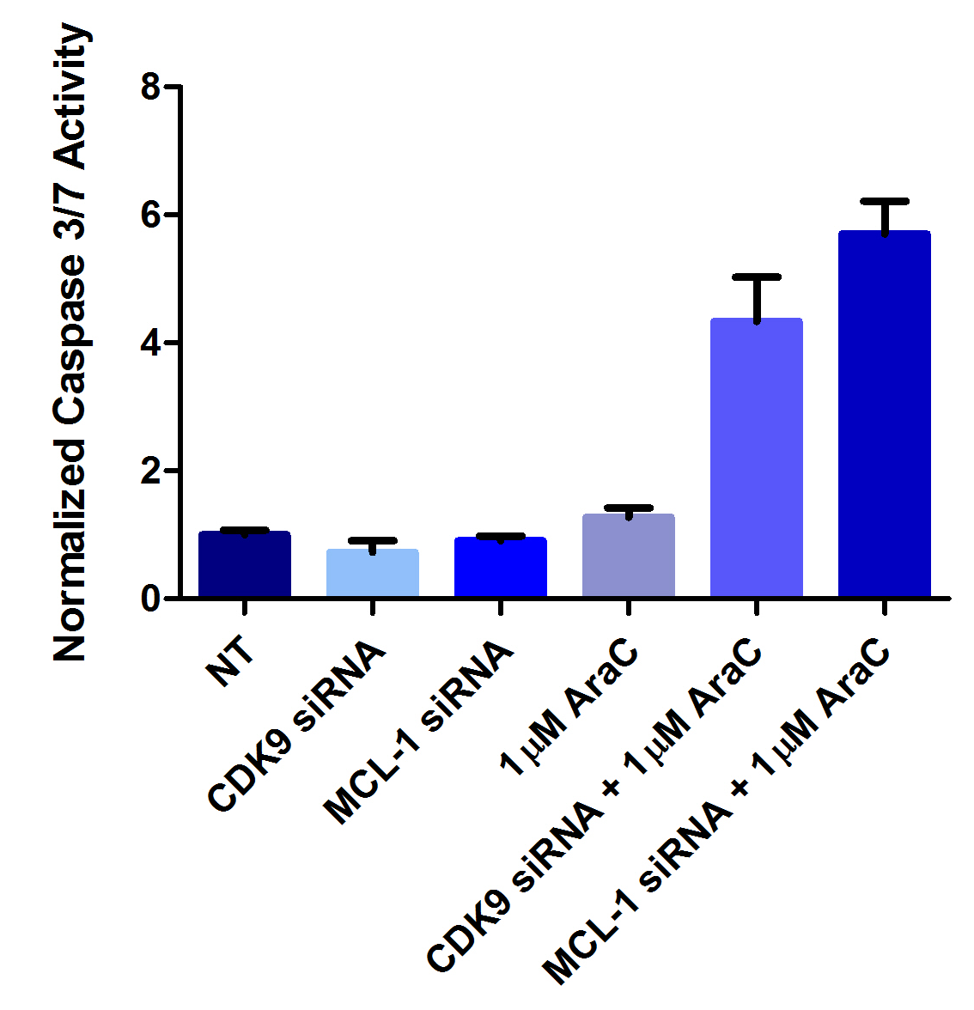
CDK9/MCL-1 Drives ACM Synergy
A
B
C

Slide 18
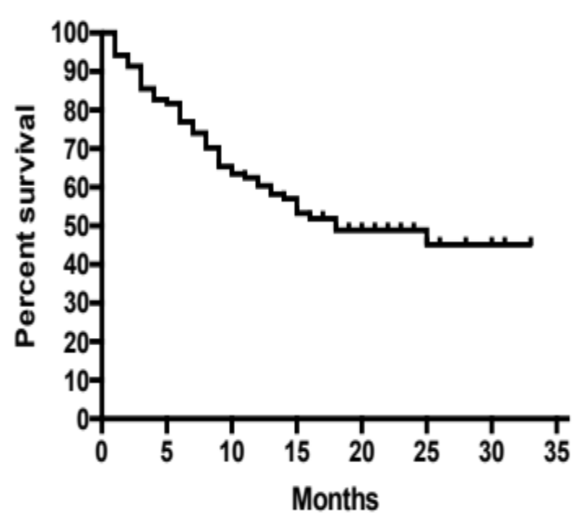
Survival Plateaus in a High Proportion of ACM-Treated Patients in Frontline and R/R AML
What distinguishes these patients?
Pooled R/R AML Patients (n=79)¹
Int. & HR Untreated AML (n=109)²
Survival Probability
Percent Probability
Months
Months
¹ Combination of R/R patients from J06133 and J0254. Tolero, data on file.
² Haematologica. 2015 Sep; 100(9): 1172–1179.

Slide 19
Predictive Biomarker Linked to Alvocidib Mechanism
The remission rate of alvocidib-treated AML patients can be enhanced by identifying those with MCL-1-dependent disease
Alvocidib’s mechanism of action can be leveraged into an assay platform which identifies sensitive patients with MCL-1 dependence
CDK9
MCL-1
AML
Alvocidib

Slide 20
Alvocidib Downregulates MCL-1
0.05µM
0.1µM
1µM
2µM
4µM
6µM
8µM
Alvocidib
-
+
+
+
+
+
+
+
MCL-1
β-actin
Alvocidib completely inhibits the expression of MCL-1 in MV4-11 cells in a concentration-dependent manner at a 16-hour time point

Slide 21
Anti-survival
(BH3 Proteins)
BIM
BAD
HRK
NOXA
BAD
BAD
BIM
HRK
BIM
NOXA
BIM
Pro-survival
BCL-2
BCL-xL
MCL-1
If suppression of cell death is dependent on BCL-2
If suppression of cell death is dependent on BCL-xL
If suppression of cell death is dependent on MCL-1
Cell Death

Slide 22
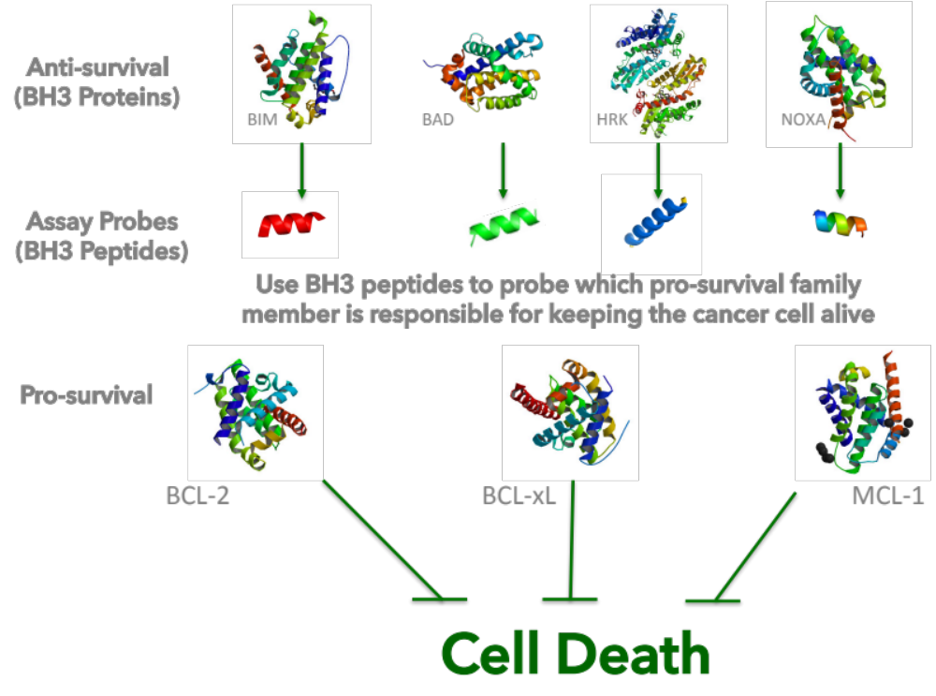

Slide 23
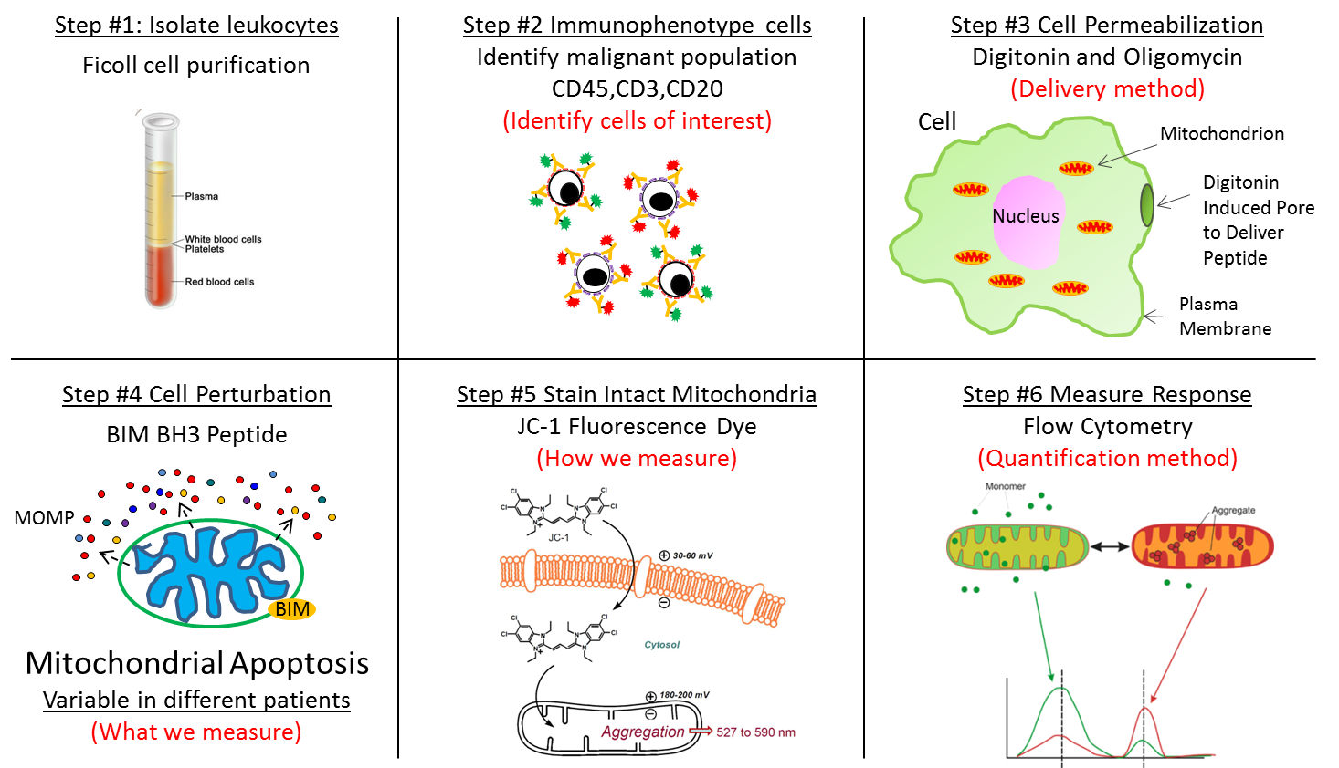
MCL-1 Dependence Assay
NOXA BH3 Peptide
NOXA

Slide 24
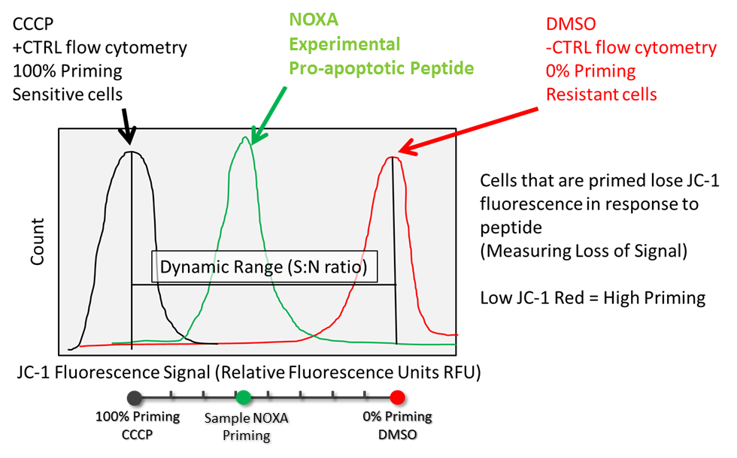
Flow Cytometry Readout

Slide 25

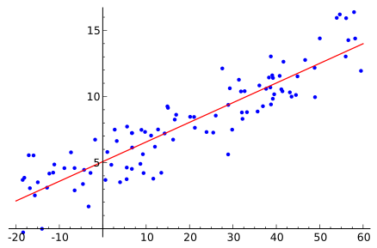




MCL-1 Dependence Study Design
Pretreatment bone marrow from newly diagnosed AML patients treated with ACM from
Phase 2 clinical trials
Immunostain and BH3 profile each sample
Correlate individual patient profiles with response

Slide 26
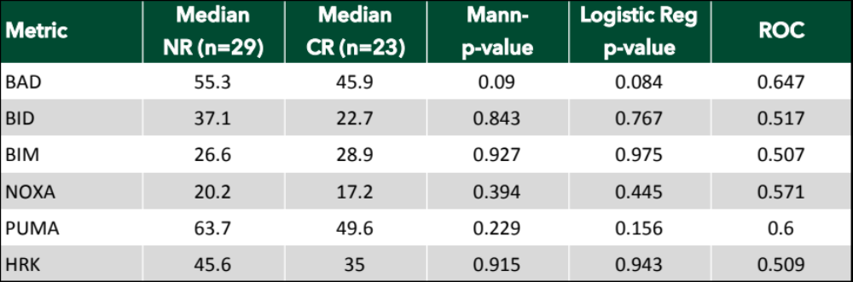
MCL-1 Dependence did not Correlate with Responses in Peripheral Blood
None of the individual BH3 peptides correlated with complete response (CR) when peripheral blood and bone marrow samples were analyzed together

Slide 27
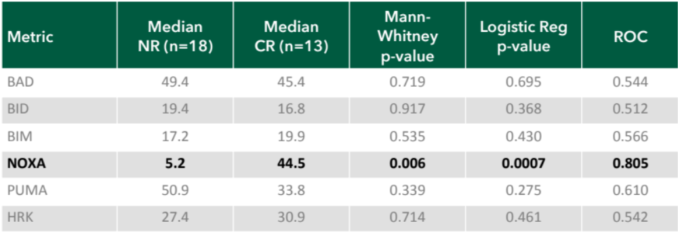
MCL-1 Dependence Highly Correlated with Complete Remission in Bone Marrow Samples from ACM-Treated Patients
Correlation consistent with CDK9 Inhibition and MCL-1 dependency

Slide 28
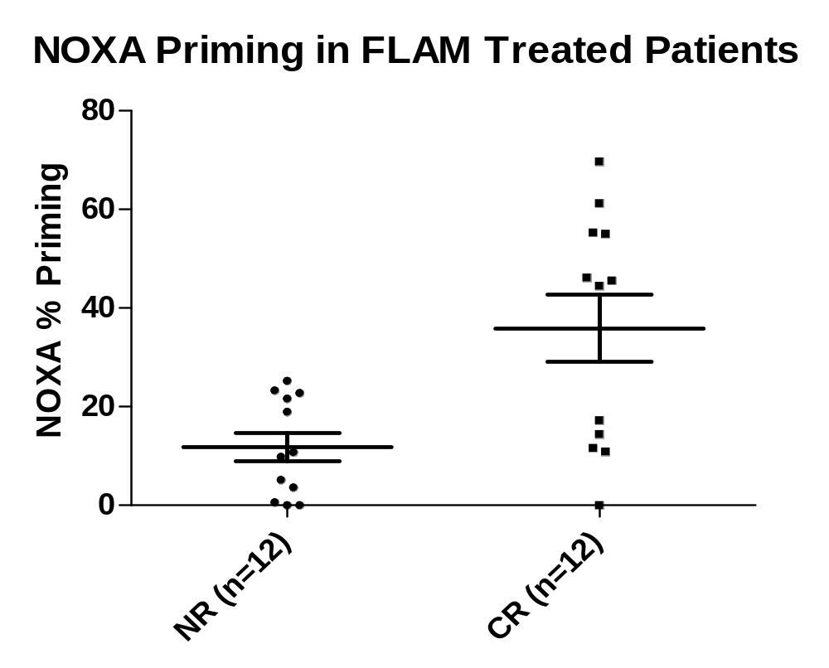
Results from Validation Set: High MCL-1 Dependency is Predictive of Alvocidib Sensitivity in AML Patients
100% CR Rate in AML Patients
with MCL-1 Dependence ≥ 40%
% MCL-1 Dependence
No Response
(n=12)
Complete Remission
(n=12)
MCL-1 Dependence in CR and NR (No Response) pre-treatment bone marrow samples from AML patients treated with the ACM regimen
MCL-1 Dependence did not predict response in patients treated with 7+3

Slide 29
ACM-Treated AML Patients with ≥ 40% MCL-1 Dependency Demonstrated Improved Survival
MCL-1 Dependent (n=7)
MCL-1 Non-Dependent (n=17)

Slide 30
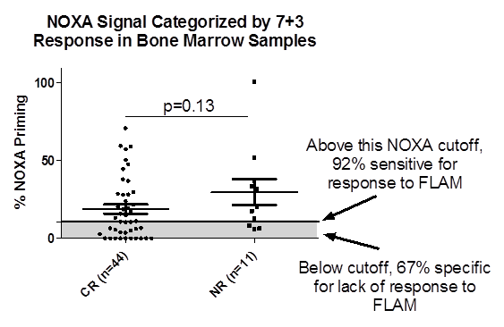
No Correlation of MCL-1 Dependency to Response to 7+3 in Patients’ Bone Marrow Samples
% MCL-1 Dependence Categorized by 7+3 Response in Bone Marrow Samples
% MCL-1 Dependence

Slide 31

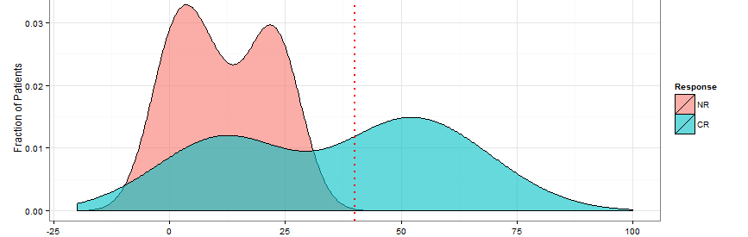
MCL-1 Dependence Predicts for ACM Response (unpublished data)
Pre-Treatment AML patient bone marrow from viably frozen
Patients treated with ACM and patients classified according to response (CR versus NR)
MCL-1 Dependence greater than 40% is used as threshold and compared to response
MCL-1 Dependency Assay Score
AUC = 0.81

Slide 32
What is the MCL-1 Dependency Assay?
A functional assay to identify patients with a malignancy dependent on MCL-1
NOXA peptide is added to patient samples and induction of apoptosis is measured – readout is percentage of cells entering apoptosis
In AML patients the assay is run on standard bone marrow aspirates, usually taken during diagnosis or determination of relapse / resistance
Easy, scalable and quick turnaround

Slide 33
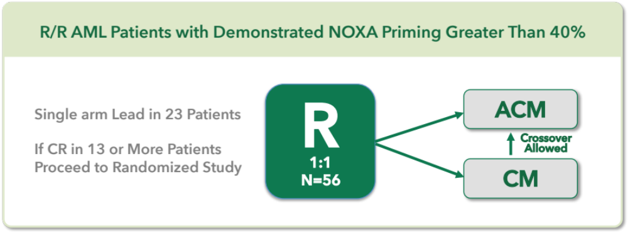
Phase II Biomarker Protocol Design
R/R AML Patients with Demonstrated MCL-1 Dependence Greater than 40%
Primary Endpoint: Rate of Complete Remission
Secondary endpoints: EFS, OS, safety, CRi, CRp, duration of response

Slide 34
Venetoclax and Alvocidib Act Synergistically
Synergy between alvocidib and venetoclax is through CDK9-dependent pharmacology
venetoclax
alvocidib
BCL-2
BCL-xL
MCL-1
Cell Death

Slide 35
MCL-1 Upregulation Conveys Resistance to Venetoclax
Venetoclax Inhibits BH3 Family Member BCL-2

Slide 36
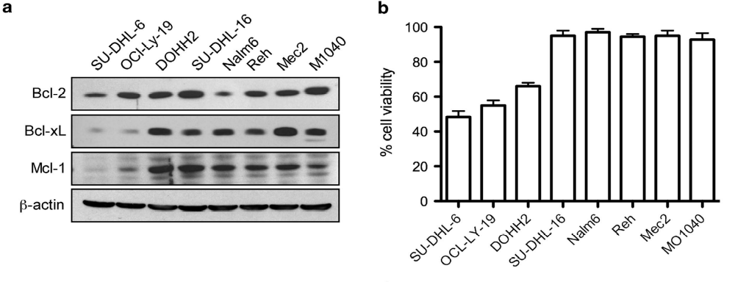
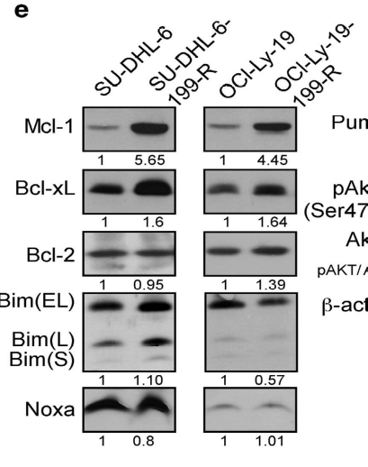
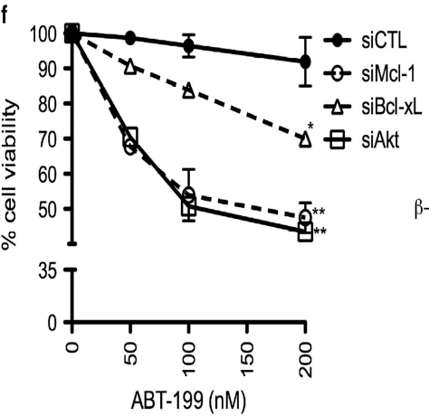
MCL-1 Expression Negatively Correlates with Venetoclax Sensitivity
Mcl-1 expression is associated with higher resistance to Venetoclax (ABT-199) in multiple lymphoid cell lines
siRNA to Mcl-1 enhances sensitivity to Venetoclax
Choudhary, GS. et al. 2015. Cell Death Dis. e1593; doi:10.1038/cddis.2014.525.

Slide 37
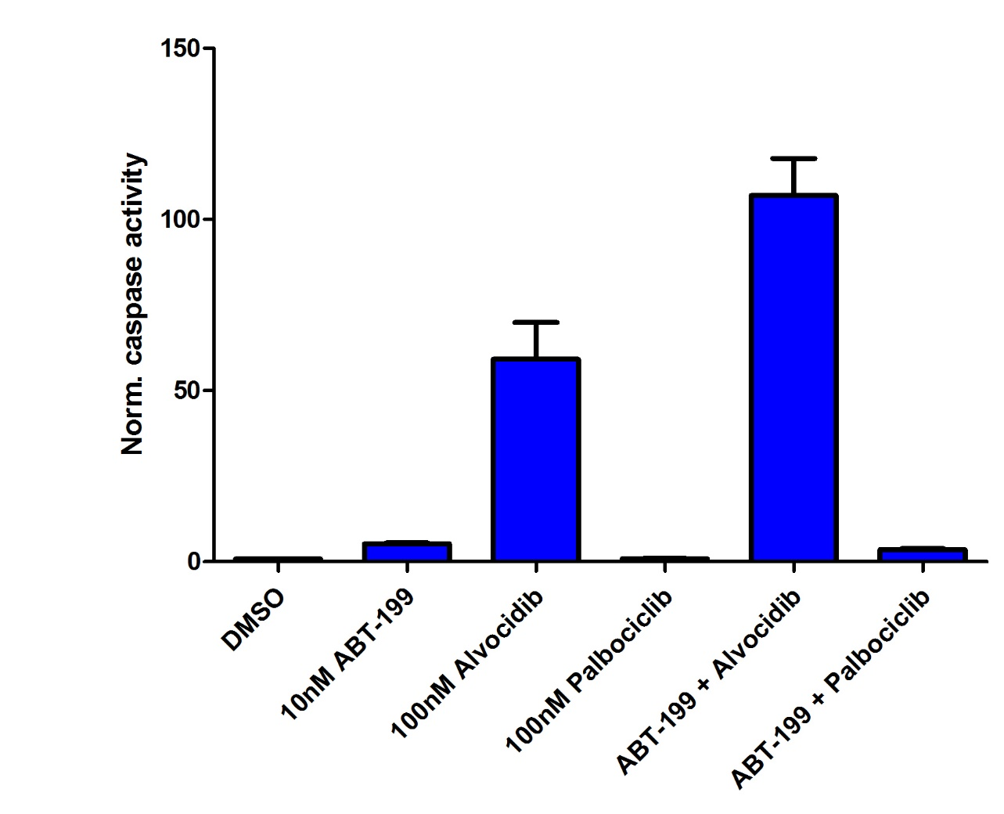
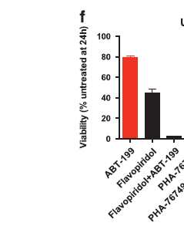
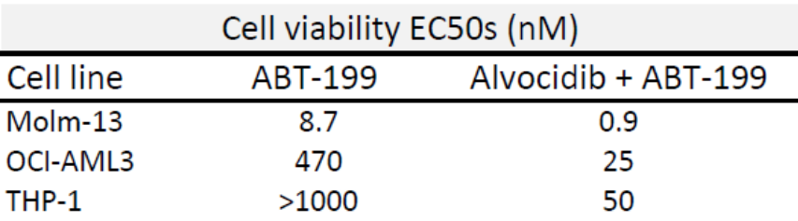
Venetoclax and Alvocidib Act Synergistically
Viability (% untreated at 24h
ABT-199
Alvocidib
Alvocidib + ABT-199
Leukemia (2015) 29, 1702-1712

Slide 38
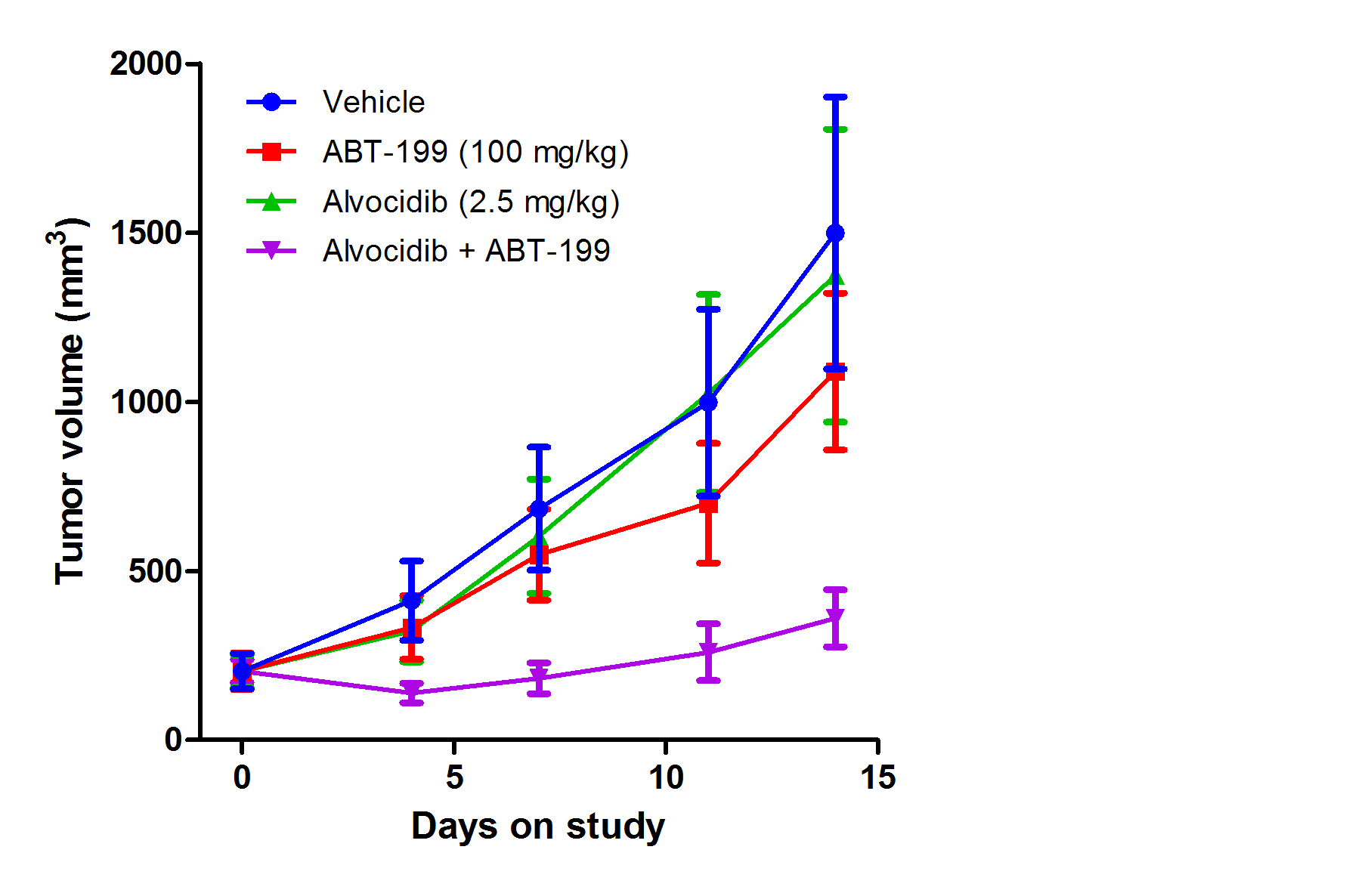
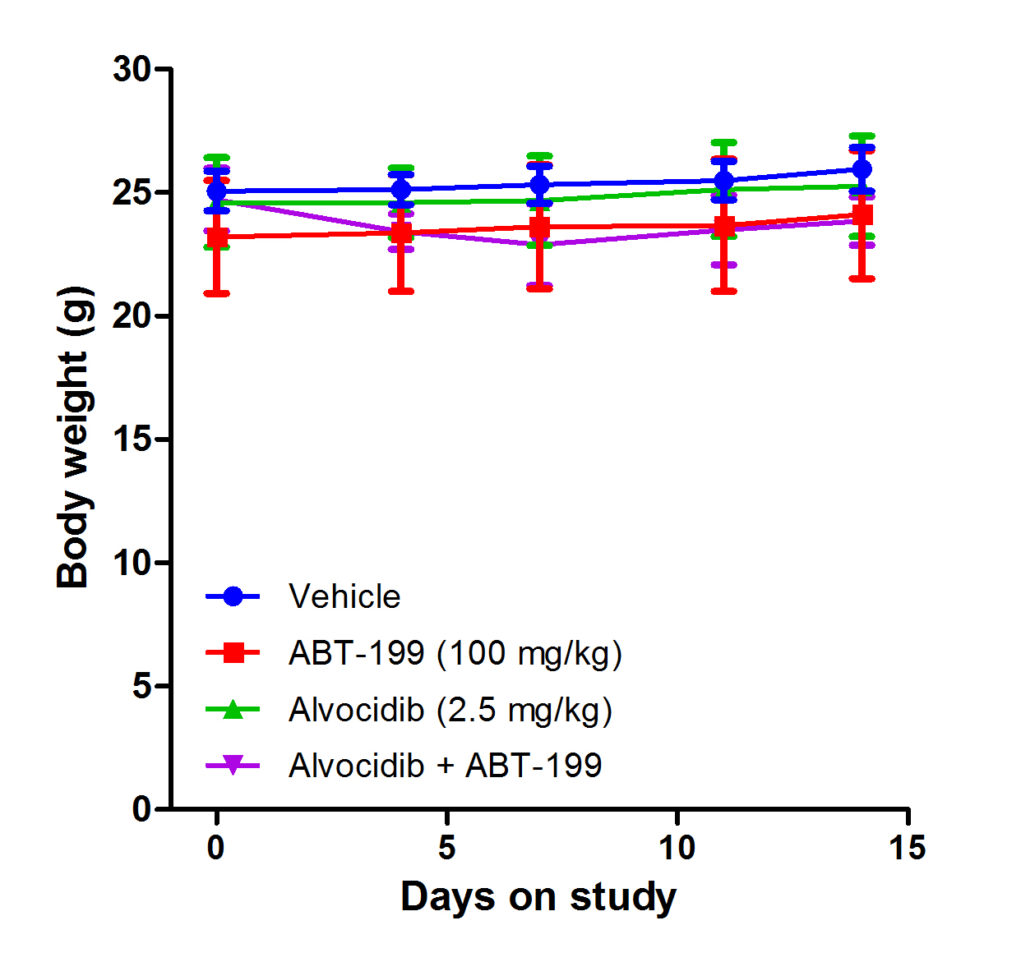
Alvocidib synergizes with ABT-199 treatment
A
B
Alvocidib + ABT-199 is an active combination in an ABT-199-resistant AML xenograft (OCI-AML3) model. Female athymic nude mice were injected subcutaneously with 1x10⁷ OCI-AML3 cells in the hind flank. Following randomization when tumors reached approximately 100mm³, mice were treated with 100 mg/kg ABT-199, 2.5 mg/kg alvocidib, or a combination of the two drugs. Mice were dosed daily by oral gavage (ABT-199) or by intraperitoneal injection (alvocidib). Tumor volumes (A) and body weights (B) were recorded twice weekly. (C) Intratumor MCL-1 changes were assessed by immunoblotting. Anti-tumor activity was not observed with treatment using sub-optimal doses of either alvocidib or ABT-199. Synergic anti-tumor activity was observed in mice treated with the combination.

Slide 39

THANK YOU!

