Slide 1





Pediatric Laboratory-Based Screening
Methodology for Nutrition-based Disorders
Steven J. Melnick, Ph.D., M.D
Department of Pathology and Clinical Laboratories

Slide 2
Assessment of Wellness
vs. Disease
The development of a nutritional status screening panel is a potentially important tool for assessing nutritional-based disorders in children and adults
A further goal is a general assessment of wellness, not simply an identification of disease or disease risk, typical of most laboratory screens
However, further delineating this process requires
an understanding of wellness

Slide 3
Definitions of Wellness
"a state of complete physical, mental, and social well-being and not merely the absence of disease or infirmity“-WHO, 1948
“healthy balance of the mind, body and spirit that results in an overall feeling of
well-being”- Wikipedia
“Wellness is a multidimensional state of being describing the existence of positive health in an individual as exemplified by quality of life and a sense of well-being”-Corbin and Pangrazi, Research Digest, Publ. of the President’s Council on Physical Fitness and Sports, 2001
“an integrated method of functioning which is oriented toward maximizing the potential of which the individual is capable. It requires that the individual maintain a continuum of balance and purposeful direction within the environment where he is functioning.”-Halbert L. Dunn

Slide 4
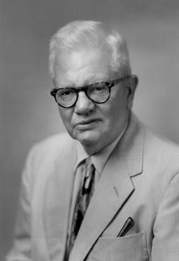
Halbert L. Dunn, M.D., Ph.D. (1896-1975)
Regarded as the “Father of the Wellness Movement”
1929- the first biostatistician hired by the Mayo Clinic and established
its computer coding system for deriving medical statistics
1935-1960- Chief of the National Office of Vital Statistics
1933- founder of the National Association for Public Health Statistics and Information Systems (NAPHSIS)
Late 1950’s-Introduced the concept of wellness in a series of 29 lectures

Slide 5




The Health Grid
Protected Poor Health
High Level Wellness
Axis
Health
Axis
Environmental
Poor
Health
Emergent High Level Wellness
Dunn H. High Level Wellness for man and society. American Journal of Public Health 1959;49:786-792

Slide 6
Steps to Quantify Positive Health
Refine incidence and prevalence rates distinguishing positive health from illness or disability
Develop susceptibility indexes using biochemical and functional tests
Establish precursors-of-disease indexes
“Once the concept of high-level wellness has been crystalized…the battle for wellness in man and society will be joined. There must be many points of engagement if the battle is to be won.”

Slide 7
Key points from his 1959 paper “High Level Wellness for Man and Society”
Both medicine and public health must be engaged in the elucidation of factors responsible for good health
Disease and health should be regarded as a continuum, not a
dichotomy.
Wellness must take into account concerns of the body, mind and
spirit; “As if we could divide the sum total of man thus!”
Wellness must eventually become measurable: “If an objective yardstick of wellness can be calibrated in biochemical, physiological, and psychological terms, it would soon become a powerful new tool for the physician, enabling him to recognize low-level wellness and to develop therapies to raise lower levels to higher ones.”

Slide 8
Nutritional Status Screening Panel
“More is missed by not looking than not knowing”
Thomas McCrae (1870-1935), Professor of Medicine at Jefferson Memorial College

Slide 9












Continuum of Nutritional Needs
Toxic
Optimal
Sufficient
Insufficient Deficient

Slide 10

Governing Principles: Screening for “Disease” Malnutrition
The condition sought should be an important health problem.
There should be an accepted treatment for patients with recognized disease.
Facilities for diagnosis and treatment should be available.
There should be a recognizable latent or early symptomatic stage.
There should be a suitable test or examination.
The test should be acceptable to the population.
The natural history of the condition, including development from latent to declared disease, should be adequately understood.
There should be an agreed policy on whom to treat as patients.
The cost of case-finding (including diagnosis and treatment of patients diagnosed) should be economically balanced in relation to possible expenditure on medical care as a whole.
Case-finding should be a continuing process and not a “once and for all” project.
Wilson JMG, Jungner G - Principles and practice of screening for Disease. WHO 1968

Slide 11
Nutrition Model

Slide 12
Reductionism vs. Systems Approach Clinical Features
Characteristic | Reductionism | Systems Approach
Principle | Behavior of a biological systems can be explained by the properties of its constituent parts | Biological systems possess emergent properties that are only possessed by the system as a whole and not by any isolated part of the system
Metaphor | Machine, magic bullet | Network
Approach | One factor is singled out for attention and is given explanatory weight on its own | Many factors are simultaneously evaluated to assess the dynamics of the system
Critical Factors | Predictors/associated factors | Time, space, context
Model Characteristics | Linear, predictable, frequently deterministic | Nonlinear, sensitive to initial conditions, stochastical, chaotic
Medical Concepts Ahn AC, et. al. PLoS Medicine. 2006;3:956-60. | Health is normalcy Health is risk reduction Health is homeostasis | Health is robustness Health is adaptation/plasticity Health is homeodynamics

Slide 13
Reductionism vs. Systems Approach
Characteristic | Reductionism | Systems Approach
Optimal | Conditions where one or few components are responsible for the overall behavior of the system | Conditions where interaction between components are responsible for the overall behavior of the system
Disease types | Acute, simple diseases | Chronic, complex diseases
Examples | Urinary tract infections Appendicitis Aortic aneurysms | Diabetes Coronary artery disease Asthma
Theoretical limitations Ahn AC, et. al. PLoS Medicine. 2006;3:956-60. | Disregards component-component interactions and dynamics | Costly in resources in time (short term)

Slide 14
Reductionist Approaches
to Nutrition are Inadequate
The early 20th Century nutrition paradigm (single-nutrient model) that explains disease based on micronutrient deficiency, is inadequate for complex forms of malnutrition:
A simple cause-effect relationship exists between a specific disease and a particular nutrient (François Magendie, Early 19th century).
Each nutrient deficiency disease can be explained physiologically in terms of the role played by the respective nutrient.
Providing the nutrient in the diet can prevent, and in many cases reverse, the disease
Obesity is a complex multifactorial disorder that is a function of
evolutionary trade-offs, socioeconomic, environmental and other factors
A comprehensive model is required to address and monitor (screen) the entire spectrum of malnutrition

Slide 15
Classification of Malnutrition
Primary nutrient deficiency/insufficiency/sufficient but suboptimal
Secondary nutrient deficiency/insufficiency
Primary metabolic disorders (inborn errors of metabolism)
Nutrition-acquired (secondary) metabolic disorders with/without primary or secondary nutrient deficiency/insufficiency

Slide 16
Systems Biology Approach
to Nutrition
Systems biology is an emerging multidisciplinary field that bridges holistic and reductionist approaches to biology and medicine
The goal is to develop predictive models that that describe how biological system act and change over time, respond to perturbations and how diseases manifest, can be diagnosed and treated
Application of a systems approach to nutrition is ideally suited to understand complex disorders such a obesity and metabolic syndrome

Slide 17
Framework for Systems Approach
to Nutrition and Wellness

Slide 18






Systems Perspective of Wellness
Evolutionary Basis-”Hypothesis Non Fingo”
Homeodynamic Space
Hormesis
Nutritional Landscape
Robustness

Slide 19
Robustness
A Fundamental Property of Biological Systems
Robustness, a concept from Systems Biology is:
The property of active maintenance of the function of a system while exposed to internal/external environmental perturbations using an integrated network of regulatory controls
Robustness of the system is manifested as adaptation to the environment and as stability against external and internal disturbances
The system exerts the capacity to “adapt” to the environment and maintain stability against perturbations or uncertainly (of variable duration and intensity) through:
Feedback control
Redundancy
Modularity
Structural stability

Slide 20
Characteristics of Robustness
Robustness has meaning only through the relationship of a system, function and perturbation
Implicit in Robustness are:
Feedback regulation that maintain homeostatic mechanisms (a function of robustness)
Functional redundancy of gene products as fail-safe mechanisms
Modularity that minimizes propagation of local perturbations from becoming system-wide (buffer)
Also minimizes drug effectiveness
Tight regulation of cellular sensing, signaling and metabolic processes that are highly conserved

Slide 21
In other words…
Robustness reflects the ability of the body to respond to changes through coordination of multiple subsystems, organs, regulatory mechanisms at a biochemical and physiological level to ensure survival (somatic maintenance)
Compromise of this capacity may correlate to disease while optimal somatic maintenance may relate to Wellness

Slide 22
Why Robustness?
Robustness is a powerful concept because it is capable of reflecting a highly dynamic system such as a biological organism
Robustness is a universal feature in biological systems (evolutionary adaptation) that is highly conserved
All biological systems are in constant motion, the behavior of which
arises from the interactions of components
While the dynamic system is complex it rests on three basis principles
Context-the components that participate in the process
Time-the temporal variations of components
Space-the topographical relationship between and among the components

Slide 23
Robustness and Disease
There is an important balance between robustness and fragility in biological systems
The cost of improved robustness is fragility against unusual perturbations
Feedback mitigates this to a point but a cost elsewhere in the
system-fragility to unexpected perturbations
Redundancy and modularity also help but at the cost of increased resources (redundancy) or ineffective therapy (modularity of system reduces drug effectiveness)
That which ensures survival can be co-opted

Slide 24
Clinical Trade-offs
In Nature there is no Free Lunch
Through evolution, humans have developed robustness against near starvation, a high energy demand lifestyle and risk of infection but the system is susceptible to the unusual perturbation of over nutrition and low energy demand
Type 2 diabetes
Metabolic syndrome
The system is relatively tolerant to the removal of some compounds or cells because of alternative mechanisms (redundancy) but vulnerable when components or mechanisms are not recognized (hijack the system)
Cancer
HIV

Slide 25


Evolutionary Basis of Obesity
Humans evolved to resist starvation, not over-
nutrition

Slide 26
Nutritional Landscape and the Ames Triage Hypothesis of Micronutrients and Chronic Diseases
Natural Selection favors short-term survival at the expense of long-term health
Short-term survival is achieved by allocating scarce micronutrients by triage
Micronutrient deficiencies that trigger the triage response accelerate aging, cancer, neural degeneration, etc. sparing critical metabolic functions such as energy metabolism (ATP) at the expense of “less essential” functions
Micronutrient malnutrition accelerates late onset diseases; damage from inflammation, oxidative stress and other stressors that increase the risk of age related diseases and disorders
Triage can be extended to macronutrients-Protein Leverage Hypothesis
Ames PNAS 2006; McCann and Ames FASEB J 2011

Slide 27






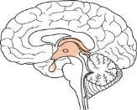










Role of Protein Leverage
Calorie restriction
Exercise
Phytochemicals
High:
AA/CHO+FA
Nutrients
Low:
AA/CHO+FA
Insulin Resistance: Inhibition of autophagy and repair
mTOR
AMPK
Insulin Sensitivity: Promotes autophagy and repair
Over eat:
Low protein and high glycemic foods
Under eat
Anorexic
Orexigenic
Anabolic Responses:
Catabolic Responses:
Protein synthesis
Lipogenesis
Cell proliferation
Growth
Reproduction
Cell cycle arrest
Inhibition of growth
Inhibition of reproduction
Lipolysis
Proteolysis
Anorexia/Cachexia
Increased Lifespan
Obesity and insulin resistance
Shortened Lifespan
Simpson SJ and Raubenheimer D, The Nature of Nutrition Princeton University Press 2012

Slide 28





Cycle of Insulin Resistance
Eat High GI Diet
Feel tired and hungry
Insulin
spike
Glucose stores as fat

Slide 29

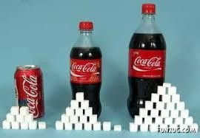
Increases in Added Sugar and Refined Carbohydrates
Sugar consumption: 152 lbs/yr up from 40 lbs in 1980
Flour consumption: 146 lbs/yr
Added sugars:
600,000 products and 80% with added sugar
8-15% calories from soda
HFCS biggest source of calories in diet
Children sugar consumption facts: 34 tsp/day
Chair of American Beverage Association in testimony to Congress: “In a well balanced diet we need two liters of liquids a day. Soft drinks can be a healthy part of that intake. I would reject any argument that they are in any way Harmful.”
Lustig, R, Nature, Feb 2012, Volume 482, 27-29

Slide 30



Consequences of Added
Sugar and HFCS
Empty calories that replace foods containing nutrients
HFCS (no physiologic role for fructose) is exclusively metabolized in the
liver-NAFLD/NASH
Induces IR and can result in obesity and metabolic syndrome in children and adults
Associated with a higher risk of cancer
Stimulates hunger and fatigue
Raises cholesterol increasing CVD risk
Cause massive dopamine release-addictive

Slide 31
Physiologic Impacts of
Obesity
Assimilation (intestine)
Changes in microbiome
Leaky Gut: metabolic endotoxemia
Defense and Repair
Chronic inflammatory state
Immune dysfunction
Energy
Mitochondrial dysfunction
Communication
Neuroendocrine dysregulation: cortisol, insulin, leptin, ghrelin, appetite
Metabolic inflexibility
Secondary malnutrition

Slide 32
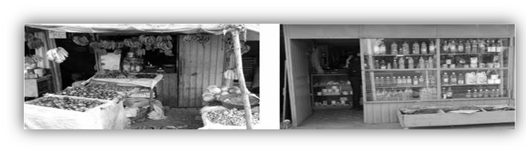
Not Only Food Composition and Quality but Loss of Agency
Commercial organizations maximize profits through making consumer decisions for them
Behavioral level: advertising, price manipulation, restriction of choice
Physiological level: Enhancement of addictive properties of foods
“Loss of agency characterizes not only individuals but also governments and other organizations promoting health. In the 21st century, the food- industrial complex has become so powerful that efforts to redress the scenario have proven futile and each of obesity and malnutrition is increasing” Wells, JCK. Am J Hum Biol, 2012 DOI 10.
Governments are also complicit
1002/ajhb.22253
Traditional and modern shops in Jimma, Ethiopia

Slide 33
Hormesis-Response to Stress
Capacity to Improve Somatic Maintenance and Resist Stress
Toxicology - biphasic dose response to an environmental agent characterized by a low dose stimulation or beneficial effect and a high dose inhibitory or toxic effect
Biological systems - biologically adaptive process whereby nonlethal improves
robustness of an organism to resist it and improve somatic maintenance
Exercise
Dietary energy restriction
Exposures to low doses of certain phytochemicals
Hormesis is integral to the normal physiological function of cells and organisms
Implicitly understood for millennia: “if you don’t use it, you lose it”; “that which does not kill you makes you stronger”
Conditioning by exogenous/endogenous stressors contribute to enhancing cells capacity to
respond to/resist stress (stress tolerance/reduced stress response mediators)
This conditioning is mediated by molecular signaling pathways and cellular processes
Interventions including nutritional or botanical therapy (adaptogens) may support the stress response capacity

Slide 34
Homeodynamic Space
A Broad Indicator of General Wellness
The dynamic range of implicit integral network of cellular and system metabolic processes involved in somatic maintenance and repair of a biological system that ensure survival
Property of biological systems that reflects the capacity to respond to stress; a measure of the system’s robustness
The ability of the living systems to respond and counteract stress, to repair and remove the damage, and to undergo constant remodeling and adaptation
Genetic polymorphism and epigenetic factors establish a personalized homeodynamic space during growth, development and maturation, within the evolutionary constraints of essential lifespan
Imperfections of the maintenance and repair systems reflect an always existing
vulnerability zone even at a young aging
The ultimate determinant of an individuals state of wellness
Rattan SIS. Current Pharmaceutical Design, 2014, 20, 3036-3039

Slide 35


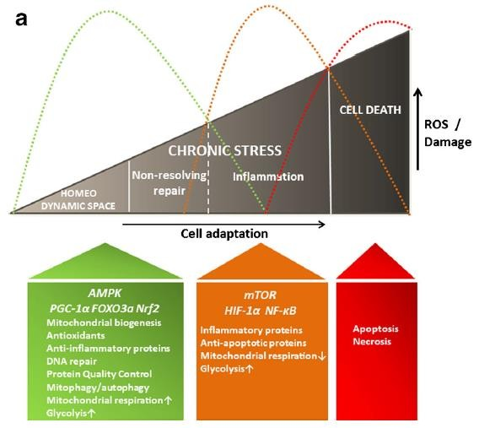
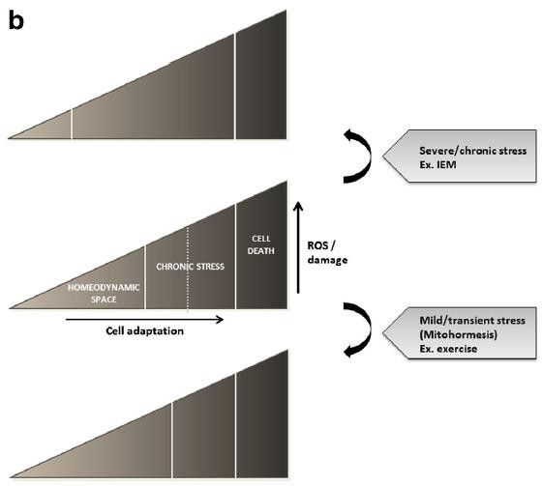

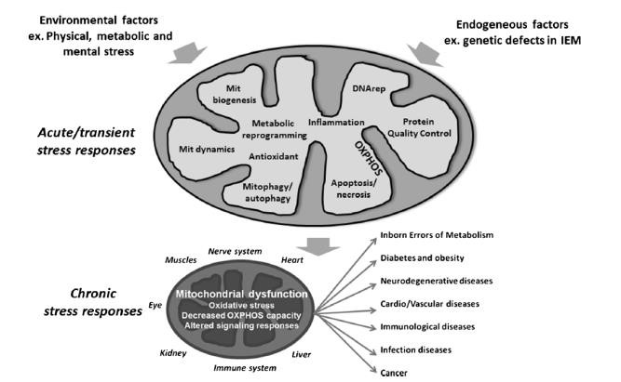
Relationship of Hormesis and Homeodynamic Space
Olsen RKJ, Cornelius N, Gregersen N. J Inherit Metab Dis (2015) 38:703–719

Slide 36
Probing the Homeodynamic Space
Role of the TOP™ Screening Panel

Slide 37
Markers of the Homeodynamic Space
Micronutrient Status-Nutritional landscape
Nutrients that ensure the potential for optimal metabolic and physiologic function
Insufficiency results in triage favoring short term survival and resulting in long term nutrition-acquired diseases
Energy Metabolism
Quantitative and qualitative features of macronutrients
Protein, carbohydrate and lipid metabolism
Stress Response Capacity
The capacity to respond to environmental stress (internal, external) as reflected by the oxidative and inflammatory states
Metabolic flexibility

Slide 38
Shrinking of the Homeodynamic Space and Chronic Disease
There is an important balance between robustness and fragility in biological systems.
The cost of improved robustness is fragility against unusual perturbations That which ensures survival can be co-opted
Reduced stress response capacity-risk of decompensation (catastrophe)
Biological trade-off (in Nature there is no free lunch)
Through evolution, humans have developed robustness against near starvation, a high energy demand lifestyle and risk of infection but the system is susceptible to the unusual perturbation of over-nutrition and low energy demand
Type 2 diabetes
Metabolic syndrome

Slide 39
Hormesis: Expansion of the Homeodynamic Space
The universal biological principle where mild, non-lethal stress improves somatic maintenance and robustness
Principle that it has been viewed as essential for life and evolution since natural selection requires the ability of adaptation to ever-changing and uncertain environmental influences
Explains the health benefits of periodic calorie restriction, activity/exercise and plant phytochemicals since they produce a mild stress that stimulates vital underlying processes that ensure improvement of organism’s maintenance
“Adaptability and resistance to stress are fundamental prerequisites for life, and every vital organ and function participates in them.”-Hans Selye 1950.
“Stress is the salt of life… total elimination of stress (cessation of demands made upon any part of the body) would be equivalent to death.”- Hans Selye 1976

Slide 40
Rationale for Analytes

Slide 41
Technical Principles of the
TOP™ Panel
The panel must be supported by evidence-based documentation
Valid for screening (non-fasting) purposes in children (or adults)
Minimal blood volume requirement
Not intended to be a comprehensive assessment of nutrition
Initial assessment for common nutritional deficiencies and insufficiencies
Potential for reflecting other nutritional disorders or health problems requiring a
secondary evaluation
Ideally performed on a single platform capable of high throughput and rapid turnaround time
The laboratory report will include:
Information about the significance of each analyte
Interpretation of each result or combination of results with appropriate disclaimers and recommendations for follow-up

Slide 42
Governing Principles of
the TOP™ Panel
Non-fasting: fasting may artificially bias or mask underlying state of insufficient or non-optimal stress response capacity
Avoid analytes that are highly dynamic and do not afford a picture over a broad
range in time
e.g; fasting glucose vs. HbA1c
Include analytes that reflect nutritional status and chronic disorders (malnutrition) at early and late stages
e.g.; Fe and ferritin
Secondary evaluation (not in TOP™ panel)-Functional assay to probe homeodynamic space

Slide 43
Consideration of Analytes

Slide 44

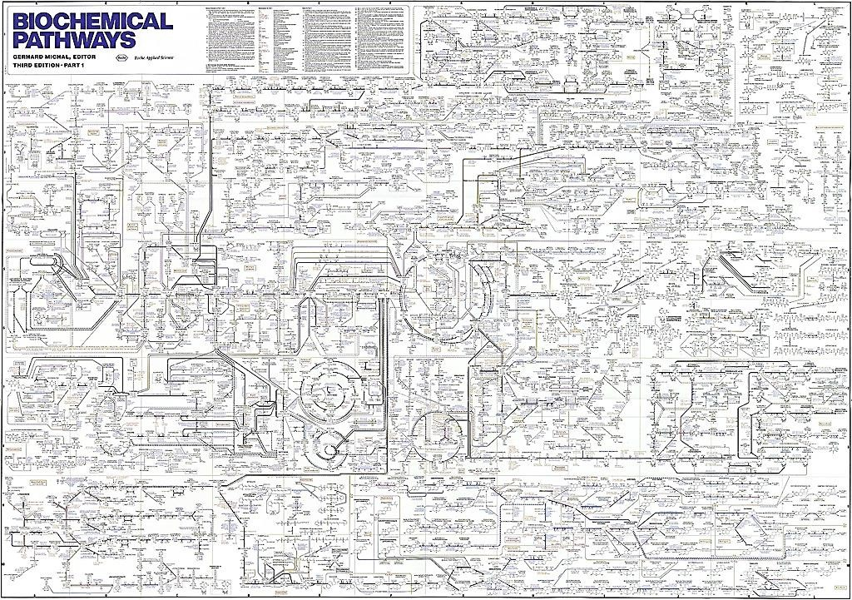
Complex Reductionist Description of Biochemical Pathways

Slide 45
Essential Micronutrients
Vitamins
Minerals
Vitamin A
Vitamin B1 (thiamine)
Vitamin B2 (riboflavin)
Vitamin B3 (niacin)
Vitamin B5 (pantothenic acid)
Vitamin B6
Vitamin B9 (folic acid)
Vitamin B12
Biotin
Vitamin C
Vitamin D
Vitamin E
Vitamin K
Choline
Calcium
Chloride
Chromium
Cobalt
Copper
Iodide
Iron
Magnesium
Manganese
Molybdenum
Potassium
Selenium
Sodium
Zinc
Amino Acids
Isoleucine
Leucine
Lysine
Methionine
Phenylalanine
Threonine
Tryptophan
Valine
histidine
Fatty Acids
alpha-Linolenic acid/DHA (omega -3)
Linoleic acid (omega-6)

Slide 46
Typical Screening Biomarkers
Hematologic
WBC
Hemoglobin
Hematocrit
Iron
Ferritin
Lipids
Total Cholesterol
LDL-cholesterol
HDL-cholesterol
Non-HDL-cholesterol
Triglycerodes
Lipoprotein particle numbers
Vascular/Inflammation
ApoB 100
Lp(a)
Hs-CRP
Homocysteine
Hepatic
AST
ALT
GGT
Glucose metabolism
Glucose
Insulin
HbA1c
Endocrine
Thyroid hormones
Free T3, T4
Total T4
rT3 - Reverse T3
TSH
Anti-TG
Anti-TPO
TG
TBG
Sex steroid hormones
DHEAS (Dehydroepiandrosterone sulfate)
Androstenedione
Testosterone
Estradiol
Estrone
Estriol, unconjugated
Progesterone
Alpha Lipoic Acid
Coenzyme Q10
Glutathione
Antioxidant

Slide 47
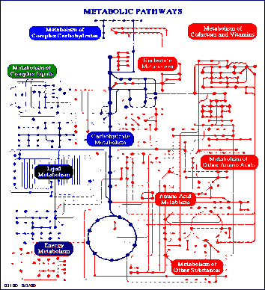
Whole Cell Metabolism
Polymerization
and assembly
Core metabolism
Transport
Autocatalytic and regulatory feedback
Doyle J Systems Biology Short Course-Introduction Cal Tech May 21-24, 1999

Slide 48
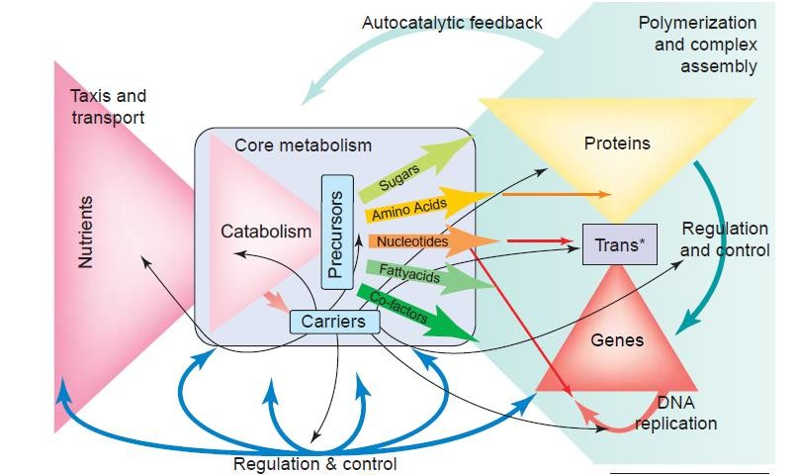
Biosynthesis Bow Tie Structure (and nested bow ties)
Structural proteins, enzymes, Co-factors, hormones, etc.
Csete M and Doyle J Trends in Biotechnology 2004;22:446-450

Slide 49
TOP Panel™
Probe of Homeodynamic Space
Energy Metabolism Status
Lipid metabolism
  Non-HDL cholesterol
  HDL-cholesterol
  Triglycerides
Carbohydrate metabolism
  HbA1c
Protein metabolism
  Transthyretin (prealbumin)
Nutrition-associated endocrine status
Thyroid stimulating hormone (TSH)
Micronutrient Status (sensitive points in metabolic cycles)
Vitamin B₁₂
Folate (Vitamin B₉)
Vitamin D
Iron (Fe)
Ferritin
Zn
Inflammation/Oxidative stress (biomarkers of stress response)
Homocysteine
hs-CRP
GGT

Slide 50
Vitamin B12/Folate (Vitamin B9) Rationale (Nexus of cycles)
Key interactions occur between folate and vitamin B12 in the folate cycle
Nucleotide, DNA and RNA synthesis Neurotransmitter synthesis
Coupling with Methylation cycle Homocysteine and glutathione synthesis Epigenetic regulation of gene expression
Vitamin B12 and folate deficiency/insufficiency in infants and young children may result in a variety of clinical manifestations; hematologic, neurologic, and gastrointestinal that may be ameliorated with administration of vitamin B12 and/or folate therapy
Prevalence of vitamin B12 deficiency in children and adolescents in the US-
<1% (<200pg/ml); <4 years- <3%

Slide 51
Vitamin B9 and B12 Insufficiency
The prevalence of Vitamin B9 and B12 deficiency is low in the US
However, the prevalence of insufficiency and associated conditions has not
been well established
Abnormal Methylation is a potential consequence of Vitamin B9 and B12 (and other micronutrients) insufficiency with or without MTHFR gene polymorphisms such as C677T or A1298C
Either may be reflected by elevated homocysteine levels
Disorders associated with deficient methylation include:
Cancer
Cardiovascular risk
Dementia

Slide 52
Vitamin D [25(OH)D] Rationale
Vitamin D [25(OH)D] deficiency (≤ 20 ng/ml) is a highly prevalent condition among infants, children, and adolescents in the USA and worldwide
Evidence links vitamin D deficiency in early childhood and specific conditions that manifest more frequently in adults; osteoporosis, multiple sclerosis, obesity, type 2 diabetes, cancer, immune suppression, asthma and cardiovascular disease
Prevalence of vitamin D deficiency (< 15 ng/ml) is as high as 24% in healthy adolescents and 14% in toddlers and infants
The highest prevalence of deficiency seen in the African American and Hispanic
populations
The prevalence of “healthy” children and adolescents with insufficiency is even higher

Slide 53
Iron/Ferritin Rationale
Clinical manifestations of iron deficiency: iron deficiency anemia, impaired psychomotor and/or mental development, cognitive impairment, susceptibility to infection, impaired immunity, decreased exercise capacity (even without evidence of anemia)
Prevalence of iron deficiency in the US
9% percent of toddlers (one to three years old) have iron deficiency
2% to 3% percent of toddlers have iron deficiency anemia
Rates decrease with advancing age until adolescence
≤16% percent of girls develop iron deficiency 3% of girls develop iron deficiency anemia
The prevalence of iron deficiency is higher among children living at or below the poverty level,
and in African American and Hispanic children
Inflammation of obesity is becoming recognized as an important cause of iron deficiency
Serum ferritin is the earliest marker of iron deficiency and thus a sensitive marker for this condition

Slide 54
Cholesterol/Non-HDL-c Rationale
American Academy of Pediatrics guidelines strongly recommend universal cholesterol screening between the ages of 9 and 11 and between 17 and 21 years
Selective screening fasting lipid profile (FLP) was expanded to include children with conditions that increase risk of cardiovascular disease with or without a family history
The new guidelines are based on research:
Early atherosclerosis exists in young patients with elevated cholesterol
Early treatment of cardiovascular risk factors in youth is effective
Lipid disorders are common in children and increasing coincident with childhood obesity
30-60% of children with dyslipidemias are missed using the traditional selective screening methods
The universal screening lipid profile can be done non-fasting
NON-high density lipoprotein cholesterol fraction (known as non-HDL-c) has comparable predictive risk
to the low density lipoprotein cholesterol (LDL-C) calculation on a standard FLP
The prevalence of abnormal lipid levels in youths (12-19 years) is at least 20%
Approximately 32% of youths are overweight or obese and are considered to be candidates for lipid screening

Slide 55
HbA1c Rationale
The American Diabetes Association position: HbA1c measurements are supported for the diagnosis of diabetes with values ≥6.5% considered diagnostic with a range of 5.7%-6.4% considered pre-diabetic
Glycated hemoglobin values reflect the 2-to-3-month average endogenous exposure to glucose, including postprandial spikes in the blood glucose level with low intra-individual variability
HbA1c testing has been recommended by International guidelines for the first-line screening and diagnosis of type 2 diabetes in Europe and other countries
HbA1c has several advantages over these tests for the majority of patients:
There is no need for fasting.
People are often non-compliant with the requirement for fasting, thereby reducing the accuracy of fasting plasma and oral glucose tolerance tests.
HbA1c is less affected by day to day variation in plasma glucose (exercise, medicines, diet, etc.)
HbA1c has simpler sampling and analysis requirements and is very stable
Glucose levels can be misleading if the sample is not processed immediately, due to pre-analytical instability since glucose consumption continues to occur in blood after sampling
The pre-analytic variability of fasting plasma glucose testing is approximately 5-10% compared to the pre-analytic variability of HbA1c which is negligible

Slide 56
HbA1c
Rationale
Drugs and Therapeutics Committee of the
Pediatric Endocrine Society
“Conclusions that dismiss HbA1c use for the diagnosis of diabetes in children are based on incomplete data. Considering that the demographics of Type 2 diabetes skew towards disadvantaged populations, we should not dismiss a valuable, flexible tool that, put into widespread use, may in fact increase, not decrease, early detection of this disease.”
Kapadia C and Zeitler P. Hemoglobin A1c measurement for the diagnosis of Type 2 diabetes in children. International Journal of Pediatric Endocrinology 2012; 2012:31-34.

Slide 57
Homocysteine Rationale
Screening of homocysteine levels (traditionally for newborn screening for homocystinuria attributable to cystathionine β-synthase deficiency) has expanded role for screening in adults and children
Screening may play a role in the risk assessment and disease diagnosis of other conditions
Folate, vitamins B2, B6 and B12 deficiencies
Renal failure, hypothyroidism and osteoporosis
Psychiatric disorders and cognitive impairment
Pregnancy complications and birth defects
Genetic factors such as the MTHFR 677C→T polymorphism
A causal relationship has been established between hyperhomocysteinemia and certain nutritional deficiencies; folate, vitamins B2, B6, B12 and Zn deficiency or insufficiency
Homocysteine has been shown to induce oxidative stress (inefficient conversion to glutathione) resulting in damage to cholesterol, inhibition of eNOS and apoptosis of endothelial progenitor cells, contributing to atherosclerosis, impaired function of immune cells and induction of inflammation
In general there exists a strong relationships between high levels of homocysteine and disease and between low levels of homocysteine and health

Slide 58
Transthyretin (Prealbumin) Rationale
Currently, transthyretin (prealbumin) testing is used in nutrition assessment and monitoring which is now one of the most utilized nutritional marker worldwide
Low transthyretin levels suggest a risk for malnutrition (status of the body's metabolic nitrogen pool)
The half-life of transthyretin is approximately 1.9 days, making this a more sensitive marker of protein status that albumin and other markers of nutritional status
Transthyretin is also depressed by anti-inflammatory response; consequently, it is a negative acute phase reactant (complement to hs-CRP)
Typically, transthyretin screening is used in the hospital setting where studies have shown substantial
benefits;
Reduced lengths of stay
Decreased morbidity/mortality through earlier nutritional intervention
Decreased costs
Measurement of transthyretin is a simple, rapid, inexpensive and accurate with well established normal ranges in children and adults
Transthyretin screening as a compliment to other markers in the community setting should be useful in uncovering children at risk for nutritional deficiencies and may be an important tool to consider (along with the panel) in the inpatient setting to address early or undocumented nutritional deficiencies

Slide 59
hs (high sensitivity)-CRP Rationale
hs-CRP is a nonspecific acute phase reactant or marker of the inflammatory state that is clinically important in clinical context
Serum hs-CRP level increases with
mild chronic infection
tissue damage
chronic diseases such as cancer and cardiovascular disease
bacterial or fungal infection (marked elevation)
hs-CRP is an excellent predictor of cardiovascular disease in children and adolescents who are overweight or obese, have metabolic syndrome or have type 2 diabetes since studies in obese children have demonstrated early functional and morphologic vascular changes
The combination of hs-CRP + total cholesterol/HDL is an even more powerful predictor of cardiovascular disease risk and may serve as a monitor to assess the effect of therapeutic intervention
While in some cases the elevated inflammatory state may be a reflection of acute disease, it may also be induced by external; factors such as poor nutrition which can lead to obesity, metabolic syndrome or type 2 diabetes
hs-CRP can also serve as a marker to assess the effect of nutritional and lifestyle intervention designed to correct behaviors that lead to disease states

Slide 60
Gamma glutamyltransferase (GGT) Rationale
Ubiquitous enzyme: liver and other organ tissues; kidney, lung, pancreas, heart, brain and blood vessels
Traditional Biomarker of liver dysfunction; however…
GGT is fundamental to glutathione metabolism and indicator of pro-oxidant activity (decreased antioxidant defenses) resulting in cell, tissue and DNA damage via oxidative and nitrosative stress-dysfunction of somatic maintenance
Growing evidence suggesting GGT is a predictive biomarker for the risk or onset chronic diseases aside from liver disease; CVD, T2D, MetS, hypertension, cancer and all-cause mortality

Slide 61
Zinc Rationale
Manifestations of nutritional deficiency of Zn (first identified in 1969) are fairly prevalent throughout the developing world
Zn deficiency is associated with increased oxidative stress and correlated to elevated levels of hs-CRP
Manifestations of severe Zn deficiency
alopecia, diarrhea, weight loss, intercurrent infections
Male hypogonadism, neurosensory disorders and delayed wound healing
Manifestations of moderate Zn deficiency
growth retardation, male hypogonadism, poor appetite, mental lethargy,
delayed wound healing, cell-mediated immune dysfunctions, abnormal neurosensory changes
Manifestations of mild Zn deficiency remain difficult
Immune dysfunction
Atherosclerosis
Diabetes
Dementia
Manifestations of conditioned Zn deficiency
Gastrointestinal, Liver and Renal disorders
Prasad AS. Adv. Nutr. 4: 176–190, 2013

Slide 62
Healthy Lifestyle Program Data

Slide 63

Healthy Lifestyles Program Data
The population consisted of 4,190 participants in a Healthy Lifestyles program
Program, managed by Interactive Health* routinely includes an assessment involving a range of laboratory analytes, clinical measures and prescribed interventions based on an algorithm used by the company called Active Engine
In this study, 50.4% of the participants were ≥ 40 years; 34% male, average age 44 years and 66% female; average age 41 years
Based on the usual evaluation, approximately 58% of individuals screened were
referred to a physician because of laboratory findings
With the addition of the TOP™ panel, this number increased to about 77%
*

Slide 64
TOP™ Panel Findings
(Fasting Levels)
TOP™ Panel
Biomarker | Decision Point | % individuals exceeding decision point
Vitamin B12* | <200 pg/ml (deficiency) | 1% (42)
Folate (Vitamin B9)* | <2.0 ng/ml (deficiency) | 0
Vitamin D | <30 nmol/L (deficiency) | 65.6% (2,750)
Iron* | <15 mcg/dL (deficiency) >300 mcg/dL (overload) | 0.21% (9) 0.05% (2)
Ferritin* | <12 ng/ml | 5.5% (230)
Non-HDL-c* | ≥ 190 mg/dL | 6.3% (265)
HDL-c* | <40 mg/dL | 11.5% (481)
Triglycerides* | >200 mg/dL | 8.8% (368)
HbA1c* | 5.7-6.4% (prediabetes) or >6.4% (diabetes) | 40.8% (1,710) 7.0% (294)
Homocysteine | >13 mcmol/L | 9.0% (379)
hs-CRP* | ≥ 3.0 mg/dL | 30.4% (1,274)
GGT* | >40 U/L | 11.3% (472)
TSH* | >5.1 mIU/L ≤0.01 mIU/L | 4.3% (182) 0.02% (1)
Zinc* | <60 mcg/dL | 0
Prealbumin (transthyretin) | <20 mg/dL | N/A
Percentage of individuals with ≥ 1 abnormality (indicated by *) - 71% (2,975)
Percentage of individuals with ≥2 abnormalities of any type - 35.5% (1,488)

Slide 65
Sobering Statistics: The Cost of Obesity
2012 estimated costs attributable to obesity (including T2D) in the US-$147B (9.1% of all US health expenditures)
2030 projected costs attributable to obesity-$1T (18% of all US health expenditures)*
AMA estimates 38% of Americans are living with pre-diabetes
TOP™ panel finding on HbA1c alone
% Pre-Diabetes: A1c: 39.0% identified
With fasting blood glucose only 10% identified
The value of stopping pre-diabetes from progressing to diabetes is conservatively
estimated at $1,095 per individual** (>$100B)
* Not included are the impacts of lost productivity or other societal costs
** Interactive Health analysis

Slide 66

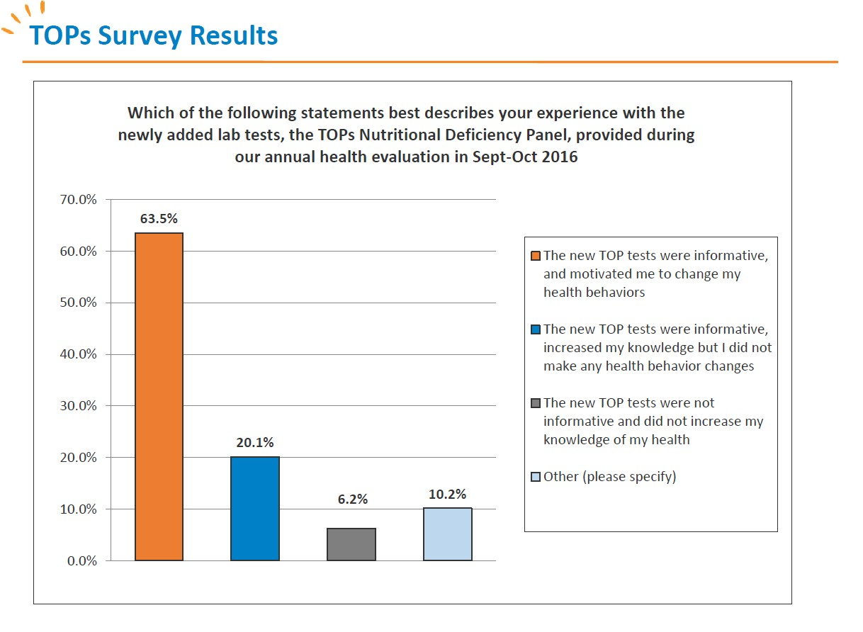
Participant Responses

Slide 67

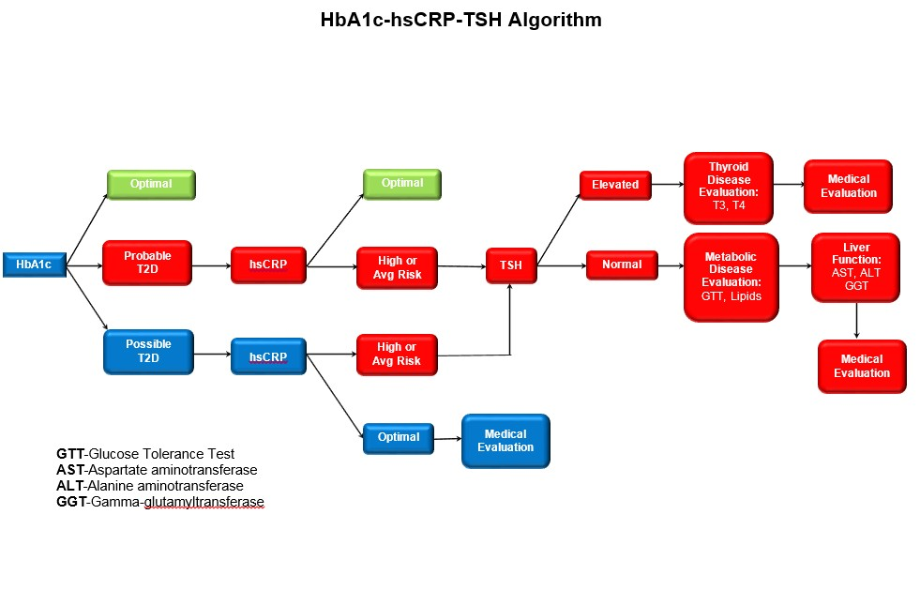
TOP™ Qualifier Algorithms
Name | Total | % of population
Optimal HbA1c | 2181 | 52.2%
Probable T2D and optimal hs- CRP | 20 | 0.50%
Possible T2D and optimal hs- CRP | 566 | 13.5%
Thyroid Evaluation | 84 | 2.0%
Metabolic Disease Evaluation | 1061 | 25.3%

Slide 68

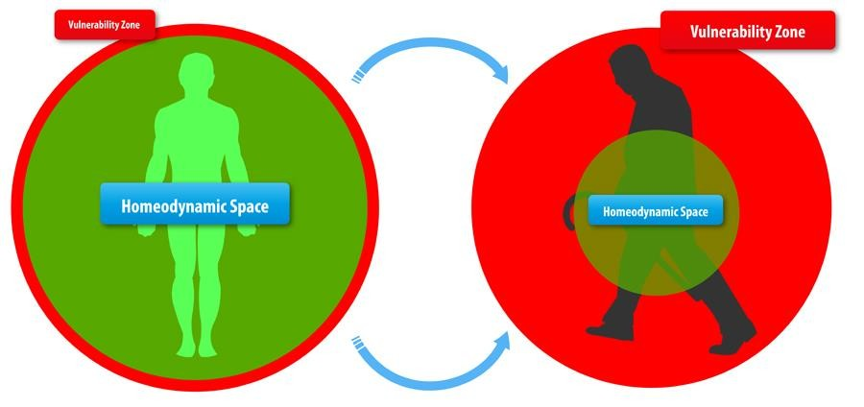
Trends-Linkages?
Increasing number of abnormality factors are associated with:
↑HbA1c
↑hs-CRP
↑GGT
↑non-HDL-c
↓HDL-c
↑Triglycerides
Homocysteine and Vitamin D not analyzed
There at least appears to be a correlation if not linkage possible related to:
Compromised somatic maintenance; chronic oxidative stress and inflammation
Micronutrient insufficiency (nutritional landscape)
Suboptimal energy metabolism
In other words…

Slide 69








TOP™ OVERVIEW
A PROGRAMMATIC APPROACH TO WELLNESS
TOP Test Nutrition Panel
Psychotherapy &
Sports Psychology
Medical Evaluation
GOAL:
Optimal Health Potential
Injury Prevention & Physical Therapy
Personalized Nutrition/Supplement Plan
Fitness Evaluation & Personal Training Plan

