Slide 1
TRANSDERMAL DRUG DELIVERY
MICROPORATION AND MICROPORE LIFETIME ENHANCEMENT
Steven A. Giannos, MS
Consultant

Slide 2
Transdermal Drug Delivery
The modern age of transdermal drug delivery started with the marketing of Transderm Scōp in 1979 as a scopolamine patch for the treatment of motion sickness, nausea and vomiting.
As a patient-centric dosage form, it is ideal for:
      Special patient populations
      Improving patient compliance
Transdermal patches deliver a drug directly through the skin to the systemic circulation, through skin permeation.
Desirable alternative to oral delivery and solid dosage forms due to lack of “first pass” metabolism.

Slide 3
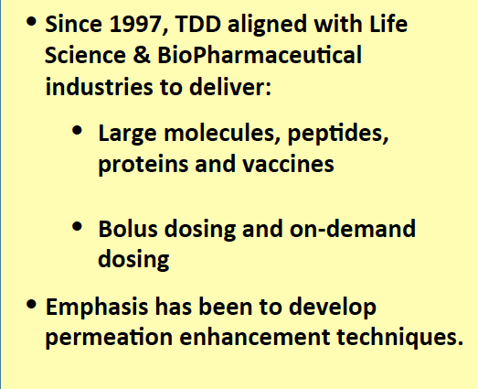
Market Direction Since 1997
Traditional Passive
Patches
Permeation Enhancement
Mechanical
Chemical
Thermal
Microneedles
Terpenes
Nuvo
Research, Inc. CHADD
Liposomes
Iontophoresis
Azones
Sonophoresis
Lipids
Nitto Denko’s
Passport
System™
Electroporation
Alcohols

Slide 4
Skin is one of the body’s largest organs and serves as a protective covering.
Functions of skin:
Barrier to abrasion and physical injury
Prevents excessive water loss and gain
Barrier to microorganisms
Protection from ultraviolet radiation
Provides means of regulating body temperature
Transduces sensory information

Slide 5
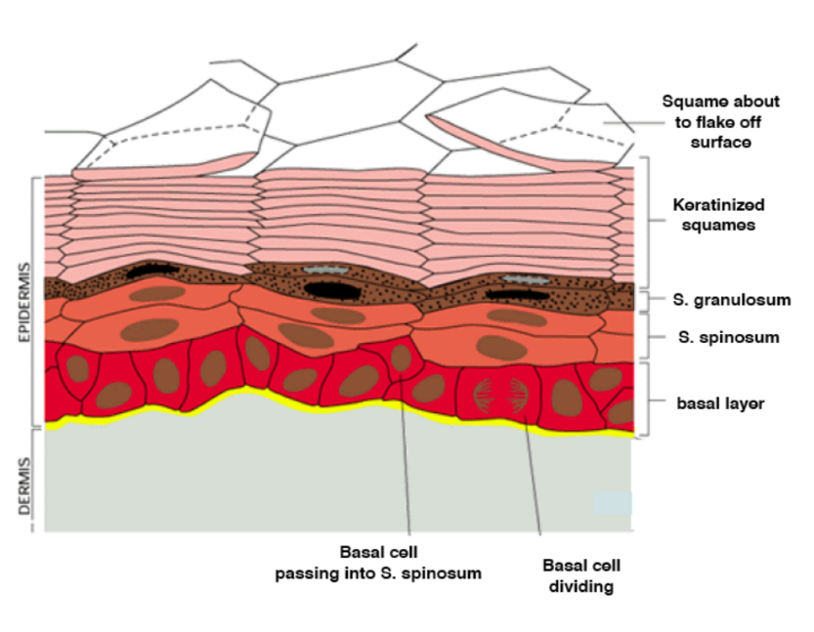
Challenges: Drug Delivery into the Skin
The term ‘‘barrier function’’ is often used synonymously with only one such defensive function, i.e., permeability barrier homeostasis.
Despite the relative importance of these protective cutaneous functions, they largely reside in the outermost layer known as the stratum corneum.
The stratum corneum is effectively a 10-20 µm thick matrix of dehydrated, dead keratinocytes (corneocytes) embedded in a lipid matrix.

Slide 6
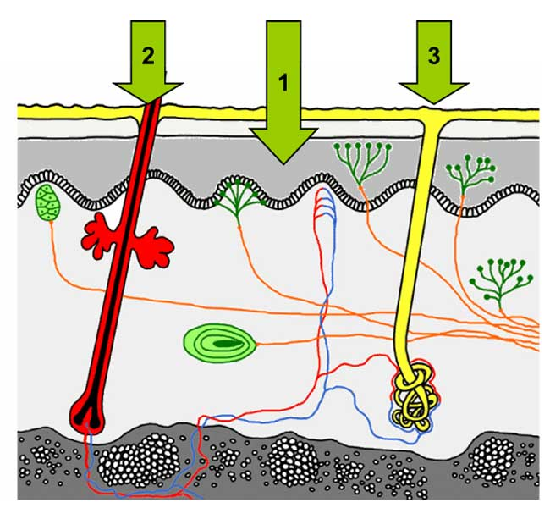
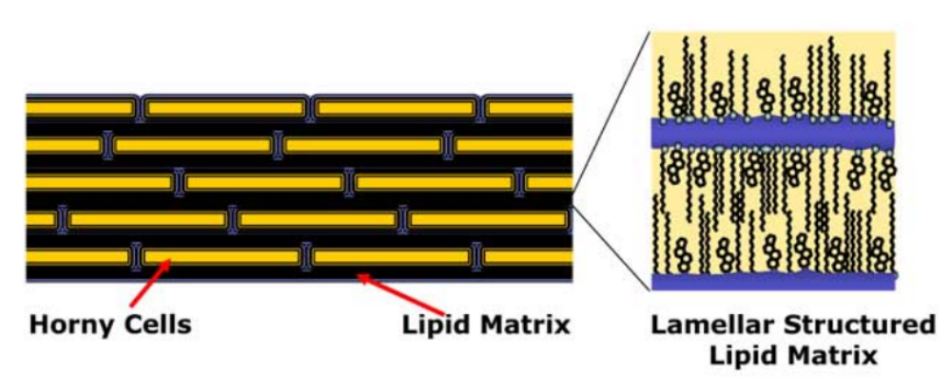
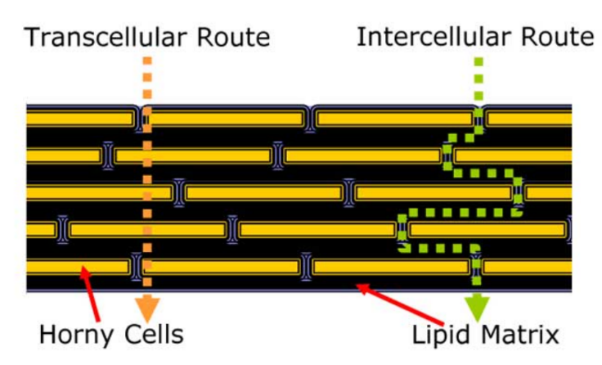
Routes for Drug Delivery into the Skin
Routes of Penetration
Directly across the stratum corneum
Via the hair follicles
Through the sweat ducts

Slide 7
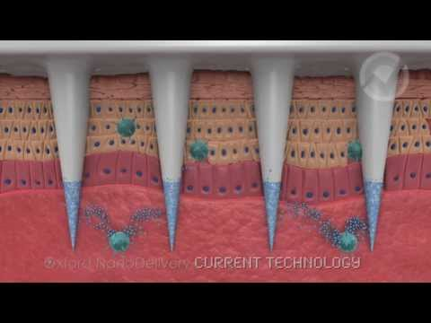
Microporation
The most effective strategy for overcoming the skin’s barrier properties has been to focus on the creation of micropores in the stratum corneum.
Microchannels or micropores can be created by external means such as microneedles, ultrasound, electroporation, radiofrequency and laser.
The key to future successes in transdermal drug delivery of large molecules, especially biopharmaceuticals, will be the understanding and maintenance of skin micropores generated by microneedle pretreatment or other external physical techniques.

Slide 8
Methods to Monitor Micropores
STRATUM CORNEUM SERVES AS THE PRIMARY BARRIER TO MOVEMENT OF WATER AND IONS.
  Transepidermal water loss (TEWL) measures the movement of water between the skin and the external environment.
    An increase in the TEWL acts as an indicator that the skin's integral barrier properties have been penetrated, by indicating that internal epidermal water is now being allowed to appear on the surface.
  Measurement of skin electrical current impedance, due to the electrical resistance of the stratum corneum.
    Impedance of intact, healthy skin is quite high.
    Decreases in response to injury or insult.
    Impedance measurements can detect small changes in skin that has been hydrated.
    This technique has very recently been used for specifically studying the kinetics of micropore closure.
  The inverse of the electrical impedance (admittance) can also be used as a measure of the skin barrier integrity.
    High admittance values signify compromised barrier integrity.
    Low baseline values are typical under normal physiological conditions (similar trends to those observed with TEWL).

Slide 9
Microporation Methods - Microneedles
Gestel and Place first envisioned microneedles for skin permeation in 1971.
    1976 patent described the use of “plurality of projections for penetrating the stratum corneum of the epidermis, and a reservoir containing a drug in immediate proximity with the projections for supplying a drug for percutaneous administration through the stratum corneum penetrated by the projections .”
Microneedles offer painless and powerful dermal permeabilization because they are long enough to perforate the topmost layers of the epidermis but short enough not to excite nerve endings in the skin .
Solid microneedles
    Painlessly pierce the skin to increase skin permeability to a variety of small molecules, proteins and nanoparticles from an extended-release patch.
An alternative method is to have drug formulations coated on or encapsulated within microneedles for rapid or controlled release of peptides and vaccines into the skin.
Systems based on microneedles being investigated:
  Microstructured Transdermal Systems (3M)
  Macroflux® (Zosano)
  MicroCor™ (Corium)

Slide 10
Microporation Methods – Cavitation
These various energy forms are applied to the skin to modify the stratum corneum at discrete sites, introducing aqueous cavitational pores or microchannels. Such techniques are particularly suitable for the transport of relatively hydrophilic macromolecules, including peptides and proteins.
External skin treatments includes
    Thermal ablation (using heating elements, lasers and radiofrequencies)
    Electroporation (high-voltage pulses)
    Low-frequency ultrasound (also referred to as sonophoresis or phonophoresis).
Examples of enhanced delivery of macromolecules with these technologies
    Human growth hormone (radiofrequencies)
    Gene transfer (lasers)
    Insulin (pulsed laser, sonophoresis or electroporation)
    Vaccines (sonophoresis or electroporation)

Slide 11
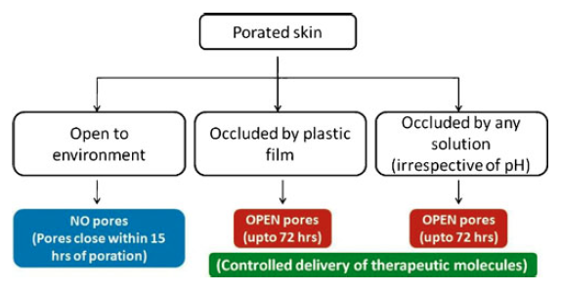
Skin Micropores and Microchannels
The question of micropore production, closure and lifetime was first investigated by Wermeling et al.
    Used to deliver naltrexone.
    Micropores began to close between 48-72 hrs.
Kalluri and Banga, characterized microchannels created in hairless rat skin by microneedles.
    Skin recovers its barrier function within 3–4 hrs, and microchannels closed within 15 hrs of poration when exposed to the external environment.
    When occluded, the microchannels remained open for up to 72 hrs in vivo.
Kalluri H., Banga A.K. - Formation and closure of microchannels in skin following microporation. - Pharm Res. 28 (1), 82-94, 2011

Slide 12
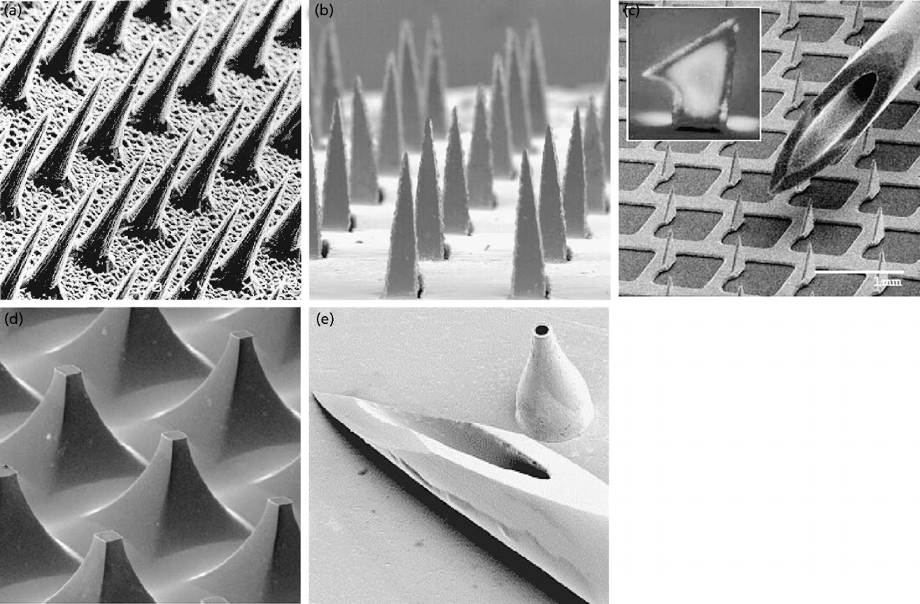
Microneedles

Slide 13
Micropores Made by Microneedles
Kalluri and Banga characterized microchannels created in hairless rat skin by maltose microneedles and investigated their closure following exposure to different occlusive conditions.
The skin recovered its barrier function within 3–4 hrs., and microchannels closed within 15 hrs. of poration when exposed to the external environment.
However, when occluded, the microchannels remained open for up to 72 hrs. in vivo, as observed by calcein imaging, transepidermal water loss measurements and methylene blue staining.

Slide 14
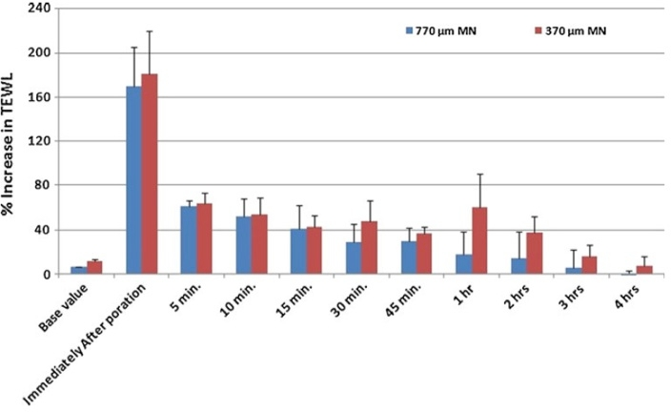
Microneedles
Studies by Kalluri et al, used a DermaRoller®
    Commercially available handheld device, has metal microneedles embedded on its surface as a means of microporation.
Microchannels were created by microneedles in a hairless rat, using models with 370 and 770 μm long microneedles.
TEWL measurements indicated that the skin regained it barrier function around 4 to 5 hr. after poration.
However, direct observation of pore closure, by calcein imaging, indicated that pores closed by 12 h for 370 μm microneedles and by 18 hr. for 770 μm microneedles.
Micropore lifetime under occlusion was not tested in this study.
Kalluri H., Kolli C.S., Banga A.K. - Characterization of microchannels created by metal microneedles: formation and closure. - AAPS J. 13 (3), 473-81, 2011.

Slide 15
Micropores made by Utrasound
Skin sonication, using low-frequency ultrasound, has been shown to create openings in the stratum corenum.
Increase skin permeability for transdermal delivery of several large and small molecules, biopharmaceuticals and for the extraction of interstitial fluid metabolites for glucose sensing.

Slide 16
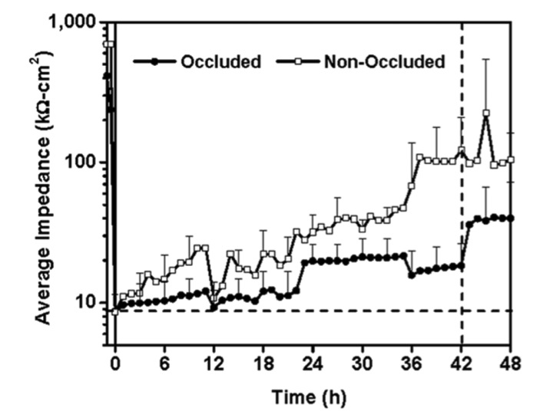
Micropore Closure After Ultrasound
Gupta and Prausnitz found that sonication dramatically increased skin permeability, as demonstrated by a large drop in skin impedance.
Under occlusion, sonicated skin remained highly permeable during the entire 42 hr. period of occlusion, which was followed by an immediate decrease in permeability upon removal of occlusion.
Without occlusion, sonicated skin retained elevated permeability throughout the 48 hr. experiment, but gradually decreased in permeability after 32 hrs.
The non-occluded sites regained their impedance more rapidly and were significantly different from the initial post-sonication impedance within 7 hrs.
Gupta J., Prausnitz M.R. - Recovery of skin barrier properties after sonication in human subjects. - Ultrasound Med Biol. 35 (8), 1405-8, 2009.

Slide 17
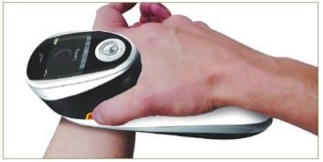
Laser
Controlled laser microporation and its effect on drug transport kinetics into and across the skin have been investigated by Bachhav et al.
Using a novel laser microporation technology, the P.L.E.A.S.E. Painless Laser Epidermal System was used to determine the effect of pore number and depth on the rate and extent of drug delivery across skin.
Confocal laser scanning microscopy visualized the created micropores, and histological studies were used to determine the effect of laser fluence (energy applied per unit area) on pore depth.
    Low energy application (4.53 and 13.59 J/cm2) selectively removed stratum corneum (20-30 μM),
    Intermediate energies (e.g., 22.65 J/cm2) produced pores penetrating viable epidermis (60-100 μM)
    Higher application energies created pores that reached the dermis (>150-200 μM).
Drug flux was quantified, however micropore lifetime and closure have not yet been investigated.
(Source: Pantec Biosolutions AG)

Slide 18
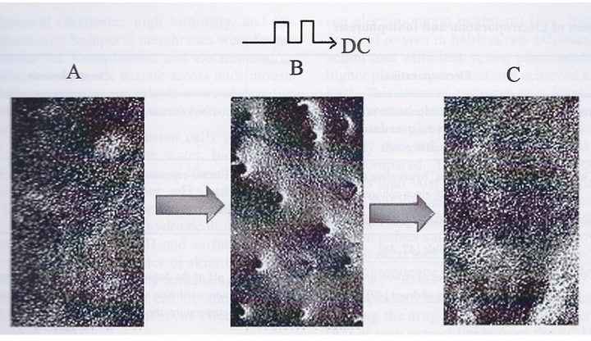
Electroporation
Electroporation is a method of creating temporary pores in the skin by the application of short high-voltage pulses to overcome the barrier of the cell membrane.
Its application to the skin has been shown to increase transdermal drug delivery by several orders of magnitude.
Electroporation, used alone or in combination with other enhancement methods, expands the range of drugs (small to macromolecules, lipophilic or hydrophilic, charged or neutral molecules) which can be delivered transdermally.
Molecular transport through transiently permeabilized skin by electroporation results mainly from enhanced diffusion and electrophoresis.
The efficacy of transport depends on the electrical parameters and the physicochemical properties of drugs.
Charoo N.A., Rahman Z., Repka M.A., Murthy S.N. - Electroporation: an avenue for transdermal drug delivery. - Curr Drug Deliv. 7 (2), 125-36, 2010.

Slide 19
Radiofrequency (RF)
Transdermal delivery through Radio-Frequency-MicroChannels (RF-MCs) has proven to be a promising delivery method for hydrophilic drugs and macromolecules.
An important issue in assessing this technology is the life span of the microchannels.
Kam et al. focused on the characterization of the ViaDor-MCs recovery and closure process by measuring transepidermal water loss (TEWL) before and after the formation of MCs, evaluation of the delivery window, and assessment of skin histology.
A testosterone-cyclodextrin complex was used as the model drug for evaluating transdermal delivery.

Slide 20
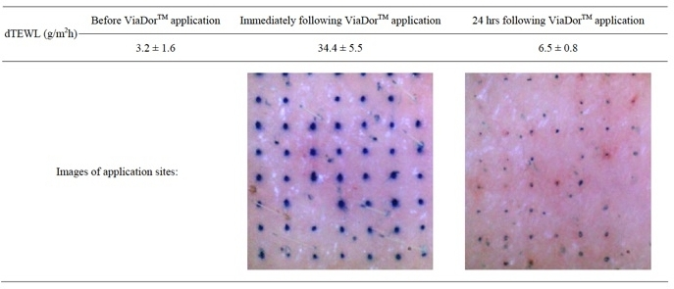
Radiofrequency (RF)
TEWL values (g/m2h), before, immediately and 24 hrs following ViaDorTM poration. Mean ± SD, N = 6
Kam Y., Sacks H., Kaplan K.M., Stern M., Levin G. - Radio Frequency-Microchannels for Transdermal Delivery: Characterization of Skin Recovery and Delivery Window. - Pharmacol. & Pharm. 3, 20-28, 2012.

Slide 21
Strategies to Improve Micropore Lifetime
Little is known about the kinetics of micropore lifetime and closure.
This issue is critical to the success of skin pretreatment with microneedles and other active transdermal technologies to deliver large molecules, biopharmaceuticals.
Also to allow for 7-day transdermal patches.
Strategies to improve micropore lifetime:
  Occlusion
  NSAIDS
  Lipid Synthesis Inhibition
  Anti-healing Agents
  pH

Slide 22
Occlusion
Occlusion and hydration are known techniques for making the skin more permeable.
Using occlusion methods, Warner et al. confirmed that water disrupts the structure of the stratum corneum barrier lipids, which helps to explain the known ability of water to increase skin permeability.
The in vivo swelling behavior of stratum corneum, when exposed to water for 4 or 24 hr., results in a 3- or 4-fold expansion of the stratum corneum thickness, respectively.
Corneocytes were found to swell uniformly with the exception of the outermost and inner two to four corneocyte layers, which swell less.
Hydration induces large pools of water in the intercellular space, pools that can exceed the size of water swollen corneocytes.
By 4 hr. of water exposure there were numerous small and large intercellular pools of water (‘‘cisternae’’) present throughout the stratum corneum, and at 24 hr. these cisternae substantially increased in size.
Within cisternae the lipid structure is disrupted by lamellar delamination (‘‘roll-up’’).

Slide 23
NSAIDS
One strategy that is under investigation has been that of co-delivering an NSAID with a drug compound in association with microneedle microporation.
  Banks et al have shown that micropores, created by microneedles, demonstrate delivery of naltrexone (an opioid antagonist) for two to three days.
  Banks et al. then studied the topical application of diclofenac, a nonspecific cyclooxygenase (COX) inhibitor and found that it prolonged micropore lifetime in hairless guinea pigs, allowing for seven days NTX delivery.
  Human studies have demonstrated a similar trend with impedance spectroscopy as a surrogate marker.
It is thought that subclinical local inflammation contributes to the micropore closure process, as one of the first responses to a micron scale breach in the skin.
However, the exact mechanisms underlying micropore closure are not clearly understood, and it is possible that diclofenac may be exerting additional effects beyond inhibiting local inflammation.

Slide 24
Lipid Synthesis Inhibition
Another strategy to delay the closure of microchannels or micropores is through the co-delivery of a lipid synthesis inhibitor.
The barrier properties of the skin are mediated by a series of lipid multilayers, enriched in ceramides, cholesterol, and free fatty acids segregated within the stratum corneum interstices.
The important role of stratum corneum lipids is that they act as the determinant of the permeability barrier to both water transport and drug penetration and is demonstrated by the inverse correlation between solute penetration and stratum corneum lipid weight.
Moreover, biophysical studies, using differential calorimetry and infrared spectroscopy, assert that it is both the hydrophobic nature of the lipids, as well as their tortuous extracellular localization, which restrict the transport of most molecules across the stratum corneum.
When the barrier is acutely perturbed by removal of these lipids with either organic solvents, detergents, or tape stripping, a sequence of biological responses is initiated, including accelerated epidermal cholesterol, sphingolipid, and fatty acid synthesis, that replenishes stratum corneum lipid content leading to rapid restoration of barrier function.
Whereas the increase in both cholesterol and fatty acids synthesis in the epidermis begins shortly after barrier disruption (within 1-2 h), the increase in sphingolipid synthesis is delayed (6-9 h).

Slide 25
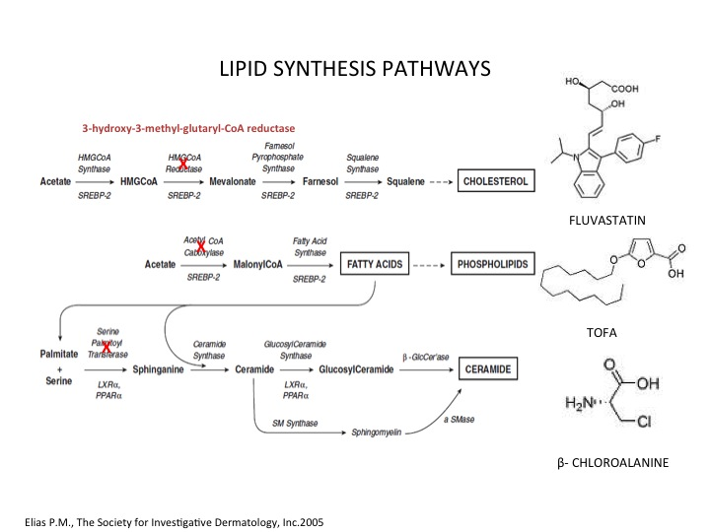
Lipid Synthesis Inhibition
Topical application of competitive inhibitors of HMG CoA reductase (e.g., lovastatin or fluvastatin) and acetyl CoA carboxylase (ACC) (e.g., 5-(tetradecyloxy)- 2-furancarboxylic acid (TOFA)), the rate-limiting enzymes of cholesterol and fatty acid synthesis, respectively, when used immediately after barrier disruption, inhibit the early stages of barrier recovery due to deletion of the target lipid from the extracellular membranes.
Likewise, β-chloroalanine, an inhibitor of serine palmitoyl transferase (SPT), the rate limiting enzyme of ceramide synthesis, suppresses ceramide synthesis and the later stages of barrier recovery.
This demonstrates that inhibition of the rate-limiting enzymes required for the synthesis of the three major stratum corneum lipid classes all delay barrier recovery, resulting in prolonged loss of barrier integrity.

Slide 26
Anti-healing Agents
Anti-healing agents are being used to prolong skin micropore lifetime.
US Patent 7,438,926, “Methods for inhibiting decrease in transdermal drug flux by inhibition of pathway closure,”
    “at least one anti-healing agent wherein the amount of the anti-healing agent is effective in inhibiting a decrease in the agent transdermal flux compared to when the delivery or sampling of the agent is done under substantially identical conditions except in the absence of the anti-healing agent(s).”
It states that the anti-healing agent can be selected from any number of the groups, including those consisting of anticoagulants, anti-inflammatory agents, agents that inhibit cellular migration, and osmotic agents such as heparin, hydrocortisone, laminin, sodium chloride, etc.

Slide 27
pH
Wound healing is a complex regeneration process, which is characterized by intercalating degradation and re-assembly of connective tissue and epidermal layer.
The pH value within the wound-milieu influences all biochemical reactions taking place in healing.
Schreml et al. found that the process of cutaneous wound healing is made up of three overlapping major phases:
    Inflammation
    Proliferation
    Tissue remodeling
While the mechanisms have been studied on the cellular and subcellular level, there is still a lack of knowledge concerning basic clinical parameters like wound pH or pO2.
It may be concluded that wound healing is affected by changes in wound pH as these changes can lead to an inhibition of endogenous and therapeutically applied enzymes.
Conformational structure of proteins and their functionality in wound healing is further altered in response to pH change.
Alterations in wound pH also contribute to the likelihood of bacterial colonization, which is a common problem in chronic wound pathogenesis.
Ghosh however, found that formulation pH could not be used to extend micropore lifetime, although formulation optimization, such as formulation pH relative to the drug’s pKa, leads to enhanced transport and thus drug delivery across microneedle treated skin.

Slide 28
Summary
There has been a great deal of work engineering and producing the devices to create micropores:
    Pressure applied microneedles
    Microneedle rollers
    Ultrasound devices
    Lasers
    RF
    Electroporation
Several factors affect the efficiency of drug transport following skin micropore creation:
    Physical parameters of microneedles
    Energy parameters of electroporation
    RF and laser ablation
    Properties of the drug compounds to be delivered.

Slide 29
Summary (cont.)
Initial studies have investigated and examined the technologies and technology parameters to make micropores and microchannels, as well the maintenance of micropores and microchannels.
Little is known about the kinetics of skin micropore closure following their creation.
Future study of micropores and their viability are needed in order to propel the industry and translate advance of transdermal technologies into successful transdermal therapies.

