Slide 1
A SINGLE BLINDED STUDY EXAMINING THE EFFECTS OF THORACIC SPINAL MOBILIZATION ON EXERCISE CAPACITY IN ASYMPTOMATIC INDIVIDUALS
Novel Physiotherapies
London, UK
June 2016
Steve Bitticker PT, PhD, Jerry Ditz DPT, Katie Tyner DPT,
Adam Cramer DPT, Chris Davis DPT, Kory Stauffer PhD
Gannon University Erie, Pennsylvania, USA

Slide 2
Background
Current evidence supports changes in heart rate (HR) and pulmonary function after thoracic mobilization
Minimal research investigating any potential impact on physiological function.

Slide 3
Purpose of this study
To examine the effects of Grade V thoracic mobilization (TM) on the exercise capacity of asymptomatic individuals through metabolic analysis during a six minute walk (SMW) test

Slide 4
Participants
Thirty-one asymptomatic volunteers ranging in age from 21-27
Randomly assigned into a control group (CG) and an intervention group (IG)

Slide 5
Methods and Procedures
Day 1:
  baseline trial six-minute walk (SMW) test
  researchers, blinded to subject group placement, recorded metabolic output, RR and HR
  Day 2:
    participants in the IG underwent four posterior-anterior HVLA (high velocity-low amplitude) TM
    Immediately after the intervention participants resumed the day one protocol
    The CG repeated day one protocol only

Slide 6
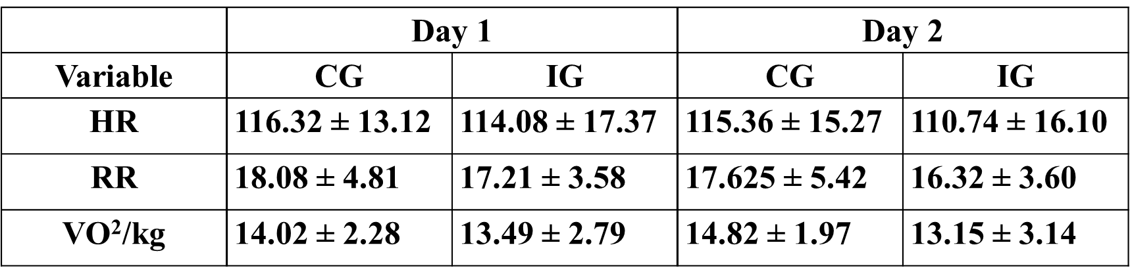
Results
p = 0.0141
p = 0.0452
p = 0.0423

Slide 7
Conclusion
Associations between Grade V HVLA TM and
  1) lowered HR,
  2) lowered RR and
  3) improved VO² during sub-maximal exercise were noted in this study
Limitations
  Relatively low number of participants in the sample
  Narrow age range of participants
  Lack of standardized treatment protocol for TM
  Researchers were unable to control environmental variables (sleep, nutrition, exercise, stress) which may have influenced participants’ cardiac or respiratory systems

Slide 8
Clinical Utility
Relevance is that improvements in cardiorespiratory function and exercise capacity post-mobilization directly relate to human performance during sub-maximal activity

