Slide 1

Oxytocin in prostate pathology
Vanitha Bhoopalan, Johnathan Surija, Angela Nova, Steve Assinder
Andrology Research Group
Discipline of Physiology, School of Medical Sciences and Bosch Institute, University of Sydney
Is there a sinister side to the “hormone of love”?

Slide 2
Oxytocin (the “hormone of love”) as a pharmacological agent
Classical roles in parturition and milk letdown in the suckling response.
OXT important social hormone:
e.g. in pair bonding, trust & maternal behavior.
Autism spectrum disorder; Schizophrenia.
Pain management.
Hypophagia, insulin/glucose homeostasis and weight loss.
Reviewed in Tom NC & Assinder SJ (2010). Oxytocin: Recent developments. Biomolecular Concepts 1: 367-380.

Slide 3
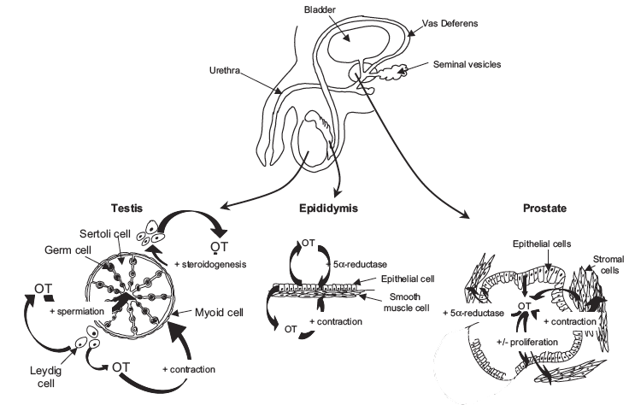
Peripheral oxytocinergic systems present in the male reproductive system.
Local androgens in BPH and CaP
From: Thackare et al., 2006 Human Repro Update 12: 437-448

Slide 4
Oxytocin is synthesised in the prostate.
From: Assinder and Tom 2010 Int J Biochem Cell Biol 42: 202-205.

Slide 5
A complete oxytocinergic system is present in the prostate.
OXT
OXTR
BPH
PIN
BPH
IC
Normal
From: Whittington et al. (2004) Cell Tissue Res 318: 375-382

Slide 6
Oxytocin concentrations are highest in benign prostatic hyperplasia.
From: Nicholson 1996 Rev Repro 1: 69-72

Slide 7
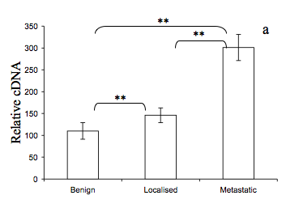
Oxytocin receptor is highest in prostate cancers.
Assinder (2010) Oxytocin in the Pathophysiology of Prostate Cancer. In: Handbook of Oxytocin Research: Synthesis, Storage and Release, Actions and Drug Forms. (Eds Jastrow H, Feuerbach D). Nova Science, NY. Chapter 7 pp. 157-170.

Slide 8
Sex steroids increases OXT in BPH tissue
+ve
Estrogen
*
Oxytocin
*
*
Oxytocin secretion as a % of control
+ve
+ve
Oxytocin secretion as a % of control
5 α-reductase I/II
+ve
Testosterone
DHT
*
Oxytocin secretion as a % of control
Assinder & Nicholson (2004) Int J Andrology, 27, 12-18

Slide 9
OXT increases SRD5A1 and 2 in normal prostate epithelial cells
Type I
Type II
SRD5A1
SRD5A2
*
*
pmol/mg protein/hr
pmol/mg protein/hr
pmol/mg protein/hr
pmol/mg protein/hr

Slide 10
Sex steroids increases OXT in BPH tissue
+ve
Estrogen
*
Oxytocin
*
*
Oxytocin secretion as a % of control
+ve
+ve
+ve
Oxytocin secretion as a % of control
5 α-reductase I/II
+ve
Testosterone
DHT
*
Androgen Receptor
Oxytocin secretion as a % of control
Proliferation?
Assinder & Nicholson (2004) Int J Andrology, 27, 12-18

Slide 11
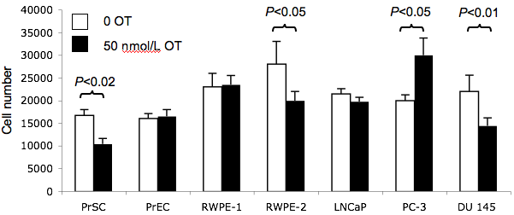
Oxytocin has differential effects on cancer cell proliferation
Oxytocin increases proliferation of sc-lung carcinoma and choriocarcinoma, but inhibits ovarian and endometrial cancer cells.
Breast cancer cells exhibit positive and negative responses.
Oxytocin either inhibits, stimulates or has no effect on prostate cancer cell proliferation.
Assinder (2010) Oxytocin in the Pathophysiology of Prostate Cancer. In: Handbook of Oxytocin Research: Synthesis, Storage and Release, Actions and Drug Forms. (Eds Jastrow H, Feuerbach D). Nova Science, NY. Chapter 7 pp. 157-170.

Slide 12
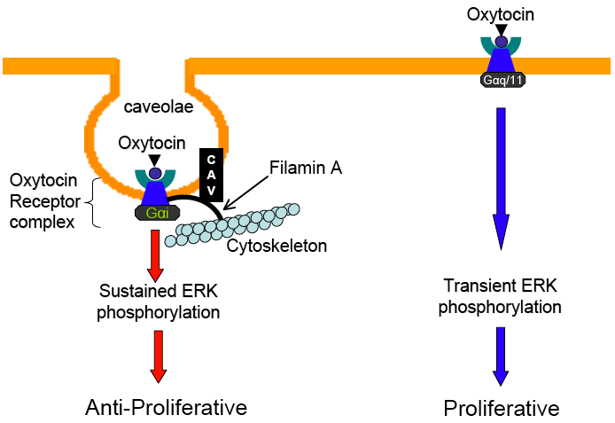
Two hypotheses for differential effects:
Different receptor localisation
Different Gα subunits coupled to the OXTR
(A)
(B)
Assinder (2010) Oxytocin in the Pathophysiology of Prostate Cancer. In: Handbook of Oxytocin Research: Synthesis, Storage and Release, Actions and Drug Forms. (Eds Jastrow H, Feuerbach D). Nova Science, NY. Chapter 7 pp. 157-170.

Slide 13
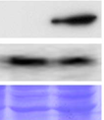
Different receptor localisation
PC-3 cells do not form caveolae, but DU 145 do
Forced expression of PTRF in PC3 results in caveolae formation (Hill et al. (2008) Cell; 132, 113-124.)
PC3 DU145
PTRF
Caveolin-1
Taken from Hill et al. (2008) Cell; 132, 113-124.

Slide 14
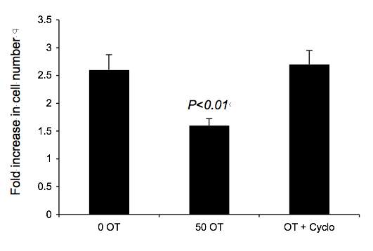
Different receptor localisation
Dispersal of caveolae attenuates inhibitory effect of OXT in DU 145

Slide 15
Different receptor localisation
Induced formation of caveolae through forced expression of PTRF results in inhibition of cell proliferation in PC-3
P<0.002
Cell number (x10⁴)

Slide 16
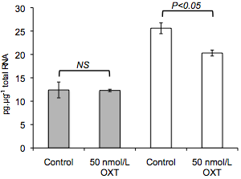
Different receptor localisation
Oxytocin suppresses caveolin-1 expression in PC-3 but not
DU 145
DU145
PC3

Slide 17
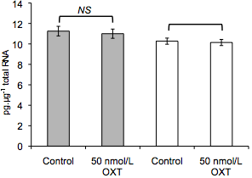
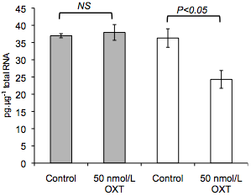
Different receptor localisation
Re-expression of PTRF abolishes inhibitory effect in PC-3
Knockdown of PTRF has no effect on response to OXT in DU145
Re-expression of PTRF abolishes OXT inhibition of CAV1 in PC-3
misense siRNA
PTRF siRNA
PC-3^{+PTRF}
PC-3^{+GFP}
NS

Slide 18
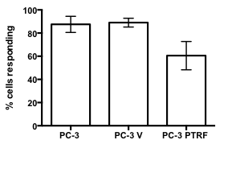
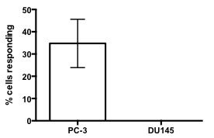
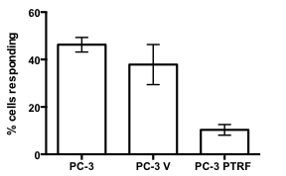
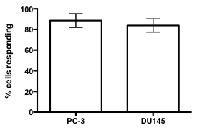
Different receptor localisation
Oxytocin evokes Ca_{i}²⁺ release in PC-3 but not DU 145 or PC-3^{PTRF}
PC-3
DU 145
PC-3^{PTRF}
P <0.01
P <0.05
P <0.05
OTA control
ATP control
ATP control
P <0.01

Slide 19
Two hypotheses for differential effects:
Different receptor localisation
Different Gα subunits coupled to the OXTR
LNCaP lack PTRF (Cavin-1) and do not form caveolae either
(A)
(B)
Moon et al. (2014) Oncogene 33: 3561-3570
From: Assinder (2010) Oxytocin in the Pathophysiology of Prostate Cancer. In: Handbook of Oxytocin Research: Synthesis, Storage and Release, Actions and Drug Forms. (Eds Jastrow H, Feuerbach D). Nova Science, NY. Chapter 7 pp. 157-170.

Slide 20
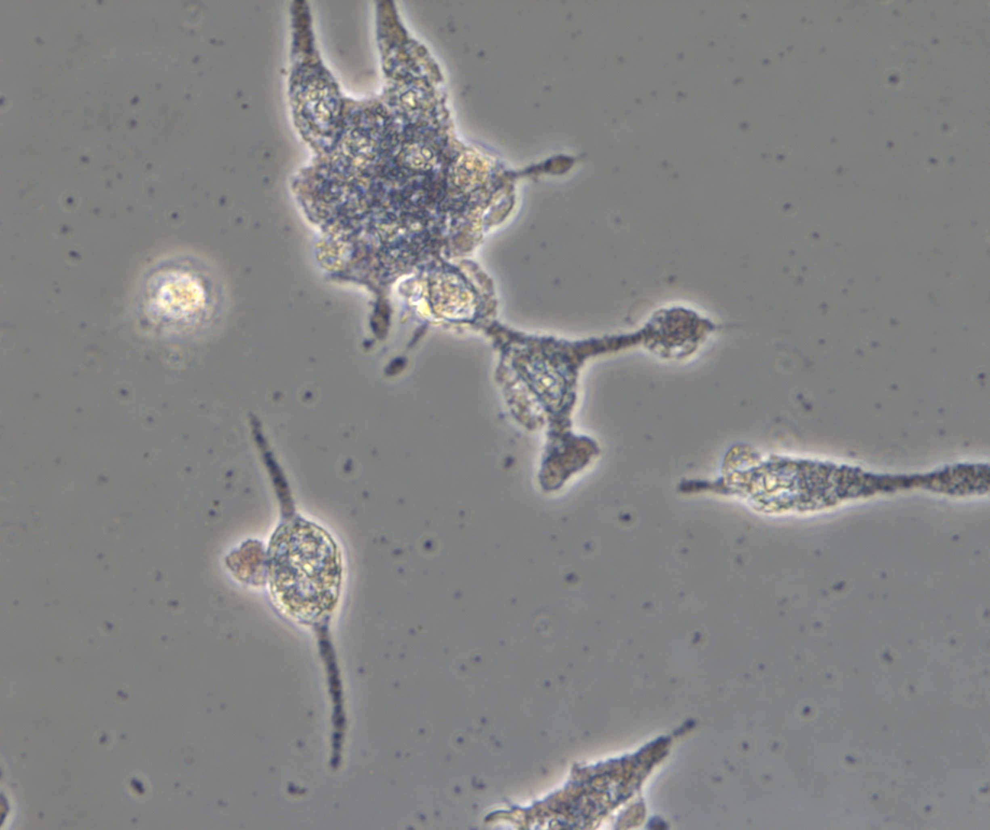
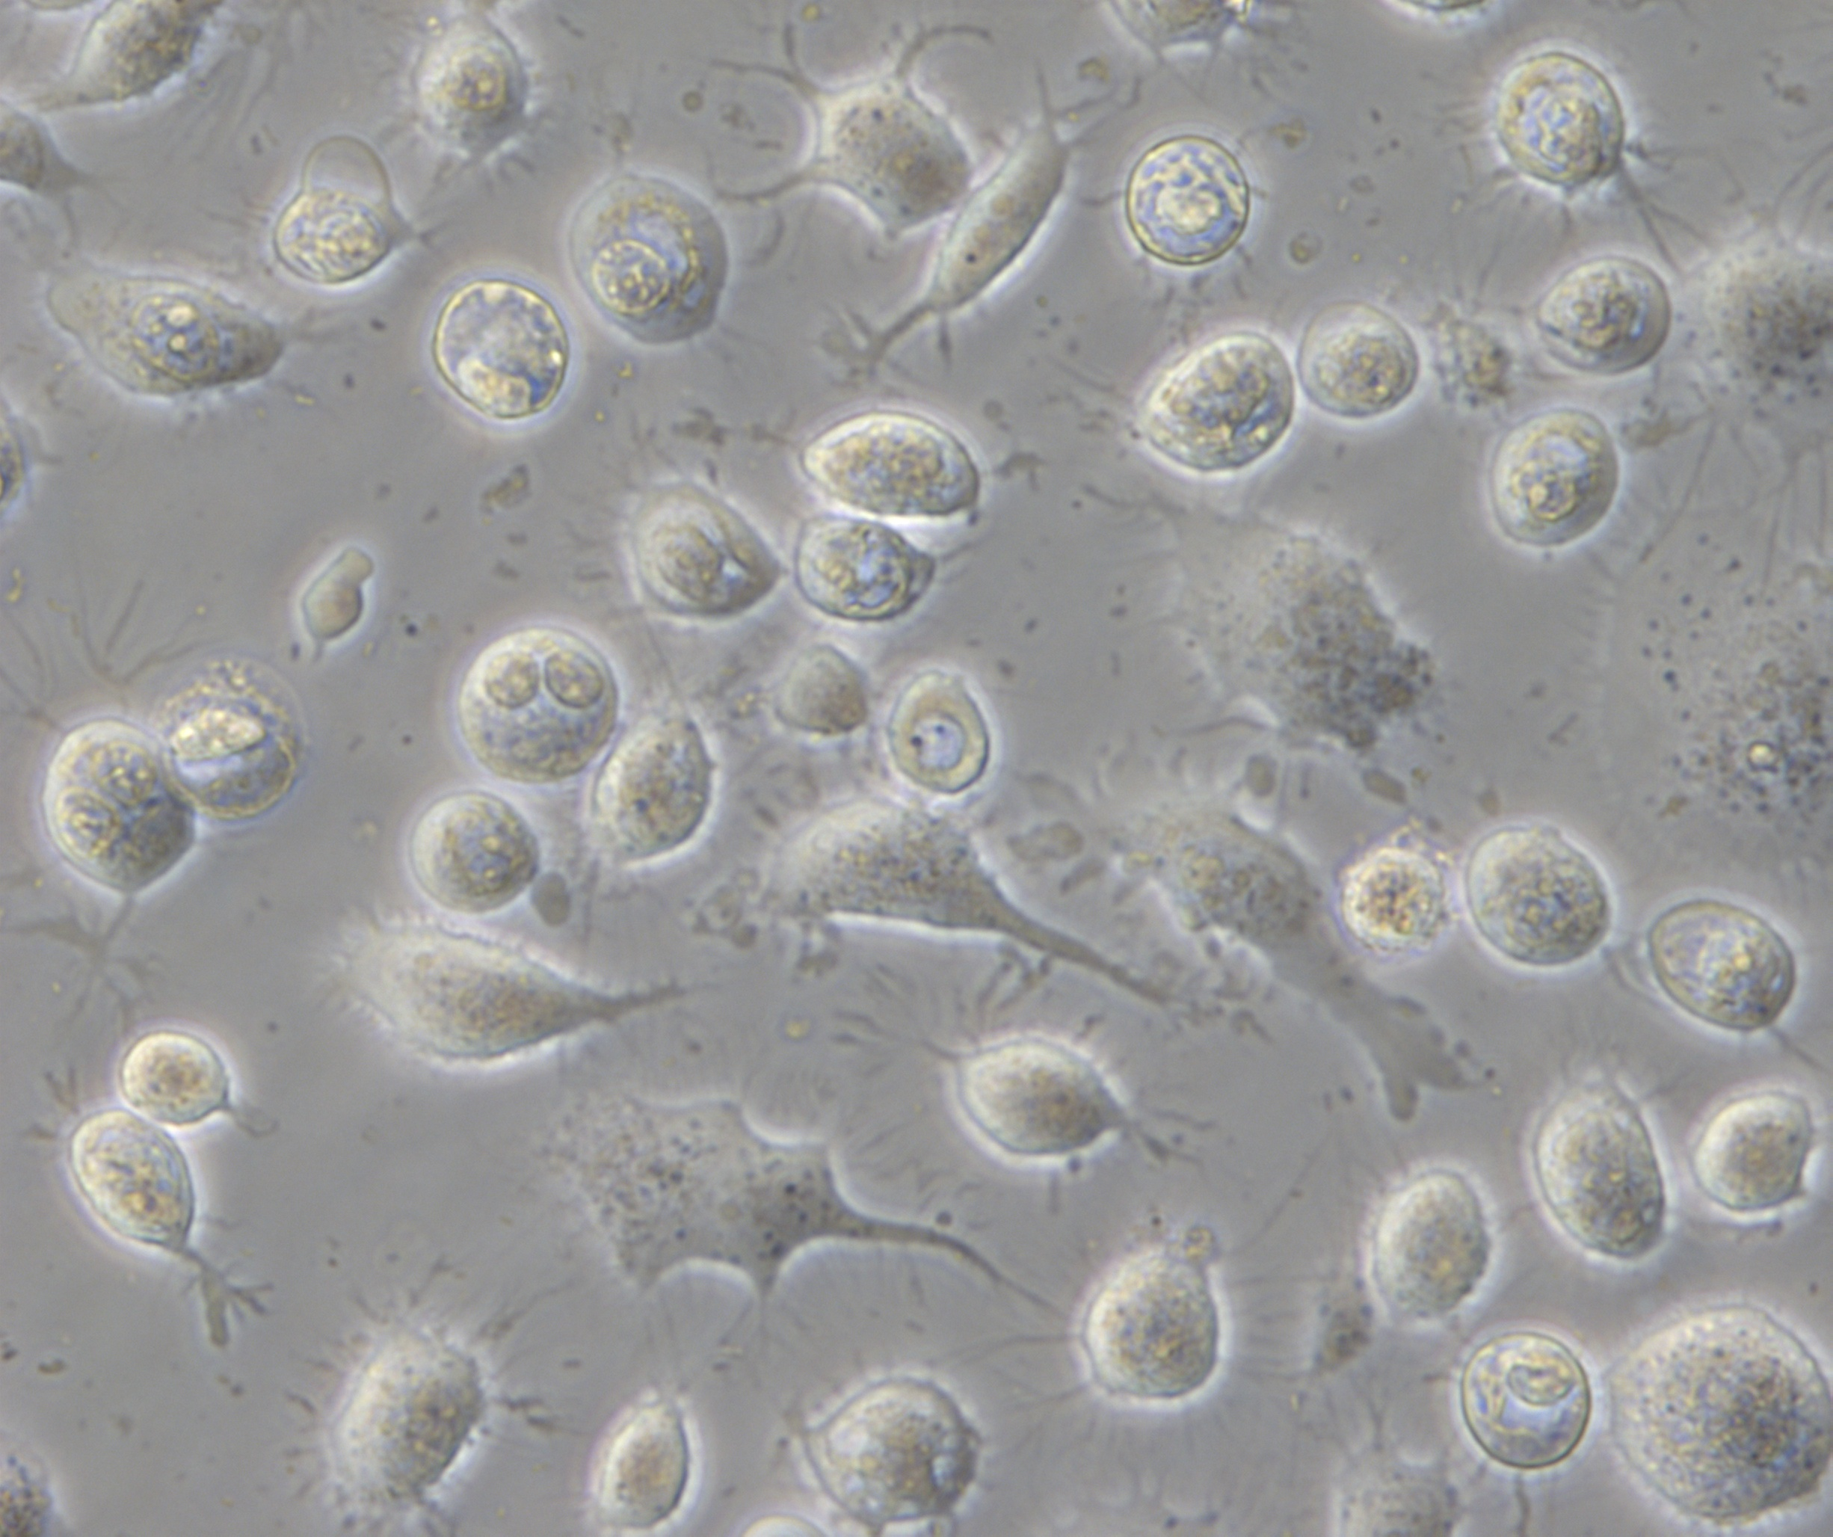
Different G-protein coupling
Differential effects of oxytocin on steroidogenic enzymes is evident
Live cell colourimetric assay for HSD3B and SRD5A
LNCaP HSD3B
PC-3 SRD5A
pregnenolone
HSD3B
progesterone
testosterone
SRD5A
dihydrotestosterone
NAD⁺
NADH
NADP⁺
NADPH
Nitroblue tetrazolium
Nitroblue formazan
Nitroblue tetrazolium
Nitroblue formazan

Slide 21
Different G-protein coupling
Oxytocin inhibits HSD3B activity in LNCaP, but increases activity in PC-3
LNCaP
De novo steroidogenesis in PCa
PC-3

Slide 22
Different G-protein coupling
Oxytocin increased SRDA activity in LNCaPs, but decreases activity in PC-3s
LNCaPs
De novo steroidogenesis in PCa
PC-3s

Slide 23
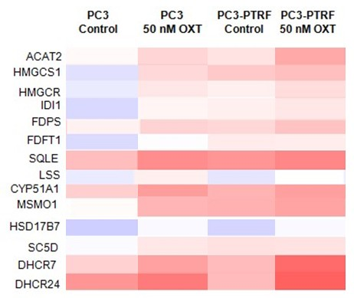
A mixed model of different receptor localisation and different Gα subunits coupling
Oxytocin increases expression of cholesterol biosynthesis genes
Cholesterol is the precursor of all steroids
PC-3
PC-3^{PTRF}
control
OXT
control
OXT
ACAT2
HMGCS1
HMGCR
IDIR1
FDPS
FDT1
SQLE
LSS
CYP15A
MSMO1
HSD17B7
SCD5
DHCR7
DHCR24
IDI1

Slide 24
Different G-protein coupling
HMGCR transcript increased by oxytocin in PC-3, PC-3^{PTRF} and DU 145
Cholesterol is the precursor of all steroids
Common to PC-3, PC-3^{PTRF} &
DU-145
PC-3
PC-3^{PTRF}
control
OXT
control
OXT
ACAT2
HMGCS1
HMGCR
IDIR1
FDPS
FDT1
SQLE
LSS
CYP15A
MSMO1
HSD17B7
SCD5
DHCR7
DHCR24
IDI1

Slide 25
SUMMARY
Oxytocin signalling is likely determined by both G protein availability and caveolae formation.
Oxytocin has differential effects according to cell type.
Oxytocin affects de novo steroidogenesis and cholesterol availability.
Implications for pharmaceutical use?

Slide 26
Acknowledgements
Prof Helen Nicholson, Bristol and Otago University
Dr Kate Whittington, Bristol University
Dr Michelle Hill, University of Queensland
Dr Margot Day, University of Sydney
Alex Cole
Kathryn Davis
Nicole Tom
Dr Stuart Fraser & Blood Cell and Development Lab, University of Sydney

Slide 28
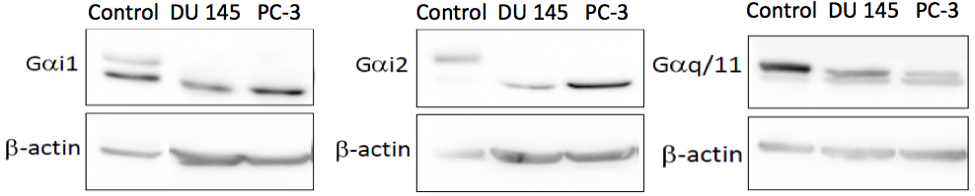
Two hypotheses for differential effects:
Different receptor localisation
Different amounts Gα subunits coupled to the OXTR
P<0.01
P<0.05

