Slide 1

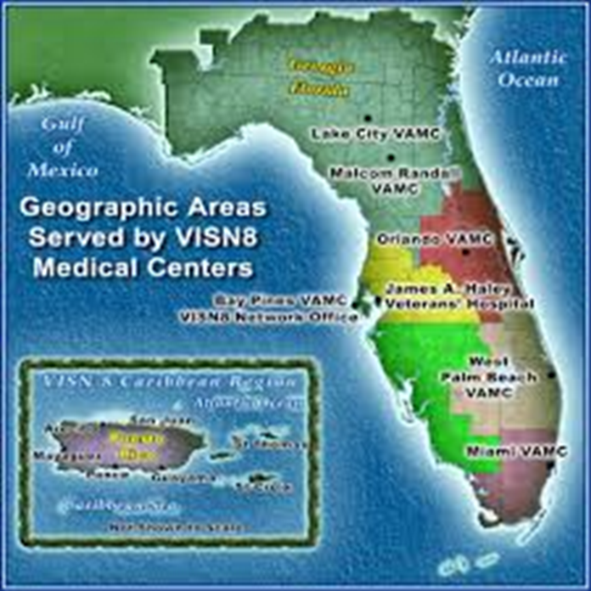

Real-Time Telepathology in VISN 8
Stephen Mastorides, Lead Pathologist VISN 8
Drazen Jukic, Chief of Dermatopathology
The Effects of Telepathology on Veterans Health: VISN 8

Slide 2
VISN 8 Telepathology
Sharing cases and seeking consultations for purpose of second opinion is an important aspect to everyday pathology practice in the Veterans Health Administration (VHA).
Digital pathology can reduce costs and geographic barriers in the VHA, allowing pathologists to share specialty cases across the VISN network. Telepathology is carving its niche in direct patient care.
The Effects of Telepathology on Veterans Health: VISN 8
Notes:
As you know sharing cases and seeking consultations is an important part of everyday pathology practice not only in the VHA but everywhere. Our vision in the VHA is to apply digital pathology to our pathology practice to reduce costs and the geographic barriers that exist.

Slide 3
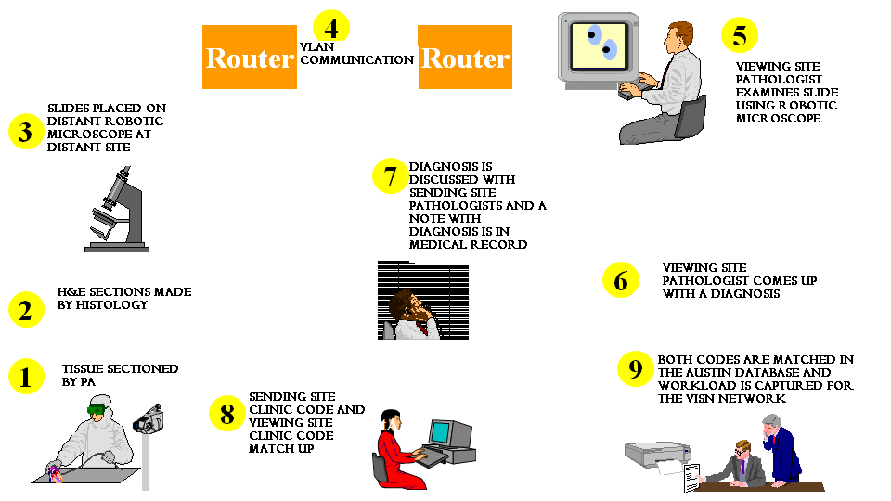
Overview of Telepathology Process
The Effects of Telepathology on Veterans Health: VISN 8

Slide 4
Telepathology Benefits
Brings the patient/provider/specimen together
Simultaneous look for second-opinion consultations
“Glassless” analysis, referral, consultation and storage
A seamless capture, storage, retrieval, and display capability
The Effects of Telepathology on Veterans Health: VISN 8

Slide 5
Benefits Cont’d
Virtual Classroom
Tele-Tumor Board Potential
Access to the limited specialty pathologists expertise
Increases efficiency of the VISN 8 Pathology Department
The Effects of Telepathology on Veterans Health: VISN 8

Slide 6
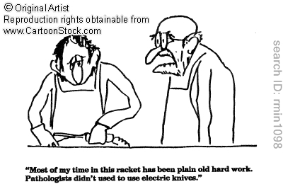
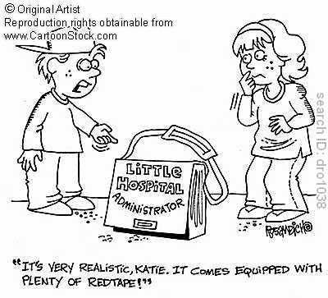
Implementation Barriers
Justify the technology for pathologists
Justify the technology for hospital administrators
The Effects of Telepathology on Veterans Health: VISN 8
Notes:
The experience with Telepathology is so different that Pathologists need to be retrained on different interface systems that are foreign. Operations Manual with step by step instructions for pathologists to use has been helpful. Hospital administrators once educated on the potential for telepathology to increase revenue with the

Slide 7
VISN 8 Business Implementation
Coding is now nationally sanctioned for telepathology clinic profiles using national stop codes
Equipment in all VISN 8 Medical Centers
Inter-Facility Consult (IFC) Pathways unique for each provider
Expediting referrals to experts and specialists, enhance secondary reading for diagnostic verification
The Effects of Telepathology on Veterans Health: VISN 8
Notes:
Expediting referrals to experts and specialist and enhance secondary reading for diagnostic verification

Slide 8
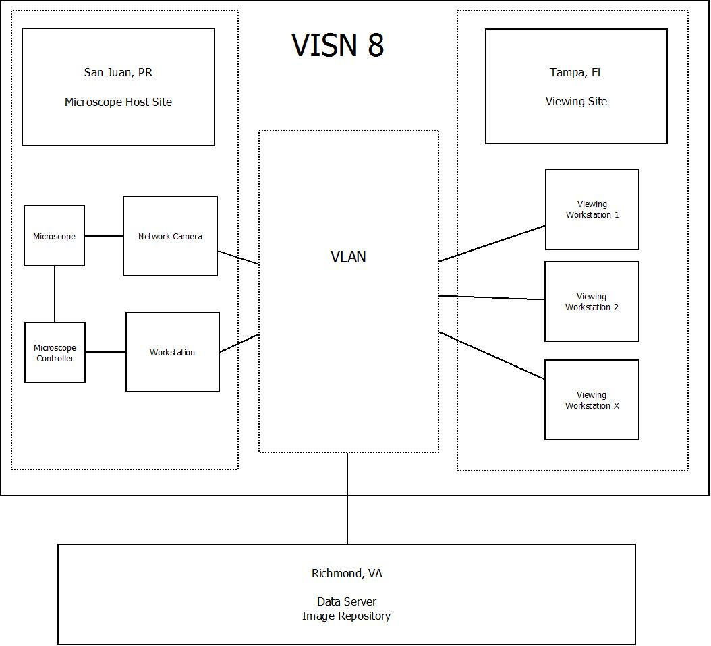
Microscope and Workstation: Data Flow
The Effects of Telepathology on Veterans Health: VISN 8
Notes:
Network Camera is an Axis M1114 with a progressive scan image sensor resolution of 1280X800 to 160x90 with a 30 second frame rate
The Robotic Microscope is a Nikon 55i

Slide 9
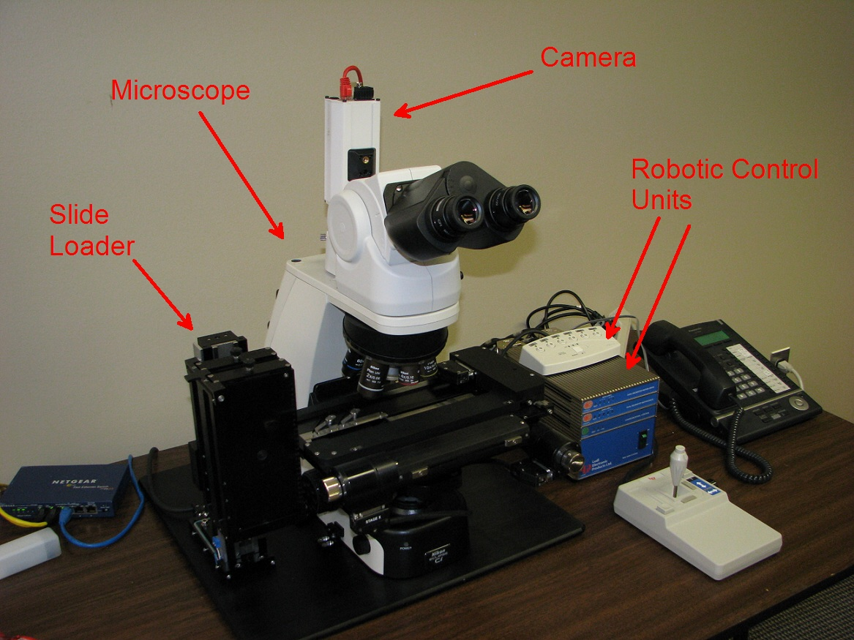
Robotic Telepathology Workstation
The Effects of Telepathology on Veterans Health: VISN 8

Slide 10
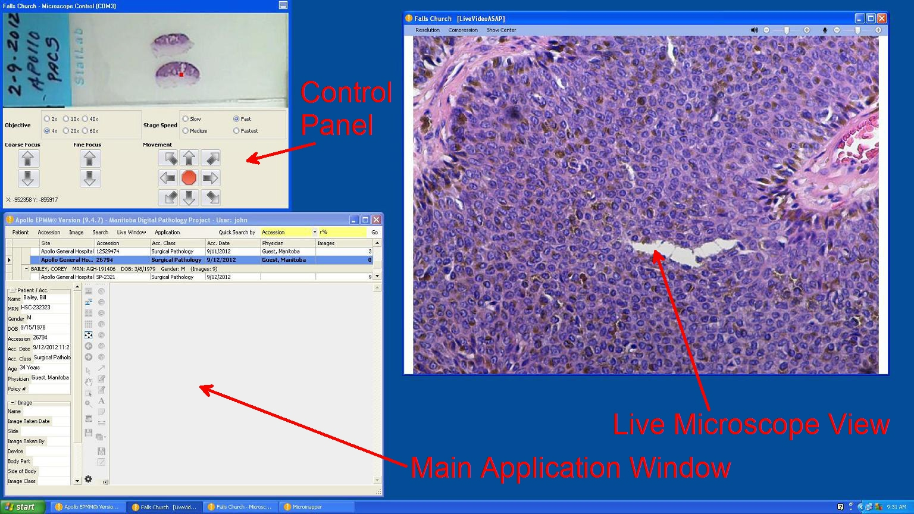
Consulting Screen
The Effects of Telepathology on Veterans Health: VISN 8
Notes:
Consulting workstations require installation of the Apollo EPMM Client software to view the specimen on the robotic scope remotely. This online interface allows the viewing site pathologist to change focus, magnification and field of view to view the specimen.

Slide 11
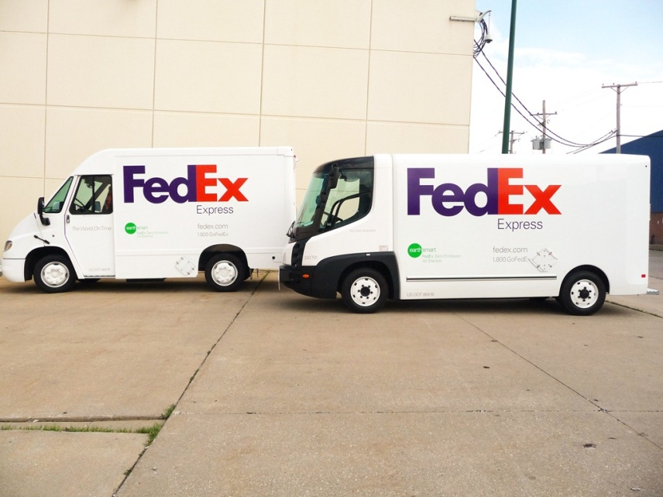
Couriers and Storage
Cost Savings:
  Courier costs -
    $27,150.00
  Slide retrieval and filing costs-
    ~$60,000.00
    Viable for in-house couriers, as well as nation-wide couriers
The Effects of Telepathology on Veterans Health: VISN 8

Slide 12
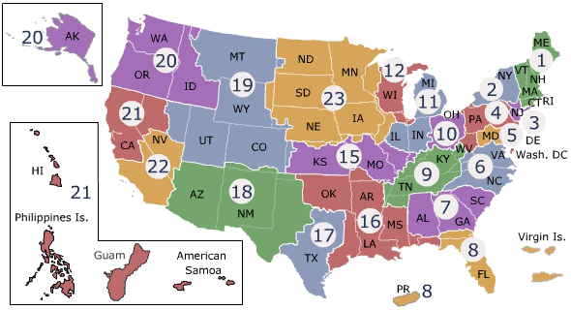
Telehealth Workload Credit
What is the motivation in gaining workload credit…
  -Workload translates to VERA dollars (Veterans Equitable Allocation Fund)
  VERA allocates resources to 21 VA VISNS and 90% of the dollars are attributed to patient care workload.
  --Strategic plan and performance standards passed down from National VA Leadership
The Effects of Telepathology on Veterans Health: VISN 8
Notes:
VERA was created in 1997 as an allocation methodology to improve accountability for support budgets. VERA allocates resources to 21 VA VISNS and 90% of the dollars are attributed to patient care workload.

Slide 13
Comparison of Pathology Services
 | On-site Pathologist | Telepathology | Courier
Frozen Section Diagnosis | Yes | Yes | No
Turn Around Time (TAT) | Days* | Minutes* | Days-Weeks
Live Consults with clinicians & slides | Yes | Yes | No
Second Opinion consultations | Delayed or Impossible | Immediate | Delayed
Agha Z, Weinstein RS, Dunn BE. Cost minimization analysis of telepathology Am J Clin Pathol 1999 Oct; 11 2:470-8
The Effects of Telepathology on Veterans Health: VISN 8

Slide 14
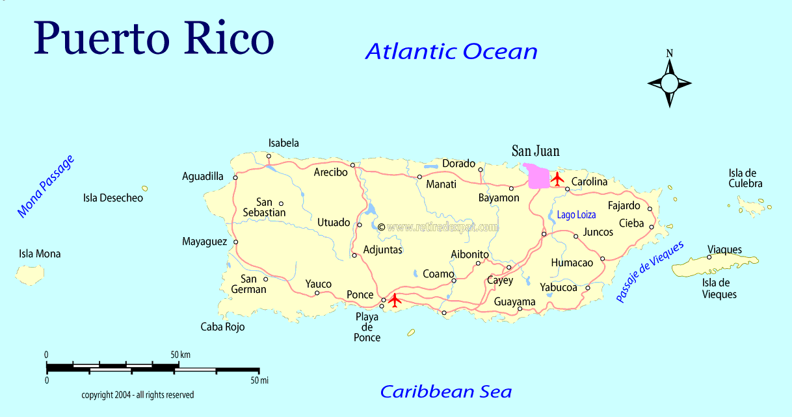
Virtual Telehealth Patients
Teledermatology and Telepathology
Patient from Utuado VA Rural Outpatient Clinic, Puerto Rico
Patients never left rural outpatient clinic
Diagnostic turnaround time was decreased by 75% with the use of telehealth services (teledermatology and telepathology)
The Effects of Telepathology on Veterans Health: VISN 8

Slide 15
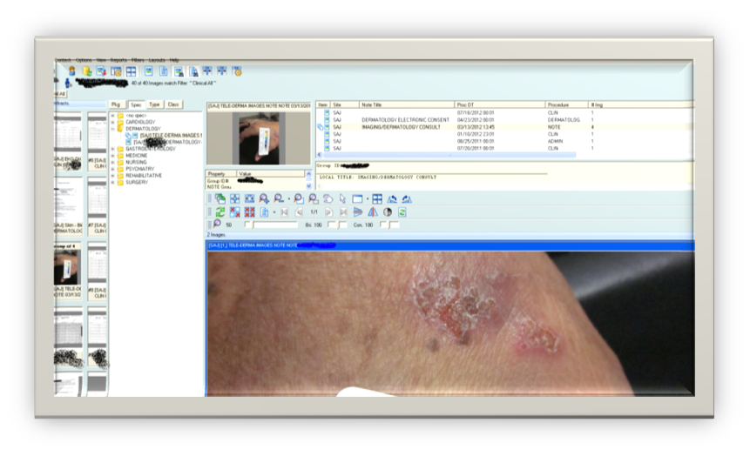
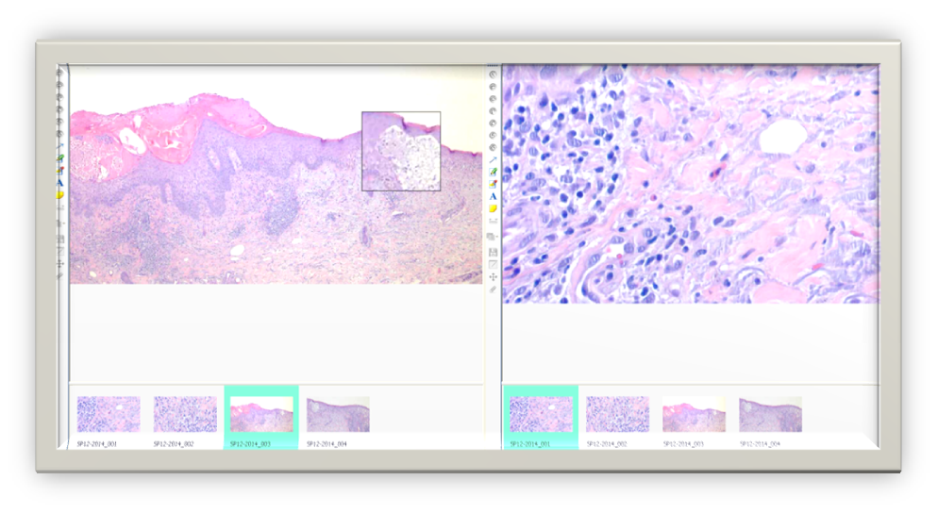
Telehealth Virtual Patient
Teledermatology in San Juan, PR
Telepathology in Tampa, FL
The Effects of Telepathology on Veterans Health: VISN 8

Slide 16

Telehealth in VISN 8
The Effects of Telepathology on Veterans Health: VISN 8
Notes:
Set a goal to hold 32 telepathology second opinion cases every 60 days- with the recent deployment of Apollo Telepathology Workstations we plan to remotely connect all the VISN 8 specialist so second opinion diagnoses will be readily available, we are contining to strive to perfect the TAT so the work of the pathologists is limited and perhaps have a PA or a Med Tech operate the scope while the sending site pathologists can continue with sign out, we are going to broaden our horizons and bring on other specialist not only in Tampa but at the other medical centers that will be receiving the equipment

Slide 17
Future Expectation in VISN 8
      Remotely connect VISN 8 via Apollo robotic telepathology
      Continue to improve diagnostic turnaround time with second opinion remote telepathology
      Involve different pathology specialists from Tampa (head neck specialists, breast cancer specialist)
      Telepathology VISN 8 Directory- access to all pathology specialists for second opinion consultations
      Expand to VISN 2, New York
The Effects of Telepathology on Veterans Health: VISN 8
Notes:
Set a goal to hold 32 telepathology second opinion cases every 60 days- with the recent deployment of Apollo Telepathology Workstations we plan to remotely connect all the VISN 8 specialist so second opinion diagnoses will be readily available, we are contining to strive to perfect the TAT so the work of the pathologists is limited and perhaps have a PA or a Med Tech operate the scope while the sending site pathologists can continue with sign out, we are going to broaden our horizons and bring on other specialist not only in Tampa but at the other medical centers that will be receiving the equipment

