Slide 1
Conference Series LLC Conferences
Conference Series LLC is a pioneer and leading science event organizer, which publishes around 500 open access journals and conducts over 500 Medical, Clinical, Engineering, Life Sciences, Pharma scientific conferences all over the globe annually with the support of more than 1000 scientific associations and 30,000 editorial board members and 3.5 million followers to its credit.
Conference Series LLC has organized 500 conferences, workshops and national symposiums across the major cities including San Francisco, Las Vegas, San Antonio, Omaha, Orlando, Raleigh, Santa Clara, Chicago, Philadelphia, Baltimore, United Kingdom, Valencia, Dubai, Beijing, Hyderabad, Bengaluru and Mumbai.

Slide 2

Development of a collaborative transitions-of-care program for heart failure patients
Stephen Gunadi, BSc, PharmD
Lead TOC Pharmacist
Co-Chair TOC Pillar Workgroup
Providence St. Peter Hospital

Slide 3
Disclosure Statement
Name: Stephen Gunadi
Investigators have no conflict of interest to disclose
This study was not funded
Proprietary information or results of ongoing research may be subject to different interpretations
Speaker’s presentation of this slide indicates agreement to abide by the non-commercialism guidelines provided in the CE Requirements page

Slide 4
Learning Objectives
Describe the process of Transition of Care (TOC)
Understand how to implement admission & discharge medication reconciliation with concierge services
Appreciate the complexity of readmission risk stratification

Slide 5
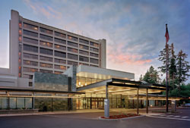
Providence St. Peter Hospital
Location: Olympia, Washington
Not-For-Profit Regional Community Teaching Hospital
  390-bed facility
  Comprehensive medical, surgical and behavioral health services
Training site for family practice and pharmacy residents
Provides clinical pharmacy, behavior health and obstetrics and gynecological services

Slide 6
Patient Case (PSPH)
70yo male admitted with acute decompensation of HF
PMH:
Ischemic dilated cardiomyopathy (EF 25%), CAD, AF, HTN, HLP, DM, Renal insufficiency
Managed inpatient by a cardiologist for 11 days then discharged in stable condition
Current Medications:
21 different medications

Slide 7
Patient Case
Three days later readmitted with symptomatic bradycardia (HR 30)
Patient had been discharged on 2 beta-blockers
  Metoprolol and Carvedilol
Discharge medication reconciliation process failed
Patient received inadequate discharge instructions/education
Patient readmitted to CCU and 14 days hospitalization at the cost of $75,353

Slide 8
Transition of Care Overview
Definition: Facilitate safe, smooth and effective transitions from one setting of care to the next
Goal:
Reduce readmissions
Reduce financial penalties to hospitals
Increase compliance with CMS & JACHO requirements
Increase quality of care for our patients
Circ Heart Fail. 2015 Mar;8(2):384-409

Slide 9
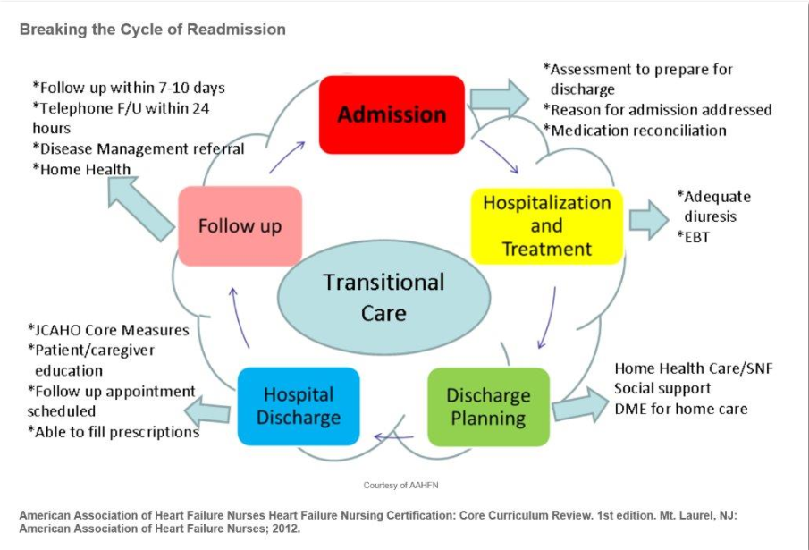
Notes:
-TOC encompasses a lot of moving pieces that need to work insync with one another for it to be successful
-Pharmacy is a key player in TOC, impacts virtually all aspects of the TOC cycle
-Multiple disciplines are involved and a lot of care coordination and communication has to happen between the various disciplines throughout the hospital stay (ie: financial barriers, medication affordability, conversion with care-coordinator, nurse, MD)
-When this TOC cycle breaks down, we see an increase in readmission rates

Slide 10
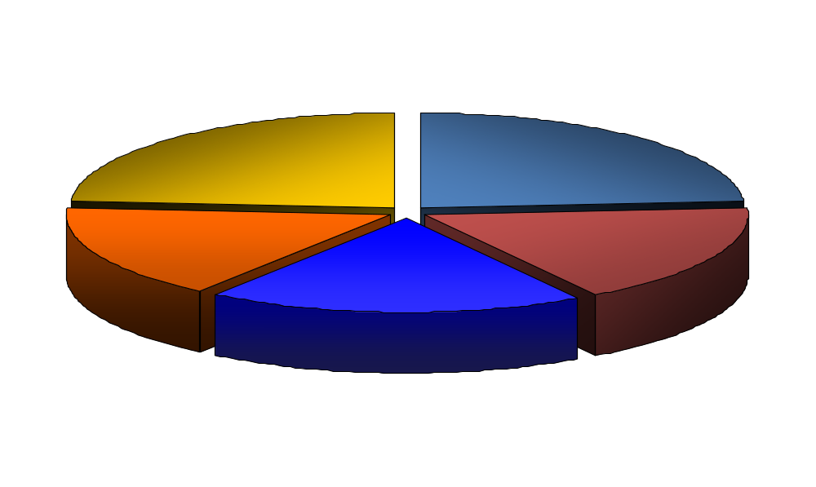
Reasons for hospitalization
Diet Noncompliance
24%
Rx Noncompliance
24%
16%
Inappropriate Rx
17%
Other
19%
Failure to Seek
Care
Annals of Internal Medicine 122:415-21, 1995
Notes:
-As mentioned before, pharmacy is a key player in the TOC cycle
-Ensuring an accurate medication list
-40% of hospitalizations are medication related
-Both non-compliance and inappropriate rx are aspects that pharmacy can make a major impact

Slide 11
Admission Med Rec

Slide 12
Admission Med Rec
According to the Institute of Medicine’s Preventing Medication Errors report, the average hospitalized patient is subject to at least one medication error per day
Research findings that medication errors represent the most common patient safety error
More than 40% of medication errors are believed to result from inadequate reconciliation in handoffs during admission, transfer, and discharge of patients
Barnsteiner JH. Medication Reconciliation. In: Hughes RG, editor. Patient Safety and Quality: An Evidence-Based Handbook for Nurses. Rockville (MD): Agency for Healthcare Research and Quality (US); 2008 Apr. Chapter 38. Available from: http://www.ncbi.nlm.nih.gov/books/NBK2648/

Slide 13
Admission Med Rec
  According to The Joint Commission, medication reconciliation is defined as the process of comparing the patient’s home medication to the to the newly prescribed hospital medication orders.
  Avoid medication errors such as omissions, duplications, dosing errors, or drug interactions
  It should be done at every transition of care in which new medications are ordered or existing orders are rewritten
Barnsteiner JH. Medication Reconciliation. In: Hughes RG, editor. Patient Safety and Quality: An Evidence-Based Handbook for Nurses. Rockville (MD): Agency for Healthcare Research and Quality (US); 2008 Apr. Chapter 38. Available from: http://www.ncbi.nlm.nih.gov/books/NBK2648/

Slide 14
Admission Med Rec
  Pharmacy technicians at one hospital reduced potential adverse drug events by 80 percent within three months by obtaining medication histories of patients scheduled for surgery
  Washington Board of Pharmacy (WA BOP) supports technicians reconcile medications under the supervision of the pharmacist
Johnston R, Saulnier L, Gould O. Best Possible Medication History in the Emergency Department: Comparing Pharmacy Technicians and Pharmacists.The Canadian Journal of Hospital Pharmacy. 2010;63(5):359-365.

Slide 15
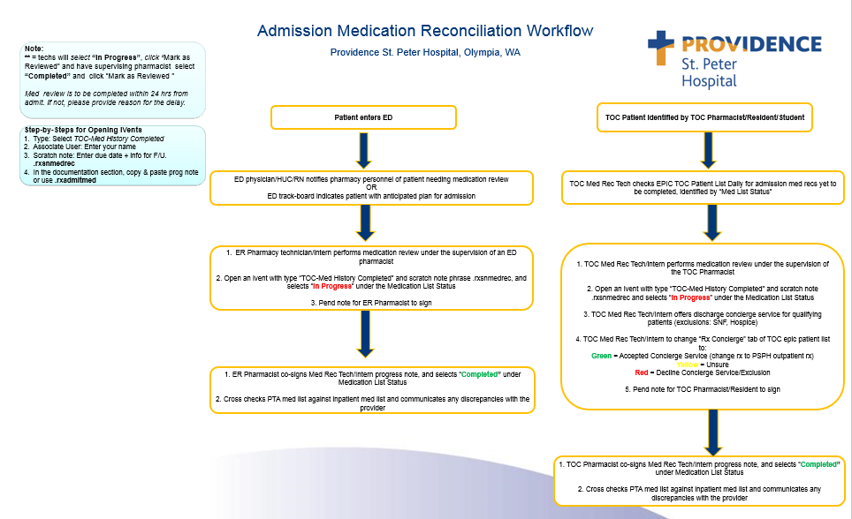

Slide 16
PSPH Admission Med Rec Program
Pharmacy Technicians
Emergency Department
  One FTE day-shift med rec tech (0800-1630)
  One FTE evening-shift med rec tech(1300-2130)
Pre-Operative Clinic
  One FTE day-shift med rec tech (0800-1630)
    (Monday & Thursdays only)
Transition of Care (TOC)
  One FTE day-shift med rec tech (0800-1630)
  Focuses on CHF, AMI & CVS patients

Slide 17
PSPH Admission Med Rec Program
Pharmacy Students/Residents
Students
  11 APPE Student Rotations available year round
  Each student responsible for performing one admission med rec/day
  Coordinate and communicate with pharmacy med rec techs
Residents
  8 residents covering various service lines year round
  Complete and sign-off on med recs as time permits
Students & Residents add a tremendous amount of horse power to our med rec program
Notes:
-This is at both PCH and PSPH
-Still have pharmacy residents rotating through all services hospital-wide, and have students rotating, but we want it to be more structured, and robust
-Can cover med rec for complex patients, admission and discharge phases
New model will:
-strengthen our teaching program
-allows for growth of the program
-consistent care 7 days a week, weekend coverage, staff concerns addressed quality was suffering on the weekends, solves this issue

Slide 18
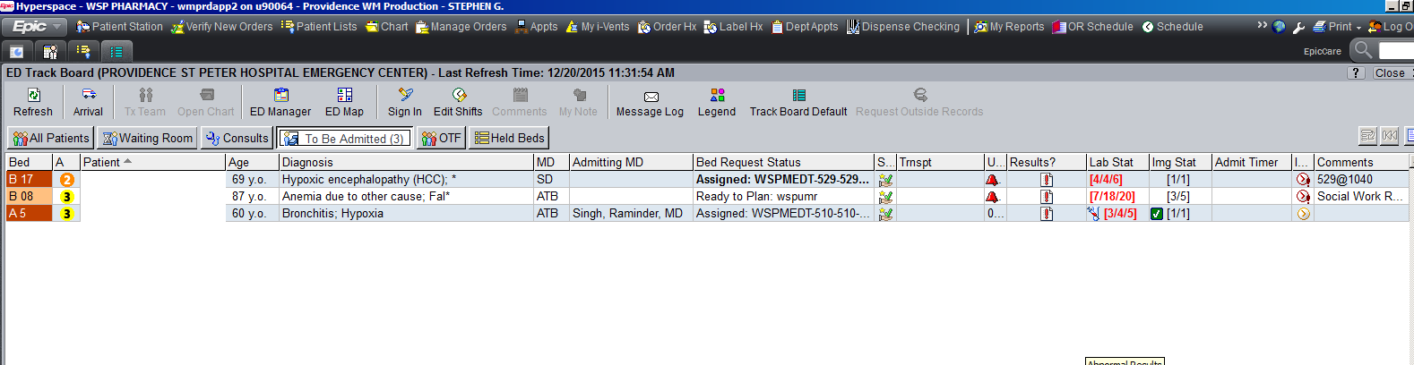
PSPH Admission Med Rec Program
Open ED Track-board in Epic → To Be Admitted

Slide 19
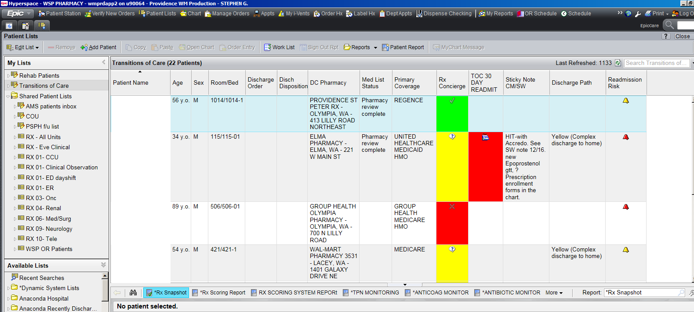
PSPH Admission Med Rec Program
TOC Epic List → Med List Status

Slide 20
PSPH Admission Med Rec Program
Interview patient or caregiver or family member
  AIDET, respect, genuine care, open ended question
  Computer in room (ask patient’s preference) or medication review form
  Do you have a medication list?
    Sometimes charts will already have a copy of patient’s medication list
  Ask allergies, reaction to allergies, vaccination status
    Flu, pneumococcal, Tdap
  Assess level of understanding of their current medications, OTC products, herbals, etc.
  Do you have a primary pharmacy?
    Some pharmacy requires fax to obtain medication list quickly
    E.g. Veterans Affairs: use pre-filled fax form on SharePoint

Slide 21
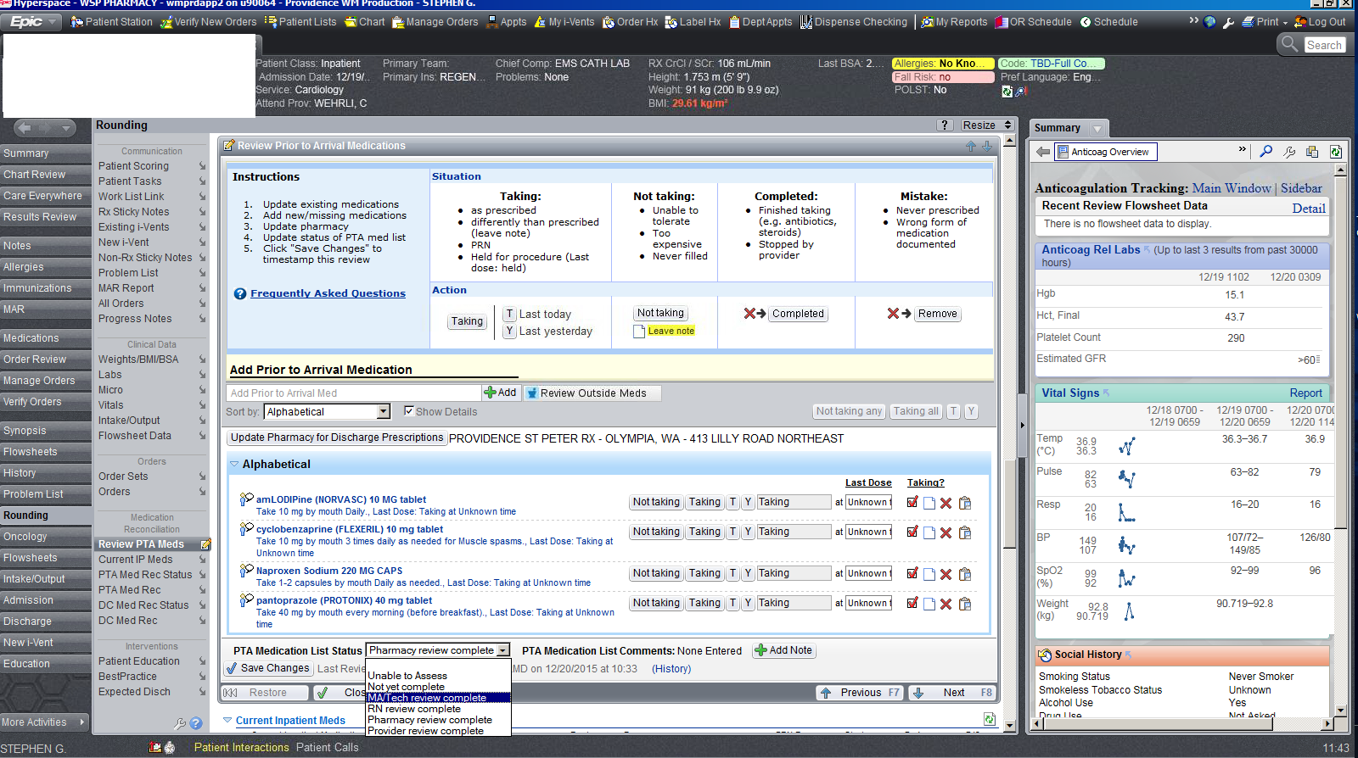
PSPH Admission Med Rec Program
Entering medication → Rounding tab → PTA Med Review

Slide 22
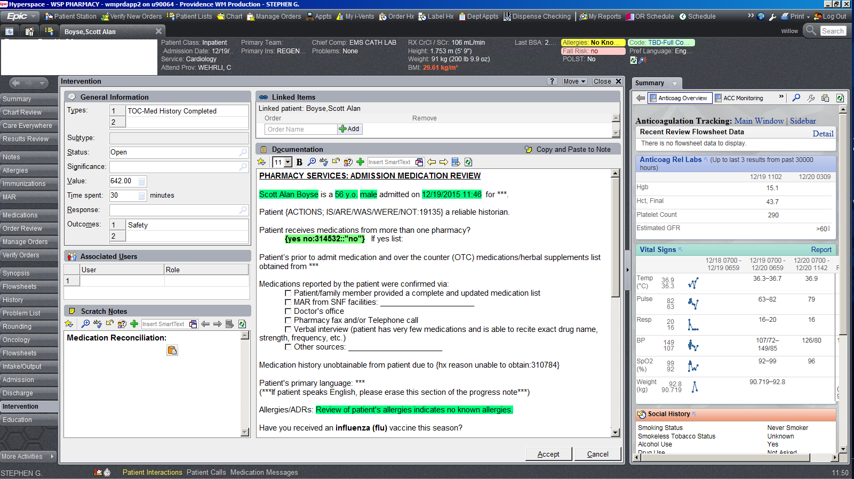
PSPH Admission Med Rec Program
Admission Med Rec Ivent Type

Slide 23
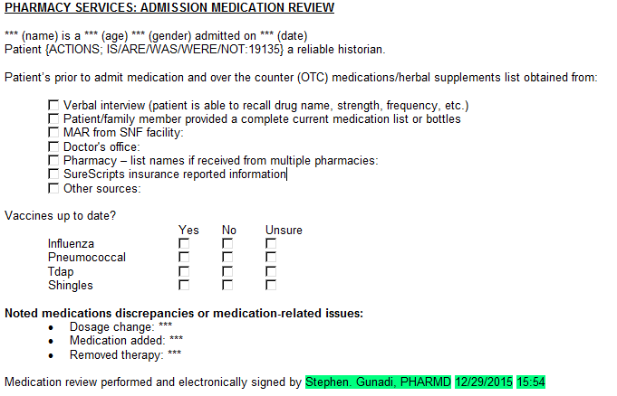
PSPH Admission Med Rec Program
Admission Med Rec Progress Note

Slide 24
TOC Patients: CHF, AMI, CVS

Slide 25
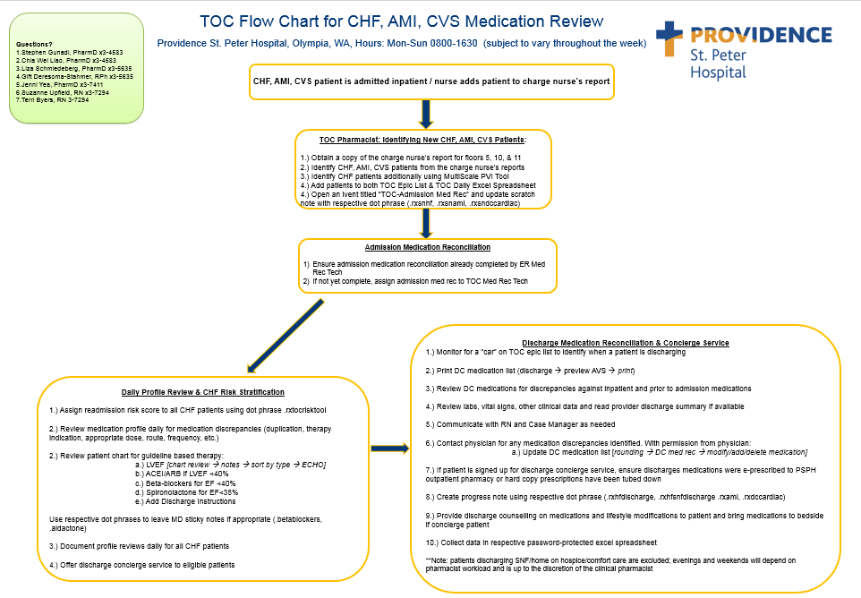

Slide 26
PSPH TOC Patients
Identified utilizing charge nurse reports and Multiscale Providence Vulnerability Index (CHF patients only)
Added to shared TOC EPIC list & daily patient excel spreadsheet
TOC ivent opened and documentation for profile review done on a daily basis
CHF patients are risk stratified utilizing readmission risk complexity scoring tool

Slide 28
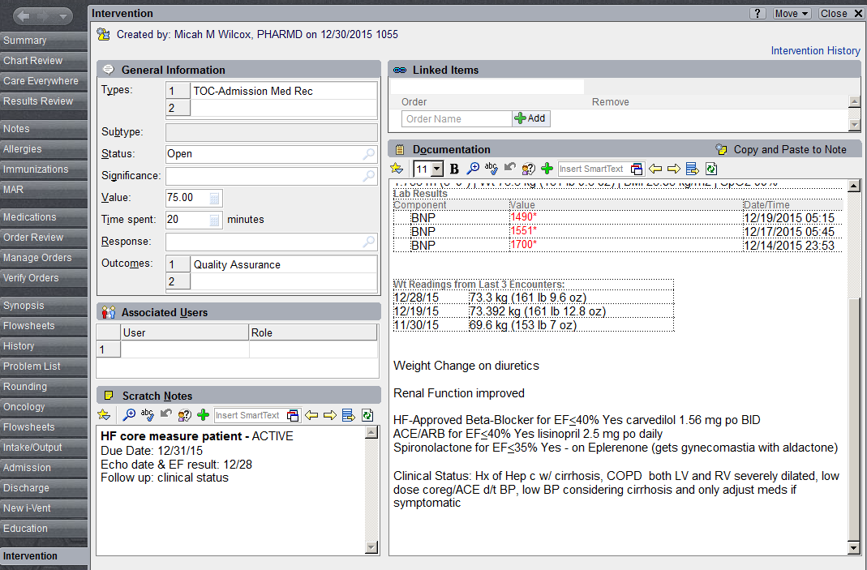

Slide 29
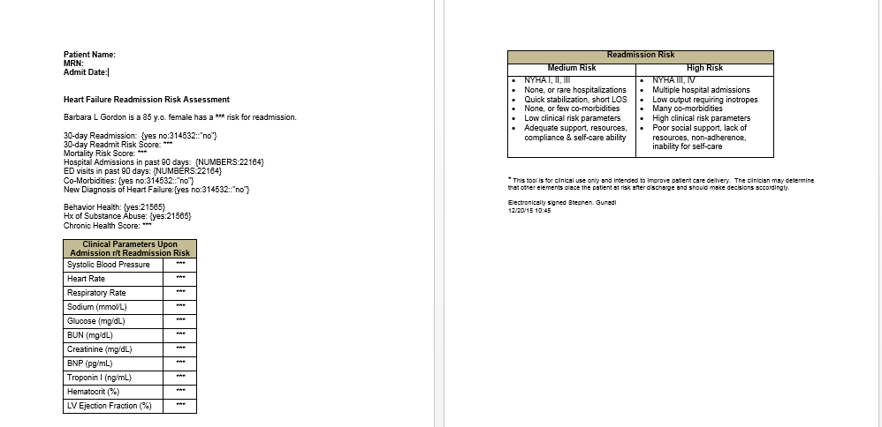
All CHF patients are risk stratified
Allows prioritization of resources

Slide 30
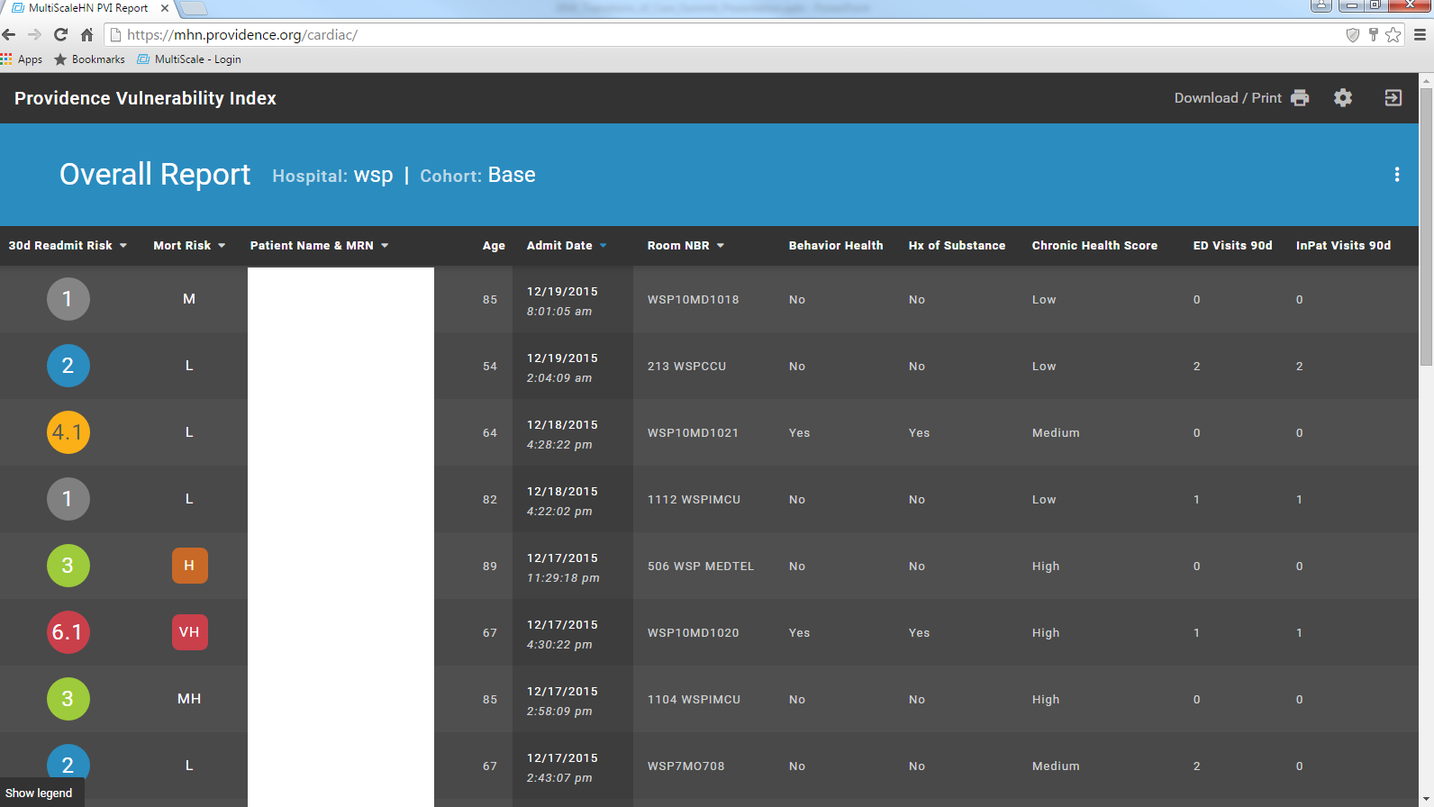
Notes:
Median Best time from HF admission to Multiscale report = 9 hours

Slide 31
Discharge Med Rec & Concierge Services

Slide 32
PSPH Discharge Med Rec Program
All CHF, AMI and CVS patients receive discharge med rec & concierge services
Proactive identification of patients discharging
After Visit Summary is printed

Slide 33
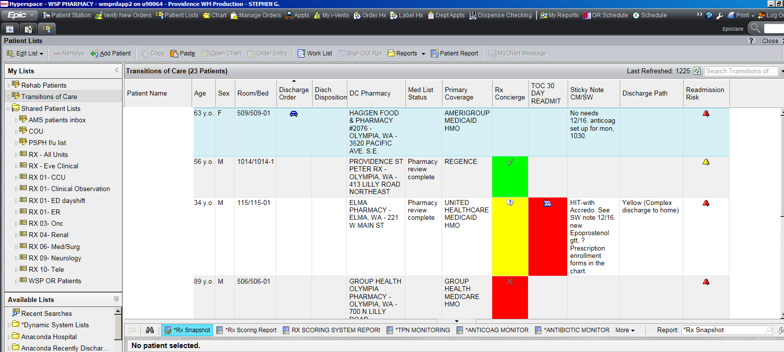

Slide 34
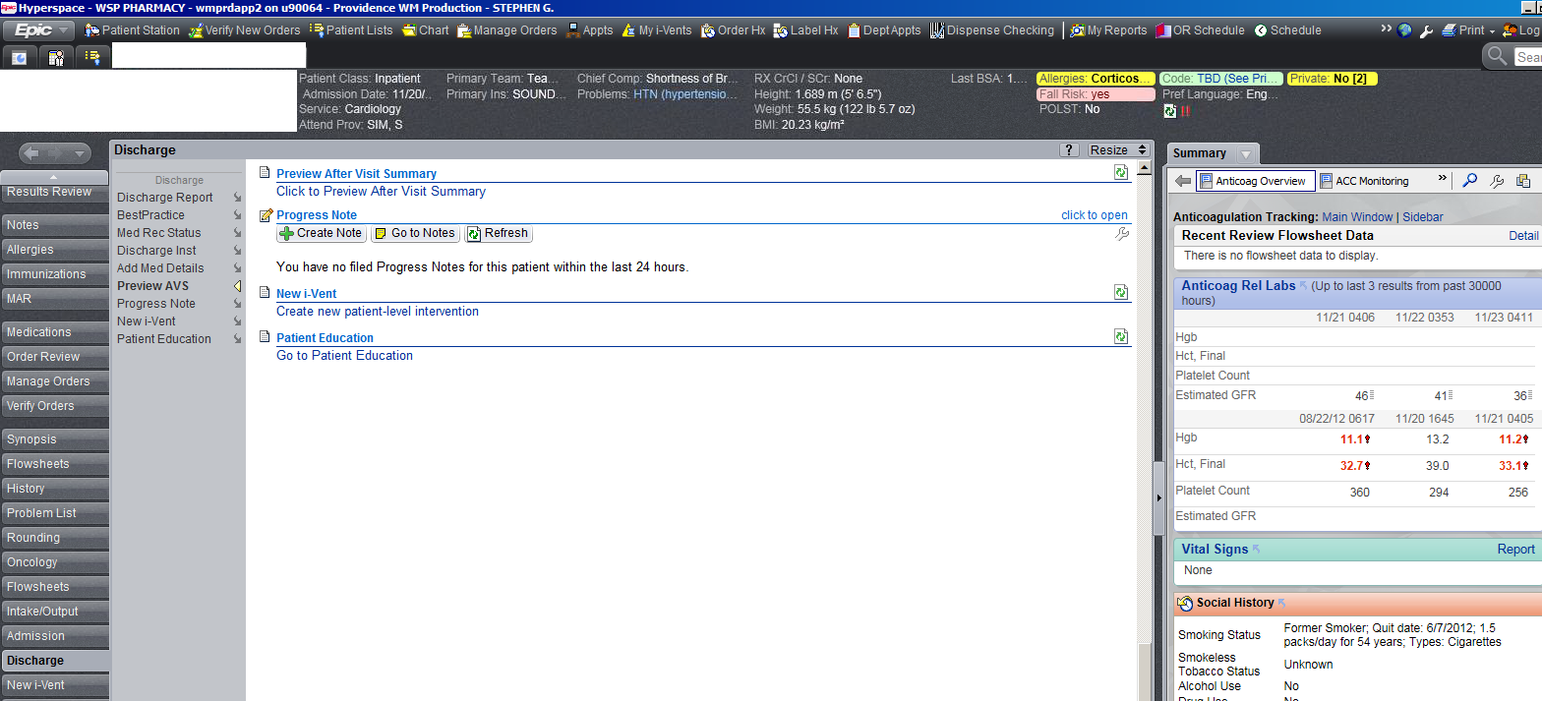

Slide 35
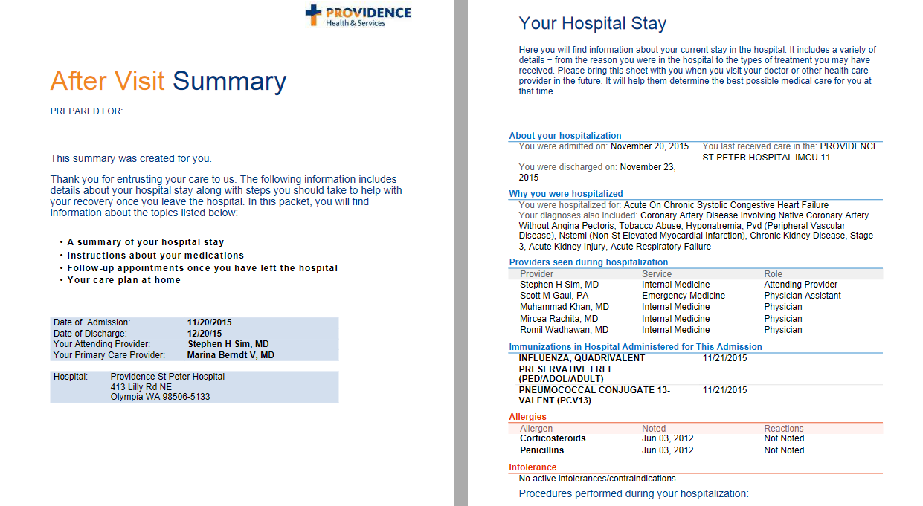

Slide 36
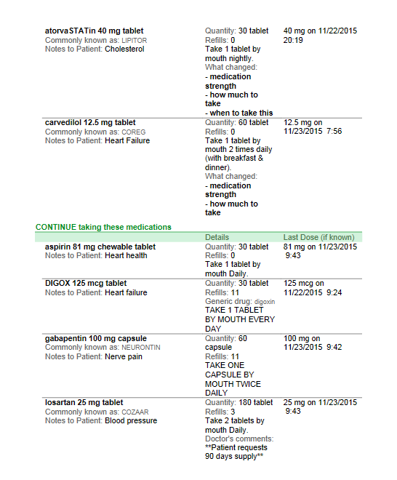
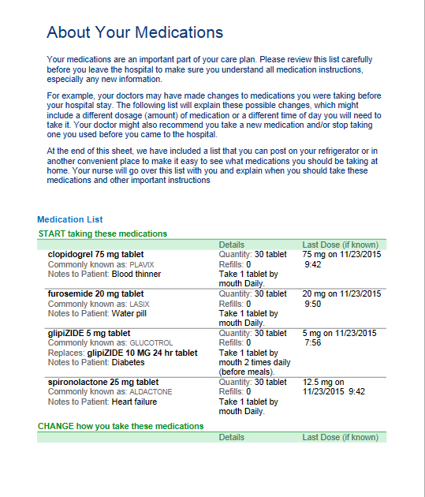

Slide 37
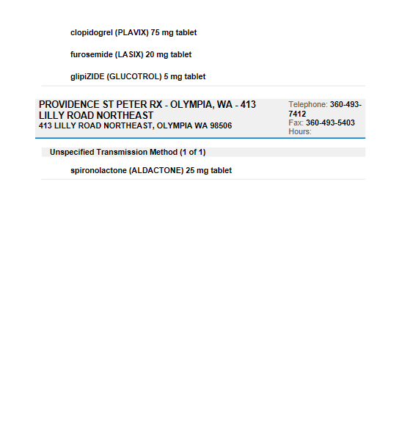
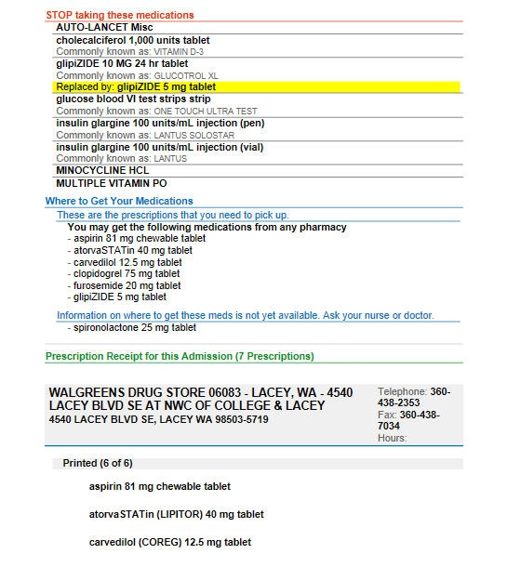

Slide 38
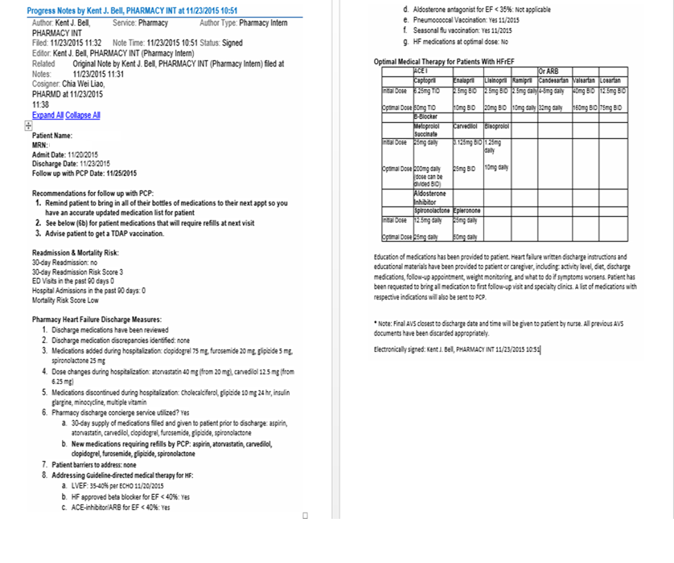

Slide 39
PSPH Discharge Med Rec Program
Discharge meds are reconciled against inpatient meds and PTA meds
Pertinent labs are reviewed
Provider discharge summary and progress notes are reviewed
Collaborate with nursing, case management and physician on any discharge medication issues (ie: financial constraint)

Slide 40
PSPH Discharge Med Rec Program
Concierge Services
All patients are offered to have their prescriptions filled at PSPH outpatient pharmacy prior to discharge
Insurance billed like any other retail pharmacy
Patient provided envelope to provide payment after discharge
Notes:
40% of patients filled their prescriptions on the day
of discharge
20% filled them one to two days later
18% waited three to nine days after discharge
Only 21% of patients reported understanding why
they were prescribed medications
Only 11% of patients understood how to take their
medications

Slide 41
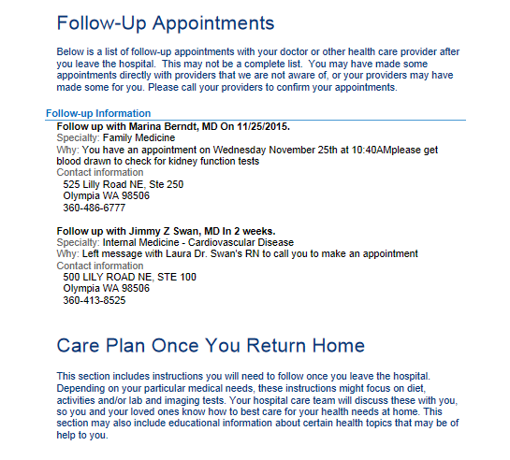
PSPH Discharge Med Rec Program

Slide 42
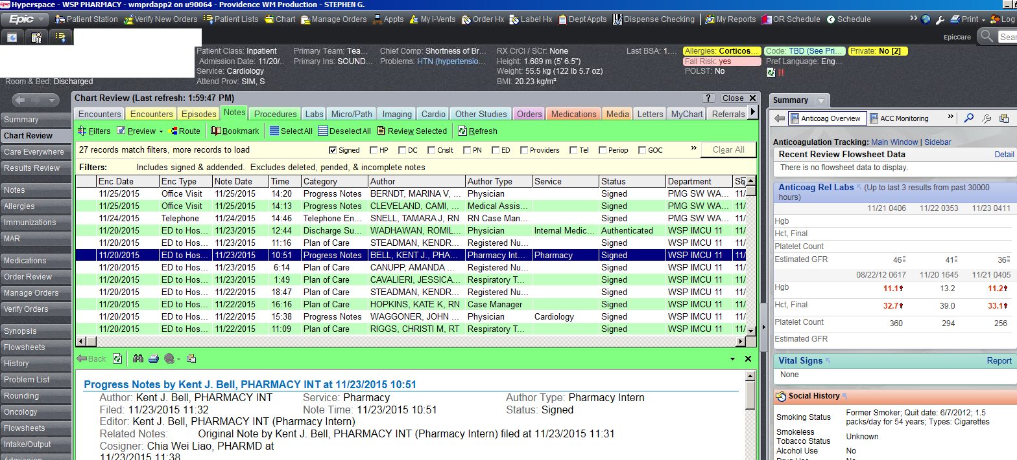
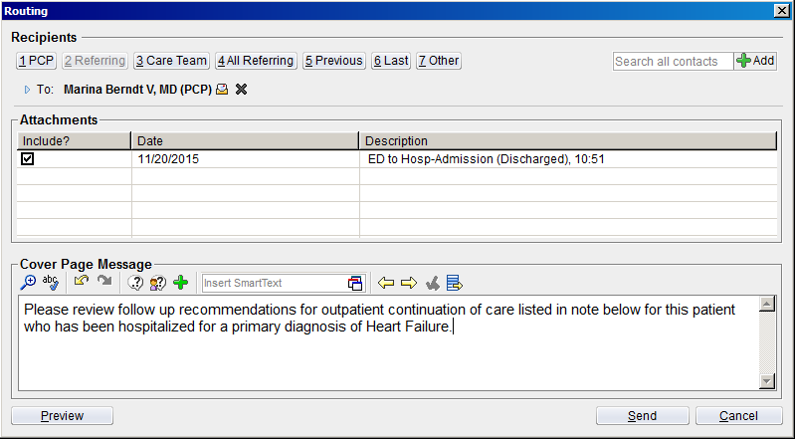

Slide 43
PSPH TOC DATA

Slide 44
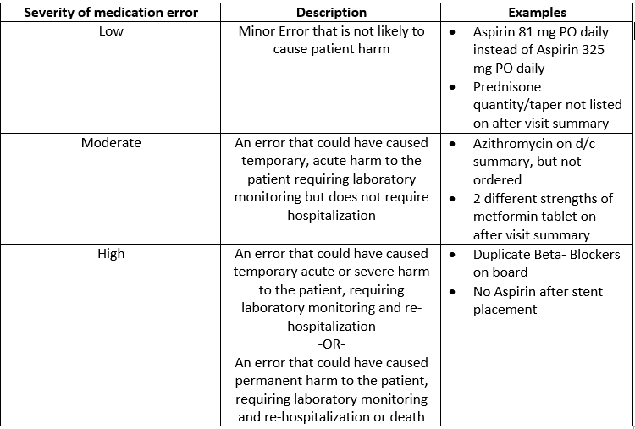
PSPH Medication Error Severity

Slide 45
Notes:
867 HF discharges 2013 (error rate 24%) – 535 Tableau
841 HF discharges 2014 (error rate 23%) – 508 Tableau
737 discharges 2015 (error rate 18%) – 581 Tableau

Slide 46
Pharm Pract (Granada) 2015 Oct-Dec;13(4):634. doi: 10.18549/PharmPract.2015.04.634. Epub 2015 Dec 15

Slide 47
US Averge HF 30 Day Readmission Rate = 22%
Notes:
Typically about 30-40 primary HF discharges/month
So roughly 400-500 patients/year

Slide 48
Notes:
O/E ratio compares your hospital to your peers
Want this ratio below 1 -> doing well

Slide 49
Notes:
835 discharges (error rate 19%)
Discharges = 494 (Tableau)

Slide 50
Pharm Pract (Granada) 2015 Oct-Dec;13(4):634. doi: 10.18549/PharmPract.2015.04.634. Epub 2015 Dec 15
Notes:
3rd quarter 2014 = 20 high severity errors
2015 = 40 high severity errors

Slide 53
# Patients = 1333
# AVG D/C Meds = 12.3
AVG Time = 52.7 minutes
Notes:
PSPH 340b program active February 2014 (inpatient) and April 2014 (outpatient)
Only ER/Hospital Discharge Patients
30-40% of scripts filled through op rx are TOC patients

Slide 54
PSPH Follow-Up Phone Call
CHF patients receive phone call from heart failure navigators within 72 hours of discharge
Follow-up phone call questions
  Symptoms/Weights
    Edema, weight gain, diet
  Medication Management
    Compliance, education
  Appointments
    PCP/Cardiologist
  Home Services

Slide 55

Questions

Slide 56
Let us meet again..
We welcome you to our future conferences of Conference Series LLC
through
6th World Pharmacists & Clinical Pharmacy Annual Congress May 22-24, 2017 Chicaago, IL, USA
http://http://annualmeeting.conferenceseries.com/pharmacists/

