Slide 1
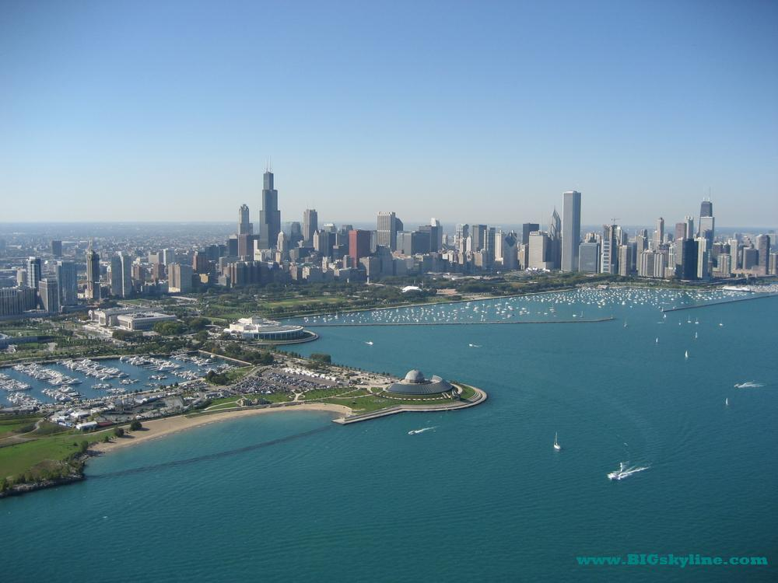

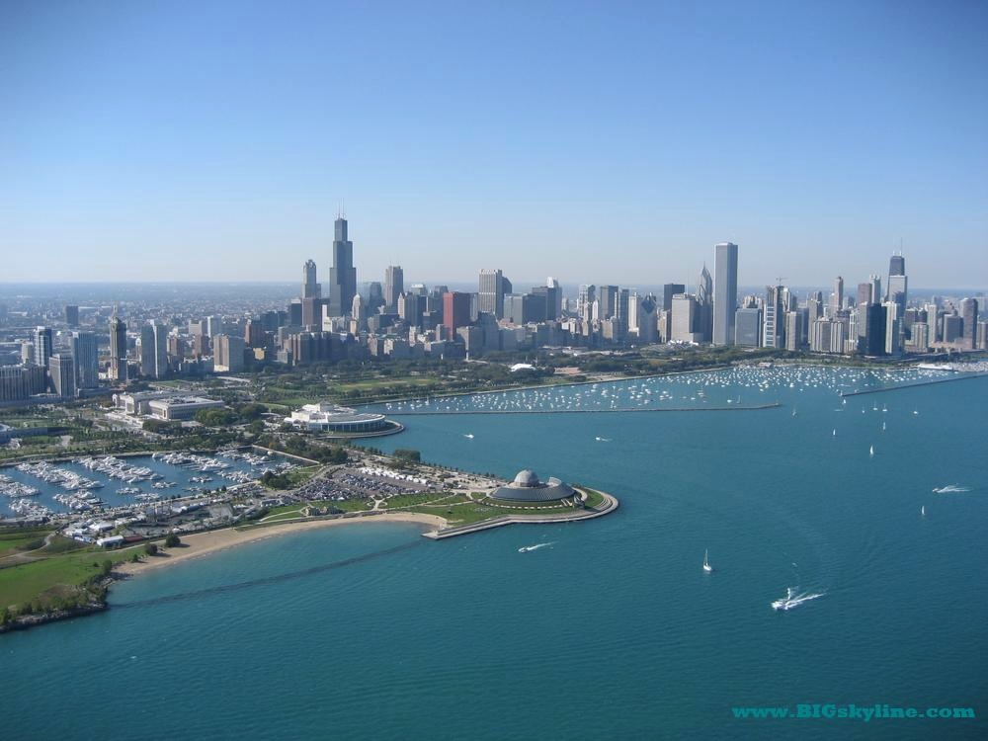
Therapeutic Inflammatory Monocyte Modulation Using MARCO-Targeting Immune-Modifying Nanoparticles for Amelioration of Neuroinflammatory Disease
Int. Congress on ‘Neuroinflammation and Therapy’
San Francisco, CA
July 22, 2015
Stephen D. Miller, Ph.D.
Department of Microbiology-Immunology and
The Interdepartmental Immunobiology Center
Northwestern University Medical School
Chicago, IL

Slide 2
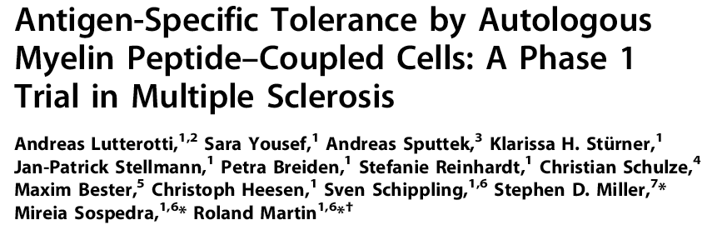
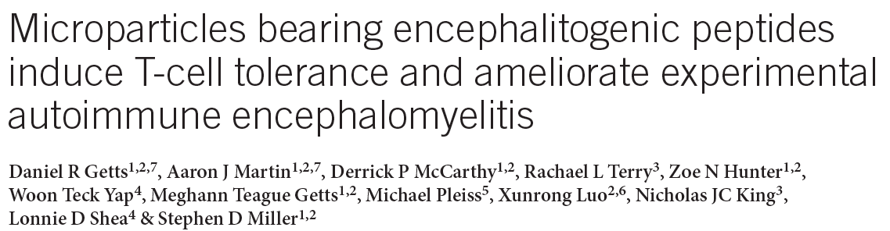
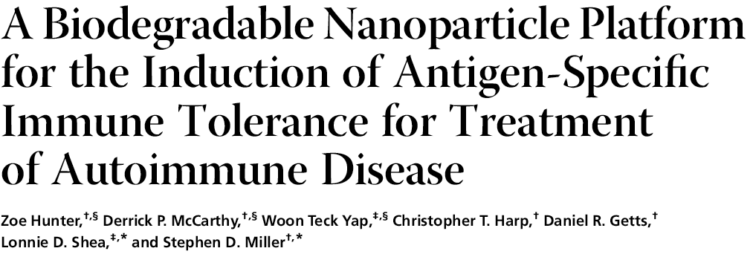
Background
Immune tolerance for the effective prevention and treatment of autoimmune disease (CD4 Th1/Th17), allergic responses (CD4 Th2), and virus-induced gene replacement therapy (CD8) can be effectively induced by the i.v. infusion of Ag-linked to apoptotic autologous leukocytes or to Ag-linked carboxylated nanoparticles composed of either polystyrene or the FDA-approved biodegradable polymer poly(lactide-co-glycolide).
Ag-nanoparticle tolerance following i.v. infusion is dependent upon uptake of Ag-linked PS and PLG nanoparticles by tolerogenic APCs in the splenic marginal zone and liver via the scavenger receptor MARCO.
During in vivo trafficking experimentation with Ag-PLG nanoparticles, it was discovered that nanoparticles with specific surface characteristics can bind circulating peripheral inflammatory monocytes. We thus asked if PLG nanoparticles could be used to ameliorate diseases associated with pro-inflammatory cytokine release by inflammatory monocytes.

Slide 3
Introduction – Role of Inflammatory Monocytes in CNS Inflammatory Diseases
Numerous subsets of monocytes have been defined, with these subsets having specific roles during homeostasis & disease
In mice Ly6C^{hi/+} CCR2⁺ monocytes are known as inflammatory (ΦM) or non-classical monocytes
These monocytes serve as precursors to numerous effector cells including DC subsets and tissue macrophages
Importantly, they are pathogenic in numerous CNS inflammatory disease models including experimental autoimmune encephalomyelitis, West Nile Virus encephalitis, stroke, spinal cord injury, and potentially epilepsy
In humans CCR2⁺CD16^{+/-} monocytes correlate with increased tissue damage after cardiac infarction, stroke, CNS infection and even alcoholic hepatitis. Critically, no effective therapy exists to modulate ΦM
During in vivo ΦM trafficking experimentation, it was discovered that ΦM express MARCO and nanoparticles with specific surface characteristics can modulate ΦM, reducing their pro-inflammatory capacity & promoting tissue regeneration.
The nanoparticles are referred to as Immune Modifying Nanoparticles (IMPs) and are effective at reducing neuroinflammation

Slide 4
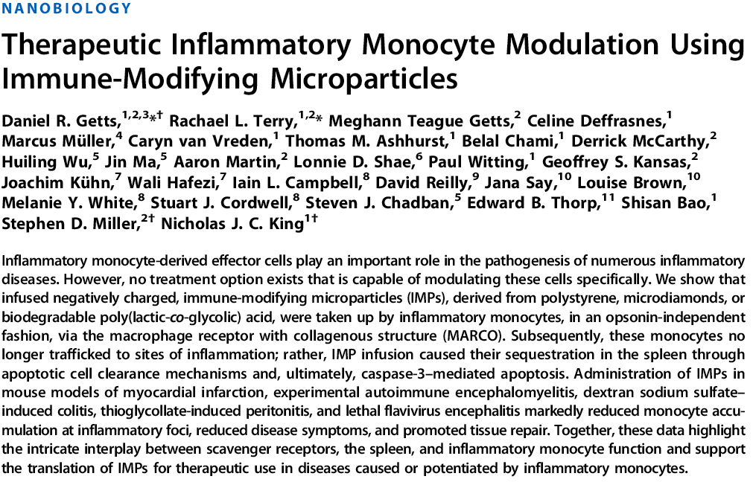
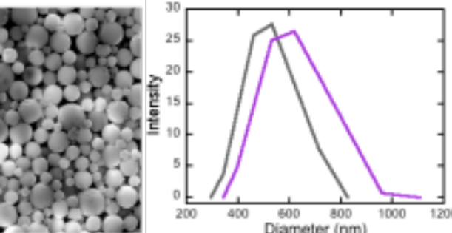
Short-term course of 3-4 daily i.v. infusions of 500 nm carboxylated ‘naked’ PLG nanoparticles target blood-borne inflammatory monocytes via the MARCO scavenger receptor and divert the monocytes from the inflammatory injury sites to the spleen where they upregulate caspase 3 and undergo apoptotic cell death. This leads to significant amelioration of:
West Nile Virus Encephalitis – prevented fatal disease
EAE
DSS Colitis
Thioglycollate-induced Peritonitis
Kidney Ischemia Reperfusion Injury
Myocardial Infarction
PLS
PLG
ζ Potential < -50 mV
PLS – polystyrene
PLG - poly(lactide-co-glycolide)

Slide 5
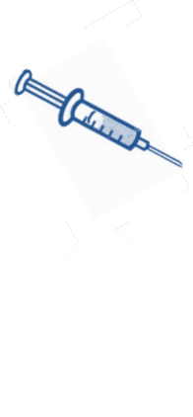

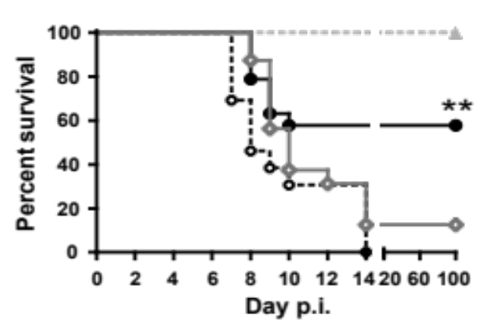
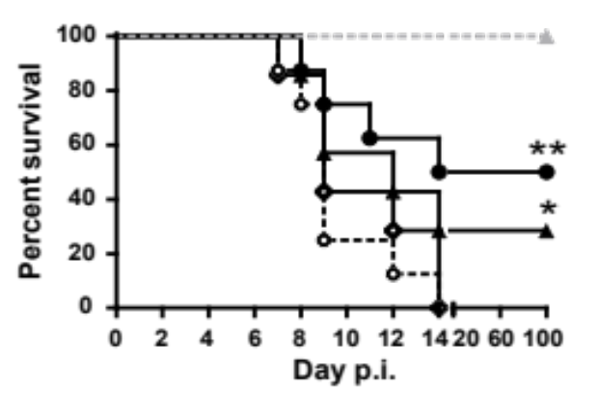



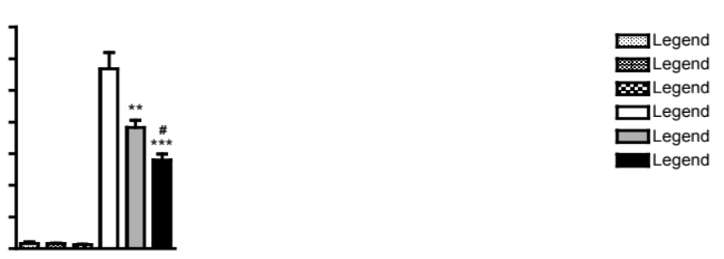

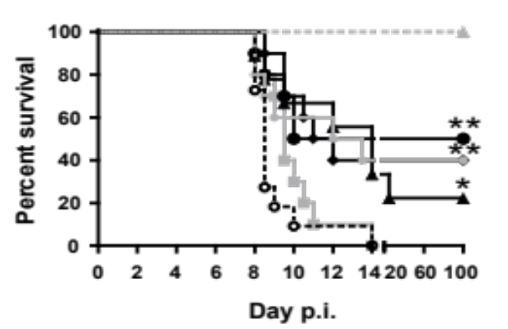

IMP Infusion Ameliorates West Nile Encephalitis in Mice
Treatment Protocol:
IMP I.V.
Infusion
Monitor Survival
Examine CNS (D7)
D0
~D6
WNV Infection
Weight loss & Seizures
A.
IMP Increase Survival
Not Opsonin Dependent
-ve Charge Dependent
B.
C.
Vehicle (n=15)
PS-NP (n=16)
PS-IMP (n=20)
No weight loss (n=40)
Vehicle (n=16)
PS-IMP (n=16)
PS-NP (n=14)
PS-PP (n=14)
No weight loss (n=28)
PS-IMP (n=10)
Opsonized PS-IMP (n=10)
No weight loss (n=10)
Reduced IMΦ In CNS
E.
Dose Response Curves
D.
1.8 x 10⁶
Mock + Vehicle
Mock + PS-NP
Mock + PS-IMP
WNV + Vehicle
WNV + PS-NP
WNV + PS-IMP
1.5 x 10⁶
1.2 x 10⁶
Vehicle (n=10)
IMP 1.775 mg (n=10)
IMP 0.71 mg (n=10)
IMP 0.355 mg (n=10)
IMP 0.1775 mg (n=10)
IMP 0.0355 mg (n=10)
No weight loss (n=58)
1.0 x 10⁶
Cell numbers
7.5 x 10⁵
5.0 x 10⁵
2.5 x 10⁵
0
ΦIM-derived
macrophages
Getts, et al. 2014. Sci. Transl. Med. 6:219:ra7.

Slide 6
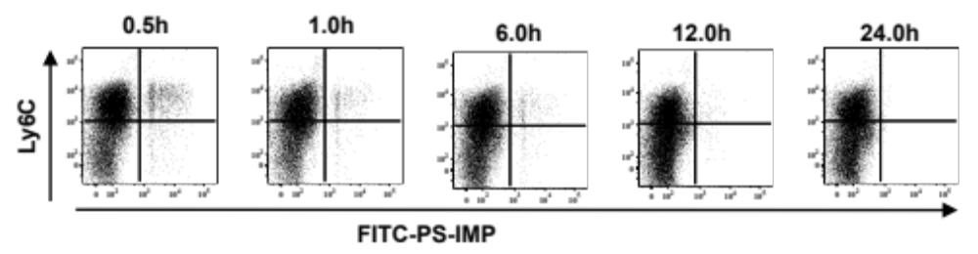
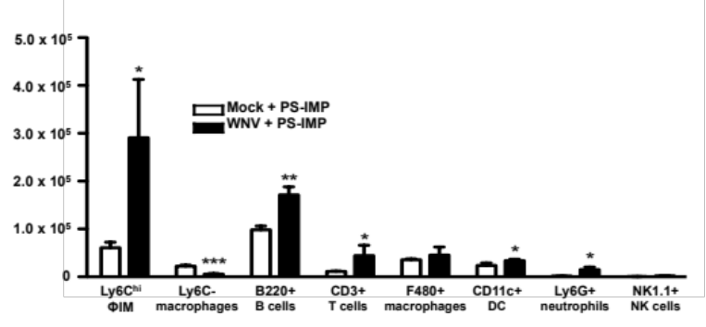
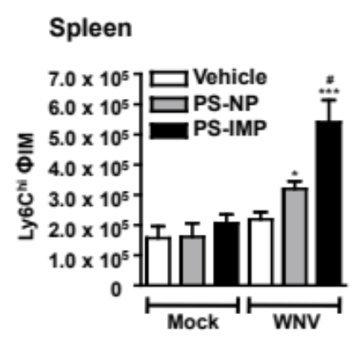
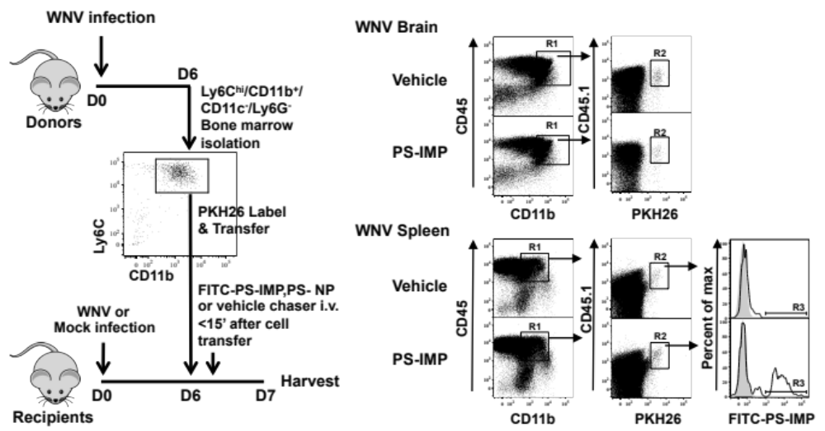

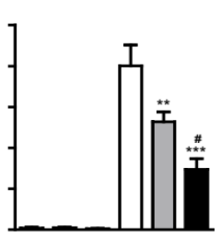
IMP Treatment Redirects IMΦs to Mouse Spleen
IMP are taken up by blood Ly6c^{hi} IMΦ
A
IMP localize with splenic IMΦ
IMP increase splenic IMΦ
B
C
D
IMP inhibit IMΦ entry into WNV infected brain
E
F
Vehicle
PS-NP
PS-IMP
2.5 x 10⁴
2.0 x 10⁴
1.5 x 10⁴
Transferred cells
1.0 x 10⁴
G
5.0 x 10³
0
Getts, et al. 2014. Sci. Transl. Med. 6:219:ra7.

Slide 7
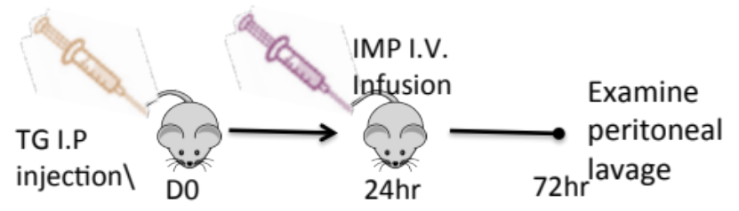
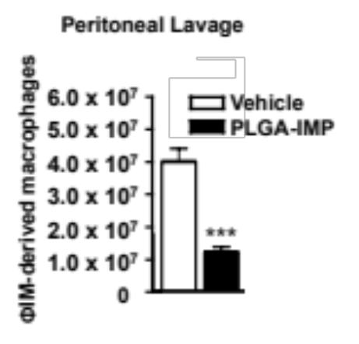
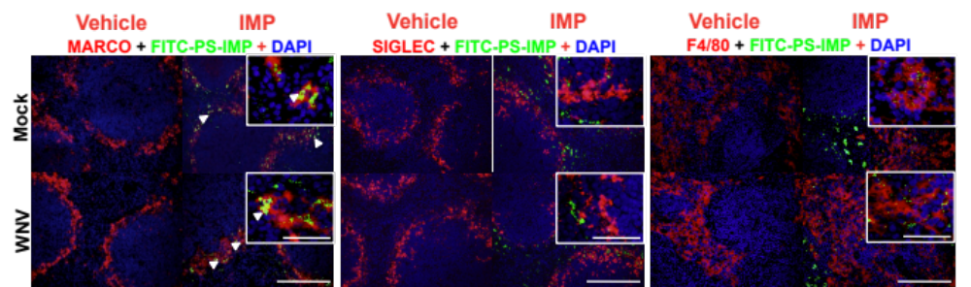
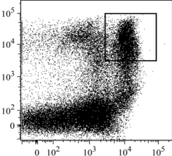
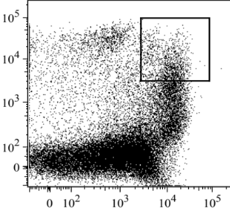
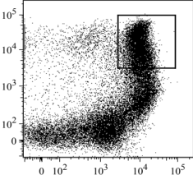
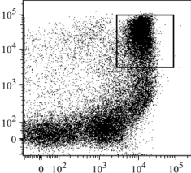
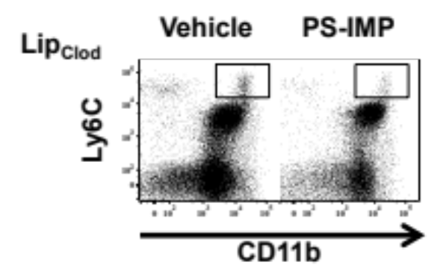
IMP Treatment Ameliorates Thioglycollate-Induced Peritonitis in a MARCO-Dependent Manner
A. Thioglycollate (TG) Peritonitis & IMP treatment
IMP Inhibit Macrophage Influx
IMP co-localize with MARCO⁺ Cells
MARCO is critical for IMP efficacy
B.
C.
D.
Vehicle
PS-IMP
WT
Ly6C
MARCO^{-/-}
CD11b
IMP Effective in Mice Depleted of MZM
E.
Getts, et al. 2014. Sci. Transl. Med. 6:219:ra7.

Slide 8
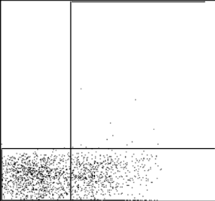
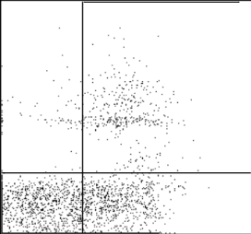
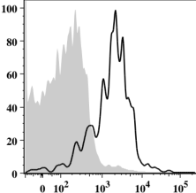
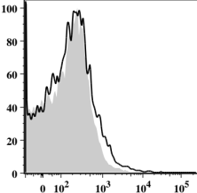
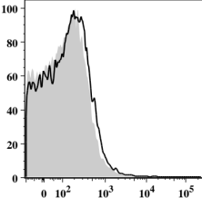
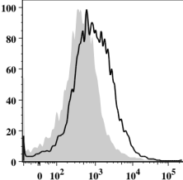
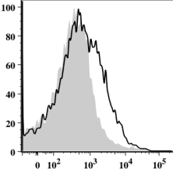
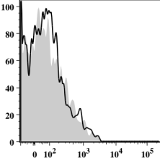
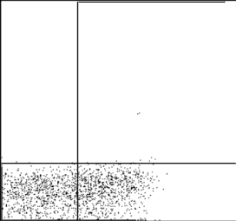
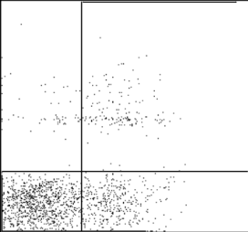

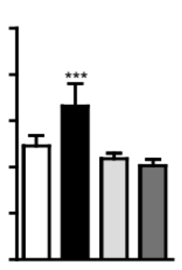
Uptake of PS-IMPs by MARCO⁺ Inflammatory Monocytes Induces Apoptosis
Circulating IMΦ Express MARCO
IMP Binding to IMΦ Induces Annexin V
Vehicle
A.
B.
PS-IMP
Ly6C⁺
Ly6C⁻
B220⁺
WT
Percent of max
F4/80⁺
CD11c⁺
Ly6G⁺
FITC-PS-IMP
MARCO^{-/-}
MARCO
TG WT
TG MARCO^{-/-}
Annexin V
IMP Binding to IMΦ Increases Caspase 3
C.
WT + Vehicle
WT + PS-IMP
MARCO^{-/-} + Vehicle
MARCO^{-/-} + PS-IMP
2.5 x 10⁵
2.0 x 10⁵
1.5 x 10⁵
Ly6C^{hi}
Caspase-3+ ΦIM
1.0 x 10⁵
5.0 x 10⁴
0
Getts, et al. 2014. Sci. Transl. Med. 6:219:ra7.

Slide 9
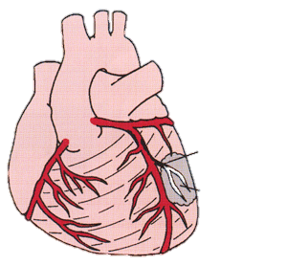
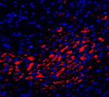
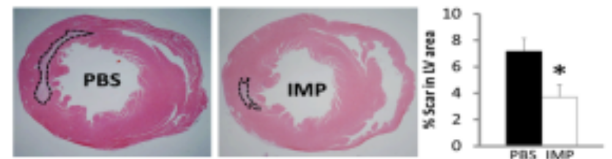
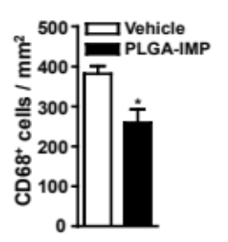
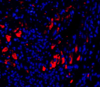
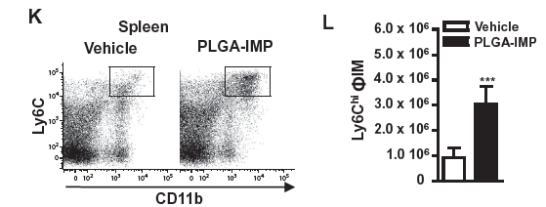
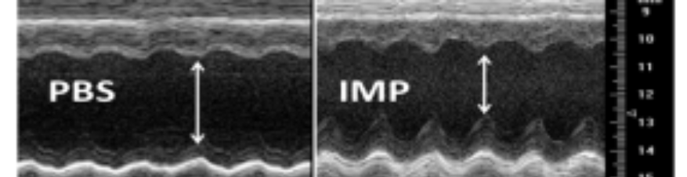
PLG-IMP Infusion Protects from Inflammatory Damage in a Myocardial Ischemia (LAD occlusion)-Reperfusion Model
Experimental Design
IMP
Harvest
Tissue
Damage
Hours
48
0
72
96
45’
24
28 days
Left Anterior Descending
Coronary Artery Occlusion and Release
A. Macrophage infiltration Reduced at
7 days post-IR
C. Infarct Scar Size Reduced 45% at
28 days post-IR
Vehicle
*
PLGA-IMP
D. 2-dimensional M-mode Echocardiography – systolic
ejection fraction increased 21% vs. controls at
28 days post-IR
Inflammatory Monocytes Diverted
to the Spleen at 7 days post-IR
Getts, et al. 2014. Sci. Transl. Med. 6:219:ra7.

Slide 10
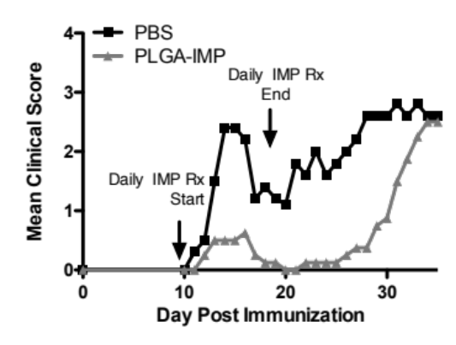
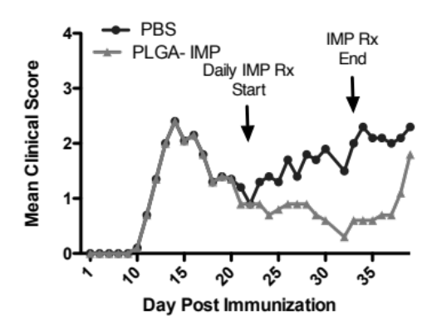
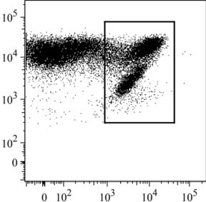
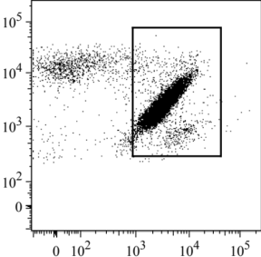
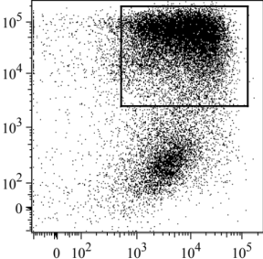
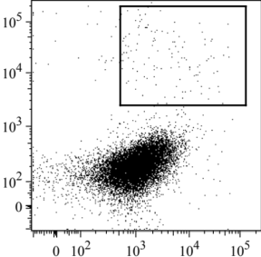
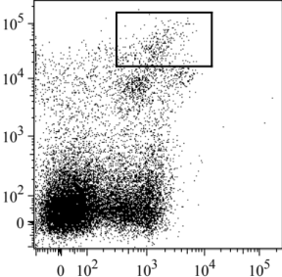



IMP Infusion Ameliorate EAE Induction/Progression by Targeting Blood-Borne Inflammatory Monocytes
A. EAE Disease Scores
Unlike tolerance with Ag-PLG, disease recurs
B. CNS Flow Cytometry
Vehicle
PLG-IMP
Vehicle
PLG-IMP
Blood-borne IMϕ are responsible for the vast majority of CNS damage and become iDCs
CD45
Ly6C
CD11b
CD11c
C. Spleen Flow Cytometry
D. CNS and Spleen Cellularity
Vehicle
PLG-IMP
Spinal
Cord
Spleen
2.5 x 10⁵
**
PBS
PSB-IMP
2.0 x 10⁵
PLG IMPs divert IMϕ to the spleen where they die via apoptosis
1.5 x 10⁵
Cell Number
*
1.0 x 10⁵
Ly6C
0.5 x 10⁵
*
0
Leuko
IM-DCs
Ly6c^{hi} IM
CD11b
Leukocytes
IM-DCs
Ly6C^{hi}
IM
Getts, et al. 2014. Sci. Transl. Med. 6:219:ra7.

Slide 11


IMP Infusion Reduces Blood-Borne Inflammatory Infiltrates and Enhances Clinical Recovery in Acute Spinal Cord Injury
A. Time Line of SCI and PLG Nanoparticle Therapy
IMP I.V. Infusions
Immunohistochemistry
Spinal
Cord
Crush
D0
2hr
24hr
48hr
Wk 12
B. Spinal Cord Flow Cytometric Analysis – 48 hrs pSCI
C. Clinical Disease Course
*
*
*
*
*
**
D. Spinal Cord Immunocytochemistry – 7d pSCI
Ifergan, et al., preliminary data

Slide 12



IMP Infusion Reduces Seizure Severity and Infiltration of Brain-Infiltrating APCs in the Kainic Acid Induced Epilepsy
A. Time Line of PLG-IMP Therapy and Kainic Acid Treatment in Post-Natal d25 B6 Mice
IMP I.V. Infusions
D0
KA
1&3hr
D1……….D7
Daily for 7 Days
D14
KA
D17
Sacrifice
B. Latency to
Seizure Onset
C. Brain
Cellularity
D. Brain-Infiltrating APCs
*
Minutes to Seizure Onset
Total Cells/ g brain
*
*
Infiltrating APCs/ g brain
*
Xu, et al., preliminary data

Slide 13
Conclusions – Role of Inflammatory Monocytes in CNS Inflammatory Diseases
IMP bind to MARCO⁺ inflammatory monocytes, resulting in apoptosis and removal in the spleen
IMP are highly potent, capable of reducing pathology in numerous unrelated models of neuroinflammation including viral encephalitis, spinal cord crush injury, epilepsy and EAE autoimmunity
Phase 1/2 clinical testing is planned for late 2015/early 2016 in MI patients

Slide 14


Proposed MARCO-Dependent Anti-Inflammatory Mechanisms of Carboxylated PLG Nanoparticles (IMPs) in MI Model
Tissue
Damage

