Slide 1


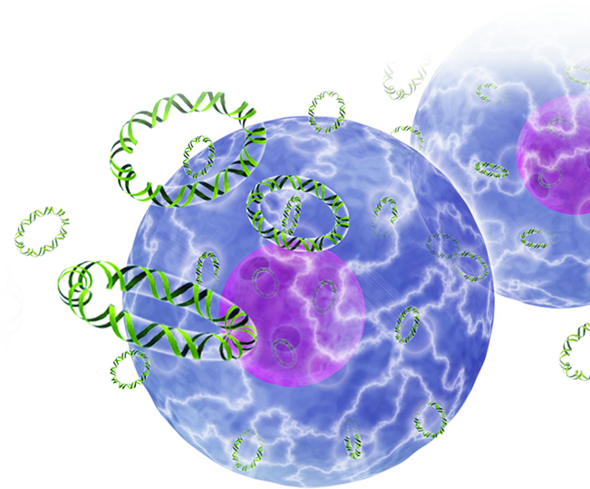
Enhanced delivery of DNA-based vaccines and immunotherapeutics through next-generation electroporation devices
Stephanie Ramos, Ph.D.
Inovio Pharmaceuticals
Cell & Gene Therapy, 2015
London, UK
August 10, 2015

Slide 2
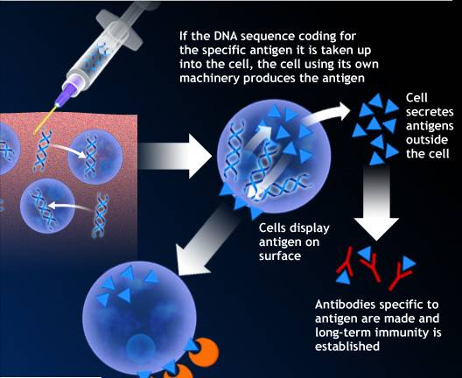
Attractiveness of DNA Vaccines
Safer than live virus vaccines
  Cannot cause disease
  No significant side effects
Prevent and treat
  Vastly expands market size
  Generate T cell & Antibody responses
Faster development
Easier to manufacture
Combination vaccines possible
Key limitation of delivery being recently overcome with electroporation
Electroporation is a key enabling technology

Slide 3
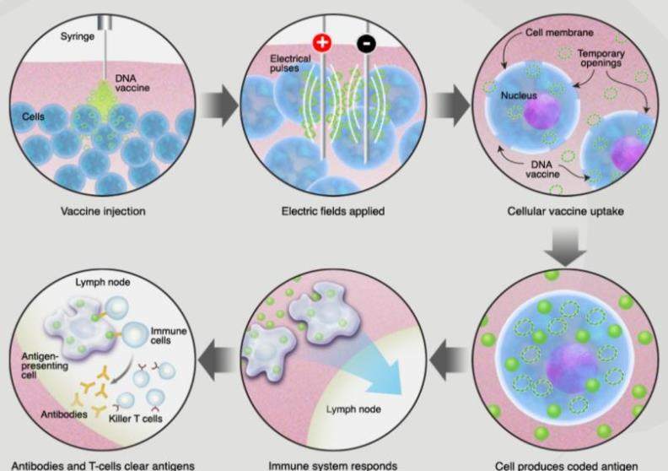
Enhanced DNA Delivery: Electroporation

Slide 4
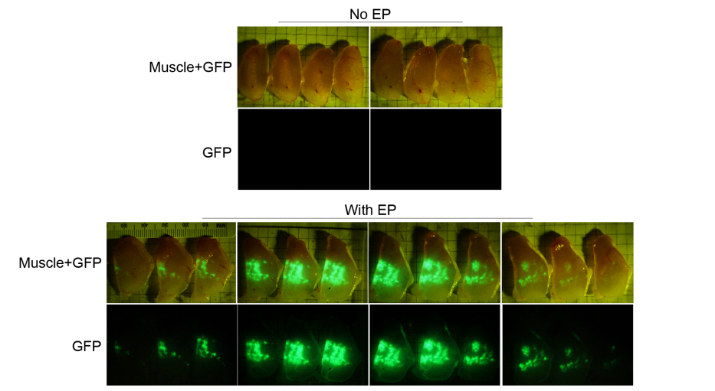
INOVIO: Electroporation Enhanced Transfection
Sardesai & Weiner, Curr Opin Immunol 2011

Slide 5
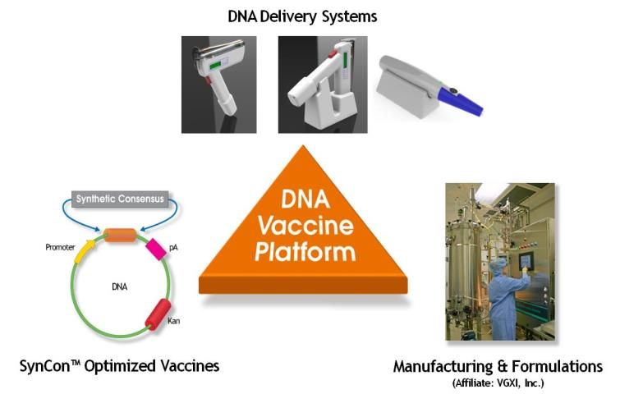
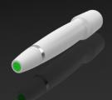
INOVIO: Fulfilling the Promise of DNA Vaccines

Slide 6
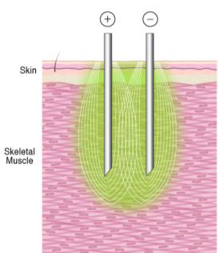
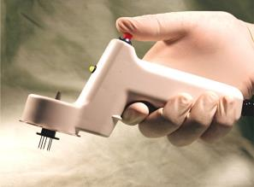
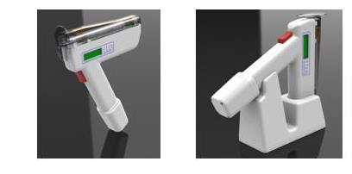
Muscle EP Device in the Clinic: CELLECTRA®-5P
Phase I/II Device
Phase III Device
IM-Electroporation
Prophylactic Phase I
FLU-001 US
FLU-001 Korea
HIV-080
RV-262
EBOV-001 (Ebola)
Therapeutic Phase I
HIV-001 (HIV)
HPV-001
HPV-002
HPV-004
HPV-005
HPV-006
TRT-001 (breast, lung, pancreatic cancers)
PCa-001 (prostate cancer)
VGX-6150-01 (chonic HepC)
HBV-001 (chronic HepB)
Therapeutic Phase II
HPV-003 (HPV-assoc cervical dysplasia)
EORTC-1411 (HPV-associated cervical cancer)
(Flu)
(HIV)
(HPV-associated CIN)
(HPV-associated cancers)
Number of total patients treated - 550+
Number of total immunizations - 1450+

Slide 7

INOVIO’s Clinical Experience
VGX-3100: Non-Surgical Option for the Treatment of HPV-Specific High-Grade Cervical Dysplasia
Combination HPV16/18 E6/E7 DNA immunotherapy
Two DNA plasmids delivered simultaneously via IM injection followed by IM electroporation (CELLECTRA®-5P)
Capitalizes on Inovio’s ability to drive the body’s own immune system to seek and destroy pre-cancerous cells
pCon16E6E7
 | HPV 16 E6 |  | HPV 16 E7
*
*
*
⬇
⬇
High Efficiency
Leader Sequence
Endoproteolytic
cleavage site
pCon18E6E7
 | HPV 18 E6 |  | HPV 18 E7
*
*
*
⬇
⬇
⬇Mutations in Rb binding site
*Deletions or mutations important for p53 binding and degradation

Slide 8
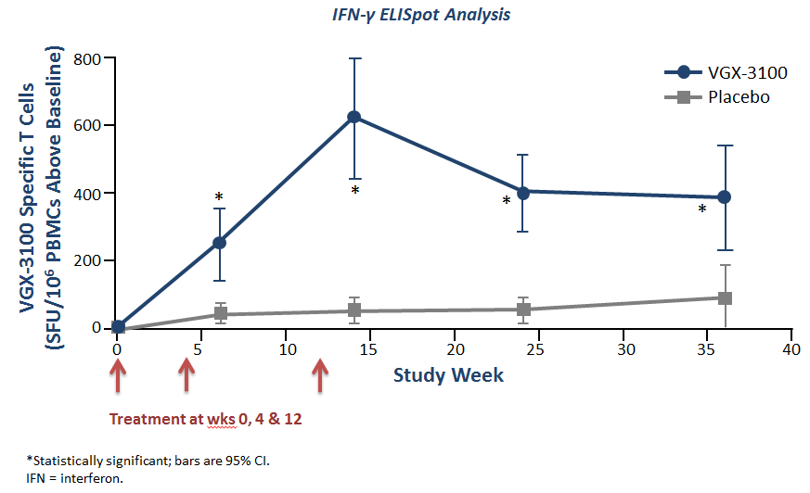
VGX-3100 Phase II:
Generation of Robust HPV-16 and HPV-18 T Cell Responses
Inovio Pharmaceuticals: Proprietary Data

Slide 9
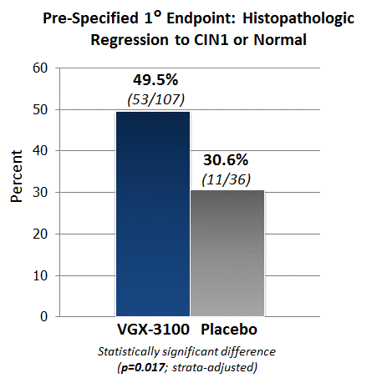
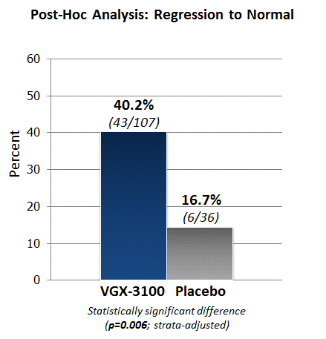
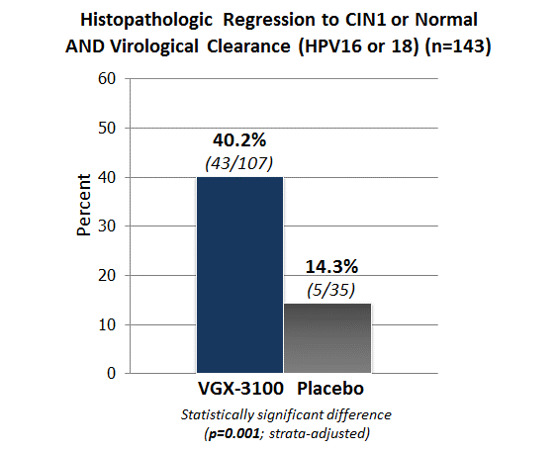
VGX-3100 Phase II:
Clinically Significant Efficacy in the Treatment of Cervical Dysplasia
Significant disease regression and viral clearance
First report of clinical efficacy with a therapeutic naked DNA vaccine using electroporation delivery
Inovio Pharmaceuticals: Proprietary Data

Slide 10
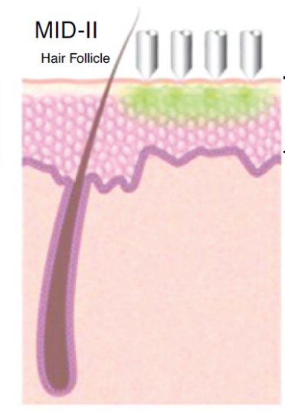
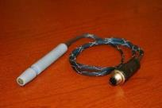
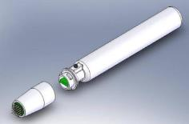
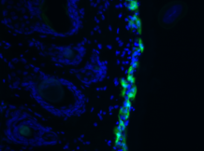
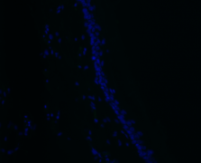




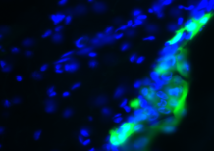
Enhanced DNA Delivery to the Skin via Surface Electroporation
Tethered Surface EP System
Surface EP System
Surface Electroporation
- EP
x20
x40
GFP expression on skin surface
x20
+ EP
- EP
+ EP
x40
- EP
+ EP

Slide 11
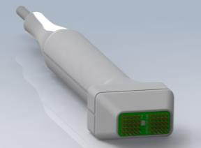
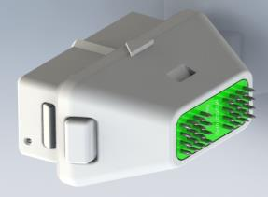



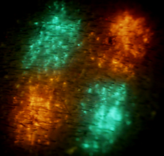


Evolution of Surface EP to a Multi-head Device
GFP only
Injection only
(No EP)
RFP only
RFP and GFP
McCoy, Hum Vacc Immunother 2014

Slide 12




























Expression Kinetics in Skin following SEP
No EP
1 Hr
2 Hr
4 Hr
6 Hr
8 Hr
24 Hr
48 Hr
Day 3
Day 7
Day 12
Day 14
Day 21
Days
1 3 6 9 12 15 18 21
Hours
1 6 12 18 24
Surface Expression
Cellular Expression
Monocyte/Granulocyte Infiltration
Mendoza, Vaccines 2013

Slide 13
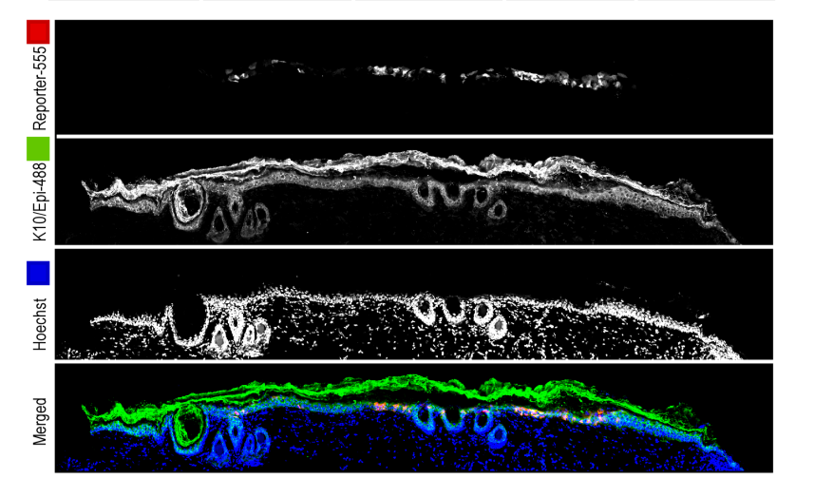
Directly Targeting the Epidermis with SEP
Stratum corneum
Epidermis
Dermis
x10
Smith, Mol Ther Methods Clin Dev 2014

Slide 14
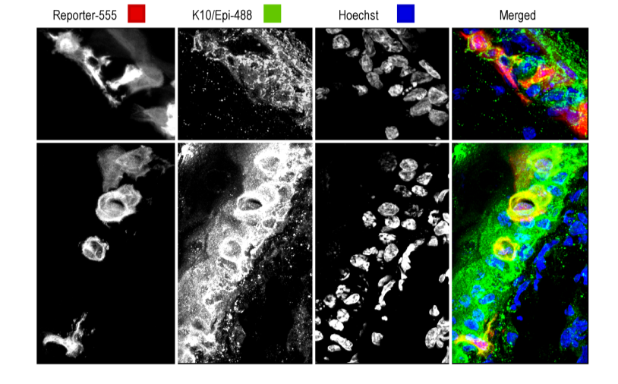
Directly Transfecting Keratinocytes with SEP
Double labeled keratinocytes
x40
Mendoza et al, Hum Vacc Imm 2013

Slide 15
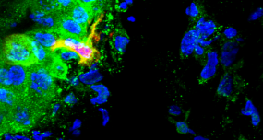
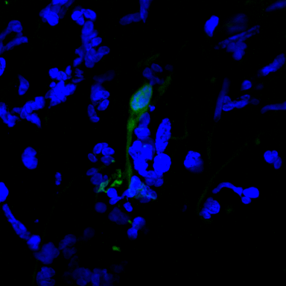
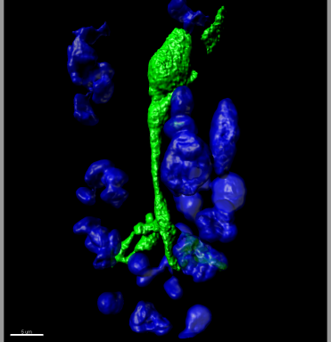
Directly Transfecting Dendritic Cells with SEP
Amante,
Hum Gene Ther Methods 2015
RFP positive dendritic cell
x40
GFP positive dendritic cell
x 60
x 60
Lymphocytes interacting with transfected dendritic cell
IMARIS-3D Rendered

Slide 16
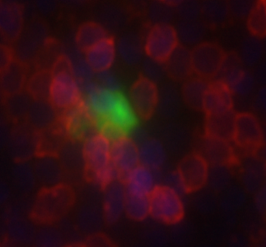
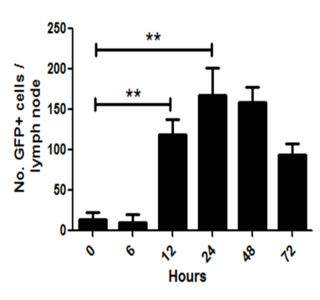
Transfected Cell Migration into Draining Lymph Nodes
GFP positive cell in the T cell zone of the cortex in the inguinal lymph node
Smith, Mol Ther Methods Clin Dev 2014

Slide 17
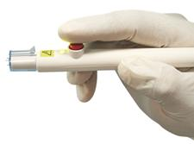
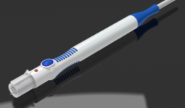
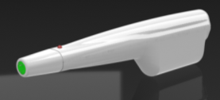
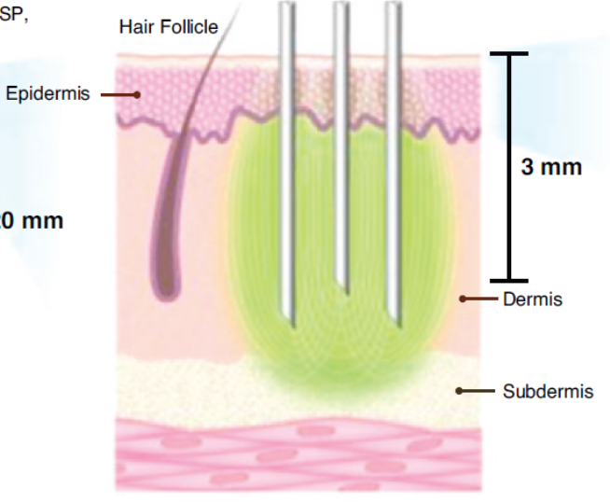

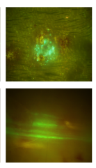
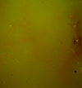
Minimally Invasive Dermal Electroporation – CELLECTRA®-3P
Tethered 3P System
Next Gen Tethered 3P System
Portable Cordless 3P System
No EP 3P-EP
Skin surface
Skin underside
ID Electroporation

Slide 18
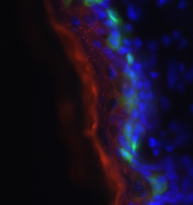
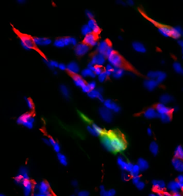
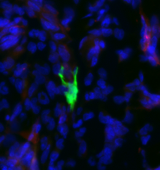
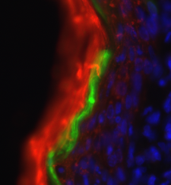
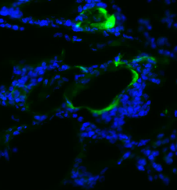
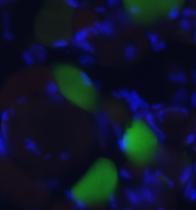
CELLECTRA®-3P targets a wide range of cell types in the skin
Keratinocytes after 1 hour
Fibroblasts
Langerhans Cell
25um
25um
25um
Keratinocytes after 24 hours
Adipocytes
Myocytes
25um
50um
25um
Amante, Hum Gene Ther Methods 2015

Slide 19


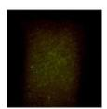
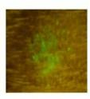


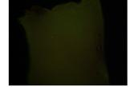
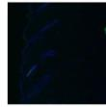
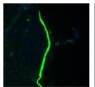
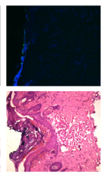
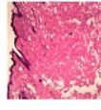
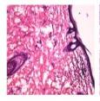



Same target tissue, different biological effect…..
DNA Injection Only
(No EP)
DNA Injection Only
(No EP)
SEP
CELLECTRA-3P
SEP
CELLECTRA-3P
Skin Surface
Epidermal Transfection
+
+++++
+++
Dermal/ Subdermal Transfection
-
-
+++++
Skin Underside
Skin Section (DAPI stained)
Epidermis
: Dermis Transfection Ratio
1:0
5:0
3:5
Skin Section (H&E stained)
Necrosis
-
+
+++++
Skin Section (TUNEL stained)
To be adde
-
++++
+++
To be adde
To be adde
Apoptosis

Slide 20

Acknowledgments
INOVIO
Dinah Amante
Mary Giffear
Alan Gomez
Kim Kraynyak
Jessica Lee
Jay McCoy
Janess Mendoza
Matthew Morrow
Sandra Oyola
Trevor Smith
Katherine Schultheis
Jian Yan
Maria Yang
Niranjan Sardesai
Mark Bagarazzi
J. Joseph Kim
Laurent Humeau
Steve Kemmerrer
Kate Broderick
Amir Khan
University of Pennsylvania
David Weiner & Lab
Scripps
Bill Kiosses
VGXI, Inc.
Dorothy Peterson
This work was supported in part by US Army grant W23RYX-8141-N604: #08023003 and US Army SBIR W81XWH-11-C-0051:# 1031550133. Additional funding support from DTRA and NIH/NIAID

