Slide 1




Forensic Anthropology:
A Novel Scale of Time Since Death Estimation For Use by Forensic Investigators
By Stephanie Giles (MSc, BSc, ACSFS)
Crime Scene Investigator
PhD Student Forensic Anthropology
United Kingdom
Notes:
1

Slide 2
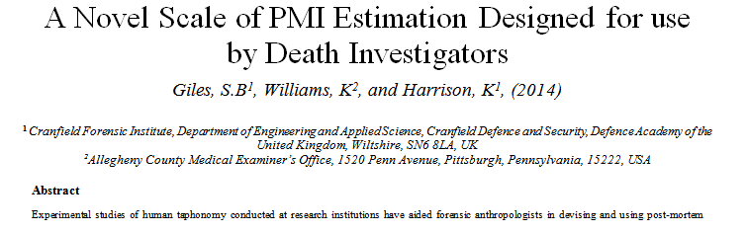
Aims
Develop a new time-since-death estimation method
2) Make a system suitable for use by forensic investigators
3) Validate against current time-since-death estimation methods

Slide 3
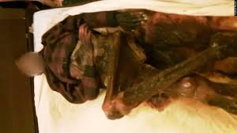


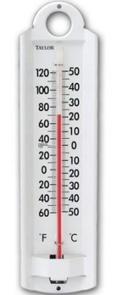



Background
PMI = Time Deceased Found - Time of Death
x No Methodology
x Qualitative
x High PMI Error
x Use for CSI's?
Notes:
3

Slide 4
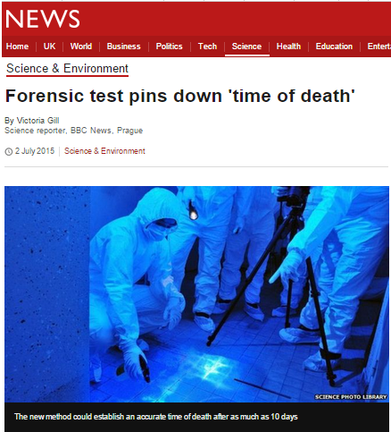
The Problem...
x Small sample sizes
x Non-human analogues
x Experimental conditions
x Low-level theories
x Limited applicability to forensic practice

Slide 5
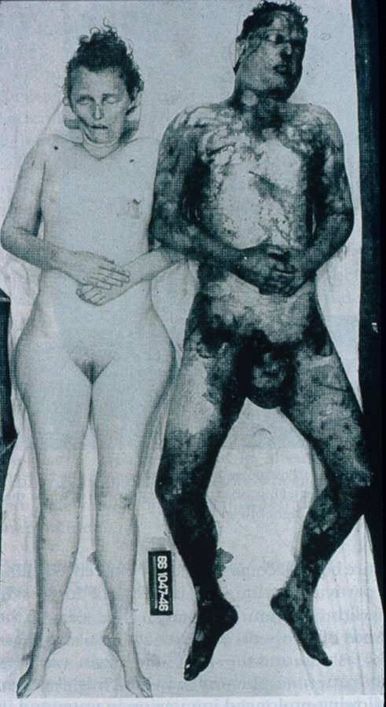

Slide 6
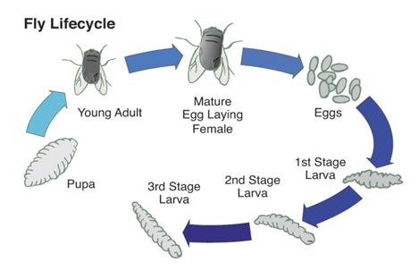
PMI Estimation Methods
Category
Methods
Laboratory / Mortuary
Biochemical Markers, Aqueous Vitreous, Stomach contents,
Algor Mortis, Rigor Mortis, Livor Mortis
Death Investigation
Circumstantial evidence, visual observations, temperature
Forensic Entomology
Experimental
Universal PMI Formulae (Vass, 2011)
Point-scoring Decomposition (Megyesi, 2005)

Slide 7
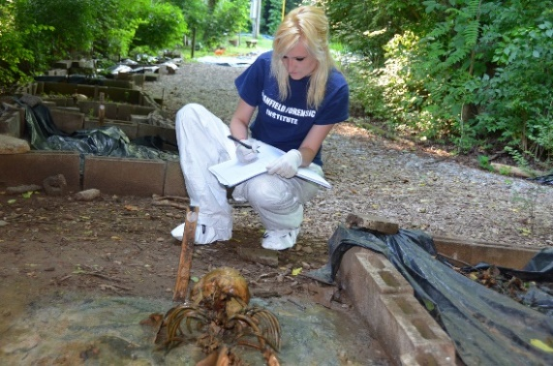
Methodology
Retrospective Study
128 cases of decomposition (Photographs + Case Reports)
31 decomposition traits assessed
G-H Scale: Statistical-based PMI method
The Body Farm - 10 donations
Comparative Study

Slide 8
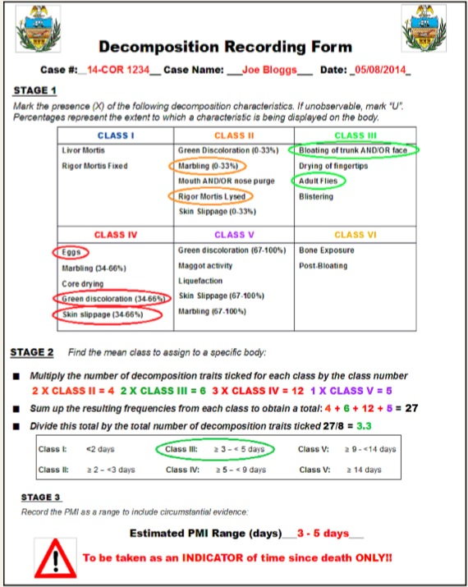
Example: G-H Scale
Simple and easy to use
Applicable to forensic setting
Based on statistical analysis
Accounts for insect activity
Weighting of PMI classes
Potential for autopsy use

Slide 9
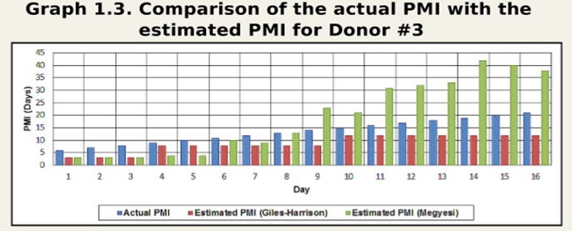
Results

Slide 10
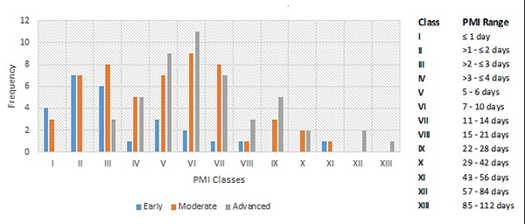
Frequency Graph: The Relationship between PMI and Stage of Decay

Slide 11
PhD Aims
Improving Police Investigations of time-since death estimations
Develop forensic taphonomy into a more rigorous scientific discipline
Establish a National Post-Mortem Interval Database
Notes:
11

Slide 12
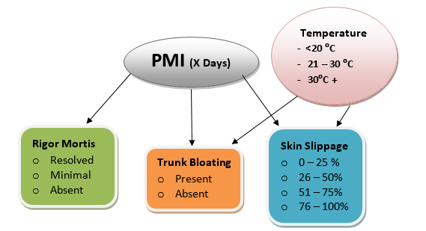
Research Questions + Methodology
Can we use retrospective datasets to inform our understanding of estimating the PMI?
Devise a UK G-H scale
(Thames Valley Police Data)
Bayesian approach to
Decomposition Data
Photography Experiments

Slide 13
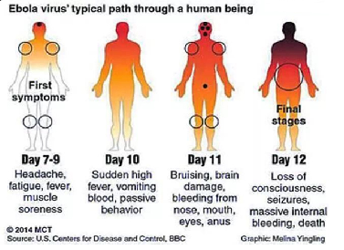
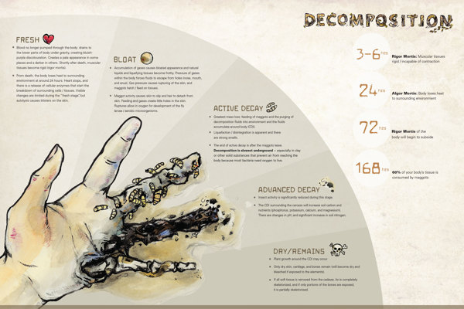
“Tapho-epidemiology”
The Epidemiology of Decomposition
(2) Can an epidemiological approach be applied to decomposition datasets?
Decomposition in the dead vs disease in the living
Understand decomposition in terms of:-
- Frequency
- Pattern
Establish a National PMI Database:
- Demographic decomposition data
- Assist unknown PMI cases

Slide 14
Forensic Application
(3) Can we develop a tool to assist in PMI estimations that is applicable to police investigations of decomposed deaths?
Develop a standard operating procedure (SOP) for recording decomposition at death scenes.
Statistically rigorous tool to improve CSI judgement of PMI estimations
Quick, uncostly & simple to implement operationally and nationally

Slide 15
Any Questions?
Stephanie Giles (MSc, BSc, ACSFS)
S.B.Giles@Cranfield.ac.uk
Acknowledgments
Dr Karl Harrison, Forensic Archaeologist, Alecto Forensics UK
Dr Nicholas Marquez-Grant, Forensic Anthropologtist, Cranfield University, UK
Dr Dawnie Steadman, Director FAC, Professor of Anthropology, University of Tennessee, USA
Dr Karl Williams, Medical Examiner, Allegheny County Medical Examiner’s Office, USA

