Slide 1








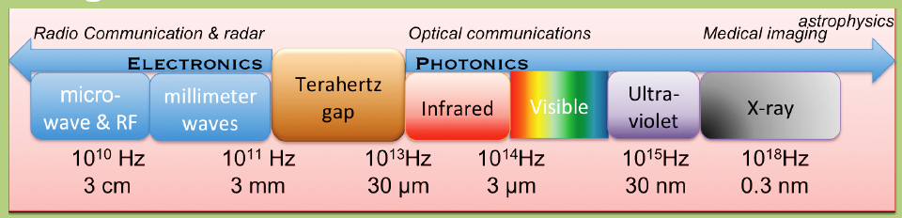


Plasmon-Resonant Terahertz Emitters and Detectors and their System Applications
1
THz
Nanotechnology congress & Expo
August 11-13, 2015
Frankfurt,
Germany
Stephane Boubanga Tombet
Research Institute of Electrical Communication
Tohoku University, Sendai, Japan
Notes:
Thank you for the introduction.
I am Otsuji of Tohoku University.
I would like to talk about terahertz emission of radiation from our original GaAs-based new device, plasmon-resonant photomixer.
This work has been done by the collaboration of my laboratory, Hanabe and Dr. Meziani and Professor Sano of Hokkaido University.

Slide 2
Outline
2
Introduction
Plasmonic THz detection & emission
  Principle of operation
  Asymmetric dual-grating-gate (A-DGG) HEMTs
  Record sensitivity and noise performances
  Coherent, monochromatic THz emission
Application to nondestructive measurement
  THz imaging and spectroscopy utilizing A-DGG HEMT detectors and emitters
Summary

Slide 3



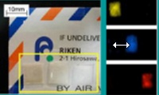

Terahertz Sources:
State-of-the Art and Objectives
3
10⁵
III-V Laser
10⁴
IMPATT
THz
Gap
1000
MMIC
QCL
100
Gunn
BWO
THz QCL
Output Power (mW)
p-Ge Laser
10
Target
1
Lead Salt Laser
p-Ge Laser
Multiplexer
0.1
RTD
0.01
Photomixer
(UTC-PD)
TUNNET
0.001
0.01
0.1
1
10
100
1000
RC, τ : Transport
Frequency (THz)
Transition: hν/kT
(Courtesy of Terahertz Technology Trend Investigation Committee, MIC, Japan)
Notes:
将来の情報通信技術の飛躍的な発展には新たな周波数資源の開拓が不可欠です。
トランジスタやレーザダイオードをはじめとする半導体集積デバイスの世界では、
光波と電波の融合域であるテラヘルツ領域は長らく未開拓領域として取り残されてきました。
従来の電子デバイスでは、ガンダイオードやショットキーダイオードによる逓倍器が
唯一テラヘルツ動作が可能ですが、
ミリワット級の巨大なミリ波入力から生成されるテラヘルツ電磁波は、
導波管などの狭帯域アンテナを用いても、高々マイクロワットに留まります。
一方、フォトニックデバイスでは、量子カスケードレーザーの進展が著しいものの、
フォノン散乱（結晶格子の熱による振動）によって、
数テラヘルツの室温レーザー発振を実現することは極めて困難な状況にあります。

Slide 4
Outline
4
Introduction
Plasmonic THz detection & emission
  Principle of operation
  Asymmetric dual-grating-gate (A-DGG) HEMTs
  Record sensitivity and noise performances
  Coherent, monochromatic THz emission
Application to nondestructive measurement
  THz imaging and spectroscopy utilizing A-DGG HEMT detectors and emitters
Summary

Slide 5
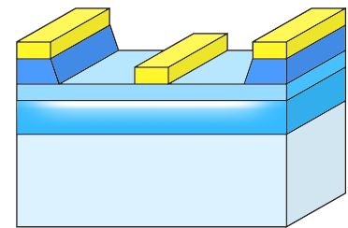
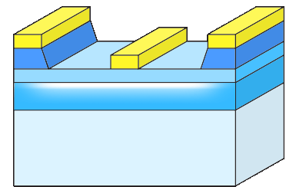
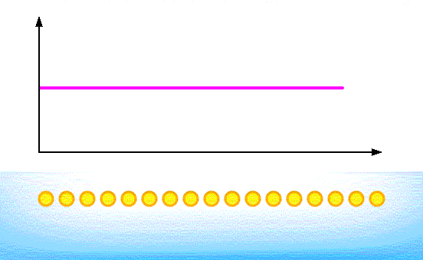
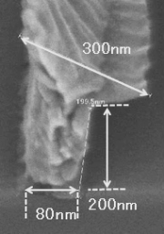
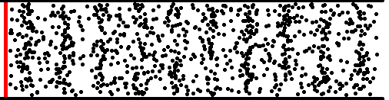
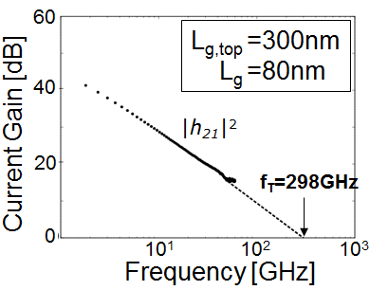
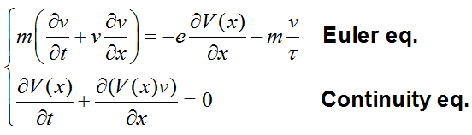
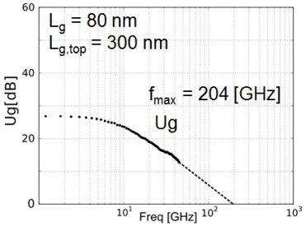
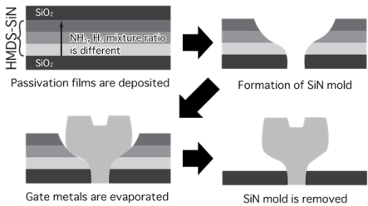
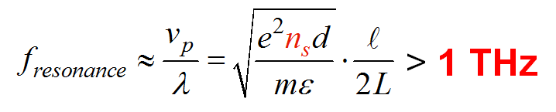
Plasmon Resonance in 2D Electrons
5
HEMT
M. Dyakonov and M. Shur, Phys. Rev. Lett. 71, 2465 (1993).
Sourve
Drain
Gate
2D Electron Systems
Sheet carrier
density
-e
2DEG
Source
Drain
Excitation
Courtesy: M. Dyakonov, W. Knap
v
v_{p}
λ
m
ε
: electron velocity
: plasma velocity
: Wavelength
: Effective mass
: Permittivity
e
n_{s}
d
L
: Elementary charge
: Sheet electron density
: Gate-channel distance
: Gate length
Submicron-gate FET can make
resonant oscillation in the THz range !!
Notes:
Two dimensional (2D) plasma-wave instabilities in submicron transistors have attracted much attention due to their nature of promoting detection and emission of electromagnetic radiation in the terahertz range, which is expected to realize detectors and emitters as well as frequency multipliers
Here schematically shows the displacement of localized electrons in an FET channel.
When its density becomes very high, the electron system behaves as plasma fluid.
As you can see once the electron system is coherently excited, polarized vibrations of longitudinal modes are promoted.
Its energy is quantized into the standing-waves so that it is called as plasmon.
In this case, the electron channel acts as a plasmon cavity.
This kind of “gated 2D plasmon” has a linear dispersion relation given by this equation.
The resonant frequency is determined by the cavity size or the gate length and the plasmon velocity.
When you assume a 100-nm gate length and GaAs or InP based material systems,
the resonant frequency falls in the terahertz range.
First proposal of its terahertz device applications was made by Dyakonov and Shur in 1993.
What is important is the plasmon velocity is proportional to the square root of the electron density which is controlled by the gate bias.
So we can get a tunability of frequency, which is applicable to realizing frequency-tunable oscillators/detectors in the terahertz range.

Slide 6

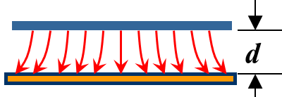
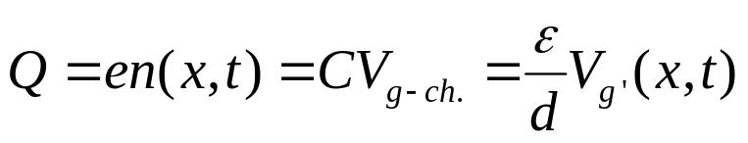

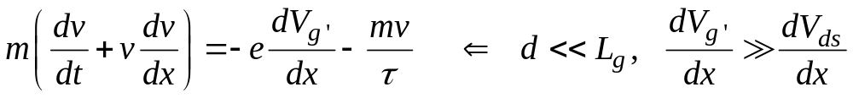
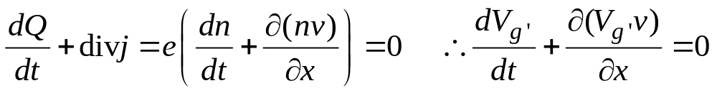
Hydrodynamic Equations of
2D Electrons’ Fluidic Motions
6
Poisson Equation: Electrostatic induction of 2D electrons in the channel
1D Euler equation with gradual-channel approximation
1D continuity equation
x

Slide 7


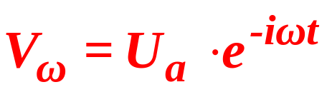
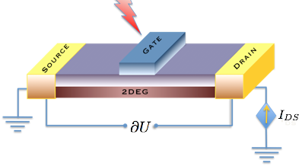




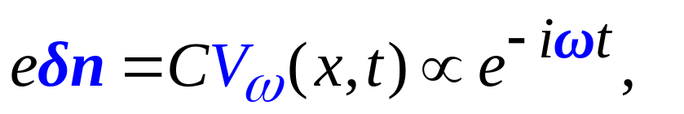
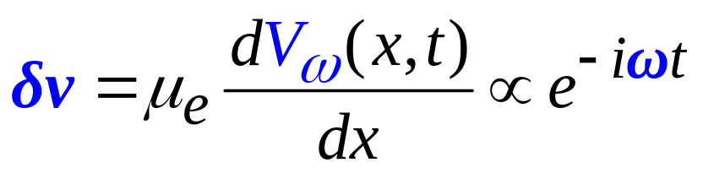
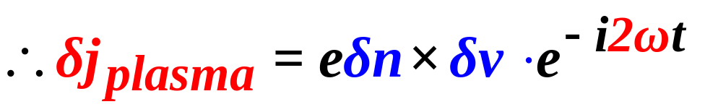
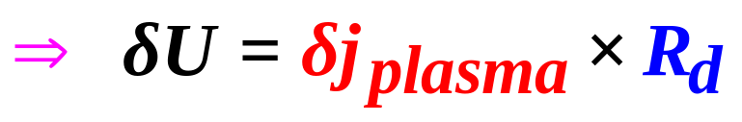
Plasma Waves Nonlinearity for
Rectification of THz Radiations
7
M. Dyakonov and M. Shur, IEEE T-ED 43, 380 (1996).
W. Knap, et al., APL 85, 675 (2004).
THz
Photovoltaic signal
Notes:
プラズモンの非線形性を利用したテラヘルツ波の検出動作。
テラヘルツの正弦波を照射してプラズモンを励振すると、
プラズモンは非線形性が強いので、高調波ひずみ成分を伴って、振動する。
その波形のひずみによって、振動成分の時間平均には入射電力に比例した直流成分が生じる。
この直流電圧（光起電力といいます）を測定することで入射されたテラヘルツ波の電力が計測できる。

Slide 8




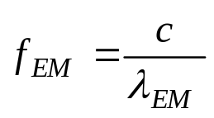



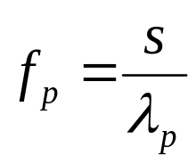




Coupling using a Broadband Antenna
8
-
-
-
-
G2
+
-
G1
+
G2
+
G1
+
G2
Grating Gates
+
-
+
-
2D channel
THz EM wave
Electromagnetic wave
Plasma wave
Plasma wave
_{Target}
Notes:
このスライドは非放射モードプラズモンが回折格子型ゲート電極を介し、電磁波と結合し、プラズモンから電磁波へとエネルギー変換をしている様子を示しています。
この図は長さWの中に長さLg1のプラズモン領域とグレーティングゲートを示したものです。
単一のプラズモン共鳴の分散関係は光のように線形分散を示します。
しかし、光の速度よりプラズマ波は3桁落ちなので、これらの2本の直線は一度も交わらず、エネルギー変換が起こりません。
ここで、グレーティングゲート構造のような周期性Wを持つ構造では、周期性Wでブリルアンゾーンが定義され、このようなゾーンフォールディングが起こり、多くのクロスオーバーをもたらします。
交差しているポイントはアンテナとして機能します。

Slide 9
Outline
9
Introduction
Plasmonic THz detection & emission
  Principle of operation
  Asymmetric dual-grating-gate (A-DGG) HEMTs
  Record sensitivity and noise performances
  Coherent, monochromatic THz emission
Application to nondestructive measurement
  THz imaging and spectroscopy utilizing A-DGG HEMT detectors and emitters
Summary

Slide 10

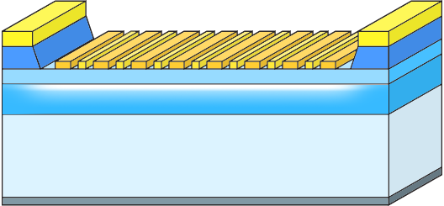
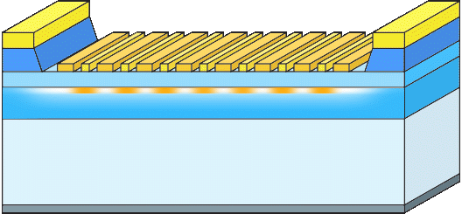
Dual Grating-Gate HEMT Structure for Broadband Operation
10
T. Otsuji et al., Optics Express 14, 4815(2006).
THz radiation
THz wave
Source
Drain
Radiative EM conversion
to non-radiative plasmon
DGG: Dual Grating Gate
Plasmon excitation
Doubly interdigitated
grating gates
THz Rectification &
photovoltaic output
Notes:
One of the solution is shown here.
We’ve recently proposed a new device structure that can improve the conversion gain and radiation power.
This is the cross sectional view. The device is based on a HEMT structure but includes two unique features.
First, it incorporates doubly interdigitated grating gates that periodically localize the 2D plasmon in sub-100-nm regions with a micron interval. This so-called grating bi-coupler can act as a broadband terahertz antenna.
The second feature is a vertical cavity structure in between the top grating plane and a terahertz mirror at the backside.
This can act as a terahertz radiation enhancer as a laser cavity
Okey, let me show you how this device works.
First, laser two photons are irradiated. Photo-generated carriers can coherently excite the plasmon at the difference frequency delta-f so that it makes a photomixing function.
If the excitation frequency matches to the standing wave condition, the plasmon makes resonant oscillation. As I mentioned the plasmon wave is non-radiative mode. In this case, periodically localized plasmon grating together with the dual gate grating can work for the mode conversion.
Once the plasmon is excited, the terahertz electromagnetic wave is reflected at the mirror and back to the plasmon so that the reflected wave can directly excites the plasmon again according to the Drude-optical conductivity
When the plasmon resonant frequency satisfies the vertical cavity resonant condition, the terahertz electromagnetic radiation will reinforce the plasmon resonance in a recursive manner.
Therefore, the vertical cavity works as an amplifier if the gain exceeds the cavity loss.

Slide 11
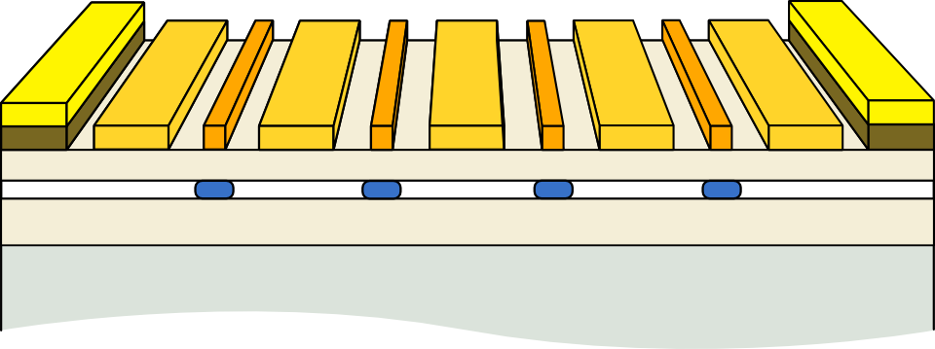

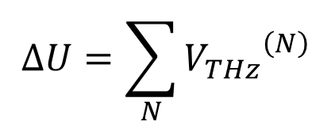





Principle and Issue:
Broadband Rectification by DGG-HEMT
11
ΔU
Unit cell
THz
G1
G2
G1
G2
S
D
$$j_{dc}$$
$$R_{ch}$$
$$δj\left(x,t\right)=eδn\left(x,t\right)δv\left(x,t\right)$$
$$j_{dc}=e\left\langle δn\left(x,t\right)δv\left(x,t\right)\right\rangle$$
$${V_{THz}}^{\left(N\right)}=R_{ch} j_{dc}$$
Cascading the unit cell
Plasmon cavity boundaries
・・・
V_{THz}⁽¹⁾
V_{THz}^{(N)}
$$∆U=\sum_{N}{{V_{THz}}^{\left(N\right)}}$$
Symmetric boundaries cancel out the photovoltaic signals
Notes:
広帯域の超高感度検出器の実現
非対称二重回折格子型ゲート電極構造の導入により 検出感度を桁違いに向上。

Slide 12


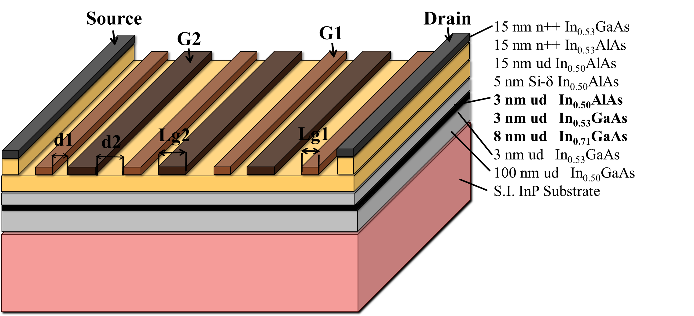
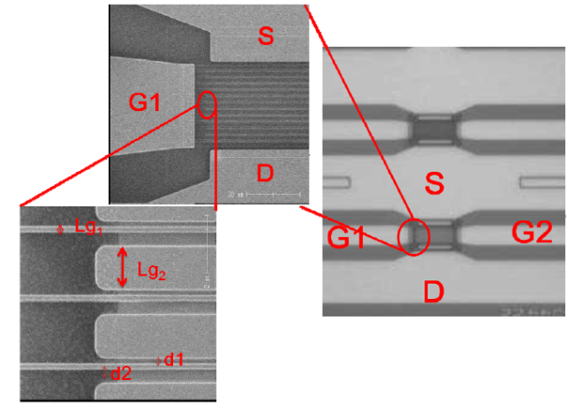
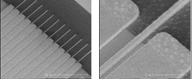
Asymmetric Dual-Grating-Gate HEMT
12
S. Boubanga-Tombet et al, APL 99, 243504 (2011)

Slide 13
Outline
13
Introduction
Plasmonic THz detection & emission
  Principle of operation
  Asymmetric dual-grating-gate (A-DGG) HEMTs
  Record sensitivity and noise performances
  Coherent, monochromatic THz emission
Application to nondestructive measurement
  THz imaging and spectroscopy utilizing A-DGG HEMT detectors and emitters
Summary

Slide 14

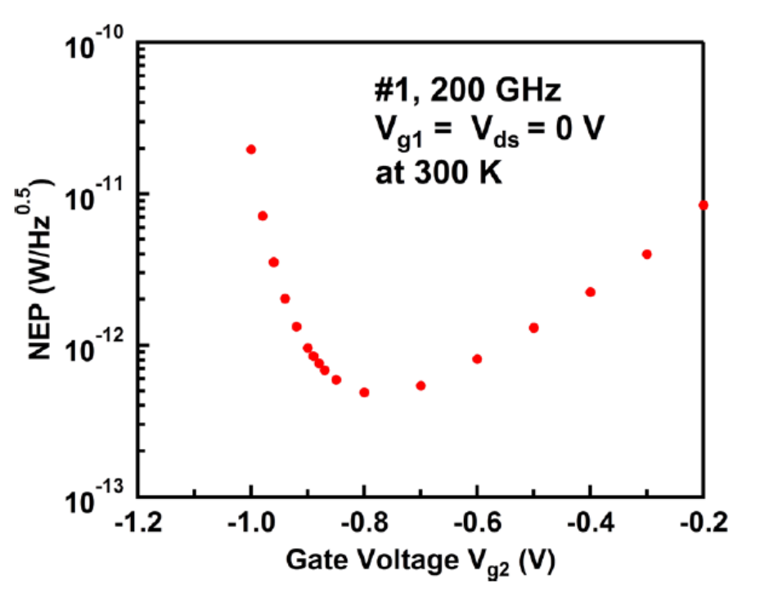
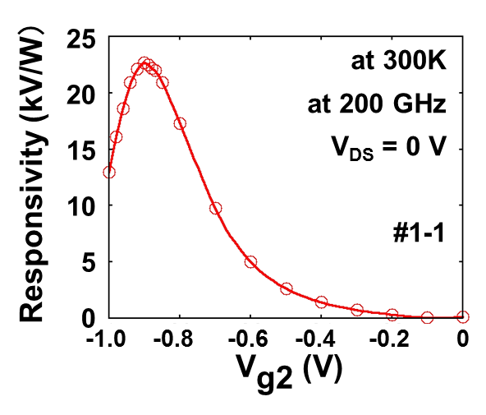

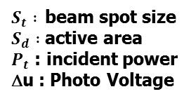
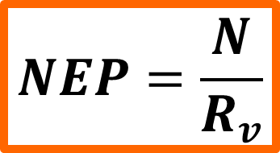
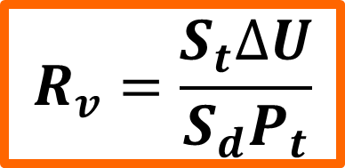
Record-Breaking Responsivity at RT for 200-GHz Radiation
14
$$NEP=\frac{N}{R_{v}}$$
$$R_{v}=\frac{S_{t}∆U}{S_{d}P_{t}}$$
$S_{t} :$beam spot size
$S_{d} :$ active area
$P_{t}$ : incident power
Δu : Photo Voltage
$N :$detector noise
0.48 pW/(Hz)^{0.5}
at V_{g2} = -0.8 V !
22.7 kV/W
at V_{g2} = -0.9 V !
Y. Kurita et al, APL. 104, 251114 (2014)

Slide 15

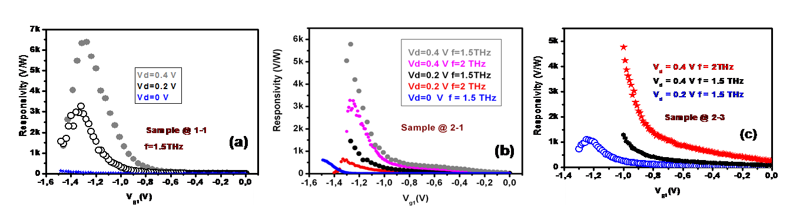
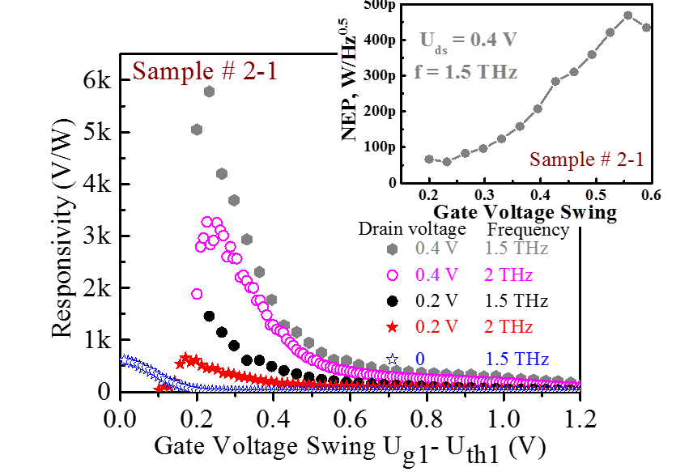
15
Detection at 1~2 THz at 300K. (Vd-biased conditions)
S. Boubanga-Tombet et al, APL. 104, 262104 (2014).
THz source: 1 - 2 THz, ~ 2 μW
60 pW/(Hz)^{0.5}
at 1.5 THz
at Vd = 0.4 V
6.4 kV/W
at 1.5 THz
at Vd = 0.4 V
7k
6k
5k
4k
3k
2K
1k
0
Vd = 0.4 V
0.2 V
0 V
Responsivity (V/W)
Sample @1-1
f = 1.5 THz
-1.6
-1.4
-1.2
-1.0
-0.8
-0.6
-0.4
-0.2
0.0
Vg1 (V)

Slide 16
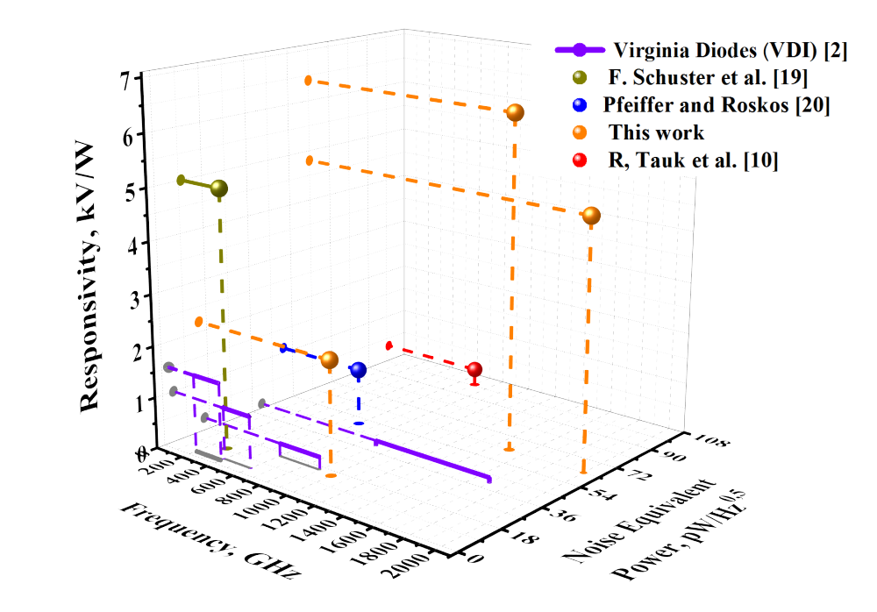
Benchmarking the Plasmonic THz
Detectors
16
20
Plasmonic
Detectors
[2]
http://virginiadiodes.com/index.php?option=com_content&view=article&id=12&Itemid=3
[10] R. Tauk et al, APL. 89, 253511 (2006).
[19] F, Schuster et al, Opt. Express, 7827
Vol. 18, No. 6 (2011).
[20] Ojefors, E., et al,,” IEEE J. Solid-state
Circuits 44(7), 1968–1976 (2009).

Slide 17
Outline
17
Introduction
Plasmonic THz detection & emission
  Principle of operation
  Asymmetric dual-grating-gate (A-DGG) HEMTs
  Record sensitivity and noise performances
  Coherent, monochromatic THz emission
Application to nondestructive measurement
  THz imaging and spectroscopy utilizing A-DGG HEMT detectors and emitters
Summary

Slide 18

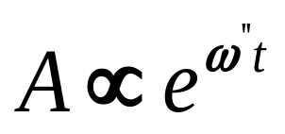
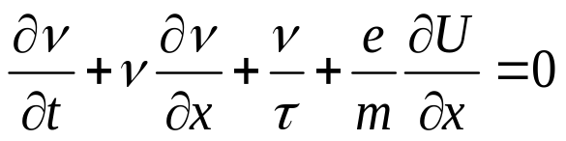
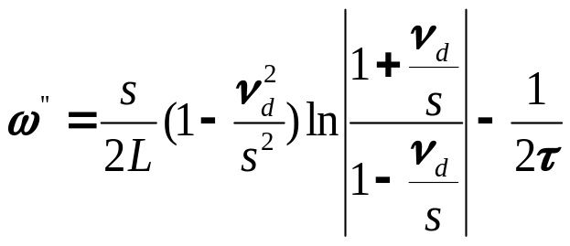

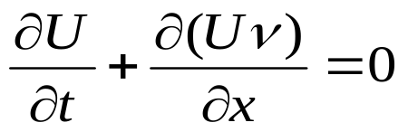
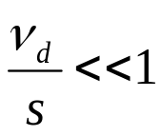
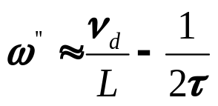
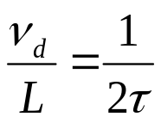

Hydrodynamic Approach
Dyakonov-Shur Plasma Instability
If the mean free path for electron-electron collisions is small compared to the mean free path for collisions with phonons and/or impurities, the hydrodynamic approach is valid
Instability Increment
threshold behaviour
Boundary conditions
{
0
0.5
1
Instability Threshold
For
M.I. Dyakonov, M.S. Shur, Phys. Rev. Lett. 71 (15), 2465 (1993)

Slide 19
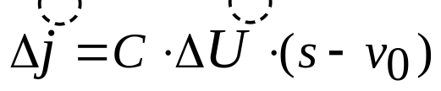
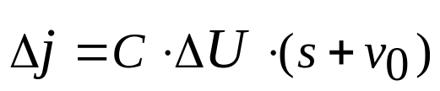
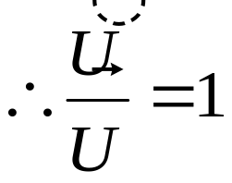
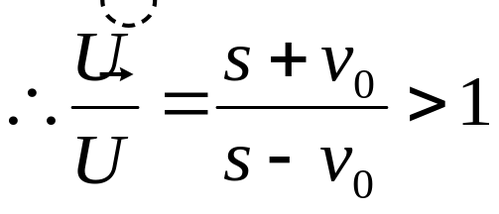
Doppler-Shift Effect:
Dyakonov-Shur Plasma Instability
Drain
open circuit boundary condition at the drain
△j = Cte
source side is shorted
U = Cte
Source
L
Gate
I_{d}
Source
Drain
Deplete
~ Open
=
Plasma wave
Plasma wave
Amplification
wave grows during each round trip between the drain and source contacts
M.I. Dyakonov, M.S. Shur, Phys. Rev. Lett. 71 (15), 2465 (1993)

Slide 20




PW Emitter: A-DGG HEMT with
Resonant-Enhanced Photonic Cavity
20
T. Watanabe et al., OTST, Th3-26, Kyoto, Apr. 2013.
T. Otsuji et al., IEEE Trans. Thz. Sci. Tech. 3, 63 (2013).

Slide 21


PW Emitter: First Success in Coherent
Monochromatic Radiation at 140 K
21
T. Watanabe et al., OTST, Th3-26, Kyoto, Apr. 2013.
T. Otsuji et al., IEEE Trans. Thz. Sci. Tech. 3, 63 (2013).
■ Dyakonov-Shur instability
promotes THz oscillation.
■ Introduction of graphene
will promise to realize the
superradiant plasmonic
lasing!

Slide 22
Outline
22
Introduction
Plasmonic THz detection & emission
  Principle of operation
  Asymmetric dual-grating-gate (A-DGG) HEMTs
  Record sensitivity and noise performances
  Coherent, monochromatic THz emission
Application to nondestructive measurement
  THz imaging and spectroscopy utilizing A-DGG HEMT detectors and emitters
Summary

Slide 23




THz Imaging for Nondestructive Detection of Hidden Substances
23
T. Watanabe et al., IEEE Sensors J. 13, 89 (2013).

Slide 24

Plasmonic Solid-State THz Lamp to FTIR Meas. Identifying Vapor Absorption
24
Y. Tsuda et al., JOSA B 26, A52 (2009).

Slide 25
Summary
25
Recent advances in coherent emission and sensitive detection of THz radiation using 2D plasmons were reviewed.
A-DGG HEMT structures greatly enhance the asymmet­ry of the cavity boundaries, resulting in record THz responsivity and world-first coherent monochromatic THz emission.
These results will open a new paradigm in THz applications of defense, security, sensing, and ultra-broadband communications.
Acknowledgements:
  The authors thank Profs. M. Dyakonov and M.S. Shur for their valuable discussion and Dr. H. Minamide and Prof. H. Ito for their contributions to the experiments.
  This work was financially supported by JST-ANR WITH program, Japan. JSPS-RFBR JPN-RUS Program, the Russian Foundation for Basic Research (Grant # 11-02-92101 and 12-02-93105) and by the RUS. The work was performed under the umbrella of the GDR-I project “Semiconductor Sources and Detectors for Terahertz Frequencies.”

Slide 26
Thank you very much for your attention!

