Slide 1





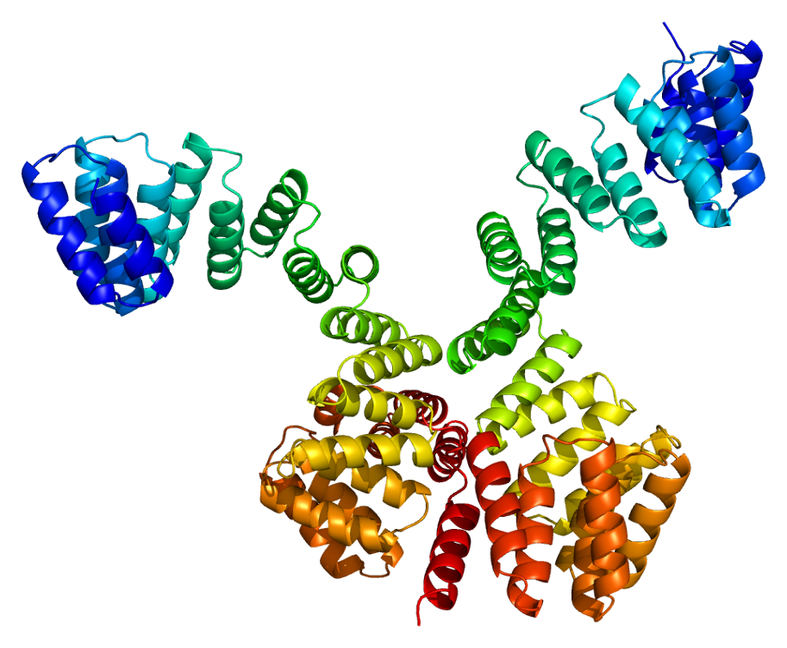
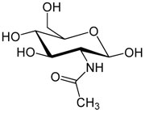
Regulation of hepatic Fatty Acid Synthase properties by O-GlcNAcylation in vivo and ex vivo
S/T
Baldini Steffi, Anne-Marie Mir, Marlène Mortuaire, Céline Guinez and Tony Lefebvre
CNRS-UMR 8576, Unit of Structural and Functional Glycobiology, FRABio FR3688, Lille 1 University, 59655 Villeneuve d’Ascq, France
Notes:
In the first place I would like to thank the organizers to give me the opportunity to present my work and I’m going to talk about the regulation of hepatic FAS properties by O-GlcNAcylation in vivo and ex vivo. This work was made at the UFSG and supervised by Pr Tony Lefebvre.

Slide 2
Control of blood glucose by the liver
Fasted
A l’état nourri
gluco-dependent organs
glucose
glycogenolysis
gluconeogenesis
β-oxydation
+
Fatty Acid
glucagon
adipocytes
pancreas
Hepatic glucose production
Notes:
Glucose is a major energy source for the organism and in spite of wide variations in the intake and the use of this nutriment, the organism set up molecular mechanisms to finely regulate blood glucose concentration.
Liver is one of the organs where the glucido-lipidic metabolism is the most regulated. Indeed it enables himself to regulate the fatty acids and glucose levels depending on nutritional conditions.
Fasted, the pancreas secretes glucagon which leads to the release of glucose by two pathways : first glycogenolysis and gluconeogenesis take over.

Slide 3
Control of blood glucose by the liver
Fasted
In the fed state
gluco-dependent organs
Glucose absorption
glucose
glucose
glycogenolysis
gluconeogenesis
glycogenogenesis
glycolysis
β-oxydation
+
lipogenesis
+
Fatty Acid
VLDL
glucagon
insulin
adipocytes
adipocytes
pancreas
pancreas
Hepatic glucose production
Hepatic glucose uptake
Notes:
However, in the fed state the pancreas secretes insulin which allows glucose storage in two forms : either as glycogen through the glycogenogenesis pathway or as fatty acid through glycolysis coupled with lipogenesis. The newly synthesized fatty acids are esterified and then exported outside the liver.
In obese people, a disturbance of this metabolism can lead to the development of hepatic steatosis.

Slide 4


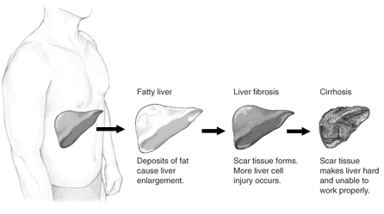
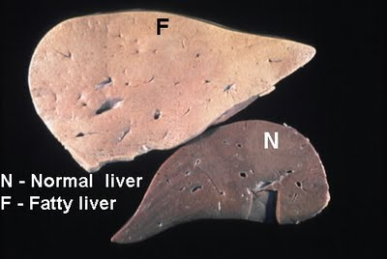
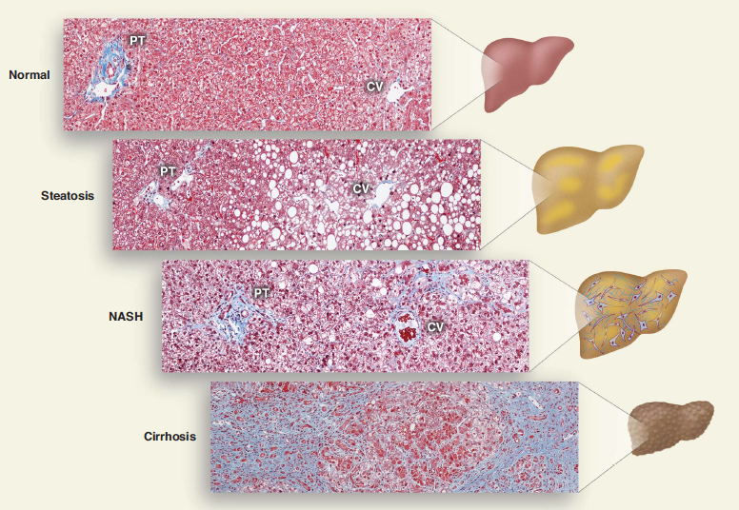
Dysregulation of glucido-lipidic metabolism
and hepatic steatosis
The fat represents at least 5 to 10% of the liver weight
15% no obese
65% obèse (IMC 30-40)
1/3
3% no obese
20% obese
10 à 29%
CHC
4 à 27%
Notes:
Hepatic steatosis corresponds to abnormal lipid droplets accumulation in hepatocytes without any inflammation state. Hepatic steatosis is reversible but in a third of cases it evolves in NASH or in hepatocarcinoma.

Slide 5

The causes of hepatic steatosis
Glucose
Food
Lipogenesis
TG
chylomicrons
Fatty
Acids
esterification
VLDL
Lipolysis
Adipose tissue
Supply
Lipolysis
Lipogenesis de novo
Food
STEATOSIS
Notes:
Fatty acids accumulated in the liver come from three different sources : food, lipogenesis which is the metabolic pathway at the origin of the biosynthesis of fatty acids, but also from fatty acids released from adipose tissue, a pathway called lipolysis

Slide 6
The causes of hepatic steatosis
Glucose
Food
Lipogenesis
β-oxydation
TG
chylomicrons
Fatty
Acids
esterification
VLDL
Lipolysis
Secretion
Adipose tissue
Supply
Lipolysis
Lipogenesis de novo
Food
Use
β-oxydation
Secretion
STEATOSIS
Notes:
Steatosis is characterized by an imbalance between the supply of fatty acids and their use. Indeed, fatty acids will be either β-oxidized in the mitochondrion or esterified in the form of triglycerides and exported outside the liver.

Slide 7
The causes of hepatic steatosis
Glucose
Food
Lipogenesis
14%
26%
β-oxydation
TG
chylomicrons
Fatty
Acids
esterification
VLDL
59%
Lipolysis
Secretion
Adipose tissue
Supply
Donnelly et al., 2005
Hepatic steatosis : Fatty acids of triglycerides come from
59% of the lipolyse
26% of the lipogenesis
14 % of the food
Lipolysis
Lipogenesis de novo
Food
Use
β-oxydation
Secretion
STEATOSIS
Notes:
For a long time, everybody thought that steatosis resulted for a very large part of the diet but a recent study showed that fatty acids accumulated in the liver came from 59% of lipolysis, 14% of food and 26% of lipogenesis. So we note the significant impact of lipogenesis on the occurrence of steatosis.

Slide 8
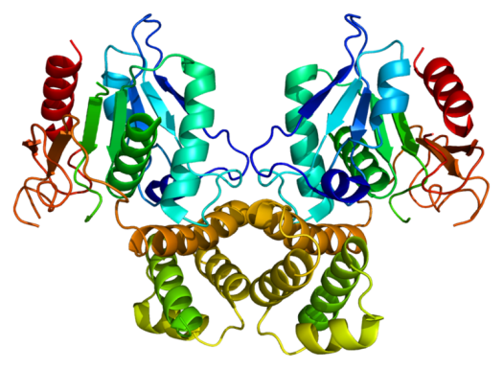
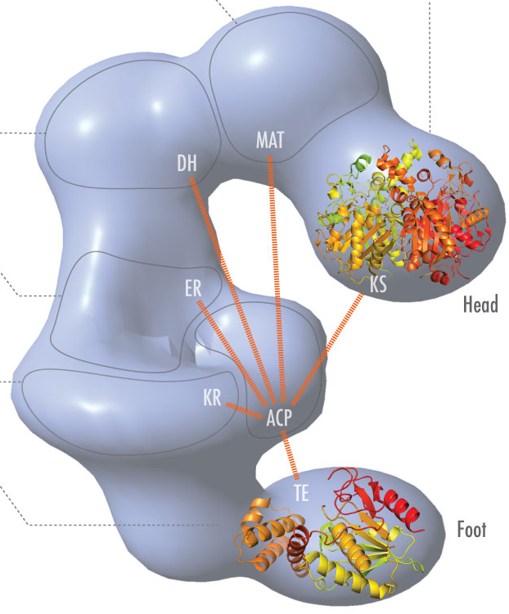
Lipogenesis and Fatty Acid Synthase
Lipogenesis
Glucose
GLUT
ACC : AcetylCoA Carboxylase
CYTOSOL
ACC
Glucose
Citrate
Acetyl-CoA
Malonyl-CoA
Glucose-6-P
FAS
Pyruvate
MITOCHONDRIA
Acyl-CoA
Pyruvate
Acetyl-CoA
Citrate
Triglycerides
Fatty Acid Synthase
Malonyl/acetyl
transferase
β-ketoacyl-synthase
β-hydroxyacyl dehydratase
Enoyl reductase
β-ketoacyl-reductase
ACP
2 subunits
7 activities
liver, adipose tissue, mammary gland
Thioesterase
Overall reaction : acetylCoA + 7 malonylCoA + 14 NADPH,H⁺ → palmitoylCoA (C16:0) + 7CO₂ + 14 NADP⁺+ 7CoA
Notes:
Lipogenesis is the metabolic pathway which leads to the formation of fatty acids, particularly from excess of glucose. Lipogenesis is managed by 2 enzymes : ACC and FAS. FAS is a homodimer, each subunit bearing seven distinct catalytic activities; this enzyme is more especially expressed in liver, adipose tissue and mammary glands. This enzyme is responsible for palmitic acid formation from acetyl and malonyl CoA.

Slide 9

Regulation of FAS
  At the transcriptional level by the transcription factors,ChREBP and SREBP-1c
glucose
insulin
glucose
ChREBP
SREBP-1c
+
insulin
+
Glycolysis
G6P
PEP
+
L-PK
+
+
Pyruvate
citrate
ACC, FAS, SCD-1
FA
Lipogenesis
Hepatocytes
  At the post translational level by phosphorylation
Notes:
Concerning its regulation, it is essentially known to be regulated by the transcription factors ChREBP and SREBP1c relaying respectively the glucose and insulin effects on glycolysis and lipogenesis. Indeed, glucose activates ChREBP, which in turn induces transcription of genes encoding some enzymes of the glucido-lipidic metabolism in particular the FAS in cooperation with SREPB1c activated by insulin. Studies have also shown that it can be regulated by phosphorylation
Numerous transcription factors regulating the glucido-lipidic metabolism are O-GlcNAcylated that’s why we are interested by this modification.

Slide 10
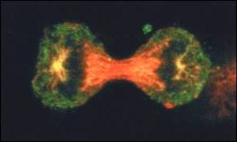

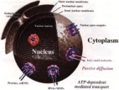
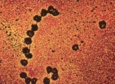





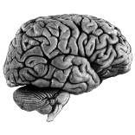
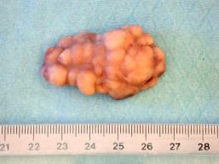
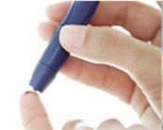

Functions of O-GlcNAcylation
… Hundreds proteins bearing O-GlcNAc have been identified
Enzymes of metabolism
Proteins of stress
Proteins of cytoskeleton
Transcription Factors
Kinases/phosphatases
Proteasome
Proteins of pore nuclear
Ribosomals proteins
OGT/OGA
… Involved in many cellular processes
Cell cycle
Translation
Transcription
Cell trafficking
Signaling
Proteins
degradation
Apoptosis
Development
Cellular architecture
… dynamism disturbed in certain diseases
Neurological diseases
Cancers
Type 2 diabetes
Cardiovascular diseases
Notes:
Several hundreds proteins were identified as O-GlcNAcylated and among which metabolic enzymes. The O-GlcNAcylation is involved in numerous physiological processes by modifying proteins involved in translation, transcription, protein degradation or cell cycle.
Nevertheless under conditions of aberrant O-GlcNAcylation levels, abnormal protein modification and a possible deregulation of signaling pathways may cause on the long term diseases such as cancers, neurological diseases or type 2 diabetes.

Slide 11
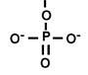
O-N-acetylglucosaminylation (O-GlcNAcylation)
O-GlcNAcylation
UDP
UDP-GlcNAc
ATP
ADP
OH
S/T
OGT (O-GlcNAc transferase)
S/T
Kinase
S/T
OGA (O-GlcNAcase)
Phosphatase
H₂O
GlcNAc
Pi
H₂O
The Hexosamine Biosynthesis Pathway (HBP)
Glc
GlcNH₂6P
AcT
UDP-GlcNAc
PPase
GFAT
UDP-
GlcNAc
Glc
G6P
F6P
GlcNH₂6P
GlcNAc6P
GlcNAc1P
Gln
Glu
Acetyl
CoA
HS-
CoA
UTP
PPi
Notes:
O-GlcNAcylation is a post translational modification highly dynamic thanks to the activity of two enzymes : O-GlcNAc transferase (OGT) which transfers a residue of GlcNAc to serine/threonine residues on nucleocytoplasmic or mitochondrial proteins and O-GlcNAcase (OGA) which hydrolyses the sugar.
This modification can regulate the phosphorylation of the same or adjacent sites and is directly dependent on nutritional conditions. Indeed, two to three percent of glucose entering in the cell is directed toward HBP and converted to UDP-GlcNAc, the OGT substrate.

Slide 12
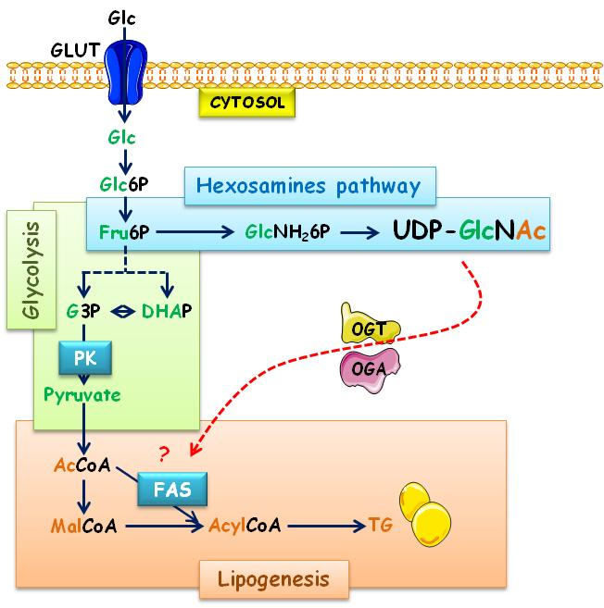

Hypothesis
FAS expression and O-GlcNAcylation level depend on glucose concentrations
Relation between O-GlcNAcylation, expression and activity of FAS
Notes:
We know that FAS expression and O-GlcNAcylation levels are dependent on glucose concentrations. Indeed, glucose can enter HBP which leads to protein O-GlcNAcylation or in glycolysis and lipogenesis.
Knowing that there is a close relationship between intracellular glucose, O-GlcNAcylation levels and activation of glucido-lipidic metabolism, a link between O-GlcNAcylation, expression and activity of FAS should exist.

Slide 13
    Relations between FAS O-GlcNAcylation and nutritional conditions
Is FAS O-GlcNAcylated ?
Do O-GlcNAcylation levels interfere with:
  FAS expression
  FAS activity
  FAS stabilization
Notes:
To check this, we looked whether FAS was or not O-GlcNAcylated and if its potential O-GlcNAcylation was dependent on nutritional conditions. Secondly, we wanted to determine the role of OG on FAS properties and particularly on its expression, its stabilisation and its enzymatic activity.
To check this hypothesis in vivo and ex vivo models were used.

Slide 14
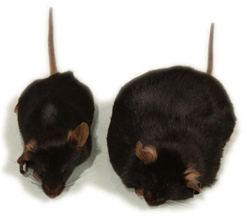
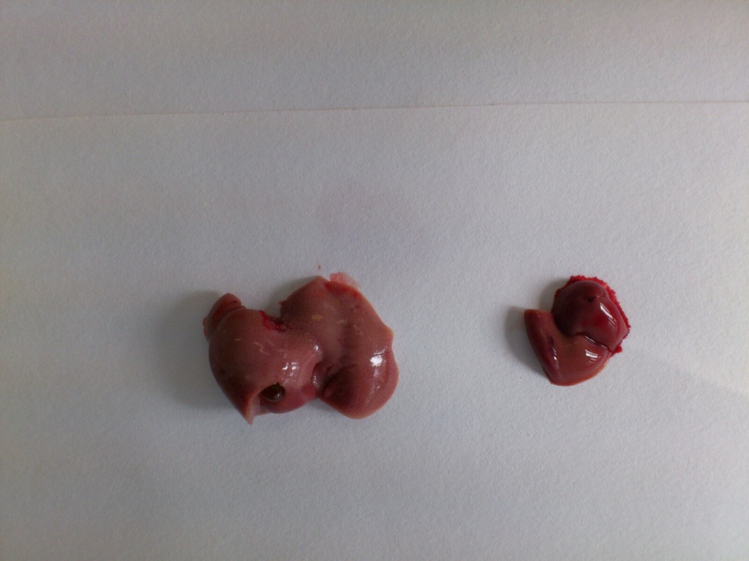
O-GlcNAcylation levels and FAS expression
in physiopathological models
Model 1 : Use of mice C57BL6 wild type or ob/ob
Day
3h
15h
3h
15h
Night
Fasted
Group1 : C57Bl6 Fasted
C57BL6
Fasted
HCHO
Group2 : C57Bl6 Refed
Fasted
Group3 : ob/ob Fasted
Ob/ob
Fasted
HCHO
Group4 : ob/ob Refed
Notes:
To reach these objectives, we first studied the O-GlcNAcylation contents and the FAS expression levels in two physiopathological models, particularly using either C57BL6 mice or ob/ob mice. In each group, mice were either fasted or refed after the fasting period to boost lipogenesis. The livers were then collected and analyzed to assess O-GlcNAcylation levels and FAS expression.

Slide 15
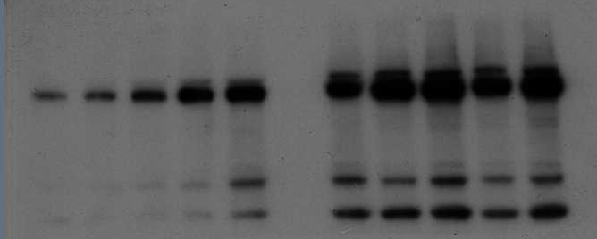
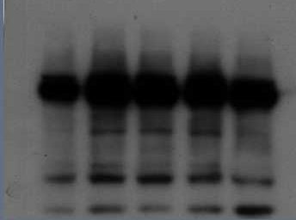
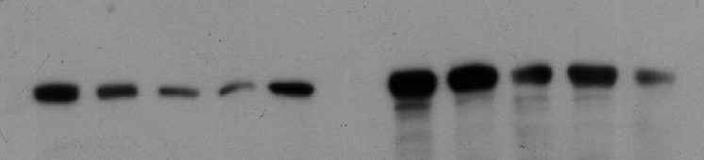
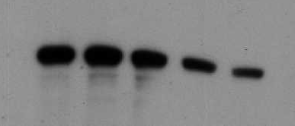
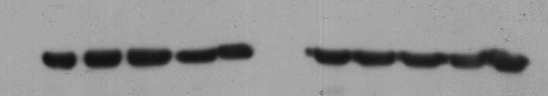
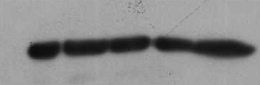
O-GlcNAcylated protein levels and FAS expression
Fasted
Refed
C57BL6
ob/ob
C57BL6
170-
130-
WB: O-GlcNAc
100-
70-
55-
WB: FAS
170-
55-
Quantification
35-
WB: GAPDH
*
FAS ARNm
***
C57
*
C57
***
Ob/ob
Ob/ob
***
C57BL6
Relative mRNA level
FAS / cyclophilin
ob/ob
O-GlcNAc/GAPDH
FAS/GAPDH
*
Fasted
Refed
Fasted
Refed
Fasted
Refed
Notes:
In control mice, O-GlcNAc levels are higher in refed mice compared to fasted mice. Now if we look at fasted mice, O-GlcNAcylation levels are higher in ob/ob mice compared to control mice.
Concerning FAS expression, it was raised when mice were refed compared to fasted mice. This increase is due to an increase of its transcription as we can see on mRNA levels. When mice were fasted, we can also observed an increase of its expression in ob/ob mice compared to control mice. Once again this increase is partly due to an increase of its transcription. Indeed, in the litterature, it is well-known that in ob/ob fasted mice, through their chronic hyperglycemia, transcription factors responsible for FAS activation are active.

Slide 16


O-GlcNAcylation levels and FAS expression
in physiopathological models
Model 2 : Use of mice C57BL6 fed a chow diet or fed a High Carbohydrate Diet.
12 weeks
Chow Diet (CD)
Fasted
Group1 : CD Fasted
65% carbohydrate, 24% protein, 11% fat
Fasted
HCHO
Group2 : CD Refed
High Carbohydrate Diet (HCD)
Fasted
Group3 : HCD Fasted
75% carbohydrate, 22% protein, 3% fat
Fasted
HCHO
Group4 : HCD Refed
Notes:
So we have used a second model where mice were fed a CD or a HCD for 12 weeks. At the end of the experiment mice were either fasted or refed after the fasting period.

Slide 17
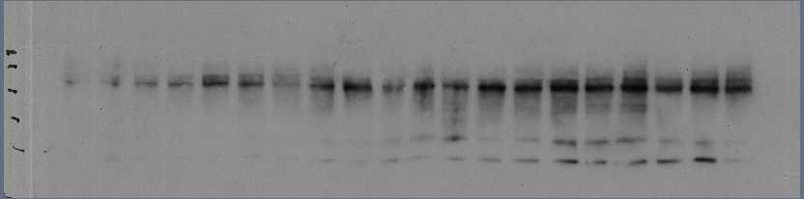
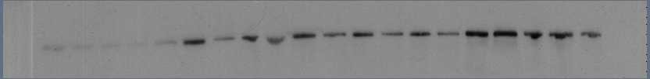
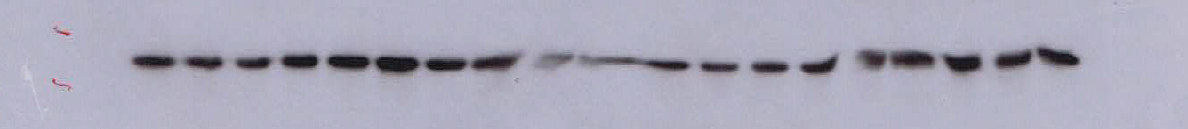
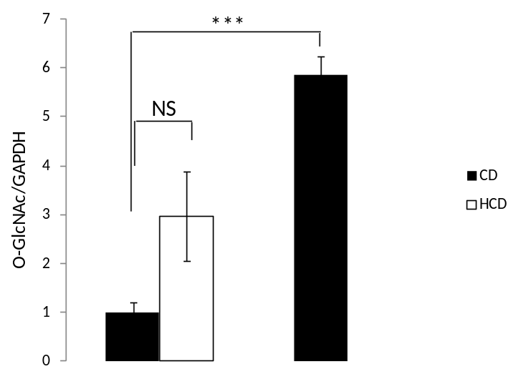
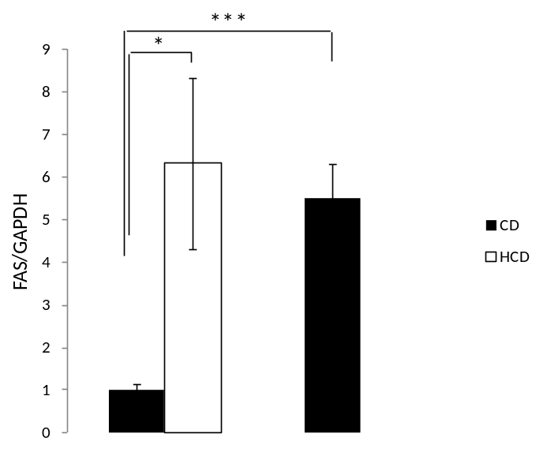
O-GlcNAcylated protein levels and FAS expression
Fasted
Refed
CD
HCD
CD
170-
130-
100-
WB: O-GlcNAc
70-
55-
WB: FAS
170-
55-
35-
WB: GAPDH
Quantification
FAS ARNm
***
CD
CD
CD
Relative mRNA level
FAS / cyclophilin
HCD
HCD
HCD
NS
Fasted
Refed
Fasted
Refed
Fasted
Refed
Notes:
When mice were fed a CD, O-GlcNAc levels were higher in refed mice compared to fasted mice. Now if we look at fasted mice, O-GlcNAc levels were higher in HCD groups compared to CD group.
Concerning FAS expression, it was raised when mice were refed compared to fasted mice. This increase is due to an increase of its transcription as we can see on mRNA levels. Whereas when mice were fasted, we can observe an increase of FAS expression in HCD group compared to CD group. However this increase is not only due to an increase of mRNA as we can see here. The increase of FAS expression seems to be due a post-translational effect, « maybe through O-GlcNAcylation »

Slide 18
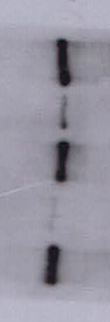

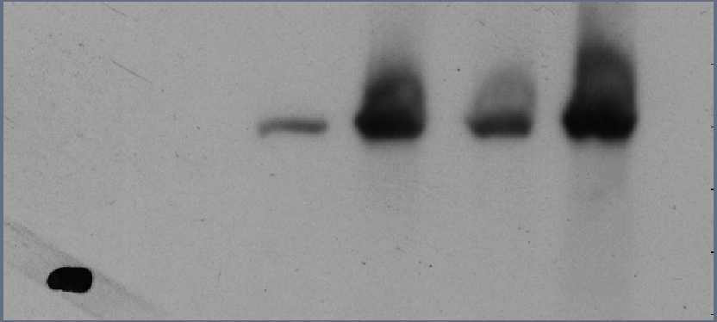
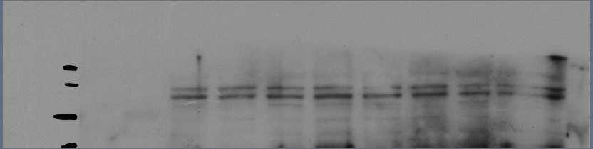

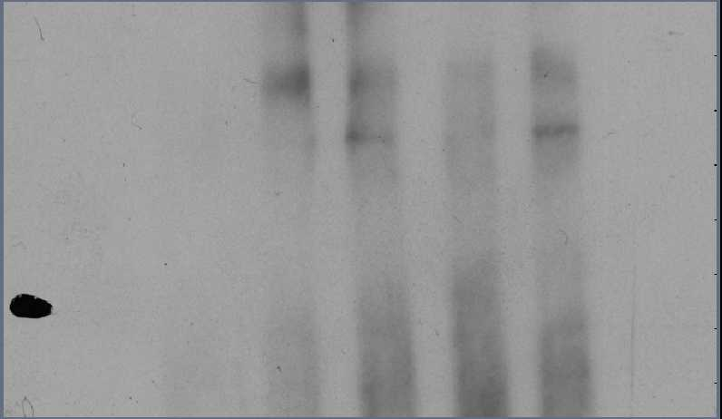
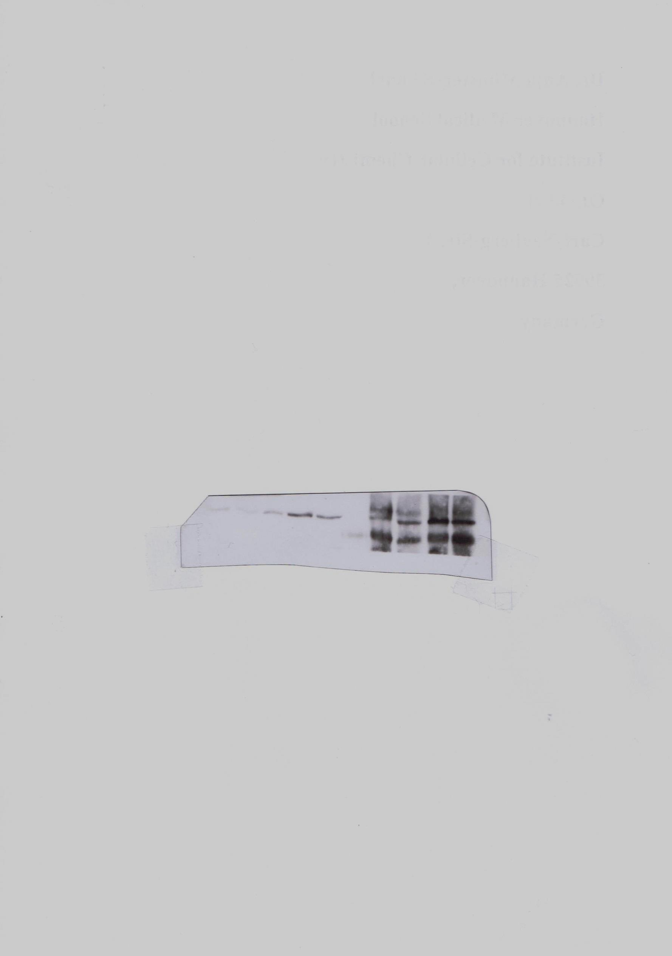
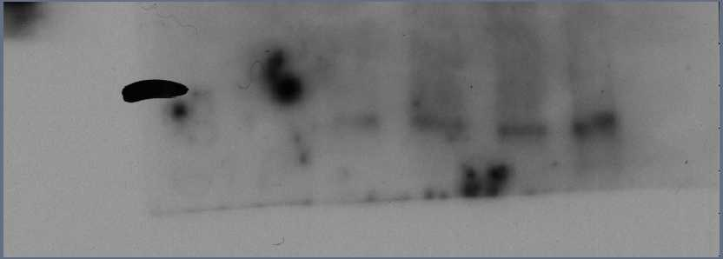
Interaction FAS/OGT
Fasted
Refed
Fasted
Refed
ob
C57
ob
C57
CD
HCD
CD
WB: FAS
WB: FAS
170-
Input
170-
Input
130-
WB: OGT
130-
WB: OGT
100-
100-
IgG
IgG
170-
WB: FAS
WB: FAS
CoIP
OGT
170-
CoIP
OGT
130-
WB: OGT
130-
WB: OGT
100-
100-
FAS and OGT are partners of interaction
Notes:
To check whether OGT and FAS are partners of interaction, OGT was immunoprecipitated with its interacting partners and interaction with FAS was controled by WB. We can see that, in the two models, the 2 proteins physically interact.

Slide 19
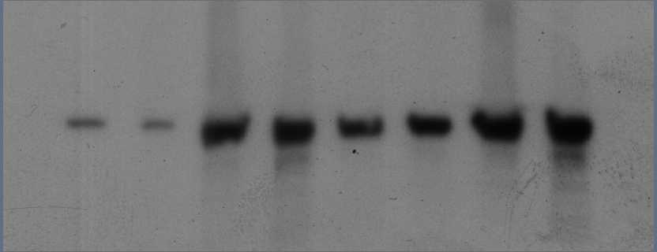
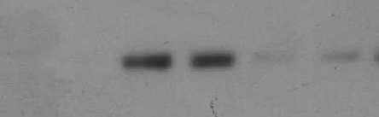
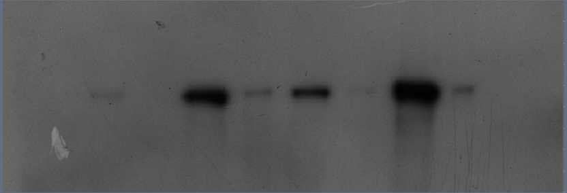
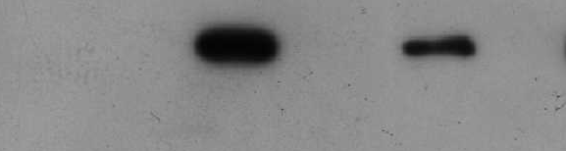

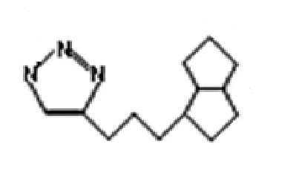
FAS O-GlcNAcylation
Use of lectins : Wheat Germ Agglutinin
Fasted
Refed
Fasted
Refed
C57BL6
ob/ob
C57BL6
CD
HCD
CD
-
+
-
+
-
+
GlcNAc 0.5M
-
+
-
+
-
+
GlcNAc 0.5M
Input
Input
170-
WB: FAS
170-
WB: FAS
170-
WGA beads
170-
WGA beads
click chemistry
UDP-GalNAz
UDP
biotin
Avidin-bead
N₃
UDP
Y289L GalT1
N₃
Notes:
Afterwards, we wanted to know if FAS was or not O-GlcNAcylated. For this 2 methods were used.
First we used WGA, a lectin recognizing proteins bearing GlcNAc and sialic acids residues. Proteins were removed to form total extracts then revealed with an antibody against FAS. We observe so the same profil as above. The rest of the sample was incubated with the beads and we observe that the FAS was retained on the beads. To verify the specificity of the beads, free GlcNac was added and we can note the loss of the signal.
We have also performed an enzymatic labelling. Proteins of cellular lysates have been enzymatically labeled by a b1-4 galactosyltransferase which tranfers GalNAz to GlcNAc residues. A biotin alkyne has been ligated to azido labeled proteins for further purification with avidin beads.

Slide 20
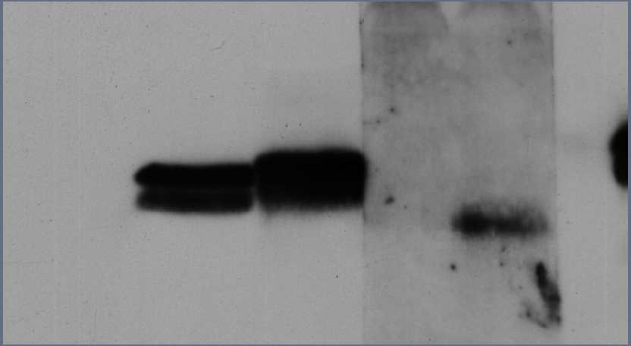

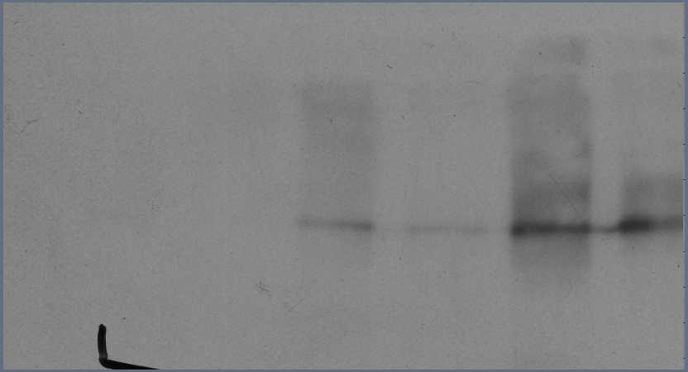
FAS O-GlcNAcylation
Use of lectins : Wheat Germ Agglutinin
Fasted
Refed
Fasted
Refed
C57BL6
ob/ob
C57BL6
CD
HCD
CD
-
+
-
+
-
+
GlcNAc 0.5M
-
+
-
+
-
+
GlcNAc 0.5M
Input
Input
170-
WB: FAS
170-
WB: FAS
170-
WGA beads
170-
WGA beads
click chemistry
-
+
GalNAz / biotin alkyne
-
+
GalNAz / biotin alkyn
Fasted
Refed
20-
Input
CD
HCD
CD
WB: Cristallin
Input
20-
Avidin beads
WB: FAS
WB: Avidin-HRP
Avidin beads
Notes:
The positive control was realized on a-cristallin which is known to be O-GlcNAcylated. Indeed the revelation with avidin HRP shows that cristallin is only present when the labeling has been performed. In liver mice samples, we have the same glycosylation profile than with previous experiments. This experiment argues that FAS is O-GlcNAcylated.

Slide 21
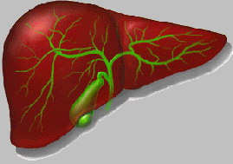

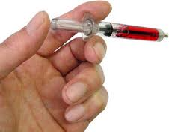
O-GlcNAcylation levels and FAS expression
in physiopathological models
Model 3 : Use of mice C57BL6 presenting an inhibition of OGA
Day 0
Day 14
Daily injection of PBS/ThiametG
20 mg/ kg/ day
Fasted
Group1 : Fasted
Fasted
HCHO
Group2 : Refed
Notes:
To determine if the O-GlcNAcylation levels could be correlated to the expression of FAS, we established an in vivo model in which only O-GlcNAcylation levels vary. To do this, mice received a daily injection of PBS or ThiametG (inhibitor of OGA) for 15 days. As previously, mice were either fasted for 24 hours or fasted for 24 hours and then refed for 18 hours.

Slide 22
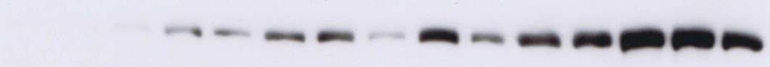
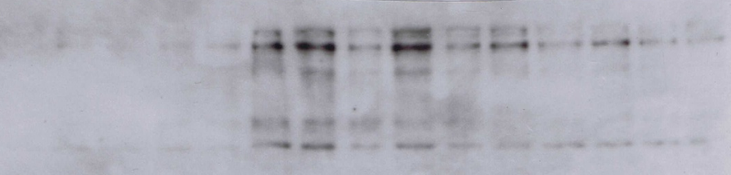

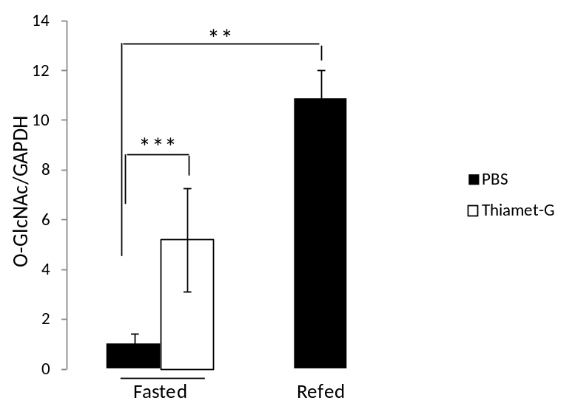
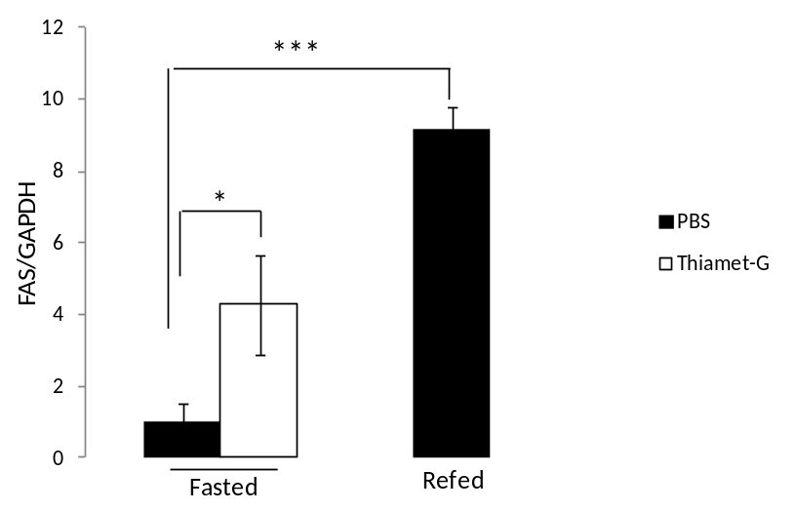
O-GlcNAcylated protein levels and FAS expression
Fasted
PBS
ThiametG
Refed PBS
WB : FAS
130
100
70
WB : O-GlcNAc
50
40
40
WB : GAPDH
35
Quantification
FAS ARNm
PBS
Relative mRNA level
FAS / cyclophilin
***
ThiametG
NS
Fasted
Refed
Notes:
As expected, we observed an increase of the O-GlcNAcylation levels when mice were injected with ThiametG,
Concerning FAS expression, it was increased when mice were refed compared to fasted mice, This increase was due to an increase of its transcription as attested by the mRNA levels. However, when mice were fasted, we can see an increase of FAS expression when mice presented an OGA inhibition. However, this increase was not due to an increase of its transcription.
These results show that the levels of FAS expression are in correlation with O-GlcNAcylation levels. Then we wanted to determine the role of O-GlcNAcylation on FAS properties and first on its expression.

Slide 23
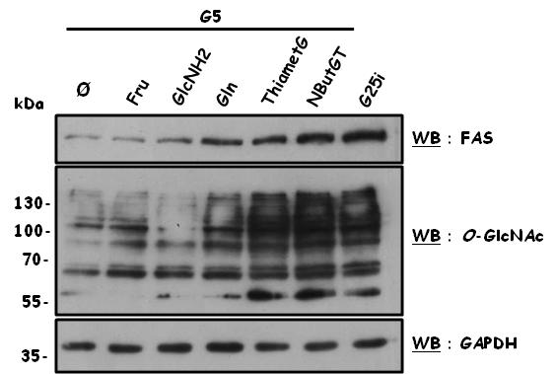
Ex vivo
Cancer human hepatocytes cell line : HepG2
Mouse primary hepatocytes cultures
Glc
Fru
Gln
GlcNH₂
Gln
Glu
Glc
G6P
F6P
GFAT
GlcNH₂6P
GlcNAc6P
GlcNAc1P
UDP-GlcNAc
Ser/Thr
OGT
Ser/Thr
O-GlcNAc
ThiametG
NButGT
OGA
Mouse primary hepatocytes culture
Expression of FAS
Notes:
For this purpose we used ex vivo models, HepG2 cells and mouse primary hepatocytes cultured in conditions that modulate O-GlcNAcylation levels. Cells were incubated with different compounds which are able to increase O-GlcNAcylation levels such as fructose, glucosamine or glutamine. We also used two inhibitors of OGA, TG and NButGT to increase O-GlcNAcylation levels.
In the two control conditions, meaning cells were cultured either in low glucose concentrations, 5mM, or in high glucose concentration plus insulin; we can see an increase of O-GlcNAcylation levels and of FAS expression in G25i compared to g5 condition.
Concerning FAS, we can see an increase of its expression in correlation with the increase of O-GlcNAcylation levels. So, we hypothesized that FAS is stabilized by O-GlcNAcylation.

Slide 24
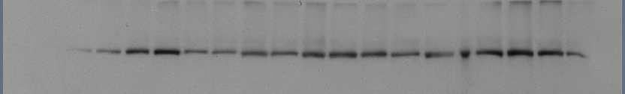
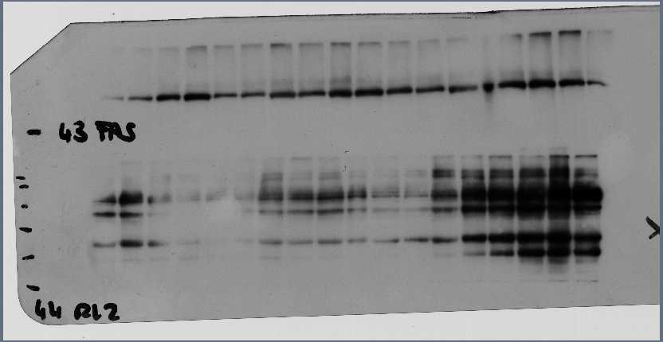




Role of O-GlcNAcylation on FAS stabilisation
HepG2
Kinetic with cycloheximide
CHX
CHX + NButGT
O-GlcNAc
Time (h)
0
1
2
6
14
24
0
1
2
6
14
24
S/T
270
WB : FAS
CHX
translation
NButGT
130
OGA
100
WB : O-GlcNAc
70
S/T
55
PROTEIN
WB : GAPDH
35
Liver mice
Treatment with β-N-acetylglucosaminidase
O-GlcNAc
Fasted
Refed
S/T
kDa
-
+
-
+
Glucosaminidase
270-
WB : FAS
Glucosaminidase
130-
100-
WB : O-GlcNAc
70-
S/T
55-
35-
WB : GAPDH
Notes:
In order to verify this, HepG2 cells were cultured with cycloheximide which is an inhibitor of the translational process supplemented or not with NButGT, the OGA inhibitor.
With cycloheximide alone we can observe a progressive decrease of FAS expression during the kinetic. With NbutGT the degradation of FAS seems to be slowed as we can see here. Another way to decrypt the role of O-GlcNAcylation on the stability of FAS was to incubate liver lysates with glucosaminidase which decreases O-GlcNAc level as we can see here. For FAS expression, we observe upon glucosaminidase treatment a decrease of its expression in both conditions, fasted and refed. It seems also that FAS degradation is accelerated when it was deglycosylated. These observations consolidate the idea that a high O-GlcNAc level leads to FAS stabilisation.
We wanted to evaluate the role of O-GlcNAcylation on FAS activity.

Slide 25

Role of O-GlcNAcylation on FAS activity
FAS O-GlcNAcylation
Fasted
Refed
Fasted
Refed
C57BL6
ob/ob
C57BL6
CD
HCD
CD
-
+
-
+
-
+
GlcNAc 0.5M
-
+
-
+
-
+
GlcNAc 0.5M
Input
Input
170-
170-
170-
WGA beads
170-
WGA beads
WB: FAS
WB: FAS
FAS activity
C57BL6
CD
PBS
***
ob/ob
HCD
ThiametG
***
***
*
µmoles of NAPDH oxydized.
min-1.mg-1 of liver
µmoles of NAPDH oxydized.
min-1.mg-1 of liver
µmoles of NAPDH oxydized.
min-1.mg-1 of liver
Fasted
Refed
Fasted
Refed
Fasted
Refed
Notes:
For that we have elaborated a FAS activity assay from mice liver lysates. Rapidly, they were ultracentrifugated then after the addition of several substrates of FAS, we follow the oxydation of NADPH which reflects FAS activity. If we focus on fasted mice, we can observe high activity of FAS in ob/ob mice, in mice on HCD, in mice harbouring an OGA inhibition compared to control mice. FAS activity was more higher when it was more O-GlcNAcylated and more heavily expressed (as we can see on the purification of O-GlcNAcylated proteins)

Slide 26


Conclusions
FAS regulation :
    by transcription factors
Glycolysis
Lipogenesis
Glucose
pyruvate
Fatty acid
PK
ACC, FAS
ChREBP
SREBP-1c
    by O-GlcNAcylation
FAS interacts with OGT and it’s O-GlcNAcylated
Roles of the O-GlcNAcylation :
  Increase of global O-GlcNAcylation levels is correlated with an increase of FAS expression through a reduction of its degradation.
  FAS activity is in correlation with its O-GlcNAcylation
Notes:
In conclusion. It is known that the FAS is regulated at the transcription level by ChREBP and SREBP1c.
Regarding our experiments, we show for the first time that FAS is also regulated at the post-translational level. Indeed we show that FAS and OGT interact together, that FAS is O-GlcNAcylated and that an increase of global O-GlcNAc levels correlates with an increase of FAS content through a reduction of its degradation. Therefore, we strongly support that FAS activity correlates with its O-GlcNAcylation.

Slide 27
Perspectives
Relation O-GlcNAcylation/ubiquitinylation of FAS
Hypothesis
O-GlcNAcylation
Stabilisation
Phosphorylation
Ubiquitinylation
Degradation
S/T
S/T
Preliminary results
Methodology
G5
ø
GlcNH₂
G25i
-
+
-
+
-
MG132
Perform siRNA to silent OGT
Evaluate FAS ubiquitinylation in function of O-GlcNAcylation levels
130-
100-
70-
WB : O-GlcNAc
55-
40-
170-
WB : ub
130-
100-
170-
WB : FAS
40-
35-
WB : GAPDH
The MG132 can restore FAS expression at G5 similar to the condition G25. FAS seems to be degraded by the proteasome in the liver
Notes:
Then, we will try to establish a link between O-GlcNAc levels and FAS ubiquitinylation. Indeed, the phosphorylation of proteins, and particularly FAS, is often associated with their degradation or with an inhibition of their activities and given the competition between phosphorylation and O-GlcNAcylation, we can suggest that an increase of FAS O-GlcNAcylation prevents FAS phosphorylation and so stabilise it and raise its activiy. A preliminary experiment showed the proteasomal degradation of FAS in the liver. Indeed MG132, which is a proteasome inhibitor restored FAS expression in G5 like G25 condition. To push forward this work we will perform siOGT and we will evaluate FAS ubiquitinylation in function of O-GlcNAcylation levels.

Slide 28

Team of Pr Tony Lefebvre
Pr Annick Pierce
Dr Ikram El Yazidi
Dr Anne Sophie Vercoutter Edouart
Dr Agata Steenackers
Dr Nao Yamakawa
Moyira Aquino-gil
Maité Leturcq
Anne-Marie Mir
Marlène Mortuaire
Jeanne Vermuse
Collaborations
Céline Guinez (Unité Environnement Périnatal et santé, V d’Ascq)
Catherine Postic (Institut de Cochin, Paris)
Isabelle Hainault (Centre des Cordeliers, Paris)
David Vocadlo (Simon Fraiser University, Burnaby)
Notes:
Finally, I thank all people of my group and Lille 1 university and Nord Pas de Calais region for financial supports and I thank you for your attention

