Slide 1



About OMICS Group
OMICS Group International is an amalgamation of Open Access publications and worldwide international science conferences and events. Established in the year 2007 with the sole aim of making the information on Sciences and technology ‘Open Access’, OMICS Group publishes 500 online open access scholarly journals in all aspects of Science, Engineering, Management and Technology journals. OMICS Group has been instrumental in taking the knowledge on Science & technology to the doorsteps of ordinary men and women. Research Scholars, Students, Libraries, Educational Institutions, Research centers and the industry are main stakeholders that benefitted greatly from this knowledge dissemination. OMICS International also organizes 500 International conferences annually across the globe, where knowledge transfer takes place through debates, round table discussions, poster presentations, workshops, symposia and exhibitions.

Slide 2
About OMICS International Conferences
About OMICS Group
OMICS International is a pioneer and leading science event organizer, which publishes around 500 open access journals and conducts over 300 Medical, Clinical, Engineering, Life Sciences, Pharma scientific conferences all over the globe annually with the support of more than 1000 scientific associations and 30,000 editorial board members and 3.5 million followers to its credit.
OMICS International has organized 500 conferences, workshops and national symposiums across the major cities including San Francisco, Las Vegas, San Antonio, Omaha, Orlando, Raleigh, Santa Clara, Chicago, Philadelphia, Baltimore, United Kingdom, Valencia, Dubai, Beijing, Hyderabad, Bengaluru and Mumbai.

Slide 3
Analyzing metabolic regulation in vitro and in vivo
Stefan Kempa, metabolic regulation @BIMSB/MDC

Slide 4
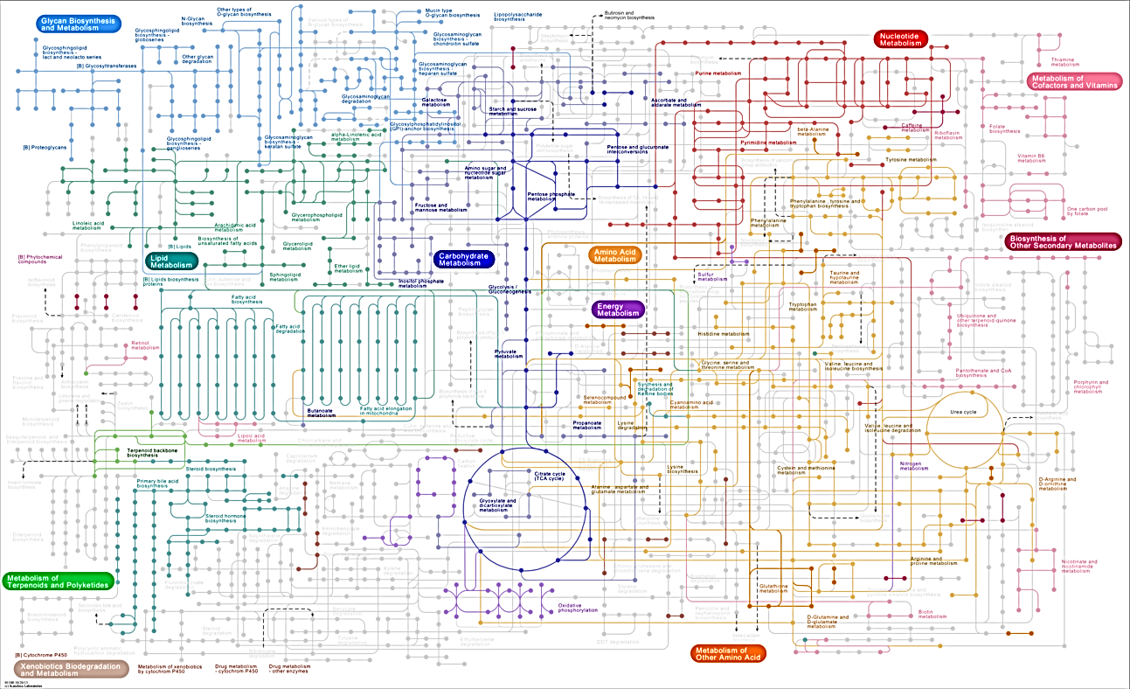
Network of the human metabolism

Slide 5
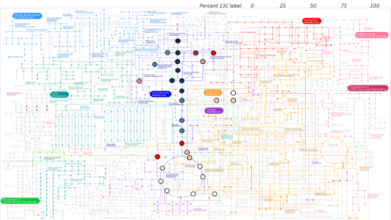
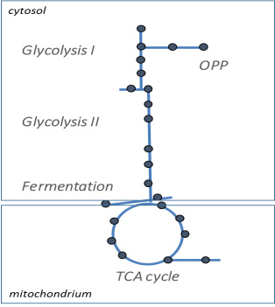
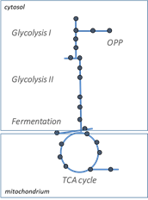
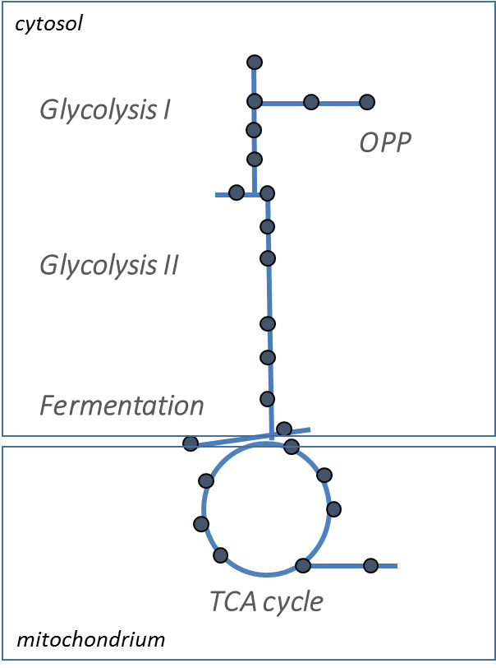
Cellular metabolism
In vivo metabolism
liver
brain
muscle
…
cancer
blood
kidney
Technology

Slide 6
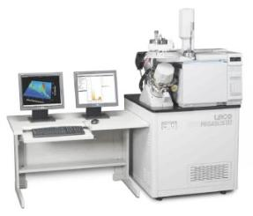
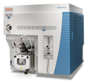
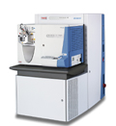
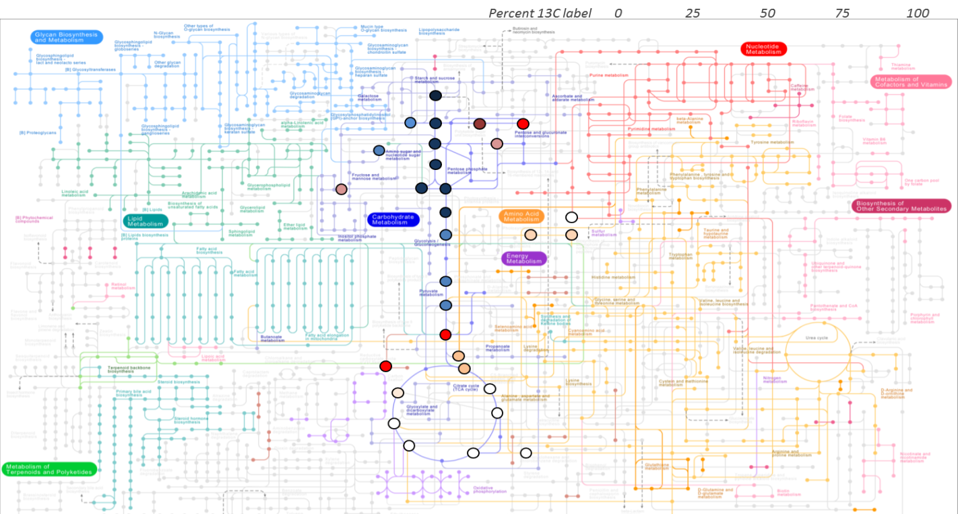
Network of the human metabolism and related MS-based techniques
Metabolic profiling
Fatty acid profiling
pSIRM
ID serum analytics
Targeted metabolomics
Lipidomics
Nucleotide analysis
Targeted proteomics
Lipidomics
Direct infusion metabolomics
MS^{n}
Proteomics
GCxGC-TOF
LC-QQQ
nLC-LTQ-Orbitrap
Current setup in our group, metabolic regulation@BIMSB

Slide 7
pulsed stable isotope resolved metabolomics (pSIRM)

Slide 8
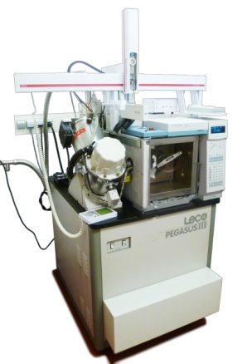
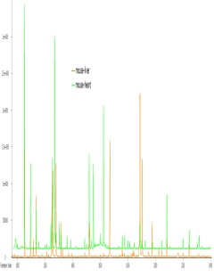
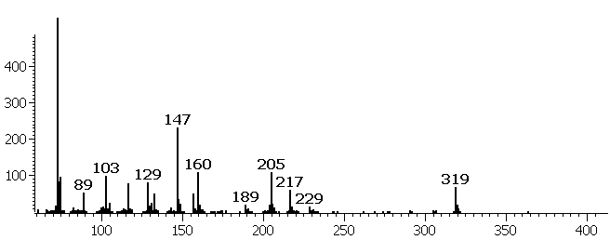
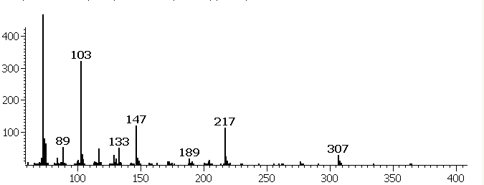
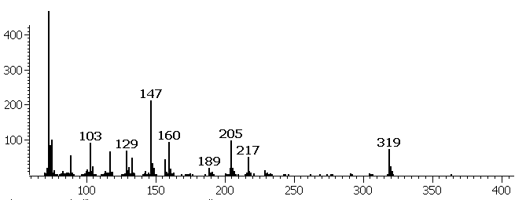
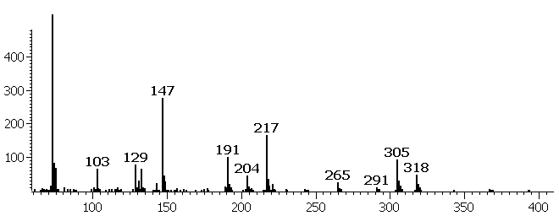
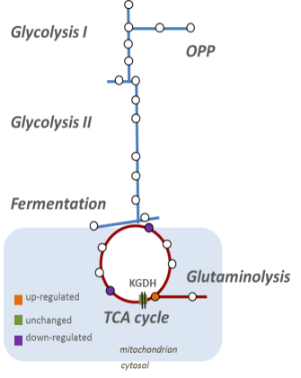
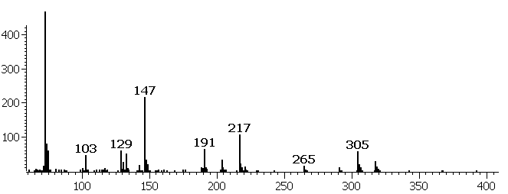
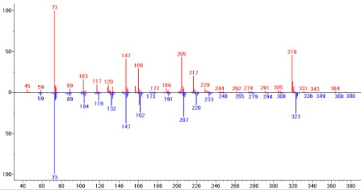
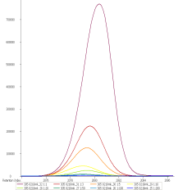
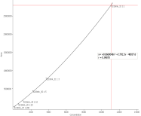
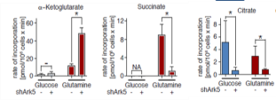
GC-MS based Metabolomics
Identification
67,5%
Fructose
GCxGC-ToF
63,9%
95,3%
Glucose
60,4%
57,3%
97,8%
myo – Inositol
Flux analysis
Quantification
Acquired spectra are compared against a library for identification.
mass
With the measurement of serial dilution of pure standards, their absolute concentration can be calculated with high precision.
Using ¹³C labeled substrates (glucose, glutamine or pyruvate), the incorporation of heavy label can be detected for a time-resolved flux analysis of metabolism.

Slide 9
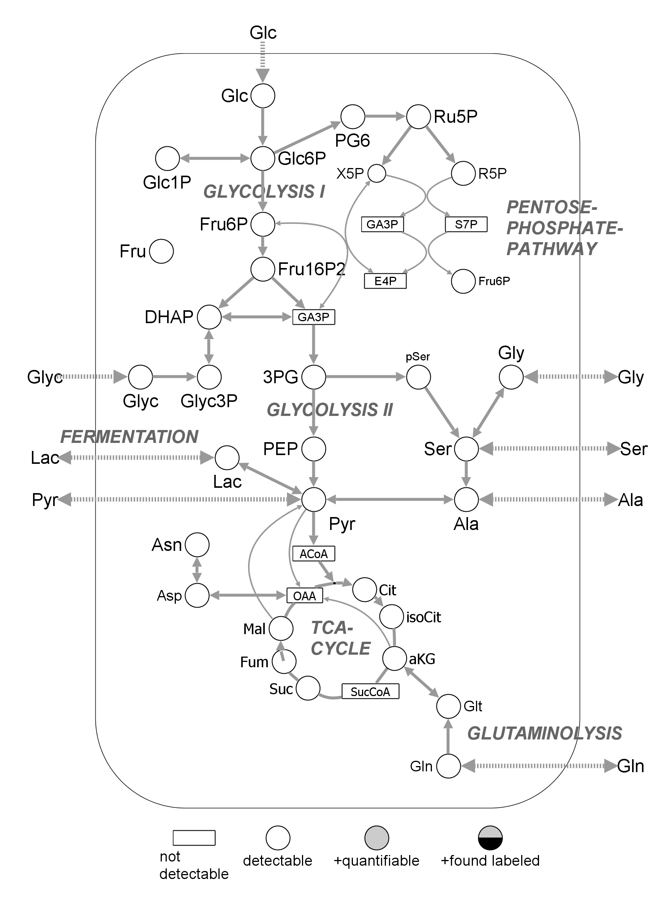
stable isotope resolved metabolomics (SIRM)
¹³C-
Glc
feeding cells with ¹³C-substrates
incorporation into cellular metabolites
detection of mass shift by mass spectrometry

Slide 10
pulsed stable isotope resolved metabolomics (pSIRM)
¹³C-
Glc
short – term label incorporation (minutes)
partial labeling of the metabolites
non-stationary metabolic flux analysis
Liu et al., Nature, 2012
Dörr et al., Nature, 2013
Pietzke and Zasada, Cancer and Metabolism et al. 2014
Pietzke and Kempa, Methods in Enz., 2014
Pietzke et al. EU-Patent No. 14168322

Slide 11
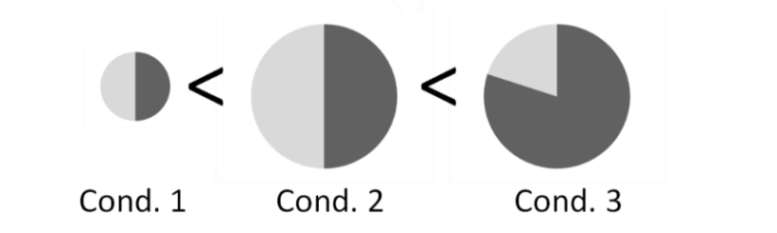
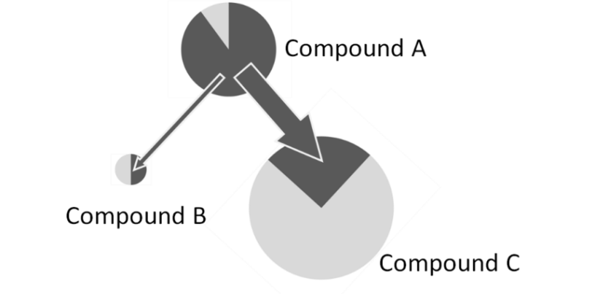

stable isotope resolved metabolomics (SIRM)
¹²C
¹³C
B
which compounds are labeled → active connection
number /position of ¹³C-atoms in the molecule → pathway direction
¹³C fraction within pool size of compound → pathway activity
quantity changes
A
-
isotopologues
-
isotopomers
C
-
pool fraction
Pietzke and Kempa, 2014

Slide 12
analysis of metabolic control in vitro

Slide 13
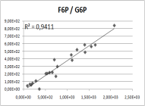
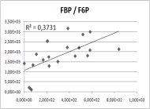
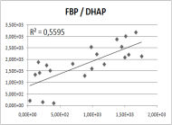
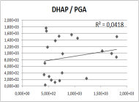
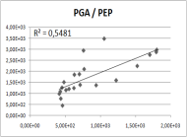
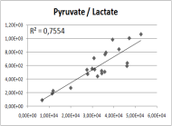
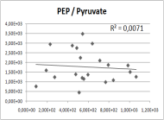
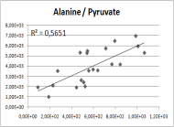
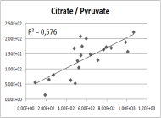
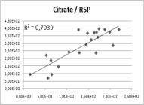
Identification of regulatory Steps
Quantitative time resolved data from 21 growth conditions
Glycolysis I
OPP
Glycolysis II
Fermentation
Glutaminolysis
TCA cycle
Zasada et al. in preparation
Pair-wise plot of substrate and product levels (abs. levels of 13C labeled substance / min)

Slide 14
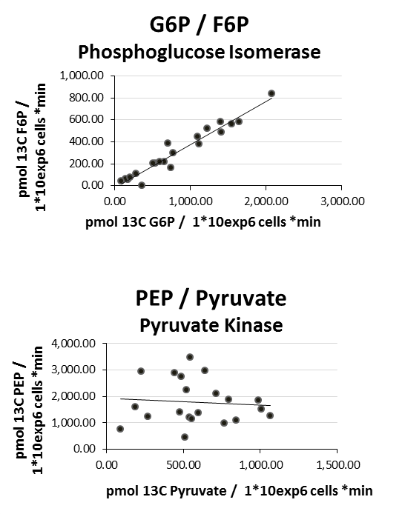
Identification of regulatory Steps
Quantitative time resolved data from 21 growth conditions
Glycolysis I
OPP
Glycolysis II
Fermentation
Glutaminolysis
TCA cycle
Zasada et al. in preparation

Slide 15
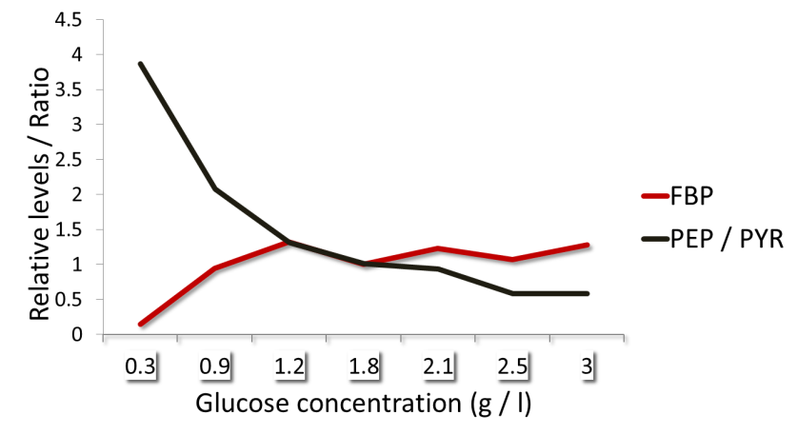
Identification of regulatory Steps
F-1,6-BP acts feed forward on Pyruvate Kinase at physiological glucose levels
Glycolysis I
OPP
Physiological range of
glucose concentration
Glycolysis II
PEP
FBP
Fermentation
PYR
Glutaminolysis
TCA cycle
Zasada et al. in preparation

Slide 16
targeting the metabolic program

Slide 17
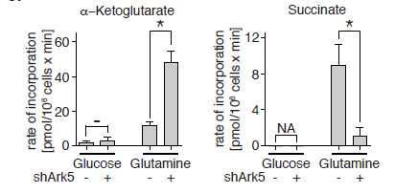
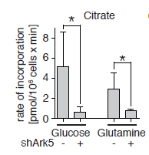
ARK5 (AMPK related kinase 5) regulates mitochondrial metabolism and is a target of synthetic lethality in MYC driven cancer cells
Glycolysis I
OPP
Glycolysis II
Fermentation
Complex I
NADH DH
KGDH
Glutaminolysis
Complex II
Succinate DH
TCA cycle
up-regulated
Complex III
Cyt C Reductase
unchanged
Complex IV
CytC Oxidase
mitochondrion
down-regulated
cytosol
Lui et al. Nature, 2012
Stefan Kempa

Slide 18
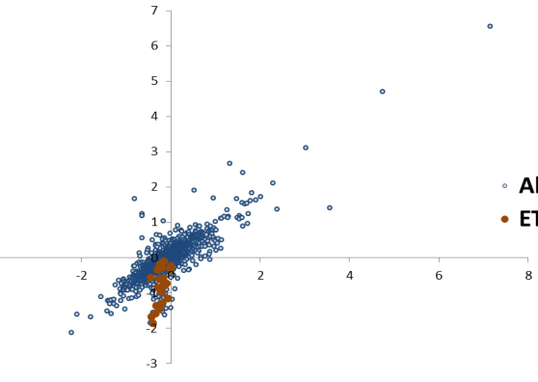



ARK5 (AMPK related kinase 5) regulates mitochondrial metabolism and is a target of synthetic lethality in MYC driven cancer cells
Glycolysis I
OPP
Glycolysis II
Fermentation
Complex I
NADH DH
KGDH
Glutaminolysis
Complex II
Succinate DH
Comparative SILAC analysis of shARK5 and control cells
TCA cycle
up-regulated
Complex III
Cyt C Reductase
unchanged
Complex IV
CytC Oxidase
mitochondrion
down-regulated
Lui et al. Nature, 2012
cytosol
Stefan Kempa

Slide 19
ARK5 (AMPK related kinase 5) regulates mitochondrial metabolism and is a target of synthetic lethality in MYC driven cancer cells
Glycolysis I
OPP
Glycolysis II
ATP production (estimate)
Glycolysis: CTRL, 500 pmol / min
shPK5, 500 pmol / min
TCA: CTRL, 470 pmol / min
shPK5, 60 pmol / min
Fermentation
Complex I
NADH DH
KGDH
Glutaminolysis
Complex II
Succinate DH
TCA cycle
up-regulated
Complex III
Cyt C Reductase
unchanged
Complex IV
CytC Oxidase
mitochondrion
down-regulated
Lui et al. Nature, 2012
cytosol
Stefan Kempa

Slide 20
ARK5 (AMPK related kinase 5) regulates mitochondrial metabolism and is a target of synthetic lethality in MYC driven cancer cells
Glycolysis I
OPP
Glycolysis II
Fermentation
Complex I
NADH DH
MYC
ARK5
KGDH
Glutaminolysis
Complex II
Succinate DH
TCA cycle
up-regulated
proliferation
ATP
Complex III
Cyt C Reductase
unchanged
Complex IV
CytC Oxidase
mitochondrion
down-regulated
Lui et al. Nature, 2012
cytosol

Slide 21
decoding the mode of action of glycolytic inhibitors

Slide 22
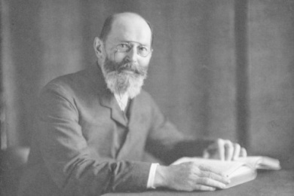

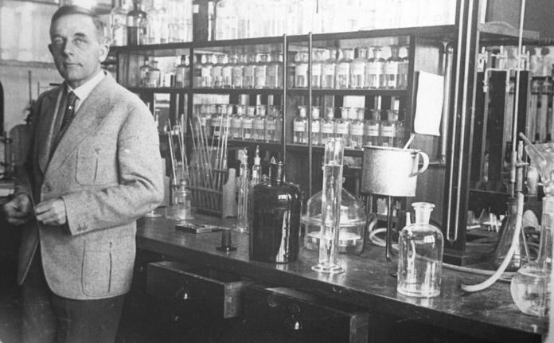
Otto Warburg
Emil Fischer
Nobelpreis for Chemistry, 1902
‘Description of sugar and purine groups’ -> Fisher projection of sugars
http://www.google.de/imgres?imgurl=http://www.welt.de/multimedia/archive/00402/lynen1964_BM_Berlin_4
02951p.jpg&imgrefurl=http://www.welt.de/wissenschaft/article2537376/Der-Mann-der-ein-Medizin-Dogma-zerst
oerte.html&usg=__AUqERii9JxH469bbGc3enLbL-qU=&h=322&w=323&sz=23&hl=de&start=3&zoom=1&um=1&itbs
=1&tbnid=41UhFySL-WYerM:&tbnh=118&tbnw=118&prev=/images%3Fq%3Dwarburg%2Bhaus%2Bberlin%2Bemil%2
Bfischer%26um%3D1%26hl%3Dde%26sa%3DN%26rlz%3D1T4SKPB_deDE352DE352%26tbs%3Disch:1
http://www.archiv-berlin.mpg.de/wiki/uploads/
Kontakt.Kontakt/Otto-Warburg-Haus_k.jpg
ikimedia.org/wikipedia/commons/7/77/Bundesarchiv_Bild_102-12525%2C_Otto_Heinrich_Warburg.jpg
Warburg-Haus in Berlin-Dahlem,
Boltzmannstrasse
Otto H. Warburg (1883 – 1970) 1931, Berlin Dahlem; after he received the Noble price for Medicine:
‘Nature and function of the respiratory ferment’
Warburg described the metabolism of cancer cells: “… that even in presence of oxygen pyruvate is fermented into lactic acid“ (1927)

Slide 23
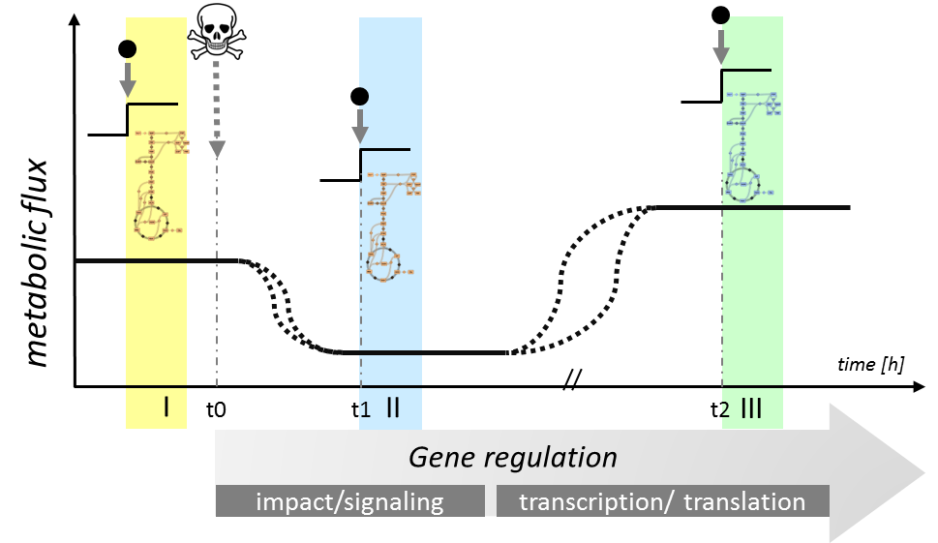
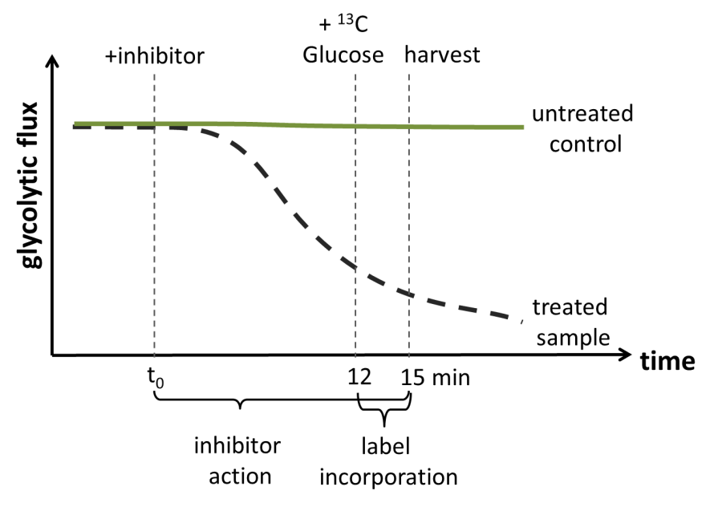
Decoding metabolic inhibition using p(i)SIRM
Pietzke & Zasada et al. 2014
Pietzke et al. in preparation

Slide 24
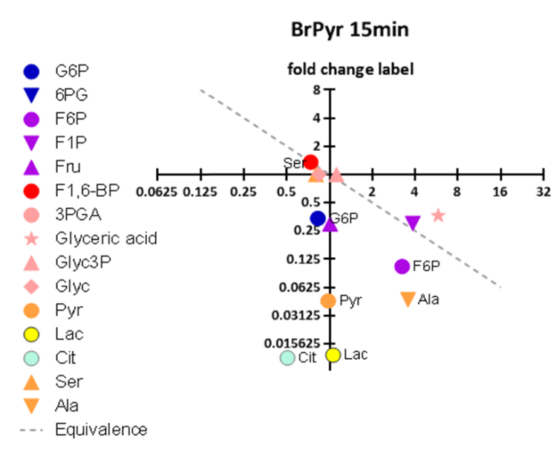
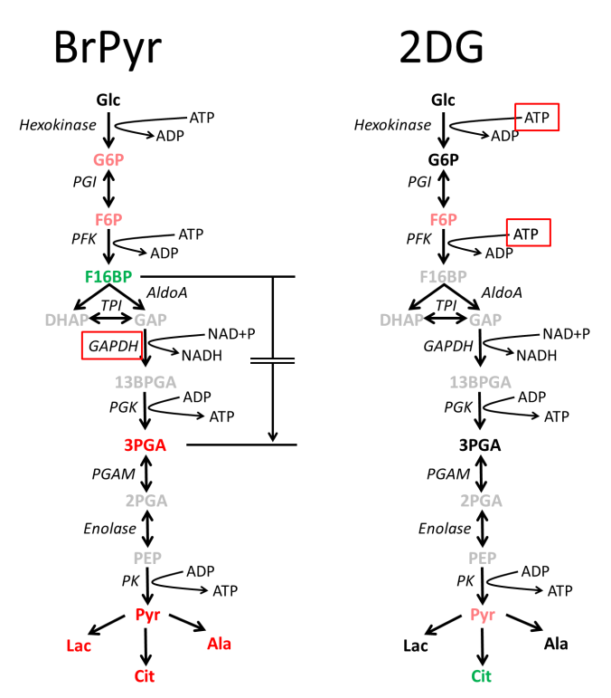
2DG is not a glycolytic inhibitor (but a metabolic suppressor at high concentrations)
Steady state metabolic data do not reflect changes of metabolic activity
Pietzke & Zasada et al. 2014
Pietzke et al. in preparation

Slide 25
analyzing metabolic reprogramming in vivo

Slide 26
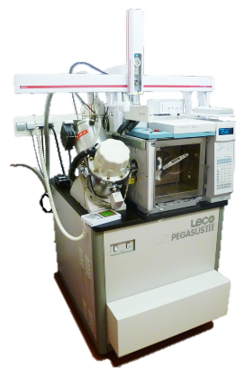
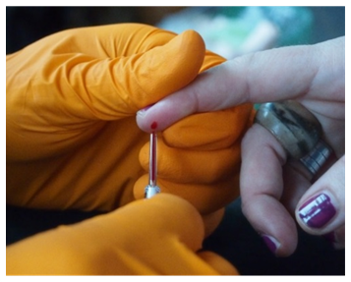
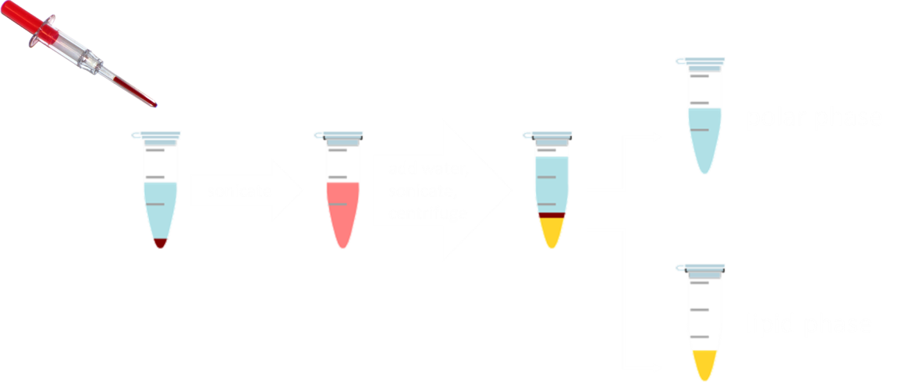
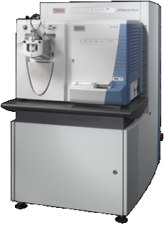
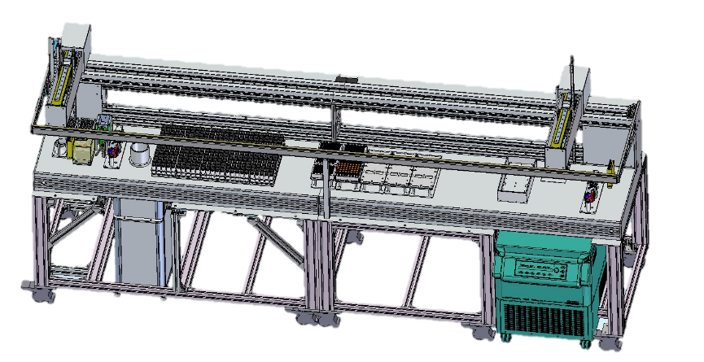
Integrative metabolomics/lipidomics workflow
GC-MS
robotized sample preparation and standard preparation
direct infusion HR-MS

Slide 27

Integrative metabolomics/lipidomics workflow
GC-MS
robotized sample preparation and standard preparation
Direct infusion HR-MS

Slide 28






http://www.bodyworlds.com/en/media/picture_database/
http://s13.postimg.org/odsog2snr/Skinned_shark_one_of_the_001.jpg
Notes:
Require a sample for molecular diagnostics → let’s look at blood!

Slide 29




Towards Blood Diagnostics
Notes:
- we wanted to know how far we could go in humans, reading the blood and understanding what is going on, since blood is the only thing we can sample
- decided to use the simplest sampling strategy we know, which is a finger lancetting as diabetic do all the time to check their blood sugar
- we use that single drop, including RBCs, and do our analysis, and taking the understanding of individual pathways and individual organ physiology from the literature and knowledge of the torpor study, and see how far we get!
- we know that most knowledge comes from studying both steady states, but especially the dynamic changes in between
- so we decided to study something of a rather personal interest to me: the metabolic challenge of exercise
Tobi and I, who contributed 50% to this study, arrived in the morning without eating breakfast, which is unlike what is usually done before a competition, for example, where you do carboloading to „charge“ your muscles with carbs that will be burned in exercise. And i did this to provoke a feeling called hitting the wall that many people are familiar with. It happens when you feel like you have no energy left, and many people stop there. If you are a serious athelete, however, you can overcome this and do it frequently. What happens is a short high, and then the feeling that „you can keep running for another 20 miles“, and at some point you stop.
- at each sampling timepoint, then, i told tobi how i felt. I started out feeling energized, got progressively tired, hit the crisis after 6.6 miles, felt the high afterwards, and continued running for another 2 laps before taking a break, and collecting a „recovery“ sample.

Slide 30



Glucose
Cori
Cycle
(Glycerol)
Fatty Acids
Lactate
Notes:
Looking at our by now familiar minimized energy metabolism map, we first focus on glucose and lactate, the substrate endprodcut of fermentative glycolysis. It is known that the initial phase of exercise is thus powered.
Cori cycle happening
Crisis!
Then second phase, with stable glucose
Glycerol, for FFA release that are fed into the TCA to produce energy, similarly show two phases. An initial release, and a second, stronger release (higher glycerol levels)
So from this we learned that there were 2 stable phases, separated by the crisis and the high

Slide 31



Notes:
- One of the principal novelties of our approach, however, was the inclusion of RBCs. We thought at the beginning that this might complicate things, but it simplified the sampling and sped up processing, which was important to us to prevent “out-of-body” metabolism and degradataion of intermedites.
- A benefit of this is that RBCs are the mediators of oxygen transport of the body, and we can measure now intermediates which are usually not measurable in serum:
Part of the PPP, and 2,3-BPG, which regulates hemoglobin‘s affinity for oxygen

Slide 32



“Hitting the Wall“
Ru5P
R5P
O₂
2,3-BPG
O₂
Citrate
Succinate
Modified from http://legacy.owensboro.kctcs.edu/ and
http://www.anatomyzone.com
Notes:
Mention intensity in lower panel!
Now we wanted to explain the crisis. What we saw very quickly was that in L2, all TCA cycle intermediates had already increased, except citrate.
Let us simplify the figure for a better understanding, where succinate represents all other intermediates which behave identically.
This suggested to us that the TCA cycle was „primed“, or ready to run, because intermediates were present. But low citrate levels indicated that it wasn‘t running. It increased only in L3, the crisis round.
What we do know is that the TCA cycle, in contrast to the fermentation of glucose into lactate, oxygen dependent.
Interestingly, 2-3BPG peaks in the crisis. Its steep increase in RBCs causes the release of oxygen. The release of oxygen in L3 was concomitant with the increase in citrate, indicating that the TCA cycle in muscle was finally running. Furthermore, the PPP intermediates were only present in L3. They are produced in RBCs in times of oxidative stress.
Taken together, the crisis was caused, therefore, by an insufficient supply of oxygen to the primed and ready TCA cylce in muscle. This asynchronicity between oxygen supply and required TCA cycle activity to produce energy during exercise caused the crisis, which is metabolic in origin. It was resolved between L3 and L4, because oxygen was strongly released, causing both oxydative stress in RBCs, and supplying the oxygen required for the muscle to finally produce the energy required that no longer was provided by fermentation.

Slide 33




Notes:
While this was fascination, we wanted to understand how this was possible.
We therefore distilled the entire dataset into what we considered the explanatory components.
We had two stable states, one glycolytic (Lactate), one oxidative (TCA) → this we captured by the relationship of the metabolite sitting at the junction between glycolysis and the TCA cycle: pyruvate, to lactate, and the first TCA cycle intermediate citrate.
Furthermore, we had figured out the metabolic basis of the crisis, which was characterized by oxygen release and oxidative stress.
What was lacking was the explanation for the similarity between the non-exercise timepoints and the „high“ lap 4.
For this, we were able to find three metabolites, our „wellbeing“ cluster, by factor analysis, which were all high in the wellbeing rounds and low in all others. While we do not know their relationsips and their meaning for wellbeing, taking these 9 metabolites only, we were able to reproduce the relationships observed when clustering with all of the data

Slide 34
Notes:
Important for me, because this meant that we were able to understand our data well enough to distill the giant dataset into the explanatory essence, which is readily communicable and entirely understandable.

Slide 35


features = 277
features = 9

Slide 36

Notes:
This circos plot then, summarizes the stages and the transitions between them, as observed in exercise from a single drop of human capillary blood.
The top of the circle are the laps, and the proportion of the color of our explanatory variables shows how much these contributed to each round.
As you can see, i started with a high wellbeing, went into a fermentative phase which resulted in the crisis, characterized by the insufficient oxygen supply for muscle that was answered by oxygen release and resulting burst of oxidative stress. Its resolution in L4 was accompanied by an increase in wellbeing, before a second stable oxidative phase of metabolism occured. After rest, i was still in an oxidative state, and wellbeing increased once more.

Slide 37
conclusions
-p(i)SIRM is the method of choice for characterizing metabolic inhibitors
-2-deoxyglucose was unmasked as a metabolic suppressor,
this may open new ways for an anti-glycolytic tumor therapy
-studies in vivo (mice, humans) are underway

Slide 38







Nikolaus Rajewsky
Ana Pombo
Markus Landthaler
Alexander Löwer
Wei Chen
BIMSB Faculty
K. Nöh, Helmholtz C. Jülich
S. Spuler, Charité, Berlin
E. Klipp, HU, Berlin
M. Poy, MDC, Berlin
M. Eilers, Uni. Würzburg
C. Schmitt, Charité, Berlin
Th. Cramer, Charité, Berlin
R. Bonneau, NYU, New York
H. Holzhütter, Charité, Berlin
G. Duda, Charité, Berlin
M. Leist, University Konstanz

Slide 39
Let Us Meet Again
We welcome you all to our future conferences of
OMICS International
Please Visit:
www.metabolomicsconference.com
www.conferenceseries.com
http://www.conferenceseries.com/clinical-research-conferences.php

