Slide 1


Optimization of particles size for lung specific drug delivery by way of microspheres
Sree Harsha, Bandar E. Al-Dhubiab, Anroop B. Nair, Mohammed Al-Khars, Mohammed Al-Hassan, Raja Rajan, Mahesh Attimarad, Venugopala N
College of Clinical Pharmacy
King Faisal University
Saudi Arabia

Slide 2
Objectives:
Introduction
Therapy
Solution
Formula
Preparation
Evaluation
Conclusion
References

Slide 3
Introduction:
Lung cancers are among the most harmful cancers and are increasingly hazardous to human.
World Health Organization 1.37 million deaths are accounted worldwide.
Saudi Arabia, every year 12,000 new cancer cases are been recorded.
Lung cancer ranked 3rd in male population and 12th among the female population.[1]
Notes:
Microsphere has its drug dispersed throughout the particle

Slide 4
Therapy:
Surgery, Radiotherapy, and Chemotherapy[2]
However, most anticancer drugs are potentially toxic and often ineffective, leading to systemic toxicities.
Methotrexate is an antitumour drug and has been proven efficiency in many types of cancer.
Still, these drugs affect not only cancer cells but also normal cells leading to side effects!
Notes:
Till know Surgery, Radiotherapy, and Chemotherapy have been the main treatment
Methotrexate uses - It is used in treatment of cancer, autoimmune diseases, ectopic pregnancy

Slide 5
Solution:
Hence, it is very important to invite new therapeutic protocol to treat lung cancer.
Microsphere can be effective by administered into body intravenously will distribute itself in difference organs.
Depending on the size of the particles and particles between 5 – 15 um are normally entrapped in the capillary network of lungs[4].

Slide 6
An attempt has been made to developing microspheres of Methotrexate(Mxt) using carbopol as a polymer to over come its main side effects.

Slide 7
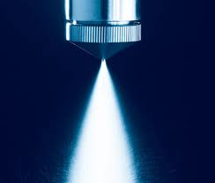
Formula:
Carbopol (0.25 g),
Methotrexate(0.25 g)
100 ml water
Solution
Spray
7 μm spray nozzle
Dried fine particles was collected

Slide 8
Experimental design methodology
Optimization of particle size - 20 runs
Stat-Ease software (Design-Expert V.8.0.7.1)
The three independent variables selected were
  Polymer concentration (A).
  Inlet temperature (B)
  Feed flow rate (C)

Slide 9
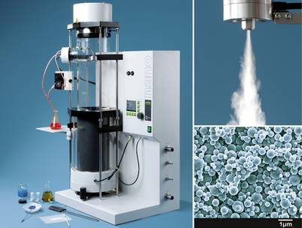
Preparation: Spray Drying Technique:
BUCHI: Nano Spray Drier B-90

Slide 10
Evaluation of fine powder (microspheres):
Drug content
Percentage yield
Surface morphology
Particle size analysis
In vitro release studies

Slide 11
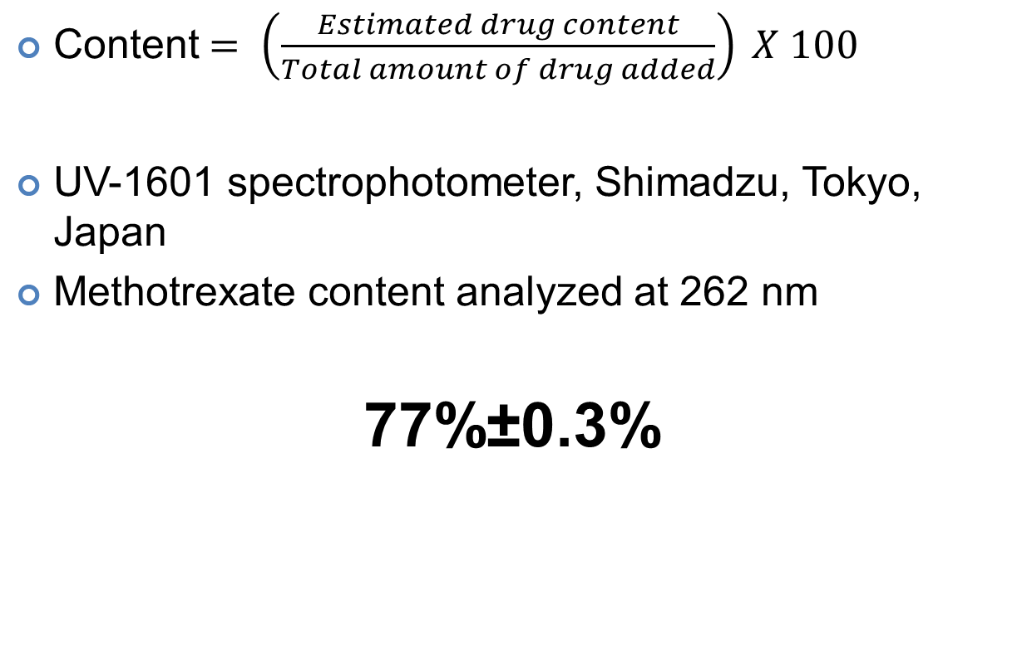
Drug content
Content$= \left.\left(\frac{Estimated drug content}{Total amount of drug added}\right.\right) X 100$
UV-1601 spectrophotometer, Shimadzu, Tokyo, Japan
Methotrexate content analyzed at 262 nm
77%±0.3%

Slide 12
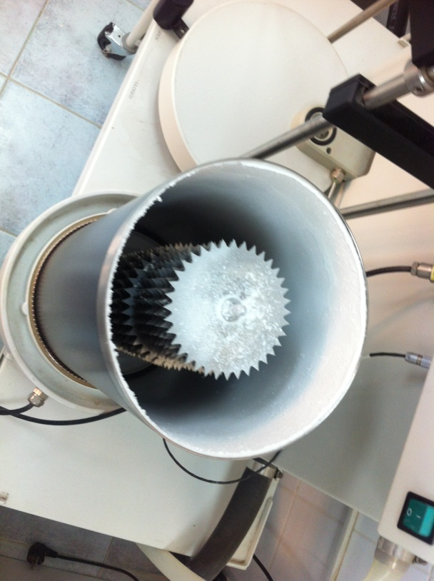
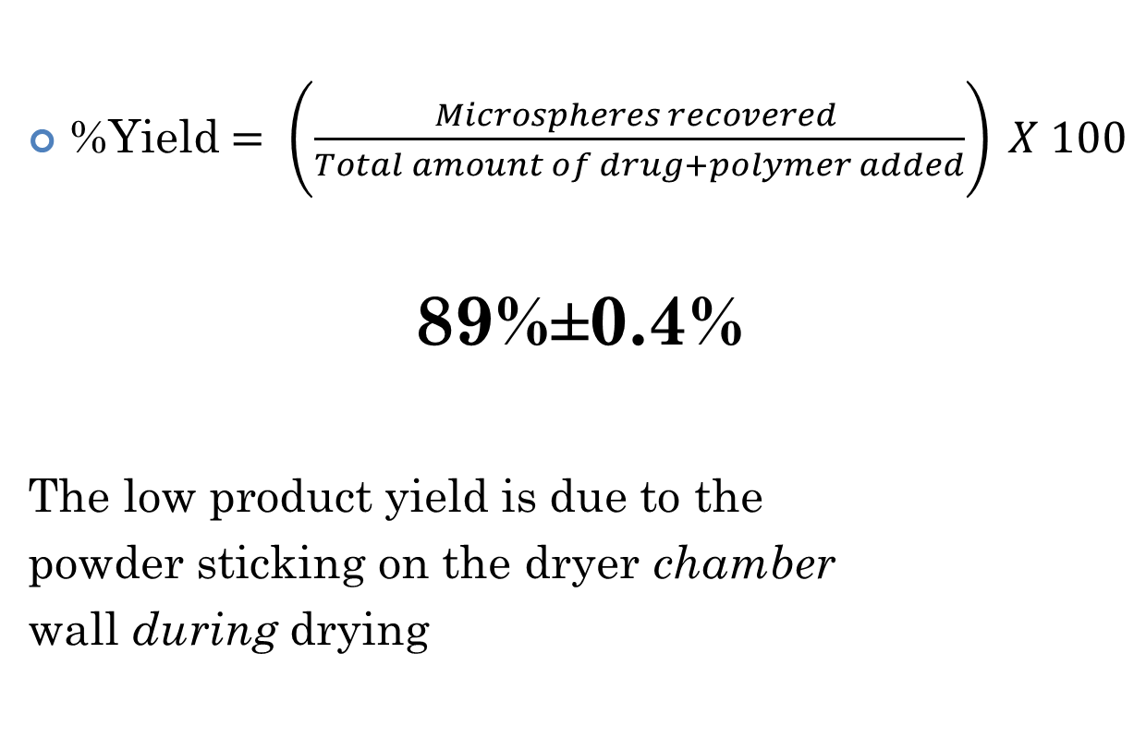
Percentage yield:
%Yield$= \left.\left(\frac{Microspheres recovered }{Total amount of drug+polymer added}\right.\right) X 100$
89%±0.4%
The low product yield is due to the
powder sticking on the dryer chamber
wall during drying

Slide 13
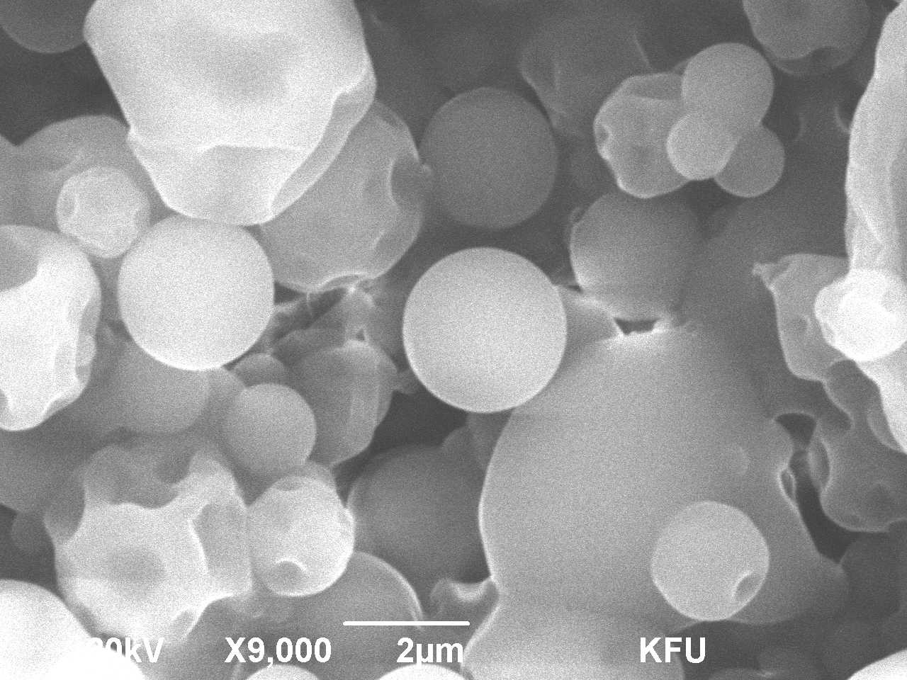
Surface Morphology:
Scanning Electron Microscope.
(Jeol Analytical Scanning Microscope, JSM-6390LA, Tokyo, Japan)
Methotrexate microspheres obtained was surprisingly were shriveled (due to surface folding).
Notes:
Outside

Slide 14
Powder lost its moisture very rapidly during the drying process in the drying chamber
due lack of a plasticizer.
Microspheres were intended to stay for longer time, plasticizer was not added in our formulation due to chances of irritation in the target site, lung.

Slide 15
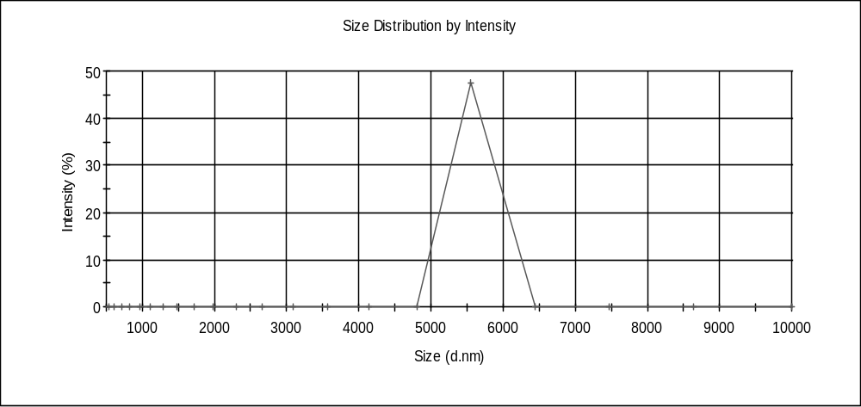
Particle Size Analysis:
Nano Series Nano-ZS, Malvern Instruments Inc, Westborough, MA.
Average particle size of 6.8 µm
Microspheres with the particle size range of 5–15μm have a prominent lung-targeting.

Slide 16
In vitro release studies:
Mxt carbopol microspheres were placed in a dialysis bag and dialyzed against 500 mL of phosphate saline buffer (PBS), pH 7.4 at 37+1~ ºC. Samples were withdrawn and sink conditions were maintained.
Time interval: 0.5 h, 1 h, 2 h, 3 h, 4 h, 6 h, 8 h, 10 h, and 12 h).
Notes:
"Sink Conditions- maintaining a volume of dissolution media that is 5 to 10 times greater than the volume at the saturation point of the drug contained in the drug delivery system being tested." as defined in the DDG book volume 1
Software ….. To see how much the drug is release

Slide 17
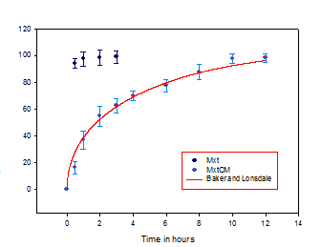
37% methotrexate in MxtCM first hour released.
Mxt adsorbed on or merged close to the external surface of the microspheres.
In clinical practice this would lead to ‘burst effect’, which enables the formulation to show fast therapeutic effect to the patients.
Notes:
Sigma plot

Slide 18
However, the methotrexate released from carbopol microspheres in 12 h was 98.2% %.
In comparison with MxtCM, the methotrexate injection releases methotrexate very fast 94.2% in 30 min.
The results directed that MxtCM had sustanined release efficiency.

Slide 19
Release Kinetics:
Results obtained from in vitro release studies fitted to various kinetic models.
(i.e., Higuchi, Korsmeyer’s Peppas, Hixon and Crowell, first-order, Baker and Lonsdale) to prove the mechanism of drug release.
The best fit with R² = 0.9807 was seen in Baker and Lonsdale model resulting to polymer swelling and drug diffusion kinetic mechanism.

Slide 20
Stability studies:
Microspheres were placed into a bottle and stored for 12 months at 3-5⁰C, 15-25⁰C, and 37⁰C, respectively. The surface morphology and methotrexate content were examined periodically.

Slide 21
During storage at 3-5⁰C or room temperature (15-25⁰C) for 12 months surface morphology and drug content of methotrexate had no notable changes.
However, at 37⁰C and RH 75% the characteristic of liquification was observed.
Notes:
Relative humidity ….. b/c gelatin

Slide 22
Conclusion:
The findings of the work can also be applied for developing effective blue-print for targeted organ specific drug delivery.
Decrease the side effects.
Decrease the dose and frequency of drug administration.
It is gives sustained release.
Avoid first pass metabolism.
as intracellular therapy with other drugs, by a slight modification in the techniques employed in the preparation of microspheres.
Notes:
And the corollary of this work can be used as…

Slide 23
References:
Jazieh, A.-R., et al., The epidemiology of lung cancer in the Kingdom of Saudi Arabia. Annals of Thoracic Medicine, 2010. 5(5): p. 5-7.
Rajput, M. and P. Agrawal, Microspheres in cancer therapy. Indian Journal of Cancer, 2010. 47(4): p. 458-468.
Sai Venkata Vedavyas Pisipati, H.P., Ganesh Bhukya, Suresh Nuthakki, Baburao Chandu, SreeKanth Nama, RajDev Adeps, Lycopene: Redress for prostate cancer. J Basic Clin Pharma, 2012. 3(2): p. 261-264.
Harsha, S., Dual drug delivery system for targeting H. pylori in the stomach: preparation and in vitro characterization of amoxicillin-loaded CarbopolÂ® nanospheres. International journal of nanomedicine, 2012. 7: p. 4787-4796.
Lu, B., J.Q. Zhang, and H. Yang, Lung-targeting microspheres of carboplatin. International Journal of Pharmaceutics, 2003. 265(1-2): p. 1-11.
Miller, D.A., et al., Spray-Drying Technology
Formulating Poorly Water Soluble Drugs. 2012, Springer New York. p. 363-442.
De Jaeghere, F., et al., pH-Dependent dissolving nano- and microparticles for improved peroral delivery of a highly lipophilic compound in dogs. The AAPS Journal, 2001. 3(1): p. 92-99.
Coowanitwong, I., et al., Slow Release Formulations of Inhaled Rifampin. The AAPS Journal, 2008. 10(2): p. 342-348.

Slide 24
Questions!?

Slide 25
Thank you…

