Slide 1
Effects of variable feedstock particle size on Birchwood gasification: A CFD approach
K.G.R.M. Jayathilake, Souman Rudra
Presented by Souman Rudra
Associate Professor, University of Agder
Madrid, Spain
June 29-30

Slide 2
Outline
Introduction
Experimental setup
Method
CFD analysis and results
Conclusions

Slide 3
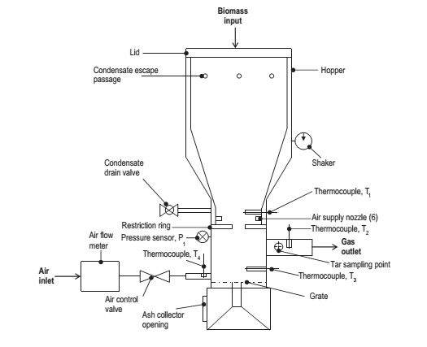
Experimental study
Introduction
Birchwood was used as the feedstock
Fixed bed downdraft gasifier available at university of Agder was used for the experiments

Slide 4
Feedstock characteristics
Birchwood chips were used for the experiment
Average chip size was 11.5 mm x 11.5 mm
About 5 kg of woodchips were used for each experiment
About 2 kg of charcoal was added before the Birchwood chips were added to the gasifier(in order to help the ignition)

Slide 5
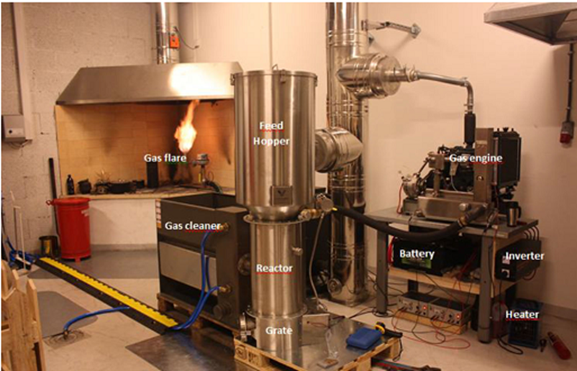
Experimental setup

Slide 6
Feedstock
Proximate analysis (dry basis)
Moisture % | 7
Volatiles % | 82.2
Fixed Carbon % | 10.45
Ash % | 0.35
LHV (MJ/kg) | 17.9
Ultimate analysis (dry basis)
Carbon % | 50.4
Hydrogen % | 5.6
Oxygen % | 43.4
Nitrogen % | 0.12
Sulphur % | 0.017
Chlorine % | 0.019

Slide 7
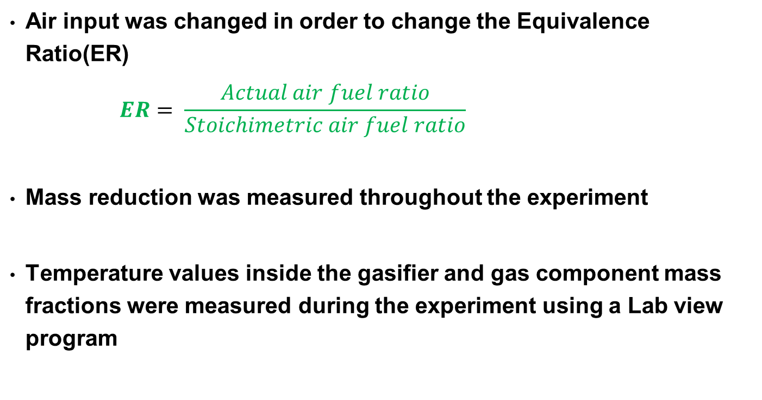
Experimental set up
Air input was changed in order to change the Equivalence Ratio(ER)
$$ER= \frac{Actual air fuel ratio}{Stoichimetric air fuel ratio}$$
Mass reduction was measured throughout the experiment
Temperature values inside the gasifier and gas component mass fractions were measured during the experiment using a Lab view program

Slide 8
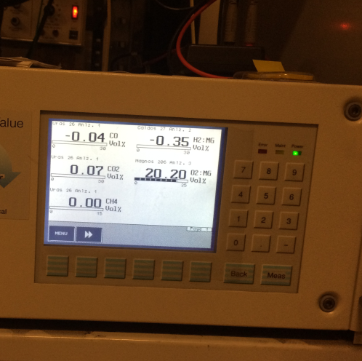
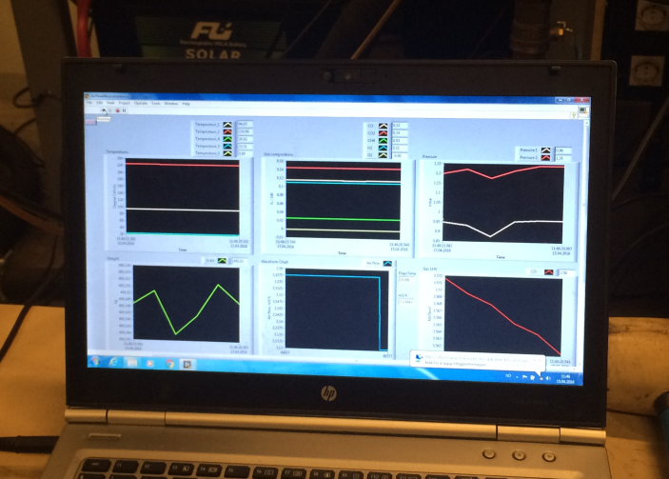
Experimental set up

Slide 9
Method
Considered ER range :- 0.2 to 0.5
Used particle sizes :- 9.18mm and 11.5mm (diameter)
For the simulations with in the ER range, both biomass particle sizes have been used with the same conditions.
For the experiments a woodchip with a size of 11.5mmx 11.5mm has been used.

Slide 10
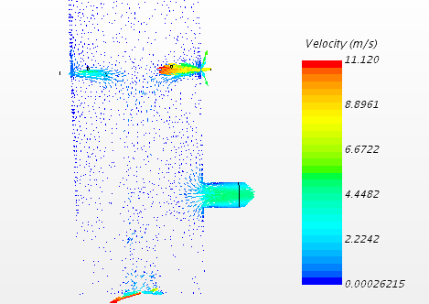
CFD analysis

Slide 11
CFD analysis
CFD Model formation
  Model Geometry and Mesh
  Physics models
  Star CCM+ was used for model simulation
Assumptions
Flow is steady
Particles are spherical shape and have an even distribution
No slip condition was applied to the reactor walls

Slide 12
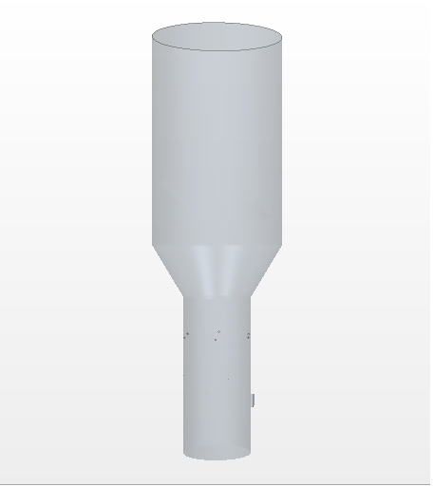
Geometry and mesh
Biomass inlet
Total height of the gasifier = 1600 mm
Air inlet diameter = 5 mm
Gas outlet diameter = 50 mm
Number of air inlets = 6
Gasifier body
Air inlets
Gas outlet

Slide 13
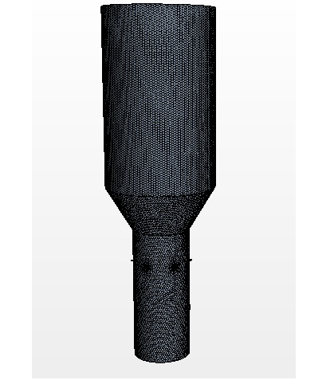
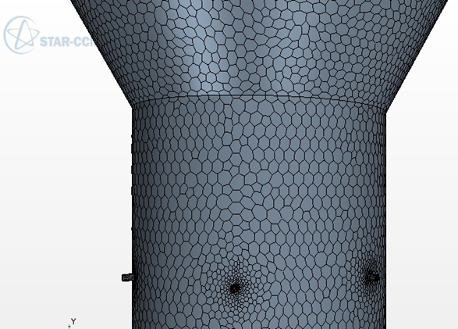
Geometry and mesh
0.01m mesh was used for the gasifier model while a 0.001m mesh was used for the air inlets and for the mixing region
Polyhedral cells with prism layers were used as the mesh

Slide 14
Physics models
Gas-Phase Modelling
3D-Steady flow
Reynolds average Navier-Stokes equation (RANS)
Standard k-є Turbulence model
Multi-component gas (Coal volatile, O₂, CO₂, CO, H₂, CH₄, H₂O, N₂)
Ideal Gas
Reacting Species
Eddy Break-up (EBU) Combustion model
Segregated flow with segregated enthalpy
  Particle-Phase Modelling
  Lagrangian approach
  Multi-component coal particle
  Spherical particles & constant density
  Coal combustion
  Coal moisture evaporation
  Single step devolatilization
  First order char oxidation
  Two-way coupling

Slide 15
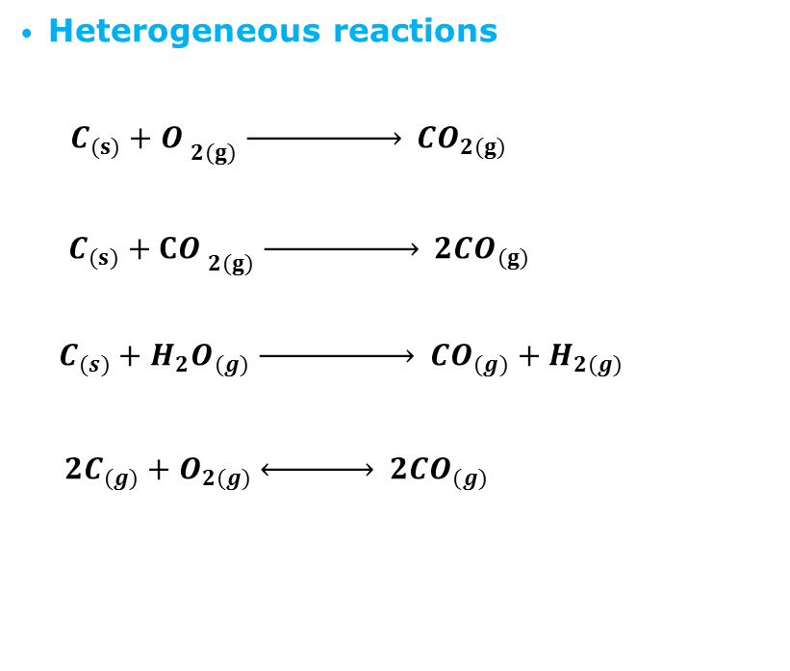
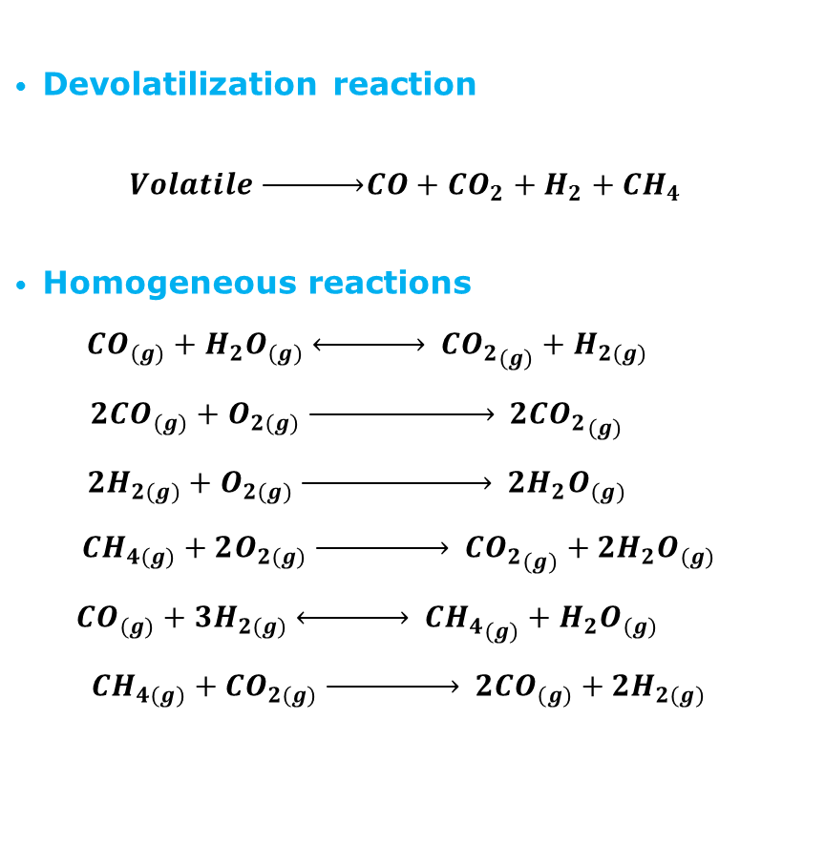
Chemical reactions
Devolatilization reaction
$$Volatile \underset{→}{ }CO+{CO}_{2}+H_{2}+{CH}_{4}$$
Homogeneous reactions
$${CO}_{(g)}+H_{2}O_{(g)} \underset{↔}{ } {{CO}_{2}}_{(g)}+H_{2(g)}$$
$${2CO}_{(g)}+O_{2(g)} \underset{→}{ } {{2CO}_{2}}_{(g)}$$
$${2H}_{2(g)}+O_{2(g)} \underset{→}{ } {2H}_{2}O_{(g)}$$
$${CH}_{4(g)}+2O_{2(g)} \underset{→}{ } {{CO}_{2}}_{(g)}+{2H}_{2}O_{(g)}$$
$${CO}_{(g)}+{3H}_{2(g)} \underset{↔}{ } {{CH}_{4}}_{(g)}+{H_{2}O}_{(g)}$$
$${CH}_{4(g)}+CO_{2(g)} \underset{→}{ } {2CO}_{(g)}+{2H}_{2(g)}$$
Heterogeneous reactions
$$C_{(s)}+{O_{ }}_{2(g)} \underset{→}{ } {CO}_{2(g)}$$
$$C_{(s)}+{CO_{ }}_{2(g)} \underset{→}{ } {2CO}_{(g)}$$
$$C_{(s)}+H_{2}O_{(g)} \underset{→}{ } {CO}_{(g)}+H_{2(g)}$$
${2C}_{(g)}+O_{2(g)} \underset{↔}{ } {2CO}_{(g)}$

Slide 16
Results
The following parameters were measured in each scenario,
Gas component mass fractions in output gas
Syngas yield
Cold Gas Efficiency (CGE) of the syngas

Slide 17
Results
CO mass fraction
CO2 mass fraction
This can be a result of the combine effect of Combustion reaction , Boudouard reaction and Carbon partial reaction. As, in lower ER values, Boudouard reaction tends to produce more CO to the system at the expense of CO₂ , while in high ER values, Combustion reaction and Carbon partial reaction convert more CO into CO₂

Slide 18
H2 mass fraction
Results
CH4 mass fraction
This can be mainly because of the effects of Dry reforming and Steam reforming reactions, which produce more H2 to the system at the expense of CH4.
When smaller particle size is used, contact area and area to volume ratio of the wood particle is increased which can be resulted in increased contact with the reactants. That can lead to a enhanced reactions.

Slide 19
Results
Syngas yield
CGE
ER has shown a average maximum close to ER value 0.35.
The smaller particle size has resulted in a higher syngas yield.
CGE has also shown a average maximum at ER value of 0.35.
Smaller particle size has improved the CGE of the syngas

Slide 20
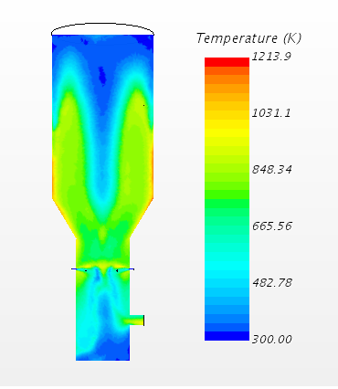
Comparison of the temperature profile
In both simulation and experimental scenarios temperature distribution inside the gasifier has shown a close correlation. Here position zero is measured at the top of the gasifier

Slide 21
Discussion
When smaller particle size is used, contact area and area to volume ratio of the wood particle is increased which can be resulted in increased contact with the reactants. That can lead to enhanced reactions which have led to produce increased values of syngas yield, CGE, CO mass fraction and CO2 mass fractions.
In the experiment the air inflow rate was a variable and a average value of air inflow rate was calculated in order to create the graphs. While in the simulations a fixed air inflow rate was used in order to achieve the pre defines ER value. So this difference in air inflow rate measurement can have a effect on the deviations in the gas component values
While the experiment bridging and channeling can be occurred and it can effect the output. When the average values are calculated from the experimental data those bridging areas also can be included and it can cause a difference from the simulation values

Slide 22
Conclusions
CFD based biomass gasification modeling was performed for two sizes of woodchips of Birchwood using commercially available code: Star-CCM+.
Both biomass particle sizes were tested within the same ER range (0.2 to 0.5)
Simulation results had shown close correlations with the experimental results obtained from the available gasifier.
Smaller biomass particle size has improved the syngas yield, CGE , CO and CO2 mass fractions of the syngas.

Slide 23


Thank you!!
Q & A
Contact : souman.rudra@uia.no

