Slide 1
Tat Oyi-based candidate therapeutic vaccine: a phase 1 clinical trial in HIV-1 infected patients
Escaich Sonia,
COO BIOSANTECH SA.

Slide 2
Tat is a virulence factor of HIV
Transactivator of transcription (Tat) of HIV-1 is essential for the viral gene expression and productive infection
Tat protein expression is a first step of the virus life cycle to transactivate its own expression
It enter the nucleus and then can regulate the expression of host genes which impact the immune system
Nearly two-thirds of Tat made by infected CD4+T-cells are secreted into the extra-cellular milieu and the extracellular Tat can be taken up by cells.(Rayne EMBO 2010)
Tat can induce viral expression from latently infected cells
Extracellular Tat acts as toxin by interacting with many cellular pathways in uninfected cells:
Directly involved in immunosuppression
  i.e triggers apoptosis in T-cell, inducing Fas on macrophages
  Tat Binds to integrins and favor viral entry in T-cell, monocytes and DC
Directly involved in immunosuppression and pathogenesis
  i.e Tat has been shown to play a direct role in inducing neuronal death
HIV provirus
CD4
LTR
gag pol env
LTR
TAR
RNA
Others proteins
Tat
Rev
Nef
virions assembly
Tat secretion

Slide 3
Why a Tat based vaccine
Tat is good target for inhibition as the early activator of the retrovirus expression
Tat Inhibition would block efficiently the viral life cycle and virion release
It could inhibit the reactivating of latent viral reservoirs
Few attemps have been made to develop pharmacological inhibitors of Tat
Neutralization of extra cellular Tat would prevent the binding of Tat to cell membranes and receptors
To Inhibit the toxic activities of Tat on immune cells and pathways, leading to restoring immune fonctions or decreasing pathogenicity
Neutralization of Tat during infection could be an important objective, making Tat a potential therapeutic vaccine candidate.
Tat still secreted under ART (S. Mediouni Inf. Dis. 2012)
Blocking replication of latent virus in reservoir cells during HAART

Slide 4
Immune response to Tat could protect subjects from disease progression?
Studies suggest that presence of Antibodies to Tat could correlate with slower progression long term survival in human
  Re et al. 1995: Retrospective study in 10 HIV hemophiliac patients followed for 10 years: inverse correlation between Anti Tat Ab and clinical progression
  Re et al. 2001: 44/53 Drug users patients with ART, had Ab to Tat (Tat full length 1-80); inverse correlation between high level of Tat Ab and viral load as measured by HIV RNA.
  Zagury et al 1998: in 182 non progressors NP (26 P-NP) follow up 1-2 years. Inverse correlation (p=0,001) between Tat Ab titers and p24 Ag, CD4 level and clinical signs of progression
  Richardson et al 2003. GRIV cohort: Antibodies to Tat and not to Vpr associated with maintenance of long-term non-progression (epitopes in Tat :N ter, basic domain and C ter Tat). A correlation was observed between anti-Tat IgG titers and cross-reactivity with Tat from diverse viral isolates, including HIV-1 subtype-E (CMU08) and SIVmac251 Tat .
  Rezza et al J. inf Dis 2005. : Ab to native Tat IIIB retrospective study of 252 subjects mean follow up 7,2 years: anti-tat positive subjects (11%) had a 60% lower risk of disease progression.
  Senkaali D,et al. AIDS Res Hum Retroviruses. 2008: No correlation between Tat Ab and disease progression in a cohort in Uganda when using differents variants of Tat proteins
  Bellino et al. Retrovirology 2014. Prospective study in 61 asymptomatic drug-naïve HIV-infected adult volunteers same baseline for CD4, follow up to 42 months, 20/60 with anti Tat Ab, 11 with high persistent levels and 9 with lower level Tat Ab. Inverse correlation was found between high Tat Ab titers and CD4 decline, increase in viral load and start of HAART.
Conflicting results suggest that anti-Tat antibodies when detectable are not necessarily efficient against Tat

Slide 5
CTL to Tat correlate with slower progression ?
  Froebel et al . AIDS res Hum Ret 1994.
  In 130 children from infected mothers: 9 infected newborns followed for 18 months, 6/9 had CTL of HIV proteins, Tat specific CTL was the earliest immune response and it was associated with better clinical profil (NS).
  Van baalen et al. J Gen Virol 1997.
  In 12 seropositives (9 seroconverting) follow up 10 years, frequency of CTL specific for Tat and Rev significantly higher in NP than Rapid Progressors (no correlation with CTL to gag , RT or nef).
  Addo et al. PNAS 2001.
  In 57 HIV seropositive: CTL to Tat 19% to Rev in 37%. Controllers targeted more CTL epitopes within HIV-1 Tat, compared with the treated individuals ( P < 0.03), and responses directed against these epitopes were of significantly higher magnitude in controllers (471 ± 270 SFC/10⁶ PBMC vs. 156 ± 71 SFC/10⁶ PBMC, P = 0.01).

Slide 6
Tat based vaccine trials in animal models
Earlier Studies of Tat vaccines in animal models did not show protection against high dose or iv challenge:
Allen et al 2002: Full Tat SIV Mac 239 or tat 28-35 DNA immunization with vaccinia virus induce a CTL specific response but no protection
Richardson et al , Silvera et al 2002: Despite specific Ab and cell response in rhesus macaques immunized with unmodified HIV-1 IIIB Tat, SHIV89.6P Tat, and carboxymethylated IIIB and 89.6P Tat toxoids no protection or effect on viral replication
Several studies reported a reduction in the rate of infection or in the level of viral replication after low dose or intrarectal challenges with native Tat vaccination in homologous challenges:
Pauza et al. 2000. Tat IIIB toxoid or native vaccination attenuated SHIV 86 viral load in 10 Rhesus macaques
Cafaro et al.2010 A retrospective analysis of 112 Mauritian cynomolgus macaques from different preclinical trials, vaccinated (n = 67) or not (n = 45) with Tat (HXB2 tat 86) and challenged with the SHIV-89.6P.
Partial protection could be achieved with multi-component Tat Env vaccines:
Monini et al 2012. In cynomolgus macaques co-immunized with HIV-1 Tat and Env proteins and challenged intrarectally with a high dose (70 MID₅₀) of the R5-tropic SHIV_{SF162P4cy}
Lakhashe SK et al. 2011. A multi-component vaccine (multimeric HIV-1 gp160, HIV-1 Tat, and SIV Gag-Pol particles) delivered systemically or mucosally and challenged orally or IR with the Heterologous C clade r5-tropic SHIV-1157ip :
  A sterilizing immunity 2/12 and control of infection (-1 log viral RNA ) was observed in 4/12 immunized rhesus macaques
  Protection correlated with strong humoral and cellular immune response to Tat or Gag
Bachler BC et al. 2013. Novel biopanning strategy to identify epitopes associated with vaccine protection : only the 6 protected animals had developed antibodies binding a dominant epitopes in Tat.
Induction of anti-Tat antibodies may be key to achieve protective immunity against HIV

Slide 7
Tat vaccine clinical trials
Immunization with peptides, whole native Tat or Tat toxoid has been reported to induce modest immunogenicity but no evidence of control of HIV replication
Tat peptides TUTI-16.
HXB2 Tat ISST-02
Tat B cell epitope (Tat 4-12), short peptides with known variant amino acids at variable positions 7, 9 and 12 ( plus a promiscuous T helper sequence and a lipopeptide toll-like receptor 2 (TLR2) agonist)
TUTI-16 in a recent randomized double-blind trial was immunogenic, with high levels of anti-Tat antibodies
Of 21 immunized subjects, 13 (62%) had HIV rebounds vs. 8 (38%) that remained aviremic after ART cessation, but this distribution was not vaccine-related (p = 0.61)
Biologically active HIV-1 Tat protein in 168 HAART patients follow up 3 years
Vaccination promoted anti-Tat IgM and IgG Abs able to neutralise Tat activity in vitro (Env entry in DC cells)
Induction T-cell response to Tat epitopes
Compare to a control cohort: CD4 mean increase was 100 c/µl at year 2 and 3
A significant reduction of blood proviral DNA was seen after week 72, with Tat (30 μg, 3x), in the group of patients treated with PI inhibitors.
Goldstein G, Chicca J. Hum Vaccin Immunother. 2012 HIV-1 Tat B-cell epitope vaccination was ineffectual in preventing viral rebound after ART cessation
Ensoli F. et al. Retrovirology 2015;12:33.
HIV-1 Tat immunization restores immune homeostasis and attacks the HAART-resistant blood HIV DNA: results of a randomized phase II exploratory clinical trial.
All Tat vaccine were safe, linear epitopes did not induce a protective Ab response, active TatHXB2 immunization could result in some level control of replication

Slide 8
Issues to solve for a Tat vaccine
Heterogenicity variability of genomes
Intrinsic moderate immunogenicity of Tat
Finding the epitopes that could Induce a protective immunity

Slide 9
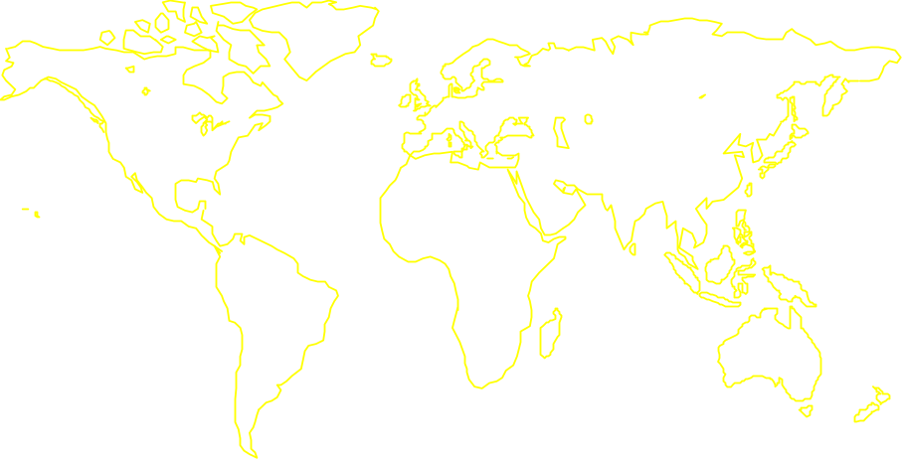


Tat Oyi rational
The HIV-1 Oyi variant was found in 1989 in Gabon
  Huet T, Jazza MC, Brun-Vézinet F, Roelants GE, Wain-Hobson S.AIDS. 1989 A highly defective HIV-1 strain isolated from a healthy Gabonese in a group of pregnant women presenting atypical western blot ( no Ab to Env) and stay asymptomatic for at least 2 years
  HIV-1 Oyi variant replicated poorly in PBMC coculture, it was recognised by anti HIV-1Env Ab
  Oyi strains has a mutated Tat protein unable to transactivate HIV transcription (the Oyi strain could be complemented in vitro with a WT Tat gene).
  Could it be a defective HIV- 1 strain that induces an immune response able to control infection and protect against the disease?

Slide 10
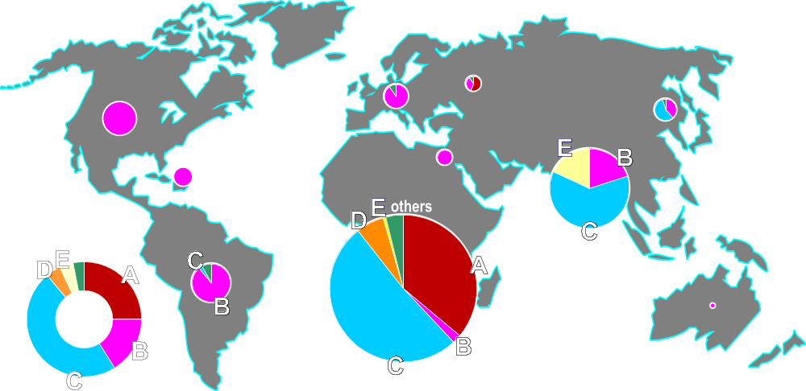


Tat Oyi has specific mutations
Tat variability in the major HIV-1 clades
1 10 20 30 40 50 60 70
TatOyi
MEPVDPRLEPWKHPGSQPKTASNNCYCKRCCLHCQVCFTKKGLGISYGRKKRRQRRRAPQDSKTHQVSLSKQ
TatUg11RP
.D....NI...N......T.P..K....V..Y..L...QS............K...GPTQSN.Q..NPIP..
TatHXB2
.....................CT.....K..F......IT.A................H.N.Q...A.....
Tat96BW
......N...........R..CTK....Y..Y..L...QT................ST.PS.ES..NLI.E.
TatEli
.D....N....N......R.PC.K.H..K..Y..P...LN................GP..GGQA...PIP..
TatCM240
..L...N....N......T..CSK....K..W...L..L..............H..GT..S..D..NPIP..
Up to 28% in sequence variation between the 5 main HIV-1 subtypes
Only C22S: loss of transactivation
80 90 100
TatOyi
PASQPRGD-PTGPKESKKKVERETETDPED
101
TatUg11RP
.IPRTQ.I-S...E.S.....DK....RR.
101
TatHXB2
.T......-......-............F.
100
Tat96BW
.LPRTQ.N-...SE.......SK..A..FA
101
TatEli
.S......-......Q.....S.A....
99
TatCM240
.LPII.RN-..D......E.ASKA...QC.
101

Slide 11
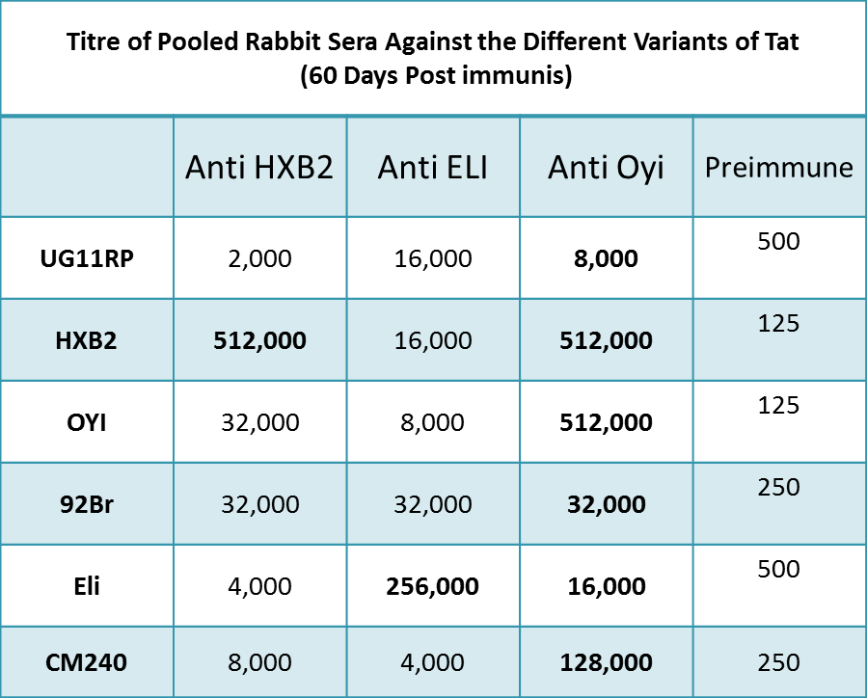
Tat Oyi has specific immunologic properties (1)
Tat Oyi induces Ab cross-recognizing 5 major Tat variants
Rabbits sera after immunisation with Tat Oyi, Eli and HXB2.
anti-Tat Oyi sera had the highest antibody titers
anti-Tat Oyi sera were the only one to have a broad antibody
response against 5 heterologous Tat variants Subtype A,B, C, D, AE.
Majority of anti-Tat Oyi Abs are directed towards a conserved 3D structure of full lenght Tat Oyi protein
Western blots showed that non-homologous Tat variants
were recognized by antibodies directed against conformational epitopes
Tat Oyi if denatured lost its capacity to induce cross reactive Abs
Full lenght Tat is neccessary for a vaccine : Rabbit antisera against HXB2 1-100 had a better capacity to neutralize Tat variants (C and D) than HXB2 1-86 antisera (Opi et al. Vaccine 2004)
(Opi et al: JBC 2002)

Slide 12
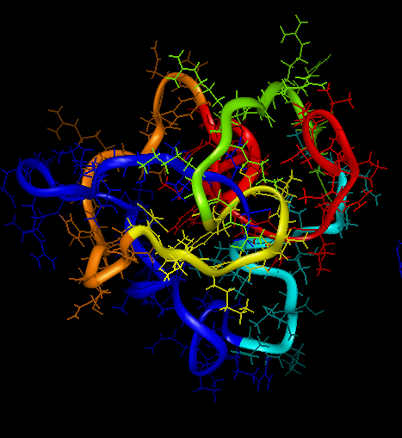
Tat Oyi has specific immunologic properties (2)
The tat Oyi induces antibodies against a conserved 3D epitope
A conserved 3D epitope was identified with a mice Monoclonal antibody to Tat Oyi, 7G12
It does recognise the 5 Tat variants :clade A (Ug11RP), clade D (Eli), circulating recombinant form AE(CM240), clade C (96Bw), and clade B (HxB2)
Anti-Tat Oyi Ab against 3D epitope can neutralized Tat activity in vitro (Mediouni et al. JBC 2012 & 2013)
MAb 7G12 was shown to neutralise all Tat variants
7G12
(Mediouni et al. JBC 2013)
Tat Oyi as a novel vaccine candidate would induce an immune response to a 3D epitope not identified previously and able to neutralized the activity of native Tat in vivo.

Slide 13
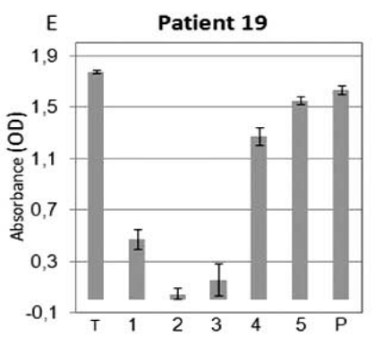
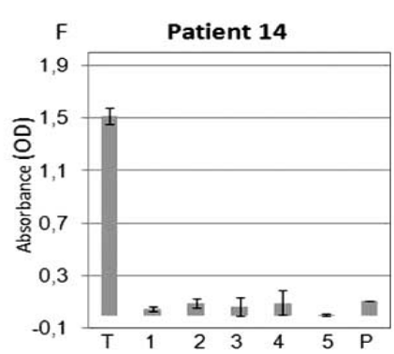


Antibodies of seropositive patients recognize folded Tat
TatHXB2
1
10 20 30 40 5
0
60 70 80 90 10
0
TatEli
MEPVDPRLEPWKHPGSQPKTAC
TNCYCKKCCFHCQVCF
ITKALGISYGR
KKRRQRRRAHQ
NSQTHQA
SLSKQ
P
TSQPRGD
-
PTGPKE
-
KKKVERETETDPFD
100
.D....N....N......R.P.
NK.H.....Y..P...
LN.........
.......GPP.
GG.A..V
PIP..
.
S......
-
......Q.....S.A...E
99
Peptide 1
Peptide 2
Peptide 3
Peptide 4
Peptide 5
  In sera from 40 HIV-1 infected patients, 19 had anti-Tat Ab:
  11 recognized Tat peptides and full length 8 recognized Tat HXB2 full length exclusively
  These 8 sera recognized Tat Oyi and HXB2
  Dot Blot showed that unfolded Tat was no longer detectable by sera of the second group (n=8) compared to folded Tat.
(Mediouni et al.Inf. Dis. 2011)
  Full lenght Tat is immunogenic and recognised by human sera as a folded protein
Tat Oyi as a novel immunogen could stimulate an immune response to a unique 3D epitope not previously identified and able to neutralized the activity of native Tat in vivo.

Slide 14
Tat oyi vaccine candidate advantage
The specific feature of Tat Oyi therapeutic vaccine candidate versus other Tat
It relies on Tat Oyi 3D specific conformation
The ability to induce an Ab response to conformational epitopes cross reactive to several Tat variants present in the world
Ability of Ab to 3D epitope to neutralize extracellular Tat
Immune response against this extracellular HIV target
Did show a protective effect in a Rhesus macaques model of HIV infection

Slide 15
Macaques vaccination with Tat Oyi and SHIV challenge
7 macaques immunized with 100µg full length Tat Oyi (montanide adjuvqnt. At TO,boost at M1,M2, M3) challenge at M7 with heterologous SHIV BX08 (with 350 AID₅₀ IR)
Main Results : 6/7 High titers Ab response to Tat,
1/7 with the highest Tat Ab titer was resistant to infection even after 2nd challenge,
5/6 lower RNA levels than controls (1-2 log) during the chronic phase,
In 7/7 vaccinee Reservoir Cells not detectable at d56 pi.
PBMC co-culture with CD4 macaque cells
Antibodies Titer against GP120
10
4
10
6
Tat Oyi Vaccinated Macaques
10
3
10
2
10
4
Second challenge
on macaque 966
10
0
10
2
Control Macaques
10
6
10
4
10
3
2
10
4
10
10
10
2
0
0
1
4
2
8
4
2
5
6
0
60
120
180
Time Post Challenge (days)
Time post challenge (days)
(Watkins et al., Retrovirology 2006)

Slide 16
Preclinical toxicity studies
No toxicity observed after a 18-months survey in macaques which received four injections of 100μg of Tat Oyi
No toxicity or loss weight observed in 40 mice which received four intradermal injections of Tat Oyi containing doses of 22μg/50μl and 10μg/50μl solubilized within NaH2PO4 100 mM pH 4.3 and NaCl 9 g/l.

Slide 17
Tat Oyi Clinical trial
A clinical trial phase I/IIa has been started for a therapeutic Tat Oyi vaccine candidate:
Vaccine candidate: synthetic Tat Oyi full length protein, no adjuvant
In a double blind study, 48 HIV seropositive under ART
1: n=12 placebo 2:n=12 at 10µg 3: n= 12 at 33µg 4- n=12 at 100µg
Three intradermal injections of at M0, M1 and M2.
Follow up 12 months
Criteria:
  Antibodies response to Tat against 5 variants
  HIV RNA level after 1 month ART interruption at M5

Slide 18
Tat Oyi Clinical trial Phase I results
In 48 patients, 36 exposed to vaccine candidate
Safety analysis of blinded AEs
No potential drug interactions identified.
Most of the reported non-serious AEs and SAEsare common symptoms of HIV infection and are therefore likely attributed to the underlying condition.
  Non serious Aes:infections, general disorders, gastrointestinal disorders, musculoskeletal disorders, headache
  The occurrence of injection site pain in four patients which cannot be attributed to the underlying disease or to concomitant medication
  Only 4 SAEs reported : 2 preimmunisition , 2 that could be attributed to HIV infection
The vaccine candidate with Tat Oyi proved to be safe as no Important identified risks during this phase

Slide 19
Thanks
Loret E. Director ETRAV Laboratory Pharmacy University of Marseille
Ravaux I. MD Investigator APHM Marseille

