Slide 1


Paleocurrents and Paleohydraulics studies of the Proterozoic Kolhans vis-a-vis Proterozoic crustal dynamics: a case study from the Chaibasa-Noamundi Basin, Jharkhand, India
International Conference on Geology , OMICS 2015
Young Researchers Forum
Smruti Rekha Sahoo
Department of Geology and Geophysics
Indian Institute of Technology Kharagpur
India
Email: smruti@iitkgp.ac.in

Slide 2


Outline of presentaion
Introduction
Introduction
Objective and organization of the work
Materials and Methodology
Result and discussion
Summary
OMICS 2015

Slide 3

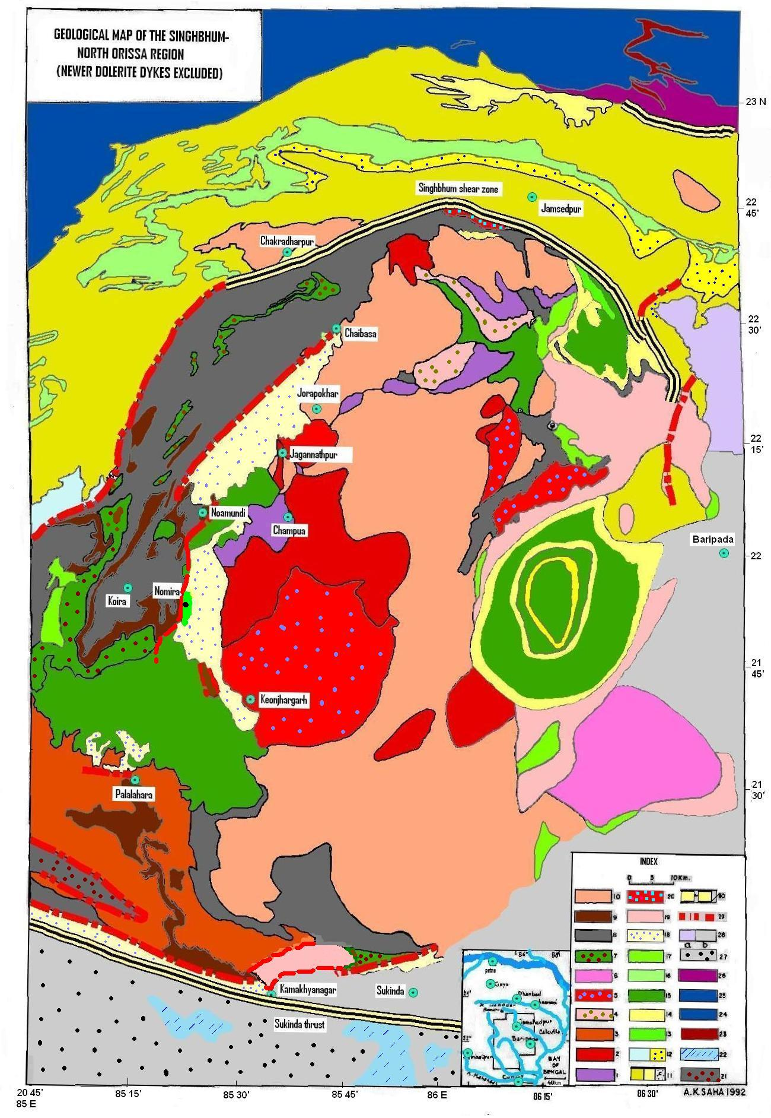
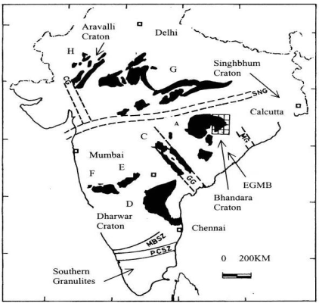
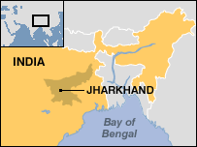
Chaibasa-Noamundi
basin
Mankarchua
basin
Chamakpur-
Keonjhar
basin
Kamakhya-
nagar
basin

Slide 4
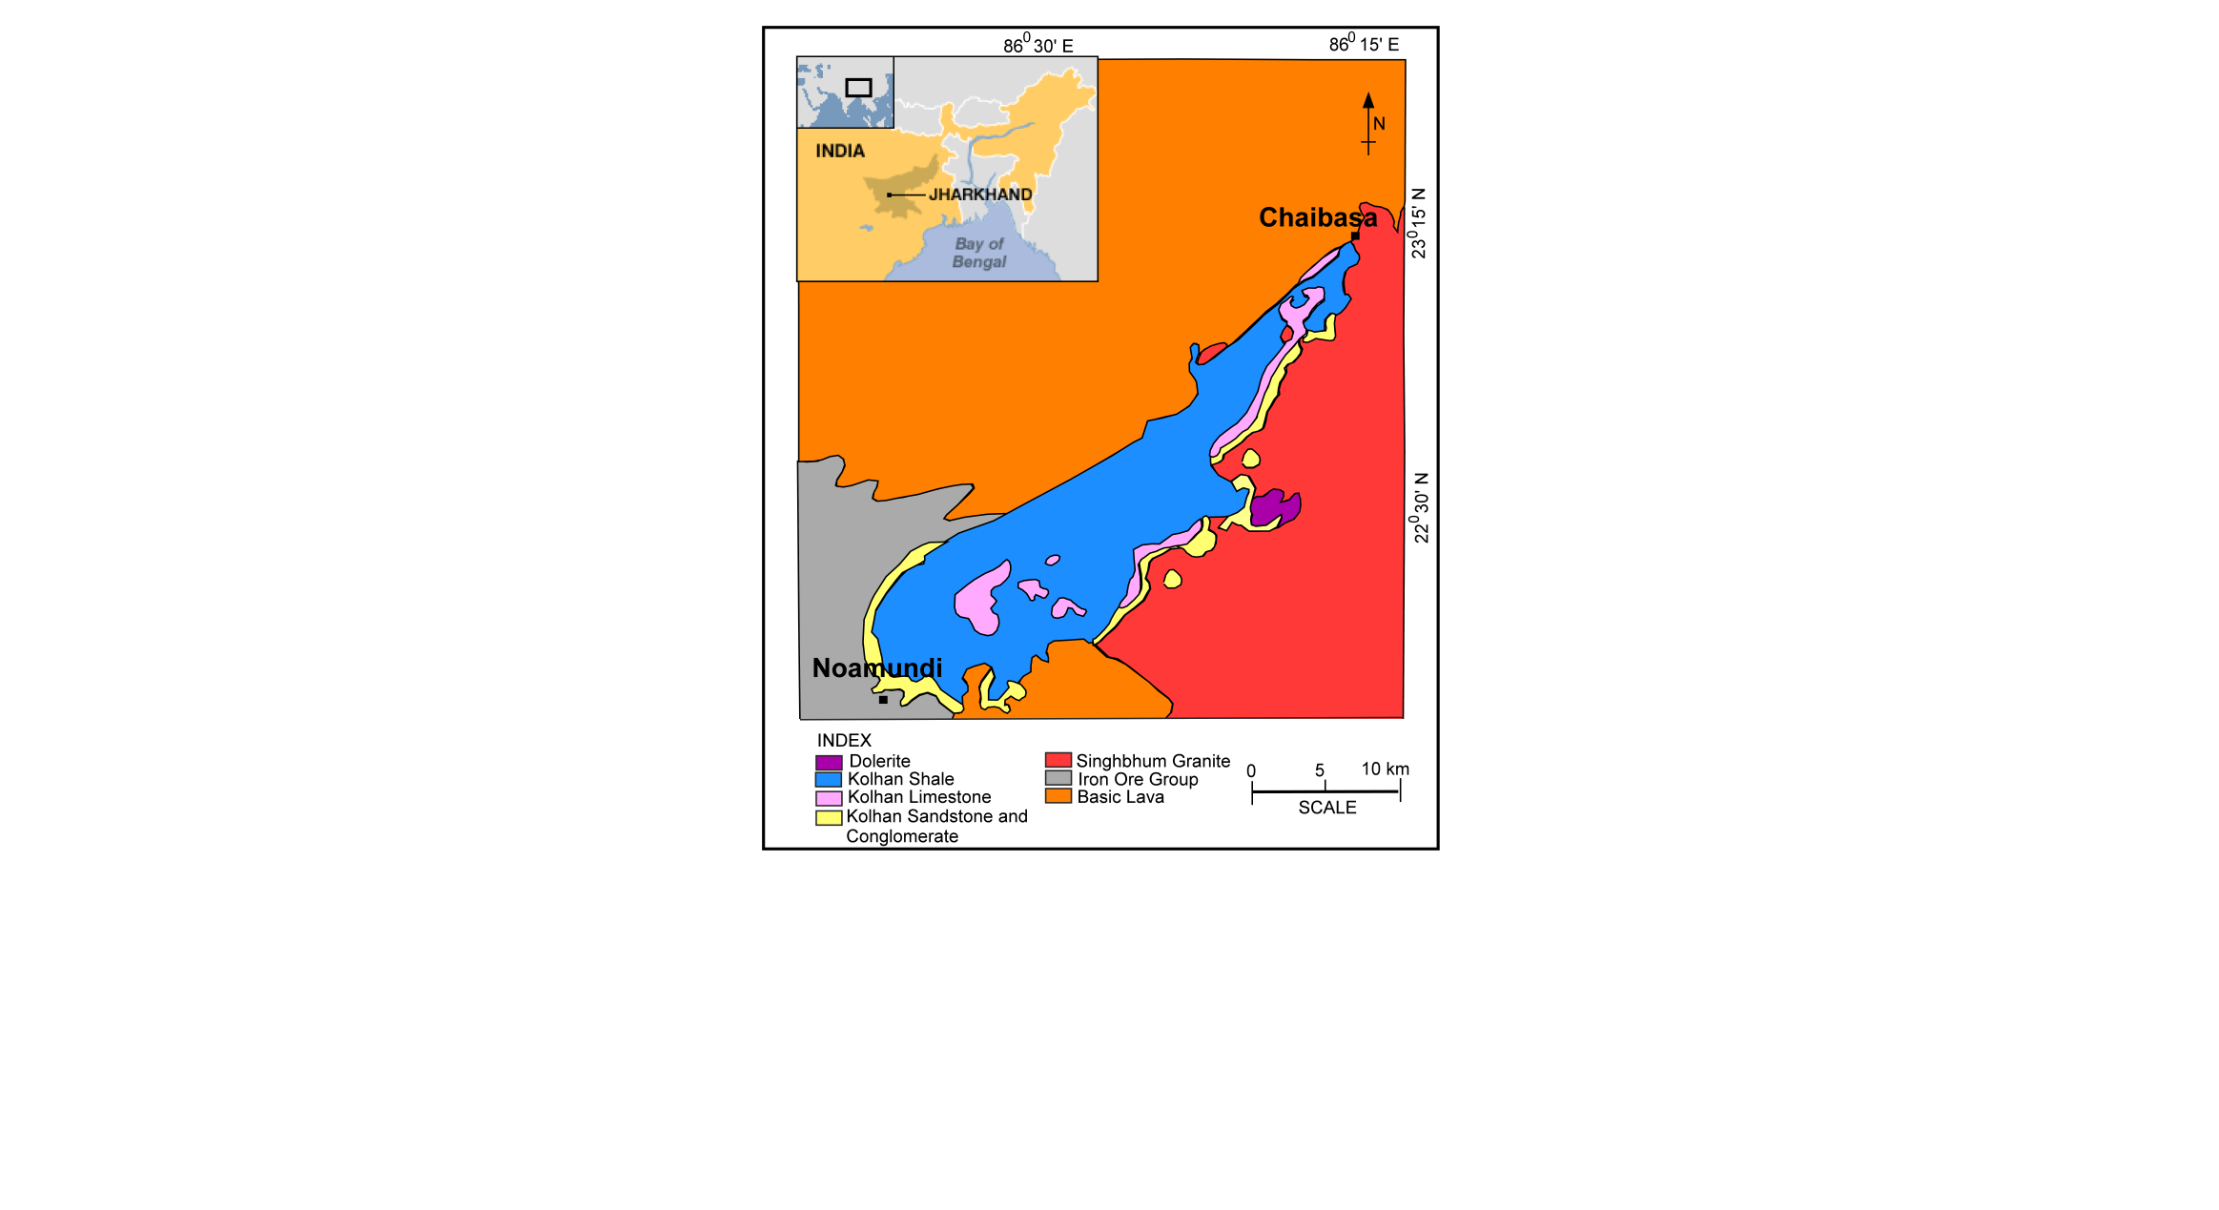
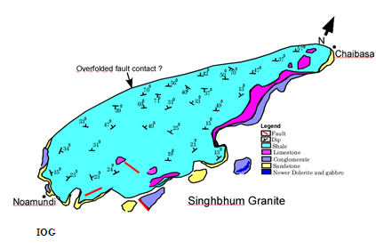
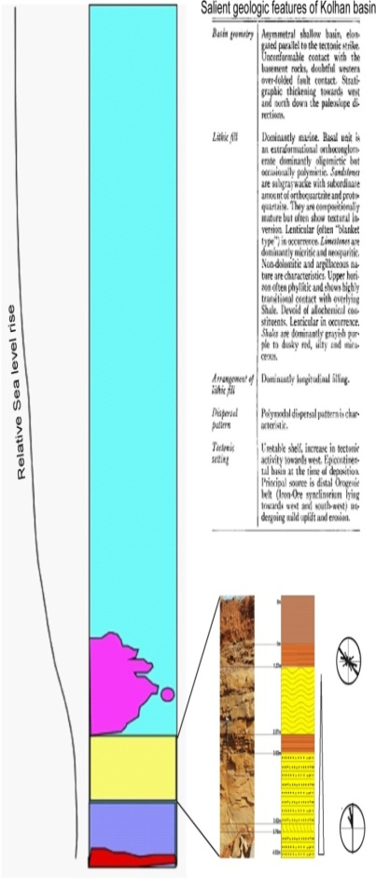

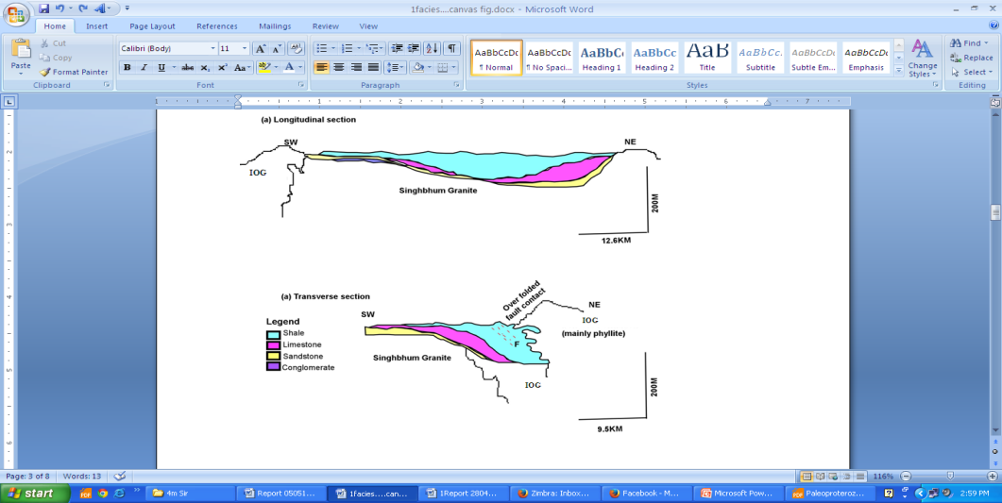
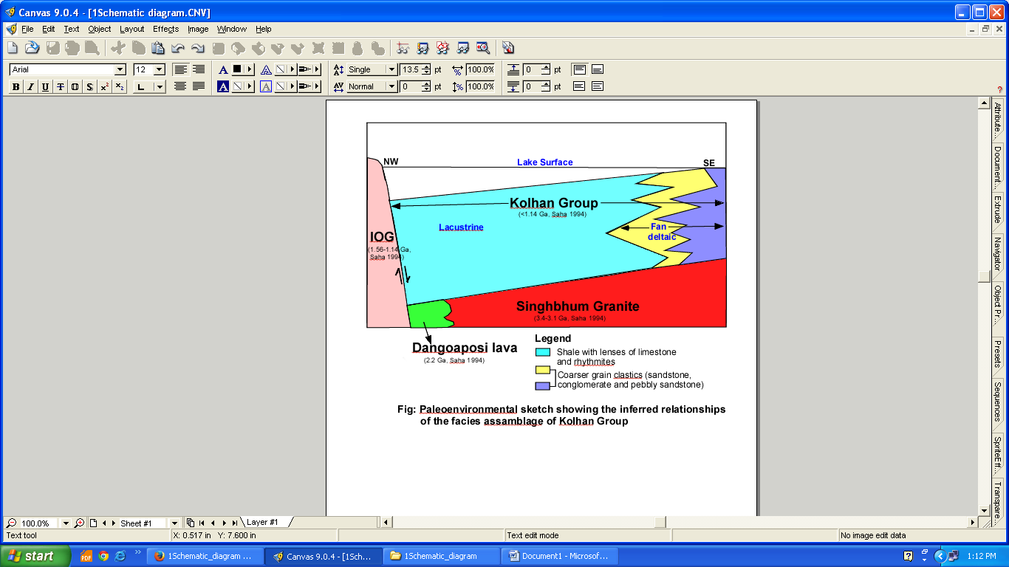
Introduction
(b)
Noamundi
(c)
(a)
(f)
(g)
(a) The geological map of Kolhan basin around Chaibasa-Noamundi region (GSI, 2006).(b) Structural map of the Chaibasa-Noamundi basin (Chatterjee and Bhattacharya, 1969) (c) Longitudinal and transverse section along and across the Chaibasa-Noamundi Basin (Sarkar and Saha, 1977), (d) Google earth image showing the study area, (e) LANDSAT-8 image showing the study area, (f) Paleo-environmental sketch showing facies assemblages of Kolhan, (g) A composite log of the Kolhan basin

Slide 5
The geological map of Kolhan basin
around Chaibasa-Noamundi region (GSI, 2006)

Slide 6
Structural map of the Chaibasa-
Noamundi basin (Chatterjee and
Bhattacharya, 1969)
Longitudinal and transverse section along and across the Chaibasa-Noamundi Basin (Sarkar and Saha, 1977)
Longitudinal and transverse section along
and across the Chaibasa-Noamundi Basin
(Sarkar and Saha, 1977)
Paleo-environmental sketch showing facies assemblages of Kolhan

Slide 7
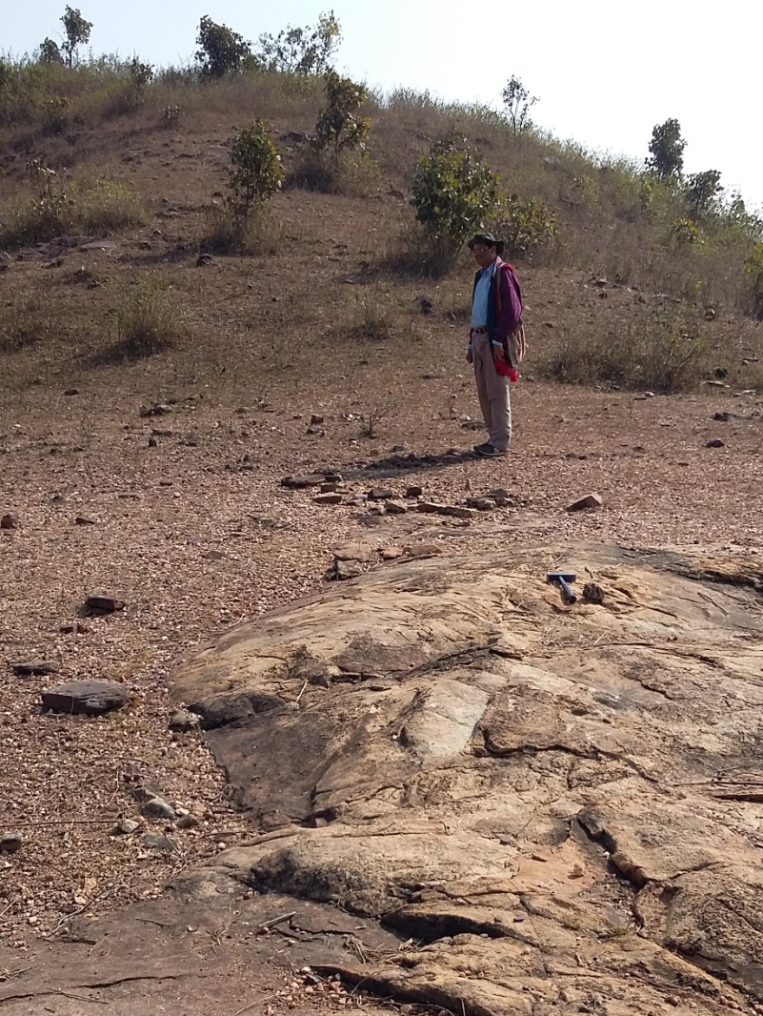
A composite log

Slide 8
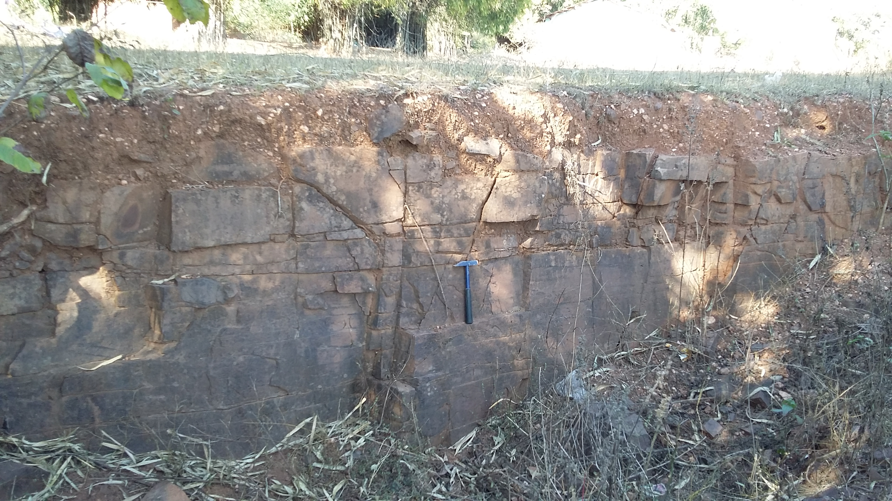
Objectives and Organizations
Analyses based on logged sections within the Kolhan basin for the paleocurrent data and the petrology of sandstones and conglomerates including heavy minerals studies to interpret provenance and source areas in detail
This study focuses on the detailed provenance evolution of young, post-orogenic extensional grabens to trace the tectonic history of such late-stage basins

Slide 9
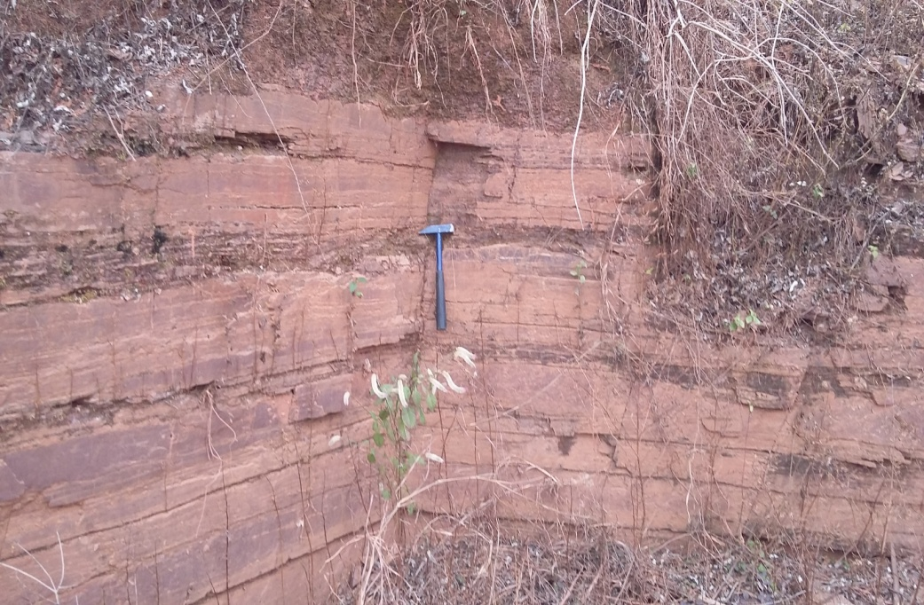
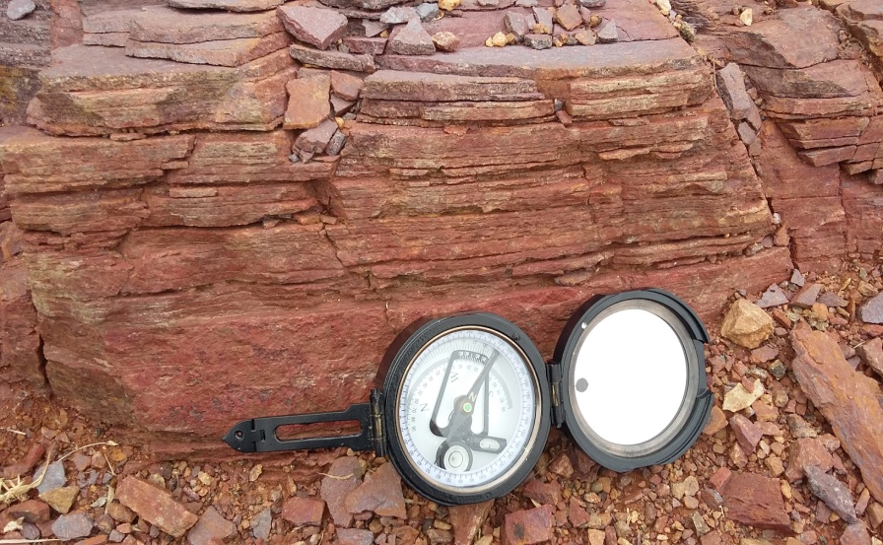
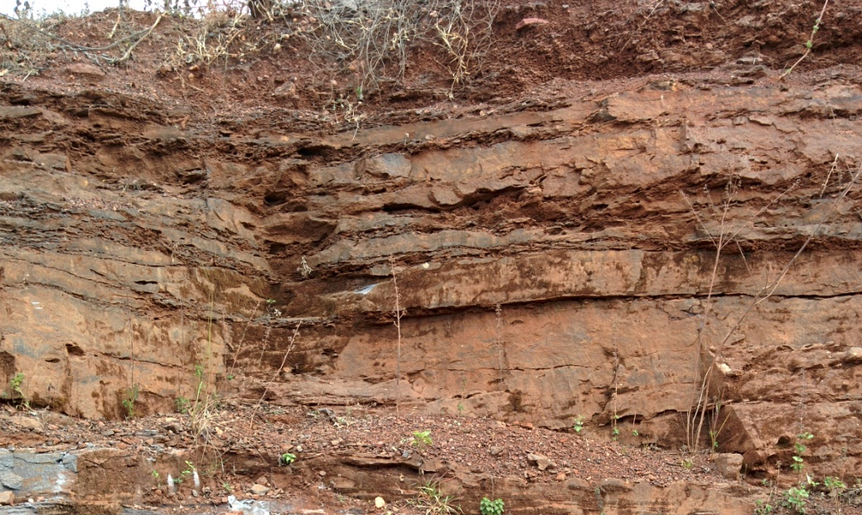
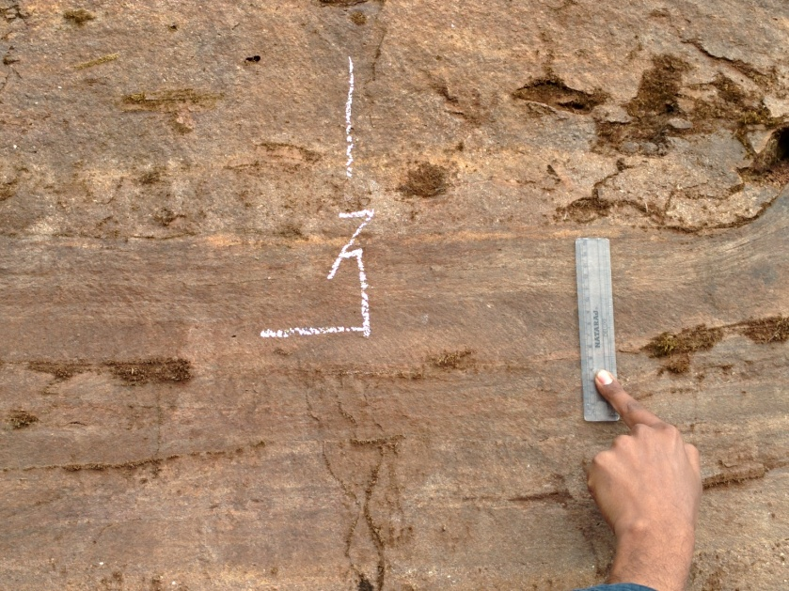
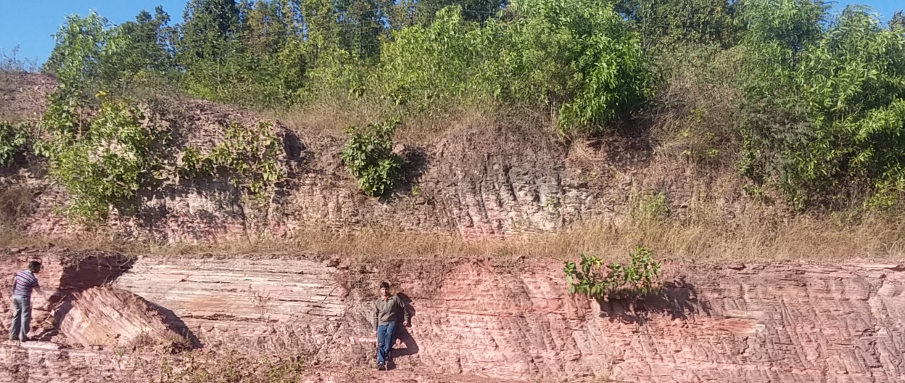
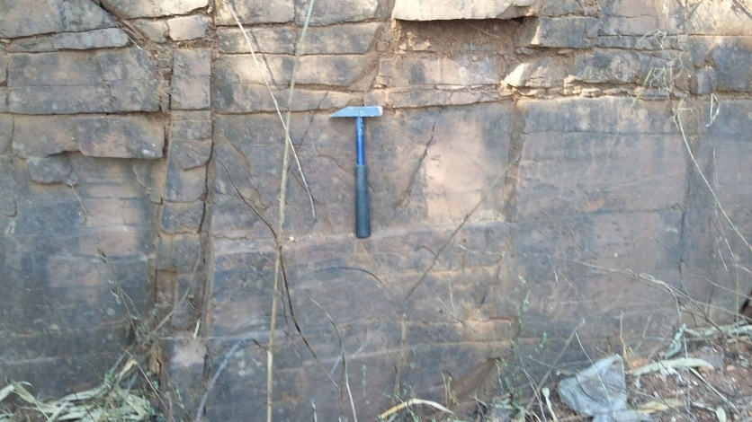
S
AND
S
TONE

Slide 10
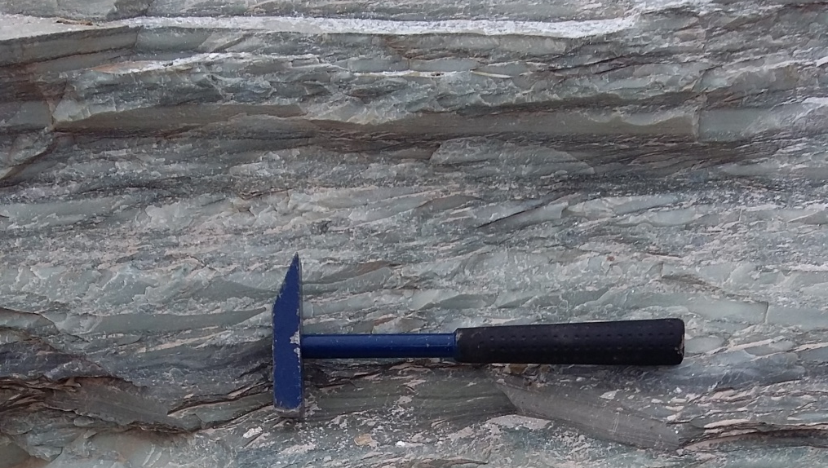
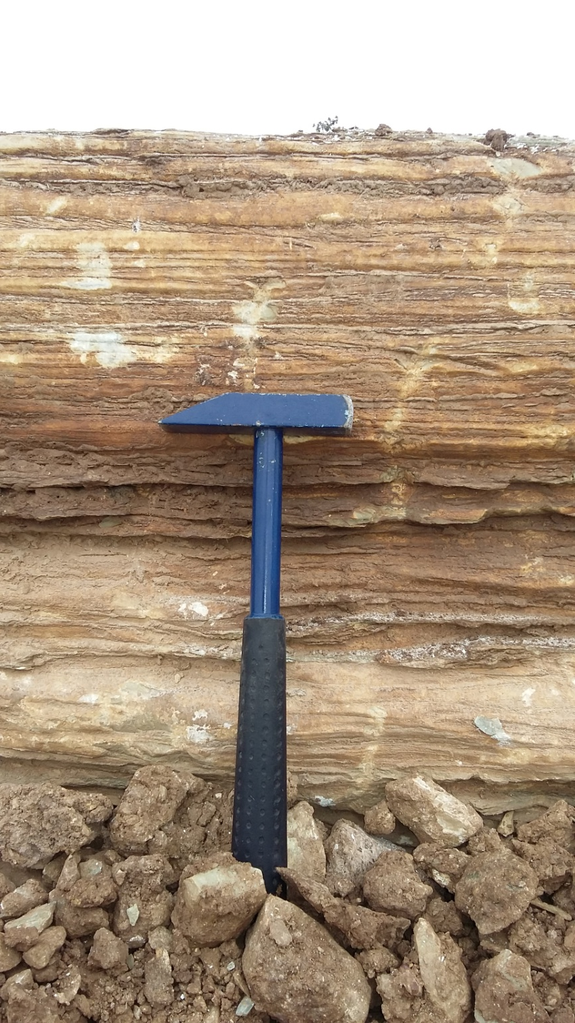
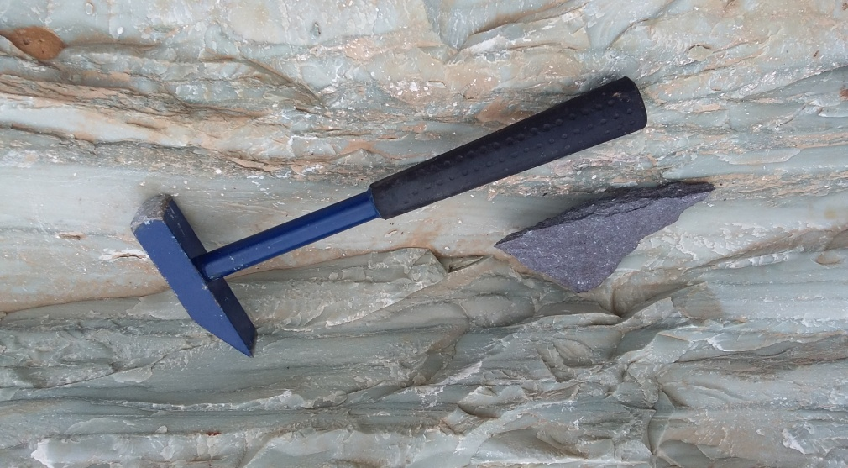
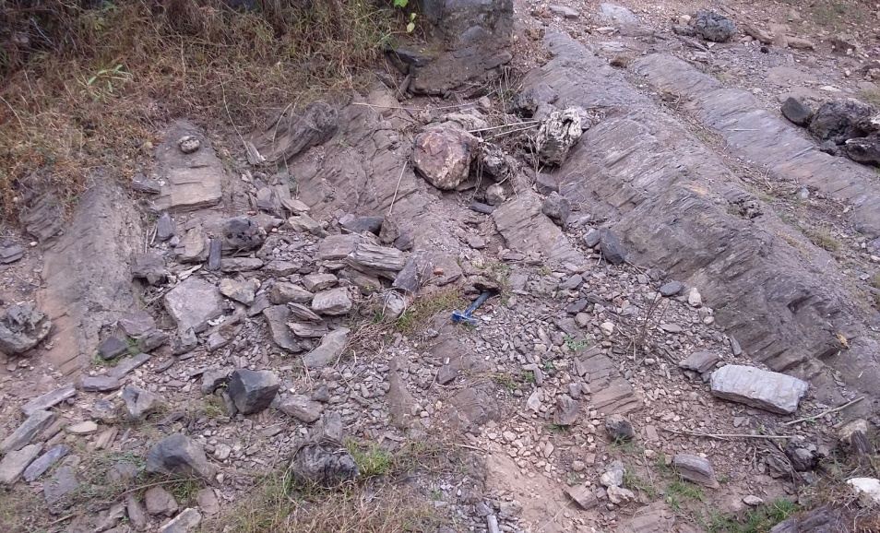
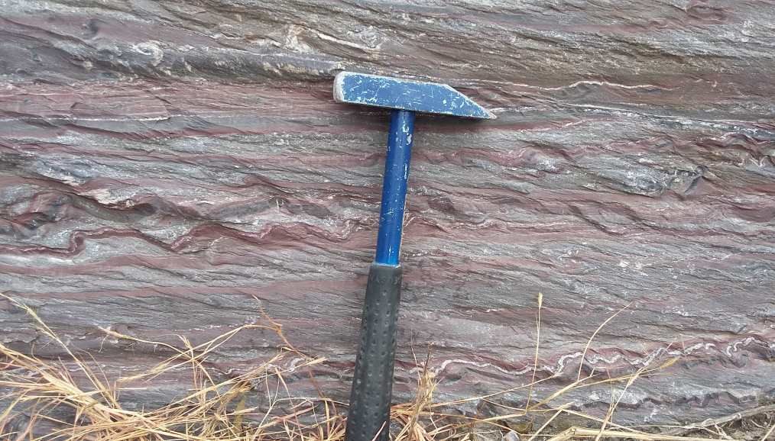
SHALE
L
IMES
TONE

Slide 11
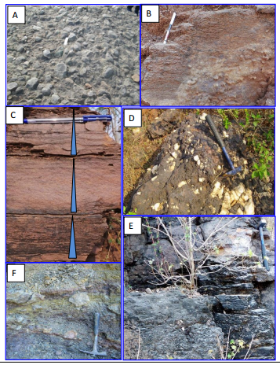
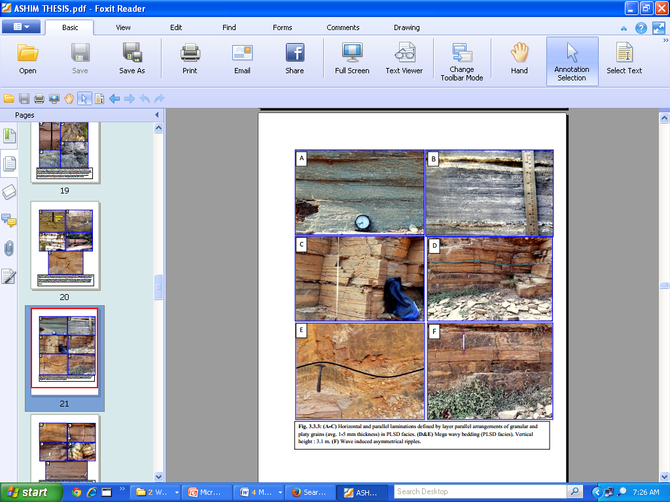
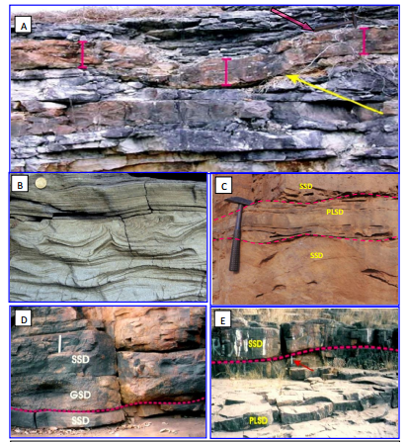
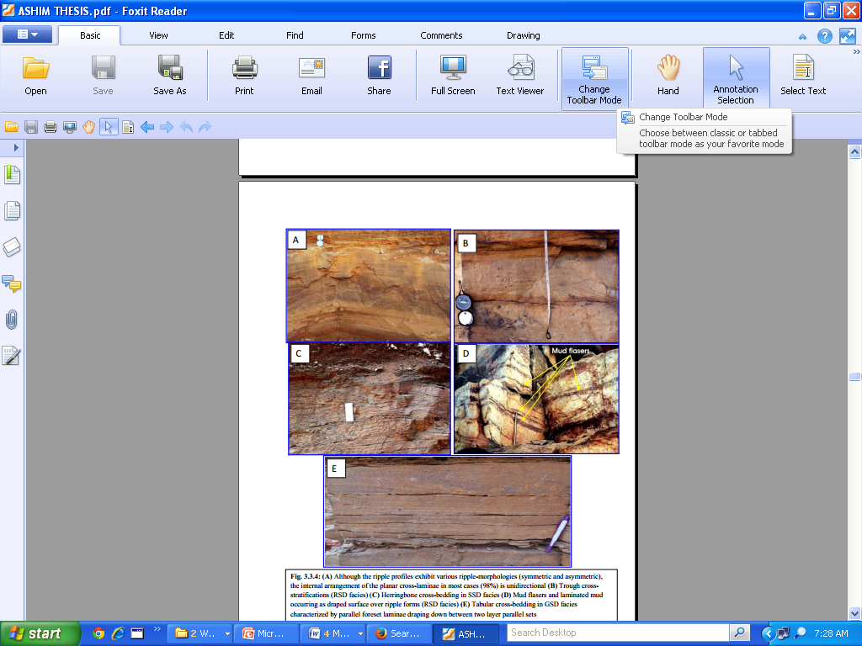
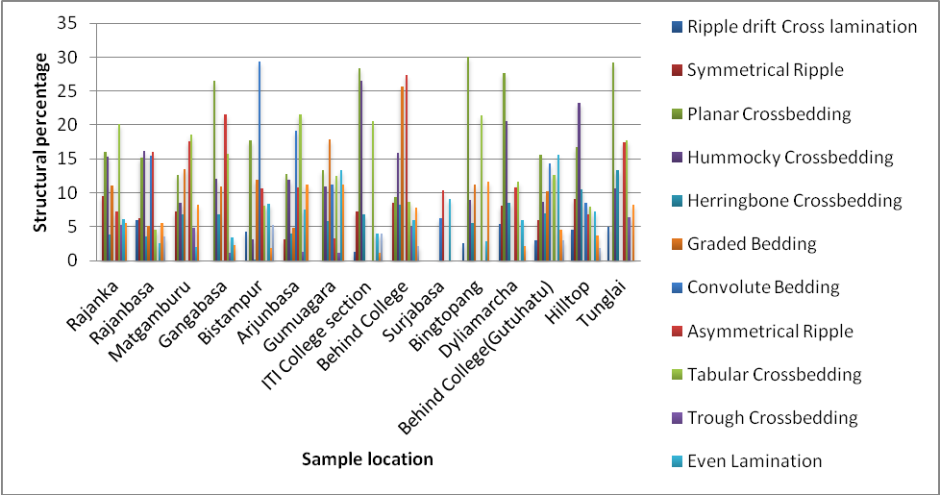
Sedimentary structures expressed as percentages
1
2
3
4
1- (A) Polymict conglomerate(B)Scour and fill structure in sheet sandstone.(C) Rhythmic fining upward gradation in granular sandstone.(D) Crudely stratified conglomerate.(E) Matrix supported conglomerate showing normal grading with poorly defined stratification (GLA facies). (F) Exposure of matrix supported conglomerate with ripped-up large clast (GLA facies).2- (A-C) Horizontal and parallel laminations in PLSD facies. (D&E) Mega wavy bedding (PLSD facies). (F) Wave induced asymmetrical ripples. 3-(A) Intraformational slumps (PLSD facies) (B) Convolute lamination (SSD facies). (C) Alternated layers of sheet sandstone facies (SSD) and plane laminated sandstone facies(PLSD) (Note : the contact between SSD and PLSD is marked by megarippled bed form). (D) Alternated layers of sheet sandstone facies (SSD) and granular sandstone facies (GSD) (Note : the contact between SSD and GSD is marked by megarippled bed form). (E) Wavy erosional contact between SSD and PLSD facies 4-(A) Planar cross-laminae (B) Trough cross-stratifications (RSD facies) (C) Herringbone cross-bedding in SSD facies (D) Mud flasers and laminated mud occurring as draped surface over ripple forms (RSD facies) (E) Tabular cross-bedding in GSD facies
1
2
3
Structures generated by flat beds are comparatively more noticeable than structures related to the bedform migration
4

Slide 12
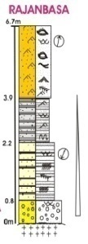
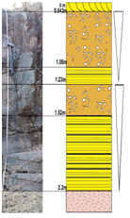





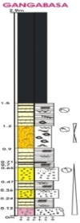

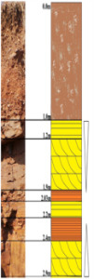

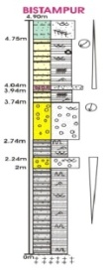




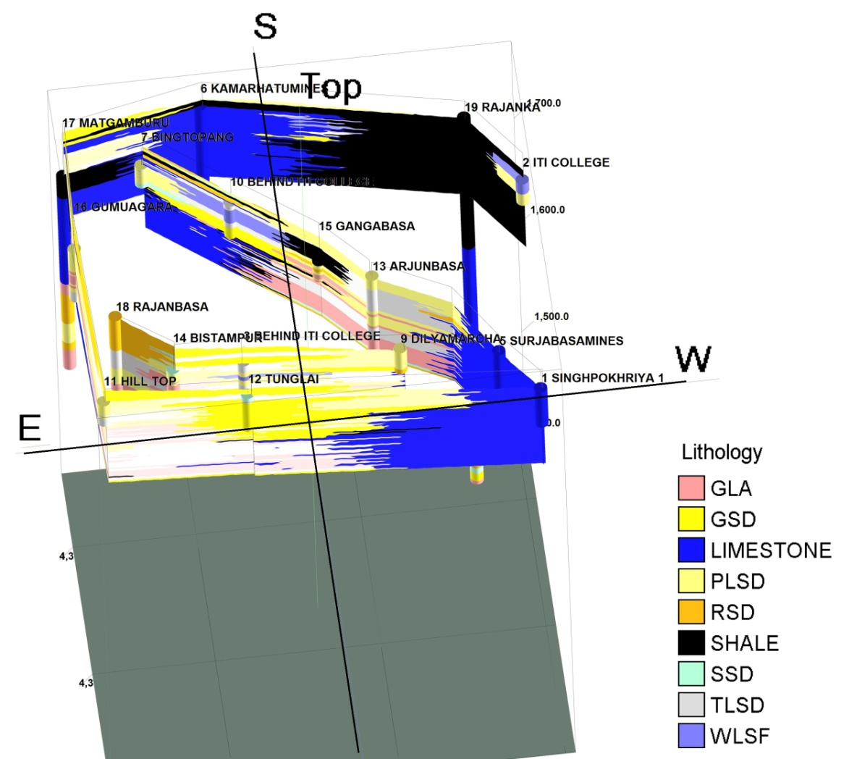
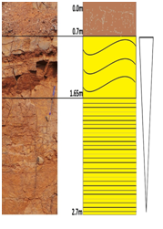
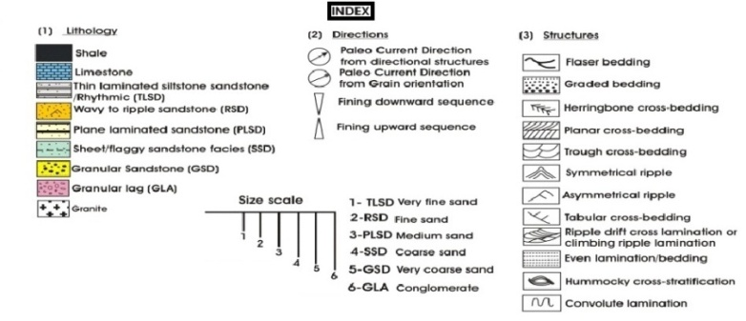
(a)Lithologs showing the vertical distribution of the lithofacies in the study area, (b) Panel diagram for seventeen lithologs
Granular lag facies (GLA)
Granular sandstone facies (GSD)
Sheet sandstone facies (SSD)
Plane laminated sandstone facies (PLSD)
Rippled sandstone facies (RSD)
Thin laminated sandstone facies (TLSD)
a
Lithofacies analyses
b

Slide 13
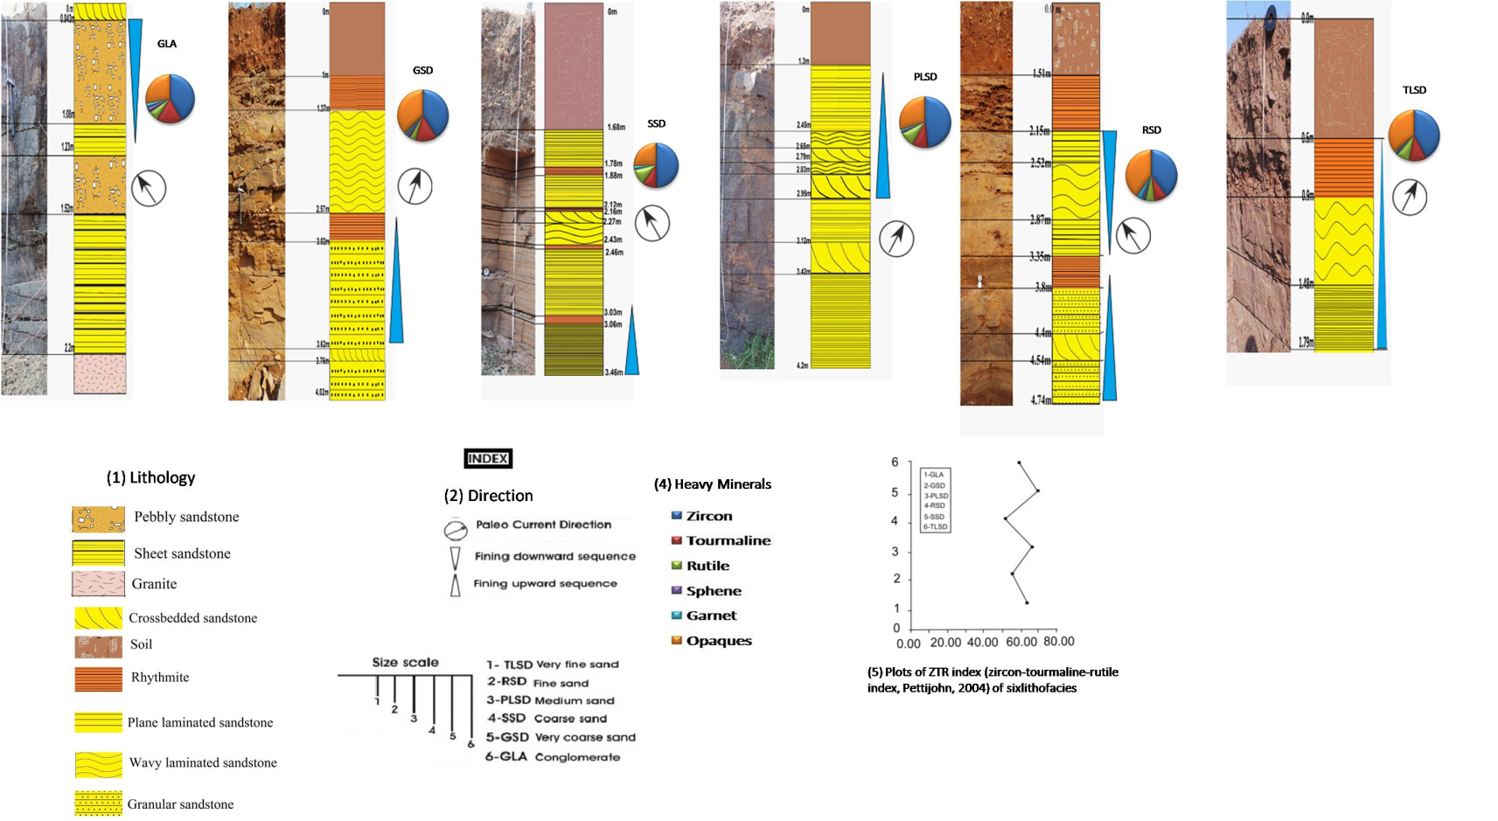
Columnar sections measured in Kolhan basin
showing the paleoflow direction and percentage of heavy mineral composition and
ZTR plot from six different locations
Locations: Rajanka, Arjunbasa, Bistampur, Matgamburu, Gangabasa and Rajanka (from left to right)

Slide 14
Columnar sections measured in Kolhan basin
showing the paleoflow direction and percentage of heavy mineral composition and
ZTR plot from six different locations
Locations: Rajanka, Arjunbasa, Bistampur,

Slide 15
Columnar sections measured in Kolhan basin
showing the paleoflow direction and percentage of heavy mineral composition and
ZTR plot from six different locations
Locations: Matgamburu, Gangabasa and Rajanka

Slide 16
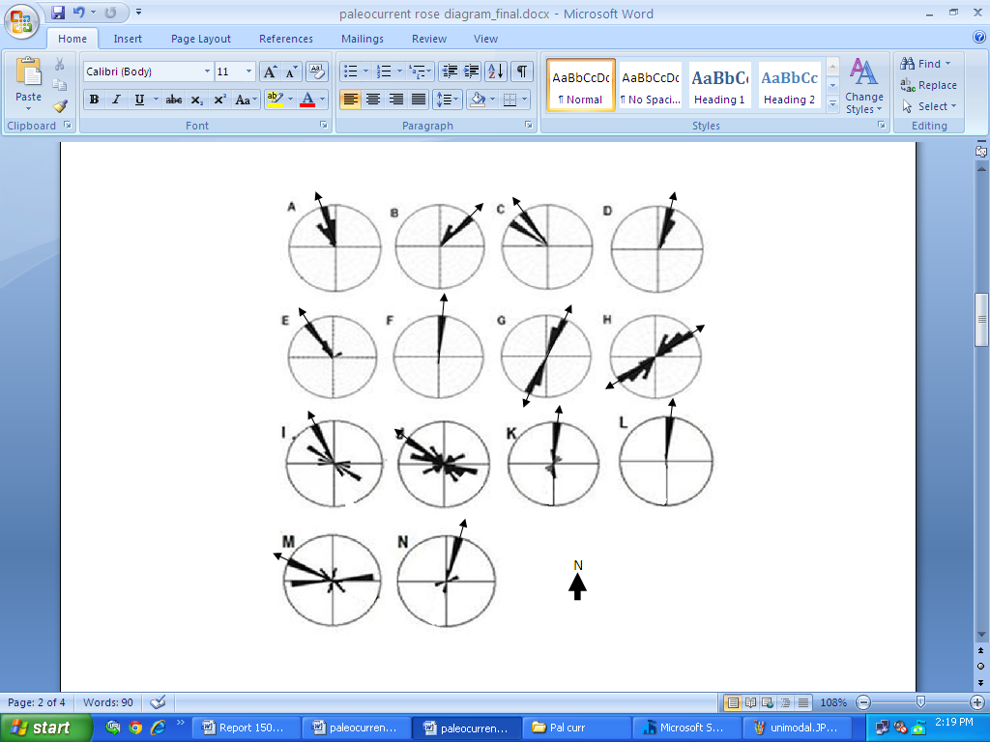
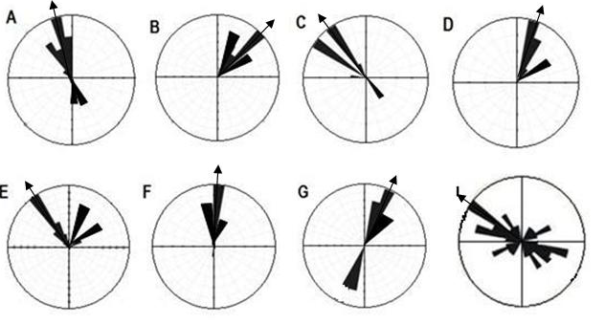
Paleocurrent analyses
from cross bed
Location | No. of data | Class intervals | Vector mean in Degrees | 95% confidence intervals in Degrees
A | 70 | 10 | 338 | 7.2
B | 55 | 10 | 36.2 | 4.1
C | 40 | 10 | 311 | 10.2
D | 78 | 10 | 23 | 5.6
E | 50 | 10 | 339 | 10.2
F | 68 | 10 | 3 | 29.9
G | 54 | 10 | 19 and 199 | 4.3
H | 47 | 10 | 46 and 226 | 13.7
I | 48 | 10 | 318 | 36
J | 51 | 10 | 294 | 38
K | 58 | 10 | 12.2 | 12
L | 44 | 10 | 06.2 | 6
M | 50 | 10 | 291 | 19
N | 47 | 10 | 28.2 | 33
from grain orientation
Location | No. of data | Preferred Orientation direction | Linear Arithmetic mean (in degrees) | Circular arithmetic mean (in degrees)
A | 47 | 332 | 201.80 | 255.88
B | 38 | 33.9 | 176.62 | 193.35
C | 43 | 309 | 205.56 | 300.26
D | 49 | 28 | 169.89 | 285.95
E | 31 | 342 | 171.00 | 275.41
F | 37 | 2 | 192.48 | 305.04
G | 46 | 22 | 193.44 | 302.05
H | 34 | 314 | 159.61 | 290.24
(A)Behind ITI Section, (B) Surjabasa Section, (C) Bingtopang Section, (D) Gumuagara River Section, (E) Dyliamarcha Section 1st, (F) Hill top, (G) Tunglai Section, (H) Dyliamarcha Section 2nd , (I) Gangabasa section, (J) Pungsiya section, (K) Bistampur section, (L) Tunglei (M) Matgamburu section, (N) Rajanbasa section
(Following standard methods of Shelly 1968, Middle Ton 1965, Potter 1965)

Slide 17
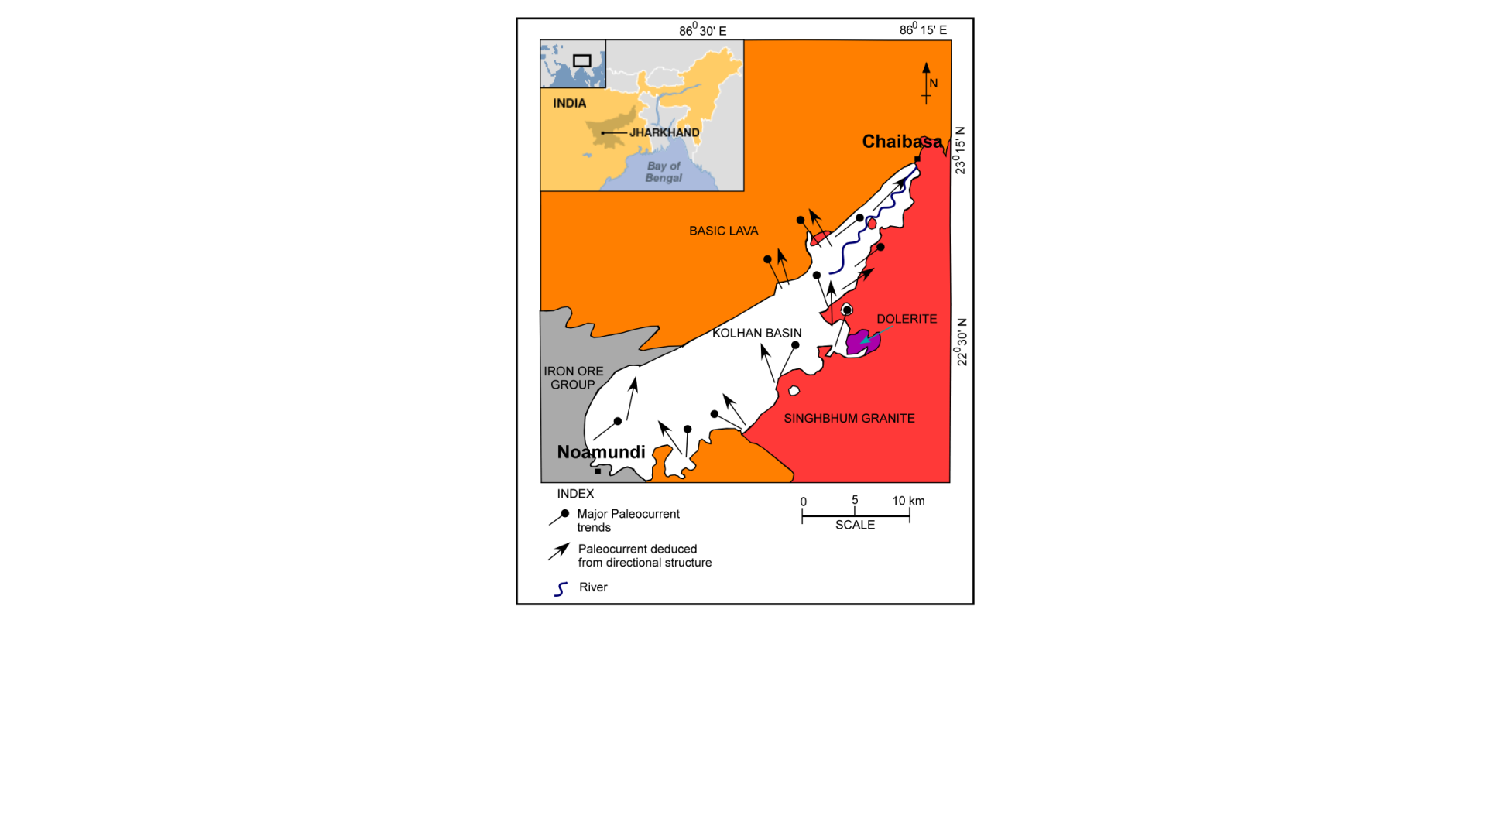
A synoptic view of the paleocurrent dispersal pattern in the study area

Slide 18
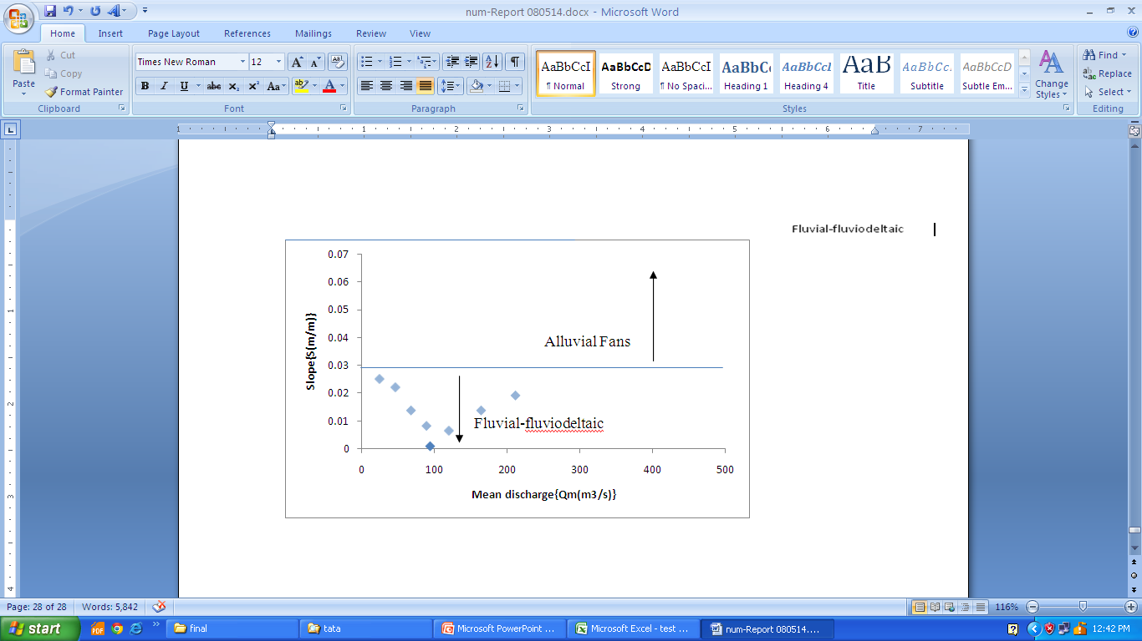
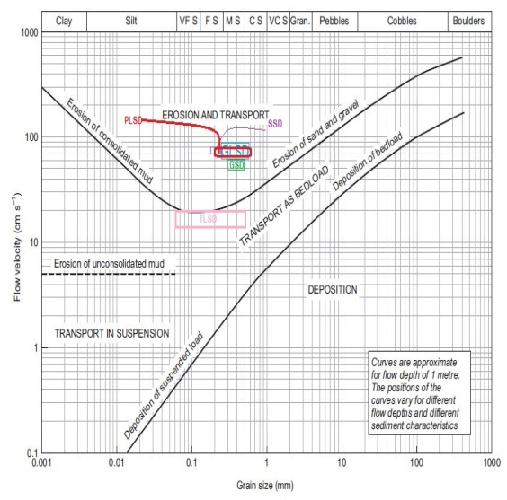
Paleohydraulic analyses
Estimates of Paleohydrologic Parameters of the Study Area
Parameters | Mean Estimate
Mean cross-bed set thickness | 0.13 m
Mean water depth (d_{s}) | 1.38 m
Channel width (w) | 61.59 m
Width/depth ratio (F) | 42.97
Meander wavelength (L_{m}) | 701.26 m
Mean annual discharge (Q_{m}) | 94.34m³/s
Channel slope (S_{c}) | 0.00084
Flow velocity (v) | 0.66m/s
Froude number (F_{r}) | 0.20
Binary plot of palaeoslope (S) and mean annual discharge values (Qm)
Hjulstorm’s diagram showing relationship among erosion, transportation and deposition of sedimentary particles
The dispersal of sediments was from the southwest and southeast directions, and the Iron Ore Group and Singhbhum granitoid terrains may be the source rock for the Kolhans (Ethridge and Suhumm 1978, Yalin 1978)

Slide 19
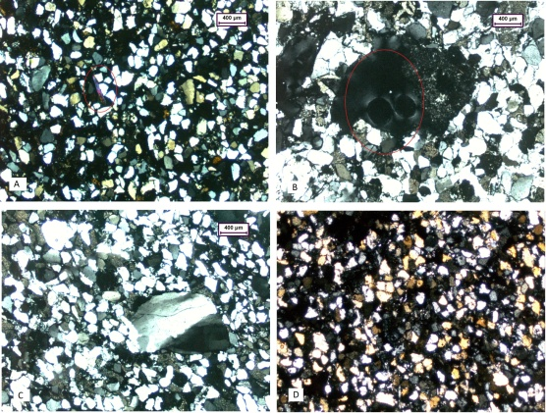
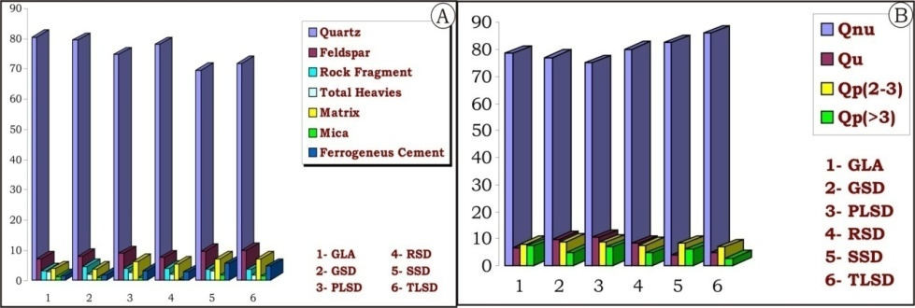
Modal analyses
A
a
b
e
c
d
f
(a) Undeformed rounded monocrystalline framework quartz grains (b)Moderately well sorted, medium-coarse grained sandstone (c) Quartz grains showing bimodal distribution in quartz arenite, (d) silica overgrowth (e) Modal analyses of 105 fine to medium-grained texturally mature to submature samples (f) Quartz type percentage
Few of the immature sandstones show textural inversion
Quartz is the dominant constituent framework grain, and monocrystalline quartz predominates over polycrystalline quartz

Slide 20
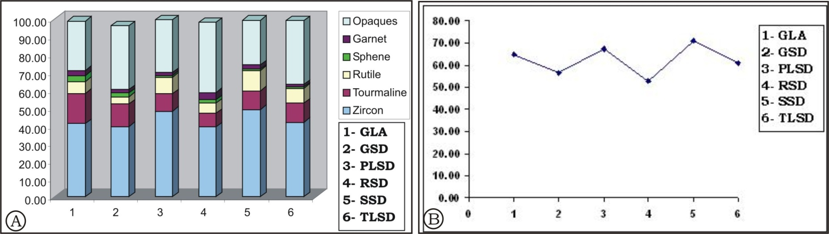
Heavy mineral assemblages
(A) Bar diagrams showing the percentage distributions of the heavy minerals in different facies (B) Plots of ZTR index of six lithofacies
Heavy mineral fraction varies from 0-3.25 % by weight
Consistent size & shape of heavy minerals suggests mostly those are derived from the Singhbhum granite and also partly from Iron Ore Group

Slide 21
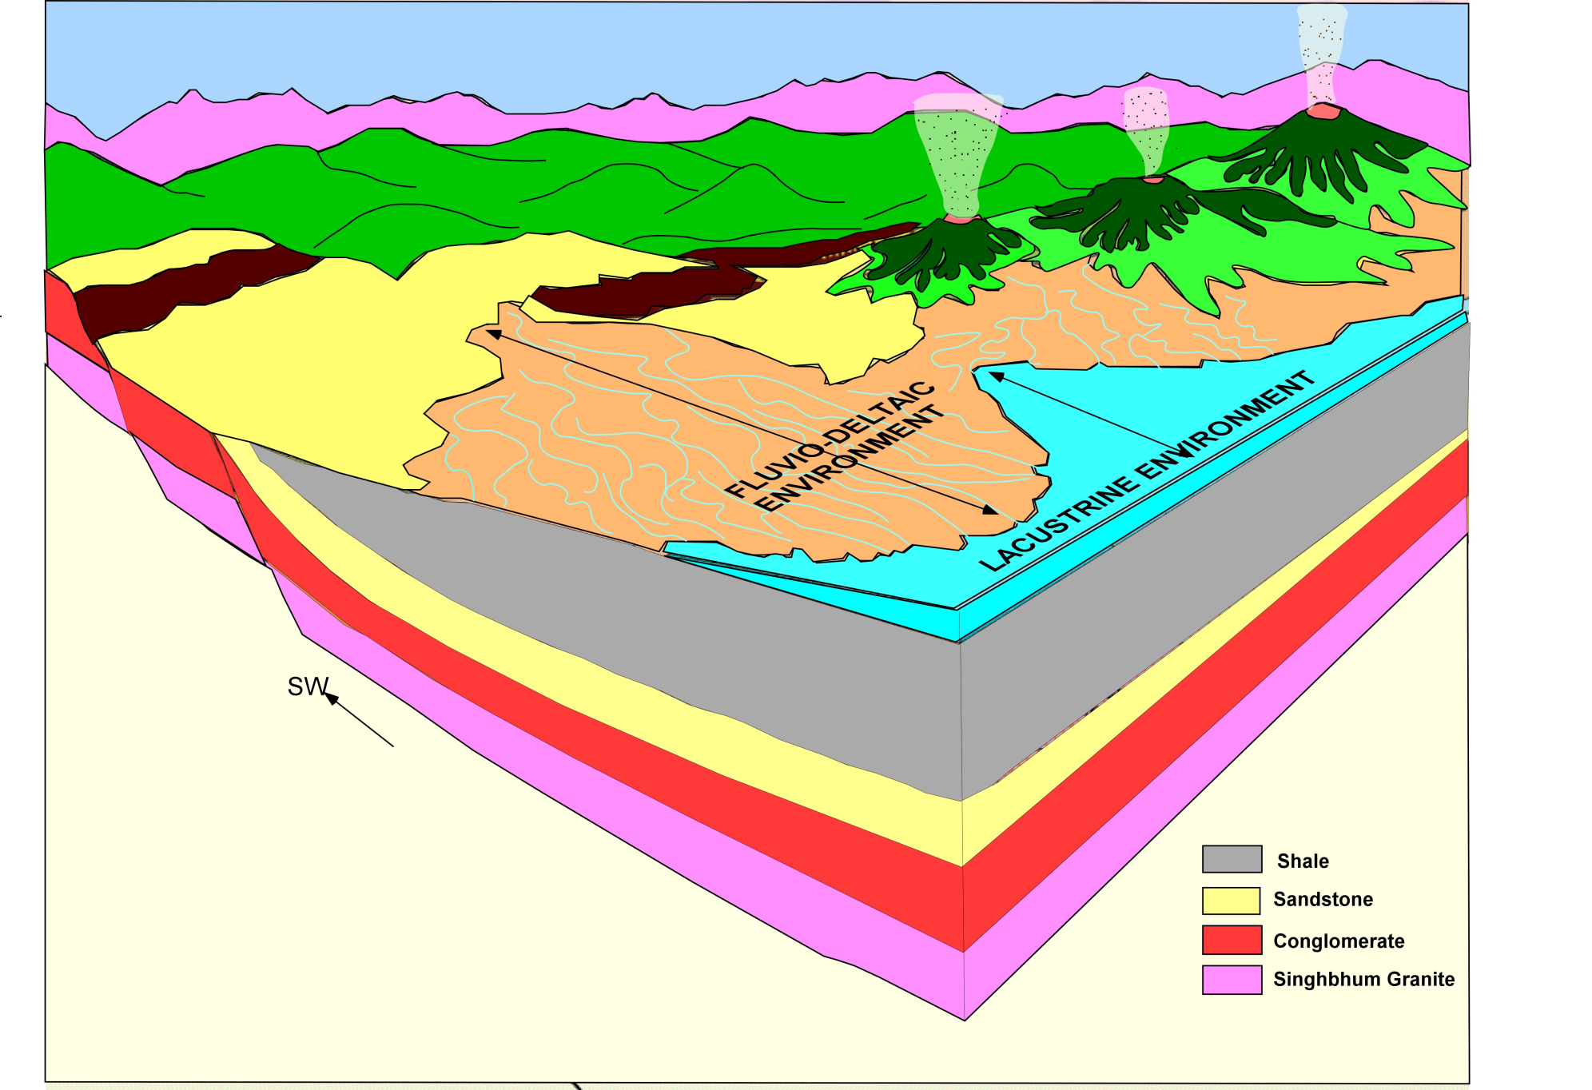
Basin Model

Slide 22
Conclusions
Paleocurrent study reveals that the low channel sinuous flow that advanced persistently from the north-northeast to a north- northwest direction along a palaeoslope, which remained unchanged throughout the deposition of the Kolhans
The Kolhan basin was filled by fluvial system, which was individually about 61.59m wide and 1.38 m deep. The river had a low sinuosity developed channels mostly in a north-northwest direction with flow velocity between 0.66 m/s. On the basis of uniformity in the paleocurrent directions, it is inferred that the basin continued north and westward down the paleoslope
The Kolhans were deposited in half-graben basins formed during the early rifting stage of the Singhbhum craton. This formation consists of fluvial, and lacustrine sequences that were deposited under arid-humid climatic conditions.

Slide 23
Conclusions
Lacustrine deposition took place in a topographic depression adjacent to the basin margin. The presence of alluvial-fan and fluvial or lacustrine deposits in vertically stacked sequences indicates that the basin topography changed through time
The lacustrine or fluvial environments responded more quickly to periods of tectonic subsidence and migrated over the fans to occupy the basin-margin depression
Aided by a decrease in basin subsidence, the fans eventually prograded and displaced the lacustrine environments away from the basin margin and more towards the Iron Ore Group margin

Slide 24
Bibliography
Bhatia M. R. (1983). Plate tectonics and geochemical composition of sandstones. J Geol: 91, pp. 611–27.
Bjorlykke, K. (1974). Geochemical and mineralogical influence of Ordovician island arcs on epicontinental elastic sedimentation. A study of Lower Paleozoic sedimentation in the Oslo region, Norway. Sedimentology 21, 251-72.
Dickinson, W. R. (1985). Interpreting provenance relations from detrital modes of sandstones. In Provenance of Arenites (ed. G. G. Zuffa), pp. 333-61. Dordrecht: D. Reidel.
Englund, J.-O. & Jorgensen, P. (1973). A chemical classification system for argillaceous sediments and factors affecting their composition. Geologiska Foreningens Stockholm Fohandlingar 95, 87-97.
Folk, R. L. (1980). Petrology of Sedimentary Rocks. Austin, Texas: Hemphill Publication Company, 182 pp.
Geological Map of West Singhbhum District, Jharkhand, India, GSI, 2006

Slide 25
Acknowledgement
OMICS Group
Prof. S. Das ( Supervisor)
Prof. D. Sengupta (Head of the Department of Geology and Geophysics, IIT Kharagpur)

Slide 26
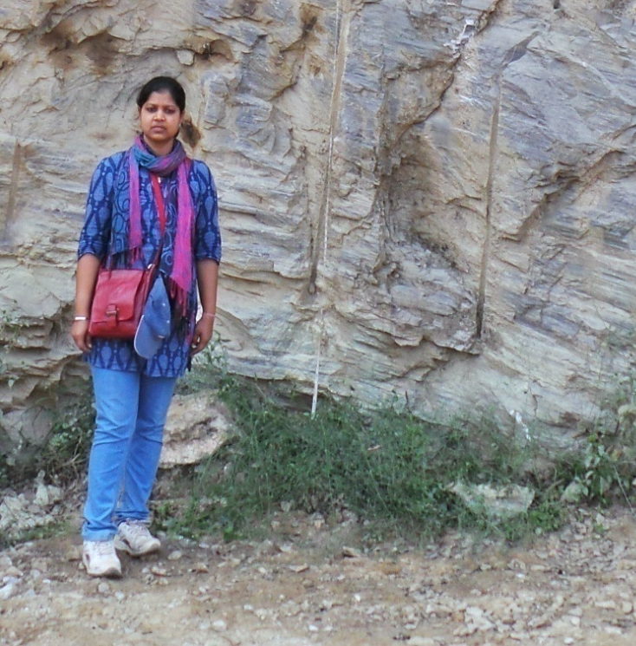
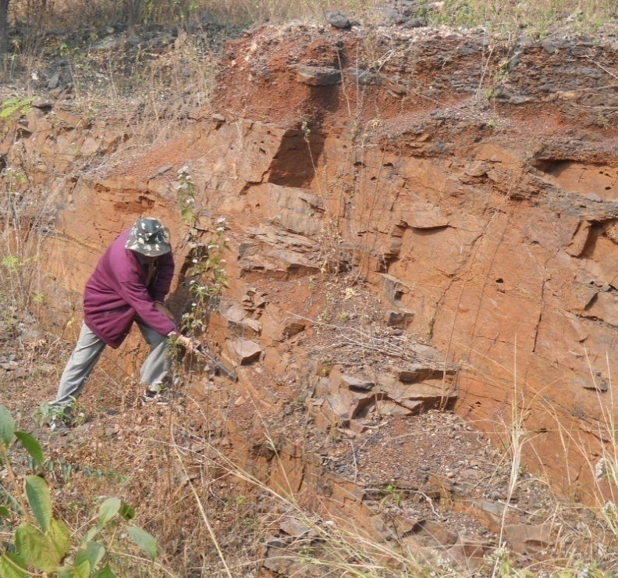
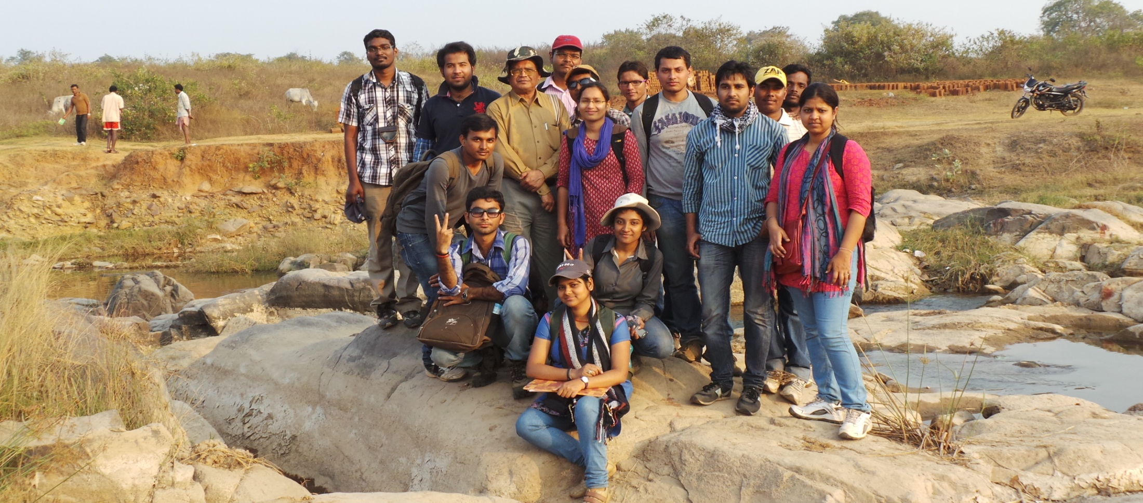
Field Visit

Slide 27
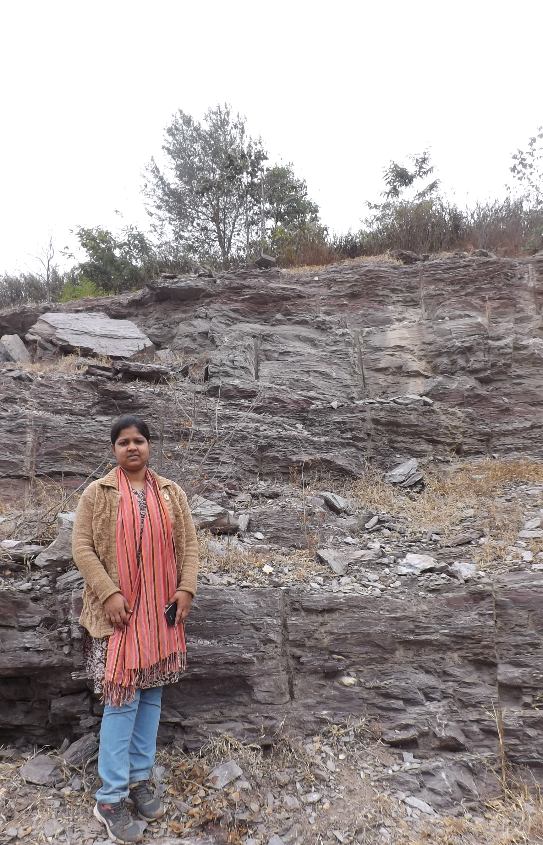
THANK YOU

