Slide 1
Bio-ethanol from Thermomyces lanuginosus DSM 28966/NCIM 1374 and Pichia stipitis
Presented by:
Dr. Smriti Shrivastava
Science and Engineering Board
Fast Track Young Scientist
Amity Institute of Microbial Technology,
Amity University Uttar Pradesh

Slide 2
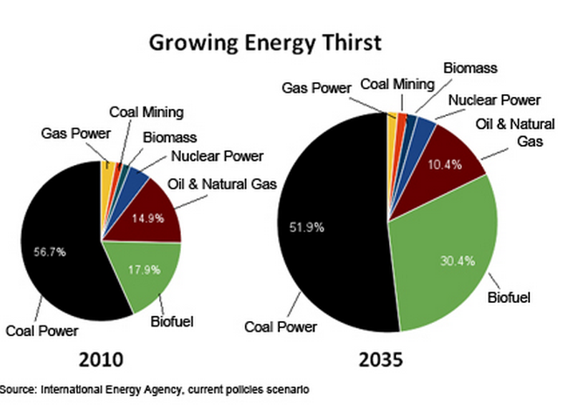
Most important biotechnology product in terms of volume and market values
Useful alternative to renewable energy sources
Why Bioethanol – Some Stats

Slide 3
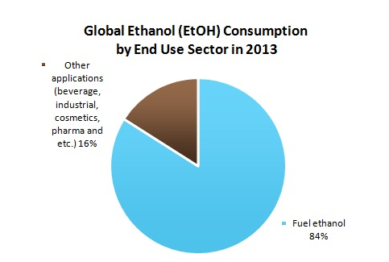
Why Bioethanol – Some Stats

Slide 4
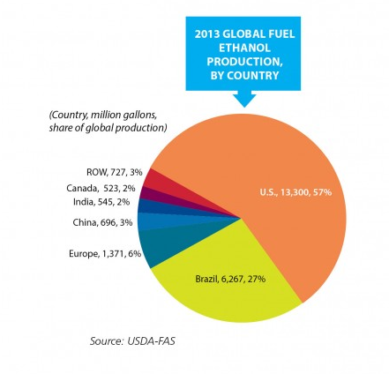
Why Bioethanol – Some Stats

Slide 5
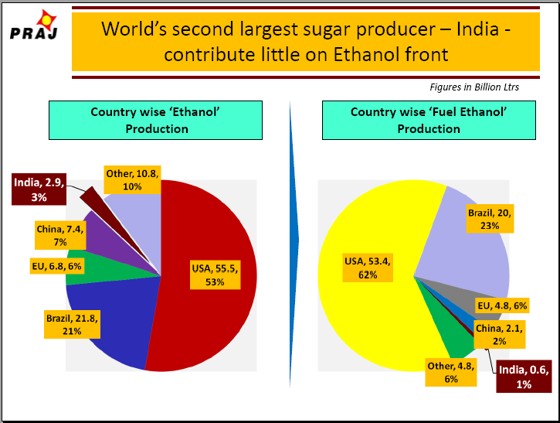
A DATA BY PRAJ INDUSTRIES

Slide 6
Building a sustainable supply for ethanol
Overcoming shortage of fossil resources
An attempt to reduce green house gas emission
Development of technically and economically efficient, innovative process for converting agricultural residues to environmental friendly bio-fuel
Using process integrated enzyme production ---- optimised enzymes ------ simultaneous conversion of cellulose and hemicellulose into ethanol
Focusing second generation bio-fuel
Rising Ethanol import bill has necessitated the requirement of an alternative fuel
Our Requisite – Experimental Level

Slide 7
Managing production cost
Optimization of common ethanol fuel mixtures
[percentage of ethanol blended in other fuels]
Justifying proper usage of agricultural waste
Catering international demand
For the same ethanol blending program have been initiated by Government of India with various mandates and objective of energy security and reduction in Green house gas emission
Our Requisite – Production Level

Slide 8
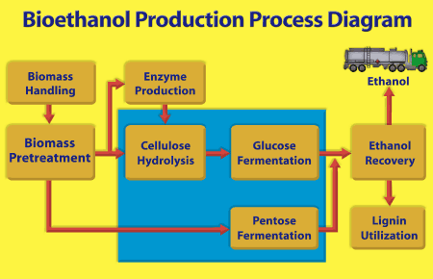

Slide 9
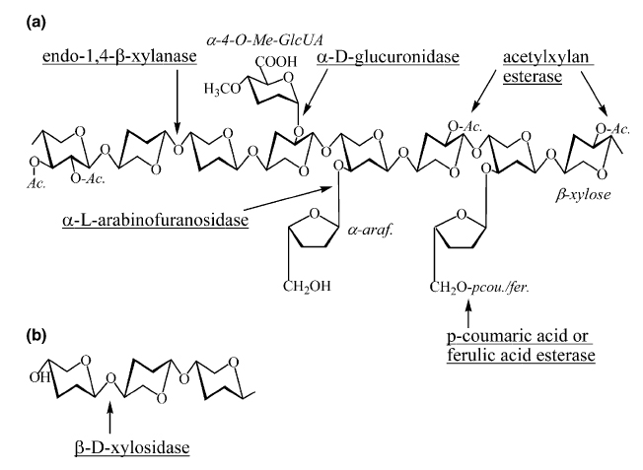
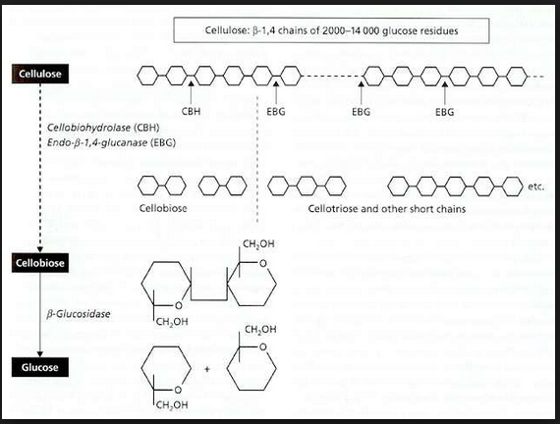
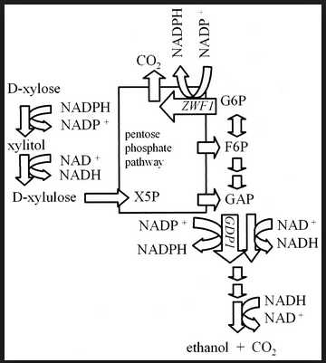
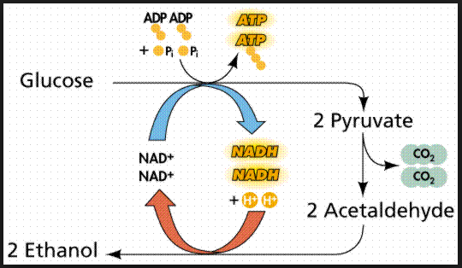
Xylan and Cellulose Degradation – Fermentation

Slide 10
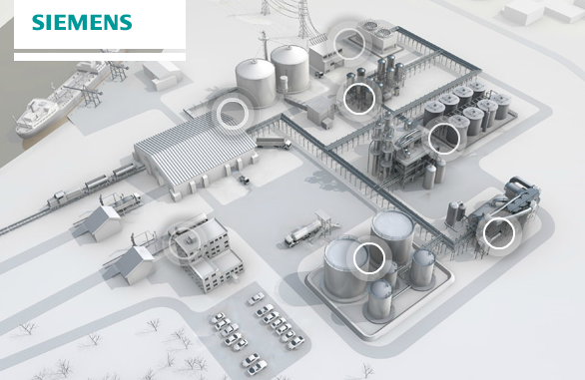

Slide 11
Enhancement in production of Bioethanol upon cohesive saccharification and fermentation process.
Second generation Bio-fuel
Fermentation by yeast Pichia stipitis
Fermentation of pentose sugar by produced by distinctive saccharification process by thermophilic fungi Thermomyces lanuginosus SS-8 (DSM 26889/ NCIM 1374)
Fermentation of pentose and hexose sugars produced by mesophilic as well as thermophilic novel bacterial isolates isolated from soil degrading microorganisms
*Hydrogenation of lignin waste
Our Focus

Slide 12
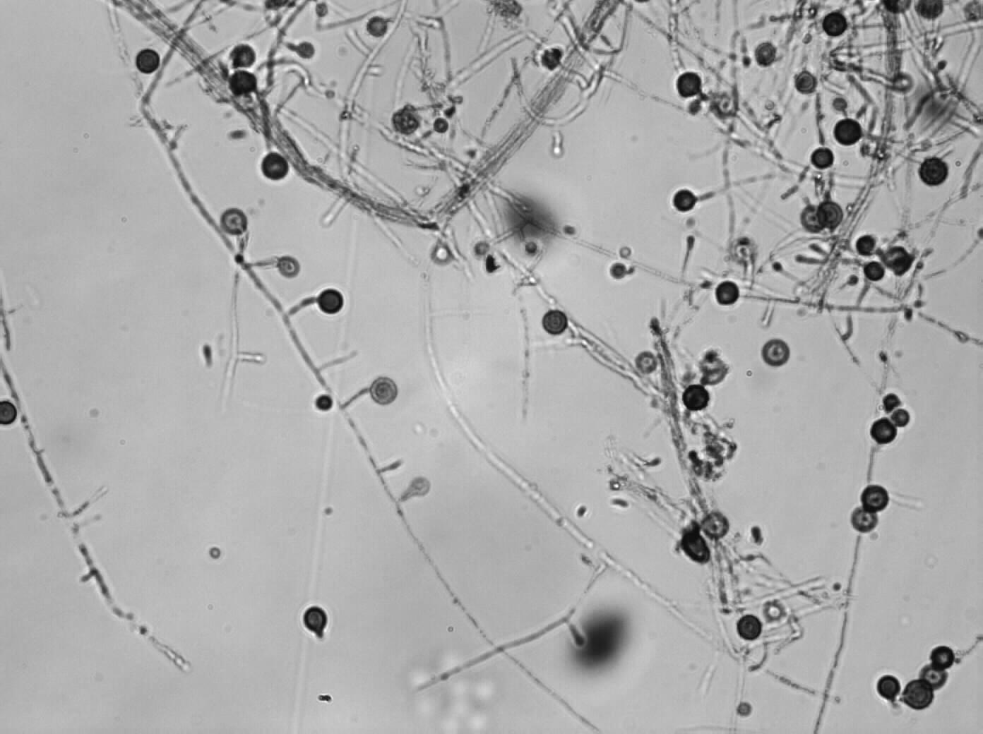
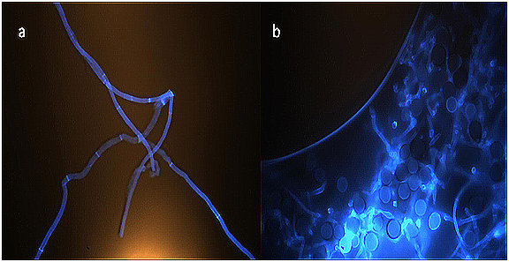
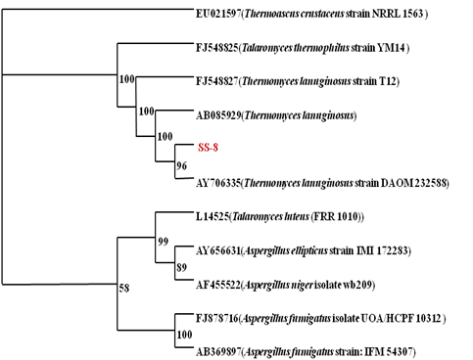
Thermomyces lanuginosus SS-8 (DSM 26889/ NCIM 1374)

Slide 13
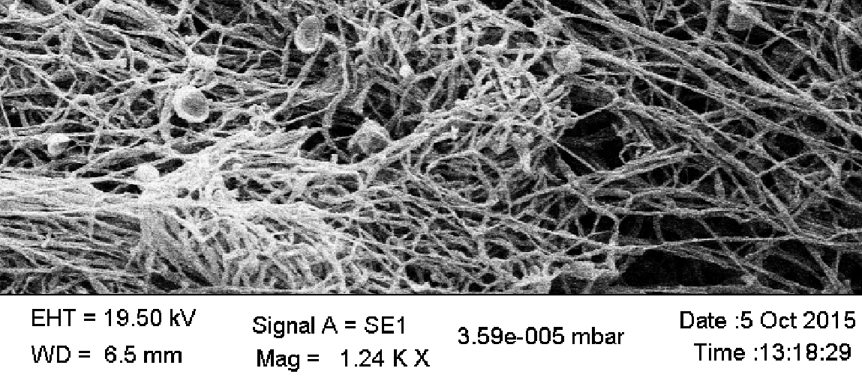
Scanning Electron Microscopy of T. lanuginosus (DSM 26889/ NCIM 1374)

Slide 14
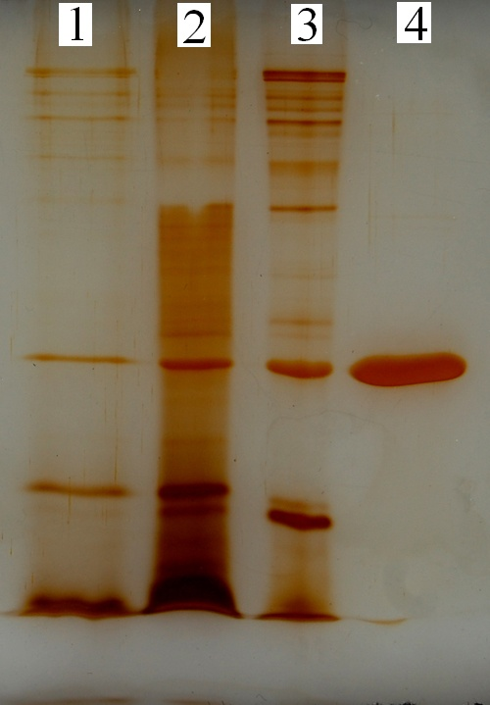
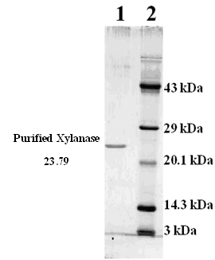
PURIFIED XYLANASE FROM Thermomyces lanuginosus SS-8

Slide 17
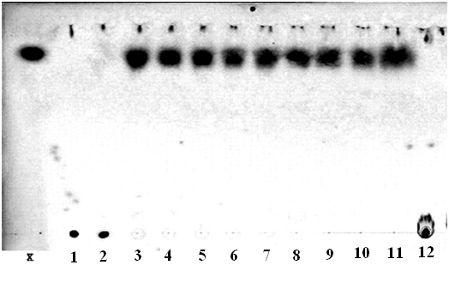
Thermomyces lanuginosus SS-8 (DSM 26889/ NCIM 1374)
TLC analysis of hydrolysis product released from OSX by xylanase from T .lanuginosus SS-8. X: xylose standard; lane 1: xylan 0 h blank; lane 2: 0 h hydrolysis; lane 3: 0.25 h hydrolysis; lane 4: 0.5 h hydrolysis; lane 5: 1 h hydrolysis; lane 6: 3 h hydrolysis; lane 7: 6 h hydrolysis; lane 8: 12 h hydrolysis; lane 9: 24 h hydrolysis; lane 10: 48 h hydrolysis; lane 11: 72 h hydrolysis; lane: 12: xylan 1 h blank
Patent: (Application number: 141/KOL/2010) “Novel ß-1, 4-endoxylanase from Thermomyces lanuginosus SS-8 and the mode of action thereof”. S. Shrivastava, P. Shukla, K. Mukhopadhyay
S. Shrivastava, P. Shukla, K. Mukhopadhyay (2011) Purification and preliminary characterization of a xylanase from Thermomyces lanuginosus strain SS-8. 3Biotech. Vol. 1, 255-259. DOI: 10.1007/s13205-011-0032-6.

Slide 18
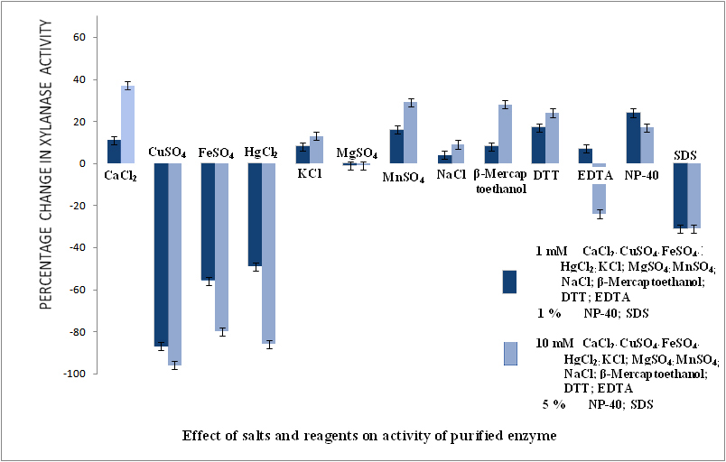

Slide 19
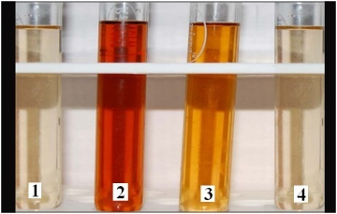
Phenol Sulphuric Acid Assay (1: Blank; 2: Ultrafiltration retentate; 3: Anion exchange positive fractions; 4: Positive fractions from continuous elution electrophoresis)
Lineweaver-Burk plot for the purified T. lanuginosus SS-8 xylanase. Enzyme activity was measured at 60°C and pH 6.0. V₀ in µmoles/(ml.min)⁻¹, [S]: OSX ( ) concentration and BWX ( ) concentration in mgml⁻¹

Slide 20
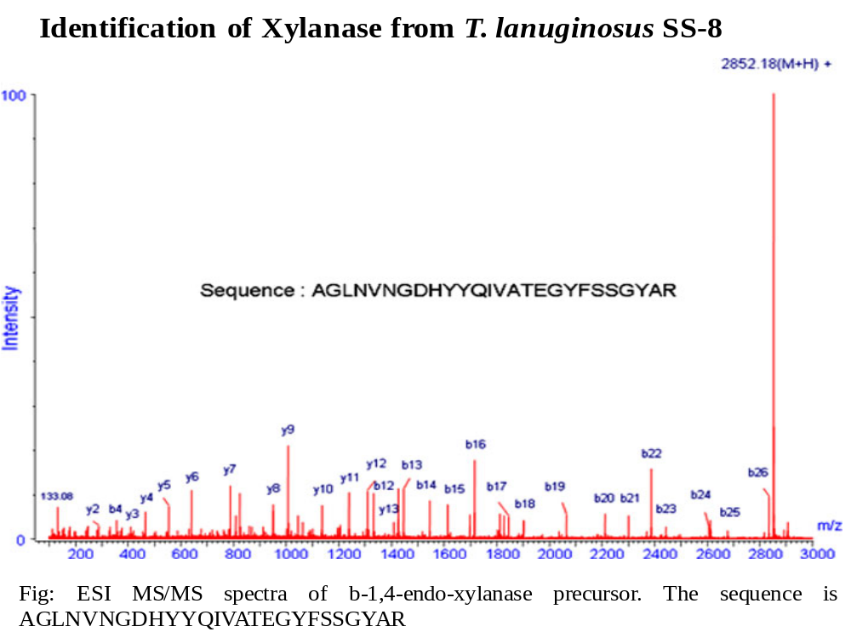

Slide 21
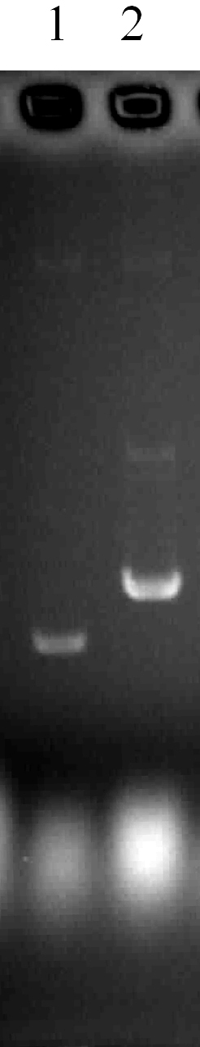
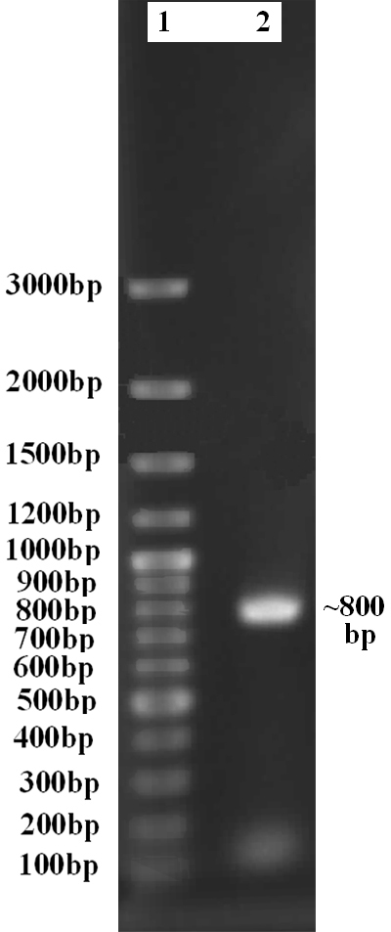
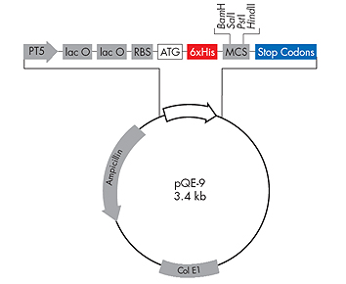
Heterologous expression of xynA gene in E. coli XL1Blue
E. coli XL1Blue
Expression of β-1,4-endo-xylanase as N-terminal 6×His tag construct under control of PT5 promoter of expression vector pQE-9 (Qiagen GmbH, Quiagen, Strasse, Germany)
S. Shrivastava, P. Shukla, Deepalakshmi P.D., K Mukhopadhyay (2013) Characterization, cloning and functional expression of novel xylanase from Thermomyces lanuginosus SS-8 isolated from self-heating plant wreckage material. World Journal of Biotechnology and Microbiology, 29 (12) 2407-2415. DOI 10.1007/s11274-013-1409-y [WIBI-D-13-00582R1]

Slide 22
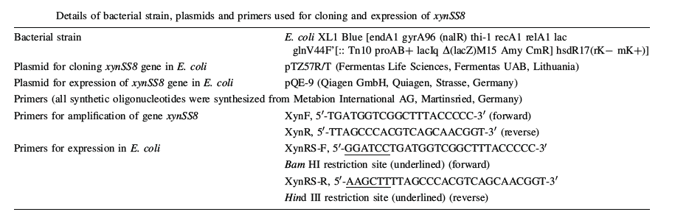

Slide 23
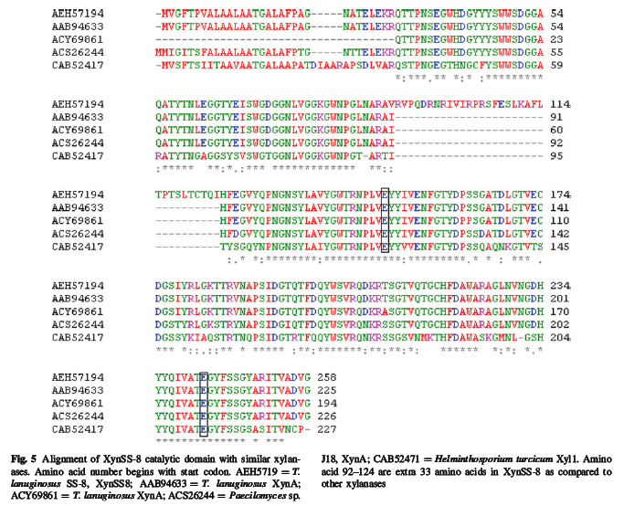

Slide 24
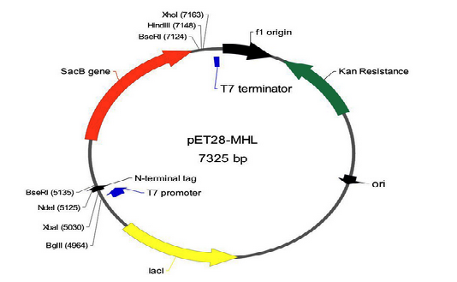
pET vector for cloning xyn SS-8 gene in Pichia
Introducing xyn SS-8 gene in Multiple cloning site of pET vector
Expressing that vector in Pichia stipitis under control of T7 promoter
Optimizing cohesive saccharification and fermentation process.
Optimizing maximal ethanol production from agricultural waste

Slide 25
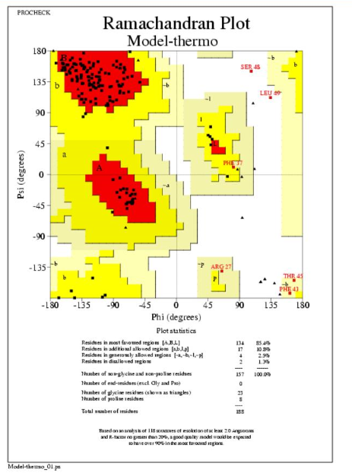

Slide 26
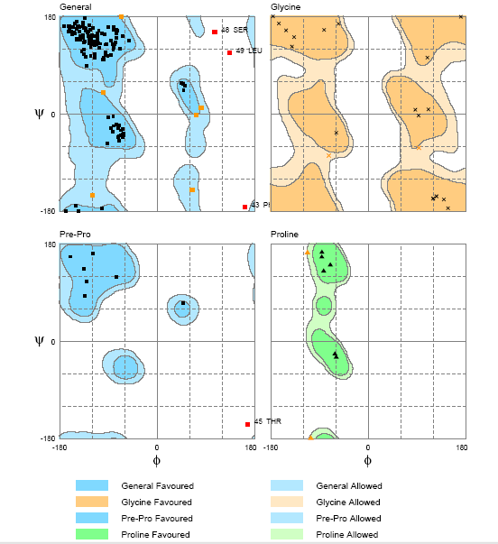
Molprobity Ramachnadran Plot Assessment

Slide 27
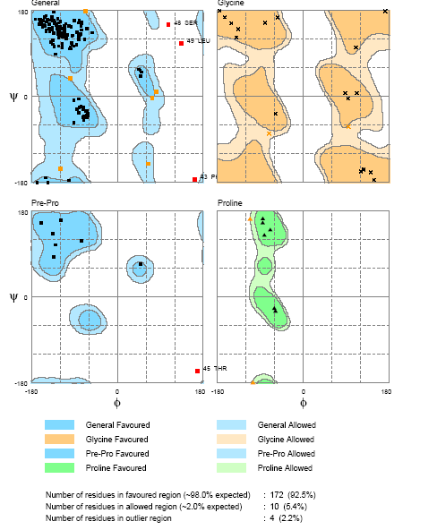

Slide 28
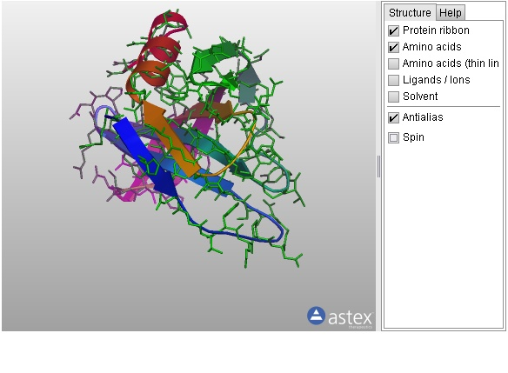
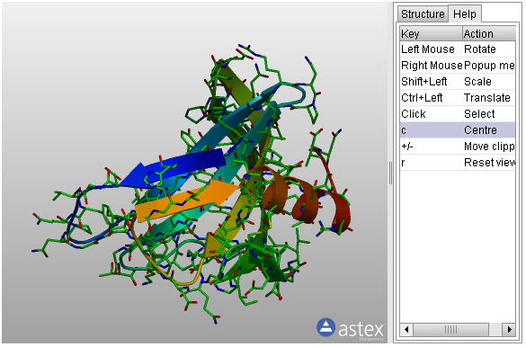
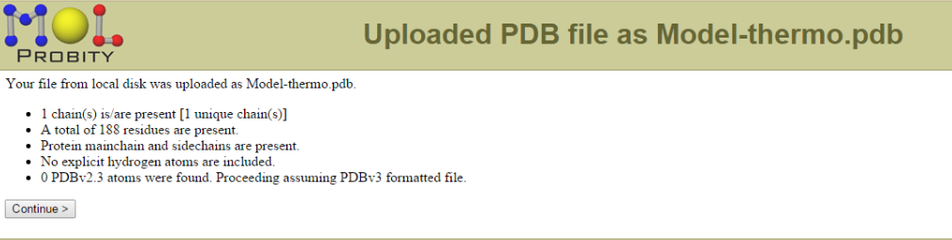

Slide 29
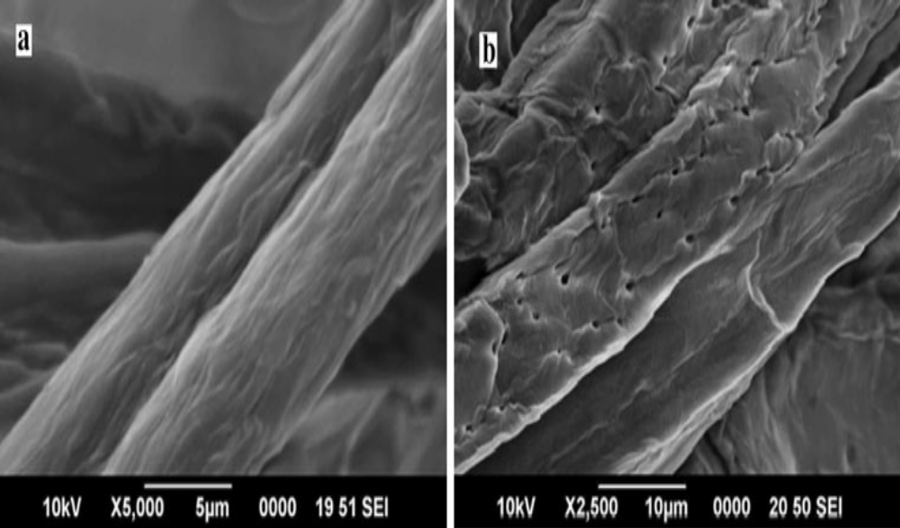
Effect of Xylanase from T. lanuginosus SS-8 on Bagasse Pulp
Fig: Scanning electron imaging a Bagasse pulp treated with inactivated xylanase, magnification 95,000. b Bagasse pulp treated with active xylanase, magnification X2,500

Slide 30
Processes to be optimized at various stages of fermentation:
Raw material Handling
Raw Material Processing
Bio-ethanol Production
Residue Handling
Product Handling
Agricultural wastes
Corn cob
Wheat bran
Sugarcane bagasse
Rice husk
Rice straw
Molasses

Slide 31
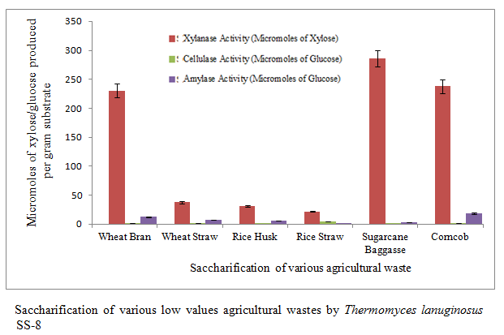
Shrivastava S, Tetarwal KG, Kharkwal AC, Varma A (2014) Bio-ethanol production by simultaneous saccharification and fermentation using microbial consortium. International Journal of Current Microbiology and Applied Sciences. Volume 3(07):505-511

Slide 32
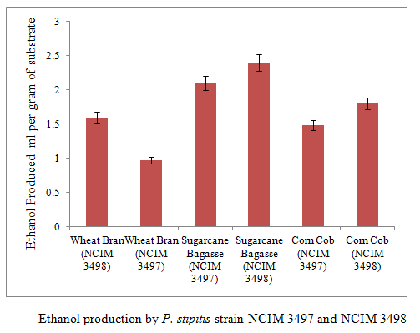
Shrivastava S, Tetarwal KG, Kharkwal AC, Varma A (2014) Bio-ethanol production by simultaneous saccharification and fermentation using microbial consortium. International Journal of Current Microbiology and Applied Sciences. Volume 3(07):505-511

Slide 33
Ms.Pragati Awasthi, Ms. Shilpi Choudhary and Mr. Ankur Agarwal
Simultaneous saccharification and fermentation of pentose and hexose sugars produced by mesophilic and thermophilic bacterial isolates

Slide 34
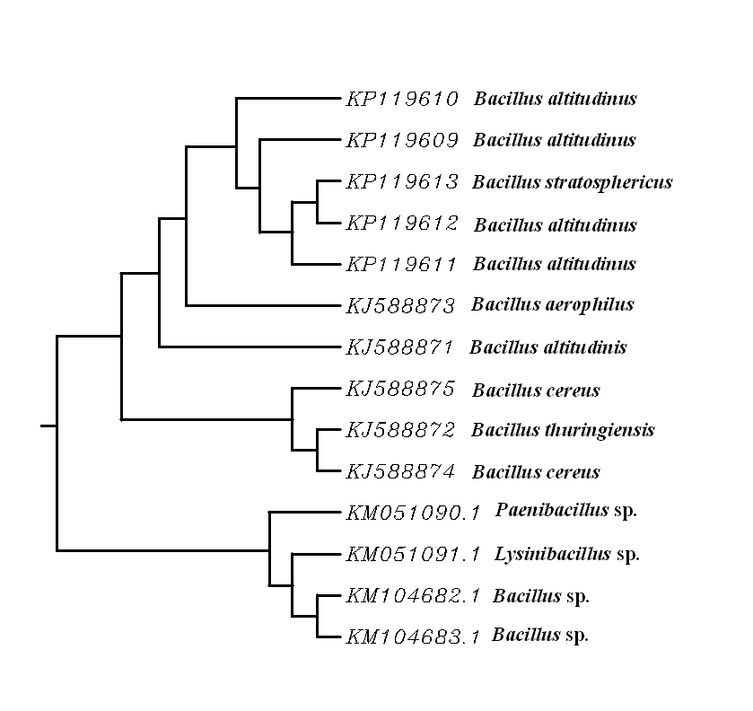
PHYLOGENETIC TREE SHOWING HOMOLOGY BETWEEN
VARIOUS NOVEL ISOLATES (PRODUCING HYDROLYTIC ENZYMES)

Slide 35
STUDY ON THERMOPHILIC BACTERIAL ISOLATES

Slide 36
Thermophilic bacteria (55°C)
Screened for maximal hydrolase producing bacterial isolates
Among all the isolates studied she could select few, for maximal hydrolase enzyme activity and simultaneous fermentation

Slide 38
A Novel efficient bio-ethanol producer: Paenibacillus sp. [Ethanol produced in microliter per 100 g of sample: substrate used: Corn cob]
KM051091 (Definition: Paenibacillus sp. BAB-4347 16S ribosomal RNA gene, partial sequence) (Authors: Joshi, M.N., Shrivastava, S., Awasthi P., Choudhary S., Agarwal A., Kharkwal A.C., Jasmani,F.P., Saxena,A.K. and Bagatharia,S.B), 2014

Slide 39
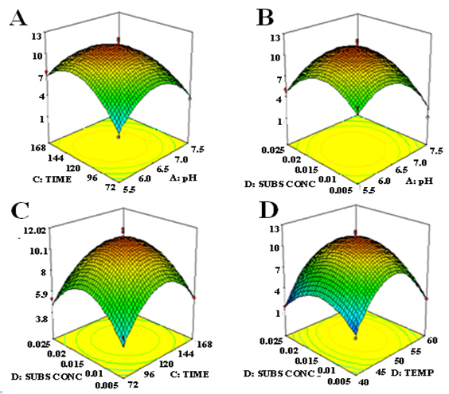
Response surface 3D plot showing effect of various process parameter

Slide 40
HPLC Analysis of products obtained by simulatneous saccharification and fermentation process
Sample No. | Sample Name | Analyte | Concentration (mg/ml)
1 | Ethanol 1 | Ethanol | 9.9378
2 | Ethanol 2 | Ethanol | 10.4703
3 | Enzyme 1 | Glucose Xylose | 1.5671 8.3512
4 | Enzyme 2 | Glucose Xylose | 1.6554 9.8107
Both pentose and hexose sugars are fermented and the amount of ethanol was substantial.

Slide 41
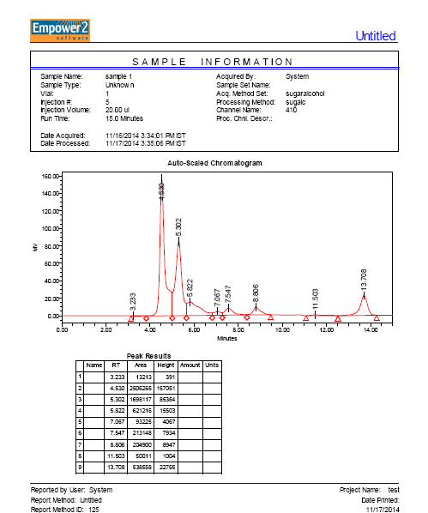

Slide 42
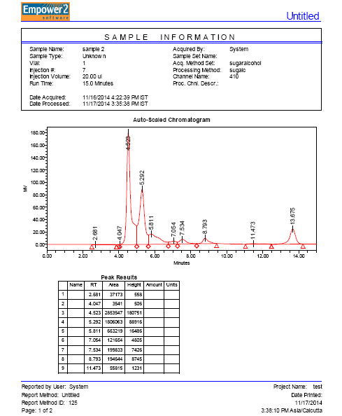

Slide 43
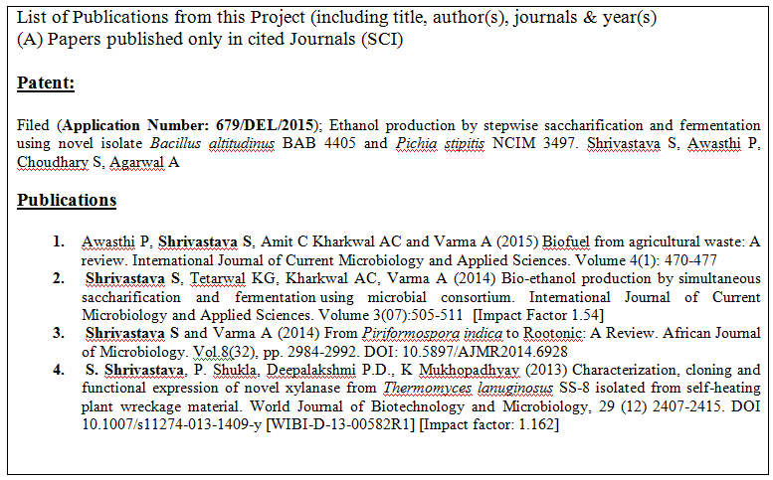

Slide 44
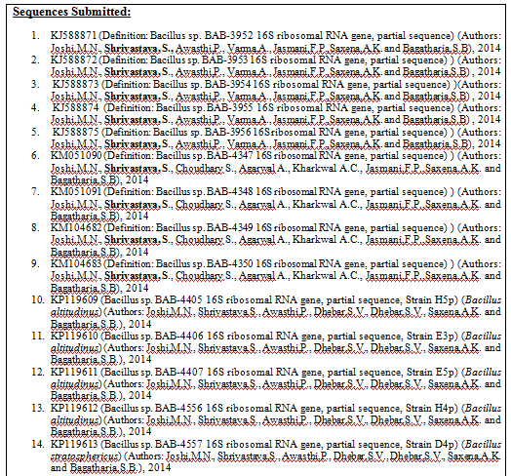

Slide 45
Thank You
Contact: shrivastava.smriti@gmail.com, sshrivastava1@amity.edu

