Slide 1
Recycle nutrients today for a better tomorrow
Sirpa Kurppa, Yrjö Virtanen and Jenni Ypyä
Natural Resources Institute Finland, Jokioinen, Humppilantie, 31600 Jokioinen, Finland

Slide 2
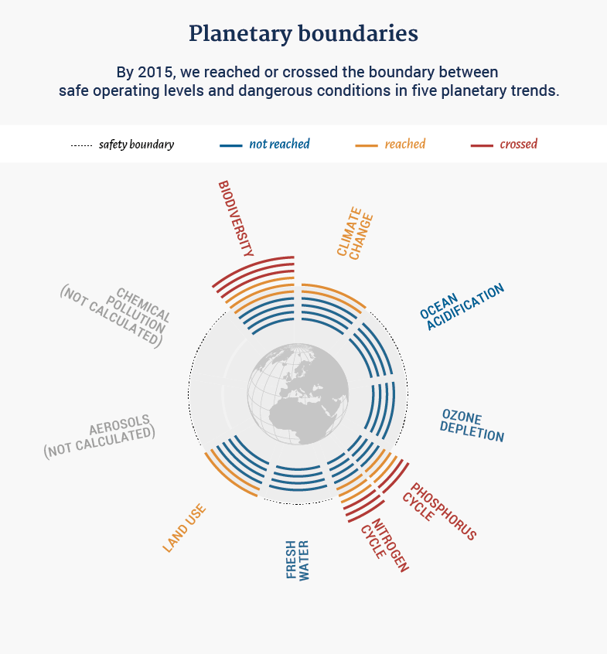
Accelerated cycling of nutrients
Is principally due to three changes in the global food system:
increase in population,
changes in diet towards more P and N intensive products,
and industrialization of agriculture.
http://www.behindenergy.com/planetary-boundaries/8046/?lang=en
Steffen, Will et al. 2015: Planetary boundaries: guiding human development on a changing planet. In: Science 347:6223.

Slide 3
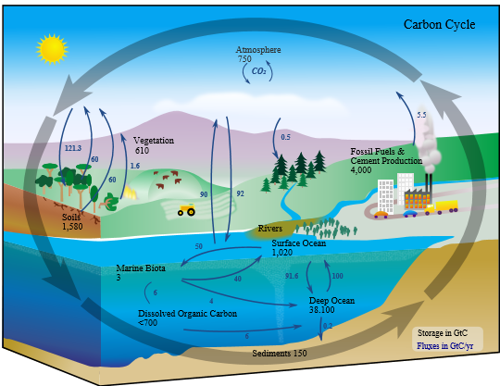
http://www.visionlearning.com/en/library/Earth-Science/6/The-Carbon-Cycle/95

Slide 4
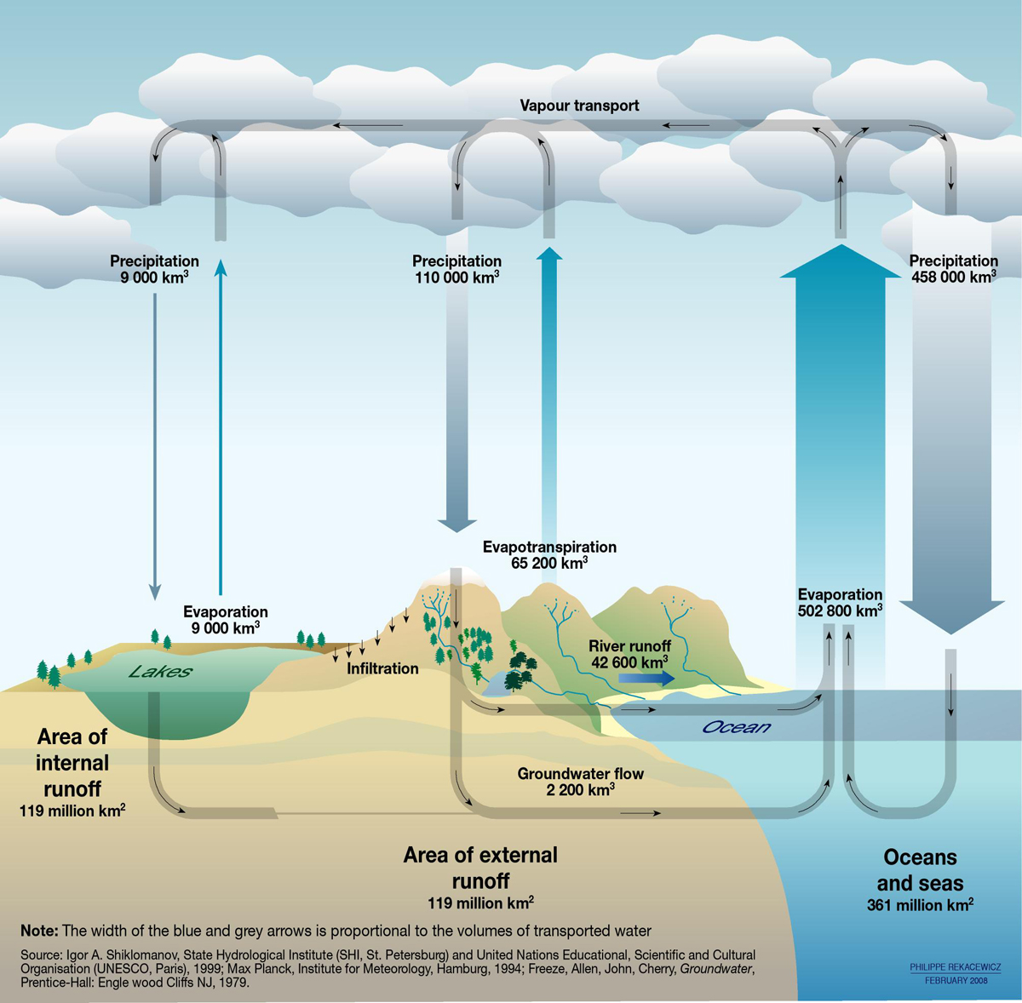
http://www.unep.org/dewa/vitalwater/jpg/0102-water-cycle-EN.jpg

Slide 5
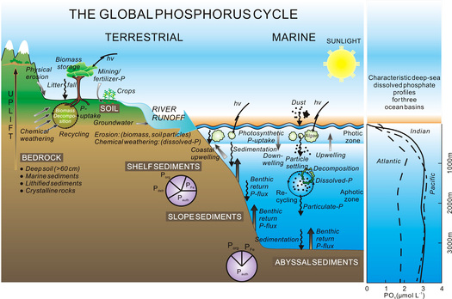
http://www.ic.ucsc.edu/~mdmccar/ocea213/readings/10_Phosphorous/Ruttenburg_2007_TOG_Global_Phosphorous_cycle.pdf

Slide 6
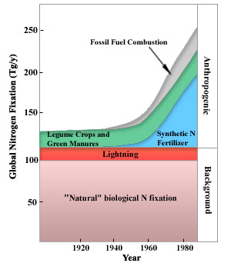
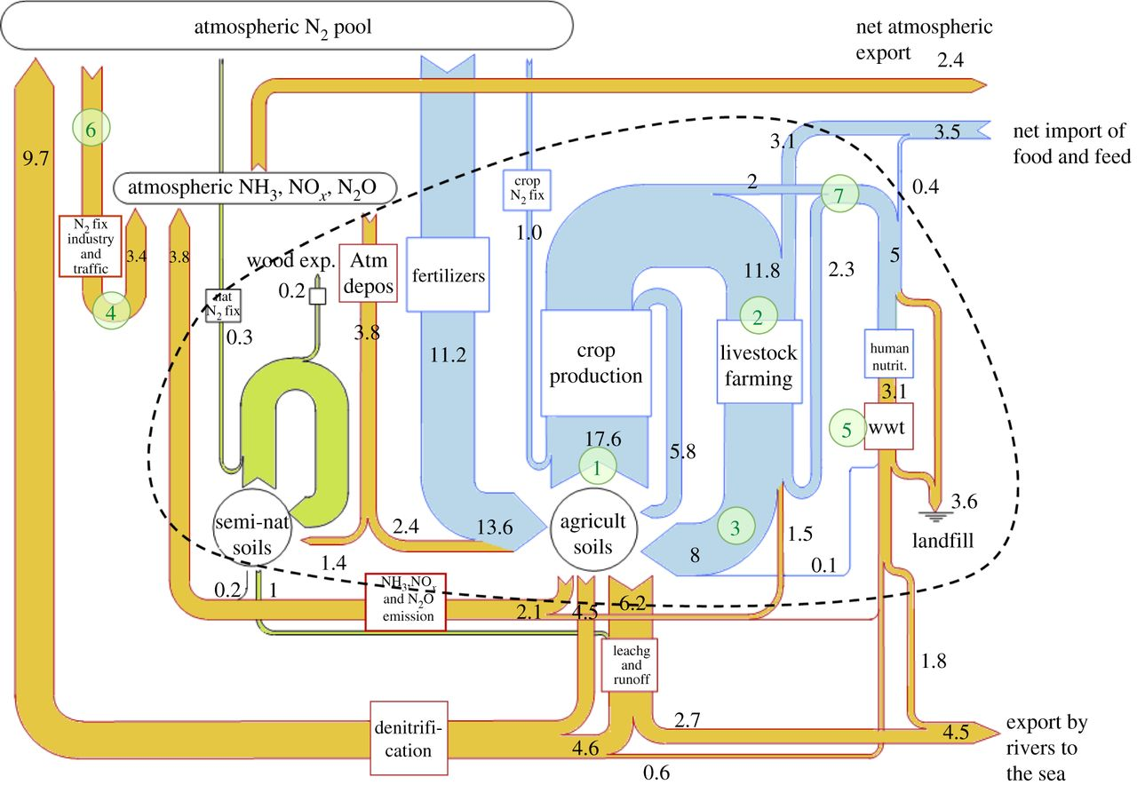
The global nitrogen cycle in the twenty-first century
David Fowler, Mhairi Coyle, Ute Skiba, Mark A. Sutton, J. Neil Cape, Stefan Reis, Lucy J. Sheppard, Alan Jenkins, Bruna Grizzetti, James N. Galloway, Peter Vitousek, Allison Leach, Alexander F. Bouwman, Klaus Butterbach-Bahl, Frank Dentener, David Stevenson, Marcus Amann, Maren Voss
Published 27 May 2013.DOI: 10.1098/rstb.2013.0164
Vitousek, P. M.. and Matson, P. A. (1993). Agriculture, the global nitrogen cycle, and trace gas flux. The Biogeochemistry of Global Change: Radiative Trace Gases. R. S. Oremland. New York, Chapman and Hall: 193-20

Slide 7
LCA thinking - Life Cycle Assessment (LCA)
well-known tool of carbon footprint LCA
measurement tool for eutrophication,
water footprint
ecotoxic footprint - new proposals
nutrient footprint - new proposals
measure for biodiversity - under development
emission footprints >< resource footprints.

Slide 8

Critical for applicability of the environmental footprints
for global applicability - standardization of data management and calculations are necessary
statistical or default values can be used - but always the most critical values must be process based and quality controlled
benchmark values are needed for making critical comparisons and proper conclusions
PRIMARY PRODUCERS >< CONSUMERS

Slide 9
Functional unit
Environmental impact measures of LCA can be related to quantities
, specific services, serviced portions or financial values of food products,
also to nutritional function of the products.
LCA approach if fully global,
  as it relates environmental impacts at each stage of production chain to sensitivity of the particular environment to each particular types of impact,
  or relates the use of resources to the scarcity of accessibility of those resources

Slide 10
Methodology Nutrient Footprint
takes into account
the amount of nutrients taken into use as virgin or recycled nutrients and
2) the efficiency of these nutrients utilized in the particular production chain. At the same time, nutrient losses at each life cycle phase are identified.
.
Kaisa Grönman, Jenni Ypyä, Yrjö Virtanen, Sirpa Kurppa, Risto Soukka,
Pentti Seuri, Aki Finer, Lassi Linnanen:
Nutrient footprint as a tool to evaluate the nutrient balance of a food
Chain. Journal of Cleaner Production 112 (2016) 2429e2440

Slide 11
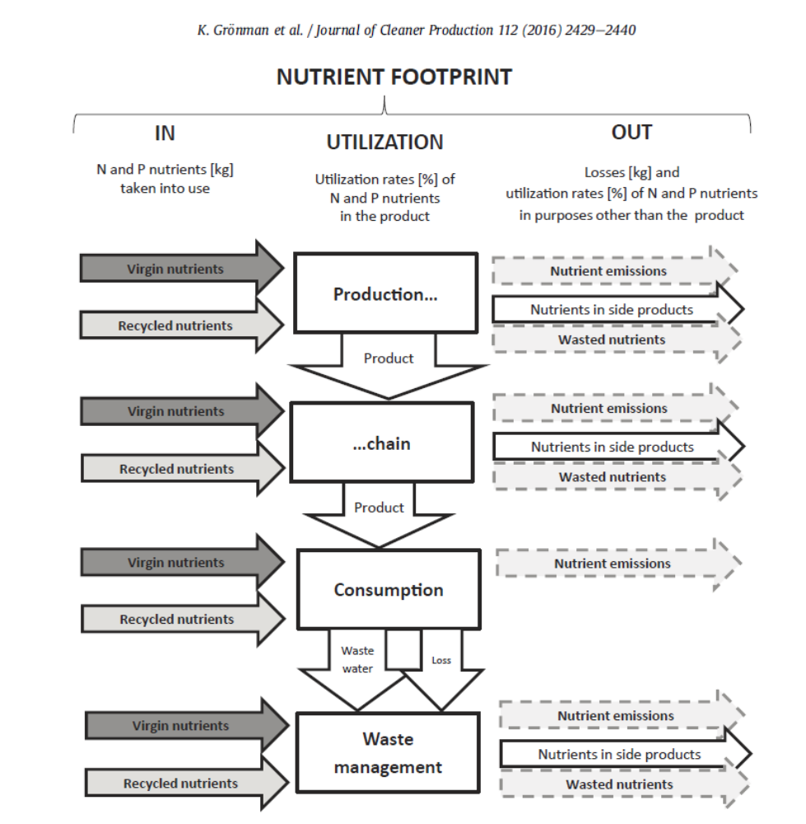

Slide 12
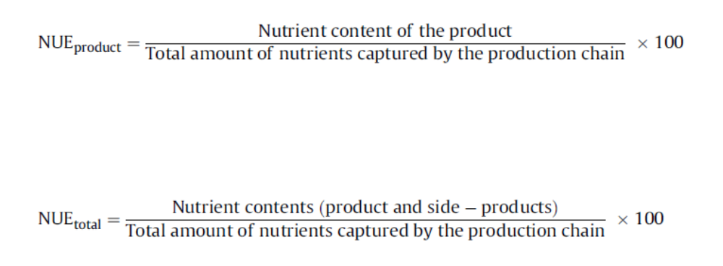

Slide 13
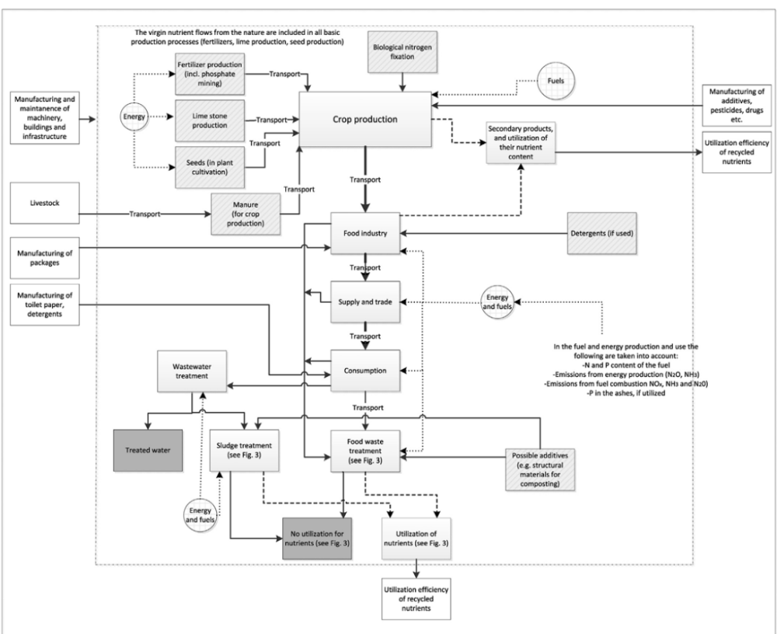

Slide 14
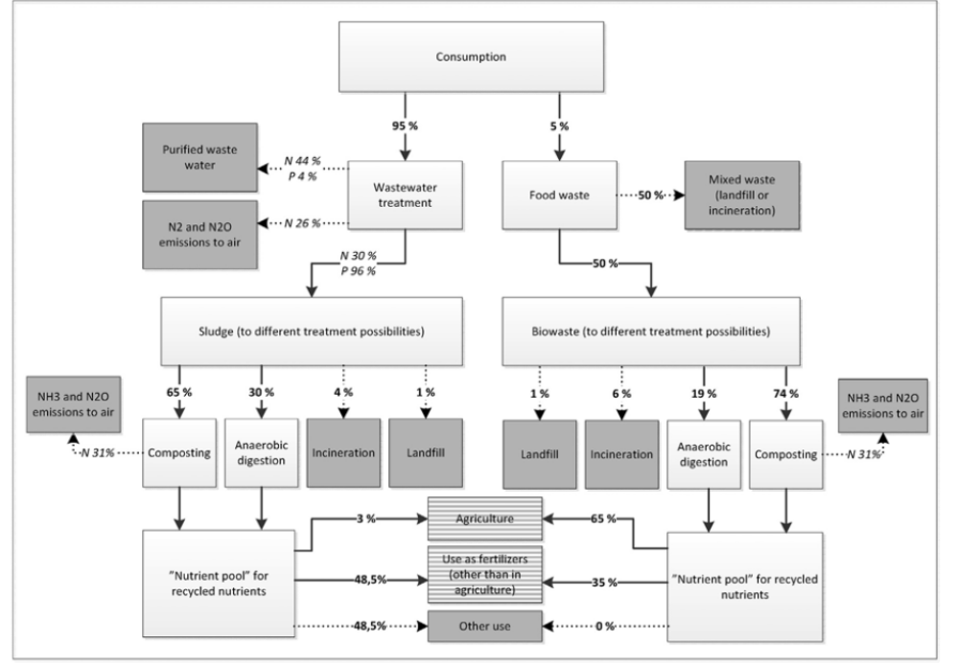

Slide 15
The nutrient footprint is an indicator
.
which combines the amount of captured nutrients, kg of N and P, for use in the production chain and
the share of nutrients utilized % either in the primary product itself or in the entire production chain,
accounting also for secondary products.

Slide 16
The nutrient footprint methodology seems to have potential
in assessing the nutrient balances of food chains
as well other bio-based production chains.
It offers information about the nutrient usage and utilization efficiency in a simple and comparable form..

Slide 17
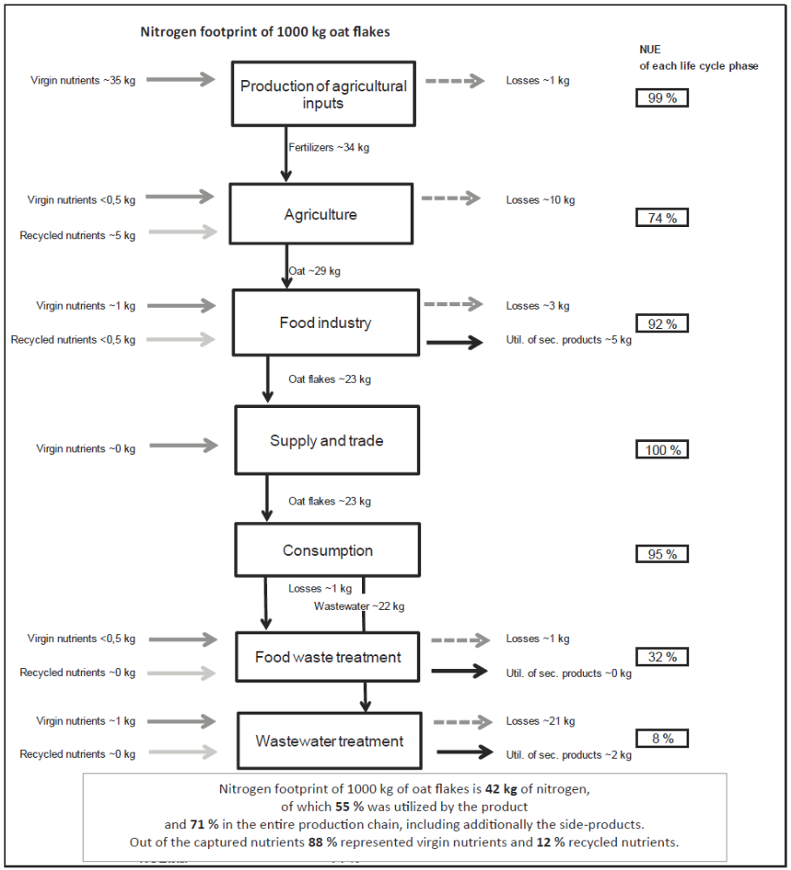

Slide 18
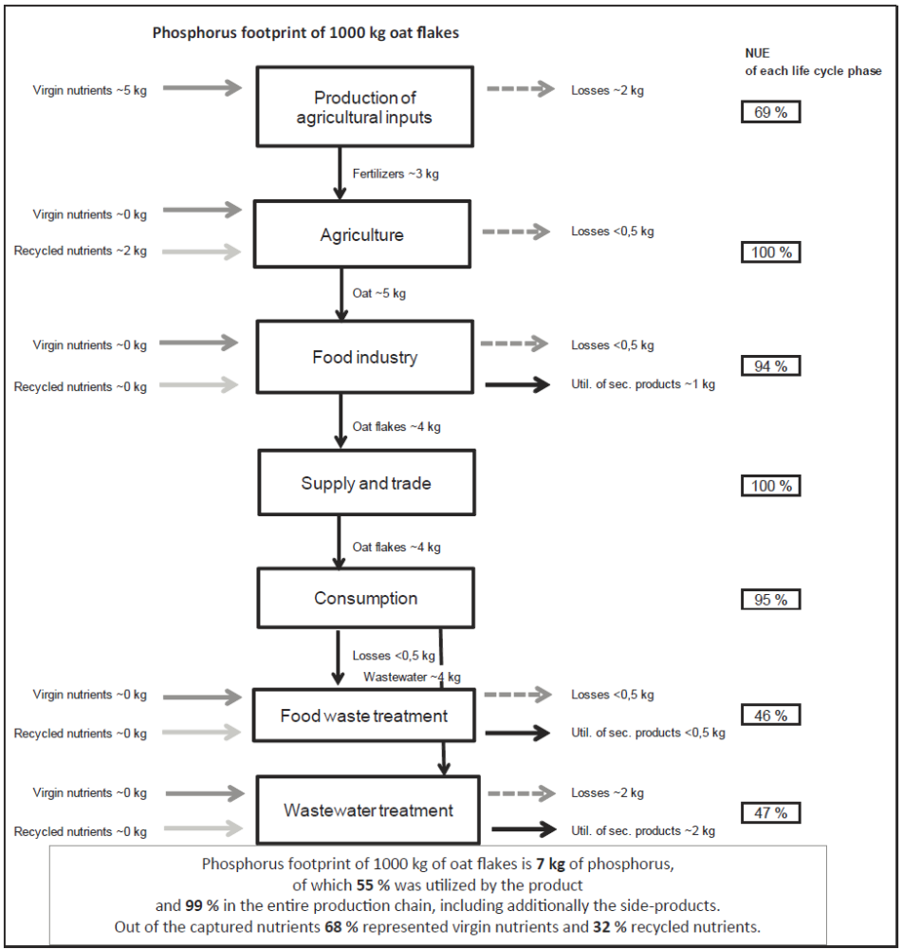

Slide 19
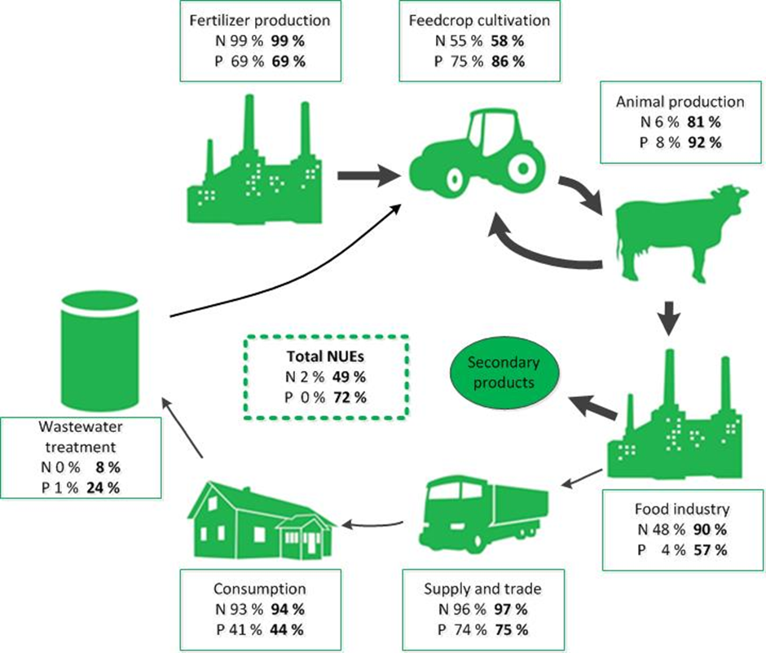
Preliminary result!

Slide 20
In comparison
Leach et al. (2012), and Pierer et al. (2014) have calculated Virtual N factors (representing the total N loss (kg) in the production chain divided by the (kg) N that remains in the consumed product) for beef (Table 3.). When calculating in a similar way, the Virtual N factor for beef in the present study is higher. However, the results of the previous studies represent averages of national beef production systems, while in the present study only the suckler cow-calf system is studied. According to Nguyen et al. (2010) nutrient use efficiencies are greater in dairy bull-calf systems than in the suckler cow-calf system.
Virtual N factors of beef:
  Reference Country VNF
  Leach et al. 2012 USA 8.,5
  Pierer et al. 2014 Austria 5.,4
  The present study Finland 12.,9**/45.,1*
  ** Including only the slaughtered animal
  * Including inputs and emissions allocated from suckler cow

Slide 21
Thee definition of the hot spots of nutrient leakage of the entire food chain in order to be able to close them
is essential to determine in transition towards sustainable nutrient economy and proper nutrient performance.
The food chain can be remarkably improved with of the Nutrient Footprint-tool by improving the efficiency of nutrient use of the whole chain or the part of the chain.
The results can be adapted as general view of nutrient management in communication with consumers and politicians.

Slide 22
Key requirements for an indicator
Relevance: indicators are relevant for decision-making and policy purposes
Acceptability: an indicator is based on the best available and reliable data
Measurability: database of an indicator is exact and measurable according to appropriate costs
Comparability: an indicator is related to the ability to track trends over time, regions and economy sectors
Absence of redundancy; but complementarity

Slide 23
Nutrient footprint NUE
Resource footprint
Does not include environmental impact
To be used with:
  Carbon footprint
  Water footprint (green, blew, grey)
  Eutrophication impact assessment
  Ecotoxic footprint
  Toxicity impact assessment
  As a component of ecological impact assessment

Slide 24


Slide 25
sirpa.kurppa@luke.fi

