Slide 1


Presenilins: a group of novel calcium channel modulators.
Simon Kaja, Ph.D.
Assistant Professor, Associate Director Preclinical Research
University of Missouri – Kansas City, School of Medicine
Dept. of Ophthalmology, Vision Research Center
Chief Executive Officer and Co-Founder
K&P Scientific LLC
Kansas City, MO
Director North American Operations
Experimentica Ltd.
Kuopio, Finalnd

Slide 2
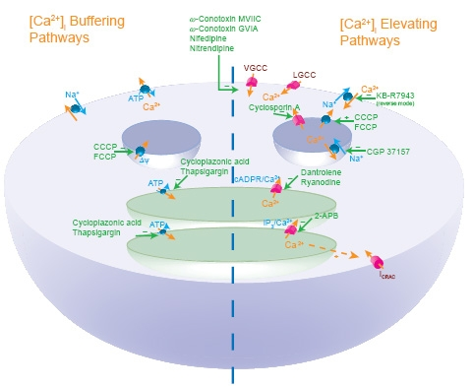
Ca²⁺ signaling
1/3 of the genome are regulated by Ca²⁺
Calcium-mediated processes: -
  Gene transcription
  Cell growth and differentiation
  Apoptosis
  Synaptic plasticity
  Secretion
  Neurotransmitter release
  Cell motility & contraction
  Enzyme activity
[Ca²⁺] elevating pathways
  Voltage-gated Ca²⁺ channels
  Intracellular Ca²⁺ channels
[Ca²⁺] buffering pathways

Slide 3
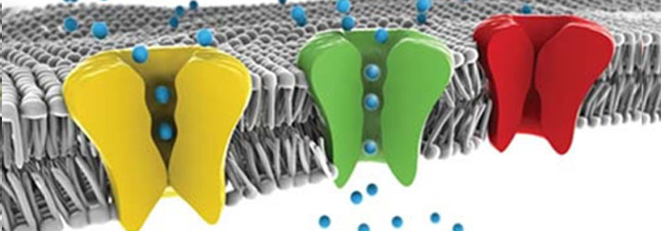
Calcium signaling in disease
Mutations in accessory proteins:
Cerebellar ataxia
Alzheimer’s disease
Autism
Movement disorders
Hypercalcemia
…
Age-related changes in Ca²⁺ signaling:
Healthy aging
Alzheimer’s disease
Glaucoma
Dementia
Parkinson’s Disease
Dry-eye disease
…
Mutations in calcium channels:
Migraine
Ataxia
Epilepsy
Polycystic kidney disease
Hypothermia
Night-blindness
Cardiac arrhythmia
Turner’s syndrome
…

Slide 4
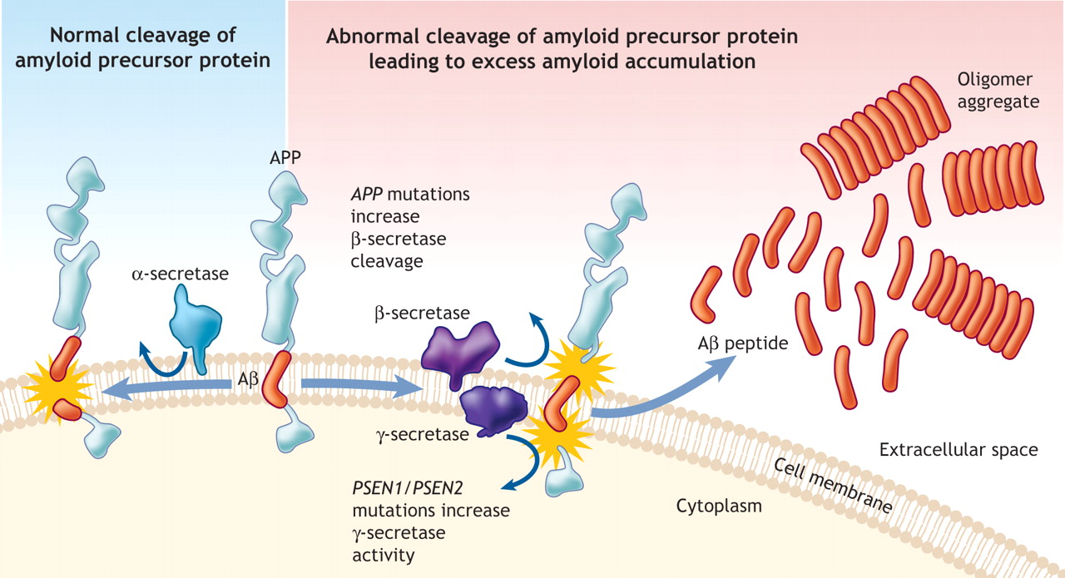
Pathological cleavage of APP in AD

Slide 5
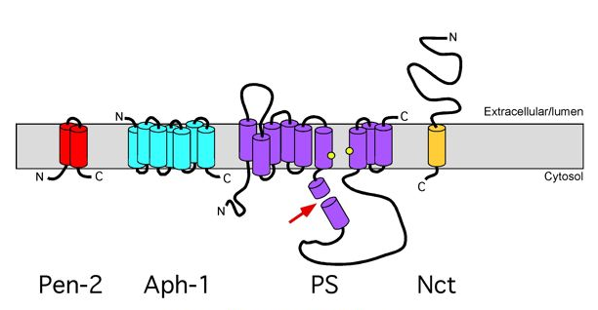
Presenilin proteins
Structure and function:
Component of the γ-secretase
  aspartyl protease component of the
  γ-secretase complex
Two proteins: PS1 and PS2
PS mutations linked to familial AD
  PS1 and PS2 mutations increase
  γ-secretase activity
9 TM SR/ER proteins
Rationale:
PS mutations increase [RyR]

Slide 6
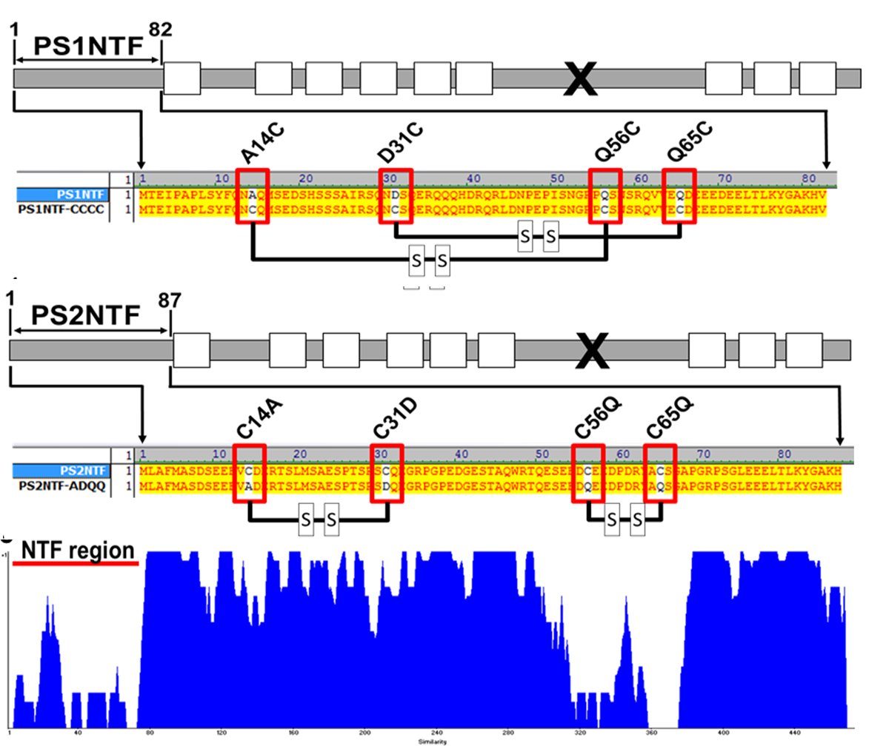
Presenilin homology

Slide 7
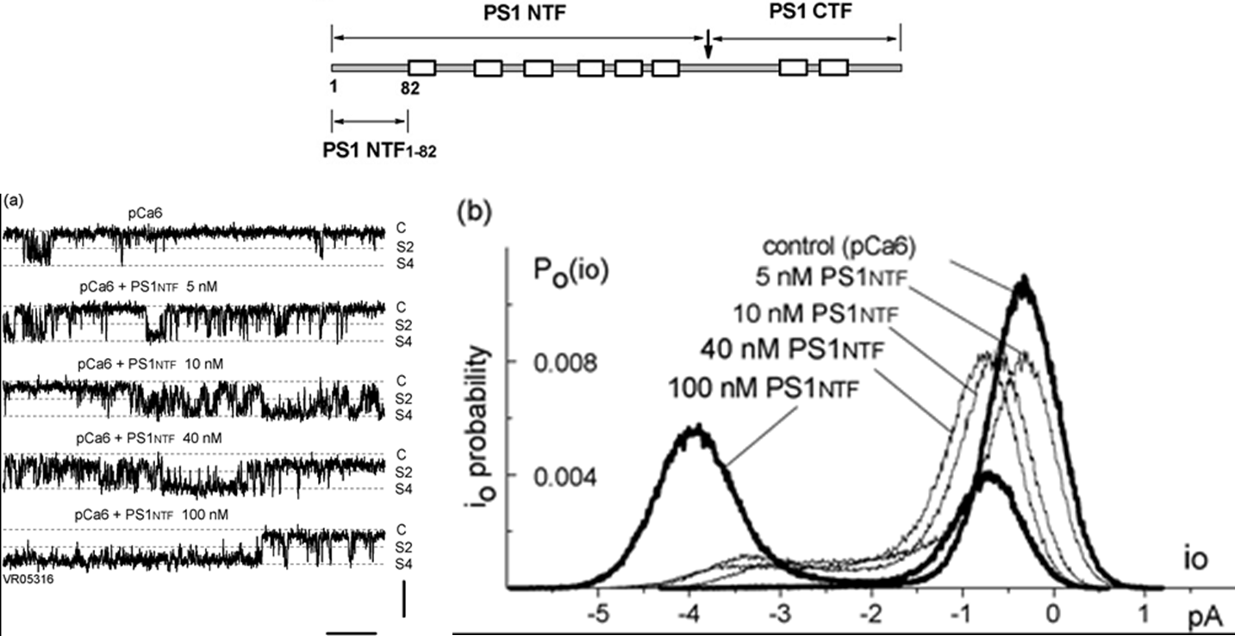
PS1 NTF increases open probability of the brain RyR

Slide 8
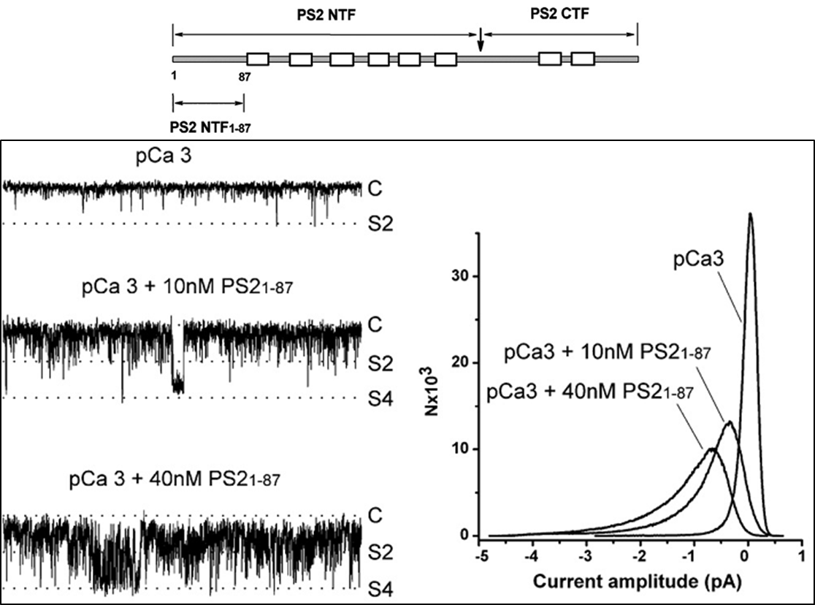
PS2 NTF increases open probability of the brain RyR

Slide 9
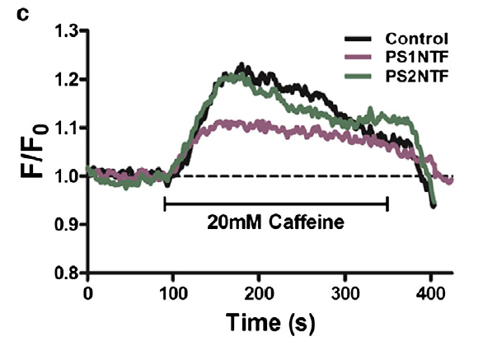
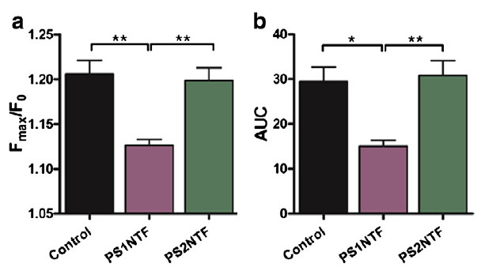
PS NTFs differentially modulate intracellular Ca²⁺ release
Functional Ca²⁺ imaging in SH-SY5Y neuroblastoma cells overexpressing PS1 or PS2

Slide 10
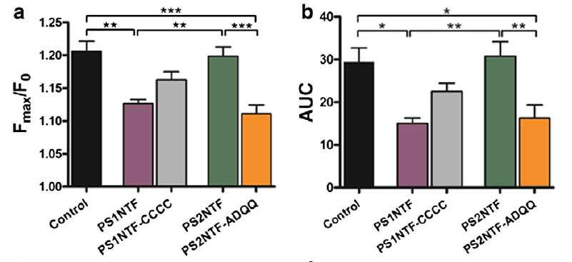
PS NTFs differentially modulate intracellular Ca²⁺ release

Slide 11
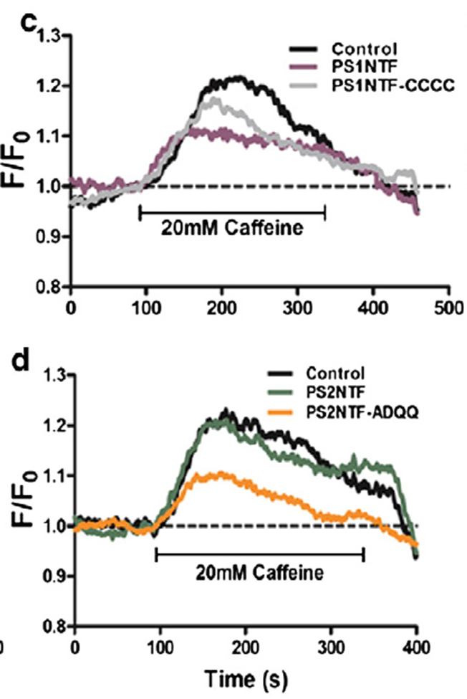
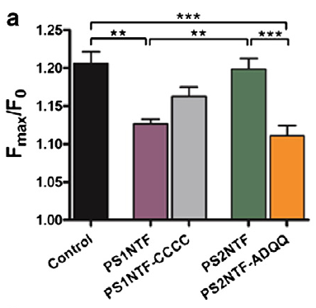
PS NTFs differentially modulate intracellular Ca²⁺ release

Slide 12
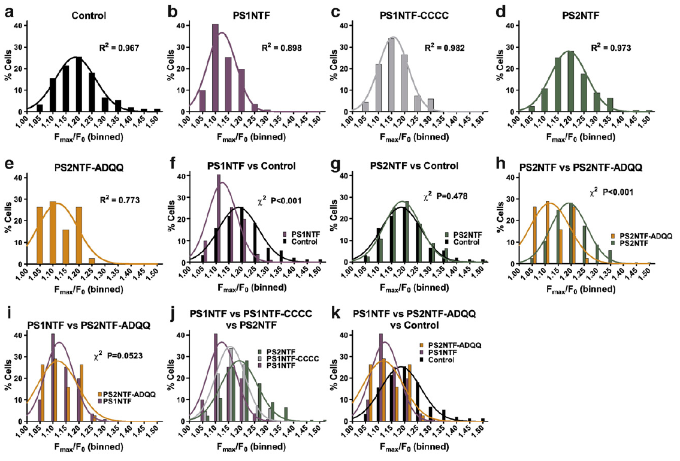
PS NTFs differentially modulate intracellular Ca²⁺ release

Slide 13
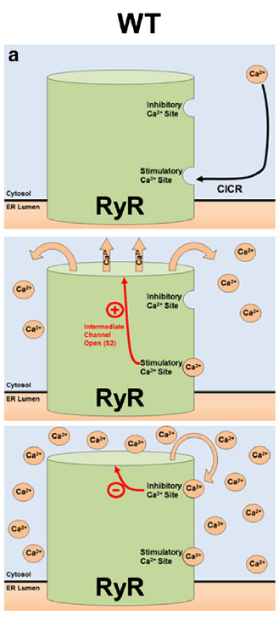
Model of PS modulation of the RyR
Ca²⁺ binds the high affinity stimulatory site resulting in moderate channel opening.
Sustained Ca²⁺ release will result in Ca²⁺ occupying the low affinity, inhibitory Ca²⁺ binding site resulting in channel closure.

Slide 14
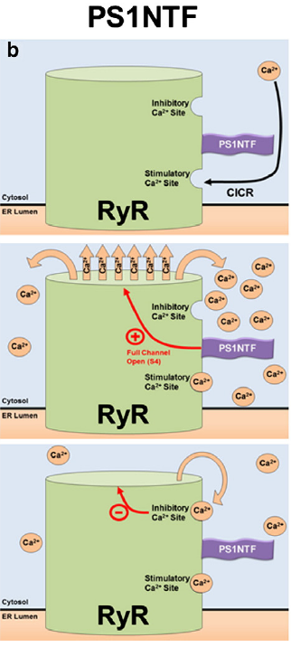
PS1NTF increases channel opening, causing rapid Ca²⁺ release.
The increased rate of Ca²⁺ release results in an overall reduced Ca²⁺ release as inhibitory concentrations are reached faster.

Slide 15
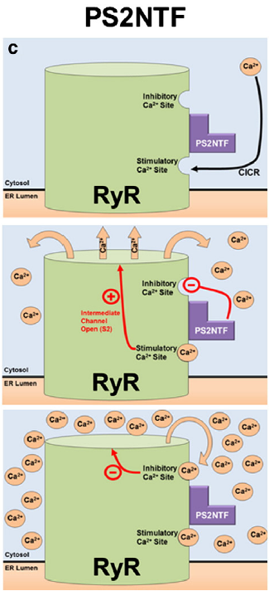
Proposed mechanism
PS2NTF has no effect on channel gating but blocks Ca²⁺ inhibition of the RyR channel at high cytosolic Ca²⁺ concentrations.
Significantly elevated cytosolic Ca²⁺ concentrations lead to eventual binding of Ca²⁺ at the low affinity inhibitory site, closing the channel and resulting in an overall higher cytosolic Ca²⁺ concentration.

Slide 16

Presenilins in “healthy” aging
Aged wild-type C57/B6 mice
6 months vs. 24 months
Advantages:
  Established non-genetic, inbred model
  Closely mimics human condition
  Many transgenic strains are based on B6 background
  Mild phenotypes compared with genetic models
Experimental approach:
  Behavioral characterization
  Quantification of Ca²⁺ signaling pathways
  Correlation between Ca²⁺ signaling molecules and behavioral phenotypes

Slide 17
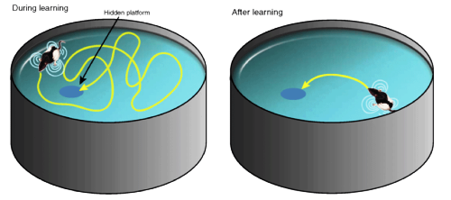
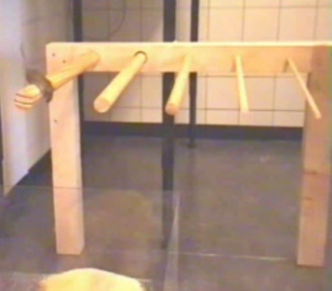
Behavioral paradigms
Water maze test
Bridge walking test
Assess spatial learning and memory
Areas involved: cortical
Measures: speed, latency, pathlength
Learning Index
Assesses motor function and fine tuning
Areas involved: cerebellum
Measures: Latency to Fall (LTF); time limit: 60 sec
Latency to Fall (LTF)

Slide 18
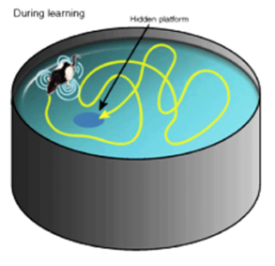
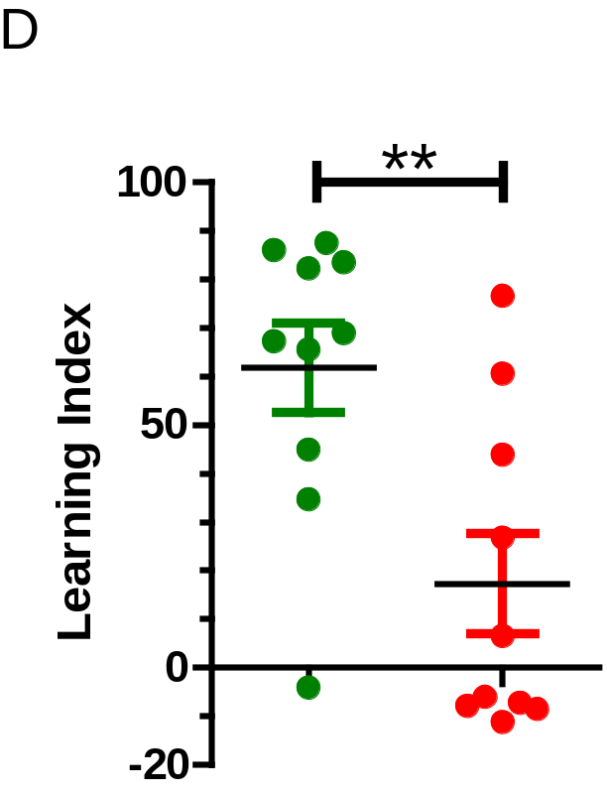
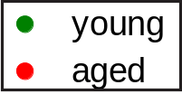
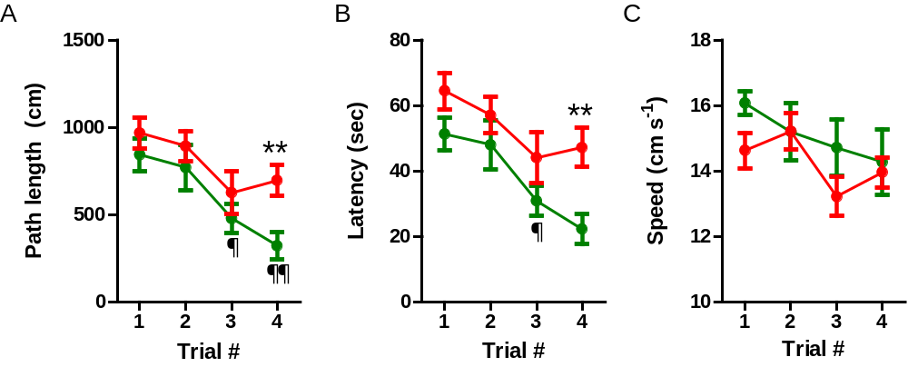
Impaired spatial learning & memory with age

Slide 19

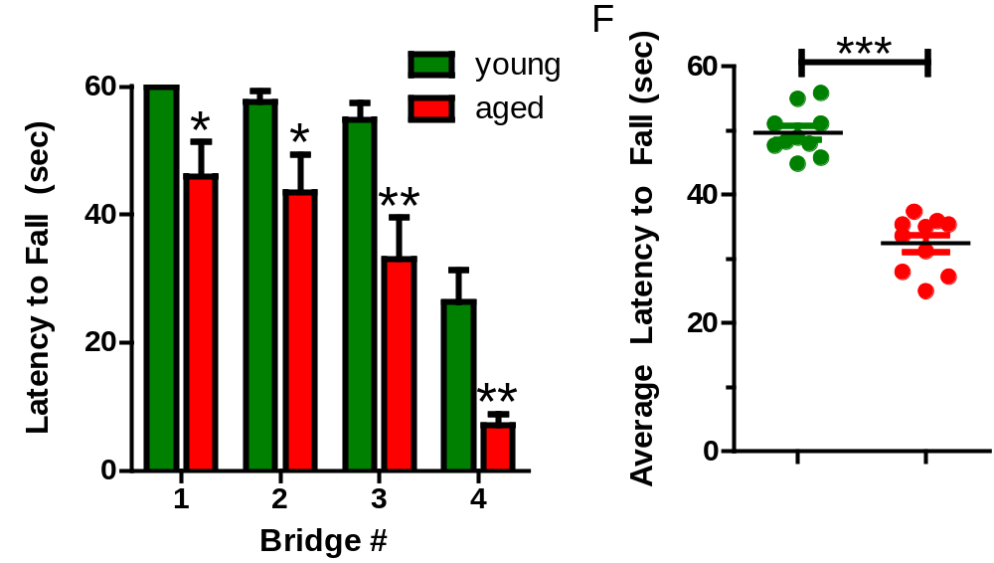
Impaired motor function with age

Slide 20
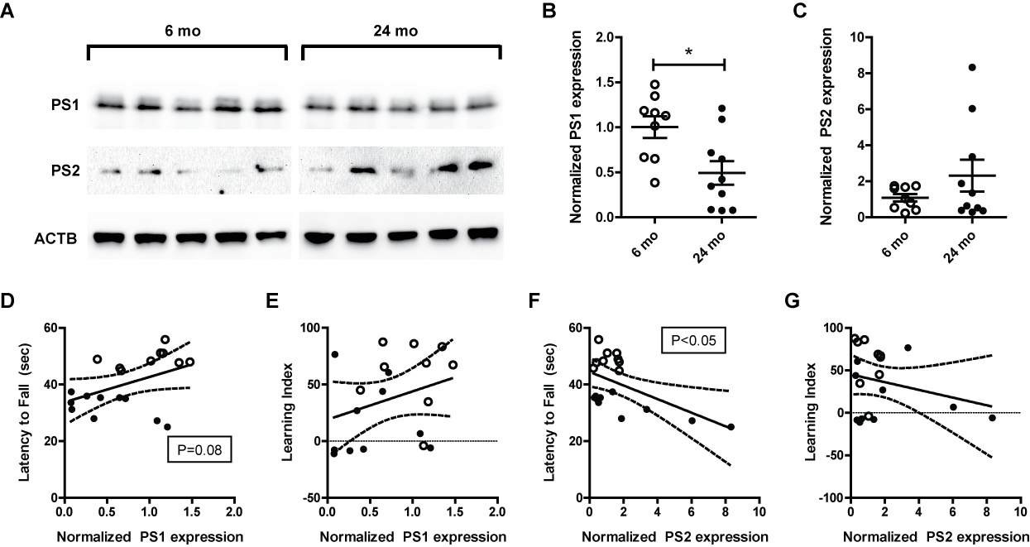
Increased in PS2 in aged cerebellum

Slide 21
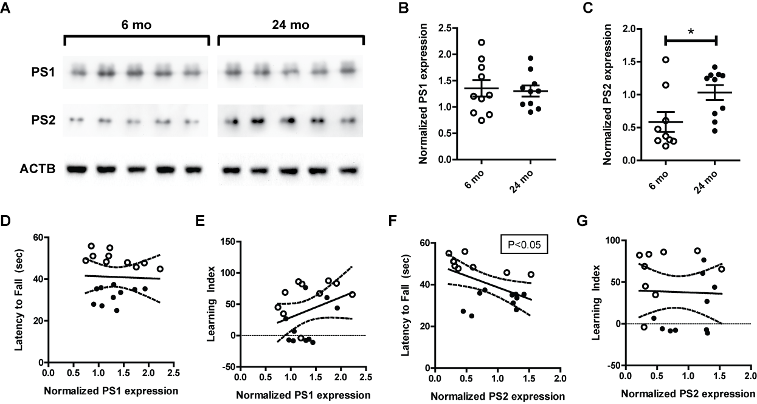
Increased PS levels in aged forebrain

Slide 22
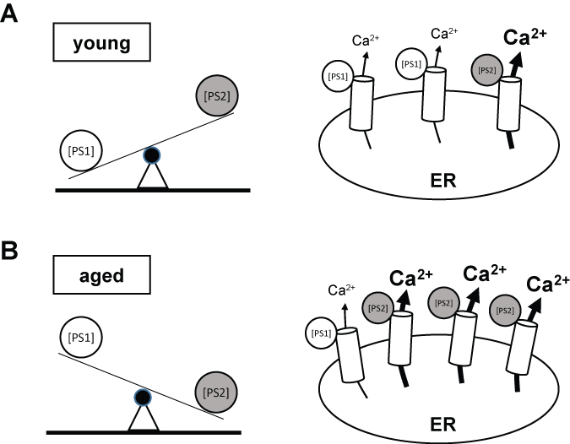
Proposed mechanism

Slide 23
Conclusions
Presenilins are potent modulators of intracellular RyR calcium channels
  The N-terminal fragment of PS increases RyR-mediated calcium release through a direct mechanism
The ratio of PS1 to PS2 is decreased in the aging brain
  Increased PS2 levels correlate with motor function deficits and cognitive decline
PS2 likely contributes to AD pathogenesis when increased cytosolic calcium concentrations are present.
Our data supports a role of PS proteins as part of both the calcium hypothesis and the Aβ hypothesis of AD.
PS proteins represent novel drug targets for neuroprotection and modulation of the intracellular calcium concentration.

Slide 24




Acknowledgements
UMKC School of Medicine
Vision Research Center
Peter Koulen, Ph.D.
Andrew Payne, Ph.D.
Bryan Gerdes, B.S.
Yuliya Naumchuk, B.S.
Students:
Imran Puthawala
Vidhi V. Shah
Alexandra N. Maynard
Audrey E. McCalley
Collaborators
University of Missouri – Kansas City
Nilofer Qureshi, Ph.D.
Asaf Qureshi, Ph.D.
Charles Van Way III, M.D.
Ann Smith, Ph.D.
University of North Texas
Michael Forster, Ph.D.
Nathalie Sumien, Ph.D.

