Slide 1

Impact of Myriad Decisions on Patent Eligibility of Biotechnology Inventions in Australia and the US
Simon Potter (PhD)
Australian & New Zealand Patent Attorney
Chemical/Life Sciences Team (Principal)
E: Simon.Potter@spruson.com
Notes:
Sparing Time
Sparing time who we are and what we can offer
I’m Simon Potter.
Principal
Colleague Lee Morrisroe
Background in medical research
PhD in HIV
Postdoc at Pasteur
great living in Paris
Coping with lab meetings and seminars in French **********

Slide 2




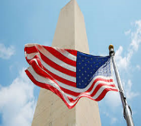
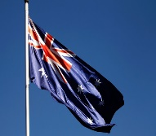
PATENTS
VACCINES
Notes:
Discuss with you today
who we are*****
benefits **** and value of working with Sprusons ****
interesting things about Australian patent law ****
raising the bar legislation****
Integration of AU and NZ patent systems****
Update on the Myriad genetics *****

Slide 3
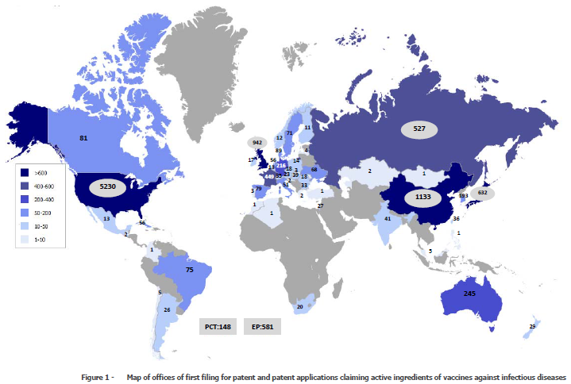
PATENTS
VACCINES
WIPO - 2012
Notes:
Here’s some statistics on our firm…
One of oldest and largest IP firm in AU ****

Slide 4
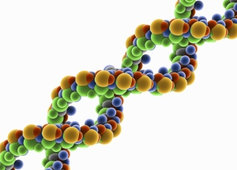
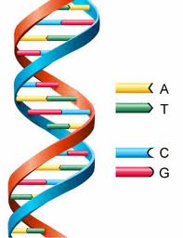
GENE PATENTS
“…to make, hire, sell (or otherwise dispose of) the product, offer to make, sell, hire (or otherwise dispose of) it, use and import it and keep it for the purpose of doing any of those things”
Gene Claim
“excludes others from synthesizing the gene..."
“excludes others from selling the gene in a product …"
“excludes others from using the gene for any purpose…"

Slide 5
GENE PATENTS
CLAIMS
1. An isolated polynucleotide comprising a nucleotide sequence set out in SEQ ID NO: 1 or a variant or a fragment thereof.
2. An isolated polypeptide encoded by the polynucleotide of claim 1.
3. A method for diagnosing a disease in a subject, the method comprising detecting levels of the polynucleotide of claim 1 or the polypeptide of claim 2 in a biological sample from the subject, wherein detection of increased levels compared to a control is indicative of the disease.
4. A pharmaceutical composition comprising the polynucleotide of claim 1 or the polypeptide of claim 2, and a pharmaceutically acceptable carrier.
5. A method for treating a disease in a subject, the method comprising administering to the subject a therapeutically effective amount of the pharmaceutical composition of claim 3.
Notes:
only AU firm with extensive Asian network.
several offices throughout the region ****

Slide 6
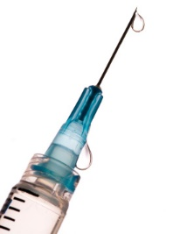
VACCINE PATENTS
CLAIMS
1. A vaccine comprising a pharmaceutically acceptable carrier and a polypeptide comprising an amino acid sequence set out in SEQ ID NO: 1.
1. A vaccine comprising an irradiated microorganism ‘X’ and a pharmaceutically acceptable carrier.
1. A vaccine comprising microorganism ‘X’ and a pharmaceutically acceptable carrier, wherein the microorganism is attenuated by a mutation introduced into gene ‘Y’.
2. A method for preventing a disease in a subject, the method comprising administering the vaccine of claim 1 to the subject.
Notes:
Sydney 180 staff
services AU, NZ south pacific region****

Slide 7
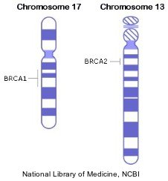
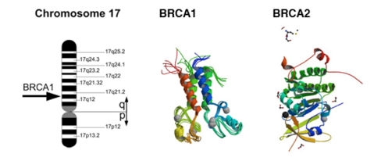
Notes:
SG 120 staff
service Asia from there.
Couldn’t justify rent in Marina Bay Sands
Remain close by
office in KL and opened in Shanghai recently****

Slide 8

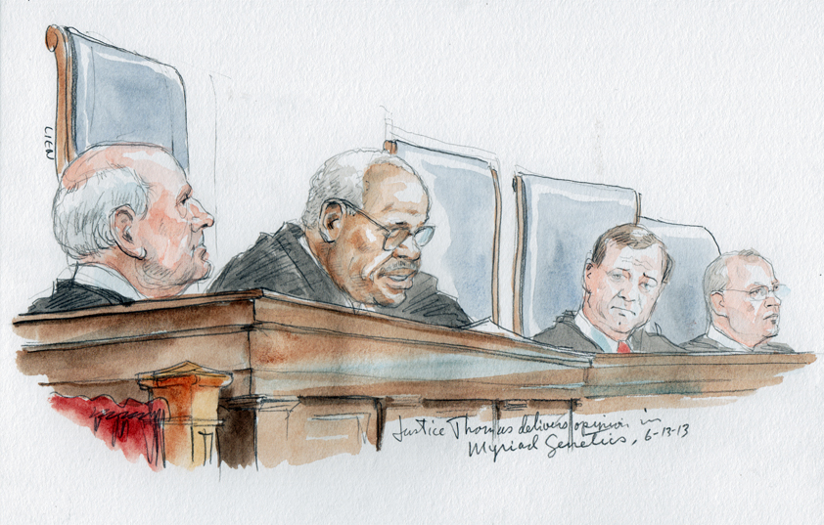
“We merely hold that genes and the information they encode are not patent eligible under §101 simply because they have been isolated from the surrounding genetic material.”
Notes:
BENEFITS from using Sprusons
considerable local knowledge extensive presence & experience in area
10,000 patent applications a year
carefully selected network of associates working under SG staff
Identified on reliability, quality, pricing, worked long time
leverage local knowledge from all over Asia via Singapore
Australia for more than 125 years/largest in Sydney
well placed in AU, NZ & South Pacific region.

Slide 9
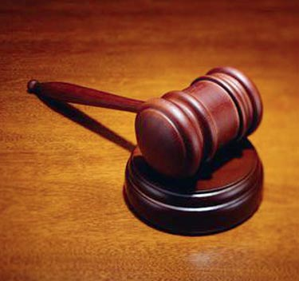






V
US Supreme Court
V
Federal Circuit Court
Of Appeals
V
Notes:
new office in Shanghai
Headed by a German-qualified
Over 15 years’ experience with Bayer
Lead IP department in Shanghai 5 years
familiar with the local market and issues****

Slide 10

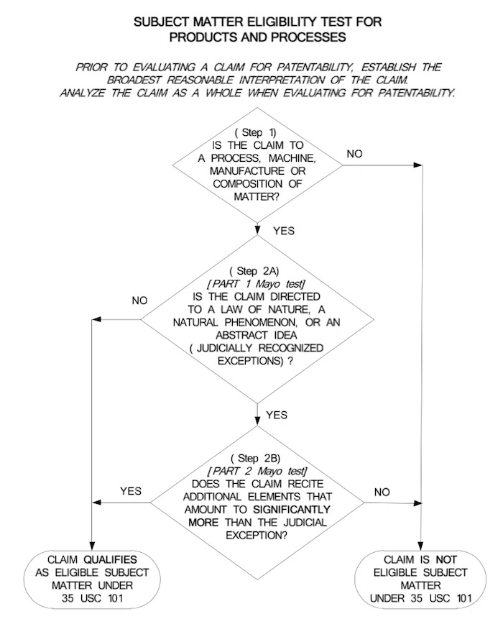
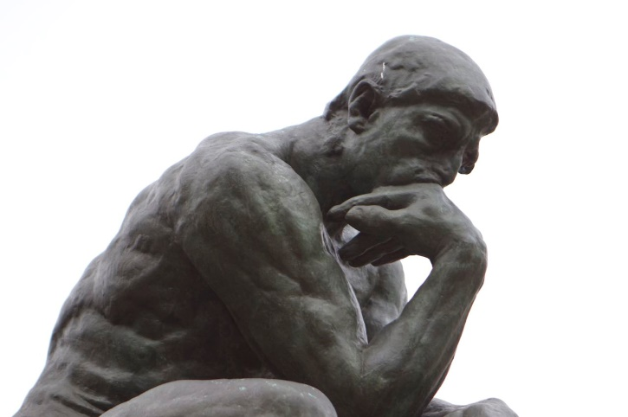

Slide 11

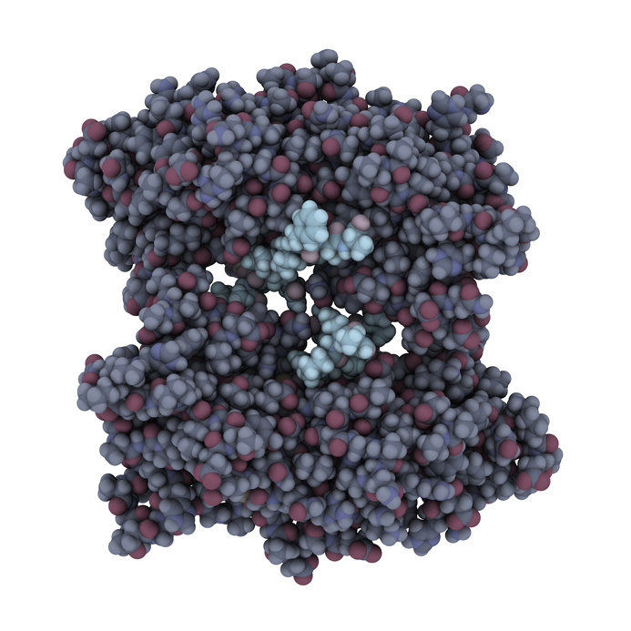
BRCA1
Notes:
BRCA1 foundation patent challenged in 2010
Sole ground
Isolated genes not a manner of manufacture *****

Slide 12
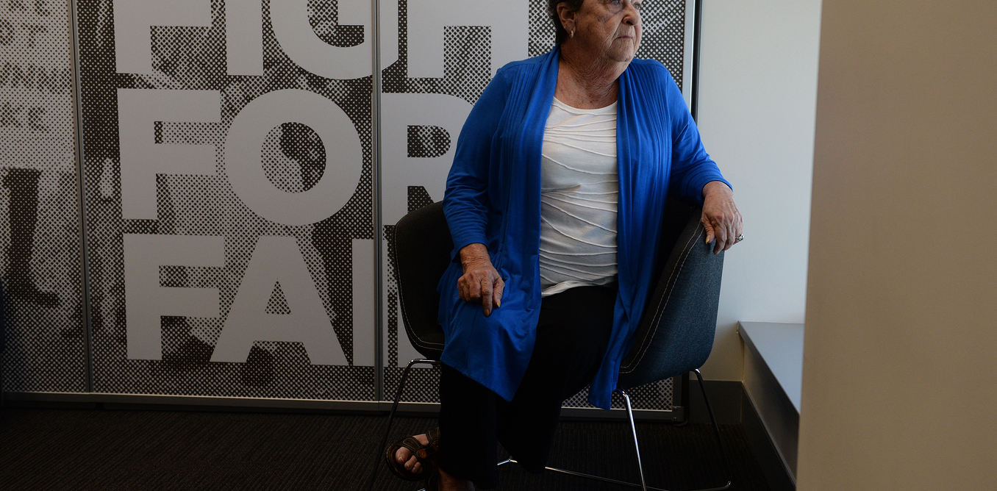

“A consideration of whether the composition of matter is a "product of nature"; or whether a microorganism is "markedly different" from something that already exists in nature.” –full federal court
“…the claimed product is not the same as the naturally occurring product. There are structural differences but, more importantly, there are functional differences because of isolation.” - full federal court
Yvonne D’Arcy
Notes:
Action launched Yvonne Darcy/Cancer Voices Australia
First instance federal court judge:
Isolation of gene = human intervention
NRDC case test for MoM satisfied
Appeal to full federal court (5 judges) considered biological materials more generally ****
held structural and functional differences arise from isolation
Judgment of US Supreme court considered
not relevant - tests for patent eligible subject matter differ ****
No “markedly different” test
Bill rejected

Slide 13
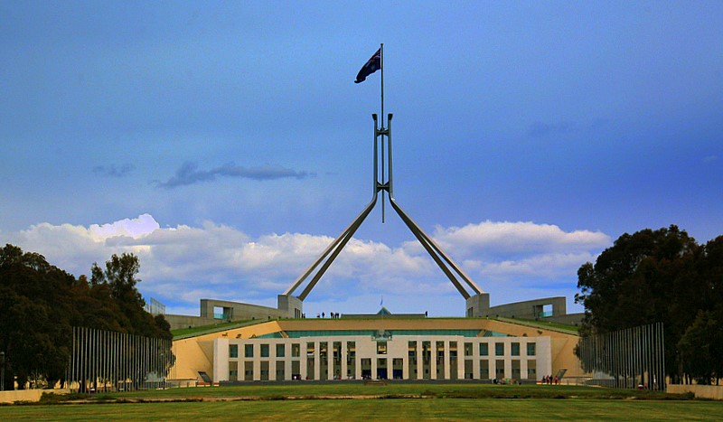

Slide 14
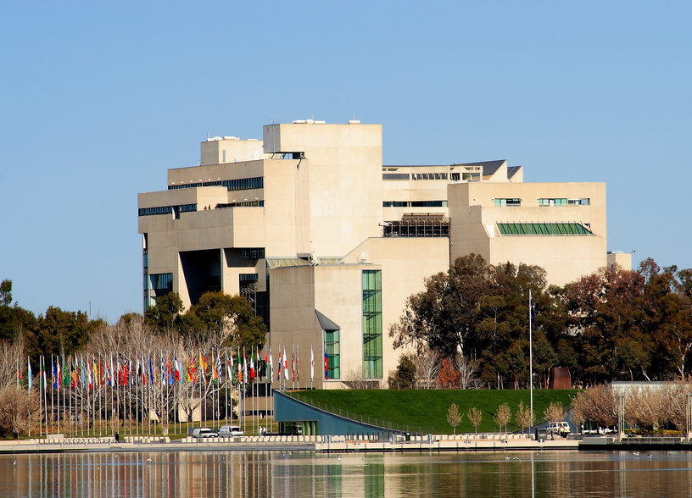
Notes:
HC Feb 2015 leave to appeal

Slide 15


Slide 16

Simon Potter (PhD)
Australian & New Zealand Patent Attorney
Chemical/Life Sciences Team (Principal)
E: Simon.Potter@spruson.com

