Slide 1

The role of complement factor H-like and factor H-related proteins in age-related macular degeneration
Dr. Simon J. Clark
MRC Career Development Fellow
Centre for Ophthalmology and Vision Sciences
University of Manchester

Slide 2
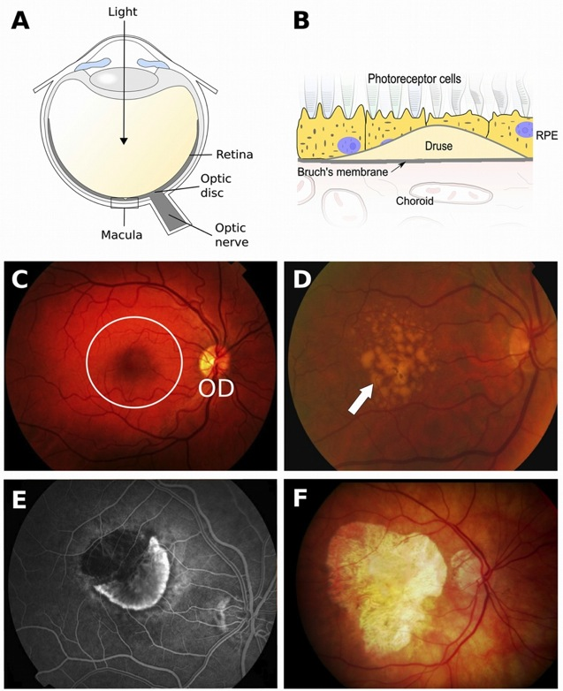
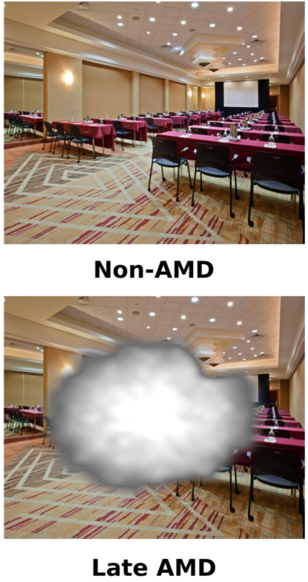
Age-related macular degeneration (AMD)
Largest cause of blindness in developed world. ~50 million people affected worldwide
Occurs around 50 y.o. - Incidence will only ever increase with burgeoning elderly population
Progressive destruction of the retina, preceded by hallmark lesions (drusen), leading to central vision loss
Healthy
Early AMD (drusen)
Anti-VEGF treatment for ‘wet’ AMD, only halts damage already suffered
No effective treatments for ‘dry’ AMD
Black and Clark (2015) Genet. Med. online 28th May
Choroidal Neovascularisation
Geographic atrophy

Slide 3
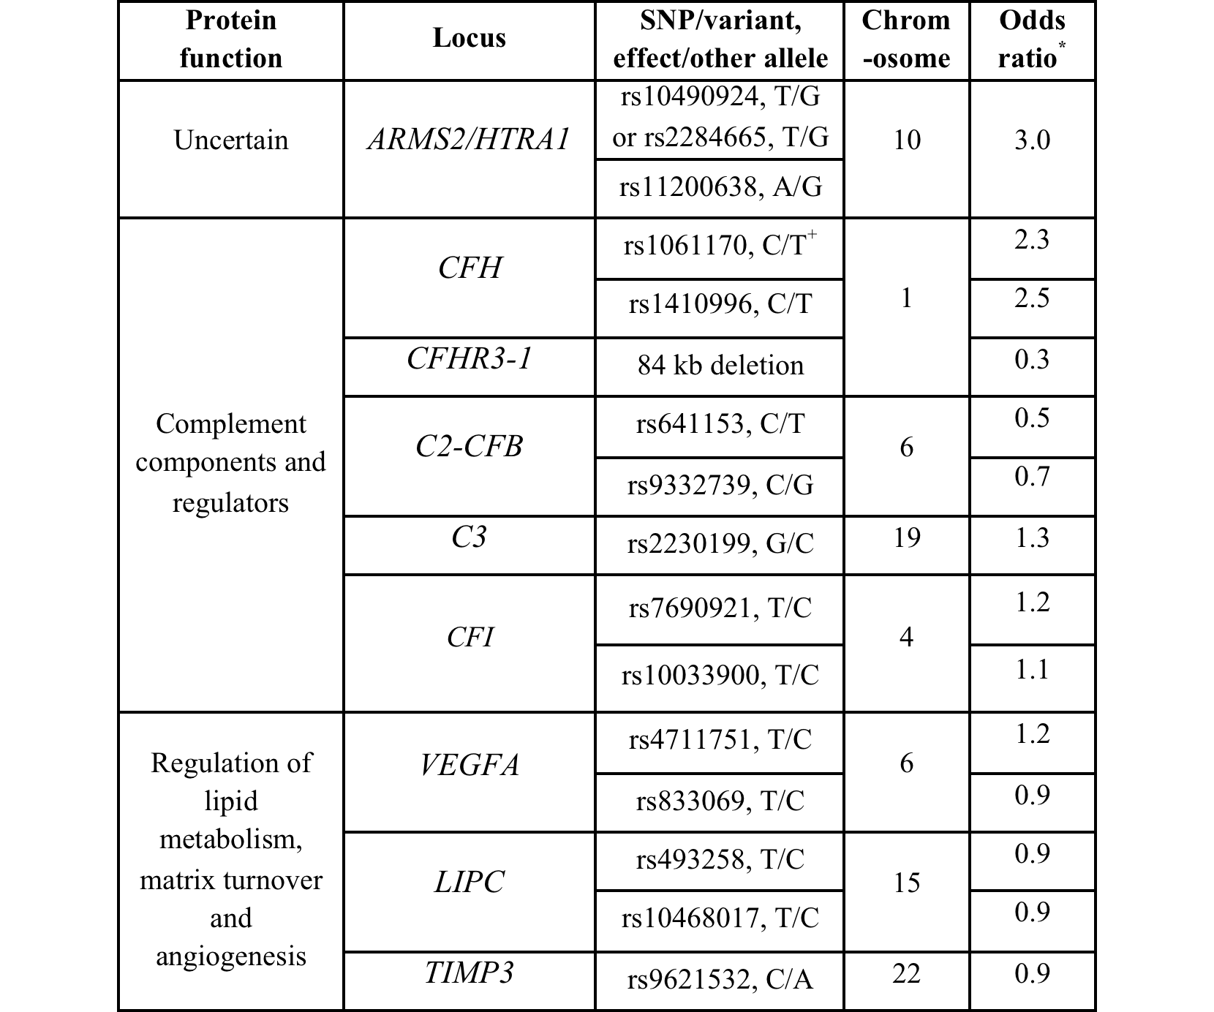
AMD – risk factors
Risk factors include environment (i.e. diet, smoking) but is essentially a genetically-driven disease

Slide 4
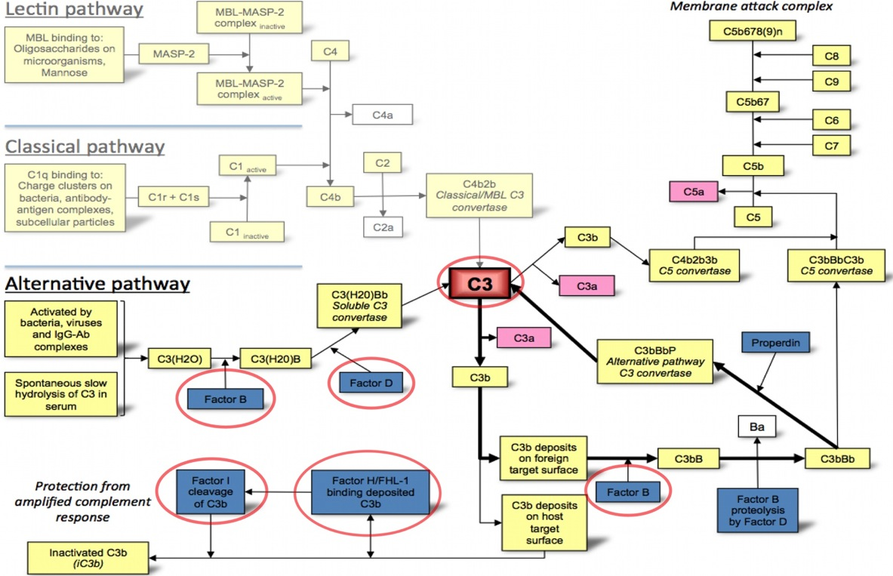
Alternative pathway of complement activation
McHarg S et al. (2015) Mol. Immunol. 67, 43-50.

Slide 5




The alternative pathway of complement
Complement factor H
C3b
C3b
-
-
polyanions
Non-activator (host)
surface
Activator
(non-host) surface
C3
FI
C3b
FB
C3bBb
C3b
C3b
C3b
C3b
C3bBb
C3b
C3b
C3b
iC3b
C3b
C3b
C3b
C3b
Inflammation
MAC formation
Phagocytosis
Phagocytosis
MAC formation

Slide 6
AMD – risk factors
Clark S.J. and Bishop P.N. (2015) J. Clin. Med. 3

Slide 7
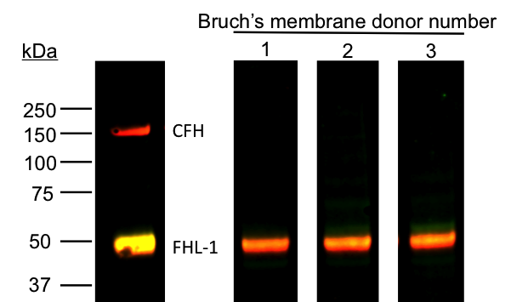
Recent discovery about the role of FHL-1
Recently identified that Factor H-like protein 1 (FHL-1) concentrates on Bruch’s membrane
Still able to regulate complement but to date no one has worried about elucidating the level of involvement in immune regulation
RPE
Bruch’s membrane
Choroid
Green = FHL-1 Red = FH
Clark S.J. et al. (2014) J. Immunol. 193, 4962-4970.

Slide 8
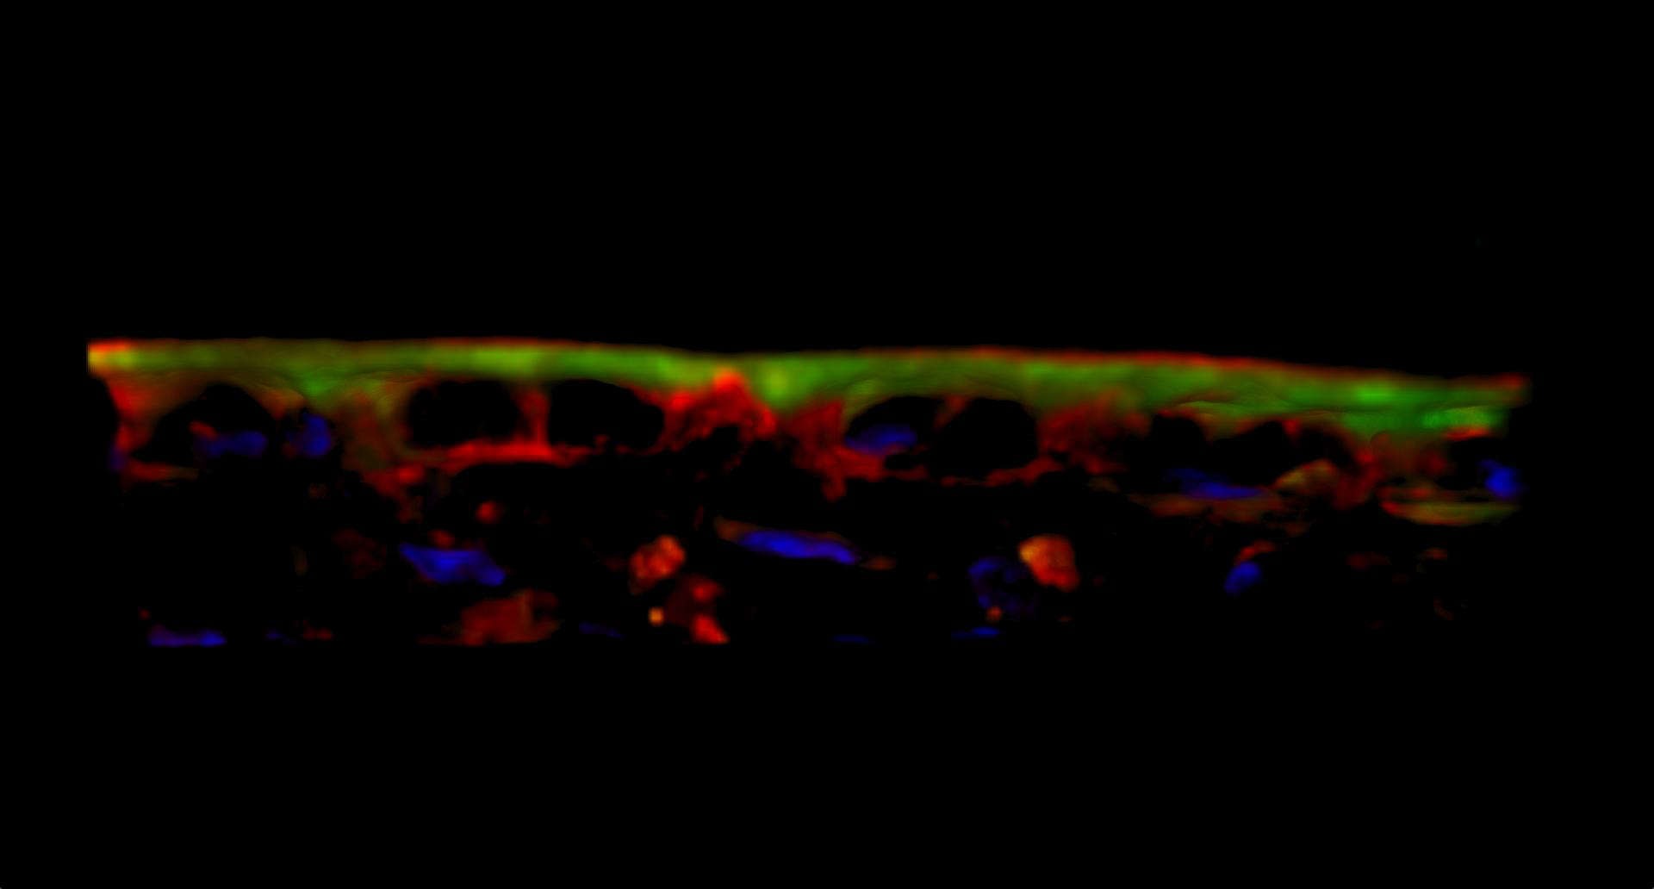
The role of FHL-1 Green = FHL-1 Red = FH

Slide 9
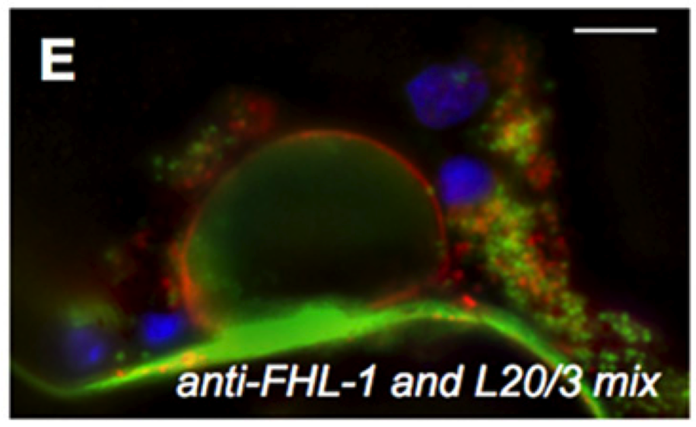
Curiously, FH seems to coat drusen
The FH that is secreted by the RPE cells ‘coats’ drusen that form in Bruch’s membrane
FH
FHL-1
Clark S.J. et al. (2014) J. Immunol. 193, 4962-4970.

Slide 10
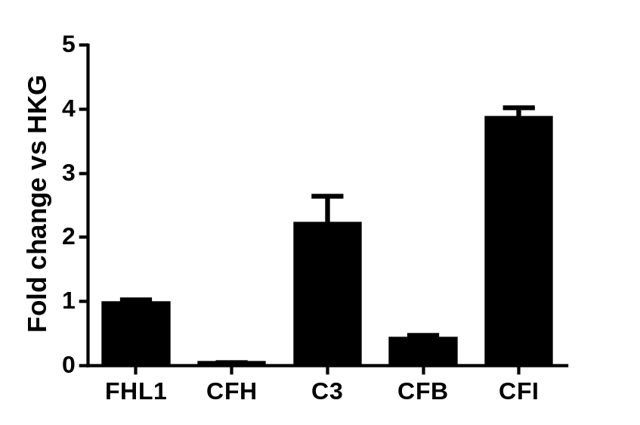









FHL-1 is locally expressed by RPE cells
First to demonstrate that FHL-1 is locally expressed by the RPE cells in human eyes
Liver
Neg. ctrl
Liver
Neg. ctrl
RPE
RPE
C3
Best-1
CFB
RPE65
CFI
FHL-1
B-actin
CFH
TBP
Clark S.J. et al. (2014) J. Immunol. 193, 4962-4970.

Slide 11
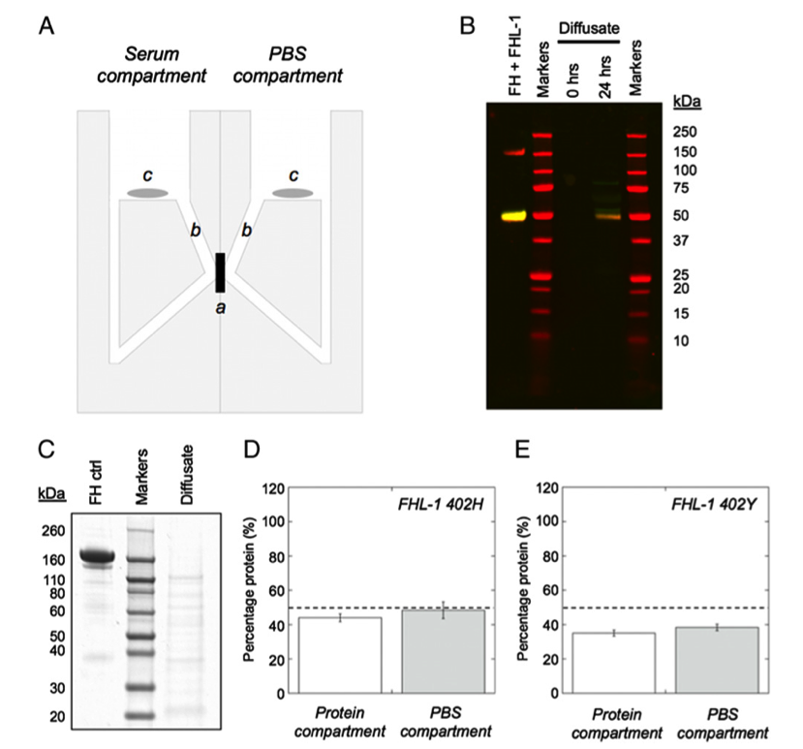
FHL-1 can diffuse through Bruch’s (FH can not)
First to demonstrate that FHL-1 can passively diffuse through Bruch’s membrane, and that FH can not
Noted that virtually no AMD-associated form of FHL-1 (402H) was retained by the Bruch’s membrane
  i.e. not being recruited, therefore not able to protect against complement attack
Clark S.J. et al. (2014) J. Immunol. 193, 4962-4970.

Slide 12
What about the factor H-related (FHR) proteins?
One major problem with investigating complement in AMD – it was still virtually impossible to distinguish between FH, FHL-1 and the 5 FHR proteins in tissue
?
?

Slide 13
Targeted mass spectrometry
We have identified an enzyme that will cleave FH, FHL-1 and FHR1-5 and produce (at least one) unique peptide(s) identifiable by mass spectrometry.
Selected Reaction Monitoring MS (SRM-MS) detects peptides using a defined (peptide specific) mass pair i.e. mass of peptide plus one of its fragments (calculated from peptide sequence).
m/z 673.2
m/z 624.2
Detector
Q1
Q3
We have had each of thee synthesized and used them to develop targeted mass spectrometry methodology that can detect all 7 proteins in tissue
  Begun work on Bruch’s membrane
  Radiolabeling our standard peptides will make technique quantifiable

Slide 14
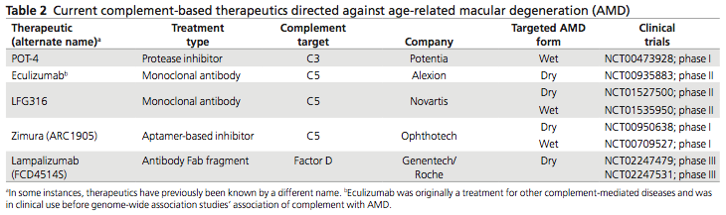
Therapeutic potential
Complement is very much a focus for novel therapeutic strategies to address AMD
A number of complement modulating therapies currently in various stages of clinical trial with a range of results
Black and Clark (2015) Genet. Med. online 28th May

Slide 15
Manchester Eye Tissue Repository (ETR)
To support eye research in Manchester we generated a unique resource of human eye tissues
Manchester Royal Eye Hospital Eye Bank
  2000 pairs of eyes per year for corneal transplantation service
  Remaining globes now given to ETR
Collect medical record data, phenotype for retinal dystrophies, genotyped (AMD only), dissect and store virtually all aspects of the eye:
  Sclera; optic nerve; vitreous; neurosensory retina; Bruch’s membrane; choroid; remaining DNA from genotyping, culturing RPE cells
  Also macular and peripheral biopsy punches for IHC

Slide 16
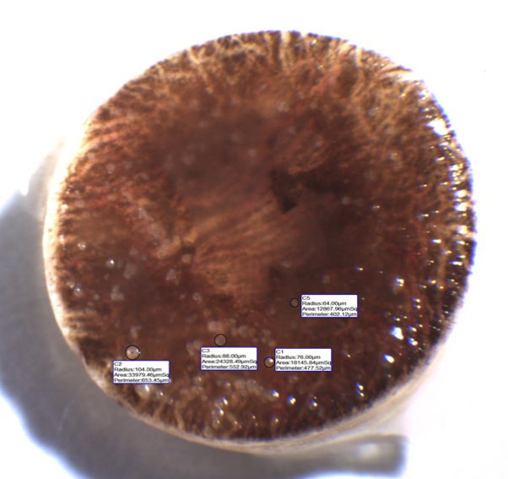
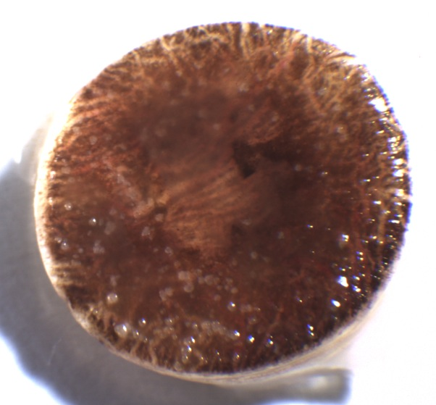
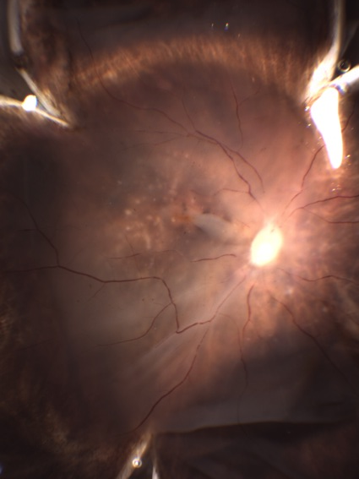
Manchester Eye Tissue Repository (ETR)
Drusen
GA
Hoping to open the facility to other researchers who are working on ocular disease

Slide 17
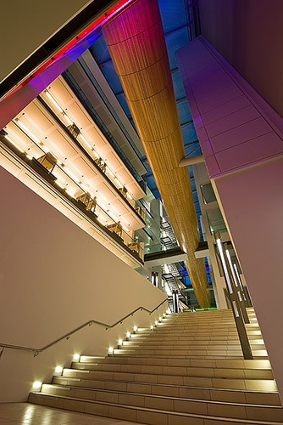



Acknowledgements
Prof. Paul Bishop (director, Centre for Vision Sciences)
Dr. Selina McHarg (Manchester, UK)
Ms. Nicole Brace (Manchester, UK)
Ms. Laura Fleming (Manchester, UK)
Prof. Garth Cooper (director, CADET)
Dr. Richard Unwin (CADET)
Dr. Isabel Riba garcia (CADET)
Dr. Isaac Zambrano (director, Manchester Eye Bank)
Prof. Graeme Black (director, Centre for Genomic Medicine)
Prof. Tony Day (Manchester, UK)
Christoph Schmidt (Ulm, Germany)
Paul Morgan (Cardiff, UK)

Slide 18
Bruch’s membrane
Bruch’s membrane is an acellular extracellular matrix (ECM) that supports the retinal pigment epithelium (RPE) cells, and subsequently the neurosensory retina.
Bruch’s membrane helps filter nutrients from the choroid that help nourish the RPC cells, but also helps keep out unwanted material/cells.
Clark and Bishop (2015) J. Clin. Med. 4, 18-31

Slide 19
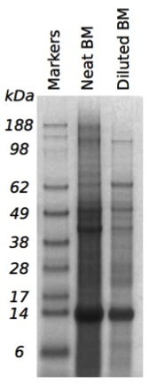
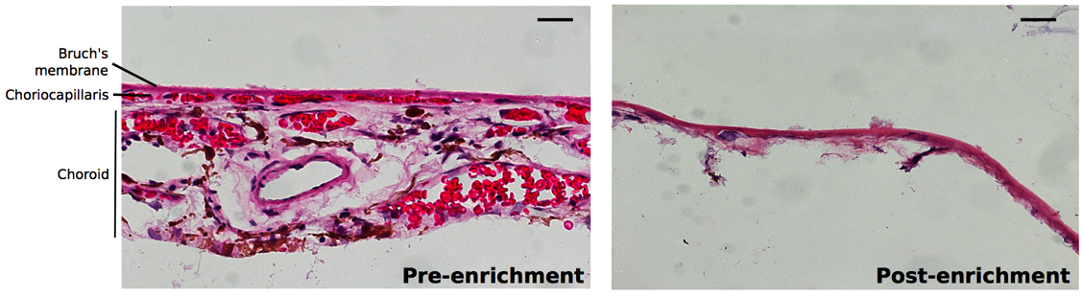
Enrichment of Bruch’s membrane
Publishing detailed method of how to enrich Bruch’s membrane
Can remove RPE, choroid and contaminating blood proteins
McHarg S et al. J. Vis. Exp. In press

Slide 20
Complement and Bruch’s membrane
Bruch’s membrane is one of only two ‘basement membrane’ ECM directly in contact with the body’s blood flow, without prior contact with cell barriers or tight junctions
  The other is the glomeruli basement membrane (GBM) in the kidney
Eye - macula
Kidney - glomeruli
Glomeruli
RPE
Bruch’s membrane
Choroid
Bowman’s capsule

