Slide 1

Quantitative Allergen Risk Assessment
Simon Flanagan
Senior Consultant - Food Safety Toxicology
Aug 2015

Slide 2
1169/2011 Voluntary Particulars
Article 36.3(a): Additional voluntary allergen labelling (“may contain” – information on the possible and unintentional presence of substances or products causing allergies or intolerances).
Covers the requirements for voluntary food information and the implementing measures that the European Commission needs to take on the application of the requirements.
Article 36.2 covers the general requirements that voluntary food information must meet:
  (a) it shall not mislead the consumer, as referred to in Article 7;
  (b) it shall not be ambiguous or confusing for the consumer; and
  (c) it shall, where appropriate, be based on relevant scientific data.
Notes:
Regulation has implementing acts which will allow different member states to specify phraseology of precautionary statements into regulatory framework at member state level and also as and when action levels are agreed to also include these
A key point here is that the contains box will now no longer be allowed – the fact that the allergens should now be highlighted in the ingredients list means that there should be no need for a separate contains box.
A lot of recalls have actually been caused by the fact that the ingredients listing was correct but the contains box was wrong – can be dangerous.

Slide 3
Hierarchy of Allergen Risks
Area of Concern | Potential Issue | Perceived Risk Level
Inaccurate consumer information (labelling / menu / verbal provision) | Undeclared allergens – Ingredient level contamination | High
Training | Skills & Awareness – potential undeclared allergen or cross-contamination | High
Management of ingredients | Undeclared allergens | High
Management of environment | Allergen cross-contamination | High
Effectiveness of cleaning | Allergen cross-contamination | Medium
Shared food contact surfaces & equipment | Allergen cross-contamination | Medium
Storage of ingredients | Allergen cross-contamination | Medium
Space constraints in preparation areas | Allergen cross-contamination | Medium
Traffic patterns | Allergen cross-contamination | Low
Notes:
If we then look at the hierarchy of allergen risks you will see that the greatest risk to the consumer is receiving ingredient level amounts of contamination
When ever we work with clients – first area covered is label management or other systems used to provide information to the consumer, menus, recipe cards etc.
As we move down through the list the potential amount of allergen delivered to the consumer decreases – trace verse ingredient levels
Highlight that there are no internationally agreed levels for safe levels of allergen contamination or levels to differentiate between trace and ingredient level contamination
We will be working through some practical examples in our workshop this afternoon……….

Slide 4
Conventional Risk Assessment - Definitions (HSE 2009)
Risk assessment – the semi-quantitative (or, in exceptional circumstances, quantitative) estimation of whether a hazard is likely to occur in practice; normally expressed as a risk factor or score by multiplying the hazard severity score by a likelihood score (unlikely (score 1), likely (score 2) or very likely (score 3)). All risk scores indicating other than low risk must be investigated and risk control/management procedures followed
Hazard – a substance etc. which has the potential to be harmful. Hazards are very varied… The severity of the hazard is determined by possible consequences; for risk assessment, the severity of hazards is scored on a simple three point scale: minor injury or effect (score 1), major injury or effect (score 2) or death (score 3).
Risk control/risk management – the means by which moderate or high risks identified through risk assessment are eliminated or reduced to acceptable levels
Notes:
Risk assessment is one of those phases that means different things to different people

Slide 5
Can We Apply To Allergen Risk Assessment?
Estimation of risk – subjective
Likelihood score – subjective
Severity of hazard
  Depends on the allergenic ingredient
  Depends on sensitised individual
  Spectrum of reaction in sensitised population from mild (1) to death (3)
Risk management
  Eliminated (?) or reduced to acceptable level (?)
  Cannot completely eliminate risk
  What is an acceptable level (no thresholds)
Notes:
Taking those definitions can we apply to allergen risk assessment?
Risk - unless you are sure that you still have traces left on the line that are visible, how can you estimate that it will go wrong?
Can we estimate risk from people / ingredients and equipment?

Slide 6
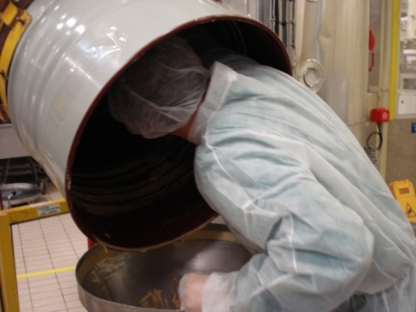
Pure HACCP Based Management Approach
System widely used for last 10+ years
Highly conservative – molecule hunting
Non-standardised approach resulted in;
  Paralysis – too difficult!
  Risk aversion – over labelling
  Managing all allergenic ingredients similarly
  Inappropriate levels of testing
  Inconsistent assessment of supply chain risk
  Increase in recalls/withdrawals
Notes:
Paralysis – maybe you have 10 allergens to manage?
Over labelling – the cabbage – may contain nuts!
Supply chain – self questionnaire – if a suplier declares a risk of may contain, do you carry that forward?

Slide 7
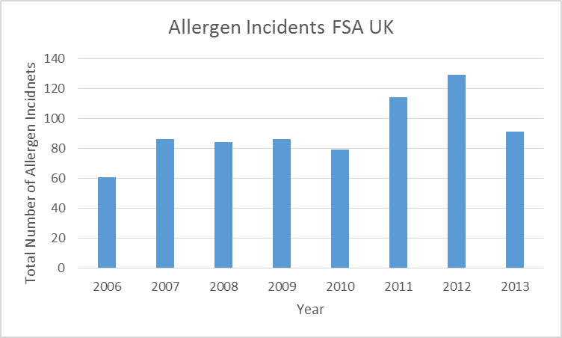
FSA Allergen Incidents
Common root cause 2008-2011 | Improvements needed
Inadequate training | Capability - allergen awareness/management
Packaging errors | Label management systems
Incorrect use of ingredients | Traceability and allergen visibility

Slide 8
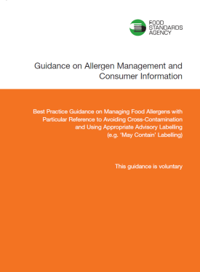
So How Do We Move Forward?
RSSL approach – Quantitative Risk Assessment Toolkit
Targeted risk assessments incorporating hazard characterisation
Evolution of 2006 FSA guidelines
Three-tier allergen mapping
Assessment of risks arising from the
following factors
  Process flow
  Environmental
  Production
  People
Rank risk probability against characterised hazard
Output drives allergen management or labelling
Notes:
Got to be pragmatic when we conduct the risk assessment and focus on high risk activities not chasing molecules around the factory
What is the next step for industry following the 2006 guidance
Need a form of quantitative risk assessment
Result from that will be “Do we need to manage or label?”

Slide 9
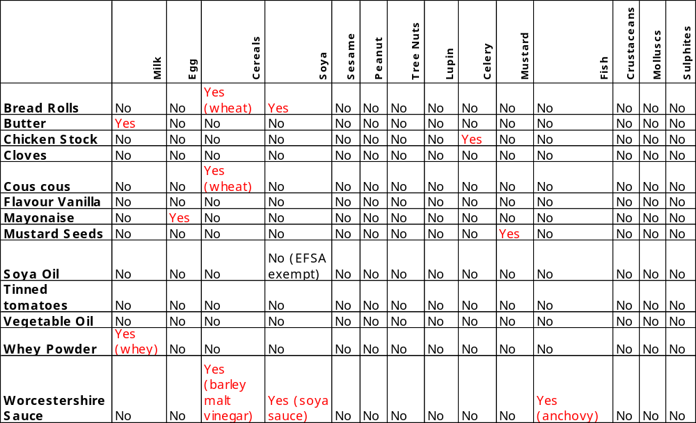
Allergen Mapping Level 1 Ingredient Matrix
Can choose to add an extra layer about possible cross contact from suppliers
Notes:
This is an example of good practice that tends to be used by larger business and
Many FBO’s have allergen information in a tabulated form, usually know as there ingredients matrix or specifications
This will also you to understand if the allergen under investigation is actually handled by the FBO
This is something that you will see in larger business or chains – maybe something much more basic in smaller business
Bare minimum for compliance would be to ensure that they have a system to retain current packaging so they have ingredients list to refer to if asked

Slide 10
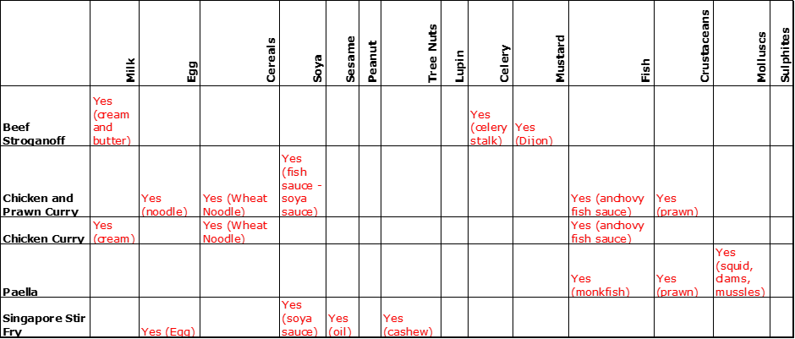
Allergen Mapping Level 2 – Recipe Matrix
Best practice to state the form of the allergen
Notes:
Best Practice - Ingredients matrix is then used to develop a recipe matrix so they know which allergens are in witch products or dishes
The allergic ingredients should be described in detail i.e. which component contains the allergen
This helps food service if a meal needs to be modified for someone with special dietary needs -
Again this may not be simpler for smaller operations – minimum compliance could be that each dish is prepared to a written recipe to give traceability back to ingredients

Slide 11
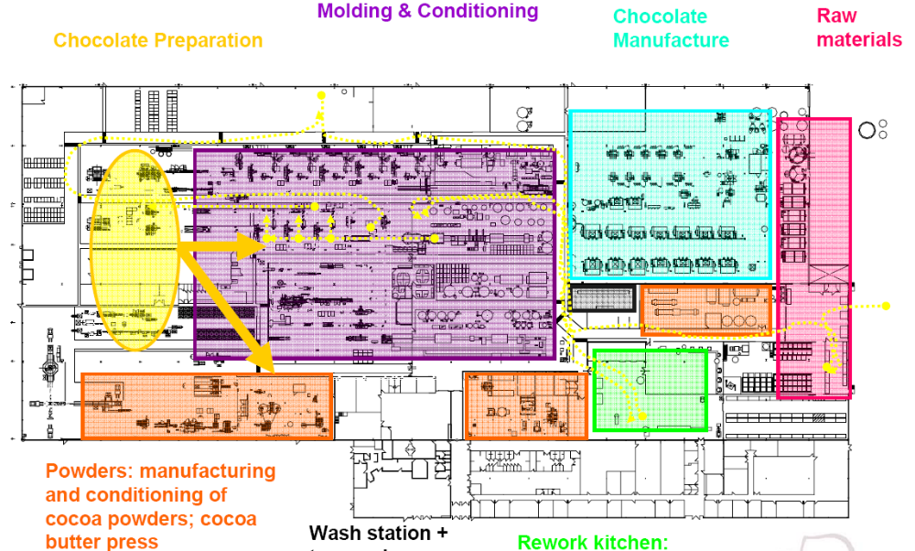
Allergen Mapping Level 3
Notes:
How does it move around the factory – one egg product in a chocolate factory
What are you trying to protect from what?

Slide 12
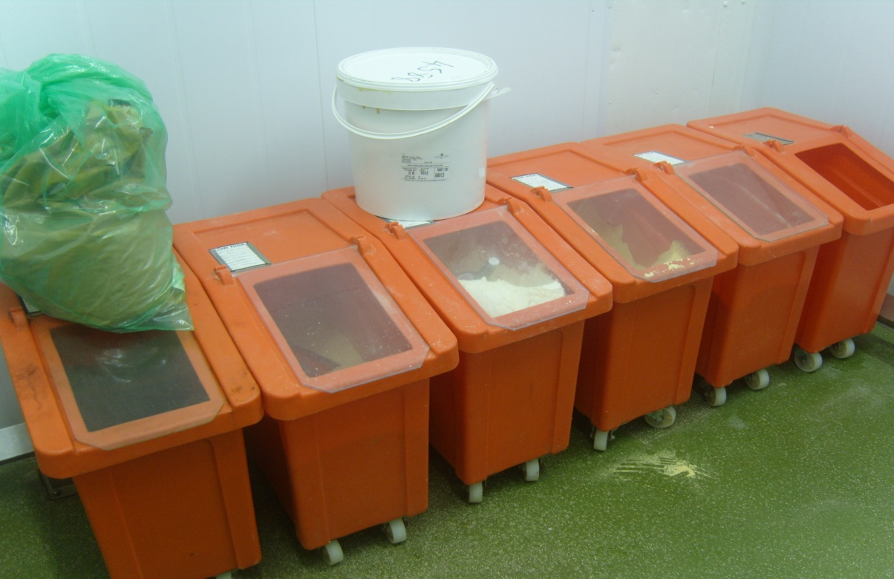
Process Flow
Notes:
Bins for dry allergens
Orange = allergens
2 scoops between all the bins
Control – either dedicated scoops or cleaning between use

Slide 13
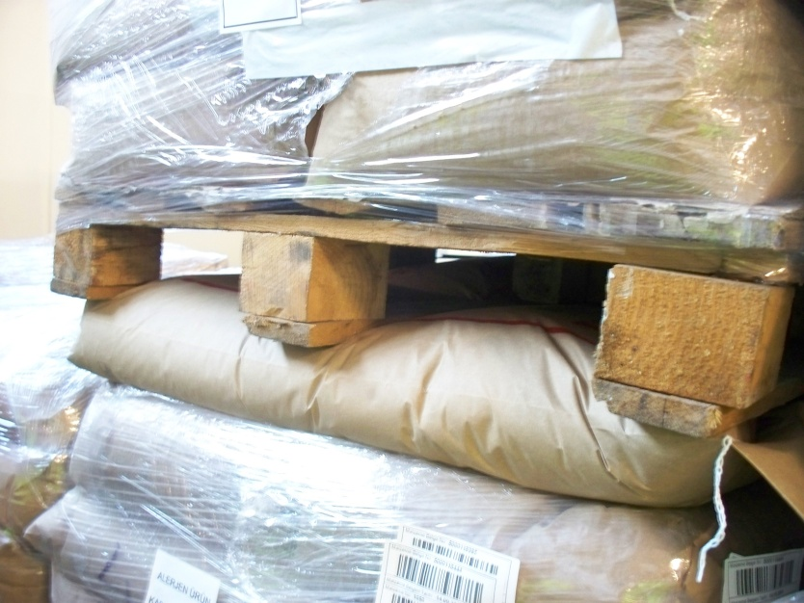
Environmental
Notes:
Milk powder between isomalt and cocoa powder

Slide 14
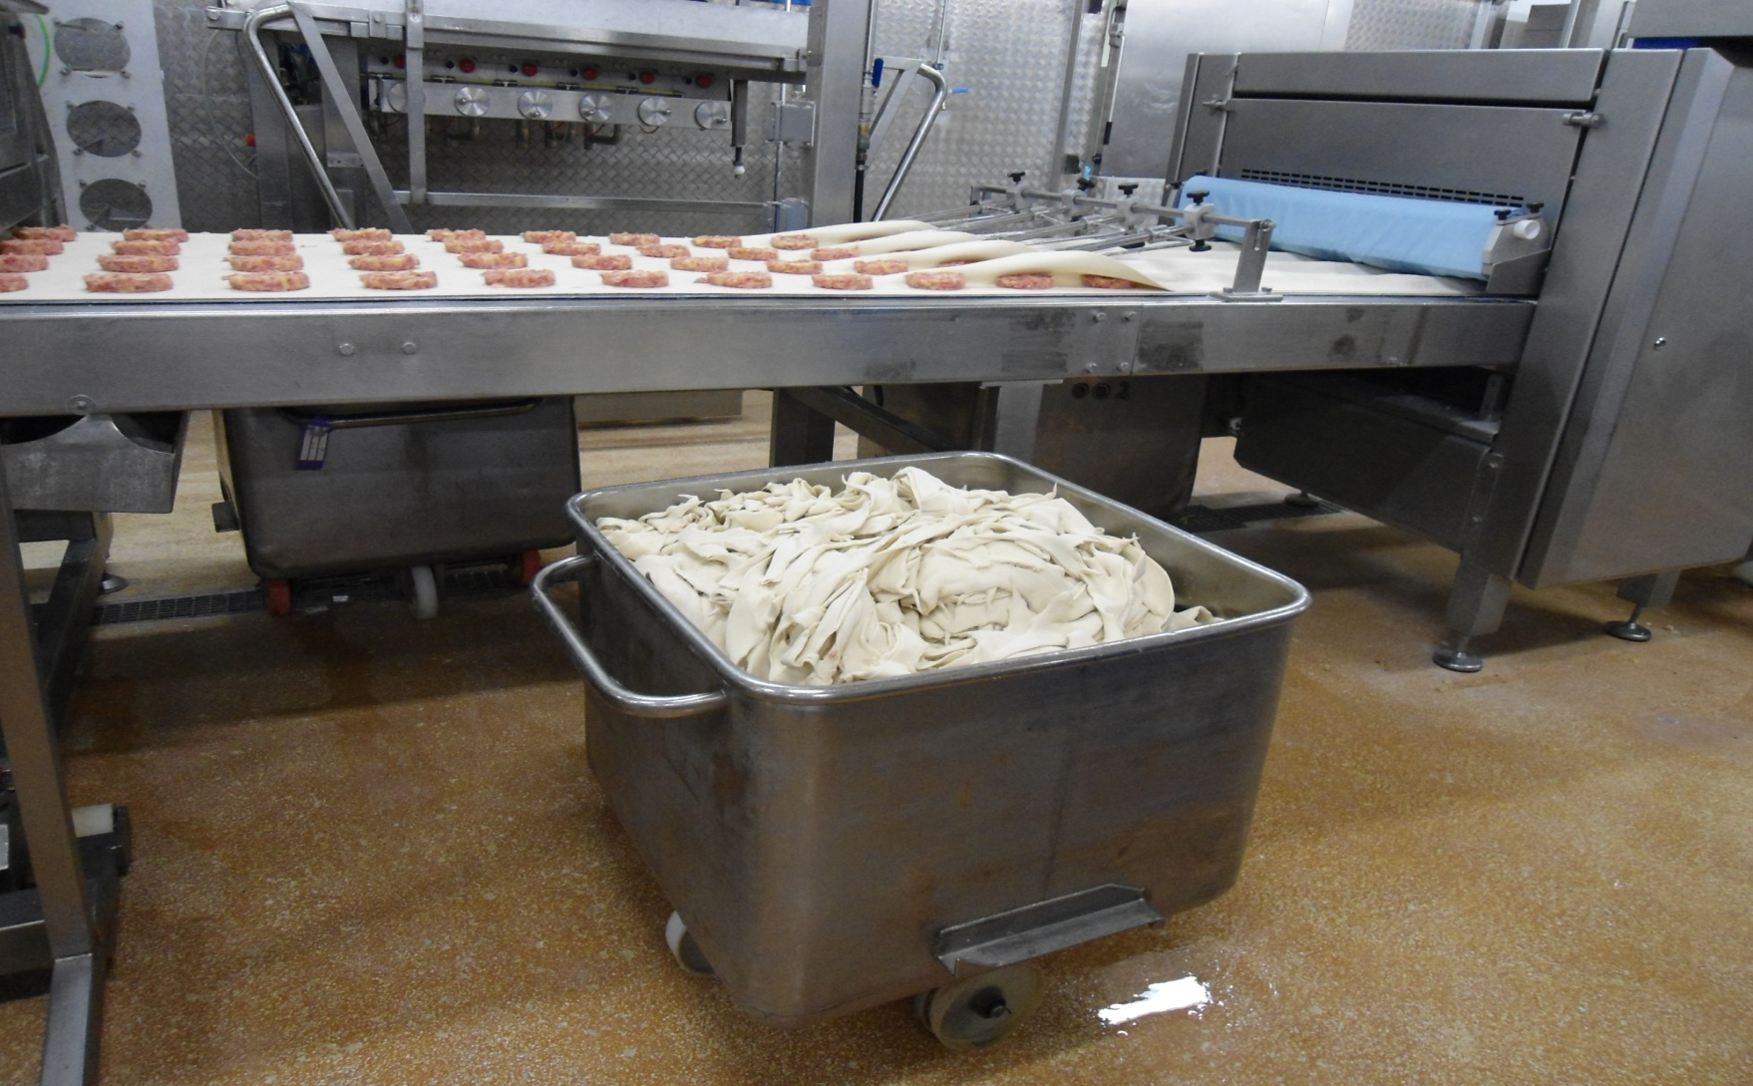
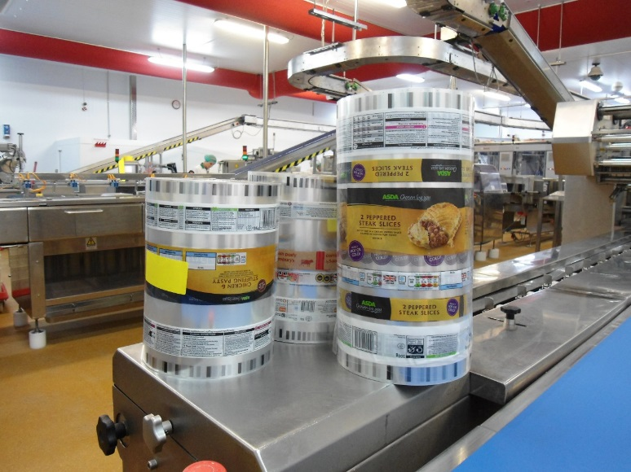
Production
Notes:
Re-work. Pastry re-work. Some containing mustard, some not

Slide 15
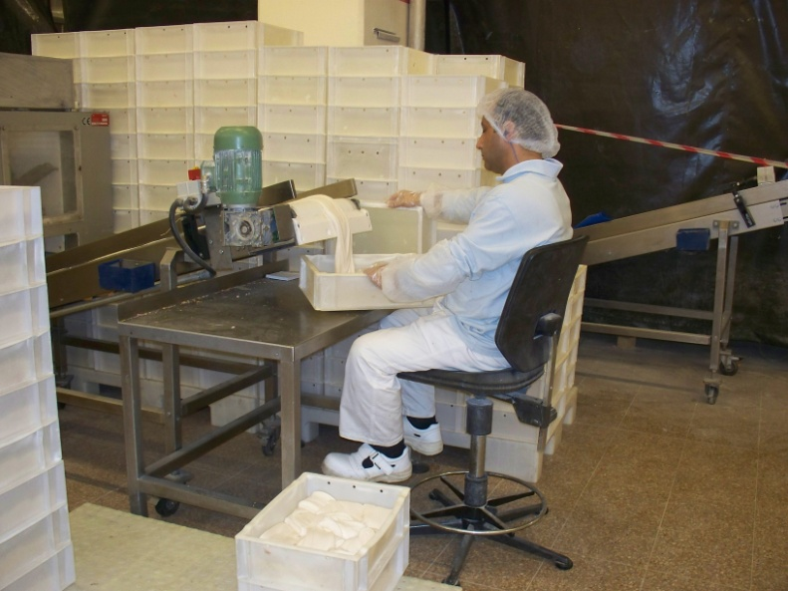
People
Notes:
Chews – containing milk protein – next line was no milk containing

Slide 16
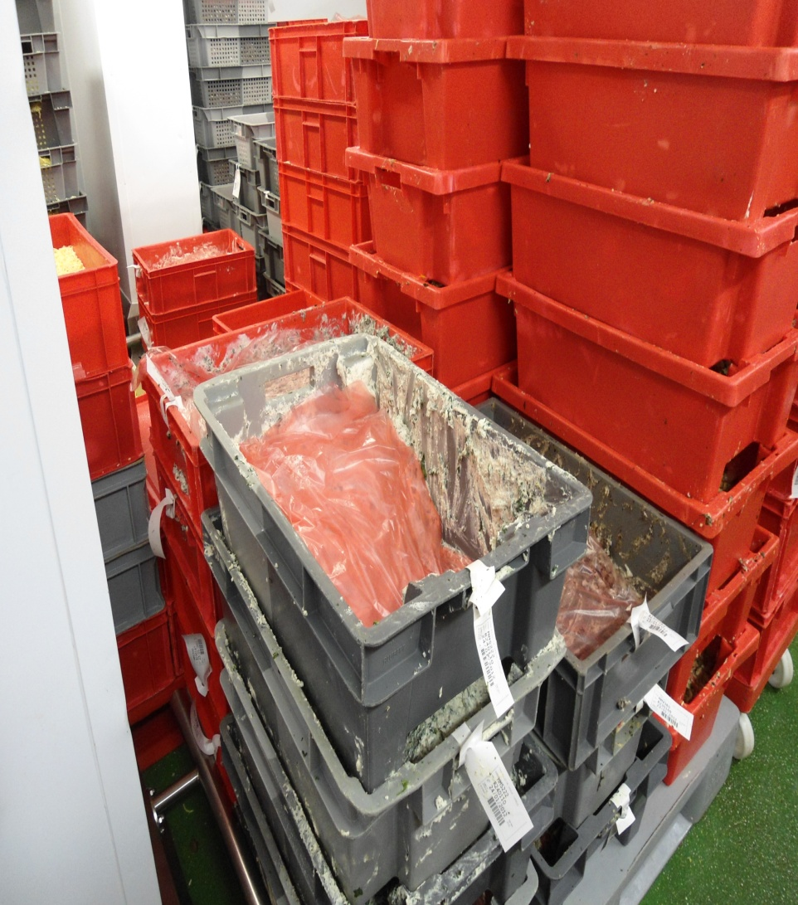
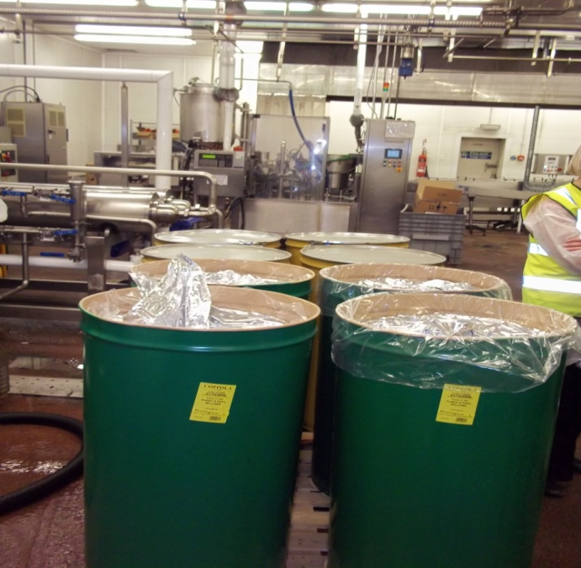
Probable Versus Remote
Notes:
Definition – probable is likely to happen under normal operating conditions
Left is part opened/ sealed packets of mixed materials
Right – go straight to line and a hose dispenses straight onto line.

Slide 17

Hazard Characterisation (1)
Allergen Biochemistry
True allergens = always proteins
Most allergens incredibly stable molecular structures
Some resistant to processing
  Heat treatment
  Mechanical
  Fermentation
  Some rendered ‘more’ allergenic
Biochemistry (and matrix) influence cleaning interventions
Notes:
So when we have identified the risk we start to consider hazard associated with risk there are key factors which influence this……..
Peanut – best characterized. Boiled turns in, dry roasted/fried turns out
Nut proteins are very lipophyllic – associated with fat layer

Slide 18
Calculation Of Hazard Score
Use available numerical data to estimate severity of hazard
Potency score (derived from threshold studies)
Allergenic protein content (%)
Physical form score
  Measure of dilution potential through processing
  Liquid, powder, particulate, highly processed etc.
Amount consumer may be exposed to
Reliable tool for risk assessment
Calculation of Hazard Score
Hazard Score = Potency Score x Allergenic Protein Concentration x Physical Form x Amount consumer may be exposed to
Notes:
Helps to prioritise

Slide 19
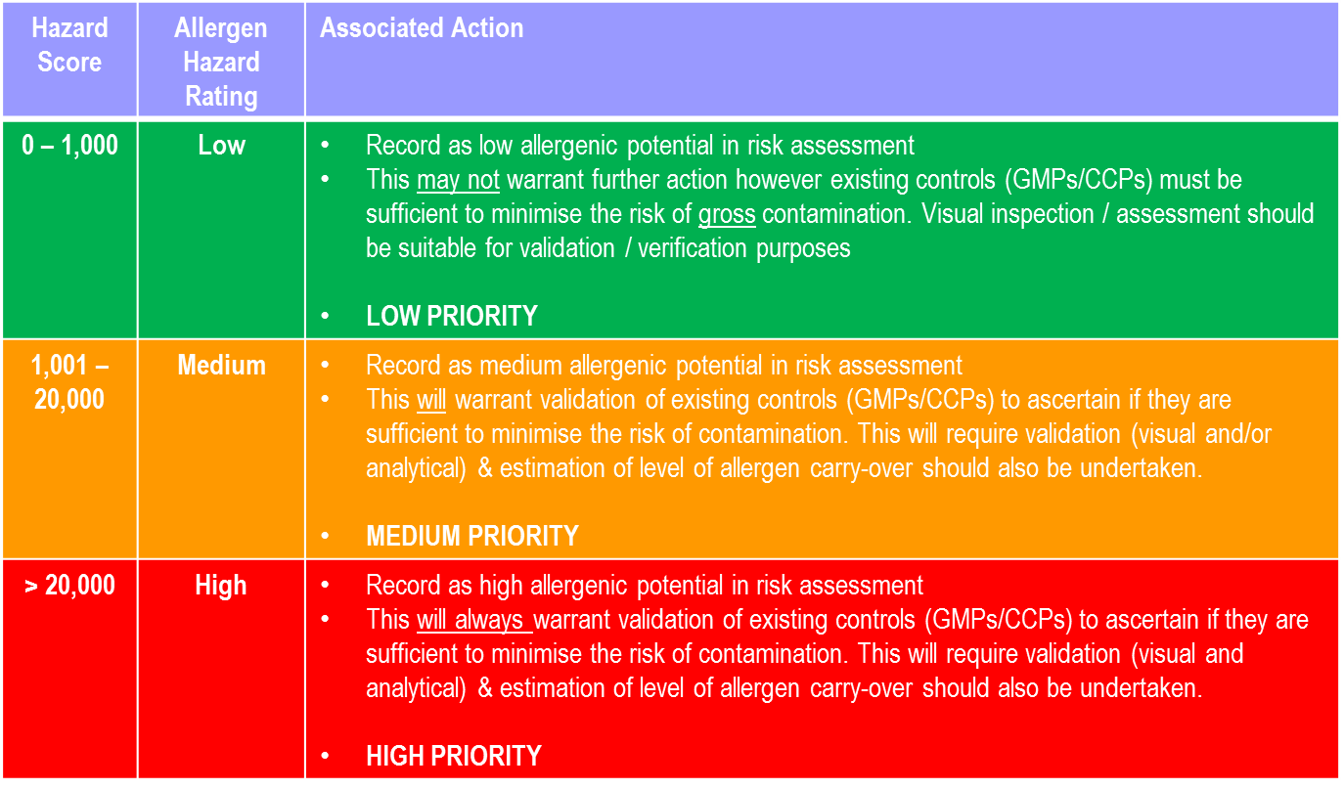
Hazard Ratings And Associated Actions
Notes:
Once we have derived these scores we can then assign actions – these will usually prompt to check is existing control measures are sufficiently robust

Slide 20
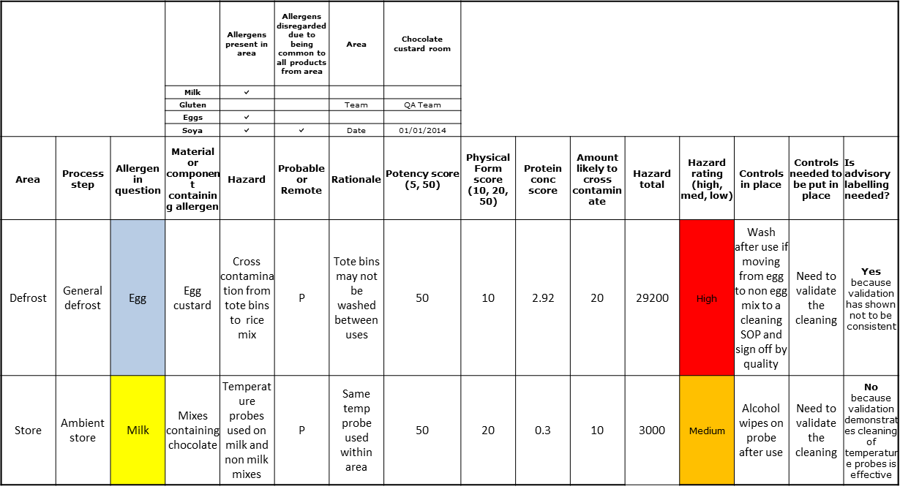
Output From Risk Assessment

Slide 21
Control Measures
Identify existing control measures
  Are they sufficient at reducing or eliminating the risk?
  Control must be validated
  If not sufficient, can they be improved?
  Re-validate
Examples of controls
  Planned production scheduling
  Physical barriers
  Dedicated equipment, lines and storage
  Cleaning
  Training
Notes:
Examples of controls
Planned production scheduling
Production segregation
Physical barriers
Dedicated equipment, lines, storage and /or maintenance
Spillage and waste control
Cleaning
Staff Facilities
Training
Production scheduling – allergen build
Segregation – separate dedicated lines / segregation by time (consider common cooking mediums like oils)
Physical barriers – protect production or prevent / restrict people movement
Dedication – equipment – gold standard but may just include ancillary equipment like scoops / sieves/ hard to clean equipment
Lines – gold standard but need physical barriers to prevent cross contact and people movement
Storage – control measures must prevent cross contact but must be validated (examples include bottom level racking, colour coding, labelling, magnetic moveable signs, robust means of maintaining packaging integrity
Maintenance – engineering controls
Cleaning – Often the most significant control – more later
Staff Facilities – food in canteen – what controls in place to prevent that getting into FP
Training – PPE , colour coding, barriers – critical to success

Slide 22
Summary
Regulatory and Standards Expect Risk assessment
Risk from Intentional and Unintentional presence
Start your risk assessment with allergen mapping
Determine probability of occurrence
Identify risk and characterise associated hazard
Next Step - Validation of Controls

