Slide 1
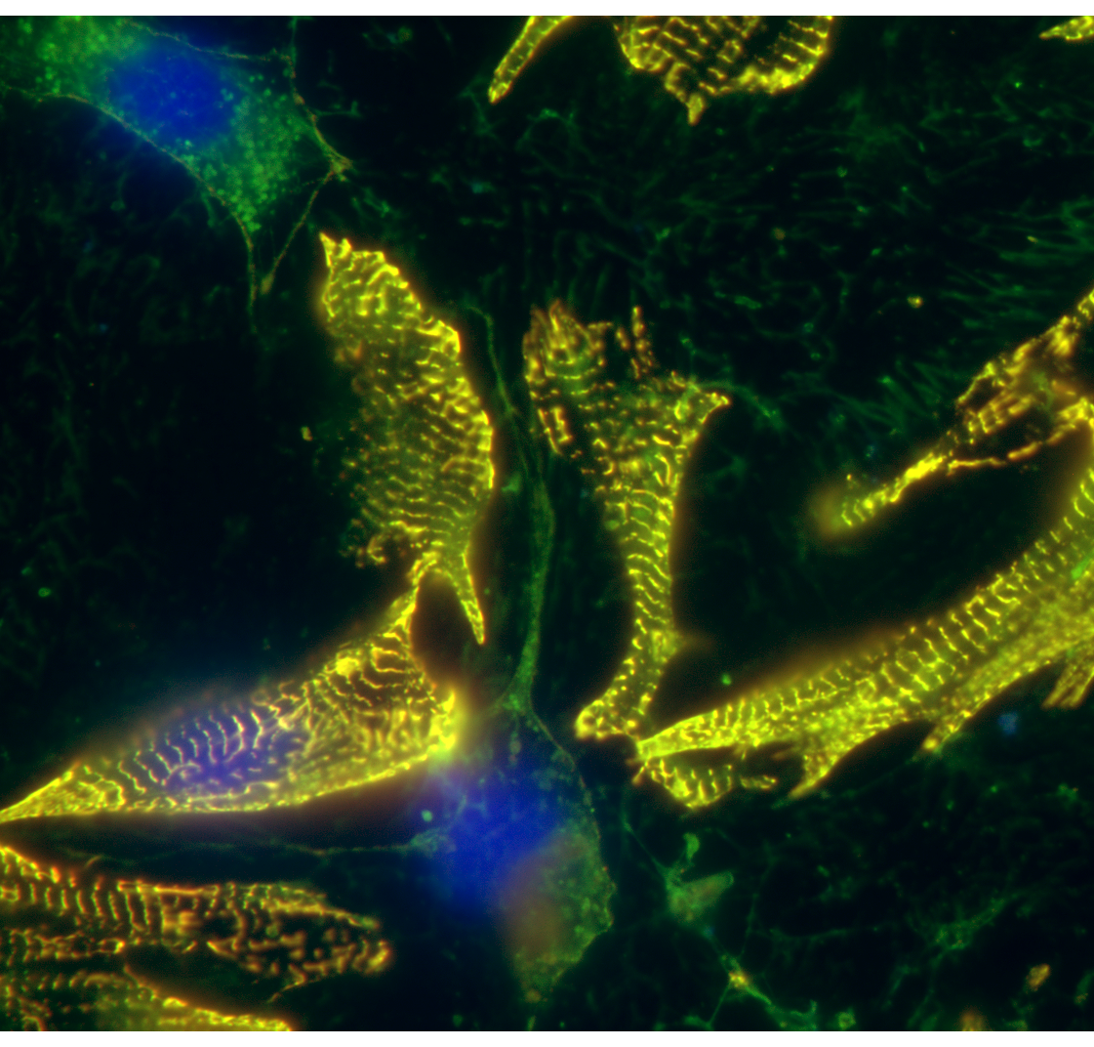
Sima T. Tarzami MS, Ph.D.
Conflict of interest: none declared
CXCR4 and CXCR7 Play Distinct Roles in Cardiac Lineage Specification & Pharmacologic β-adrenergic Response

Slide 2
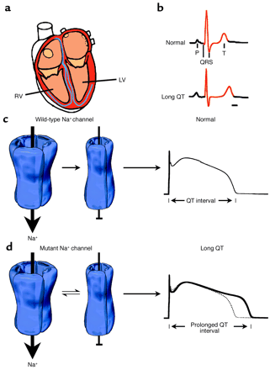
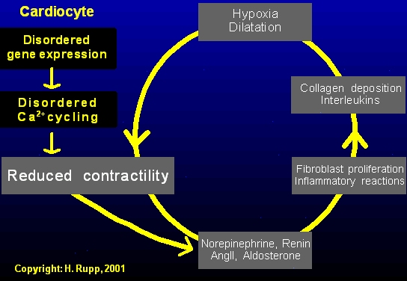
Development and Progression of HF
Normal contractile function
Depressed contractile function

Slide 3
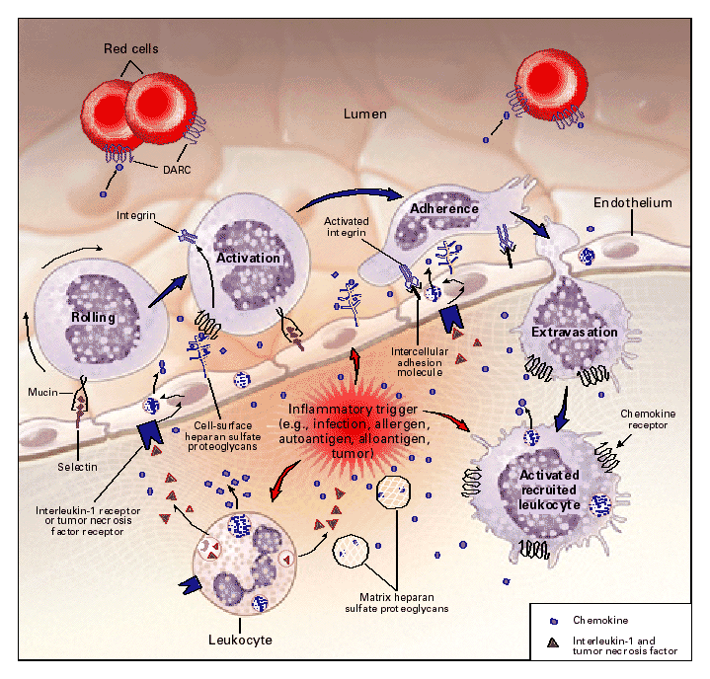
Chemokine Regulation of Leukocyte Movement

Slide 4
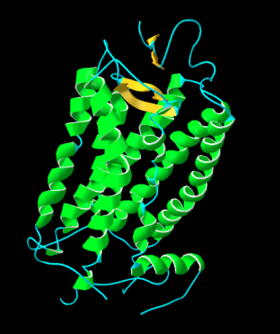
Human
Chemokines
CXCL1
CXCL2
CXCL4
CXCL7
SDF-1
also known as
CXCL6
CXCL3
CXCL12
CXCL5
CXCL14
Largest known family of cytokines
Small, secreted polypeptides
Chemokine families
  CC - 28 ligands
  CXC - 16 ligands
  C - 2 ligands
  CX3C - 1 ligand
CXCL8
CXCL11
CXCL13
CXCL10
CXCL16
CXCL9
CCL20
CCL25
CXCL2
CCL27
CXCL1
CX3CL1
CCL22
CCL21
CCL13
CCL19
CCL8
CCL11
CXCR4
CCL7
CCL2
CCL16
CCL14
CCL26
CXCR7
CCL23
CCL4
CCL3
CCL24
CCL1
CCL15
CCL18
CCL5
CCL17
0.1

Slide 5
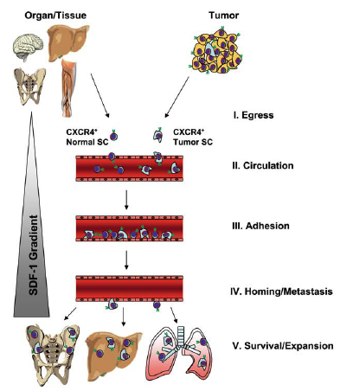
Chemokines and the heart: Old players with the
new roles
Two major human SDF-1(CXCL12) isoforms, SDF-1alpha and SDF-1beta
CXCR4 is the only known cognate receptor for SDF-1 , recently CXCR7 has been identified as the SDF-1 alternative receptor
SDF-1/CXCR4 KO is embryonic lethal
CXCR4-SDF-1 interaction plays a key role in regulating bone marrow cells retention/mobilization, angiogenesis, tumor metastatic potential
CXCR4-SDF-1 counteracts action potential in the neurons
CXCR4-SDF-1 are expressed on cardiac myocytes and have distinct functions: CXCR4 activation negatively modulates β adrenergic receptor agonist, isoproterenol-induced contractility
Ratajczak MZ etal. Stem Cells, 23:879-894 (2005)

Slide 6
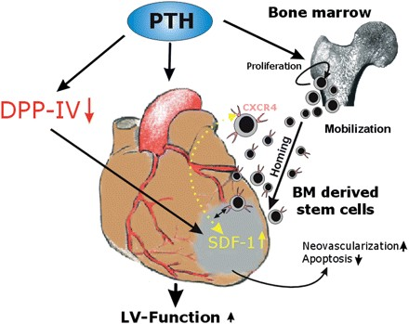
Importance of the CXCL12:CXCR4 Axis in Myocardial Repair
Acute MI
SDF-1 upregulation

Slide 7
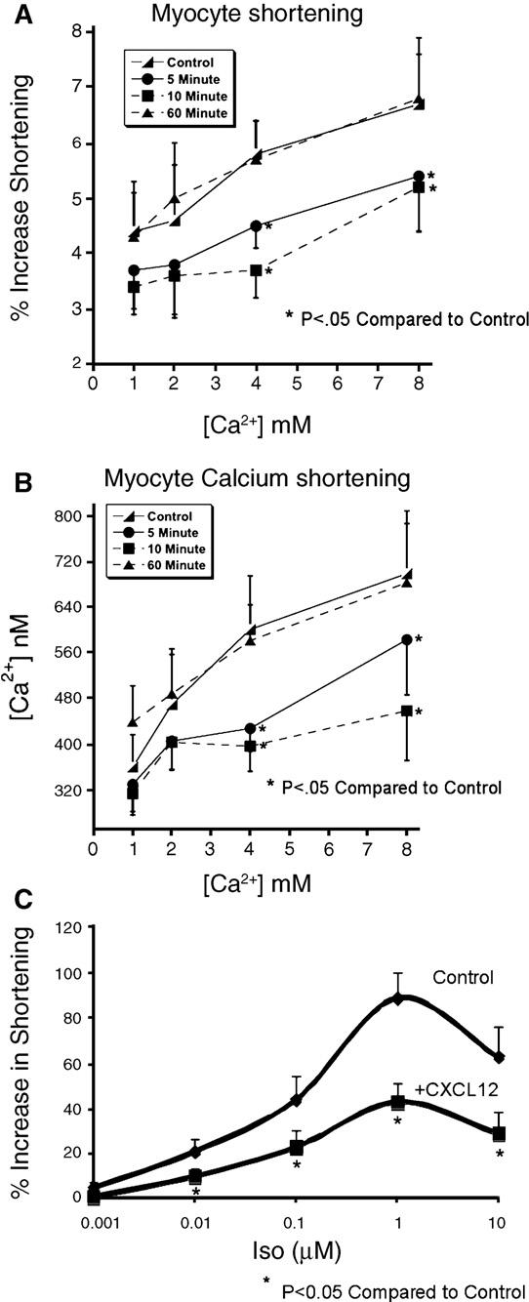
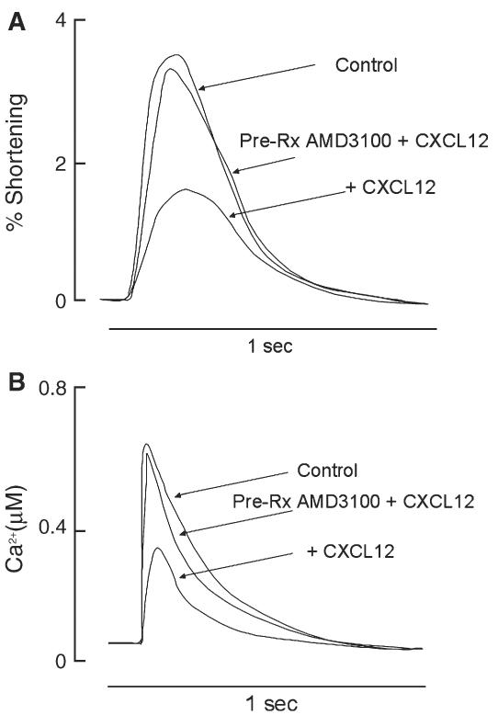
CXCR4 negatively modulates contractility in adult cardiac myocytes
J Mol Cell Cardiol. 2006 November; 41(5): 834–844

Slide 8
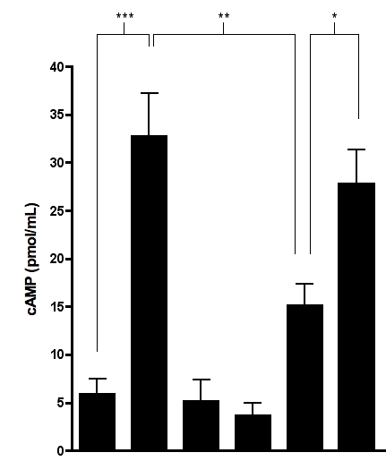

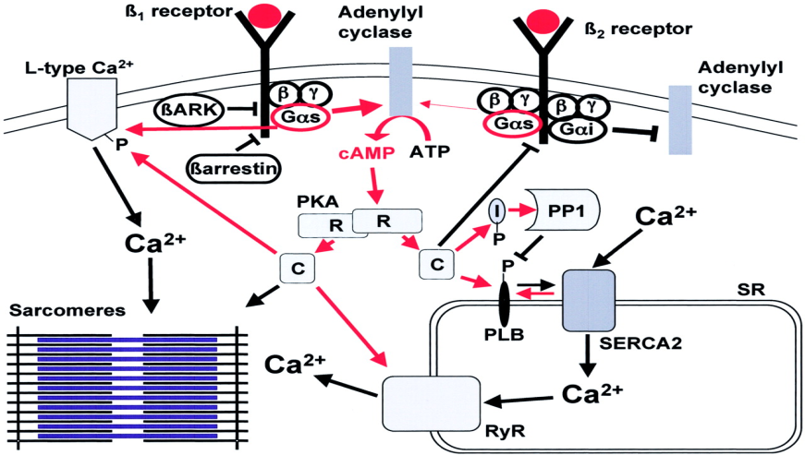
CXCR4 Activation Negatively Modulates β₂AR Downstream Signaling
7000
7000
7000
7000
7000
700
7000
7000
7000
7000
7000
700
7000
7000
7000
7000
7000
700
0
0
S
0
6000
6000
6000
6000
6000
6000
6000
6000
6000
6000
6000
6000
6000
6000
6000
6000
6000
γ
6000
5000
5000
5000
5000
5000
5000
5000
5000
5000
5000
5000
5000
5000
5000
5000
5000
5000
5000
*
*
*
*
*
*
*
*
*
*
*
*
*
*
*
*
*
*
*
*
*
*
*
S] GTP
*
4000
4000
4000
4000
4000
4000
4000
4000
4000
4000
4000
4000
4000
4000
4000
4000
4000
4000
3000
3000
3000
3000
3000
3000
3000
3000
3000
3000
3000
3000
3000
3000
3000
3000
3000
35
3000
2000
2000
2000
2000
2000
2000
2000
2000
2000
2000
2000
2000
2000
2000
2000
2000
2000
[
2000
1000
1000
1000
1000
1000
1000
1000
1000
1000
1000
1000
1000
1000
1000
1000
1000
1000
1000
-
-
-
-
-
-
-
-
-
-
-
-
-
-
-
-
-
-
+
+
+
+
+
+
+
+
+
+
+
+
+
+
+
+
+
-
+
-
-
-
-
-
-
-
-
-
-
-
-
-
-
-
-
-
+
+
+
+
+
+
+
+
+
+
+
+
+
+
+
+
+
ISO
+
ISO
ISO
ISO
ISO
ISO
ISO
ISO
ISO
ISO
ISO
ISO
ISO
ISO
ISO
ISO
ISO
ISO
ISO
ISO
ISO
ISO
ISO
ISO
ISO
ISO
ISO
ISO
ISO
ISO
ISO
ISO
ISO
ISO
ISO
ISO
+
+
+
+
+
+
+
+
+
+
+
+
+
+
+
+
+
-
+
-
-
-
-
-
-
-
-
-
-
-
-
-
-
-
-
-
-
-
-
-
-
-
-
-
-
-
-
-
-
-
-
-
-
-
+
+
+
+
+
+
+
+
+
+
+
+
+
+
+
+
+
SDF
+
SDF
SDF
SDF
SDF
SDF
SDF
SDF
SDF
SDF
SDF
SDF
SDF
SDF
SDF
SDF
SDF
SDF
-
-
-
-
-
-
-
-
-
-
-
-
-
-
-
-
-
-
-
-
-
-
-
-
-
-
-
-
-
-
-
-
-
-
-
-
-
-
-
-
-
-
-
-
-
-
-
-
-
-
-
-
-
-
+
+
+
+
+
+
+
+
+
-
-
-
-
-
-
-
-
-
-
-
-
-
-
-
-
-
-
-
-
-
-
-
-
-
-
+
-
+
+
+
+
+
+
+
+
+
+
+
+
+
+
+
+
+
+
+
+
+
+
+
+
+
ISO
+
ISO
ISO
ISO
ISO
ISO
ISO
ISO
ISO
ISO
ISO
ISO
ISO
ISO
ISO
ISO
ISO
ISO
-
-
-
-
-
-
-
-
-
-
-
-
-
-
-
-
-
-
-
-
-
-
-
-
-
-
-
-
-
-
-
-
-
-
-
-
-
-
-
-
-
-
-
-
-
-
-
-
-
-
-
-
-
-
+
+
+
+
+
+
+
+
+
+
+
+
+
+
+
+
+
+
+
+
+
+
+
+
+
+
+
+
+
+
+
+
+
+
+
SDF
+
SDF
SDF
SDF
SDF
SDF
SDF
SDF
SDF
+
+
+
+
+
+
+
+
-
+
-
-
-
-
-
-
-
-
-
-
-
-
-
-
-
-
-
-
-
-
-
-
-
-
-
-
-
-
-
-
-
-
-
-
-
-
-
-
-
-
-
-
-
-
-
-
-
-
-
-
-
-
-
-
-
-
-
-
-
-
-
-
-
-
-
-
-
-
-
-
-
-
-
-
-
-
-
-
-
-
-
-
-
-
-
-
-
-
-
-
-
-
-
-
-
-
-
-
-
-
-
-
-
-
-
-
-
+
+
+
+
+
+
+
+
+
+
+
+
+
+
+
+
+
ICI 115881
+
ICI 115881
ICI 115881
E
E
E
E
E
E
E
E
E
-
-
-
-
-
-
PLB
PLB
PLB
PLB
PLB
P
PLB
P
P
P
P
P
(ser 16)
(ser 16)
(ser 16)
(ser 16)
(ser 16)
(ser 16)
PLB
PLB
PLB
PLB
PLB
PLB
-
-
-
-
-
-
-
-
-
-
-
-
-
-
+
+
+
+
+
+
+
+
+
-
+
-
-
-
-
-
-
-
-
-
-
-
+
+
+
+
+
+
+
+
+
+
+
+
+
+
+
+
+
ISO
+
ISO
ISO
ISO
ISO
ISO
ISO
ISO
+
+
+
+
+
+
+
+
+
+
+
-
+
-
-
-
-
-
-
-
-
-
-
-
-
-
-
-
-
-
-
-
-
-
-
-
-
-
-
-
-
-
-
-
-
-
+
+
+
+
+
+
+
+
+
+
+
+
+
+
+
+
+
+
+
+
+
+
+
+
+
+
+
SDF
+
SDF
SDF
SDF
SDF
SDF
SDF
SDF
SDF
SDF
SDF
SDF
+
+
+
+
+
+
+
+
+
+
+
+
+
+
+
+
+
+
+
+
+
+
+
-
+
-
-
-
-
-
-
-
-
-
-
-
-
-
-
-
-
-
-
-
-
-
-
-
-
-
-
-
-
-
-
-
-
-
-
-
-
-
-
-
-
-
-
-
-
-
-
-
-
-
-
-
-
-
-
-
-
-
-
ICI 115881
-
ICI 115881
J Cardiovasc Pharmacol. 2010 Nov;56(5):548-59.

Slide 9
CXCR4 and CXCR7
G-protein coupled receptors
Ligand is CXCL12
CXCR4 is widely expressed; essential for development, hematopoiesis, organogenesis and vascularization
CXCR4 interacts with β2-AR; activation of CXCR4 by CXCL12 results in diminished downstream signaling (↓ PKA activity= ↓cAMP and ↓ PLN phosphorylation)
CXCR7 forms a dimer with CXCR4, does not interact with β2-AR; deletion is perinatally lethal due to cardiovascular defects; binds CXCL12 10-fold higher than CXCR4 and acts as a decoy receptor, reducing acute CXCR4 signaling

Slide 10
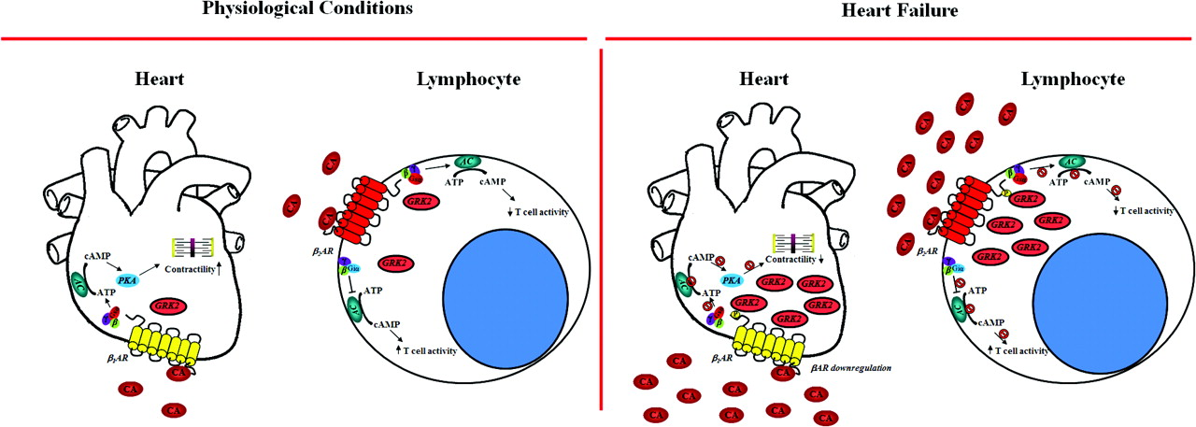
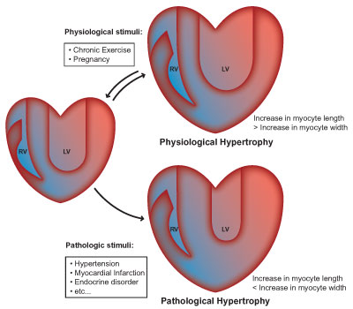
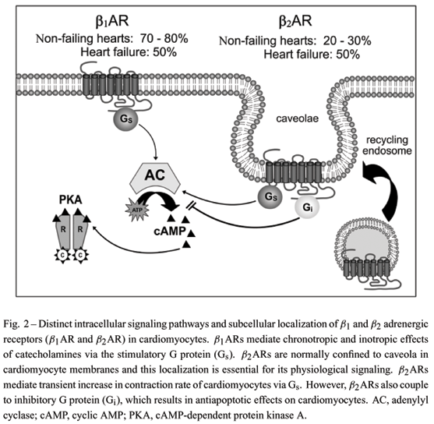
What Is the Role of β-Adrenergic Signaling in Heart Failure?

Slide 11
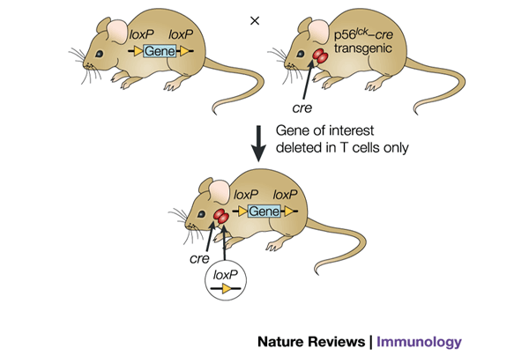


A mouse is generated in which the gene of interest “CXCr4” is 'floxed', or flanked by loxP sites. This mouse is then crossed with a cre transgenic mouse, ...
Cardiomyocyte-Specific CXCR4-Knockouts
α-MHC-cre- tg
Gene of interest “CXCr4”
deleted in cardiomyocytes only

Slide 12
CXCL12/CXCR4 Axis
Deletion of CXCR4 in Cardiomyocytes Exacerbates Cardiac Dysfunction Following Isoproterenol Administration (Gene Ther. 2014 May;21(5):496-506)
CXCL12/CXCR4 axis prevents β-adrenergic induced cardiac myocyte hypertrophy in vitro and in vivo (J Mol Cell Cardiol. 2012 Aug;53(2):223-32. Gene Ther. 2014 May;21(5):496-506)
CXCR4 ablation increased susceptibility to isoproterenol-induced HF, by upregulating apoptotic markers and reducing mitochondrial function; cardiac function decreases whereas fibrosis increases (Gene Ther. 2014 May;21(5):496-506)

Slide 13
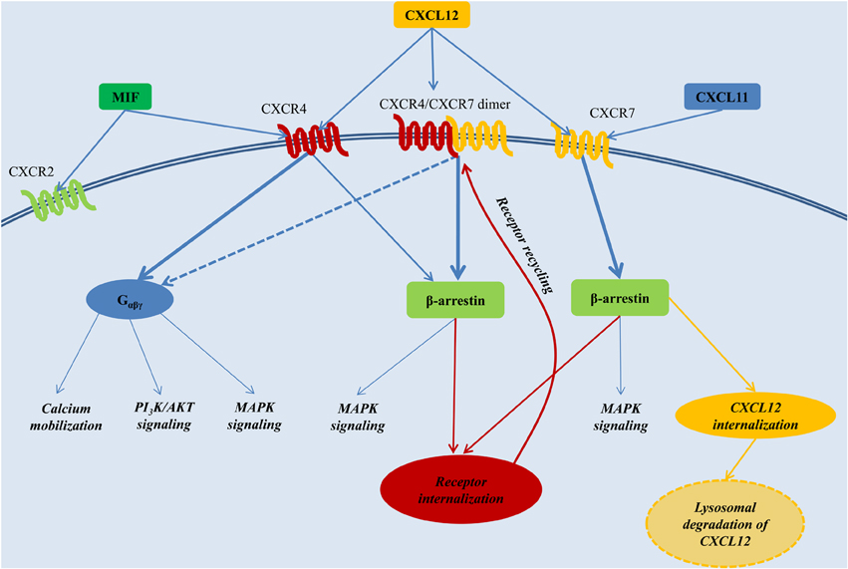

Slide 14
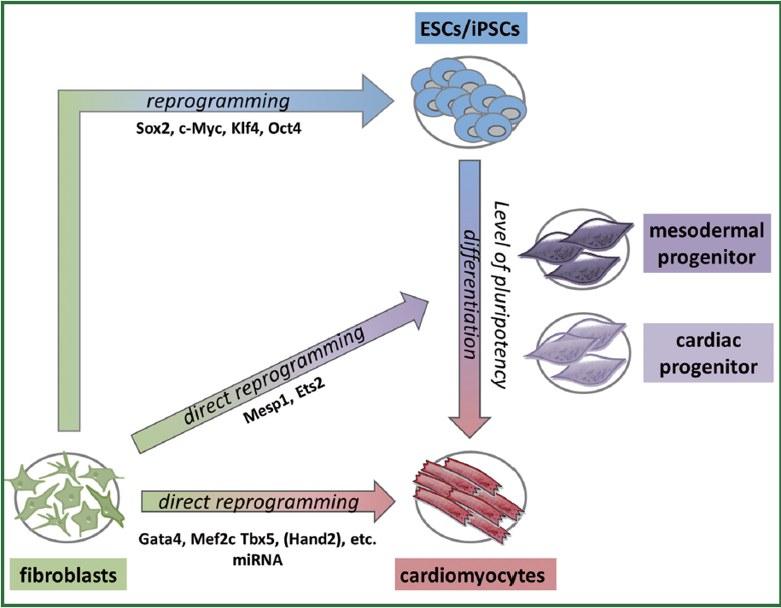
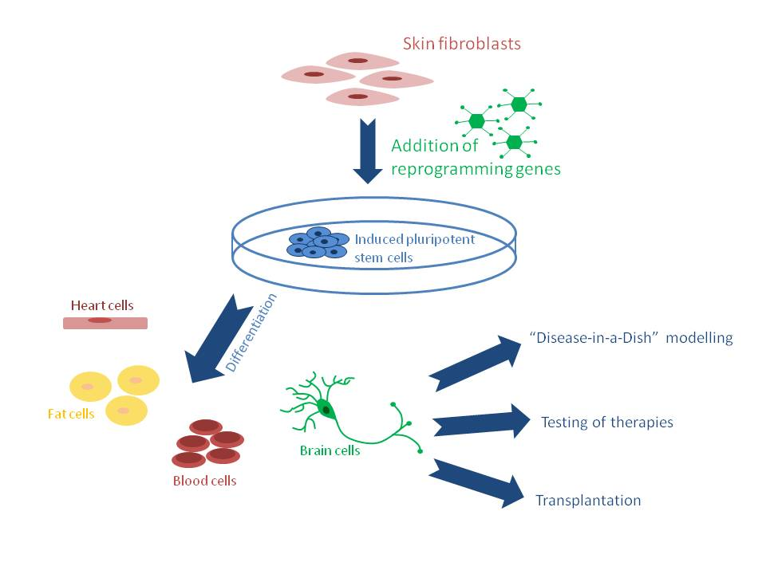
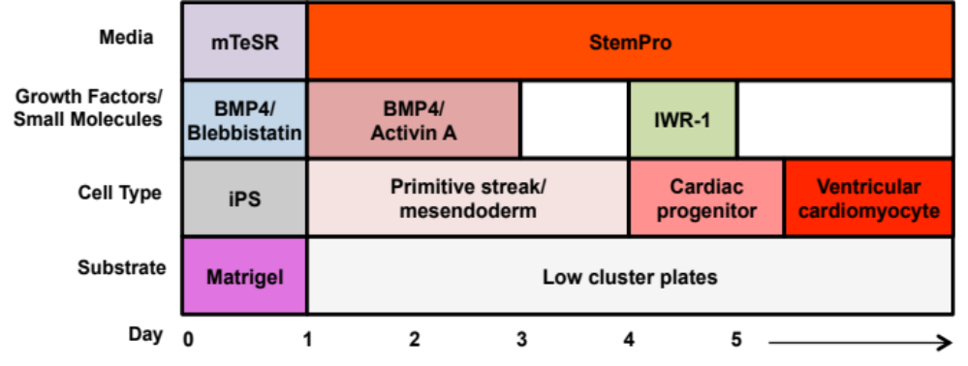
Genetic manipulation of hiPSCs
shCXCR4
shCXCR7
Cardiac lineage differentiation procedure for human iPSCs.
Sci Transl Med. 2012 Apr 18;4(130):130ra47.

Slide 15
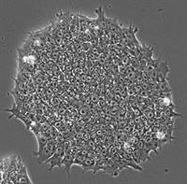
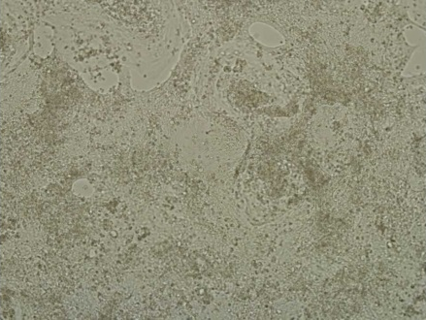
Knockdown of CXCR4 and CXCR7
shRNA lentivirus (shScramble, shCXCR4, shCXCR7) from Santa Cruz:
  Control
  shScramble
  shCXCR4
  shCXCR7
  shCXCR4 and shCXCR7
Puromycin
4 days
iPS infected with
20ul of 1e⁶ at day 0
Cardiomyocytes

Slide 16
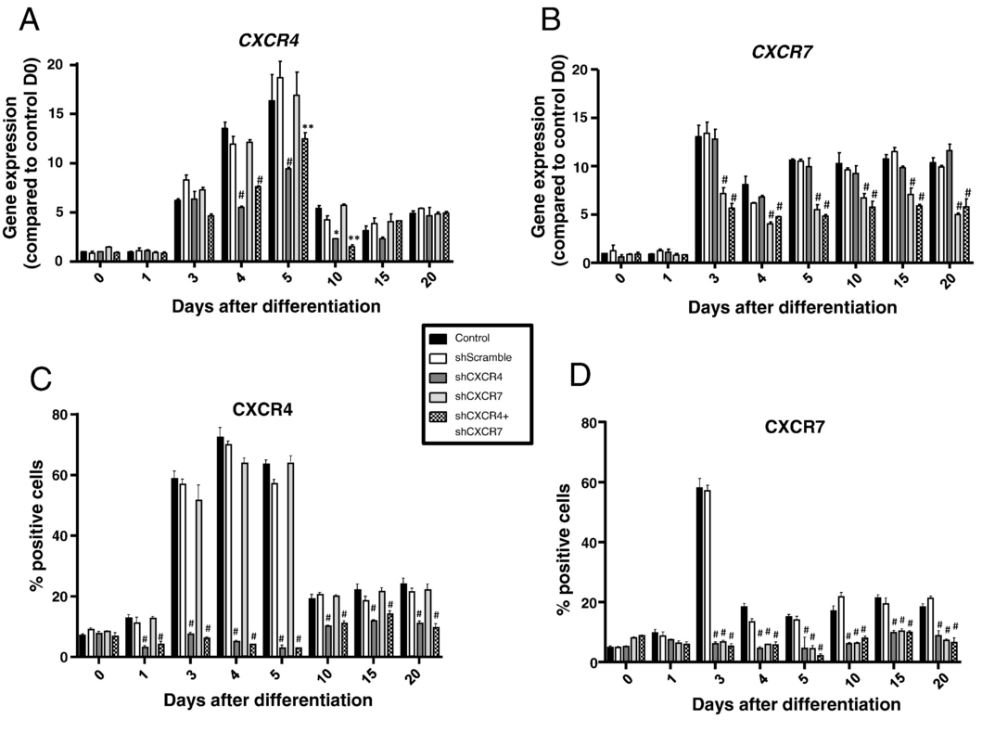

Slide 17
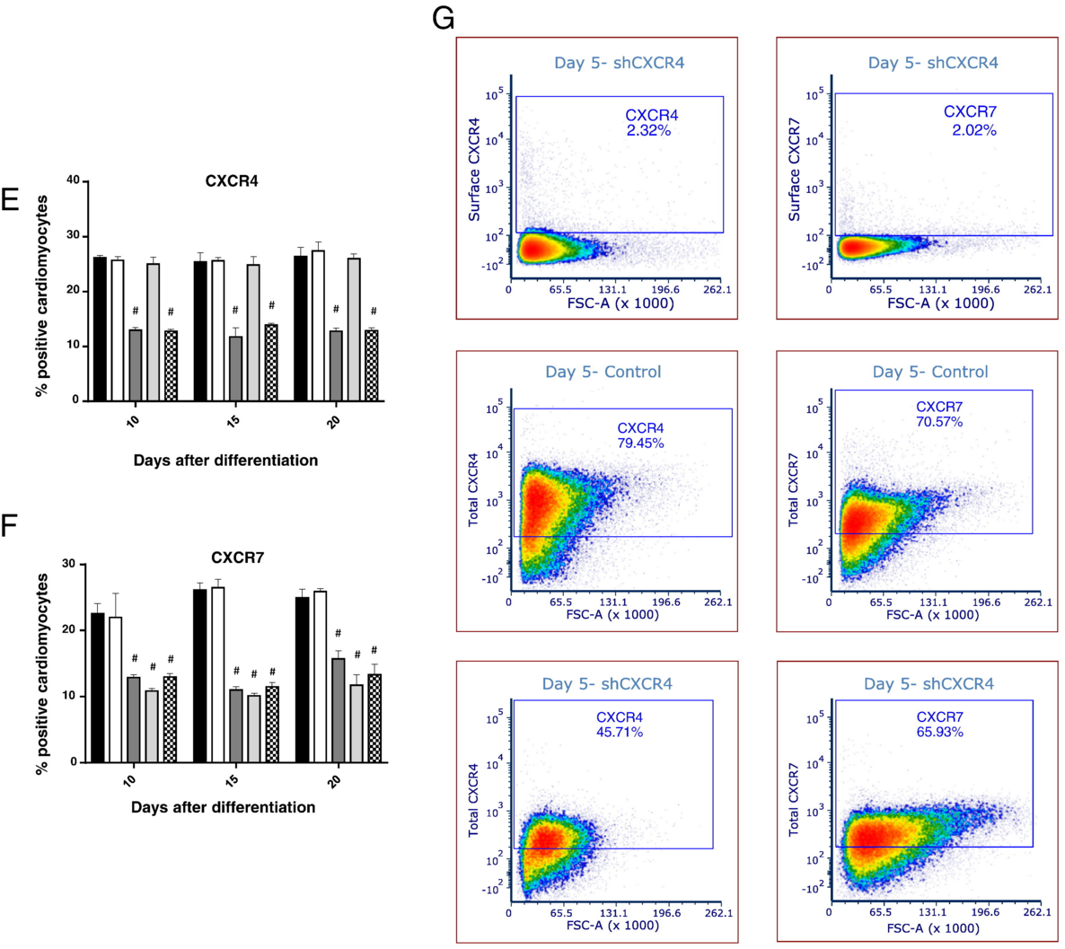

Slide 18
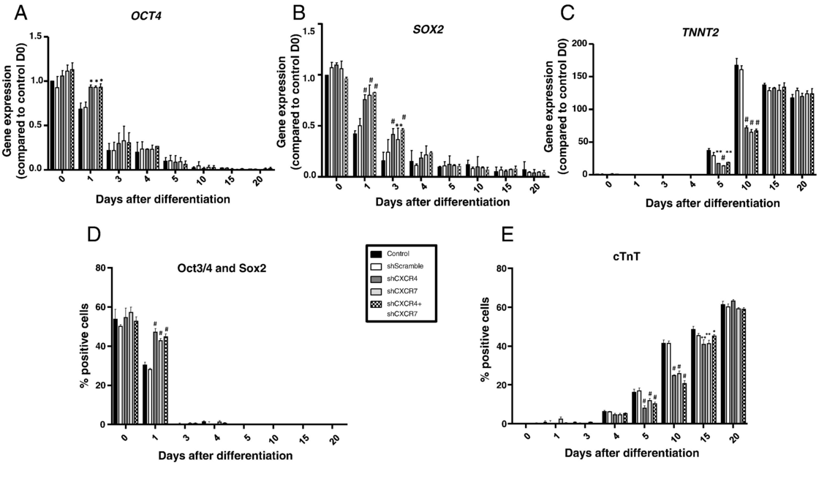
Knockdown of CXCR4 and CXCR7 Delays Cardiogenesis in hiPSC-CMs

Slide 19
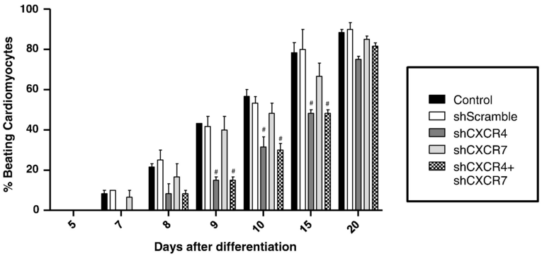
Knockdown of CXCR4 Inhibits Spontaneous Beating of hiPSC-CMs

Slide 20
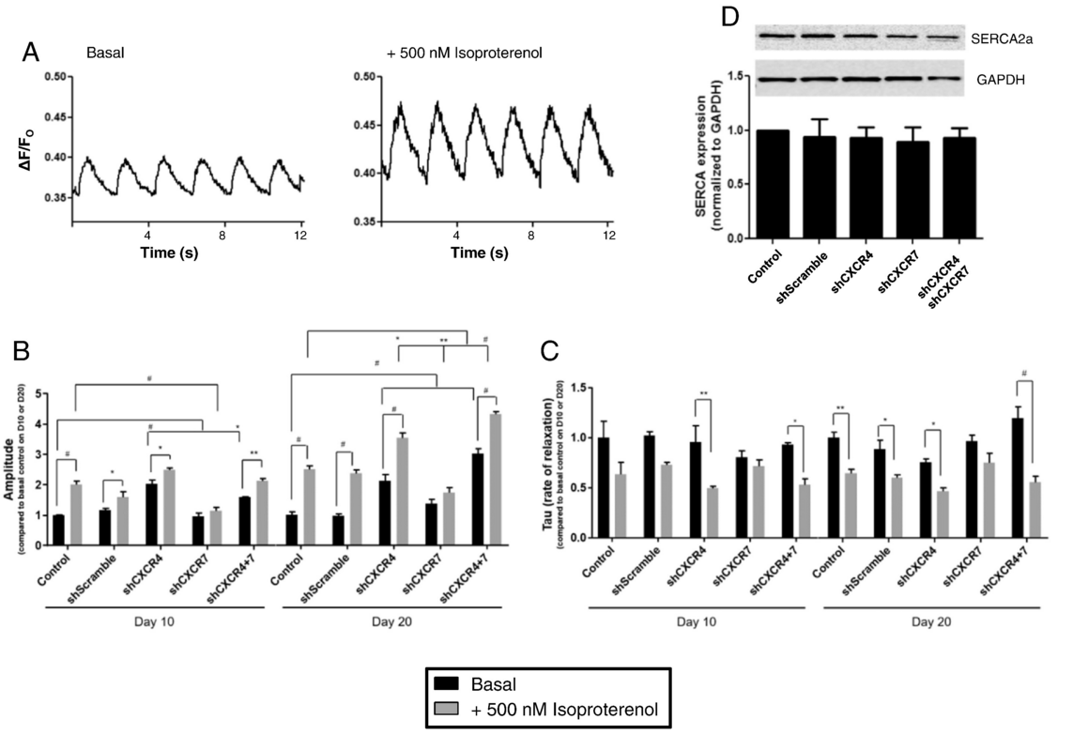

Slide 21
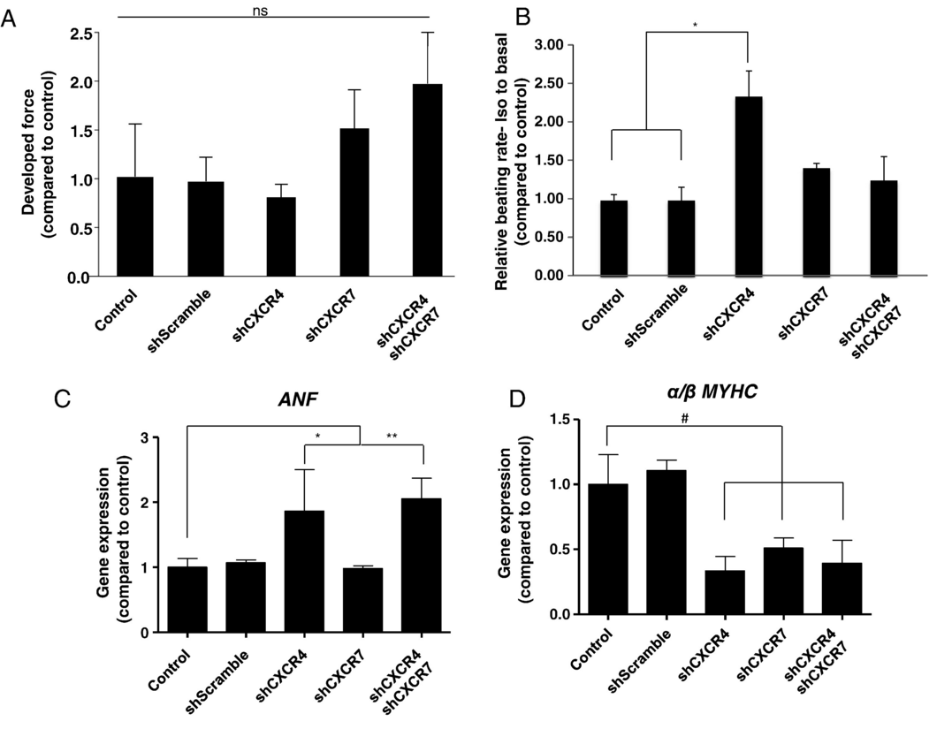

Slide 22
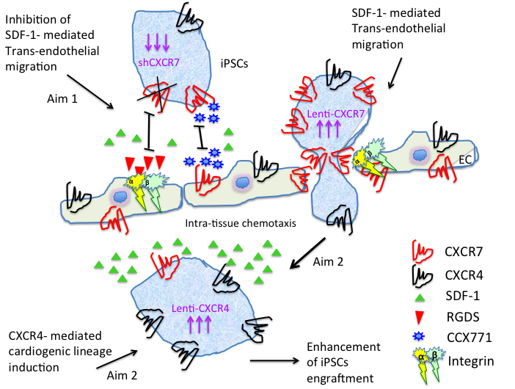
SDF-1/CXCR4/CXCR7 Axis Coordinates hiPSCs Cardiac Lineage Mobilization

Slide 23
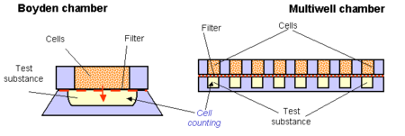
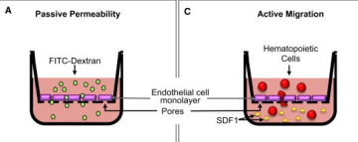
Chemotaxis assay
SDF-1

Slide 24
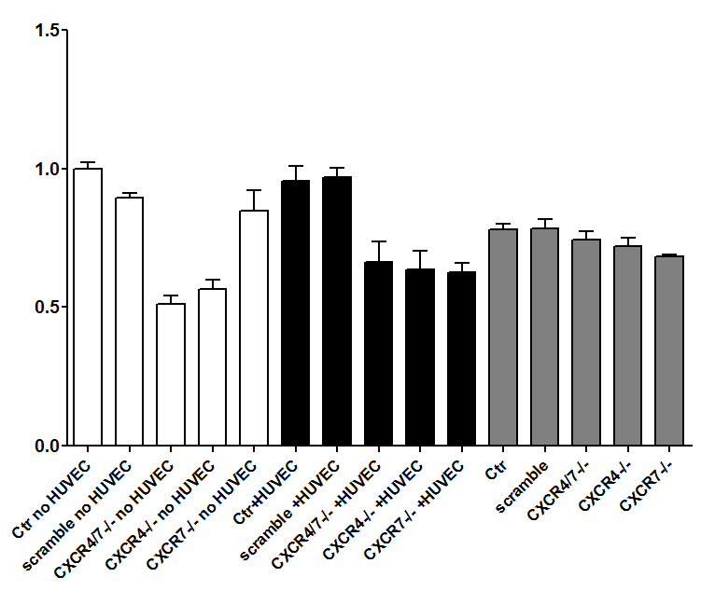
Essentiality of Both CXCR4 and CXCR7 for the Transendothelial Migration of hiPSCs
*
*
*
*
*

Slide 25
Summary
Although reduction of CXCR4 and CXCR7 expression resulted in a delayed cardiac phenotype, only knockdown of CXCR4 delayed the spontaneous beating of hiPSC-CMs.
Knockdown of CXCR4 and CXCR7 differentially altered calcium transients and β-adrenergic response in hiPSC-CMs.
In engineered cardiac tissues, depletion of CXCR4 or CXCR7 had opposing effects on developed force and chronotropic response to β-agonists.
The transendothelial migration response to SDF-1 was suppressed by knockdown of either CXCR4 or CXCR7
In contrast, in a trans-well chemotaxis assay, only depletion of CXCR4 reduced hiPSC migration in response to SDF-1

Slide 26
Acknowledgment
Tarzami’s Group
Collaborators
Icahn School of Medicine at Mount Sinai:
Roger Hajjar
Lahouaria Hadri
Kevin Costa
Lakshmi Devi
Albert Einstein College of Medicine
Joan Berman
Richard Kitsis
Howard University:
Georges Haddad
Delaine Ceholski
Edward Wang
Andrew Jarrah
Martina Schwartzkopf

