Slide 1
Supercritical CO₂ for
Green Polymer Chemistry
by
Silvio Curia
International Conference on Biopolymers and Bioplastics
10 August 2015, San Francisco

Slide 2
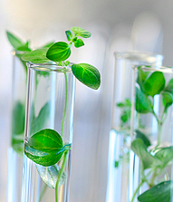
REFINE project: REnewable FunctIoNal matErials for a sustainable polymer industry
Plastic industry is heavily reliant on petrochemicals.
REFINE aims to combine:
green raw materials
green synthesis
green processing and modification
Notes:
My PhD is part of the refine project. Refine stands for… and it aims to …. in order to achieve a greener polymer industry

Slide 3
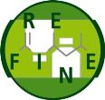
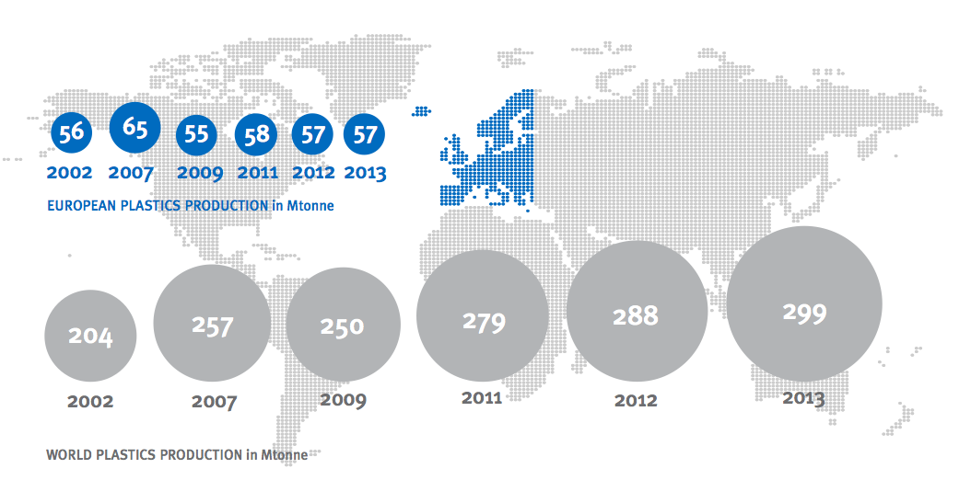
Plastics: the facts (2014)
57 Mtonnes in EU
300 Mtonnes globally
Plastics – the Facts 2014, PlasticsEurope and European Plastics Converters, 2014
Notes:
Now you’re maybe wondering why it is important to obtain a greener poly science/industry.
Well: this slide is to show u some facts about plastics. The plastic industry is heaviliy reliant on non-biodegr and non renewable polymers. More in detail 58Mtonnes… and most of the used polymer were derived from petrochemicals… etc

Slide 4
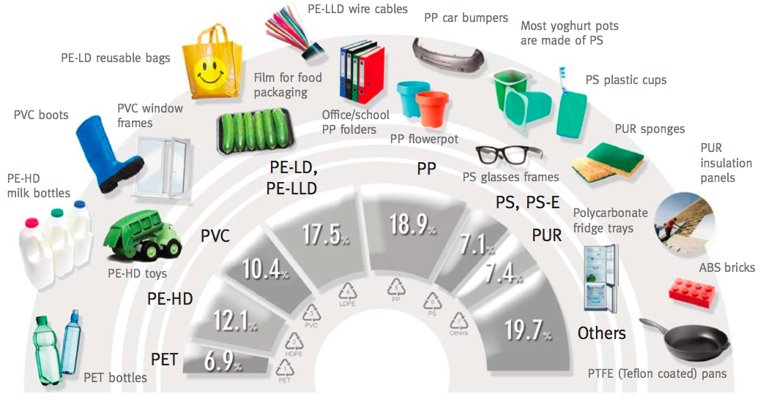
Plastics: the facts (2014)
Plastics – the Facts 2014, PlasticsEurope and European Plastics Converters, 2014
<10% derived from biodegradable polymers¹
[1] C. Rolando, Biodegradation – Life of Science, 2013
Notes:
Now you’re maybe wondering why it is important to obtain a greener poly science/industry.
Well: this slide is to show u some facts about plastics. The plastic industry is heaviliy reliant on non-biodegr and non renewable polymers. More in detail 58Mtonnes… and most of the used polymer were derived from petrochemicals… etc

Slide 5
CO₂ for polymer chemistry
Reduce the
viscosity
Energy saving
New green routes
Notes:
Now you’re maybe wondering why it is important to obtain a greener poly science/industry.
Well: this slide is to show u some facts about plastics. The plastic industry is heaviliy reliant on non-biodegr and non renewable polymers. More in detail 58Mtonnes… and most of the used polymer were derived from petrochemicals… etc

Slide 6
Polymer processing & synthesis: high viscosity problem
Major obstacle
High Viscosity!
Notes:
Since the common poin of plymer processing is the use of polymer melts, high viscosity is a big issue. it can make the processing hard and expensive.
So We have several solutions. The use of… but they can be toxic and bad for the environment, the use of.. But its very easy to have the degrad of the polymers and any bioactive addtitives sush as drugs etc when using HT… and finally we can use the scCO2 as plasticiser that is non toxic, inexpensive and can be very useful to make easier the processing of polymers.

Slide 7
Polymer processing & synthesis:
high viscosity problem
Major obstacle
High Viscosity!
✗
Solvents
Toxic
Solutions
Notes:
Since the common poin of plymer processing is the use of polymer melts, high viscosity is a big issue. it can make the processing hard and expensive.
So We have several solutions. The use of… but they can be toxic and bad for the environment, the use of.. But its very easy to have the degrad of the polymers and any bioactive addtitives sush as drugs etc when using HT… and finally we can use the scCO2 as plasticiser that is non toxic, inexpensive and can be very useful to make easier the processing of polymers.

Slide 8
Polymer processing & synthesis:
high viscosity problem
Major obstacle
High Viscosity!
✗
Solvents
Toxic
Solutions
✗
Thermal degradation + expensive
High T
Notes:
Since the common poin of plymer processing is the use of polymer melts, high viscosity is a big issue. it can make the processing hard and expensive.
So We have several solutions. The use of… but they can be toxic and bad for the environment, the use of.. But its very easy to have the degrad of the polymers and any bioactive addtitives sush as drugs etc when using HT… and finally we can use the scCO2 as plasticiser that is non toxic, inexpensive and can be very useful to make easier the processing of polymers.

Slide 9
Polymer processing & synthesis:
high viscosity problem
Major obstacle
High Viscosity!
Temporary plasticiser
Non-toxic
Inexpensive
Accessible T_{c} & p_{c}
✓
Solutions
scCO₂
Notes:
Since the common poin of plymer processing is the use of polymer melts, high viscosity in a big issue. it can make the processing hard and expensive.
So We have several solutions. The use of… but they can be toxic and bad for the environment, the use of.. But its very easy to have the degrad of the polymers and any bioactive addtitives sush as drugs etc when using HT… and finally we can use the scCO2 as plasticiser that is non toxic, inexpensive and can be very useful to make easier the processing of polymers.

Slide 10
CO₂-induced polymer plasticisation
- how does it work?
Polymer chains
Notes:
The reason behind the plasticisation is the fact that CO2 molecules can increase the free volume of polymers decreasing their viscosity...in this way we can process the materials as we want…
Without using HT and solvents And we can obtain a very clean and pure material by simply depressurizing the autoclave! This can clearly be really important for food pakcaging and medical applications

Slide 11
CO₂-induced polymer plasticisation
- how does it work?
scCO₂
Polymer chains
CO₂ molecule
Lower viscosity
Lower melting point
Notes:
The reason behind the plasticisation is the fact that CO2 molecules can increase the free volume of polymers decreasing their viscosity...in this way we can process the materials as we want…
Without using HT and solvents And we can obtain a very clean and pure material by simply depressurizing the autoclave! This can clearly be really important for food packaging and medical applications

Slide 12
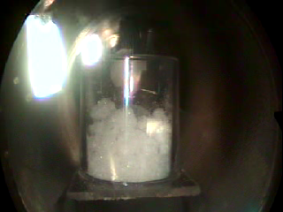
CO₂-induced polymer plasticisation
- how does it work?
Poly(lactic acid) at 35 ºC
Notes:
The reason behind the plasticisation is the fact that CO2 molecules can increase the free volume of polymers decreasing their viscosity...in this way we can process the materials as we want…
Without using HT and solvents And we can obtain a very clean and pure material by simply depressurizing the autoclave! This can clearly be really important for food packaging and medical applications

Slide 13
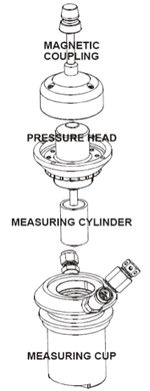
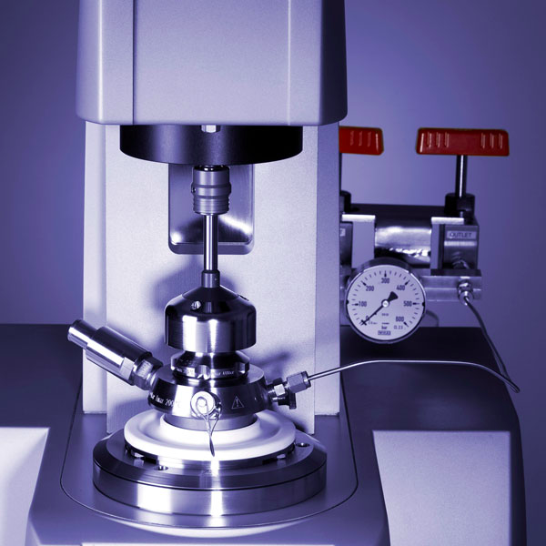
High Pressure Rheometer
Max Pressure: 300 bar
Notes:
In oreder to understand and quantify the effects of CO2 on polyesters, I used an high pressure rheometer that allows to measure rheological properties of polymers at several shear rates and up to 300°C and 15 Mpa. It can work both in a rotating mode and in an oscillating mode.
I chose PCL as a model because PLA has been widely studied while data on PCL are currently lacking.

Slide 14
Oscillatory vs rotational experiments
Polymer
Oscillation
Full rotation
Stiffness
Melting point
Shear-Viscosity
Flow properties

Slide 15
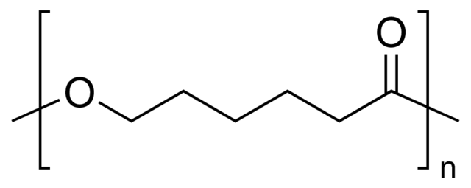
Elastic modulus of PCL – ambient pressure
P_{amb}
Semi-crystalline
Biodegradable
Used for packaging
Suitable for medical applications
S. Curia et al., Polymer, 2015
Notes:
Adding more CO2 and waiting again 50mins it was possible to shift even more the G’ drop. As you can see from this slide…

Slide 16
Elastic modulus of PCL – in CO₂
Soaking time
50 mins
P_{amb}
50 bar
S. Curia et al., Polymer, 2015
Notes:
Adding more CO2 and waiting again 50mins it was possible to shift even more the G’ drop. As you can see from this slide…

Slide 17
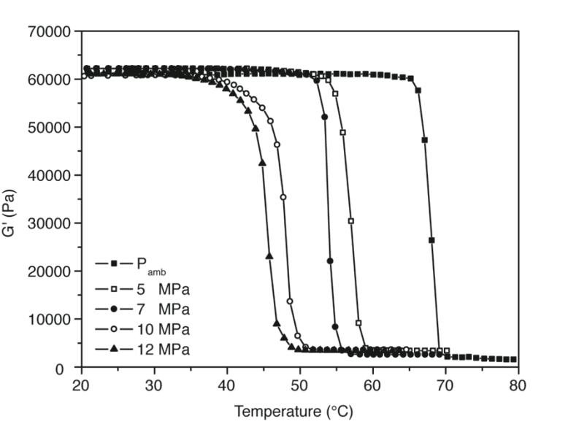
Elastic modulus of PCL – in CO₂
Soaking time
50 mins
P_{amb}
100 bar
50 bar
120 bar
70 bar
∼23 ºC
S. Curia et al., Polymer, 2015
Notes:
Adding more CO2 and waiting again 50mins it was possible to shift even more the G’ drop. As you can see from this slide…

Slide 18
Viscosity of PCL 10 kDa: ambient pressure
80 ºC
S. Curia et al., Polymer, 2015
Notes:
so taking the viscosity at a given shear rate you can see on the left the data taken at fixed T (20 °C) while increasing pressure and the data taken at fixed p (ambient p) while increasing T…

Slide 19
Viscosity reduction under CO₂: PCL 10 kDa
80 ºC
PRESSURE
S. Curia et al., Polymer, 2015
Notes:
so taking the viscosity at a given shear rate you can see on the left the data taken at fixed T (20 °C) while increasing pressure and the data taken at fixed p (ambient p) while increasing T…

Slide 20
Viscosity reduction under CO₂: PCL 10 kDa
80 ºC
PRESSURE
96%
S. Curia et al., Polymer, 2015
Notes:
so taking the viscosity at a given shear rate you can see on the left the data taken at fixed T (20 °C) while increasing pressure and the data taken at fixed p (ambient p) while increasing T…

Slide 21
Q: can CO₂ plasticise higher MW PCL?
Notes:
so taking the viscosity at a given shear rate you can see on the left the data taken at fixed T (20 °C) while increasing pressure and the data taken at fixed p (ambient p) while increasing T…

Slide 22

Viscosity: PCL 80 kDa vs 10 kDa
80 ºC
Viscosity (Pa.s)
10 kDa
(ambient pressure)
Longer chains = higher viscosity
Shear Rate (s⁻¹)
S. Curia et al., Polymer, 2015
Notes:
so taking the viscosity at a given shear rate you can see on the left the data taken at fixed T (20 °C) while increasing pressure and the data taken at fixed p (ambient p) while increasing T…

Slide 23
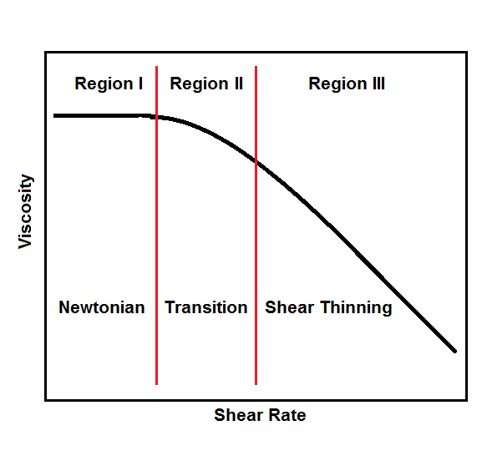
Polymers: non-Newtonian fluids
Zero Shear Viscosity
log Viscosity
log Shear Rate
Notes:
so taking the viscosity at a given shear rate you can see on the left the data taken at fixed T (20 °C) while increasing pressure and the data taken at fixed p (ambient p) while increasing T…

Slide 24
Viscosity of PCL 80 kDa: ambient pressure
80 °C
Viscosity (Pa.s)
Shear Rate (s⁻¹)
S. Curia et al., Polymer, 2015
Notes:
so taking the viscosity at a given shear rate you can see on the left the data taken at fixed T (20 °C) while increasing pressure and the data taken at fixed p (ambient p) while increasing T…

Slide 25
Viscosity reduction under CO₂: PCL 80 kDa
PRESSURE
Viscosity (Pa.s)
Shear Rate (s⁻¹)
S. Curia et al., Polymer, 2015, in press
Notes:
so taking the viscosity at a given shear rate you can see on the left the data taken at fixed T (20 °C) while increasing pressure and the data taken at fixed p (ambient p) while increasing T…

Slide 26
Viscosity reduction under CO₂: PCL 80 kDa
80 ºC
PRESSURE
Viscosity (Pa.s)
95%
Shear Rate (s⁻¹)
S. Curia et al., Polymer, 2015
Notes:
so taking the viscosity at a given shear rate you can see on the left the data taken at fixed T (20 °C) while increasing pressure and the data taken at fixed p (ambient p) while increasing T…

Slide 27
Viscosity vs pressure
PCL80
80 ºC
CO₂
Zero Shear Viscosity (Pa.s)
Q: can we use another gas?
Pressure (bar)
S. Curia et al., Polymer, 2015
Notes:
so taking the viscosity at a given shear rate you can see on the left the data taken at fixed T (20 °C) while increasing pressure and the data taken at fixed p (ambient p) while increasing T…

Slide 28
CO₂ vs N₂
N₂
80 ºC
PCL80
CO₂
Zero Shear Viscosity (Pa.s)
Pressure (bar)
S. Curia et al., Polymer, 2015
Notes:
so taking the viscosity at a given shear rate you can see on the left the data taken at fixed T (20 °C) while increasing pressure and the data taken at fixed p (ambient p) while increasing T…

Slide 29
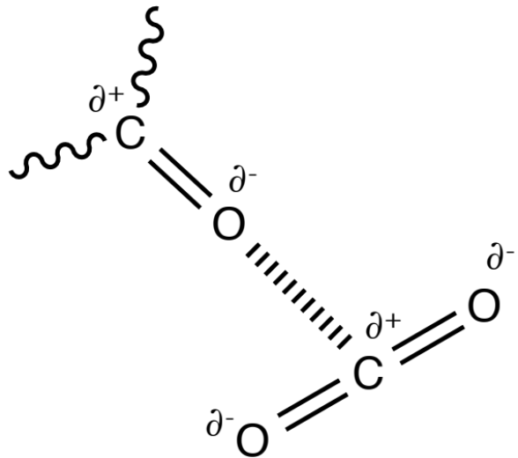
CO₂ vs N₂
80 ºC
Zero Shear Viscosity (Pa.s)
Pressure (bar)
S. Curia et al., Polymer, 2015
Notes:
so taking the viscosity at a given shear rate you can see on the left the data taken at fixed T (20 °C) while increasing pressure and the data taken at fixed p (ambient p) while increasing T…

Slide 30
Viscosity of PCL vs T
80 ºC
Without CO₂
180 ºC
Zero Shear Viscosity (Pa.s)
1/Temperature (1/K)
S. Curia et al., Polymer, 2015
Notes:
so taking the viscosity at a given shear rate you can see on the left the data taken at fixed T (20 °C) while increasing pressure and the data taken at fixed p (ambient p) while increasing T…

Slide 31
Viscosity of PCL vs T
80 ºC
180 ºC
80 kDa
80 ºC
CO₂ 300 bar
Zero Shear Viscosity (Pa.s)
10 kDa
80 ºC
CO₂ 300 bar
1/Temperature (1/K)
300 bar at 80 ºC in CO₂ = 250 ºC without CO₂!
S. Curia et al., Polymer, 2015
Notes:
so taking the viscosity at a given shear rate you can see on the left the data taken at fixed T (20 °C) while increasing pressure and the data taken at fixed p (ambient p) while increasing T…

Slide 32
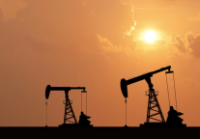
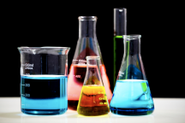

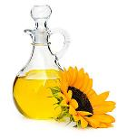


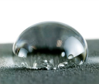
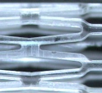
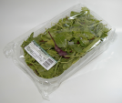
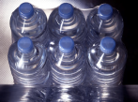
High T
Organic solvents
Toxic catalysts
Polyesters
Fossil-based resources
Monomers
Low T
No solvents
Enzyme catalysed
Green resources

Slide 33

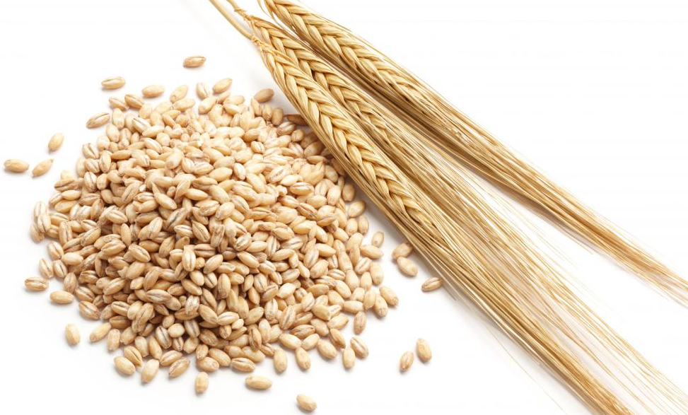
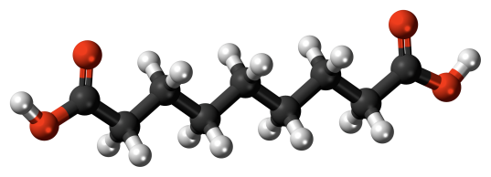
Oleic acid
Barley, rye, wheat
Ozonolysis
Extraction
Azelaic acid
Bio-derived ✓
Non-harmful ✓

Slide 34
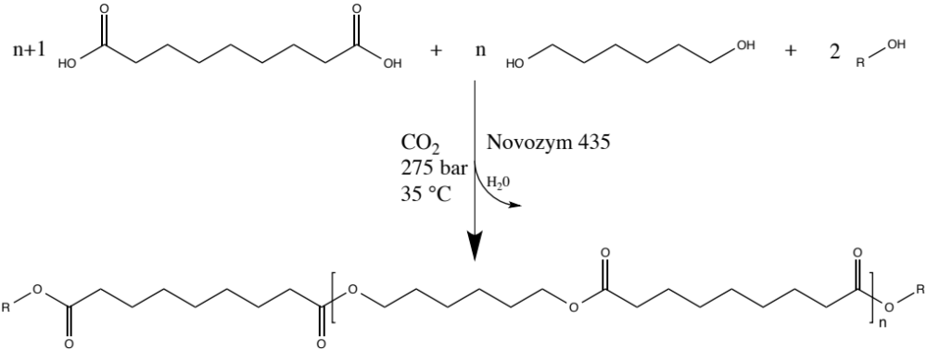
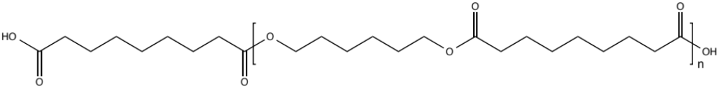
Polymerisation of azelaic acid
T>200 ºC
Metal catalysts

Slide 35
Oleic acid
Barley, rye, wheat
Ozonolysis
Extraction
Azelaic acid
T_{m}≈110 ºC ✗
Insoluble in apolar solvents ✗

Slide 36
Polymerisation of azelaic acid
Can a green lower T approach be achieved in CO₂?

Slide 37
HP reaction vessel
Mechanical stirrer
\
CO₂ in
CO₂ out
(60 mL or 20 mL base)

Slide 38
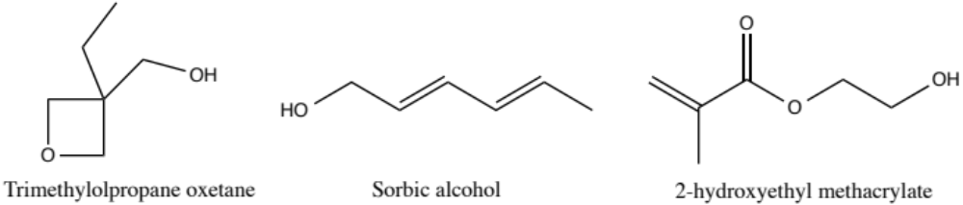
Green Route to Green Functional Materials
Low T:
Save €€€/£££
Preserve enzyme
Preserve functionalities
Lipase
Molecular sieves
Naturally derived → 100% bio-content
S. Curia et al., Phil Trans A, 2015, accepted

Slide 39
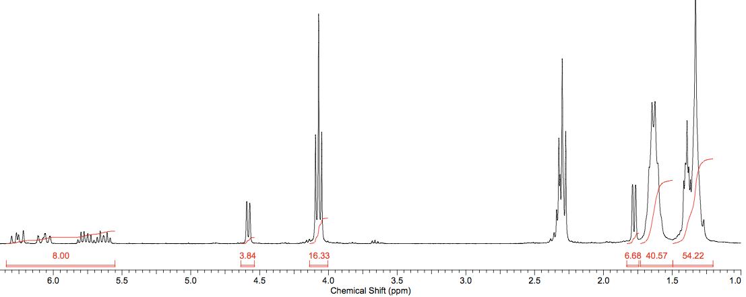
Sorbic alcohol end-capping: NMR
3
End-capped ✓
MW ✓
No side reactions ✓
S. Curia et al., Phil Trans A, 2015, accepted

Slide 40
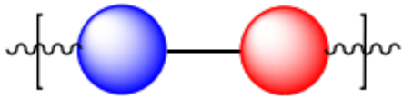
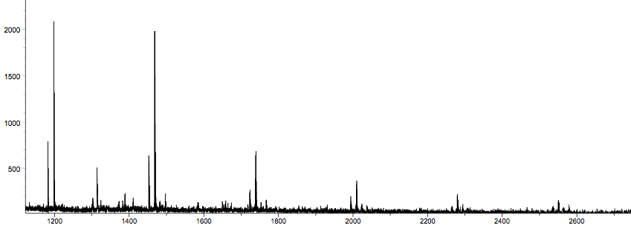
Sorbic alcohol end-capping: MALDI-ToF
270.4 g/mol
Intensity (a.u. x 10⁴)
m/z
S. Curia et al., Phil Trans A, 2015, accepted

Slide 41
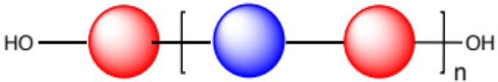
Sorbic alcohol end-capping: MALDI-ToF
A=
B=
Intensity (a.u. x 10⁴)
A₃
A₄
A₅
B₄
A₆
A₇
A₈
m/z
S. Curia et al., Phil Trans A, 2015, accepted

Slide 42
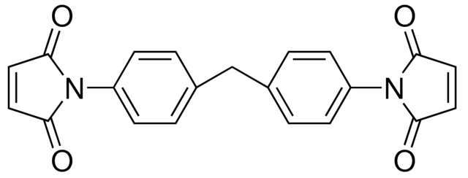
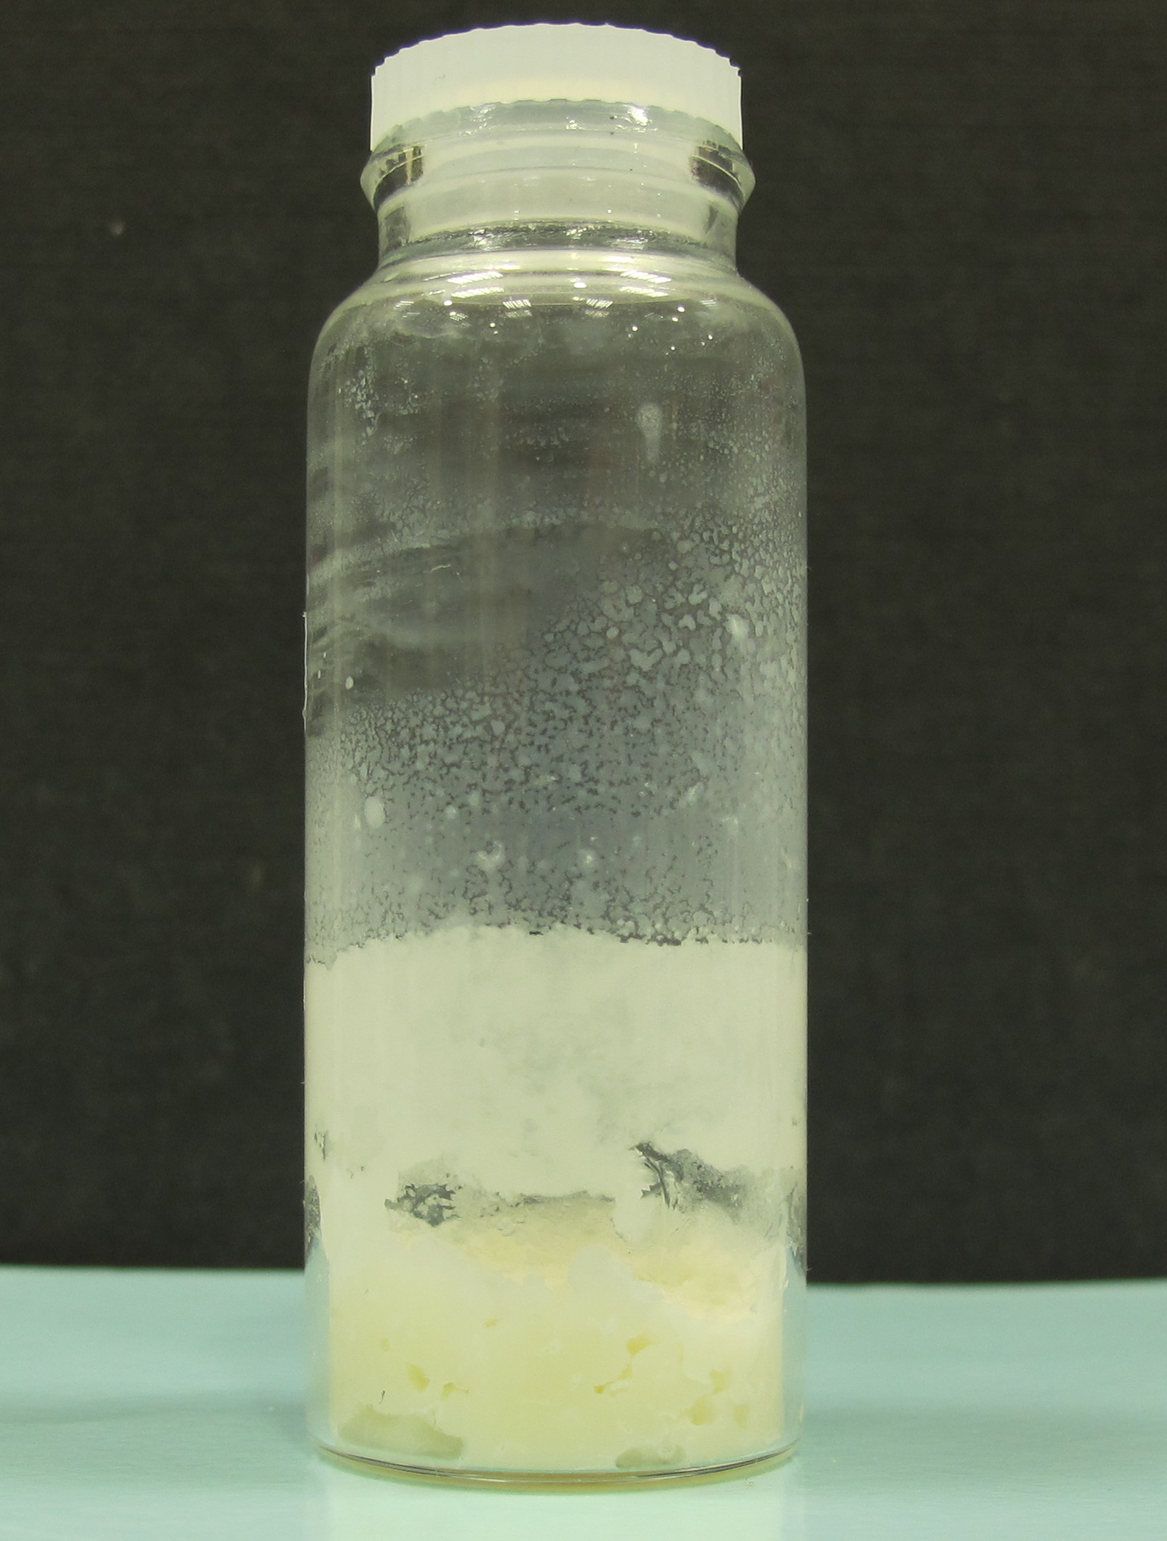
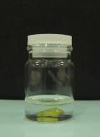
Further reaction: Diels Alder chain extension
n
+
2n
DA
RT, 24 h
Chain extended interpenetrated network
DA
Swollen in
CHCl₃

Slide 43
Thermal analysis
Before curing
Heat Flow (endo down)
40 °C
After curing
Decreased
crystallinity
25 °C

Slide 44
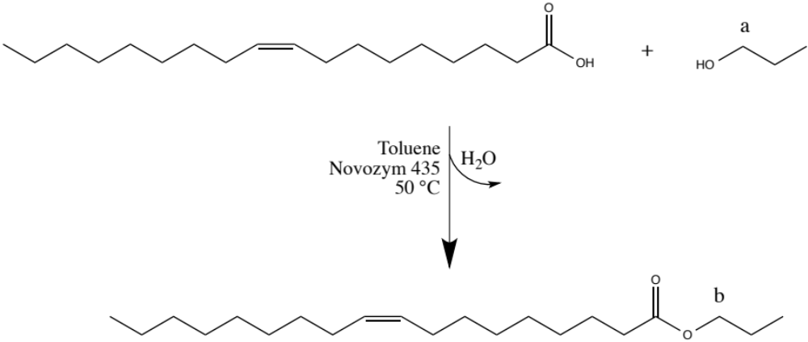
Enzyme recycling: propyl oleate synthesis
Fresh enzyme
Enzyme used at 35 ºC/275 bar (CO₂)
Enzyme used at 110 ºC (melt synthesis)

Slide 45
Enzyme recycling: propyl oleate synthesis
Fresh
S. Curia et al., Phil Trans A, 2015, accepted

Slide 46
Enzyme recycling: propyl oleate synthesis
CO₂ (35 ºC, 275 bar)
Fresh
S. Curia et al., Phil Trans A, 2015, accepted

Slide 47
Enzyme recycling: propyl oleate synthesis
CO₂ (35 ºC, 275 bar)
Fresh
Melt process (110 ºC)
S. Curia et al., Phil Trans A, 2015, accepted

Slide 48
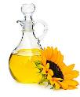
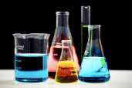

Conclusions
CO₂ is able to plasticise PCL with varied MW
Used CO₂ as a reaction medium to achieve a green low T route to functional materials
Recycling tests showed that the high-pressure reactions are commercially sustainable

Slide 49
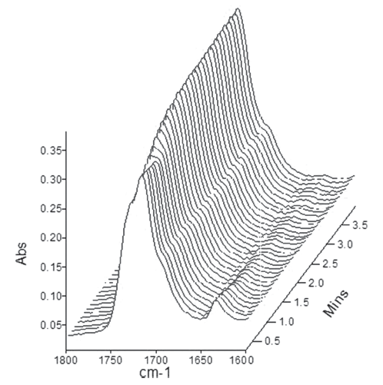
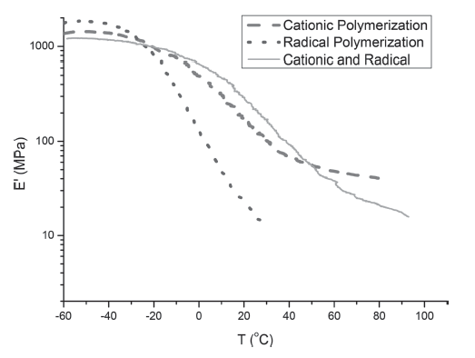
Next Steps
Test cross-linking of the green functional polymers (DSC, DMA) + efficiency test (real time FTIR etc.) (collaboration with KTH)
S. Torron et al., Macromol Phys and Chem, 2014

Slide 50
Next Steps & future outlook
Radical chain extension of telechelic
A-B-A block copolymer synthesis + analysis
Hydrophobic
Hydrophilic
Hydrophilic
Micelle?
Hydrogel?
Drug delivery?

Slide 51
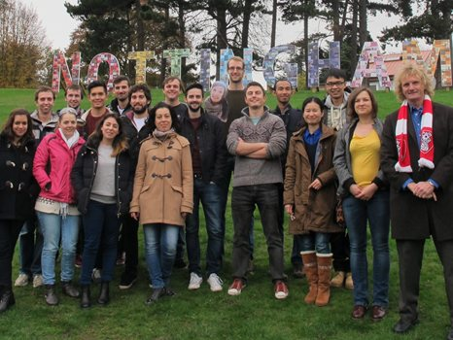
Acknowledgments:
Prof Steven M Howdle and Dr Derek J Irvine
KTH people: Prof Karl Hult, Prof Mats Johansson, Prof Mats Martinelle, Susana Timhagen, Stefan Semlitsch
Mark Guyler, Pete Fields and Richard Wilson
Helen Carson
EU, 7th FP and MC actions for funding

Slide 52
Thank you!
… any questions?

