Slide 1
Conference Series LLC Conferences
Conference Series LLC is a pioneer and leading science event organizer, which publishes around 500 open access journals and conducts over 500 Medical, Clinical, Engineering, Life Sciences, Pharma scientific conferences all over the globe annually with the support of more than 1000 scientific associations and 30,000 editorial board members and 3.5 million followers to its credit.
Conference Series LLC has organized 500 conferences, workshops and national symposiums across the major cities including San Francisco, Las Vegas, San Antonio, Omaha, Orlando, Raleigh, Santa Clara, Chicago, Philadelphia, Baltimore, United Kingdom, Valencia, Dubai, Beijing, Hyderabad, Bengaluru and Mumbai.

Slide 2

August 23rd, 2016
C1- inhibitors (Berinert ®) versus Icatibant in the treatment of Hereditary Angioedema
Dr. SILVIA LEONE, MD
Post-Graduate Student – School of Clinical Toxicology and Pharmacology, Genoa, Italy
Medical Doctor at A&E Dept., «Galliera Hospital», Genoa, Italy
Cruise Chief Doctor, Governmental Official of Health on Cruises
drsilvialeone@gmail.com

Slide 3
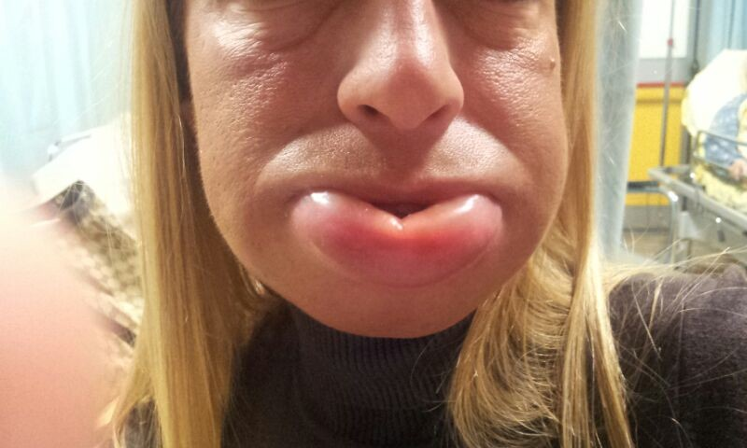

Slide 4

5 hours later
Notes:
C1-INH is a member of the serpin family of protease inhibitors, as are alpha-antitrypsin, antithrombin III, and angiotensinogen.^{[13]} These proteins stoichiometrically inactivate their target proteases by forming stable, one-to-one complexes with the protein to be inhibited.
Synthesized primarily by hepatocytes, C1-INH is also synthesized by monocytes. The regulation of the protein production is not completely understood but, since patients respond clinically to androgen therapy and demonstrate increased serum levels of C1-INH, it is believed that androgens may stimulate C1-INH synthesis. C1-INH also blocks activation of the lectin pathway by binding to mannose-binding lectin-associated serine proteases (MASPs).
Although named for its action on the first component of complement (C1 esterase), C1-INH also inhibits components of the fibrinolytic, clotting, and kinin pathways. Specifically, C1-INH inactivates plasmin-activated Hageman factor (factor XII), activated factor XI, plasma thromboplastin antecedent (PTA), and kallikrein.
Within the complement system, C1-INH blocks the activation of C1 and the rest of the classic complement pathway by binding to C1r and C1s. Without C1-INH, unchecked activation of C1, C2, and C4 occur before other inhibitors (C4-binding protein and factors H and I) can halt the cascade.
Evidence is now overwhelming that bradykinin is the mediator responsible for capillary leakage.^{[13]} Researchers have demonstrated activation of the kinin system with increased blood bradykinin levels associated with clinical flares. Bradykinin is an important inflammatory mediator formed by the action of the plasma enzyme kallikrein on the substrate high molecular weight kininogen that causes neutrophil chemotaxis, capillary dilation with plasma leakage, and smooth muscle relaxation, and it has been linked to other forms of angioedema.
Racial and sexual differences in incidence
Persons of any race can be affected by HAE, with no reported bias in different ethnic groups. Men and women are equally affected for HAE types I and II, although women tend to have more severe attacks.^{[1]} HAE type III was initially thought to occur only in women, but recent family studies have described males with HAE and normal C1 inhibitor levels. Nevertheless, HAE type III is still thought to predominantly affect women.
Age-related differences in incidence
C1-INH deficiency is present at birth in HAE, although only a few patients have been reported with perinatal angioedema. Symptoms usually become apparent in the first or second decade of life.
Approximately 40% of people with hereditary angioedema (HAE) experience their first episode before age 5 years, and 75% present before age 15 years.^{[18]}Patients typically experience minor swelling in childhood that may go unnoticed, with increased severity around puberty. However, type III HAE is found in the second decade of life or later and occurs only rarely before puberty.^{[5]}
HAE is a lifelong affliction, although some report decreased symptoms with age. Five percent of adult HAE carriers are asymptomatic, and they are identified only after their children are found to be symptomatic.
Diagnostic and Therapeutic Management of Hereditary Angioedema Due to C1-Inhibitor Deficiency
The Italian Experience
Mauro Cancian
DisclosuresCurr Opin Allergy Clin Immunol. 2015;15(4):383-391.

Slide 5
Transient subcutaneous or submucosal swelling (non-pitting when pressure is applied).
Just a few words about Angioedema
Bradykinins-mediated Angioedema
HEREDITARY (HA) or ACQUIRED
It is a rare genetic disorder (prevalence 1:50,000); the inheritance is autosomal dominant. Most cases are due to mutations in SERPING1 gene encoding for C1-esterase inhibitors resulting in:
Low plasma concentrations of C1-INH (HA type1);
Functionally impaired C1-INH – normal concentrations (HA type 2).
* Normal C1-INH (concentrations and functions), but probable mutation in the gene encoding for Coagulation Factor XII (HA type 3 – not yet fully understood).
Histamin-mediated Angioedema – ACQUIRED
the most common form, often triggered by allergens (insect stings, food, drugs like: NSAIDs and ACE-Is);
Urticaria is common and it is mediated by mast-cells degranulation;
Itching is common as well;
It can occur quickly, usually within a hour from the exposure to the allergens.

Slide 6
Transient subcutaneous or submucosal swelling (non-pitting when pressure is applied).
Just a few words about Angioedema
Bradykinins-mediated Angioedema
HEREDITARY (HA) or ACQUIRED
Urticaria and itching don’t occur
The attack usually develops over several hours (sometimes during the night)
Attacks tend to be more severe and persistent lasting up to 7 days and involving the abdomen.
Histamin-mediated Angioedema – ACQUIRED
the most common form, often triggered by allergens (insect stings, food, drugs like: NSAIDs and ACE-Is);
Uricaria is common and it is mediated by mast-cells degranulation;
Itching is common as well;
It can occur quickly, usually within a hour from the eposure to the allergens.

Slide 7
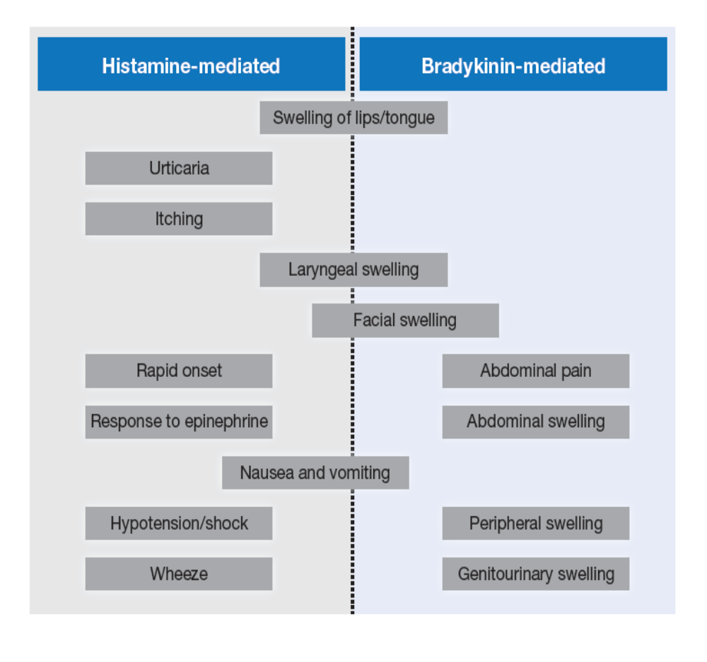
Bradykinins-mediated Angioedema
HEREDITARY (HA) or ACQUIRED
Associated with ACE-Is therapy: the enzyme degrades bradykinin (accumulation).
Other drugs include: NSAIDs, antibiotics, angiotensin receptor blockers (ARBs) and oral antidiabetic DDP-IV inhibitors plus ACE-Is.
Symptoms:
Usually localized in the face or upper aero-digestive tract,
Non-itchiness and erythema lasting 24 to 72 hours
Bradykinin-mediated angioedema can also develop later in life, and is known as ACQUIRED ANGIOEDEMA. This condition is very rare (prevalence of 1:100,000 to 1:500,000). The symptoms are the same of HA. Almost all cases are diagnosed during or after the 4th decade of life and are often associated with an underlying lymphatic disorder and/or antibodies against C1-INH.

Slide 8
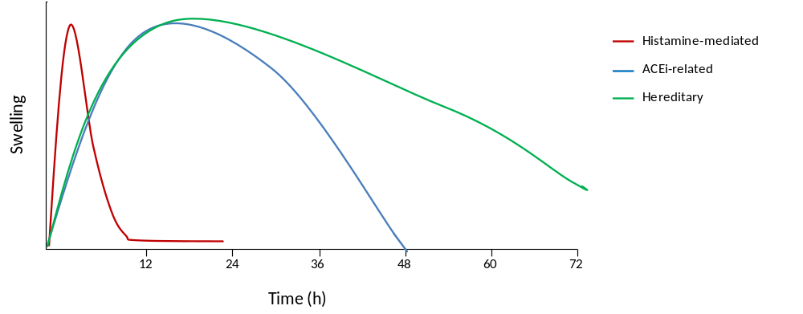
Schematic representation of angioedema attack onset and duration.
Histamine-mediated angioedema attacks tend to have rapid onset and resolution. Bradykinin-mediated angioedema usually develops more slowly and can persist for up to 5 days, although ACE-Is-Induced angioedema will usually resolve within 48 hours once the drug is discontinued.

Slide 9
Diagnosis
A diagnosis of hereditary or acquired angioedema can be confirmed with blood test; however currently available blood tests cannot confirm ACE-Is-Induced Angioedema.
Low C1-INH concentration together with low C1-INH function indicate type 1 HA or acquired angioedema.
Whereas low C1-INH function in the presence of normal ot high C1-INH concentrations is diagnostic for type 2 HA.
C4 concentrations, which are substantially reduced during an attack of HA are useful for screening, but false positive/negative results are possible.
Both C1-INH and C4 concentrations are normal in patients with ACE-Is-induced angioedema.
If the attack is histamine-mediated tryptase concentrations in blood drawn within 4 to 6 hours from the onset and are indicative of anaphylaxis.

Slide 10
Different pathophysiology does mean →
Different therapies
Whereas Bradykinin-mediated Angioedema won’t respond to corticosteroids and needs specific therapies:
C1 esterase INH :
Human: C1-INH concentrate - Berinert® [Germany: 1979; FDA: September 2009 + January 2012] and Cinryze® [FDA 2008 for HA prophylaxis]
Recombinant (rhC1-INH): Ruconest ® [FDA 2014]
Selective Bradykinin B2 receptor antagonist:
Icatibant - Firazyr ® [EMEA: 2008; FDA: 2011]
Plasma Kallikrein Inhibitor: Not approved in Europe !!!
Human: ecallantide [Kalbitor ®]
Histamine-mediated Angioedema
must be treated with: anti-histamines, corticosteroids and epinephrine

Slide 11
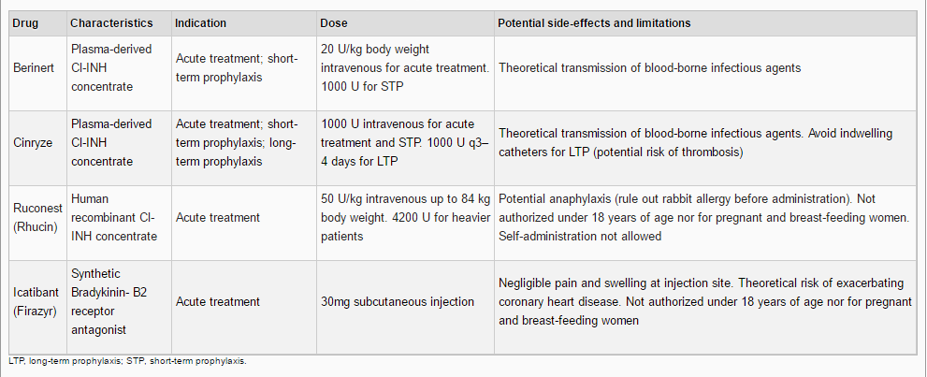
STP
before a medical or surgical procedure
LTP: the frequency of recurrences has an extremely high intra-subject and inter-subject variability, ranging from less then once a year up to every 3-4 days. The most common therapies are: androgens (danazol – 200 mg/daily or less), tranexamic acid, C1-INH nano-filtered (Cinryze®)

Slide 12
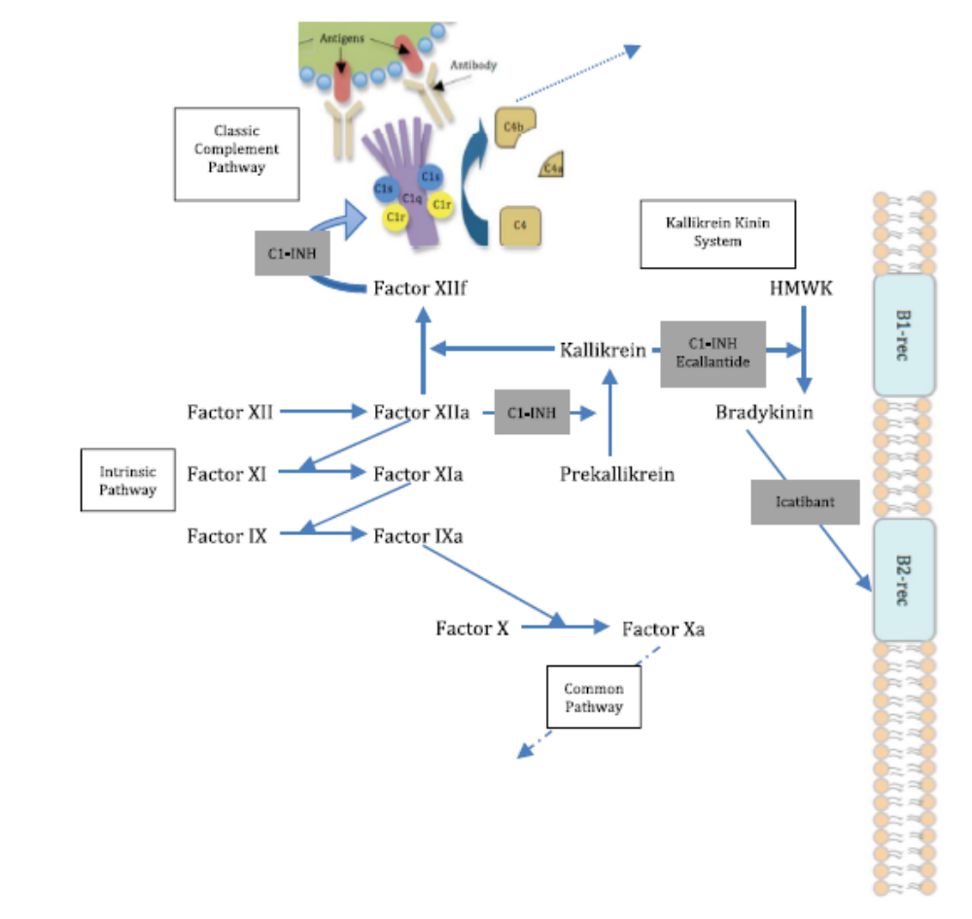
Pathophysiology & Mechanisms of Action of Drugs
C1-INH is a member of the serpin family of protease inhibitors, as are alpha-antitrypsin, anti-thrombin III, and angiotensinogen. Synthesized primarily by hepatocytes, C1-INH is also synthesized by monocytes.
The regulation of the protein production is not completely understood but, since patients respond clinically to androgen therapy and demonstrate increased serum levels of C1-INH, it is believed that androgens may stimulate C1-INH synthesis.
C1-INH also inhibits components of the fibrinolytic, clotting, and kinin pathways. Specifically, C1-INH inactivates plasmin-activated Hageman factor (factor XII), activated factor XI, plasma thromboplastin antecedent (PTA), and kallikrein.
Within the complement system, C1-INH blocks the activation of C1 and the rest of the classic complement pathway by binding to C1r and C1s. Without C1-INH, unchecked activation of C1, C2, and C4 occur before other inhibitors (C4-binding protein and factors H and I) can halt the cascade.
Evidence is now overwhelming that bradykinin is the mediator responsible for capillary leakage. Bradykinin is an important inflammatory mediator that causes neutrophil chemotaxis, capillary dilation with plasma leakage, and smooth muscle relaxation, and it has been linked to other forms of angioedema.

Slide 13
Let’s focus on BERINERT® and Icatibant (FIRAZYR®)…
WHY?
Two different mechanisms of action
«oldest» molecules, more clinical trials, more knowledge :
PHARMACOVIGILANCE !!!!
Most used in Italy
My Personal Experience in the A&E Dept. «Galliera Hospital», Genoa, Italy
Notes:
Cicardi M, Levy RJ, McNeil DL, et al. Ecallantide for the treatment of acute attacks in hereditary angioedema. N Engl J Med 2010; 363:523–531.

Slide 14
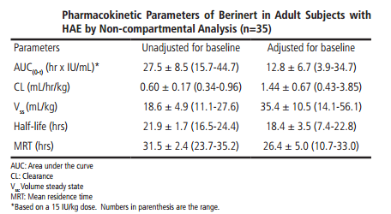
Berinert®
Highly purified, freeze dried C1 esterase INH concentrate derived from human plasma.
PK → investigated in in an open-label, uncontrolled, single-centre study in 40 subjects, (6 patients < 18 years) with either mild or severe HA.
25 subjects were treated on demand for an acute attack
15 subjects were treated on a prophylactic basis.
Dosage: single IV injection ranging from 500 to 1500 IU.
Median Recovery: 86.7% for children: 98.2% vs. 82.5%
for severe attacks was higher than for mild attacks.
Median Increase of C1est-INH activity was 2.3%/IU/kg body weight with a maximum concentration within 0.8 hours after administration.
Clinical Trials about efficacy and safety:
I.M.P.A.C.T.1 a pivotal phase III RCT: prospective, multinational, randomized, parallel-group, placebo-controlled, dose-finding, three-arm, double-blind.
I.M.P.A.C.T.2 another prospective, open-label, uncontrolled, multicenter extension study in subject who had participated in the pivotal phase III study and experienced a life-threatening laryngeal attack prior to enrolment (in this trial attacks at any body location were treated).

Slide 15
I.M.P.A.C.T.1
It assessed the efficacy and safety of Berinert in 124 adult and pediatric subjects with C1 esterase inhibitor deficiency who were experiencing an acute moderate to severe attack of abdominal or facial HAE. Subjects ranged in age from six to 72 years of age; 67.7% were female and 32.3% were male; and approximately 90% were Caucasian. The study objectives were to evaluate whether Berinert shortens the time to onset of relief of symptoms of an abdominal or facial attack compared to placebo and to compare the efficacy of two different doses of Berinert. Subjects were randomized to receive a single 10 IU/kg body weight dose of Berinert (39 subjects), a single 20 IU/kg dose of Berinert (43 subjects), or a single dose of placebo (42 subjects) by slow intravenous infusion (recommended to be given at a rate of approximately 4 mL per minute) within 5 hours of an HAE attack. At least 70% of the subjects in each treatment group were required to be experiencing an abdominal attack. If a subject experienced no relief or insufficient relief of symptoms by 4 hours after infusion, investigators had the option to administer a second infusion of Berinert (20 IU/ kg for the placebo group, 10 IU/kg for the 10 IU/kg group), or placebo (for the 20 IU/kg group). This masked (blinded) “rescue study medication” was administered to subjects and they were then followed until complete resolution of symptoms was achieved. Adverse events were collected for up to 7 to 9 days following the initial administration of Berinert or placebo. In the rare case that a subject developed life-threatening laryngeal edema after inclusion into the study, immediate start of open-label treatment with a 20 IU/kg body weight dose of Berinert® was allowed. All subjects who received confounding medication (rescue medication) before symptom relief were regarded as “non-responders.”

Slide 16
I.M.P.A.C.T.2
Berinert was evaluated in a prospective, open-label, uncontrolled, multicenter extension study conducted at 15 centers in the US and Canada in subjects who had participated in the RCT study for the treatment of acute abdominal or facial attacks in subjects with hereditary angioedema. The purpose of this extension study was to provide Berinert to subjects who had participated in the RCT study and who experienced any type of subsequent HAE attack (i.e., abdominal, facial, peripheral, or laryngeal). The safety analysis of the open-label extension study included a total of 57 subjects (19 males and 38 females, age range: 10 to 53 years) with 1085 HAE attacks treated with 20 IU/kg body weight dose of Berinert per attack, who were observed at the study site until onset of relief of HAE symptoms, and were followed up for adverse reactions for 7 to 9 days following treatment of each HAE attack. During the extension study, 51 subjects experienced 747 abdominal attacks, 21 subjects experienced 51 facial attacks, 30 subjects experienced 235 peripheral attacks, and 16 subjects experienced 48 laryngeal attacks. Some study subjects may have experienced HAE attacks in more than one location. An analysis of laryngeal HAE attacks showed that the median time to initial onset of symptom relief and median time to complete resolution in the per-attack analysis were 0.25 hours and 8.4 hours, respectively, which were the shortest times among the various attack locations.

Slide 17
WHAT ABOUT Adverse Events?

Slide 18
AEs reported in the RCT I.M.P.A.C.T.1 in patients receiving Berinert® 20UI/kg :
NAUSEA (7%)
HEADACHE (7%)
ABDOMINAL PAIN (7%)
DYSGEUSIA (4.7%)
VOMITING (2.3%)
No AEs or Serious AEs (SEAs) leading to discontinuation occurred within 4 hours after study treatment.
Subjects were tested at baseline and after 3 months for possible exposure to Parvovirus B19, hepatitis B, hepatitis C, and HIV-1 and HIV-2. No subject who underwent testing evidenced seroconversion or treatment-emergent positive polymerase chain reaction testing for these pathogens.
In I.M.P.A.C.T.2 AEs possibly related to treatment were reported in 8/57 (14%) patients. One patient discontinued the treatment due to an infusion-related reaction.

Slide 19
Since 1985 approximately 30,000 patients
per year were treated with Berinert®.
The most important identified and potential risks are:
hypersensitivity reactions, thromboembolic events and the risk of transmission of infectious agents.
Adverse reactions reported in Europe since 1979 in patients receiving Berinert® for treatment of HA include:
hypersensitivity/anaphylactic reactions, injection-site pain, injection-site redness, chills, and fever.
Plasma-derived products need continuous surveillance for their infectivity potential, but no case of blood-borne infection has been reported for pd-C1-INHs currently available for HA since their presence on the market.
Serious arterial and venous thromboembolic (TE) events have been reported at the recommended dose of Berinert®, following administration in patients with HA. Risk factors may include the presence of an indwelling venous catheter/access device, prior history of thrombosis, underlying atherosclerosis, use of oral contraceptives or certain androgens, morbid obesity, and immobility. Benefits of treatment of HAE attacks should be weighed against the risks of TE events in patients with underlying risk factors. Monitor patients with known risk factors for TE events during and after Berinert administration. TE events have also been reported following administration at higher than recommended doses.
It was concluded that pdC1-INH (Berinert®) has a favorable safety profile, which is in agreement with numerous observational studies conducted.

Slide 20
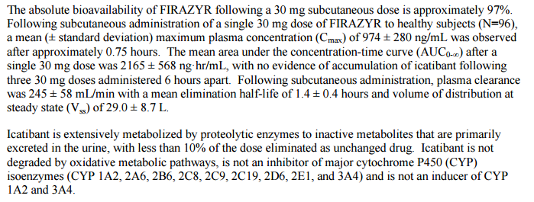
Icatibant - Firazyr®
Icatibant (Firazyr®), a synthetic, selective BK-B2r antagonist (inhibits bradykinin from binding the B2 receptor and thereby treats the clinical symptoms of an acute, episodic attack of HA), has been available in Italy since 2009 as prefilled syringes containing 30 mg of drug to be self-injected subcutaneously for treatment of acute attacks in adult patients.
The recommended dose of FIRAZYR® is 30 mg administered by subcutaneous (SC) injection in the abdominal area. Additional doses may be administered at intervals of at least 6 hours if response is inadequate or if symptoms recur. No more than 3 doses may be administered in any 24 hour period.
  PK → bioavailability of 97%
  mean half-life of 1.4 ± 0.4 hours
  metabolized by proteolytic enzymes to inactive metabolites excreted in the urine (no interference with CYP)
  Clinical Trials about efficacy and safety:
Two parallel phase III studies, FAST-1 (in the United States) and FAST-2 (in Europe and Israel), respectively, against placebo and tranexamic acid assessed efficacy to obtain relief of symptoms in acute HA attacks. As the endpoint was initially reached just in FAST-2, Icatibant was licensed in Europe starting from 2008.
Another similar trial, FAST-3, showing Icatibant to be significantly superior to placebo was necessary for FDA approval given in 2011.
.

Slide 21
KNOWN ADVERSE EVENTS
Injection site reactions are reported in most patients after administration. Other adverse reactions reported include pyrexia, increase in transaminases, dizziness, and rash, tiredness, drowsiness, and dizziness.
The B2 receptor has been implicated in the cardio-protective effects of bradykinin and antagonism of this receptor could potentially have negative cardiovascular effects
It should be used during acute coronary ischemia, unstable angina pectoris, or in the weeks following a stroke only if the benefit exceeds the theoretical risk to the patient.

Slide 22
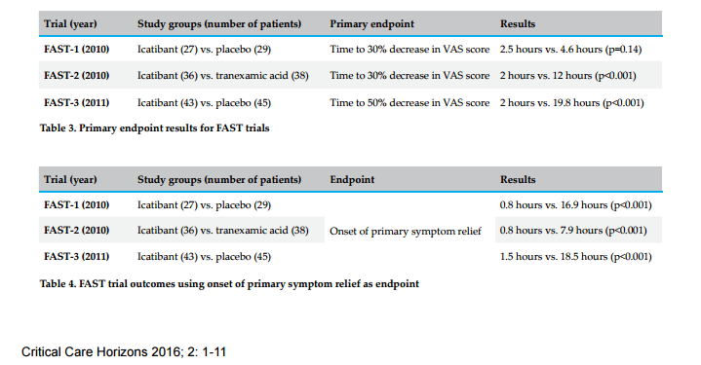
The primary endpoint in all three FAST trials was assessed using a three-point visual analogue scale (VAS) assessment of symptoms – skin swelling, skin pain and abdominal pain.

Slide 23
 | Berinert® | Firazyr®
INDICATIONS | Treatment of acute abdominal, facial, or laryngeal attacks of hereditary angioedema (HAE) in adult and children. | Treatment of acute attacks of HA in adults. It may also be used in suspected case of ACE-Is AE. It can be considered for empiric use when the cause is unknown
DOSAGE, STORAGE, DOSAGE FORM | Store the vial in the original carton in order to protect from light. Store at 2-25°C. 500 units lyophilized concentrate in a single-use vial for reconstitution with 10 mL of diluent (sterile water). | Prefilled syringes containing 30 mg of drug. Store at 2-25 °C. It doesn’t need a refrigerator.
ADMINISTRATION | Administer 20 units per kg body weight I.V. at a rate of 4 ml/minute. Self-administration not advised. | Self-injection subcutaneously in the abdominal area
PREGNANCY | Limited human data. Use only if clearly needed. Pregnancy Category C. | Limited human data. Use only if clearly needed. Pregnancy Category C.
CHILDREN | Compared to adults, when adjusted for baseline, the half-life was shorter and clearance (on per kg basis) was faster in children. | Safety and effectiveness below the age of 18 years have not been established yet.
HALF-LIFE | 18.4 ± 3.5 hours (until 87 hours for Berinert® 1500 UI) | 1.4 ± 0.4 hours
CONTRAINDICATIONS | Contraindicated in individuals with a history of life-threatening systemic reactions to C1 esterase inhibitor preparations (including anaphylaxis). TE events: Risk factors may include having an indwelling venous catheter/access device; prior history of thrombosis; underlying atherosclerosis; use of oral contraceptives or certain androgens; morbid obesity; and immobility | It should be used during acute coronary ischemia, unstable angina pectoris, or in the weeks following a stroke only if the benefit exceeds the theoretical risk to the patient.
TIME TO ONSET OF RELIEF/RESOLUTION | Time to onset of relief from ABDOMINAL symptoms: median of 48 minutes, while time to onset of LARYNGEAL symptoms: 0.25 mins. Time to resolution: 8.4 hours | Median time to 50% reduction from baseline symptoms ranging from 2.0 to 2.3 hours.

Slide 24
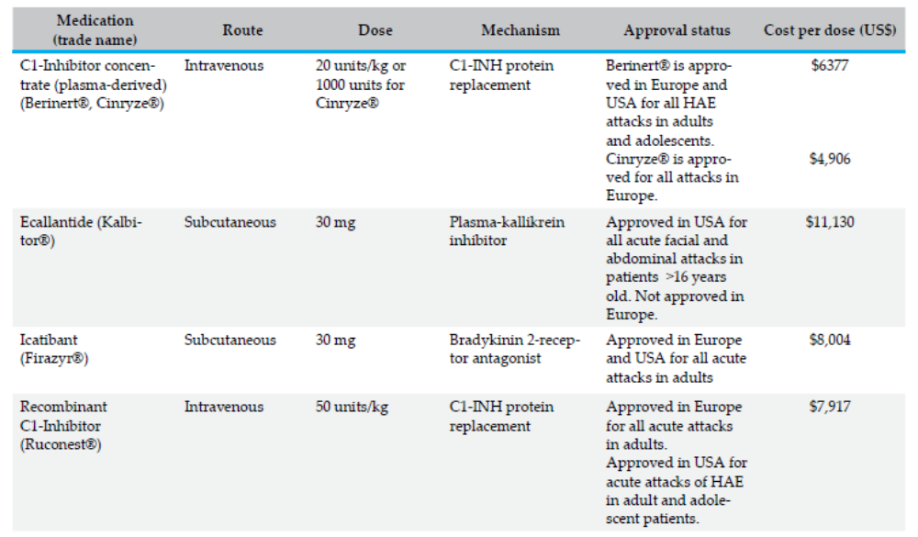
In Italy:
Berinert®: the commercialized box contains 50 UI. The recommended posology (20 UI/Kg) for a patients of about 70 kg (3 boxes) costs 1,680 € (ex-factory).
Icatibant: the cost of a single dose is 1529,75 € (ex-factory), but often we should use more than one box….

Slide 25
My Experience at A&E Dept. «GALLIERA Hospital», Genoa, Italy
All cases of hereditary angioedema were registered for a period of 1 year (2015) in the Emergency Dept. of “Galliera Hospital” (Genoa, Italy), using a Program called ‘PIESSE’.
We observed a total of 39 cases of angioedema. 11 of them were bradykinin-mediated. We are glad to point out that all the hereditary angioedema were recognized immediately by the Medical Doctors due to a particular awareness of this kind of disease.
6 cases were treated with Icatibant, and 5 with C1-inhibitors (Berinert ®).
We use both drugs, but in the A&E Dept., we usually prefer Icatibant:
Usually quick response
Short half-life
AND
No need of refrigeration
Subcutaneous Injection
Possibility to use it also in case of ACE-Is angioedema and in unknown causes angioedema (empiric use).
[Christian Longley, Icatibant and its therapeutic indications, Critical Care Horizon 2016; 2:1-11]

Slide 26
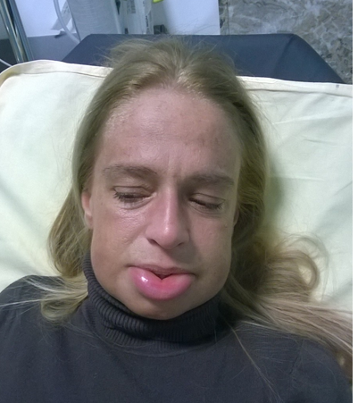
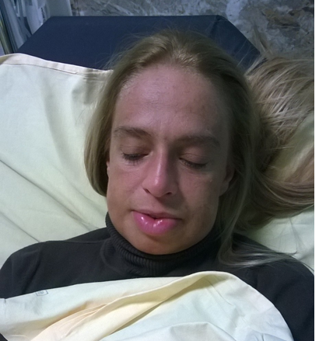

My Experience at A&E Dept. «GALLIERA Hospital», Genoa, Italy
This is a case treated with Icatibant:
1 hour later
Arrival at A&E
At Icatibant injection
3 hours later

Slide 27
5 hours later
Notes:
C1-INH is a member of the serpin family of protease inhibitors, as are alpha-antitrypsin, antithrombin III, and angiotensinogen.^{[13]} These proteins stoichiometrically inactivate their target proteases by forming stable, one-to-one complexes with the protein to be inhibited.
Synthesized primarily by hepatocytes, C1-INH is also synthesized by monocytes. The regulation of the protein production is not completely understood but, since patients respond clinically to androgen therapy and demonstrate increased serum levels of C1-INH, it is believed that androgens may stimulate C1-INH synthesis. C1-INH also blocks activation of the lectin pathway by binding to mannose-binding lectin-associated serine proteases (MASPs).
Although named for its action on the first component of complement (C1 esterase), C1-INH also inhibits components of the fibrinolytic, clotting, and kinin pathways. Specifically, C1-INH inactivates plasmin-activated Hageman factor (factor XII), activated factor XI, plasma thromboplastin antecedent (PTA), and kallikrein.
Within the complement system, C1-INH blocks the activation of C1 and the rest of the classic complement pathway by binding to C1r and C1s. Without C1-INH, unchecked activation of C1, C2, and C4 occur before other inhibitors (C4-binding protein and factors H and I) can halt the cascade.
Evidence is now overwhelming that bradykinin is the mediator responsible for capillary leakage.^{[13]} Researchers have demonstrated activation of the kinin system with increased blood bradykinin levels associated with clinical flares. Bradykinin is an important inflammatory mediator formed by the action of the plasma enzyme kallikrein on the substrate high molecular weight kininogen that causes neutrophil chemotaxis, capillary dilation with plasma leakage, and smooth muscle relaxation, and it has been linked to other forms of angioedema.
Racial and sexual differences in incidence
Persons of any race can be affected by HAE, with no reported bias in different ethnic groups. Men and women are equally affected for HAE types I and II, although women tend to have more severe attacks.^{[1]} HAE type III was initially thought to occur only in women, but recent family studies have described males with HAE and normal C1 inhibitor levels. Nevertheless, HAE type III is still thought to predominantly affect women.
Age-related differences in incidence
C1-INH deficiency is present at birth in HAE, although only a few patients have been reported with perinatal angioedema. Symptoms usually become apparent in the first or second decade of life.
Approximately 40% of people with hereditary angioedema (HAE) experience their first episode before age 5 years, and 75% present before age 15 years.^{[18]}Patients typically experience minor swelling in childhood that may go unnoticed, with increased severity around puberty. However, type III HAE is found in the second decade of life or later and occurs only rarely before puberty.^{[5]}
HAE is a lifelong affliction, although some report decreased symptoms with age. Five percent of adult HAE carriers are asymptomatic, and they are identified only after their children are found to be symptomatic.
Diagnostic and Therapeutic Management of Hereditary Angioedema Due to C1-Inhibitor Deficiency
The Italian Experience
Mauro Cancian
DisclosuresCurr Opin Allergy Clin Immunol. 2015;15(4):383-391.

Slide 28
References:
Bernstein JA, Moellman J. Emerging concepts in the diagnosis and treatment of patients with undifferentiated angioedema. Int J Emerg Med. 2012;5(1):39.
Kelly M, Donnelly JP, McAnnally JR, Wang HE. National estimates of emergency department visits for angioedema and allergic reactions in the United States. Allergy Asthma Proc. 2013;34(2):150-154.
Bernstein JA. HAE update: epidemiology and burden of disease. Allergy Asthma Proc. 2013;34(1):3-6.
Lombardi C, Crivellaro M, Dama A, Senna G, Gargioni S, Passalacqua G. Are physicians aware of the side effects of angiotensin-converting enzyme inhibitors?: a questionnaire survey in different medical categories. Chest. 2005;128(2):976-979.
Jaiganesh T, Hughan C, Webster A, Bethune C. Hereditary angioedema: a survey of UK emergency departments and recommendations for management. Eur J Emerg Med. 2012;19(4):271-274.
Brown NJ, Snowden M, Griffin MR. Recurrent angiotensin-converting enzyme inhibitor--associated angioedema. JAMA. 1997;278(3):232-233.
Roberts DS, Mahoney EJ, Hutchinson CT, Aliphas A, Grundfast KM. Analysis of recurrent angiotensin converting enzyme inhibitor-induced angioedema. Laryngoscope. 2008;118(12):2115-2120.
Jaiganesh T, Wiese M, Hollingsworth J, Hughan C, Kamara M, Wood P et al. Acute angioedema: recognition and management in the emergency department. Eur J Emerg Med. 2013;20(1):10-17.
Burton OT, Oettgen HC. Beyond immediate hypersensitivity: evolving roles for IgE antibodies in immune homeostasis and allergic diseases. Immunol Rev. 2011;242(1):128-143.
Kaplan AP, Joseph K, Silverberg M. Pathways for bradykinin formation and inflammatory disease. J Allergy Clin Immunol. 2002;109(2):195-209.
Zuraw B, Banerji A, Bernstein JA, Busse PJ, Christiansen SC, Davis-Lorton M et al. US Hereditary Angioedema Association Medical Advisory Board 2013 Recommendations for the Management of Hereditary Angioedema Due to C1 Inhibitor Deficiency. J Allergy Clin Immunol Pract. 2013;1(5):458-467.
Dewald G, Bork K. Missense mutations in the coagulation factor XII (Hageman factor) gene in hereditary angioedema with normal C1 inhibitor. Biochem Biophys Res Commun. 2006;343(4):1286-1289.
Cicardi M, Zanichelli A. Acquired angioedema. Allergy Asthma Clin Immunol. 2010;6(1):14.
Bertazzoni G, Spina MT, Scarpellini MG, Buccelletti F, De SM, Gregori M et al. Drug-induced angioedema: experience of Italian emergency departments. Intern Emerg Med. 2013.
Toh S, Reichman ME, Houstoun M, Ross SM, Ding X, Hernandez AF et al. Comparative risk for angioedema associated with the use of drugs that target the renin-angiotensin-aldosterone system. Arch Intern Med. 2012;172(20):1582-1589.
Grouzmann E, Livio F, Buclin T. Angiotensin-converting enzyme and dipeptidyl peptidase IV inhibitors: an increased risk of angioedema. Hypertension. 2009;54(3):468-470.
Cicardi M, Bergamaschini L, Zingale LC, Gioffre D, Agostoni A. Idiopathic non-histaminergic angioedema. Am J Med. 1999;106(6):650-654.
Moellman JJ, Bernstein JA, Lindsell C, Banerji A, Busse PJ, Camargo CA, Jr. et al. A consensus parameter for the evaluation and management of angioedema in the emergency department. Acad Emerg Med. 2014;21(4):469-484.
Zilberberg MD, Jacobsen T, Tillotson G. The burden of hospitalizations and emergency department visits with hereditary angioedema and angioedema in the United States, 2007. Allergy Asthma Proc. 2010;31(6):511-519.
Zilberberg MD, Nathanson BH, Jacobsen T, Tillotson G. Descriptive epidemiology of hereditary angioedema emergency department visits in the United States, 2006-2007. Allergy Asthma Proc. 2011;32(5):390-394.
Felder S, Curtis RM, Ball I, Borici-Mazi R. Prognostic factors in outcome of angioedema in the emergency department. Allergy Asthma Proc. 2014;35(5):362-370.
Jolles S, Williams P, Carne E, Mian H, Huissoon A, Wong G et al. A UK national audit of hereditary and acquired angioedema. Clin Exp Immunol. 2014;175(1):59-67.
Brown NJ, Ray WA, Snowden M, Griffin MR. Black Americans have an increased rate of angiotensin converting enzyme inhibitor-associated angioedema. Clin Pharmacol Ther. 1996;60(1):8-13.
Miller DR, Oliveria SA, Berlowitz DR, Fincke BG, Stang P, Lillienfeld DE. Angioedema incidence in US veterans initiating angiotensin-converting enzyme inhibitors. Hypertension. 2008;51(6):1624-1630.
Malde B, Regalado J, Greenberger PA. Investigation of angioedema associated with the use of angiotensin-converting enzyme inhibitors and angiotensin receptor blockers. Ann Allergy Asthma Immunol. 2007;98(1):57-63.
Banerji A, Clark S, Blanda M, LoVecchio F, Snyder B, Camargo CA, Jr. Multicenter study of patients with angiotensin-converting enzyme inhibitor-induced angioedema who present to the emergency department. Ann Allergy Asthma Immunol. 2008;100(4):327-332.
Bluestein HM, Hoover TA, Banerji AS, Camargo CA, Jr., Reshef A, Herscu P. Angiotensin-converting enzyme inhibitor-induced angioedema in a community hospital emergency department. Ann Allergy Asthma Immunol. 2009;103(6):502-507.
Gang C, Lindsell CJ, Moellman J, Sublett W, Hart K, Collins S et al. Factors associated with hospitalization of patients with angiotensin-converting enzyme inhibitor-induced angioedema. Allergy Asthma Proc. 2013;34(3):267-273.

Slide 29
Holm JP, Ovesen T. Increasing rate of angiotensin-converting enzyme inhibitor-related upper airway angioedema. Dan Med J. 2012;59(6):A4449.
Williams-Johnson JA, Hemmings S, Williams EW, Channer G, McDonald AH. Six years experience of angioedema at the University Hospital of the West Indies. West Indian Med J. 2007;56(3):278-281.
Lin RY, Shah SN. Increasing hospitalizations due to angioedema in the United States. Ann Allergy Asthma Immunol. 2008;101(2):185-192.
Lin RY, Levine RJ, Lin H. Adverse drug effects and angioedema hospitalizations in the United States from 2000 to 2009. Allergy Asthma Proc. 2013;34(1):65-71.
Bork K, Hardt J, Witzke G. Fatal laryngeal attacks and mortality in hereditary angioedema due to C1-INH deficiency. J Allergy Clin Immunol. 2012;130(3):692-697.
Benson BC, Smith C, Laczek JT. Angiotensin converting enzyme inhibitor-induced gastrointestinal angioedema: a case series and literature review. J Clin Gastroenterol. 2013;47(10):844-849.
Craig T, Aygören-Pürsün E, Bork K, Bowen T, Boysen H, Farkas H et al. WAO guideline for the management of hereditary angioedema. World Allergy Organ J. 2012;5(12):182-199.
Lang DM, Aberer W, Bernstein JA, Chng HH, Grumach AS, Hide M et al. International consensus on hereditary and acquired angioedema. Ann Allergy Asthma Immunol. 2012;109(6):395-402.
Ishoo E, Shah UK, Grillone GA, Stram JR, Fuleihan NS. Predicting airway risk in angioedema: staging system based on presentation. Otolaryngol Head Neck Surg. 1999;121(3):263-268.
Beltrami L, Zanichelli A, Zingale L, Vacchini R, Carugo S, Cicardi M. Long-term follow-up of 111 patients with angiotensin-converting enzyme inhibitor-related angioedema. J Hypertens. 2011;29(11):2273-2277.
Jalaj S, Scolapio JS. Gastrointestinal manifestations, diagnosis, and management of hereditary angioedema. J Clin Gastroenterol. 2013;47(10):817-823.
Agostoni A, Cicardi M. Hereditary and acquired C1-inhibitor deficiency: biological and clinical characteristics in 235 patients. Medicine (Baltimore). 1992;71206-215.
de Graaff LC, van EM, Schipper EM, Boom H, Duschek EJ. Unnecessary surgery for acute abdomen secondary to angiotensin-converting enzyme inhibitor use. Am J Emerg Med. 2012;30(8):1607-1612.
Bork K, Staubach P, Eckardt AJ, Hardt J. Symptoms, course, and complications of abdominal attacks in hereditary angioedema due to C1 inhibitor deficiency. Am J Gastroenterol. 2006;101(3):619-627.
Cicardi M, Bork K, Caballero T, Craig T, Li HH, Longhurst H et al. Evidence-based recommendations for the therapeutic management of angioedema owing to hereditary C1 inhibitor deficiency: consensus report of an International Working Group. Allergy. 2012;67(2):147-157.
Nosbaum A, Bouillet L, Floccard B, Javaud N, Launay D, Boccon-Gibod I et al. [Management of angiotensin-converting enzyme inhibitor-related angioedema: recommendations from the French National Center for Angioedema]. Rev Med Interne. 2013;34(4):209-213.
Bas M, Greve J, Bier H, Knopf A, Stark T, Schuler P et al. [Emergency management of acute angioedema]. Dtsch Med Wochenschr. 2010;135(20):1027-1031.
Cicardi M, Bellis P, Bertazzoni G, Cancian M, Chiesa M, Cremonesi P et al. Guidance for diagnosis and treatment of acute angioedema in the emergency department: consensus statement by a panel of Italian experts. Intern Emerg Med. 2014;9(1):85-92.
Caballero T, Baeza ML, Cabanas R, Campos A, Cimbollek S, Gomez-Traseira C et al. Consensus statement on the diagnosis, management, and treatment of angioedema mediated by bradykinin. Part I. Classification, epidemiology, pathophysiology, genetics, clinical symptoms, and diagnosis. J Investig Allergol Clin Immunol. 2011;21(5):333-347.
Caballero T, Baeza ML, Cabanas R, Campos A, Cimbollek S, Gomez-Traseira C et al. Consensus statement on the diagnosis, management, and treatment of angioedema mediated by bradykinin. Part II. Treatment, follow-up, and special situations. J Investig Allergol Clin Immunol. 2011;21(6):422-441.
Longley C. Icatibant and its Therapeutic Indications. Critical Care Horizons, 2016; 2:1-11
Costantino G, Casazza G, Bossi I, Duca P, Cicardi M. Long-term prophylaxis in hereditary angioedema: a systematic review. BMJ Open. 2012;2:e000524.

Slide 30
Thank you for you kind attention !
Do you have any questions?
What is your experience?
What do you think about?
Honored to be here.
Dr. Silvia Leone, MD - drsilvialeone@gmail.com

Slide 31
Let us meet again..
We welcome you to our future conferences of Conference Series LLC
through
9th International Conference and Exhibition on Pharmacovigilance
July 17-19, 2017 Munich, Germany
http://pharmacovigilance.pharmaceuticalconferences.com/

