Slide 1




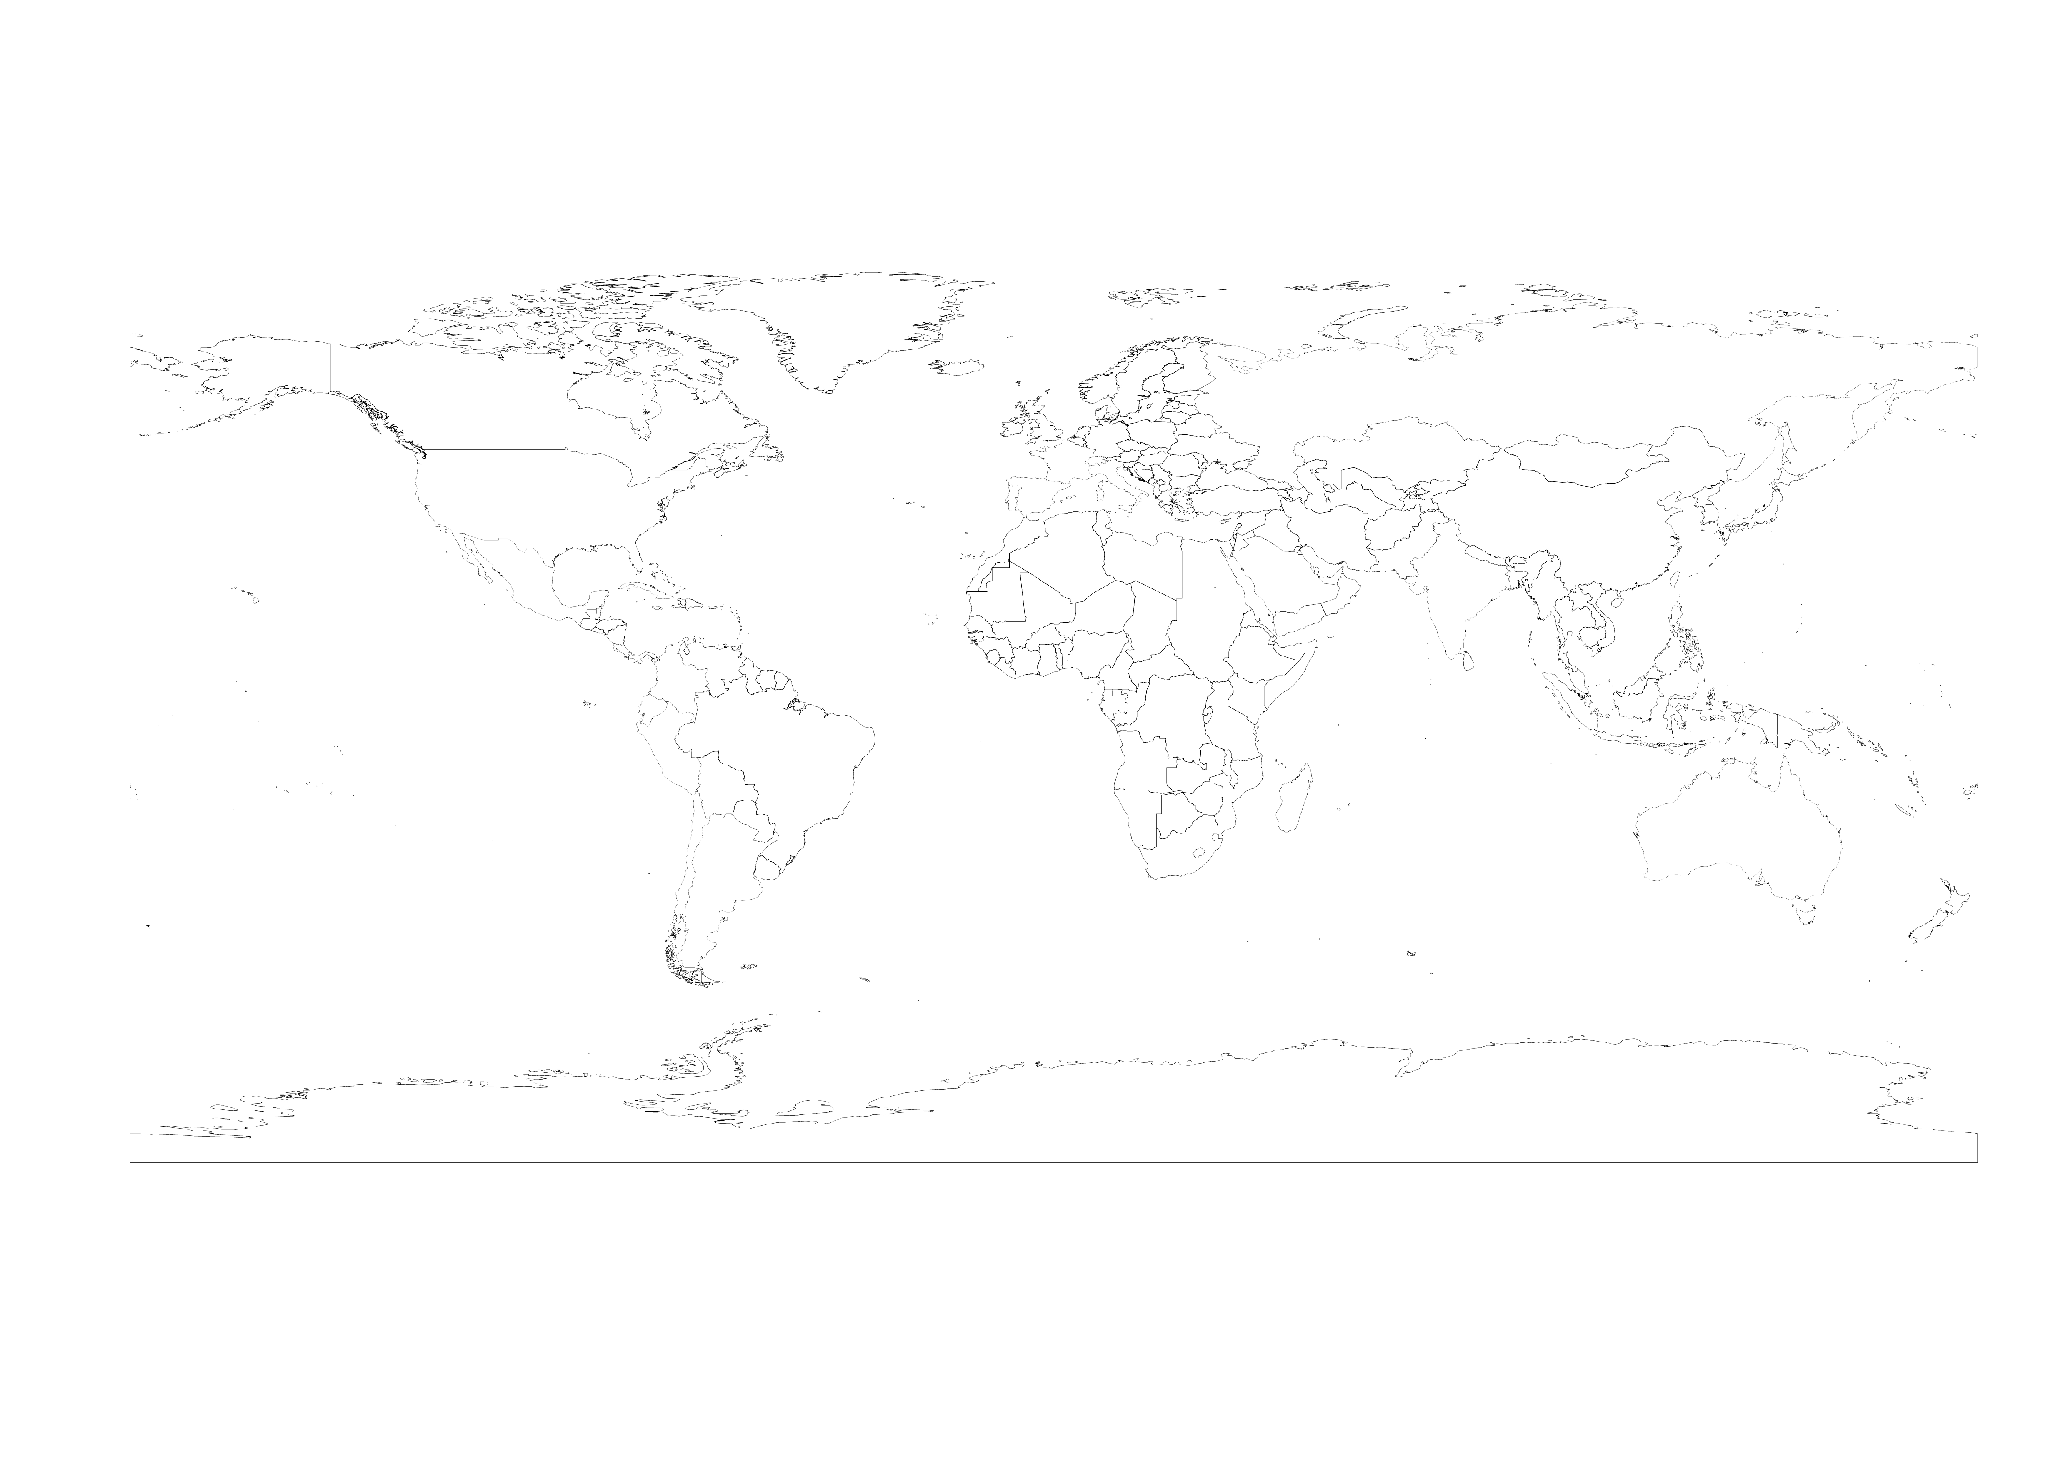
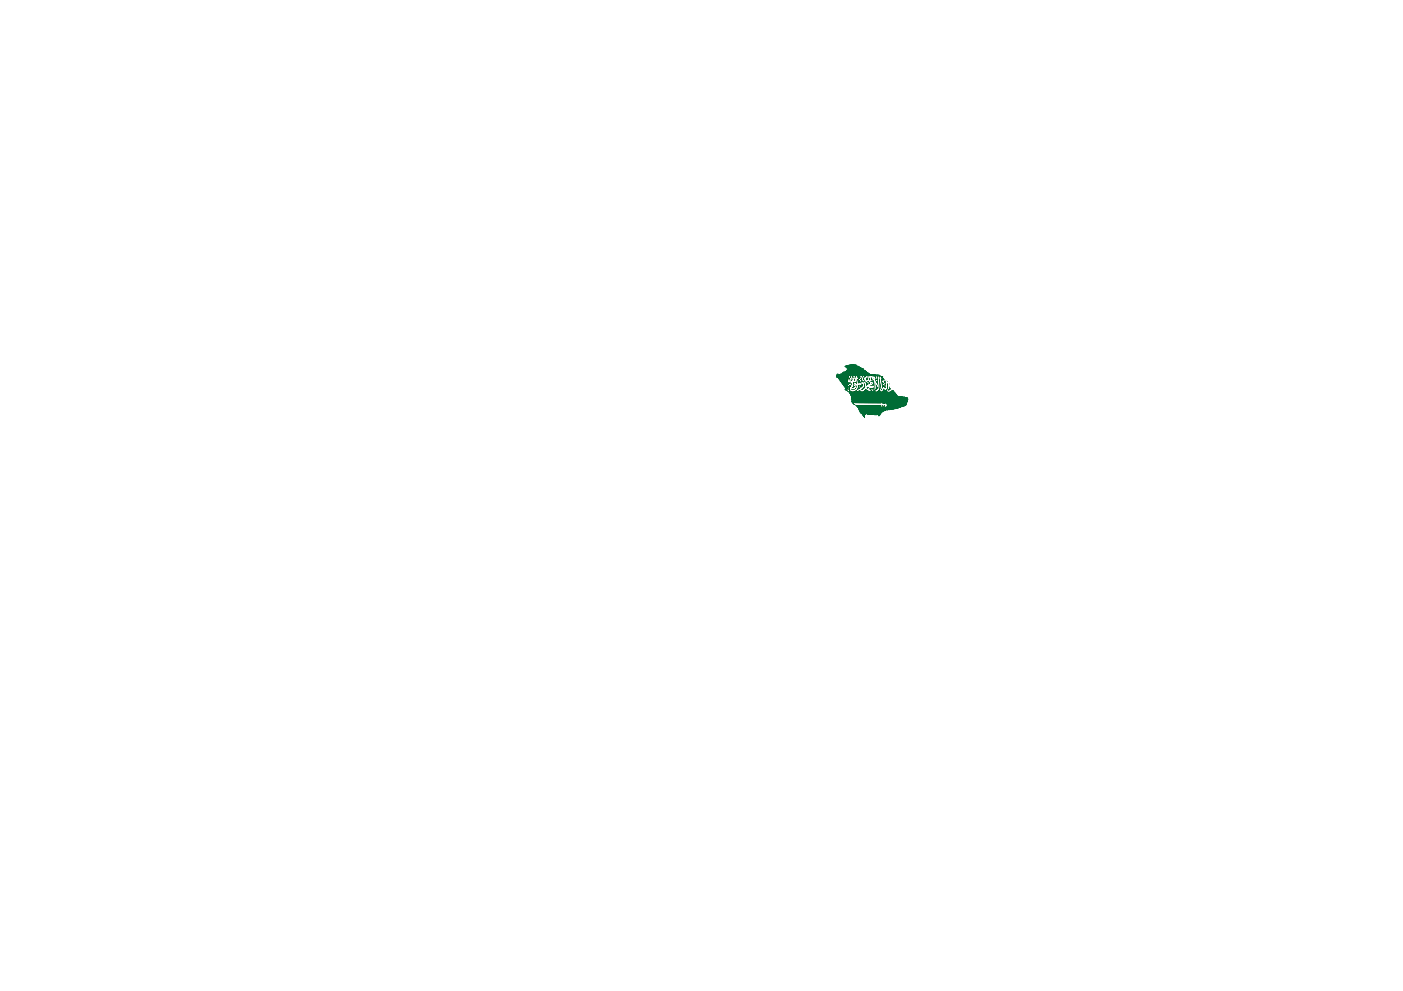



U. S. A.
ARAB EMIRATES
SAUDI ARABIA
SWITZERLAND
AUSTRALIA
COSTA RICA
ARGENTINA
ECUADOR
FRANCE
PORTUGAL
COLOMBIA
RUSSIA
ITALY
MEXICO
SPAIN
INDIA
CHILE
CUBA
PERU

Slide 2
M.P.R.
New point of view in rehabilitation
Myofunctional Postural Rehabilitation
Di Rocca Method
Prof Dr Silverio Di Rocca
Dr in Dentistry
Specialist in Dento Facial Orthopeadics
Expert in Postural Deseases
www.mpr.posturalworld.com
www.silverstone-ch.com
www.mpr.posturalworld.com
www.dirocca-silverio.com

Slide 3
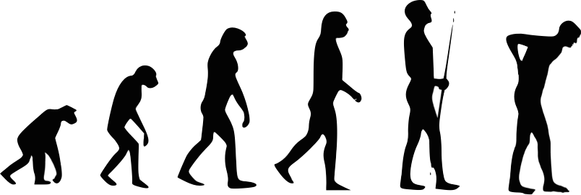
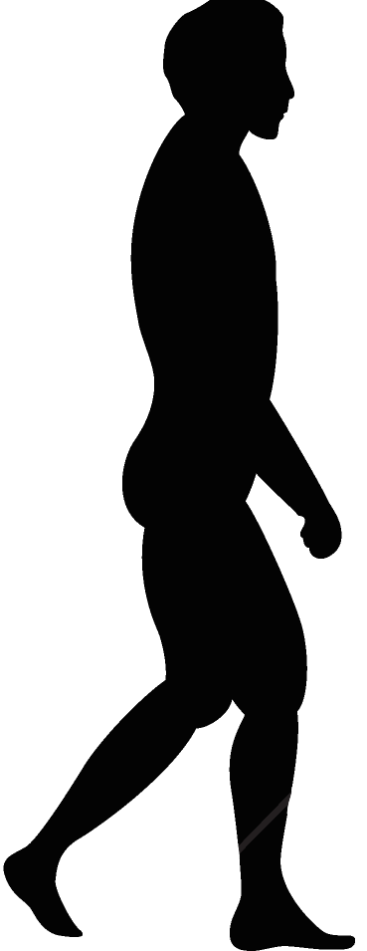
WALKING TOWARDS THE FUTURE
INCREASING
KNOWLEDGE
www.dirocca-silverio.com

Slide 4
'THE MIND IS LIKE A PARACHUTE. IT DOESN'T WORK IF IT IS NOT OPEN.'

Slide 5
“IF THE ONLY TOOL YOU HAVE IS A HAMMER, YOU TEND TO SEE EVERY PROBLEM AS A NAIL.”
-ABRAHAM HAROLD MASLOW

Slide 6
PARADIGM
The paradigm is changing the diagnosis target:
Taking it from local to global
From sectoral to holistic.
          … Even more so: INTERDISCIPLINARY
Speaking the same diagnostic and therapeutic language
www.dirocca-silverio.com

Slide 7
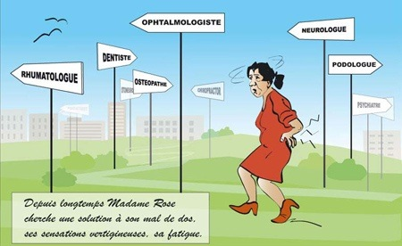
AFTER A LONG TIME MRS. ROSE HAS DECIDED TO FIND A SOLUTION TO HER BACK PAIN, HER DIZZINESS AND HER CHRONIC FATIGUE

Slide 8
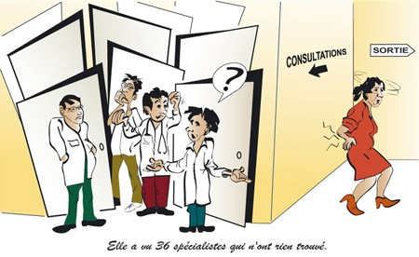
SHE VISITED 36 SPECIALISTS, AND NONE OF THEM COULD FIND ANYTHING WRONG

Slide 9

THE COMMON DIAGNOSIS
Neurologic patient
Muscle pain
Headaches
Relapsing orthodontic treatment
Joint pain
PSYCHIATRIC
PATIENT
TMJ click
Broken dental prothesis
Relapsing patient
Dizziness
Neck pain

Slide 10
IT ALL DEPENDS ON HOW WE LOOK AT THINGS

Slide 11
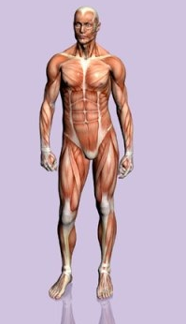
WE SEE EVERYTHING FROM OUR SPECIALITY’S POINT OF VIEW
Dentist
Medical Doctor
Physiotherapist
Osteopath
Podiatrist
BUT THE TRUTH IS THE BODY IS ONE AND INDIVISIBLE

Slide 12
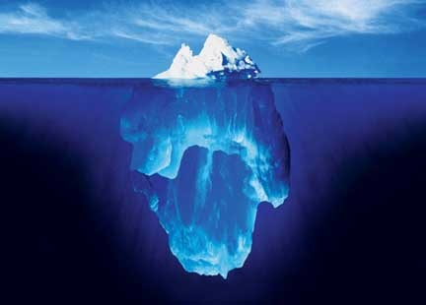
The Tip Of The Iceberg

Slide 13
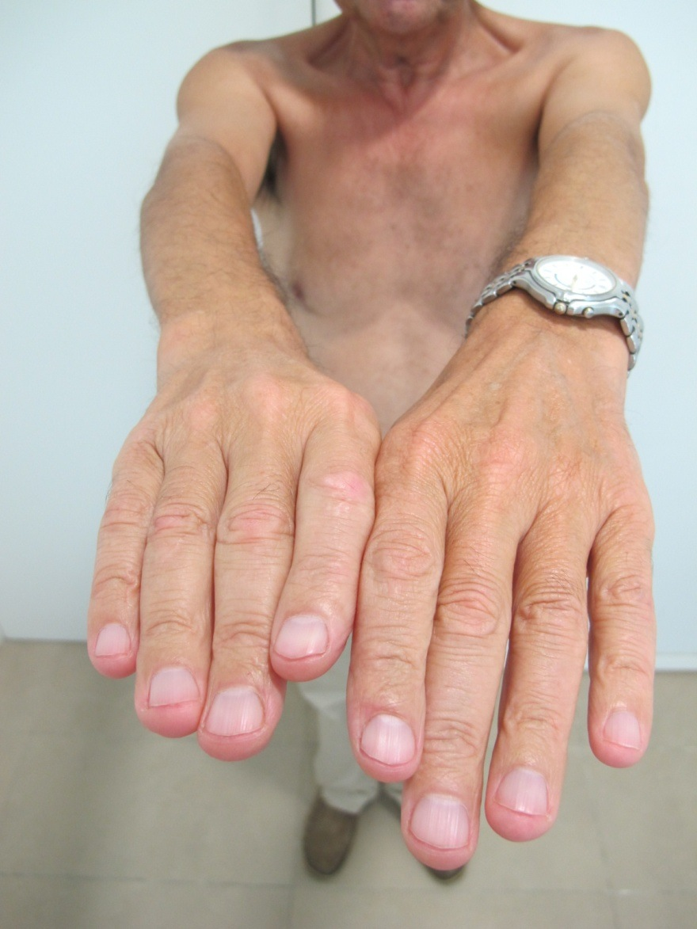
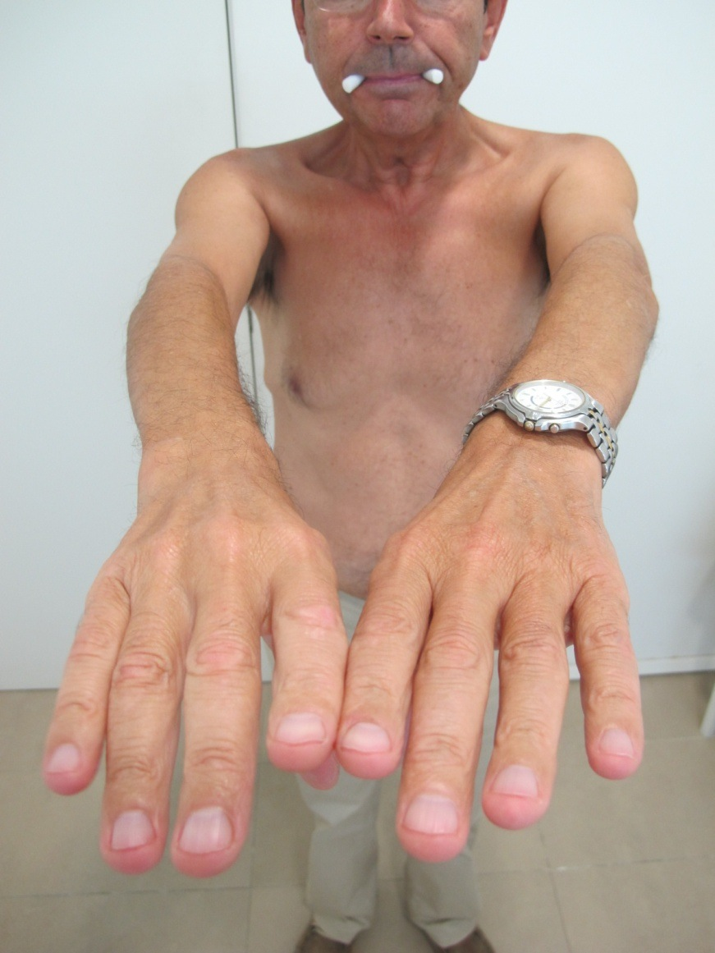
By removing the interference of the masticatory system.
No more torsion

Slide 14
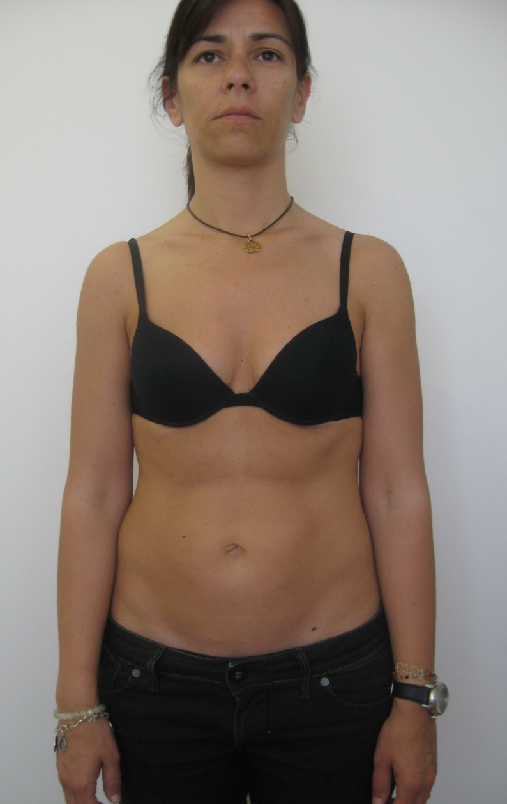
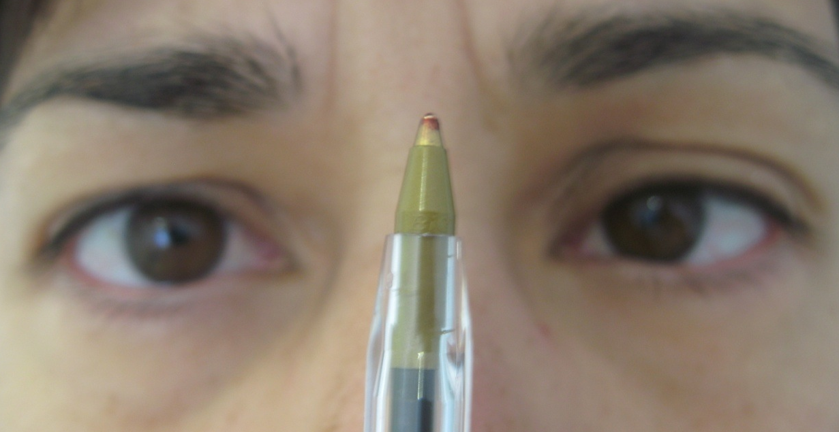
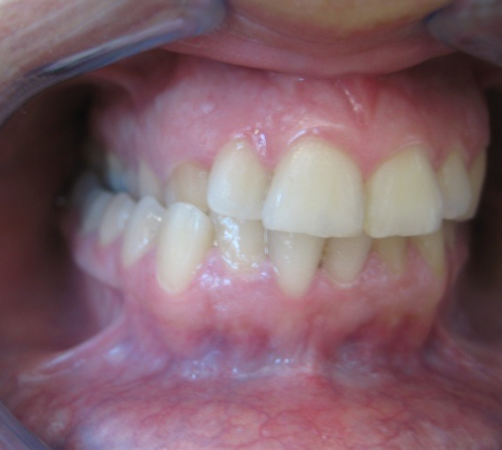
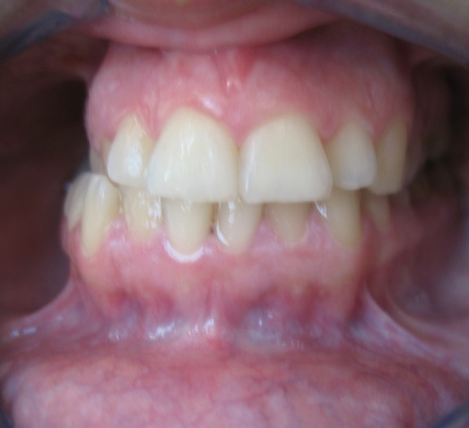
HOW DO WE TREAT IT?

Slide 15
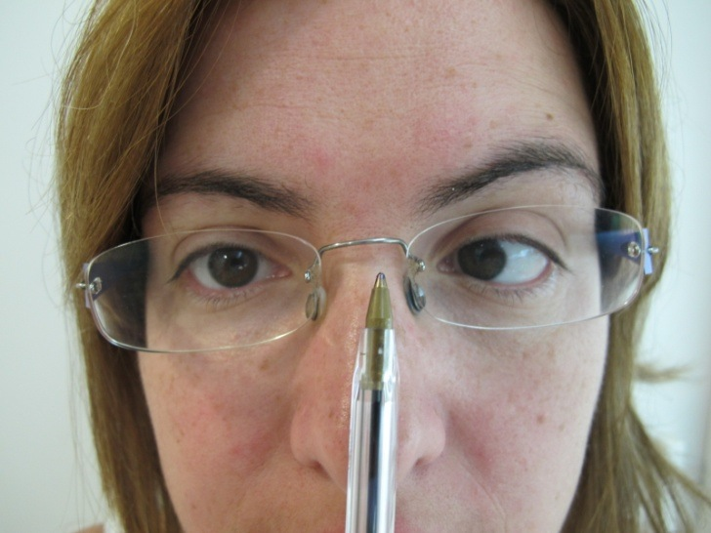
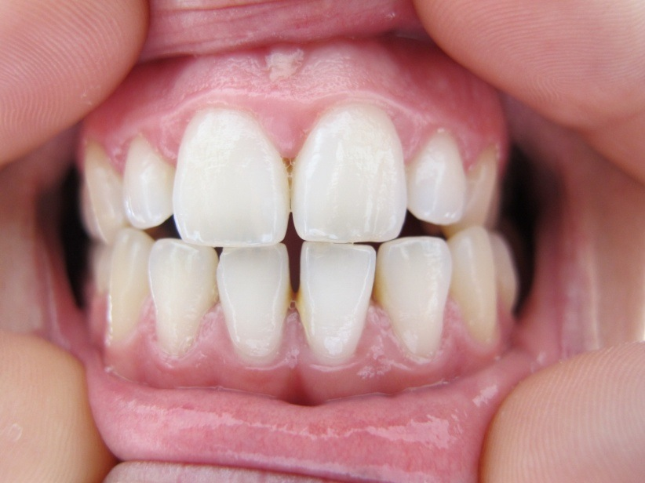
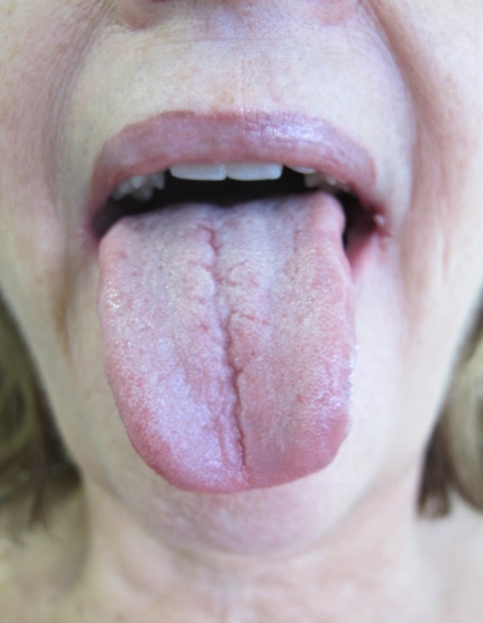
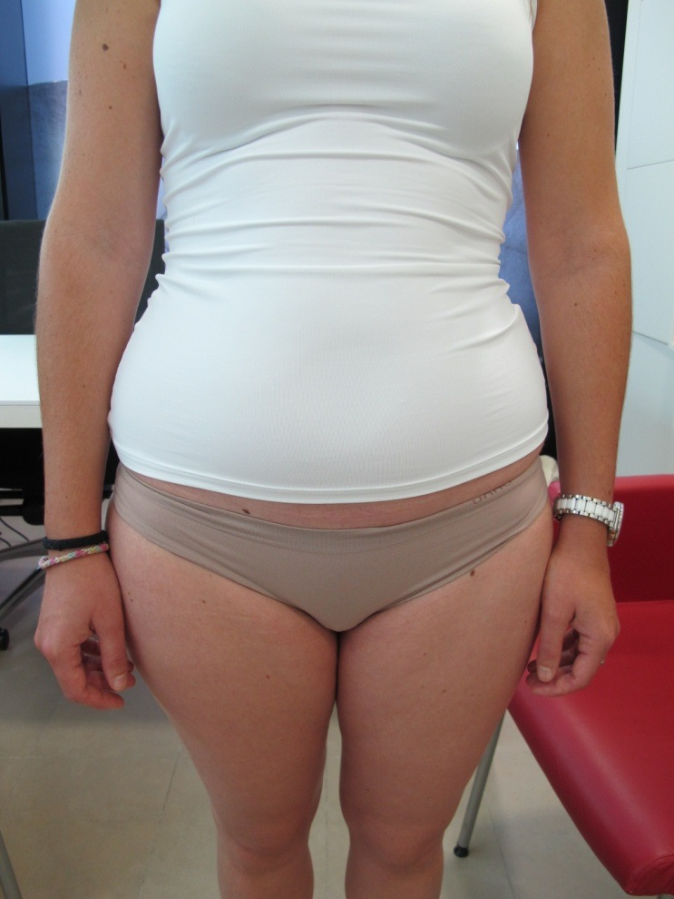
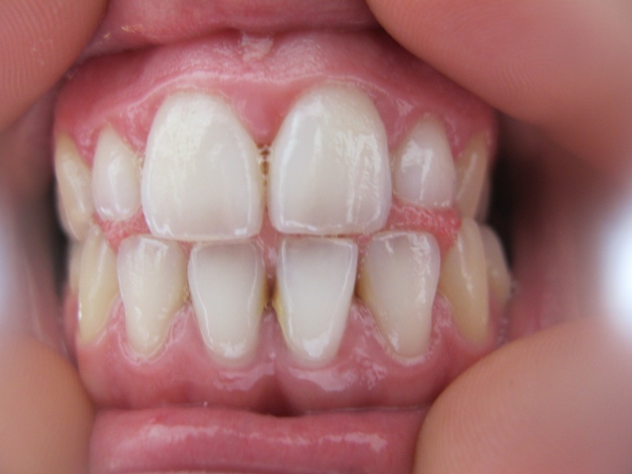
III PAR, V PAR AND FOOT

Slide 16
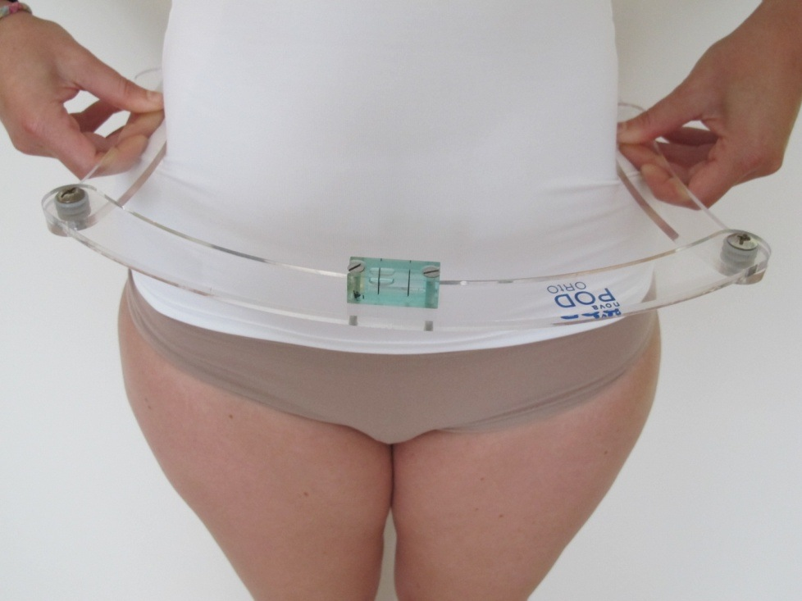
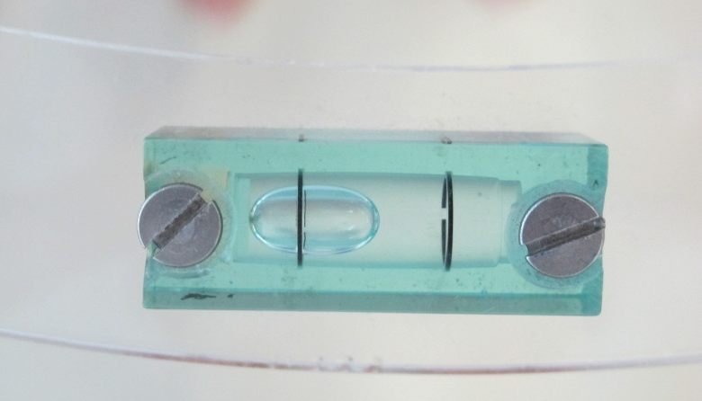
LEG LENGTH DISCREPANCY
(SHORT LEFT LEG)

Slide 17
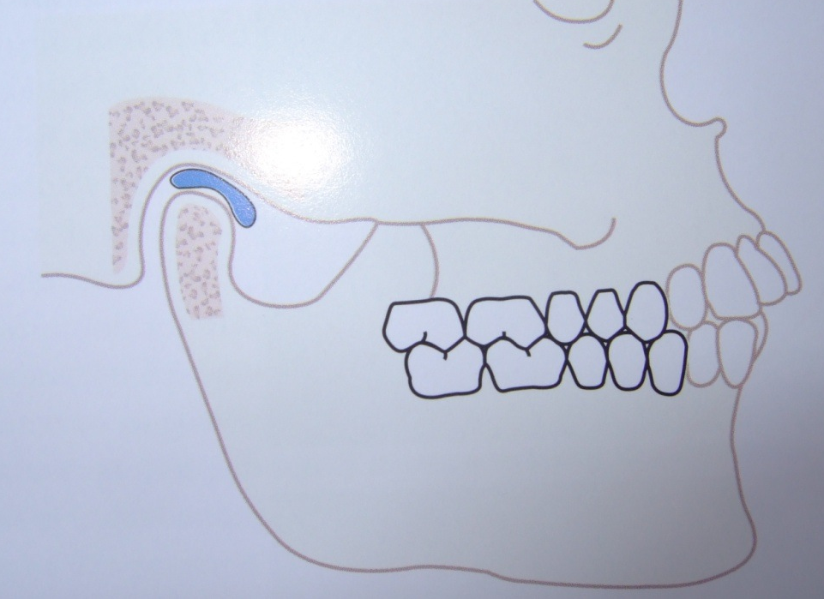
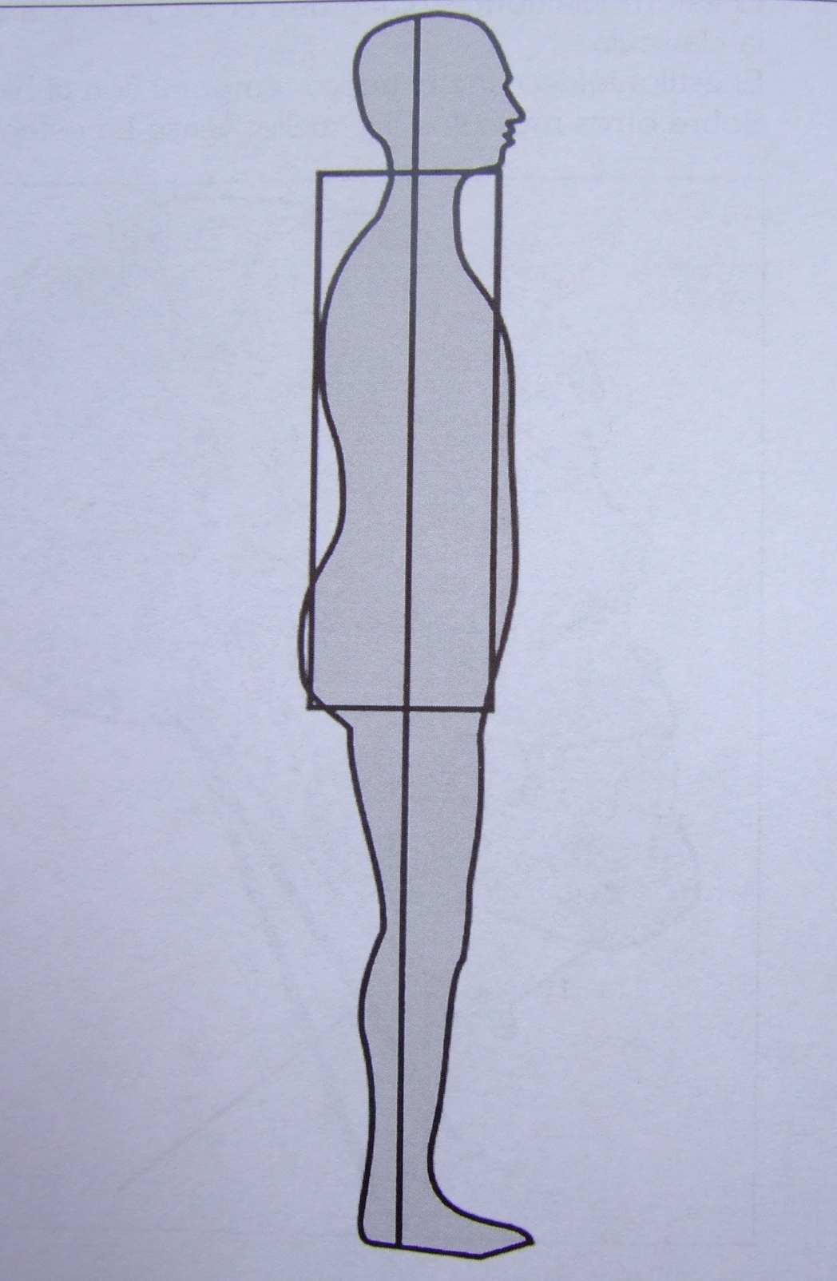
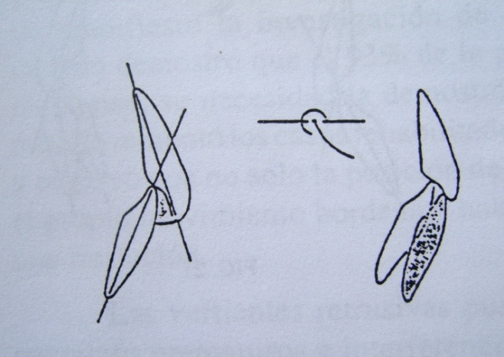
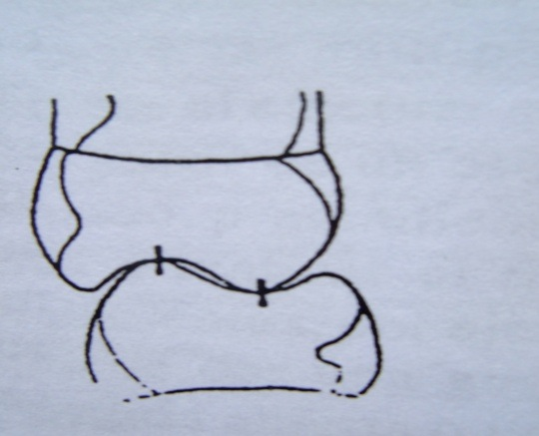

Slide 18
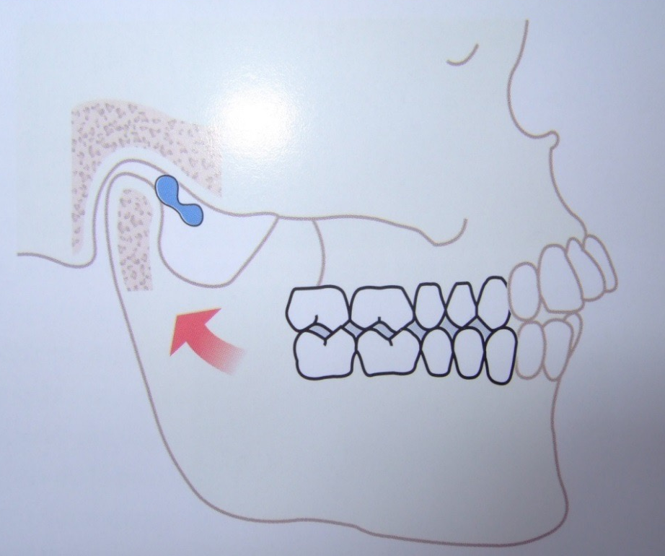
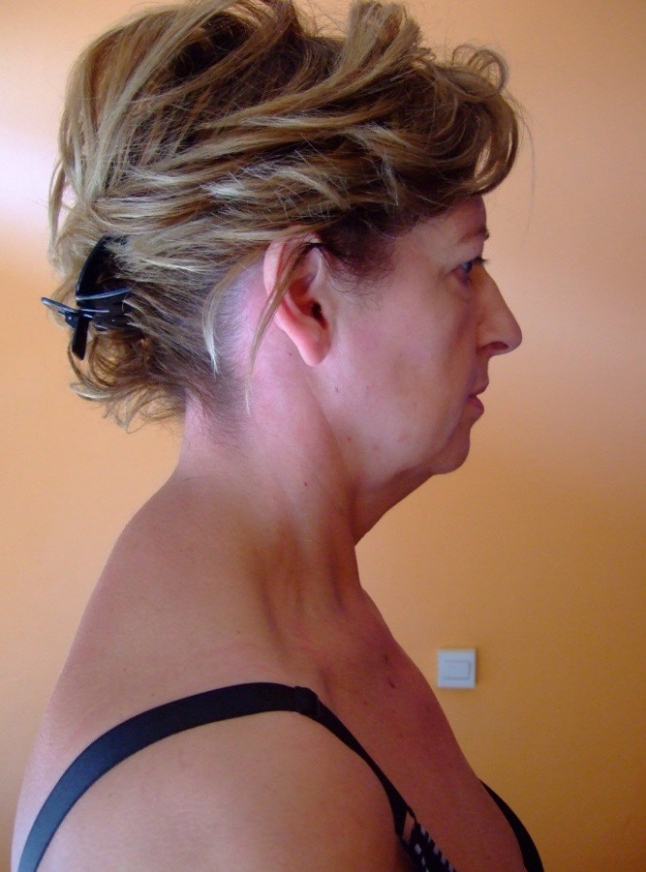
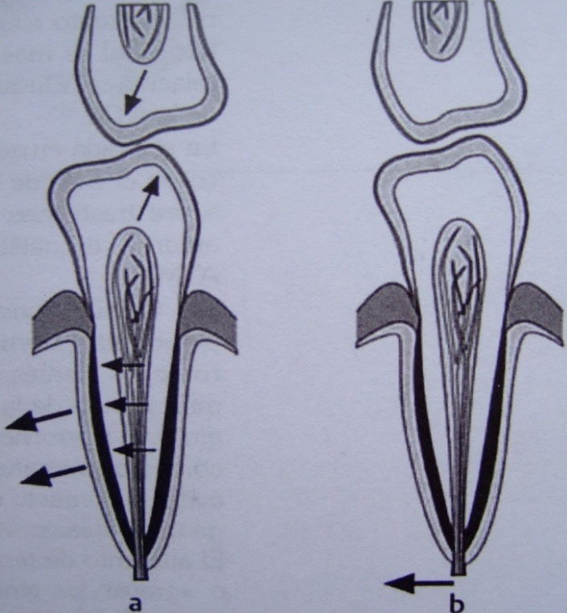
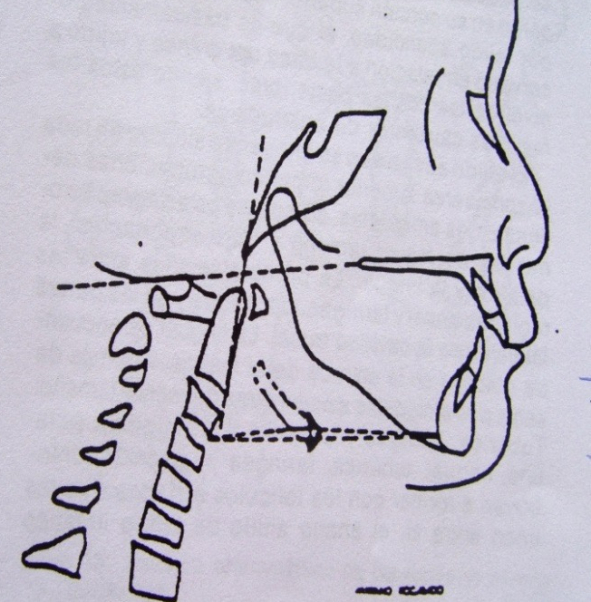
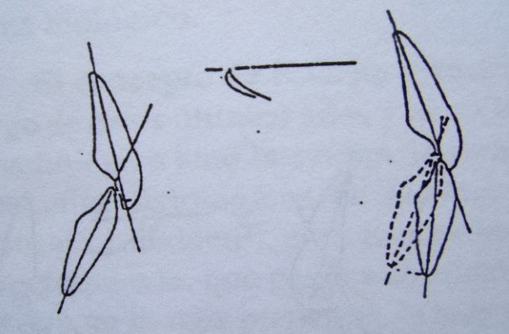

Slide 19
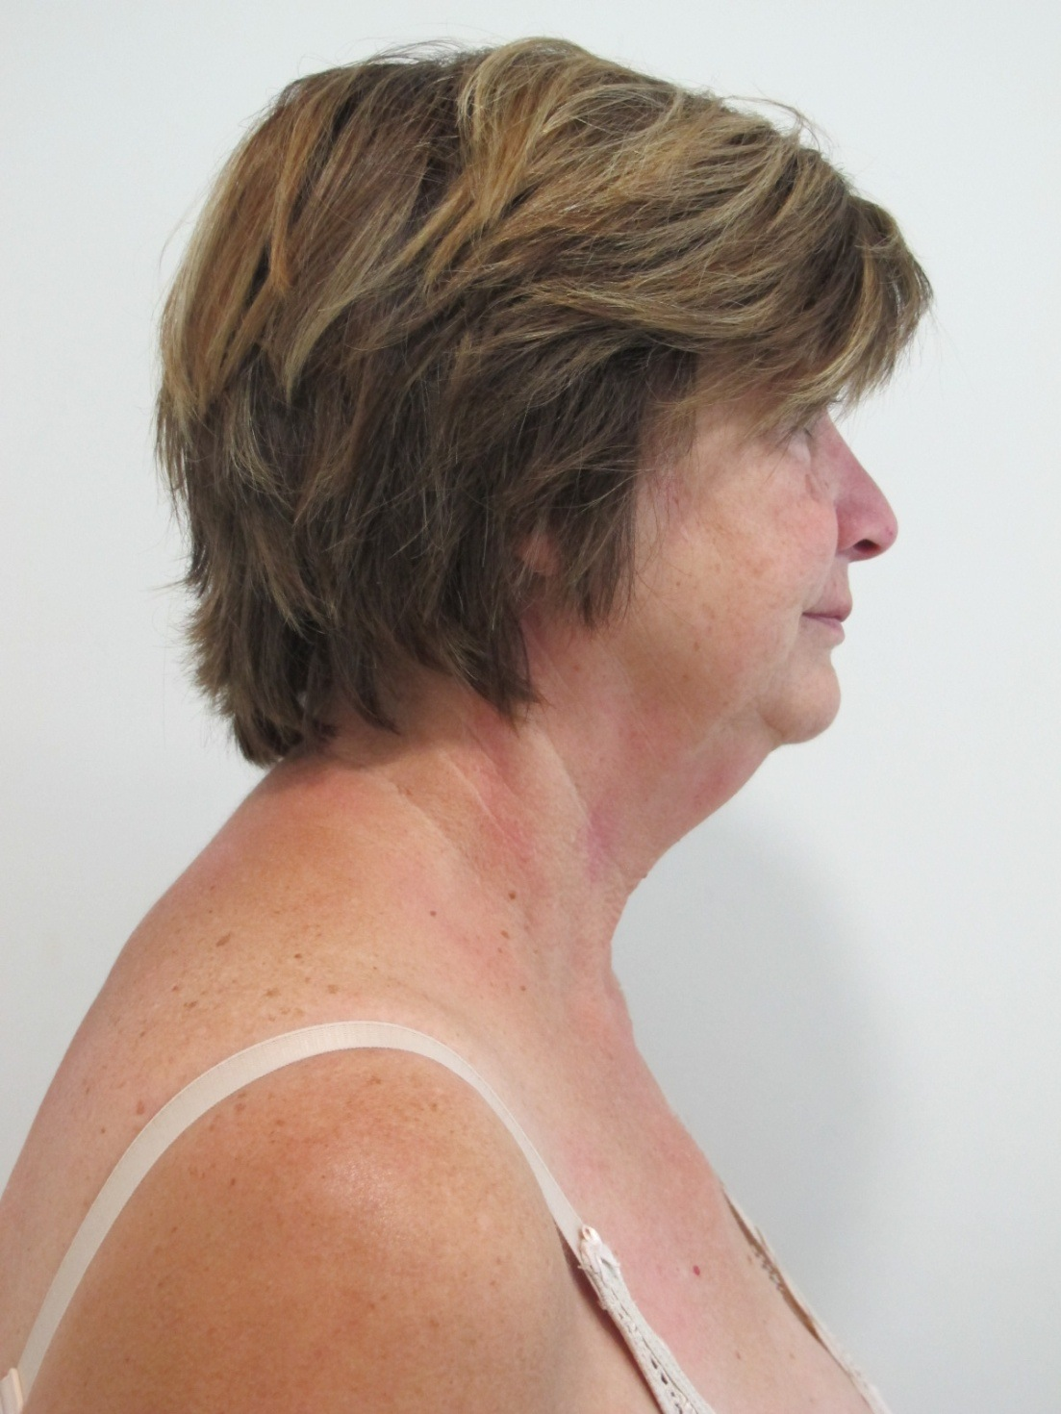
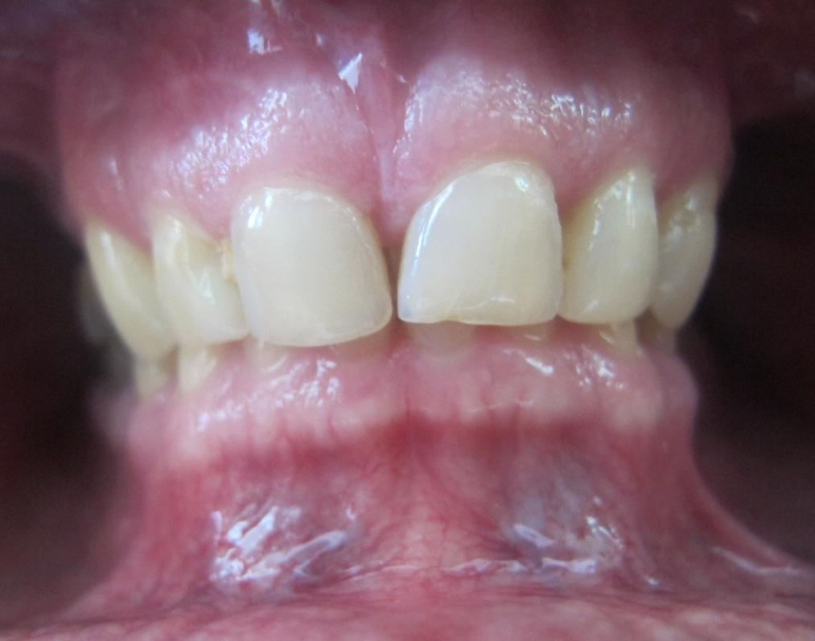
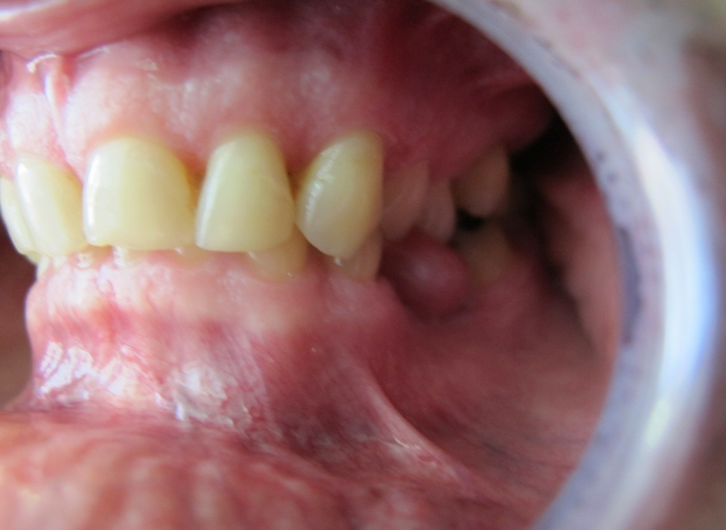

Slide 20
TREATING THE NEUROPHYSIOLOGICAL INTEGRATION

Slide 21
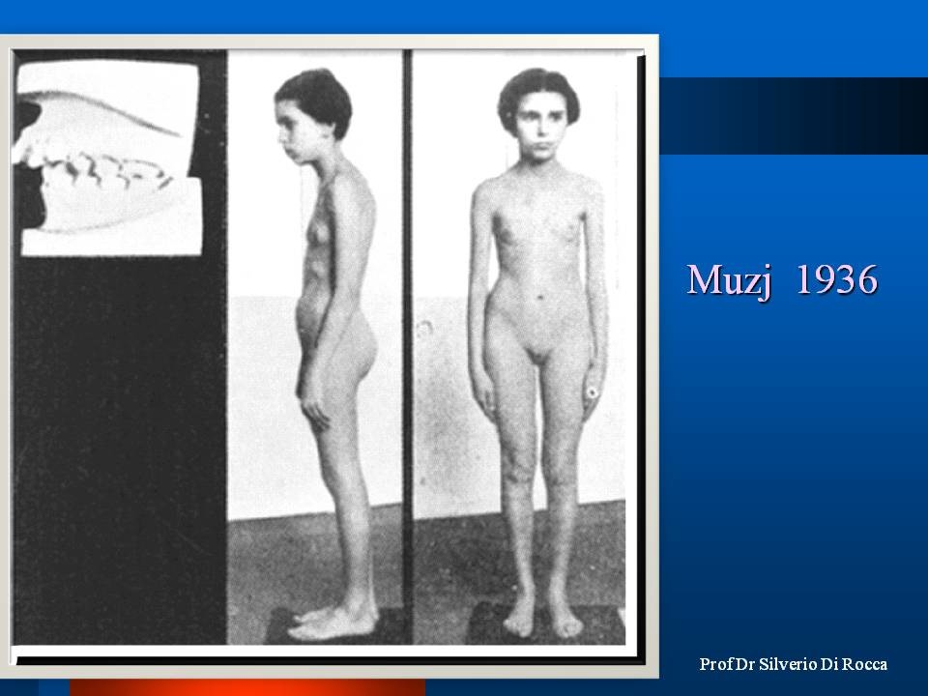

Slide 22
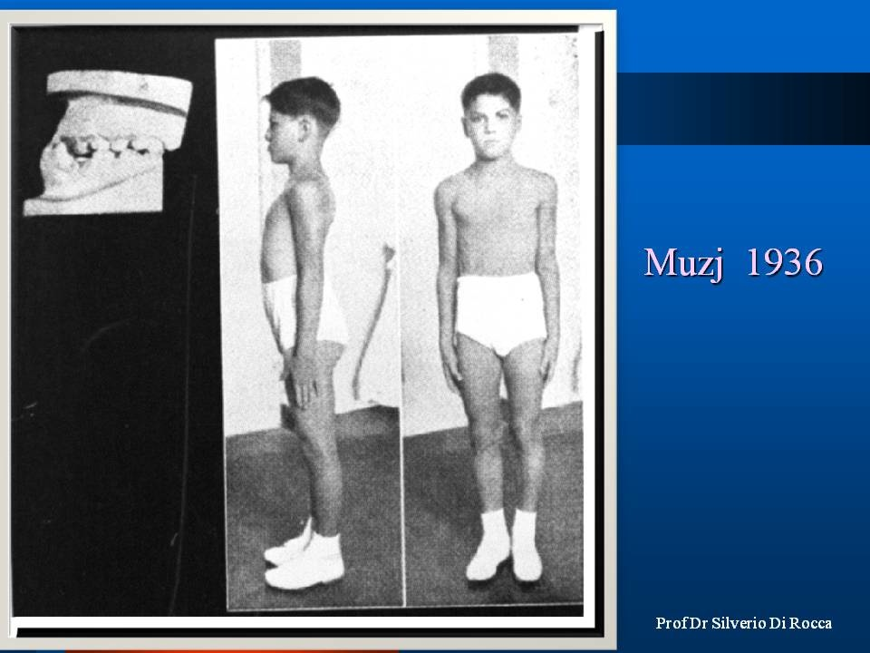

Slide 23
MIND
BODY
STRUCTURE
BIOCHEMISTRY

Slide 24

CLINIC POSTUROMETRY AND POSTUROLOGY

Slide 25
POSTUROLOGY CANNOT BE CONCENTRATED IN:
AN APPLIANCE, AN INSOLE, A PAIR OF GLASSES, A PHYSIOTHERAPEUTIC TREATMENT OR A MEDICAL TREATMENT.
ITS A DIAGNOSTIC PHILOSOPHY, BASED ON THREE FUNDAMENTAL PRINCIPLES OF MEDICINE:
ANATOMY
PHYSIOLOGY
PHYSIOPATHOLOGY
INDIVIDUAL HOLISTIC DIAGNOSIS

Slide 26
THE BASIS OF POSTUROLOGY

Slide 27
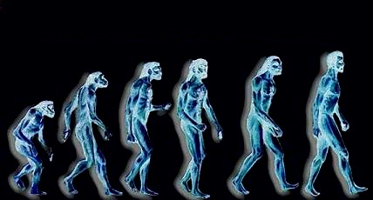
WHEN HUMANS STOPPED WALKING ON FOUR PAWS, AND ADOPTED THE ERECT POSITION, THEIR SKELETAL-MUSCLE SYSTEM REQUIRED A NEW POSTURAL REGULATION

Slide 28
ATMOSPHERIC PRESSURE
BODY
GRAVITY

Slide 29
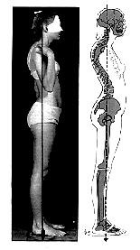
These natural forces compress our body and try to crush it.
This deforms the entire physiological static posture
It's not about the structures not working properly.

Slide 30
A neurologically complex, yet functionally simple, system was developed to counteract this natural daily phenomenon:
THE TONIC POSTURAL SYSTEM
(T.P.S.)
A system in charge of creating the basic muscle tone, necessary to counteract these natural forces, allowing the body to function in harmony.

Slide 31
T.P.S. BASIC DIAGRAM
SNC
RECEPTORS
MUSCLE:
receptor and
effector

Slide 32
THE TONIC POSTURAL SYSTEM
(T.P.S.)
RECEPTORS:
- EYE
- MOUTH (great disturber of the tonic postural system)
- FOOT

Slide 33
TAMPOM
SYSTEM
SHOULDER GIRDLE
FEED
BACK
SYSTEM
TAMPOM
SYSTEM
The system is in a closed cybernetic, self-powered loop.
It has superior centers, peripheral receptors and system buffers to balance the posture

Slide 34
THE EYE AS A POSTURAL RECEPTOR

Slide 36
RIGHT HYPOCONVERGENCE
INOCCLUSION
OCCLUSION
RIGHT LATERO-DEVIATION

Slide 37
BI-LATERAL HYPOCONVERGENCE
INOCCLUSIONE
OCCLUSIONE
ANTEPOSIZIONE
MANDIBOLARE

Slide 39
EFFECTS OF THE FOOT ON THE
STATIC POSTURE
VALGUS FOOT INCREASES VERTEBRAL CURVES
VARUS FOOT DECREASES VERTEBRAL CURVES

Slide 41
“CLINICAL OPINION MAY BE TRUE OR FALSE, BUT IT REMAINS AN OPINION. WHEN IT IS MEASURED IT BECOMES SCIENCE”
-BERNARD JENKELSON

Slide 42
POSTUROMETRY AND STABILOMETRY
A diagnostic and therapeutic viewpoint

Slide 43
WHAT IS POSTUROMETRY?

Slide 44
It is the science that measures the body’s static posture
It puts in relation the receptors’ activity (eyes, mouth, feet)
With it we can check if they are in balance
…When they aren’t…
It can analyze what pathology has affected the tonic postural system

Slide 45

WHAT TO THESE SUBJECTS HAVE IN COMMON?
The search for the best possible center of gravity.

Slide 46
Posturometry

Slide 47
POSTURE
1 2 3
OCCLUSION
FOOT

Slide 48
How to read the results
NORMAL
HIGHER
LOWER

Slide 49
Just like a traffic light
RED - Alteration
YELLOW -Caution
GREEN - Ok

Slide 50
THIS IS WHY M.P.R. AND THE INTEGRATED INTERDISCIPLINARY PROTOCOL WERE CREATED

Slide 51
THE INTEGRATED INTERDISCIPLINARY PROTOCOL

Slide 52
ACTIVE
IT ADAPTS TO THE PATIENTS’ EVOLUTION
ALL SPECIALISTS INTERVENE WITH THE SAME DIAGNOSTIC AND THERAPEUTIC STANDARDS
INTEGRATED
IT INVOLVES DIFFERENT DISCIPLINES
INTERDISCIPLINARY

Slide 53
M. P. R.

Slide 54
REHABILITATION
REBALANCES ALL SYSTEMS
E PHYSIOLOGICAL SKELETAL NEUROMUSCULAR
EQUILIBRIUM
MYOFUNCTIONAL
REHABILITATES THE STOMATOGNATHIC SYSTEM WITH THE REST OF THE BODY
POSTURAL

Slide 55
DIAGNOSTICS
CLINICAL
INSTRUMENTAL
ADDITIONAL ANALYSIS

Slide 56
CLINICAL
Oculomotor system
Postural analysis
Stomatognathic analysis
Podal analysis

Slide 57
INSTRUMENTAL
Posturometry
Stabilometry

Slide 58
ADDITIONAL ANALYSIS
Food intolerances
Amino-acids test

Slide 59
M. P. R.
PHILOSOPHY

Slide 61
PROTOCOL
Deprogramming
Myopostural re-equilibrium
Reprogramming

Slide 62
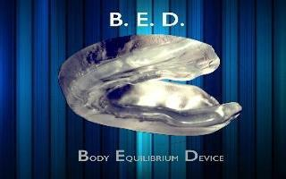
Sensorial deprogramming
EYE
MOUTH
FOOT
BIOCHEMICAL

Slide 63
Interdisciplinary protocol:
Working in the same diagnostic and therapeutic direction
REACHING THE ROOT CAUSES NOT SIMPLY TREATING THE SYMPTOMS

Slide 64
TREATING PATIENTS OF ALL AGES PHYSIOLOGICALLY, WITHOUT TRAUMA, LISTENING TO THE BODY’S PRIORITIES
GETTING REAL, PERMANENT RESULTS.

Slide 65
“PRIMUM NON NOCERE”

Slide 66
SOME SAMPLES OF DIAGNOSIS

Slide 68
Sintomatology
Headache
Neck pain
Diffuse muscle pain
Dizziness
Bilateral tmj Clicking

Slide 69
Occular convergence
LEFT HIPO CONVERGENCE
RELATED WITH MALOCCLUSION.

Slide 70
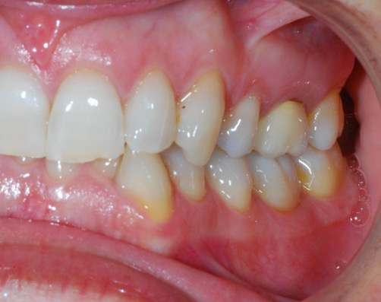
DEEP BITE
MANDIBULAR LOCK
ANTERIOR WIDE AND COMPENSATION CURVE LOST

Slide 71
INCISOR RETRUSION AND CROWDING
RELATED WITH LACK OF ANTERIOR GUIDANCE

Slide 72
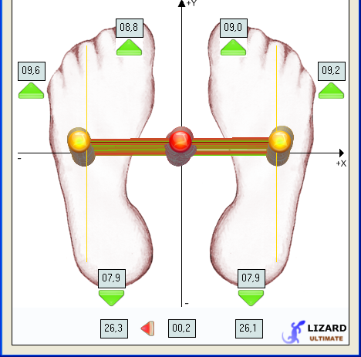
POSTUROMETRY
OBSERVE THE OVER
LOAD TO THE RIGTH
MATCH WITH THE
JAW LATERO
DEVIATION
occlusion
Free space

Slide 73
BARICENTER
In the grafic we observe
Three baricenters not
Match between them
That means receivers are
Not in balance

Slide 74
TORSION
EVEN BODY TORSION
IS DIFFERENT IN EVERY
EXAMS.

Slide 75
www.dirocca-silverio.com

Slide 76
www.dirocca-silverio.com

Slide 77
www.dirocca-silverio.com

Slide 78
www.dirocca-silverio.com

Slide 79
www.dirocca-silverio.com

Slide 81
www.dirocca-silverio.com

Slide 82
www.dirocca-silverio.com

Slide 83
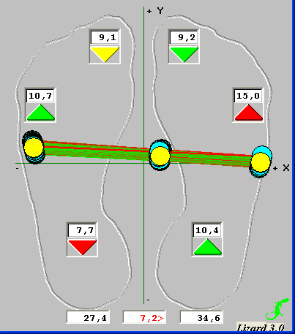
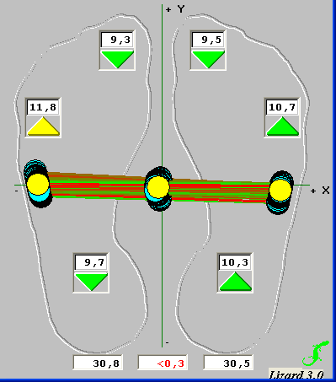
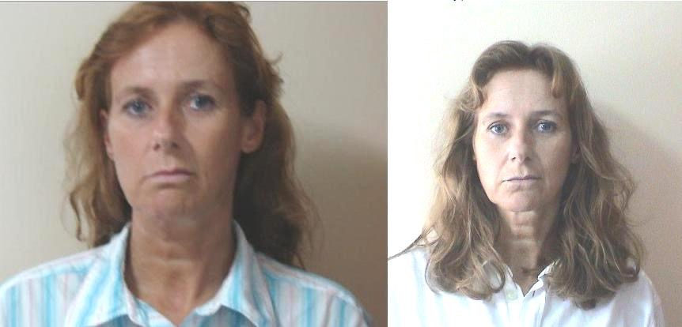
www.dirocca-silverio.com

Slide 84
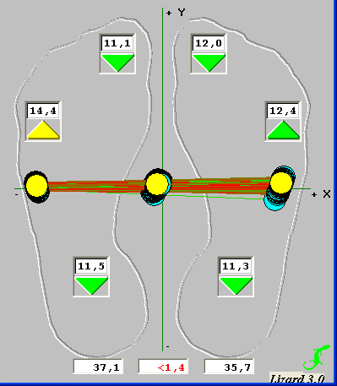
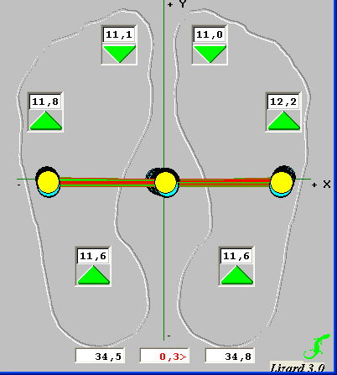
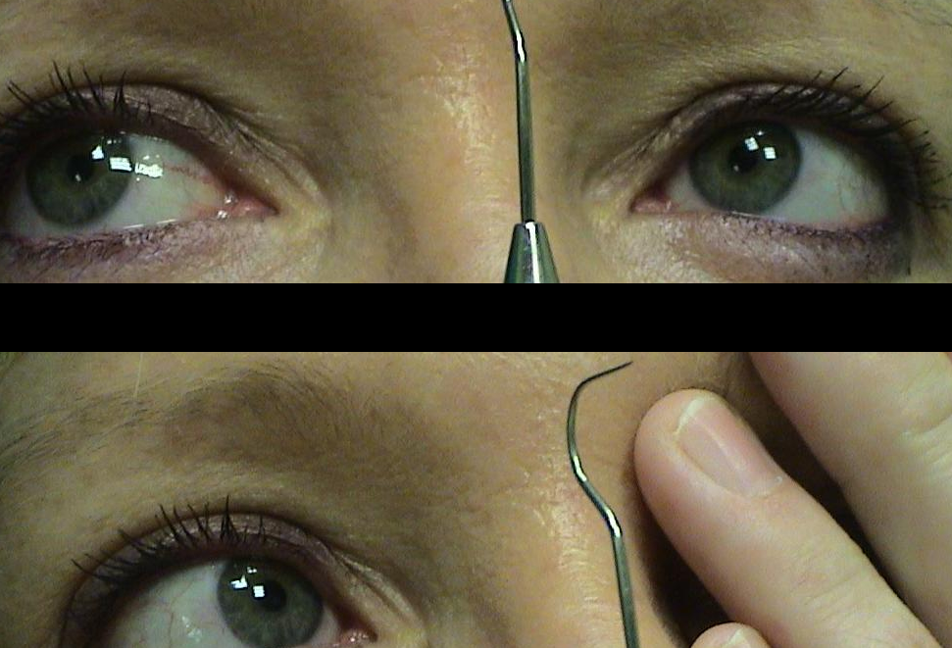
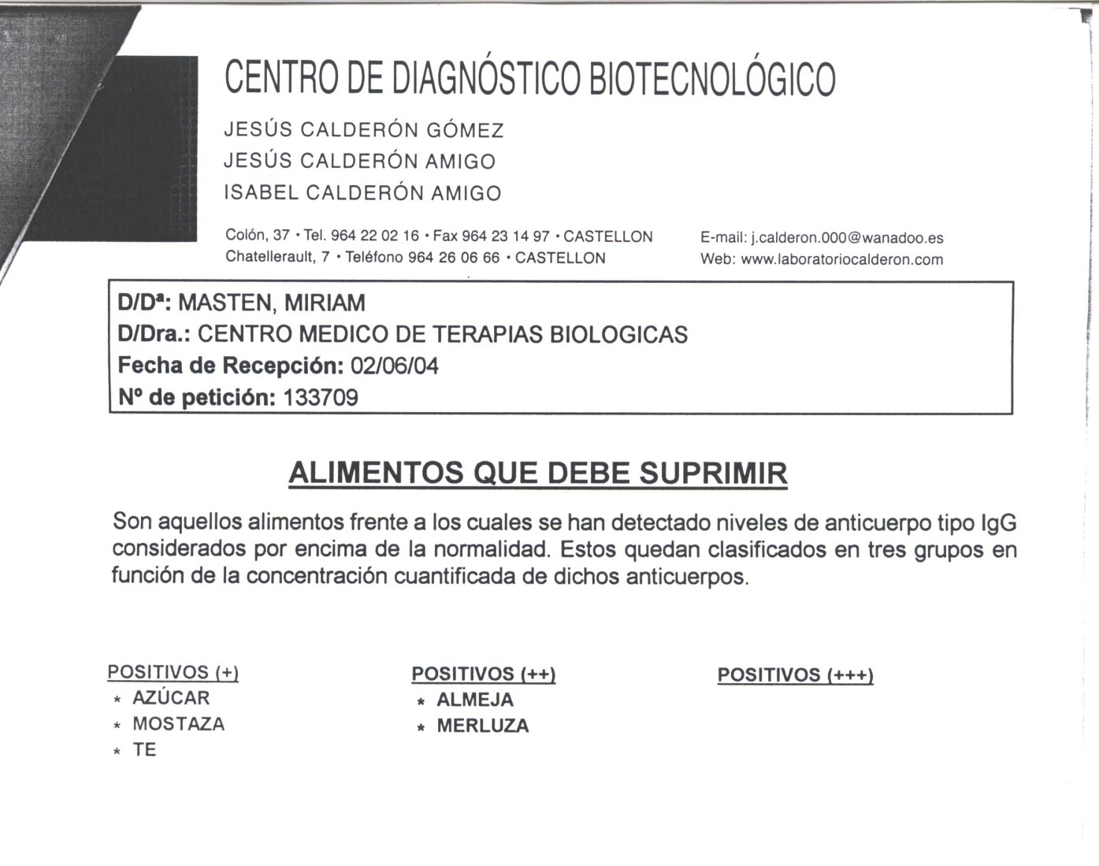
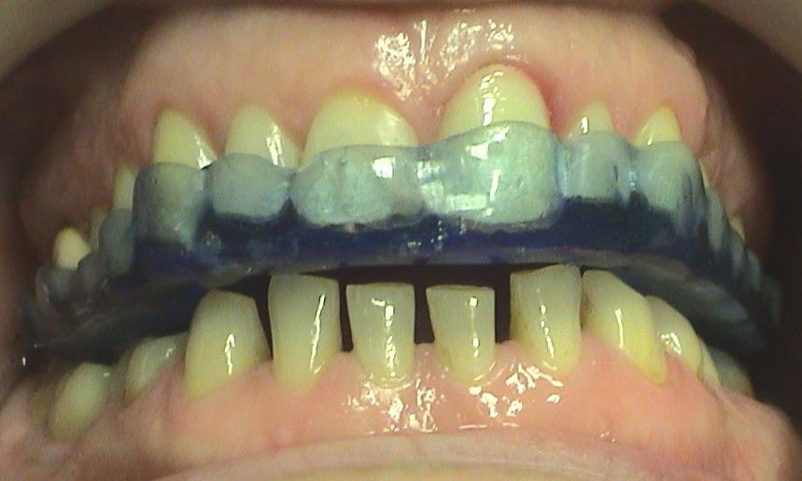
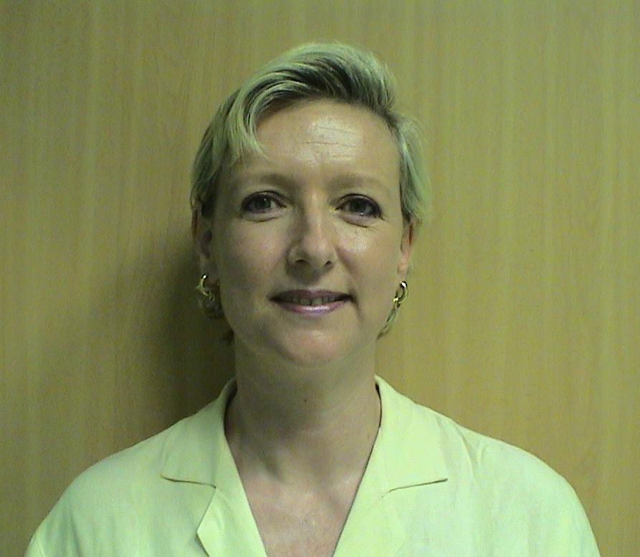
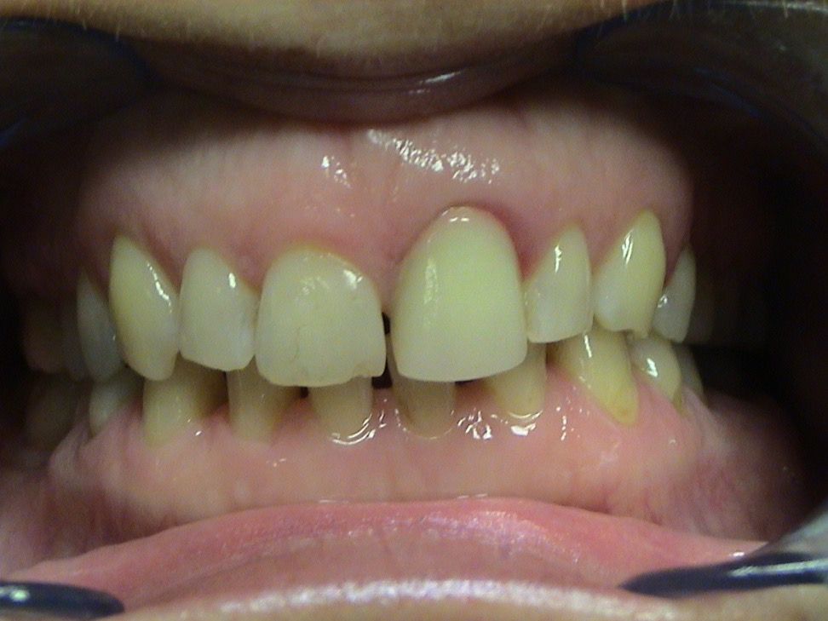


www.dirocca-silverio.com

Slide 85





www.dirocca-silverio.com

Slide 86








www.dirocca-silverio.com

Slide 87
CONCLUSIONS
EVIDENCE OF THE ORIGEN THE PROBLEM
FOLLOW THE THERAPEUTIC PRIORITY
PLANNING OF THE THERAPY
LONG TERM FOLLOW UP

Slide 88
Conclusions
The masticatory system is closely related with the tonic postural system.
When it is decompensated it is constantly disturbed.
With posturometry and stabilometry we can measure and detect all these situations.
Measurements make clinical opinions substantial.
Measurements allow for diagnostic evaluation. It is also useful during treatments, to identify the priorities.

Slide 89
“Start by doing what's necessary; then do what's possible; and suddenly you are doing the impossible.”
Francis of Assisi

Slide 90

THANK YOU
FOR YOUR ATTENTION
Prof Dr Silverio Di Rocca
sdirocca@gmail.com
www.dirocca-silverio.com
Skype: sdirocca

