Slide 1

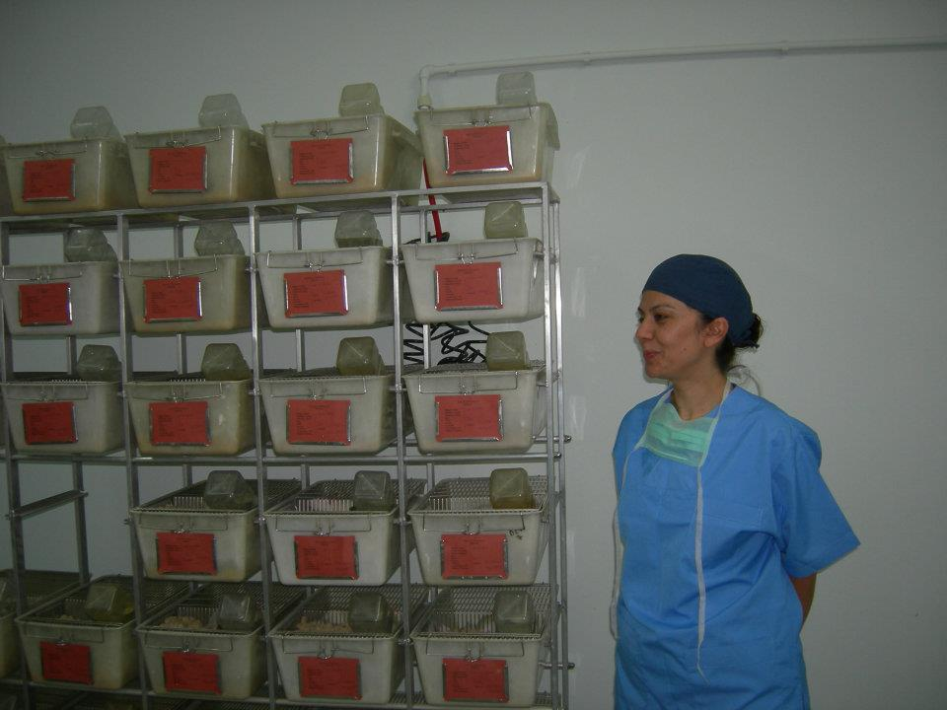
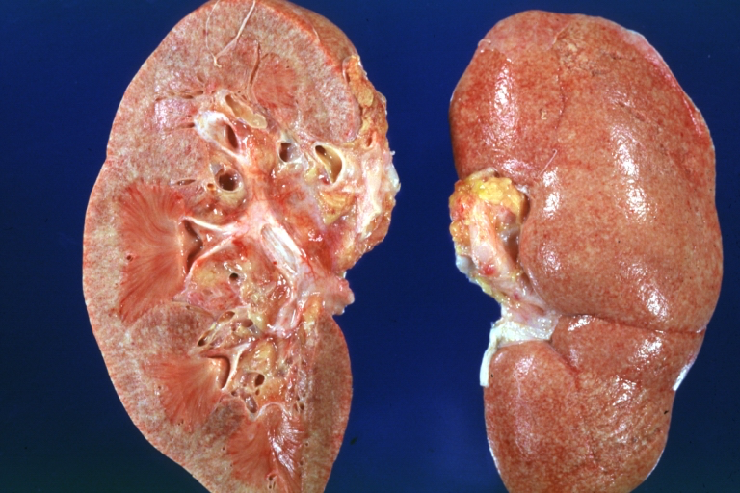
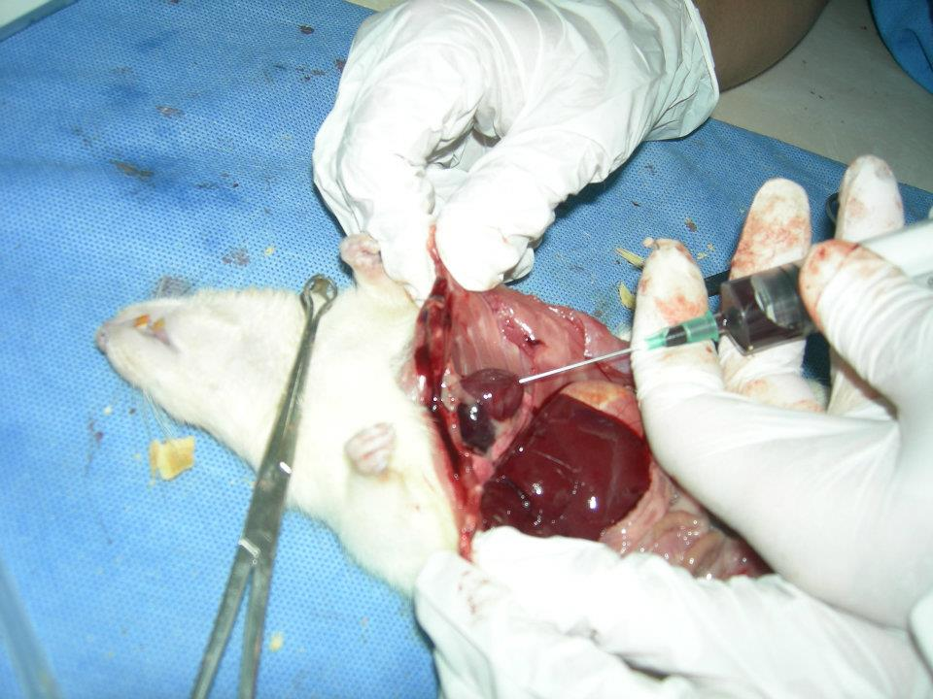

EFFICIENCY OF PROPOLIS ON EXPERIMENTAL ENDOTOXEMIC RENAL DAMAGE
Züleyha DOGANYİGİT, PhD BirkanYAKAN,MD
Derya AKKUŞ,PhD
A.Timucin ATAYOGLU, MD
Sibel SİLİCİ, PhD

Slide 2
Endotoxic shock,
*is a leading life-threatening complication among critically ill patients in hospitals
*is characterized by
hypotension,
poor tissue perfusion and
multi-organ dysfunction

Slide 3
Lipopolysaccharide (LPS; also known as endotoxin)
*major structural and functional component of endotoxic shock
*In Gram-negative bacteria, LPS plays a dominant role
*The outer membrane of Gram-negative bacteria is constructed of a lipid bilayer and separated from the inner cytoplasmic membrane by peptidoglycan

Slide 4
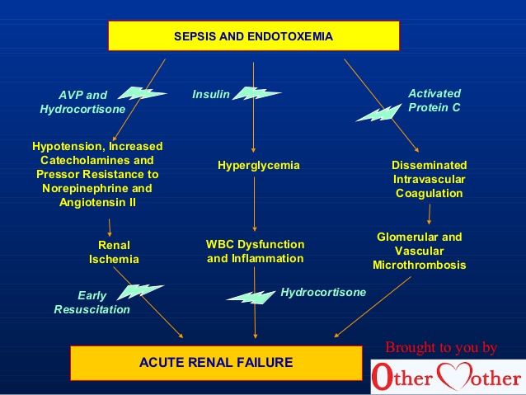

Slide 5
*The LPS molecule is embedded in the outer membrane and the lipid A portion of the molecule serves to anchor LPS in the bacterial cell wall
*Bacterial lipopolysaccharide (LPS), the major structural component of the outer wall of Gram-negative bacteria, is a potent activator of macrophages and activated macrophages produce a variety of inflammatory cytokines
LPS cause oxidative stress through the generation of free radicals and changes in antioxidant enzymes and oxygen-free radical scavengers. Lipid peroxidation is known to be one of the molecular mechanisms of LPS-induced toxicity

Slide 6
Gram negative bacteria, contributing greatly to the structural integrity of the bacteria, and protecting the membrane from certain kinds of chemical attack.
LPS also increases the negative charge of the cell membrane and helps stabilize the overall mmebrane structure
Within Gram-negative bacteria, the membrane lipopolysaccharides protect the bacterium against the action of bile salts and lipophilic antibiotics

Slide 7
It is crucial importance to gram-negative bacteria, whose death results if it is mutated or removed.
LPS induced a strong response from normal animal immune systems. It has also been implicated in non-pathogenic aspects of bacterial ecology, including surface adhesion, bacteriophage sensitivity, and interaction with predators such as amoebae

Slide 8
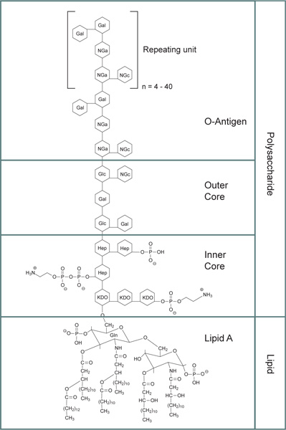
General structure for bacterial lipopolysaccharides. KDO: 3‑deoxy-α-D-mannooctulosonic acid; Hep: Heptulose (ketoheptose); NGa: Galactosamine; NGc: NGc: Glucosamine.
The lipid A core is made up of a beta-glucosamine-(1-6)-glucosamine-1-phosphate base with fatty acid esters attached to both carbohydrates
The inner polysaccharide core typically contains between 1 and 4 molecules of the KDO
The outer core of the lipopolysaccharide contains more common hexoses, including glucose, galactose, and N-acetylglucosamine and is structurally more diverse than the inner core.
The O-antigen is a repeating oligosaccharide unit typically comprised of two to six sugars
The core section and the lipid A section of a lipopolysaccharide may have some variability in structure..

Slide 9
Lipopolysaccharides are heat stable endotoxins and have long been recognized as a key factor in septic shock (septicemia) in humans and, more generally, in inducing a strong immune response in normal mammalian cells.
The lipid A moiety has been identified as critical to the endotoxin activity of lipopolysaccharide.

Slide 10
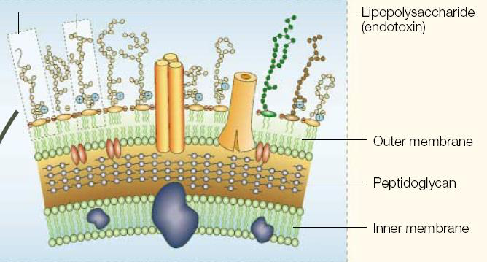

Slide 11
Lipopolysaccharide preparations have been used in research for the elucidation of LPS structure, metabolism,immunology, physiology, toxicity, and biosynthesis.
They have also been used to induce synthesis and secretion of growth promoting factors such as interleukins. Because of its connection to septicemia, lipopolysaccharide has been studied to identify possible targets for antibodies and inhibitors to LPS biosynthesis.

Slide 12
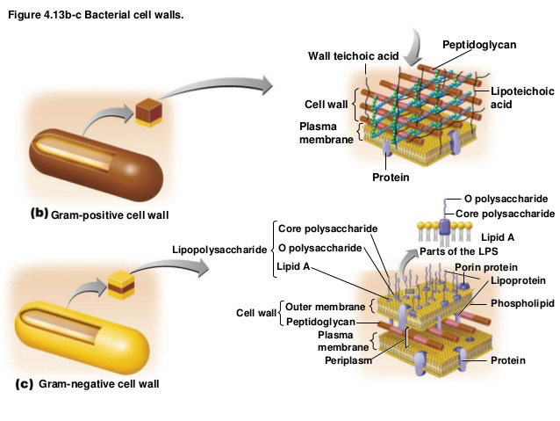

Slide 13
Despite antibiotic therapy and intensive care management, the morbidity and mortality rates of Gram-negative septic shock remain high. Endotoxin mediates its effects through interaction with receptors on the surface of a variety of host cells. These interactions result in the production and release of numerous biochemical mediators that exert toxic effects during endotoxic shock

Slide 14
Lipid peroxidation is the initial step of cellular membrane damage caused by pesticides, metals, other xenobiotics, and antibiotics and considered to be a valuable indicator of oxidative damage of cellular components.. This may lead to muscle degradation, impairment of the nervous system, haemolysis, the general deterioration of cellular metabolism, and eventually cell death.

Slide 15
Propolis
Propolis is a resinous material collected by honey bees from exudates and bud of the plants and mixed with wax and bee enzymes.
It is a complex resinous mixture which contains approximately 50% resin and balsam, 30% wax, 10% essential and aromatic oils, 5% pollen, and 5% impurities.

Slide 16
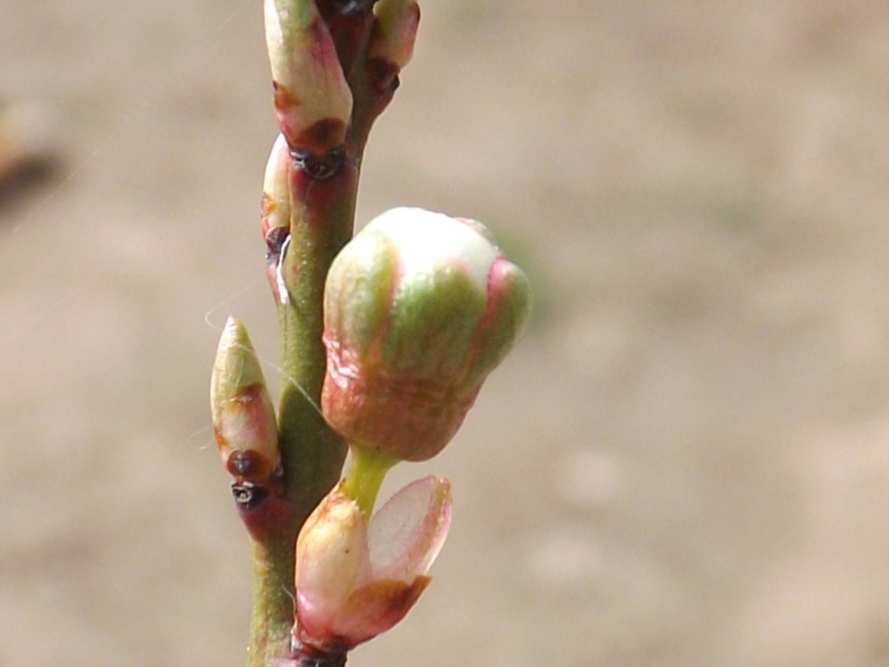
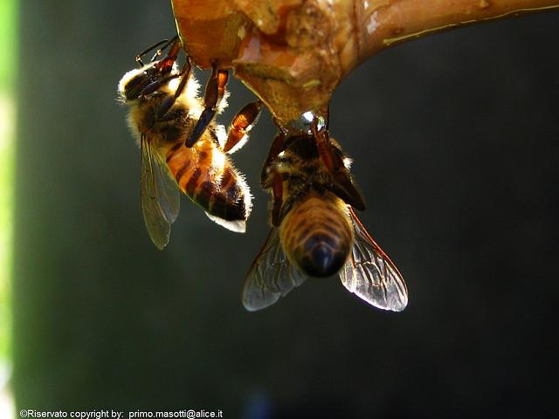
Notes:
Undubtedly, poplar type propolis is the most studied and the best known type of propolis, both from chemical and pharmacological point of view.

Slide 17
Propolis is one of the most abundant sources of polyphenols, and mainly contains flavonoides, phenolic acids, and their esters
The principal flavonoids in propolis are: flavones, flavonols, and flavanones
Flavone is a class of flavonoids (chrysin, apigenin, luteolin, and rutin )
Flavonol is a class of flavonoids such as galangin, quercetin, kaempferol and rhamnazin.

Slide 18

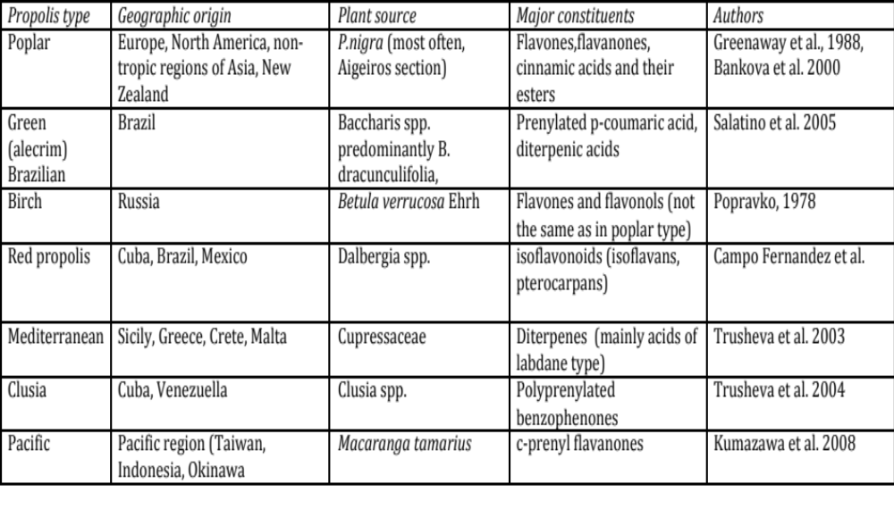
Propolis sources in the world
Notes:
Propoliisn bitkisel orijini Türkiye ve dünyada

Slide 19
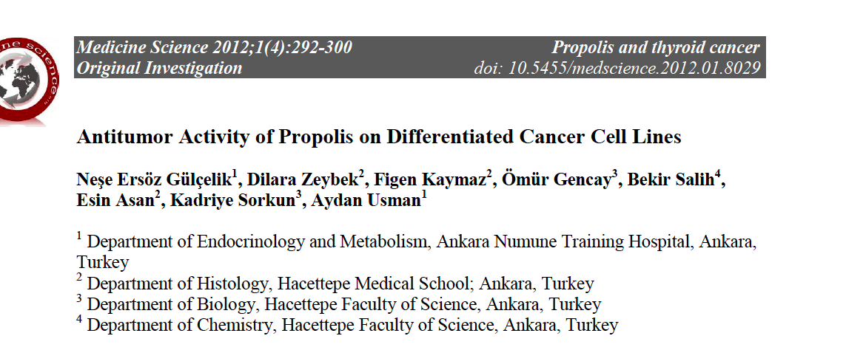
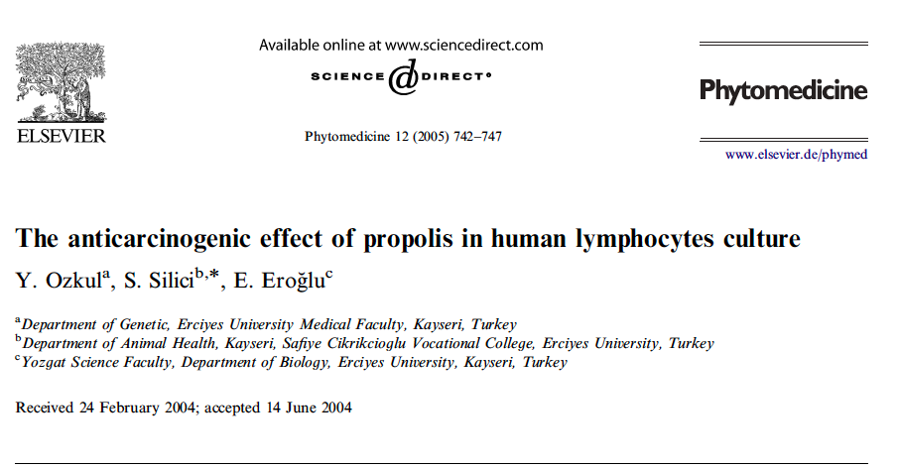

Slide 20
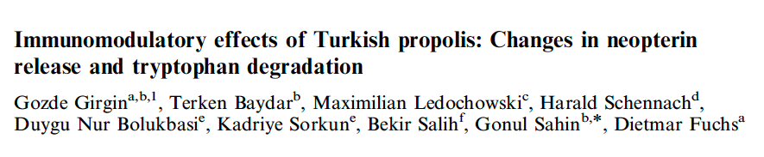
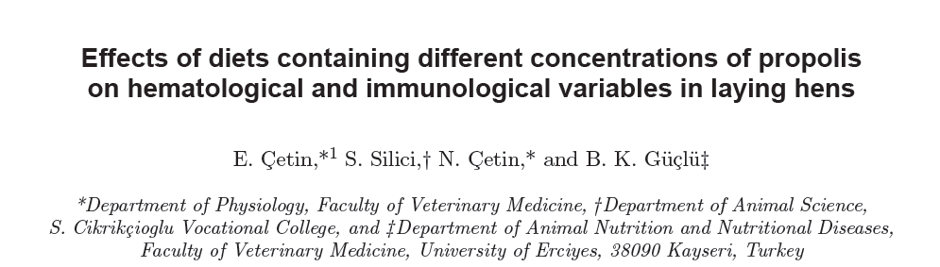

Slide 21
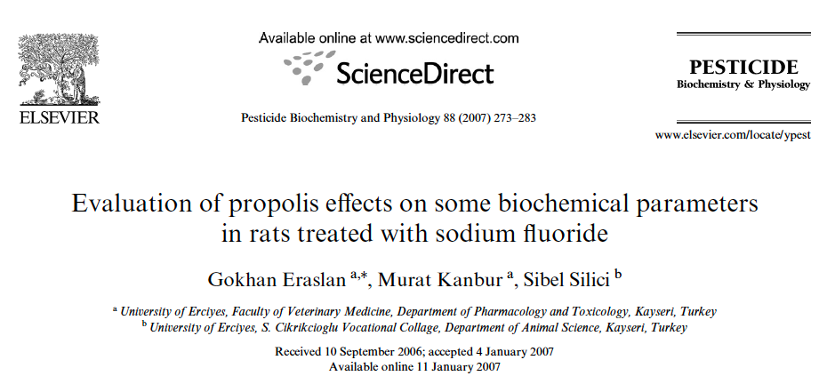
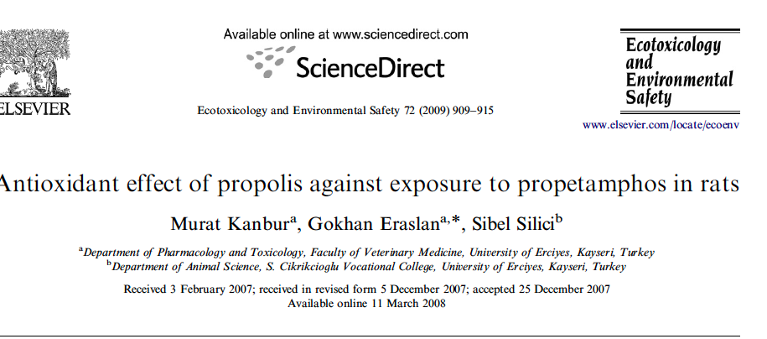

Slide 22
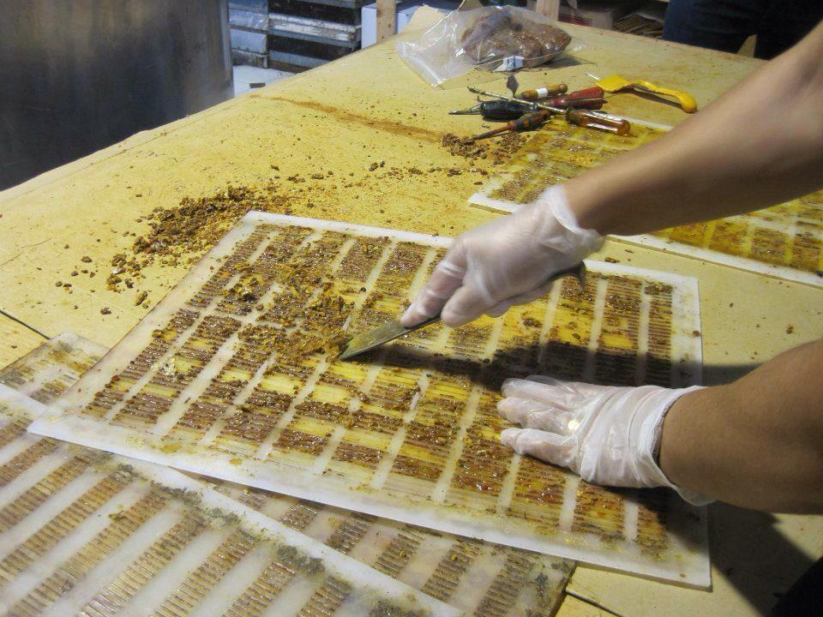
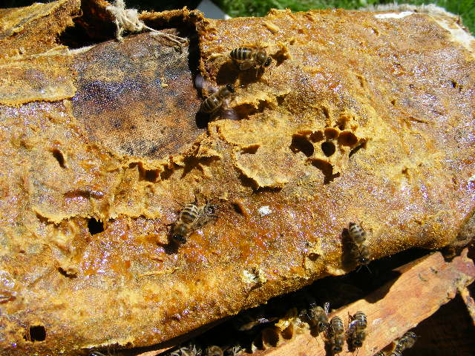
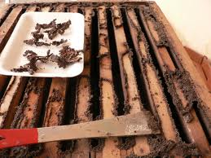
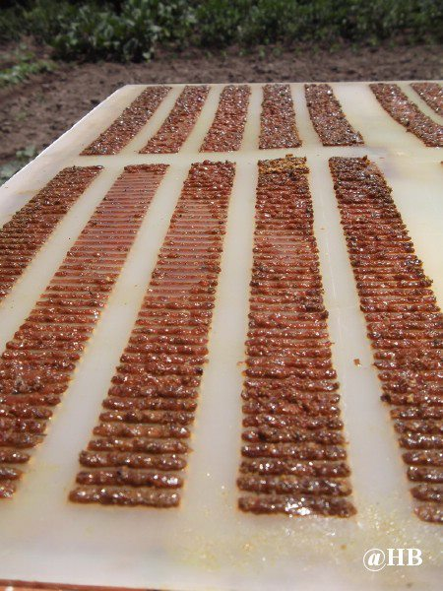
Propolis harvesting
Notes:
Propolis collecting is quite basic: scraping or trapping. Although of plant origin, propolis is a bee product and in different ecosystems bees collect it from different source plants, choosing appropriate representatives of the
local flora. For example, Brazilian green propolis is derived mainly from alecrim plant (Baccharis dracunculifolia
The amount of balsam extracted from crude propolis is an important characteristic because high percentage of balsam means the propolis contained a low percentage of wax and insoluble mattter.

Slide 23
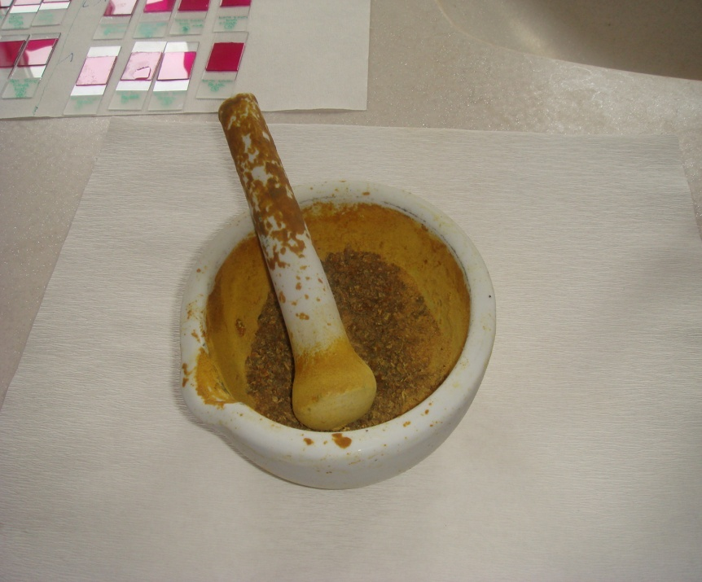
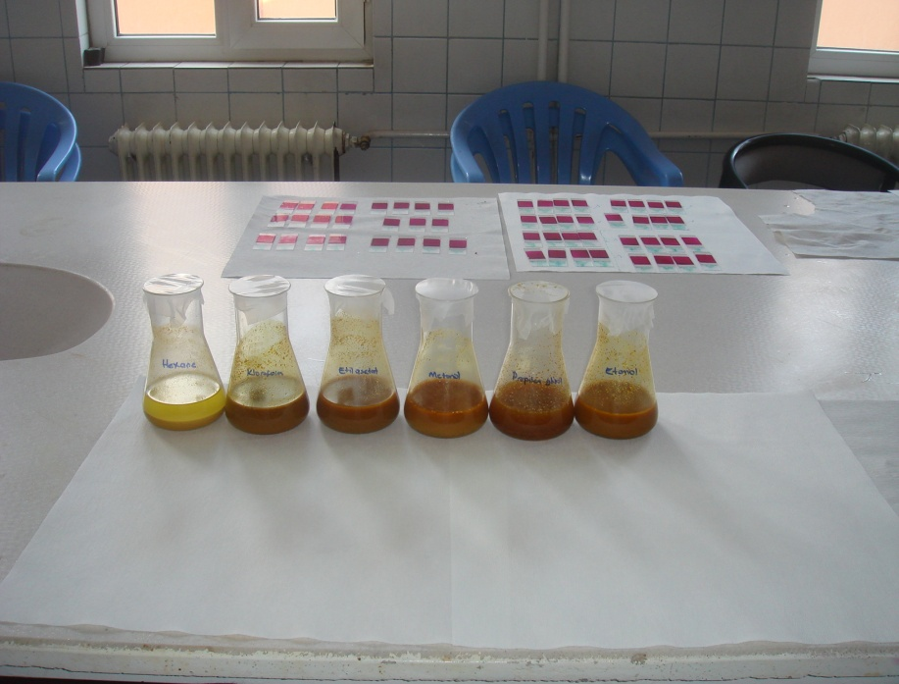
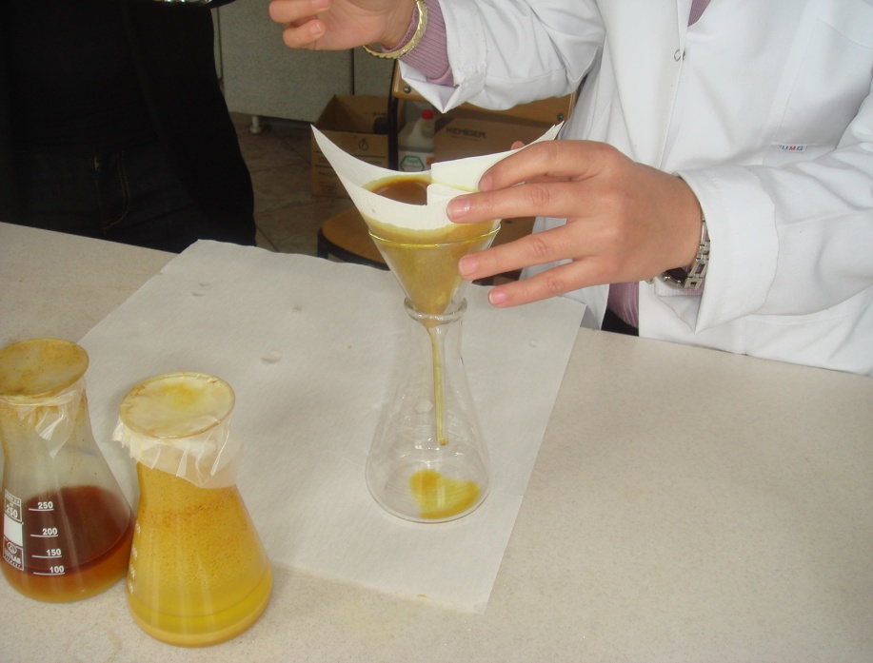
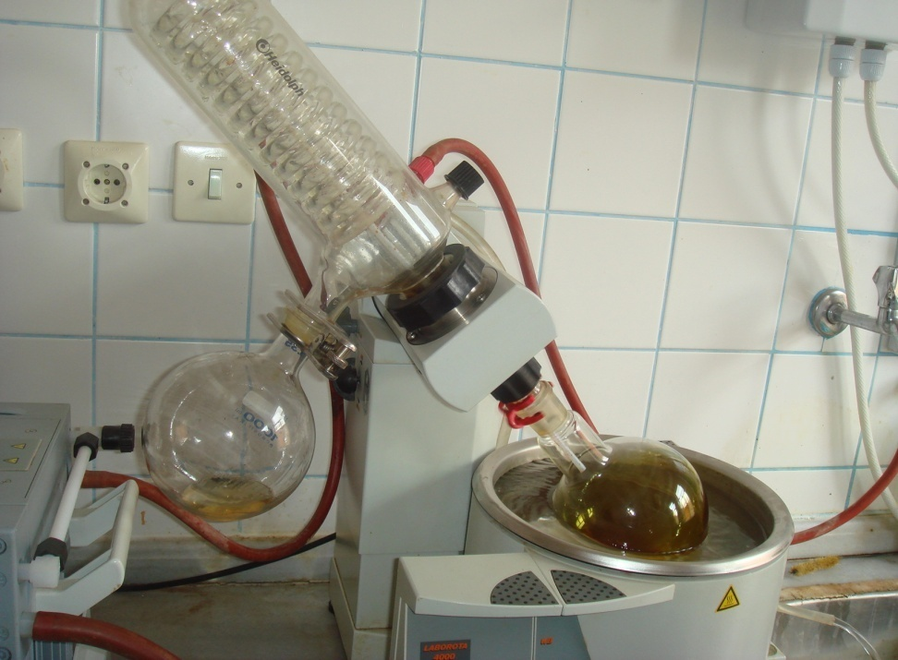
  Erciyes Uni. Biotechnology Lab.
Pounding
Propolis extracting
Evaporation
Filtration
Notes:
The most common propolis extracting process is uses ethanol as the solvent.

Slide 24
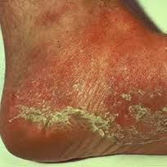
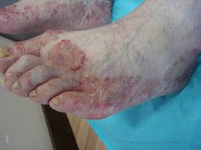
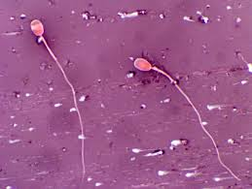
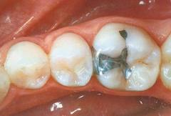
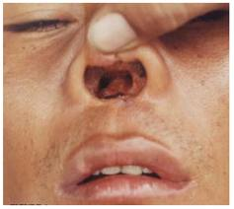
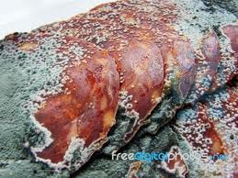
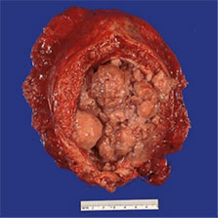
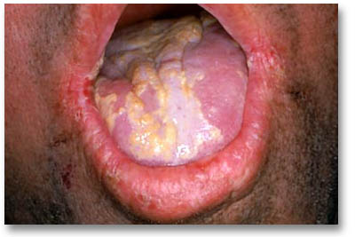
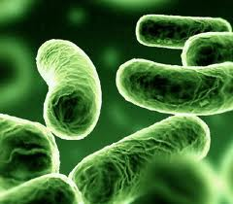
PROPOLİS VE SAĞLIK
Koc et al. 2005, Mycoses
Silici et al.,2005 J Pharm.Sci
Artan et al 2012, Saudi Med J
Arslan et al 2012, Lasers Med Sci
Kaynar et al 2012, Afr J Tradit
Koc et al 2011, J Med Food
Silici and Koc 2011, Let Apl Mic
Notes:
Our research groups have found evidence of several biological activities of Turkish propolis extract, mainly poplar propolis.The studies were focused on the antimicrobial, antioxidant, anticarcnogenic, anti-leshmanial ……activities.

Slide 25
*Antioxidant agents improve renal damage when used immediately after bacterial inoculation. For example
treatment by thymoquinone before or during Escherichia coli inoculation prevented oxidative damage in acute pyelonephritis in an ascending obstructive rat model
LPS-induced NO generation resulted in peroxynitrite formation and oxidant stress in the kidney and that inhibitors of iNOS may offer protection against LPS-induced renal toxicity
*the protective effect of chelating agent, N-(2-hydroxy ethyl ethylene diamine triacetic acid, HEDTA) with and without propolis against aluminum (Al) induced toxicity in rats.

Slide 26
*combined treatment of HEDTA and propolis preserved histological features, mitigated oxidative stress and improved liver, kidney and brain functions more profoundly
*the biochemical changes in cobalt-exposed rats and investigated the potential role of Tunisian propolis against the cobalt-induced renal damage

Slide 27
Caffeic acid phenethyl ester (CAPE), a bioactive component of propolis extract, exhibits antioxidant and anti-inflammatory properties.
protective effect of CAPE on carbon tetrachloride (CCl₄)-induced renal damage.

Slide 28
Study groups
Group 1 (Control): 0.1ml of normal saline (NS), ie. 0.9 % NaCl solution i.p. 30 minutes apart as twice; (n=10)
Group 2 (LPS): 30 mg/kg of LPS i.p., 30 minutes after NS administration (n=10)
Group 3 (Propolis): 250 mg/kg of propolis orally, 30 minutes after NS administration (n=10)
Group 4 (Propolis + LPS): 250 mg/kg of propolis orally, 60 minutes before LPS administration (n=10),
Group 5 (LPS + Propolis): 250mg/kg of propolis orally, 60 minutes after LPS administration (n=10),

Slide 29
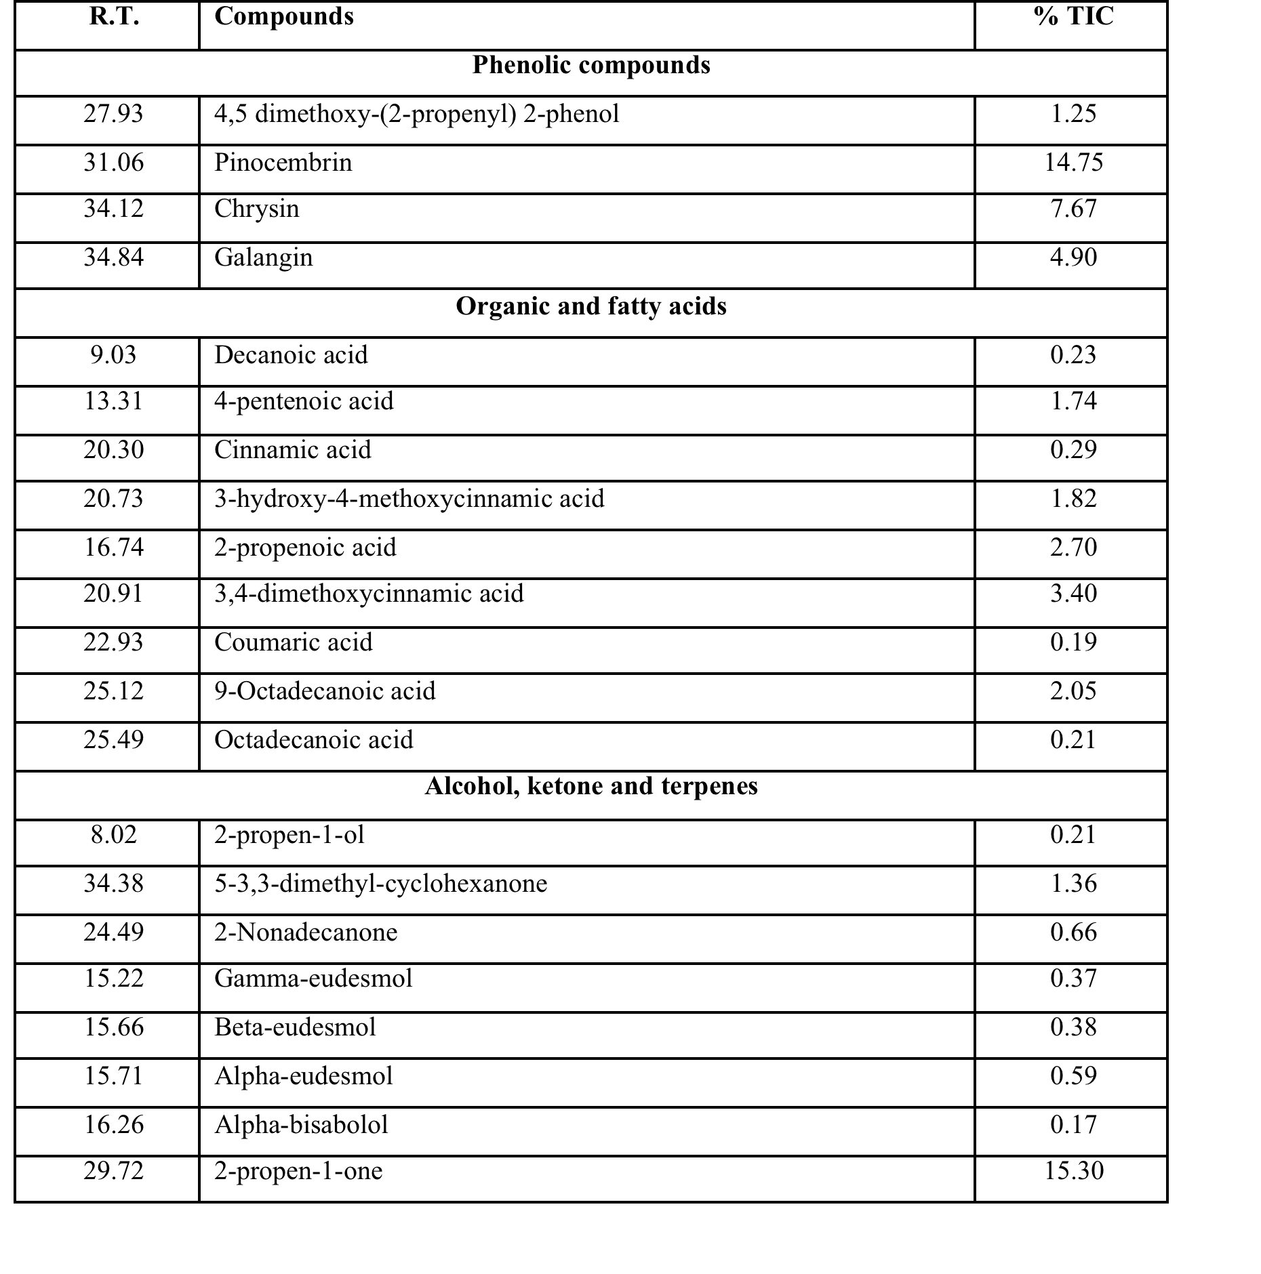
Results

Slide 30
Results (biochemical changes)
Compared with the control group the MDA levels increased in the group administered LPS only
In the group administered propolis only, the MDA levels increased compared with the control group while decreased compared with the group administered LPS only.

Slide 31
In the group administered propolis before LPS, the MDA levels increased compared with the control group while decreased compared with the group administered LPS only.
In the group administered propolis after LPS, the MDA levels increased compared with the control group
The MDA levels increased in the group administered LPS only and decreased in the groups pre-treated, posttreated and simultaneously treated with propolis. The group that was administered propolis only showed no statistically significant difference from the control group.

Slide 32
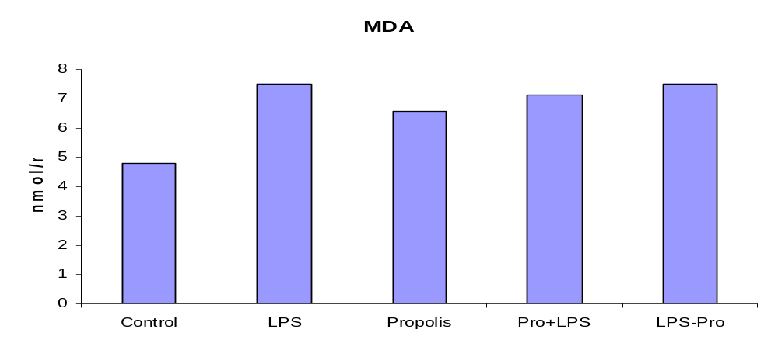

Slide 33
All sections were collected in slides and then stained with PAS. Histopathological examination of kidney sections from Group 1 (control animals) revealed normal structures (Figure1A). Compared with normal kidney tissues from the control group, Group 2 (NS+LPS) kidney sections of rats treated with only LPS demonstrated slight tubular damage, mild ischemic injury, ischemic damage in the form of vacuolization, tubule epithelial vacuolization, vascular congestion and glomerular atrophy (Figure 1B).

Slide 34
Group 3 (NS+Propolis) kidney sections of rats treated with only propolis showed mild ischemic injury (Figure 1C). While in Group 4 (propolis+LPS) kidney sections of rats treated with propolis prior to LPS challenge showed mild ischemic injury (Figure 1D), in Group 5 (LPS+propolis) sections of rats treated with propolis after LPS challenge showed mild ischemic injury, tubule epithelial vacuolization, vascular congestion and glomerular atrophy (Figure 1E).

Slide 35
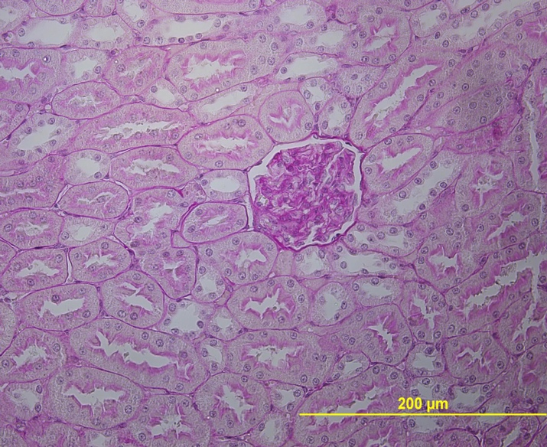
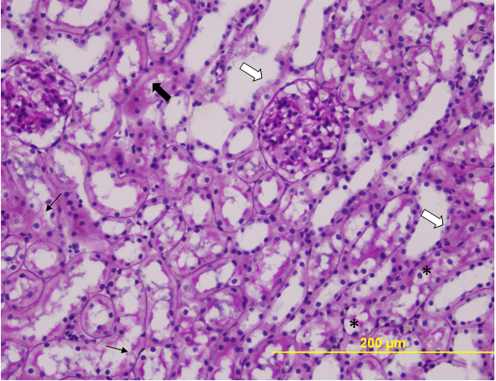
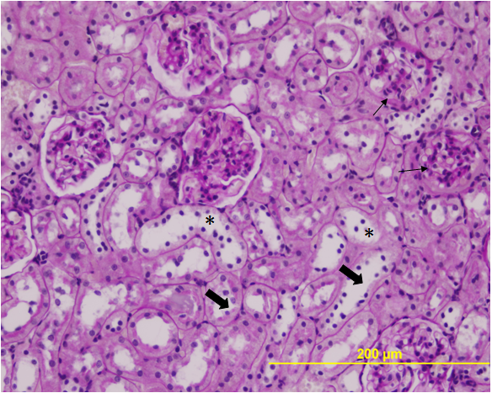
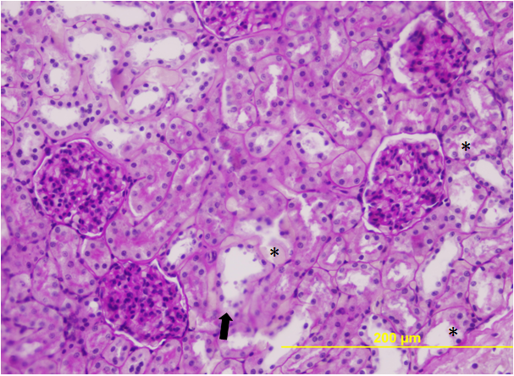
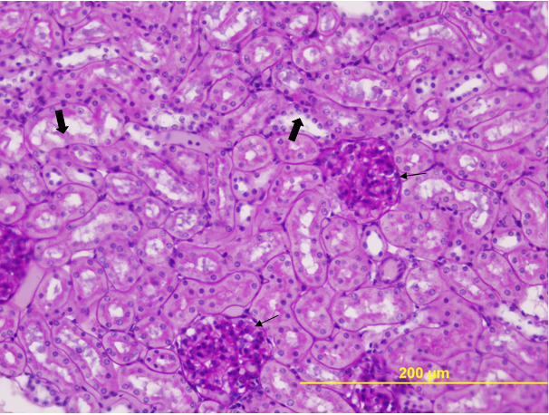

Slide 36
Discussion
It is known that pharmacological properties of propolis are due to the high polyphenolic contents. Flavonoids are polyphenolic compounds that are present in plants. They have been shown to possess a variety of biological activities. For example, chrysin is present in honey and propolis and in low concentrations in fruits, vegetables, and certain beverages.

Slide 37
It has been reported that chrysin has potent anti-inflammatory, anti-cancer, and antioxidant properties. The flavanone pinocembrin has strong antifeedant, anti-inflammatory, and antioxidant activities . Results from in vitro and in vivo studies indicate that galangin, with its antioxidant and radical scavenging activities, is capable of modulating enzyme activities and suppressing the genotoxicity of chemicals.

Slide 38
In the present study, it was demonstrated that compared with the normal kidney tissues from the control group, kidney sections of rats treated with only LPS demonstrated slight tubular damage, ischemic injury, ischemic damage in the form of vacuolization, tubule epithelial vacuolization, vascular congestion and glomerular atrophy.

Slide 39
In comparison with the kidney sections of rats treated with only LPS, administration of propolis showed a mild but not a significant effect against LPS-induced renal damage. In addition, in the present study the increase in serum MDA levels in the group that was administered LPS only demonstrates lipid peroxidation to have developed.

